Slide 1

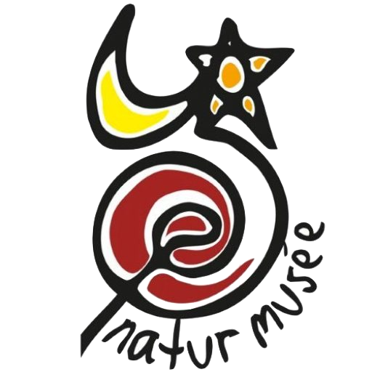









Modelling Research Expeditions in Wikidata: Best Practice for Standardisation and Contextualisation
Sabine von Mering, Paul Braun, Robert Cubey, Quentin Groom, Elspeth Haston, Annika Hendriksen, Rukaya Johaadien, Siobhan Leachman, Luke Marsden, Heimo Rainer, Joaquim Santos, Dag Endresen
In Contributed Oral presentations CO1
Creative Commons Attribution CC BY 4.0
Notes:
von Mering S, Braun PJ-C, Cubey RWN, Groom Q, Haston EM, Hendriksen A, Johaadien R, Leachman S, Marsden L, Rainer H, Santos J, Endresen D (2023) Modelling Research Expeditions in Wikidata: Best Practice for Standardisation and Contextualisation. Biodiversity Information Science and Standards 7: e111427. https://doi.org/10.3897/biss.7.111427

Slide 2

Modelling Research Expeditions in Wikidata
Developing Best Practice for Standardisation and Contextualisation
Expeditions and other collecting events are a major source of objects in natural history museums.
There is a need to link historical or contemporary research expeditions to other entities, requiring the unambiguous labelling (and persistent identifiers) of such events.
Stable identifiers for expeditions plus the sharing of metadata and descriptions will facilitate the linking of material objects distributed across museums and related research data.
Wikidata is a multilingual community-curated knowledge base containing data structured in a human- and machine-readable format.
Our informal working group has started to explore using Wikidata to describe research expeditions.
Notes:
Background information and rationale for proposing a new task group
Illustration: https://commons.wikimedia.org/wiki/Category:Wikidata_logos
we are aware of the sometimes loaded terminology, regarding 'scientific' or 'resarch' expeditions and related terms in the colonial context

Slide 3

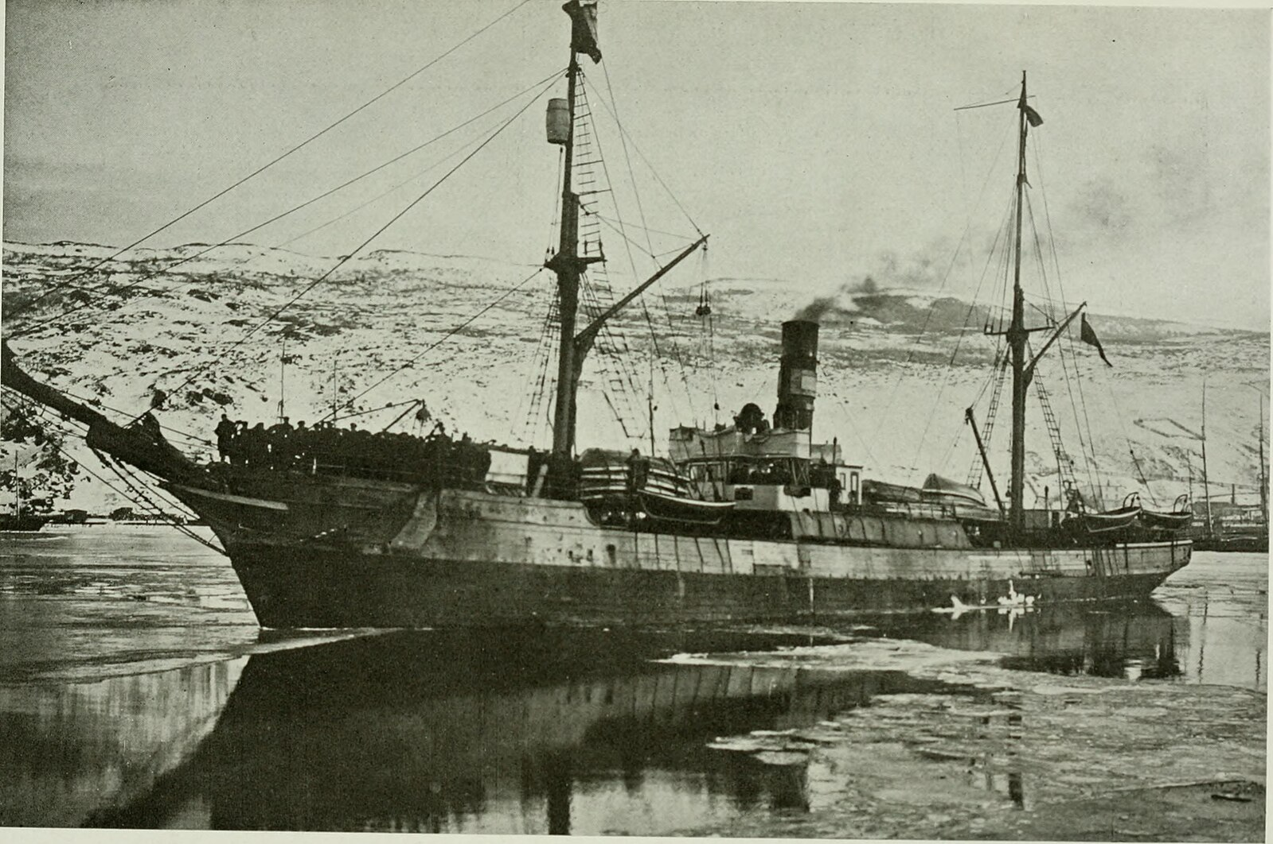
TDWG Task group on Research Expeditions
Proposal - new task group on describing research expeditions
Objectives of the task group:
Develop guidelines and best practices for describing research expeditions in Wikidata.
Identify and develop Wikidata metadata properties and tools for describing research expeditions.
Develop metadata solutions for linking research expeditions to museum objects, to the people who collected these objects, and to publications about or resulting from research expeditions.
CC0 American Museum of Natiural History
Notes:
Wikidata research expedition http://www.wikidata.org/entity/Q366301 mapped to http://rs.tdwg.org/dwc/terms/Event
Linking specimens to expeditions using http://rs.tdwg.org/dwc/terms/parentEventID
Illustration: CC0 American Museum of Natural History, https://commons.wikimedia.org/wiki/File:The_American_Museum_journal_(c1900-(1918))_(17538187204).jpg

Slide 4
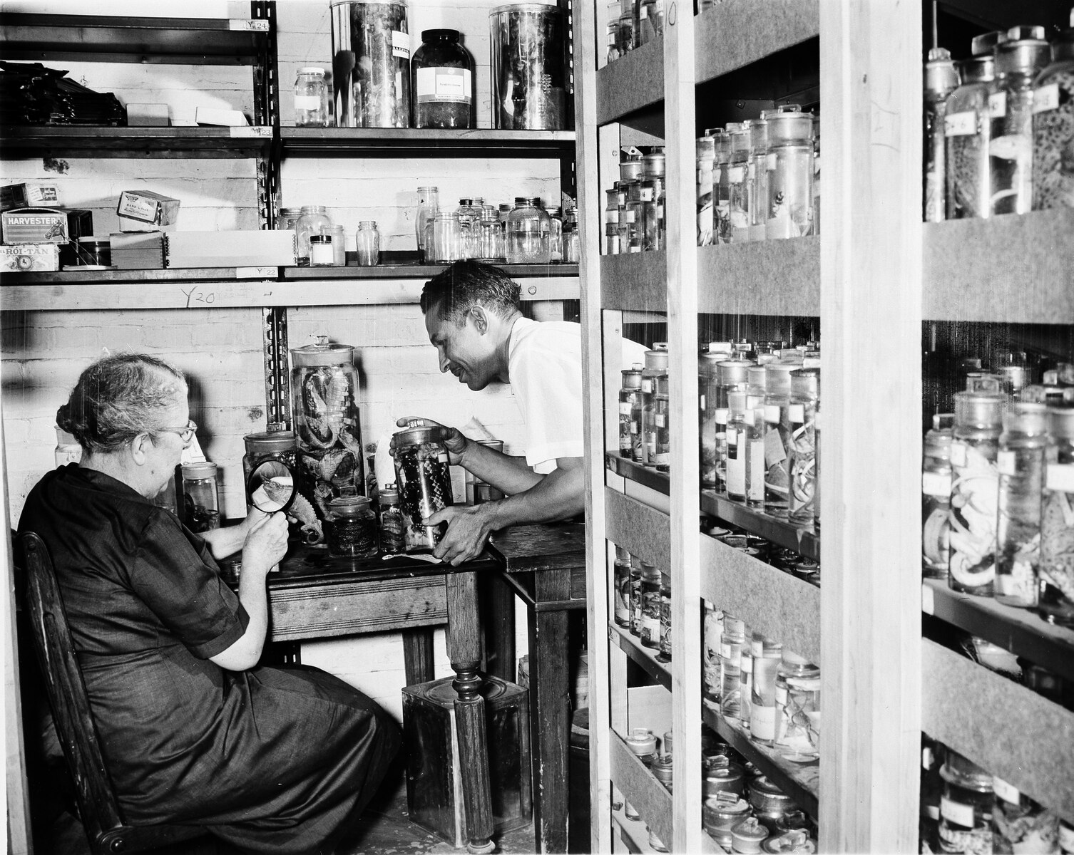
TDWG Task group on Research Expeditions
Proposal - new task group on describing research expeditions
We want to explore:
If Wikidata is an appropriate metadata authoring system for describing research expeditions.
Using Wikidata Research expedition, QID Q366301.
And if Q366301 can be mapped to the Darwin Core Event as the appropriate class for describing such research expeditions.
Linking expeditions to specimens using dwc:parentEventID
CC0, United States National Museum
Notes:
Wikidata research expedition http://www.wikidata.org/entity/Q366301 mapped to http://rs.tdwg.org/dwc/terms/Event
Linking specimens to expeditions using http://rs.tdwg.org/dwc/terms/parentEventID
Photo: CC0, Doris M. Cochran Working with Collections, https://commons.wikimedia.org/wiki/File:Doris_M._Cochran_Working_with_Collections,_Image_ID_96-949.tif#%7B%7Bint%3Afiledesc%7D%7D

Slide 5
Why document research expeditions in Wikidata?
The open knowledge base Wikidata is a collaborative and multilingual tool to collect and link structured data (on expeditions) in a human- and machine-readable format.
As of writing, more than 100 million data items exist in Wikidata, many of them relevant for scientific collections and expedition data.
Wikidata allows easy creation, updating and enriching of items on specific expeditions, and provide stable identifiers for expeditions (that can be used in collection management systems).
Expeditions can be linked to participants and other agents (sponsors, funders, etc.), regions, localities, objects, archival material, maps, and publications (often in the Biodiversity Heritage Library), field notebooks, documentary footage and art works resulting from the expeditions.
Thus, providing historical context for the objects collected and assisting with the acknowledgment of any imperial or colonial impact that may have resulted from the expedition.
Notes:
And 414 research expeditions (https://w.wiki/7NGU)

Slide 6
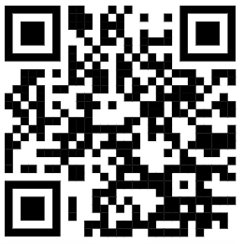
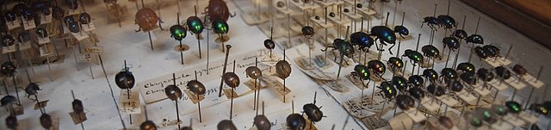
Wikidata Research Expedition - Q366301
More than 400 instances of research expeditions are already described in Wikidata (SPARQL https://w.wiki/7NGU)
Many of these are sources of natural history objects.
Many linked to specimens published in GBIF.
CC BY-SA 4.0 Smirkybec
Notes:
414 Instances of = Q366301 | https://w.wiki/7NGU | SELECT (COUNT(*) AS ?count) WHERE { ?item wdt:P31 wd:Q366301. }
List 469 instances of = Q366301 itemLabel | https://w.wiki/6Fgj
Illustration: Insect collections Natural History Museum Dublin, CC BY-SA 4.0 Smirkybec
https://commons.wikimedia.org/wiki/File:Insect_collections_Natural_History_Museum_Dublin_02.jpg

Slide 7
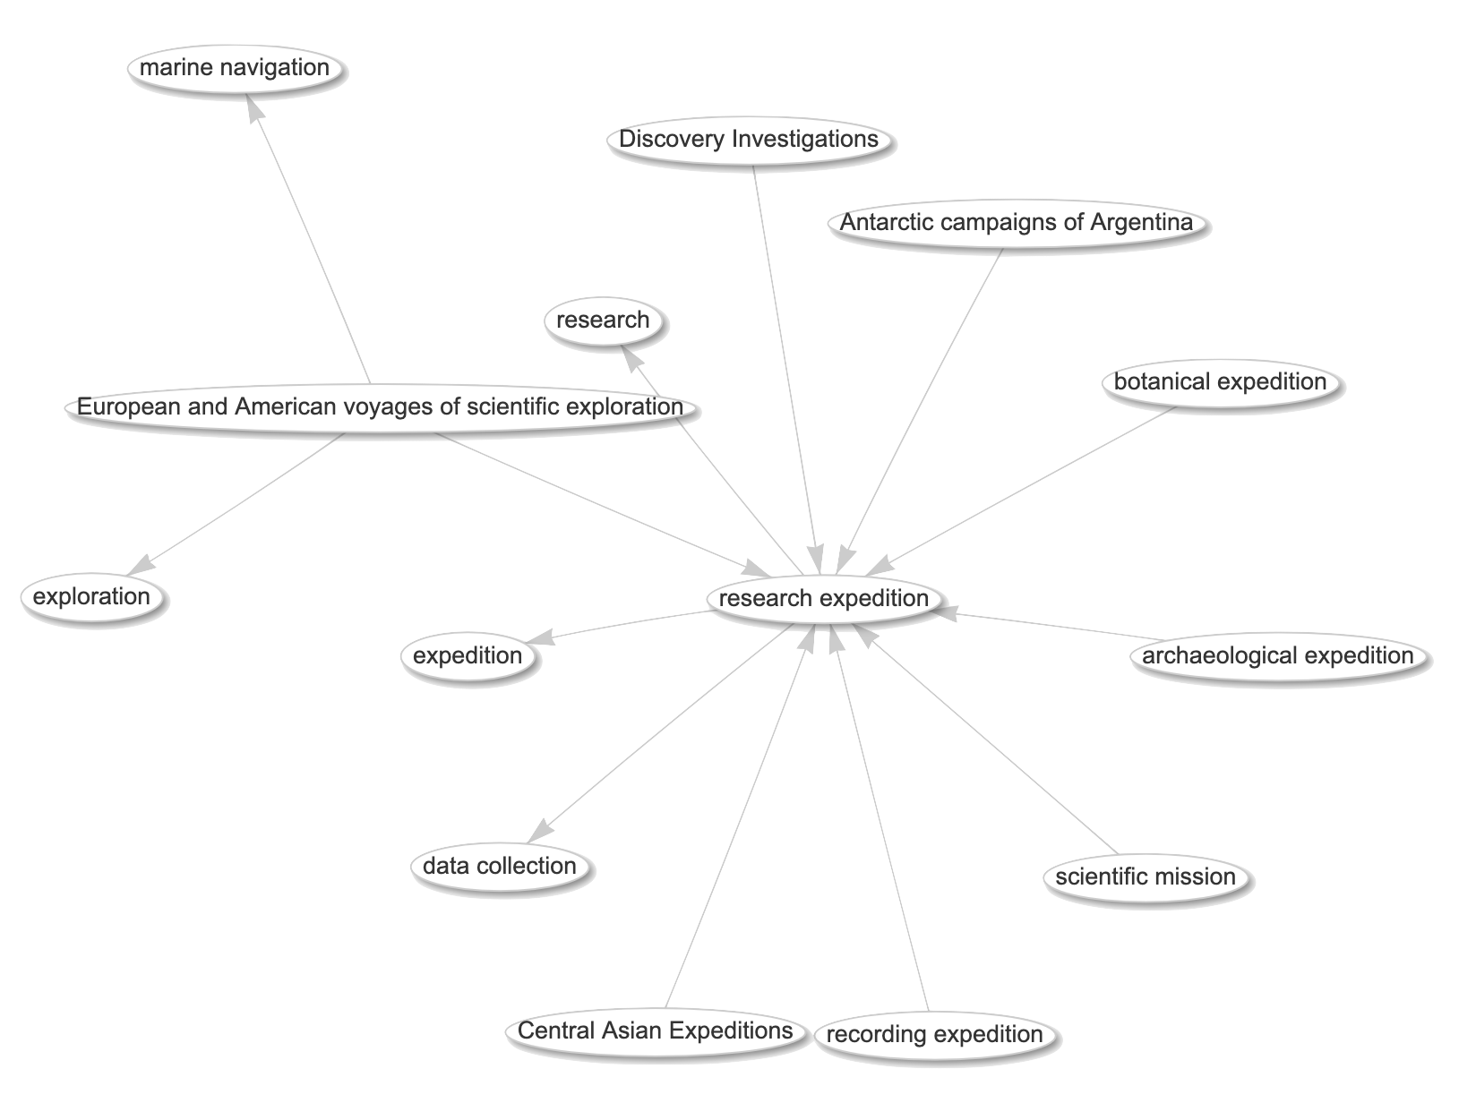
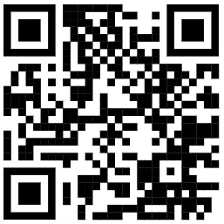
Wikidata Research Expedition - Q366301
13 sub-classes of Q366301
SPARQL at
https://w.wiki/7dCF
Notes:
List sub-classes of Q366301 https://w.wiki/7dCF

Slide 8
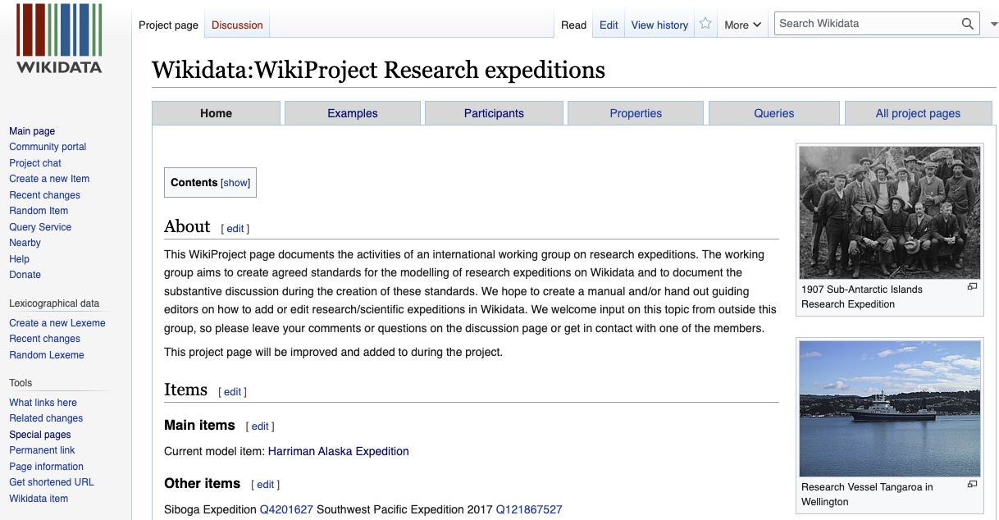
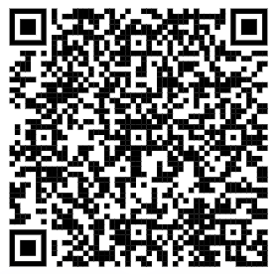
Wikidata WikiProject Research Expeditions
Screenshot of Wikidata Wikiproject Research Expeditions CC BY-SA 4.0
Notes:
https://www.wikidata.org/wiki/Wikidata:WikiProject_Research_expeditions

Slide 9
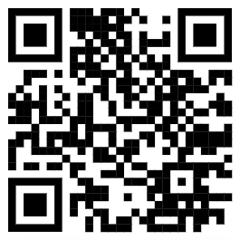
Wikidata Research Expedition - Q366301
Most used properties for Q366301 | SPARQL at https://w.wiki/7KYC
1137 participant
471 instance of
281 start time
242 via
237 end time
227 country
153 Freebase ID
118 location
116 destination point
96 Commons category
90 vessel
89 image
73 number of participants
70 collection items at
60 described by source
60 sponsor
57 VIAF ID
56 start point
54 described at URL
54 point in time
54 Google Knowledge Graph ID
48 Library of Congress authority ID
44 WorldCat Identities ID (superseded)
42 part of
40 organizer
… etc
We are currently discussing recommended properties at the Wikidata Project page
https://www.wikidata.org/wiki/Wikidata:WikiProject_Research_expeditions/Properties
Notes:
Currently we are discussing the use of several properties related to the item and having semantic debate on the meaning of each of them in a proper way, which we want to discuss with other users, in our aim to find a uniform usage of these properties so that queries come up with useful results - and so that we can link information in a structured way.
SPARQL https://w.wiki/7KYC
SELECT DISTINCT ?property ?propLabel ?type (COUNT(?property) AS ?count)
WHERE {
?item wdt:P31 wd:Q366301 .
?item ?property ?value .
?prop wikibase:directClaim ?property .
?prop wikibase:propertyType ?type .
SERVICE wikibase:label { bd:serviceParam wikibase:language "en" }
}
GROUP BY ?property ?propLabel ?type
ORDER BY DESC(?count)

Slide 10
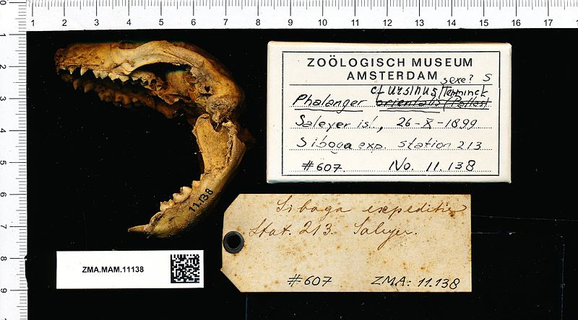
Examples of expeditions described in Wikidata
The TG has selected some expeditions in Wikidata as use cases to be developed into guiding examples.
CC0 Naturalis Biodiversity Center, Siboga Expedition QQ4201627
Notes:
Illustration: Ailurops ursinus Catalog number: ZMA.MAM.11138, CC0 Naturalis Biodiversity Center https://commons.wikimedia.org/wiki/File:Naturalis_Biodiversity_Center_-_ZMA.MAM.11138_lat_-_Ailurops_ursinus_-_skull.jpeg
Use cases, to be developed into guiding examples:
Tristan da Cunha Expedition (1937-1938) - Q12007460
Harriman Alaska Expedition - Q1586167
1907 Sub-Antarctic Islands Scientific Expedition - Q4558719
Third Archbold Expedition (1938-1939) - Q109712735
Valdivia Expedition - Q1312945

Slide 11
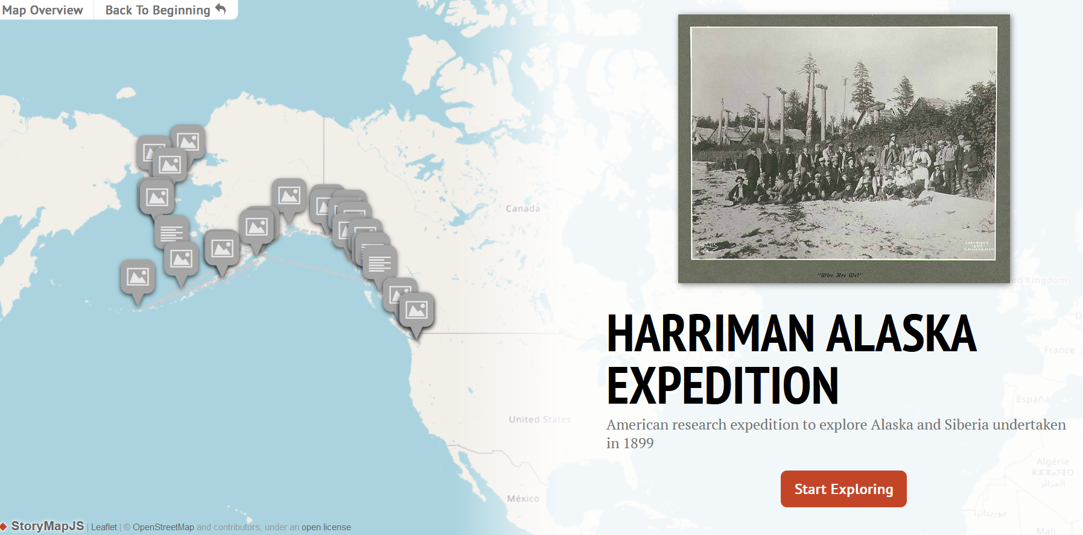
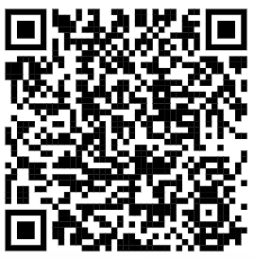
Visualisation of Wikidata expeditions
General text
General text
Add an illustration image here
Harriman Alaska Exp
Q1586167
Screenshot from https://invirtu.com/researchexpeditions/?QID=Q1586167, Photo: Edward S. Curtis, Public domain, via Wikimedia Commons
Notes:
https://invirtu.com/researchexpeditions/
https://invirtu.com/researchexpeditions/?QID=Q1586167
Illustration: Harriman Alaska Expedition, CC0 by Edward S. Curtis, https://commons.wikimedia.org/wiki/File:Harriman_Alaska_Expedition_party_on_the_beach_at_a_deserted_Tlingit_Indian_village,_Cape_Fox,_Alaska,_July_1899_(HARRIMAN_232).jpg

Slide 12
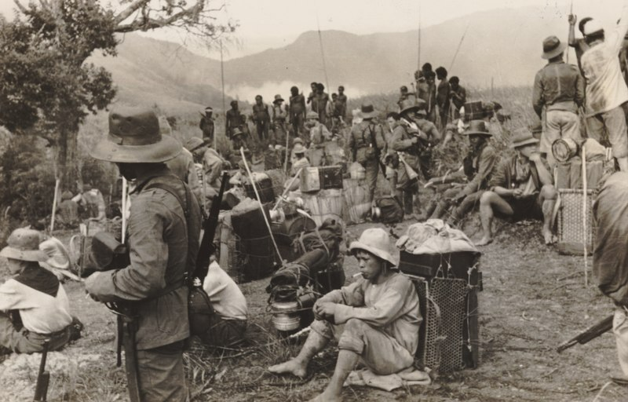
Third Archbold Expedition (1938-1939) - Q109712735
Connects collections from several institutes and platforms
The Wikidata item of the Third Archbold Expedition contains a.o.:
  P Collecting camps
  P Participants
  P Described by source
  P Commons Category:
    documentary pictures of
      locations
      crew
    scans of journals
< What’s missing?
< How to connect specimens on GBIF? Use the parentEventID in CMS
Archbold expedition in the Baliem valley KITLV 113841, CC BY 4.0 Leiden University Libraries
Overview of item using tool Reasonator: https://reasonator.toolforge.org/?q=Q109712735&lang=en
Notes:
Point of discussion: Although quite extensive in descriptive properties (f.e. each collecting camp has it's own item) : what kind of information do we miss so far in describing this expedition, in sources, references but also concerning types of information, or maybe specific properties.
What information is missing, f.e. : only western participants are mentioned.
What is collected? link to GBIF specimen?
https://www.wikidata.org/wiki/Q109712735
Illustration: Archbold expeditie in de Baliem-vallei ca 1938, CC BY 4.0 Leiden University Libraries
http://hdl.handle.net/1887.1/item:821706
https://commons.wikimedia.org/wiki/File:Archbold_expeditie_in_de_Baliem-vallei,_KITLV_113841.tiff

Slide 13
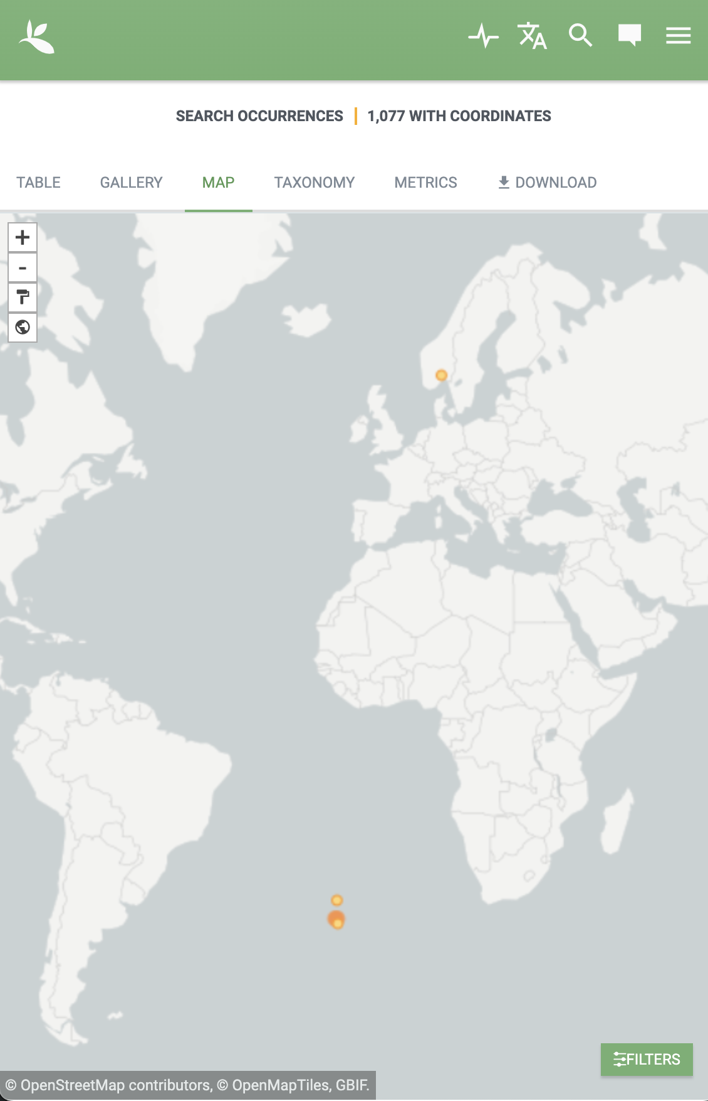
Tristan da Cunha Expedition (1937-1938) - Q12007460
Norwegian expedition from the Natural History Museum in Oslo
Collected material deposited in the Natural History Museum in Oslo.
Can be linked to approximately 1354 specimens published in GBIF.
Not yet linked using parentEventID (annotation system under development at the GBIF Node).
Notes:
Tristan da Cunha Expedition, https://www.wikidata.org/wiki/Q12007460
Approximately 1354 specimens published in GBIF, https://www.gbif.org/occurrence/search?q=Tristan%20da%20Cunha&publishing_org=f314b0b0-e3dc-11d9-8d81-b8a03c50a862&year=1937,1938&occurrence_status=present

Slide 14

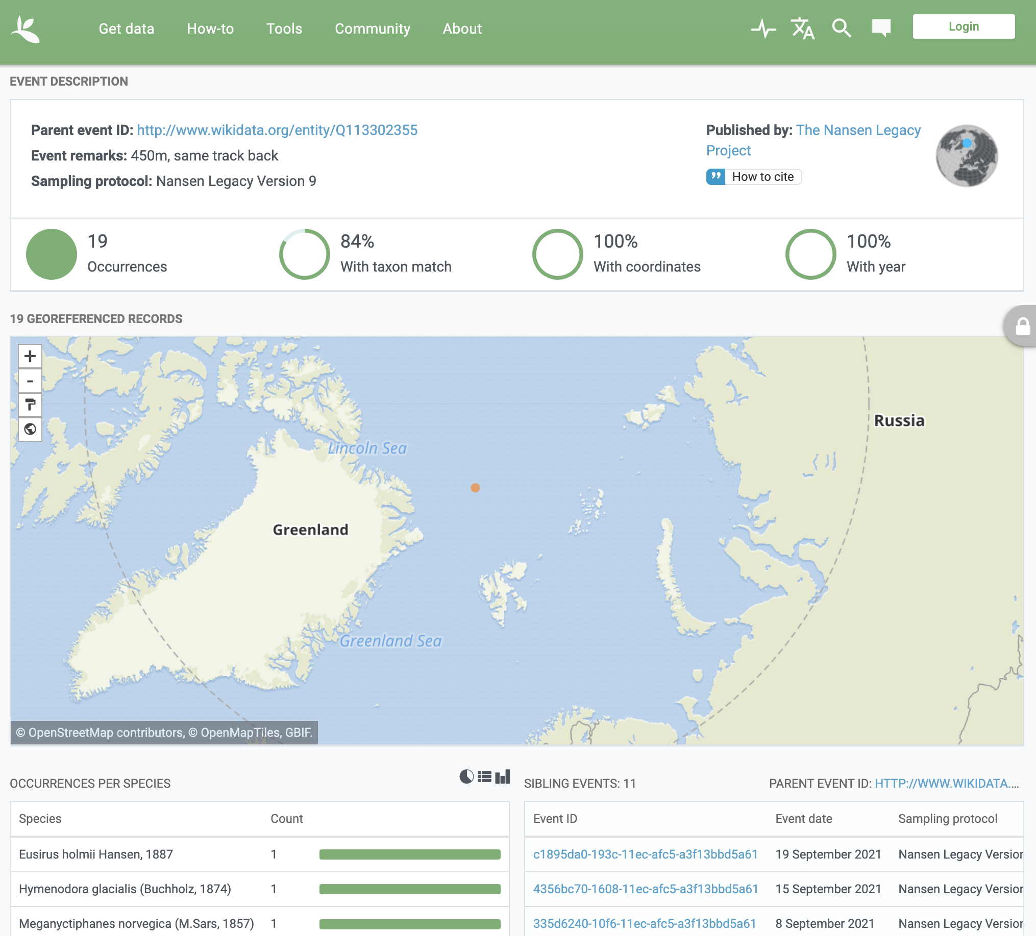


Nansen Legacy dataset linked to Wikidata expedition
Dataset on GBIF:
Trawl catch data from Nansen Legacy
doi:10.21335/nmdc-194651742
Wikidata Expedition:
Nansen Legacy Joint Cruise 2-2 24th August - 25th September 2021
Wikidata Q113302355
Linked using parentEventID
Dataset Events linked to the Wikidata Expedition Entity
Current new datasets published in GBIF from contemporary Nansen Legacy expeditions in the Arctic are linked to Wikidata using parentEventID.
Notes:
Dataset in GBIF https://doi.org/10.21335/nmdc-194651742
Expedition in Wikidata: http://www.wikidata.org/entity/Q113302355
Example of an Event with parentEventID = Q113302355 (in Wikidata):
https://www.gbif.org/dataset/7a184e2e-1307-4473-afeb-6355a01b89d6/event/10ac8bc0-0e87-11ec-afc5-a3f13bbd5a61
GBIF query for specimens (occurrences) linked to this parentEventID (Q113302355):
https://www.gbif.org/dataset/7a184e2e-1307-4473-afeb-6355a01b89d6/parentevent/http:~2F~2Fwww.wikidata.org~2Fentity~2FQ113302355

Slide 15
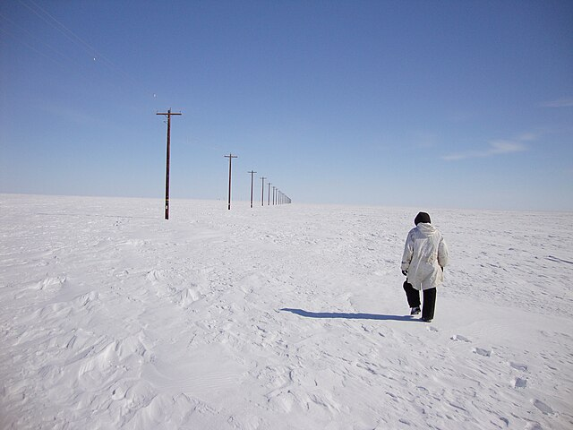
Outlook and further work
Further tasks planned for the Expeditions task group
CC BY 2.0 Oak Ridge National Laboratory
Notes:
Illustration: Arctic long-term experiments, CC BY 2.0 Oak Ridge National Laboratory https://commons.wikimedia.org/wiki/File:Arctic_research_(4733285767).jpg

Slide 16
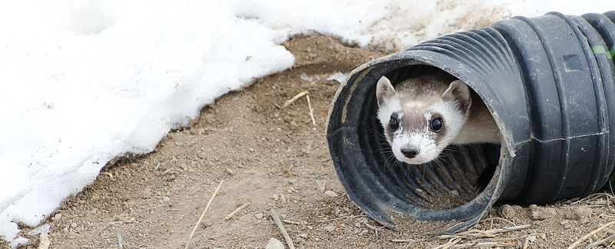


Outlook
New applications for Research Expedition descriptions
CC BY 4.0 Kimberly Tamkun
Bionomia
We want to explore linking Research Expeditions in Wikidata to specimens with Bionomia.
The whereabout of expedition participants can be used to validate Bionomia annotations for collectors.
Participants in given research expeditions can guide suggestions for Bionomia annotations on specimens linked to the expedition.
GRSciColl
We want to explore if GRSciColl (or something similar) can be expanded to include the normative identifiers for research expeditions.
And designed to be linked to their Wikidata items and described further here, in Wikidata.
Notes:
Illustration: Black-Footed Ferret peeking out of tube CC BY 4.0 Kimberly Tamkun / USFWS
https://commons.wikimedia.org/wiki/File:BLACK-FOOTED_FERRET_IN_SNOW_(6842042373).jpg

Slide 17
Task Groups are organized under one of the Interest Groups
Which IG is most relevant for the proposed Research Expeditions TG?
Contact us if you are interested to join this task group!
Sabine von Mering sabine.vonmering@mfn.berlin
https://www.wikidata.org/wiki/Wikidata:WikiProject_Research_expeditions
Notes:
Join us at: https://www.wikidata.org/wiki/Wikidata:WikiProject_Research_expeditions/
IG Attribution
We propose using Wikidata for collaborative metadata authoring
IG Collection Descriptions
Material from expeditions sometimes form a thematic collection
IG Observations & Specimens
Research expeditions are a major source of scientific observations and specimens

Slide 18
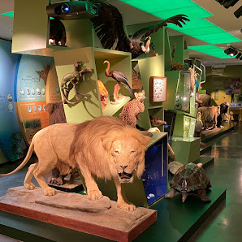

Acknowledgements
David Shorthouse, Bionomia
Biodiversity Heritage Library
GRSciColl editors
Wikidata editors
Image
Photo:CC0 Dag Endresen, Luxembourg Natural History Museum
Logo 1

