Slide 1

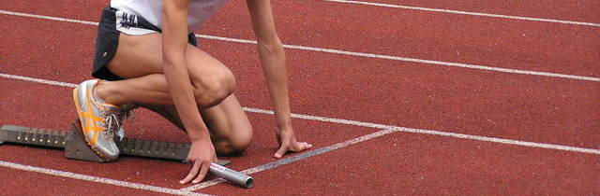

Course introduction
Dag Endresen, GBIF Norway (Credits: Alberto González)
Data publishing workshop at NINA, Trondheim – 29-30 October 2015
Notes:
Image from Jason Young, shared via http://www.freeimages.com/photo/logbook-1548276.
http://community.gbif.org/pg/pages/view/48369/session-01-introduction-to-the-course

Slide 2

INDEX
Welcome
Practical information
Programme of the course
Work groups and group dynamics
Introductions

Slide 3
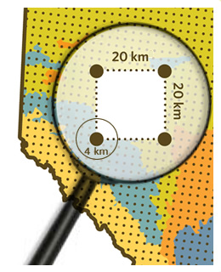
welcome
Welcome to the first Norwegian GBIF data publishing workshop on:
  Survey and monitoring based occurrence data (using the GBIF event core)

Slide 4
Practical information
Internet access Network: ninagjest/ gjest
Lunch 12:15 NINA lunch cantina
Social media hashtag #GBIF
#GBIFNorway
#Naturforskning
#Vitenskapsmuseet

Slide 5
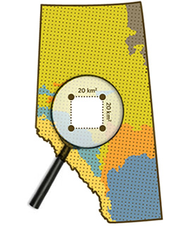
Agenda Thursday 29th October 2015
09:30 Coffee and registration
10:00 Introduction to the course
Overview course content and practical information.
Round-table presentation of your background (maximum 2 minutes each).
10:30 Getting started with data publication
Data publishing landscape, publishing software (20 min, Dag Endresen)
Introduction to data publishing at NINA (20 min, Roald Vang)
Dataset registration and data publishing at the GBIF portal (20 min, Jan Legind)
Darwin Core data standard and the Darwin Core archive format (20 min, Dag Endresen)
12:15 Lunch break
13:15 Demonstration: Data publishing using the IPT software
Occurrence data, multimedia, measurements and facts (20 min, Christian Svindseth)
Hands-on exercise with IPT for all participants using a Occurrence demo-dataset.
14:15 What is survey based monitoring data (event core) (15 min, Dag Endresen)
14:30 Publication survey based monitoring data (event core) (30 min, Anders Finstad)
Hands-on exercise with IPT for all participants using a Event core demo-dataset.
17:00 End of day 1

Slide 6
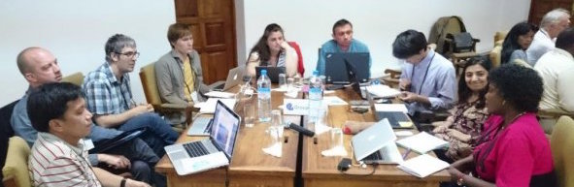
Agenda Friday 30th October 2015
09:00 Survey-based data (continued)
Dataset metadata and long-term data archiving and data management plan
10:00 Presentation of participants own datasets (max 10 min each)
Organization of participants into groups, working with some of participants datasets
12:15 Lunch break
13:15 Hands-on work with your own datasets, divided in groups
17:00 End of day 2
GBIF GB22 Nodes training, working groups by Alberto González Talaván
Notes:
Image: http://community.gbif.org/pg/photos/view/49732/training-day-1-introductions-group-purple

Slide 7
Pre-course activities
Bring your own dataset
Reading list

Slide 8
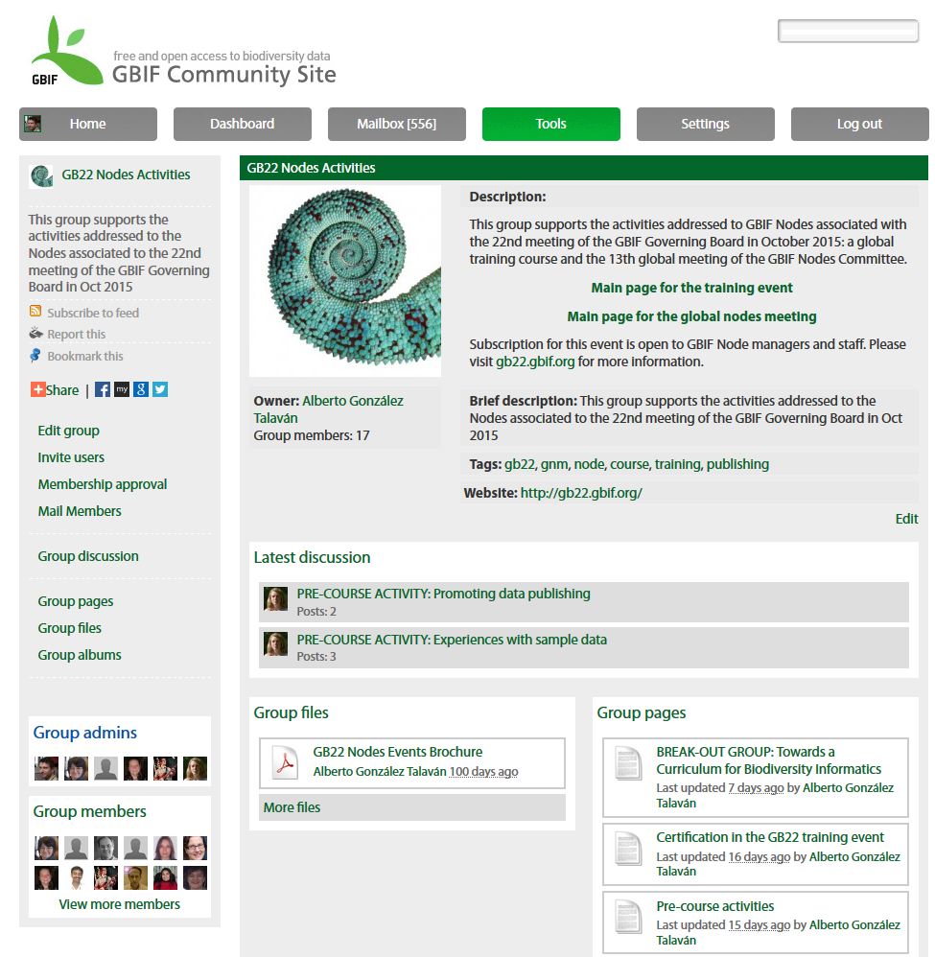

Online interactions
GBIF Community Site
Download/upload resources
Forum
Cross-group interactions
links.gbif.org/gb22nodes

Slide 9


INTRODUCTIONS
You should share in 1 minute:
  Your name, role and institutional affiliation
  Skills and experience with data publishing
  What you expect to learn and how do you plan to use it back in your workplace

Slide 10
Course introduction
Dag Endresen, GBIF Norway
Data publishing workshop at NINA, Trondheim – 29-30 October 2015
Notes:
Image from Jason Young, shared via http://www.freeimages.com/photo/logbook-1548276.
http://community.gbif.org/pg/pages/view/48369/session-01-introduction-to-the-course

