Slide 1



2015 Data Publishing Landscape
Dag Endresen, GBIF Norway (Credits: Laura Russell)
Data publishing workshop at NINA, Trondheim – 29-30 October 2015
Notes:
Image from Piotr Lewandowski, shared via http://www.freeimages.com/photo/learning-with-pencil-1415671
http://community.gbif.org/pg/pages/view/48332/session-01-the-gbif-data-publishing-landscape-in-2015

Slide 2
Index
Data publishing landscape
Biodiversity data publishing
Data types
Data standards
Data normalization and data quality
Data publishing methods
Promotion of data publishing

Slide 3
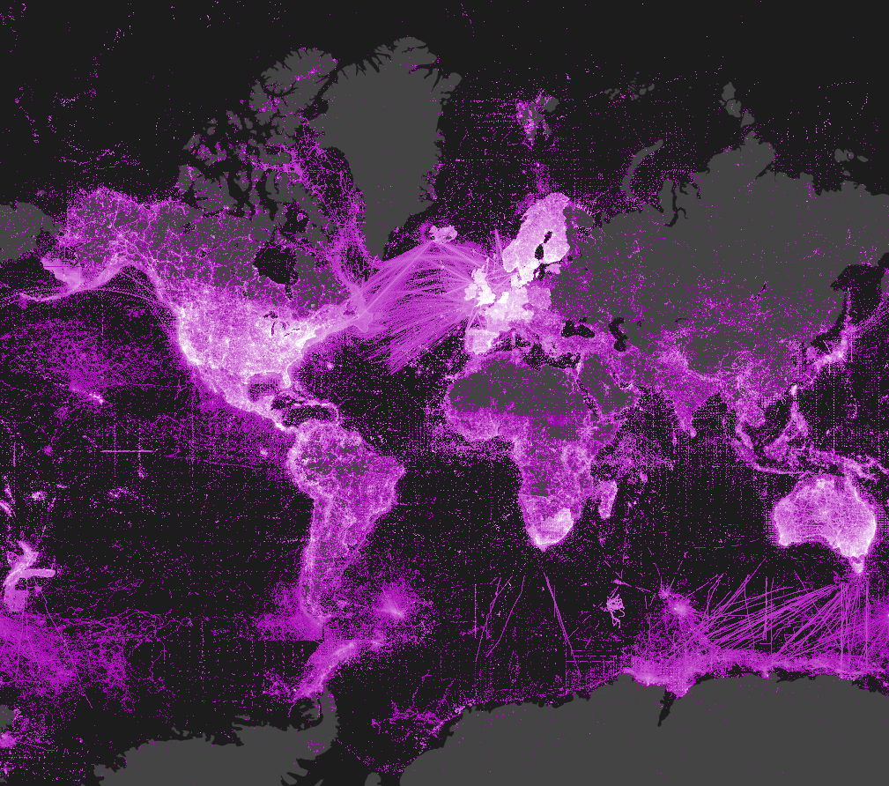
Data distribution in GBIF
Last updated: 2014-07-09

Slide 4



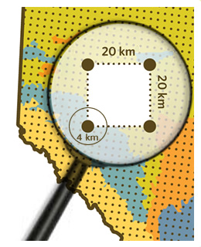

data publishing landscape
GBIF introduces IPT 1.0
GBIF redevelops IPT with less memory requirements
GBIF introduces IPT 2.0
DiGIR (2001), BioCASE (2001),TapirLink (2007) in use for publishing biodiversity data
Idea for simple, compressed text-based file for publishing introduced at TDWG
Nodes and aggregators (including GBIF Norway) begin to install and use IPTs
Demo/test Event core developed by GBIF and EU BON
IPT more than 100 installations and serving more than 800 datasets
Dataset DOIs with DataCite (March 2015).
IPT becomes the dominant data-publishing solution in GBIF.
2007
2008
2009
2010
2011
2012
2013
2014
2015
Event core is released for use (October 2015).
Notes:
GBIF (2010). Darwin Core Archives – How-to Guide, version 1, released on 1 March 2011, (contributed by Remsen D, Braak, K, Döring M, Robertson, T), Copenhagen: Global Biodiversity Information Facility, 21 pp, accessible online at: http://links.gbif.org/gbif_dwca_how_to_guide_v1
GBIF, 2015, “GBIF Integrated Publishing Toolkit v. 2.0”. Copenhagen: Global Biodiversity Information Facility. Available online at http://www.gbif.org/ipt. http://www.gbif.org/resource/81278
Robertson T, Döring M, Guralnick R, Bloom D, Wieczorek J, Braak K, et al. (2014) The GBIF Integrated Publishing Toolkit: Facilitating the Efficient Publishing of Biodiversity Data on the Internet. PLoS ONE 9(8): e102623. doi:10.1371/journal.pone.0102623

Slide 5
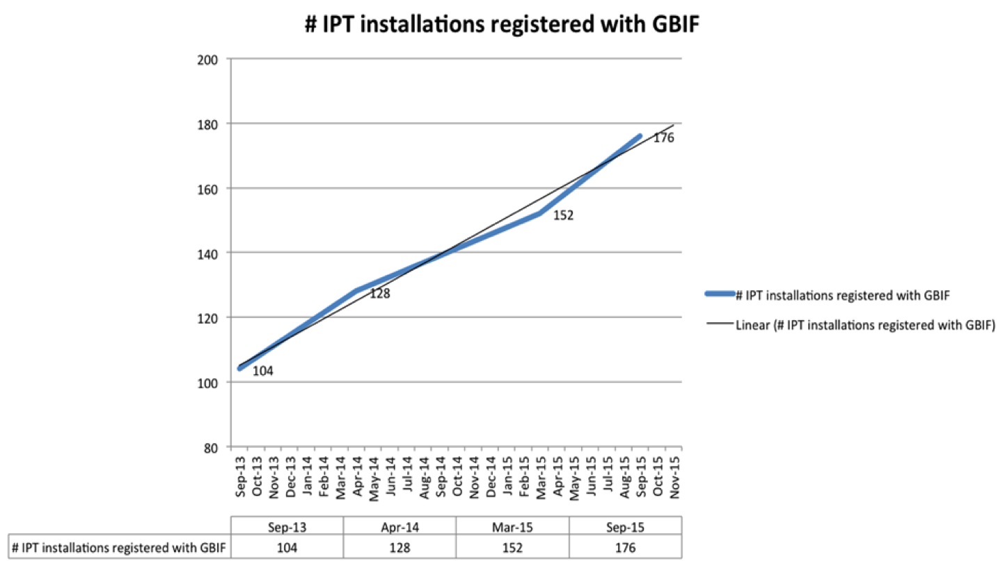
Data publishing landscape - statistics
http://www.gbif.org/ipt/stats
Notes:
Data/chart provided by Kyle Braak, GBIF.

Slide 6
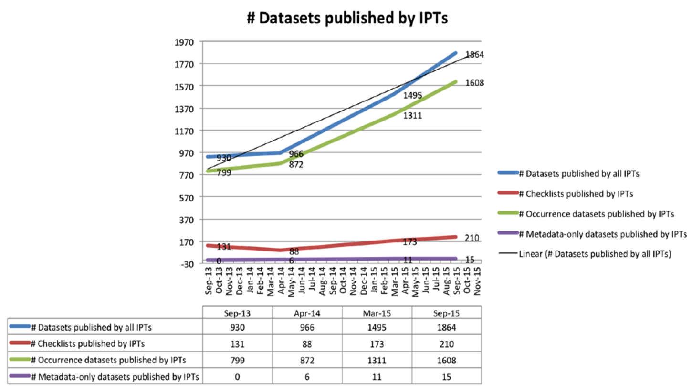
Data publishing landscape - statistics
Notes:
Data/chart provided by Kyle Braak, GBIF.

Slide 7
Data publishing landscape: status 2015
The continued GBIF commitment to improving access to biodiversity data.
Refinement and expansion of standards and publishing software.
Evolving social norms.
Most data still published with simple occurrence core.
Portals do not contain the features to support richer data.
Many institutions still need convincing to publish biodiversity data.
http://www.gbif.org/page/82104
Notes:
Good and needs improvement
The data publishing area is in continuous evolution and expansion. The standards are refined and expanded, the software is improved and debugged, the social norms evolve. That requires that we all recycle our knowledge periodically.
Despite biodiversity data publication in a standard way is possible for a long time now, most of the data is still published in a very simple way: just the occurrence core, single identifications, few/no connections among objects, simple metadata... Much richness of the original data is still non accessible because of the way data is published. This is one of the main reasons to organize this course.
· The data already published determines (although only to a certain extent) the technical developments in the GBIF network, namely in GBIF.org and its API. Only when a certain amount of data of certain type is published (e.g. through an extension), the priority to enable discovery and retrieval of that information raises in importance. Examples of this is the indexing of occurrences published using the occurrence extension of the taxon core, and the possibility to search and retrieve images from the simple multimedia extension.
Most data still published with simple occurrence core and is missing the known richness of the original data
Without the rich data, portal developers do not have the priority to enhance with features to support rich data

Slide 8

What is biodiversity data?
Digital text or multimedia data record detailing facts about the instance of occurrence of an organism, i.e. on the what, where, when, how and by whom of the occurrence and the recording.
Notes:
Reused slide from 1B Publishing Primary Biodiversity Data by Alberto González-Talaván^{1~} Data Sharing, Data Standards, and Demystifying the IPT ~ Gainesville, FL, USA. 13 January 2015

Slide 9




What is data publishing?
“Publishing” refers to making biodiversity datasets publicly accessible and discoverable, in a standardized form, via an access point, typically a web address (a URL).
IPT
Notes:
Modified from Reused slide from 1B Publishing Primary Biodiversity Data by Alberto González-Talaván^{1~} Data Sharing, Data Standards, and Demystifying the IPT ~ Gainesville, FL, USA. 13 January 2015

Slide 10
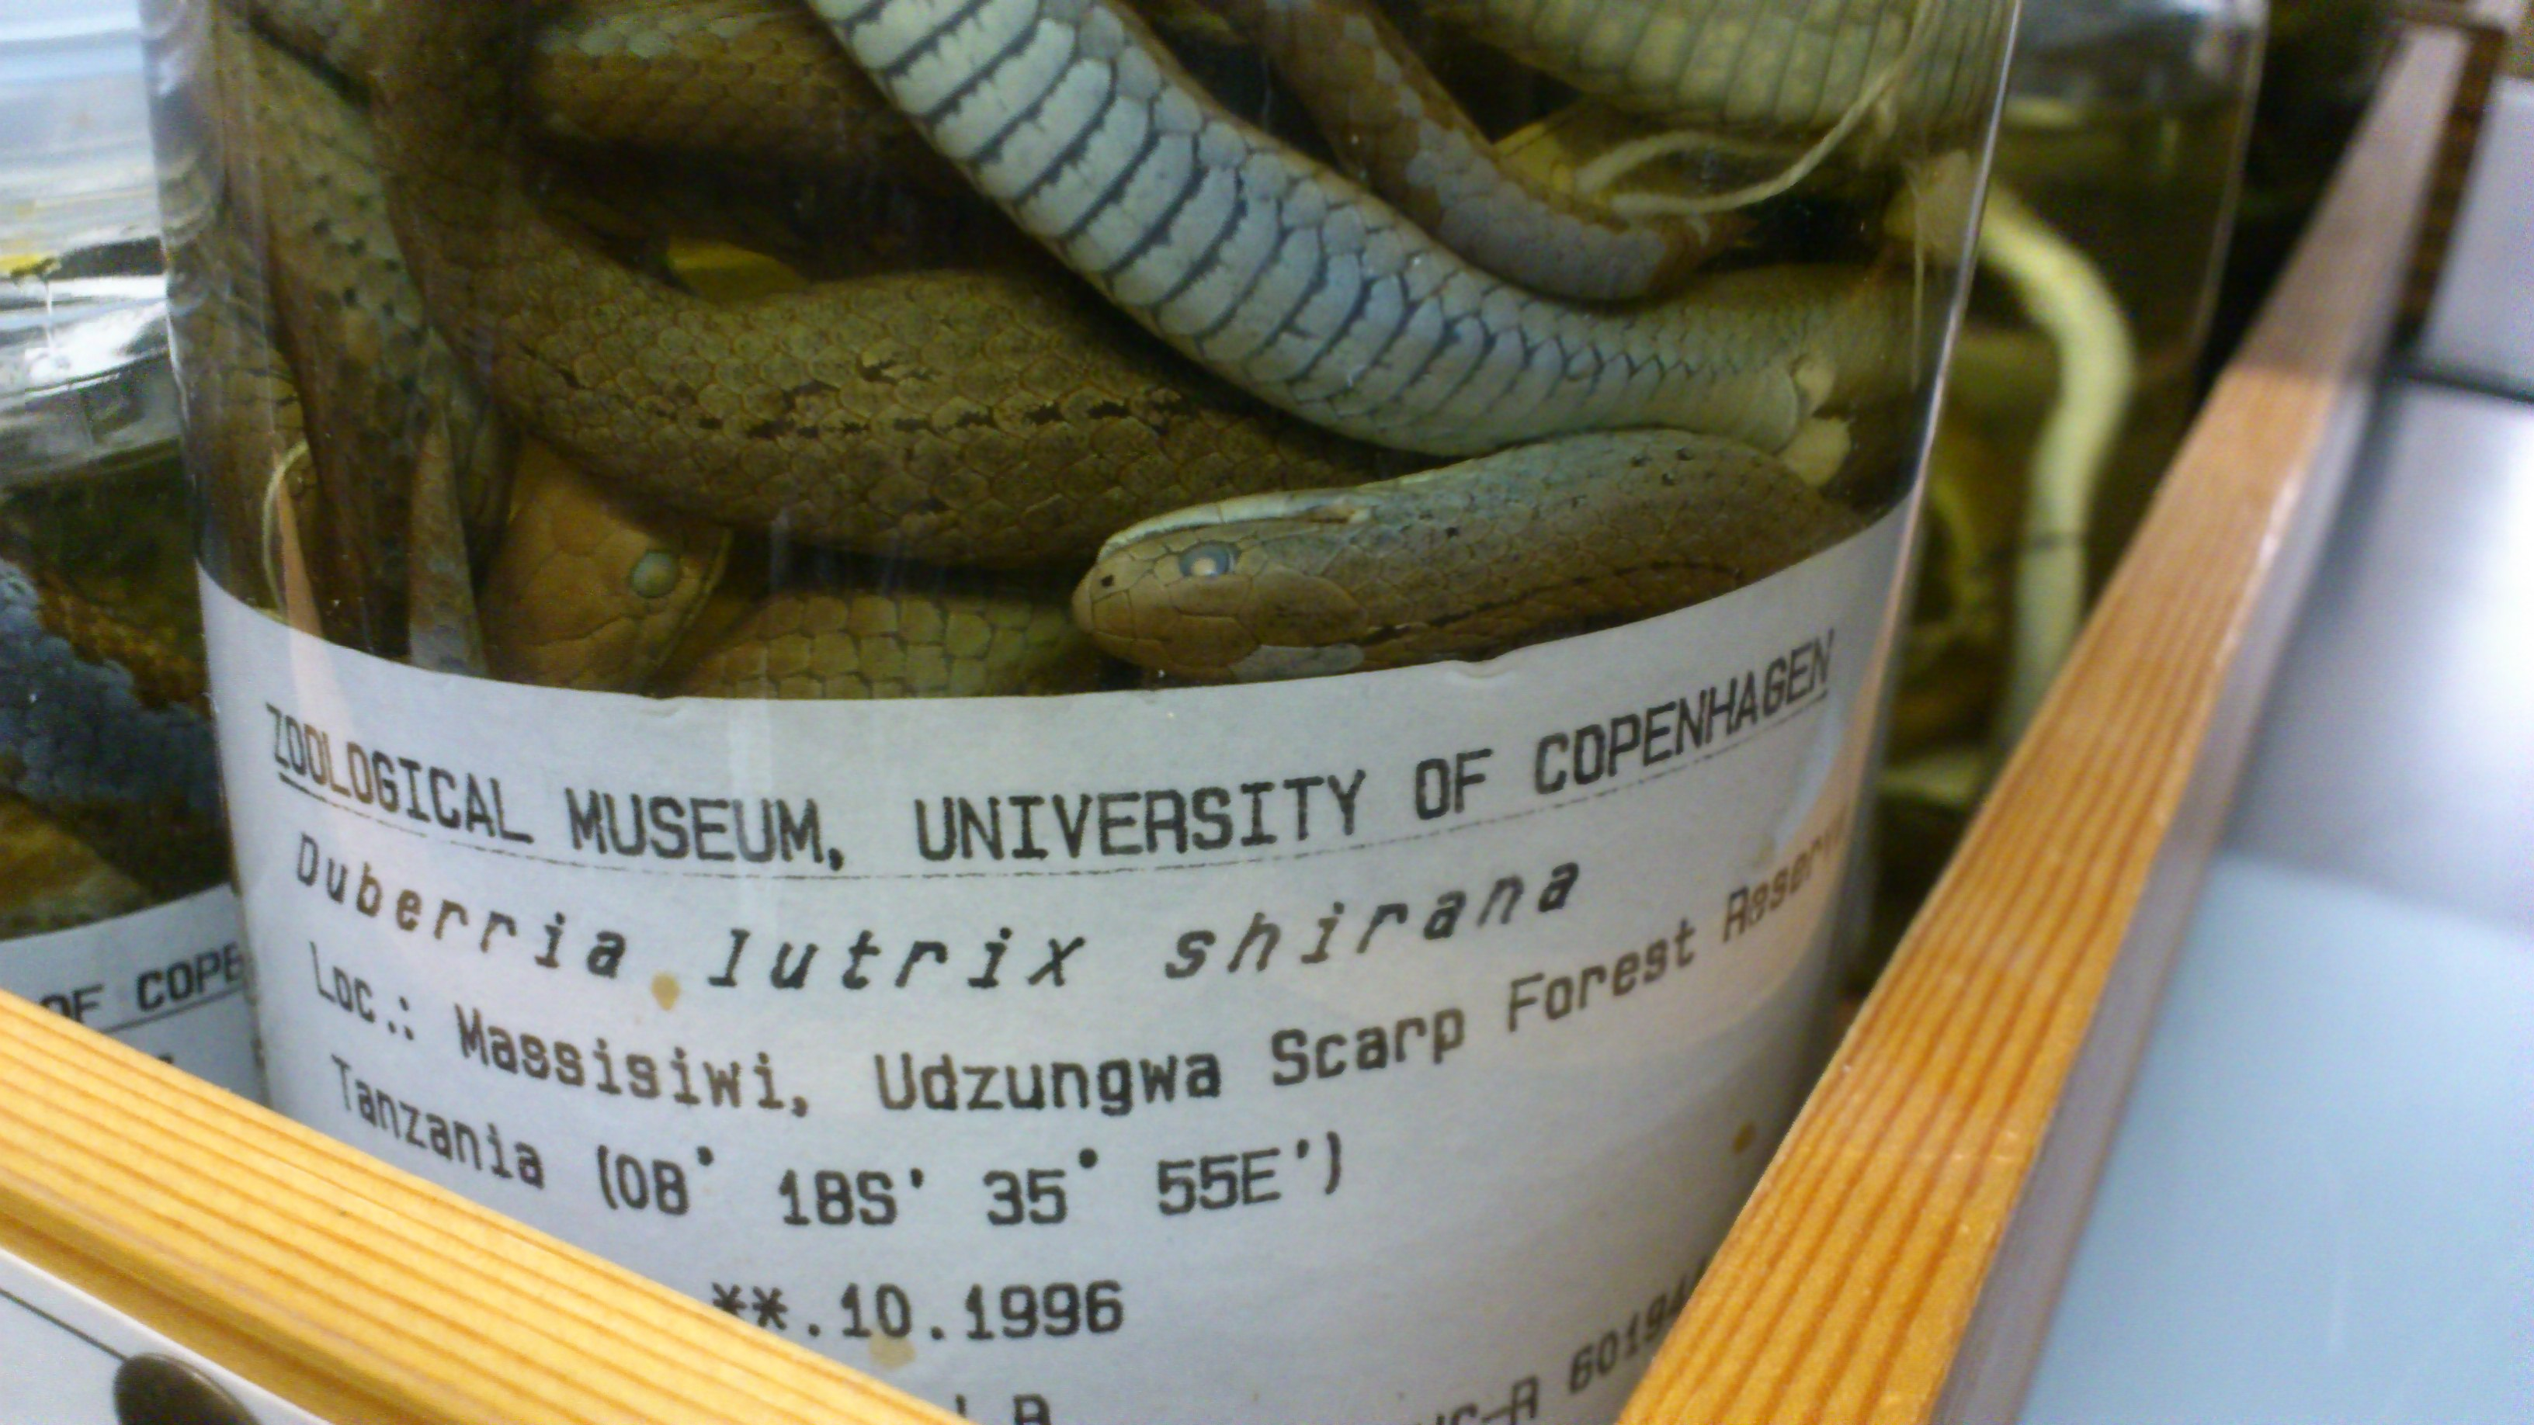
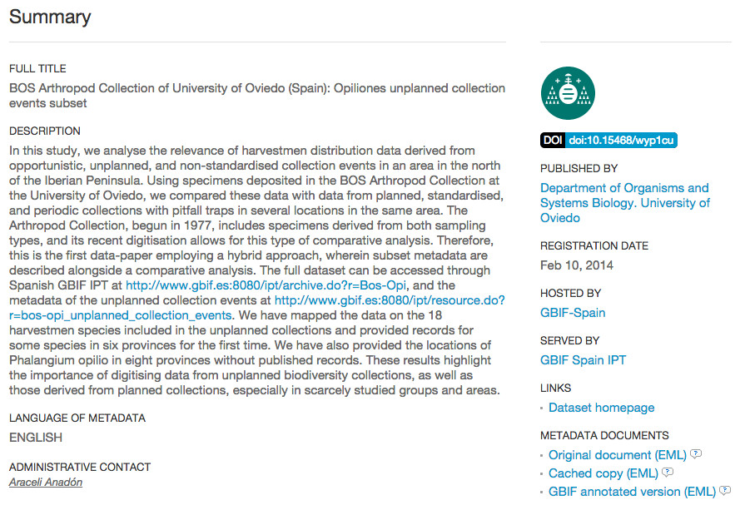
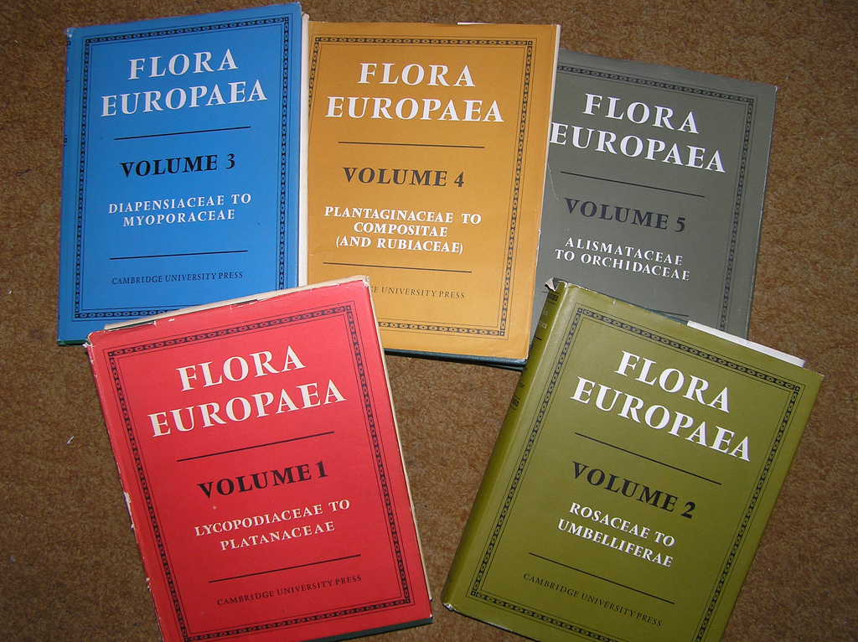
Biodiversity data types
Occurrences
Checklists (of taxon names)
Metadata (dataset description)
http://www.gbif.org/publishing-data/summary#datatypes
Notes:
Modified from 1B Publishing Primary Biodiversity Data by Alberto González-Talaván^{1~} Data Sharing, Data Standards, and Demystifying the IPT ~ Gainesville, FL, USA. 13 January 2015
Review of the data types for publishing (http://www.gbif.org/publishing-data/summary#datatypes). This will be the first attempt to cover the instructional objectives 1a, 1b & 1c.
GBIF now deals with four types of biodiversity data:
Occurrences (observations, specimens etc)
Checklists (names)
Metadata (data about data) - http://www.gbif.org/dataset/search?type=METADATA
Occurrences are records that document a 'collection event'—evidence that a particular, named organism was found at a particular time and place. Also known as primary biodiversity data, occurrences document the 'what, where, when, how and by whom' of our exploration of the planet's species. An occurrence record can be based on an observation in the field, vouchered (labeled) specimen in a museum or herbarium, or other evidence.
Checklists are lists of scientific names of organisms grouped into taxonomic hierarchies. They serve two main functions: first, they provide data that help to enrich information about particular species, for example by including them on national checklists, and on lists of invasive or threatened species; and they provide taxonomic 'backbones' around which species information can be organized.
Metadata are structured descriptions of datasets giving essential details such as the geographic and taxonomic scope of the data, methods of collection or observation, contact details and citation requirements. They help to give context to datasets and enable users to assess whether data are fit for use in a particular research project or application.

Slide 11
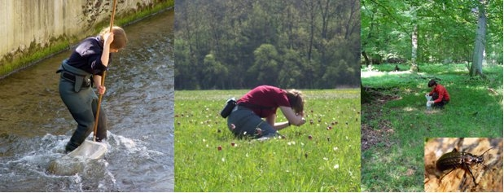
Biodiversity data types – sample data
Samples
Introduction of the Event core in March - October 2015
http://www.gbif.org/newsroom/news/sample-based-data
Notes:
introduce the need/push for sample-based datasets (introduction of the event core) (http://www.gbif.org/page/82105) - released March 24, 2015
beyond “presence only” data -- more quantitative information used in other areas of scientific discovery and research, particularly ecological monitoring and assessment.
Sample-based data (ecological monitoring and assessment data)
Sample-based data are records from thousands of different kinds of environmental, ecological, and natural resource monitoring and assessment investigations. These events range from one-off surveys to ongoing monitoring and includes activities like freshwater and marine sampling, plant cover and vegetation plots, and citizen science bird counts, among others.

Slide 12

Data Standards
ABCD Access to Biological Collection Data (2005)
DwC Darwin Core (2009)
AC Audubon Core Multimedia Resources Metadata Schema (2013)
NCD Natural Collection Descriptions (Draft)
EML Ecological Metadata Language
http://www.tdwg.org/standards/
Notes:
Modified from 1B Publishing Primary Biodiversity Data by Alberto González-Talaván^{1~} Data Sharing, Data Standards, and Demystifying the IPT ~ Gainesville, FL, USA. 13 January 2015
This section will cover the instructional objective 2a.
Biodiversity Information Standards (TDWG), also known as the Taxonomic Databases Working Group, is a not for profit scientific and educational association that is affiliated with the International Union of Biological Sciences.
TDWG was formed to establish international collaboration among biological database projects. TDWG promoted the wider and more effective dissemination of information about the World's heritage of biological organisms for the benefit of the world at large. Biodiversity Information Standards (TDWG) now focuses on the development of standards for the exchange of biological/biodiversity data.
Our Mission
Develop, adopt and promote standards and guidelines for the recording and exchange of data about organisms
Promote the use of standards through the most appropriate and effective means and
Act as a forum for discussion through holding meetings and through publications

Slide 13

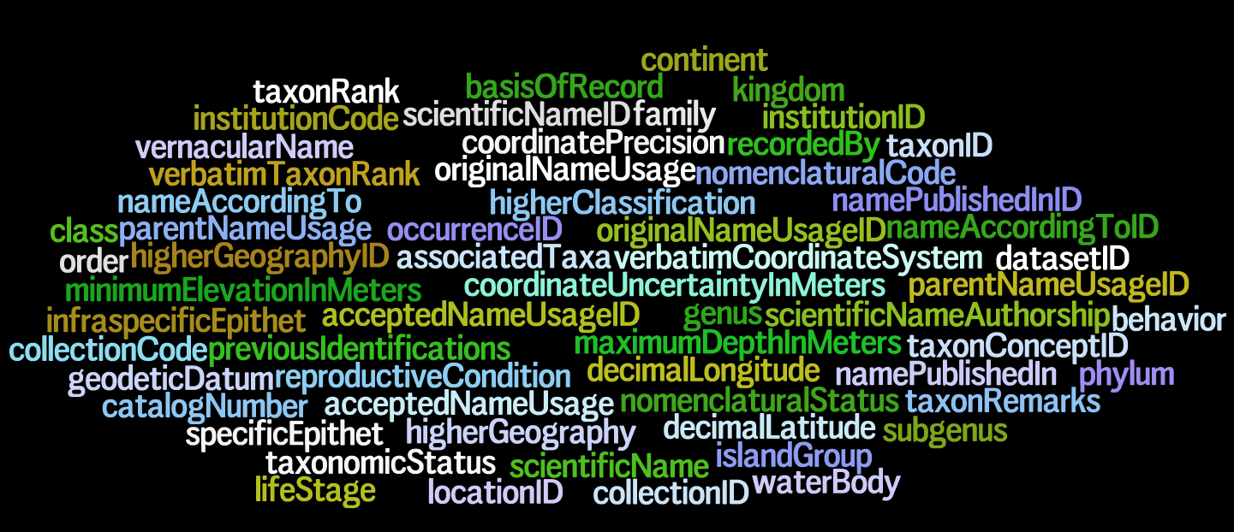
Darwin Core – a glossary of terms
Wieczorek J, Bloom D, Guralnick R, Blum S, Döring M, De Giovanni R, Robertson T, and Vieglais D (2012) Darwin Core: An Evolving Community-Developed Biodiversity Data Standard. PLoS ONE 7(1): e29715. doi:10.1371/journal.pone.0029715
Notes:
Wieczorek, John; D. Bloom, R. Guralnick, S. Blum, M. Döring, R. De Giovanni, T. Robertson, and D. Vieglais (2012) Darwin Core: An Evolving Community-Developed Biodiversity Data Standard. PLoS ONE 7(1): e29715. doi:10.1371/journal.pone.0029715
It includes a glossary of terms intended to facilitate the sharing of information about biological diversity by providing reference definitions, examples, and commentaries.
It is primarily based on taxa, their occurrence in nature as documented by observations, specimens, and samples, and related information.

Slide 14
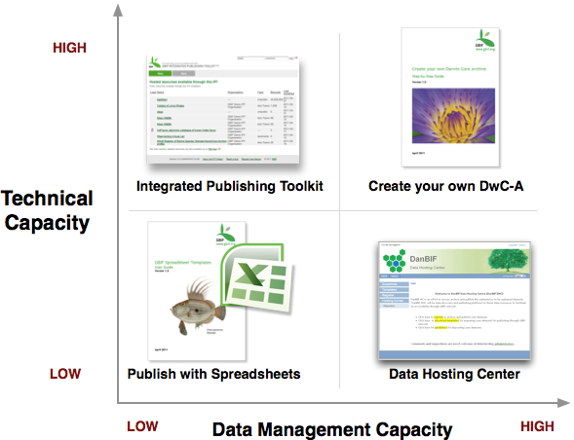

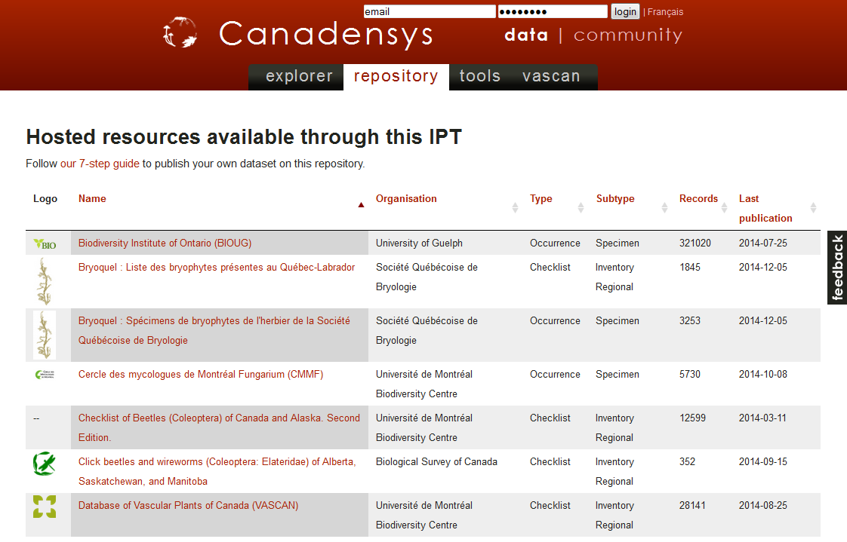
Data publishing Methods
Notes:
Slide from 1B Publishing Primary Biodiversity Data by Alberto González-Talaván^{1~} Data Sharing, Data Standards, and Demystifying the IPT ~ Gainesville, FL, USA. 13 January 2015
Ways to publish (strengths and weaknesses of each; include stats for numbers of datasets published via each way; how to identify what method was used when viewing datasets on gbif.org). This will cover the instructional objective 2b.
simple spreadsheets
IPT
custom-created DwCA

Slide 15
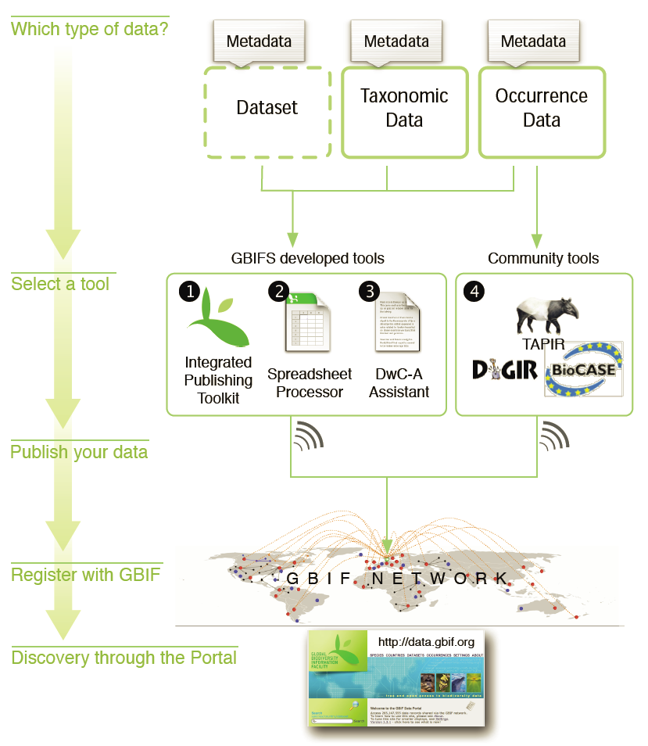
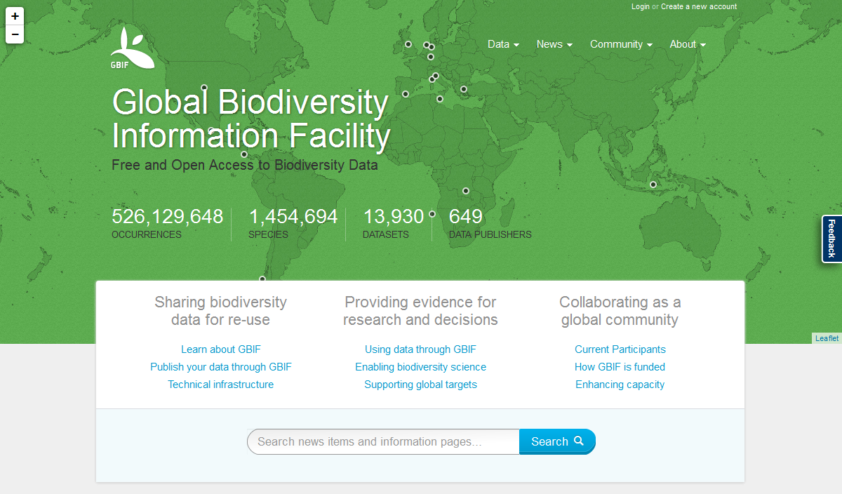
Data publishing Methods
Notes:
Slide from 1B Publishing Primary Biodiversity Data by Alberto González-Talaván^{1~} Data Sharing, Data Standards, and Demystifying the IPT ~ Gainesville, FL, USA. 13 January 2015
IPT currently under development with future planned updates
Web tools and templates for excel tools were contracted for development in ???? And have not been updated since then.
DiGIR protocol development ceased in 2006
TAPIR protocol last updated in 2010
BioCASE protocol last updated 2015

Slide 16
Promotion of data publishing - barriers
Psychological &
cultural
barriers
Lack of knowledge about
Lack of understanding
Lack of will
Perceived data value
Privacy concerns
Lack of authorization
Lack of time / planning
Lack of capacity and skills
Lack of funding
Lack of infrastructure
Institutional
barriers
Capacity
barriers
Practical
barriers
http://www.gbif.org/publishing-data/benefits, http://www.gbif.org/resource/81196
Notes:
Slide from Module 3 – Knowledge exchange I Supporting data digitization and publishing ~ Alberto González-Talaván ~ 4 October 2013, GBIF Nodes Training ~ Berlin, Germany
Barriers to publishing
On these points:
Lack of knowledge: The holder may not be aware how sharing on the internet works, and the existence of initiatives such as GBIF.
Lack of understanding: the holder may have heard about GBIF and data publishing, but thinks it must be complicated, bureaucratic, very technical…
Lack of will: The holder understand the process but does not want to go through it because of cultural issues, perceived sensitivity of the data,
Perceived data value: the holder thinks that the data has economic or intrinsic value that (s)he wants to exploit.
Privacy concerns:
Lack of authorization: The holder would like to share the data, but institutional policies prevent it.
Lack of time / planning: The holder never finds an appropriate moment to start the digitization, data transformation or publishing. Or got discouraged after not properly planned attempts.
Lack of capacity: the holder would like to digitize and share the data, but (s)he doesn’t know what is the best (or any) way to do it.
Lack of resources/funding: the holder would like to digitize and share the data, but there is no spare capacity in the institution to carry out such tasks.
Lack of infrastructure: the holder would like to digitize and share the data, but (s)he does not have the technical infrastructure to do it.
----- Meeting Notes (10/3/15 07:09) -----
Least to most open
Objective is to get to 5 or any advancement on the scale is positive

Slide 17
Promotion of data publishing - restrictions
Refuse to share.
Refuse to share until they have exhausted the
planned use of the data.
Will only share their data for a fee.
Will only share data under specific restrictions.
Hesitation to share data openly.
Notes:
Slide from Module 3 – Knowledge exchange I Supporting data digitization and publishing ~ Alberto González-Talaván ~ 4 October 2013, GBIF Nodes Training ~ Berlin, Germany
Least to most open
Objective is to get to 5 or any advancement on the scale is positive

Slide 18
Promotion of data publishing - strategies
Facilitate access to financial support.
Call upon commitments or legal mandates.
Call upon open access / moral principles.
Show the benefits of a better data management.
Show the benefit for their scientific careers.
Peer pressure.
Start / support big digitization programmes.
Start / support data repatriation efforts.
Notes:
Slide from Module 3 – Knowledge exchange I Supporting data digitization and publishing ~ Alberto González-Talaván ~ 4 October 2013, GBIF Nodes Training ~ Berlin, Germany
Strategies and arguments to overcome barriers/Incentives for publishing
On these points:
Facilitate access to financial support: provide digitization grants or help the data holders to obtain funding that funds directly or indirectly the digitization.
Call upon commitments or legal mandates: Try to use commitments or legal mandates that apply to the institution or the country as a way to convince the data holder.
Call upon open access / moral principles: the results of publicly funded research should be made public, access to science should not be restricted, etc.
Show the benefits of a better data management: management of digital information can facilitate the data holder’s daily work.
Show the benefit for their scientific careers: publishing data can provide scientific credit through data papers, citations and data usage indexes.
Peer pressure: competing/fellow institutions are already sharing data and the holder’s institution is being left behind.
Start / support big digitization programmes: promote the start of big digitization programmes that will benefit many holders at the same time.
Start / support data repatriation efforts: start programmes that will allow the return of digital data describing your county’s biodiversity.

Slide 19
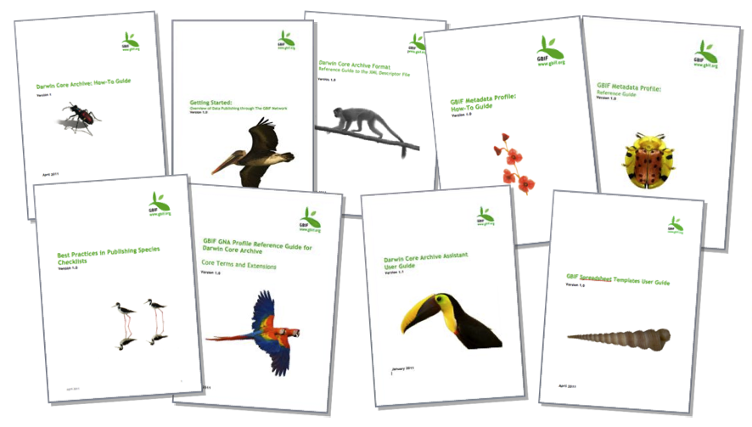
Data publishing guidelines
http://www.gbif.org/resources?f[0]=gr_purpose%3A955
Notes:
http://www.gbif.org/resources?f[0]=gr_purpose%3A955
http://www.gbif.org/resources?f[0]=gr_purpose%3A955&f[1]=gr_language%3A971&f[2]=gr_resource_type%3A895&f[3]=gr_resource_type%3A1010&searched=1

Slide 20
2015 Data Publishing Landscape
Dag Endresen, GBIF Norway (Credits: Laura Russell)
Data publishing workshop at NINA, Trondheim – 29-30 October 2015
Notes:
Image from Piotr Lewandowski, shared via http://www.freeimages.com/photo/learning-with-pencil-1415671
http://community.gbif.org/pg/pages/view/48332/session-01-the-gbif-data-publishing-landscape-in-2015

