Slide 1
Introduction to data publishing at NINA
Roald Vang, NINA 29.10.2015

Slide 2
Data publishing - challenges
Some large databases exist, but most data often stored as text or excel files
Data optimized for analyses, not for data sharing
Data not ready for immediate publishing and not according to Darwin Core standard
Strategy: develop tools to help the researchers prepare their data for data sharing and publishing

Slide 3
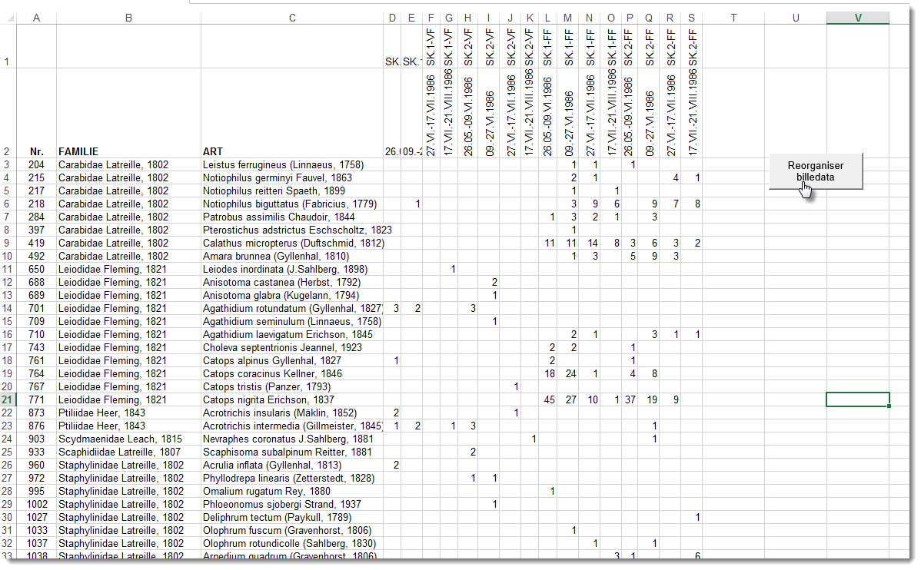
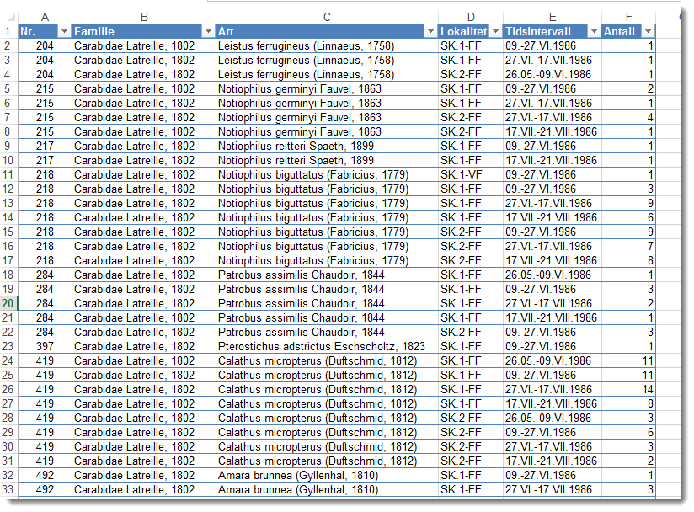
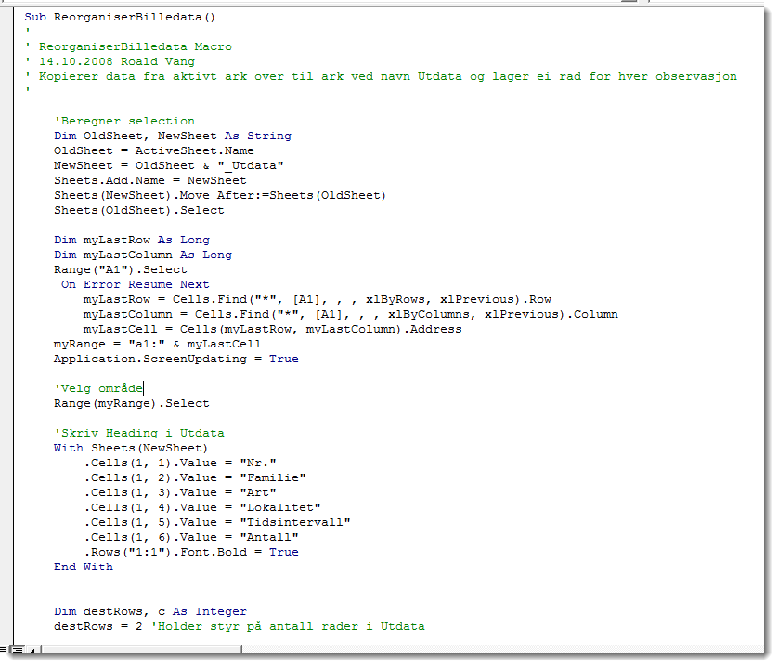
Tools– excel reorganizer macro

Slide 4
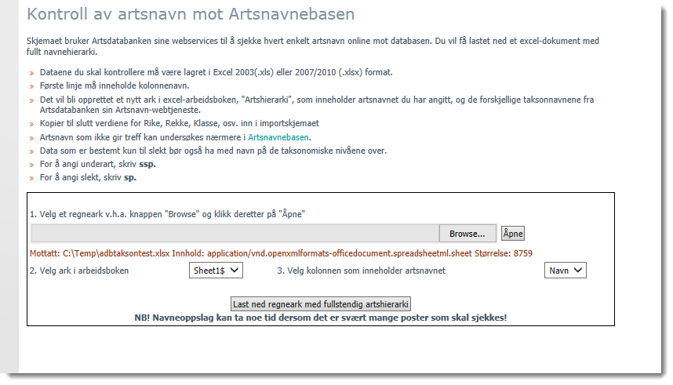
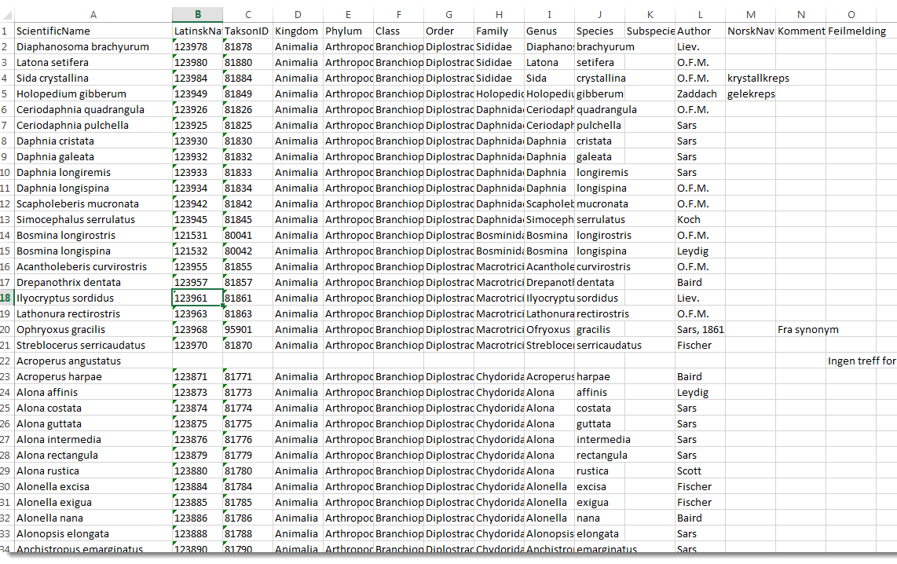
Tools – Taxonomy lookup WS

Slide 5
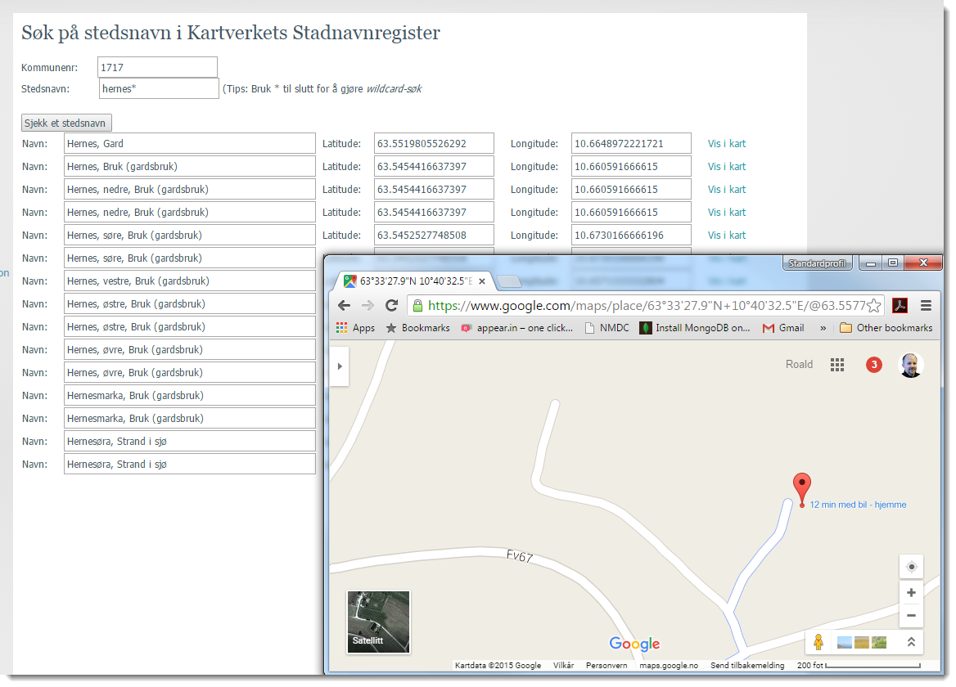
Tools – Place names lookup

Slide 6
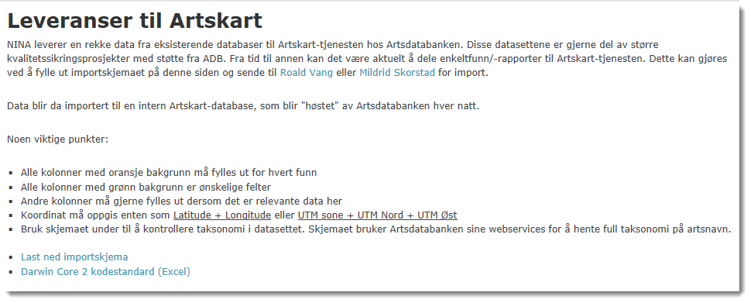
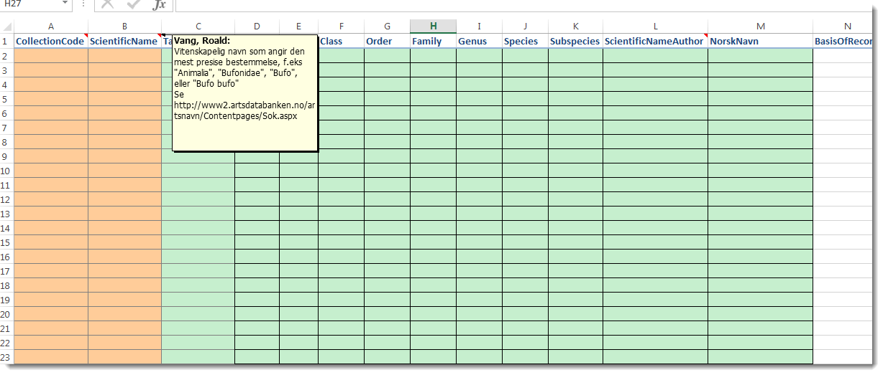
Tools – Darwin Core 2 form

Slide 7
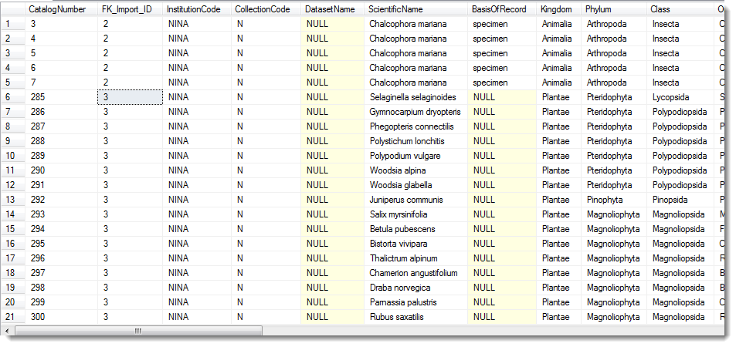
Data imported to SQL Server table
«Darwin Core table»
Each import linked to metadata table

Slide 8
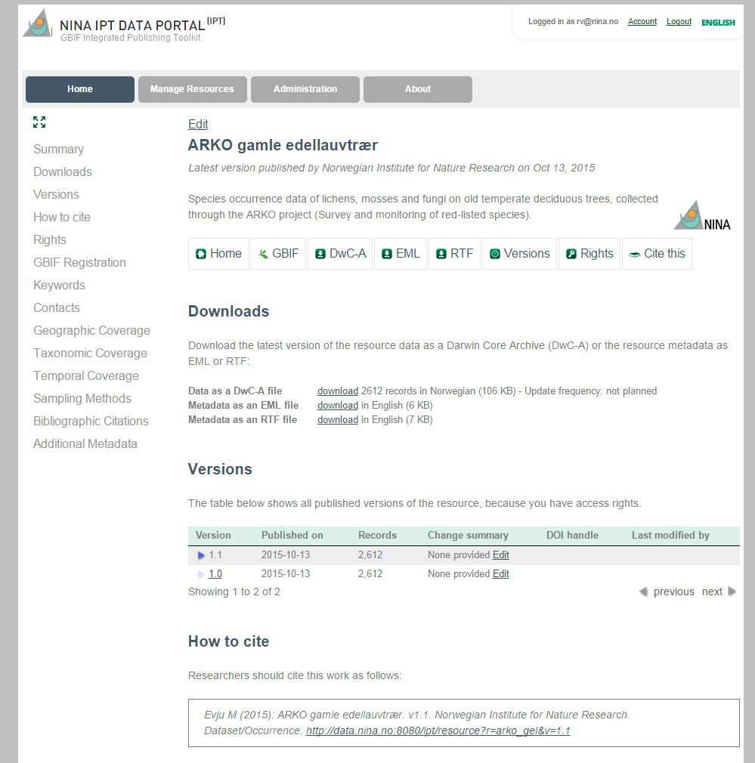
IPT Metadata
Enter metadata in IPT http://data.nina.no:8080/ipt

Slide 9
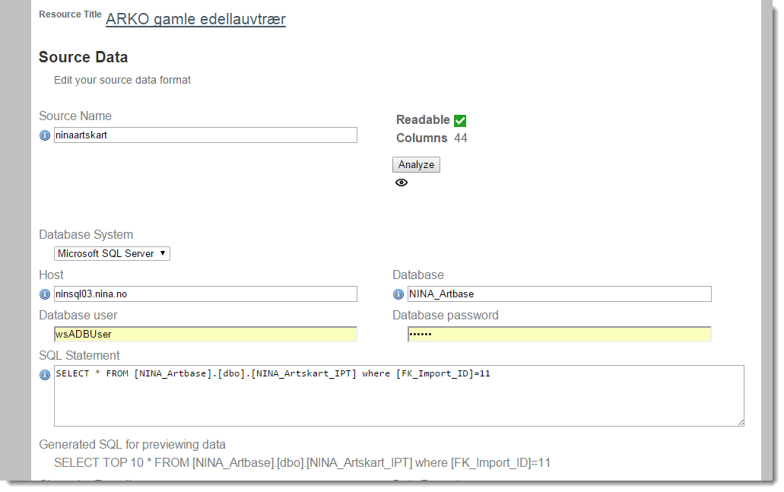
IPT data connection

Slide 10
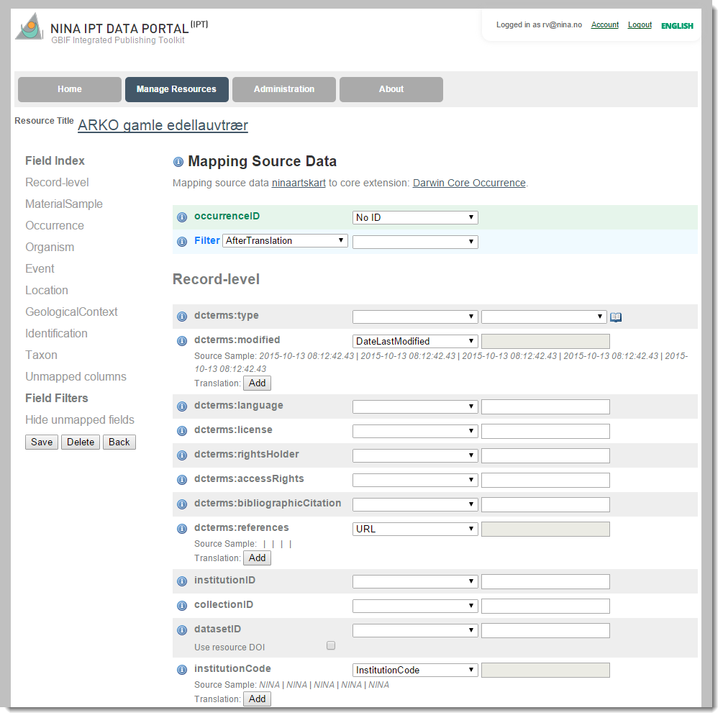
IPT data mapping

Slide 11
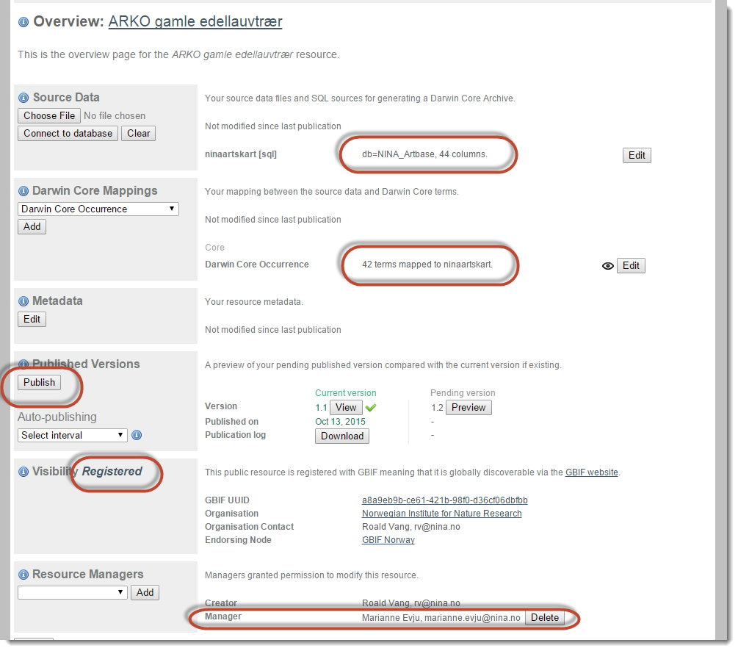
IPT Publishing

Slide 12
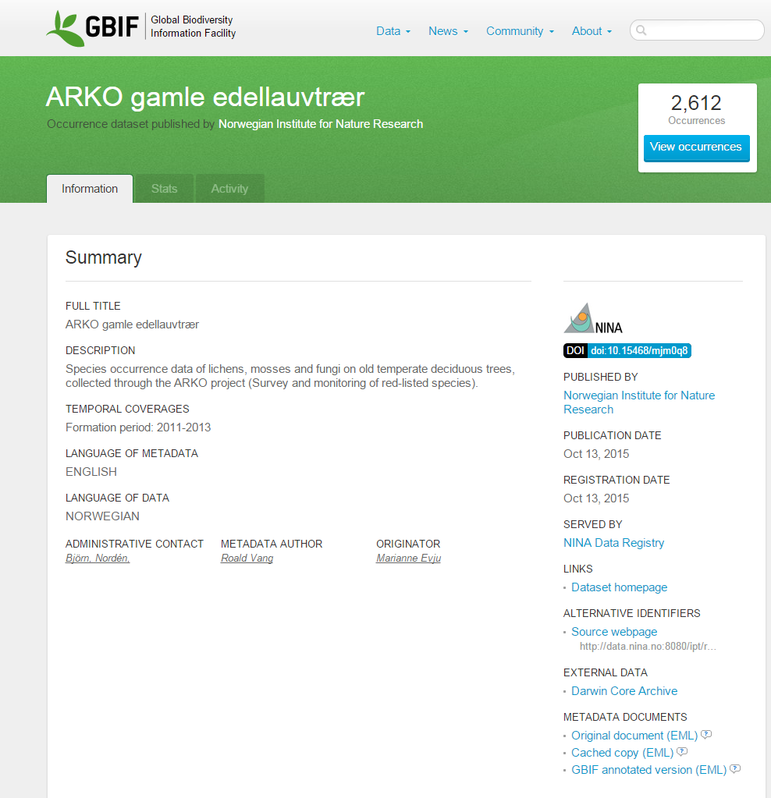
Data published on local IPT and in GBIF

Slide 13




Les dette
Ønsker du animert avslutning kan du bruke denne siden som avslutning
Foto på side 1: P. Jordhøy, J. Thomassen, E. B. Thorstad, A. Staverløkk, T. Aarvak, B. Løken/Samfoto

