Slide 1
Publishing and datasets in GBIF
Jan Kristoffer Legind
26 OCT 2015

Slide 2
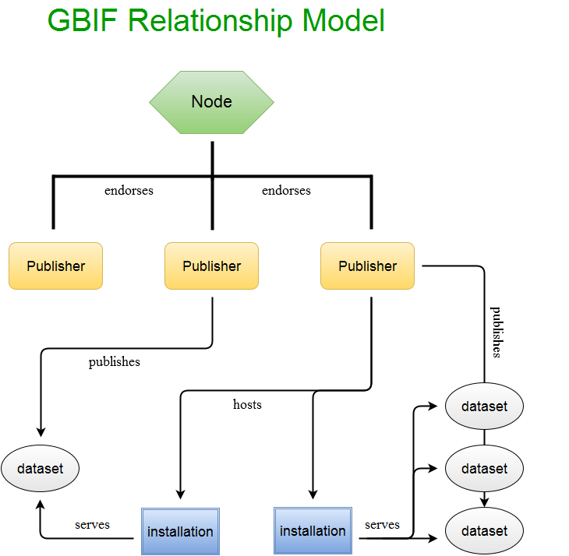
How things fit together...
Record
Record
Record
IPT
IPT

Slide 3
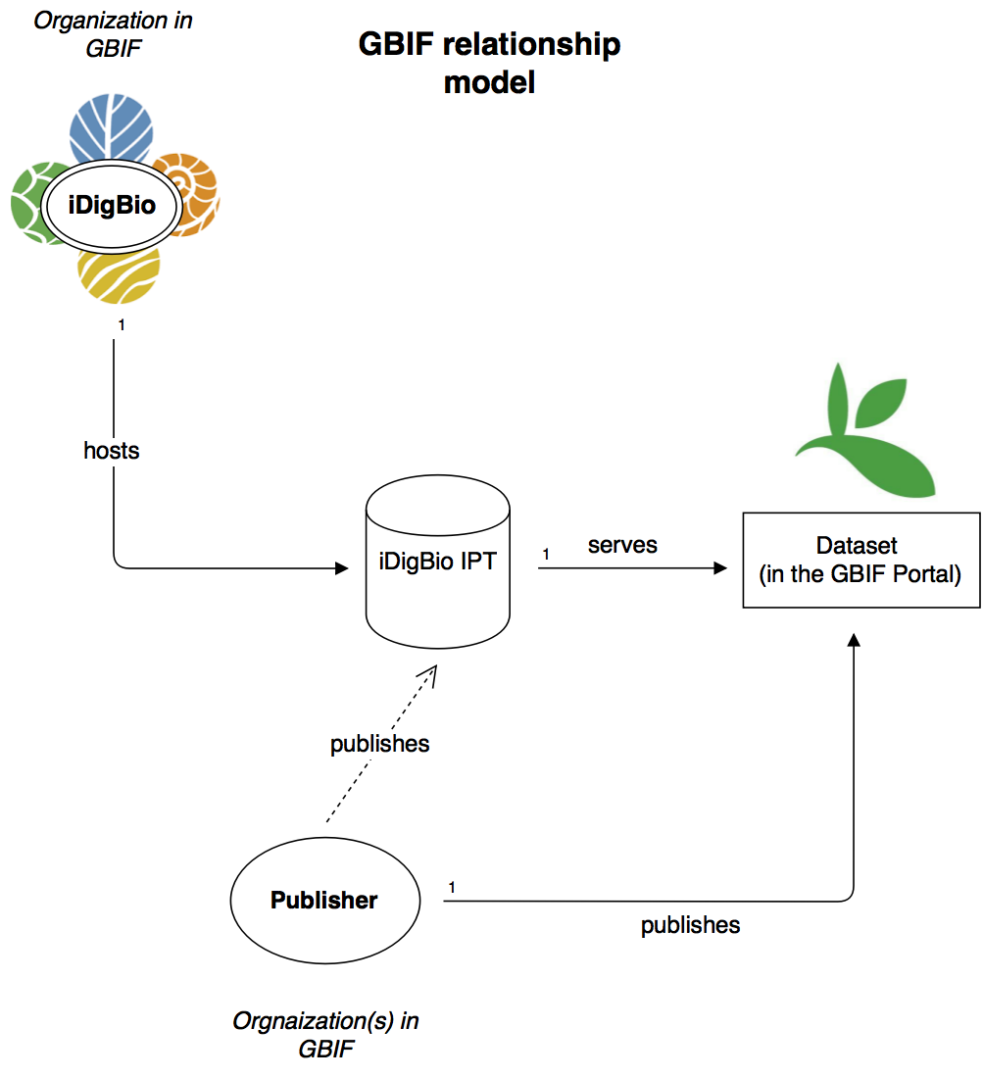
Author ??
http://www.gbif.org/dataset/a8a9eb9b-ce61-421b-98f0-d36cf06dbfbb

Slide 4
What you can get away with
Rich dataset description
Minimal dataset description
3 or 5 terms:
Record id, scientific name, basis-of-record
200+ terms
http://rs.tdwg.org/dwc/terms/

Slide 5
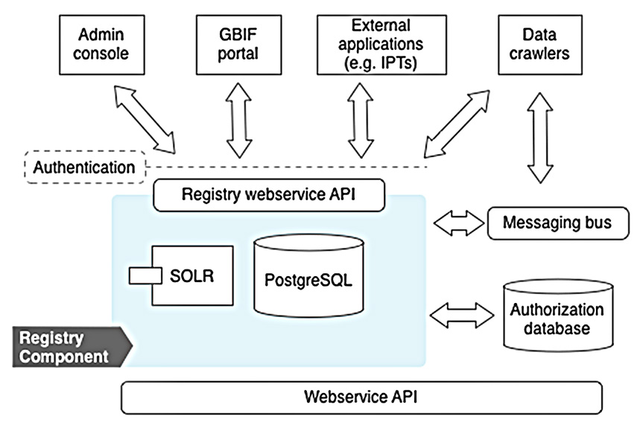

Registry architecture

Slide 6
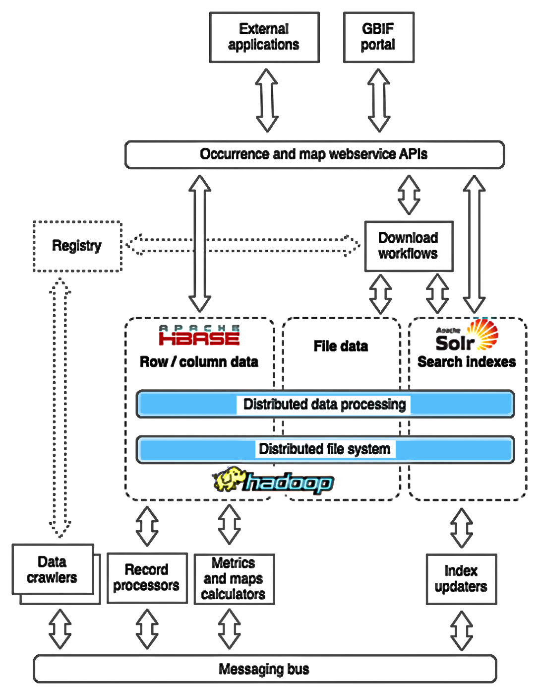
Occcurrence architecture

