Slide 1

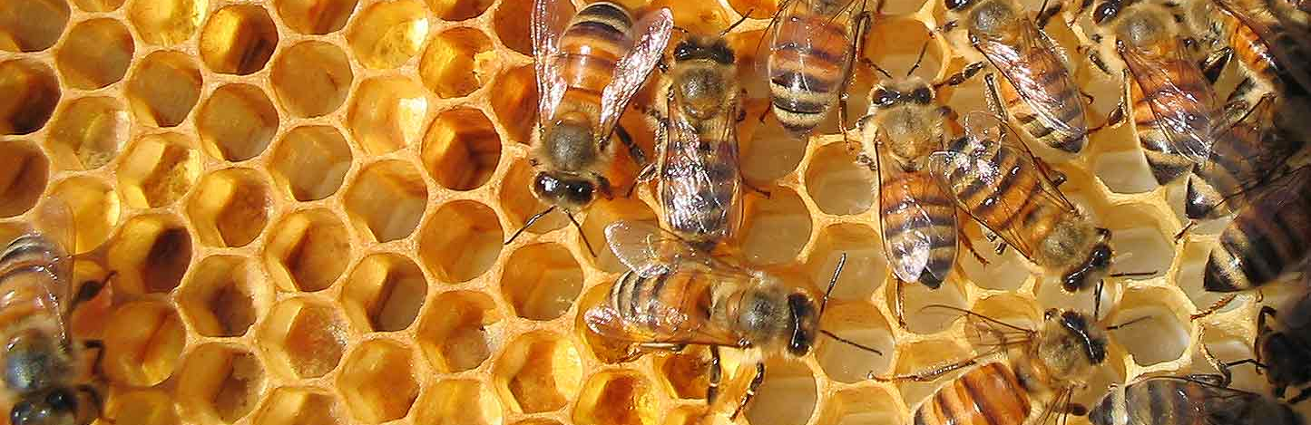
Darwin Core & Darwin Core Archive
Dag Endresen, GBIF Norway (Credits: Laura Russell)
Data publishing workshop at NINA, Trondheim – 29-30 October 2015
Notes:
Image from Billy W obtained via http://www.freeimages.com/photo/bee-keeping-11-1491032

Slide 2

Data Standards
ABCD Access to Biological Collection Data (2005)
DwC Darwin Core (2009)
AC Audubon Core Multimedia Resources Metadata Schema (2013)
NCD Natural Collection Descriptions (Draft)
EML Ecological Metadata Language
http://www.tdwg.org/standards/
Notes:
Modified from 1B Publishing Primary Biodiversity Data by Alberto González-Talaván^{1~} Data Sharing, Data Standards, and Demystifying the IPT ~ Gainesville, FL, USA. 13 January 2015
This section will cover the instructional objective 2a.
Biodiversity Information Standards (TDWG), also known as the Taxonomic Databases Working Group, is a not for profit scientific and educational association that is affiliated with the International Union of Biological Sciences.
TDWG was formed to establish international collaboration among biological database projects. TDWG promoted the wider and more effective dissemination of information about the World's heritage of biological organisms for the benefit of the world at large. Biodiversity Information Standards (TDWG) now focuses on the development of standards for the exchange of biological/biodiversity data.
Our Mission
Develop, adopt and promote standards and guidelines for the recording and exchange of data about organisms
Promote the use of standards through the most appropriate and effective means and
Act as a forum for discussion through holding meetings and through publications

Slide 3
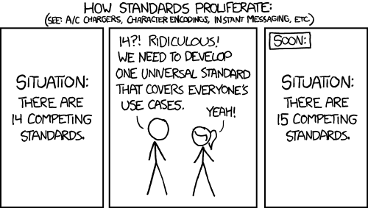
Data standards
Important principle: Re-use of terms from standardized terminologies wherever possible.
Credits: xkcd, https://xkcd.com/927/ CC-BY-NC
Notes:
REUSE, REUSE, REUSE!
Credits xkcd, https://xkcd.com/927/ CC-BY-NC

Slide 4

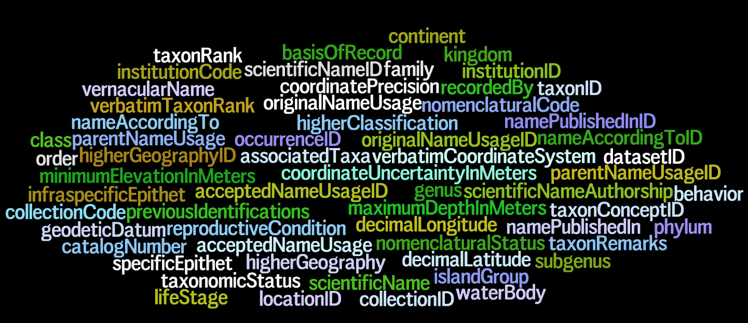
Darwin Core – a glossary of terms
Wieczorek J, Bloom D, Guralnick R, Blum S, Döring M, De Giovanni R, Robertson T, and Vieglais D (2012) Darwin Core: An Evolving Community-Developed Biodiversity Data Standard. PLoS ONE 7(1): e29715. doi:10.1371/journal.pone.0029715
Notes:
Wieczorek, John; D. Bloom, R. Guralnick, S. Blum, M. Döring, R. De Giovanni, T. Robertson, and D. Vieglais (2012) Darwin Core: An Evolving Community-Developed Biodiversity Data Standard. PLoS ONE 7(1): e29715. doi:10.1371/journal.pone.0029715
It includes a glossary of terms intended to facilitate the sharing of information about biological diversity by providing reference definitions, examples, and commentaries.
It is primarily based on taxa, their occurrence in nature as documented by observations, specimens, and samples, and related information.

Slide 5
Record-level Terms
dcterms:type | dcterms:modified | dcterms:language | dcterms:rights | dcterms:rightsHolder | dcterms:accessRights | dcterms:bibliographicCitation | dcterms:references | institutionID | collectionID | datasetID | institutionCode | collectionCode | datasetName | ownerInstitutionCode | basisOfRecord | informationWithheld | dataGeneralizations | dynamicProperties
Occurrence
occurrenceID | catalogNumber | recordNumber | recordedBy | individualCount | organismQuantity | organismQuantityType | sex | lifeStage | reproductiveCondition | behavior | establishmentMeans | occurrenceStatus | preparations | disposition | associatedMedia | associatedReferences | associatedSequences | associatedTaxa | otherCatalogNumbers | occurrenceRemarks
Organism
organismID | organismName | organismScope | assocoatedOccurrences | associatedOrganisms | previousIdentifications | organismRemarks
MaterialSample | LivingSpecimen | PreservedSpecimen | FossilSpecimen
materialSampleID
Event | HumanObservation | MachineObservation
eventID | parentEventID | fieldNumber | eventDate | eventTime | startDayOfYear | endDayOfYear | year | month | day | verbatimEventDate | habitat | samplingProtocol | sampleSizeValue | sampleSizeUnit | samplingEffort | fieldNotes | eventRemarks
Location
locationID | higherGeographyID | higherGeography | continent | waterBody | islandGroup | island | country | countryCode | stateProvince | county | municipality | locality | verbatimLocality | verbatimElevation | minimumElevationInMeters | maximumElevationInMeters | verbatimDepth | minimumDepthInMeters | maximumDepthInMeters | minimumDistanceAboveSurfaceInMeters | maximumDistanceAboveSurfaceInMeters | locationAccordingTo | locationRemarks | verbatimCoordinates | verbatimLatitude | verbatimLongitude | verbatimCoordinateSystem | verbatimSRS | decimalLatitude | decimalLongitude | geodeticDatum | coordinateUncertaintyInMeters | coordinatePrecision | pointRadiusSpatialFit | footprintWKT | footprintSRS | footprintSpatialFit | georeferencedBy | georeferencedDate | georeferenceProtocol | georeferenceSources | georeferenceVerificationStatus | georeferenceRemarks
GeologicalContext
geologicalContextID | earliestEonOrLowestEonothem | latestEonOrHighestEonothem | earliestEraOrLowestErathem | latestEraOrHighestErathem | earliestPeriodOrLowestSystem | latestPeriodOrHighestSystem | earliestEpochOrLowestSeries | latestEpochOrHighestSeries | earliestAgeOrLowestStage | latestAgeOrHighestStage | lowestBiostratigraphicZone | highestBiostratigraphicZone | lithostratigraphicTerms | group | formation | member | bed
Identification
identificationID | identifiedBy | typeStatus | identificationQualifier | dateIdentified | identificationReferences | identificationVerificationStatus | identificationRemarks
Taxon
taxonID | scientificNameID | acceptedNameUsageID | parentNameUsageID | originalNameUsageID | nameAccordingToID | namePublishedInID | taxonConceptID | scientificName | acceptedNameUsage | parentNameUsage | originalNameUsage | nameAccordingTo | namePublishedIn | namePublishedInYear | higherClassification | kingdom | phylum | class | order | family | genus | subgenus | specificEpithet | infraspecificEpithet | taxonRank | verbatimTaxonRank | scientificNameAuthorship | vernacularName | nomenclaturalCode | taxonomicStatus | nomenclaturalStatus | taxonRemarks
ResourceRelationship (Auxiliary Terms)
resourceRelationshipID | resourceID | relatedResourceID | relationshipOfResource | relationshipAccordingTo | relationshipEstablishedDate | relationshipRemarks
MeasurementOrFact (Auxiliary Terms)
measurementID | measurementType | measurementValue | measurementAccuracy | measurementUnit | measurementDeterminedDate | measurementDeterminedBy | measurementMethod | measurementRemarks
http://rs.tdwg.org/dwc/terms/
Notes:
Darwin Core, http://rs.tdwg.org/dwc/terms/

Slide 6
Darwin Core (DwC) provides a flat list of concepts and terms, expressed using RDF.
DwC “extensions” for the declaration of complementary, additional concepts.
Reuse concepts from other vocabularies whenever possible, do not re-invent terms.
Darwin Core Archive (DwC-A) is a data exchange format based on Darwin Core. DwC-A has a star schema model.
DwC-A cores, extensions and controlled value vocabularies.
DwC-A resources always REUSE terms from Darwin Core or other concept vocabularies.
Notes:
See also: Endresen, D.T.F., and H. Knüpffer (2012). The Darwin Core extension for genebanks opens up new opportunities for sharing germplasm data sets. Biodiversity Informatics 8:12-29. https://journals.ku.edu/index.php/jbi/article/view/4095

Slide 7
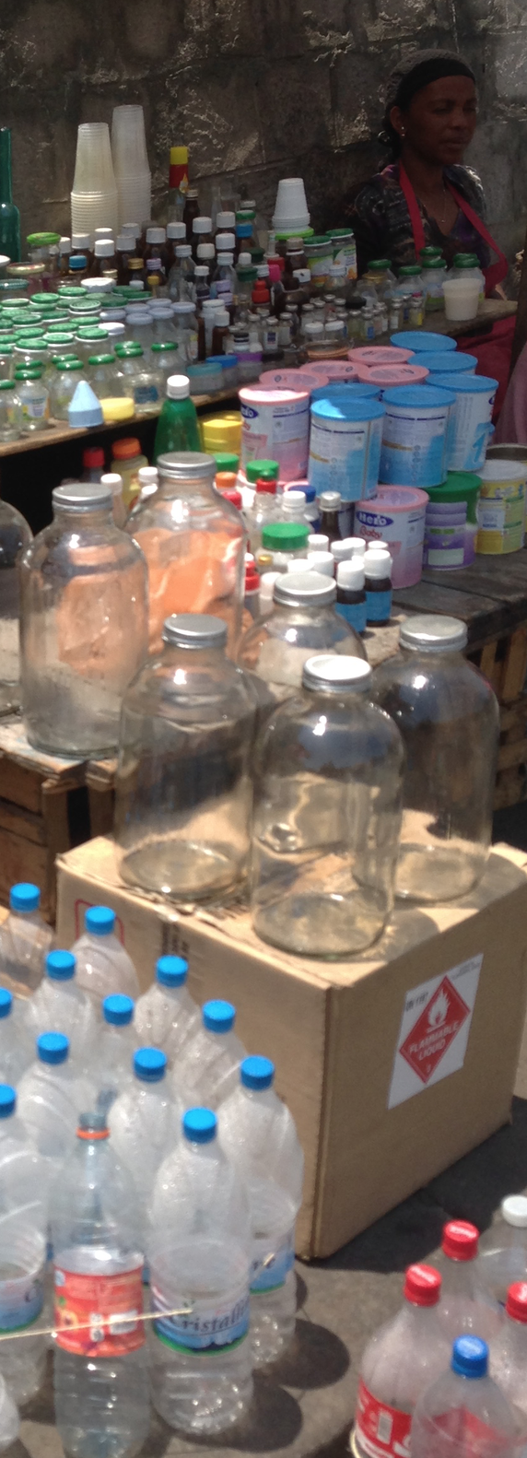
Reuse standardized terms
Concept vocabularies (skos:conceptSchema, RDF)
Darwin Core, Darwin Core “extensions”, NCD, GNA, Audubon Core (and other concept vocabularies).
as a basis and foundation for
Software application schema (XML, XML schema)
Darwin Core Archive (DwC-A) controlled terminology and controlled value vocabularies.
Resources such as the DwC-A controlled term and value vocabularies REUSE terms (by URI) from a concept vocabulary.

Slide 8
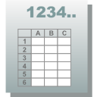
Simple Darwin core
Simple-DwC is a specification for one particular way to use the Darwin Core terms - to share data about taxa and their occurrences in a flat and simply structured way - and is probably what is meant if someone suggests to "format your data according to the Darwin Core".
http://rs.tdwg.org/dwc/terms/simple/index.htm
Notes:
Modified from 1B Publishing Primary Biodiversity Data by Alberto González-Talaván^{1~} Data Sharing, Data Standards, and Demystifying the IPT ~ Gainesville, FL, USA. 13 January 2015
Flat table
Few restrictions

Slide 9
Data normalization
What is data normalization?
Reasons to normalize a database
Normal forms
"Data normalization is the process of reducing data to its canonical form. For instance, Database normalization is the process of organizing the fields and tables of a relational database to minimize redundancy and dependency" (Wikipedia).
"Denormalization is the process of attempting to optimize the read performance of a database by adding redundant data or by grouping data" (Wikipedia).
http://www.essentialsql.com/get-ready-to-learn-sql-database-normalization-explained-in-simple-english/, http://databases.about.com/od/specificproducts/a/normalization.htm, http://www.dotnet-tricks.com/Tutorial/sqlserver/756N210512-Database-Normalization-Basics.html
Notes:
Database normalization is process used to organize a database into tables and columns. The idea is that a table should be about a specific topic and that only those columns which support that topic are included.
There are three main reasons to normalize a database. The first is to minimize duplicate data, the second is to minimize or avoid data modification issues, and the third is to simplify queries.
To assist in achieving these objectives, some rules for database table organization have been developed. The stages of organization are called normal forms; there are three normal forms most databases adhere to using.
First Normal Form – The information is stored in a relational table and each column contains atomic values, and there are not repeating groups of columns.
Second Normal Form – The table is in first normal form and all the columns depend on the table’s primary key.
Third Normal Form – the table is in second normal form and all of its columns are not transitively dependent on the primary key
There are further norms if there is interest in learning more.
For the purposes of the Star Schema, you’ll find your data adhering to the…
https://en.wikipedia.org/wiki/Denormalization

Slide 10
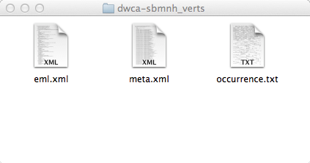
Darwin core Archive
A Darwin Core Archive (DwC-A) is the text representation of data formatted to Darwin Core.
A DwC-A is a compressed file containing a minimum of three files.
http://rs.tdwg.org/dwc/terms/guides/text/index.htm
Notes:
A data file (occurrence.txt) conforming to the SIMPLEDWC in a CSV format. The first row includes Darwin Core standard term names.
A meta file (meta.xml) in an XML format. It contains technical details to instruct a computer on how to use the data file.
A meta file (eml.xml) in an XML format. It contains explanatory details about the records contained within the data file to instruct a user if the data will be fit for their use.
http://gbif.blogspot.no/2012/01/biocase-now-producing-darwincore.html

Slide 11

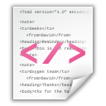
Star schema
DwC Archive
Ext 5
Ext 1
+
meta.xml
Core
Ext 2
Ext 4
EML.xml
Ext 3
Notes:
Modified from 1B Publishing Primary Biodiversity Data by Alberto González-Talaván^{1~} Data Sharing, Data Standards, and Demystifying the IPT ~ Gainesville, FL, USA. 13 January 2015

Slide 12
Mapping cores
Taxon core
  The category of information pertaining to taxonomic names, taxon name usages, or taxon concepts. Updated in April 2015, 43 terms.
  This version removes terms dcterms:source and dcterms:rights, and adds dcterms:license.
Occurrence core
  The category of information pertaining to evidence of an occurrence in nature, in a collection, or in a dataset (specimen, observation, etc.). Updated in July 2015, 169 terms.
  This version removes terms dcterms:source, dcterms:rights, dwc:individualID, dwc:occurrenceDetails, and adds dcterms:license, dwc:organismQuantity, dwc:organismQuantityType, dwc:organismID, dwc:organismName, dwc:organismScope, dwc:associatedOrganisms, dwc:organismRemarks, dwc:parentEventID, dwc:sampleSizeValue, dwc:sampleSizeUnit.
Event core
  The category of information pertaining to a sampling event. Issued 29 May 2015, 95 terms.
Notes:
Cores updated based on updated

Slide 13
Extensions
Darwin Core does not provide terms for every possible type of data.
  22 registered extensions (to the Darwin Core Archive)
  25 under development
Examples
  Audubon Media Description (aka Audubon Core)
  Darwin Core Identification History
  Darwin Core Measurement or Facts
http://tools.gbif.org/dwca-validator/extensions.do
Notes:
Modified from Standards and sharing complex primary biodiversity data; and what is an extension anyway? ~ Deb Paul ~ Data Sharing, Data Standards, and Demystifying the IPT Workshop – Day 1, Jan. 13, 2015 ~ Gainesville, FL

Slide 14
Star schema example - occurrence
DwC Archive
Occurrence
Geographical
+
meta.xml
Occurrence Core
Media
Germplasm
EML.xml
Determination
Notes:
Modified from 1B Publishing Primary Biodiversity Data by Alberto González-Talaván^{1~} Data Sharing, Data Standards, and Demystifying the IPT ~ Gainesville, FL, USA. 13 January 2015

Slide 15
Star schema example - checklist
DwC Archive
Checklist
Types
Description
Distribution
+
meta.xml
Taxon Core
Literature
Vernacular
EML.xml
Occurrences
Notes:
Modified from 1B Publishing Primary Biodiversity Data by Alberto González-Talaván^{1~} Data Sharing, Data Standards, and Demystifying the IPT ~ Gainesville, FL, USA. 13 January 2015

Slide 16
Star schema example - Event
DwC Archive
Samples
Relevé
Occurrences
+
meta.xml
Event Core
EML.xml
Measurement or Fact
Notes:
Modified from 1B Publishing Primary Biodiversity Data by Alberto González-Talaván^{1~} Data Sharing, Data Standards, and Demystifying the IPT ~ Gainesville, FL, USA. 13 January 2015

Slide 17
Darwin Core & Darwin Core Archive
Dag Endresen, GBIF Norway (Credits: Laura Russell)
Data publishing workshop at NINA, Trondheim – 29-30 October 2015
Notes:
Image from Billy W obtained via http://www.freeimages.com/photo/bee-keeping-11-1491032

