Slide 1


Practical demo on how to prepare and map different types of data
Christian Svindseth, GBIF Norway
Data publishing workshop at NINA, Trondheim – 29-30 October 2015

Slide 2
Step 1: Get access to the resources
IPT instances:
  http://dev.gbif.no/ipt-sandbox/
  Login: your e-mail
  Password: <is sent in separate email>
Sample datasets: http://gbif.no/…
Notes:
http://dev.gbif.no/ipt-sandbox/
http://ipt.gbif.org
http://ipt.gbif-uat.org/

Slide 3
Step 2: Create a new resource in the IPT

Slide 4
Step 3: Import data files

Slide 5
Step 4: Darwin Core mappings

Slide 6
Step 5: Metadata authoring

Slide 7
Step 6: Publishing

Slide 8
Step 7: Configuring visibility

Slide 9
Step 8: Managers

Slide 10
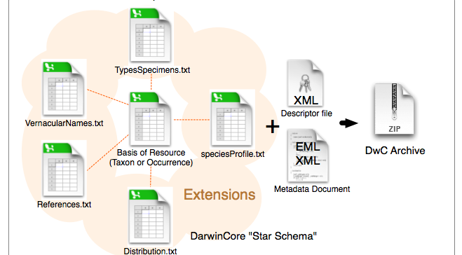
Darwin Core Archive structure

Slide 11
Practical demo on how to prepare and map different types of data
Christian Svindseth, GBIF Norway
Data publishing workshop at NINA, Trondheim – 29-30 October 2015

