Slide 1




Introduction to sample-data publishing
Credits: Larissa Smirnova
Data publishing workshop at NINA, Trondheim – 29-30 October 2015
Notes:
Image from Jason Young, shared via http://www.freeimages.com/photo/logbook-1548276.
http://community.gbif.org/pg/pages/view/48381/session-06-introduction-to-samplebased-data-publishing

Slide 2
INDEX
Introduction
Definition of sample-based data
GEO BON and EBVs
Applications of sample-based data
Enabling sample-based data publishing
The importance of metadata
Using the event core in the IPT

Slide 3
sample-based data: our definition
“a type of data available from environmental, ecological, and natural resource investigations: one-off studies or monitoring programs. Such data are usually quantitative, calibrated, and follow certain protocols so that changes and trends of populations can be detected“.
http://community.gbif.org/pg/pages/view/48381/session-06-introduction-to-samplebased-data-publishing
Sample-data publishing primer

Slide 4

What is sample-based data?
Output of monitoring programmes (survey, census, plot)
Quantitative, calibrated
Repeatable, comparable
Collected using standard protocols
Detect changes (patterns, processes) and
trends in populations
Link environment to biodiversity

Slide 5
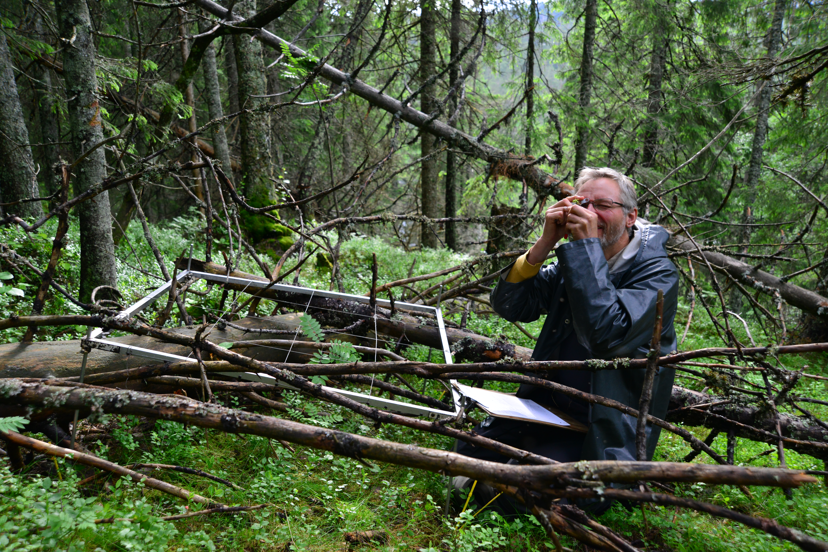
Vegetation plot data
Image credit: Anders Bryn, NHM-UiO, Skog og Landskap
Notes:
Professor Rune Halvorsen (NHM-UiO) making vegetation plot observations at Solhomfjell in Telemark, summer of 2013. Credit: Anders Bryn, NHM-UiO, Skog og Landskap.

Slide 6
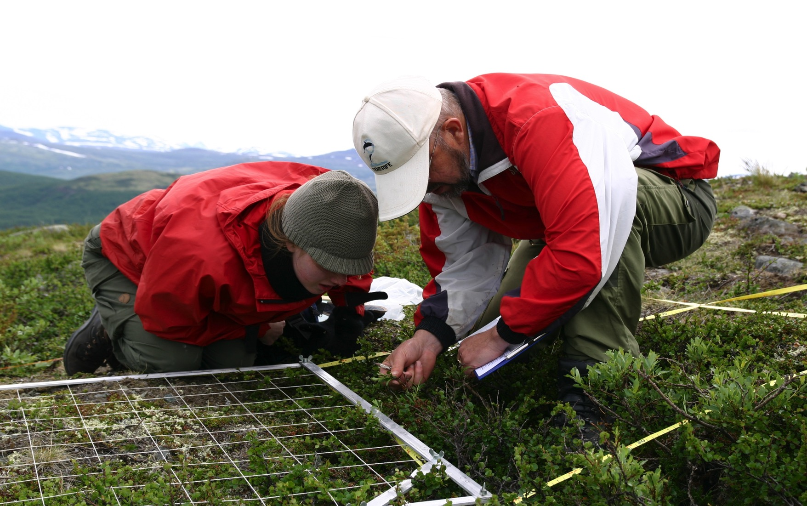
Vegetation plot data
Image credit: Ottar Michelsen, Norwegian University of Science and Technology
Notes:
Anne Olga Syverhuset (left, then a master's student at the Norwegian University of Science and Technology) and researcher Jarle Inge Holten check a plant plot in the Dovre mountains, in Norway in 2008 as a part of a European-wide research effort to document the effects of climate change on mountain vegetation. Credit: Ottar Michelsen, Norwegian University of Science and Technology, http://www.sciencedaily.com/releases/2012/01/120108143605.htm

Slide 7
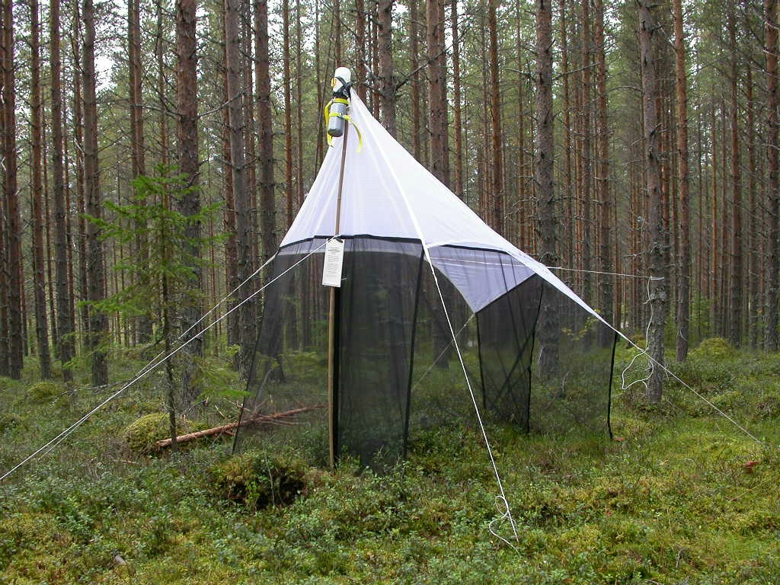
Insect trap data
Notes:
Trap ID 58 – Kulbäckslidens trail park, pine plantation, http://www.stationlinne.se/sv/forskning/the-swedish-malaise-trap-project-smtp/traps/trap-id-58-kulbacksliden-pine-forest/

Slide 8
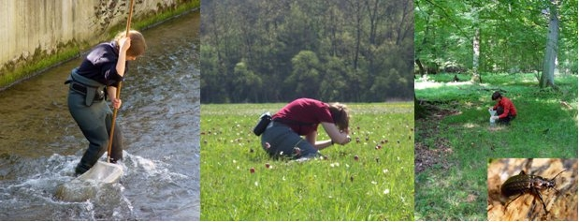
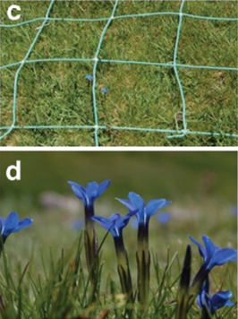

sample-based data is collected by...
Botanists, zoologists
Natural resource managers
Ecologists and concervation biologists
Citizen scientists
NGO’s, assosiations, professionals from other disciplines (fisheries, agriculture…)

Slide 9
“If a biodiversity datum is produced, and no one can find it,
does it create change?”
Show me the Data: JRS Report on Access
to Biodiversity Data in our Projects

Slide 10


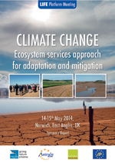
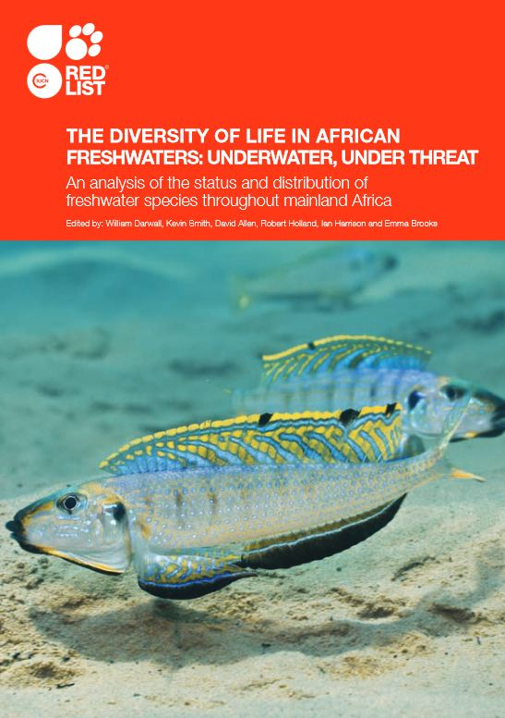
sample-based data is used by...
Scientists
Natural resource managers
Ecologists and concervation biologists
Citizen scientists
Decision makers!

Slide 11
EU BON, GBIF and ebvs
Enabling discovery and access to sample-based data
  GBIF in collaboration with EU BON partners, has adapted the Integrated Publishing Toolkit (IPT) and Darwin Core Archives to enable the flow of sample-based data (2015).
  One of the objectives is to support GEO BON’s Essential Biodiversity Variables (EBVs).
  Support detection of changes and trends in populations.

Slide 12
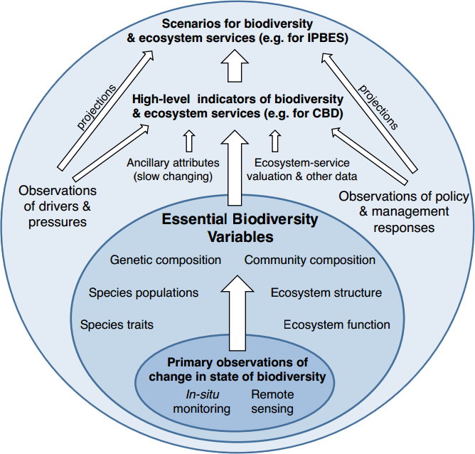
What are EBVs?
Essential Biodiversity Variables (EBV).
Measurements required for study, reporting, and management of biodiversity change.
Serve as intermediate layer between raw data and indicators (e.g., for CBD).
Notes:
Essential Biodiversity Variables (EBVs)

Slide 13
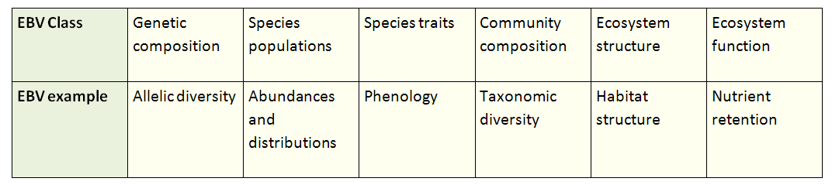
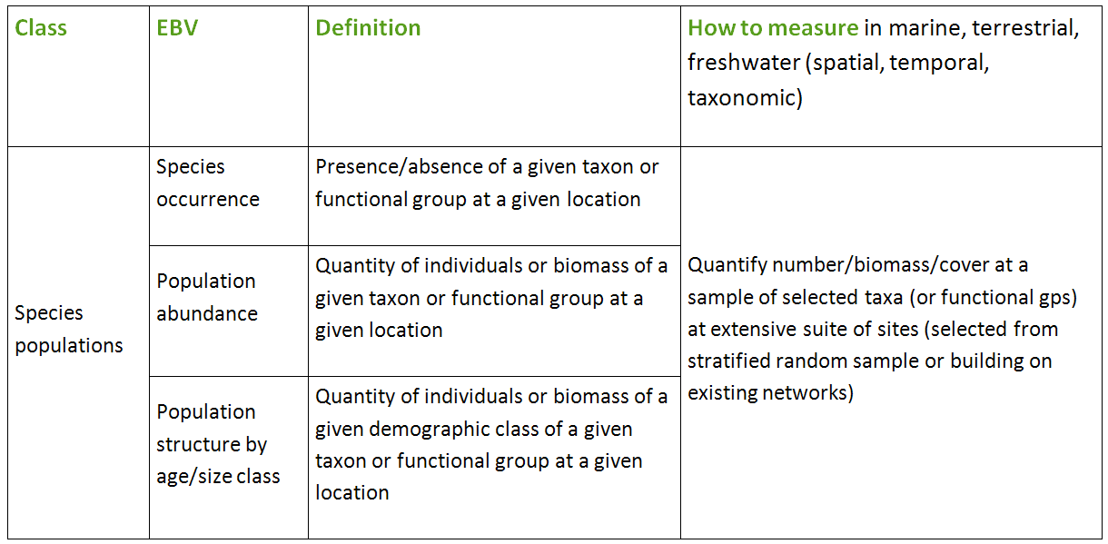
EBV Classes

Slide 14
GBIF Event core
“Monitoring biodiversity change often requires repeated measures at the same place. This extension will enable data holders publishing through the GBIF network to share population abundance data (including time series population data) and presence/absence data, and also to document the sampling protocol”.
Henrique Pereira, chair of GEO BON

Slide 15
applications of sample-based data (1/3)
Goals: Modeling to support conservation or wildlife management.
  prediction of distribution
  identification of important areas (e.g. those areas more suitable for a species or more likely to hold high densities)
Methods:
  camera traps
  GPS tracking
  point-count surveys
Measurements:
  abundance
  presence / absence

Slide 16
applications of sample-based data (2/3)
Goals: Modeling supporting biodiversity conservation, environmental monitoring, ecosystem health and condition and impact of climate change.
  vegetation research (phyto sociology, trend analysis)
  forest degradation
  land use
  carbon monitoring
  ecological dynamics
Methods:
  vegetation plot
  relevé
Measurements:
  species abundance
  cover (e.g. Braun-Blanquet scale)

Slide 17
applications of sample-based data (3/3)
Goals: Interactions between biodiversity and environment.
  species monitoring
  temporal patterns
  population trends and responses to drivers
  biological indicators of land use change
Methods:
  long-term monitoring data (census)
  atlas data (survey)
Measurements:
  number of individuals
  relative abundances

Slide 18
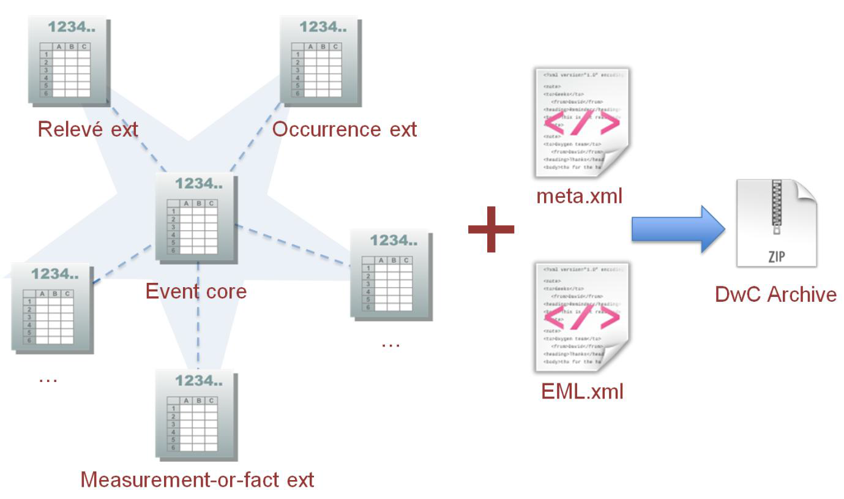
Enabling Sample-Data publishing: Star schema

Slide 19
Enabling Sample-Data publishing: DWC vocabulary
7 essential terms for encoding sample data:
eventID
parentEventID (new)
samplingProtocol
sampleSize (new)
sampleSizeUnit (new)
organismQuantity (new)
organismQuantityType (new)

Slide 20
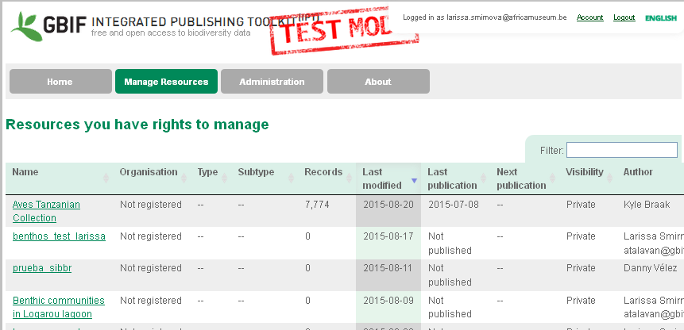
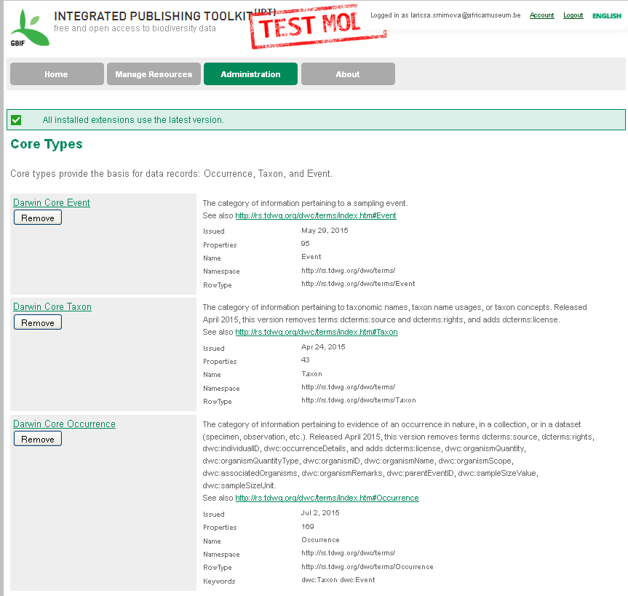
Enabling Sample-Data publishing: IPT v.2.3
NEW FEATURES:
Event core and extensions.
Possibility to assign DOIs to resources.
Auto-generation of a citation for a resource including the version number and DOI.
Machine readable licenses.

Slide 21
The importance of metadata
Metadata is ESSENTIAL for sample-based data:
Documenting the project data: description of sampling/monitoring activity.
Documenting sampling methods: protocols, data quality and sampling steps.
Dataset documentation enables users to evaluate the fitness for use of a dataset.

Slide 22
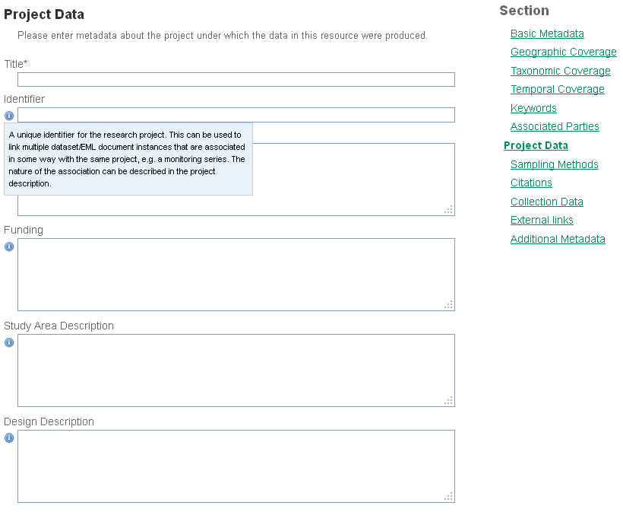
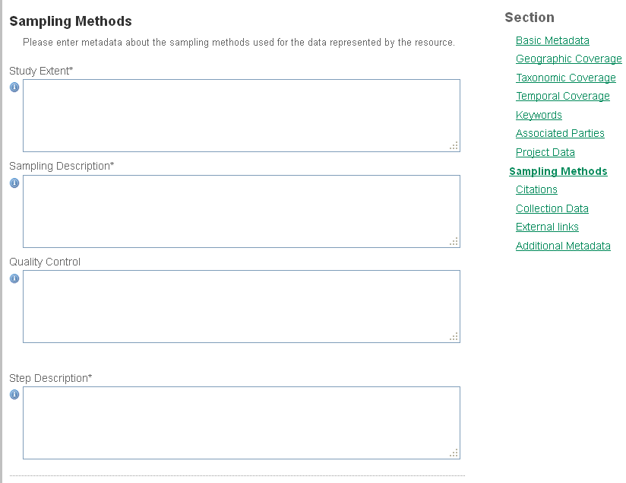
METADATA: project data & Sampling Methods

Slide 23
Metadata EXAMPLE: Study extent
“Seasonal (4 seasons) records of zoobenthic communities across confinement gradient in 5 coastal lagoons (Mazoma, Tsopeli,Tsoukalio, Rodia and Logarou)”.
“The floristic inventories was conducted at the Sierra Nevada (Andalusia, southeast Spain). Forest cover in Sierra Nevada is dominated by pine plantations (Pinus halepensis Mill., Pinus pinaster Ait., Pinus nigra Arnold. subsp. salzmannii (Dunal) Franco, and Pinus sylvestris L.) that covering approximately 40,000 ha…”.
“Transect walks were conducted once in two weeks from the beginning of October to the end of June on the territory of Israel”.
Sampling area/habitat + Sampling frequency

Slide 24
metadata EXAMPLE: Sampling description
“Box corer for 0.03 square meters area sampled”.
“Transect lengths range between 300 and 600 m in length, and divide into 50 m sections. Transect usually cover a single habitat type. In each visit, transect-walkers count all butterfly species that can be seen within a range of 5 m range. Special behaviours (egg laying or nectaring), as well as butterfly larvae or eggs, can be registered as well”.
“The dataset includes data from 1,879 sites, collected using standard RLS survey methods, described in detail in an online methods manual. Surveys involve underwater visual census by SCUBA divers along a 50 m transect line, laid along a depth contour on hard substrate. All fish species observed within 5 m of the transect line were recorded on a waterproof datasheet as the diver swam slowly along the line (at approximately 2 m/min)…”
Description of sampling procedures

Slide 25
metadata EXAMPLE: Quality control
“Record validation and cleaning was incorporated at several steps of the documentation process: the scientific names on labels were checked with a taxonomic thesaurus… We assigned scientific names in accordance to current taxonomy trends. Geographic coordinates were verified using the “Check Coordinates” function in DIVA-GIS”.
“Every reported record is flagged ‘forApproval’. Record status is changed to "Approved" upon and by expert only“.
“Each sampling plot was checked to ensure whether the geographical coordinates were correct. The databases of International Plant Names Index (IPNI, 2013) and Catalogue of Life/Species 2000 to verify the taxonomical classification”.
Quality control actions

Slide 26
metadata EXAMPLE: Step description
“Replicates were collected at two stations, one inside and one outside the lagoon, using a box corer (0.03 m2 sampling surface). The samples were sieved through a 0.5 mm mesh sieve, stained with Rose Bengal and preserved in 4% formalin. All benthic organisms were sorted in the lab and identified and counted using stereo- and microscopes”.
“1. Selection and rout of transect is accompanied by an scientific/principal investigator. 2. Identification of the capabilities of the observer are verified tested along timeline 3. Time start and weather condition are recorded first. 4. During transect walk, the number seen of every species is counted…”.
“This dataset was compiled from data collected in a combination of collaborative surveys with scientific colleagues worldwide, targeted RLS field campaigns and ad-hoc local surveys by trained RLS divers at their regular dive sites or when on holidays. Field campaigns involved small groups of divers (usually 4 to 8) undertaking survey dives over a period of four days to two weeks under the direction and supervision of a scientist or experienced survey diver“.
Methods, procedures, processing steps

Slide 27
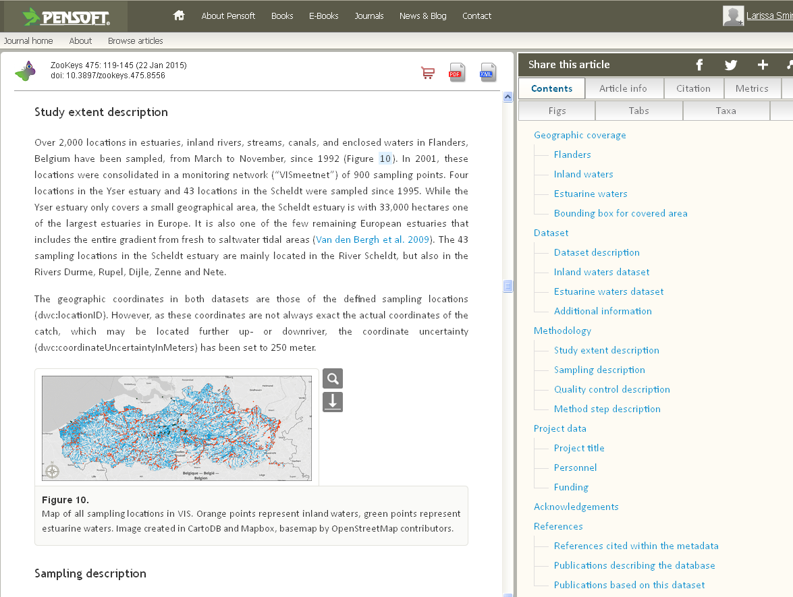
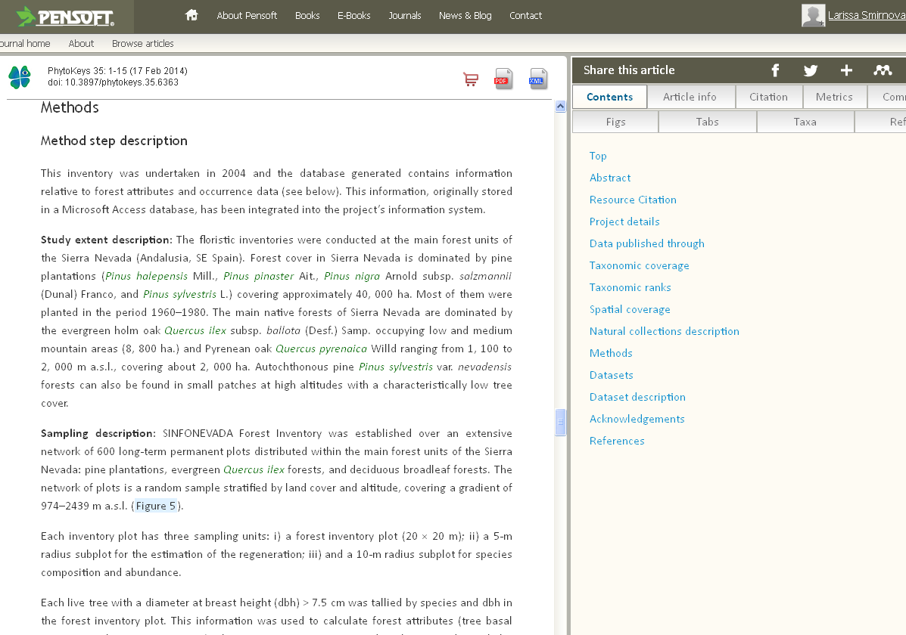
Metadata and data papers
Notes:
http://www.gbif.org/publishing-data/data-papers

Slide 28
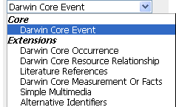
The new Event Core
In IPT 2.3, you can select the new event core:
  When creating new resources
  When mapping terms
Three classes are available:
  Event
  Location
  GeologicalContext

Slide 29
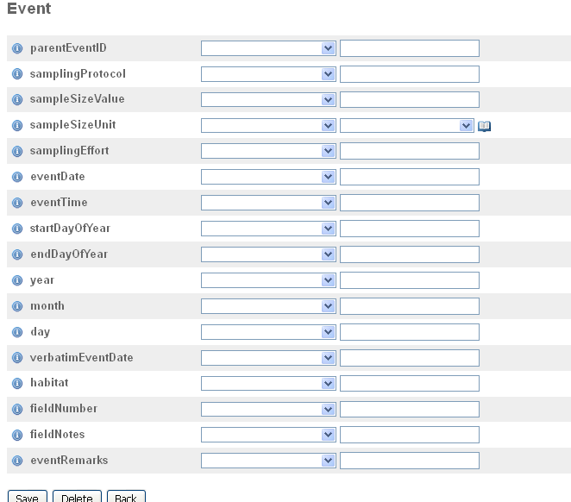
Event CORE – KEY TERMS

Slide 30
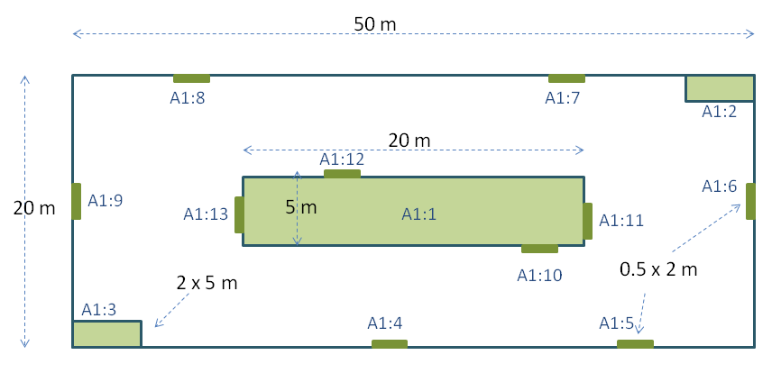
new DwC terms
eventID and parentEventID
Sampling events can be related to each other (e.g. nested samples) via a common parent identifier.
Information on the nature of the relationship (e.g. part of a monitoring series) can be described in the project section of the accompanying metadata.
A Whittaker plot with sub-plots of varying area

Slide 31
new DwC terms
sampleSize
A numeric value for the time duration, length, area or volume involved in the sampling event.
sampleSizeUnit
The unit of measurement used in the sampling event, e.g., minute, hour, day, metre, square metre, cubic metre.
sampleSize | sampleSizeUnit
2 | hour
6 | m2
1 | litre
3 | km

Slide 32
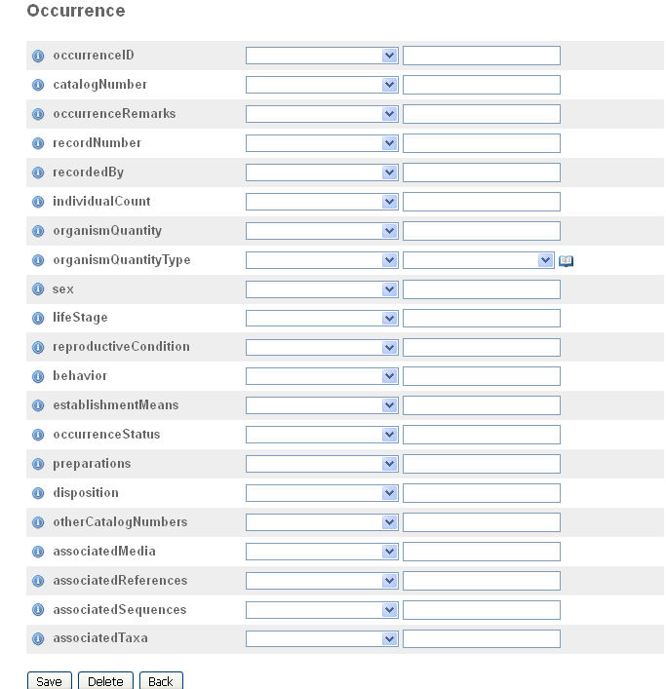
Occurrence extension: KEY TERMS

Slide 33
Data: new DwC terms
organismQuantity
A number or enumeration value for the quantity of organisms. Use with organismQuantityType to indicate the type of entity that is being quantified.
organismQuantityType
The type of entity to which the number or enumeration value reported for the quantity of organisms in organismQuantity refers.
organismQuantity | organismQuantityType
14 | Individuals
r | BraunBlanquetScale
31 | %Biomass
0.4 | %Species

Slide 34
“What we’ve got today is a lot of data records but probably not yet enough modeling on top of it to understand the significance”.
“We are now in a transitional period in which the challenges are less about gathering data than understanding what to do with it”.
  Ruby Russell (2014) Big data brings new possibilities to biodiversity science.

Slide 35
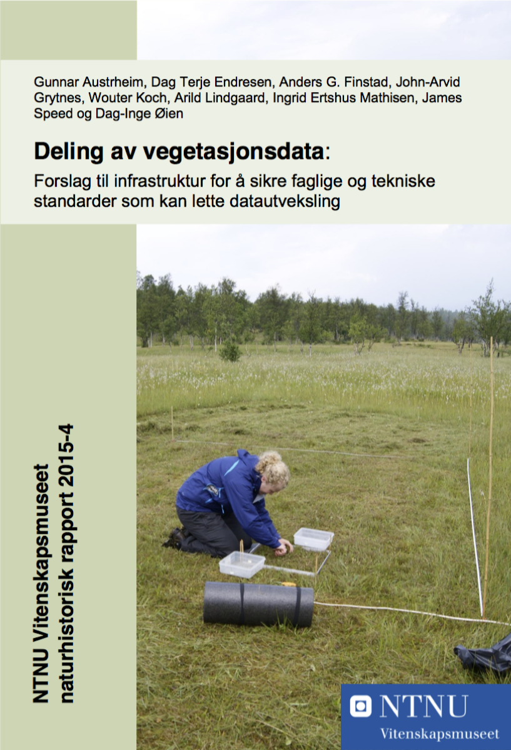
Deling av vegetasjonsdata
^{Abstract}
Vegetation data constitute an important knowledge base for research and management, but the sharing of data has been difficult to realize for various reasons. This report reviews important legal principles for data sharing and collaboration, as well as possible scientific and technical standards and solutions to facilitate data exchange. In order to demonstrate specific challenges related to sharing vegetation data, we used three different vegetation datasets throughout the report. Finally, we present a draft for a national infrastructure for sharing vegetation data where legal principles, standards for data flow, organization and responsibilities, measures and resource needs are considered.
http://www.ntnu.no/vitenskapsmuseet/publikasjoner
Notes:
Austrheim G, Endresen DTF, Finstad AG, Grytnes J-A, Koch W, Lindgaard A, Mathisen IE, Speed JDM, and Øien D-I (2015). Deling av vegetasjonsdata: Forslag til infrastruktur for å sikre faglige og tekniske standarder som kan lette datautveksling.
http://www.ntnu.no/vitenskapsmuseet/publikasjoner

Slide 36
Introduction to sample-data publishing
Credits: Larissa Smirnova
Data publishing workshop at NINA, Trondheim – 29-30 October 2015
Notes:
Image from Jason Young, shared via http://www.freeimages.com/photo/logbook-1548276.
http://community.gbif.org/pg/pages/view/48381/session-06-introduction-to-samplebased-data-publishing

