Slide 1


Data management plan
Dag Endresen, GBIF Norway
Data publishing workshop at NINA, Trondheim – 29-30 October 2015
Notes:
Image from Abdulaziz Almansour, shared via http://www.freeimages.com/photo/steps-1353099

Slide 2

INDEX
Develop a data management plan
Publish & archive biodiversity data
Data paper & metadata
Use data standards
Use persistent data identifiers

Slide 3
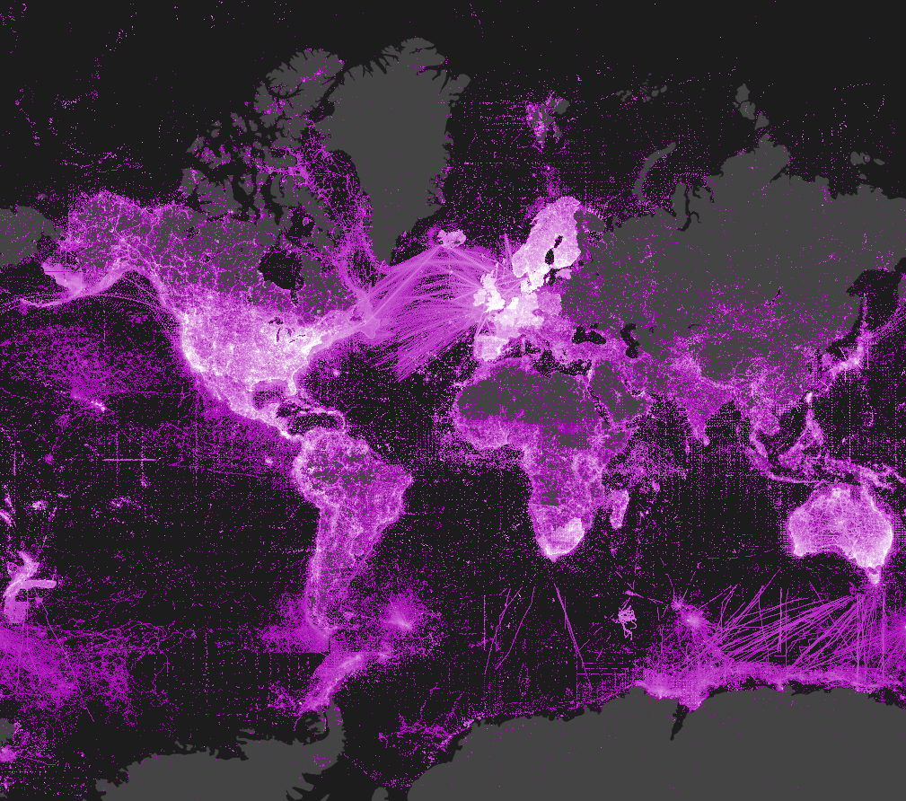
Data distribution in GBIF
Last updated: 2014-07-09

Slide 4
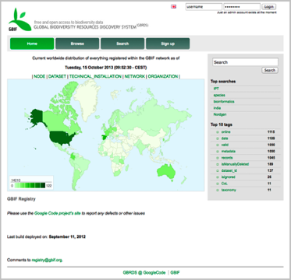
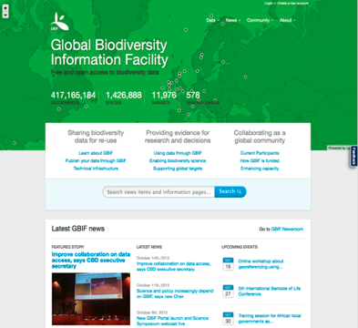
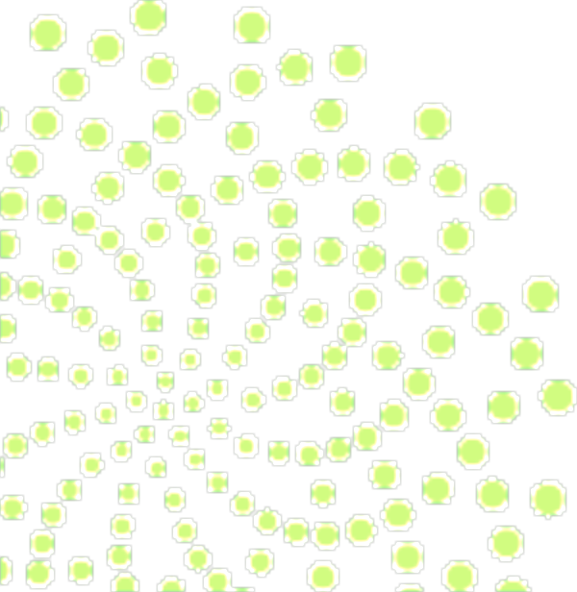
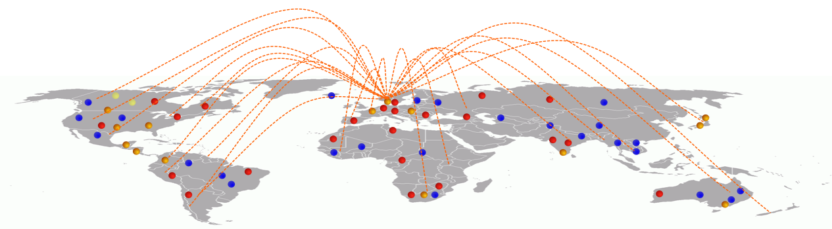
GBIF provides a data discovery system
that is dependent on resolvable stable identifiers for efficient functionality
global registry
data portal
Notes:
GBIF is dependent on resolvable and stable identifiers for efficient functionality. Identifiers for occurrences and for datasets etc.

Slide 5
Develop a data management plan

Slide 6

Data management plan
Making your data available to others ensures
that your research is truly reproducible.
Managing your research data saves you time because it ensures that you and others in your collaboration will be able to find, understand, and use the data.
Sharing your research data enables wider dissemination of your work.
Enabling others to use your data reinforces open scientific inquiry and can lead to new and unanticipated discoveries.
Graphics by Jørgen Stamp CC-BY
Notes:
Data Management Plan, http://d7.library.gatech.edu/research-data/data-management-plan-components
Graphics created by Jørgen Stamp and published under a Creative Commons Attribution 2.5 Denmark License.
10 Simple Rules for the Care and Feeding of Scientific Data, http://arxiv.org/abs/1401.2134, doi:10.1371/journal.pcbi.1003542

Slide 7
Data management plan
Description of data to be produced or collected, including data standards or formats.
Identification of protocols or workflows to help manage data throughout the project.
Description of documentation and metadata standards to describe the data.
Plan for short-term data storage & backup, including necessary security measures.
Plan for sharing data, including legal and ethical issues, intellectual property issues, or access policies and provisions.
Plan for data preservation, archiving and long-term access.
Plan for allocating responsibility for data management within your research project.
Notes:
Data Management Plan, http://d7.library.gatech.edu/research-data/data-management-plan-components
Graphics created by Jørgen Stamp and published under a Creative Commons Attribution 2.5 Denmark License.
10 Simple Rules for the Care and Feeding of Scientific Data, http://arxiv.org/abs/1401.2134, doi:10.1371/journal.pcbi.1003542

Slide 8








Online data archiving repository
Rather than leaving your research data on a
local server or in cloud storage, archive your data with a trusted digital repository. Many repositories create metadata and documentation to ensure that the data will be discoverable in the future.
Graphics by Jørgen Stamp CC-BY
Notes:
http://dataverse.org/
http://figshare.com/
https://zenodo.org/
http://datadryad.org/

Slide 9
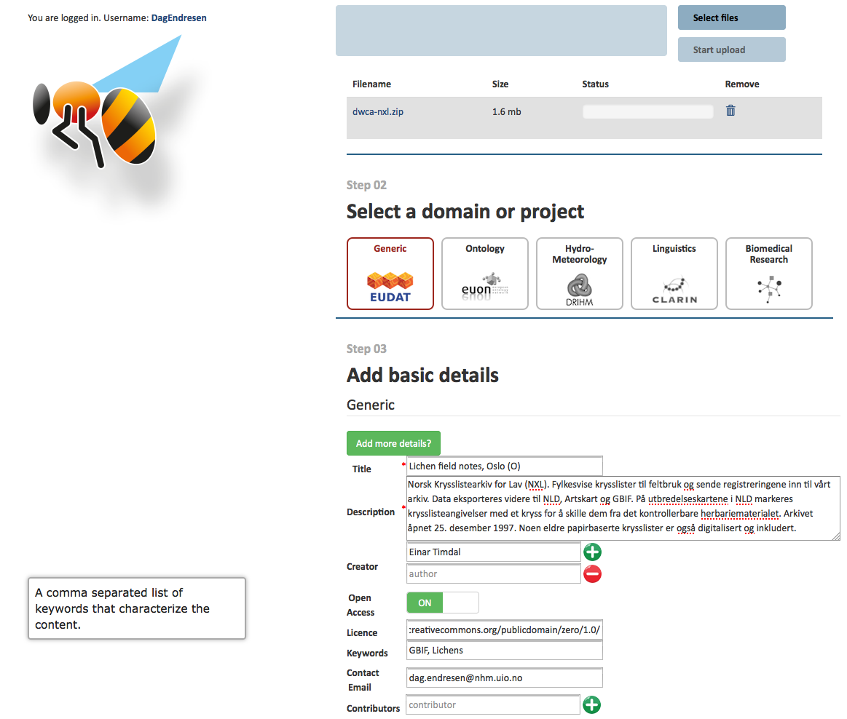
Notes:
https://b2share.eudat.eu/record/136
https://b2share.eudat.eu/record/136/files/dwca-nxl.zip?version=1&download=1

Slide 10
Publish & archive your own research data!

Slide 11
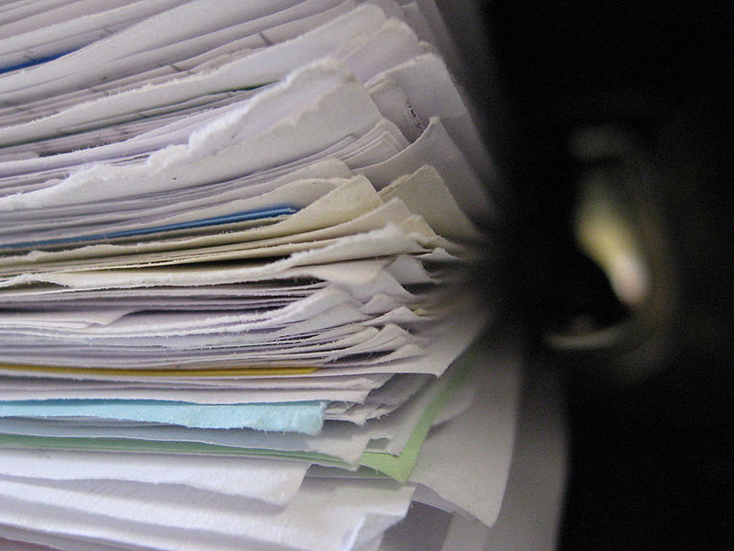

Many biodiversity research data are “hidden” in reports and documents produced by universities, research institutes, public agencies and the university museums.
Publish your biodiversity data!
Photo by: Niklas Bildhauer
Notes:
Image originally posted to Flickr as folder Author Niklas Bildhauer (who also is User gerolsteiner91. http://flickr.com/photos/14498569@N05/2434418686. Licensed under the Creative Commons Attribution-Share Alike 2.0 Generic license. http://commons.wikimedia.org/wiki/File:FileStack.jpg

Slide 12
Publish and archive your own species occurrence data
You can easily publish your species occurrence data by sending an email to gbif-drift@nhm.uio.no
The GBIF Norway helpdesk will assist with data publishing (to GBIF and Artskart)!
You can also install a data publishing software such as the GBIF Integrated Publishing Toolkit (IPT).
Citizen Science portals such as Artsobservasjoner, iNaturalist, Anymals + Plants, …
We recommend always using a long-term data archiving platform such as B2SHARE (EUDAT) or NorStore (Norwegian research data, EUDAT).
Notes:
http://www.gbif.org/publishingdata/summary
http://www.gbif.org/ipt

Slide 13










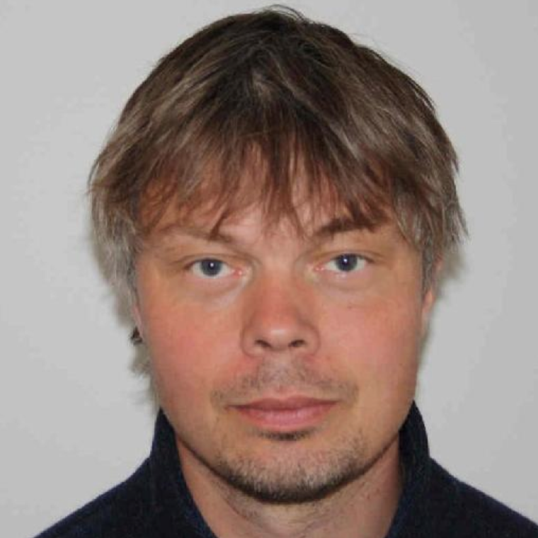


Node team at UiO NHM:
  Dag Endresen, Node Manager
  Christian Svindseth, Database Manager
Artsdatabanken Trondheim:
  Wouter Koch, Advisor
The Research Council of Norway:
  Per Backe-Hansen, Head of delegation
Data node at NINA/NTNU VM:
Roald Vang, NINA
Anders Finstad, NTNU VM
13

Slide 14
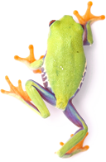
Data paper & metadata
Notes:
http://www.gbif.org/publishingdata/datapapers

Slide 15

Data paper
Peer review option for biodiversity datasets.
Authors get scientific credit for data publication.
Meeting concerns over data quality.
Meeting concerns over data citation mechanism.
http://www.gbif.org/publishingdata/datapapers
Notes:
Biodiversity Data Journal (BDJ) is a community peer-reviewed, open-access, comprehensive online platform, designed to accelerate publishing, dissemination and sharing of biodiversity-related data of any kind. http://www.pensoft.net/journals/bdj
Some examples:
* Narwade, S., Kalra, M., Jagdish, R., Varier, D., Satpute, S., Khan, N., Talukdar, G., et al. (2011). Literature based species occurrence data of birds of northeast India. ZooKeys, 150: 407-417. Pensoft Publishers. DOI: 10.3897/zookeys.150.2002
* Jones, K. E., Bielby, J., Cardillo, M., Fritz, S. A., OʼDell, J., Orme, C. D. L., Safi, K., et al. (2009). PanTHERIA: a species-level database of life history, ecology, and geography of extant and recently extinct mammals. (W. K. Michener, Ed.) Ecology, 90(9): 2648. Ecological Society of America. DOI: 10.1890/08-1494.1

Slide 16
Metadata requirements
Dataset description
Project description
People and Organizations (including roles)
Coverage
  Taxonomic coverage
  Geographic coverage
  Temporal coverage
Methods
Intellectual property rights, licensing
Keywords
Notes:
GBIF (2011). GBIF Metadata Profile – How-to Guide, (contributed by Ó Tuama, Eamonn, Braak, K. Remsen, D.), Copenhagen: Global Biodiversity Information Facility, 11 pp, accessible online at http://links.gbif.org/gbif_metadata_profile_howto_en_v1/, http://www.gbif.org/resources/2561

Slide 17

Data paper workshop
The first Norwegian data paper writing workshop, in Oslo 2nd to 3rd December 2014 with 11 participants http://goo.gl/GtW1Vx
A second data paper workshop will be organized in Trondheim, 24th to 25th March 2015 with 20-25 participants http://goo.gl/Ef1ZAy
Dimitri Brosens, GBIF Belgium
Notes:
First workshop in Oslo, 2-3 December 2014: http://goo.gl/GtW1Vx
Teacher: Dimitri Brosens, GBIF Belgium

Slide 18
Use data standards

Slide 19

Data Standards
ABCD Access to Biological Collection Data (2005)
DwC Darwin Core (2009)
AC Audubon Core Multimedia Resources Metadata Schema (2013)
NCD Natural Collection Descriptions (Draft)
EML Ecological Metadata Language
http://www.tdwg.org/standards/
Notes:
Modified from 1B Publishing Primary Biodiversity Data by Alberto González-Talaván^{1~} Data Sharing, Data Standards, and Demystifying the IPT ~ Gainesville, FL, USA. 13 January 2015
This section will cover the instructional objective 2a.
Biodiversity Information Standards (TDWG), also known as the Taxonomic Databases Working Group, is a not for profit scientific and educational association that is affiliated with the International Union of Biological Sciences.
TDWG was formed to establish international collaboration among biological database projects. TDWG promoted the wider and more effective dissemination of information about the World's heritage of biological organisms for the benefit of the world at large. Biodiversity Information Standards (TDWG) now focuses on the development of standards for the exchange of biological/biodiversity data.
Our Mission
Develop, adopt and promote standards and guidelines for the recording and exchange of data about organisms
Promote the use of standards through the most appropriate and effective means and
Act as a forum for discussion through holding meetings and through publications

Slide 20

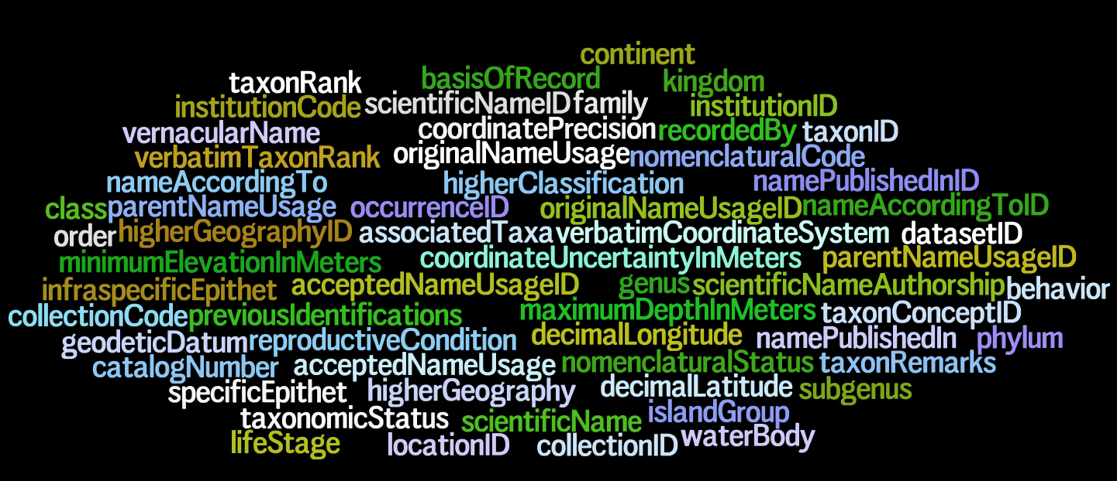
Darwin Core – a glossary of terms
Wieczorek J, Bloom D, Guralnick R, Blum S, Döring M, De Giovanni R, Robertson T, and Vieglais D (2012) Darwin Core: An Evolving Community-Developed Biodiversity Data Standard. PLoS ONE 7(1): e29715. doi:10.1371/journal.pone.0029715
Notes:
Wieczorek, John; D. Bloom, R. Guralnick, S. Blum, M. Döring, R. De Giovanni, T. Robertson, and D. Vieglais (2012) Darwin Core: An Evolving Community-Developed Biodiversity Data Standard. PLoS ONE 7(1): e29715. doi:10.1371/journal.pone.0029715
It includes a glossary of terms intended to facilitate the sharing of information about biological diversity by providing reference definitions, examples, and commentaries.
It is primarily based on taxa, their occurrence in nature as documented by observations, specimens, and samples, and related information.

Slide 21
Use persistent identifiers

Slide 22
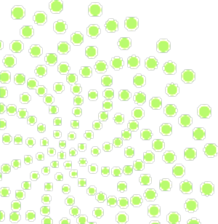
The purpose of identifiers
…is to name things,
making it possible to refer to them.
Notes:
Kunze, J. A. (2003). Towards electronic persistence using ARK identifiers. Proceedings of the ECDL Web Archiving Workshop 2003. Available at http://www.cdlib.org/inside/diglib/ark/arkcdl.pdf
Coyle, K. (2006). Managing technology: Identifiers: unique, persistent, global. Journal of academic librarianship, 34(4): 428-431.
Campbell, D. (2007). Identifying the identifiers. Proceedings of the International Conference on Dublin Core and Metadata Applications.

Slide 23
The purpose of identifiers
…is to name things,
making it possible to refer to them.
“Each identifier refers to one and only one thing” (Coyle 2006).
“A assosiation between a string and a thing” (Kunze 2003).
“A stated association between a symbol and a thing; that the symbol may be used to unambiguously refer to the thing within a given context” (Campbell 2007).
Notes:
Kunze, J. A. (2003). Towards electronic persistence using ARK identifiers. Proceedings of the ECDL Web Archiving Workshop 2003. Available at http://www.cdlib.org/inside/diglib/ark/arkcdl.pdf
Coyle, K. (2006). Managing technology: Identifiers: unique, persistent, global. Journal of academic librarianship, 34(4): 428-431.
Campbell, D. (2007). Identifying the identifiers. Proceedings of the International Conference on Dublin Core and Metadata Applications.
The purpose of identifiers
…is to name things, making it possible to refer to them.
What is an identifier:
“Each identifier refers to one and only one thing” (Coyle 2006).
“An association between a string and a thing” (Kunze 2003).
“A stated association between a symbol and a thing; that the symbol may be used to unambiguously refer to the thing within a given context” (Campbell 2007).

Slide 24
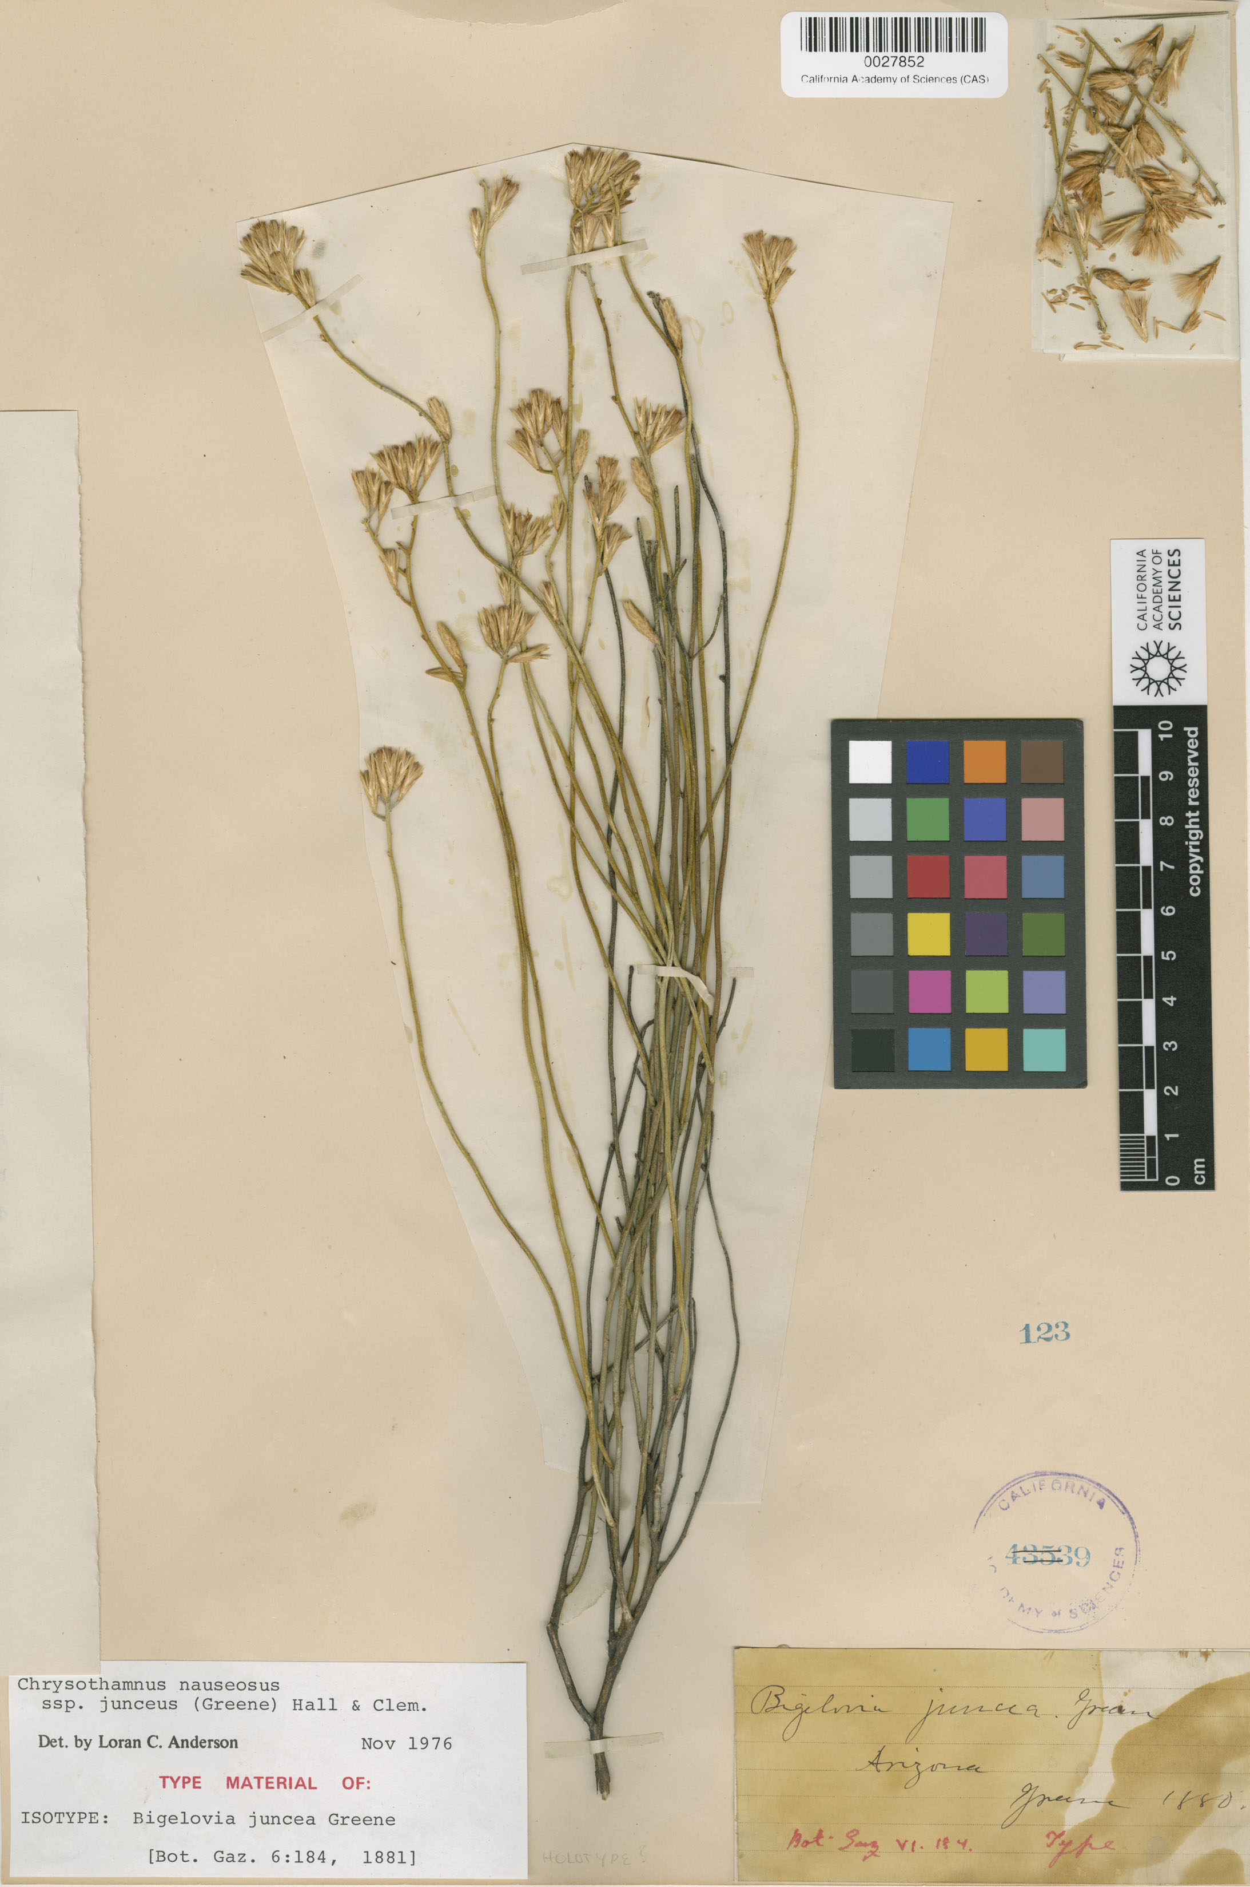
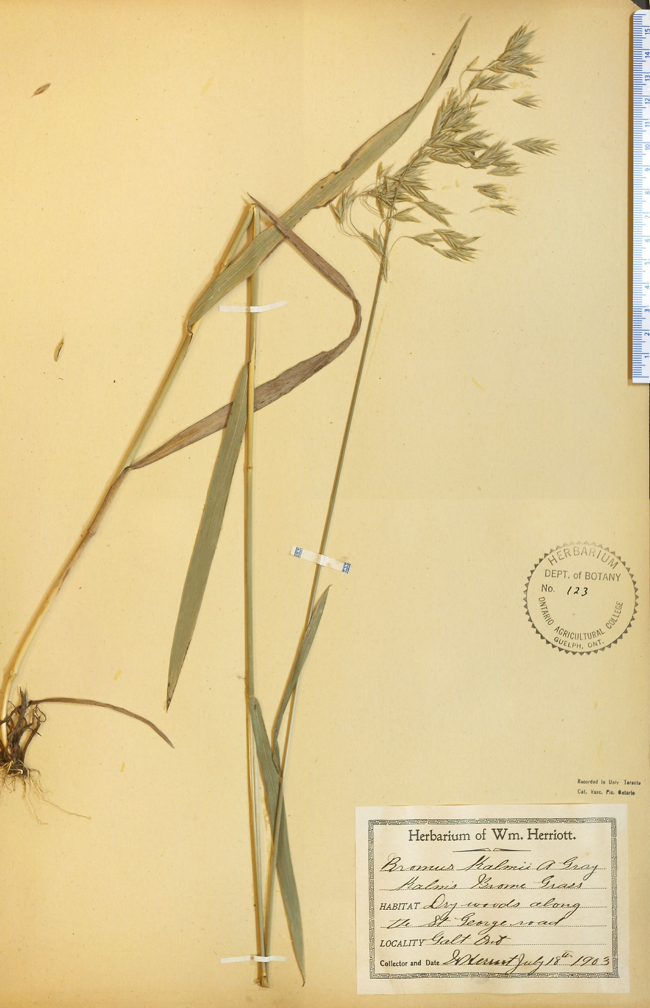
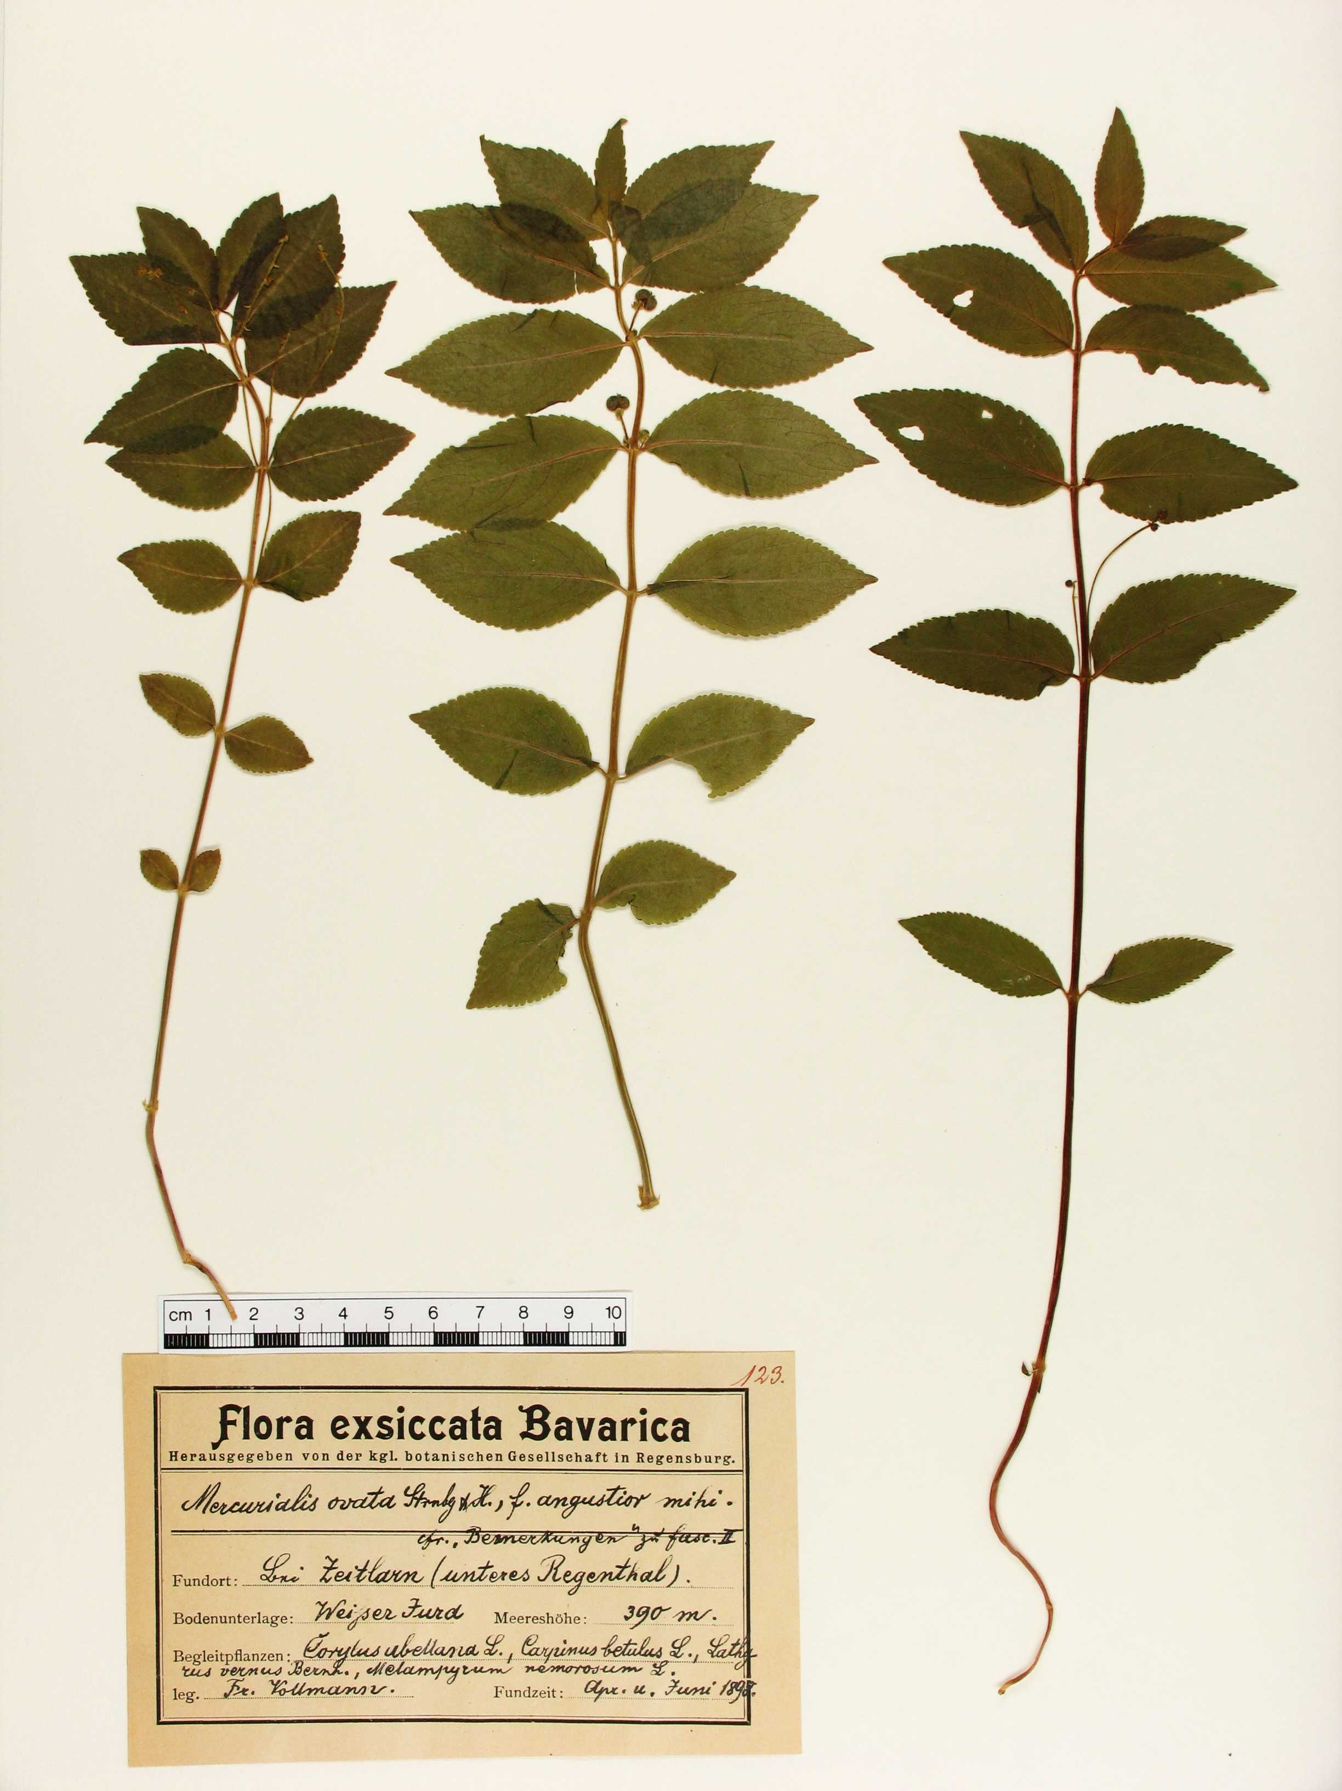
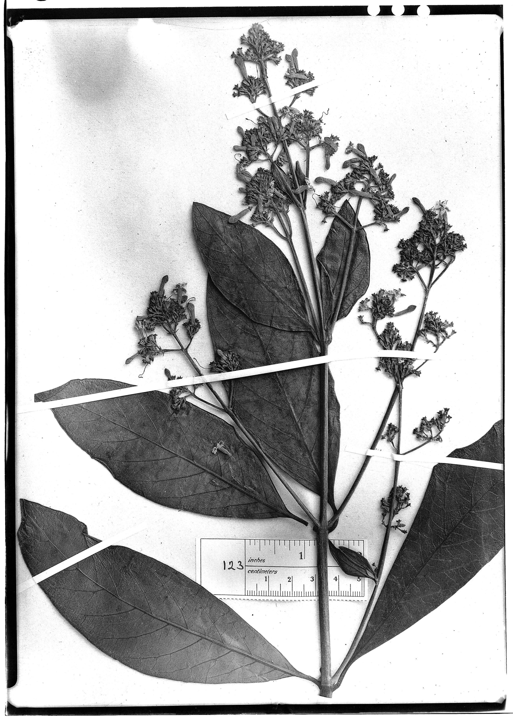
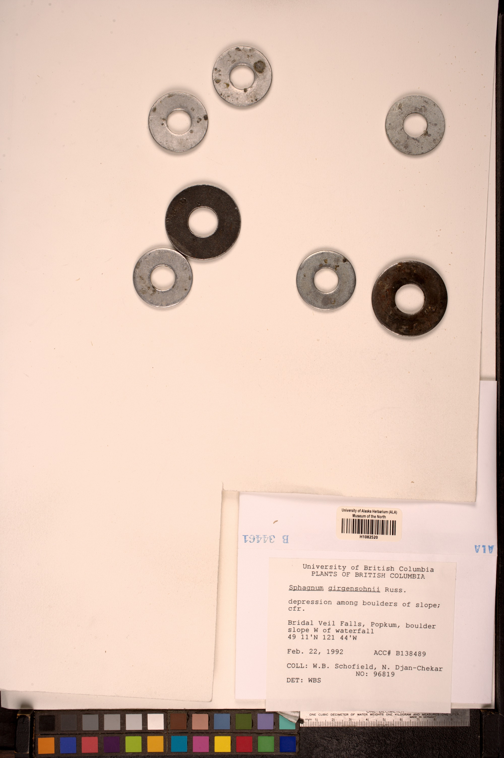
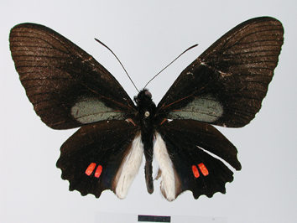
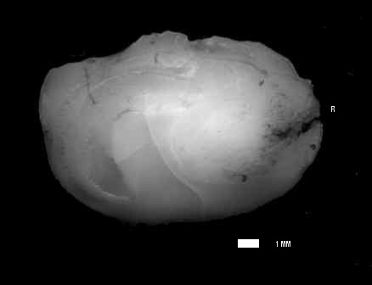
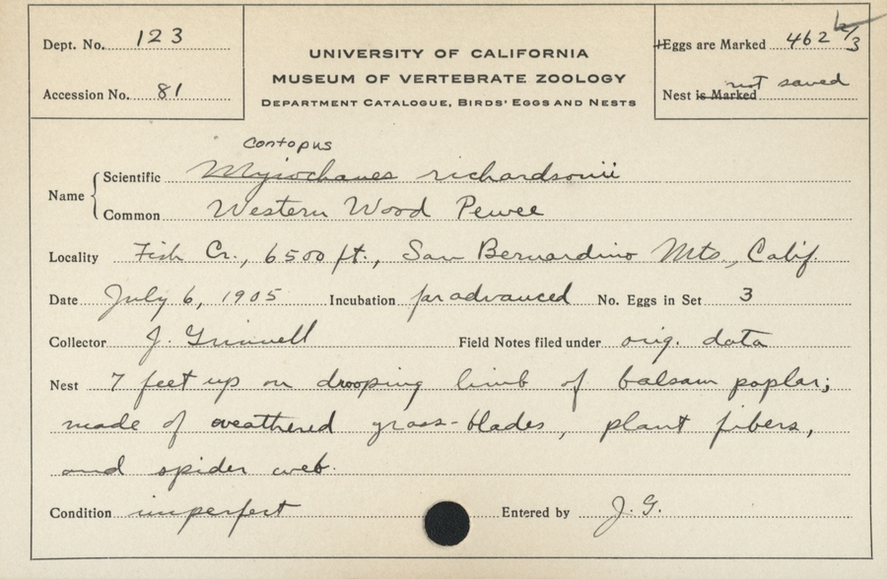
Name ambiguity: 123
Many things (in GBIF) are named 123
Catalog number: 123
GBIF ID: 1050327334
Cinchona ledgeriana
Catalog number: 123
GBIF ID: 931031820
Bromus kalmii
Catalog number: 123
GBIF ID: 543392241
urn:catalog:CAS:BOT:123
Bigelowia juncea
Catalog number: 123
GBIF ID: 283363
urn:occurrence:Arctos:MVZ:Egg:123:164
Mercurialis ovata
Catalog number: 123
GBIF ID: 231564351
Umbrina canariensis
Catalog number: 123
GBIF ID: 1030591721
UAMb:Herb:123
Sphagnum girgensohnii
Catalog number: 123
GBIF ID: 896547722
urn:occurrence:Arctos:MVZ:Egg:123:164
Contopus sordidulus veliei
Catalog number: 123
GBIF ID: 893477175
Parides erithalion
Notes:
Catalog number 123:
http://www.gbif.org/occurrence/896547722, urn:occurrence:Arctos:MVZ:Egg:123:1646019
http://www.gbif.org/occurrence/283363
http://www.gbif.org/occurrence/543392241, urn:catalog:CAS:BOT:123
http://www.gbif.org/occurrence/1030591721, http://arctos.database.museum/MediaSearch.cfm?action=search&specimen_id=22550909, UAMb:Herb:123
http://www.gbif.org/occurrence/893477175, Parides erithalion
http://www.gbif.org/occurrence/1050327334, Cinchona ledgeriana
http://www.gbif.org/occurrence/231564351, Umbrina canariensis
http://www.gbif.org/occurrence/931031820, Bromus kalmii

Slide 25

http – PURL – UUID
http://purl.org/nhmuio/id/41d9cbb4-4590-4265-8079-ca44d46d27c3
Notes:
http – PURL – UUID
http://purl.org/nhmuio/id/41d9cbb4-4590-4265-8079-ca44d46d27c3

Slide 26
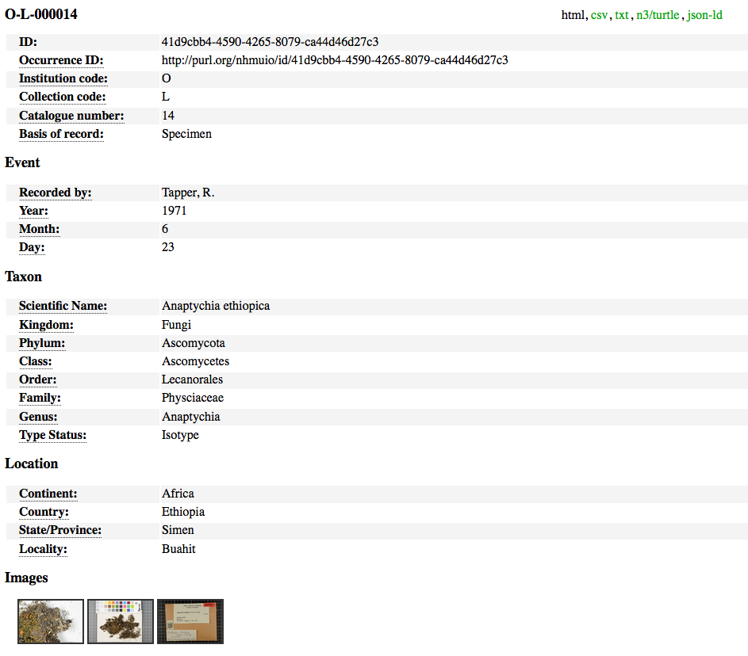
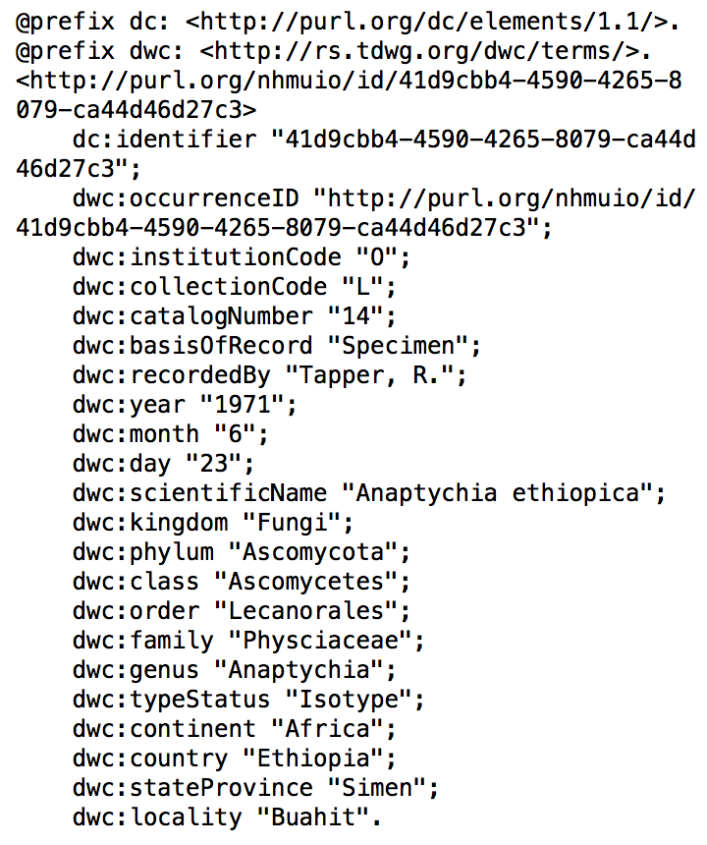
Including machine readable formats
Notes:
http://purl.org/nhmuio/id/41d9cbb4-4590-4265-8079-ca44d46d27c3 using content negotiation and MIME types, default to human friendly html
http://purl.org/nhmuio/id/41d9cbb4-4590-4265-8079-ca44d46d27c3.html
http://purl.org/nhmuio/id/41d9cbb4-4590-4265-8079-ca44d46d27c3.csv
http://purl.org/nhmuio/id/41d9cbb4-4590-4265-8079-ca44d46d27c3.n3
http://purl.org/nhmuio/id/41d9cbb4-4590-4265-8079-ca44d46d27c3.json

Slide 27



Dag Endresen
dag.endresen@nhm.uio.no
Christian Svindseth
christian.svindseth@nhm.uio.no
gbif-drift@nhm.uio.no
Notes:
http://www.nhm.uio.no/forskning/prosjekter/gbif/
http://www.gbif.no

Slide 28
Data management plan
Dag Endresen, GBIF Norway
Data publishing workshop at NINA, Trondheim – 29-30 October 2015
Notes:
Image from Abdulaziz Almansour, shared via http://www.freeimages.com/photo/steps-1353099

