Slide 1
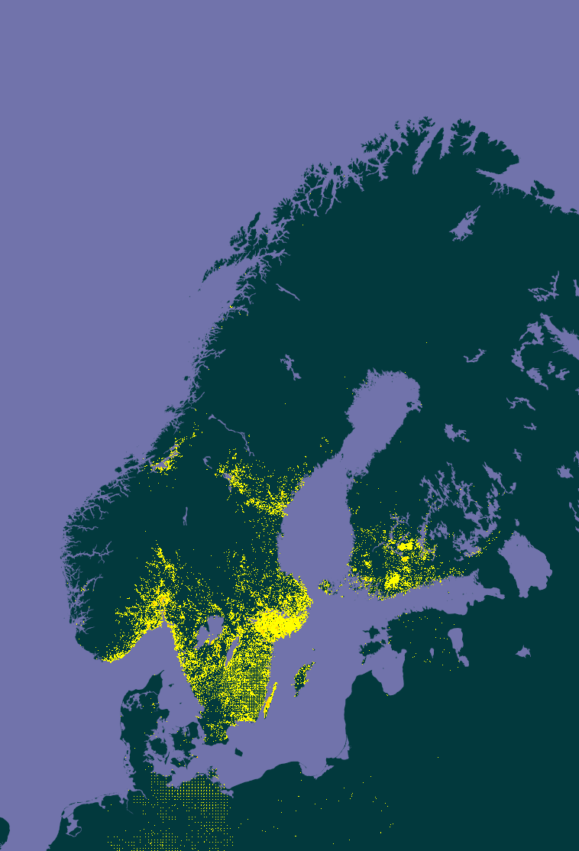
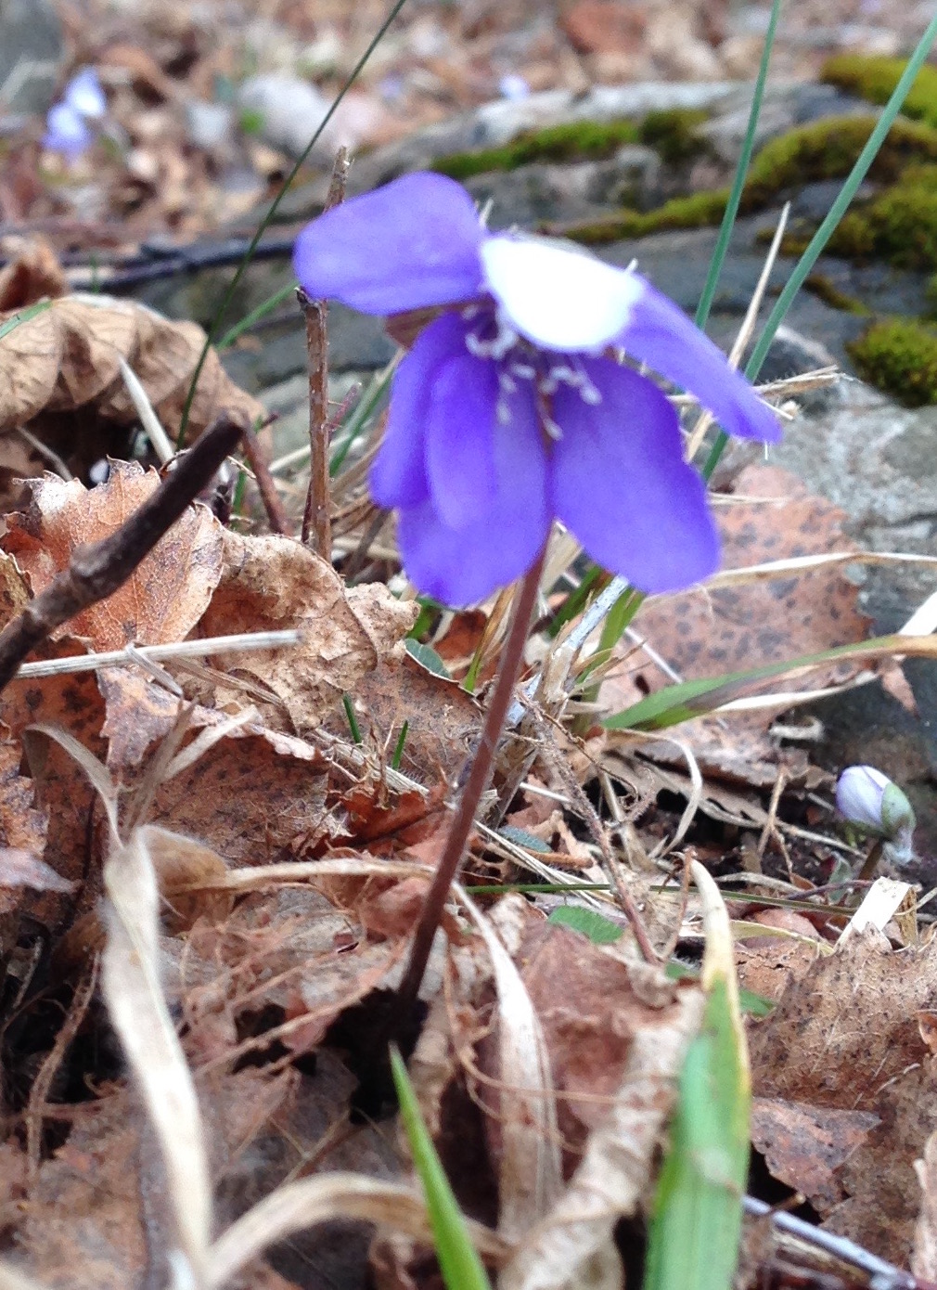


#HepaticaWeek
April 2016
Photo by Dag Endresen, March 2016
Occurrences of liverleaf available in GBIF
Notes:
#HepaticaWeek April 2016, CC-by Dag Endresen, GBIF-Norway, UiO Natural History Museum in Oslo
Illustration: Liverleaf data available in GBIF, http://www.gbif.org/species/5371699
Illustration: Liverleaf at Øland, CC-BY Dag Endresen, http://www.inaturalist.org/observations/2851616

Slide 2
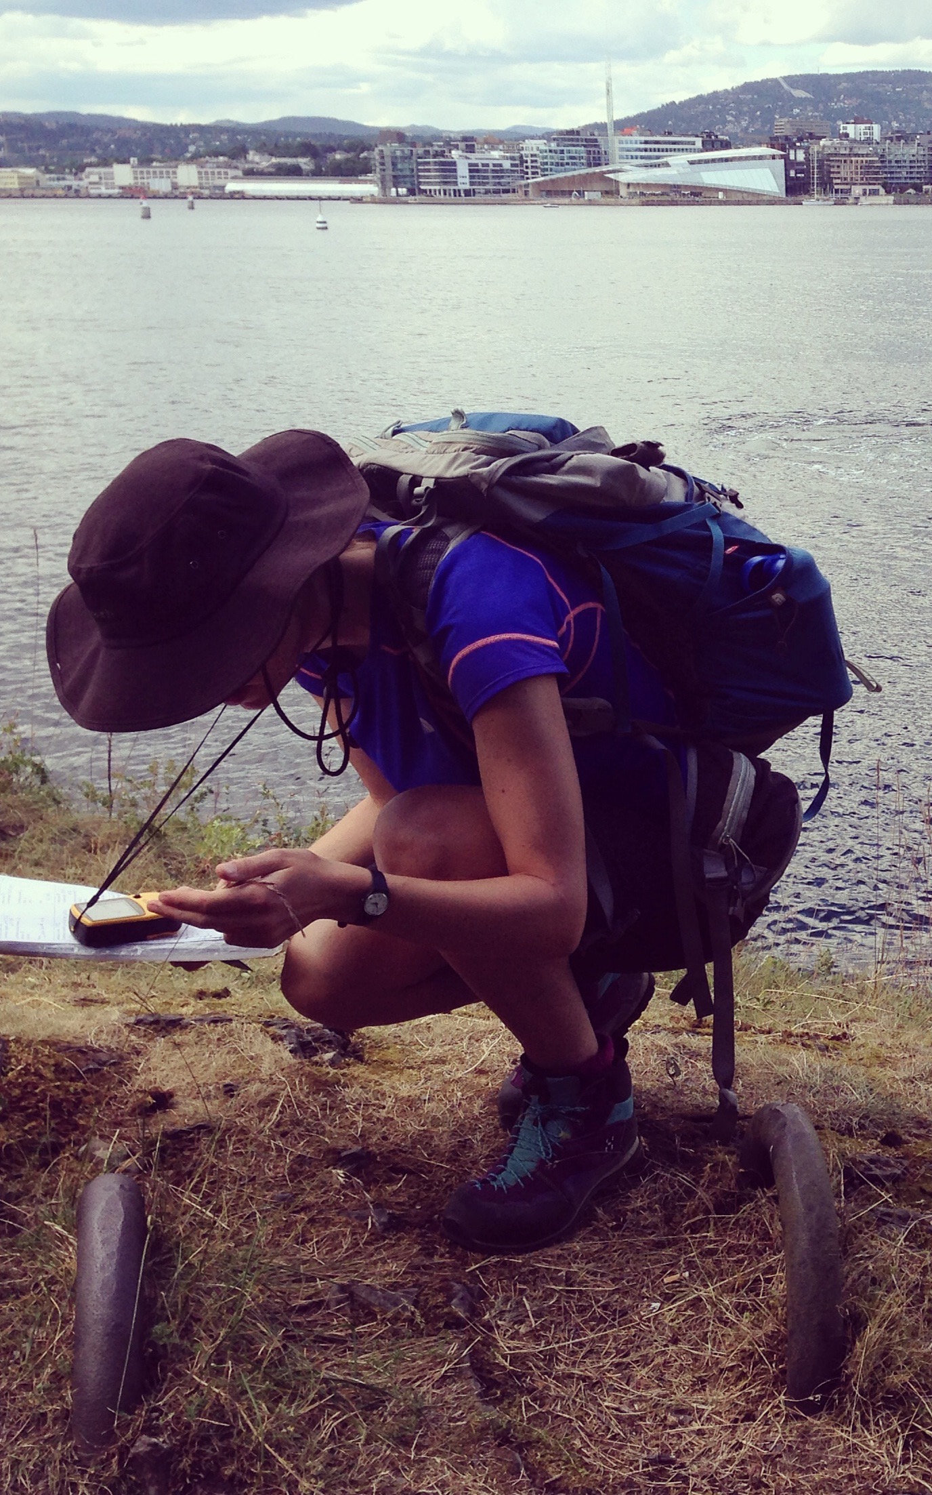
Citizen science report – what happens next?
Conversion to standardized format (Darwin Core)
Quality assessment
Publication in GBIF
Data accessed by scientists and other users
Photo CC-BY Dag Endresen June 2014
Notes:
Photo CC-BY Dag Endresen June 2014, Jade Philips at Hovedøya, Oslo

Slide 3
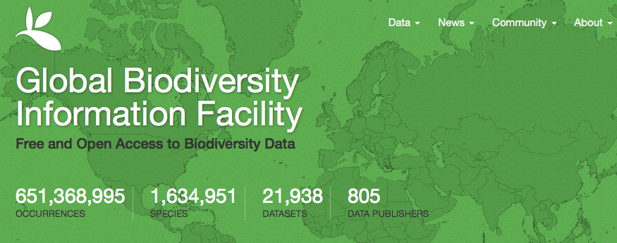
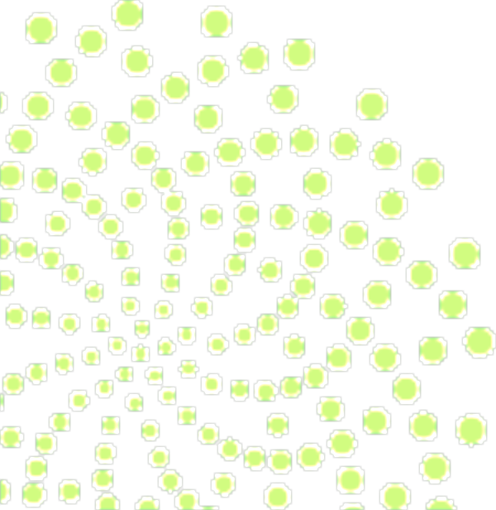
Status
12 April 2016
GBIF enables free and open access to biodiversity data online.
We are an international government-initiated and -funded initiative focused on making biodiversity data available to all and anyone, for scientific research, conservation and sustainable development.
Notes:
GBIF: http://www.gbif.org/
what is the Global Biodiversity Information Facility? GBIF enables free and open access to biodiversity data online. We are an international government-initiated and funded initiative focused on making biodiversity data available to all and anyone, for scientific research, conservation and sustainable development.
Hva er Global Biodiversity Information Facility (GBIF)? GBIF arbeider for fri og åpen tilgang til biodiversitetsdata online. Vi er et internasjonalt og statlig initiert og finansiert nettverk med fokus på å bidra til at biodiversitetsdata er tilgjengelig for alle og enhver, for vitenskapelig forskning, bevaring og bærekraftig utvikling.

Slide 4
Data published through GBIf.org
data mobilization
Occurrence records (millions)
http://www.gbif.org | 3 MAR 2016

Slide 5
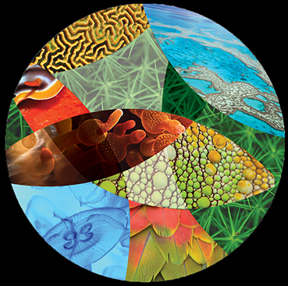
March 2016:
+4,166,212 species occurrence records
+366
datasets
+6
data-publishing institutions
http://www.gbif.org | 1 April 2016
Notes:
GBIF monthly status slides

Slide 6
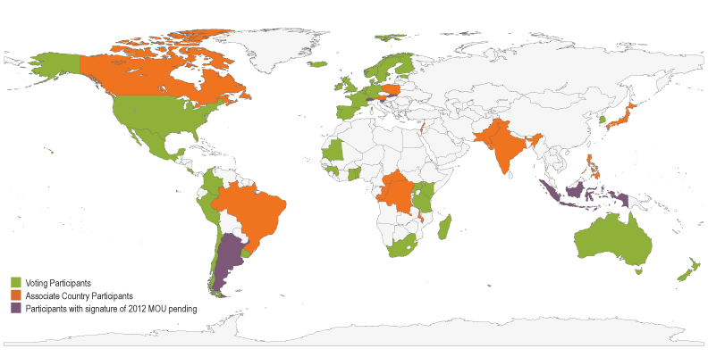
Map of GBIF Country Participants
participation
38 country members
16 Associate countries
40 organizations
Norway joined GBIF in February 2004.
4 Mars 2016

Slide 7
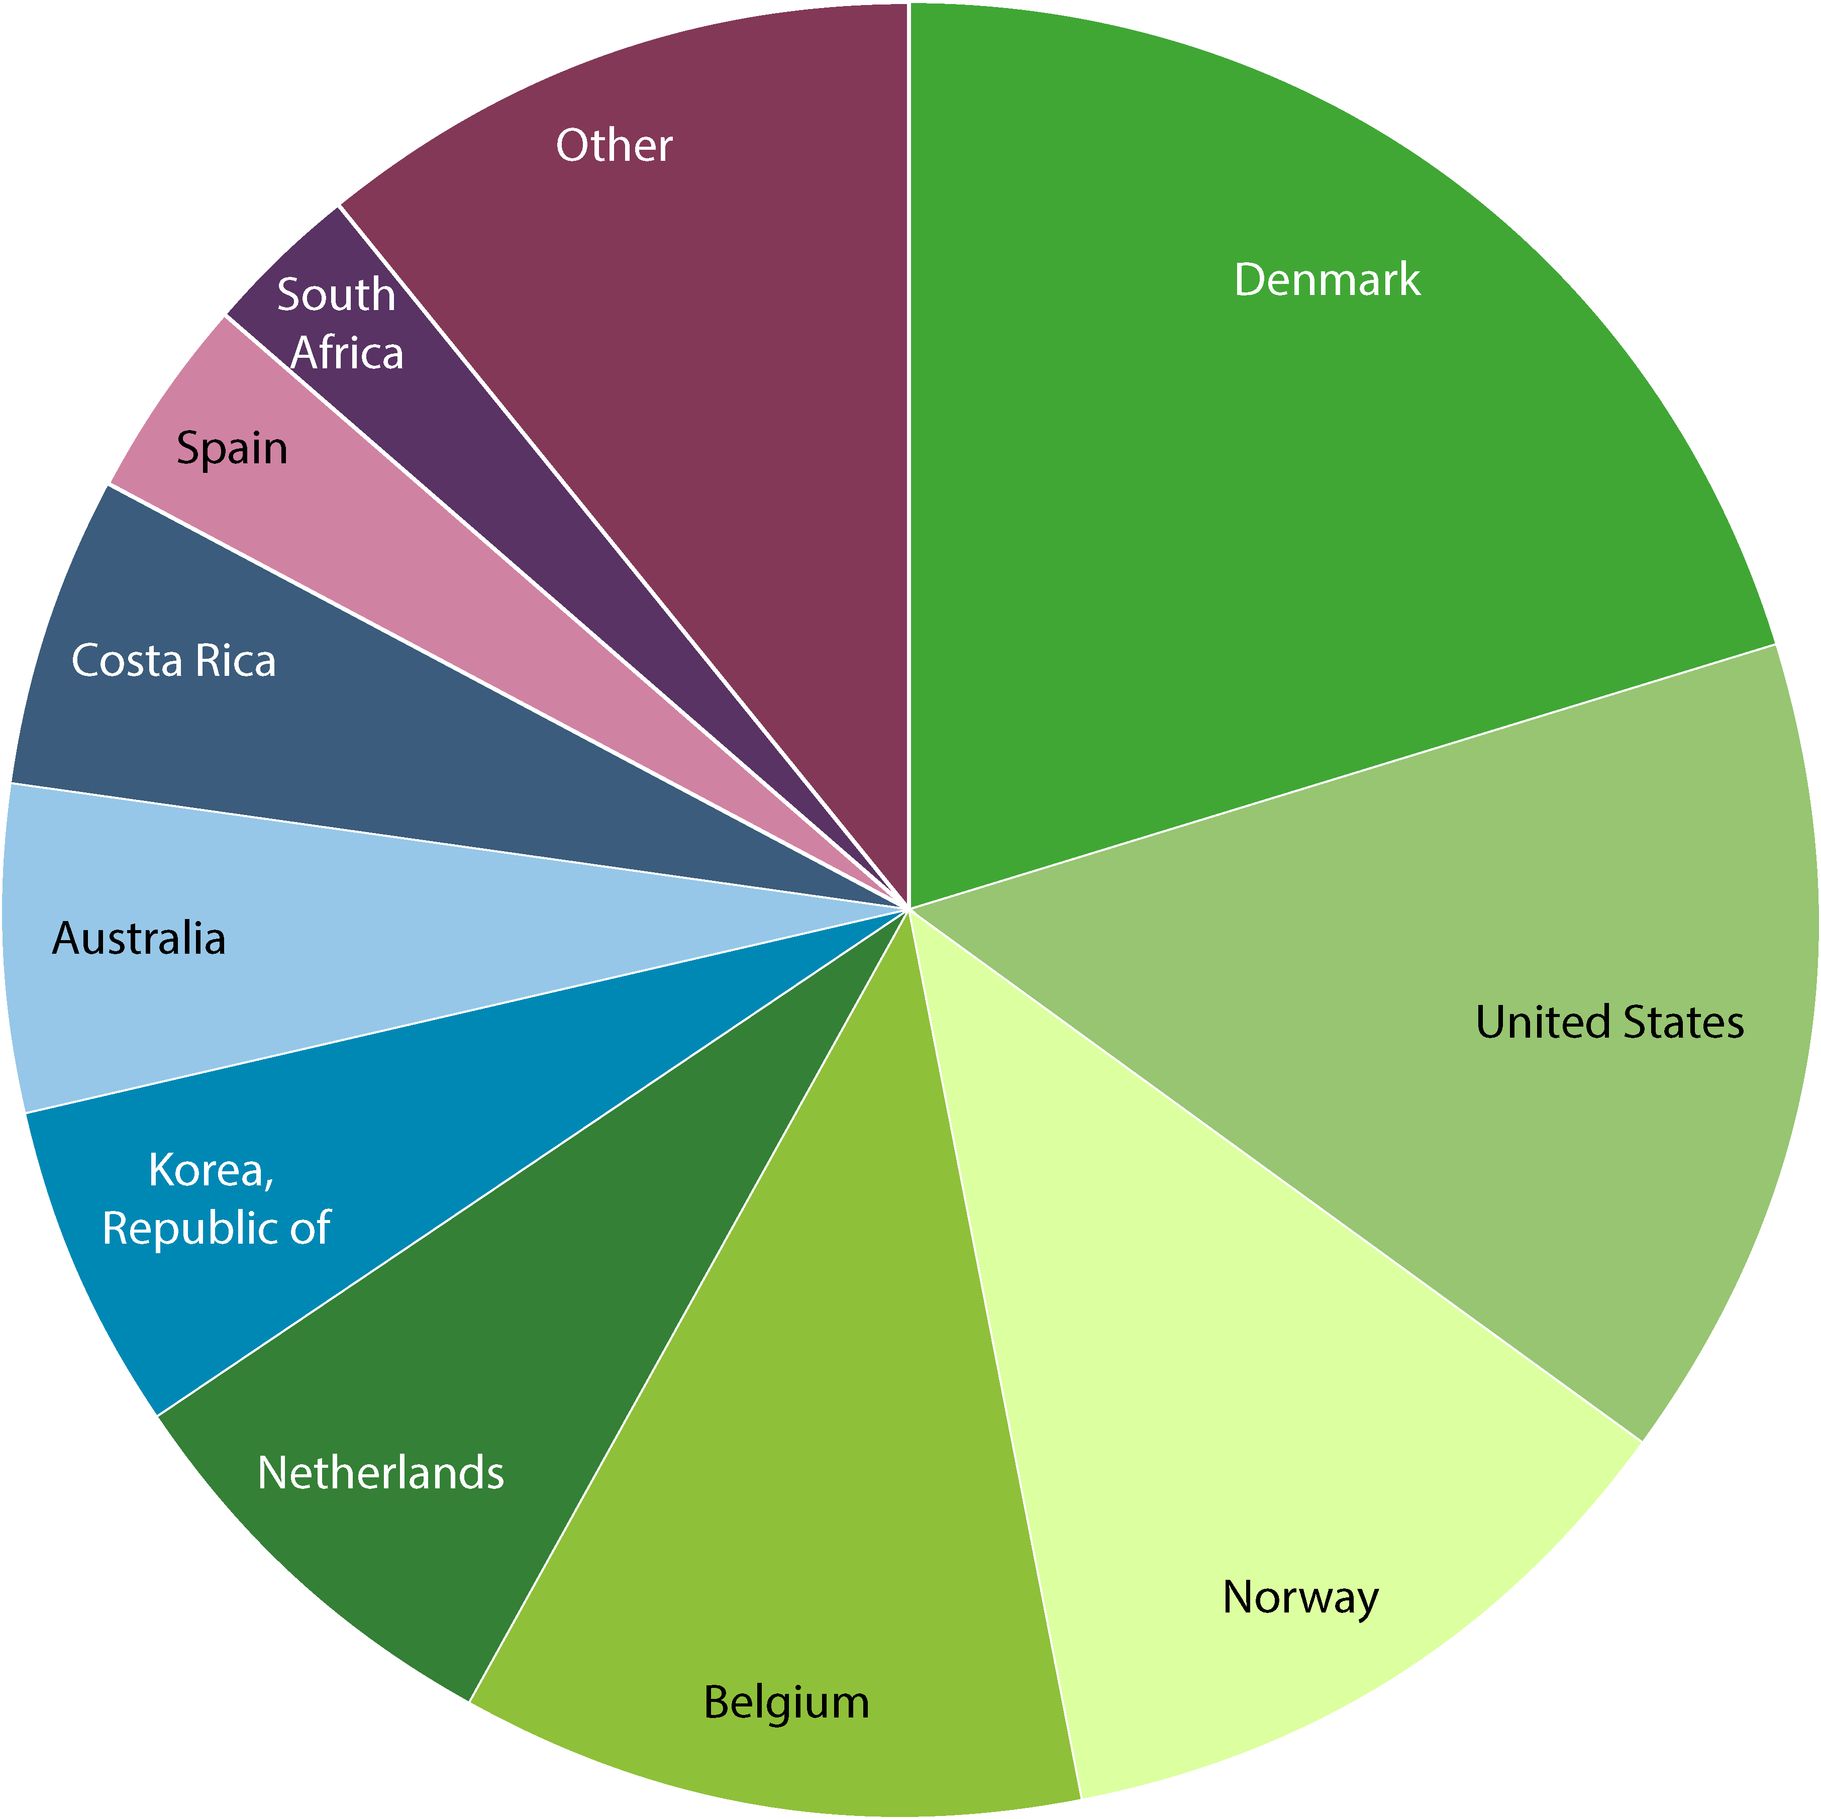
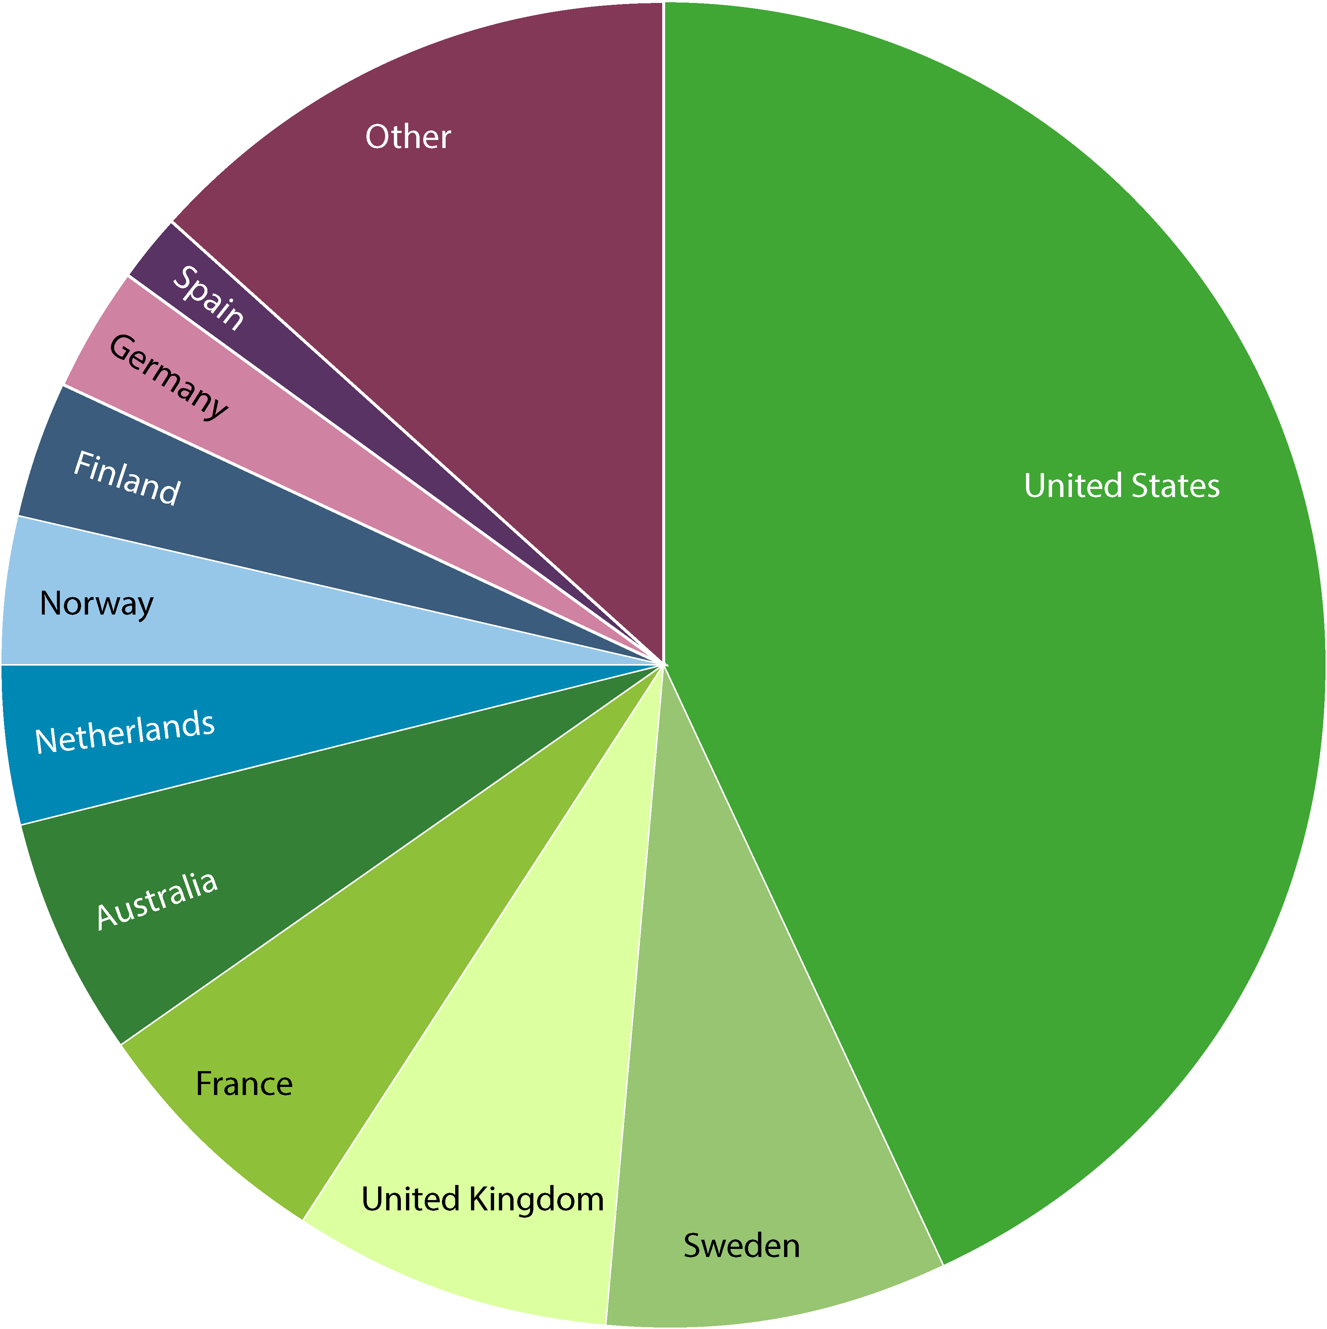
Data—by gbif participant
data publishing
Norway
Norway
Number of new records published—Top 10 participant Countries
(1 to 31 March 2016)
Total number of records published—Top 10 Participant Countries
(as of 31 March 2016)
1. Denmark | 2,972,094 | 6. Rep. of Korea | 867,846
2. United States | 2,198,532 | 7. Australia | 851,138
3. Norway | 1,740,039 | 8. Costa Rica | 808,503
4. Belgium | 1,620,423 | 9. Spain | 521,730
5. Netherlands | 1,089,171 | 10. South Africa | 422,521
1. United States | 276,045,103 | 6. Netherlands | 24,235,610
2. Sweden | 53,689,661 | 7. Norway | 23,366,646
3. United Kingdom | 49,707,687 | 8. Finland | 20,634,024
4. France | 39,848,574 | 9. Germany | 19,436,198
5. Australia | 37,480,629 | 10. Spain | 11,911,359
NOTE: Datasets are assigned to countries according to the location of the publishing institution,
including aggregated datasets with contributors from many other countries. http://www.gbif.org | 01 APR 2016

Slide 8
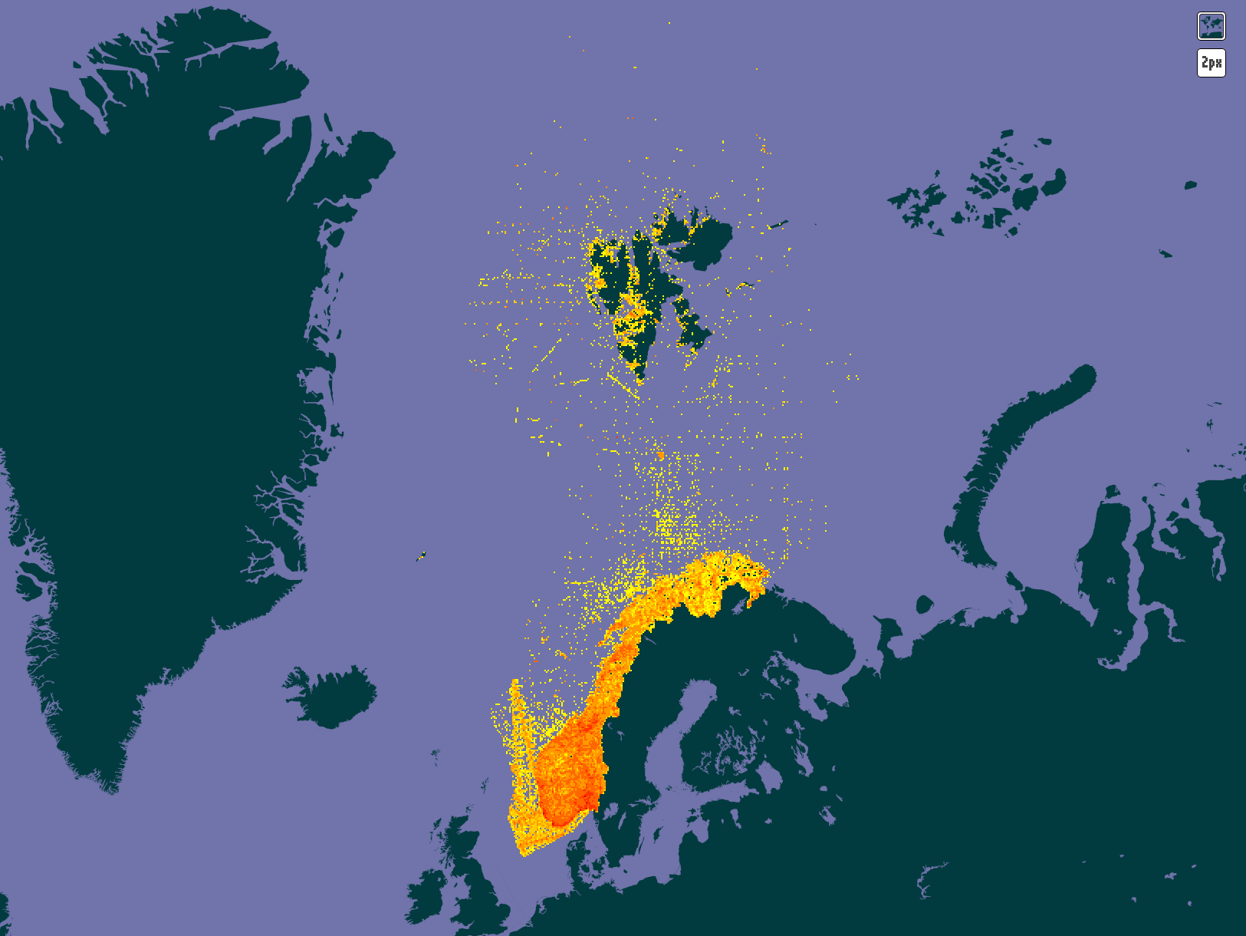
GBIF portal:
24,4 million occurrences with locations in Norway.
Published from 32 countries worldwide.
Updated 5 April 2016
Notes:
Data set published about Norway (localities in Norway): 24,408,452 total records. Updated 5th April 2014, GBIF Data Portal, Norway, http://www.gbif.org/country/NO/about
--

Slide 9
Data publishing infrastructure

Slide 10
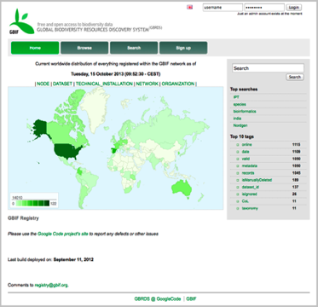
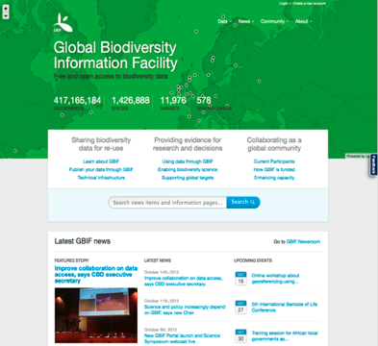
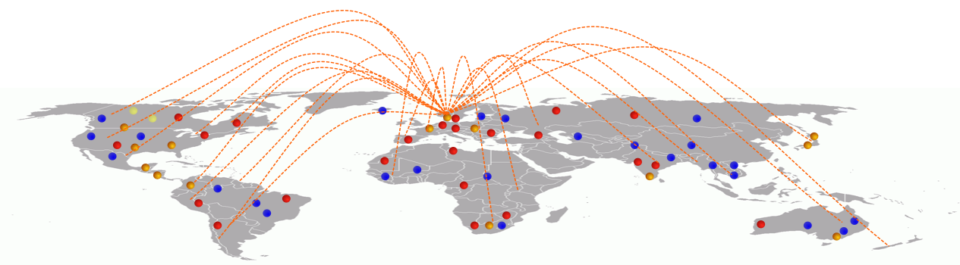
GBIF provides a data discovery system
that is dependent on resolvable stable identifiers for efficient functionality
global registry
data portal
Notes:
GBIF is dependent on resolvable and stable identifiers for efficient functionality. Identifiers for occurrences and for datasets etc.

Slide 11

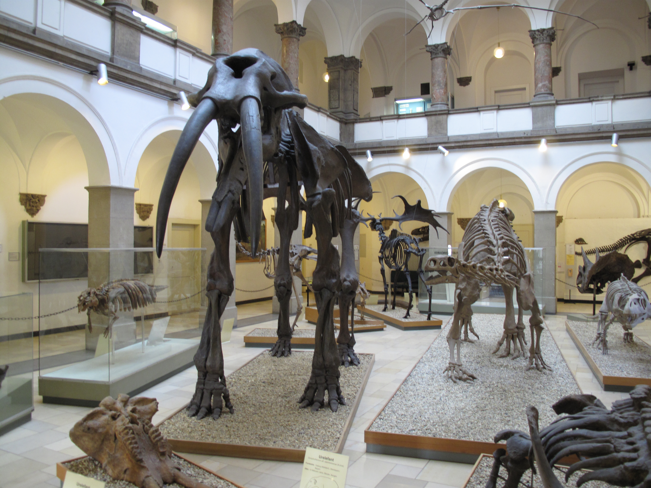







Multiple-purpose data services
Global
information
systems
Darwin Core
archive
Research
institute
Scientific
Research
Biodiversity Conservation
Biodiversity
Analysis
GBIF portal

Slide 12
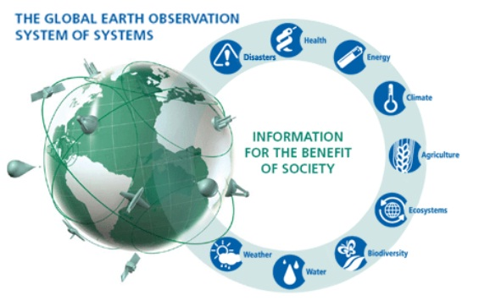

GBIF and GEO
Intergovernmental group on earth observations
GEO BON
Biodiversity observation network
Data Integration & Interoperability
GBIF provides the infrastructure delivering species occurrence data in GEO.
Notes:
GEO BON, http://www.earthobservations.org/geobon.shtml
EU BON, http://www.eubon.eu/
LifeWatch, http://www.lifewatch.eu/

Slide 13


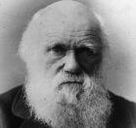
Darwin Core
data exchange standard

Slide 14

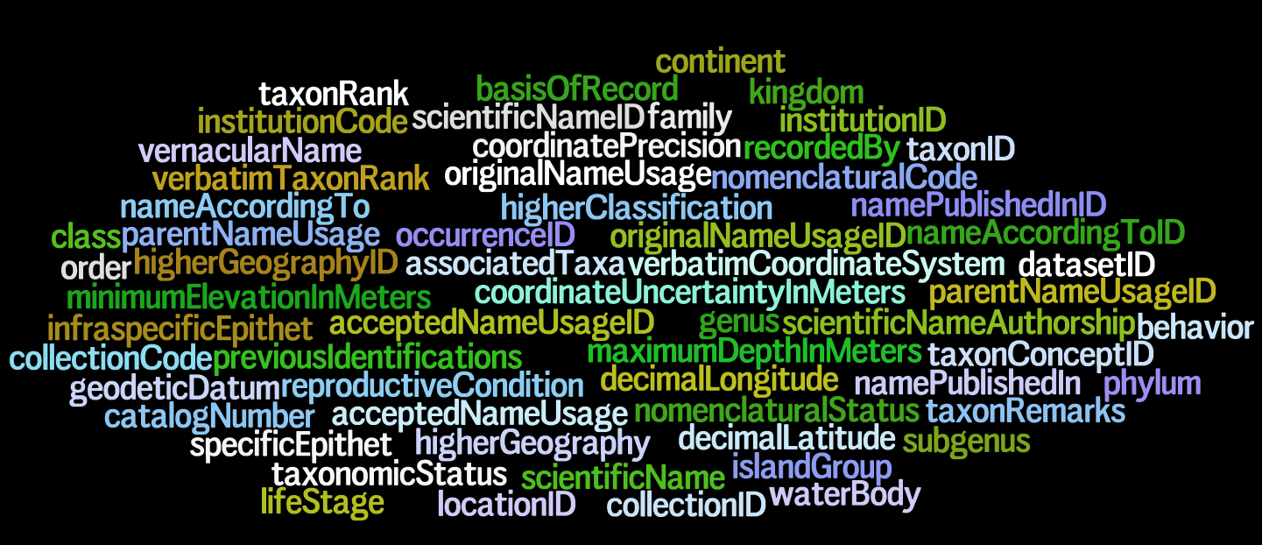
Darwin Core – a vocabulary of terms
Wieczorek J, Bloom D, Guralnick R, Blum S, Döring M, De Giovanni R, Robertson T, and Vieglais D (2012) Darwin Core: An Evolving Community-Developed Biodiversity Data Standard. PLoS ONE 7(1): e29715. (doi:10.1371/journal.pone.0029715)
Notes:
Wieczorek, John; D. Bloom, R. Guralnick, S. Blum, M. Döring, R. De Giovanni, T. Robertson, and D. Vieglais (2012) Darwin Core: An Evolving Community-Developed Biodiversity Data Standard. PLoS ONE 7(1): e29715. doi:10.1371/journal.pone.0029715

Slide 15
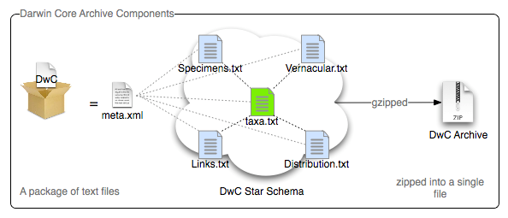

Darwin Core Archive (DwC-A)
DwC-A publish DwC records including terms from DwC-A extensions.
Simple text based format.
Zipped single file archive.
occurrence.txt
Notes:
http://code.google.com/p/gbif-ecat/wiki/DwCArchive

Slide 16
Publish your biodiversity data with GBIF

Slide 17
Publish data in GBIF
data publishing
Step 1: data holding research institutes seek endorsement as an approved data publisher.
Step 2: datasets are identified and converted to standard Darwin Core format.
Step 3: datasets can be published directly from the data node and/or with the assistance from a national GBIF node.
Citizen science data platforms also publish in GBIF.
Notes:
http://www.gbif.org/resource/80635
http://www.gbif.org/publishing-data/summary
http://www.gbif.org/publishing-data/request-endorsement#/intro

Slide 18
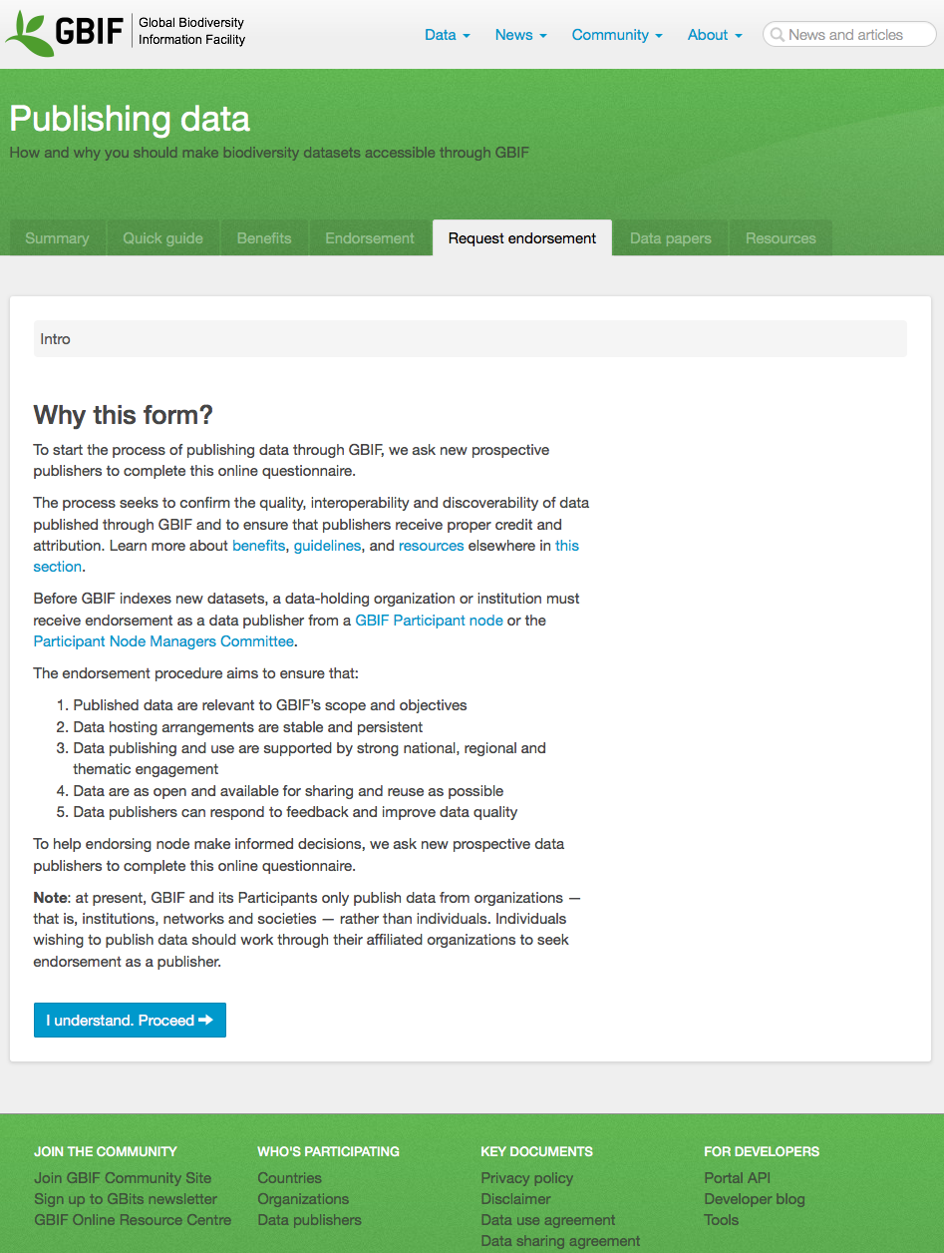
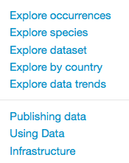


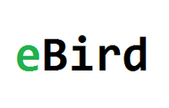



Citizen Science platforms publish biodiversity observations in GBIF.
1
2
42 mill. occurrences
published in GBIF
16 mill. occurrences
published in GBIF
212 mill. occurrences
published in GBIF
951,235 occurrences
published in GBIF
28,990 occurrences
published in GBIF
14,719 occurrences
published in GBIF
and many more ...
Notes:
http://www.gbif.org/publishing-data/request-endorsement#/intro
Citizen Science projects in GBIF - http://www.gbif.org/search/node?keys=citizen+science
BioCaching - https://www.facebook.com/biocaching - http://biocaching.no/
MyGeoss - http://digitalearthlab.jrc.ec.europa.eu/mygeoss/
iSpot Nature - http://www.ispotnature.org
iNaturalist - http://www.gbif.org/dataset/50c9509d-22c7-4a22-a47d-8c48425ef4a7 – 951,235 occurrences in GBIF - http://www.gbif.org/publisher/28eb1a3f-1c15-4a95-931a-4af90ecb574d (endorsed by USGS, USA)
eBird - http://www.gbif.org/dataset/4fa7b334-ce0d-4e88-aaae-2e0c138d049e - 211,883,652 occurrences - http://www.gbif.org/publisher/e2e717bf-551a-4917-bdc9-4fa0f342c530 (endorsed by USGS, USA)
DiveBoard - http://www.gbif.org/dataset/66f6192f-6cc0-45fd-a2d1-e76f5ae3eab2 – 28,990 occurrences - http://www.gbif.org/publisher/1989b627-2a61-44db-83e4-392efc5da0a9 (endorsed by GBIF France)
ALA Volunteer Portal - http://volunteer.ala.org.au/
AnyMals+Plants - http://www.gbif.org/dataset/e6c97f6e-e952-11e2-961f-00145eb45e9a - 14,719 occurrences - published by Museum für Naturkunde Berlin – endorsed by GBIF Germany
Artsobservasjoner.no - http://www.gbif.org/dataset/b124e1e0-4755-430f-9eab-894f25a9b59c – 16,473,757 occurrences - published by Norwegian Biodiversity Information Centre - endorsed by GBIF Norway
Artsportalen.se - http://www.gbif.org/dataset/38b4c89f-584c-41bb-bd8f-cd1def33e92f – 41,630,940 occurrences - http://www.gbif.org/publisher/b8323864-602a-4a7d-9127-bb903054e97d – published by ArtDatabanken - GBIF Sweden
New Zealand Biodiversity Recording Network - http://www.gbif.org/dataset/d3484430-8876-11dd-986c-b8a03c50a862 – 23,593 occurrences
iRecord - http://www.gbif.org/publisher/07f617d0-c688-11d8-bf62-b8a03c50a862 - UK National Biodiversity Network - http://www.brc.ac.uk/irecord/

Slide 19
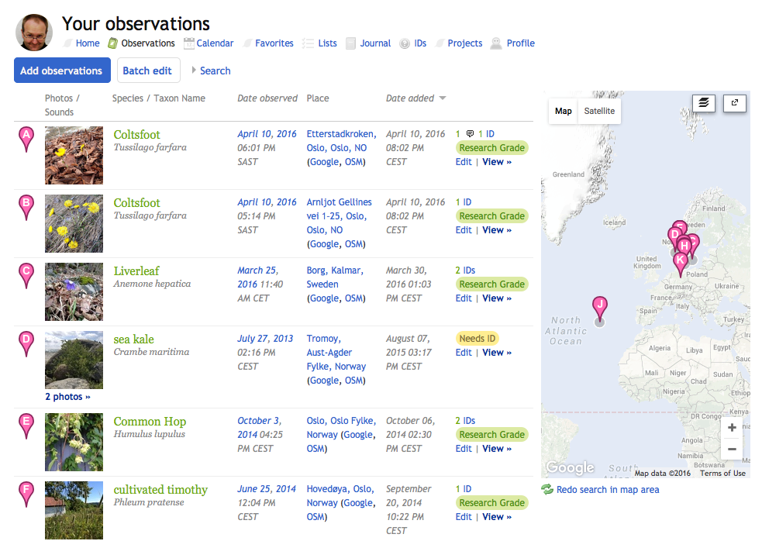
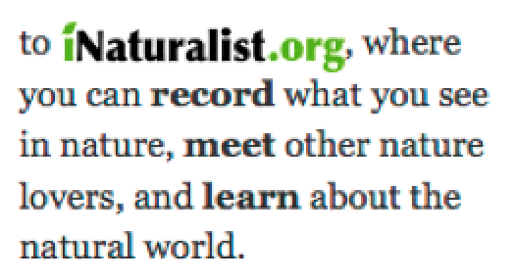
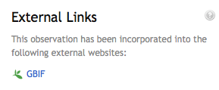
Notes:
http://www.inaturalist.org/
http://www.inaturalist.org/observations/dagendresen
http://www.gbif.org/dataset/50c9509d-22c7-4a22-a47d-8c48425ef4a7
http://www.gbif.org/occurrence/1024229755
http://inaturalist.tumblr.com/search/research+grade

Slide 20
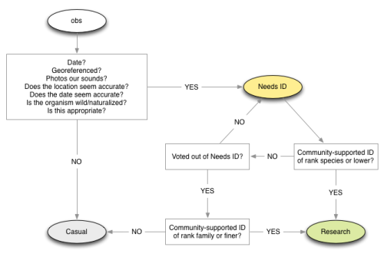

Research grade: an observation must have media, coordinates, a date, and pass quality metrics, but now the community ID must be finer than family.
Needs ID: Any observation that could become “Research” grade but needs more identifications.
Casual: Any observation that cannot become “Research” grade.
Notes:
http://inaturalist.tumblr.com/search/research+grade
iNaturalist by California Academy of Sciences

Slide 21
Download data

Slide 22
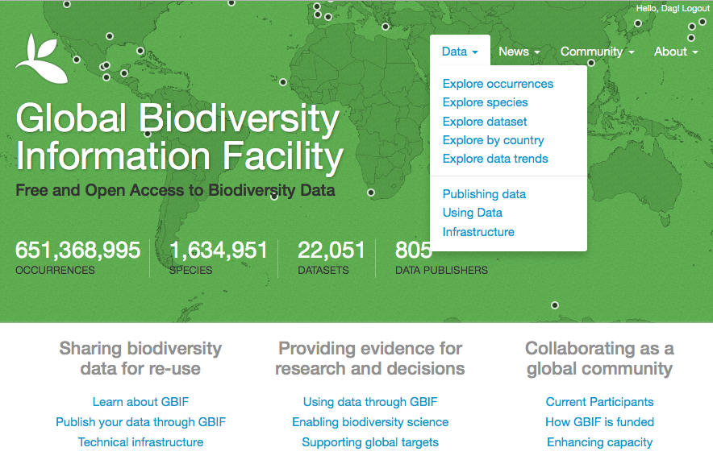
GBIF DATA PORTAL
Notes:
This is the GBIF 2013 Data Portal

Slide 23
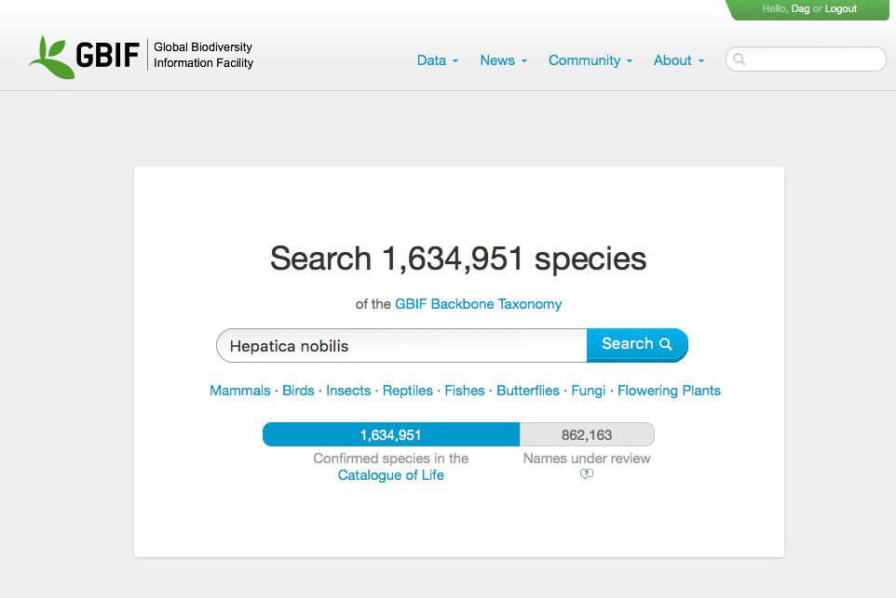
Notes:
http://www.gbif.org/occurrence/search

Slide 24
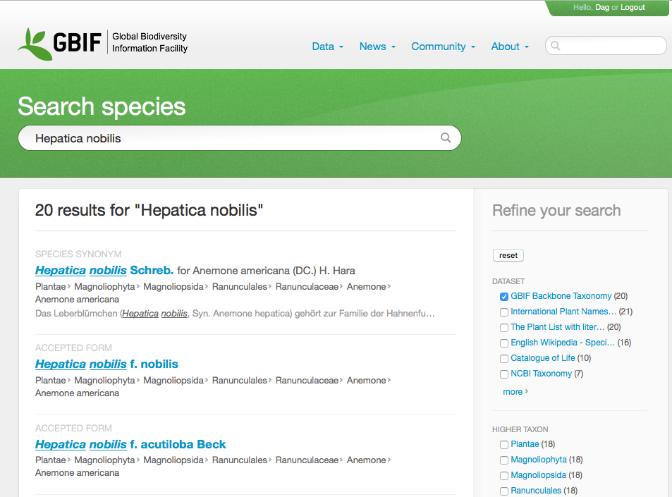
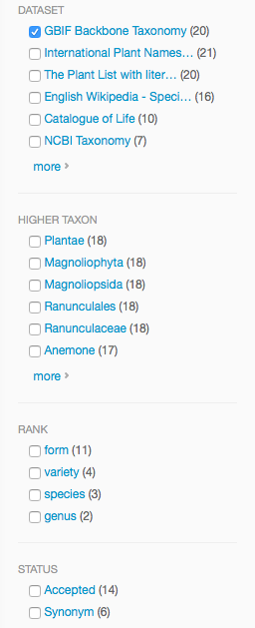
Notes:
http://www.gbif.org/species/search?q=Hepatica+nobilis&dataset_key=d7dddbf4-2cf0-4f39-9b2a-bb099caae36c

Slide 25
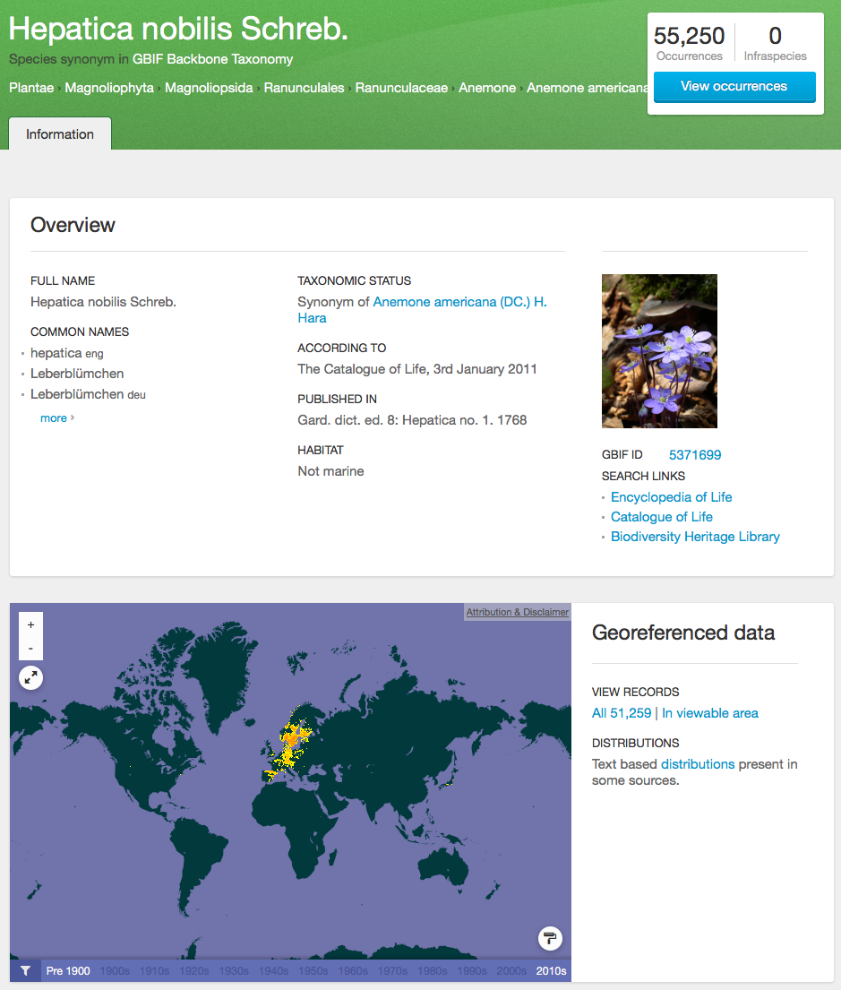
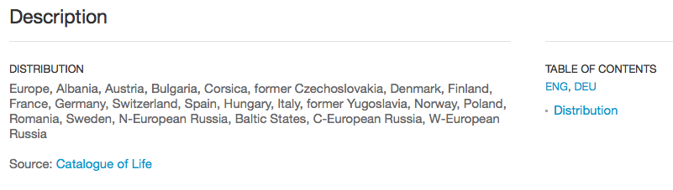
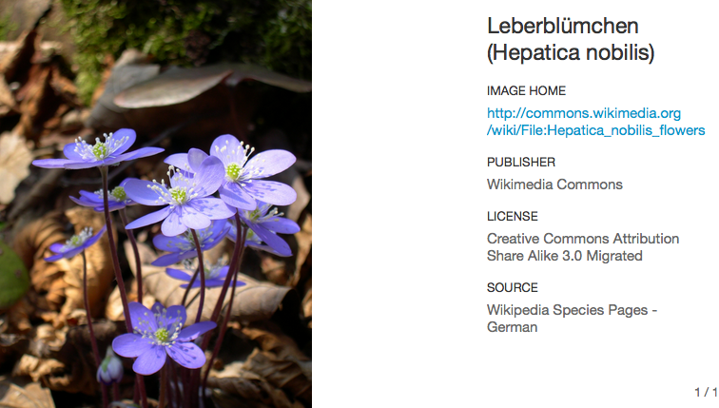
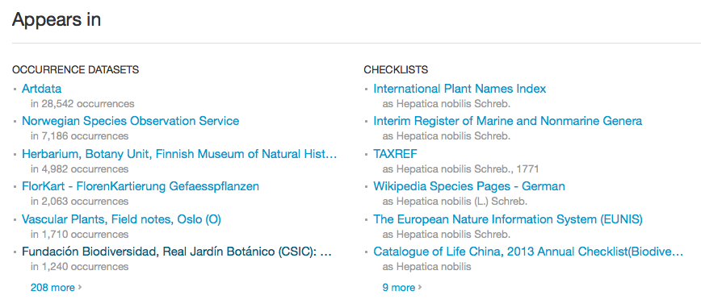
SPECIES SEARCH
Notes:
Navigating though an specie search, show the results related with the search and also there is the capability to filter the results.

Slide 26
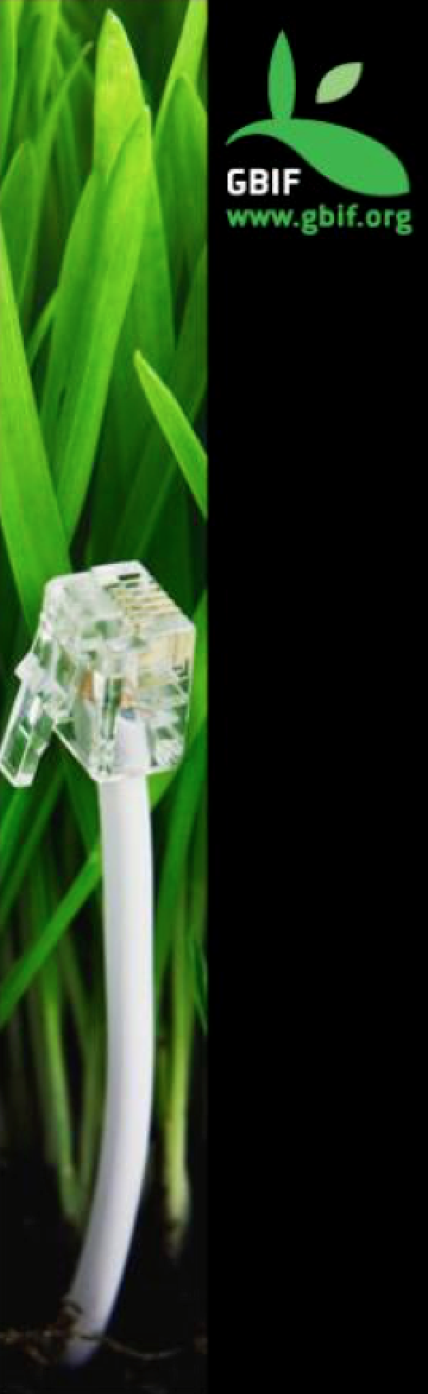
GBIF DATA PORTAL API
An interface to access data published through the GBIF network using web services.
Notes:
What’s the Data Portal API? An interface to access the data published through the GBIF network using Web Services.

Slide 27

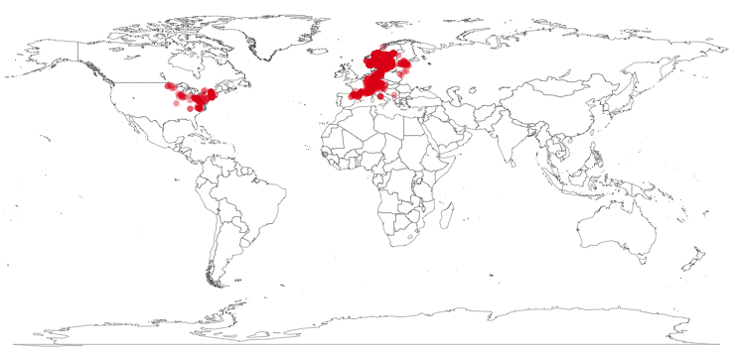
rOpenSci : rgbif
library(rgbif)
key <- name_backbone(name='Hepatica nobilis', kingdom=‘Plantae')$speciesKey
sp <- occ_search(taxonKey=key, return='data', hasCoordinate=TRUE, limit=1000)
gbifmap(sp)

Slide 28
Data use in research

Slide 29
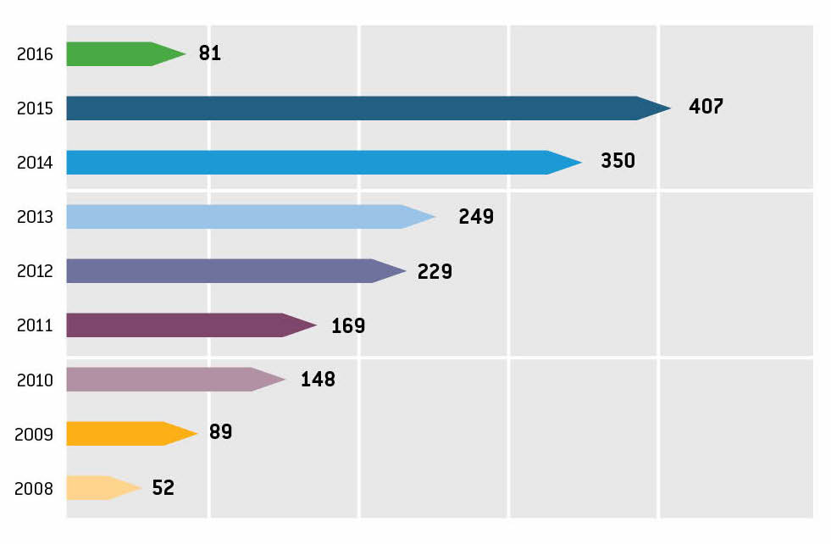
Citations in peer-reviewed research
data use
Annual number of peer-reviewed publications using GBIF-mediated data
4 APR 2016

Slide 30










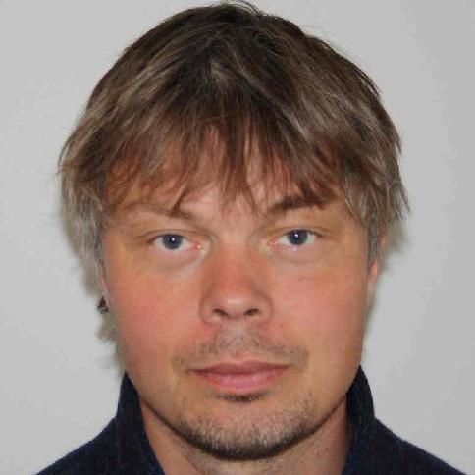



Node team at NHM, University of Oslo
  Dag Endresen, Node Manager
  Christian Svindseth, Database manager
  Fridtjof Mehlum, Research Director
  Einar Timdal, Associate Professor
  Geir Søli, Associate Professor
Artsdatabanken, Trondheim
  Wouter Koch, Advisor
  Nils Valland, Senior advisor
NTNU University Museum
Anders Finstad, GBIF Science committee
Research Council of Norway
  Per Backe-Hansen, Head of delegation
Contact us at: gbif-drift@nhm.uio.no
Notes:
http://www.nhm.uio.no/forskning/prosjekter/gbif/
http://www.gbif.no

