Slide 1





Data publishing workshop
Introduction to GBIF
First day 4th July 2016
Los Baños, Laguna, Philippines
Dag Endresen, GBIF Norway, UiO
Notes:
GBIF BIFA data publishing workshop, 4-8 July 2016, ASEAN Heritage Parks, ASEAN Centre for Biodiversity, Los Baños, Laguna, Philippines
Slides CC-BY/CC0 Dag Endresen, Global Biodiversity Information Facility (GBIF) in Norway, UiO Natural History Museum in Oslo, University of Oslo (feel free to reuse slides)
Day 1: 4th July 2016: The GBIF Facility – Introduction to GBIF and the GBIF biodiversity data publishing infrastructure (2016-07-04, 08:40-09:00, 20 minutes)
Mobilizing biodiversity data from ASEAN protected areas
The goal of this project is to facilitate the mobilization of biodiversity information from the Association of Southeast Asian Nations (ASEAN) Heritage Parks – regionally significant protected areas for biodiversity.
At present, biodiversity data collected from park surveys are documented through various means and do not always conform to global standards. A workshop for selected park management staff will strengthen their skills in biodiversity information management and data publishing through hands-on exercises using datasets from the heritage parks. This project will also orient heritage park staff towards monitoring sites with camera traps, and prepare them for the publishing of sample-based data in the future.
The outcome of the project will be an increase in the availability and access to data from the protected areas, to assist policy development.
http://www.gbif.org/programme/bifa/2015/ASEAN-heritage-parks
Slide source: GB23 Nodes Madagascar October 2015, http://community.gbif.org/pg/pages/view/47903/ & Norwegian GBIF data publishing workshop in Trondheim October 2015, http://www.gbif.no/events/2015/data-publishing-workshop-october-2015.html

Slide 2
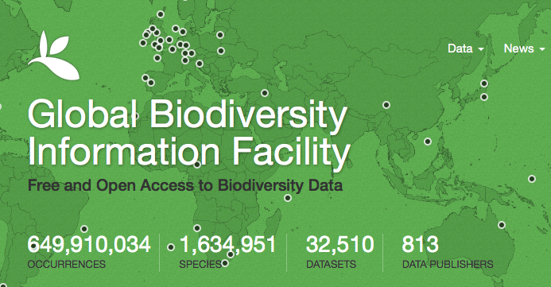
Status 10 June 2016
GBIF enables free and open access to biodiversity data online
We are an international government-initiated and -funded initiative focused on making biodiversity data available to all and anyone, for scientific research, conservation and sustainable development.
Notes:
GBIF: http://www.gbif.org/
what is the Global Biodiversity Information Facility? GBIF enables free and open access to biodiversity data online. We are an international government-initiated and funded initiative focused on making biodiversity data available to all and anyone, for scientific research, conservation and sustainable development.
Hva er Global Biodiversity Information Facility (GBIF)? GBIF arbeider for fri og åpen tilgang til biodiversitetsdata online. Vi er et internasjonalt og statlig initiert og finansiert nettverk med fokus på å bidra til at biodiversitetsdata er tilgjengelig for alle og enhver, for vitenskapelig forskning, bevaring og bærekraftig utvikling.

Slide 3
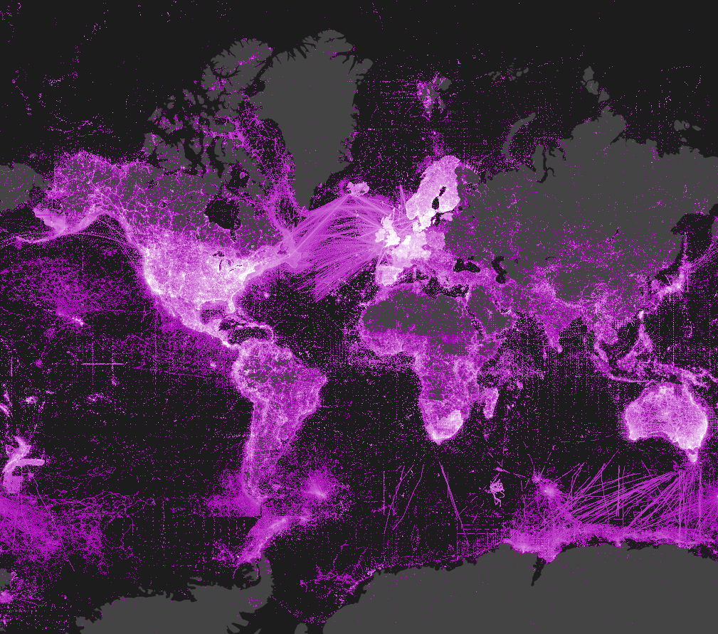
http://www.gbif.org
Notes:
ASEAN Heritage Parks, data publishing workshop, Philippines July 2016, CC-by Dag Endresen, Global Biodiversity Information Facility (GBIF) in Norway, UiO Natural History Museum in Oslo
Density of georeferenced species occurrence records published through GBIF (see http://www.gbif.org/occurrence) http://www.gbif.org

Slide 4

GBIF BY THE NUMBERS
649,054,525 species occurrence records
32,440
datasets
813
data-publishing institutions
http://www.gbif.org | 06 JUN 2016

Slide 5
GBIF BY THE NUMBERS: MAY 2016
+3,818,408 species occurrence records
+4,267
datasets
+4
data-publishing institutions
http://www.gbif.org | 6 JUN 2016

Slide 6
Data published through GBIf.org
data mobilization
Occurrence records (millions)
http://www.gbif.org | 6 JUN 2016

Slide 7
Data publishers
data mobilization
Number of institutions registered as GBIF data publishers
. http://www.gbif.org | 6 JUN 2016

Slide 8
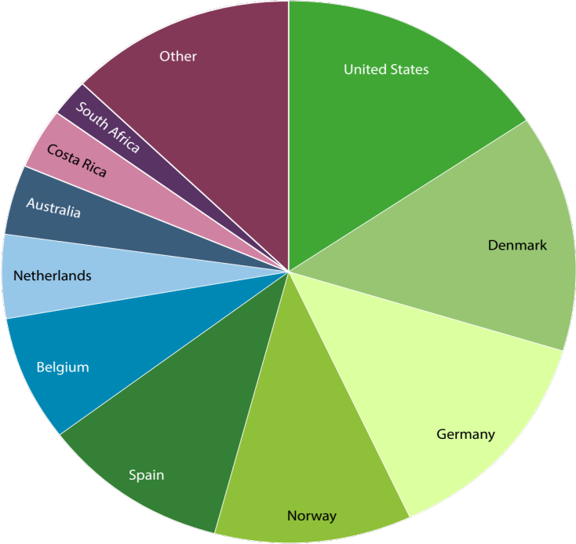
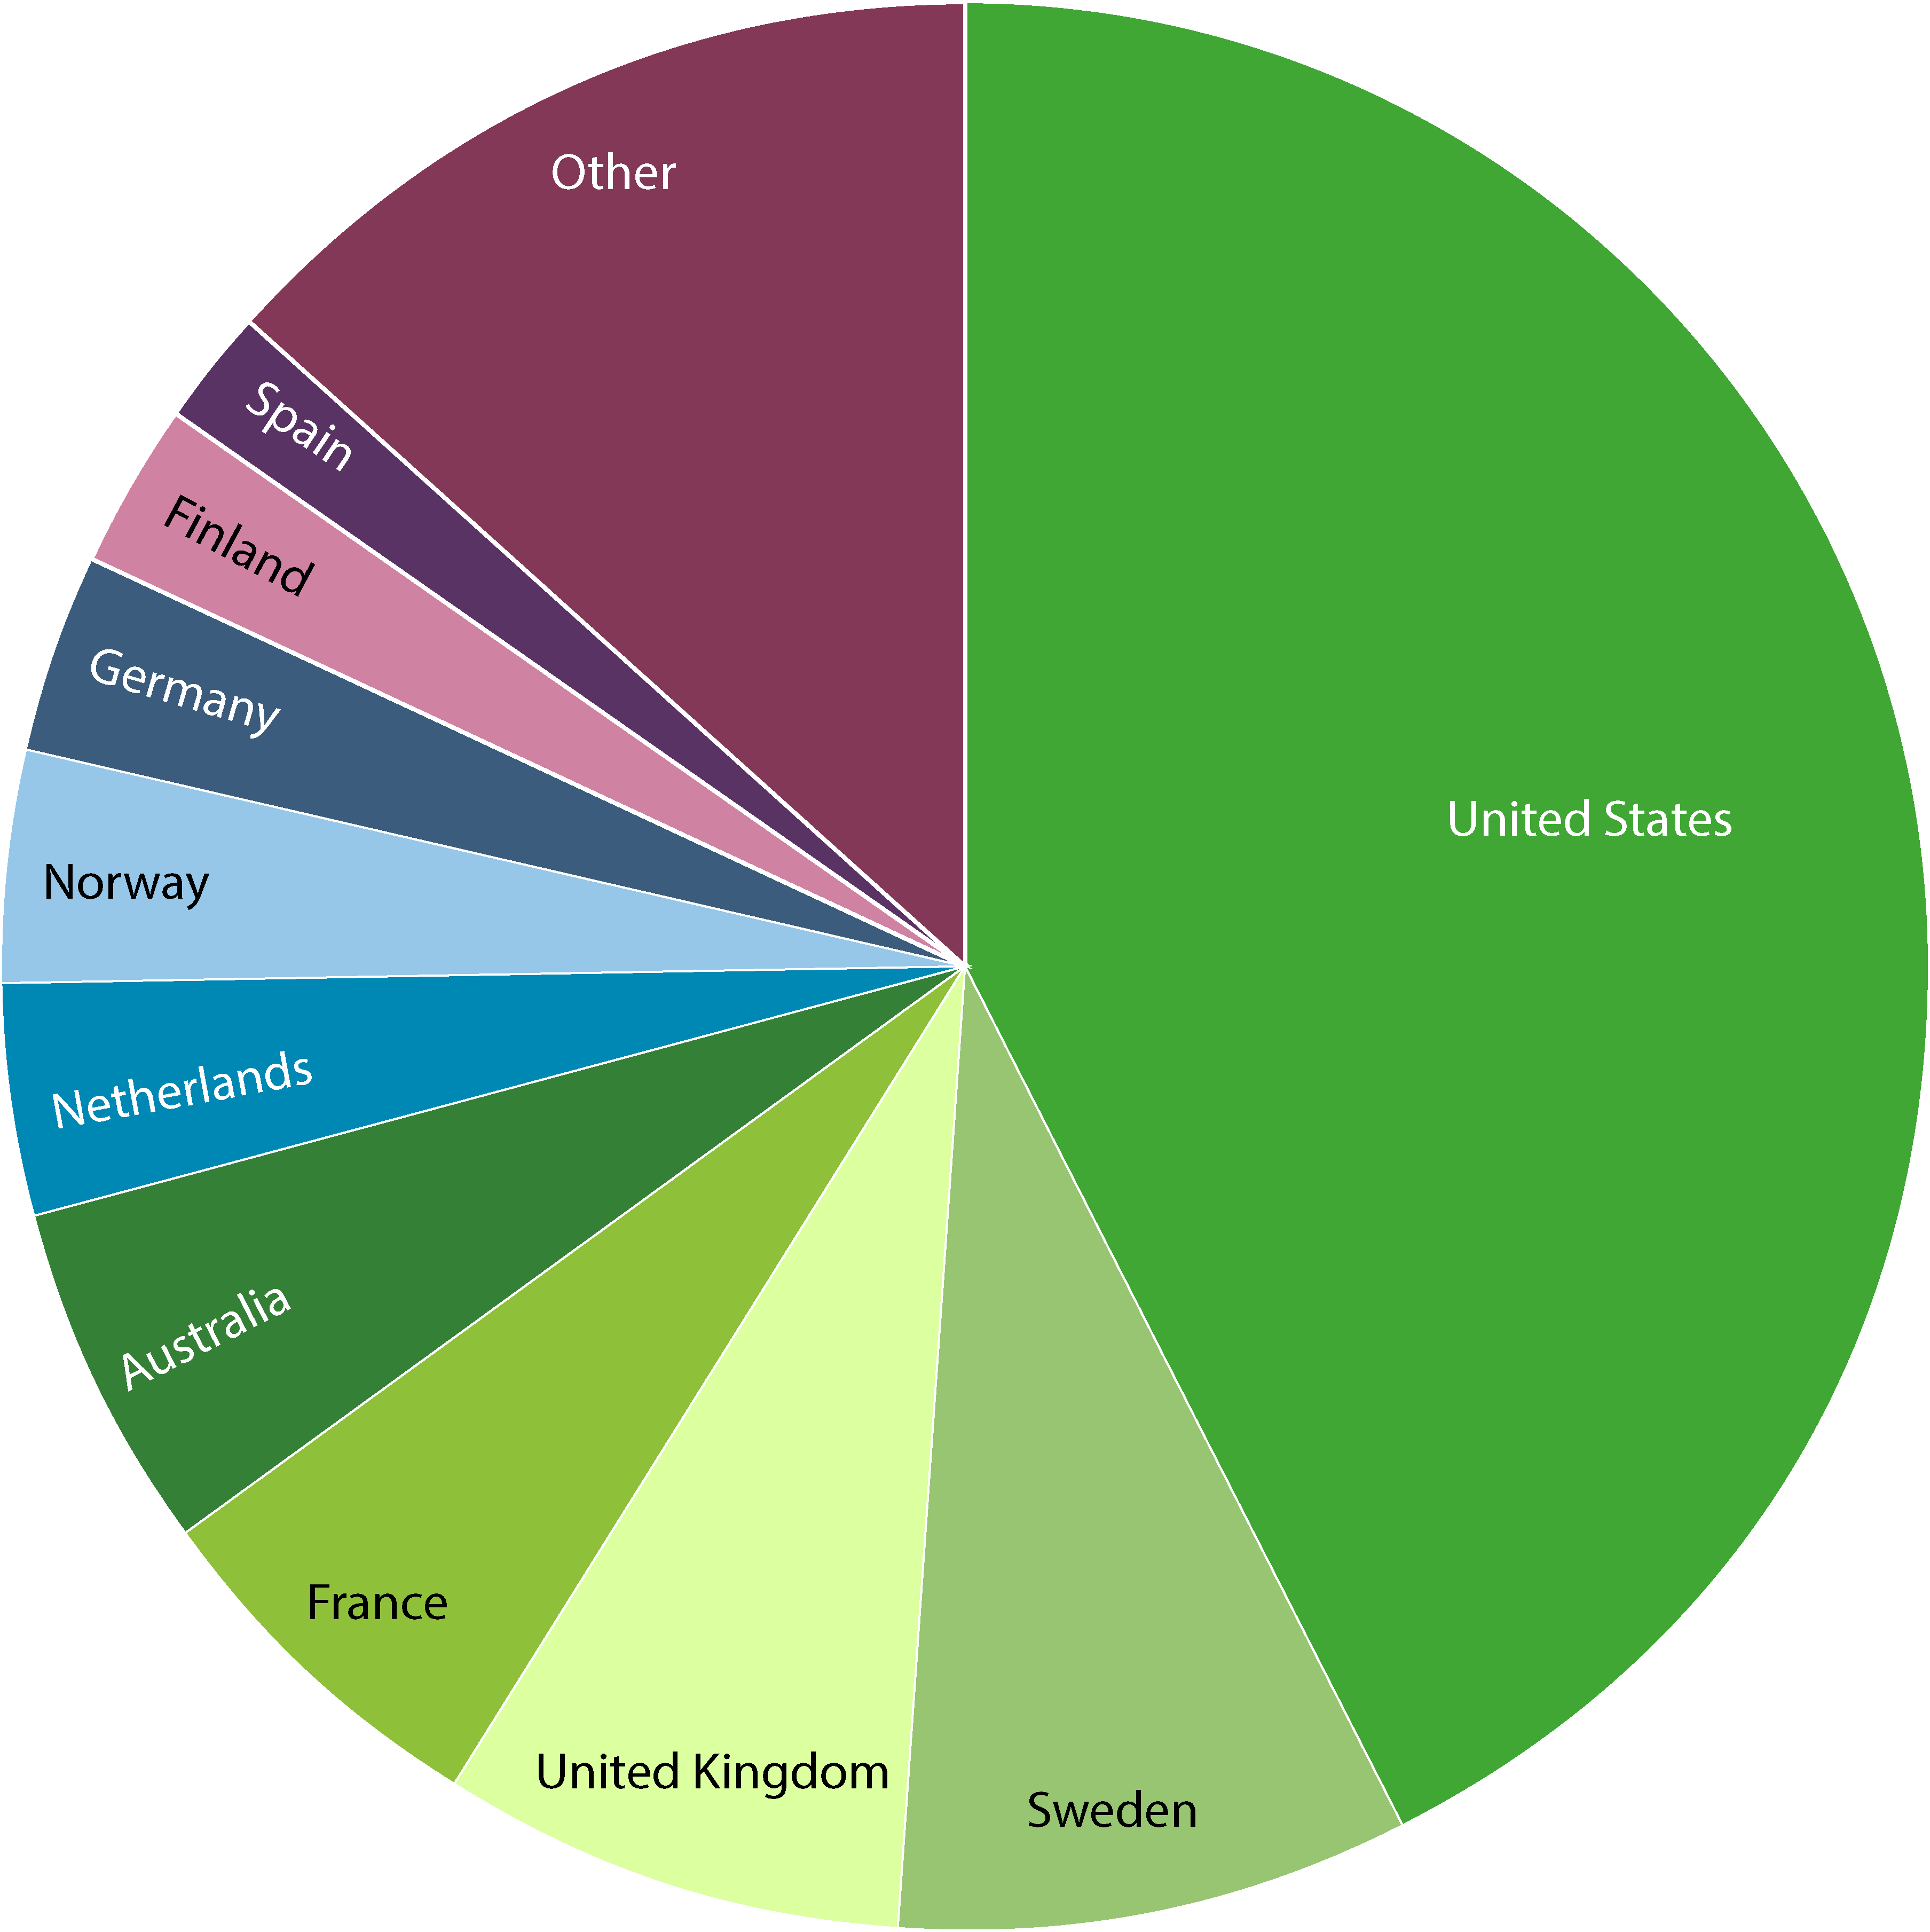
Data—by gbif participant
data publishing
Number of new records published—Top 10 participant Countries
(1 to 31 May 2016)
Total number of records published—Top 10 Participant Countries
(as of 31 May 2016)
1. United States | 3,348,499 | 6. Belgium | 1,620423
2. Denmark | 2,972,094 | 7. Netherlands | 1,094,804
3. Germany | 2,868,240 | 8. Australia | 859,896
4. Norway | 2,322,797 | 9. Costa Rica | 810,035
5. Spain | 2,238,363 | 10. South Africa | 436,236
1. United States | 271,901,500 | 6. Netherlands | 24,241,092
2. Sweden | 53,776,182 | 7. Norway | 23,811,863
3. United Kingdom | 49,786,646 | 8. Germany | 22,151,479
4. France | 39,896,982 | 9. Finland | 16,612,735
5. Australia | 37,489,401 | 10. Spain | 13,630,866
NOTE: Datasets are assigned to countries according to the location of the publishing institution,
including aggregated datasets with contributors from many other countries. http://www.gbif.org | 09 JUN 2016

Slide 9
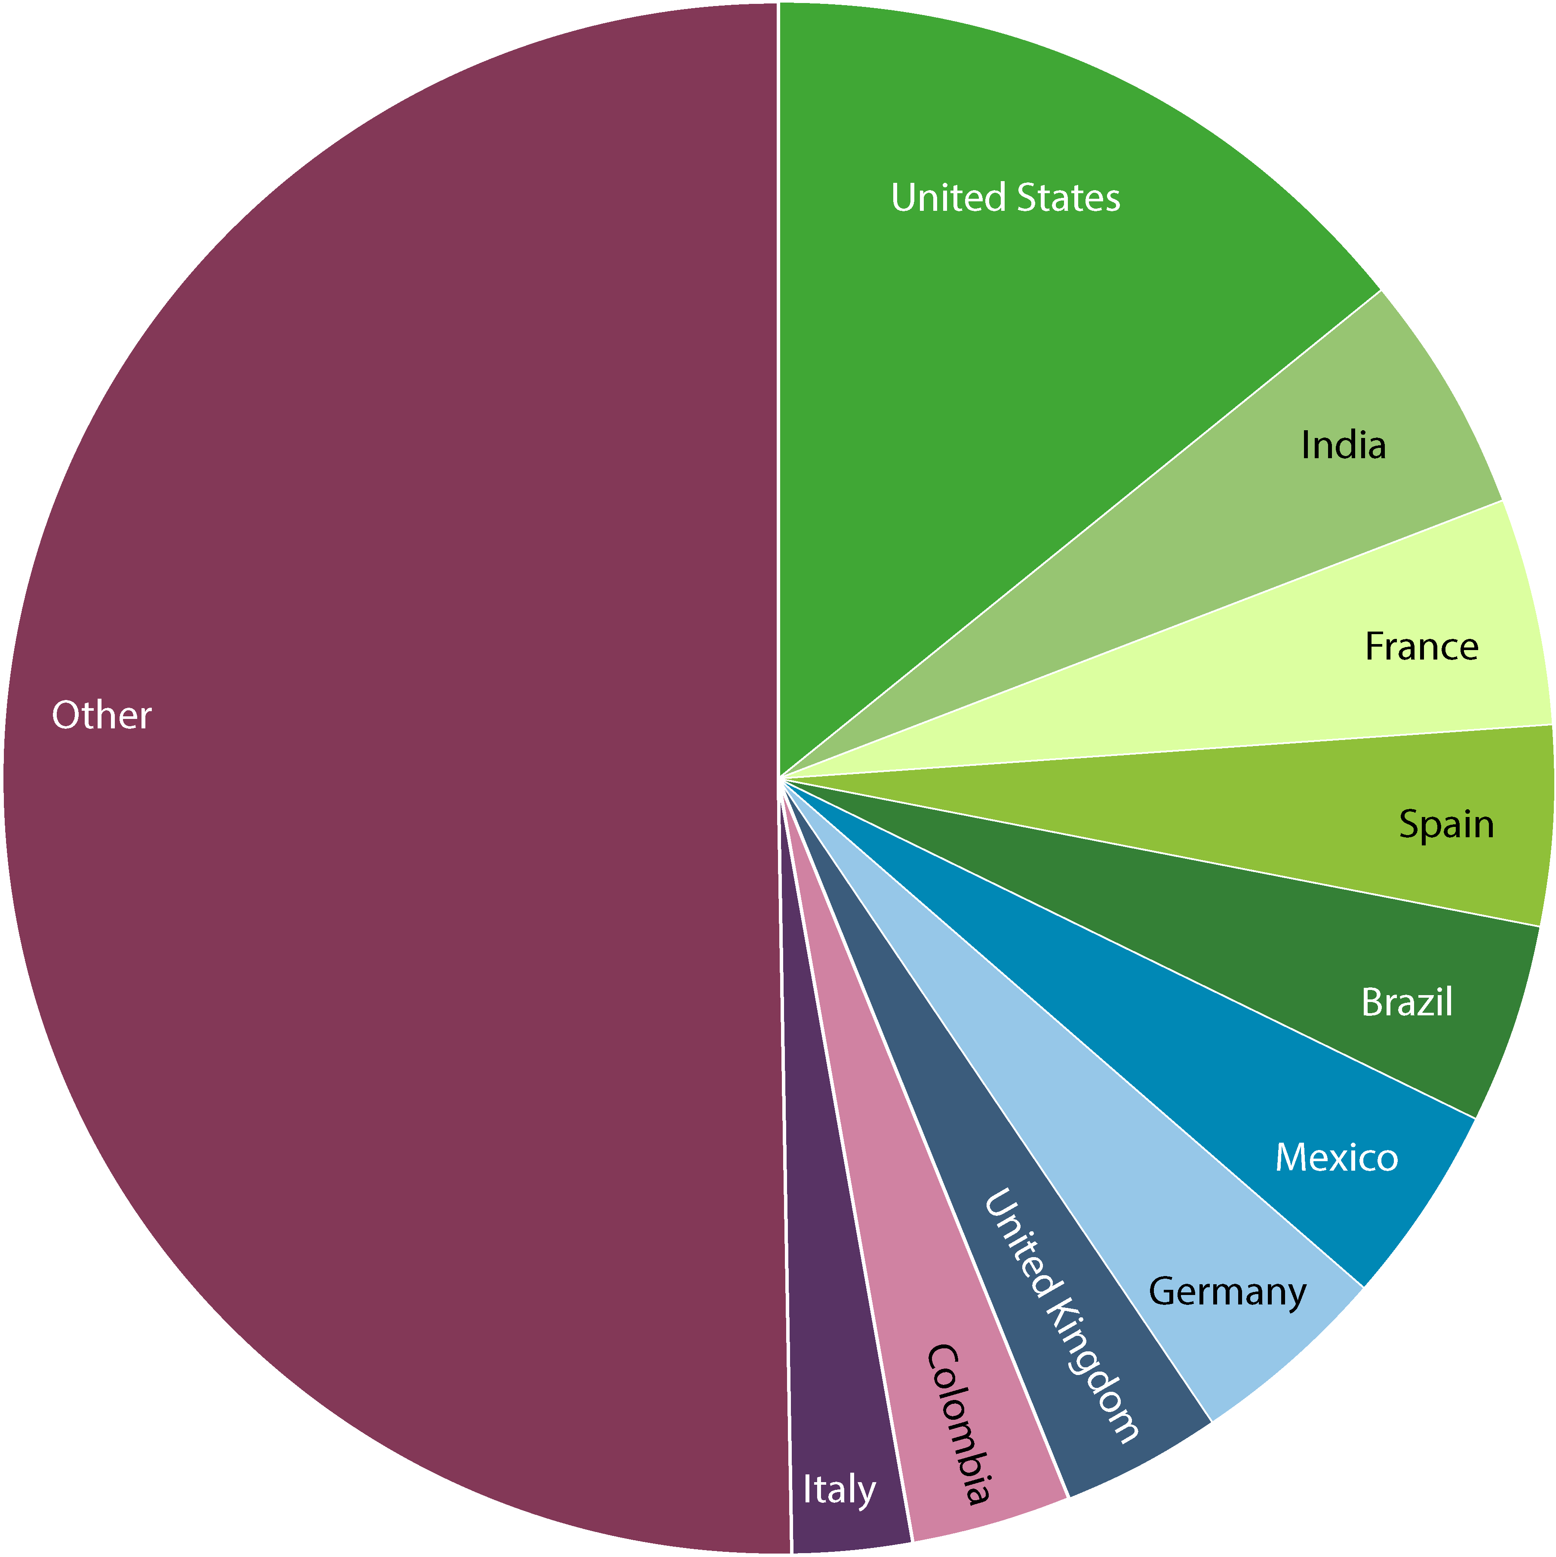
Visits to GBIF.org by Country
use of gbif.org
May 2016
1. United States | 20,354 | 6. Mexico | 5,867
2. India | 7,488 | 7. Germany | 5,763
3. France | 6,477 | 8. United Kingdom | 4,999
4. Spain | 6,162 | 9. Colombia | 4,653
5. Brazil | 6,102 | 10. Italy | 3,586
Access available upon request from comms@gbif.org | 09 JUN 2016

Slide 10
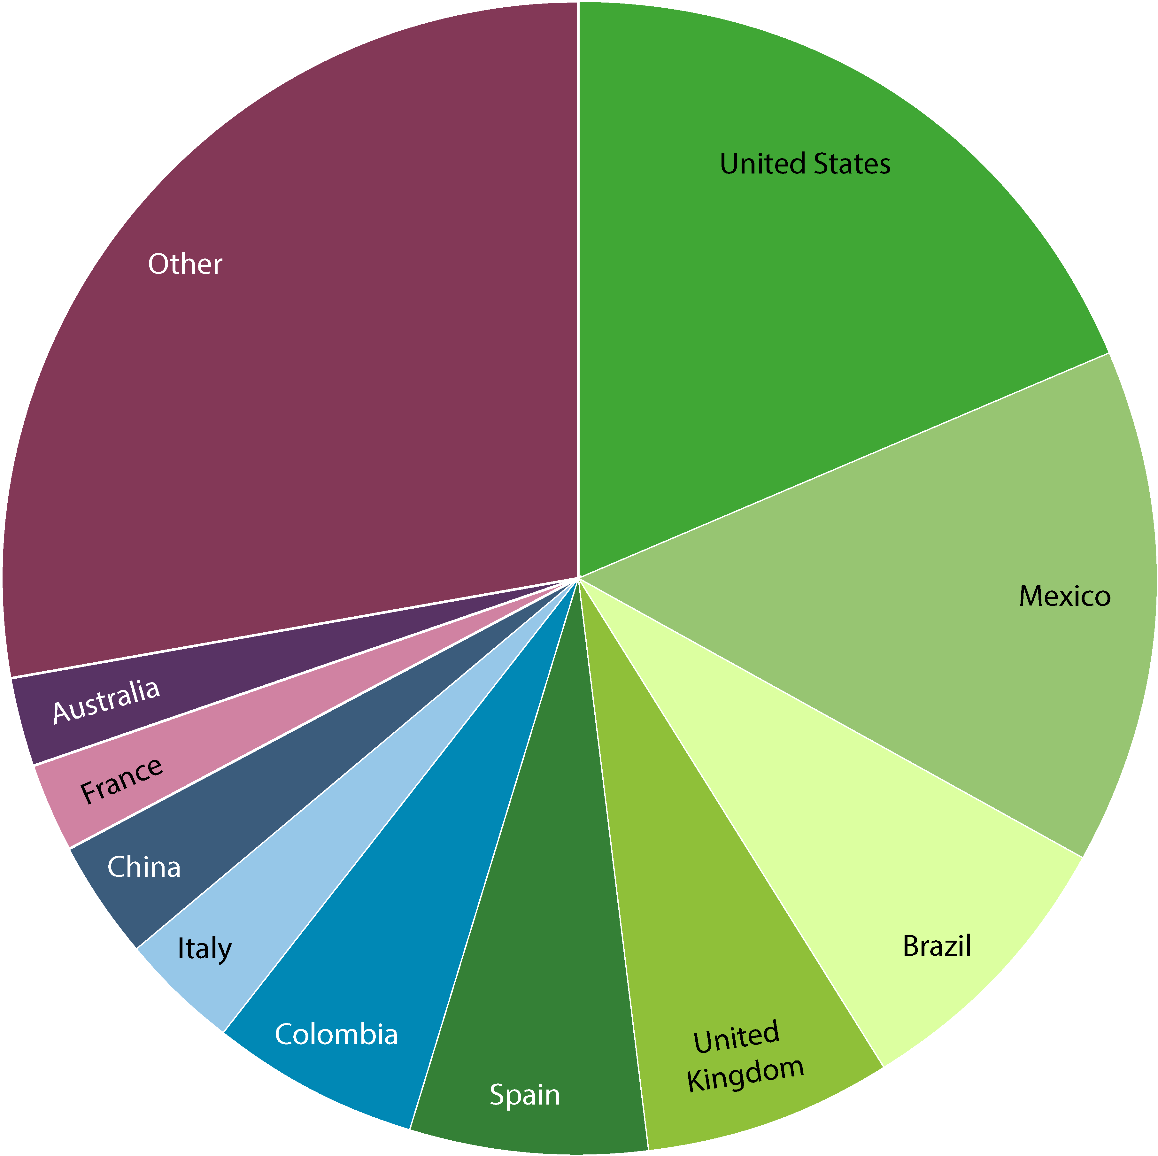
Data download requests, by country
use of gbif.org
1 January – 31 May 2016
Total of
37,552 requests
From 5,131 users in
127 countries, islands and territories
1. United States | 7128 | 6. Colombia | 2235
2. Mexico | 5526 | 7. Italy | 1319
3. Brazil | 3079 | 8. China | 1263
4. United Kingdom | 2670 | 9. France | 949
5. Spain | 2478 | 10. Australia | 858
Requests for download do not necessarily result in data actually being downloaded. Based on country indicated by user login | 06 JUN 2016

Slide 11
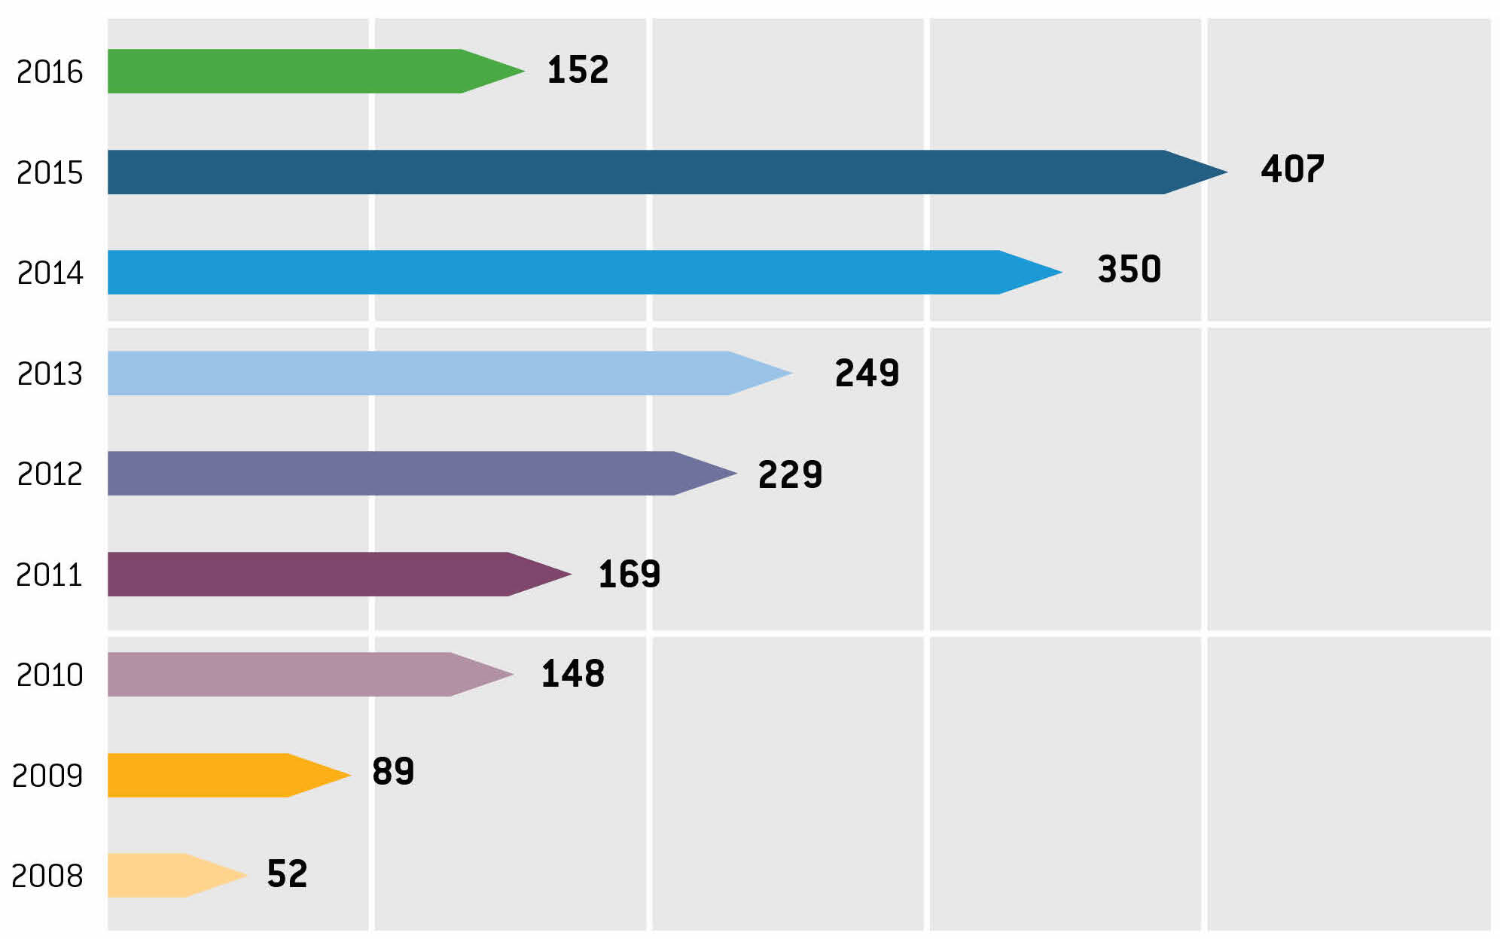
Citations in peer-reviewed research
data use
Annual number of peer-reviewed publications using GBIF-mediated data
9 JUN 2016

Slide 12
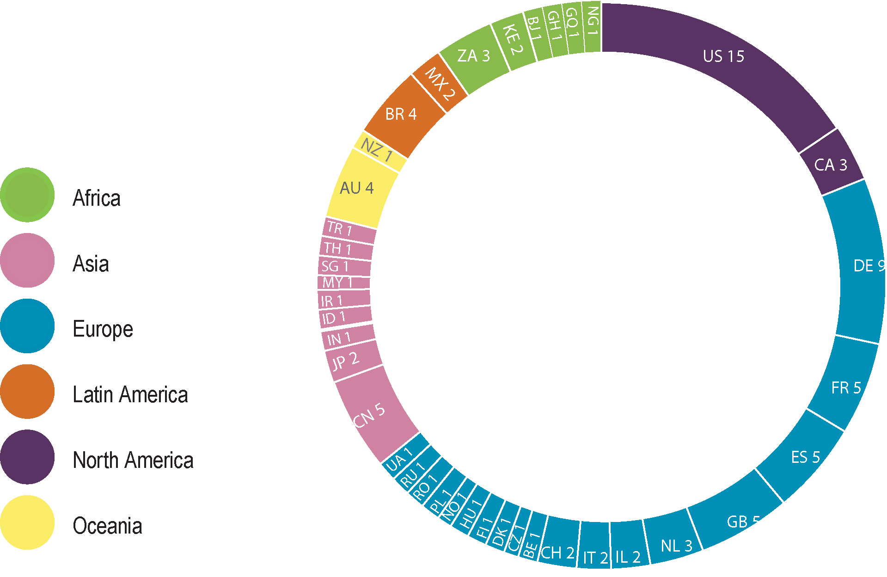
Use citations, by country of authors
research use
May 2016
1. United States | 15 | 7. Australia | 4
2. Germany | 9 | 7. Brazil | 4
3. China | 5 | 9. Canada | 3
3. France | 5 | 9. Netherlands | 3
3. Spain | 5 | 9. South Africa | 3
3. United Kingdom | 5
Number of research publications in May 2016 citing use of
GBIF-mediated data, ranked by country according to affiliation of author.
Top 11 countries shown.
Total 2016
1. United States | 49 | 5. Brazil | 14
2. Germany | 22 | 5. United Kingdom | 14
3. France | 18 | 8. Australia | 11
4. China | 17 | 8. Spain | 11
5. Mexico | 14 | 10. Canada | 10
Indonesia | 1
Malaysia | 1
Singapore | 1
Thailand | 1
Number of research publications in 2016 citing use of GBIF-mediated data, ranked by country according to affiliation of author. Top 10 countries shown.
10 JUN 2016
Notes:
Cambodia KH, Indonesia ID, Laos PDR LA, Malaysia MY, Myanmar MM, Philippines, PH Singapore SG, Thailand TH, Vietnam VN

Slide 13

About GBIF

Slide 14

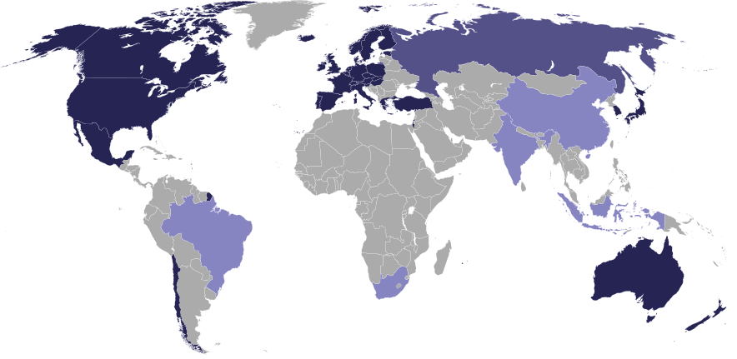

The OECD Origin…
OECD Global Science Forum (1999):
“establish and support a distributed system of interlinked and interoperable modules (databases, software and networking tools, search engines, analytical algorithms, etc.) that together will form a Global Biodiversity Information Facility (GBIF)”.
Notes:
OECD (1999). Final report of the OECD Megascience Forum Working Group on Biological Informatics that in 1999 recommended the creation of a Global Biodiversity Information Facility. Organisation for Economic Co-operation and Development (OECD), Secretariat, Paris, France. Available at http://www.oecd.org/dataoecd/24/32/2105199.pdf, and at http://www.gbif.org/orc/?doc_id=1306, verified 5 November 2012.
http://en.wikipedia.org/wiki/Organisation_for_Economic_Co-operation_and_Development

Slide 15


Biodiversity data infrastructure
The Millennium Ecosystem Assessment (2005) showed that human actions often lead to irreversible losses in the diversity of life, and these losses have been more rapid in the past 50 years than ever before in human history.
Biological diversity is key to resilience – the ability of natural and social systems to adapt to change, and is essential for nearly every aspect of human well-being.
Because human threats to biodiversity occur across large spatial and temporal scales, biodiversity and ecosystem monitoring, forecasting, and risk assessments require data to be organized in a globally-accessible, integrated infrastructure.
GBIF provides this infrastructure.
Notes:
GBIF about, http://www.gbif.org/index.php?id=269, Wilson, 2002; Worm et al., 2006; Duke et al., 2007.
Millennium Ecosystems Assessment, 2005
https://en.wikipedia.org/wiki/Millennium_Ecosystem_Assessment
http://millenniumassessment.org/en/Synthesis.html
http://www.greenfacts.org/en/ecosystems/index.htm

Slide 16

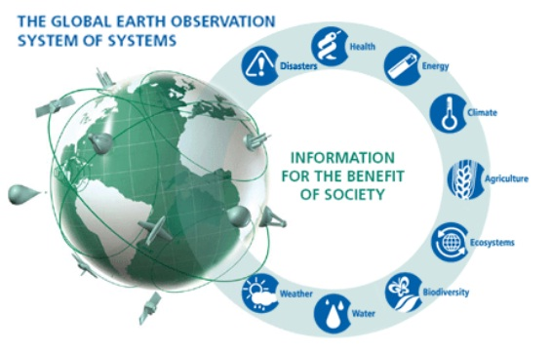


GBIF and GEO
Intergovernmental group on earth observations
GEO BON
Biodiversity observation network
Data Integration & Interoperability
GBIF provides the infrastructure delivering species occurrence data in GEO.
Notes:
GEO BON, http://www.earthobservations.org/geobon.shtml
EU BON, http://www.eubon.eu/
LifeWatch, http://www.lifewatch.eu/

Slide 17



Organizational partnerships
Modified from slide by Donald Hobern
  Taxon names and nomenclature
    Catalog of Life (CoL)
    IPT to publish global and regional species checklists
    GBIF infrastructure to support construction of CoL
  Biodiversity literature
    Biodiversity Heritage Library (BHL)
    User annotations to extract occurrence records
    Link original (and other) descriptions to taxonomy
  Species information and traits
    Encyclopedia of Life (EoL)
    Support EOL as global species information aggregator
    Include EOL summary box on each GBIF species page
Notes:
More specific opportunities in the short to medium term for GBIF to collaborate with global biodiversity informatics projects.
Catalogue of Life, http://www.catalogueoflife.org/
Biodiversity Heritage Library, http://biodiversitylibrary.org/
Encyclopedia of Life, http://www.eol.org/

Slide 18
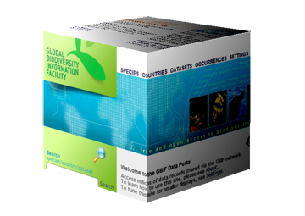
GBIF’s unique role
Modified from slide by Donald Hobern
Registry of biodiversity data resources.
Tools and support for biodiversity data publication.
Network development at national, regional and global levels.
Global virtual natural history collection.
Cross-domain linkage between data from collections, ecology and genomics.
Access to global biodiversity data for GIS analysis and environmental monitoring.
Notes:
Suggested areas in which GBIF’s global mandate gives it a unique responsibility and leadership role.

Slide 19
GBIF participation

Slide 20
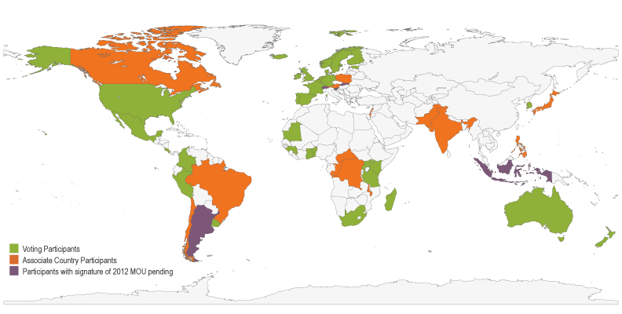
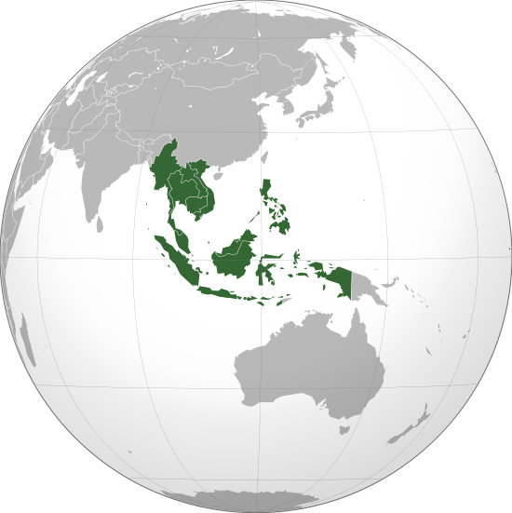
Map of GBIF Country Participants
participation
37 country members
17 Associate countries
39 organizations
Indonesia member since 2004
Philippines member since 2005
Updated 3 May 2016
Notes:
Indonesia member since 2004
Philippines member since 2005

Slide 21
GBIF Participant LisT
participation
May 2016
Voting Participants
Andorra
Argentina *
Australia
Belgium
Benin
Colombia
Costa Rica
Denmark
Estonia
Finland
France
Germany
Ghana
Guinea
Iceland
Ireland
Kenya
Madagascar
Mauritania
Mexico
Netherlands
New Zealand
Norway
Peru
Portugal
Republic of Korea
Slovakia *
Slovenia *
South Africa
Spain
Sweden
Tanzania
Togo
Uganda
United Kingdom
United States
Uruguay
Associate Country Participants
Austria
Brazil
Canada
Central African Republic
Chile
Democratic Republic of Congo
India
Indonesia *
Israel
Japan
Luxembourg
Malawi
Pakistan
Philippines
Poland
Republic of Congo
Switzerland *
Other Associate Participants
ASEAN Centre for Biodiversity (ACB)
Albertine Rift Conservation Society (ARCOS)
Biodiversity Heritage Library
BioNET-Andionet
BioNET-INTERNATIONAL
Bioversity International
Botanic Gardens Conservation International (BGCI)
Canadensys
Chinese Academy of Sciences
Chinese Taipei
Ciencia y Tecnología para el Desarrollo (CYTED)
Consortium for the Barcode of Life (CBOL)
Consortium of European Taxonomic Facilities (CETAF)
Discover Life
Encyclopedia of Life (EOL)
Endangered Wildlife Trust (EWT)
European Environment Agency (EEA)
Horn of Africa Regional Environment Centre and Network (HoA-REC&N)
ICLEI – Local Governments for Sustainability
Inter-American Biodiversity Information Network (IABIN)
Integrated Taxonomic Information System (ITIS)
International Barcode of Life Consortium (iBOL)
International Centre for Insect Physiology and Ecology (ICIPE)
International Centre for Integrated Mountain Development (ICIMOD)
International Long-Term Ecological Research Network (ILTER)
Naturalis Biodiversity Center
Natural Science Collections Alliance (NSCA)
NatureServe
NordGen
Pacific Biodiversity Information Forum (PBIF)
Plazi
Scientific Committee on Antarctic Research (SCAR)
Society for the Preservation of Natural History Collections (SPNHC)
Species 2000
TDWG
UNEP-WCMC
VertNet
Wildscreen
World Federation for Culture Collections (WFCC)
GBIF Affiliates
Data Observation Network for Earth (DataOne)
Intergovernmental Oceanographic Commission of the United Nations Educational, Scientific and Cultural Organisation (IOC/UNESCO)
Conservation of Arctic Flora and Fauna (CAFF)
* Signature of 2012 MoU pending | http://www.gbif.org/participation/list
4 MAY 2016

Slide 22
Sources of funding
support
Agencies contributing to GBIF core funds
Supplementary funding
Andorra | Institute d’estudis Andorrans
Argentina | CONICET – Consejo Nacional de Investigaciones Cientificas y Técnicas
Australia | Atlas of Living Australia, CSIRO National Research Collections Australia
Belgium | Belgian Federal Science Policy Office (belspo)
Benin | Laboratoire des Sciences Forestières
Colombia | Instituto de Investigación de Recursos Biólogicos Alexander von Humboldt
Costa Rica | Asociación Instituto Nacional de Biodiversidad (INBio)
Denmark | The Danish Agency for Science, Technology and Innovation
Estonia | Ministry of Environment
Finland | Academy of Finland
France | Direction Générale pour la Recherche et l’Innovation (DGRI)
Germany | Deutsche Forschungsgemeinschaft (DFG) , German Aerospace Center, BMBF
Ghana | Council for Scientific and Industrial Research (CSIR)
Guinea, Republic of | Ministère de l’Environnement, des Eaux et Forêts
Iceland | Ministry for the Environment and Natural Resources
Ireland | National Parks & Wildlife Service
Kenya | National Museums of Kenya
Madagascar | Centre National de Recherches sur l’Environnement (CNRE)
Mauritania | École Normale Supérieure de Nouakchott
Mexico | Consejo Nacional de Ciencia y Tecnología (CONACYT)
Netherlands | Ministry of Education, Culture and Science
New Zealand | Ministry of Business, Innovation and Employment
Norway | The Research Council of Norway
Peru | Ministerio del Ambiente
Portugal | Foundation for Science and Technology
Republic of Korea | Ministry of Science, ICT and Future Planning
Slovak Republic | Ministry of the Environment
Slovenia | Ministry of Higher Education, Science and Technology
South Africa | Department of Science and Technology
Sweden | Swedish Research Council
Tanzania | Tanzania Commission for Science and Technology (COSTECH)
Togo | Université de Lomé
Uganda | Uganda National Council for Science and Technology
United Kingdom | Department for Environment, Food and Rural Affairs (DEFRA); Natural Environment Research Council (NERC); Royal Botanic Gardens, Kew; Natural History Museum, London; Joint Nature Conservation Committee
United States | National Science Foundation; Smithsonian Institution; U.S. Department of State; U.S. Department of Agriculture
Uruguay | Dirección de Innovación, Ciencia y Tecnología para el Desarrollo (DICYT)
University of Copenhagen (IT equipment)
Biodiversity Information Standards - TDWG
CBD Secretariat (GIASIP, GBO-4)
EMODnet Biology
EU BON
European Union
Eye on Earth
Ministry of the Environment of Japan
NLBIF
*BIFA - Japan
Note on Agencies
Voting Participants that have financially contributed or declared their intention to contribute to GBIF core funds within the period of January 2015 until present. Those shown in bold have paid their contribution for the current year.
Note on Supplementary funding
Projects or agencies that contributed or declared their intention to contribute to GBIF supplementary funds within the period of January 2015 until present.
4 MAY 2016
Notes:
BIFA - http://www.gbif.org/newsroom/news/biodiversity-information-fund-for-asia-announced

Slide 23
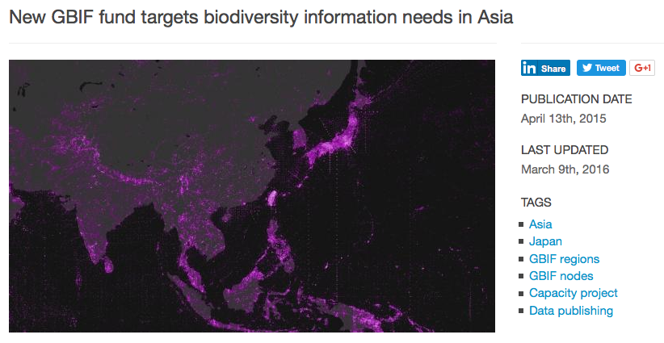
A new fund aims to supplement existing activities of GBIF to support the needs of researchers and policymakers in Asia through mobilization and use of biodiversity data.
The Biodiversity Information Fund for Asia (BIFA) is the outcome of a contribution to GBIF supplementary funds of more than €156,000 from the Japanese government, earmarked for activities in the Asia region.
Notes:
Biodiversity Information Fund for Asia (BIFA)
http://www.gbif.org/programme/bifa
http://www.gbif.org/newsroom/news/biodiversity-information-fund-for-asia-announced (March 9th 2016)
http://www.gbif.org/programme/bifa/2015/ASEAN-heritage-parks (April to August 2016)
http://www.gbif.org/programme/bifa/2015/BI-cookbook (May to June 2016)

Slide 24
ASEAN and GBIF

Slide 25
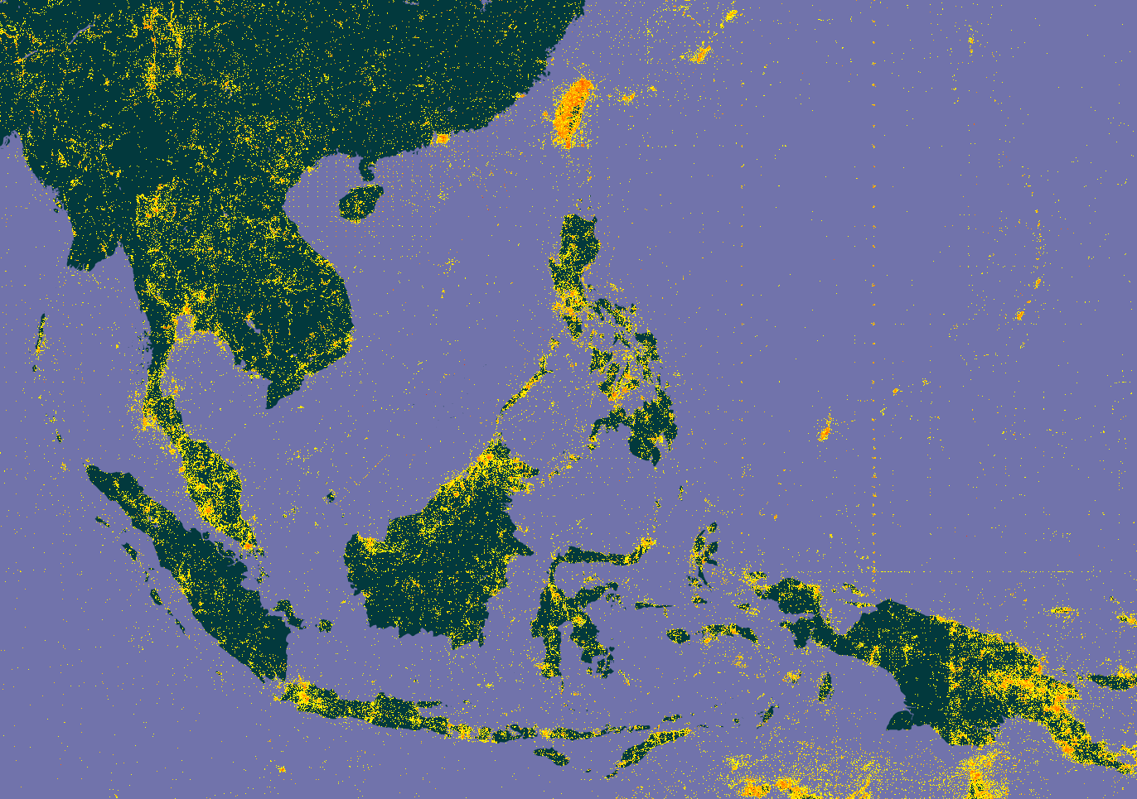
In total 4,7 million species occurrence records published in GBIF with locality in the ASEAN region
Notes:
Indonesia : http://www.gbif.org/country/ID/summary
Thailand : http://www.gbif.org/country/TH/summary
Malaysia : http://www.gbif.org/country/MY/summary
Philippines : http://www.gbif.org/country/PH/summary
Singapore : http://www.gbif.org/country/SG/summary
Vietnam : http://www.gbif.org/country/VN/summary
Brunei Darussalem : http://www.gbif.org/country/BN/summary
Laos PDR : http://www.gbif.org/country/LA/summary
Cambodia : http://www.gbif.org/country/KH/summary
Myanmar : http://www.gbif.org/country/MM/summary
In total 2 datasets and 554 occurrence records published in GBIF from ASEAN countries
In total 4,7 million species occurrence records published in GBIF with locality in the ASEAN region

Slide 26
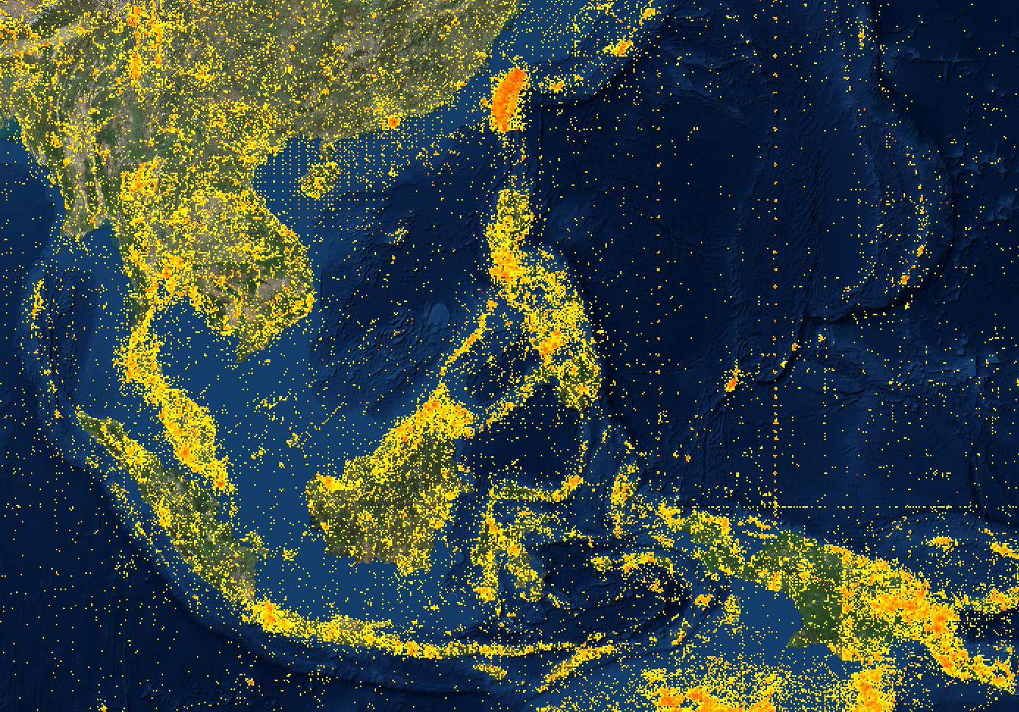
Countries publishing data located in the ASEAN region
Country | Occurrences
United States | 2 641 535
Netherlands | 1 421 999
United Kingdom | 957 481
France | 609 039
Japan | 201 121
Australia | 155 220
Germany | 128 610
etc … | …
Notes:
Indonesia : http://www.gbif.org/country/ID/summary
Thailand : http://www.gbif.org/country/TH/summary
Malaysia : http://www.gbif.org/country/MY/summary
Philippines : http://www.gbif.org/country/PH/summary
Singapore : http://www.gbif.org/country/SG/summary
Vietnam : http://www.gbif.org/country/VN/summary
Brunei Darussalem : http://www.gbif.org/country/BN/summary
Laos PDR : http://www.gbif.org/country/LA/summary
Cambodia : http://www.gbif.org/country/KH/summary
Myanmar : http://www.gbif.org/country/MM/summary
In total 2 datasets and 554 occurrence records published in GBIF from ASEAN countries
In total 4,7 million species occurrence records published in GBIF with locality in the ASEAN region
--
Countries publishing data about, located in the ASEAN region
USA 2641535
Netherlands 1421999
UK 957481
France 609039
Japan 201121
Australia 155220
Germany 128610
Sweden 93936
Canada 91177
--
Brunei
Netherlands 15,580 occurrences, 28.69% geo-referenced.
United Kingdom 9,572 occurrences, 75.13% geo-referenced.
United States 4,696 occurrences, 37.50% geo-referenced.
Australia 1,497 occurrences, 67.54% geo-referenced.
Germany 253 occurrences, 64.03% geo-referenced.
Japan 127 occurrences, 77.95% geo-referenced.
--
Cambodia
United States 48,468 occurrences, 85.80% geo-referenced.
France 42,662 occurrences, 15.82% geo-referenced.
United Kingdom 5,341 occurrences, 39.75% geo-referenced.
Netherlands 3,320 occurrences, 18.13% geo-referenced.
Japan 1,784 occurrences, 23.37% geo-referenced.
Australia 821 occurrences, 87.09% geo-referenced.
--
Indonesia
Netherlands 918,016 occurrences, 19.61% geo-referenced.
United States 520,598 occurrences, 47.58% geo-referenced.
United Kingdom 222,625 occurrences, 53.30% geo-referenced.
Australia 93,148 occurrences, 79.81% geo-referenced.
France 91,953 occurrences, 27.02% geo-referenced.
Germany 37,214 occurrences, 27.66% geo-referenced.
--
Laos PDR
United States 37,017 occurrences, 45.77% geo-referenced.
France 32,655 occurrences, 5.73% geo-referenced.
United Kingdom 19,873 occurrences, 18.40% geo-referenced.
Netherlands 7,098 occurrences, 48.46% geo-referenced.
Australia 4,631 occurrences, 93.91% geo-referenced.
Germany 3,049 occurrences, 60.81% geo-referenced.
--
Malaysia
United States 387,877 occurrences, 54.07% geo-referenced.
United Kingdom 235,067 occurrences, 42.42% geo-referenced.
Netherlands 216,988 occurrences, 15.84% geo-referenced.
France 26,738 occurrences, 6.84% geo-referenced.
Japan 17,748 occurrences, 3.34% geo-referenced.
Australia 17,258 occurrences, 59.67% geo-referenced.
--
Myanmar
United States 101,351 occurrences, 64.85% geo-referenced.
United Kingdom 50,406 occurrences, 12.36% geo-referenced.
Sweden 6,018 occurrences, 5.50% geo-referenced.
France 4,784 occurrences, 4.10% geo-referenced.
Netherlands 3,651 occurrences, 5.67% geo-referenced.
Germany 2,911 occurrences, 41.29% geo-referenced.
--
Philippines
United States 942,498 occurrences, 37.54% geo-referenced.
France 176,606 occurrences, 78.77% geo-referenced.
Netherlands 123,444 occurrences, 24.37% geo-referenced.
United Kingdom 102,210 occurrences, 46.30% geo-referenced.
Sweden 37,508 occurrences, 16.69% geo-referenced.
Germany 36,947 occurrences, 56.89% geo-referenced.
--
Singapore
United States 57,267 occurrences, 73.50% geo-referenced.
United Kingdom 21,130 occurrences, 28.99% geo-referenced.
Netherlands 5,537 occurrences, 6.28% geo-referenced.
Australia 2,651 occurrences, 69.03% geo-referenced.
Germany 2,379 occurrences, 62.46% geo-referenced.
France 2,254 occurrences, 10.20% geo-referenced.
--
Thailand
United States 404,764 occurrences, 70.59% geo-referenced.
United Kingdom 265,199 occurrences, 74.64% geo-referenced.
Japan 114,223 occurrences, 0.69% geo-referenced.
Netherlands 109,722 occurrences, 23.45% geo-referenced.
France 44,708 occurrences, 18.18% geo-referenced.
Germany 15,086 occurrences, 30.94% geo-referenced.
--
Vietnam
France 186,598 occurrences, 5.15% geo-referenced.
United States 136,999 occurrences, 65.04% geo-referenced.
Canada 48,148 occurrences, 90.19% geo-referenced.
United Kingdom 26,058 occurrences, 25.36% geo-referenced.
Netherlands 18,643 occurrences, 21.87% geo-referenced.
Germany 14,488 occurrences, 84.12% geo-referenced.
--

Slide 27
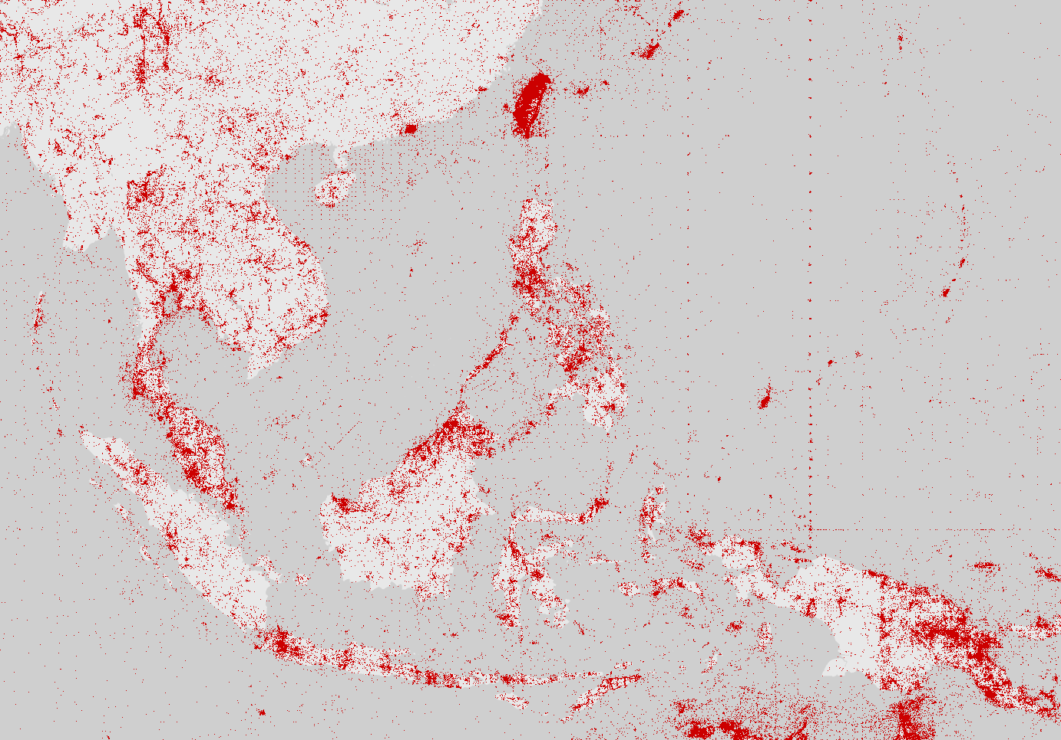
Philippines GBIF member since 2005
Indonesia GBIF member since 2004
Notes:
Indonesia : http://www.gbif.org/country/ID/summary
Thailand : http://www.gbif.org/country/TH/summary
Malaysia : http://www.gbif.org/country/MY/summary
Philippines : http://www.gbif.org/country/PH/summary
Singapore : http://www.gbif.org/country/SG/summary
Vietnam : http://www.gbif.org/country/VN/summary
Brunei Darussalem : http://www.gbif.org/country/BN/summary
Laos PDR : http://www.gbif.org/country/LA/summary
Cambodia : http://www.gbif.org/country/KH/summary
Myanmar : http://www.gbif.org/country/MM/summary
In total 2 datasets and 554 occurrence records published in GBIF from ASEAN countries
In total 4,7 million species occurrence records published in GBIF with locality in the ASEAN region

Slide 28
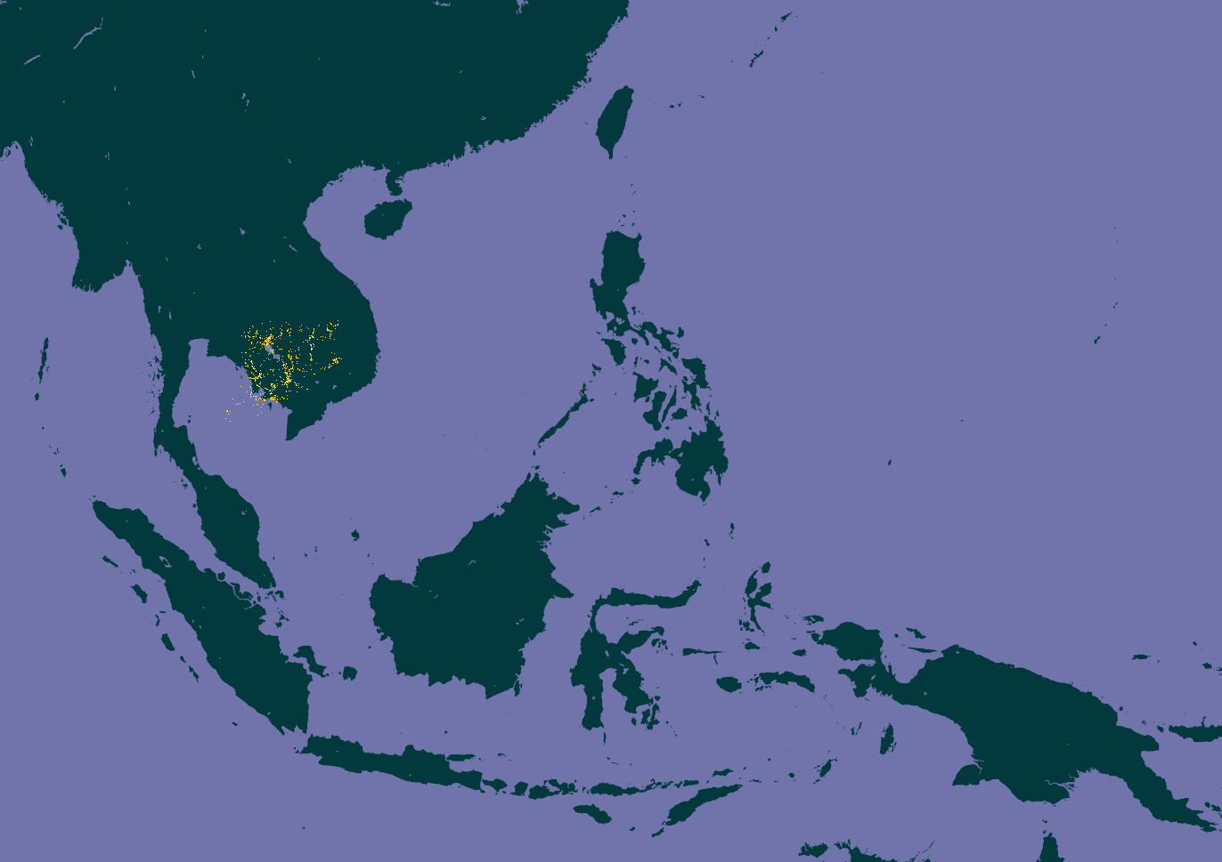
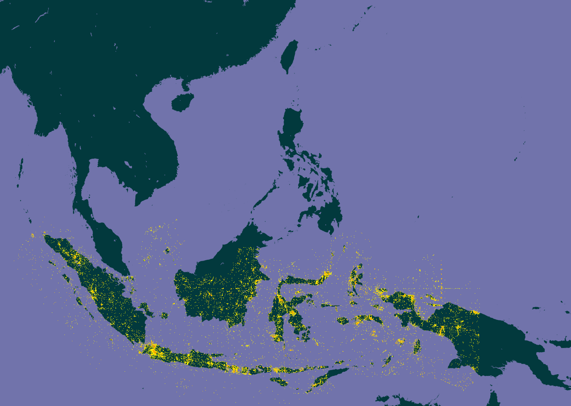
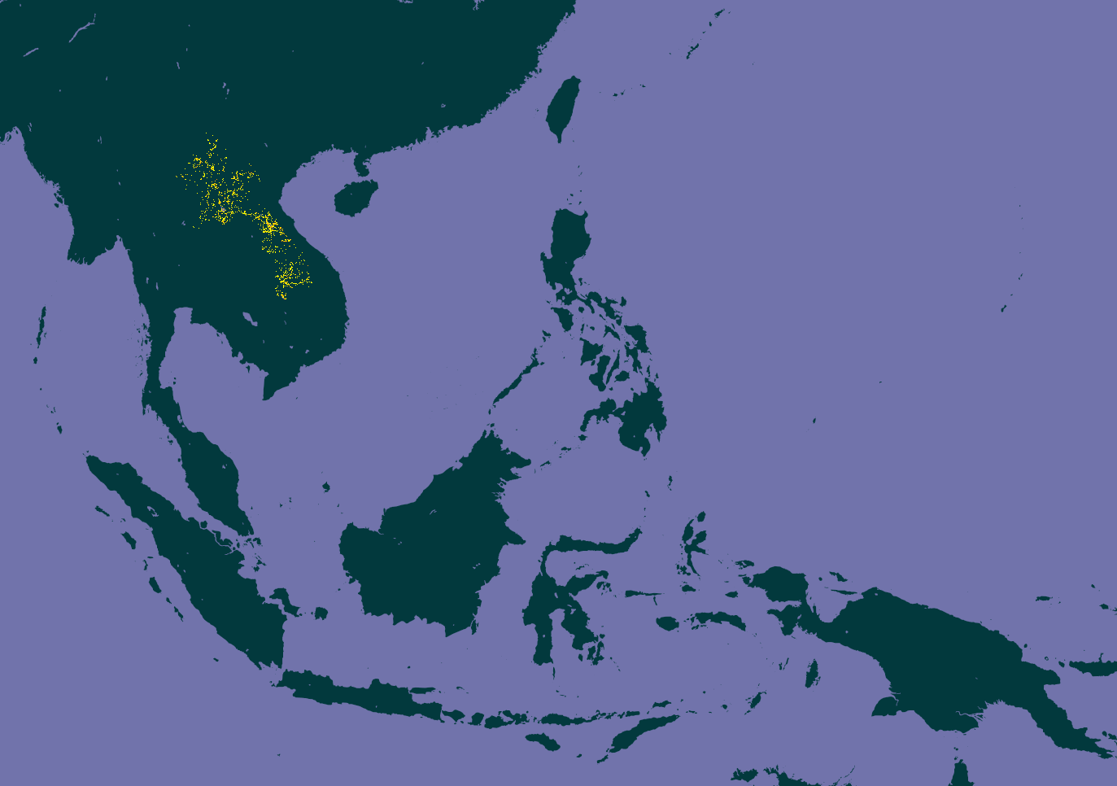

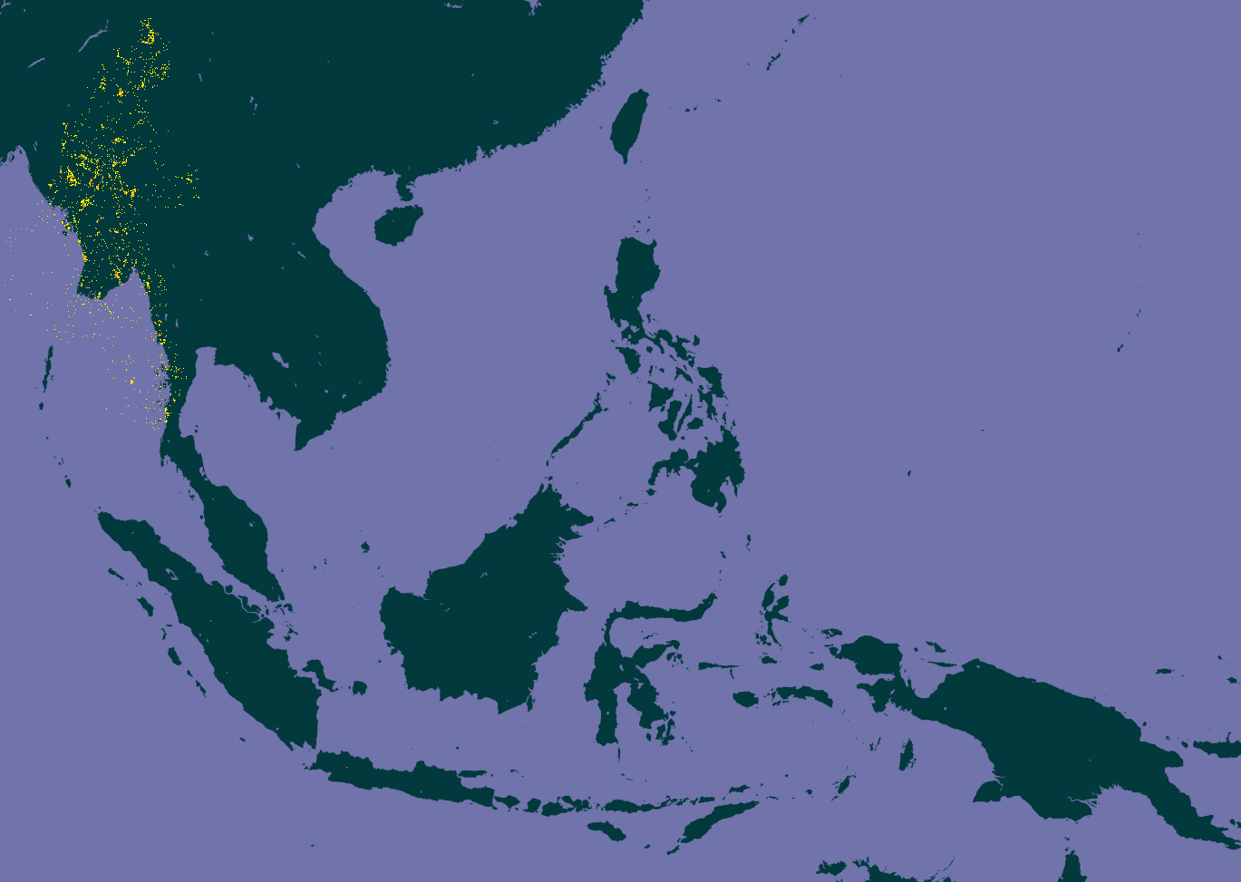
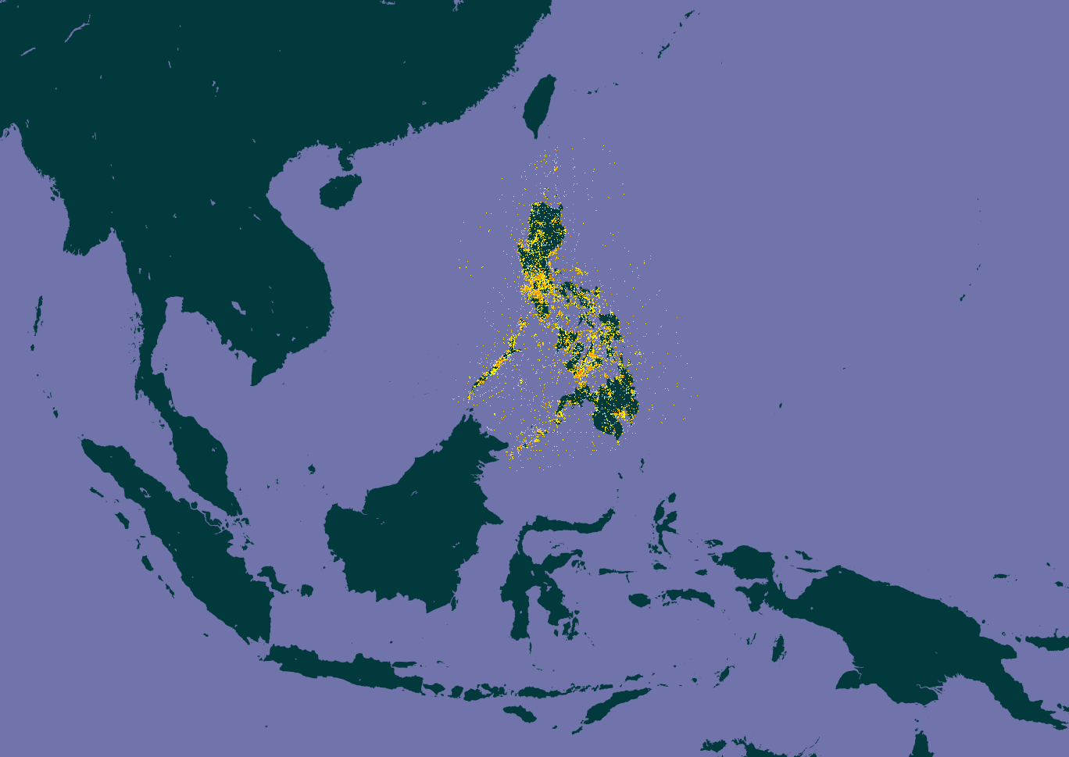
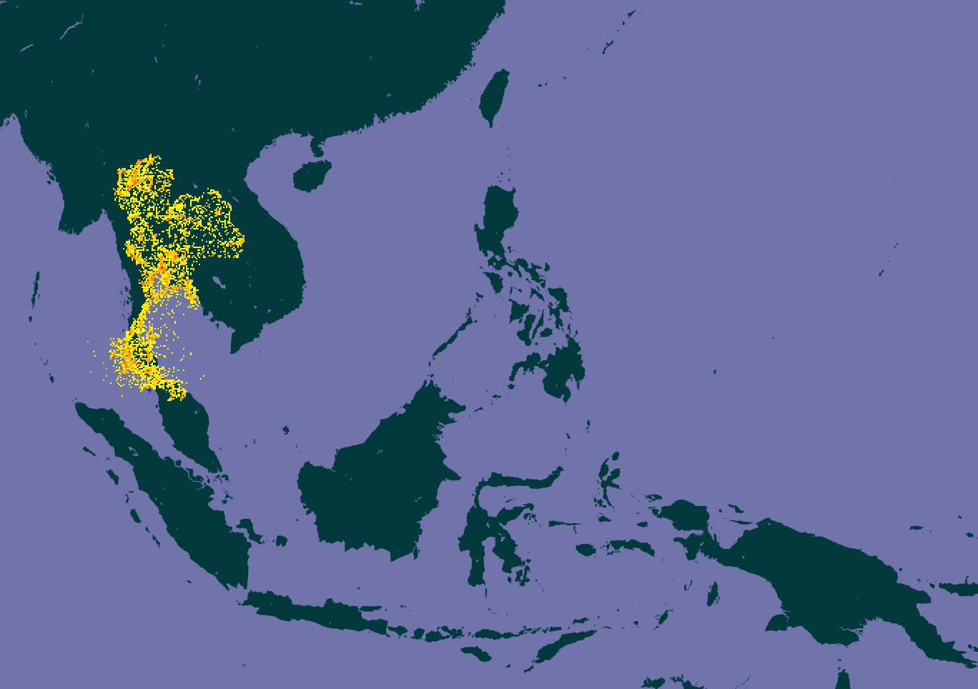

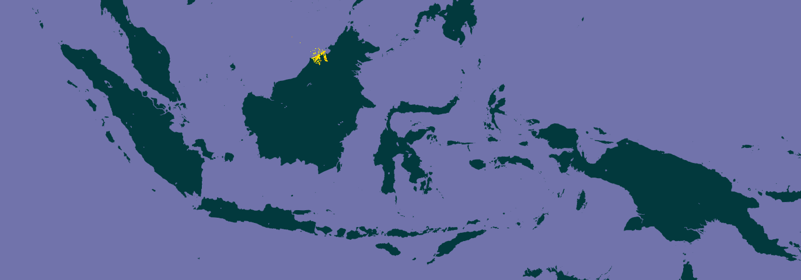

Cambodia
62 513 occ.
Indonesia*
1 619 100 occ.
Lao PDR
75 381 occ.
Malaysia
698 996 occ.
Myanmar
109 491 occ.
Philippines*
943 552 occ.
Brunei
25 326 occ.
Thailand
833 983 occ.
Viet Nam
244 567 occ.
Singapore
71 524 occ.
Notes:
Indonesia : http://www.gbif.org/country/ID/summary
Thailand : http://www.gbif.org/country/TH/summary
Malaysia : http://www.gbif.org/country/MY/summary
Philippines : http://www.gbif.org/country/PH/summary
Singapore : http://www.gbif.org/country/SG/summary
Vietnam : http://www.gbif.org/country/VN/summary
Brunei Darussalem : http://www.gbif.org/country/BN/summary
Laos PDR : http://www.gbif.org/country/LA/summary
Cambodia : http://www.gbif.org/country/KH/summary
Myanmar : http://www.gbif.org/country/MM/summary
In total 2 datasets and 554 occurrence records published in GBIF from ASEAN countries
In total 4,7 million species occurrence records published in GBIF with locality in the ASEAN region
--
Brunei
Netherlands 15,580 occurrences, 28.69% geo-referenced.
United Kingdom 9,572 occurrences, 75.13% geo-referenced.
United States 4,696 occurrences, 37.50% geo-referenced.
Australia 1,497 occurrences, 67.54% geo-referenced.
Germany 253 occurrences, 64.03% geo-referenced.
Japan 127 occurrences, 77.95% geo-referenced.
--
Cambodia
United States 48,468 occurrences, 85.80% geo-referenced.
France 42,662 occurrences, 15.82% geo-referenced.
United Kingdom 5,341 occurrences, 39.75% geo-referenced.
Netherlands 3,320 occurrences, 18.13% geo-referenced.
Japan 1,784 occurrences, 23.37% geo-referenced.
Australia 821 occurrences, 87.09% geo-referenced.
--
Indonesia
Netherlands 918,016 occurrences, 19.61% geo-referenced.
United States 520,598 occurrences, 47.58% geo-referenced.
United Kingdom 222,625 occurrences, 53.30% geo-referenced.
Australia 93,148 occurrences, 79.81% geo-referenced.
France 91,953 occurrences, 27.02% geo-referenced.
Germany 37,214 occurrences, 27.66% geo-referenced.
--
Laos PDR
United States 37,017 occurrences, 45.77% geo-referenced.
France 32,655 occurrences, 5.73% geo-referenced.
United Kingdom 19,873 occurrences, 18.40% geo-referenced.
Netherlands 7,098 occurrences, 48.46% geo-referenced.
Australia 4,631 occurrences, 93.91% geo-referenced.
Germany 3,049 occurrences, 60.81% geo-referenced.
--
Malaysia
United States 387,877 occurrences, 54.07% geo-referenced.
United Kingdom 235,067 occurrences, 42.42% geo-referenced.
Netherlands 216,988 occurrences, 15.84% geo-referenced.
France 26,738 occurrences, 6.84% geo-referenced.
Japan 17,748 occurrences, 3.34% geo-referenced.
Australia 17,258 occurrences, 59.67% geo-referenced.
--
Myanmar
United States 101,351 occurrences, 64.85% geo-referenced.
United Kingdom 50,406 occurrences, 12.36% geo-referenced.
Sweden 6,018 occurrences, 5.50% geo-referenced.
France 4,784 occurrences, 4.10% geo-referenced.
Netherlands 3,651 occurrences, 5.67% geo-referenced.
Germany 2,911 occurrences, 41.29% geo-referenced.
--
Philippines
United States 942,498 occurrences, 37.54% geo-referenced.
France 176,606 occurrences, 78.77% geo-referenced.
Netherlands 123,444 occurrences, 24.37% geo-referenced.
United Kingdom 102,210 occurrences, 46.30% geo-referenced.
Sweden 37,508 occurrences, 16.69% geo-referenced.
Germany 36,947 occurrences, 56.89% geo-referenced.
--
Singapore
United States 57,267 occurrences, 73.50% geo-referenced.
United Kingdom 21,130 occurrences, 28.99% geo-referenced.
Netherlands 5,537 occurrences, 6.28% geo-referenced.
Australia 2,651 occurrences, 69.03% geo-referenced.
Germany 2,379 occurrences, 62.46% geo-referenced.
France 2,254 occurrences, 10.20% geo-referenced.
--
Thailand
United States 404,764 occurrences, 70.59% geo-referenced.
United Kingdom 265,199 occurrences, 74.64% geo-referenced.
Japan 114,223 occurrences, 0.69% geo-referenced.
Netherlands 109,722 occurrences, 23.45% geo-referenced.
France 44,708 occurrences, 18.18% geo-referenced.
Germany 15,086 occurrences, 30.94% geo-referenced.
--
Vietnam
France 186,598 occurrences, 5.15% geo-referenced.
United States 136,999 occurrences, 65.04% geo-referenced.
Canada 48,148 occurrences, 90.19% geo-referenced.
United Kingdom 26,058 occurrences, 25.36% geo-referenced.
Netherlands 18,643 occurrences, 21.87% geo-referenced.
Germany 14,488 occurrences, 84.12% geo-referenced.
--

Slide 29
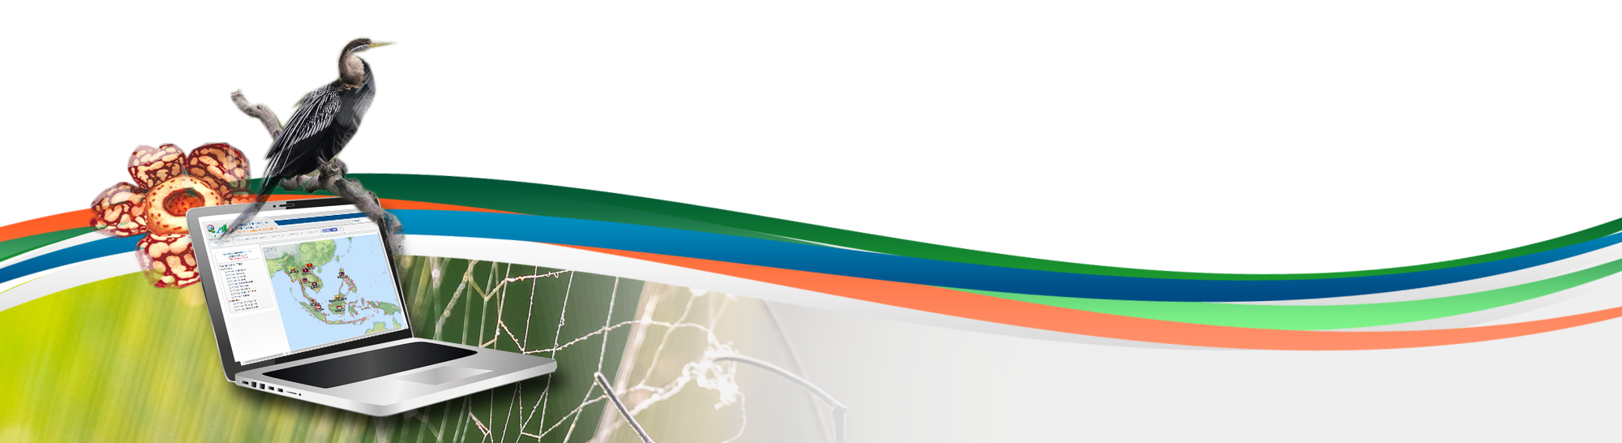
Data publishing workshop
Introduction to GBIF
First day 4th July 2016
Los Baños, Laguna, Philippines
Dag Endresen, GBIF Norway, UiO

