Slide 1





Data publishing workshop
GBIF data publishing
Second day 5th July 2016
Los Baños, Laguna, Philippines
Dag Endresen, GBIF Norway, UiO
Notes:
GBIF/BIFA data publishing workshop, 4-8 July 2016, ASEAN Heritage Parks, ASEAN Centre for Biodiversity, Los Baños, Laguna, Philippines
Slides CC-BY/CC0 Dag Endresen, Global Biodiversity Information Facility (GBIF) in Norway, UiO Natural History Museum in Oslo, University of Oslo (feel free to reuse slides)
Day 2: 5th July 2016: The GBIF Facility –GBIF biodiversity data publishing with IPT (2016-07-05, 08:50 – 09:20, 30 minutes)
Mobilizing biodiversity data from ASEAN protected areas
The goal of this project is to facilitate the mobilization of biodiversity information from the Association of Southeast Asian Nations (ASEAN) Heritage Parks – regionally significant protected areas for biodiversity.
At present, biodiversity data collected from park surveys are documented through various means and do not always conform to global standards. A workshop for selected park management staff will strengthen their skills in biodiversity information management and data publishing through hands-on exercises using datasets from the heritage parks. This project will also orient heritage park staff towards monitoring sites with camera traps, and prepare them for the publishing of sample-based data in the future.
The outcome of the project will be an increase in the availability and access to data from the protected areas, to assist policy development.
http://www.gbif.org/programme/bifa/2015/ASEAN-heritage-parks
Slide source: GB23 Nodes Madagascar October 2015, http://community.gbif.org/pg/pages/view/47903/ & Norwegian GBIF data publishing workshop in Trondheim October 2015, http://www.gbif.no/events/2015/data-publishing-workshop-october-2015.html

Slide 2

Topics
Darwin Core standard
Darwin Core archives data exchange format
Occurrence, Event and Taxon cores
Data profiles in GBIF at rs.gbif.org
What is the GBIF Integrated data Publishing Toolkit?
Download data from GBIF

Slide 3
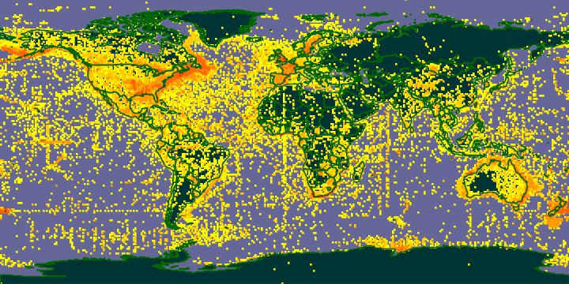
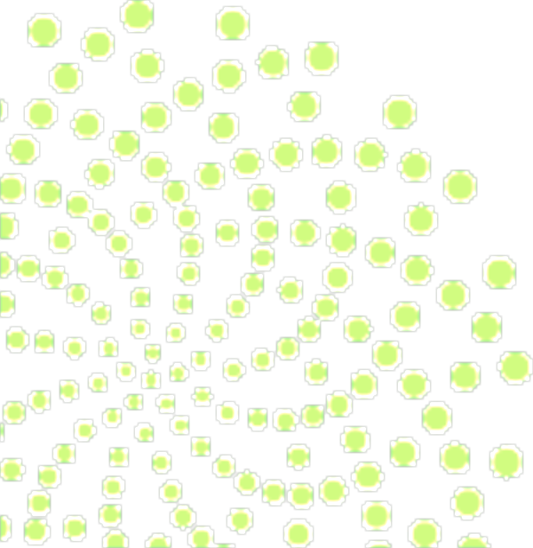
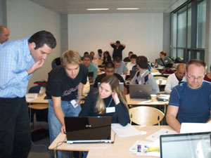
GBIF provides three core services and products:
Information infrastructure – an Internet-based index of a globally distributed network of interoperable databases that contain primary biodiversity data.
Community-developed tools, standards and protocols – the tools data providers need to format and share their data.
Capacity-building and training – and access to a global expert community.
Notes:
About GBIF: http://www.gbif.org/index.php?id=269, verified 5 November 2012.

Slide 4
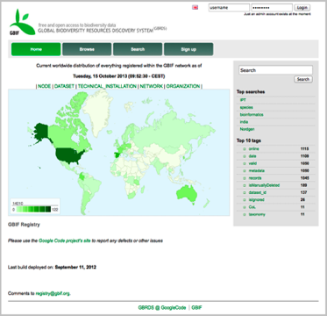
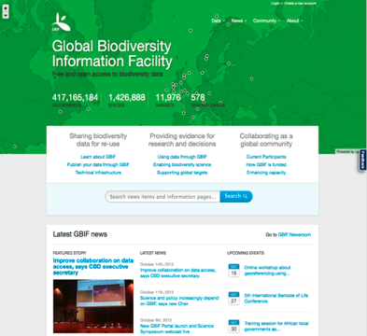
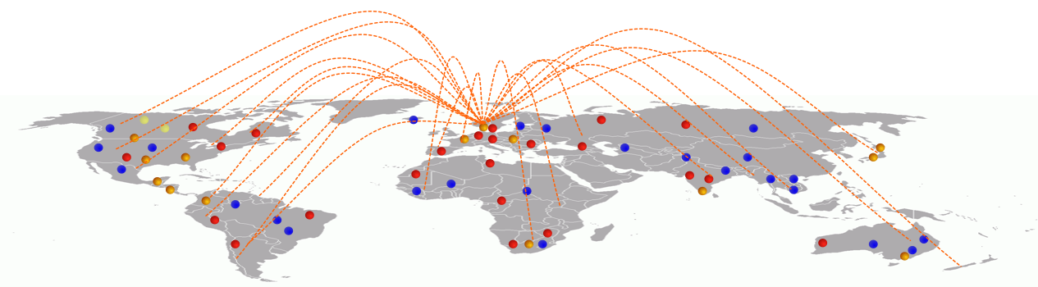
GBIF provides a data discovery system
that is dependent on resolvable stable identifiers for efficient functionality
global registry
data portal
Notes:
GBIF is dependent on resolvable and stable identifiers for efficient functionality. Identifiers for occurrences and for datasets etc.

Slide 5



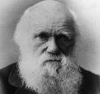

Darwin Core

Slide 6

Data Standards
ABCD Access to Biological Collection Data (2005)
DwC Darwin Core (2009)
AC Audubon Core Multimedia Resources Metadata Schema (2013)
NCD Natural Collection Descriptions
(Draft 2008)
EML Ecological Metadata Language
(Ecological Society of America)
Slide source: GB23 Nodes Madagascar October 2015 & iDigBio Florida January 2015 - http://www.tdwg.org/standards/
Notes:
Slide source: GB23 Nodes Madagascar October 2015, http://community.gbif.org/pg/pages/view/47903/ & Modified from 1B Publishing Primary Biodiversity Data by Alberto González-Talaván^{1~} Data Sharing, Data Standards, and Demystifying the IPT ~ Gainesville, FL, USA. 13 January 2015
Biodiversity Information Standards (TDWG), also known as the Taxonomic Databases Working Group, is a not for profit scientific and educational association that is affiliated with the International Union of Biological Sciences.
TDWG was formed to establish international collaboration among biological database projects. TDWG promoted the wider and more effective dissemination of information about the World's heritage of biological organisms for the benefit of the world at large. Biodiversity Information Standards (TDWG) now focuses on the development of standards for the exchange of biological/biodiversity data.
Our Mission
Develop, adopt and promote standards and guidelines for the recording and exchange of data about organisms
Promote the use of standards through the most appropriate and effective means and
Act as a forum for discussion through holding meetings and through publications
--
Ecological Metadata Language (EML)
https://knb.ecoinformatics.org/#external//emlparser/docs/index.html
https://en.wikipedia.org/wiki/Ecological_Metadata_Language
http://www.tdwg.org/activities/osr/obs/
--
Natural History Collections (NCD)
http://www.tdwg.org/standards/312
https://github.com/tdwg/ncd
http://www.tdwg.org/activities/ncd/
--
Audubon Core
http://www.tdwg.org/standards/638
https://github.com/tdwg/ac
--

Slide 7

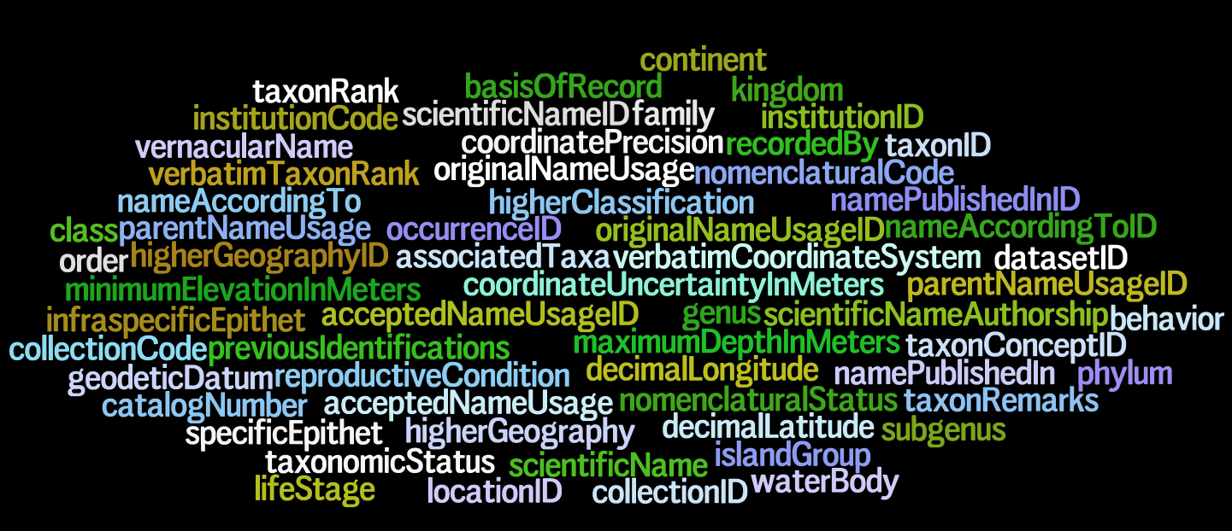
Darwin Core – a glossary of terms
Wieczorek J, Bloom D, Guralnick R, Blum S, Döring M, De Giovanni R, Robertson T, and Vieglais D (2012) Darwin Core: An Evolving Community-Developed Biodiversity Data Standard. PLoS ONE 7(1): e29715. doi:10.1371/journal.pone.0029715
Notes:
Wieczorek, John; D. Bloom, R. Guralnick, S. Blum, M. Döring, R. De Giovanni, T. Robertson, and D. Vieglais (2012) Darwin Core: An Evolving Community-Developed Biodiversity Data Standard. PLoS ONE 7(1): e29715. doi:10.1371/journal.pone.0029715
It includes a glossary of terms intended to facilitate the sharing of information about biological diversity by providing reference definitions, examples, and commentaries.
It is primarily based on taxa, their occurrence in nature as documented by observations, specimens, and samples, and related information.

Slide 8
Record-level Terms
dcterms:type | dcterms:modified | dcterms:language | dcterms:rights | dcterms:rightsHolder | dcterms:accessRights | dcterms:bibliographicCitation | dcterms:references | institutionID | collectionID | datasetID | institutionCode | collectionCode | datasetName | ownerInstitutionCode | basisOfRecord | informationWithheld | dataGeneralizations | dynamicProperties
Occurrence
occurrenceID | catalogNumber | recordNumber | recordedBy | individualCount | organismQuantity | organismQuantityType | sex | lifeStage | reproductiveCondition | behavior | establishmentMeans | occurrenceStatus | preparations | disposition | associatedMedia | associatedReferences | associatedSequences | associatedTaxa | otherCatalogNumbers | occurrenceRemarks
Organism
organismID | organismName | organismScope | assocoatedOccurrences | associatedOrganisms | previousIdentifications | organismRemarks
MaterialSample | LivingSpecimen | PreservedSpecimen | FossilSpecimen
materialSampleID
Event | HumanObservation | MachineObservation
eventID | parentEventID | fieldNumber | eventDate | eventTime | startDayOfYear | endDayOfYear | year | month | day | verbatimEventDate | habitat | samplingProtocol | sampleSizeValue | sampleSizeUnit | samplingEffort | fieldNotes | eventRemarks
Location
locationID | higherGeographyID | higherGeography | continent | waterBody | islandGroup | island | country | countryCode | stateProvince | county | municipality | locality | verbatimLocality | verbatimElevation | minimumElevationInMeters | maximumElevationInMeters | verbatimDepth | minimumDepthInMeters | maximumDepthInMeters | minimumDistanceAboveSurfaceInMeters | maximumDistanceAboveSurfaceInMeters | locationAccordingTo | locationRemarks | verbatimCoordinates | verbatimLatitude | verbatimLongitude | verbatimCoordinateSystem | verbatimSRS | decimalLatitude | decimalLongitude | geodeticDatum | coordinateUncertaintyInMeters | coordinatePrecision | pointRadiusSpatialFit | footprintWKT | footprintSRS | footprintSpatialFit | georeferencedBy | georeferencedDate | georeferenceProtocol | georeferenceSources | georeferenceVerificationStatus | georeferenceRemarks
GeologicalContext
geologicalContextID | earliestEonOrLowestEonothem | latestEonOrHighestEonothem | earliestEraOrLowestErathem | latestEraOrHighestErathem | earliestPeriodOrLowestSystem | latestPeriodOrHighestSystem | earliestEpochOrLowestSeries | latestEpochOrHighestSeries | earliestAgeOrLowestStage | latestAgeOrHighestStage | lowestBiostratigraphicZone | highestBiostratigraphicZone | lithostratigraphicTerms | group | formation | member | bed
Identification
identificationID | identifiedBy | typeStatus | identificationQualifier | dateIdentified | identificationReferences | identificationVerificationStatus | identificationRemarks
Taxon
taxonID | scientificNameID | acceptedNameUsageID | parentNameUsageID | originalNameUsageID | nameAccordingToID | namePublishedInID | taxonConceptID | scientificName | acceptedNameUsage | parentNameUsage | originalNameUsage | nameAccordingTo | namePublishedIn | namePublishedInYear | higherClassification | kingdom | phylum | class | order | family | genus | subgenus | specificEpithet | infraspecificEpithet | taxonRank | verbatimTaxonRank | scientificNameAuthorship | vernacularName | nomenclaturalCode | taxonomicStatus | nomenclaturalStatus | taxonRemarks
ResourceRelationship (Auxiliary Terms)
resourceRelationshipID | resourceID | relatedResourceID | relationshipOfResource | relationshipAccordingTo | relationshipEstablishedDate | relationshipRemarks
MeasurementOrFact (Auxiliary Terms)
measurementID | measurementType | measurementValue | measurementAccuracy | measurementUnit | measurementDeterminedDate | measurementDeterminedBy | measurementMethod | measurementRemarks
http://rs.tdwg.org/dwc/terms/
Notes:
Darwin Core, http://rs.tdwg.org/dwc/terms/
basisOfRecord is mandatory (red)
Identifier ID terms in blue
Other important terms in green

Slide 9
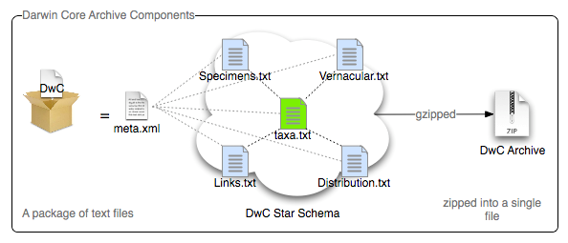

Darwin Core Archive (DwC-A)
DwC-A publish DwC records including terms from DwC-A extensions.
Simple text based format.
Zipped single file archive.
occurrence.txt
Notes:
http://code.google.com/p/gbif-ecat/wiki/DwCArchive

Slide 10

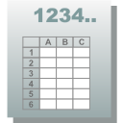
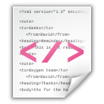
Star schema
DwC Archive
Ext 5
Ext 1
+
meta.xml
Core
Ext 2
Ext 4
EML.xml
Ext 3
Slide source: GB23 Nodes Madagascar October 2015 & iDigBio Florida January 2015
Notes:
Slide source: GB23 Nodes Madagascar October 2015, http://community.gbif.org/pg/pages/view/47903/ & Modified from 1B Publishing Primary Biodiversity Data by Alberto González-Talaván^{1~} Data Sharing, Data Standards, and Demystifying the IPT ~ Gainesville, FL, USA. 13 January 2015

Slide 11
Data types

Slide 12
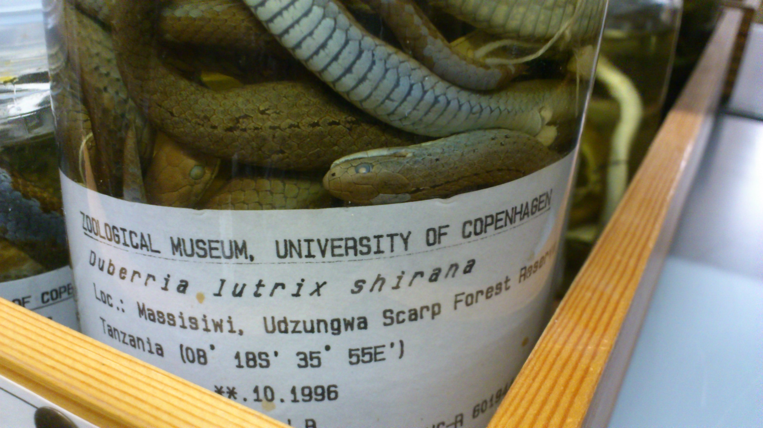
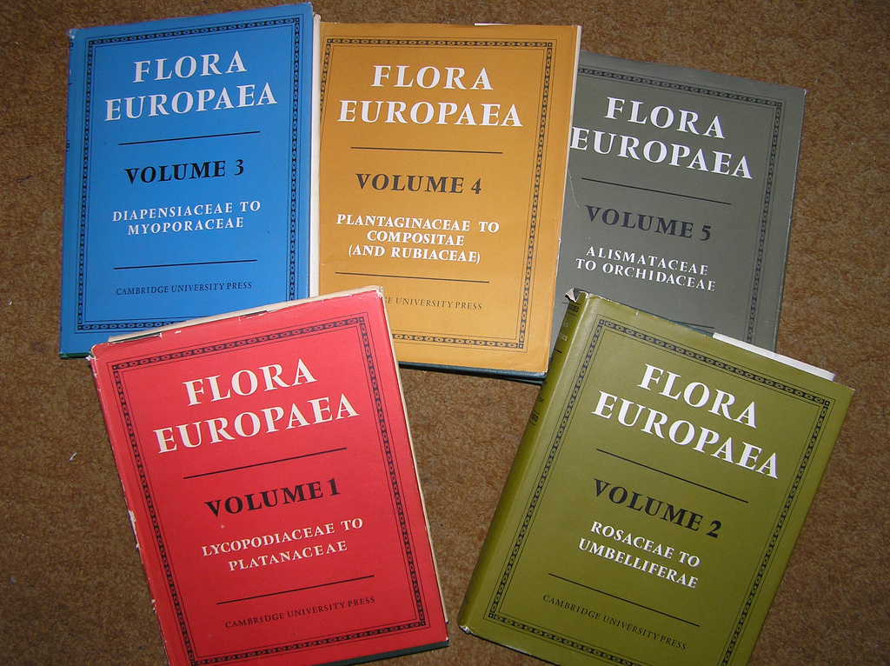
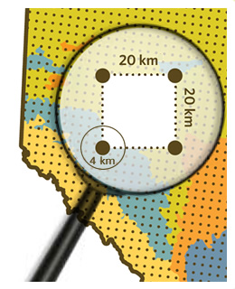
Mapping cores – Data types
Occurrence core
  The category of information pertaining to evidence of an occurrence in nature, in a collection, or in a dataset (specimen, observation, etc.). Updated in July 2015, 169 terms.
Taxon core
  The category of information pertaining to taxonomic names, taxon name usages, or taxon concepts. Updated in April 2015, 43 terms.
Event core
  The category of information pertaining to a sampling event. Issued 29 May 2015, 95 terms.
Occurrences
Checklists (of taxon names)
http://www.gbif.org/publishing-data/summary - http://www.gbif.org/newsroom/news/sample-based-data - http://rs.gbif.org/core/
Notes:
Slide source: GB23 Nodes Madagascar October 2015, http://community.gbif.org/pg/pages/view/47903/ & Modified from 1B Publishing Primary Biodiversity Data by Alberto González-Talaván^{1~} Data Sharing, Data Standards, and Demystifying the IPT ~ Gainesville, FL, USA. 13 January 2015
Review of the data types for publishing (http://www.gbif.org/publishing-data/summary#datatypes).
--
GBIF now deals with four types of biodiversity data:
Occurrences (observations, specimens etc)
Checklists (names)
Metadata (data about data) - http://www.gbif.org/dataset/search?type=METADATA
--
Occurrences are records that document a 'collection event'—evidence that a particular, named organism was found at a particular time and place. Also known as primary biodiversity data, occurrences document the 'what, where, when, how and by whom' of our exploration of the planet's species. An occurrence record can be based on an observation in the field, vouchered (labeled) specimen in a museum or herbarium, or other evidence.
Checklists are lists of scientific names of organisms grouped into taxonomic hierarchies. They serve two main functions: first, they provide data that help to enrich information about particular species, for example by including them on national checklists, and on lists of invasive or threatened species; and they provide taxonomic 'backbones' around which species information can be organized.
Metadata are structured descriptions of datasets giving essential details such as the geographic and taxonomic scope of the data, methods of collection or observation, contact details and citation requirements. They help to give context to datasets and enable users to assess whether data are fit for use in a particular research project or application.
--

Slide 13
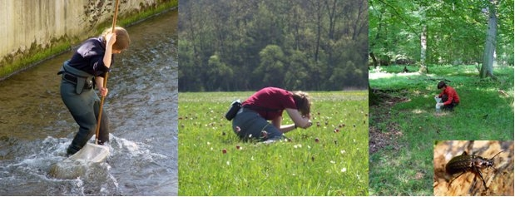
Biodiversity data types – sample data
Sample data
Release and first use of the Event core in March - October 2015
Slide source: GB23 Nodes Madagascar October 2015 - http://www.gbif.org/newsroom/news/sample-based-data
Notes:
Slide source: GB23 Nodes Madagascar October 2015, http://community.gbif.org/pg/pages/view/47903/
introduce the need/push for sample-based datasets (introduction of the event core) (http://www.gbif.org/page/82105) - released March 24, 2015
beyond “presence only” data -- more quantitative information used in other areas of scientific discovery and research, particularly ecological monitoring and assessment.
Sample-based data (ecological monitoring and assessment data)
Sample-based data are records from thousands of different kinds of environmental, ecological, and natural resource monitoring and assessment investigations. These events range from one-off surveys to ongoing monitoring and includes activities like freshwater and marine sampling, plant cover and vegetation plots, and citizen science bird counts, among others.

Slide 14
Event core
“Monitoring biodiversity change often requires repeated measures at the same place. This extension will enable data holders publishing through the GBIF network to share population abundance data (including time series population data) and presence/absence data, and also to document the sampling protocol”.
Henrique Pereira, chair of GEO BON
Slide source: GB23 Nodes Madagascar October 2015
Notes:
Slide source: GB23 Nodes Madagascar October 2015

Slide 15
Extensions
Darwin Core does not provide terms for every possible type of data.
  22 registered extensions (for Darwin Core Archive format)
Examples
  Darwin Core Identification History
  Darwin Core Measurement or Facts
  Audubon Media Description (aka Audubon Core)
  Darwin Core extension for germplasm genebanks
Slide source: GB23 Nodes Madagascar October 2015 & iDigBio Florida January 2015 - http://rs.gbif.org/extension/ - http://tools.gbif.org/dwca-validator/extensions.do
Notes:
http://rs.gbif.org/extension/
Slide source: GB23 Nodes Madagascar October 2015, http://community.gbif.org/pg/pages/view/47903/ & modified from Standards and sharing complex primary biodiversity data; and what is an extension anyway? ~ Deb Paul ~ Data Sharing, Data Standards, and Demystifying the IPT Workshop – Day 1, Jan. 13, 2015 ~ Gainesville, FL

Slide 16
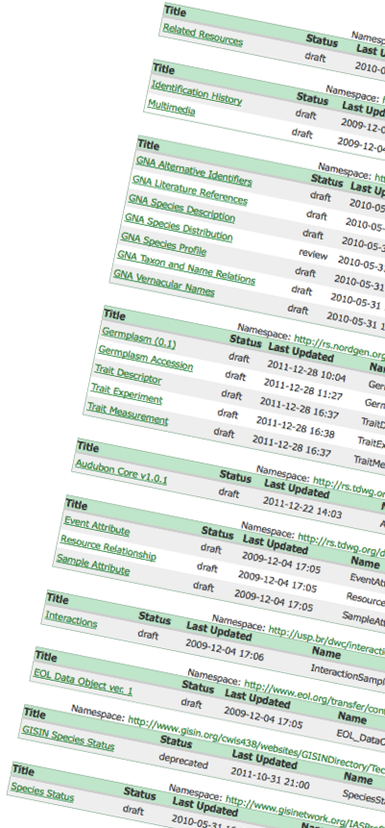
Darwin Core Archive extensions
Global Names Architecture (GNA)
Audubon Core (multimedia)
Invasive species (GISIN)
Genetic Resources (Germplasm)
EOL species profile
Taxonomic Concept Schema (TCS)
Genomics Standards Consortium (GSC)
Meta-genomics
ABCD
…
Notes:
Darwin Core Archive (DwC-A) extensions under development. Controlled terminologies for the DwC-As.

Slide 17
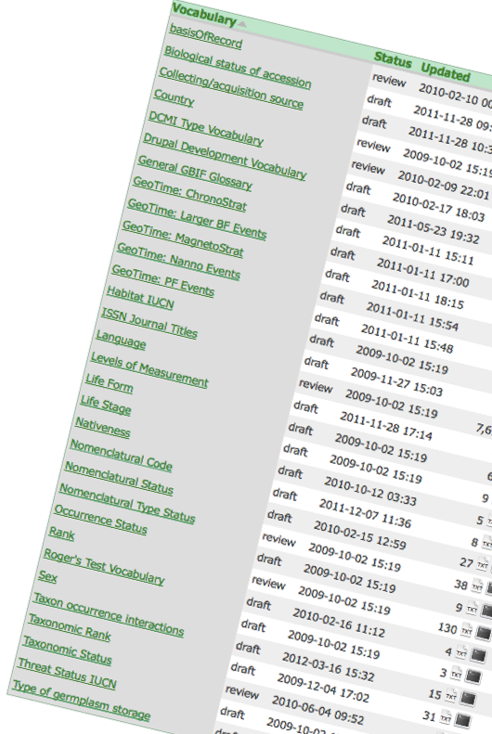
Controlled value vocabularies
Country codes
Language
Basis of record
Taxonomic rank
Nomenclatural status
Life form
Life stage
Geological time periods
  chronostratigraphy
  magnetostratigraphy
Species interactions
  saproxylic interactions
  pollinators
…
Notes:
Darwin Core Archive (DwC-A) controlled value vocabularies under development. Controlled values for terms included in the DwC-As.

Slide 18
Star schema example - occurrence
DwC Archive
Occurrence
Geographical
+
meta.xml
Occurrence Core
Media
Germplasm
EML.xml
Determination
Slide source: GB23 Nodes Madagascar October 2015 & iDigBio Florida January 2015
Notes:
Slide source: GB23 Nodes Madagascar October 2015, http://community.gbif.org/pg/pages/view/47903/ & Modified from 1B Publishing Primary Biodiversity Data by Alberto González-Talaván^{1~} Data Sharing, Data Standards, and Demystifying the IPT ~ Gainesville, FL, USA. 13 January 2015

Slide 19
Star schema example - checklist
DwC Archive
Checklist
Types
Description
Distribution
+
meta.xml
Taxon Core
Literature
Vernacular
EML.xml
Occurrences
Slide source: GB23 Nodes Madagascar October 2015 & iDigBio Florida January 2015
Notes:
Slide source: GB23 Nodes Madagascar October 2015, http://community.gbif.org/pg/pages/view/47903/ & Modified from 1B Publishing Primary Biodiversity Data by Alberto González-Talaván^{1~} Data Sharing, Data Standards, and Demystifying the IPT ~ Gainesville, FL, USA. 13 January 2015

Slide 20
Star schema example - Event
DwC Archive
Samples
Relevé
Occurrences
+
meta.xml
Event Core
EML.xml
Measurement or Fact
Slide source: GB23 Nodes Madagascar October 2015 & iDigBio Florida January 2015
Notes:
Slide source: GB23 Nodes Madagascar October 2015, http://community.gbif.org/pg/pages/view/47903/ & Modified from 1B Publishing Primary Biodiversity Data by Alberto González-Talaván^{1~} Data Sharing, Data Standards, and Demystifying the IPT ~ Gainesville, FL, USA. 13 January 2015

Slide 21
Publish your biodiversity data with GBIF

Slide 22
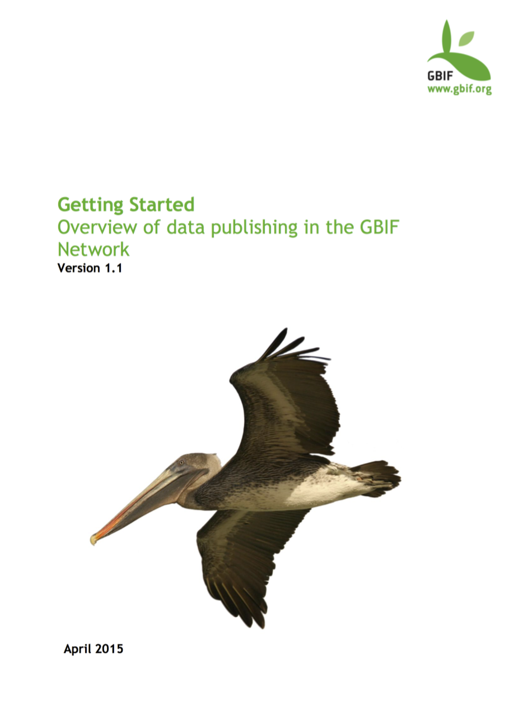
Getting started GBIF guidelines
GBIF Secretariat (2015). Getting Started: An overview of data publishing in the GBIF network, version 1.1. Copenhagen: Global Biodiversity Information Facility, 17 pp. ISBN: 87-92020-28-3 (for version 1.0). http://www.gbif.org/resource/80635
http://www.gbif.org/publishing-data/summary

Slide 23
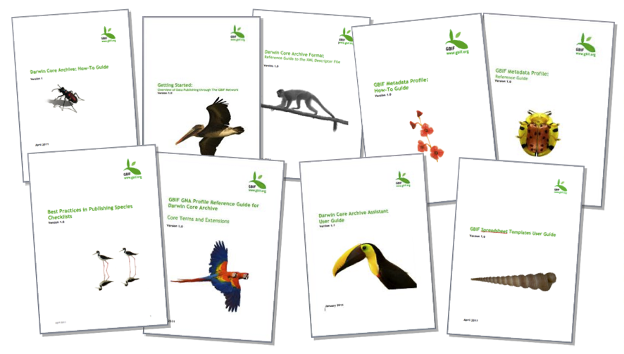
Data publishing guidelines
http://www.gbif.org/resources?f[0]=gr_purpose%3A955
Notes:
http://www.gbif.org/resources?f[0]=gr_purpose%3A955
http://www.gbif.org/resources?f[0]=gr_purpose%3A955&f[1]=gr_language%3A971&f[2]=gr_resource_type%3A895&f[3]=gr_resource_type%3A1010&searched=1

Slide 24
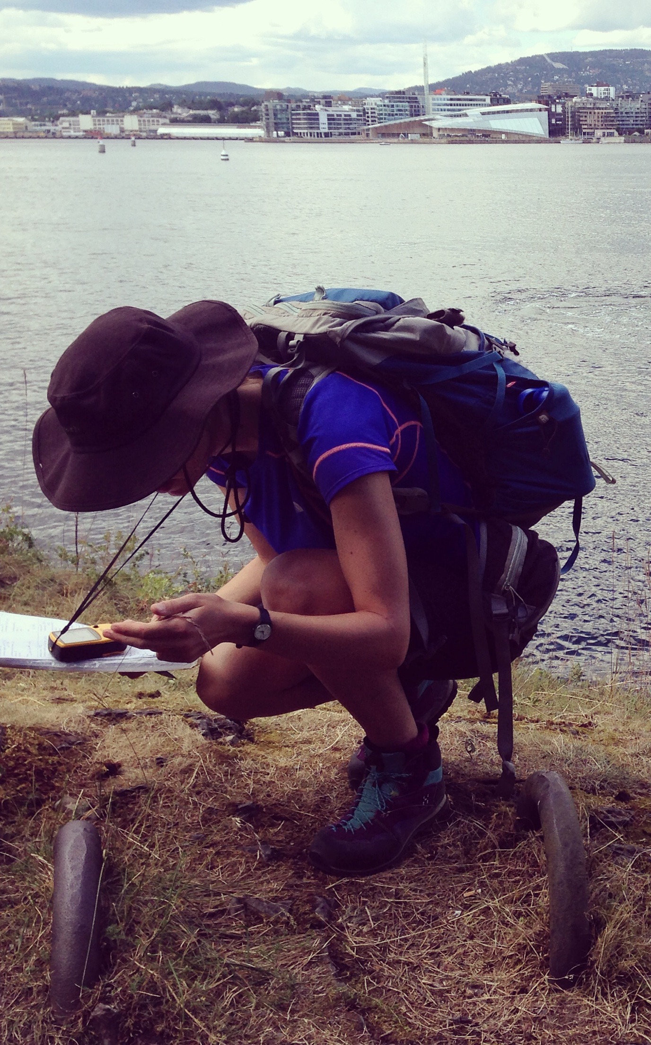
Data publication in GBIF
Conversion to standardized format (Darwin Core, ABCD)
Quality assessment & clearance/endorsement
Publication in GBIF
Data accessed by scientists and other users
Photo CC-BY Dag Endresen, Oslo, June 2014
Notes:
Photo CC-BY Dag Endresen, June 2014, Jade Philips collecting tissue samples for DNA analysis of crop wild relatives at Hovedøya in Oslo

Slide 25
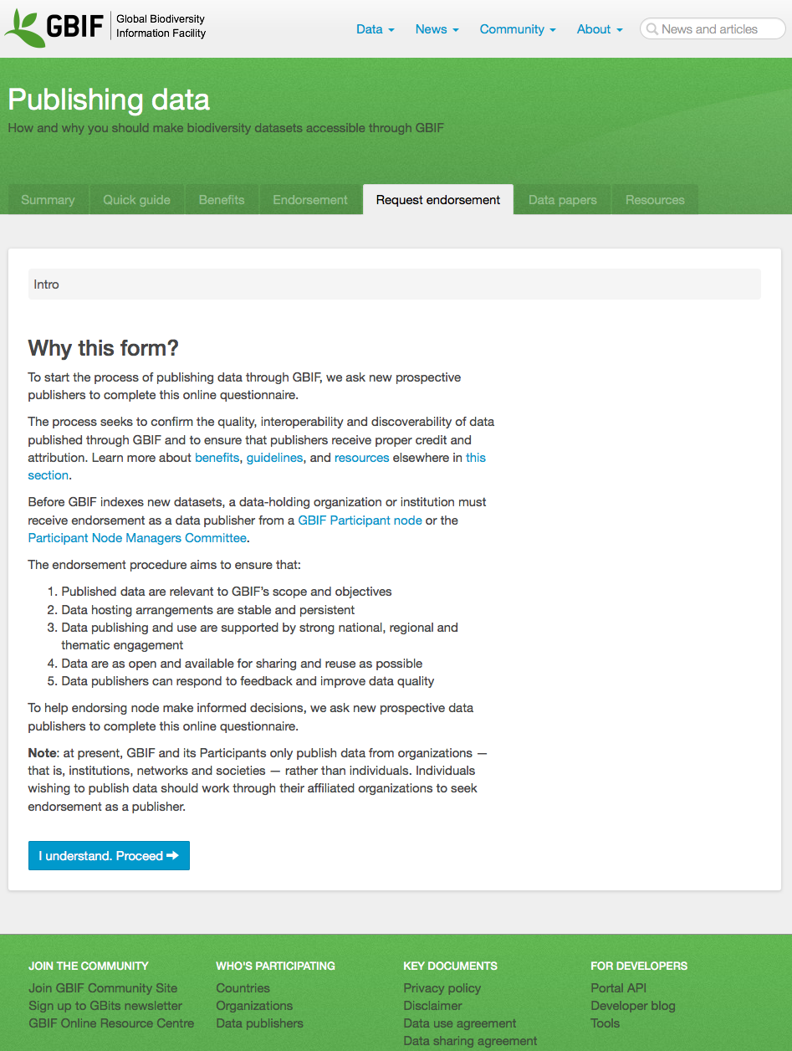
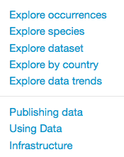
1
First step to start publishing data in GBIF is to seek endorsement as a data node/publisher.
Endorsement requests are forwarded to the appropriate GBIF member node - or evaluated by the GBIF secretariat.
2
Notes:
http://www.gbif.org/publishing-data/request-endorsement#/intro

Slide 26








Multiple-purpose data services
Global
information
systems
Darwin Core
archive
Institute
(AHP reserve)
Scientific
Research
ACB
Portal
Biodiversity Conservation
GBIF portal

Slide 27
Data publishing clearance at ACB?
Global
information
systems
ACB
Portal
Scientific
Research
Institute
(AHP reserve)
GBIF portal
Biodiversity Conservation

Slide 28

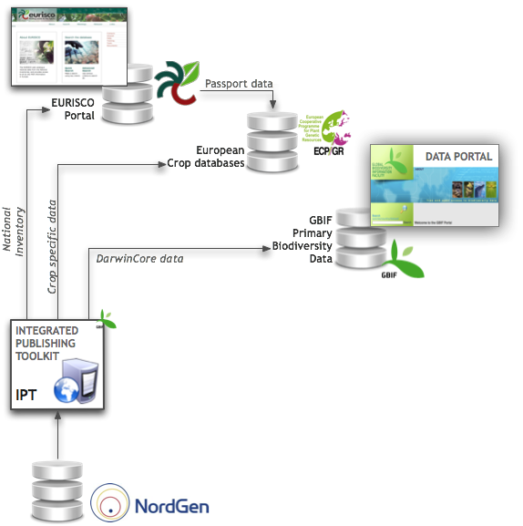
Plant Genetic resources Network Model
Each dataset is shared from the holding gene bank.
The National Inventory (NI), National Focal Person (NFP) endorses all national gene bank datasets for EURISCO.
ECPGR Crop databases can access passport data from EURISCO and additional crop specific data from the gene bank IPT interface.
Standard data sharing tools ensure that the genebank dataset is available to other relevant decentralized thematic, regional or global networks.
Illustration from the GBIF annual report 2009, page 47.
Notes:
Illustration from the GBIF annual report 2009, page 47.

Slide 29
Publish data in GBIF
data publishing
Step 1: data holding research institutes seek endorsement as an approved data publisher.
Step 2: datasets are identified and converted to standard Darwin Core format.
Step 3: datasets can be published directly from the data node and/or with the assistance from a national GBIF node.
Citizen science data platforms also publish in GBIF.
Notes:
http://www.gbif.org/resource/80635
http://www.gbif.org/publishing-data/summary
http://www.gbif.org/publishing-data/request-endorsement#/intro

Slide 30
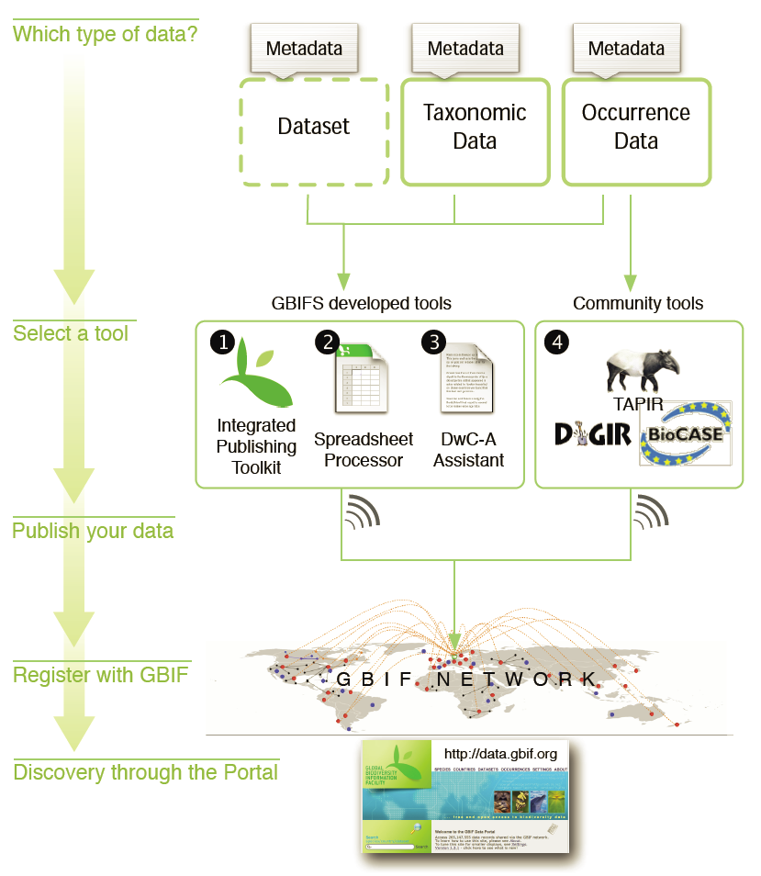

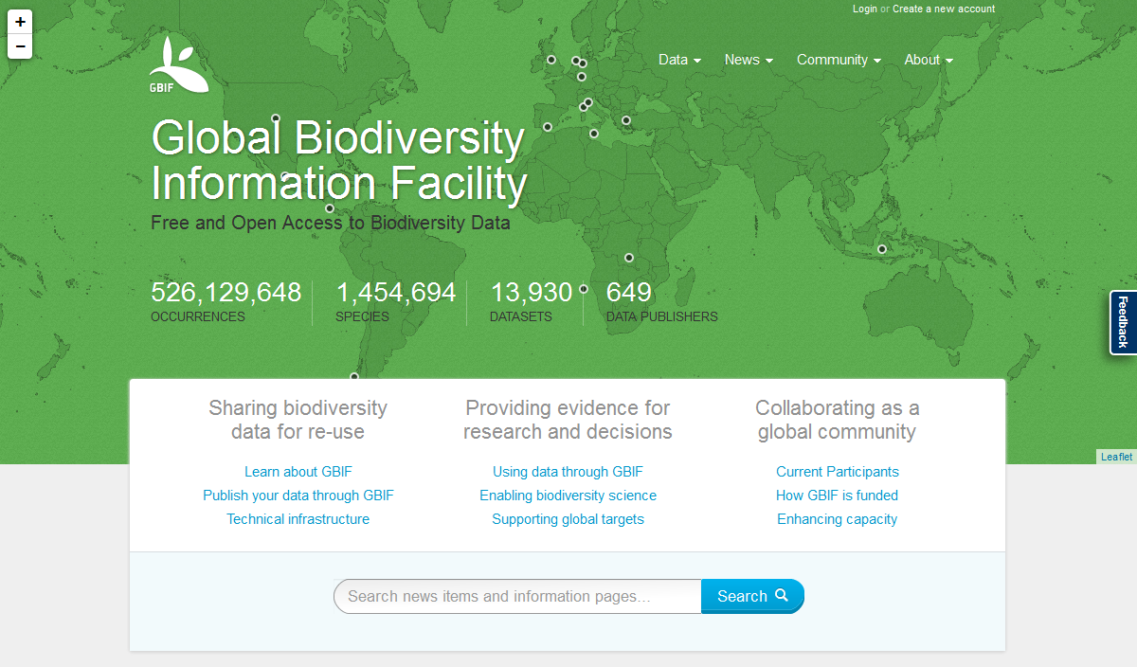
Data publishing Methods
Slide source: GB23 Nodes Madagascar October 2015 & iDigBio Florida January 2015
Notes:
Slide source: GB23 Nodes Madagascar October 2015, http://community.gbif.org/pg/pages/view/47903/ & modified from 1B Publishing Primary Biodiversity Data by Alberto González-Talaván^{1~} Data Sharing, Data Standards, and Demystifying the IPT ~ Gainesville, FL, USA. 13 January 2015
--
IPT currently under development with future planned updates
Web tools and templates for excel tools were contracted for development in ???? And have not been updated since then.
DiGIR protocol development ceased in 2006
TAPIR protocol last updated in 2010
BioCASE protocol last updated 2015

Slide 31
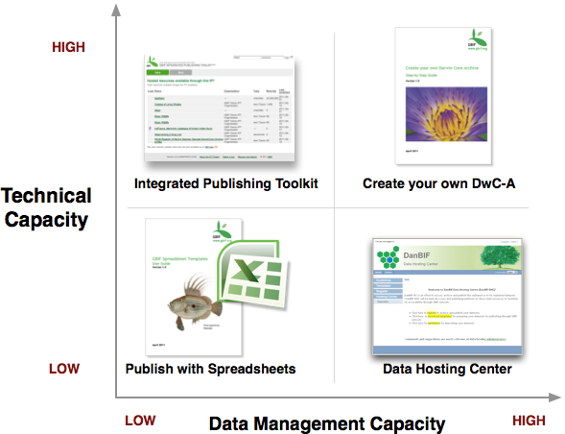

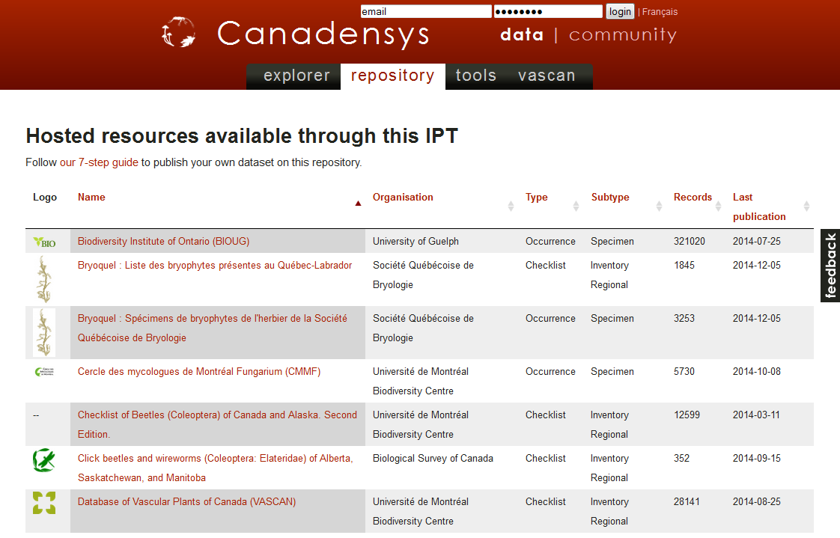
Data publishing Methods
Slide source: GB23 Nodes Madagascar October 2015 & iDigBio Florida January 2015
Notes:
Slide source: GB23 Nodes Madagascar October 2015, http://community.gbif.org/pg/pages/view/47903/ & modified from 1B Publishing Primary Biodiversity Data by Alberto González-Talaván^{1~} Data Sharing, Data Standards, and Demystifying the IPT ~ Gainesville, FL, USA. 13 January 2015
Ways to publish (strengths and weaknesses of each; include stats for numbers of datasets published via each way; how to identify what method was used when viewing datasets on gbif.org).
(1) simple spreadsheets, (2) IPT, (3) custom-created DwCA

Slide 32



Data publishing toolkits
DiGIR (PHP, 2001 - 2006)
TapirLink (PHP, 2007 →)
BioCASE (Python, 2001 →)
GBIF IPT (Java, 2009 →)
"2"
Notes:
ICIS (International Crop Information System): http://www.icis.cgiar.org
BioMOBY (2001) http://biomoby.org , http://en.wikipedia.org/wiki/BioMOBY
EURISCO (2003, tab-delimited text) http://eurisco.ecpgr.org
DiGIR (2002, not active) http://digir.sourceforge.net :: TapirLink (2007) http://wiki.tdwg.org/twiki/bin/view/TAPIR/TapirLink
BioCASE (2003, PyWrapper v2) http://www.biocase.org :: PyWrapper 3 (2006, not active) http://trac.pywrapper.org
TAPIR (2004 ->) http://www.tdwg.org/standards/449/
GBIF Provider Toolkit (2009) http://code.google.com/p/gbif-providertoolkit

Slide 33
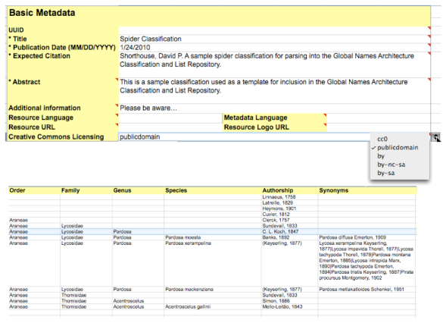
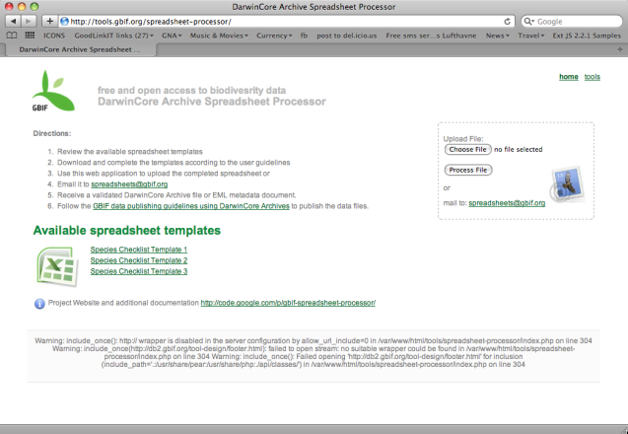
Data publishing software: spreadsheets
Metadata
Primary Biodiversity data
Species Checklists
Slide source: iDigBio Florida January 2015
Notes:
Slide source: Modified from 1B Publishing Primary Biodiversity Data by Alberto González-Talaván^{1~} Data Sharing, Data Standards, and Demystifying the IPT ~ Gainesville, FL, USA. 13 January 2015

Slide 34
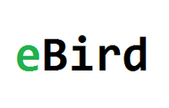





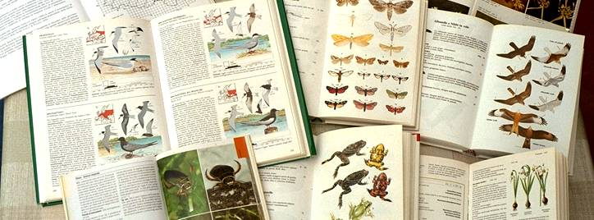
Citizen Science platforms publish biodiversity observations in GBIF.
Amateur naturalists and self-taught citizens can report their own species observations.
212 mill. occurrences
published in GBIF
951,235 occurrences
published in GBIF
28,990 occurrences
published in GBIF
14,719 occurrences
published in GBIF
42 mill. occurrences
published in GBIF
16 mill. occurrences
published in GBIF
and many more ...
Notes:
http://www.gbif.org/publishing-data/request-endorsement#/intro
Citizen Science projects in GBIF - http://www.gbif.org/search/node?keys=citizen+science
BioCaching - https://www.facebook.com/biocaching - http://biocaching.no/
MyGeoss - http://digitalearthlab.jrc.ec.europa.eu/mygeoss/
iSpot Nature - http://www.ispotnature.org
iNaturalist - http://www.gbif.org/dataset/50c9509d-22c7-4a22-a47d-8c48425ef4a7 – 951,235 occurrences in GBIF - http://www.gbif.org/publisher/28eb1a3f-1c15-4a95-931a-4af90ecb574d (endorsed by USGS, USA)
eBird - http://www.gbif.org/dataset/4fa7b334-ce0d-4e88-aaae-2e0c138d049e - 211,883,652 occurrences - http://www.gbif.org/publisher/e2e717bf-551a-4917-bdc9-4fa0f342c530 (endorsed by USGS, USA)
DiveBoard - http://www.gbif.org/dataset/66f6192f-6cc0-45fd-a2d1-e76f5ae3eab2 – 28,990 occurrences - http://www.gbif.org/publisher/1989b627-2a61-44db-83e4-392efc5da0a9 (endorsed by GBIF France)
ALA Volunteer Portal - http://volunteer.ala.org.au/
AnyMals+Plants - http://www.gbif.org/dataset/e6c97f6e-e952-11e2-961f-00145eb45e9a - 14,719 occurrences - published by Museum für Naturkunde Berlin – endorsed by GBIF Germany
Artsobservasjoner.no - http://www.gbif.org/dataset/b124e1e0-4755-430f-9eab-894f25a9b59c – 16,473,757 occurrences - published by Norwegian Biodiversity Information Centre - endorsed by GBIF Norway
Artsportalen.se - http://www.gbif.org/dataset/38b4c89f-584c-41bb-bd8f-cd1def33e92f – 41,630,940 occurrences - http://www.gbif.org/publisher/b8323864-602a-4a7d-9127-bb903054e97d – published by ArtDatabanken - GBIF Sweden
New Zealand Biodiversity Recording Network - http://www.gbif.org/dataset/d3484430-8876-11dd-986c-b8a03c50a862 – 23,593 occurrences
iRecord - http://www.gbif.org/publisher/07f617d0-c688-11d8-bf62-b8a03c50a862 - UK National Biodiversity Network - http://www.brc.ac.uk/irecord/

Slide 35
GBIF Integrated data Publishing Toolkit

Slide 36

data publishing landscape
GBIF introduces IPT 1.0
GBIF redevelops IPT with less memory requirements
GBIF introduces IPT 2.0
DiGIR (2001), BioCASE (2001),TapirLink (2007) in use for publishing biodiversity data
Idea for simple, compressed text-based file for publishing introduced at TDWG
Nodes and aggregators (including GBIF Norway) begin to install and use IPTs
Demo/test Event core developed by GBIF and EU BON
IPT more than 100 installations and serving more than 800 datasets
Dataset DOIs with DataCite (March 2015).
IPT becomes the dominant data-publishing solution in GBIF.
2007
2008
2009
2010
2011
2012
2013
2014
2015
Event core is released for use (October 2015).
Slide source: modified from GB23 Nodes Madagascar October 2015
Notes:
GBIF (2010). Darwin Core Archives – How-to Guide, version 1, released on 1 March 2011, (contributed by Remsen D, Braak, K, Döring M, Robertson, T), Copenhagen: Global Biodiversity Information Facility, 21 pp, accessible online at: http://links.gbif.org/gbif_dwca_how_to_guide_v1
GBIF, 2015, “GBIF Integrated Publishing Toolkit v. 2.0”. Copenhagen: Global Biodiversity Information Facility. Available online at http://www.gbif.org/ipt. http://www.gbif.org/resource/81278
Robertson T, Döring M, Guralnick R, Bloom D, Wieczorek J, Braak K, et al. (2014) The GBIF Integrated Publishing Toolkit: Facilitating the Efficient Publishing of Biodiversity Data on the Internet. PLoS ONE 9(8): e102623. doi:10.1371/journal.pone.0102623

Slide 37
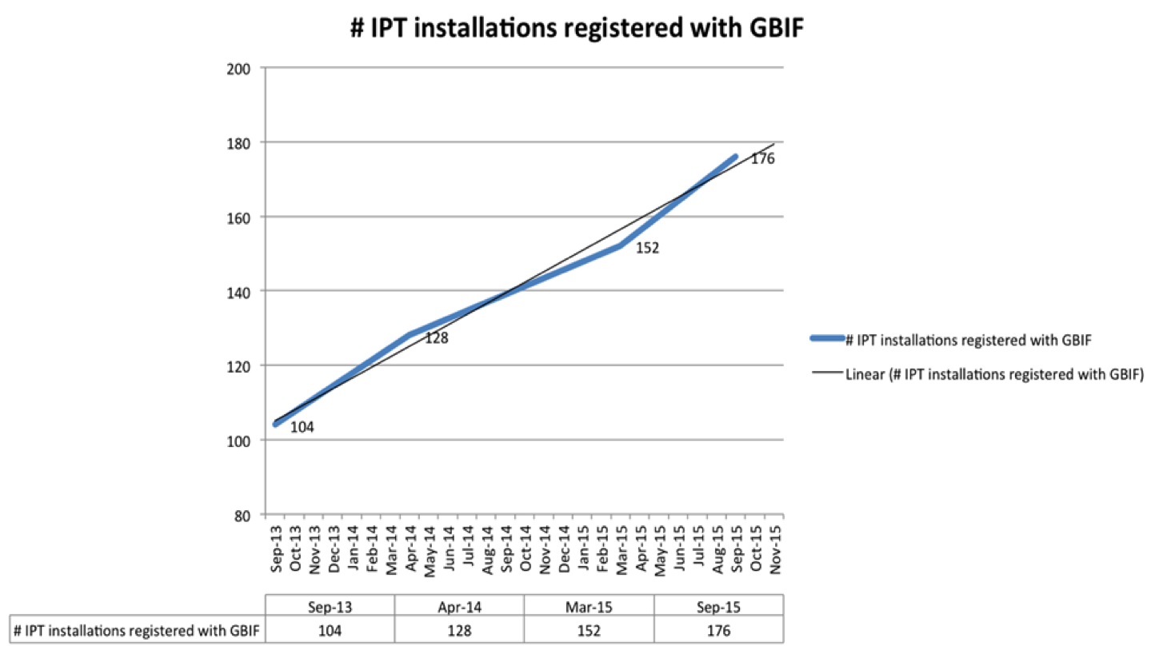
Data publishing landscape - statistics
Slide source: GB23 Nodes Madagascar October - http://www.gbif.org/ipt/stats
Notes:
Slide source: GB23 Nodes Madagascar October 2015, http://community.gbif.org/pg/pages/view/47903/
Data/chart provided by Kyle Braak, GBIF.

Slide 38
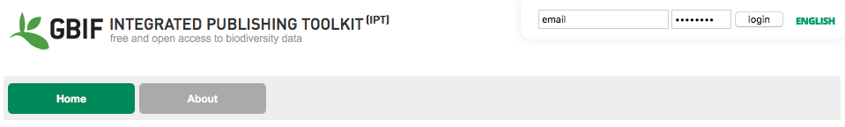
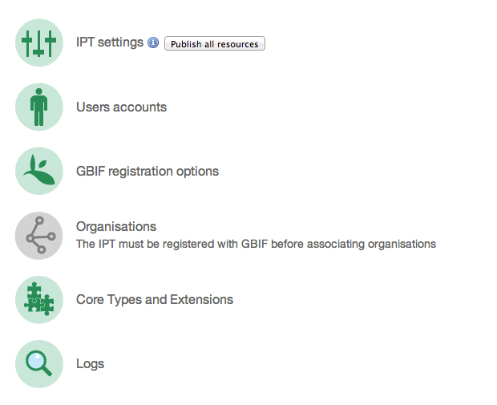
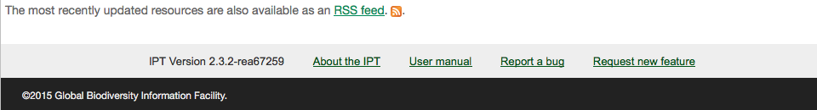
The GBIF Integrated data Publishing Toolkit (IPT)
is a free open source software tool written in Java that is used to publish and share biodiversity datasets through the GBIF network.
http://www.gbif.org/ipt
IPT User Manual:
https://github.com/gbif/ipt/wiki/IPT2ManualNotes.wiki
Robertson T, Döring M, Guralnick R, Bloom D, Wieczorek J, Braak K, Otegui J, Russell L, Desmet P (2014). The GBIF integrated publishing toolkit: Facilitating the efficient publishing of biodiversity data on the internet. PLoS One 9(8). doi:10.1371/journal.pone.0102623

Slide 39
Download data

Slide 40
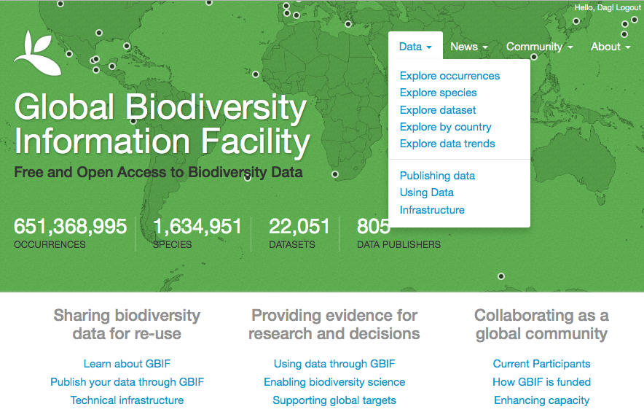
GBIF DATA PORTAL
Notes:
This is the GBIF Data Portal

Slide 41
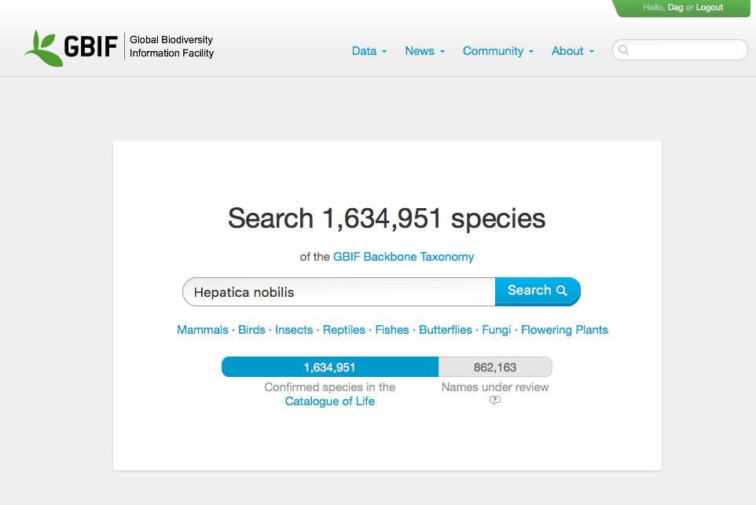
Notes:
http://www.gbif.org/occurrence/search

Slide 42
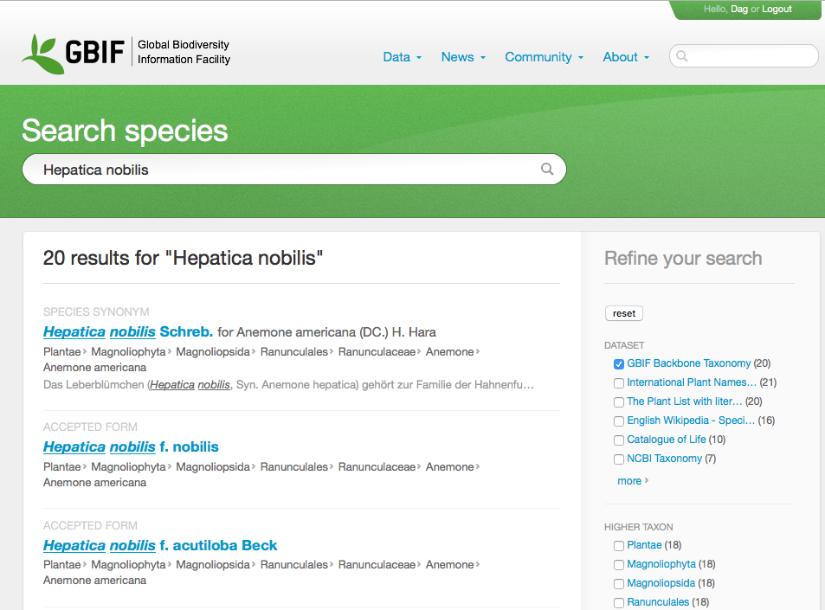
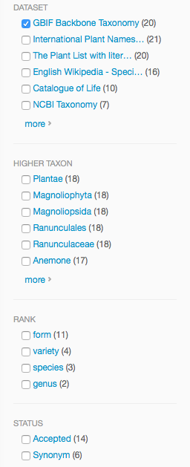
Notes:
http://www.gbif.org/species/search?q=Hepatica+nobilis&dataset_key=d7dddbf4-2cf0-4f39-9b2a-bb099caae36c

Slide 43
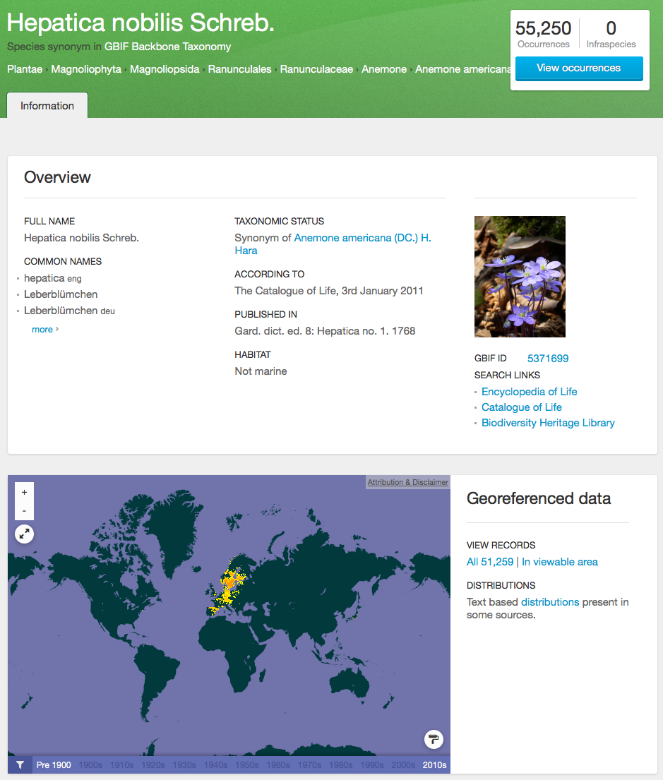
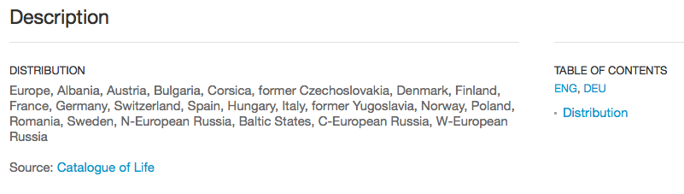
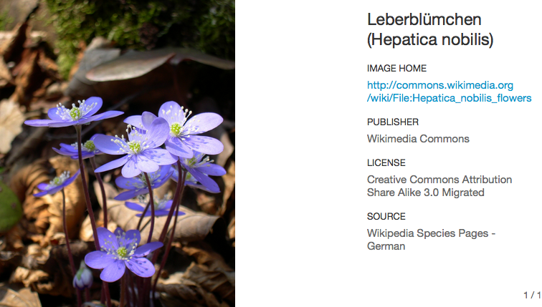
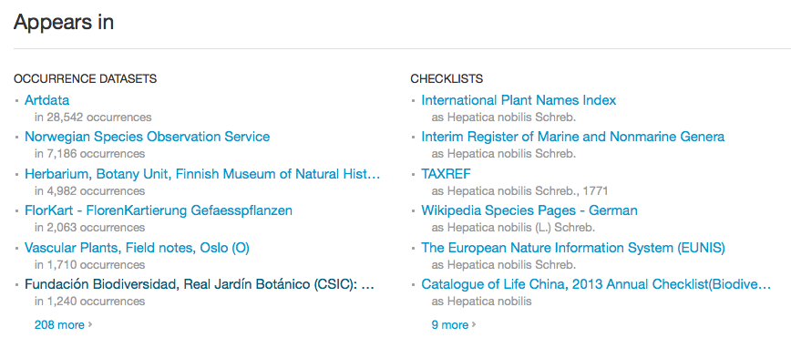
SPECIES SEARCH
Notes:
Navigating though an specie search, show the results related with the search and also there is the capability to filter the results.

Slide 44
GBIF Portal – download data
Before downloading species occurrence data from GBIF, please take the time to register.
http://www.gbif.org/user/register
Downloads from the GBIF portal are packaged as a Darwin Core Archive (DwC-A).
http://www.gbif.org/faq/datause
The species occurrence data are found in the “occurrence.txt” data file.
This tab-delimited text file can be imported to a spreadsheet such as Excel or to a database.
NOTE: the data files can become very large! So look at the file size before you open them in MS Excel.
Notes:
http://www.gbif.org/faq/datause

Slide 45
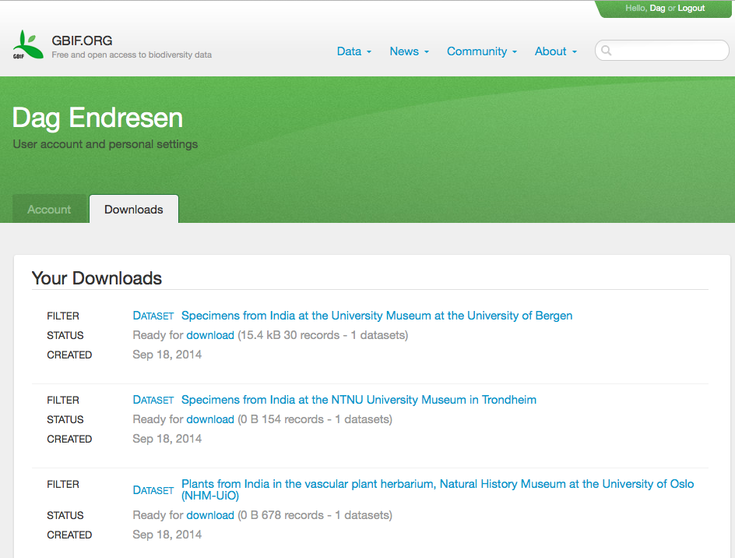
Login to find your current and previous downloads
Notes:
Login to find your current and previous downloads

Slide 46
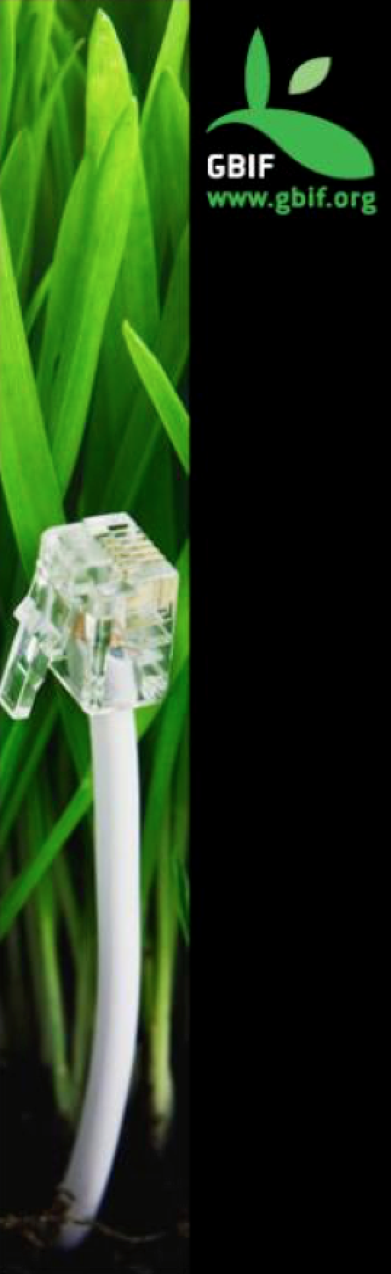
GBIF DATA PORTAL API
An interface to access data published through the GBIF network using web services.
Notes:
What’s the Data Portal API? An interface to access the data published through the GBIF network using Web Services.

Slide 47

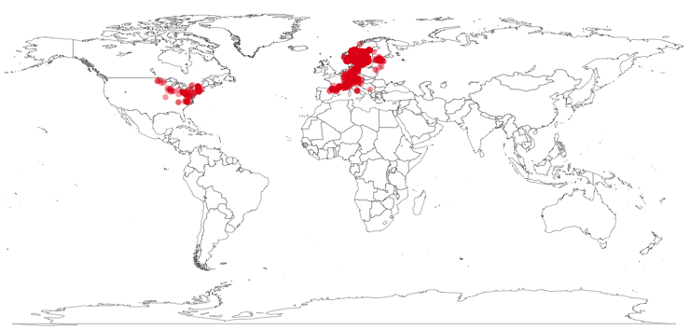
rOpenSci : rgbif
library(rgbif)
key <- name_backbone(name='Hepatica nobilis', kingdom=‘Plantae')$speciesKey
sp <- occ_search(taxonKey=key, return='data', hasCoordinate=TRUE, limit=1000)
gbifmap(sp)

Slide 48
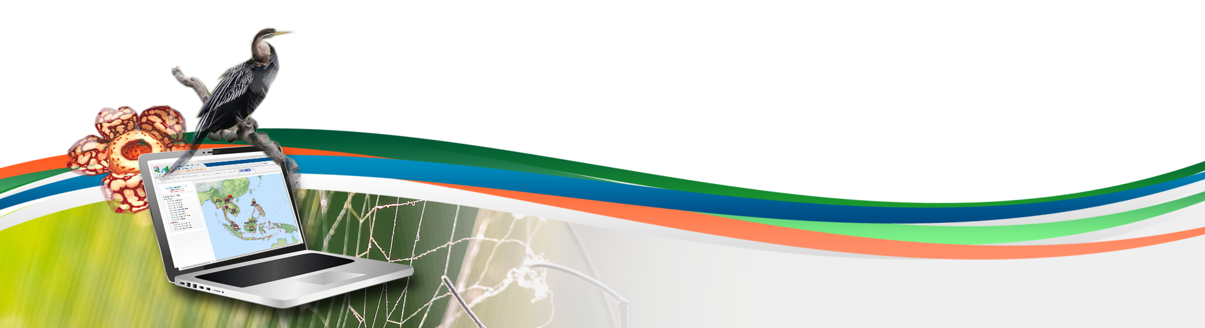
Data publishing workshop
GBIF data publishing
Second day 5th July 2016
Los Baños, Laguna, Philippines
Dag Endresen, GBIF Norway, UiO

