Slide 1





Data publishing workshop
IPT - Integrated data publishing toolkit
Forth day 7th July 2016
Los Baños, Laguna, Philippines
Dag Endresen, GBIF Norway, UiO
Notes:
GBIF/BIFA data publishing workshop, 4-8 July 2016, ASEAN Heritage Parks, ASEAN Centre for Biodiversity, Los Baños, Laguna, Philippines
Slides CC-BY/CC0 Dag Endresen, Global Biodiversity Information Facility (GBIF) in Norway, UiO Natural History Museum in Oslo, University of Oslo (feel free to reuse slides)
Day 4: 7th July 2016: The GBIF Facility –GBIF biodiversity data publishing with IPT (2016-07-07, 08:20 – 09:00, 40 minutes)
Mobilizing biodiversity data from ASEAN protected areas
The goal of this project is to facilitate the mobilization of biodiversity information from the Association of Southeast Asian Nations (ASEAN) Heritage Parks – regionally significant protected areas for biodiversity.
At present, biodiversity data collected from park surveys are documented through various means and do not always conform to global standards. A workshop for selected park management staff will strengthen their skills in biodiversity information management and data publishing through hands-on exercises using datasets from the heritage parks. This project will also orient heritage park staff towards monitoring sites with camera traps, and prepare them for the publishing of sample-based data in the future.
The outcome of the project will be an increase in the availability and access to data from the protected areas, to assist policy development.
http://www.gbif.org/programme/bifa/2015/ASEAN-heritage-parks
Slide source: GB23 Nodes Madagascar October 2015, http://community.gbif.org/pg/pages/view/47903/ & Norwegian GBIF data publishing workshop in Trondheim October 2015, http://www.gbif.no/events/2015/data-publishing-workshop-october-2015.html

Slide 2

INDEX
GBIF Integrated data Publishing Toolkit, IPT
Install IPT
Add and map data source
Event core

Slide 3
Demo hands-on IPT
ACP BIFA Workshop demo IPT:
http://bim-mirror.aseanbiodiversity.org:8080/ipt_test/
Login: <removed from public slides>
Password: <removed from public slides>
GBIF Demo portal (after you publish and register):
http://www.gbif-uat.org/installation/94087c7f-8682-4984-a65d-7bacb95d1665

Slide 4

GBIF Integrated data Publishing Toolkit - IPT

Slide 5










The GBIF Integrated Publishing Toolkit: Vision
A single platform allowing the sharing of
    Primary biodiversity data
    Species name information
    Dataset descriptions (metadata)
The ability to register with GBIF
    Technical contact information
      E.g. Internet URLs
    Physical contact information
      E.g. telephone details
    Institutional affiliations
      Accurate attribution
Connect
    Databases
    Upload text files
    Lower the technical threshold for participation
    Flexibility to accommodate data extensions
    Support efficient and simple transfer of content
    An open source project
Slide source: GBIF GB23 Nodes training & iDigBio, Florida 2015
Notes:
Slide source: Modified from 1B Publishing Primary Biodiversity Data by Alberto González-Talaván^{1~} Data Sharing, Data Standards, and Demystifying the IPT ~ Gainesville, FL, USA. 13 January 2015

Slide 6

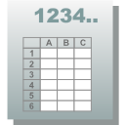
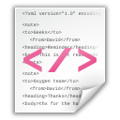
Darwin Core Archive - Star schema
DwC Archive
Ext 5
Ext 1
+
meta.xml
Core
Ext 2
Ext 4
EML.xml
Ext 3
Slide source: GBIF GB23 Nodes training & iDigBio, Florida 2015
Notes:
Slide source: GB23 Nodes Madagascar October 2015, http://community.gbif.org/pg/pages/view/47903/ & Modified from 1B Publishing Primary Biodiversity Data by Alberto González-Talaván^{1~} Data Sharing, Data Standards, and Demystifying the IPT ~ Gainesville, FL, USA. 13 January 2015

Slide 7
Install IPT

Slide 8
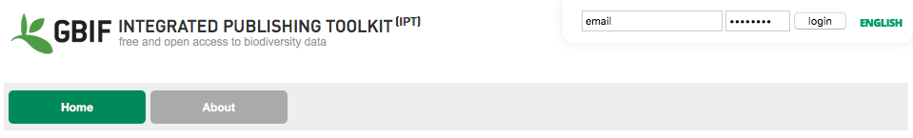
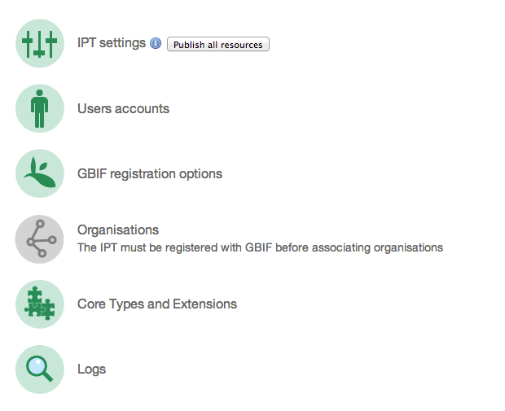
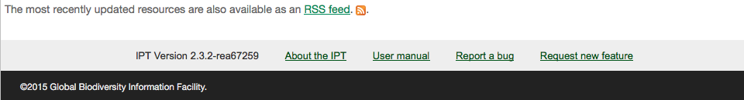
The GBIF Integrated data Publishing Toolkit (IPT)
is a free open source software tool written in Java that is used to publish and share biodiversity datasets through the GBIF network.
http://www.gbif.org/ipt
IPT User Manual:
https://github.com/gbif/ipt/wiki/IPT2ManualNotes.wiki
Robertson T, Döring M, Guralnick R, Bloom D, Wieczorek J, Braak K, Otegui J, Russell L, Desmet P (2014). The GBIF integrated publishing toolkit: Facilitating the efficient publishing of biodiversity data on the internet. PLoS One 9(8). doi:10.1371/journal.pone.0102623
Notes:
https://github.com/gbif/ipt/wiki/IPT2ManualNotes.wiki

Slide 9
Requirements – Connectivity and URL
Internet Connectivity
  Many aspects of the IPT require communication with external Internet services
Public and Stable URL
  IPT is meant to be discoverable and accessible
  Domain name preferable to an IP address
Slide source: Laura Russell, iDigBio, 2015
Notes:
Slide source: Laura Russell, iDigBio, IPT Installation Webinar 7 January 2015, http://www.gbif.org/resource/81919
Internet Connectivity
The IPT is designed under the assumption that the server on which it is run has consistent Internet connectivity. Though many functions of the IPT work even when offline, some aspects of the IPT (GBIF registration, extension installation, controlled vocabularies, and external databases for source data), require communication with external Internet resources. From the perspective of IPT administration and management, the speed of the Internet connection affects only such communications. Access to the IPT web application and its services from beyond a local intranet also requires consistent connectivity, and slow connectivity may have an adverse affect on these aspects, especially when transferring large data sets.
Stable URL
Though it can be used simply as a tool to generate Darwin Core Archives (see http://rs.tdwg.org/dwc/terms/guides/text/), the IPT is meant to be a discoverable and accessible Internet-based application and service. To support this functionality, the server on which the IPT is installed must be able to support access to the application and services through a stable URL.

Slide 10
Requirements – Memory and Disk Space
Memory
  Minimum 256MB RAM (more is better)
Disk Space
  IPT application and configuration files less than 25 MB
  Size of data directory grows as resources are created.
Slide source: Laura Russell, iDigBio, 2015
Notes:
Slide source: Laura Russell, iDigBio, IPT Installation Webinar 7 January 2015, http://www.gbif.org/resource/81919
Memory
The server hosting the IPT installation must make at least 256 MB RAM memory available to the application. Additional memory can be made available by configuring the
Disk Space
The space required by the IPT application is less then 20MB. The contents of the IPT data directory after installation require less than 1MB of disk storage, writable by the IPT. However, the content of the data directory will grow as resources are created, and will require space roughly equal to the size of the files or tables containing the imported data sets. A reasonable estimate for the size of a relatively rich occurrence data set is one kilobyte per record. Normal usage of the IPT appends information to the log files, which will grow over time, but which generally require minimal disk space.

Slide 11

Requirements – Java and Servlet Container
Java
  Java 6 or Java 7
  Installed prior to installing IPT
Servlet Container
  IPT is packaged with Jetty
  IPT can be deployed with other servlet containers (e.g. Tomcat)
Slide source: Laura Russell, iDigBio, 2015
Notes:
Slide source: Laura Russell, iDigBio, IPT Installation Webinar 7 January 2015, http://www.gbif.org/resource/81919
Java
The server hosting the IPT must have a version no less than Java 6 installed and functional prior to the installation of the IPT.
Servlet Container
A Servlet Container is a program which can receive requests from web pages and redirect those requests to a Java object (the servlet object) for processing
The IPT application comes packaged with Jetty and therefore requires no further servlet container. Jetty also requires Maven and Subversion as well to run. (Mac OSX comes with all 3 installed)
IPT can be deployed in another servlet container (e.g., Tomcat) that is already in use.
Information about how to use various servlet containers with the IPT can be found at https://code.google.com/p/gbif-providertoolkit/wiki/IPTServerPreparation
Comparison of servlet containers can be found at http://zeroturnaround.com/rebellabs/the-great-java-application-server-debate-with-tomcat-jboss-glassfish-jetty-and-liberty-profile

Slide 12
IPT - add new user account
Notes:
Slide modified from iDigBio 2015, Data Sharing, Data Standards, and Demystifying the IPT Workshop, https://www.idigbio.org/ :: Laura Russell (David Shorthouse) - Demo: Publishing with the IPT: Adding a data source and mapping data

Slide 13
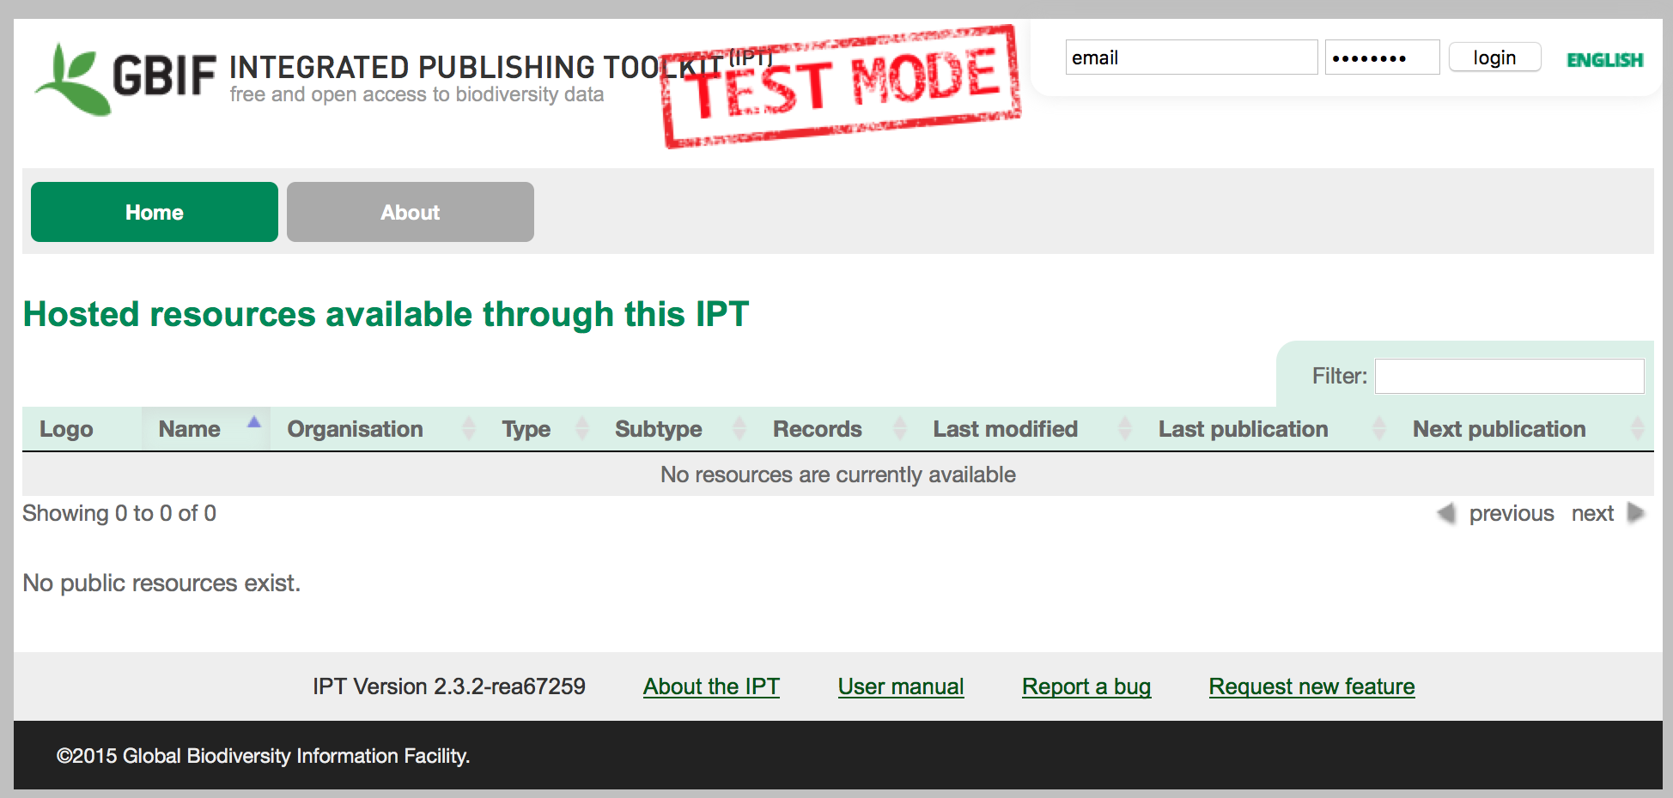
IPT add user account
Login as Admin
Notes:
Slide modified from iDigBio 2015, Data Sharing, Data Standards, and Demystifying the IPT Workshop, https://www.idigbio.org/ :: Laura Russell (David Shorthouse) - Demo: Publishing with the IPT: Adding a data source and mapping data

Slide 14
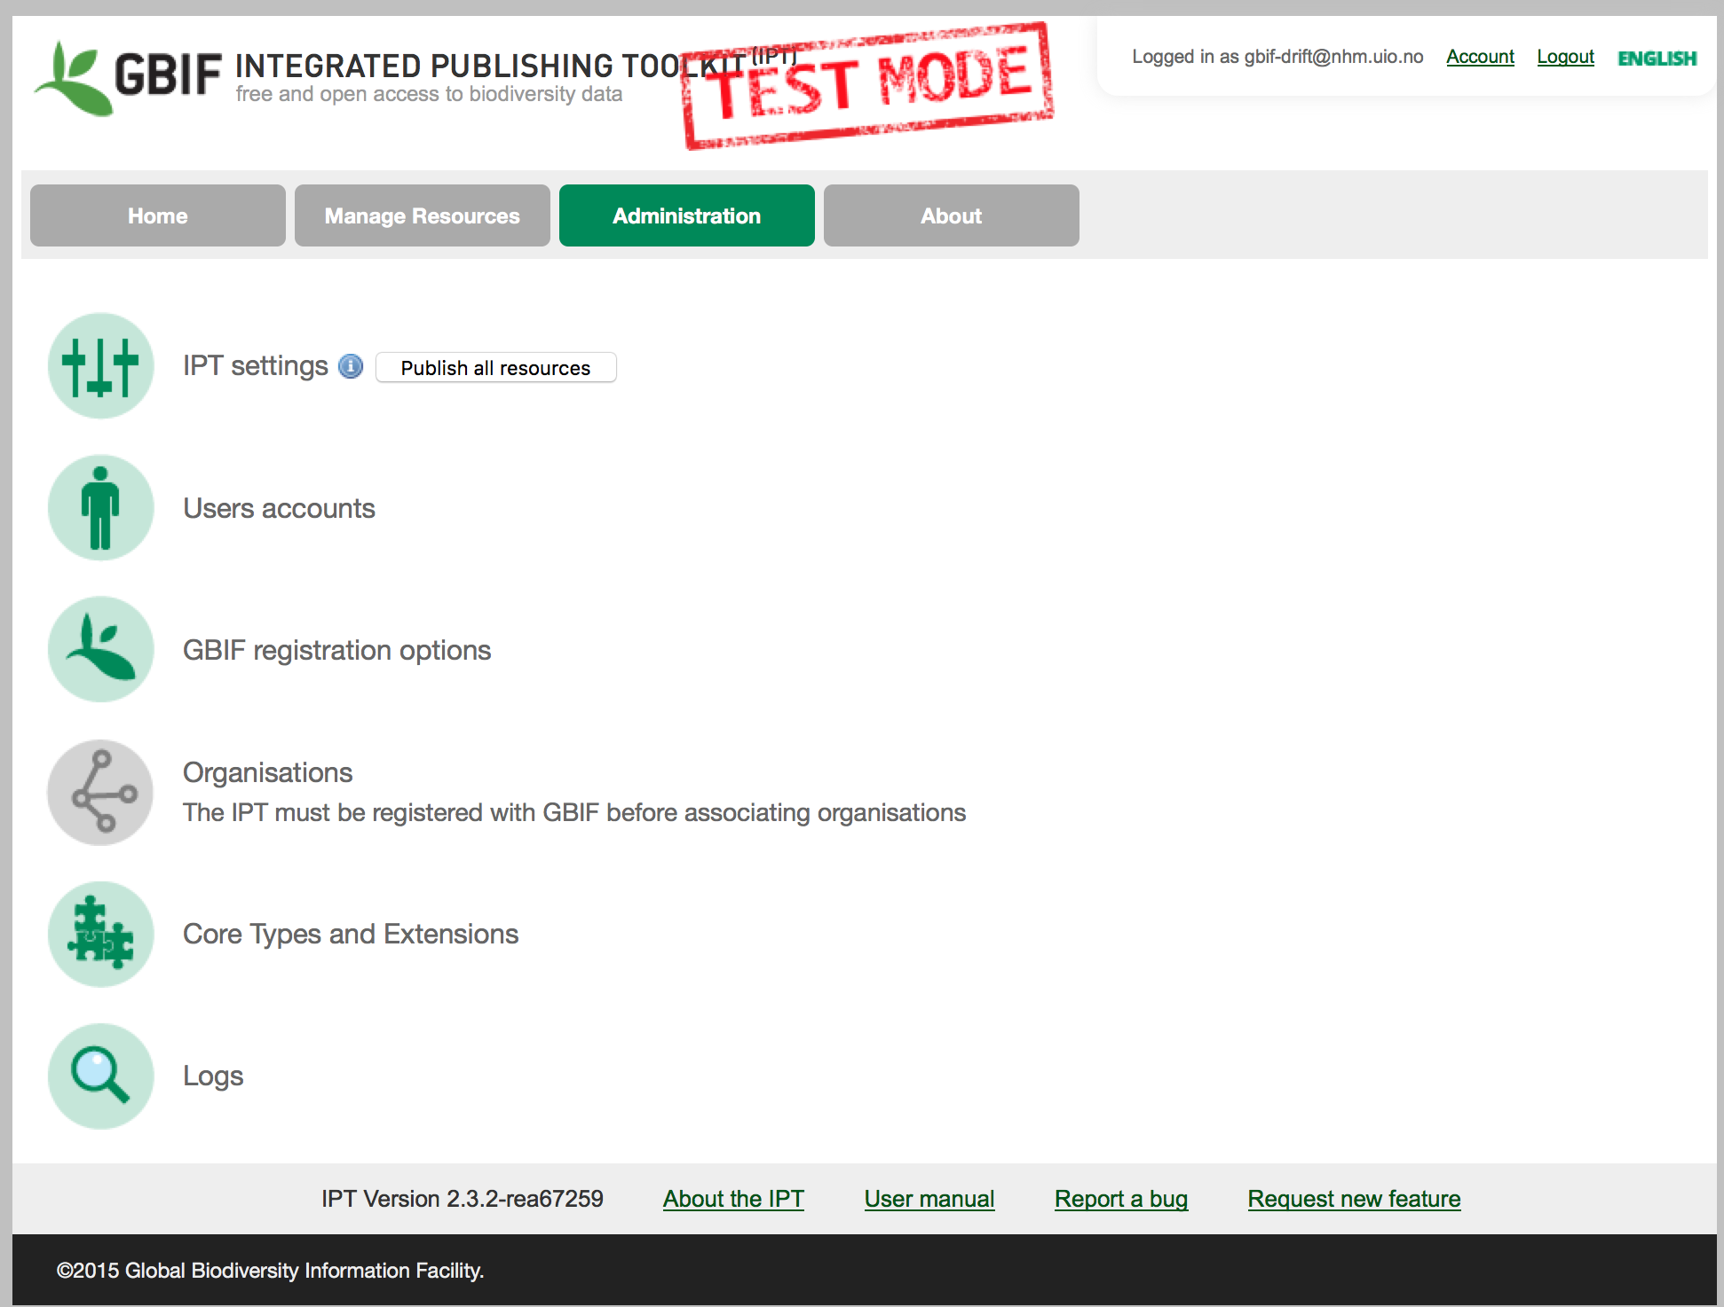
IPT add user account (2)
Notes:
Slide modified from iDigBio 2015, Data Sharing, Data Standards, and Demystifying the IPT Workshop, https://www.idigbio.org/ :: Laura Russell (David Shorthouse) - Demo: Publishing with the IPT: Adding a data source and mapping data

Slide 15
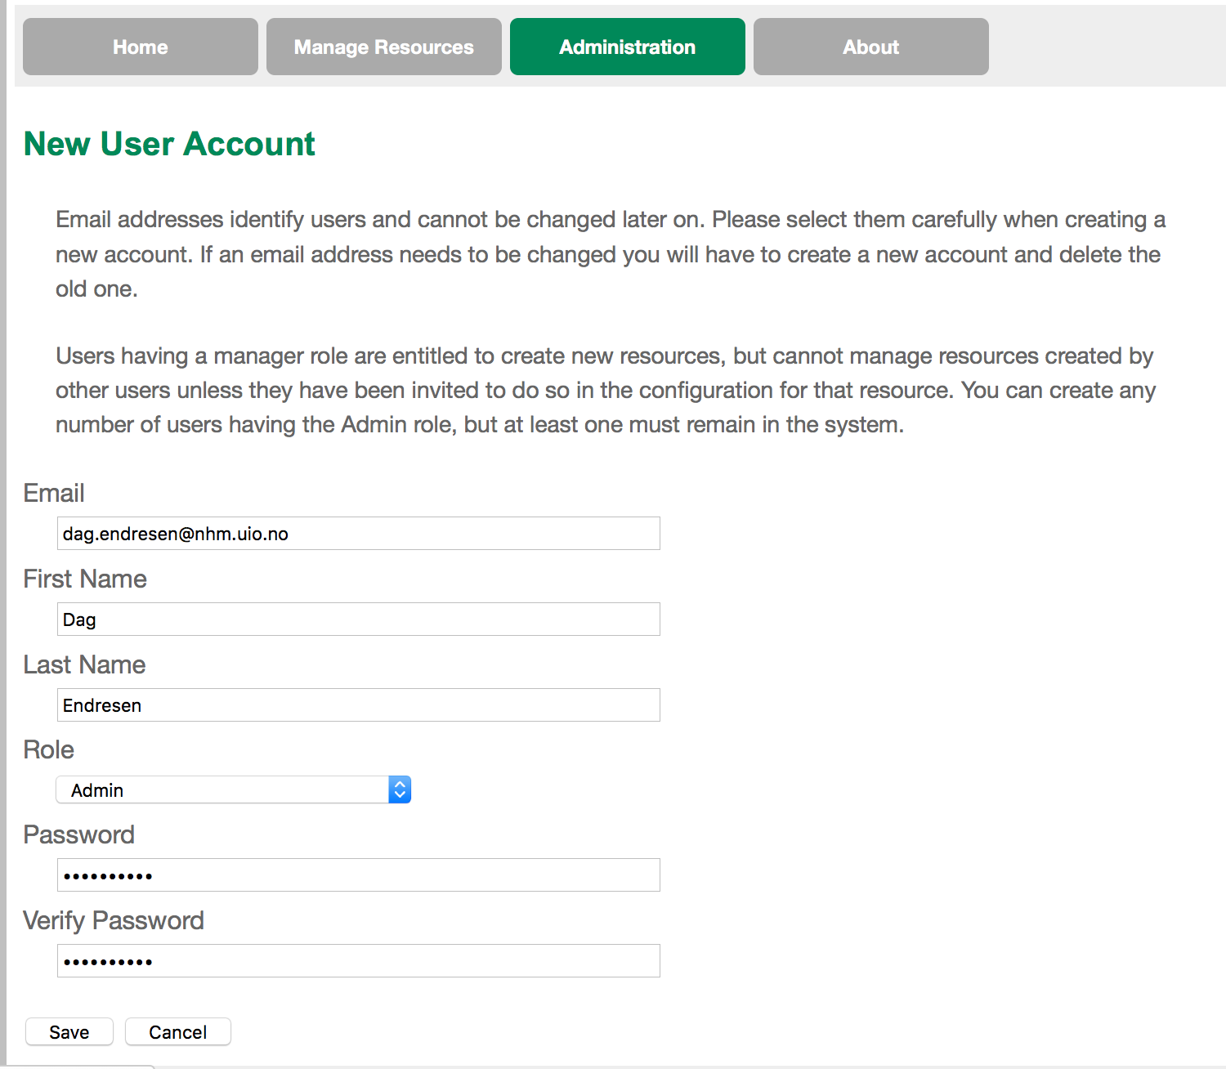
IPT add user account (3)
Notes:
Slide modified from iDigBio 2015, Data Sharing, Data Standards, and Demystifying the IPT Workshop, https://www.idigbio.org/ :: Laura Russell (David Shorthouse) - Demo: Publishing with the IPT: Adding a data source and mapping data

Slide 16
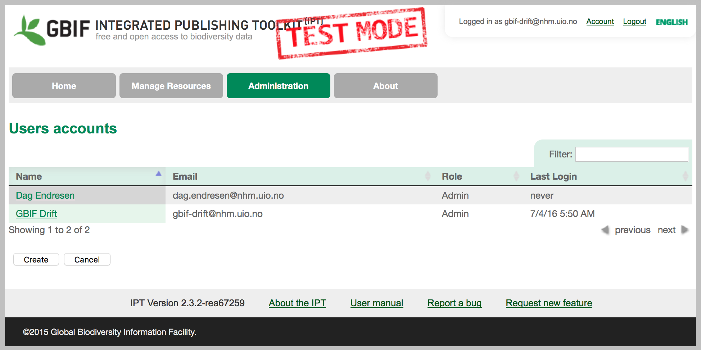
IPT add user account (4)
Notes:
Slide modified from iDigBio 2015, Data Sharing, Data Standards, and Demystifying the IPT Workshop, https://www.idigbio.org/ :: Laura Russell (David Shorthouse) - Demo: Publishing with the IPT: Adding a data source and mapping data

Slide 17
IPT - add new data source
Notes:
Slide modified from iDigBio 2015, Data Sharing, Data Standards, and Demystifying the IPT Workshop, https://www.idigbio.org/ :: Laura Russell (David Shorthouse) - Demo: Publishing with the IPT: Adding a data source and mapping data

Slide 18
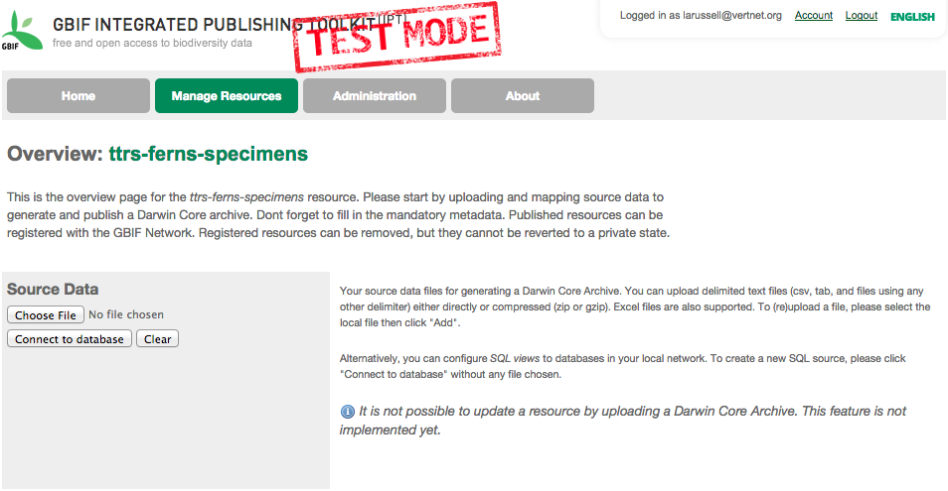
IPT Source Data – File Upload
Slide modified from: iDigBio workshop 2015
Notes:
Slide modified from iDigBio 2015, Data Sharing, Data Standards, and Demystifying the IPT Workshop, https://www.idigbio.org/ :: Laura Russell (David Shorthouse) - Demo: Publishing with the IPT: Adding a data source and mapping data

Slide 19
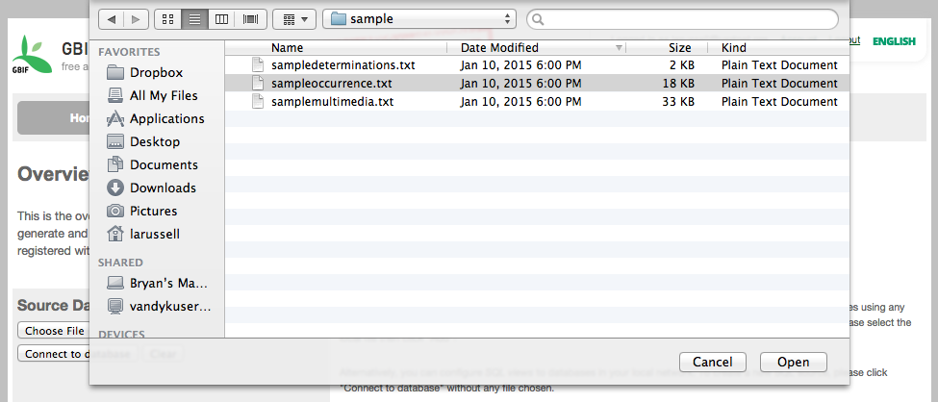
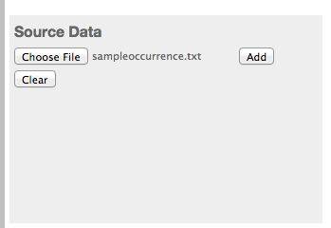
IPT Source Data – File Upload
Select an occurrence file and click the Open button.
Once the file is selected and the file name shows next to “Choose File,” click the Add button.
Slide modified from: iDigBio workshop 2015
Notes:
Slide modified from iDigBio 2015, Data Sharing, Data Standards, and Demystifying the IPT Workshop, https://www.idigbio.org/ :: Laura Russell (David Shorthouse) - Demo: Publishing with the IPT: Adding a data source and mapping data

Slide 20
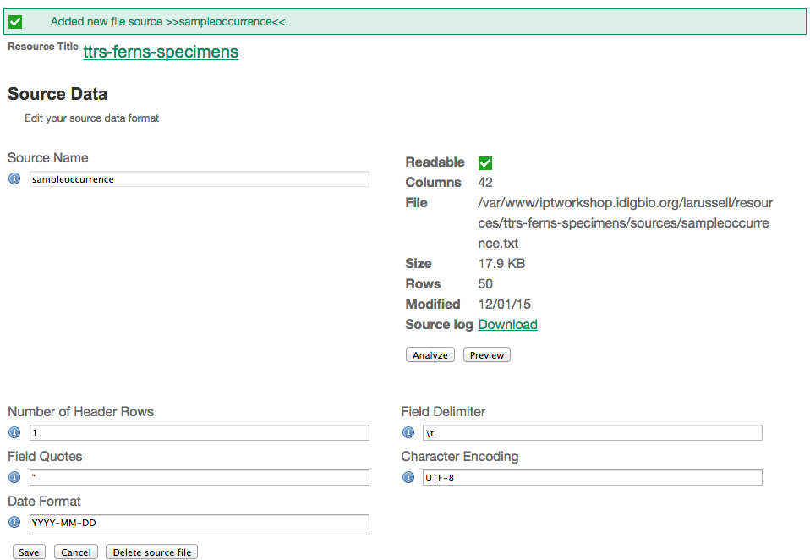
IPT Source Data – Upload Review
42 columns as read from source
Upload file location on server
File specifications as read from source
Number of records as read from source
Slide modified from: iDigBio workshop 2015
Notes:
Slide modified from iDigBio 2015, Data Sharing, Data Standards, and Demystifying the IPT Workshop, https://www.idigbio.org/ :: Laura Russell (David Shorthouse) - Demo: Publishing with the IPT: Adding a data source and mapping data

Slide 21
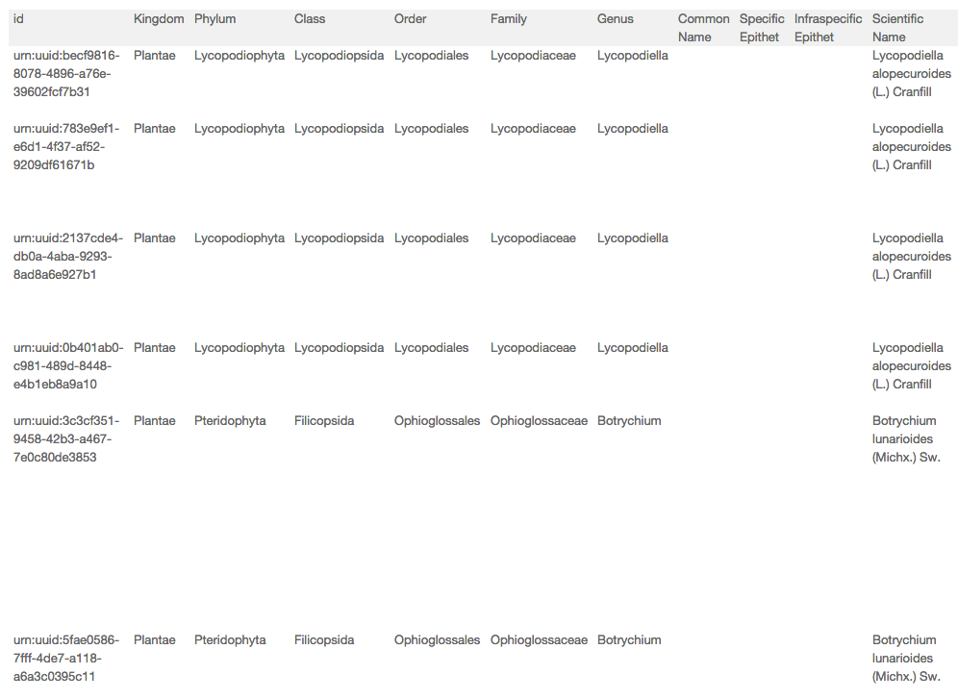
IPT Source Data – Upload Preview
Slide modified from: iDigBio workshop 2015
Notes:
Slide modified from iDigBio 2015, Data Sharing, Data Standards, and Demystifying the IPT Workshop, https://www.idigbio.org/ :: Laura Russell (David Shorthouse) - Demo: Publishing with the IPT: Adding a data source and mapping data

Slide 22
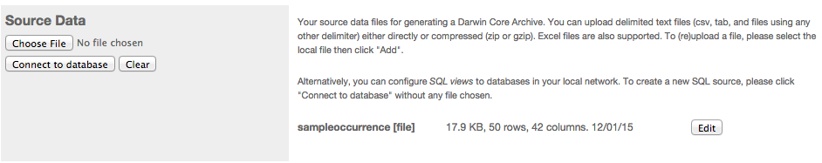
IPT Source Data – Upload Complete
Slide modified from: iDigBio workshop 2015
Notes:
Slide modified from iDigBio 2015, Data Sharing, Data Standards, and Demystifying the IPT Workshop, https://www.idigbio.org/ :: Laura Russell (David Shorthouse) - Demo: Publishing with the IPT: Adding a data source and mapping data

Slide 23
IPT Source Data – Database Connection
Slide modified from: iDigBio workshop 2015
Notes:
Slide modified from iDigBio 2015, Data Sharing, Data Standards, and Demystifying the IPT Workshop, https://www.idigbio.org/ :: Laura Russell (David Shorthouse) - Demo: Publishing with the IPT: Adding a data source and mapping data

Slide 24
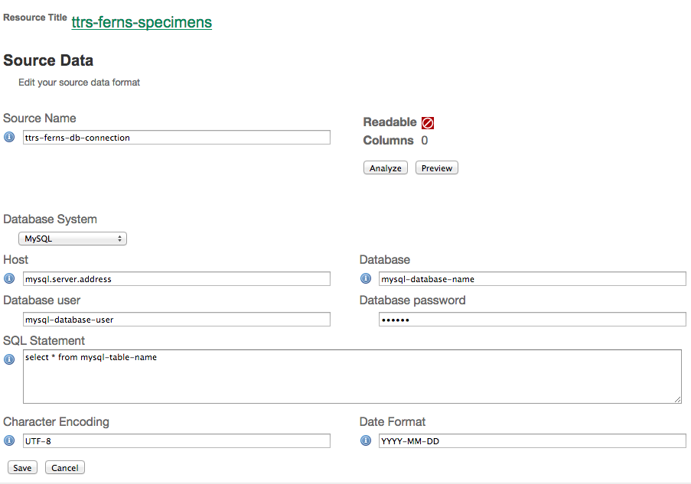
IPT Source Data – Database Connection
Slide modified from: iDigBio workshop 2015
Notes:
Slide modified from iDigBio 2015, Data Sharing, Data Standards, and Demystifying the IPT Workshop, https://www.idigbio.org/ :: Laura Russell (David Shorthouse) - Demo: Publishing with the IPT: Adding a data source and mapping data

Slide 25
IPT
mapping data
Notes:
Slide modified from iDigBio 2015, Data Sharing, Data Standards, and Demystifying the IPT Workshop, https://www.idigbio.org/ :: Laura Russell (David Shorthouse) - Demo: Publishing with the IPT: Adding a data source and mapping data

Slide 26
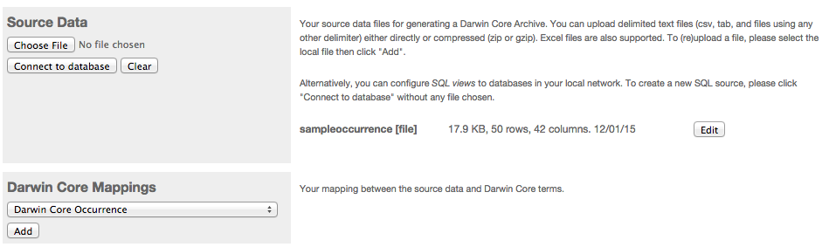
IPT Darwin Core Mappings
Slide modified from: iDigBio workshop 2015
Notes:
Slide modified from iDigBio 2015, Data Sharing, Data Standards, and Demystifying the IPT Workshop, https://www.idigbio.org/ :: Laura Russell (David Shorthouse) - Demo: Publishing with the IPT: Adding a data source and mapping data

Slide 27
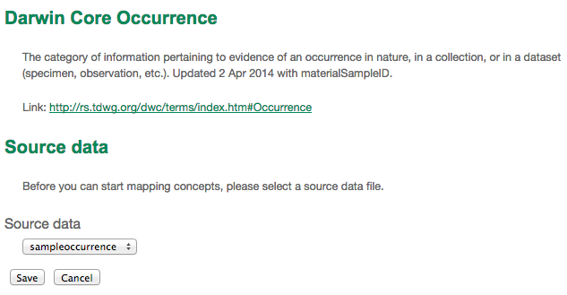
IPT Darwin Core Mappings – Selecting Source
Slide modified from: iDigBio workshop 2015
Notes:
Slide modified from iDigBio 2015, Data Sharing, Data Standards, and Demystifying the IPT Workshop, https://www.idigbio.org/ :: Laura Russell (David Shorthouse) - Demo: Publishing with the IPT: Adding a data source and mapping data

Slide 28
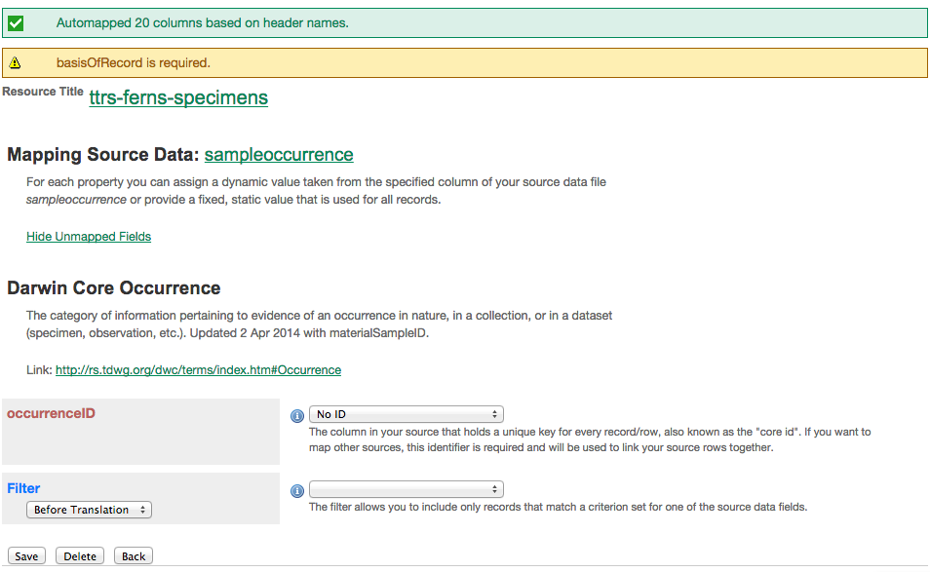
IPT Darwin Core Mappings – Automapping
If source names match DwC, automapping occurrs
Alerts users to missing required field
Shortcut to Data Source
Please remember occurrenceID
Slide modified from: iDigBio workshop 2015
Notes:
Slide modified from iDigBio 2015, Data Sharing, Data Standards, and Demystifying the IPT Workshop, https://www.idigbio.org/ :: Laura Russell (David Shorthouse) - Demo: Publishing with the IPT: Adding a data source and mapping data

Slide 29
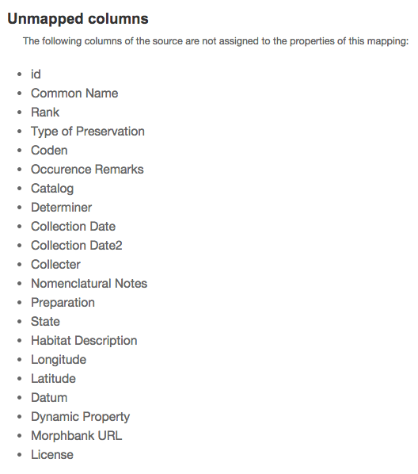
IPT Darwin Core Mappings – Unmapped Fields
Additional columns provided in the source that should be mapped to DwC terms
Slide modified from: iDigBio workshop 2015
Notes:
Slide modified from iDigBio 2015, Data Sharing, Data Standards, and Demystifying the IPT Workshop, https://www.idigbio.org/ :: Laura Russell (David Shorthouse) - Demo: Publishing with the IPT: Adding a data source and mapping data

Slide 30
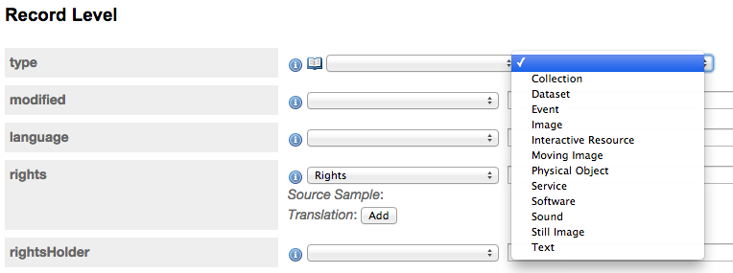
IPT Darwin Core Mappings – Dropdowns
Some terms, like type, have recommended vocabularies, that you can use if the data is not present in your source. basisOfRecord is another term with a recommended vocabulary.
Slide modified from: iDigBio workshop 2015
Notes:
Slide modified from iDigBio 2015, Data Sharing, Data Standards, and Demystifying the IPT Workshop, https://www.idigbio.org/ :: Laura Russell (David Shorthouse) - Demo: Publishing with the IPT: Adding a data source and mapping data

Slide 31
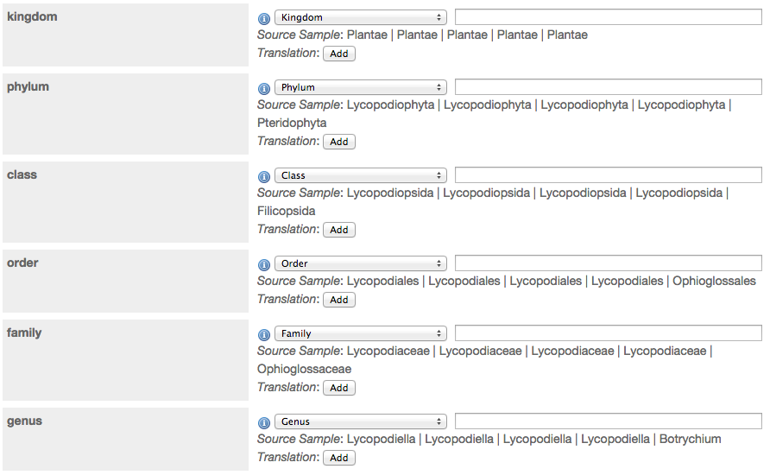
IPT Darwin Core Mappings – Preview data
Mapped fields with data in the first 5 records, show a preview of that data.
Slide modified from: iDigBio workshop 2015
Notes:
Slide modified from iDigBio 2015, Data Sharing, Data Standards, and Demystifying the IPT Workshop, https://www.idigbio.org/ :: Laura Russell (David Shorthouse) - Demo: Publishing with the IPT: Adding a data source and mapping data

Slide 32
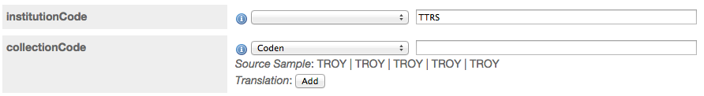
IPT Darwin Core Mappings – Fill-in Values
If no mapping is provided for a term, a value can be supplied.
Slide modified from: iDigBio workshop 2015
Notes:
Slide modified from iDigBio 2015, Data Sharing, Data Standards, and Demystifying the IPT Workshop, https://www.idigbio.org/ :: Laura Russell (David Shorthouse) - Demo: Publishing with the IPT: Adding a data source and mapping data

Slide 33
IPT dataset
publish and register
Notes:
Slide modified from iDigBio 2015, Data Sharing, Data Standards, and Demystifying the IPT Workshop, https://www.idigbio.org/ :: Laura Russell (David Shorthouse) - Demo: Publishing with the IPT: Adding a data source and mapping data

Slide 34
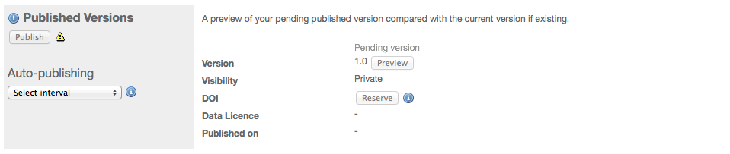
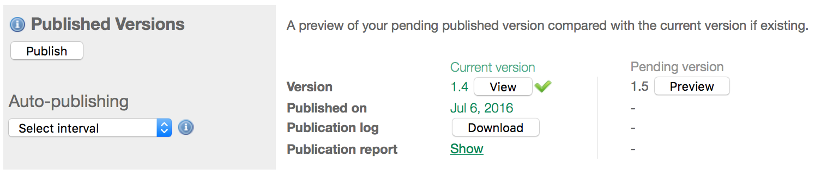
Publish dataset
Notes:
http://bim-mirror.aseanbiodiversity.org:8080/ipt_test/manage/resource.do?r=makiling_mmfr

Slide 35

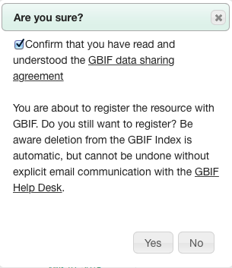

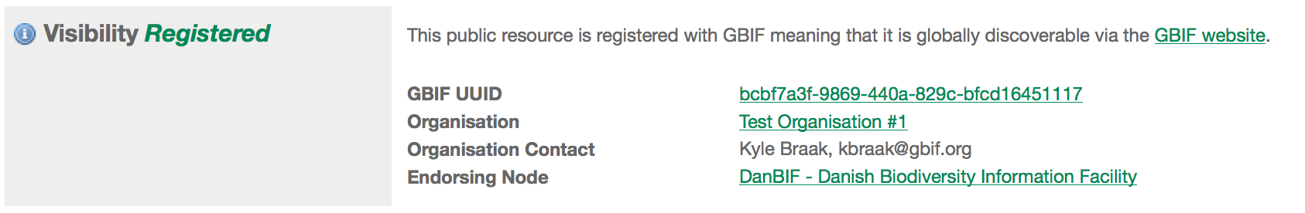
Register dataset
The button labeled "Register" will only be enabled if metadata complete
Notes:
http://bim-mirror.aseanbiodiversity.org:8080/ipt_test/manage/resource.do?r=makiling_mmfr

Slide 36
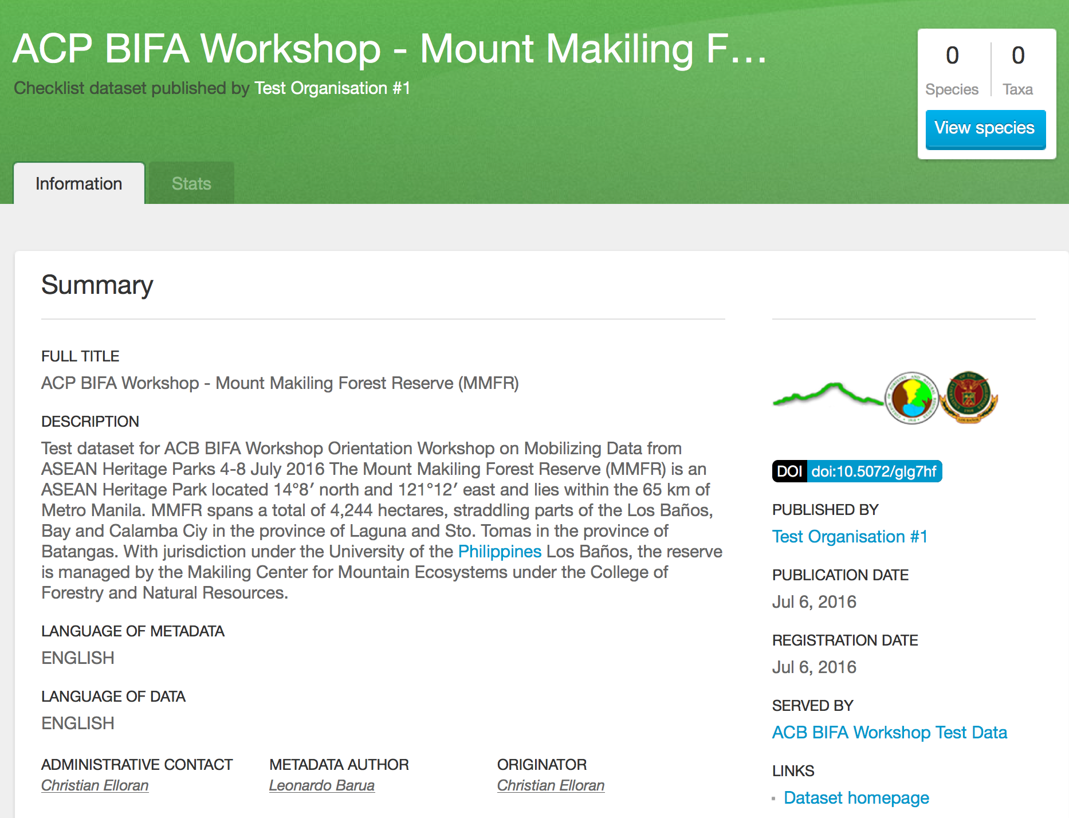
PubliC dataset
Notes:
http://www.gbif-uat.org/dataset/bcbf7a3f-9869-440a-829c-bfcd16451117
http://bim-mirror.aseanbiodiversity.org:8080/ipt_test/manage/resource.do?r=makiling_mmfr
--
http://bim-mirror.aseanbiodiversity.org:8080/ipt/resource?r=mcme_uplb_museum_plant_collection

Slide 37
IPT hands-on
try yourself
Notes:
Slide modified from iDigBio 2015, Data Sharing, Data Standards, and Demystifying the IPT Workshop, https://www.idigbio.org/ :: Laura Russell (David Shorthouse) - Demo: Publishing with the IPT: Adding a data source and mapping data

Slide 38
Demo hands-on IPT – User manual
GBIF IPT Manual
https://github.com/gbif/ipt/wiki/IPT2ManualNotes.wiki
Notes:
https://github.com/gbif/ipt/wiki/IPT2ManualNotes.wiki

Slide 39
Demo hands-on IPT – Try yourself
ACP BIFA Workshop demo IPT:
http://bim-mirror.aseanbiodiversity.org:8080/ipt_test/
Login: <removed from public slides>
Password: <removed from public slides>
GBIF Demo portal (after you publish and register):
http://www.gbif-uat.org/installation/94087c7f-8682-4984-a65d-7bacb95d1665
Notes:
ACP BIFA Workshop demo IPT:
http://bim-mirror.aseanbiodiversity.org:8080/ipt_test/
Login: <removed from public slides>
Password: <removed from public slides>
GBIF Demo portal (after you publish and register):
http://www.gbif-uat.org/installation/94087c7f-8682-4984-a65d-7bacb95d1665

Slide 40
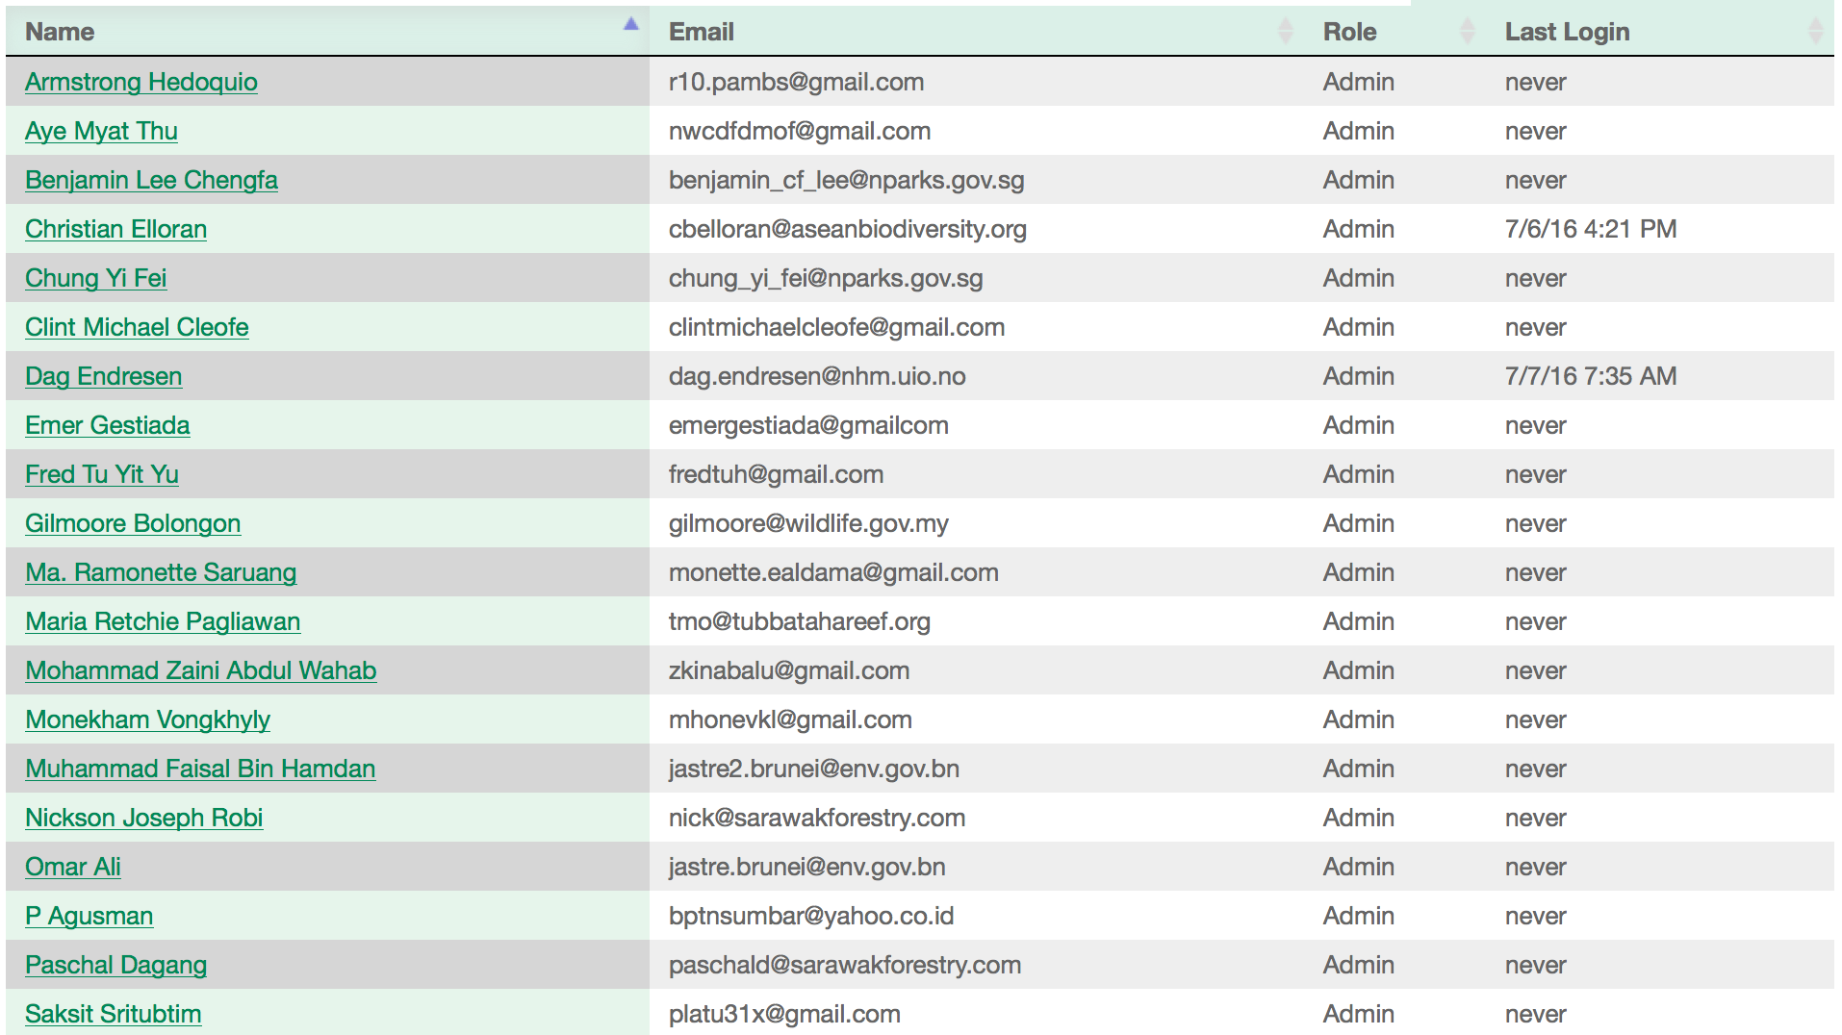
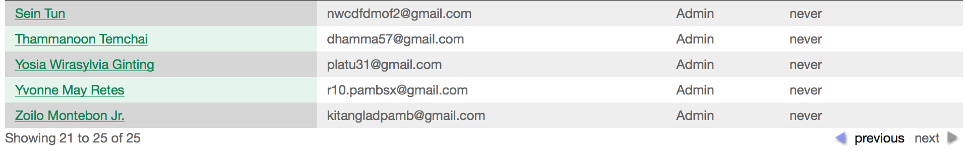
Demo hands-on IPT – User Accounts
Notes:
ACP BIFA Workshop demo IPT:
http://bim-mirror.aseanbiodiversity.org:8080/ipt_test/
Login: <removed from public slides>
Password: <removed from public slides>
GBIF Demo portal (after you publish and register):
http://www.gbif-uat.org/installation/94087c7f-8682-4984-a65d-7bacb95d1665

Slide 41
Demo hands-on IPT
ACP BIFA Workshop demo IPT (test dataset):
http://bim-mirror.aseanbiodiversity.org:8080/ipt_test/resource?r=makiling_mmfr
GBIF Demo portal (after publish and register):
http://www.gbif-uat.org/dataset/bcbf7a3f-9869-440a-829c-bfcd16451117
Notes:
ACP BIFA Workshop demo IPT (test dataset):
http://bim-mirror.aseanbiodiversity.org:8080/ipt_test/resource?r=makiling_mmfr
GBIF Demo portal (after publish and register):
http://www.gbif-uat.org/dataset/bcbf7a3f-9869-440a-829c-bfcd16451117

Slide 42
Demo hands-on IPT – Alternative
GBIF Norway Demo IPT (for this workshop):
http://data.gbif.no/ipt-sandbox/
Admin login: <removed from public slides>
Admin password: <removed from public slides>
(you can create your own user account)
Notes:
GBIF Norway Demo IPT (for this workshop):
http://data.gbif.no/ipt-sandbox/
Admin login: <removed from public slides>
Admin password: <removed from public slides>

Slide 43
IPT Support
GBIF Helpdesk: helpdesk@gbif.org
IPT GitHub site: https://github.com/gbif/ipt/
Community site: http://community.gbif.org/pg/groups/3529/gbif-ipt-helpdesk-and-training-experts/
IPT mailing list: http://lists.gbif.org/mailman/listinfo/ipt/
IPT user manual: https://github.com/gbif/ipt/wiki/IPT2ManualNotes.wiki

Slide 44

Data publishing workshop
IPT – Integrated data publishing toolkit
Forth day 7th July 2016
Los Baños, Laguna, Philippines
Dag Endresen, GBIF Norway, UiO

