Slide 1





Data publishing workshop
IPT Event core, sampling data
Forth day 7th July 2016
Los Baños, Laguna, Philippines
Dag Endresen, GBIF Norway, UiO
Notes:
GBIF/BIFA data publishing workshop, 4-8 July 2016, ASEAN Heritage Parks, ASEAN Centre for Biodiversity, Los Baños, Laguna, Philippines
Slides CC-BY/CC0 Dag Endresen, Global Biodiversity Information Facility (GBIF) in Norway, UiO Natural History Museum in Oslo, University of Oslo (feel free to reuse slides)
Day 4: 7th July 2016: IPT Event core, sampling and monitoring data
Mobilizing biodiversity data from ASEAN protected areas
The goal of this project is to facilitate the mobilization of biodiversity information from the Association of Southeast Asian Nations (ASEAN) Heritage Parks – regionally significant protected areas for biodiversity.
At present, biodiversity data collected from park surveys are documented through various means and do not always conform to global standards. A workshop for selected park management staff will strengthen their skills in biodiversity information management and data publishing through hands-on exercises using datasets from the heritage parks. This project will also orient heritage park staff towards monitoring sites with camera traps, and prepare them for the publishing of sample-based data in the future.
The outcome of the project will be an increase in the availability and access to data from the protected areas, to assist policy development.
http://www.gbif.org/programme/bifa/2015/ASEAN-heritage-parks
Slide source: GB23 Nodes Madagascar October 2015, http://community.gbif.org/pg/pages/view/47903/ & Norwegian GBIF data publishing workshop in Trondheim October 2015, http://www.gbif.no/events/2015/data-publishing-workshop-october-2015.html

Slide 2

INDEX
Event core (for IPT)
Metadata for sample-based data

Slide 3

Event core

Slide 4
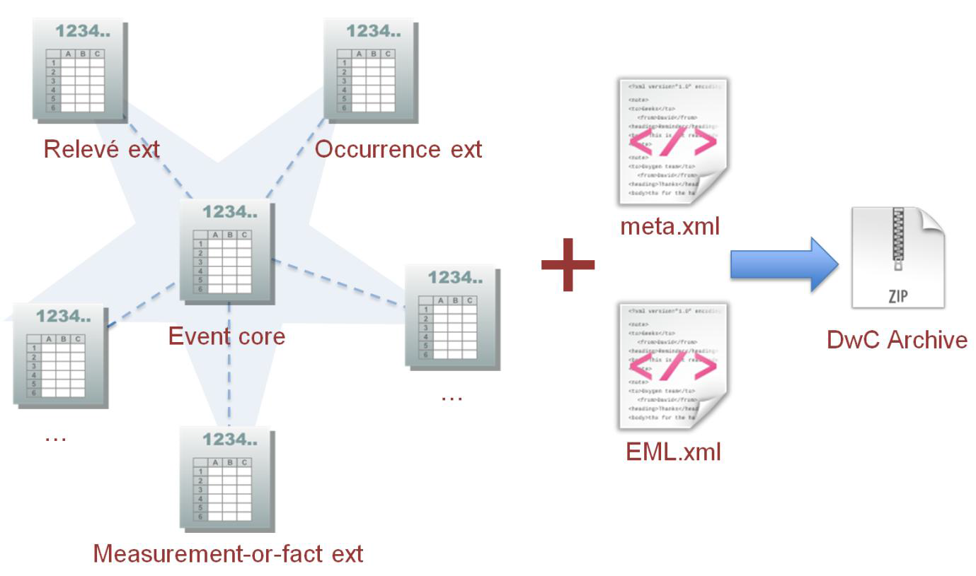
Enabling Sample-Data publishing: Star schema

Slide 5
Enabling Sample-Data publishing: DWC vocabulary
7 essential terms for encoding sample data:
eventID
parentEventID (new)
samplingProtocol
sampleSize (new)
sampleSizeUnit (new)
organismQuantity (new)
organismQuantityType (new)

Slide 6
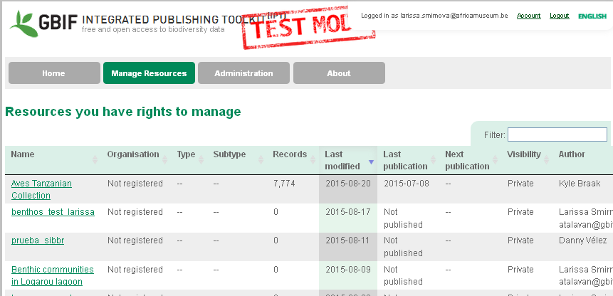
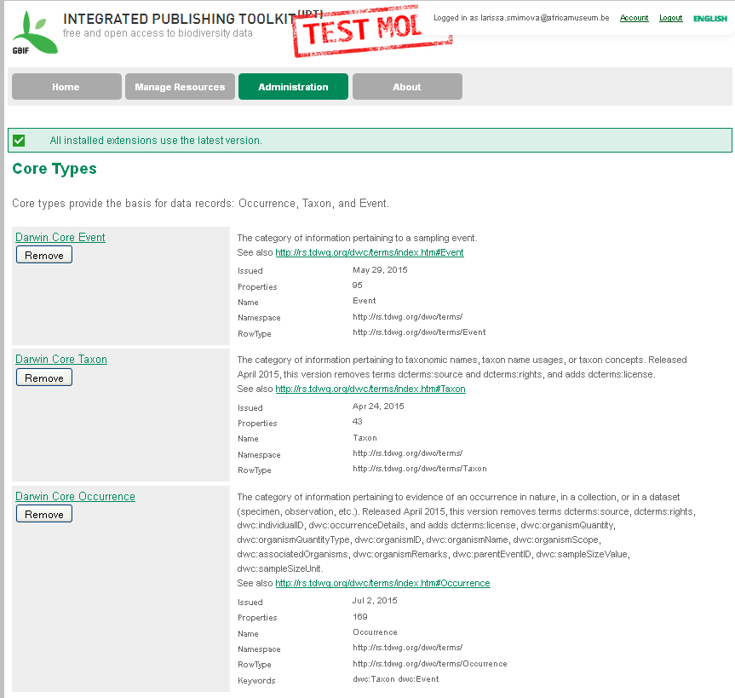
Enabling Sample-Data publishing: IPT v.2.3
NEW FEATURES:
Event core and extensions.
Possibility to assign DOIs to resources.
Auto-generation of a citation for a resource including the version number and DOI.
Machine readable licenses.

Slide 7
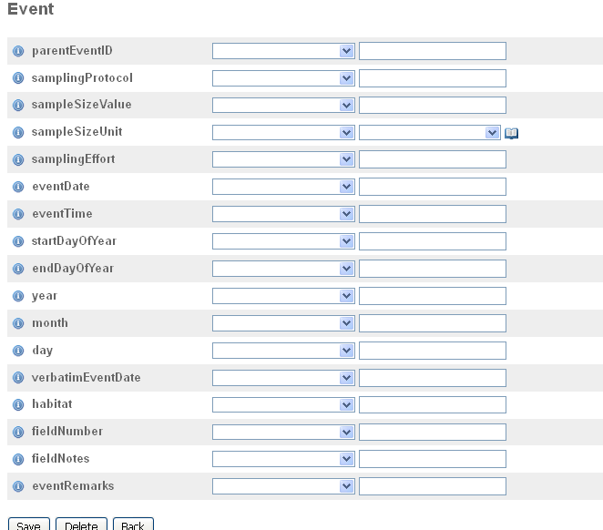
Event CORE – KEY TERMS
Slide source: GBIF GB23 Nodes training 2015

Slide 8
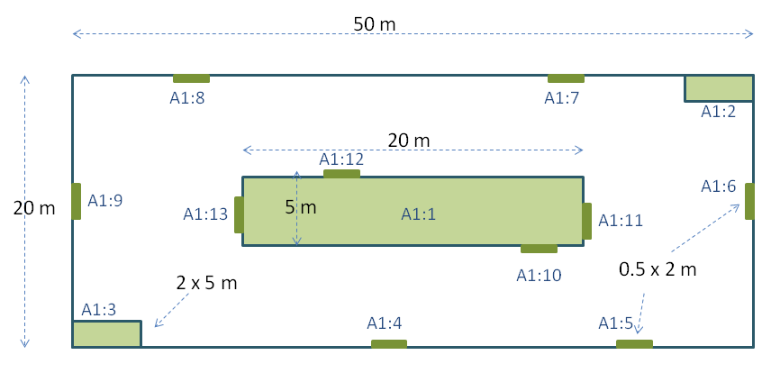
new DwC terms
eventID and parentEventID
Sampling events can be related to each other (e.g. nested samples) via a common parent identifier.
Information on the nature of the relationship (e.g. part of a monitoring series) can be described in the project section of the accompanying metadata.
A Whittaker plot with sub-plots of varying area
Slide source: GBIF GB23 Nodes training 2015

Slide 9
new DwC terms
sampleSize
A numeric value for the time duration, length, area or volume involved in the sampling event.
sampleSizeUnit
The unit of measurement used in the sampling event, e.g., minute, hour, day, metre, square metre, cubic metre.
sampleSize | sampleSizeUnit
2 | hour
6 | m2
1 | litre
3 | km
Slide source: GBIF GB23 Nodes training 2015

Slide 10
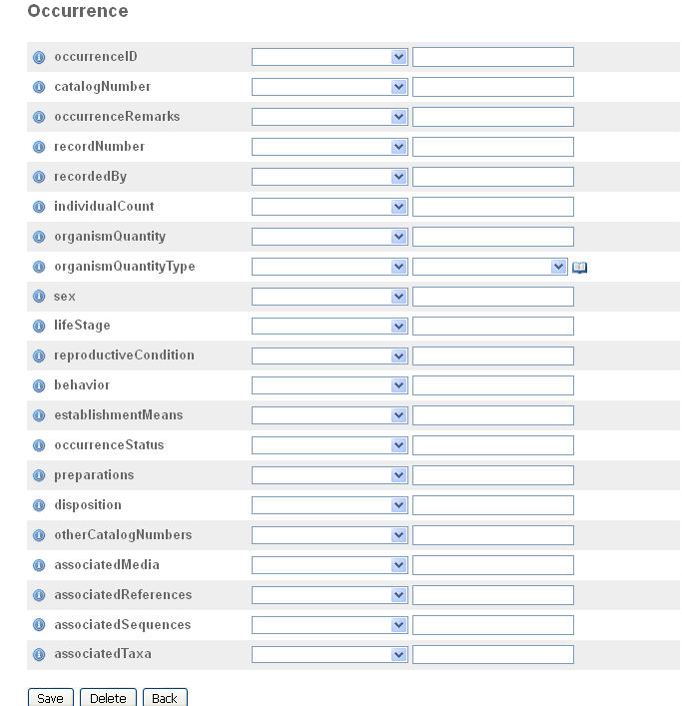
Occurrence extension: KEY TERMS
Slide source: GBIF GB23 Nodes training 2015

Slide 11
Data: new DwC terms
organismQuantity
A number or enumeration value for the quantity of organisms. Use with organismQuantityType to indicate the type of entity that is being quantified.
organismQuantityType
The type of entity to which the number or enumeration value reported for the quantity of organisms in organismQuantity refers.
organismQuantity | organismQuantityType
14 | Individuals
r | BraunBlanquetScale
31 | %Biomass
0.4 | %Species
Slide source: GBIF GB23 Nodes training 2015

Slide 12
Event core & metadata

Slide 13
The importance of metadata
Metadata is ESSENTIAL for sample-based data:
Documenting the project data: description of sampling/monitoring activity.
Documenting sampling methods: protocols, data quality and sampling steps.
Dataset documentation enables users to evaluate the fitness for use of a dataset.
Slide source: GBIF GB23 Nodes training 2015, Alberto González-Talaván
Notes:
Slide source: Modified from 1B Publishing Primary Biodiversity Data by Alberto González-Talaván^{1~} Data Sharing, Data Standards, and Demystifying the IPT ~ Gainesville, FL, USA. 13 January 2015, http://www.gbif.org/resource/82197

Slide 14
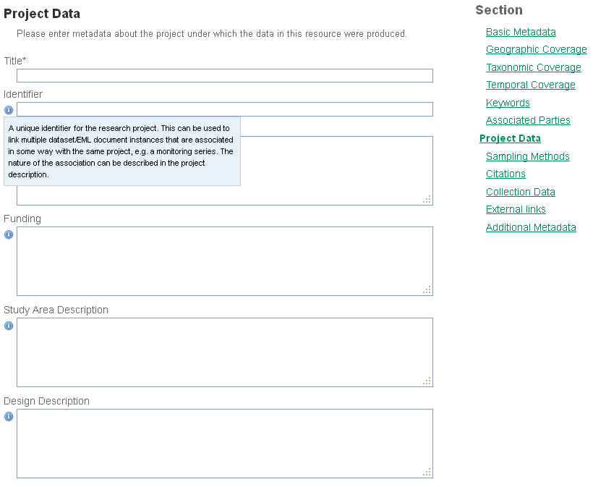
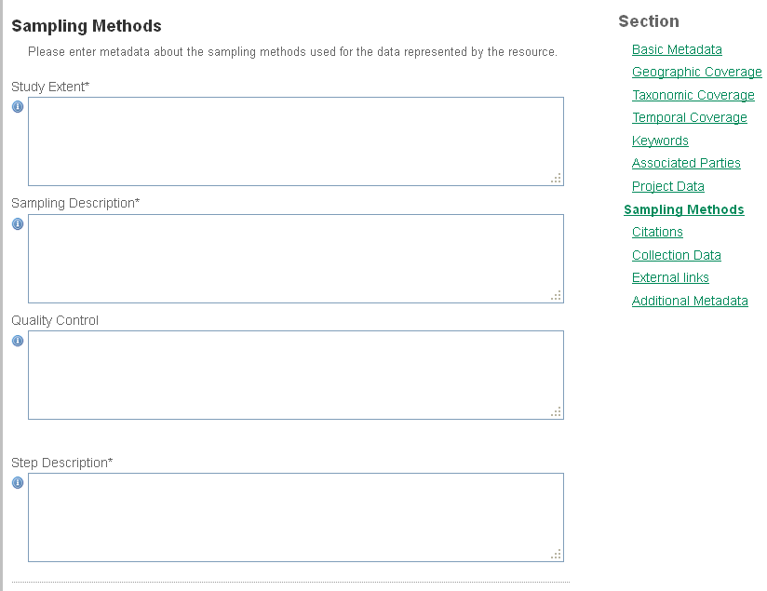
METADATA: project data & Sampling Methods
Slide source: GBIF GB23 Nodes training 2015

Slide 15
Metadata EXAMPLE: Study extent
“Seasonal (4 seasons) records of zoobenthic communities across confinement gradient in 5 coastal lagoons (Mazoma, Tsopeli,Tsoukalio, Rodia and Logarou)”.
“The floristic inventories was conducted at the Sierra Nevada (Andalusia, southeast Spain). Forest cover in Sierra Nevada is dominated by pine plantations (Pinus halepensis Mill., Pinus pinaster Ait., Pinus nigra Arnold. subsp. salzmannii (Dunal) Franco, and Pinus sylvestris L.) that covering approximately 40,000 ha…”.
“Transect walks were conducted once in two weeks from the beginning of October to the end of June on the territory of Israel”.
Sampling area/habitat + Sampling frequency
Slide source: GBIF GB23 Nodes training 2015

Slide 16
metadata EXAMPLE: Sampling description
“Box corer for 0.03 square meters area sampled”.
“Transect lengths range between 300 and 600 m in length, and divide into 50 m sections. Transect usually cover a single habitat type. In each visit, transect-walkers count all butterfly species that can be seen within a range of 5 m range. Special behaviours (egg laying or nectaring), as well as butterfly larvae or eggs, can be registered as well”.
“The dataset includes data from 1,879 sites, collected using standard RLS survey methods, described in detail in an online methods manual. Surveys involve underwater visual census by SCUBA divers along a 50 m transect line, laid along a depth contour on hard substrate. All fish species observed within 5 m of the transect line were recorded on a waterproof datasheet as the diver swam slowly along the line (at approximately 2 m/min)…”
Description of sampling procedures
Slide source: GBIF GB23 Nodes training 2015

Slide 17
metadata EXAMPLE: Quality control
“Record validation and cleaning was incorporated at several steps of the documentation process: the scientific names on labels were checked with a taxonomic thesaurus… We assigned scientific names in accordance to current taxonomy trends. Geographic coordinates were verified using the “Check Coordinates” function in DIVA-GIS”.
“Every reported record is flagged ‘forApproval’. Record status is changed to "Approved" upon and by expert only“.
“Each sampling plot was checked to ensure whether the geographical coordinates were correct. The databases of International Plant Names Index (IPNI, 2013) and Catalogue of Life/Species 2000 to verify the taxonomical classification”.
Quality control actions
Slide source: GBIF GB23 Nodes training 2015

Slide 18
metadata EXAMPLE: Step description
“Replicates were collected at two stations, one inside and one outside the lagoon, using a box corer (0.03 m2 sampling surface). The samples were sieved through a 0.5 mm mesh sieve, stained with Rose Bengal and preserved in 4% formalin. All benthic organisms were sorted in the lab and identified and counted using stereo- and microscopes”.
“1. Selection and rout of transect is accompanied by an scientific/principal investigator. 2. Identification of the capabilities of the observer are verified tested along timeline 3. Time start and weather condition are recorded first. 4. During transect walk, the number seen of every species is counted…”.
“This dataset was compiled from data collected in a combination of collaborative surveys with scientific colleagues worldwide, targeted RLS field campaigns and ad-hoc local surveys by trained RLS divers at their regular dive sites or when on holidays. Field campaigns involved small groups of divers (usually 4 to 8) undertaking survey dives over a period of four days to two weeks under the direction and supervision of a scientist or experienced survey diver“.
Methods, procedures, processing steps
Slide source: GBIF GB23 Nodes training 2015

Slide 19
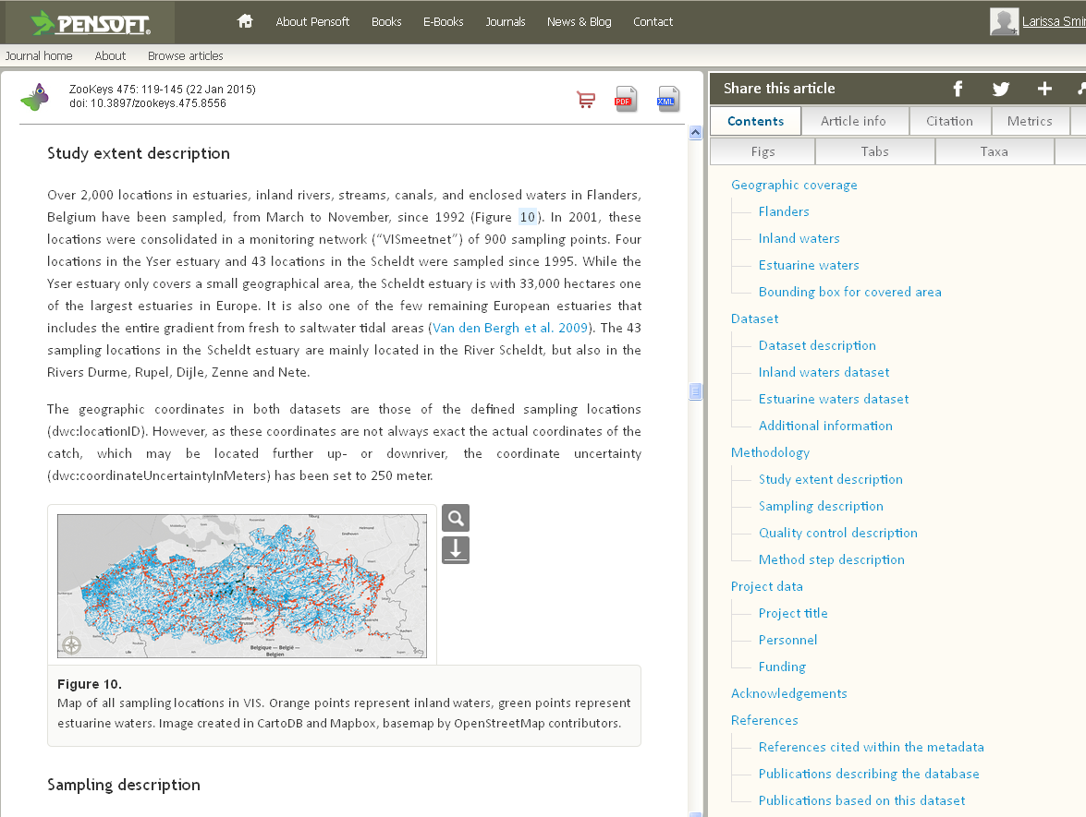
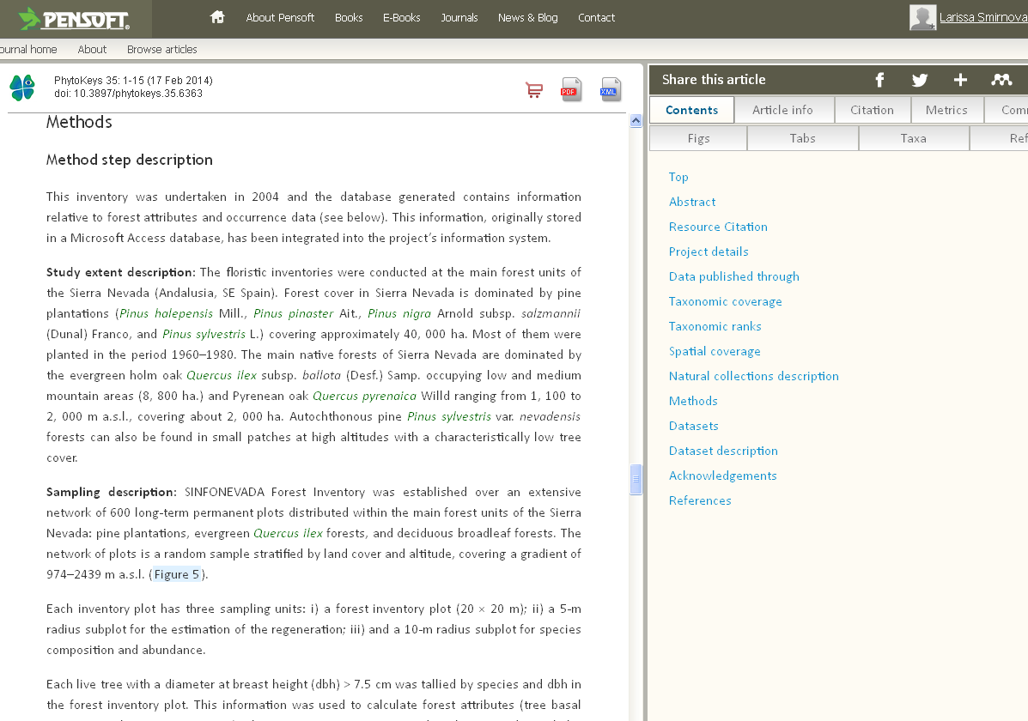
Metadata and data papers
Slide source: GBIF GB23 Nodes training 2015, Alberto González-Talaván
Notes:
http://www.gbif.org/publishing-data/data-papers

Slide 20
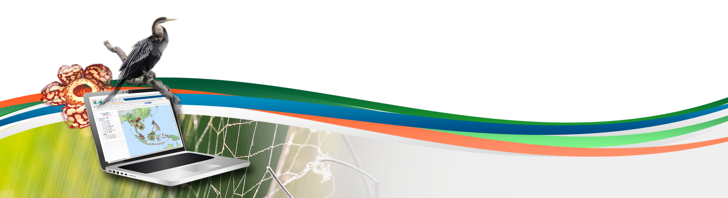
Data publishing workshop
IPT Event core, sampling data
Forth day 7th July 2016
Los Baños, Laguna, Philippines
Dag Endresen, GBIF Norway, UiO

