Slide 1





Data publishing workshop
Data management
Fifth day 8th July 2016
Los Baños, Laguna, Philippines
Dag Endresen, GBIF Norway, UiO
Notes:
GBIF/BIFA data publishing workshop, 4-8 July 2016, ASEAN Heritage Parks, ASEAN Centre for Biodiversity, Los Baños, Laguna, Philippines
Slides CC-BY/CC0 Dag Endresen, Global Biodiversity Information Facility (GBIF) in Norway, UiO Natural History Museum in Oslo, University of Oslo (feel free to reuse slides)
Day 5: 8th July 2016: The GBIF Facility – Data management, dataset metadata, Pensoft data paper (2016-07-06, 08:30 – 09:30, 1 hour)
Mobilizing biodiversity data from ASEAN protected areas
The goal of this project is to facilitate the mobilization of biodiversity information from the Association of Southeast Asian Nations (ASEAN) Heritage Parks – regionally significant protected areas for biodiversity.
At present, biodiversity data collected from park surveys are documented through various means and do not always conform to global standards. A workshop for selected park management staff will strengthen their skills in biodiversity information management and data publishing through hands-on exercises using datasets from the heritage parks. This project will also orient heritage park staff towards monitoring sites with camera traps, and prepare them for the publishing of sample-based data in the future.
The outcome of the project will be an increase in the availability and access to data from the protected areas, to assist policy development.
http://www.gbif.org/programme/bifa/2015/ASEAN-heritage-parks
Slide source: GB23 Nodes Madagascar October 2015, http://community.gbif.org/pg/pages/view/47903/
& Norwegian GBIF data publishing workshop in Trondheim October 2015, http://www.gbif.no/events/2015/data-publishing-workshop-october-2015.html
Credits: EUDAT/OpenAire, December 2015 & May 2016, CC-BY-4.0
* http://www.slideshare.net/EUDAT/eudat-research-data-management
* http://www.slideshare.net/EUDAT/research-data-management-introduction-eudatopen-aire-webinar?ref=https://eudat.eu/events/webinar/research-data-management-an-introductory-webinar-from-openaire-and-eudat
* https://eudat.eu/events/webinar/research-data-management-an-introductory-webinar-from-openaire-and-eudat
* http://www.instantpresenter.com/WebConference/RecordingDefault.aspx?c_psrid=EB57D6888147

Slide 2

INDEX
Develop a data management plan
Publish & archive biodiversity data
Use persistent data identifiers
Use data standards
Ecological Metadata Language (EML)
Data paper & data citation

Slide 3
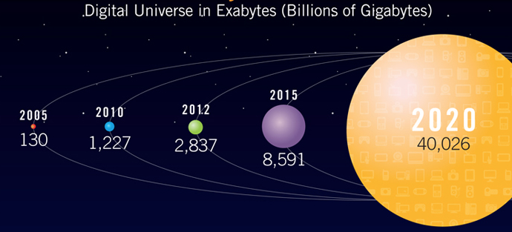


Exponential growth of digital data
The digital universe will double every two years between now and 2020. The growth is mostly unstructured data.
A major factor behind the expansion is the growth of machine generated data (from 11% in 2005 to over 40% in 2020).
Source: EMC/IDC Digital Universe Study, 2012
Notes:
Source: EMC/IDC Digital Universe Study, 2012, http://www.informationleap.com/infographics/digital-universe-business-infographic.htm
http://www.informationleap.com/about/news/press/2012/20121211-01.htm
http://www.emc.com/leadership/digital-universe/index.htm

Slide 4
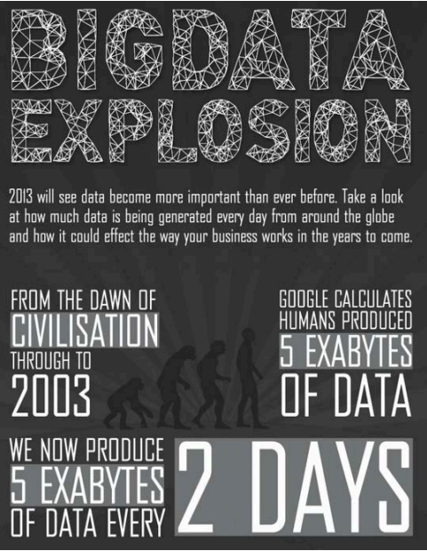
Data explosion
More and more data is being created
Issue is not creating data, but being able to navigate and use it
Data management is critical to make sure data are well-organised, understandable and reusable
Source: OpenAIRE, 2013
Source: OpenAIRE & EUDAT, CC-BY-4.0, 2013
Notes:
Slide source: OpenAIRE & EUDAT, Research data management, CC-BY-4.0 Tony Ross-Hellauer (OpenAIRE) and Sarah Jones (EUDAT), http://www.slideshare.net/EUDAT/research-data-management-introduction-eudatopen-aire-webinar
There’s been a data explosion.
1. 90% of all the data in the world has been generated over the last 2 years.
2. Scientific data output is currently increasing at an annual rate of 30%.
As the amount of data being created now is growing exponentially, the biggest challenge is being able to navigate and use it. This is why data management is critical.

Slide 5
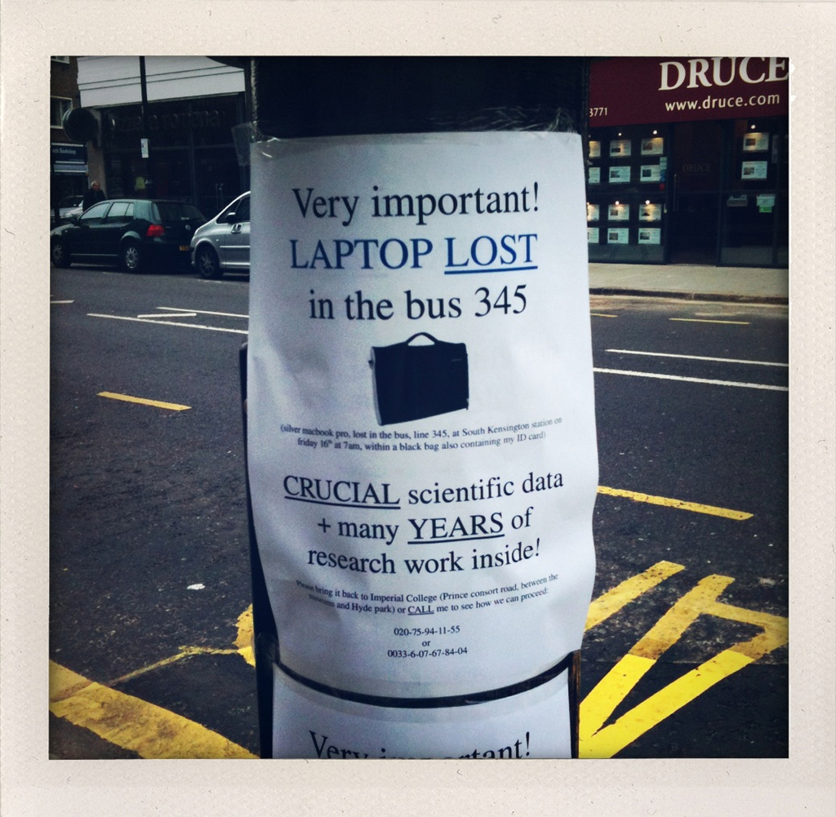
Data loss
Digital data are fragile and susceptible
to loss for a wide variety of reasons:
  Natural disaster
  Facilities infrastructure failure
  Storage failure
  Server hardware/software failure
  Application software failure
  Format obsolescence
  Legal encumbrance
  Human error
  Malicious attack
  Loss of staffing competencies
  Loss of institutional commitment
  Loss of financial stability
  Changes in user expectations
Slide source: OpenAIRE & EUDAT, CC-BY-4.0, 2013
Image CC BY-NC-SA 2.0 by Dave Hill https://www.flickr.com/photos/dmh650/4031607067
Notes:
Slide source: OpenAIRE & EUDAT, Research data management, CC-BY-4.0 Tony Ross-Hellauer (OpenAIRE) and Sarah Jones (EUDAT), http://www.slideshare.net/EUDAT/research-data-management-introduction-eudatopen-aire-webinar
Image CC-BY-NC-SA-2.0 Dave Hill, https://www.flickr.com/photos/dmh650/4031607067
Digital data are fragile. There are lots of ways in which data can be lost. Hardware and software can fail, formats can become obsolete, you can lose the knowledge and skills needed to understand the data, and you can lose the investment needed to keep the data accessible. Despite significant investment, data is not being managed effectively
The current estimated total global spend on research and development is $1.5 trillion, which could be at risk.
Much of the data generated is lost – in one study, the odds of sourcing datasets declined by 17% each year.
The same study found 80% of datasets over 20 years old not available.

Slide 6

Where to store data?
Your own drive (PC, server, flash drive, etc.)
  And if you lose it? Or it breaks?
Somebody else’s drive / departmental drive
“Cloud” drive
    Do they care as much about your data as you do?
Large scale infrastructure services like Data One or EUDAT
3... 2... 1... backup!
  at least 3 copies of a file
  on at least 2 different media
  with at least 1 offsite
Slide source: OpenAIRE & EUDAT, CC-BY-4.0, 2013
Notes:
Slide source: OpenAIRE & EUDAT, Research data management, CC-BY-4.0 Tony Ross-Hellauer (OpenAIRE) and Sarah Jones (EUDAT), http://www.slideshare.net/EUDAT/research-data-management-introduction-eudatopen-aire-webinar
There are lots of places you can store your data. You’re best to use managed services where possible as they’re more resilient. If you store data on standalone computers, memory sticks or in the cloud, be mindful of the risk of loss or security breaches.

Slide 7
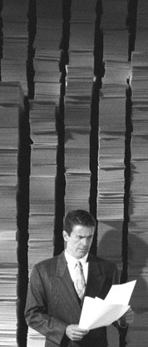
Backup and preservation
– not the same thing!
Backups
  Periodic snapshots of data in case the current version is destroyed or lost
  Backups are copies of files stored for short or near-long-term
  Often performed on a somewhat frequent schedule
Archiving
  Preserve data for historical reference
  Usually the final version, stored for long-term, and generally not copied over
  Often performed at the end of a project or during major milestones
Slide source: OpenAIRE & EUDAT, CC-BY-4.0, 2013
Notes:
Slide source: OpenAIRE & EUDAT, Research data management, CC-BY-4.0 Tony Ross-Hellauer (OpenAIRE) and Sarah Jones (EUDAT), http://www.slideshare.net/EUDAT/research-data-management-introduction-eudatopen-aire-webinar
Remember that backup and preservation are not the same thing (though the terms are often used interchangeably).
Backups are performed regularly to take periodic snapshots of the data for the short to medium term, whereas archiving is preserving the final version of the data for the long-term.
You should make sure your data are backed-up during the active phase of research and that any data needed for the long-term are archived.

Slide 8

FAIR data
Findable
  assign persistent IDs, provide rich metadata, register in a searchable resource... (such as GBIF)
Accessible
  Retrievable by their ID using a standard protocol, metadata remain accessible even if data aren’t...
Interoperable
  Use formal, broadly applicable languages, use standard vocabularies, qualified references... (e.g. Darwin Core, …)
Reusable
  Rich, accurate metadata, clear licences, provenance, use of community standards... (e.g. Dublin Core, EML, …)
www.force11.org/group/fairgroup/fairprinciples
Slide source: OpenAIRE & EUDAT, CC-BY-4.0, 2013
Notes:
Slide source: OpenAIRE & EUDAT, Research data management, CC-BY-4.0 Tony Ross-Hellauer (OpenAIRE) and Sarah Jones (EUDAT), http://www.slideshare.net/EUDAT/research-data-management-introduction-eudatopen-aire-webinar

Slide 9
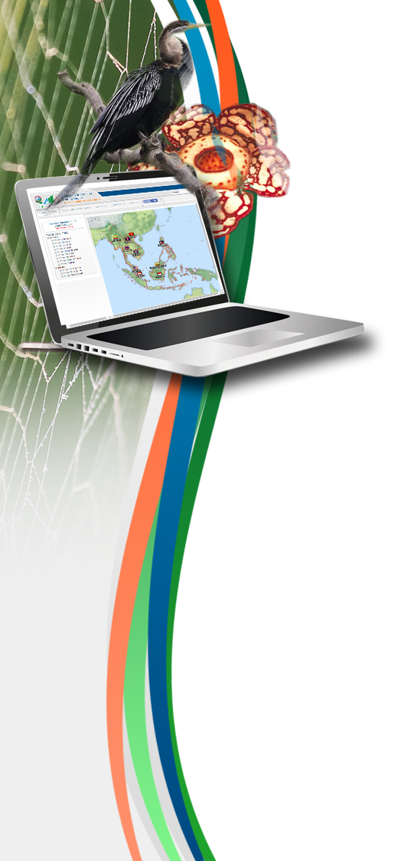
Develop a data management plan

Slide 10
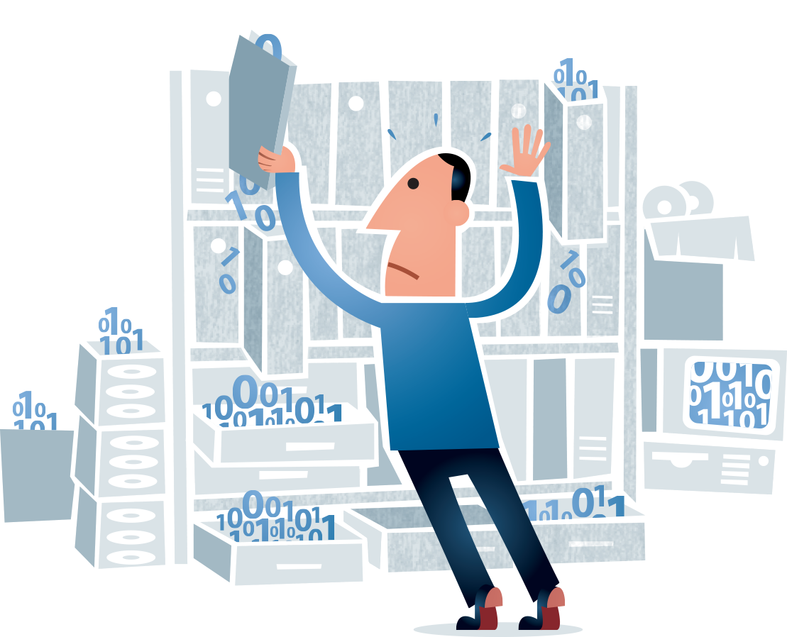
Data management plan
Making your data available to others ensures
that your research is truly reproducible.
Managing your research data saves you time because it ensures that you and others in your collaboration will be able to find, understand, and use the data.
Sharing your research data enables wider dissemination of your work.
Enabling others to use your data reinforces open scientific inquiry and can lead to new and unanticipated discoveries.
Graphics by Jørgen Stamp CC-BY
Source: Georgia Tech Library
Notes:
Slide source: Data Management Plan, Georgia Tech Library, http://d7.library.gatech.edu/research-data/data-management-plan-components
Graphics created by Jørgen Stamp and published under a Creative Commons Attribution 2.5 Denmark License.
10 Simple Rules for the Care and Feeding of Scientific Data, http://arxiv.org/abs/1401.2134, doi:10.1371/journal.pcbi.1003542

Slide 11

Data management plan
Description of data to be produced or collected, including data standards or formats. [e.g. Darwin Core & Darwin Core archive]
Identification of protocols or workflows to help manage data throughout the project.
Description of documentation and metadata standards to describe the data. [e.g. Ecological Metadata Language, EML]
Plan for short-term data storage & backup, including necessary security measures.
Plan for sharing data, including legal and ethical issues, intellectual property issues, or access policies and provisions.
Plan for data preservation, archiving and long-term access.
Plan for allocating responsibility for data management within your research project.
Source: Georgia Tech Library
Notes:
Slide source: Data Management Plan, http://d7.library.gatech.edu/research-data/data-management-plan-components
Graphics created by Jørgen Stamp and published under a Creative Commons Attribution 2.5 Denmark License.
10 Simple Rules for the Care and Feeding of Scientific Data, http://arxiv.org/abs/1401.2134, doi:10.1371/journal.pcbi.1003542

Slide 12

Data Management Plan
A DMP is a brief plan to define:
how the data will be created?
how it will be documented?
who will access it?
where it will be stored?
who will back it up?
whether (and how) it will be shared & preserved?
DMPs are often submitted as part of grant applications, but are useful whenever researchers are creating data.
Slide source: OpenAIRE & EUDAT, CC-BY-4.0, 2013
Notes:
Slide source: OpenAIRE & EUDAT, Research data management, CC-BY-4.0 Tony Ross-Hellauer (OpenAIRE) and Sarah Jones (EUDAT), http://www.slideshare.net/EUDAT/research-data-management-introduction-eudatopen-aire-webinar
A Data Management Plan is often written early on in the research process to determine what data will be created and how it will be managed. Sometime you are asked for a DMP as part of a grant application, but they are useful to write regardless as it helps to develop consistent procedures from the outset.

Slide 13
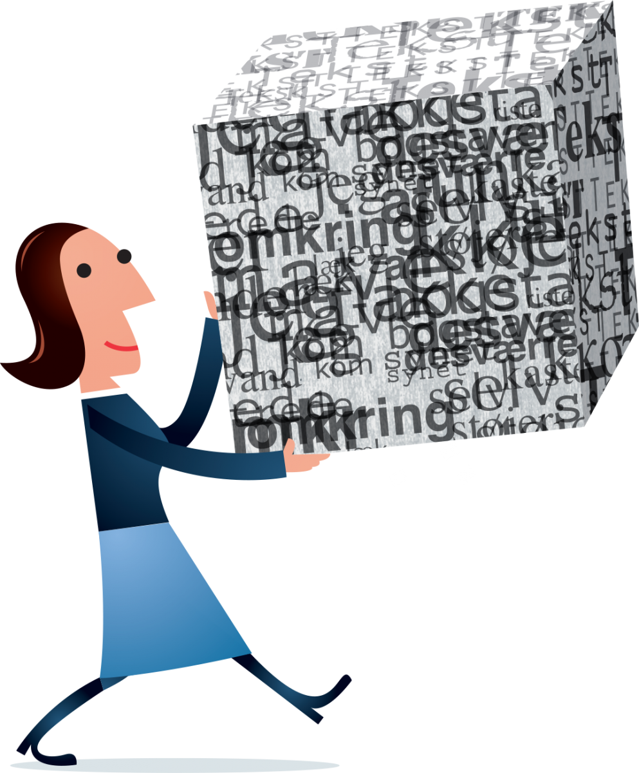
Publish & archive your research data!
Graphic by Jørgen Stamp CC-BY

Slide 14
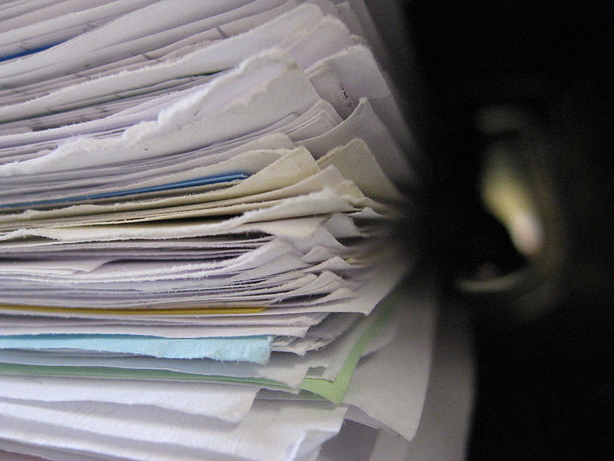

Many biodiversity research data are “hidden” in reports and documents produced by universities, research institutes, public agencies and the university museums.
Publish your biodiversity data!
Photo by: Niklas Bildhauer
Notes:
Image originally posted to Flickr as folder Author Niklas Bildhauer (who also is User gerolsteiner91. http://flickr.com/photos/14498569@N05/2434418686. Licensed under the Creative Commons Attribution-Share Alike 2.0 Generic license. http://commons.wikimedia.org/wiki/File:FileStack.jpg

Slide 15
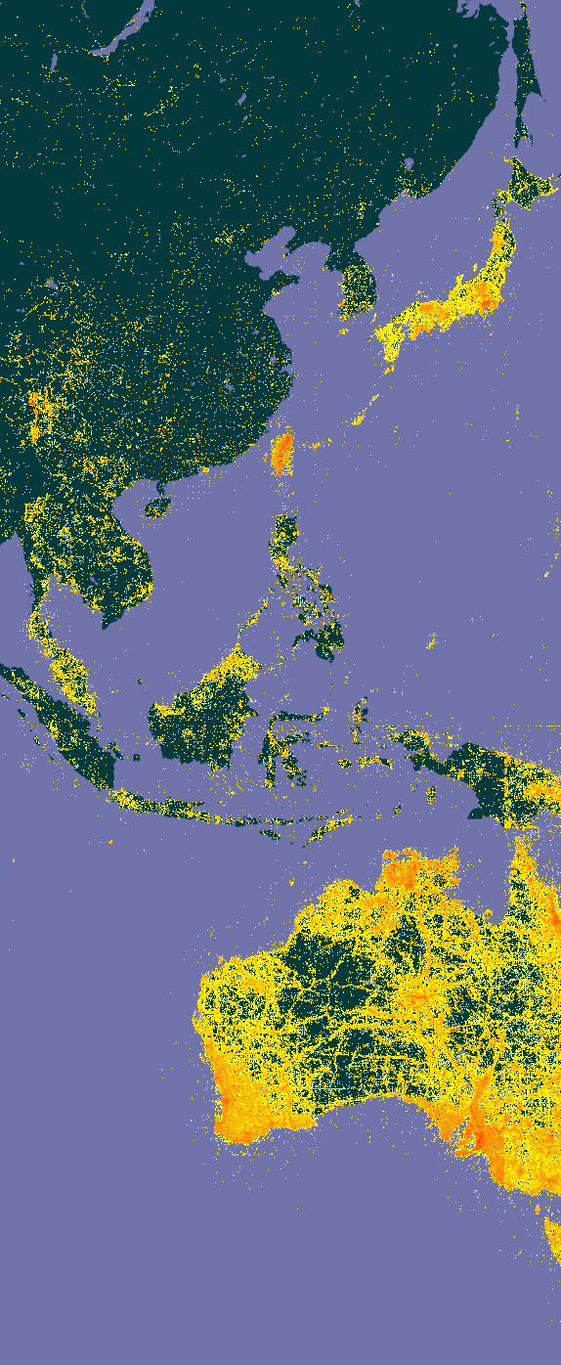
Publish and archive your own Biodiversity data
The GBIF helpdesk will assist with publishing your species occurrence data: send an email to helpdesk@gbif.org
You can also install a data publishing software such as the GBIF Integrated Publishing Toolkit (IPT).
Citizen Science portals such as iNaturalist, …
We recommend using a long-term data archiving platform such as Data ONE, Dryad, FigShare, etc…
Notes:
http://www.gbif.org/publishingdata/summary
http://www.gbif.org/ipt

Slide 16



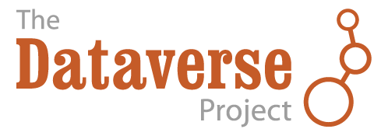



Online data archiving repository
Rather than leaving your research data on a local server or in cloud storage, archive your data with a trusted digital repository. Many repositories create metadata and documentation to ensure that the data will be discoverable in the future.
Notes:
https://www.dataone.org/
http://dataverse.org/
http://figshare.com/
https://zenodo.org/
http://datadryad.org/

Slide 17

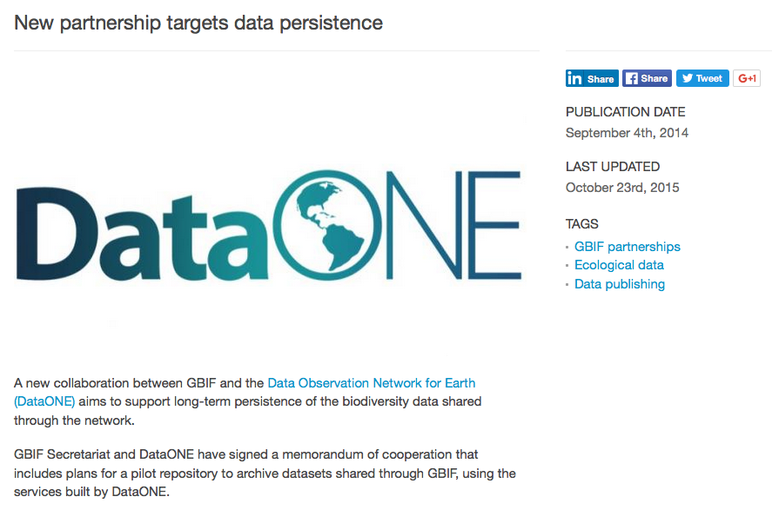
Data ONE
Source: GBIF News story, September 2014, DataONE: http://www.gbif.org/page/8199
Notes:
http://www.gbif.org/page/8199
https://www.dataone.org/
http://dataverse.org/
http://figshare.com/
https://zenodo.org/
http://datadryad.org/

Slide 18
GBIF and the Data Observation Network for Earth (DataONE) collaborate to support long-term persistence of the biodiversity data shared through the GBIF network. The collaboration is part of a commitment in the GBIF Work Programme to explore data archival services offering redundancy to handle scenarios such as technical failure and the disappearance of projects or institutions that share data through the network.
Source: GBIF News story, September 2014, DataONE: http://www.gbif.org/page/8199
Notes:
GBIF News September 4th 2014, DataONE: http://www.gbif.org/page/8199
https://www.dataone.org/
http://dataverse.org/
http://figshare.com/
https://zenodo.org/
http://datadryad.org/

Slide 19
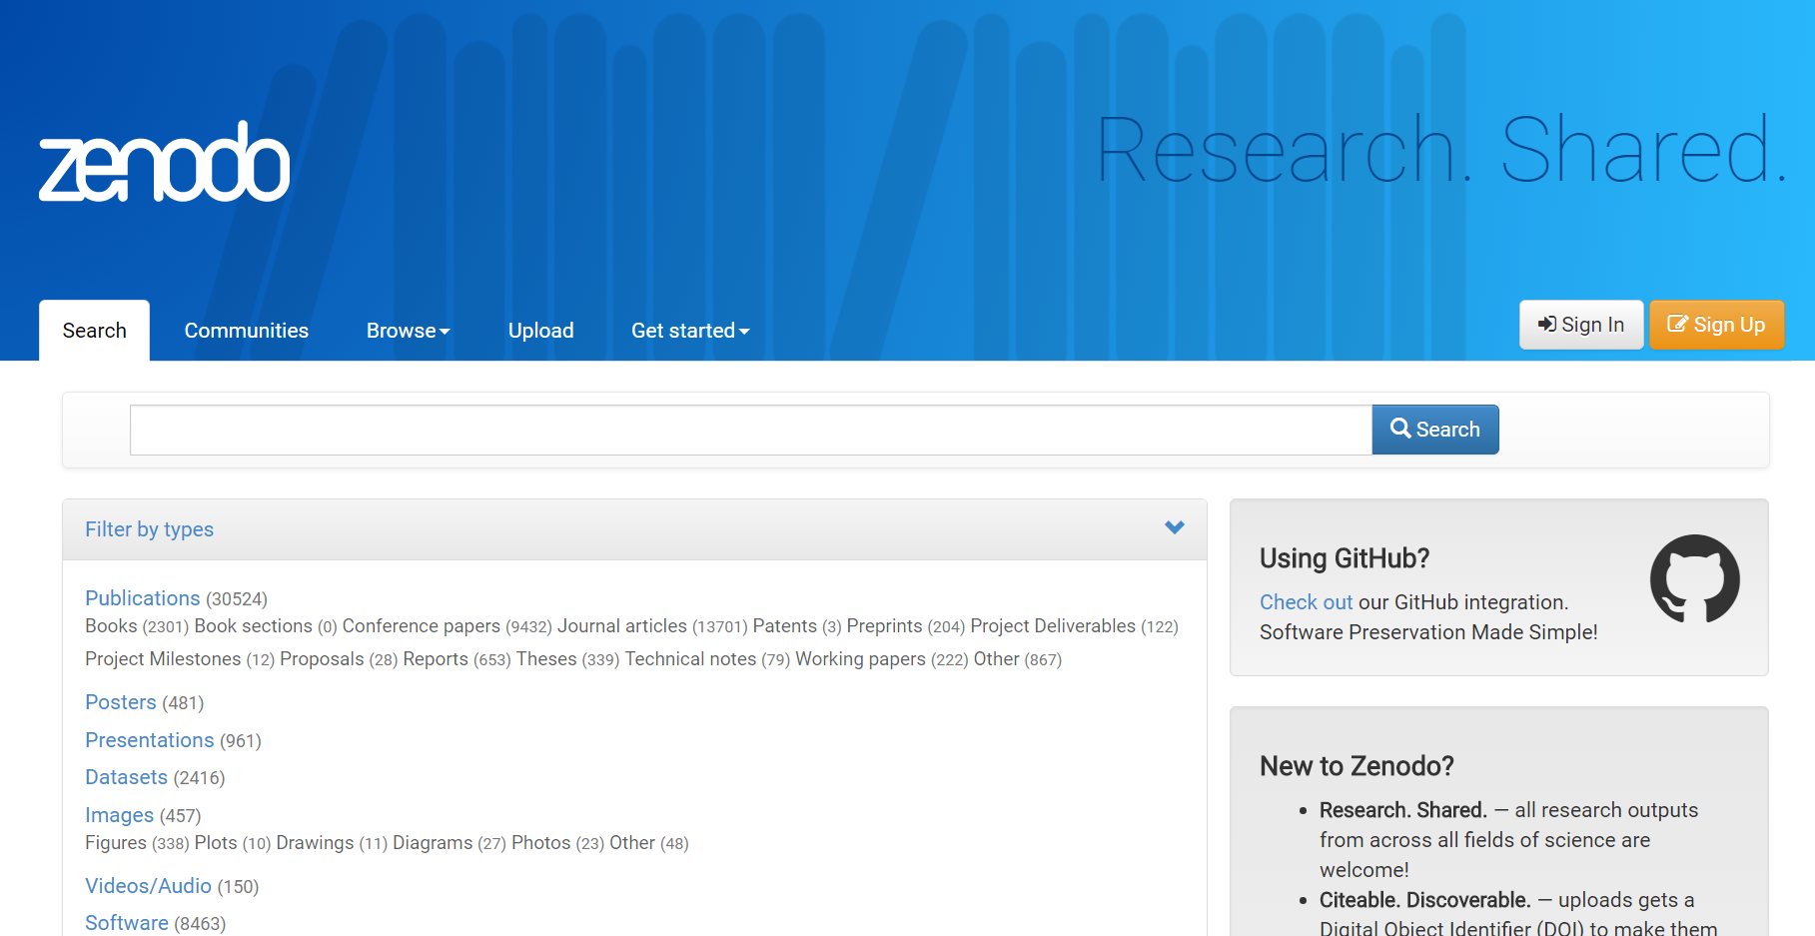
zenodo.org
Slide source:
OpenAIRE & EUDAT,
CC-BY-4.0, 2013
Upload
Describe
Publish
Create communities!
With GitHub integration!
For all content types!
Notes:
Slide source: OpenAIRE & EUDAT, Research data management, CC-BY-4.0 Tony Ross-Hellauer (OpenAIRE) and Sarah Jones (EUDAT), http://www.slideshare.net/EUDAT/research-data-management-introduction-eudatopen-aire-webinar
Catch-all repository
Multiple data types
Publications
Long tail of research data
Citable data (DOI)
Links to funding, pubs, data, software

Slide 20
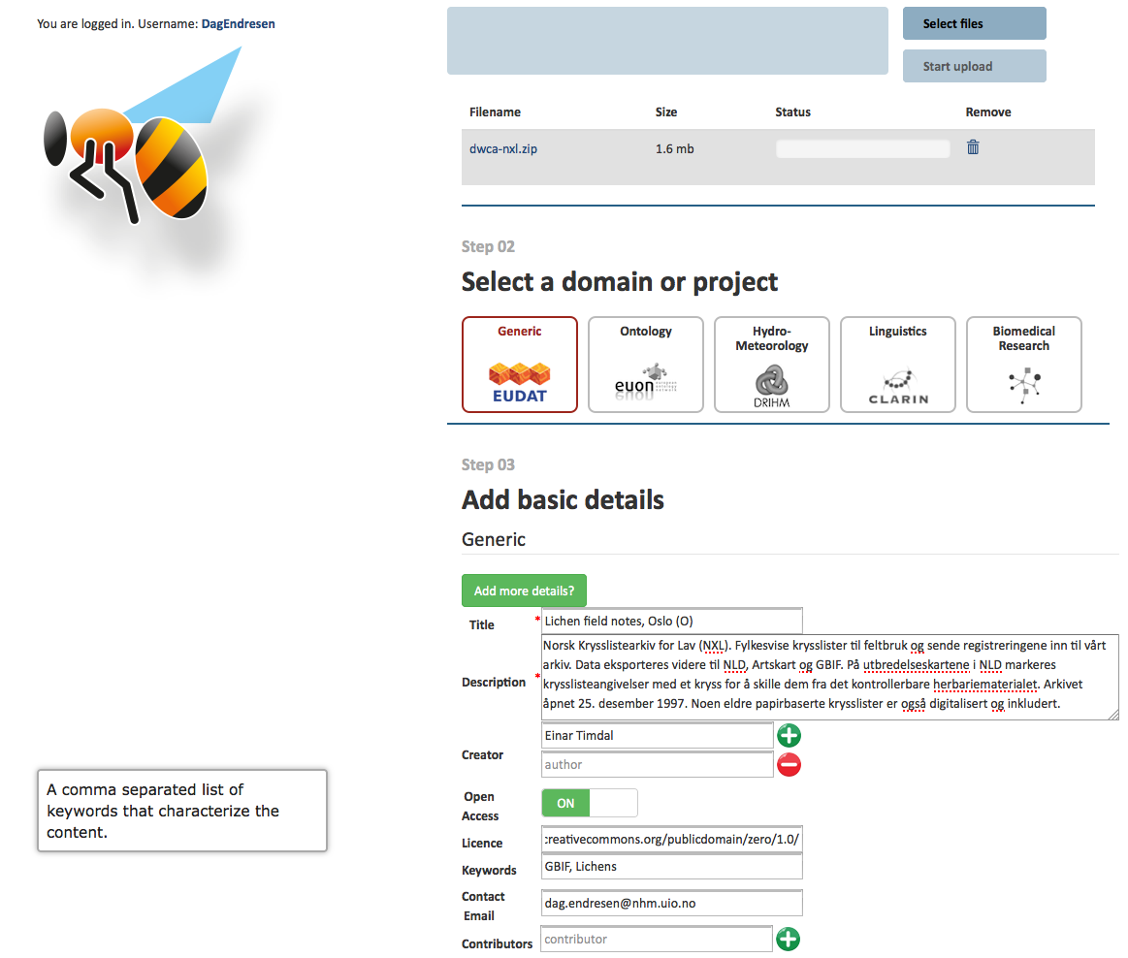

Notes:
https://b2share.eudat.eu/record/136
https://b2share.eudat.eu/record/136/files/dwca-nxl.zip?version=1&download=1

Slide 21
Use data standards

Slide 22
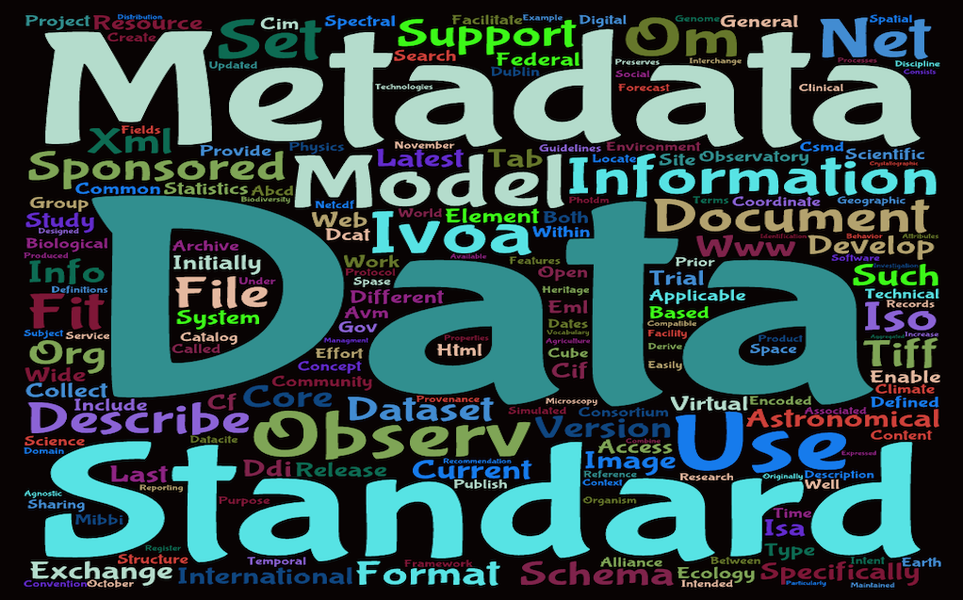
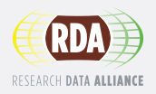
Metadata standards
Use relevant standards for interoperability
http://rd-alliance.github.io/metadata-directory
Slide source: OpenAIRE & EUDAT, CC-BY-4.0, 2013
Notes:
Slide source: OpenAIRE & EUDAT, Research data management, CC-BY-4.0 Tony Ross-Hellauer (OpenAIRE) and Sarah Jones (EUDAT), http://www.slideshare.net/EUDAT/research-data-management-introduction-eudatopen-aire-webinar
To make sure their data can be understood by themselves, their community and others, researchers should create metadata and documentation.
Metadata is basic descriptive information to help identify and understand the structure of the data e.g. title, author...
Documentation provides the wider context. It’s useful to share the methodology / workflow, software and any information needed to understand the data e.g. explanation of abbreviations or acronyms
There are lots of standards that can be used. The DCC started a catalogue of disciplinary metadata standards which is now being taken forward as an international initiative via an RDA working group
22

Slide 23
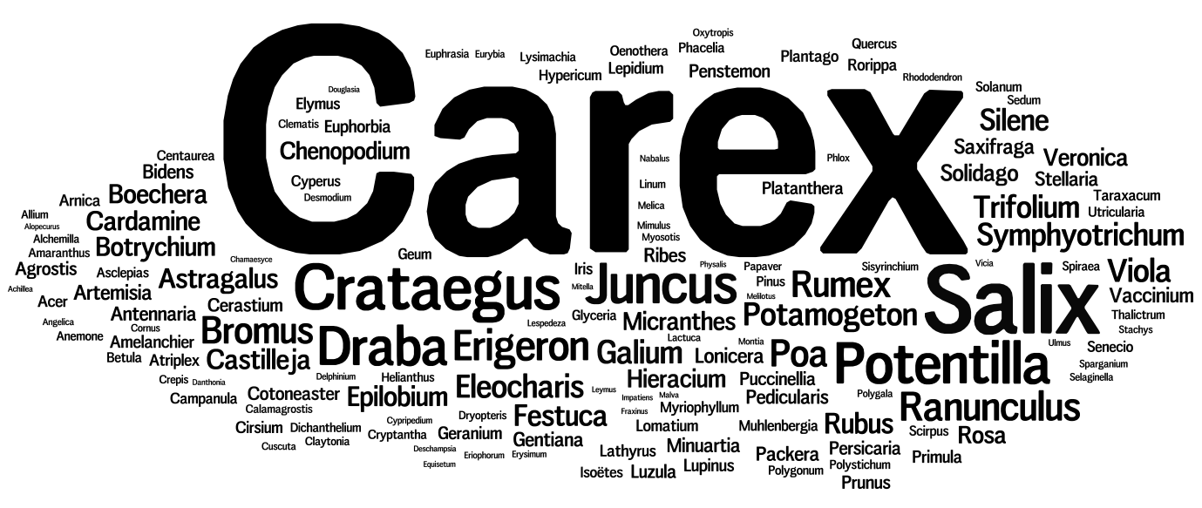
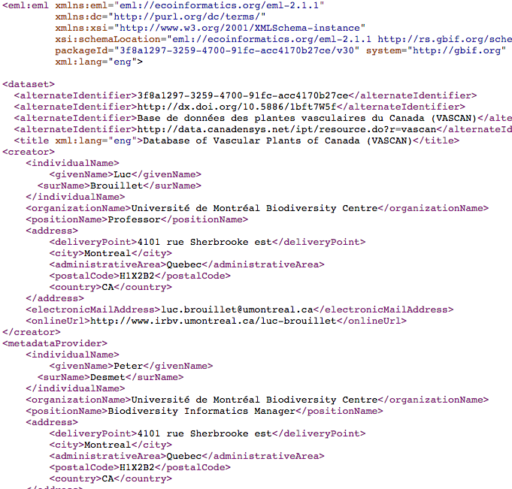
Structured data & Metadata
Unstructured
Structured
Slide modified from: IDigBio workshop 2015
Notes:
Slide modified from iDigBio workshop 2015, Data Sharing Data Standards and Demystifying the IPT, https://www.idigbio.org/
Metadata can take many forms.
One person’s metadata is another’s data.
Traditionally, metadata can be unstructured (such as a collection of keywords) or structured documents (such as XML with schema), which may include controlled vocabularies.

Slide 24

Data Standards
ABCD Access to Biological Collection Data (2005)
DwC Darwin Core (2009)
AC Audubon Core Multimedia Resources Metadata Schema (2013)
NCD Natural Collection Descriptions
(Draft 2008)
EML Ecological Metadata Language
(Ecological Society of America)
Slide source: GB23 Nodes Madagascar October 2015 & iDigBio Florida January 2015 - http://www.tdwg.org/standards/
Notes:
Slide source: GB23 Nodes Madagascar October 2015, http://community.gbif.org/pg/pages/view/47903/ & Modified from 1B Publishing Primary Biodiversity Data by Alberto González-Talaván^{1~} Data Sharing, Data Standards, and Demystifying the IPT ~ Gainesville, FL, USA. 13 January 2015
Biodiversity Information Standards (TDWG), also known as the Taxonomic Databases Working Group, is a not for profit scientific and educational association that is affiliated with the International Union of Biological Sciences.
TDWG was formed to establish international collaboration among biological database projects. TDWG promoted the wider and more effective dissemination of information about the World's heritage of biological organisms for the benefit of the world at large. Biodiversity Information Standards (TDWG) now focuses on the development of standards for the exchange of biological/biodiversity data.
Our Mission
Develop, adopt and promote standards and guidelines for the recording and exchange of data about organisms
Promote the use of standards through the most appropriate and effective means and
Act as a forum for discussion through holding meetings and through publications
--
Ecological Metadata Language (EML)
https://knb.ecoinformatics.org/#external//emlparser/docs/index.html
https://en.wikipedia.org/wiki/Ecological_Metadata_Language
http://www.tdwg.org/activities/osr/obs/
--
Natural History Collections (NCD)
http://www.tdwg.org/standards/312
https://github.com/tdwg/ncd
http://www.tdwg.org/activities/ncd/
--
Audubon Core
http://www.tdwg.org/standards/638
https://github.com/tdwg/ac
--

Slide 25
Ecological Metadata Language - EML
Developed for ecologists by ecologists
Lead by NCEAS, DataONE
XML schema for the structural expression of metadata
Basic subset of EML used by GBIF, « eml-gbif-profile »
http://www.gbif.org/resources/2559
http://rs.gbif.org/schema/eml-gbif-profile/
Slide modified from iDigBio workshop 2015
Notes:
Slide modified from iDigBio workshop in 2015, Demystifying the IPT, https://www.idigbio.org/wiki/index.php/Data_Sharing_Data_Standards_and_Demystifying_the_IPT
NCEAS – National Center for Ecological Analysis and Synthesis

Slide 26
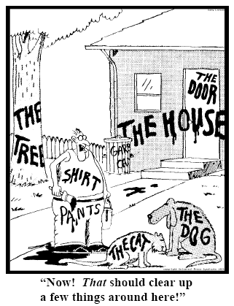
Persistent identifiers

Slide 27
The purpose of identifiers
…is to name things,
making it possible to refer to them.
“Each identifier refers to one and only one thing” (Coyle 2006).
“A assosiation between a string and a thing” (Kunze 2003).
“A stated association between a symbol and a thing; that the symbol may be used to unambiguously refer to the thing within a given context” (Campbell 2007).
Notes:
Kunze, J. A. (2003). Towards electronic persistence using ARK identifiers. Proceedings of the ECDL Web Archiving Workshop 2003. Available at http://www.cdlib.org/inside/diglib/ark/arkcdl.pdf
Coyle, K. (2006). Managing technology: Identifiers: unique, persistent, global. Journal of academic librarianship, 34(4): 428-431.
Campbell, D. (2007). Identifying the identifiers. Proceedings of the International Conference on Dublin Core and Metadata Applications.
The purpose of identifiers
…is to name things, making it possible to refer to them.
What is an identifier:
“Each identifier refers to one and only one thing” (Coyle 2006).
“An association between a string and a thing” (Kunze 2003).
“A stated association between a symbol and a thing; that the symbol may be used to unambiguously refer to the thing within a given context” (Campbell 2007).

Slide 28
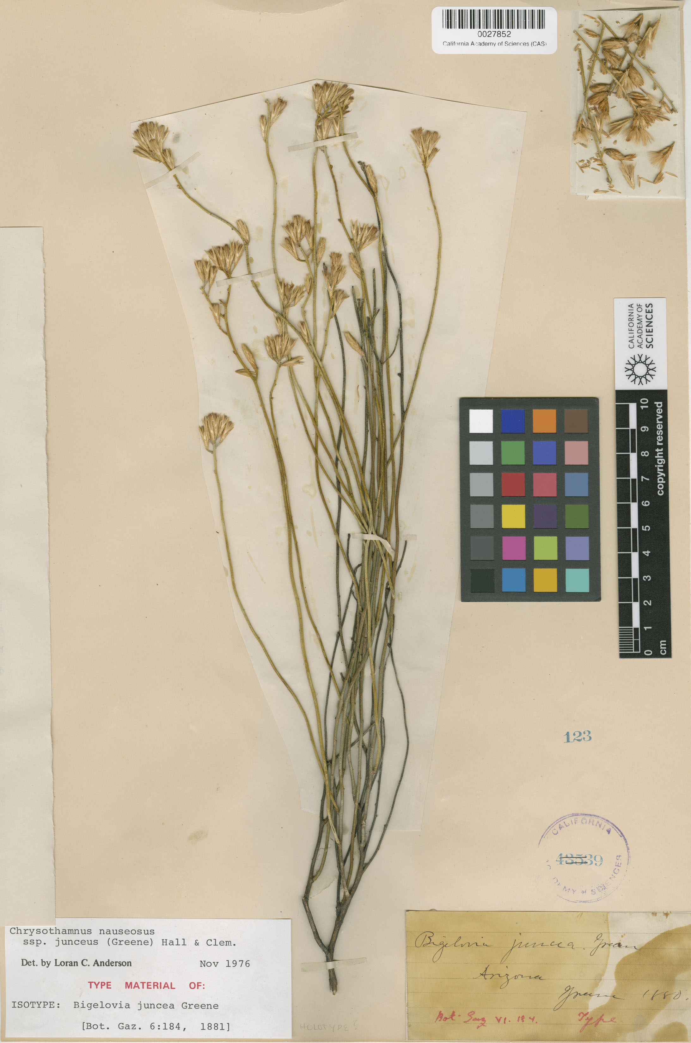
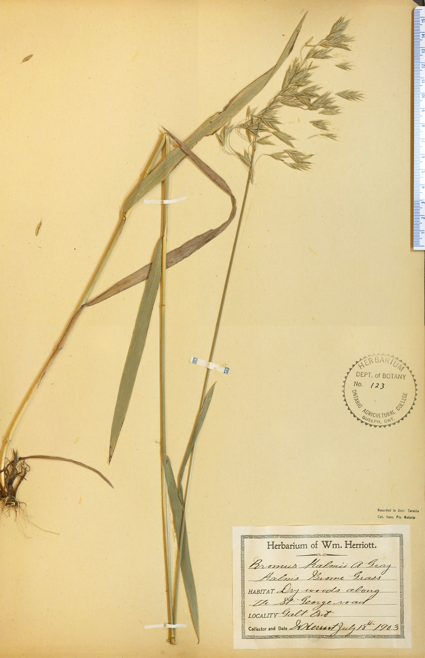
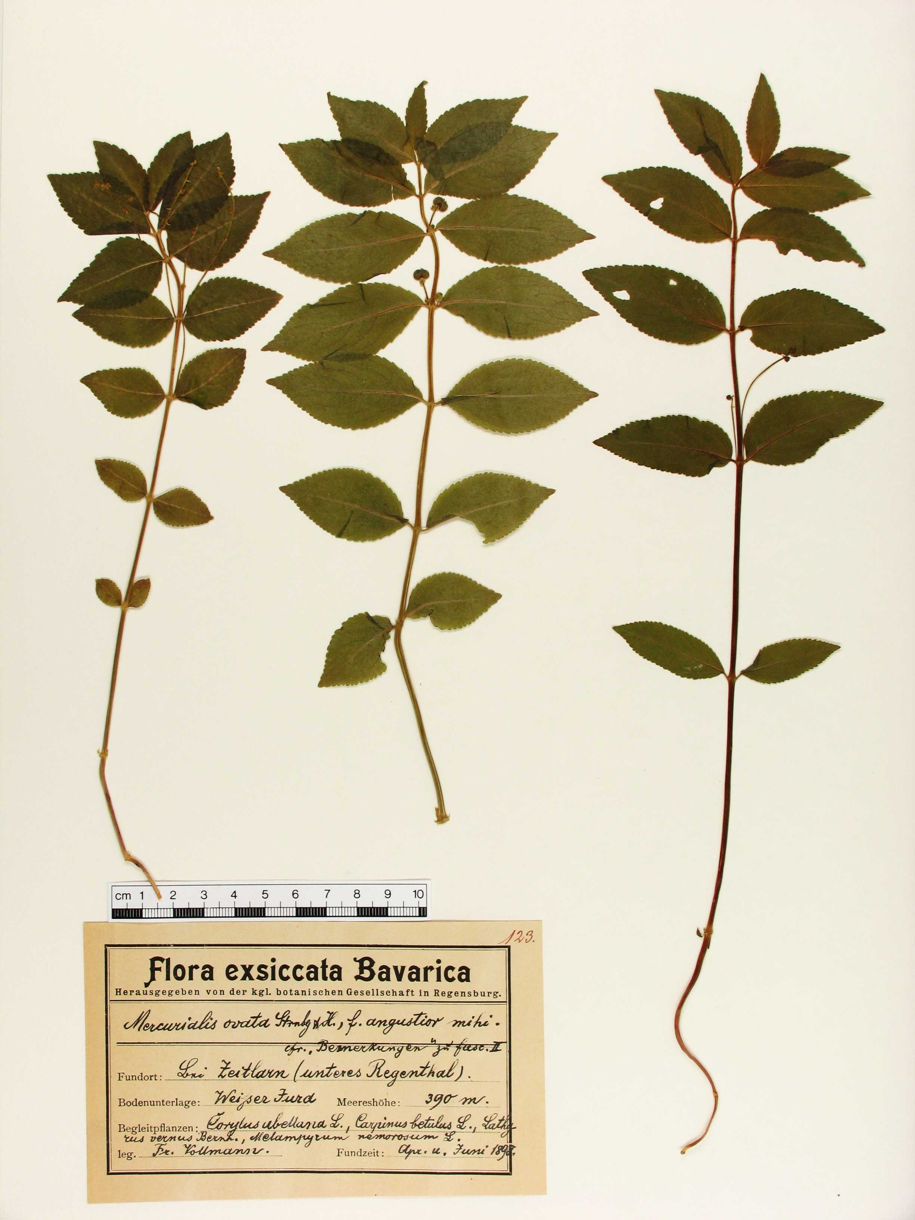
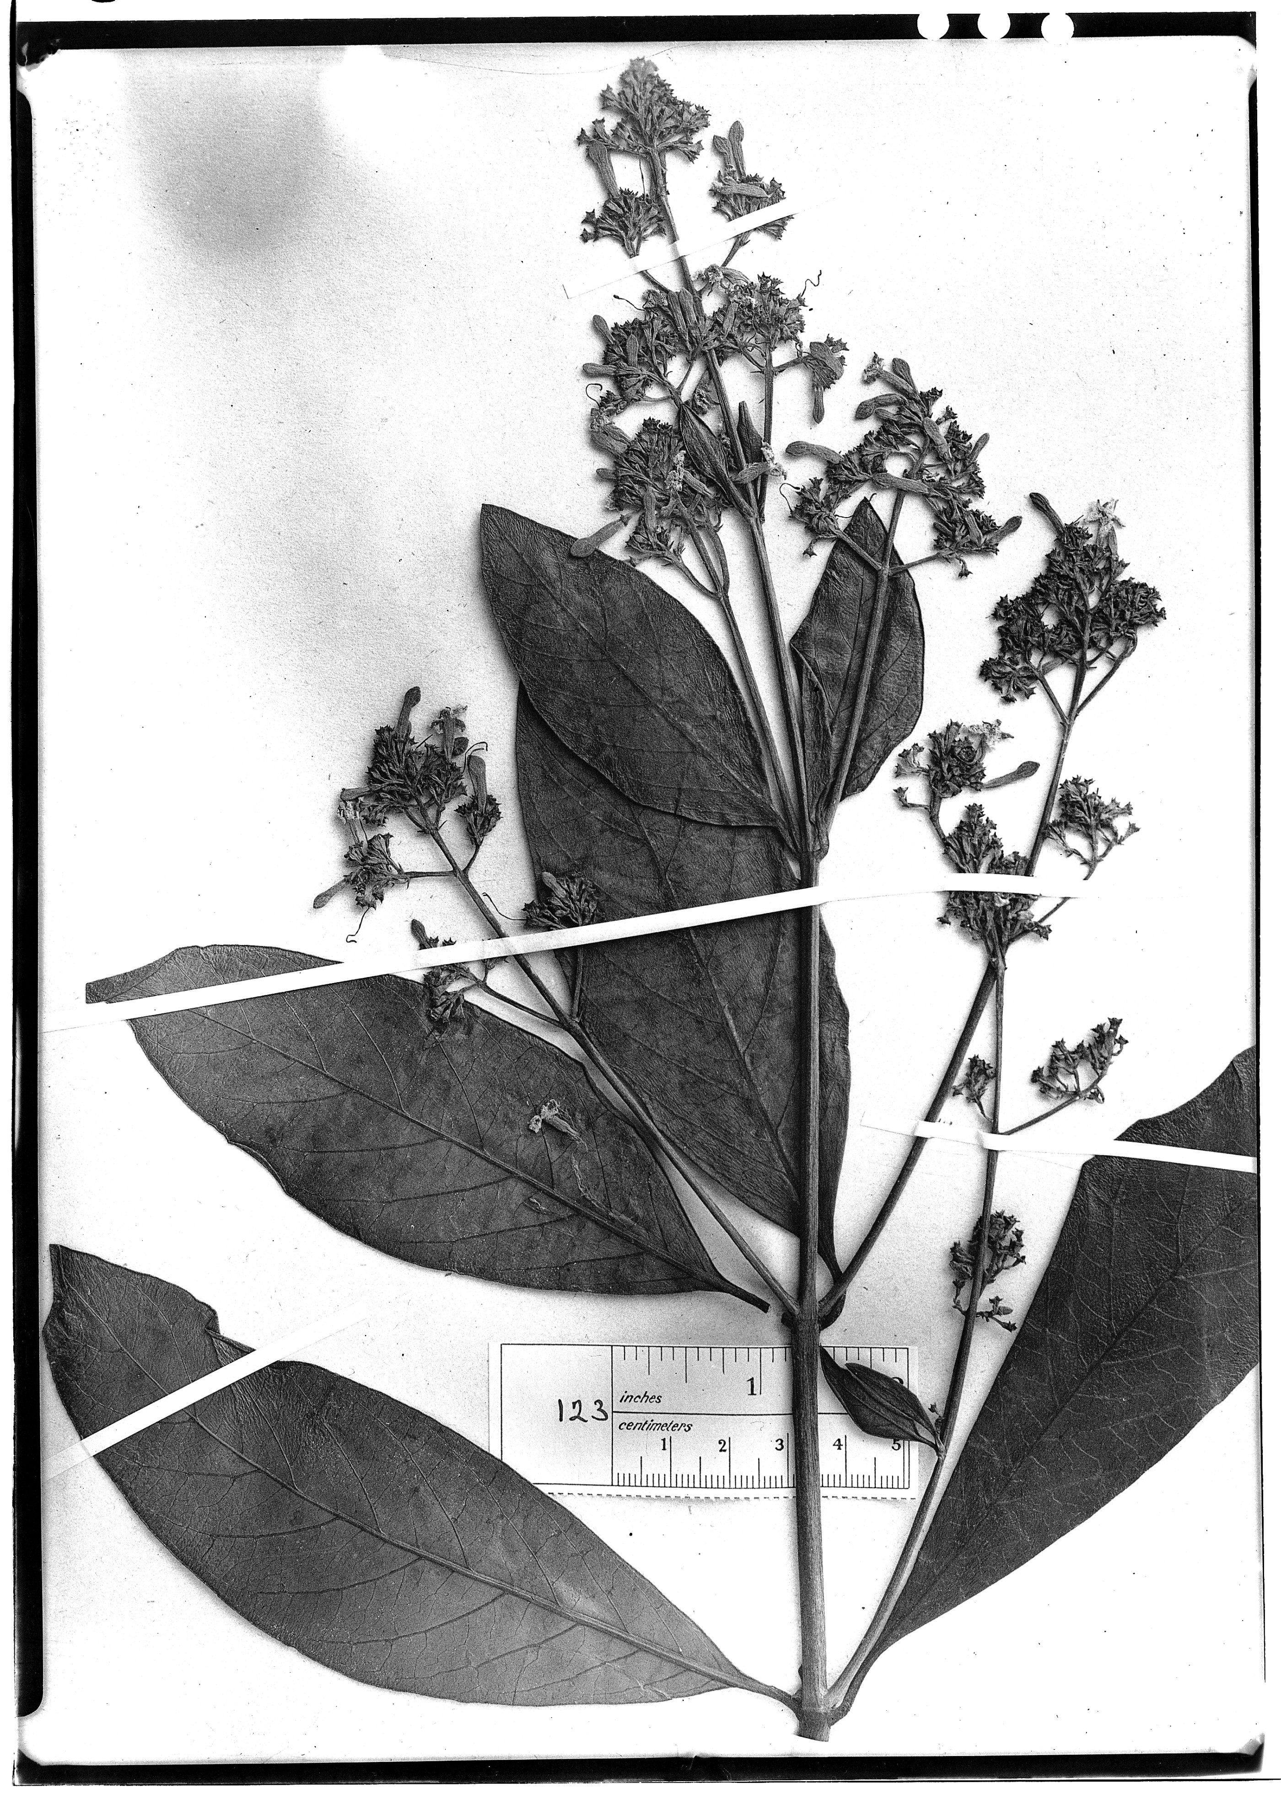
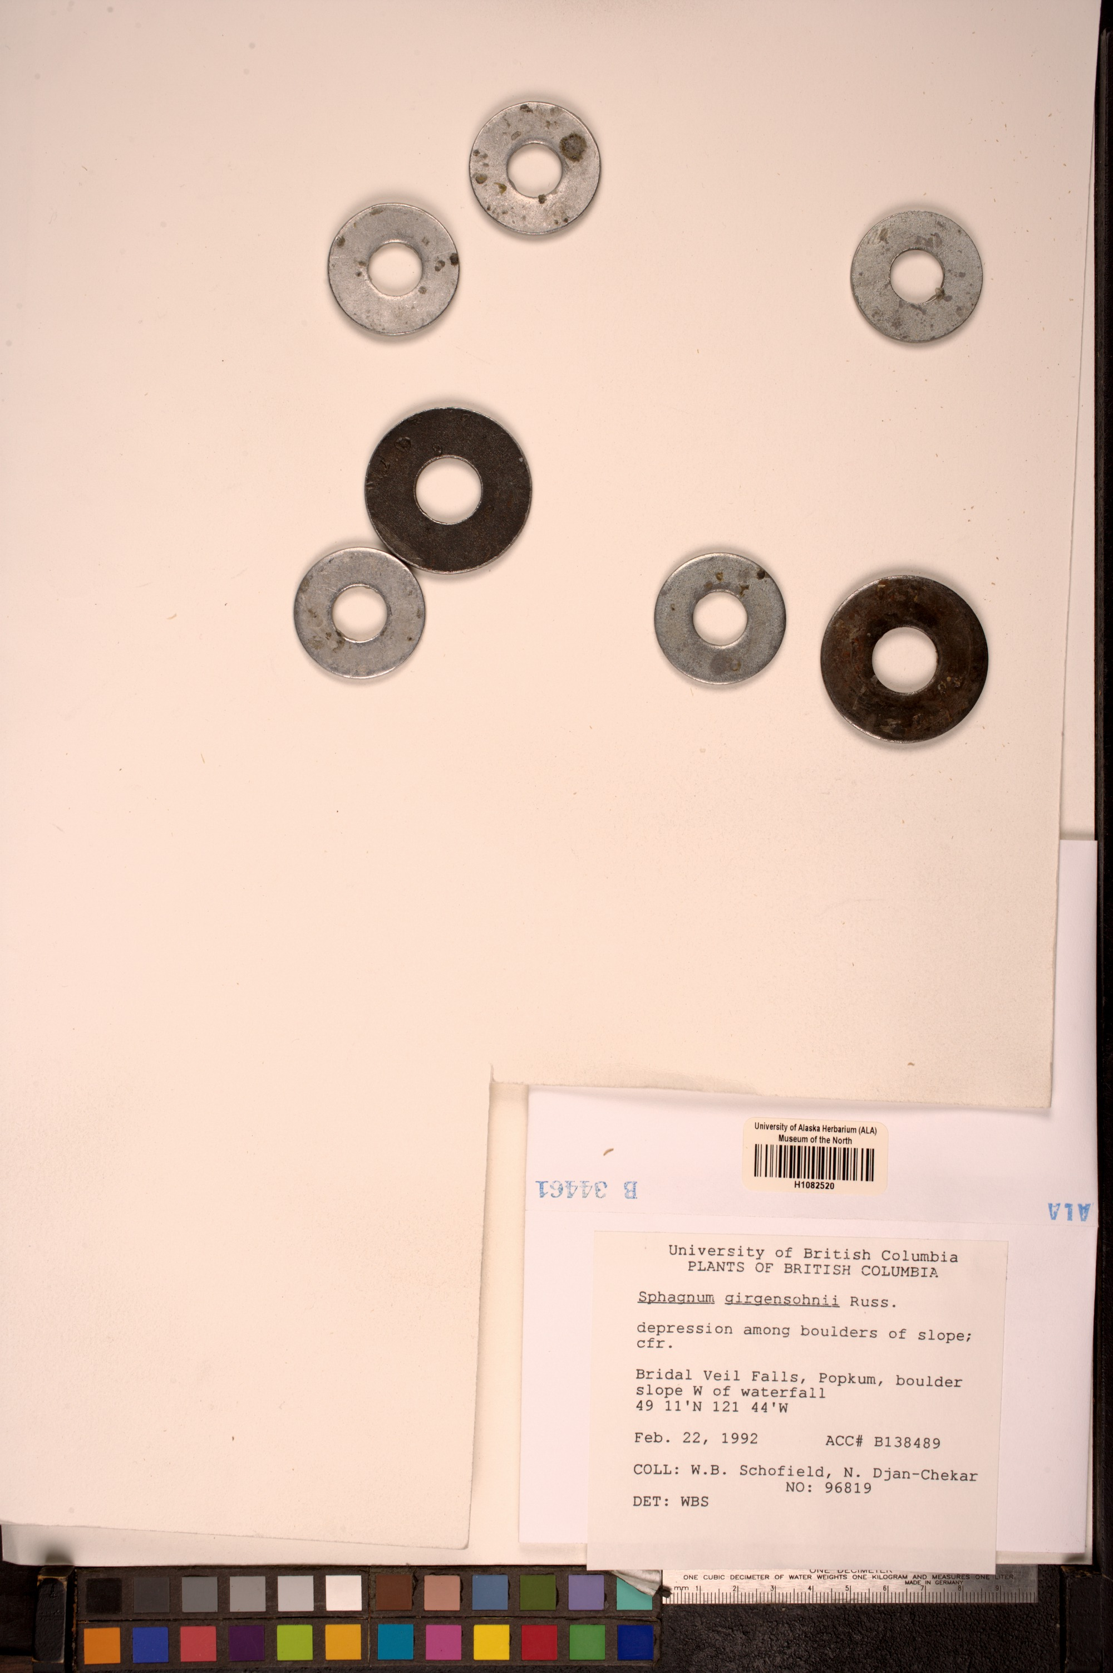
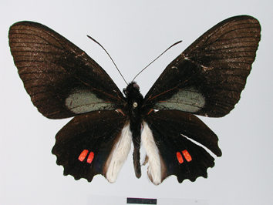
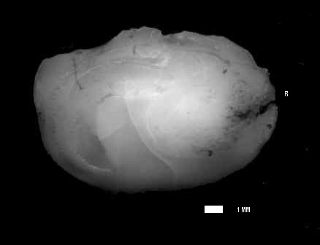
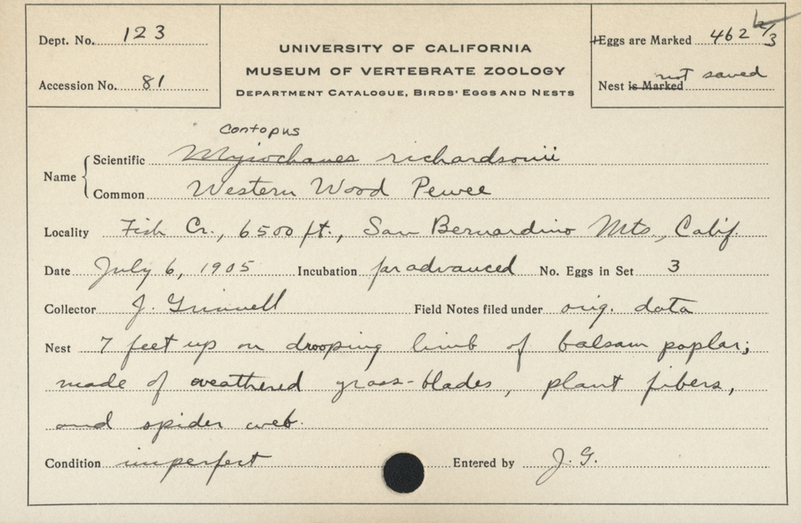
Name ambiguity: 123
Many things (in GBIF) are named 123
Catalog number: 123
GBIF ID: 1050327334
Cinchona ledgeriana
Catalog number: 123
GBIF ID: 931031820
Bromus kalmii
Catalog number: 123
GBIF ID: 543392241
urn:catalog:CAS:BOT:123
Bigelowia juncea
Catalog number: 123
GBIF ID: 283363
urn:occurrence:Arctos:MVZ:Egg:123:164
Mercurialis ovata
Catalog number: 123
GBIF ID: 231564351
Umbrina canariensis
Catalog number: 123
GBIF ID: 1030591721
UAMb:Herb:123
Sphagnum girgensohnii
Catalog number: 123
GBIF ID: 896547722
urn:occurrence:Arctos:MVZ:Egg:123:164
Contopus sordidulus veliei
Catalog number: 123
GBIF ID: 893477175
Parides erithalion
Notes:
Catalog number 123:
http://www.gbif.org/occurrence/896547722, urn:occurrence:Arctos:MVZ:Egg:123:1646019
http://www.gbif.org/occurrence/283363
http://www.gbif.org/occurrence/543392241, urn:catalog:CAS:BOT:123
http://www.gbif.org/occurrence/1030591721, http://arctos.database.museum/MediaSearch.cfm?action=search&specimen_id=22550909, UAMb:Herb:123
http://www.gbif.org/occurrence/893477175, Parides erithalion
http://www.gbif.org/occurrence/1050327334, Cinchona ledgeriana
http://www.gbif.org/occurrence/231564351, Umbrina canariensis
http://www.gbif.org/occurrence/931031820, Bromus kalmii

Slide 29
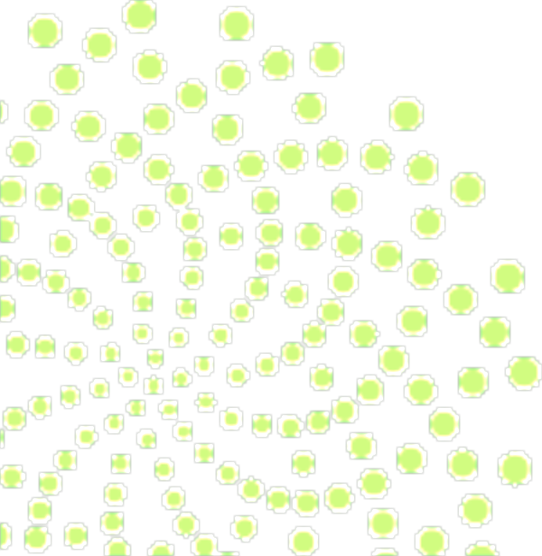


http – PURL – UUID
http://purl.org/nhmuio/id/41d9cbb4-4590-4265-8079-ca44d46d27c3
Notes:
http – PURL – UUID
http://purl.org/nhmuio/id/41d9cbb4-4590-4265-8079-ca44d46d27c3

Slide 30
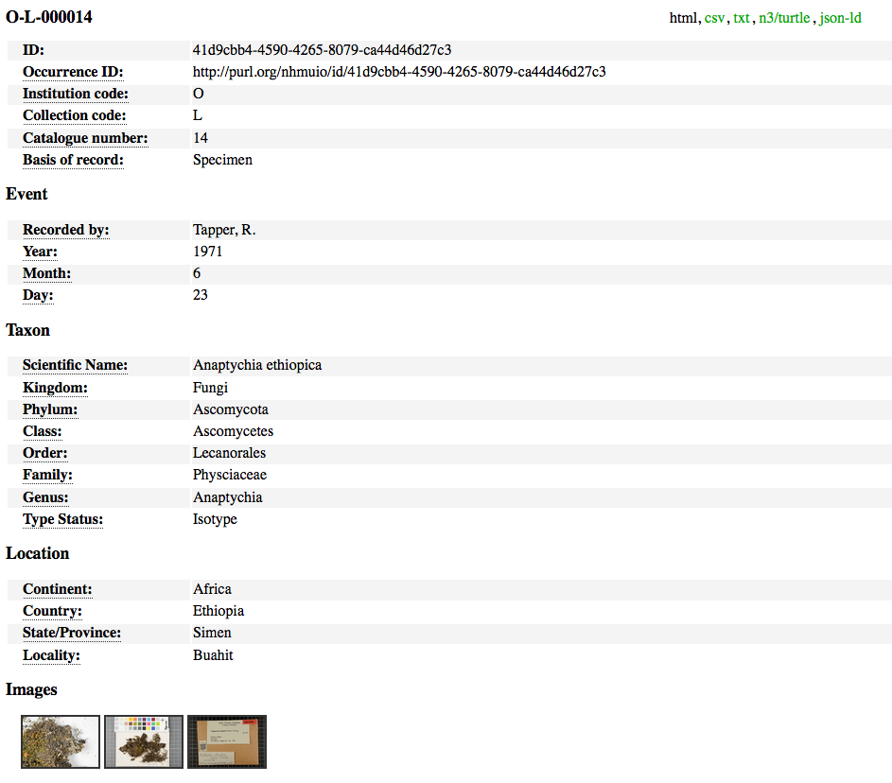
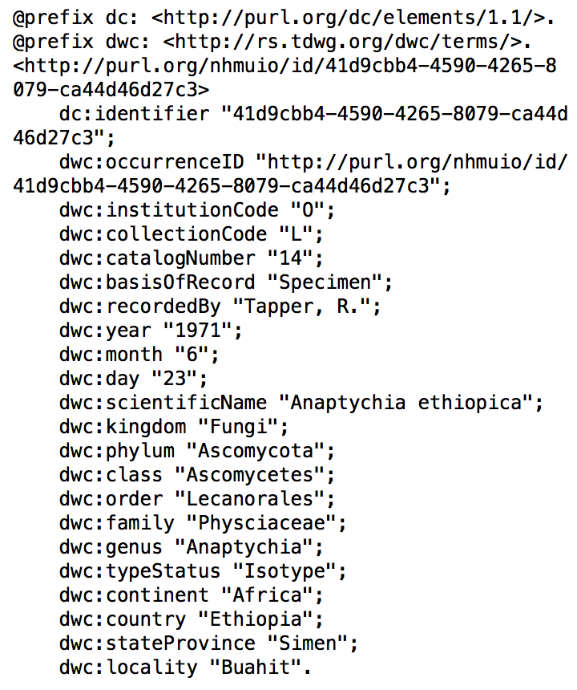
Including machine readable formats
Notes:
http://purl.org/nhmuio/id/41d9cbb4-4590-4265-8079-ca44d46d27c3 using content negotiation and MIME types, default to human friendly html
http://purl.org/nhmuio/id/41d9cbb4-4590-4265-8079-ca44d46d27c3.html
http://purl.org/nhmuio/id/41d9cbb4-4590-4265-8079-ca44d46d27c3.csv
http://purl.org/nhmuio/id/41d9cbb4-4590-4265-8079-ca44d46d27c3.n3
http://purl.org/nhmuio/id/41d9cbb4-4590-4265-8079-ca44d46d27c3.json

Slide 31
Dataset metadata

Slide 32
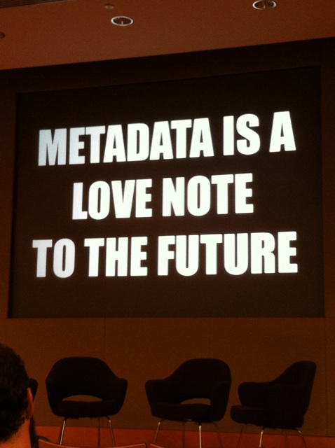
What is metadata?
Image CC-BY ‘Metadata is a love note to the future’ by Cea+ www.flickr.com/photos/ centralasian/8071729256
Notes:
Slide source: EUDAT: Introduction to metadata, version 1, December 2015, CC-BY-4.0 EUDAT, http://www.slideshare.net/EUDAT/introduction-to-metadata-57336324
So let’s begin by thinking about what metadata is.
The quote in the image here that ‘metadata is a love note to the future’ really gets at the meaning.
Metadata is critical to ensure data can be found, understood and reused. If you don’t create metadata, it’s unlikely you will still understand your data in a few years time. The act of creating metadata opens up possibilities for future use.
Image CC-BY ‘Metadata is a love note to the future’ by Cea+ www.flickr.com/photos/ centralasian/8071729256

Slide 33
What is metadata?
Commonly defined as ‘data about data’, metadata helps to make data findable and understandable
Metadata can be:
Descriptive: information about the content and context of the data
Structural: information about the structure of the data
Administrative: information about the file type, rights management and preservation processes
Slide source: CC-BY EUDAT, 2015
Notes:
Slide source: EUDAT: Introduction to metadata, version 1, December 2015, CC-BY EUDAT, http://www.slideshare.net/EUDAT/introduction-to-metadata-57336324
Metadata is commonly defined as ‘data about data’. By creating metadata, you will ensure that others can find and understand your data.
There are different types of metadata:
Descriptive metadata includes things like the title, author, date, location, coverage and subjects. It’s all the basic information people would need to find the data and understand the main content and context.
Structural metadata explains how data interrelate. For example, if a book has been digitised, you want to understand which set of images form each chapter.
Administrative metadata may include information added by others e.g. preservation metadata added by a repository to note what processes have been performed on the data

Slide 34
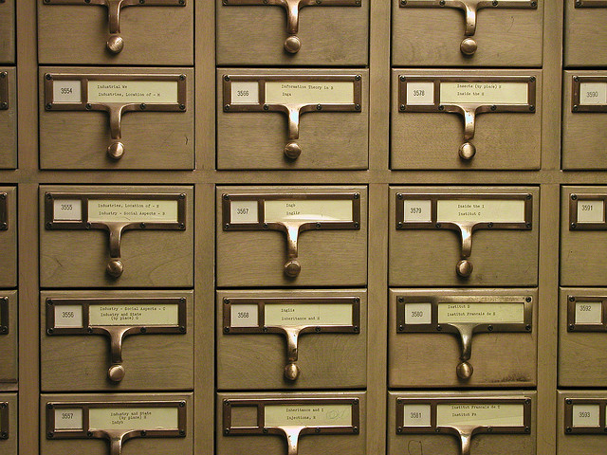
metadata catalog
Image CC-BY ‘University of Michigan Library Card Catalog’ by David Fulmer www.flickr.com/photos/annarbor/4350629792
Notes:
Slide source: EUDAT: Introduction to metadata, version 1, December 2015, CC-BY EUDAT, http://www.slideshare.net/EUDAT/introduction-to-metadata-57336324
To close we want to explain how EUDAT is approaching metadata and how services like B2FIND can help you
Image CC-BY ‘University of Michigan Library Card Catalog’ by David Fulmer www.flickr.com/photos/annarbor/4350629792

Slide 35
Why use metadata?
Comprehensive metadata will:
Facilitate data discovery
Help users determine the applicability of the data
Enable interpretation and reuse
Allow any limitations to be understood
Clarify ownership and restrictions on reuse
Offer permanence as it transcends people and time
Provide interoperability
Slide source: CC-BY EUDAT, 2015
Notes:
Slide source: EUDAT: Introduction to metadata, version 1, December 2015, CC-BY EUDAT, http://www.slideshare.net/EUDAT/introduction-to-metadata-57336324
There are lots of reasons to create metadata. It:
Facilitates data discovery so others can find your data and your research gains more recognition and impact
Good metadata helps potential users determine whether the data meet their needs, and enables them to interpret and reuse the data
Metadata should outline any limitations and clarify data ownership and restrictions on reuse. This ensures others use the data appropriately
Without metadata, your data will become meaningless over time as others can’t understand and reuse them. Providing associated metadata will give your data permanence and ensure they live on.
By creating high quality metadata and using standards, you can also make your data interoperable

Slide 36
Metadata and documentation
Think about what will be needed in order to find, evaluate, understand, and reuse the data.
Have you documented what you did and how?
Did you develop code to run analyses? If so, this should be kept and shared too.
Is it clear what each bit of your dataset means? Make sure the units are labelled and abbreviations explained.
Record all the information needed for you and others to understand the data in the future
Slide source: CC-BY EUDAT, 2015
Notes:
Slide source: EUDAT: Introduction to metadata, version 1, December 2015, CC-BY EUDAT, http://www.slideshare.net/EUDAT/introduction-to-metadata-57336324
When you create metadata, it is useful to think broadly. You may come across the concept of ‘documentation’ to explain all the details you need to capture and share too.
You should aim to provide all the information a third-party would need to understand and reuse your data. This may include a description of what you did, your workflows, any code created and data dictionaries or clarification of all terms and abbreviations.

Slide 37
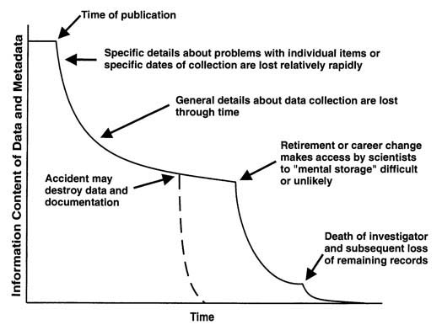
Information entropy
The Loss of Information about Data (Metadata) Over Time, Michener et al, 1997
Slide source: CC-BY EUDAT, 2015
Notes:
Slide source: EUDAT: Introduction to metadata, version 1, December 2015, CC-BY EUDAT, http://www.slideshare.net/EUDAT/introduction-to-metadata-57336324
This diagram from Bill Michener from DataOne in the United States shows how much information is lost over time.
Metadata is a way to formalise this knowledge so your data retain meaning.

Slide 38
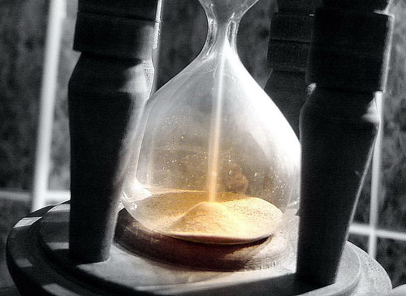
Time matters!
Create metadata at the time of data creation
Information will be forgotten and there won’t be time or effort left to capture it later.
Metadata benefits from quality control at an early stage too.
Image CC-BY-SA ‘egg timer – hour glass running out’ by OpenDemocracy www.flickr.com/photos/opendemocracy/523438942
Slide source: CC-BY EUDAT, 2015
Notes:
Slide source: EUDAT: Introduction to metadata, version 1, December 2015, CC-BY EUDAT, http://www.slideshare.net/EUDAT/introduction-to-metadata-57336324
Time really matters when creating metadata – you should create metadata at the time of data creation as information is forgotten quickly. This also gives you an opportunity to do quality control early on.

Slide 39
Dataset titles
Titles are critical in helping readers find your data
  While individuals are searching for the most appropriate data sets, they are most likely going to use the title as the first criteria to determine if a dataset meets their needs.
  Treat the title as the opportunity to sell your dataset.
A complete title includes: What, Where, When, Who, and Scale
An informative title includes: topic, timeliness of the data, specific information about place and geography
Slide source: CC-BY EUDAT, 2015
Notes:
Slide source: EUDAT: Introduction to metadata, version 1, December 2015, CC-BY EUDAT, http://www.slideshare.net/EUDAT/introduction-to-metadata-57336324
Be comprehensive when writing your dataset title as this is how others will determine whether to look into your data further.
A complete title should explain what the data relates to, a location, time period, subject and scale.

Slide 40
Which is the better title?
Rivers
  OR
Greater Yellowstone Rivers from 1:126,700 U.S. Forest Service Visitor Maps (1961-1983)
Greater Yellowstone (where) Rivers (what) from 1:126,700 (scale) U.S. Forest Service (who) Visitor Maps (1961-1983) (when)
Slide source: CC-BY EUDAT, 2015
Notes:
Slide source: EUDAT: Introduction to metadata, version 1, December 2015, CC-BY EUDAT, http://www.slideshare.net/EUDAT/introduction-to-metadata-57336324
This example illustrates the importance of descriptive titles in metadata records.
The second title gives enough detail for a reader to discern whether they might like more information about your data.

Slide 41
Write for machines, not just humans
Remember: a computer will read your metadata
Do not use symbols that could be misinterpreted: Examples: ! @ # % { } | / \ < > ~
Don’t use tabs, indents, or line feeds/carriage returns
When copying and pasting from other sources, use a text editor (e.g., Notepad) to eliminate hidden characters
Slide source: CC-BY EUDAT, 2015
Notes:
Slide source: EUDAT: Introduction to metadata, version 1, December 2015, CC-BY EUDAT, http://www.slideshare.net/EUDAT/introduction-to-metadata-57336324
When you are writing your metadata, remember that it will be read by machines as well as people.
You should avoid using symbols that could be misinterpreted, and tabs/indents/breaks that may be stripped out. Using a text editor for copying data will ensure hidden characters and formatting are removed.

Slide 42
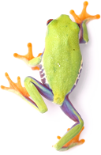
Data paper

Slide 43
Metadata categories
Dataset description
Project description
People and Organizations (including roles)
Coverage
  Taxonomic coverage
  Geographic coverage
  Temporal coverage
Methods
Intellectual property rights, licensing
Keywords
Notes:
GBIF (2011). GBIF Metadata Profile – How-to Guide, (contributed by Ó Tuama, Eamonn, Braak, K. Remsen, D.), Copenhagen: Global Biodiversity Information Facility, 11 pp, accessible online at http://links.gbif.org/gbif_metadata_profile_howto_en_v1/, http://www.gbif.org/resources/2561

Slide 44


Peer review option for biodiversity datasets.
Authors get scientific credit for data publication.
Meeting concerns over data quality.
Meeting concerns over data citation mechanism.
http://www.gbif.org/publishingdata/datapapers
Notes:
Biodiversity Data Journal (BDJ) is a community peer-reviewed, open-access, comprehensive online platform, designed to accelerate publishing, dissemination and sharing of biodiversity-related data of any kind. http://www.pensoft.net/journals/bdj
Some examples:
* Narwade, S., Kalra, M., Jagdish, R., Varier, D., Satpute, S., Khan, N., Talukdar, G., et al. (2011). Literature based species occurrence data of birds of northeast India. ZooKeys, 150: 407-417. Pensoft Publishers. DOI: 10.3897/zookeys.150.2002
* Jones, K. E., Bielby, J., Cardillo, M., Fritz, S. A., OʼDell, J., Orme, C. D. L., Safi, K., et al. (2009). PanTHERIA: a species-level database of life history, ecology, and geography of extant and recently extinct mammals. (W. K. Michener, Ed.) Ecology, 90(9): 2648. Ecological Society of America. DOI: 10.1890/08-1494.1

Slide 45
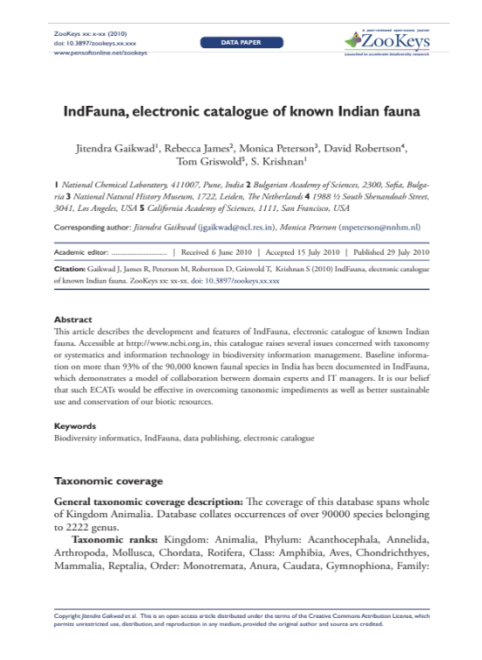
Rationale for data publishing
Data Paper
A scholarly publication of searchable metadata document describing a dataset, or a group of datasets.
Promote and publicize the existence of the data
Provide scholarly credit to data publishers through citable journal publications
Describe the data in a structured human-readable form
Slide source: Alberto González-Talavá, 2015
Notes:
Slide source: Modified from 1B Publishing Primary Biodiversity Data by Alberto González-Talaván - Data Sharing, Data Standards, and Demystifying the IPT ~ Gainesville, FL, USA. 13 January 2015, http://www.gbif.org/resource/82197
In the section talking about the metadata, you will notice that it can be produced as an RDF file. Those files can be submitted to different journals and

Slide 46
Data citation

Slide 47
Rationale for Data Publishing: citation & usage
“Data citation standards can form the basis for increased incentives, recognition, and rewards for scientific data activities. Unfortunately, such standards and good practices are lacking”
CODATA Data Citation Task Group
“We believe that the lack of incentive similar to the impact factor for scholarly publication remains a major impediment to the provision of free and open access to biodiversity data”
GBIF Data Publishing Framework Task Group
Slide source: Alberto González-Talaván, 2015
Notes:
In the section talking about the metadata, you will notice that it can be produced as an RDF file. Those files can be submitted to different journals and
Slide source: Modified from 1B Publishing Primary Biodiversity Data by Alberto González-Talaván^{1~} Data Sharing, Data Standards, and Demystifying the IPT ~ Gainesville, FL, USA. 13 January 2015, http://www.gbif.org/resource/82197

Slide 48
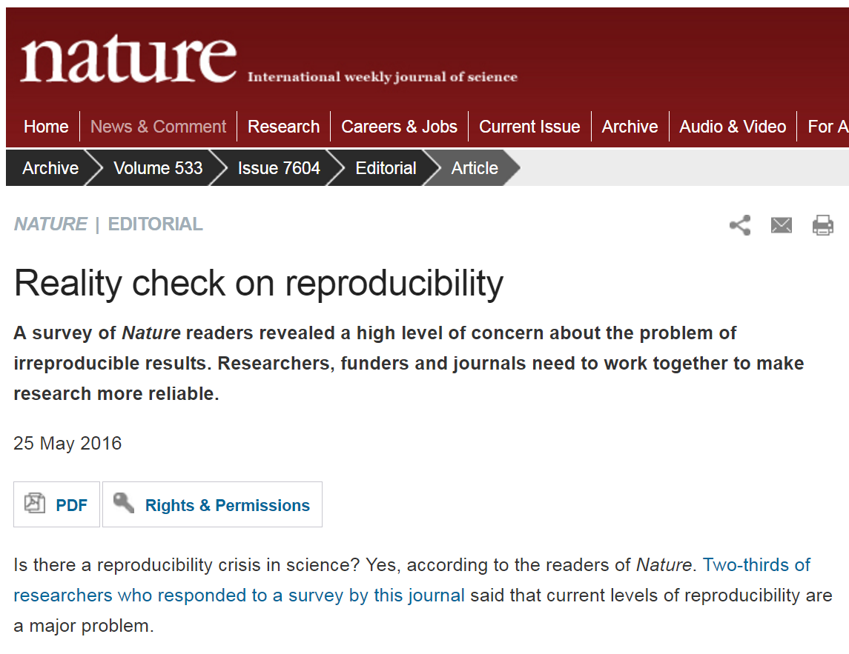
A reproducibility crisis
Slide source: OpenAIRE & EUDAT, CC-BY-4.0, 2013
Notes:
Many experimentally established "facts" don't seem to hold up to repeated investigation. Several studies have shown alarming numbers of published papers that don’t stand up to scrutiny.
Over half of psychology studies fail reproducibility test (61/100) – Nosek et al, Science, 2015
Causes of reproducibility not well understood – but can say that it is obvious that where the original data is available, accountability is increased – able to review where questions arise.

Slide 49

Why manage data?
Because well-managed data opens up opportunities for re-use, sharing and makes for better science!
Make your research easier
Stop yourself drowning in irrelevant stuff
Save data for later
Avoid accusations of fraud or bad science
Share your data for re-use
Get credit for it
Meet funder/institution requirements
Slide source: OpenAIRE & EUDAT, CC-BY-4.0, 2013
Notes:
There are lots of reasons to manage research data. Ultimately though, it’s to make your research easier. If data are properly documented and organised, you can stop yourself drowning in irrelevant stuff and find the data when you need it – for example to validate findings. By managing your data you can also more easily share it with others to get more credit and impact. You may also be required to explain how you will manage your data by your funder or university.
Well-managed data opens up opportunities for re-use, integration and new science

Slide 50

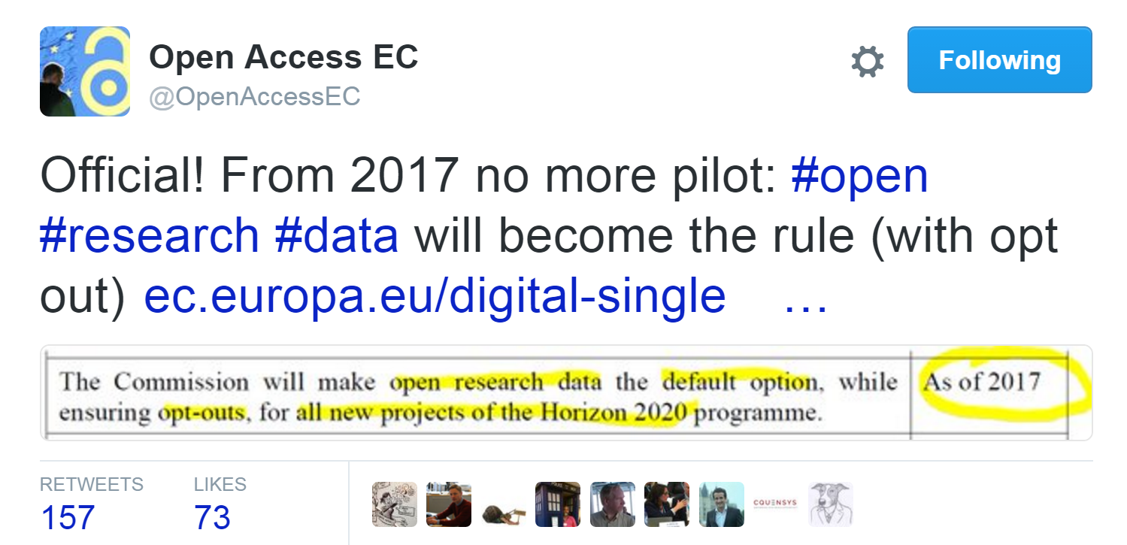
H2020 - Open Data by Default from 2017
Slide source: OpenAIRE & EUDAT, CC-BY-4.0, 2013

Slide 51

Concerns about data sharing
Concern | Solution
inappropriate use due to misunderstanding of research purpose or parameters
security and confidentiality of sensitive data
lack of acknowledgement / credit
loss of advantage when competing for research funding
metadata
metadata
metadata
metadata
Slide source: OpenAIRE & EUDAT, CC-BY-4.0, 2013
Notes:
Slide source: OpenAIRE & EUDAT, Research data management, CC-BY-4.0 Tony Ross-Hellauer (OpenAIRE) and Sarah Jones (EUDAT), http://www.slideshare.net/EUDAT/research-data-management-introduction-eudatopen-aire-webinar
Each of these issues can, in great part, be addressed by providing rich data documentation known as ‘metadata’.

Slide 52
Concerns about data sharing
Concern | Solution
inappropriate use due to misunderstanding of research purpose or parameters | provide rich Abstract, Purpose, Use Constraints and Supplemental Information where needed
security and confidentiality of sensitive data | the metadata does NOT contain the data Use Constraints specify who may access the data and how
lack of acknowledgement / credit | specify a required data citation within the Use Constraints
loss of data insight and competitive advantage when vying for research funding | create second, public version with generalised Data Processing Description
Slide source: OpenAIRE & EUDAT, CC-BY-4.0, 2013
Notes:
Slide source: OpenAIRE & EUDAT, Research data management, CC-BY-4.0 Tony Ross-Hellauer (OpenAIRE) and Sarah Jones (EUDAT), http://www.slideshare.net/EUDAT/research-data-management-introduction-eudatopen-aire-webinar
By providing metadata, the research scientist establishes the purpose, methods, sources and parameters of the data. As such, data users are given the information necessary to appropriately apply, protect and cite the data. If the metadata contains information about proprietary data processing or analysis techniques, the competitive advantage can be maintained by creating a second, more generalized, metadata record for public distribution.

Slide 53
Make data shareable
Create robust metadata that has been checked
Include reference information in metadata e.g. unique IDs & properly formatted data citations
Publish your metadata so it’s discoverable. Use portals, clearing houses, online resources…
Package up the data and associated metadata to deposit in repositories
License the data clearly
Slide source: OpenAIRE & EUDAT, CC-BY-4.0, 2013
Notes:
Slide source: OpenAIRE & EUDAT, Research data management, CC-BY-4.0 Tony Ross-Hellauer (OpenAIRE) and Sarah Jones (EUDAT), http://www.slideshare.net/EUDAT/research-data-management-introduction-eudatopen-aire-webinar
To make your data shareable, you should create robust metadata and seek a second a second opinion on this to ensure it’s understandable to others. Also include reference information so others can find your data and give you credit. The metadata should be published online and packaged up with your data to deposit in repositories.

Slide 54
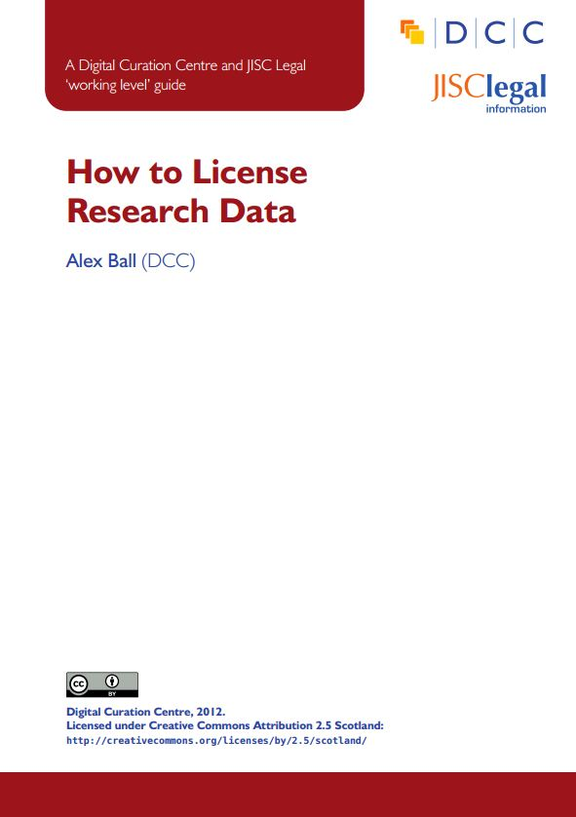




Licensing research data
This DCC guide outlines the pros and cons of each approach and gives practical advice on how to implement your licence
CREATIVE COMMONS LIMITATIONS
NC Non-Commercial
What counts as commercial?
ND No Derivatives
Severely restricts use
These clauses are not open licenses
Horizon 2020 Open Access guidelines point to:
or
www.dcc.ac.uk/resources/how-guides/license-research-data
Slide source: OpenAIRE & EUDAT, CC-BY-4.0, 2013
Notes:
Slide source: OpenAIRE & EUDAT, Research data management, CC-BY-4.0 Tony Ross-Hellauer (OpenAIRE) and Sarah Jones (EUDAT), http://www.slideshare.net/EUDAT/research-data-management-introduction-eudatopen-aire-webinar
Guidance from the DCC can also help researchers to understand data licensing. This guide outlines the pros and cons of each approach e.g. the limitations of some CC options
The OA guidelines under Horizon 2020 point to CC-0 or CC-BY as a straightforward and effective way to make it possible for others to mine, exploit and reproduce the data. See p11 at: http://ec.europa.eu/research/participants/data/ref/h2020/grants_manual/hi/oa_pilot/h2020-hi-oa-pilot-guide_en.pdf
54

Slide 55







Licensing for data published through GBIF
GBIF Governing Board established in 2014 GBIF support for three licenses:
CC0, under which data are made available for any use without restriction or particular requirements on the part of users CC0 is strongly recommended whenever possible
CC-BY, under which data are made available for any use provided that attribution is appropriately given for the sources of data used, in the manner specified by the owner
CC-BY-NC, under which data are made available for any use provided that attribution is appropriately given and provided the use is not for commercial purposes
http://www.gbif.org/terms/licences
Notes:
http://www.gbif.org/terms/licences
https://en.wikipedia.org/wiki/Creative_Commons_license
https://en.wikipedia.org/wiki/CC0
https://en.wikipedia.org/wiki/CC_BY
https://en.wikipedia.org/wiki/Non-commercial
55

Slide 56
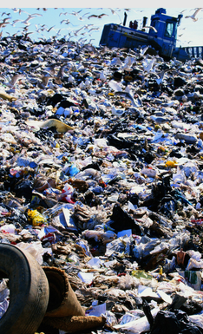
What to preserve & share
It’s not possible to keep everything.
Select based on:
  What has to be kept e.g. data underlying publications
  What can’t be recreated e.g. environmental recordings
  What is potentially useful to others
  What has scientific, cultural or historical value
  What legally must be destroyed
How to select and appraise research data:
www.dcc.ac.uk/resources/how-guides/appraise-select-research-data
Slide source: OpenAIRE & EUDAT, CC-BY-4.0, 2013
Notes:
Slide source: OpenAIRE & EUDAT, Research data management, CC-BY-4.0 Tony Ross-Hellauer (OpenAIRE) and Sarah Jones (EUDAT), http://www.slideshare.net/EUDAT/research-data-management-introduction-eudatopen-aire-webinar
It might not be possible to preserve and share all your data, so you may need to make a selection. Some factor to consider could be what has to be kept, for example for legal reasons or to evidence findings, what is potentially useful to others or can’t be recreated. You may also be under obligation to destroy certain data due to consent agreements or commercial non-disclosure restrictions.
The Digital Curation Centre has guidance on how to select what data to keep.

Slide 57
Slide Credit – GB23, EUDAT & OpenAire
GB23 Nodes Madagascar, October 2015
http://community.gbif.org/pg/pages/view/47903/
Norwegian GBIF data publishing workshop in Trondheim, October 2015,
http://www.gbif.no/events/2015/data-publishing-workshop-october-2015.html
Slide credits: EUDAT/OpenAire, December 2015 & May 2016, CC-BY-4.0
http://www.slideshare.net/EUDAT/eudat-research-data-management
http://www.slideshare.net/EUDAT/research-data-management-introduction-eudatopen-aire-webinar?ref=https://eudat.eu/events/webinar/research-data-management-an-introductory-webinar-from-openaire-and-eudat
https://eudat.eu/events/webinar/research-data-management-an-introductory-webinar-from-openaire-and-eudat
http://www.instantpresenter.com/WebConference/RecordingDefault.aspx?c_psrid=EB57D6888147
Slide credits: EUDAT & OpenAire

Slide 58
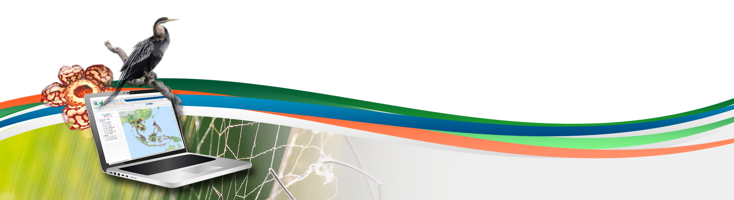
Data publishing workshop
Data management
Fifth day 8th July 2016
Los Baños, Laguna, Philippines
Dag Endresen, GBIF Norway, UiO

