Slide 1
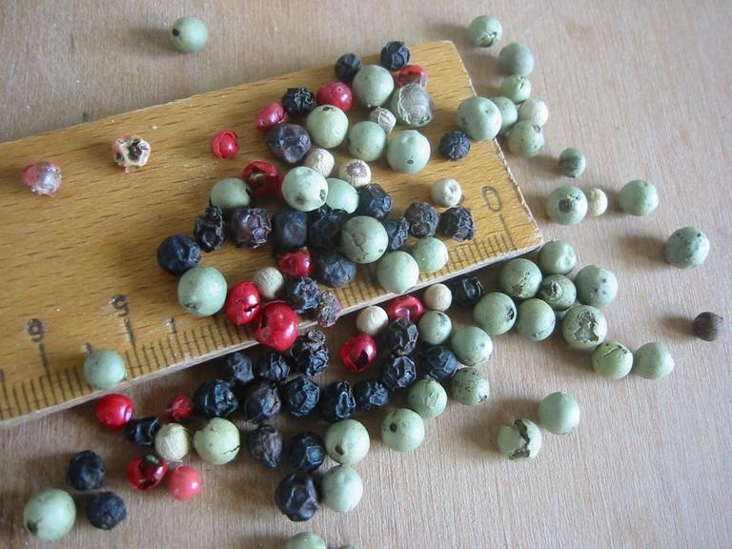
Event core for measurement or fact data
9th European GBIF Nodes Meeting, Stockholm May 2017
Image CC-BY Dag Endresen
Notes:
Event core for measurement or fact, 9th European GBIF Nodes Meeting, Stockholm May 2017
Illustration image CC-BY Dag Endresen, http://sesto.nordgen.org/sesto/index.php?scp=ngb&thm=pictures&mod=det&id=003844

Slide 2

Sampling more data than just species occurrence
Water sample from a Niskin bottle
Core sample from a Van Veen grab
plankton net with CTD
Video plankton recorder
OTN tags

Slide 3
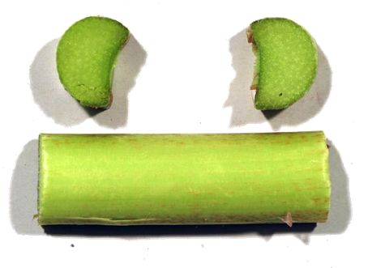
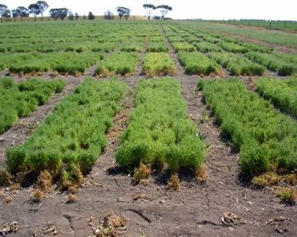
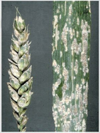
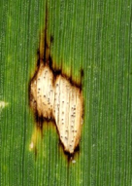
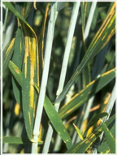
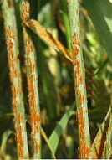
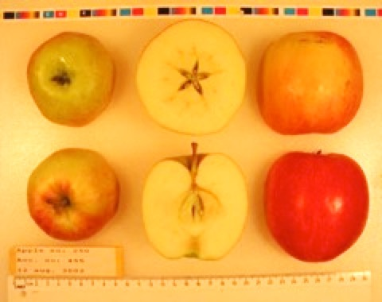
Crop genetic diversity for agricultural traits
Field trials in Horsham Australia for cold tolerance in chickpea (Cicer arietinum L.). CC-by D. Endresen
Rhubarb, Rheum x hybridum Murray, DKRHE43, by Gitte K. Bjørn
Powdery Mildew,
Blumeria graminis
Leaf spots
Ascochyta sp.
Yellow rust
Puccinia strilformis
Black stem rust
Puccinia graminis
Apple, Malus domestica Borkh.
Cultivar “Nanna” by Stein H Hjeltnes
Notes:
Fungus plant diseases, http://www.hgca.com/hgca/wde/diseases/
Apple, Malus domestica “Nanna” from Njøs in Norway by Stein Harald Hjeltnes, http://sesto.nordgen.org/sesto/index.php?scp=ngb&thm=pictures&mod=det&id=004019&img_size=768x512
Rhubarb, Rheum x hybridum Murray, DKRHE43, by Gitte K. Bjørn, http://sesto.nordgen.org/sesto/index.php?scp=ngb&thm=sesto&lev=acc&accide=28981&lst=img
Chickpea at Horsham in Australia, CC-by D Endresen, https://plus.google.com/photos/+DagEndresen/albums/5323049422958990705/5365279366656917090?banner=pwa&pid=5365279366656917090&oid=115547050550954466285

Slide 4
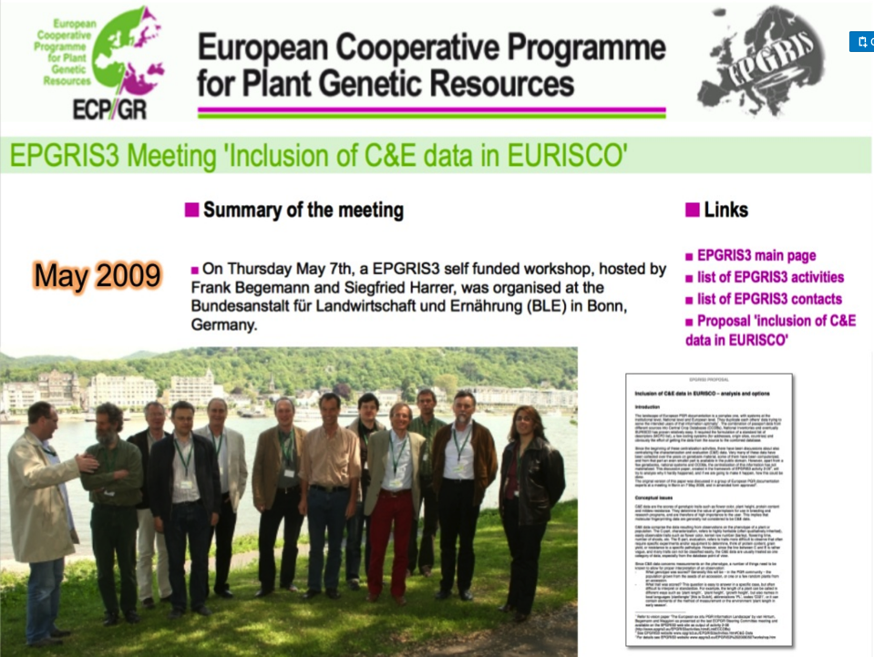

Slide 5
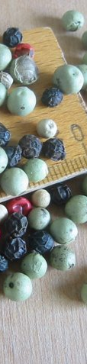
Why did we make a Darwin Core extension for germplasm data?
Upgrade germplasm data pathways to use web services
The objective (1) was to enable sharing of germplasm information using the standard web-service based biodiversity data publishing toolkits maintained by the Global Biodiversity Information Facility (GBIF) and the Biodiversity Information Standards (TDWG).
Upgrade data types to include trait data
The objective (2) was to expand on the germplasm data types published to germplasm data portal from basic passport data to include in particular crop trait information.
CC-BY, Dag Endresen
Notes:
Illustration photo by Dag Endresen (CC-by), Black pepper, white and green pepper (Piper nigrum L.); pink pepper (Schinus terebinthifolius Raddi).

Slide 6

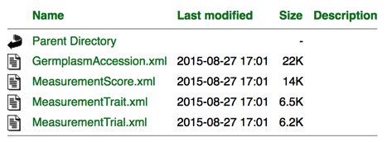
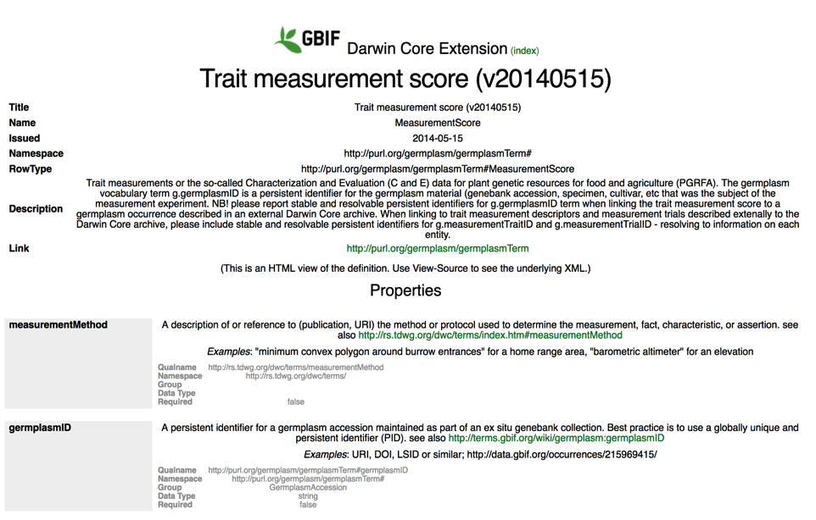
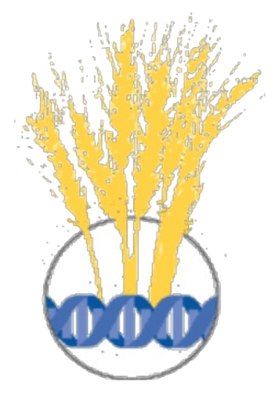
dwc:MeasurementOrFact
g:MeasurementScore (2013)
iode:eMeasurementOrFact (2016)
Notes:
http://rs.gbif.org/extension/germplasm/

Slide 7
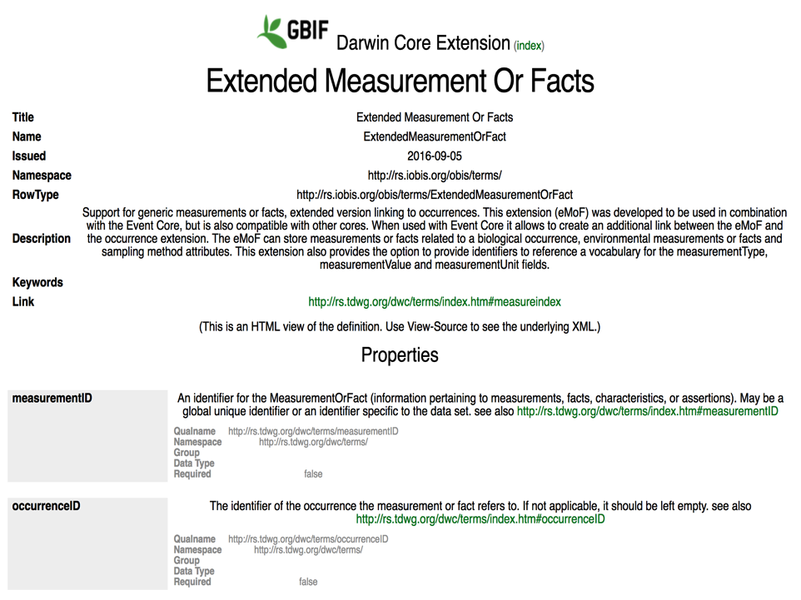
Notes:
http://rs.gbif.org/extension/obis/

Slide 8
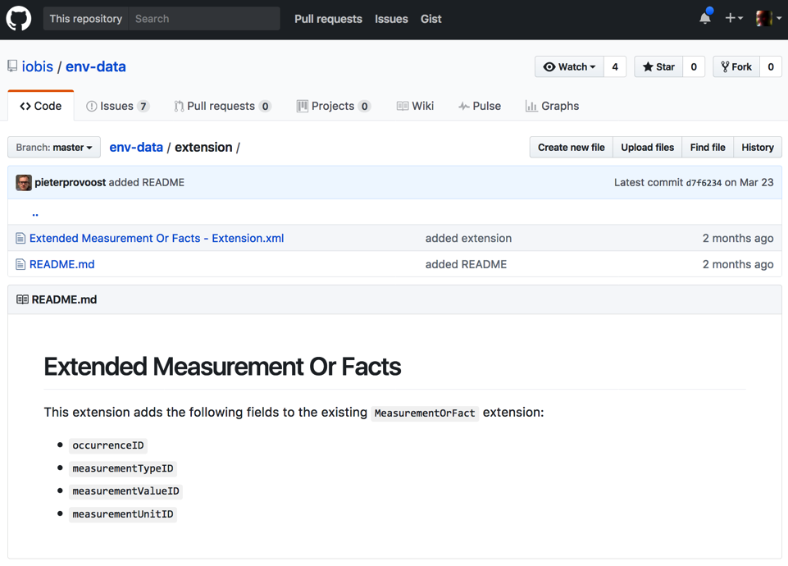
dwc:MeasurementOrFact
g:MeasurementScore (2013)
iode:eMeasurementOrFact (2016)
Notes:
https://github.com/iobis/env-data/tree/master/extension
https://github.com/iobis/env-data/wiki/eMoF-data-standardization
https://github.com/iobis/env-data/wiki/When-to-use-the-OBIS-env-data-standard

Slide 9

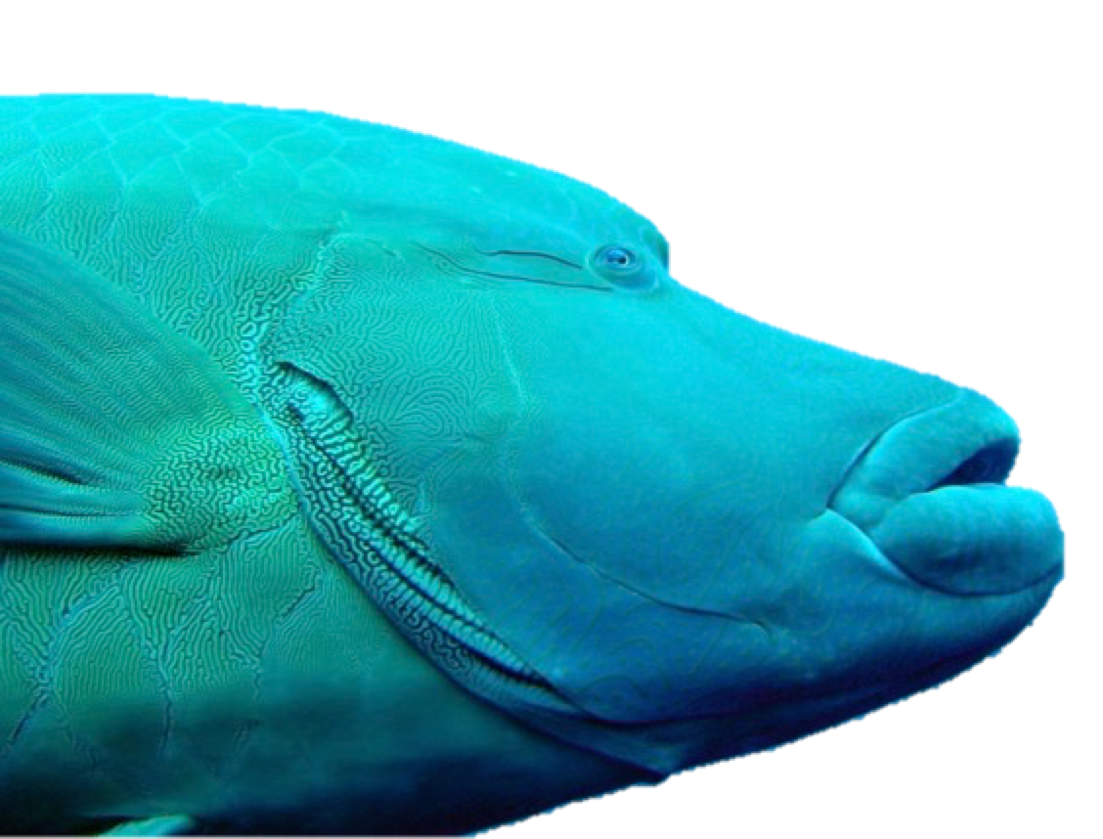

Expanding OBIS beyond species occurrence data, with an extension for dwc:MeasurementOrFact
The following slides are borrowed from the:
OBIS-ENV-DATA project consortium
International Oceanographic
Data and Information Exchange
Photo credits Molly Timmers - NOAA
w.appeltans@unesco.org
Notes:
Slides source: https://www.slideshare.net/OBIS-IOC/expanding-obis-beyond-species-occurrence-data-including-sampling-event-facts-and-measurements-related-to-the-environment

Slide 10





Integrated Publishing Toolkit
Star Schema
Slide by:
OBIS-ENV-DATA
Occurrence core
MoF = Measurement or Fact
1
MoF addresses methods, abiotic and biological measurements
∞
MoF Extension
Event core
Sample event is the DwC core
1
1
∞
Occurrence Extension
∞
MoF Extension
Here: MoF describes the Event

Slide 11
What we needed
Slide by:
OBIS-ENV-DATA
Event Core
Occurrence Extension
MeasurementOrFacts Extension
measurement 1
event 1
Not compatible with star schema
occurrence 1
occurrence 2
Star schema is limited to only ONE layer
measurement 2
OBIS-ENV-DATA

Slide 12
Option 1
Slide by:
OBIS-ENV-DATA
Occurrence Core
MeasurementOrFacts Extension
measurement 1
event 1
occurrence 1
event 1
measurement 1
event 1
occurrence 2
occurrence 1
measurement 1
occurrence 2
measurement 2
measurement 2
Event-MoF needs to be repeated for each occurrence record
OBIS-ENV-DATA

Slide 13
Option 2
Slide by:
OBIS-ENV-DATA
Event Core
Occurrence Extension
MeasurementOrFacts Extension
measurement 1
event 1
Not possible when both abundance and biomass measurements are made and can’t record measurements or facts related to the occurrence.
occurrence 1
occurrence 2
measurement 2
OBIS-ENV-DATA

Slide 14
Option 3
Slide by:
OBIS-ENV-DATA
Archive 1
Archive 2
Event Core
MeasurementOrFacts Extension
Occurrence Core
MeasurementOrFacts Extension
occurrence 1
occurrence 2
2 DwC-archives for one dataset might sometimes be confusing – and we need links between archives.
measurement 2
event 1
Creating 2 Archives (DwC-A):
one DwC-A for Events and abiotic measurements; and one DwC-A for Occurrences and biological
measurements.
measurement 1
OBIS-ENV-DATA

Slide 15
Option 4
Slide by:
OBIS-ENV-DATA
Occurrence Core
MeasurementOrFacts Extension
event 1
Creating dummy occurrence records, treat as an event record
measurement 1
occurrence 1
occurrence 2
Is abusing the Occurrence Core
measurement 2
OBIS-ENV-DATA

Slide 16
Option 5
Slide by:
OBIS-ENV-DATA
Event Core
Occurrence Extension
MeasurementOrFacts Extension
measurement 1
event 1
event 1_1
Complex and not intuitive.
occurrence 1
event 1_2
Creating a dummy event for each occurrence extension record
occurrence 2
measurement 2
OBIS-ENV-DATA

Slide 17
Slide by:
OBIS-ENV-DATA
Event Core
Occurrence Extension
MeasurementOrFacts Extension
measurement 1
measurement 2
We need to customize the MoF Extension
event 1
occurrence 1
occurrence 2
OBIS-ENV-DATA

Slide 18
Option 6
Slide by:
OBIS-ENV-DATA
Event Core
eventID
Extended
MeasurementOrFact Extension
eventID
occurrenceID
Occurrence Extension
OBIS-ENV-DATA
eventID
occurrenceID

Slide 19
Slide by:
OBIS-ENV-DATA
Extended MeasurementOrFact(s) Extension
allows for parameter standardization (linking to external URI of a controlled vocabulary)
    ID: the identifier used by DwC-A standard to link the eMoF to the Core file.
    occurrenceID (new): identifier to link the eMoF with the occurrence extension.
    measurementType: The nature of the measurement, fact, characteristic, or assertion.
    measurementTypeID (new): An identifier for the measurementType (global unique identifier, URI)
    measurementValue: The value of the measurement, fact, characteristic, or assertion.
    measurementValueID (new): An identifier for facts stored in the column measurementValue (global unique identifier, URI)
    measurementAccuracy: The description of the potential error associated with the measurementValue.
    measurementUnit: The value of the measurement, fact, characteristic, or assertion.
    measurementUnitID (new): An identifier for the measurementUnit (global unique identifier, URI)
    measurementDeterminedDate: The date on which the MeasurementOrFact was made.
    measurementDeterminedBy: A list (concatenated and separated) of names of people, groups, or organizations who determined the value of the MeasurementOrFact.
    measurementMethod: A description of or reference to (publication, URI) the method or protocol used to determine the measurement, fact, characteristic, or assertion.
    measurementRemarks: Comments or notes accompanying the MeasurementOrFact.

Slide 20
Extended MeasurementOrFact(s) Extension
Slides by:
OBIS-ENV-DATA
EXAMPLE benthic sample Van Veen grab
ID | Occurrence-ID | MoF-Type | MoF-TypeID | MoF-Value | MoF-ValueID | MoF-Unit | MoF-UnitID
1 |  | Sampling device name | L19/current/SDNKG01/ | Van-Veen grab | L22/current/TOOL0653/
1 |  | Area sampled | P01/current/AREABEDS/ | 0.112 |  | m² | P06/current/UMSQ/
1 |  | Sample volume | P01/current/VOLXXXXX/ | 20 |  | L | P06/current/ULIT/
1 |  | Sieze mesh size |  | 250 |  | µm | P06/current/UMIC/
1 |  | Biological entity size sampled |  | 250-1000 |  | µm | P06/current/UMIC/
1 | 1 | Ash-free dry weight biomass | P01/current/SDBIOL03/ | 0.2 |  | Kg/m² | P06/current/KMP2/
1 | 1 | ObservedindividualCount | P01/current/OCOUNT01/ | 112 |  | individuals
1 | 1 | Abundance | P01/current/SDBIOL02/ | 1000 |  | individuals/m² | P06/current/UPMS/
1 | 1 | lifeStage | S11/ | juvenile | S11/current/S1127/
Notes:
Linking to external URI of a controlled vocabulary for parameter standardization

Slide 21
Event
1
EVENT HIERARCHY makes it possible to record differences in sampling time, location, and depth while still grouping these samples together to the same station visit.
Event 1.1
MoF
A1
MoF
A2
Event 1.1.1
MoF
B3
MoF
B1
Occ
3
Occ
1
Occ
2
MoF
B2
OBIS-ENV-DATA
Slides by:
OBIS-ENV-DATA

Slide 22

Proposing a new use case:
dwc:Event for experiment events
Experiments with living specimens
at a location and date that is
different from the collecting event.

Slide 23
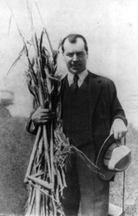
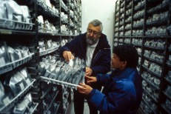
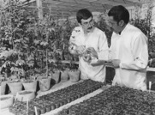
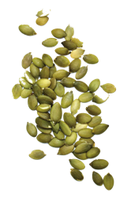
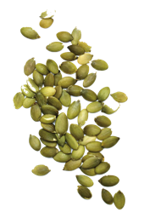
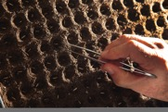
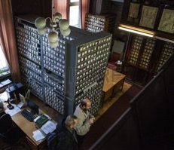
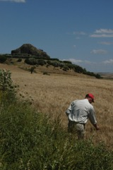
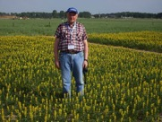
Collecting expeditions
Genebank, collections
Field/lab experiments
eventID::E1
mofID::E11
occurrenceID::C11
institutionID::C1
occurrenceID::C11
occurrenceID::C12
…
eventID::A1
occurrenceID::A11
Seeds from collecting trip expeditions are deposited in genebank collections.
eventID::F2
mofID::F21
occurrenceID::D11
Living seeds from genebank collections are used for field or laboratory experiments.
institutionID::D1
occurrenceID::D11
occurrenceID::D12
…
eventID::G3
mofID::G31
…
eventID::B1
occurrenceID::B11
Notes:
Seeds from expeditions deposited in genebank collections

Slide 24
Use case of linking between two archives:
Joint, collaborative collecting expeditions
often collect material that is divided between
different museums, herbaria, and genebanks.
Collecting events published in one archive (DwC-A)
Specimens published in other archive
… and experiments in a third archive

Slide 25
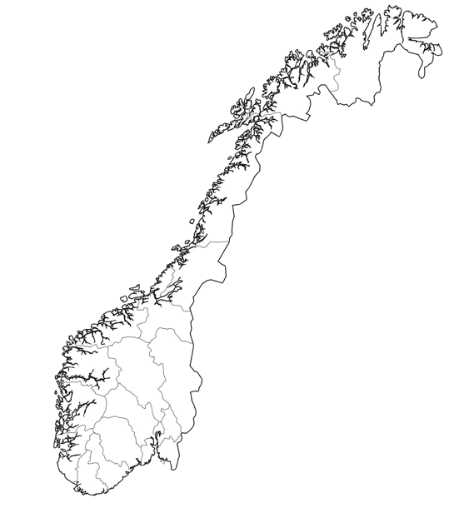

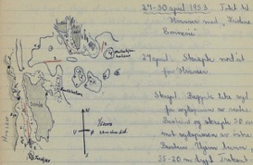

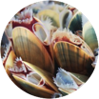
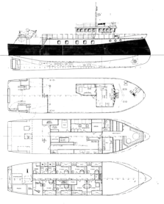





Example of a joint, collaborative collection mission:
same sampling event – but specimens sent to to different museum collections
Dannevig collections (280 collecting events)
http://doi.org/10.15468/hwvr0m
Material from the same expedition –> 4 herbaria, and 4 datasets (DwC-A).
UiT : Arthropod collection
http://doi.org/10.15468/vjkvxg
NTNU : Algae herbarium
https://doi.org/10.15468/elzhsu
UiB : Cephalaspidean Gastropods
http://doi.org/10.15468/sbomfu
UiO : Dannevig- and Drobak-
collections Polychaeta
https://doi.org/10.15468/y6cctp
Notes:
Joint collection missions, same event, specimens sent to to different museum collections

