Slide 1



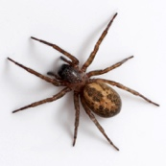
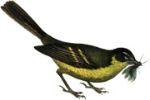



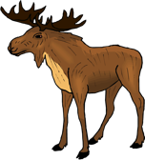






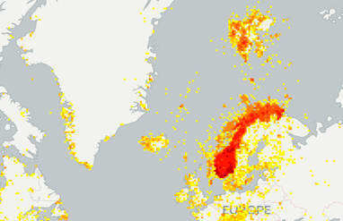


If a tree falls in the forest and nobody publishes the event in GBIF, did it really happen?
Global Biodiversity Information Facility, free and open access to biodiversity data
BIO4115/9115 course 14th November 2017 UiO Tøyen
Notes:
BIO4115/9115 at UiO Natural History Museum in Oslo, 14th November 2017, CC-by Dag Endresen, GBIF-Norway, UiO Natural History Museum in Oslo
Illustration: Occurrences located in Norway from the GBIF data portal, http://www.gbif.org/country/NO/summary

Slide 2
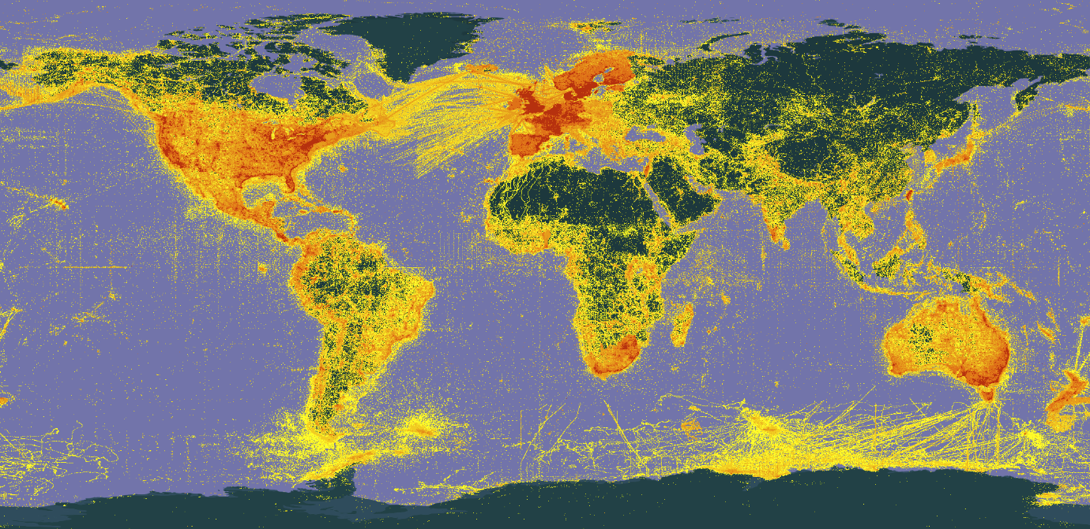
GBIF enables free and open access to biodiversity data online.
We are an international government-initiated and -funded initiative focused on making biodiversity data available to all and anyone, for scientific research, conservation and sustainable development.
Map updated 8th November 2017
Notes:
GBIF: http://www.gbif.org/
what is the Global Biodiversity Information Facility? GBIF enables free and open access to biodiversity data online. We are an international government-initiated and funded initiative focused on making biodiversity data available to all and anyone, for scientific research, conservation and sustainable development.
Hva er Global Biodiversity Information Facility (GBIF)? GBIF arbeider for fri og åpen tilgang til biodiversitetsdata online. Vi er et internasjonalt og statlig initiert og finansiert nettverk med fokus på å bidra til at biodiversitetsdata er tilgjengelig for alle og enhver, for vitenskapelig forskning, bevaring og bærekraftig utvikling.

Slide 3

BY THE NUMBERS
10th November 2017
Species occurrence records
Datasets
874,657,042
36,988
Country Participants
Organizational Participants
Publishers
54
40
1,125
Records downloaded per month (avg Jan-Aug 2017)
Total page views (August 2017)
43.4 billion
97,053
Notes:
Useful to see GBIF in its different modalities:
A window on biodiversity
An informatics infrastructure focuseD on tools and standards in service to science and society
A global network on bioinformatics

Slide 4
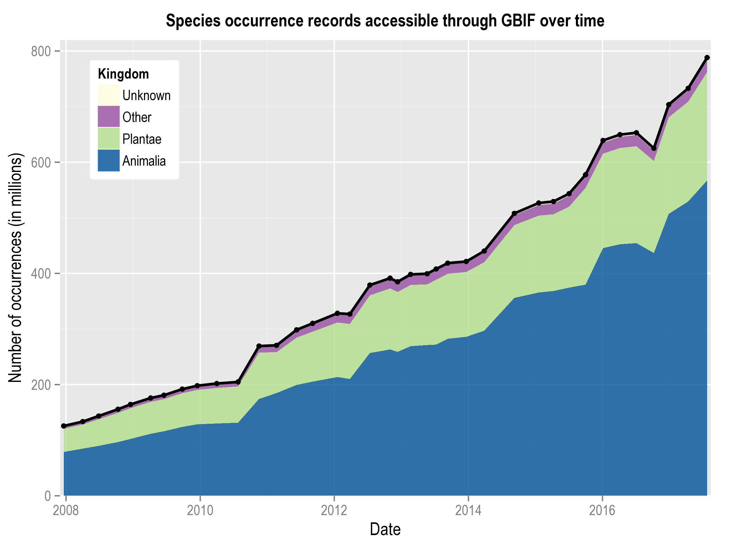
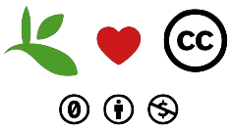
Data published through GBIF.org
www.gbif.org/analytics/global
Notes:
https://www.gbif.org/terms
2014-06 http://www.bouchoutdeclaration.org/declaration/
2014-09-22 https://www.gbif.org/news/82363/new-approaches-to-data-licensing-and-endorsement
2016-08-18 https://www.gbif.org/news/82812/licensing-milestone-for-data-access-in-gbiforg
2016-10-06 https://www.gbif.org/news/82868/gbiforg-implements-licensing-changes-updates-terms-of-service
--
Built on a 2014 decision by GBIF’s governing board, all occurrence datasets are now assigned one of the following three licences from Creative Commons:
CC0, under which data are made available for any use without restriction or particular requirements on the part of users
CC BY, under which data are made available for any use provided that attribution is appropriately given for the sources of data used
CC BY-NC, under which data are made available for any use provided that attribution is appropriately given and provided the use is not for commercial purposes
--
FORCE11 Data Citation Principles https://www.force11.org/datacitation
FAIR Guiding Principles http://dx.doi.org/10.1038/sdata.2016.18

Slide 5
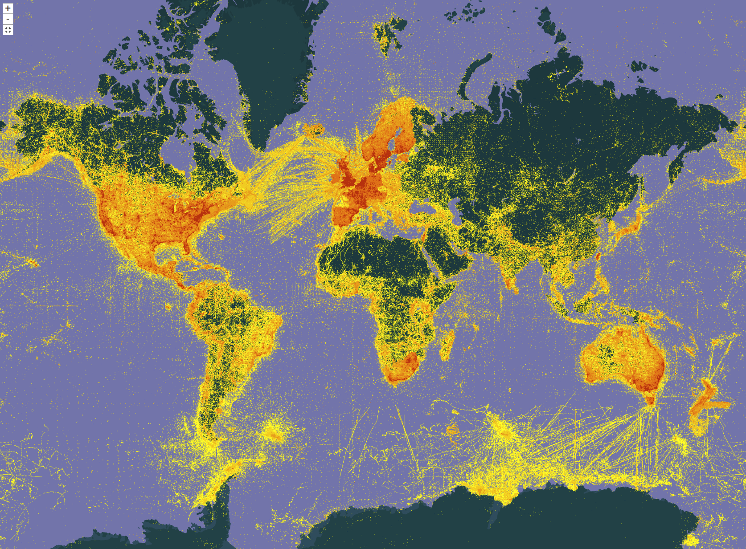
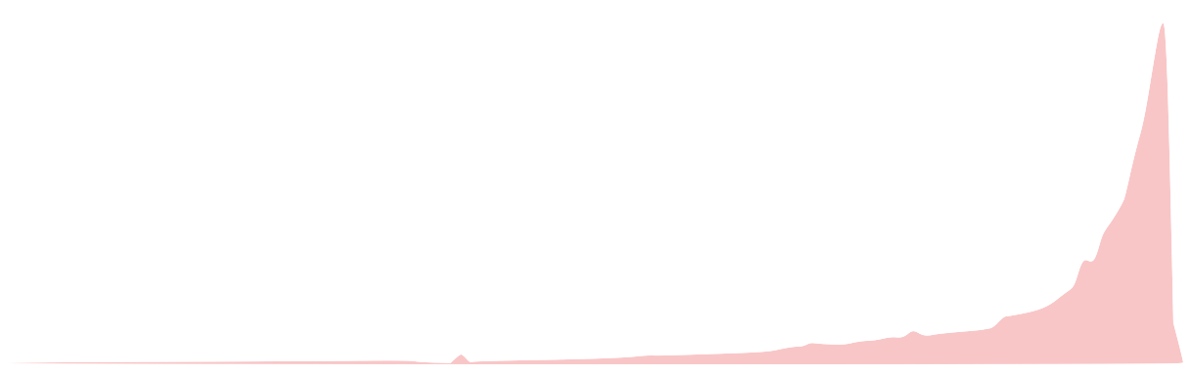
Data coverage and gaps
Map updated 8th November 2017
Asia (gap in data coverage)
Africa (gap in data)
Most data are from
more recent dates
1900
1950
2017
Notes:
Map updated 8th November 2017

Slide 6
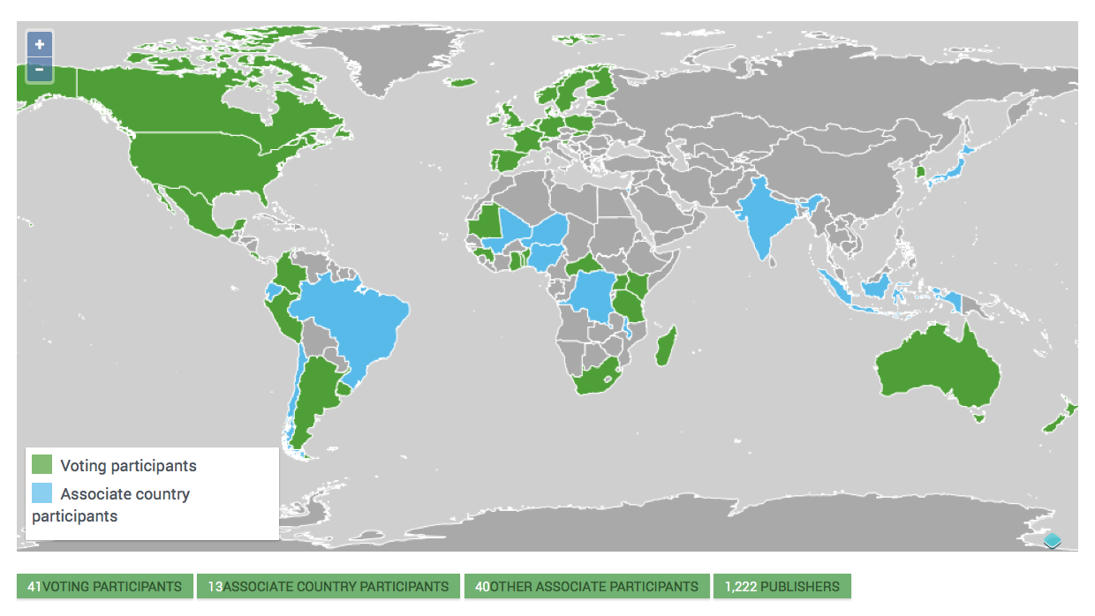
Current network
Norway joined GBIF in 2004
Asia (gap in membership)
Africa (gap in membership)
https://gbif.org/the-gbif-network
Notes:
Norway joined GBIF in February 2004

Slide 7
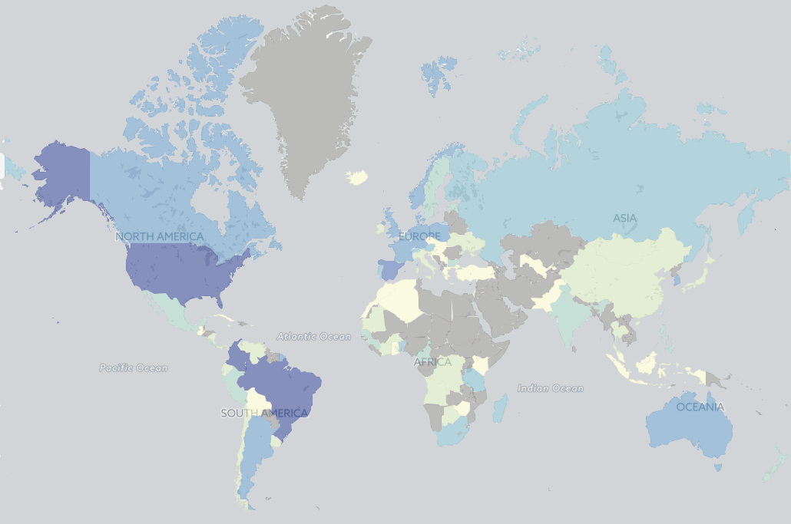
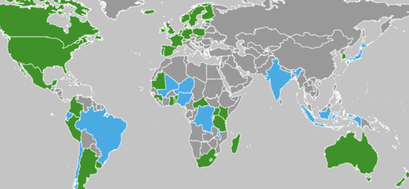
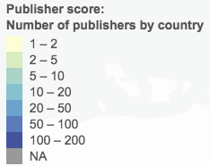
Data publishing through gbif

Slide 8
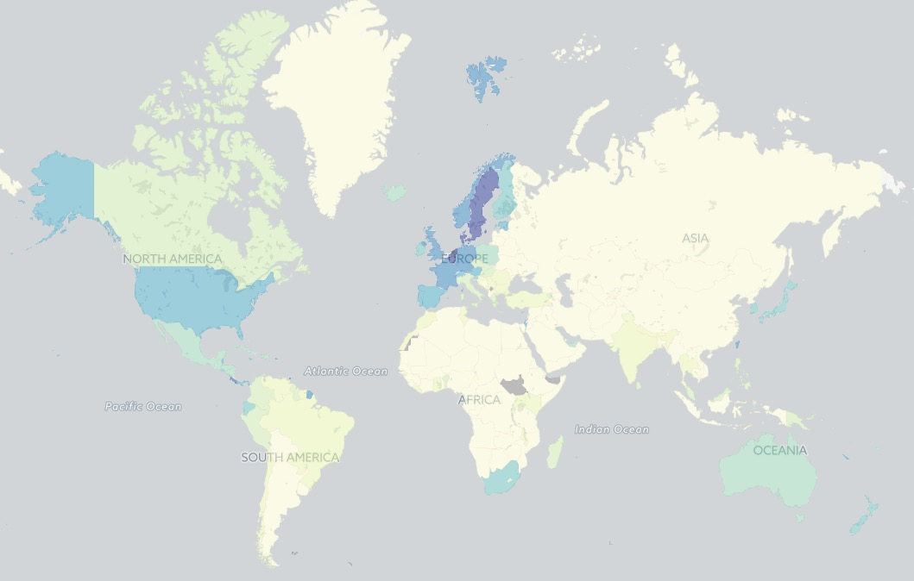
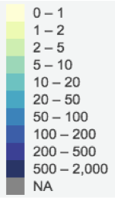
Data coverage in gbif
Number of records per square kilometer
Density score: land area divided by occurrence count

Slide 9
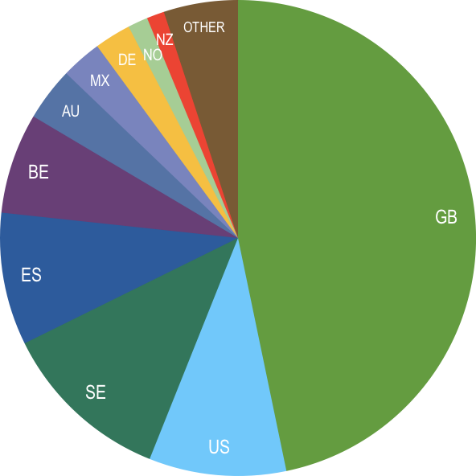
Occurrence records published during 2017 by country as of 31 Aug 2017
 | Country | New records
1 | United Kingdom | 59,462,652
2 | United States | 14,599,475
3 | Sweden | 11,847,209
4 | Spain | 11,451,395
5 | Belgium | 8,630,814
6 | Australia | 4,570,041
7 | Mexico | 3,516,388
8 | Germany | 3,079,611
9 | Norway | 1,697,240
10 | New Zealand | 1,515,354
data availability
2017
http://www.gbif.org/country

Slide 10
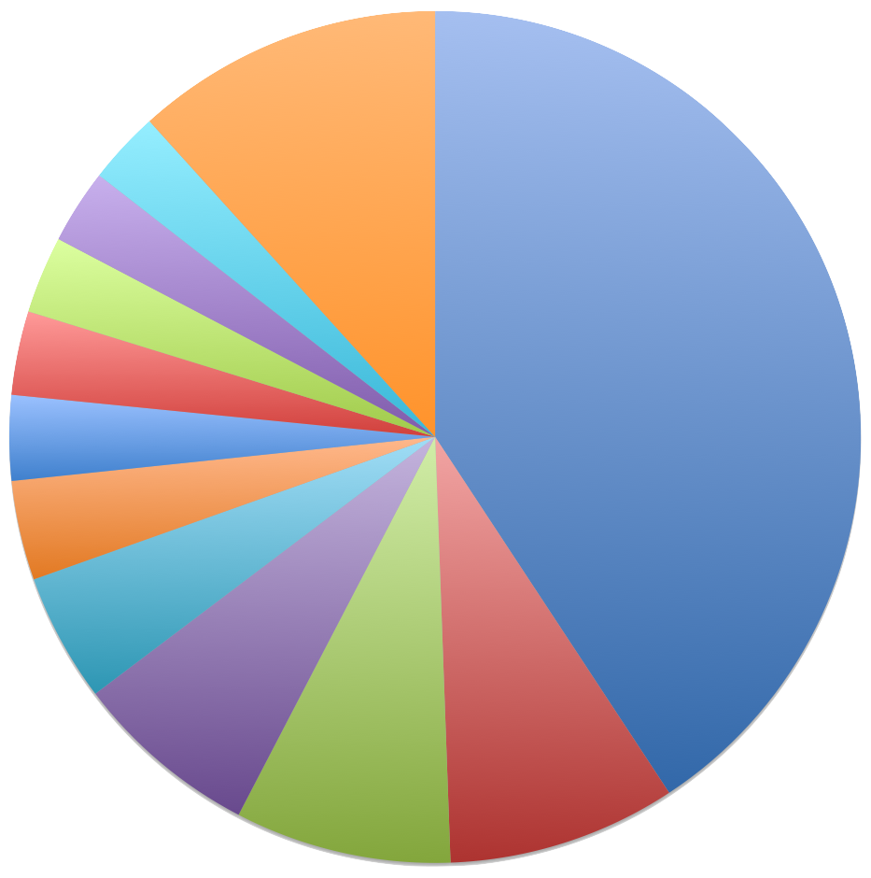
Total number of occurrence records published by country as of 10 November 2017
Other
NO
ES
1 | United States | 351,131,472
2 | United Kingdom | 74,870,402
3 | Sweden | 70,776,421
4 | Australia | 60,896,329
5 | France | 41,989,525
6 | Germany | 32,543,009
7 | Netherlands | 27,852,278
8 | Denmark | 27,422,869
9 | Finland | 25,286,056
10 | Spain | 24,400,609
11 | Norway | 23,840,434
FI
US
DA
data availability
NL
Total
DE
FR
AU
SE
GB
Notes:
Status 2017-11-08
157 occurrence datasets with 23,858,484 records -- https://www.gbif.org/dataset/search?type=OCCURRENCE&publishing_country=NO
2 checklist datasets with 167,035 records -- https://www.gbif.org/dataset/search?type=CHECKLIST&publishing_country=NO
26 sampling-event datasets -- https://www.gbif.org/dataset/search?type=SAMPLING_EVENT&publishing_country=NO
4 metadata-only datasets -- https://www.gbif.org/dataset/search?type=METADATA&publishing_country=NO
----
Status 2017-03-15
128 occurrence datasets with 24,189,098 records.
2 checklist datasets with 167,035 records.
7 metadata-only datasets.
Norway publishes data covering 221 countries, territories and islands.
----
Status 2016-12-09
117 occurrence datasets with 22,558,484 records.
2 checklist datasets with 167,035 records.
5 metadata-only datasets.
Norway publishes data covering 220 countries, territories and islands.
----
http://www.gbif.org/country/US/publishing
http://www.gbif.org/country/SE/publishing
http://www.gbif.org/country/FR/publishing
http://www.gbif.org/country/AU/publishing
http://www.gbif.org/country/GB/publishing
http://www.gbif.org/country/DE/publishing
http://www.gbif.org/country/NL/publishing
http://www.gbif.org/country/NO/publishing
http://www.gbif.org/country/ZA/publishing
http://www.gbif.org/country/ES/publishing
----

Slide 11
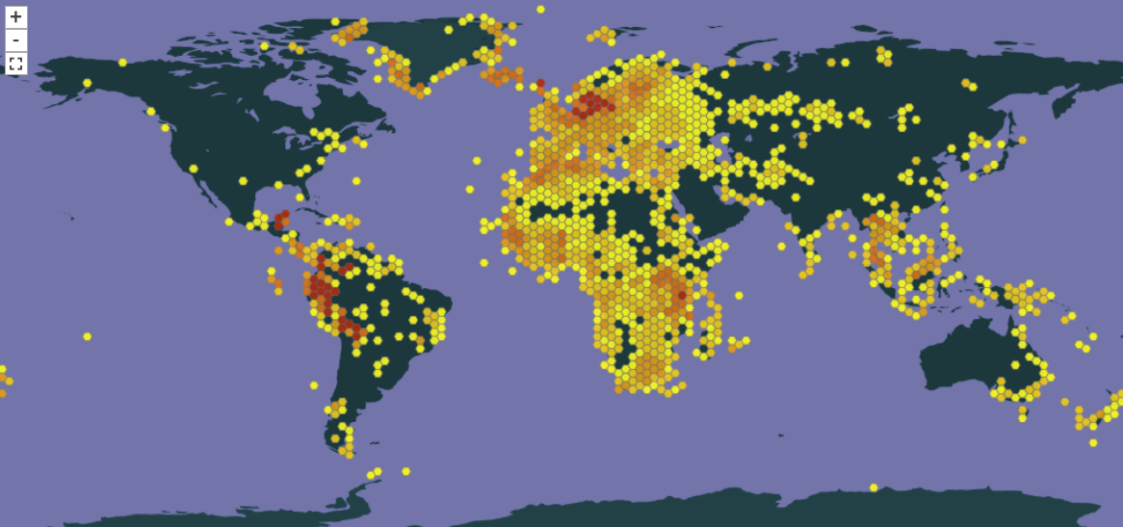
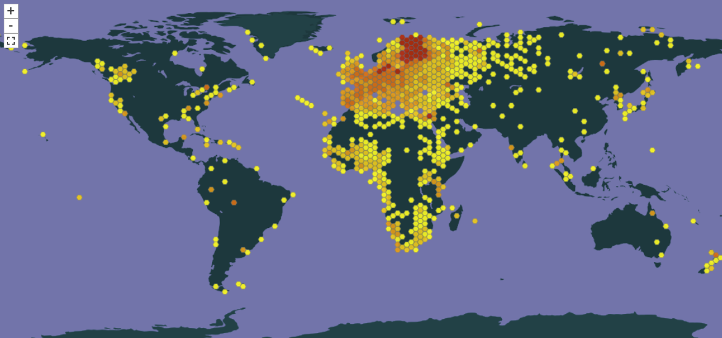


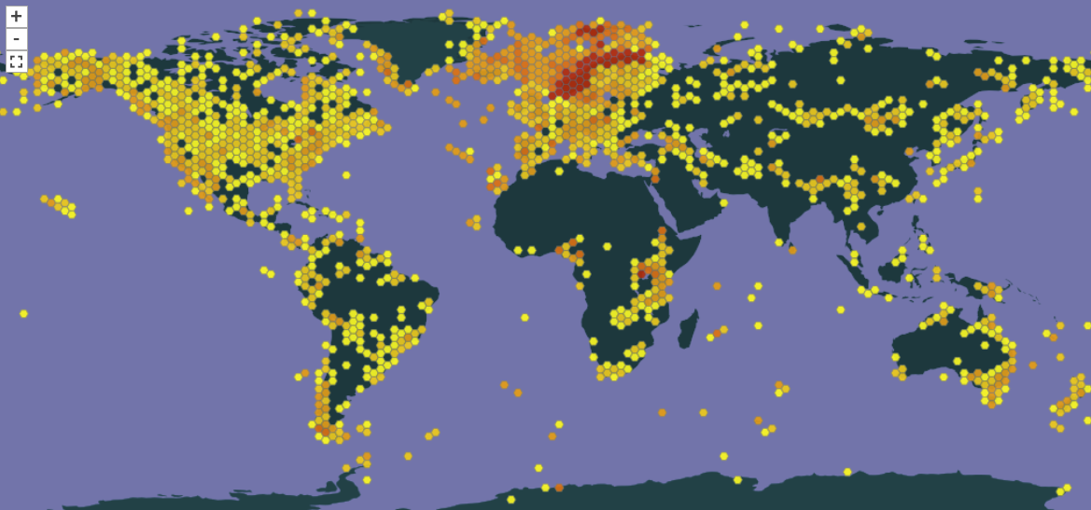
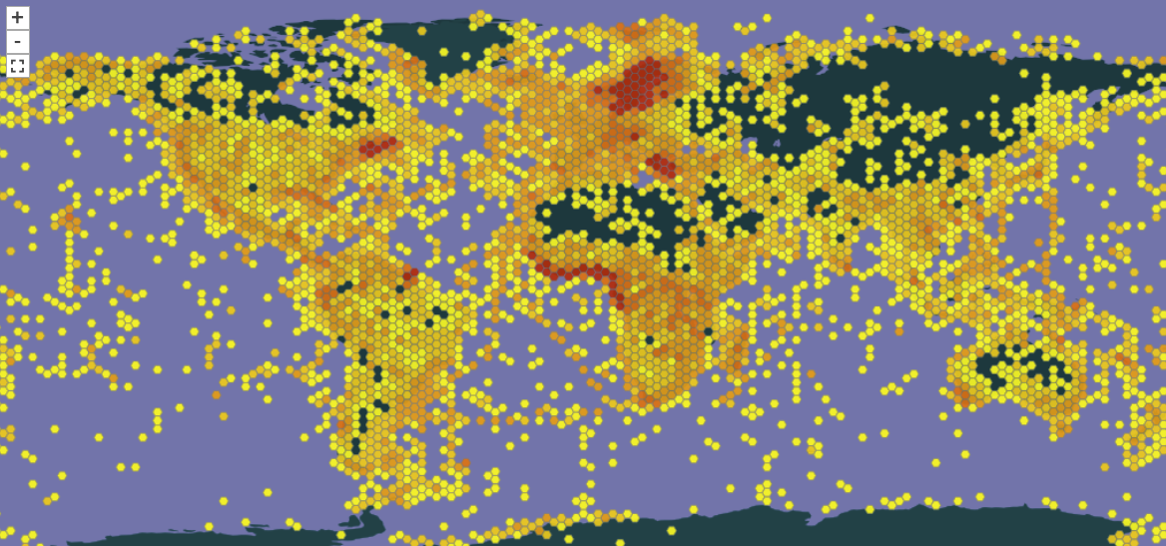

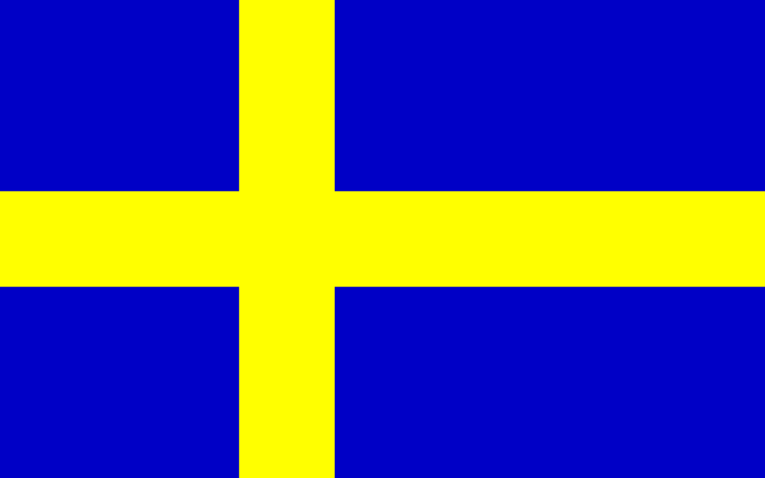
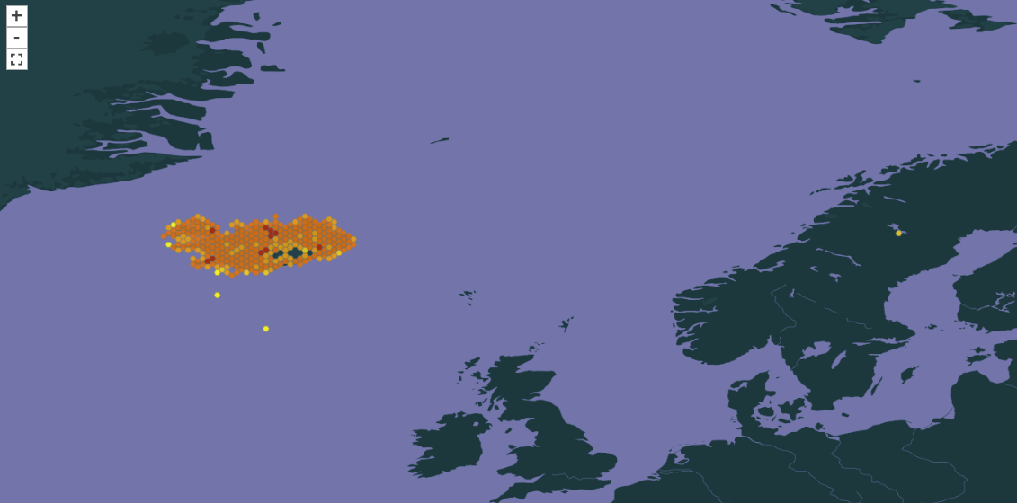

Nordic GBIF nodes
Danmark
Finland
http://www.gbif.org/country/NO
Norway
Sweden
Nov 2017 | Datasets | Occurrences
Denmark | 164 | 27 422 869
Finland | 57 | 25 286 056
Iceland | 4 | 458 705
Norway | 189 | 23 840 434
Sweden | 43 | 70 776 421
Iceland
Updated 10th November 2017
Notes:
Denmark: http://www.gbif.org/country/DK/publishing
Finland: http://www.gbif.org/country/FI/publishing
Iceland: http://www.gbif.org/country/IS/publishing
Norway: http://www.gbif.org/country/NO/publishing
Sweden: http://www.gbif.org/country/SE/publishing
--
Status in March 2017
Country, datasets, occurrences
Denmark, 68+2 ds, 11 924 383 occ
Finland, 54 ds, 3 164 965 occ
Iceland, 4 ds, 458 705 occ
Norway, 129+2+6 ds, 24 198 151 occ
Sweden, 43+1 ds, 61 523 557 occ
--
Status in November 2016
Country, datasets, occurrences
Denmark, 68+2 ds, 11 919 745 occ
Finland, 54 ds, 3 164 965 occ
Iceland, 4 ds, 458 705 occ
Norway, 117+2+5 ds, 22 558 484 occ
Sweden, 42 ds, 53 818 302 occ
--
Status in April 2015:
Country, datasets, occurrences
Denmark, 55ds, 10 250 100 occ
Finland, 58 ds, 19 626 137 occ
Iceland, 4 ds, 458 705 occ
Norway, 93 ds, 17 425 011 occ
Sweden, 34 ds, 50 997 763 occ

Slide 12
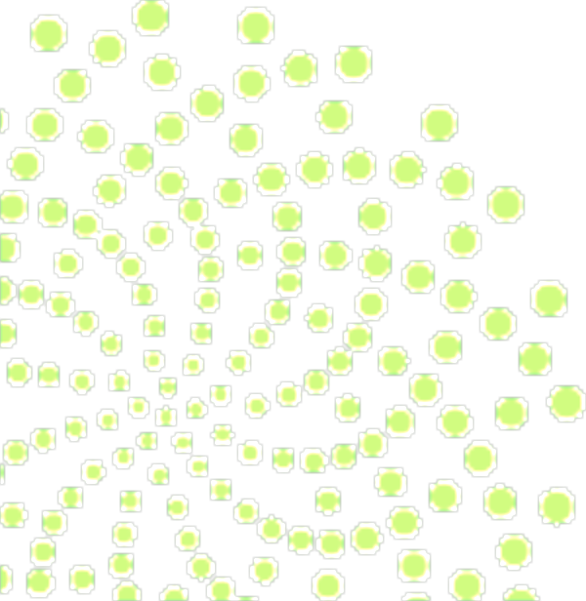


Discover and download data
in GBIF

Slide 13
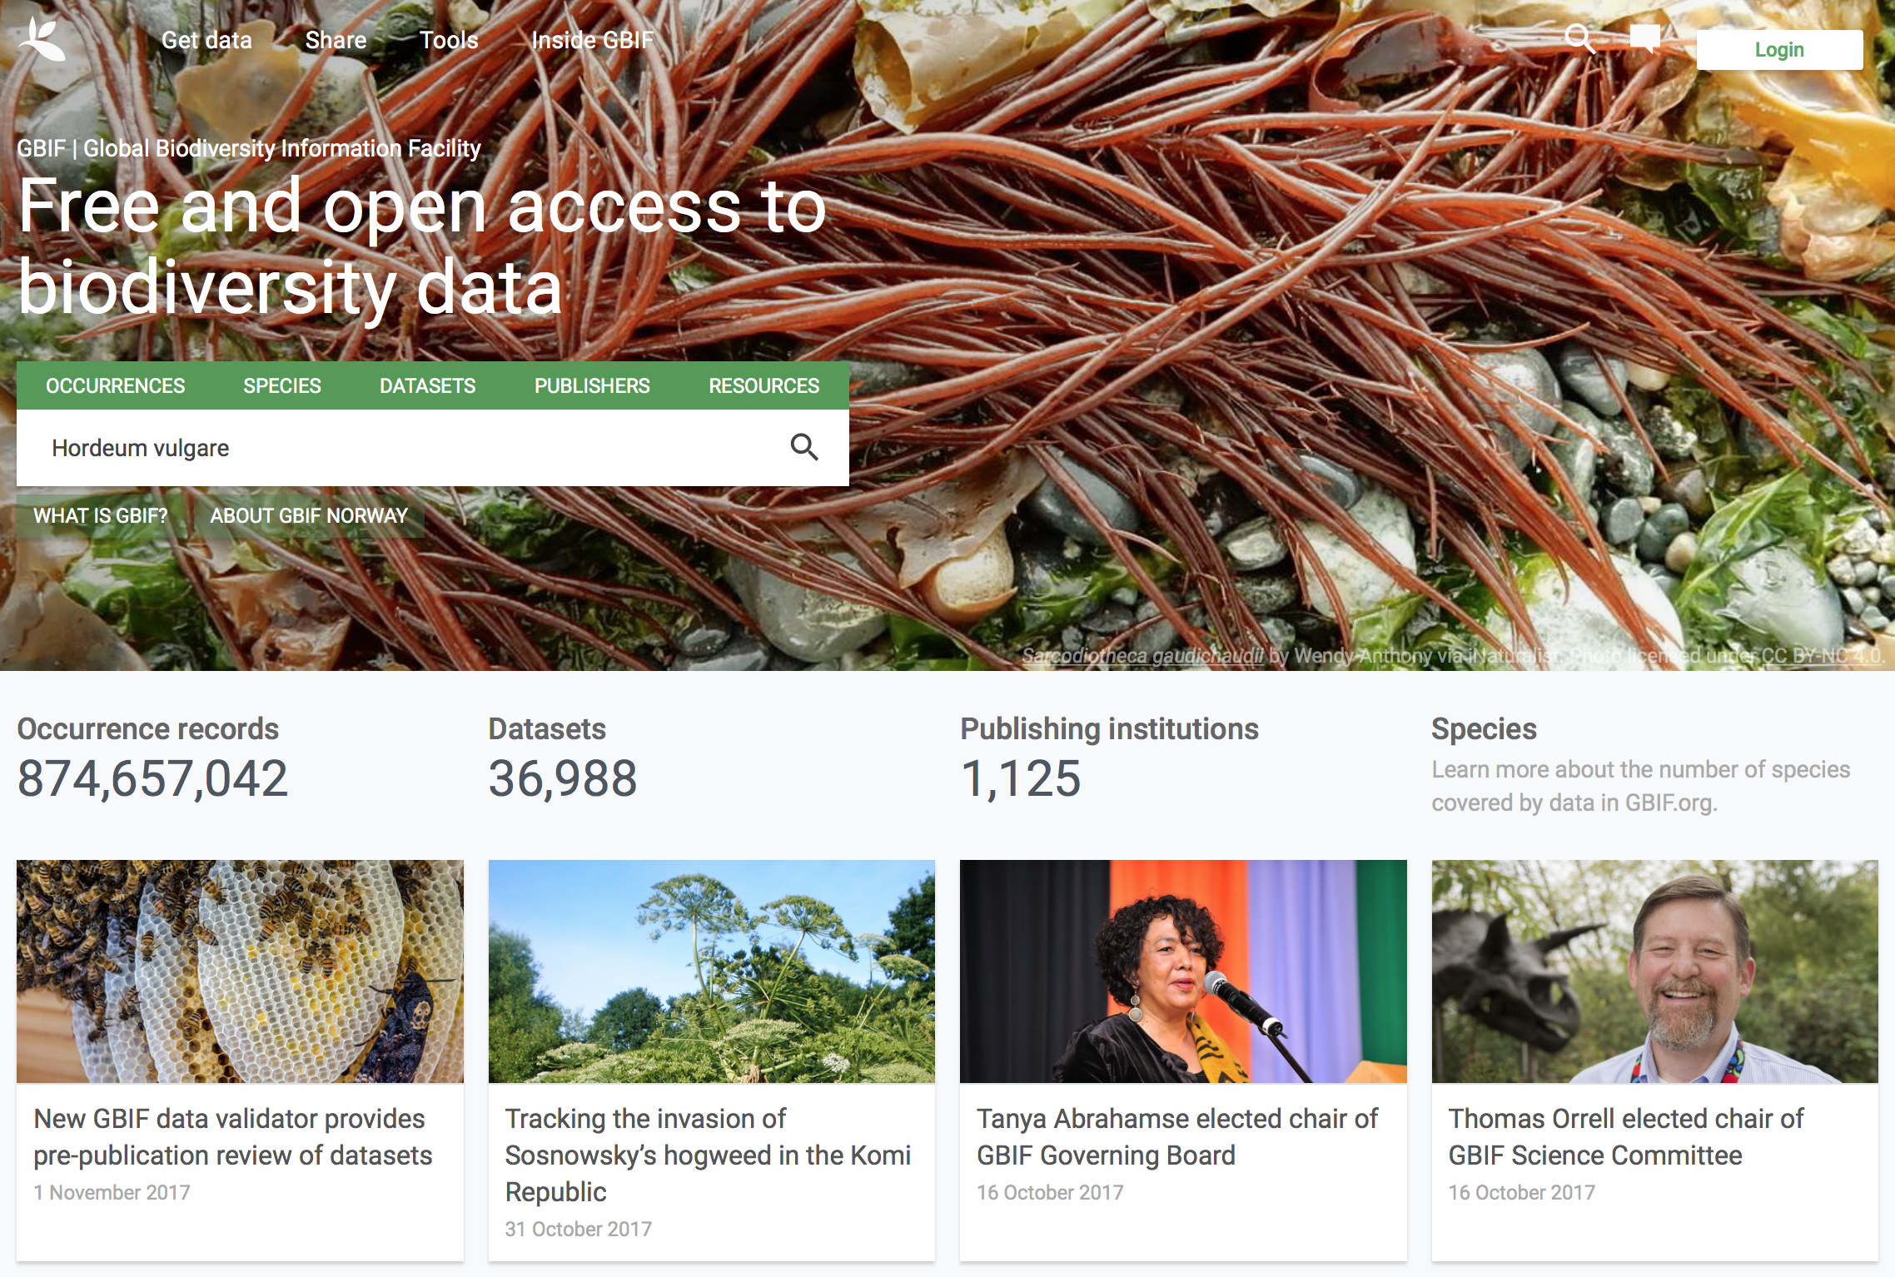
Notes:
https://www.gbif.org

Slide 14
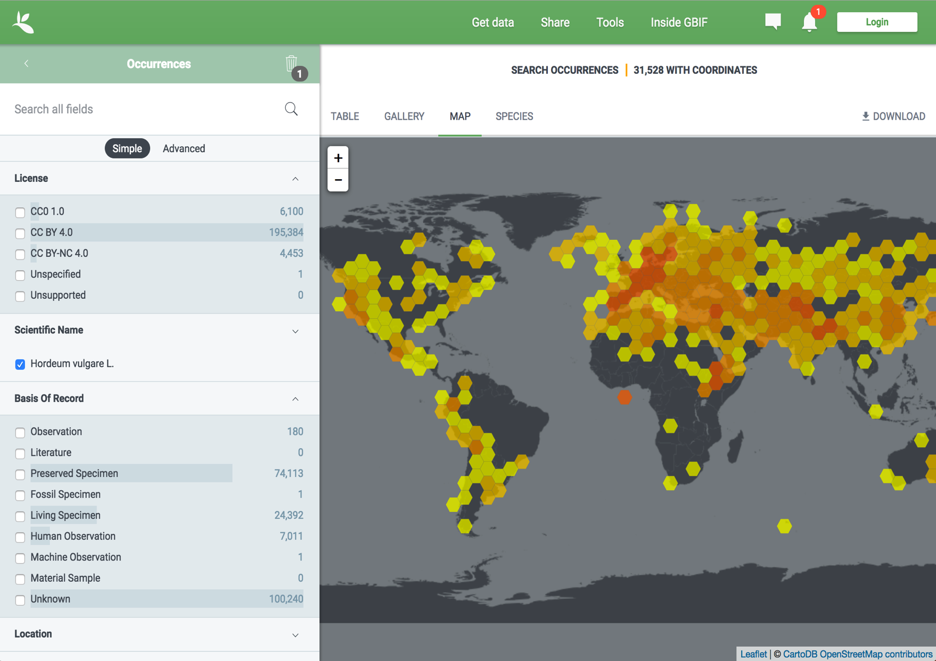
Barley – Hordeum vulgare L.
Notes:
Barley – Hordeum vulgare
https://www.gbif.org/occurrence/search?taxon_key=2706056

Slide 15
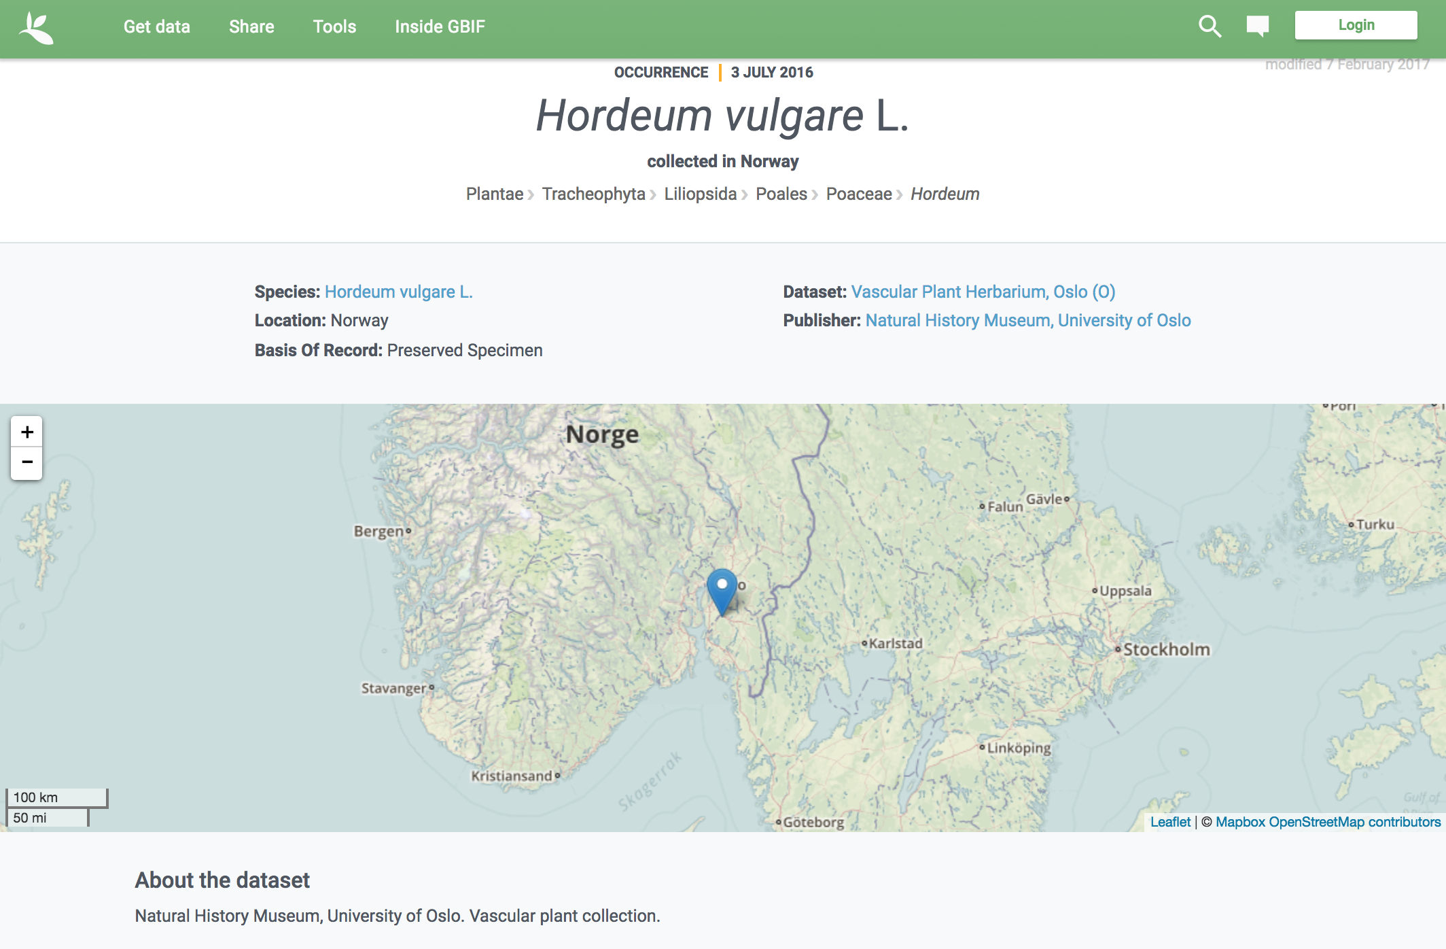
Barley – Hordeum vulgare L.
Notes:
Barley – Hordeum vulgare
https://www.gbif.org/occurrence/1427569601

Slide 16
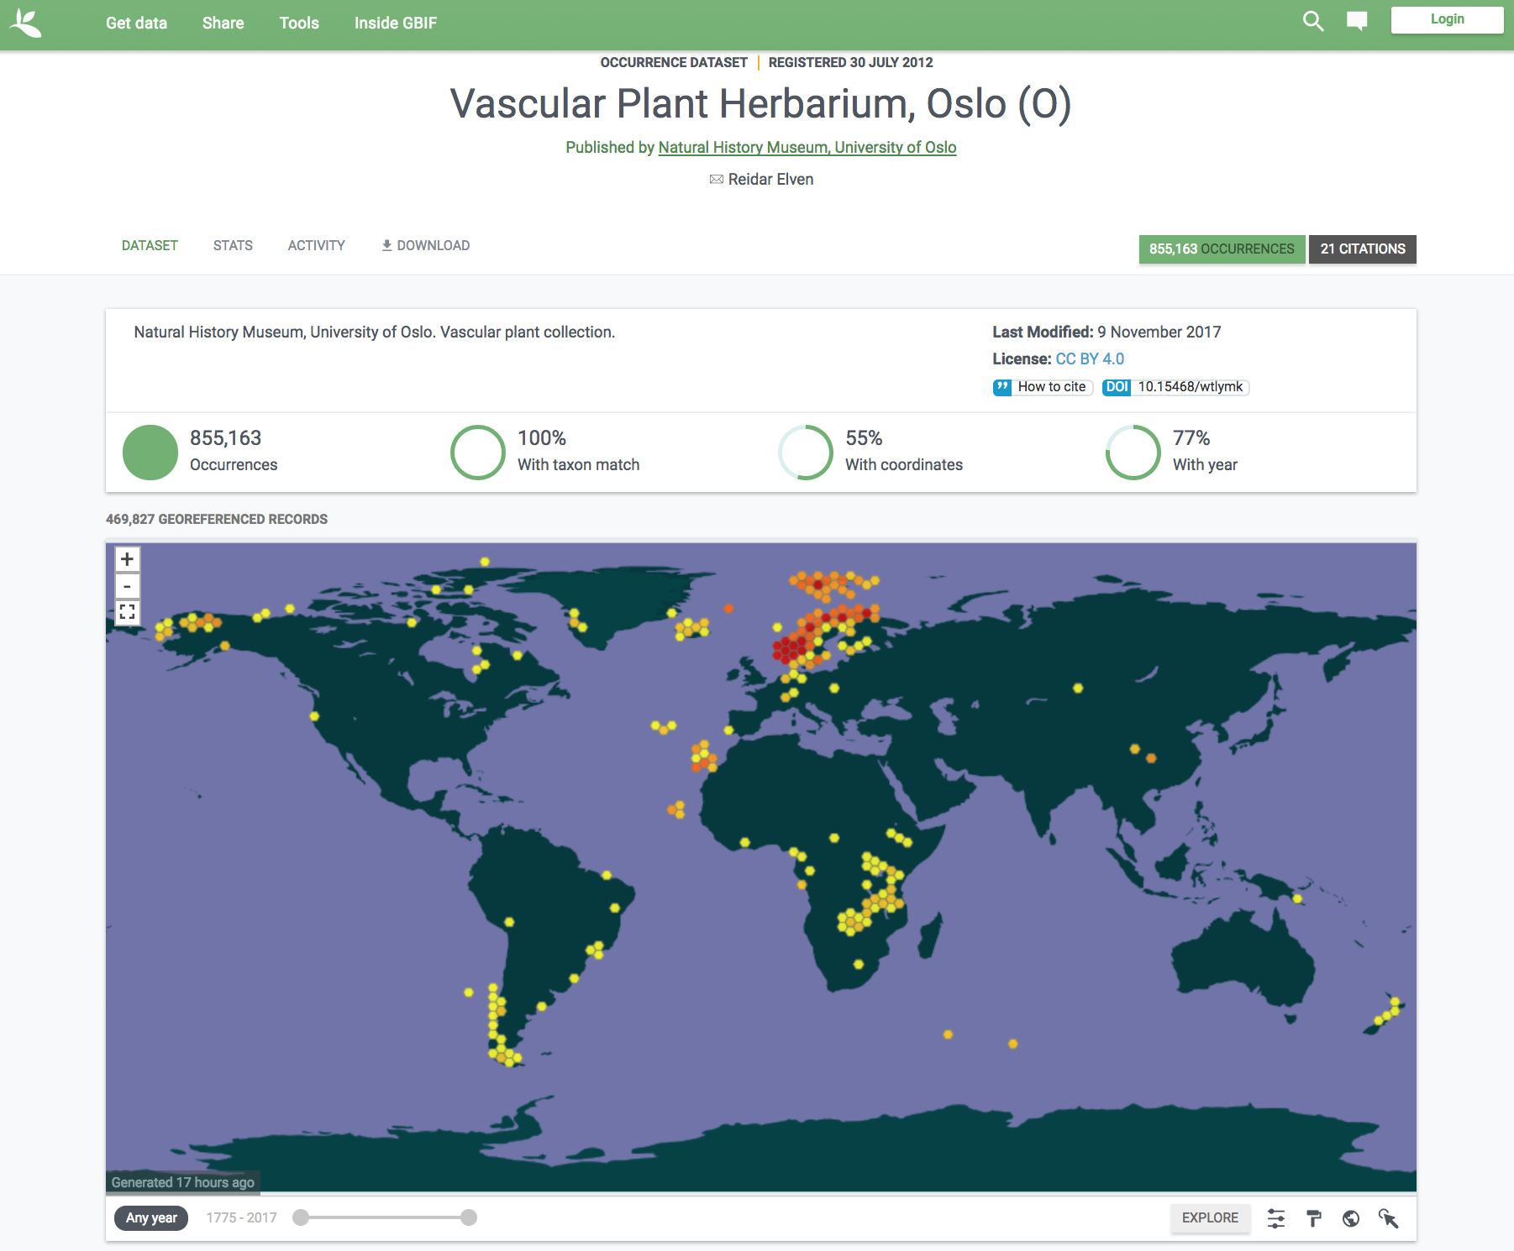
All datasets are assigned a DOI:
https://doi.org/10.15468/wtlymk
Barley – Hordeum vulgare L.
Notes:
Vascular Plant Herbarium, Oslo (O)
https://doi.org/10.15468/wtlymk
https://www.gbif.org/dataset/e45c7d91-81c6-4455-86e3-2965a5739b1f

Slide 17
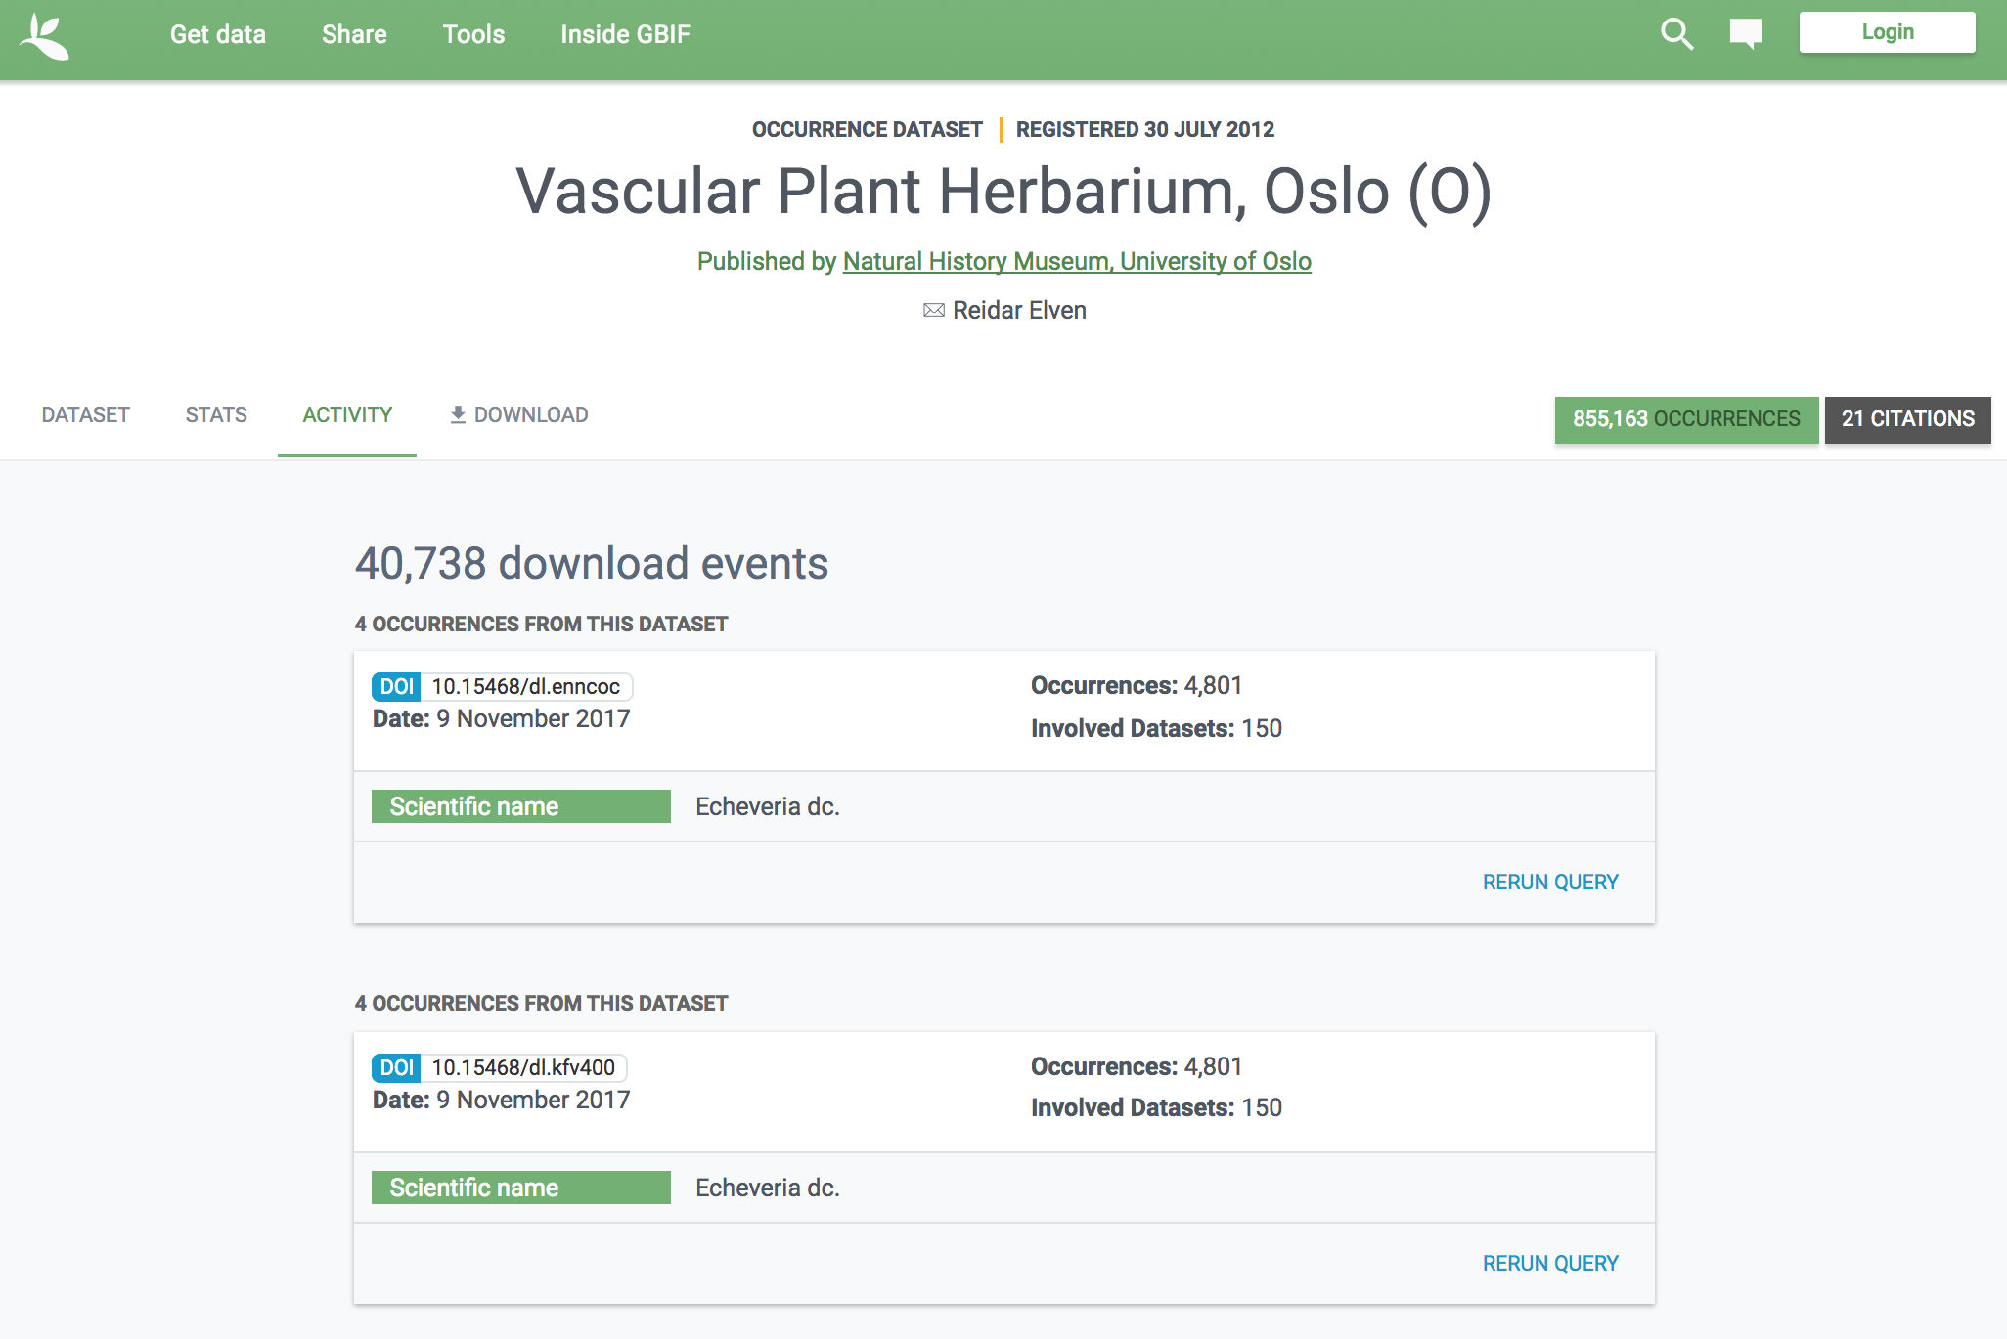
Barley – Hordeum vulgare L.
Notes:
Vascular Plant Herbarium, Oslo (O)
https://doi.org/10.15468/wtlymk
https://www.gbif.org/dataset/e45c7d91-81c6-4455-86e3-2965a5739b1f

Slide 18
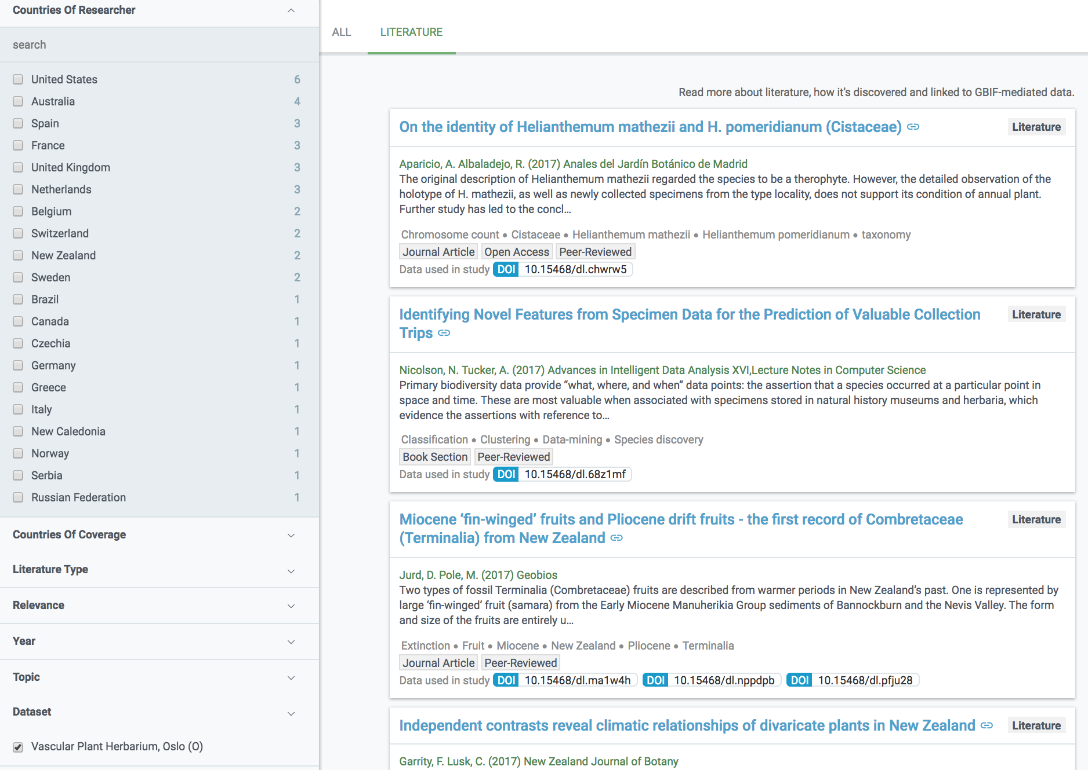
Reporting data use to publishers
Barley – Hordeum vulgare L.
Notes:
Vascular Plant Herbarium, Oslo (O)
https://doi.org/10.15468/wtlymk
https://www.gbif.org/dataset/e45c7d91-81c6-4455-86e3-2965a5739b1f

Slide 19
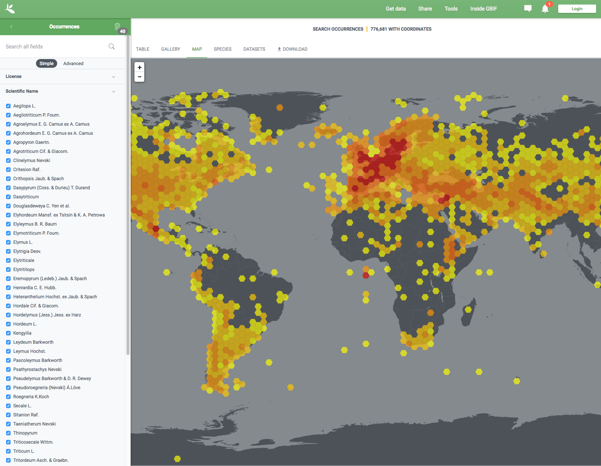
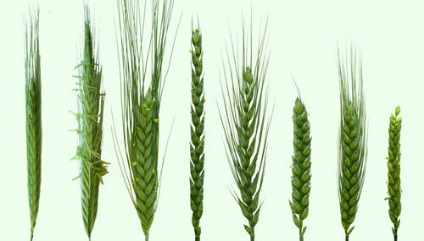
tribe: Triticeae
Total 1,565,639 occurrences of Triticeae
Notes:
Triticeae occurrence data published in GBIF
--
https://www.gbif.org/occurrence/map?taxon_key=2703501&taxon_key=4127121&taxon_key=2703050&taxon_key=2705808&taxon_key=2705193&taxon_key=4113716&taxon_key=4115295&taxon_key=6432586&taxon_key=4142061&taxon_key=2704853&taxon_key=7415787&taxon_key=8255807&taxon_key=2705881&taxon_key=2705934&taxon_key=7324780&taxon_key=5290243&taxon_key=2703302&taxon_key=4932540&taxon_key=4932451&taxon_key=2704657&taxon_key=3232809&taxon_key=8180972&taxon_key=4117265&taxon_key=5428469&taxon_key=2706050&taxon_key=7325479&taxon_key=4130607&taxon_key=2706325&taxon_key=6431292&taxon_key=2705041&taxon_key=6432785&taxon_key=6432756&taxon_key=6432319&taxon_key=2705965&taxon_key=2703542&taxon_key=2705665&taxon_key=2704132&taxon_key=8365666&taxon_key=2706388&taxon_key=7325825
--
http://www.gbif.org/occurrence/search?TAXON_KEY=2703501&TAXON_KEY=4127121&TAXON_KEY=2703050&TAXON_KEY=2705808&TAXON_KEY=2705193&TAXON_KEY=4113716&TAXON_KEY=4115295&TAXON_KEY=6432586&TAXON_KEY=4142061&TAXON_KEY=2704853&TAXON_KEY=7415787&TAXON_KEY=8255807&TAXON_KEY=2705881&TAXON_KEY=2705934&TAXON_KEY=7324780&TAXON_KEY=5290243&TAXON_KEY=2703302&TAXON_KEY=4932540&TAXON_KEY=4932451&TAXON_KEY=2704657&TAXON_KEY=3232809&TAXON_KEY=8180972&TAXON_KEY=4117265&TAXON_KEY=5428469&TAXON_KEY=2706050&TAXON_KEY=7325479&TAXON_KEY=4130607&TAXON_KEY=2706325&TAXON_KEY=6431292&TAXON_KEY=2705041&TAXON_KEY=6432785&TAXON_KEY=6432756&TAXON_KEY=6432319&TAXON_KEY=2705965&TAXON_KEY=2703542&TAXON_KEY=2705665&TAXON_KEY=2704132&TAXON_KEY=8365666&TAXON_KEY=2706388&TAXON_KEY=7325825#
--
--
Basis of record:
observation, 29 488
literature, 608
preserved specimen, 481 275
fossil specimen, 35
living specimen, 79 530
human observation, 559 058
machine observation, 150
material sample, 46
unknown, 408 964
--
Country:
Netherlands: 179605
France: 126707
United States: 99317
Germany: 88617
United Kingdom: 64632
Sweden: 64355
Spain: 60301
Afghanistan: 42334
Denmark: 40290
Belgium: 38939
--
Publisher
Bioversity International 511,179
Alterra, Wageningen UR 161,621
Centro Internacional de Agricultura Tropical (CIAT) 130,226
SPN - Service du Patrimoine naturel, Muséum national d'Histoire naturelle, Paris 88,187
ArtDatabanken 40,918
US National Plant Germplasm System 40,040
Bundesamt für Naturschutz / Netzwerk Phytodiversität Deutschland 35,487
Research Institute for Nature and Forest (INBO) 26,843
Plant Breeding and Acclimatization Institute (IHAR) - National Research Institute 24,299
Botanical Society of Britain & Ireland 20,841
--
Institution code:
wur-alterra 161,621
mex002 94,100
bioversity-ecpgr 80,689
ita303 66,441
syr002 60,383
rus001 55,749
deu146 53,727
pol003 45,076
bfn 31,800
usa029 31,179
--
Dataset:
EURISCO, The European Genetic Resources Search Catalogue 283,167
Dutch Vegetation Database (LVD) 161,621
The System-wide Information Network for Genetic Resources (SINGER) 155,046
A global database for the distributions of crop wild relatives 130,226
INPN - Données flore des CBN agrégées par la FCBN 76,432
SINGER Coordinator 66,441
Artportalen (Swedish Species Observation System) 40,918
United States National Plant Germplasm System Collection 40,040
Flora von Deutschland (Phanerogamen) 31,800
Florabank1 - A grid-based database on vascular plant distribution in the northern part of Belgium (Flanders and the Brussels Capital region) 26,831
--
License:
CC0 1.0: 147915
CC BY 4.0: 1176429
CC BY-NC 4.0: 234810
unspecified: 0
unsupported: 0
--
Year:
1994: 17617
2005: 17222
1999: 16267
1984: 15449
2009: 14768
2004: 14537
2003: 13770
2010: 13491
1987: 13067
1995: 13062
--
Month:
July: 128063
June: 109216
August: 95497
September: 56116
May: 53805
January: 51449
October: 29994
April: 15829
December: 13853
November: 8387
--

Slide 20
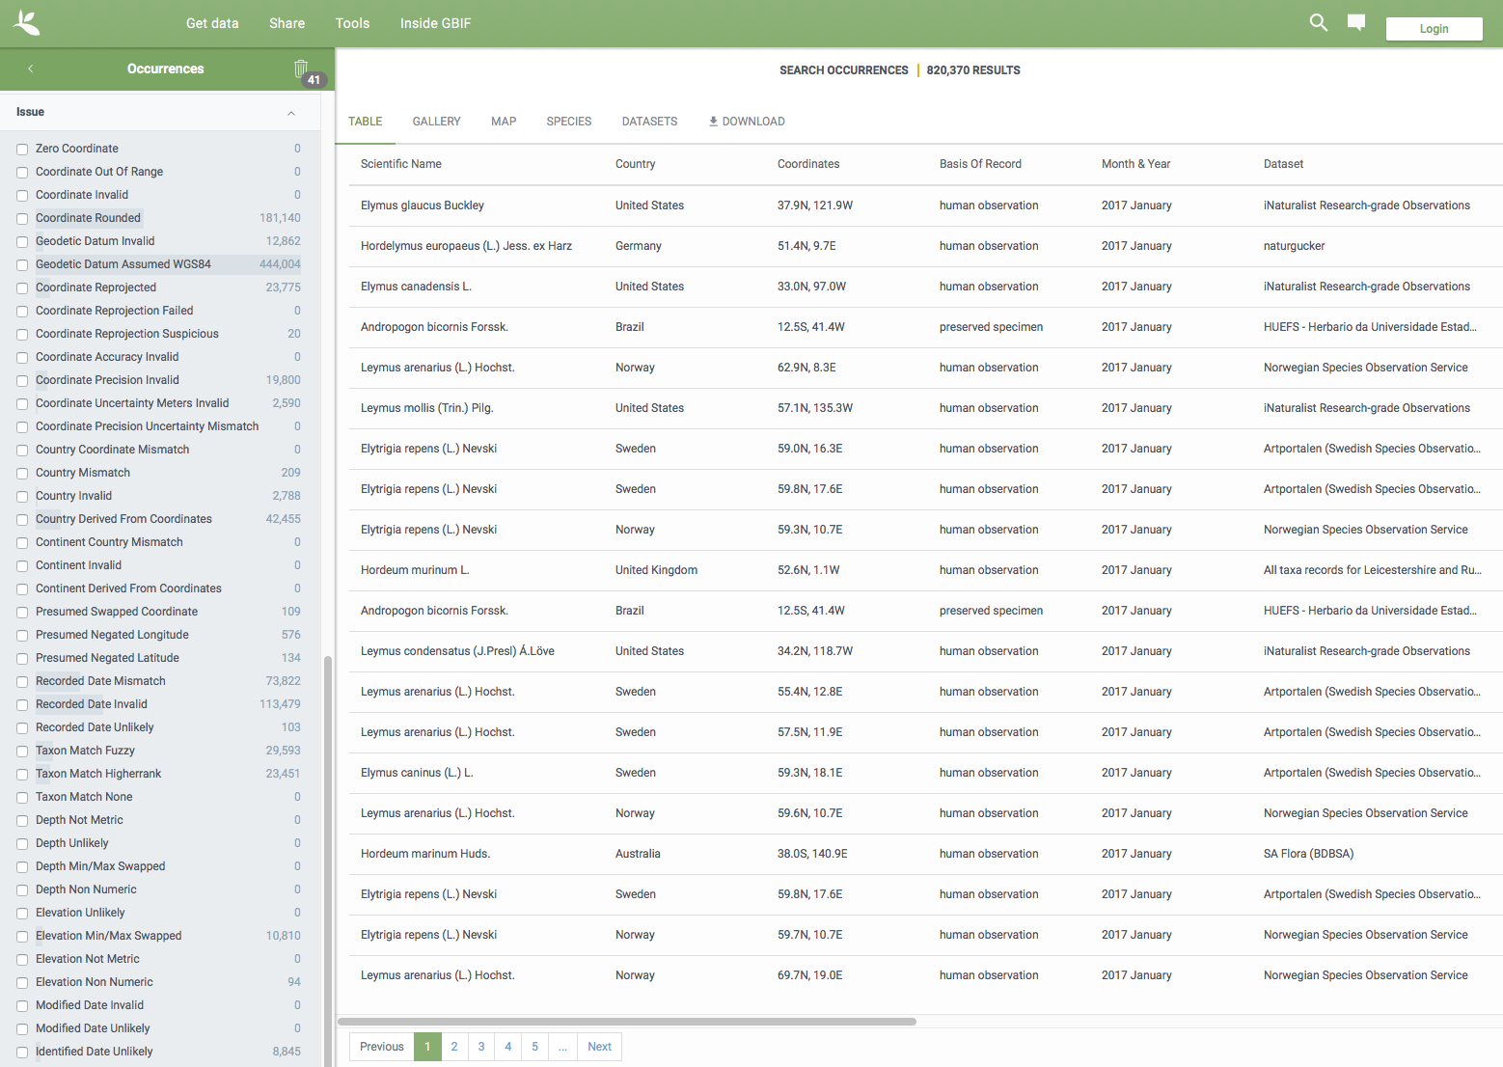
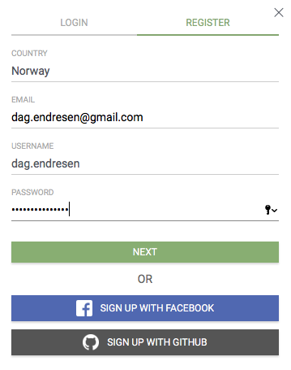

Slide 21
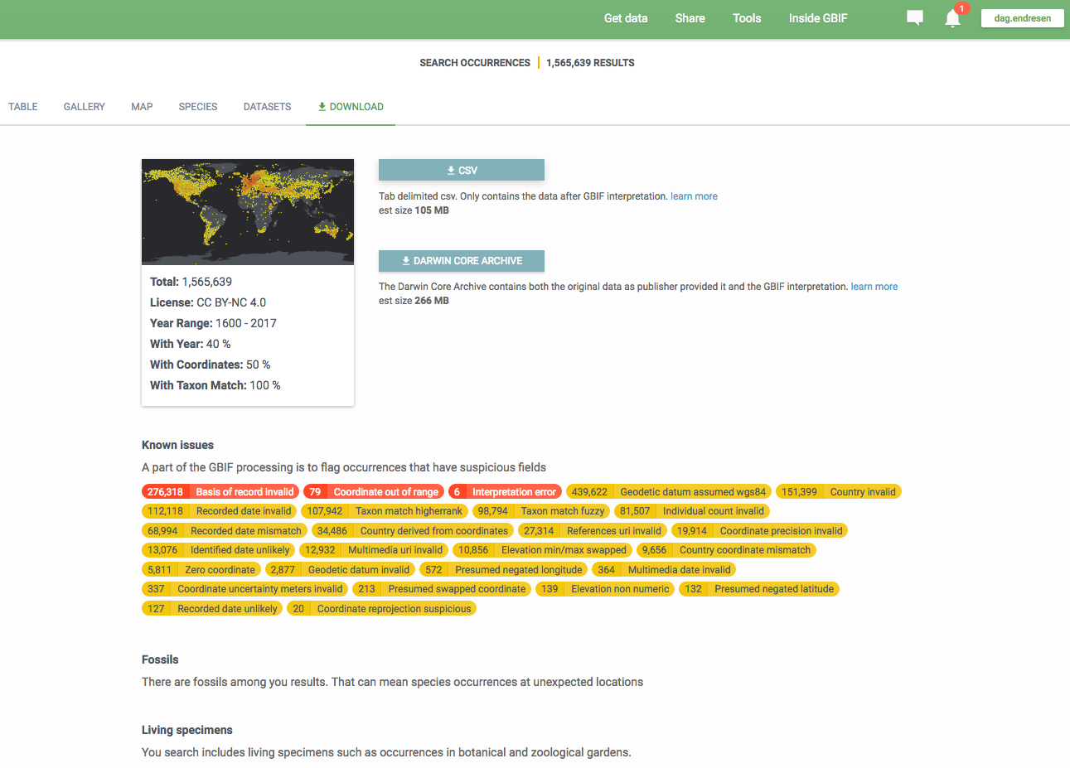
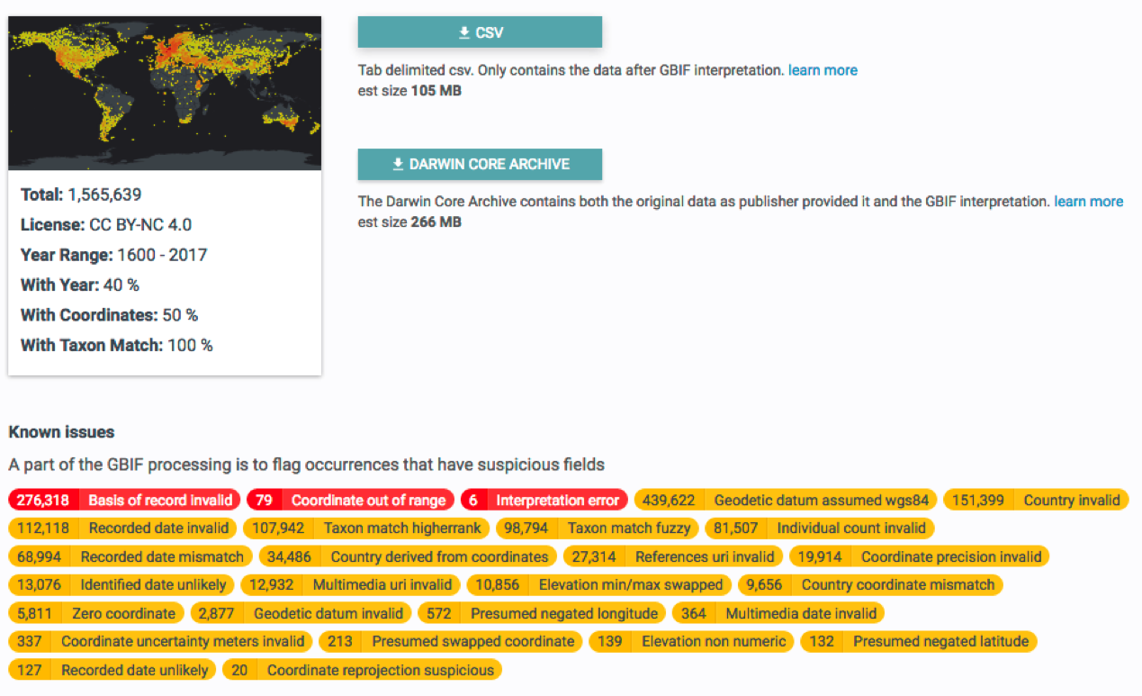
Download Triticeae data published in GBIF
Notes:
Download identifier: doi:10.15468/dl.3z2bmo
GBIF.org (9 June 2017) GBIF Occurrence Download doi:10.15468/dl.3z2bmo
https://doi.org/10.15468/dl.3z2bmo
https://demo.gbif.org/occurrence/download/0099404-160910150852091
--
Total 1 565 639 occurrences of Triticeae
--
Search query that was run (first)
http://demo.gbif.org/occurrence/search?TAXON_KEY=2703501&TAXON_KEY=4127121&TAXON_KEY=2703050&TAXON_KEY=2705808&TAXON_KEY=2705193&TAXON_KEY=4113716&TAXON_KEY=4115295&TAXON_KEY=6432586&TAXON_KEY=4142061&TAXON_KEY=2704853&TAXON_KEY=7415787&TAXON_KEY=8255807&TAXON_KEY=2705881&TAXON_KEY=2705934&TAXON_KEY=7324780&TAXON_KEY=5290243&TAXON_KEY=2703302&TAXON_KEY=4932540&TAXON_KEY=4932451&TAXON_KEY=2704657&TAXON_KEY=3232809&TAXON_KEY=8180972&TAXON_KEY=4117265&TAXON_KEY=5428469&TAXON_KEY=2706050&TAXON_KEY=7325479&TAXON_KEY=4130607&TAXON_KEY=2706325&TAXON_KEY=6431292&TAXON_KEY=2705041&TAXON_KEY=6432785&TAXON_KEY=6432756&TAXON_KEY=6432319&TAXON_KEY=2705965&TAXON_KEY=2703542&TAXON_KEY=2705665&TAXON_KEY=2704132&TAXON_KEY=8365666&TAXON_KEY=2706388&TAXON_KEY=7325825
--
Download query that was run:
https://demo.gbif.org/occurrence/download?taxon_key=2703501&taxon_key=4127121&taxon_key=2703050&taxon_key=2705808&taxon_key=2705193&taxon_key=4113716&taxon_key=4115295&taxon_key=6432586&taxon_key=4142061&taxon_key=2704853&taxon_key=7415787&taxon_key=8255807&taxon_key=2705881&taxon_key=2705934&taxon_key=7324780&taxon_key=5290243&taxon_key=2703302&taxon_key=4932540&taxon_key=4932451&taxon_key=2704657&taxon_key=3232809&taxon_key=8180972&taxon_key=4117265&taxon_key=5428469&taxon_key=2706050&taxon_key=7325479&taxon_key=4130607&taxon_key=2706325&taxon_key=6431292&taxon_key=2705041&taxon_key=6432785&taxon_key=6432756&taxon_key=6432319&taxon_key=2705965&taxon_key=2703542&taxon_key=2705665&taxon_key=2704132&taxon_key=8365666&taxon_key=2706388&taxon_key=7325825

Slide 22
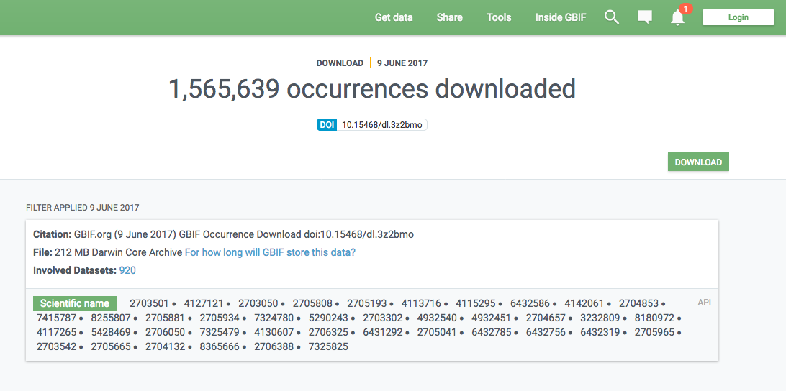
Triticeae published data in GBIF
Citing the data download DOI will resolve to the dataset DOIs assigned for each dataset contributing data records to the download set.
This way, all data publishers contributing data records will be accredited!
Notes:
Download identifier: doi:10.15468/dl.3z2bmo
GBIF.org (9 June 2017) GBIF Occurrence Download doi:10.15468/dl.3z2bmo
https://doi.org/10.15468/dl.3z2bmo
https://demo.gbif.org/occurrence/download/0099404-160910150852091

Slide 23
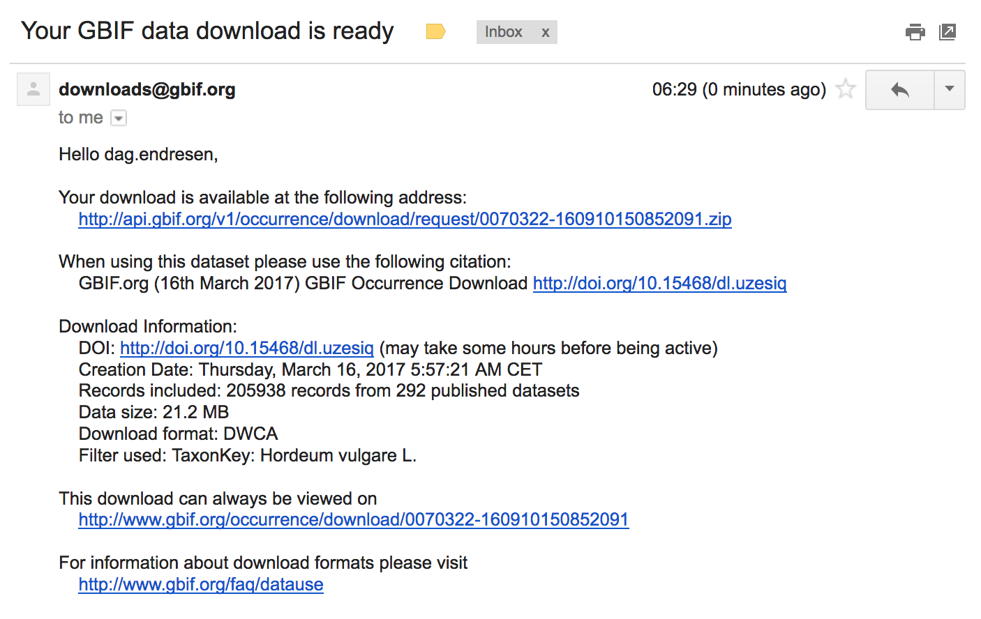
You receive an email when the download file is ready
Notes:
https://demo.gbif.org/occurrence/download/0070322-160910150852091

Slide 24
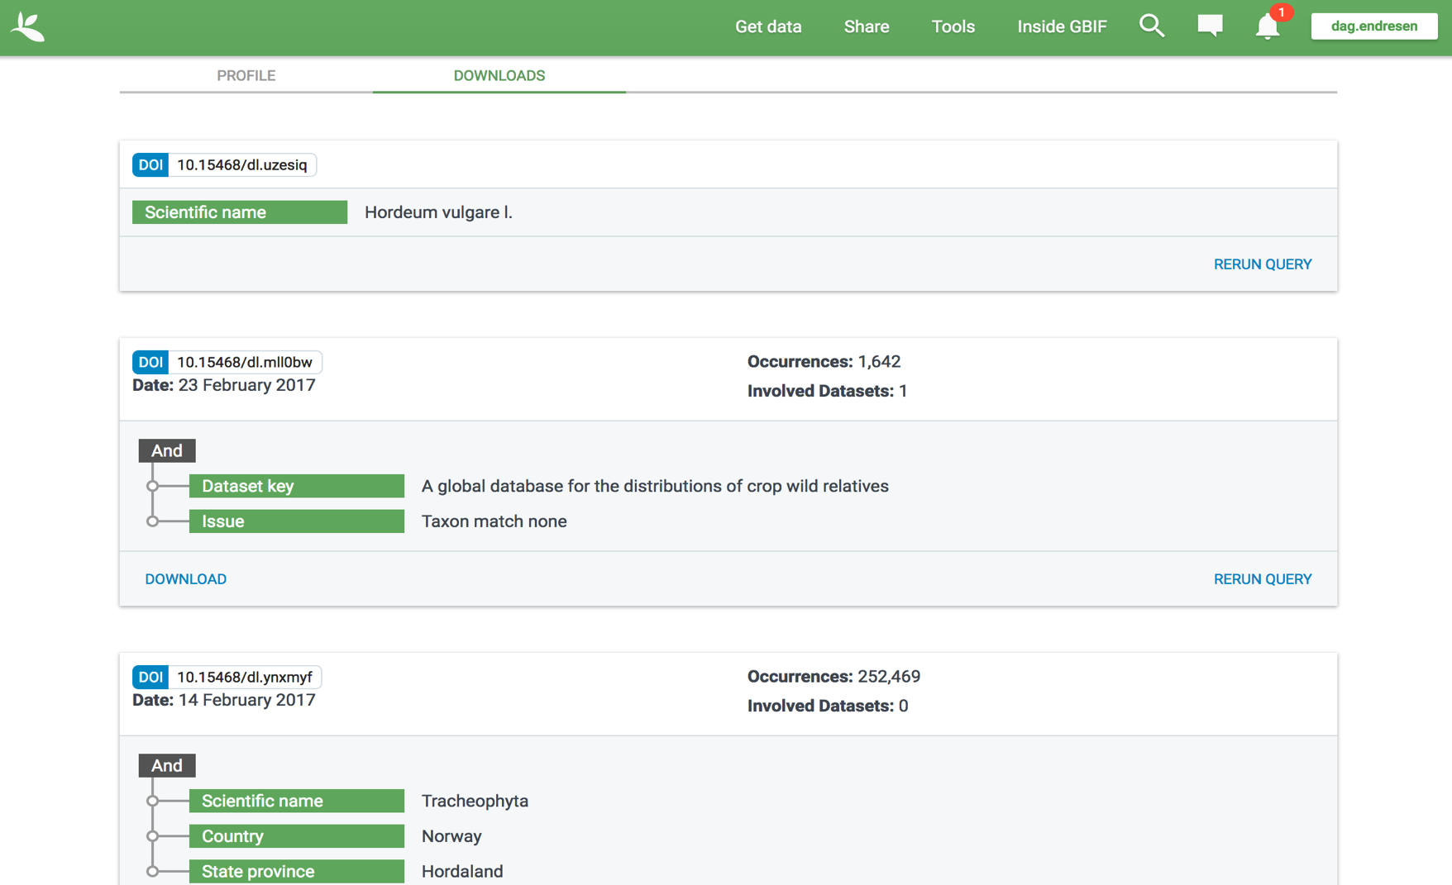
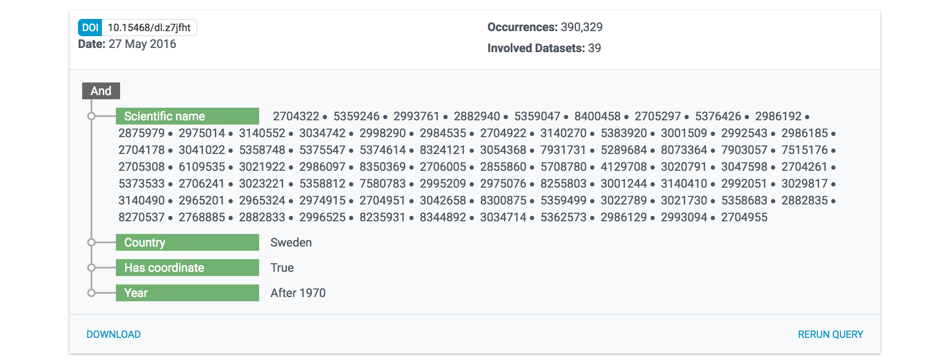

Slide 25

We store all download files as long as possible.
The download metadata page will always resolve, but the data file itself might be removed in the future.
We strive to store all download files, but prioritize downloads that have been cited.

Slide 26

Services to enable data analysis

Slide 27
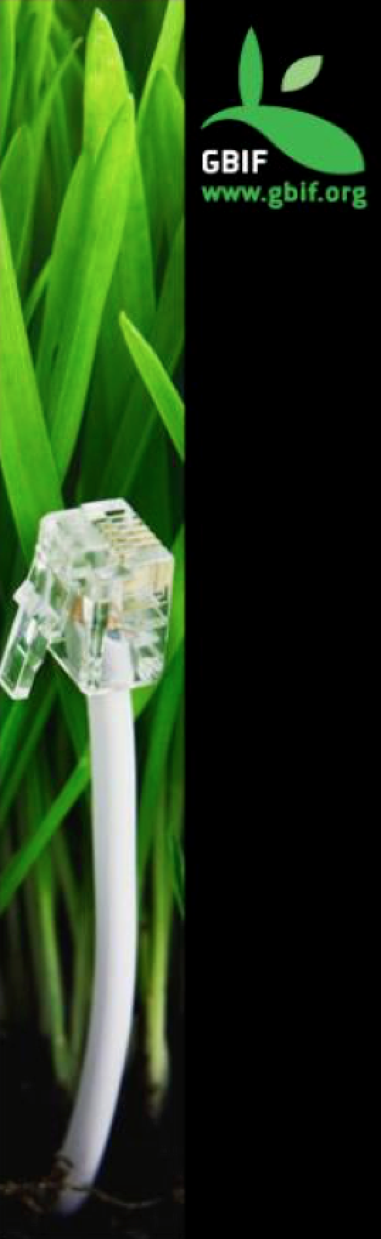
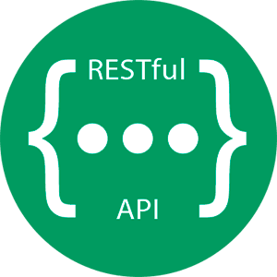

GBIF DATA PORTAL API
An interface to access data published through the GBIF network using web services.
Notes:
What’s the Data Portal API? An interface to access the data published through the GBIF network using Web Services.

Slide 28


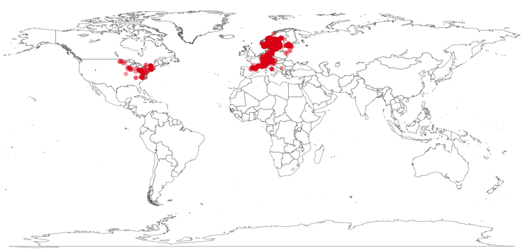
rOpenSci : rgbif
library(rgbif)
key <- name_backbone(name='Hepatica nobilis', kingdom=‘Plantae')$speciesKey
sp <- occ_search(taxonKey=key, return='data', hasCoordinate=TRUE, limit=1000)
gbifmap(sp)

Slide 29

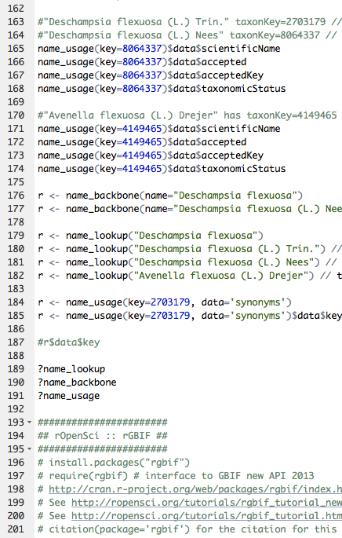


R workshop
The Norwegian GBIF node (GBIF.no) and the ForBio Research School in Biosystematics organizes R training for the Nordic Oikos conference in Trondheim in February 2018.
http://www.gbif.no/events/2018/Nordic-Oikos-2018-R-workshop.html
Notes:
https://www.ntnu.edu/web/oikos2018/workshops
http://www.gbif.no/events/2018/Nordic-Oikos-2018-R-workshop.html
http://www.forbio.uio.no/events/courses/2018/GBIF_R.html

Slide 30

Publish your biodiversity data with GBIF

Slide 31
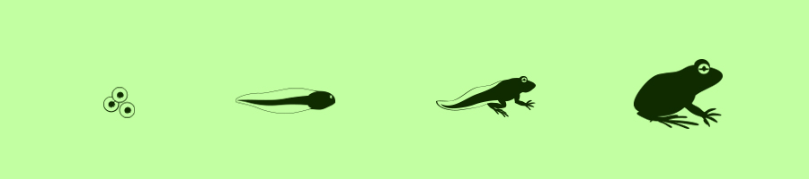

Biodiversity data life cycle
Study design (reuse or publish protocols)
Data management plan, data standards
Data collection, field work (persistent identifiers)
Bio-repository, herbarium (physical samples)
Data storage, archiving
Data publication, open data
Data analysis (publish your algorithms)
Data synthesis, research, policy
}
https://www.gbif.org/publishing-data
Notes:
https://www.gbif.org/publishing-data

Slide 32



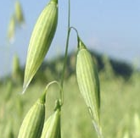





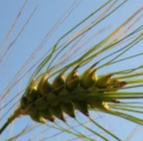

→ Multiple-purpose data services
Darwin Core
archive
Dataset
Research data portals
32

Slide 33
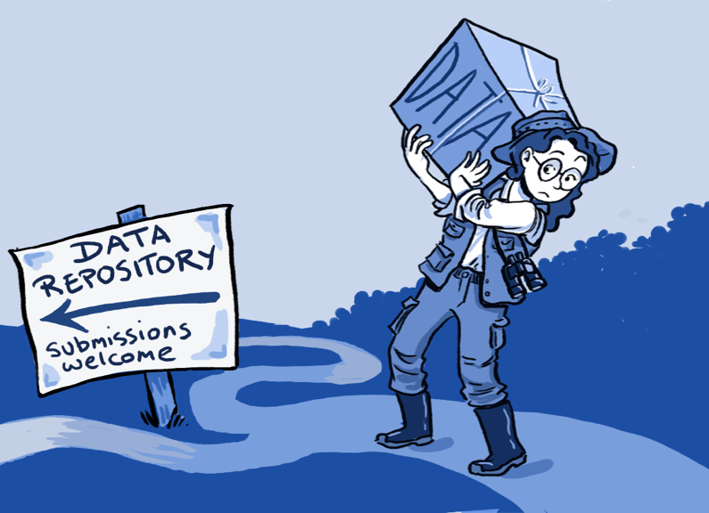
Publish data in GBIF
data publishing
Step 1: data holding research institutes seek endorsement as an approved data publisher.
Step 2: datasets are identified and converted to standard Darwin Core format.
Step 3: datasets can be published directly from the data node and/or with the assistance from a national GBIF node.
Citizen science data platforms also publish in GBIF.
https://www.gbif.org/publishing-data
Notes:
http://www.gbif.org/resource/80635
http://www.gbif.org/publishing-data/summary
http://www.gbif.org/publishing-data/request-endorsement#/intro

Slide 34

















Node team at NHM, University of Oslo
  Dag Endresen, GBIF Node manager
  Christian Svindseth, Data manager
  Fridtjof Mehlum, Research director
  Vidar Bakken, Head engineer
  Einar Timdal, Associate professor
  Geir Søli, Associate professor
Artsdatabanken, Trondheim
  Wouter Koch, GBIF.no node member
  Nils Valland, GBIF.no board member
NTNU University Museum
Anders Finstad, GBIF Science committee
Research Council of Norway
  Christian Wexels Riser
  Per Backe-Hansen (until 2016)
Contact us at: gbif-drift@nhm.uio.no
Notes:
http://www.nhm.uio.no/forskning/prosjekter/gbif/
http://www.gbif.no
http://www.gbif.no/people/
http://www.gbif.no/about/

Slide 35

Use of GBIF-mediated data

Slide 36

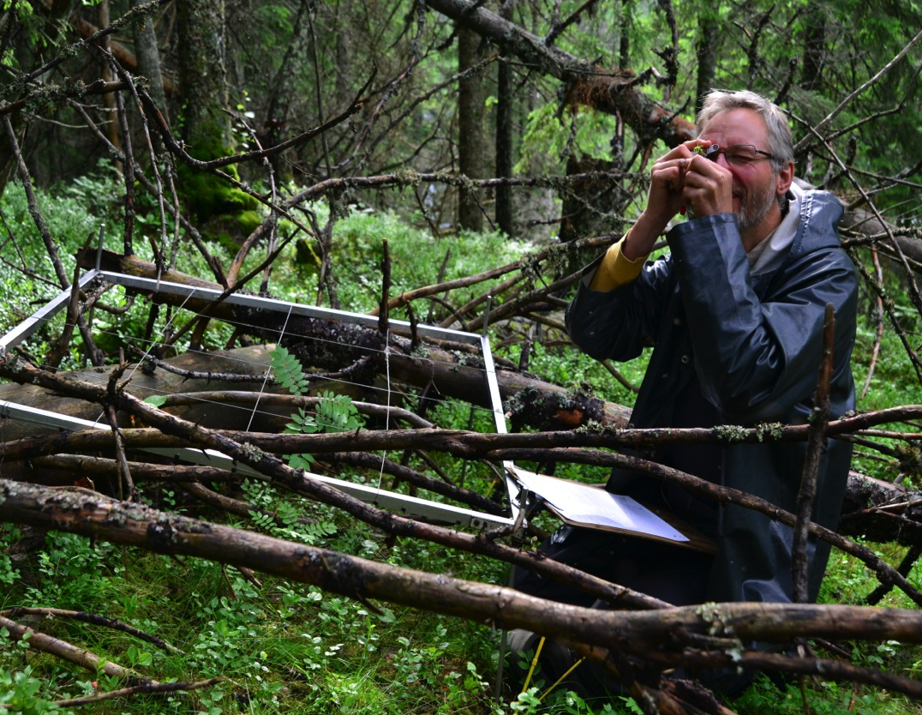

If a tree falls in the forest and nobody reuses this information in peer review validated research — for what purpose did we then publish the event in GBIF?
Geo-Ecology research group (GEco)
Illustration image by Anders Bryn, UiO-NHM, NIBIO
Notes:
BIO4115/9115 at UiO Natural History Museum in Oslo, 14th November 2017, CC-by Dag Endresen, GBIF-Norway, UiO Natural History Museum in Oslo
Illustration image credits by Anders Bryn, UiO-NHM, NIBIO

Slide 37
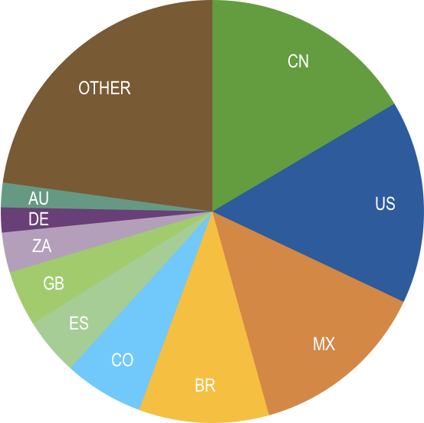
Data download requests by country, 2017 as of 31 Aug 2017
China is not a member
 | Country | Downloads | Jul-17 rank
1 | China | 11,687 | 2
2 | United States | 11,012 | 1
3 | Mexico | 9,672 | 3
4 | Brazil | 7,056 | 4
5 | Colombia | 4,310 | 5
6 | Spain | 3,126 | 6
7 | United Kingdom | 2,991 | 7
8 | South Africa | 2,167 | 8
9 | Germany | 1,350 | 9
10 | Australia | 1,337 | 11
data access and use
2017
Brazil is an associate member

Slide 38

research use of gbif-mediated data
Number of papers citing use of GBIF as data source, per country of at least one author
https://www.gbif.org/resource/search?contentType=literature&year=2017,2017&peerReview=true

Slide 39


data access and use
Peer-reviewed publications using GBIF-mediated data
through 31 August 2017
Illustration CC-BY Doublecompile
Notes:
Illustration: CC-BY Doublecompile, https://commons.wikimedia.org/wiki/File:DrawingIntellectGirl.svg
--
Per November 2017: 792 results
https://www.gbif.org/resource/search?contentType=literature&year=2017,2017&peerReview=true

Slide 40

Peer-reviewed uses, by country and region, 2017
Citing GBIF published data (per Nov. 2017)
Total # of peer-reviewed papers by country
1 | United States | 219
2 | United Kingdom | 115
3 | Germany | 110
4 | Brazil | 87
5 | Australia | 82
6 | Spain | 80
7 | Canada | 64
8 | France | 58
9 | Mexico | 57
10 | China | 53
18 | Norway | 27
2017
data access and use
Total # of papers by region (Aug 2017)
1 | Europe | 374
2 | Latin America | 169
3 | North America | 158
4 | Asia | 101
5 | Oceania | 53
6 | Africa | 36
https://www.gbif.org/resource/search?contentType=literature&year=2017,2017&peerReview=true (…&countriesOfResearcher=NO)
Notes:
Ranking -- https://www.gbif.org/resource/search?contentType=literature&year=2017,2017&peerReview=true
Norway -- https://www.gbif.org/resource/search?contentType=literature&year=2017,2017&countriesOfResearcher=NO&peerReview=true

Slide 41



Scientific use of GBIF-mediated data
5286 papers - 224 members
Notes:
A complete archive of research citing use of GBIF can be accessed at http://www.mendeley.com/groups/1068301/gbif-public-library
Status November 2017: 5286 papers - 224 members

Slide 42
Featured research
2017
Topic categories
 | Bicknell JE, Collins MB, Pickles RSA et al. (2017) Designing protected area networks that translate international conservation commitments into national action. Biological Conservation. doi:10.1016/j.biocon.2017.08.024 Author countries: United Kingdom, Canada, Guyana, Australia
 | Bowler DE, Hof C, Haase P et al. Cross-realm assessment of climate change impacts on species’ abundance trends. Nature Ecology & Evolution. doi:10.1038/s41559-016-0067 Author countries: Germany, Belgium, United Kingdom, United States, Spain, Netherlands, Switzerland
 | Caudullo G, Welk E & San-Miguel-Ayanz J (2017) Chorological maps for the main European woody species. Data in Brief 12: 662-666. doi:10.1016/j.dib.2017.05.007 Author countries: Italy, Germany
 | Filazzola A, Sotomayor DA & Lortie CJ (2017) Modelling the niche space of desert annuals needs to include positive interactions. Oikos. doi:10.1111/oik.04688 Author country: Canada
 | Fonseca É, Solé M, Rödder D & de Marco P (2017) Pet snakes illegally marketed in Brazil: Climatic viability and establishment risk. PLoS ONE 12(8): e0183143. doi:10.1371/journal.pone.0183143 Author countries: Brazil, Germany
 | Golding N, August TA, Lucas TCD, Gavaghan DJ, van Loon EE & McInerny G (2017) The zoon R package for reproducible and shareable species distribution modelling. Methods in Ecology and Evolution. doi:10.1111/2041-210X.12858 Author countries: Australia, United Kingdom, Netherlands
 | Walsh MG, Wiethoelter A & Haseeb MA (2017) The impact of human population pressure on flying fox niches and the potential consequences for Hendra virus spillover. Scientific Reports 7: 8226. doi:10.1038/s41598-017-08065-z Author countries: Australia, United States
data access and use
Invasive alien species
Impact of climate change
Species conservation and protected areas
Biodiversity and human health
Food, farming and biofuels
Ecosystem services
Advancing biodiversity science
Data management
Data papers
https://www.gbif.org/resource/search?contentType=literature&year=2017,2017&peerReview=true
Notes:
https://www.gbif.org/resource/search?contentType=literature&year=2017,2017&peerReview=true
https://www.gbif.org/resource/search?contentType=literature&literatureType=journal

Slide 43

Featured research
From Norway
Aug 2017
Wiklund H, Taylor JD, Dahlgren TG, Todt C, Ikebe C, Rabone M, Glover AG (2017) Abyssal fauna of the UK-1 polymetallic nodule exploration area, Clarion-Clipperton Zone, central Pacific Ocean: Mollusca. ZooKeys 707: 1-46. https://doi.org/10.3897/zookeys.707.13042 Author countries: United Kingdom, Norway, Sweden
Taher D, Solberg SØ, Prohens J, Chou Y, Rakha M and Wu T (2017) World Vegetable Center Eggplant Collection: Origin, Composition, Seed Dissemination and Utilization in Breeding. Front. Plant Sci. https://doi.org/10.3389/fpls.2017.01484 Author countries: Taiwan, Egypt, Norway, Spain
Jeger, M. Bragard, C. Caffier, D. Candresse, T. Chatzivassiliou, E. Dehnen‐Schmutz, K. et al. (2017) Pest risk assessment of Diaporthe vaccinii for the EU territory. EFSA Journal https://doi.org/10.2903/j.efsa.2017.4924
Sverdrup-Thygeson A, Skarpaas O, Blumentrath S, Birkemoe T, Evju M (2017) Habitat connectivity affects specialist species richness more than generalists in veteran trees. Forest Ecology and Management 403: 96-102 https://doi.org/10.1016/j.foreco.2017.08.003 Author countries: Norway
Tingstad L, Gjerde I, Dahlberg A, Grytnes JA (2017) The influence of spatial scales on Red List composition: Forest species in Fennoscandia. Global Ecology and Conservation 11: 247-297 https://doi.org/10.1016/j.gecco.2017.07.005 Author countries: Norway, Sweden
Domisch S, Portmann F, Kuemmerlen M, O’Hara R, Johnson R, Davy-Bowker J, Bækken T et al. (2017) Using streamflow observations to estimate the impact of hydrological regimes and anthropogenic water use on European stream macroinvertebrate occurrences. Ecohydrology e1895. https://doi.org/10.1002/eco.1895 Author countries: Germany, Switzerland, Norway, Sweden, UK, Spain
data access and use
https://www.gbif.org/country/NO/research
https://www.gbif.org/resource/search?contentType=literature&year=2017,2017&countriesOfResearcher=NO&peerReview=true
Notes:
https://www.gbif.org/country/NO/research
https://www.gbif.org/resource/search?contentType=literature&year=2017,2017&countriesOfResearcher=NO&peerReview=true
--
GBIF Portal, data use: http://www.gbif.org/using-data/summary
Featured data use – agriculture: http://www.gbif.org/newsroom/uses/agriculture
GBIF Science Review 2016: http://www.gbif.org/resource/82873
GBIF Brochure 2016, http://www.gbif.org/resource/80813

Slide 44



Featured research
Norway
 | Almada F, Francisco S, Lima C, FitzGerald R, Mirimin L, Villegas-Ríos D et al. (2017) Historical gene flow constraints in a northeastern Atlantic fish: phylogeography of the ballan wrasse Labrus bergylta across its distribution range. Royal Society Open Science 4(2) 160773. Author countries: Portugal, Ireland, Norway, Spain. Published 15 February 2017. DOI:10.1098/rsos.160773
 | Chala D, Zimmermann N, Brochmann C, Bakkestuen V (2017) Migration corridors for alpine plants among the ‘sky islands’ of eastern Africa: do they, or did they exist? Alpine Botany 1-12. Author countries: Norway, Switzerland. First Online 08 February 2017. doi:10.1007/s00035-017-0184-z
 | Solberg, SØ and Chou, YY (2017) Conservation of Indigenous Vegetables from a Hotspot in Tropical Asia: What Did We Learn from Vavilov? Frontiers in Plant Science. doi:10.3389/fpls.2016.01982 Author country: Taiwan, (Norway). 108 787 species occurrence records used. Crop: Vegetables.
 | Phillips, J., Magos Brehm, J., van Oort, B., Asdal, Å., Rasmussen, M., & Maxted, N. (2017) Climate change and national crop wild relative conservation planning. Ambio 1-14. First Online 18 February 2017 doi:10.1007/s13280-017-0905-y Author countries: UK, Norway
 | R. M. Araújo, J. Assis, R. Aguillar, L. Airoldi, I. Bárbara, I. Bartsch, T. Bekkby, H. Christie, D. Davoult, S. Derrien-Courtel, C. Fernandez, S. Fredriksen, F. Gevaert, H. Gundersen, A. Le Gal, L. Lévêque, N. Mieszkowska, K. M. Norderhaug, P. Oliveira, A. Puente, J. M. Rico, E. Rinde, H. Schubert, E. M. Strain, M. Valero, F. Viard, I. Sousa-Pinto (2016) Status, trends and drivers of kelp forests in Europe: an expert assessment. Biodiversity and Conservation 25(7) 1319-1348. doi:10.1007/s10531-016-1141-7 Author countries: Portugal, Spain, Italy, Germany, Norway, France, UK, Australia.
 | Speed J.D.M., Austrheim G. (2017) The importance of herbivore density and management as determinants of the distribution of rare plant species. Biological Conservation 205: 77–84. doi:10.1016/j.biocon.2016.11.030 Author country: Norway
 | Phillips J, Asdal Å, Brehm JM, Rasmussen M, and Maxted N (2016) In situ and ex situ diversity analysis of priority crop wild relatives in Norway. Diversity and distributions 22(11): 1112-1126. doi:10.1111/ddi.12470. Author countries: United Kingdom, Portugal, Norway. 382,605 occurrence data records used – GBIF News Story
data access and use
Almanda et al. (2017) Map of sampling locations for Labrus bergylta
Philips et al. (2016) predicted distribution of 187 priority CWR in Norway
A complete archive of research citing use of GBIF can be accessed at http://www.mendeley.com/groups/1068301/gbif-public-library
Notes:
http://www.gbif.org/page/151
Will Artic mammals benefit from climate change? Researcher from Umeå Sweden, data from Artsobs-se/-no
--
http://www.gbif.org/newsroom/uses/2016-phillips-et-al
Philips et al 2016, 2017; doi:10.1007/s13280-017-0905-y
Figure. The predicted distribution of 187 priority CWR in Norway under the current climatic conditions. Red areas indicate taxon-rich areas with up to 124 taxa found there, and green areas indicate low taxon richness. Raster grid cell size 0.0416, approximately equal to 4 × 8 km2 (Philips et al. 2017)

Slide 45
Examples of use for GBIF-mediated data
CWR conservation
Development of a conservation plan for Crop Wild Relatives in Norway extracted the CWR species occurrence data points from GBIF
Phillips, J., Magos Brehm, J., van Oort, B. Asdal, Å., Rasmussen, M., & Maxted, N. (2017) Climate change and national crop wild relative conservation planning. Ambio. DOI:10.1007/s13280-017-0905-y
Phillips, J., Asdal, Å., Brehm, J.M., Rasmussen M., & & Maxted, N. (2016) In situ and ex situ diversity analysis of priority crop wild relatives in Norway. Diversity and Distributions, 22, 1112–1126. DOI: 10.1111/ddi.12470
Figure. The predicted distribution of 187 priority CWR in Norway under the current climatic conditions. Red areas indicate taxon-rich areas with up to 124 taxa found there, and green areas indicate low taxon richness. Raster grid cell size 0.0416, approximately equal to 4 × 8 km2 (Philips et al. 2017)
http://www.gbif.org/newsroom/uses/2016-phillips-et-al
Notes:
http://www.gbif.org/newsroom/uses/2016-phillips-et-al
Philips et al 2016, 2017; doi:10.1007/s13280-017-0905-y
Figure. The predicted distribution of 187 priority CWR in Norway under the current climatic conditions. Red areas indicate taxon-rich areas with up to 124 taxa found there, and green areas indicate low taxon richness. Raster grid cell size 0.0416, approximately equal to 4 × 8 km2 (Philips et al. 2017)

Slide 46

Examples of use for GBIF-mediated data
CWR conservation
Development of a conservation plan for Crop Wild Relatives in Norway with extracted CWR species occurrence data points from GBIF
Phillips, J., Magos Brehm, J., van Oort, B. Asdal, Å., Rasmussen, M., Maxted, N. (2017) Climate change and national crop wild relative conservation planning. Ambio. DOI:10.1007/s13280-017-0905-y
Phillips, J., Asdal, Å., Brehm, J.M., Rasmussen M., Maxted, N. (2016) In situ and ex situ diversity analysis of priority crop wild relatives in Norway. Diversity and Distributions, 22, 1112–1126. DOI: 10.1111/ddi.12470
2030
2050
2070
2080
Figure. The average predicted taxon richness of 187 priority CWR in Norway under RCP 2.6 for the years a 2030, b 2050, c 2070, d 2080. Raster grid cell size 0.0416, approximately equal to 4 × 8 km² (Philips et al. 2017)
http://www.gbif.org/newsroom/uses/2016-phillips-et-al
Notes:
http://www.gbif.org/newsroom/uses/2016-phillips-et-al
Philips et al 2016, 2017; doi:10.1007/s13280-017-0905-y
Figure. The average predicted taxon richness of 187 priority CWR in Norway under RCP 2.6 for the years a 2030, b 2050, c 2070, d 2080. Raster grid cell size 0.0416, approximately equal to 4 × 8 km² (Philips et al. 2017)
--
Figure. The predicted distribution of 187 priority CWR in Norway under the current climatic conditions. Red areas indicate taxon-rich areas with up to 124 taxa found there, and green areas indicate low taxon richness. Raster grid cell size 0.0416, approximately equal to 4 × 8 km2 (Philips et al. 2017)

Slide 47


Examples of use for GBIF-mediated data
ELC maps
Development of a Ecological Land Characterization (ELC) maps using species occurrence data points from GBIF
Thormann, I.; Parra-Quijano, M.; Endresen, D.T.F.; Rubio-Teso, M.L.; Iriondo, J.M., & Maxted, N. (2014). Predictive characterization of crop wild relatives and landraces: Technical guidelines version 1. Bioversity International. ISBN 978-92-9255-004-2.
Phillips, J., Magos Brehm, J., van Oort, B. Asdal, Å., Rasmussen, M., & Maxted, N. (2017) Climate change and national crop wild relative conservation planning. Ambio. DOI:10.1007/s13280-017-0905-y
Phillips, J., Asdal, Å., Brehm, J.M., Rasmussen M., & Maxted, N. (2016) In situ and ex situ diversity analysis of priority crop wild relatives in Norway. Diversity and Distributions, 22, 1112–1126. DOI: 10.1111/ddi.12470
Notes:
http://www.gbif.org/newsroom/uses/2016-phillips-et-al
Philips et al 2016, 2017; doi:10.1007/s13280-017-0905-y

Slide 48




10-year, 50 mill USD
Notes:
http://www.cwrdiversity.org/checklist/cwr-occurrences.php
--
2010-12-10 Norway pledges support to CWR, providing 50 million USD
https://www.croptrust.org/press-release/norway-pledges-support-crop-wild-relatives/
http://www.bistandsaktuelt.no/nyheter/nyheter---tidligere-ar/2011/superplanter-skal-redde-verden/
--
2013-09-13 Norway providing 23.7 million USD to the Crop Trust endowment fund
https://www.croptrust.org/press-release/contribution-from-norway/#
2013-09-23 Reuters coverage of 23.7 million USD from Norway
https://www.croptrust.org/in-the-news/reuters-norway-invests-usd-23-7-million-crop-diversity/
--
2007-04-19, Gates Foundation provides 37.5 million USD to Crop Trust, Norway provides USD 7.5 million
https://www.croptrust.org/press-release/gates-foundation-funds-rescue-worlds-crop-biodiversity/#

Slide 49


The Global Crop Wild Relative Occurrence Database include data from hundreds of data sources – including GBIF
The CWR Database is again published in GBIF (excluding the data records originating from GBIF)
DOI: 10.15468/jyrthk
Vincent et al. (2013). A prioritized crop wild relative inventory to help underpin global food security. doi:10.1016/j.biocon.2013.08.011
Notes:
The Global Crop Wild Relative Occurrence Database
http://www.cwrdiversity.org/checklist/cwr-occurrences.php
https://doi.org/10.15468/jyrthk
http://www.gbif.org/dataset/07044577-bd82-4089-9f3a-f4a9d2170b2e/activity
--
Vincent H, Wiersema J, Kell S, Fielder H, Dobbie S, Castañeda-Álvarez NP, Guarino L, Eastwood R, Leon B, and Maxted N (2013). A prioritized crop wild relative inventory to help underpin global food security. Biological Conservation 167: 265–275. doi:10.1016/j.biocon.2013.08.011
/dataset/07044577-bd82-4089-9f3a-f4a9d2170b2e/activity

Slide 50



The Nordic Crop Wild Relative (CWR) checklist is published in GBIF
doi:10.15468/itkype
Nordic CWR conservation priorities are developed using GBIF-mediated data.

Slide 51





Add your own observations to this Nordic CWR group in iNaturalist
Observations peer-review validated by other amateur naturalists are published in GBIF
http://www.inaturalist.org/projects/nordic-crop-wild-relatives
Notes:
http://www.inaturalist.org/projects/nordic-crop-wild-relatives

Slide 52

GBIF Science Review
    Annual publication summarizes peer-reviewed articles that rely on GBIF-mediated data.
    Accompanying Sourcebook with citations.
    gbif.org/science-review
data access and use
http://www.gbif.org/science-review
Notes:
https://www.gbif.org/science-review
https://downloads.contentful.com/uo17ejk9rkwj/2CKoanjOXq4MyuGiau6GeU/ee2568270c19fe32ea479e36ee796778/SR17-final-web.pdf
https://assets.contentful.com/uo17ejk9rkwj/1iRtwRUlasmAI8maeoKYmA/f9722c65f8e25763917799f8d381d935/SR17-sourcebook-v2.pdf

Slide 53

BIG DATA
A new paradigm:
reuse of research data

Slide 54


Future perspectives
The future is already here — it's just not very evenly distributed
William Gibson
Notes:
The future is already here — it's just not very evenly distributed (William Gibson)
https://quoteinvestigator.com/2012/01/24/future-has-arrived/

Slide 55

ESSENTIAL BIODIVERSITY VARIABLES
Schmeller, D.S., Mihoub, JB., Bowser, A. et al., An operational definition of essential biodiversity variables, Biodivers Conserv (2017). doi:10.1007/s10531-017-1386-9

Slide 56




GBIF and cbd
Only confirmed indicator of progress towards Aichi Target 19
https://www.bipindicators.net/indicators/growth-in-species-occurrence-records-accessible-through-gbif
Notes:
GBIF AND THE CBD
Growth in species occurrence records accessible through GBIF is the only fully-developed indicator for Aichi Target 19, recognized by the Biodiversity Indicators Partnership and formally adopted by the CBD. Target 19 deals with the improvement, sharing, transfer and application of biodiversity knowledge. GBIF produces regular metrics showing trends in the mobilization of data at the global level, and these metrics are also available at national scale to help countries to monitor progress towards this target. In addition, sharing of data through GBIF is recognized as providing important knowledge support for achieving a number of other targets, including: Target 9 on addressing the impact of invasive alien species; Target 10 on reducing threats to climate-vulnerable ecosystems such as coral reefs and mountains; Target 11 on expanding and improving protected areas; Target 12 on reducing the risk of species extinctions; and Target 13 on conserving genetic diversity for example among plant species important for crop development.

Slide 57



GBIF indicator for Aichi target 19 (2016)
Growth in Species Occurrence Records Accessible Through GBIF
Indicator description
This indicator tracks the number of digitally-accessible records published through the Global Biodiversity Information Facility (GBIF).
An increase in the value of this indicator means that a larger volume of records documenting the spatial and temporal occurrence of species is being shared by holders of biodiversity data, in formats that make them free for use by researchers and policymakers via the Internet. A decline would indicate reduced availability of such data for research and policy.
Indicator classification
Operational and included in the CBD's list of indicators.
Last update: 2016
https://www.bipindicators.net/indicators/growth-in-species-occurrence-records-accessible-through-gbif
Notes:
https://www.bipindicators.net/indicators/growth-in-species-occurrence-records-accessible-through-gbif

Slide 58



CBD Aichi target 19
The 13th COP meeting of the CBD on 13 December 2016:
welcomes the Global Biodiversity Informatics Outlook (GBIF 2013)
promote open access to biodiversity-related data
promote the use of common data standards (TDWG.org)
invest in digitization of natural history collections
establish national biodiversity information facilities (GBIF nodes)
continued support from Governments for networks such as the Global Biodiversity Information Facility
Notes:
CONFERENCE OF THE PARTIES TO THE CONVENTION ON BIOLOGICAL DIVERSITY
Thirteenth meeting CBD/COP/DEC/XIII/31 13 December 2016

Slide 59

"Scientific irreproducibility — the inability to repeat others' experiments and reach the same conclusion — is a growing concern"
Nature (May 2016)
doi:10.1038/533452a
doi:10.1038/533437a
Open Science solution: researchers to share their methods, data, computer code and results in central data repositories.
Note that we also need herbarium specimen and bio-repositories (museums).
Notes:
Baker (2016) Reproducibility: Seek out stronger scioence. Nature 537: 703-704 (29 September 2016) doi:10.1038/nj7622-703a
Baker (2016) 1,500 scientists lift the lid on reproducibility. Nature 533: 452-454 (26 May 2016) doi:10.1038/533452a
Nature editorial (2016) Reality check on reproducibility. Nature 533: 437 (26 May 2016) doi:10.1038/533437a
Baker (2016) Statisticians issue warning over misuse of P values. Nature 531: 151 (10 March 2016) doi:10.1038/nature.2016.19503
Nosek et al. (2015) Promoting an open research culture. Science 348(6242): 1422-1425. DOI:10.1126/science.aab2374
Leek and Peng (2015) Statistics: P values are just the tip of the iceberg. Nature 520: 612 (30 April 2015) doi:10.1038/520612°
Nuzzo (2015) How scientists fool themnselves – and how they can stop. Nature 526: 182–185 (08 October 2015) doi:10.1038/526182a
Hayden (2013) Weak statistical standards implicated in scientific irreproducibility. Nature doi:10.1038/nature.2013.14131
Young (2012) Replication studies: Bad copy. Nature 485, 298–300 (17 May 2012) doi:10.1038/485298a
Callaway (2011) Reports finds massive fraud at Dutch universities. Nature 479, 15 (1 November 2011) doi:10.1038/479015a

Slide 60

Open research data
The Research Council of Norway expects all research data from projects funded by the Research Council to be made freely available as open data. In some situations there can be valid and justified reasons for exceptions.
Forskningsrådet (2014) Tilgjengeliggjøring av forskningsdata: Policy for Norges forskningsråd. ISBN: 978-82-12-03361-0
Kunnskapsdepartementet (2016) Nasjonale retningslinjer for åpen tilgang til forskningsdata
Notes:
Forskningsrådet (2014) Tilgjengeliggjøring av forskningsdata: Policy for Norges forskningsråd. ISBN: 978-82-12-03361-0
Forskningsrådet (2016) Tilgjengeliggjøring av forskningsdata og data for forskning: Kunnskapsgrunnlag til KDs arbeid med en nasjonal strategi for tilgjengeliggjøring av data. ISBN: 978-82-12-03566-9
DAMVAD (2014) Sharing and archiving of publicly funded research data: Report to the Research Council of Norway. 11/04/14.
--
"Forskningsrådet forventer at alle forskningsdata i prosjekter finansiert av Forskningsrådet, er åpent tilgjengelig. I noen tilfeller kan det likevel være gode grunner til at ikke alle er åpne"
http://www.forskningsradet.no/no/Apen_tilgang/1254001019169
http://www.forskningsradet.no/no/Artikkel/Apen_tilgang_til_forskningsdata/1254001013535
--
Kunnskapsdepartementet (2016) Nasjonale retningslinjer for åpen tilgang til forskningsdata: Rapport til Kunnskapsdepartementet 14.06.2016.
https://www.regjeringen.no/contentassets/72e9794a183647e5b53ec39ba8cf516a/rapport-nasjonale-retningslinjer-for-apen-tilgang-til-forskningsresultater.pdf
--
UiO open data
http://www.uio.no/om/aktuelt/rektors-blogg/2017/hvordan-behandler-vi-forskningsdata.html

Slide 61



Open Science
Norway to be a careful pioneer in open access to research results.
Norway to follow the ambition of EU on full open access to publicly funded research by 2020.
Results of research supported by public and public-private funds freely available to and reusable by anyone.
Kunnskapsdepartementet (2016)
EU (2016) Competitiveness Council, 26-27/05/2016
EU (2007) INSPIRE Directive
Notes:
--
Kunnskapsdepartementet (2016) Nasjonale retningslinjer for åpen tilgang til forskningsresultater: Rapport til Kunnskapsdepartementet 14.06.2016.
https://www.regjeringen.no/contentassets/72e9794a183647e5b53ec39ba8cf516a/rapport-nasjonale-retningslinjer-for-apen-tilgang-til-forskningsresultater.pdf
--
EU - Competitiveness Council, 26-27/05/2016
http://www.consilium.europa.eu/en/meetings/compet/2016/05/26-27/
"Open Science is a topic which is very dear to our hearts. During the Netherlands presidency, we have aimed at bringing Europe to the forefront of global change and at leading the transition to a new way of doing research and science based on openness, big data and cloud computing." Sander Dekker, State Secretary of Education, Culture and Science of the Netherlands
--
Enserink M (2016) In dramatic stetement, European leaders call for 'immediate' open access to all scientific papers by 2020. Science May. 27, 2016, DOI: 10.1126/science.aag0577
--
https://www.theguardian.com/science/2016/may/28/eu-ministers-2020-target-free-access-scientific-papers
--
EU INSPIRE Directive :: Infrastructure for spatial information in Europe
http://inspire.ec.europa.eu/
The INSPIRE Directive: a brief description: https://www.youtube.com/watch?v=xew6qI-6wNk
2007-04-26, Directive 2007/2/EC of the European Parliament and of the Council of 14 March 2007 establishing an Infrastructure for Spatial Information in the European Community (INSPIRE)
--
ec.europa.eu/research/openscience
openAIRE.eu
http://ec.europa.eu/research/press/2016/pdf/opendata-infographic_072016.pdf#view=fit&pagemode=none

Slide 62

Data Citation Principles
Data to be legitimate citable products of research.
Data citations giving scholarly credit and attribution.
In scholarly literature, whenever claims are based on data, data should always be cited.
Persistent method for identification of data, that is machine actionable, globally unique, universal.
Data citation facilitate access to data or at least to metadata.
Unique identifiers that persist even beyond the lifespan of the data.
Data citation identify and access the specific data that support verification of the claim (provenance, time-slice, version).
Flexible, but attention to interoperability of practices across communities.
Data Citation Synthesis Group: Joint Declaration of Data Citation Principles. Martone M. (ed.) San Diego CA: FORCE11; 2014
Notes:
Joint Declaration of Data Citation Principles - FINAL
When citing please use: Data Citation Synthesis Group: Joint Declaration of Data Citation Principles. Martone M. (ed.) San Diego CA: FORCE11; 2014 [/datacitation].
Endorsement List
Preamble
Sound, reproducible scholarship rests upon a foundation of robust, accessible data. For this to be so in practice as well as theory, data must be accorded due importance in the practice of scholarship and in the enduring scholarly record. In other words, data should be considered legitimate, citable products of research. Data citation, like the citation of other evidence and sources, is good research practice and is part of the scholarly ecosystem supporting data reuse.
In support of this assertion, and to encourage good practice, we offer a set of guiding principles for data within scholarly literature, another dataset, or any other research object.
These principles are the synthesis of work by a number of groups. As we move into the next phase, we welcome your participation and endorsement of these principles.
--
Principles
The Data Citation Principles cover purpose, function and attributes of citations. These principles recognize the dual necessity of creating citation practices that are both human understandable and machine-actionable.
These citation principles are not comprehensive recommendations for data stewardship. And, as practices vary across communities and technologies will evolve over time, we do not include recommendations for specific implementations, but encourage communities to develop practices and tools that embody these principles.
The principles are grouped so as to facilitate understanding, rather than according to any perceived criteria of importance.
1. Importance
Data should be considered legitimate, citable products of research. Data citations should be accorded the same importance in the scholarly record as citations of other research objects, such as publications[1].
2. Credit and Attribution
Data citations should facilitate giving scholarly credit and normative and legal attribution to all contributors to the data, recognizing that a single style or mechanism of attribution may not be applicable to all data[2].
3. Evidence
In scholarly literature, whenever and wherever a claim relies upon data, the corresponding data should be cited[3].
4. Unique Identification
A data citation should include a persistent method for identification that is machine actionable, globally unique, and widely used by a community[4].
5. Access
Data citations should facilitate access to the data themselves and to such associated metadata, documentation, code, and other materials, as are necessary for both humans and machines to make informed use of the referenced data[5].
6. Persistence
Unique identifiers, and metadata describing the data, and its disposition, should persist -- even beyond the lifespan of the data they describe[6].
7. Specificity and Verifiability
Data citations should facilitate identification of, access to, and verification of the specific data that support a claim. Citations or citation metadata should include information about provenance and fixity sufficient to facilitate verfiying that the specific timeslice, version and/or granular portion of data retrieved subsequently is the same as was originally cited[7].
8. Interoperability and Flexibility
Data citation methods should be sufficiently flexible to accommodate the variant practices among communities, but should not differ so much that they compromise interoperability of data citation practices across communities[8].
When citing this document please use: Data Citation Synthesis Group: Joint Declaration of Data Citation Principles. Martone M. (ed.) San Diego CA: FORCE11; 2014 [https://www.force11.org/group/joint-declaration-data-citation-principles-final].

Slide 63

"FAIR" data
Findable
  assign persistent IDs, provide rich metadata, register in a searchable resource (such as GBIF)
Accessible
  Retrievable by their ID using a standard protocol, metadata remain accessible even if data aren’t
Interoperable
  Use formal, broadly applicable languages, use standard vocabularies, qualified references (e.g. Darwin Core)
Reusable
  Rich, accurate metadata, clear licences, provenance, use of community standards (e.g. Dublin Core, EML)
www.force11.org/group/fairgroup/fairprinciples
Slide source: OpenAIRE & EUDAT, CC-BY-4.0, 2013
Notes:
Slide source: OpenAIRE & EUDAT, Research data management, CC-BY-4.0 Tony Ross-Hellauer (OpenAIRE) and Sarah Jones (EUDAT), http://www.slideshare.net/EUDAT/research-data-management-introduction-eudatopen-aire-webinar

Slide 64

Semantic technologies for integrating different types of biodiversity information (herbarium collections and specimens, phenotypic trait data, and molecular data) are well advanced.
More efforts will be needed to advance organizational and institutional uptake for these types of (big data) information infrastructures to realize their potential.
Notes:
Semantic technologies for integrating different types of PGRFA information (genebank collections and accessions, phenotypic trait data, and molecular data) are well advanced. More efforts will be needed to advance organizational and institutional uptake for these types of data structures to realize their potential.

Slide 65

"The new availability of huge amounts of data, along with the statistical tools to crunch these numbers, offers a whole new way of understanding the world. Correlation supersedes causation, and science can advance even without coherent models, unified theories, or really any mechanistic explanation at all." (Chris Anderson, Wired Magazine, 2008)
Notes:
"The new availability of huge amounts of data, along with the statistical tools to crunch these numbers, offers a whole new way of understanding the world. Correlation supersedes causation, and science can advance even without coherent models, unified theories, or really any mechanistic explanation at all." Chris Anderson (2008) the End of Theory: The data deluge makes the scientific method obsolete. WIRED Magazine 16.07
Pigliucci M (2009) The end of theory in science? EMBO Reports 10(6). doi:10.1038/embor.2009.111

Slide 66

"We are increasingly relying on machines that derive conclusions from models that they themselves have created, models that are often beyond human comprehension, models that “think” about the world differently than we do" (David Weinberger 2017).
Notes:
"We are increasingly relying on machines that derive conclusions from models that they themselves have created, models that are often beyond human comprehension, models that “think” about the world differently than we do."
David Weinberger (2017) Alien Knowledge: When machines justify knowledge. Backchannel blog, https://backchannel.com/our-machines-now-have-knowledge-well-never-understand-857a479dcc0e
--
"The new availability of huge amounts of data, along with the statistical tools to crunch these numbers, offers a whole new way of understanding the world. Correlation supersedes causation, and science can advance even without coherent models, unified theories, or really any mechanistic explanation at all." Chris Anderson (2008) the End of Theory: The data deluge makes the scientific method obsolete. WIRED Magazine 16.07

Slide 67


