Slide 1
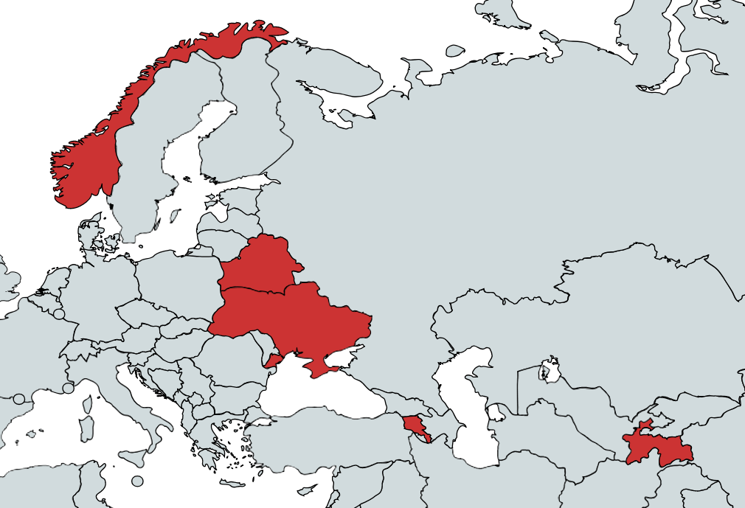

Biodiversity Data for
Internationalization in higher education
SS48 - Biodiversity informatics community capacity enhancement, Biodiversity Next, Leiden | 25 October 2019
Notes:
Symposium SS48 – Strengthening the biodiversity informatics community of practice through caåacity enhancement, Biodiversity Next, Leiden Friday 25 October 2019 (12 minutes)
BioDATA – Biodiversity Data for Internationalization in Higher Education | www.nhm.uio.no/english/research/projects/biodata
Global Biodiversity Information Facility | www.gbif.org
GBIF Norway, UiO Natural History Museum in Oslo, University in Oslo | www.gbif.no
ForBio Research School in Biosystematics | www.forbio.uio.no

Slide 2




BioDATA 2018 - 2021
Norway
2018 - 2021
Belarus
Armenia
Tajikistan
Ukraine

Slide 3
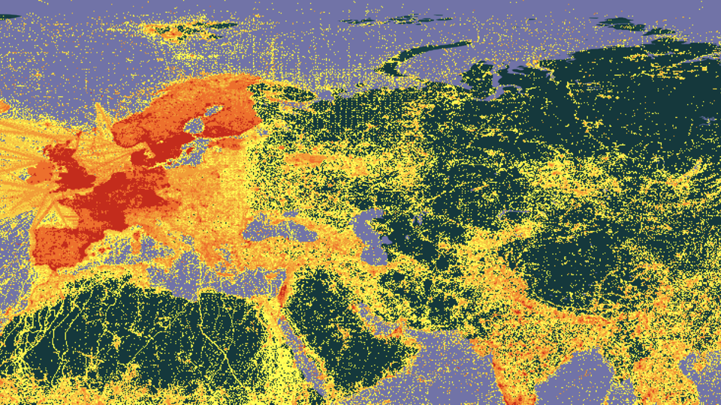
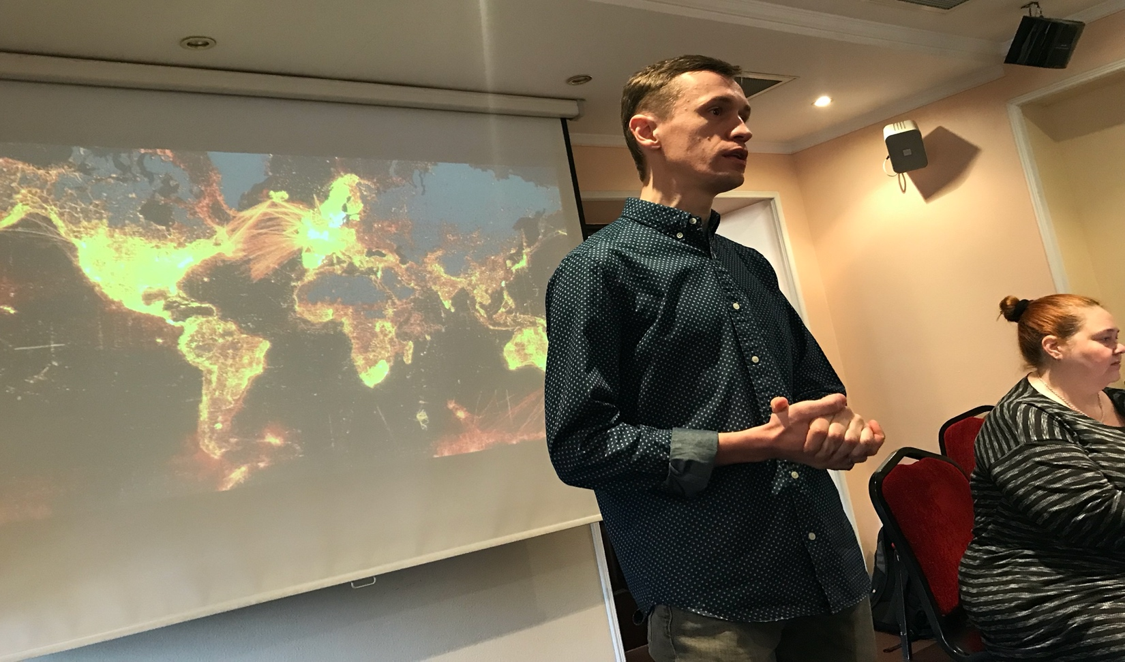
Goals
Offer professional training in data skills to biodiversity researchers
Promote open data and open science to foster international collaboration
Involve partner countries in international biodiversity networks like GBIF
64 students (16 x 4) and 16 staff (mentors) trained on biodiversity informatics skills
Organize a total of 7-8 events during the project period 2018 to 2021

Slide 4
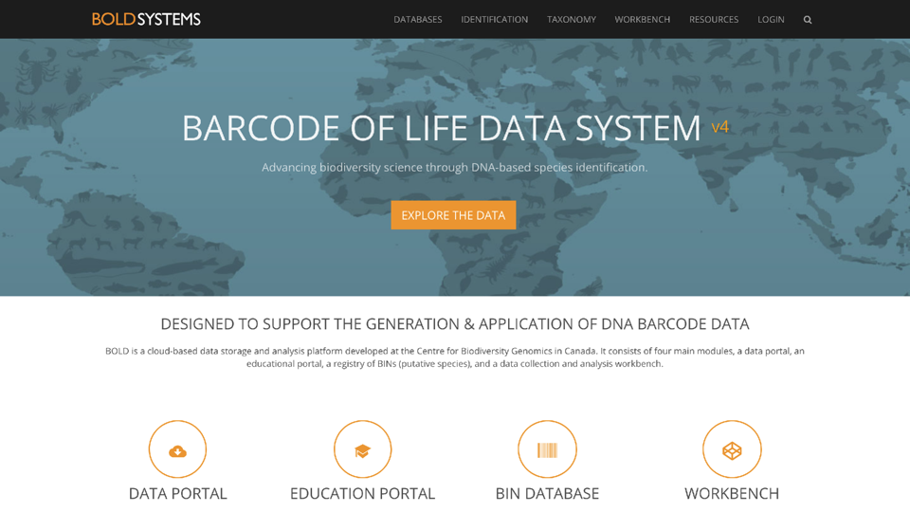
Investing in the future
Specialized training to raise the quality of research in post-soviet societies
Empower partners to establish long-lasting collaborations with western institutes
Mobilization of biodiversity data from non-digital archives to online databases
Establish regional data hubs in
Eastern Europe, Caucasus, Central Asia

Slide 5
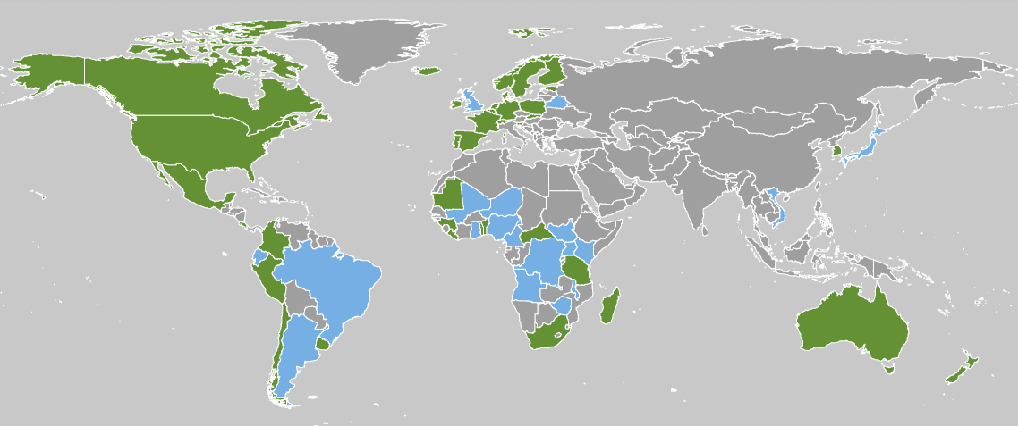
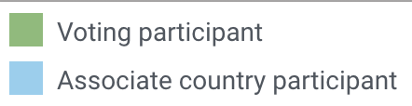
outreach to mobilize new countries in GBIF
Low GBIF membership coverage in Eurasia
BioDATA is organized in coordination with GBIF Secretariat staff to ensure good alignment with strategic outreach priorities

Slide 6


Funding
Funded by the Eurasia program of the Norwegian Agency for International Cooperation and Quality Enhancement in Higher Education (Diku)
Budget 3M NOK | € 300 000 Euro
2018 to 2021 (3 years)

Slide 7





Partners
University of Oslo (ForBio & GBIF Norway)
Armenian National Agrarian University
National Academy of Sciences of Belarus
Academy of Science & Zan va Zamin, Tajikistan
V.N. Karazin Kharkiv National University, Ukraine
GBIF Secretariat, Copenhagen

Slide 8
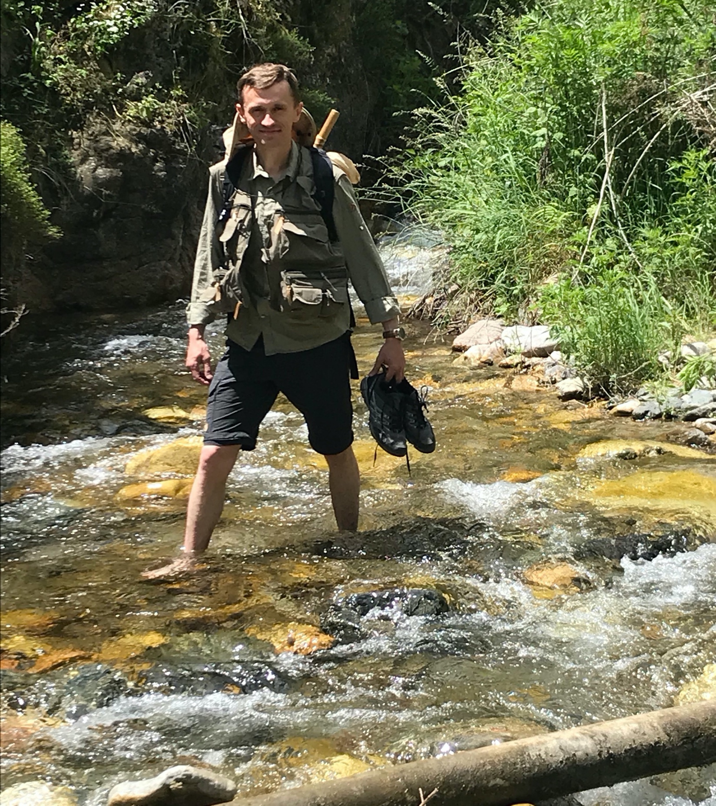
Roles
ForBio based in Oslo provides the central coordination team and financial center of operation
Local project partners in Tajikistan, Belarus and Armenia – responsible for organization of project events in Minsk, Dushanbe and Yerevan
GBIF (Secretariat and Norwegian GBIF-node) is responsible for coordinating the Biodiversity Informatics curriculum and providing training materials
Support from the “GBIF.ru team” in Russia with training and translation services

Slide 9
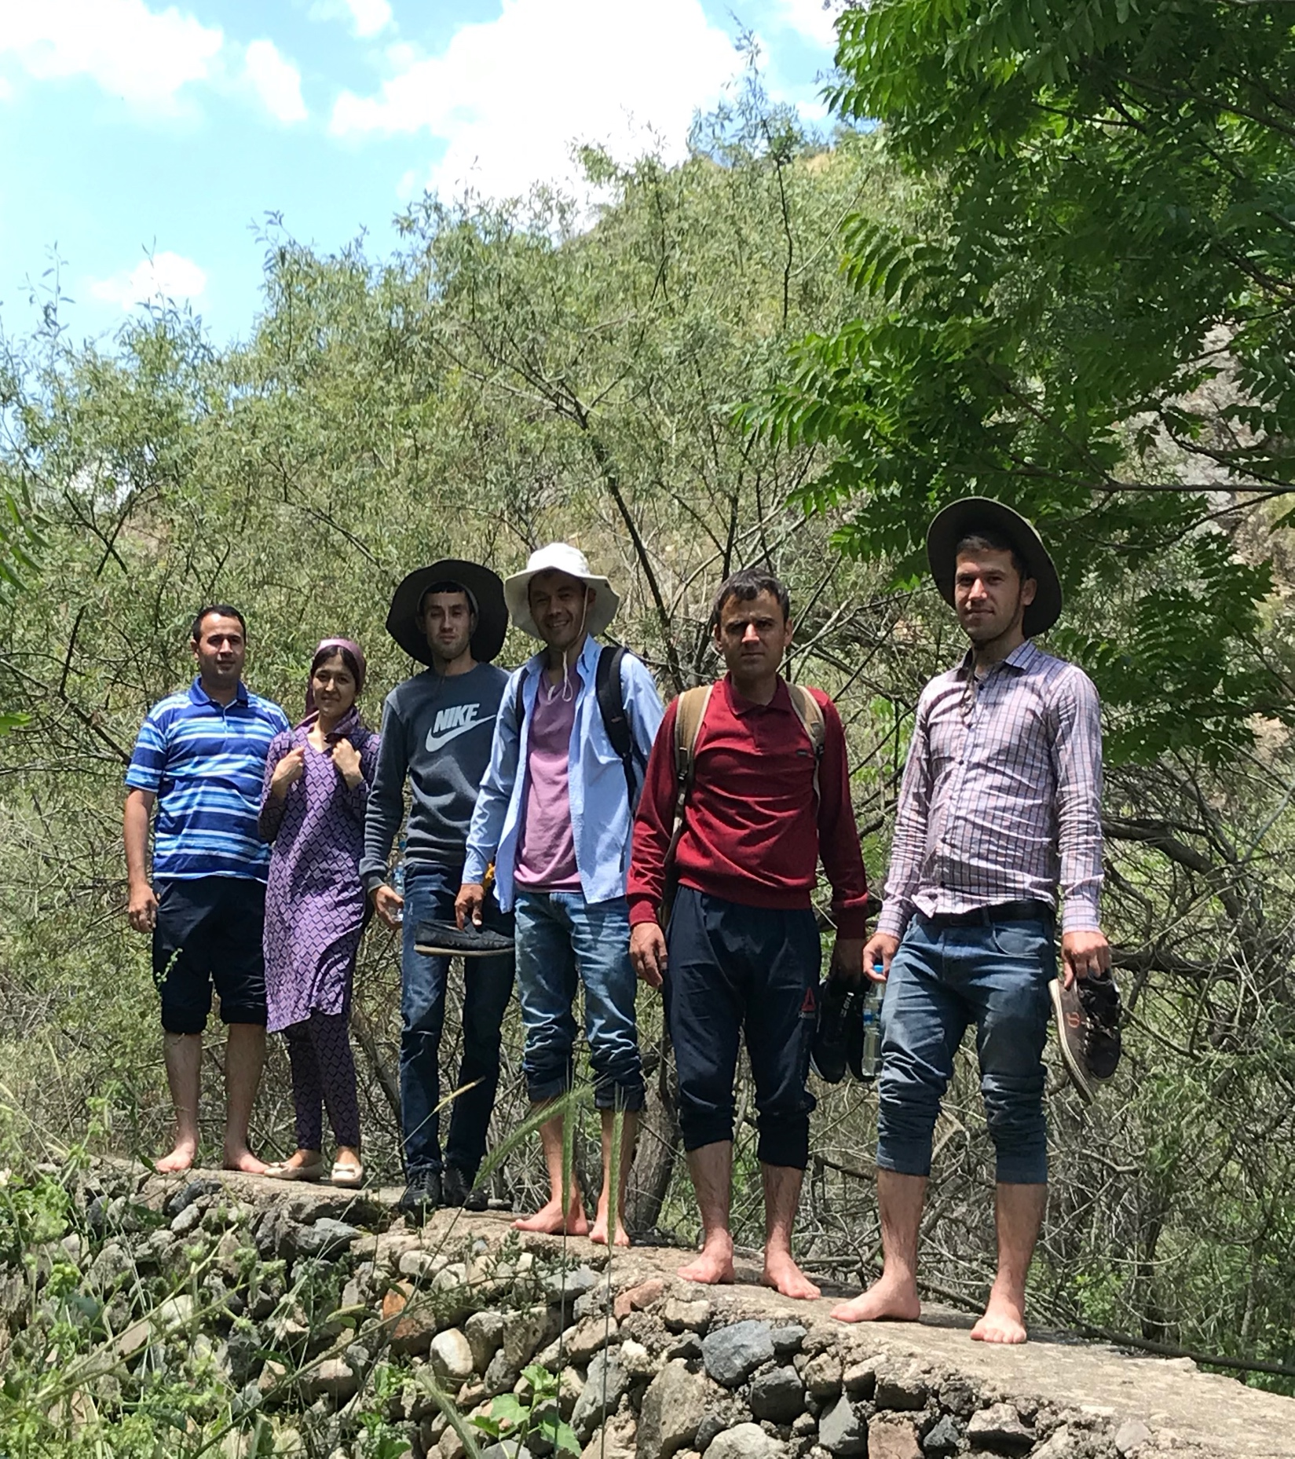
Target group
Primary target: Graduate (MSc) and postgraduate (PhD) students from BioDATA partner countries
Secondary target: postdocs, museum curators, collection managers and researchers in Armenia, Belarus, Norway, Tajikistan, and Ukraine
Objective is to offer professional training on biodiversity informatics for future museum curators, researchers, and potential GBIF node staff

Slide 10


Curriculum
BioDATA is re-using the training curriculum developed for the EU-funded GBIF Biodiversity Information for Development (BID) program
And the e-learning platform hosted by GBIF Spain
Successful students are awarded a digital certification badge from GBIF – which will qualify to contribute as mentor in the wide GBIF network

Slide 11
Curriculum
2-week online introduction – background
5-day on-site workshop with hands-on training
2-week online follow up exercises for certification
Day 1: Biodiversity informatics fundamentals, Darwin Core and data mobilization planning skills
Day 2: Digitization, data quality, data management
Day 3: Open data and field trip with iNaturalist
Day 4: Biodiversity data publication (IPT)
Day 5: Hands-on practice using prepared use case exercises

Slide 12
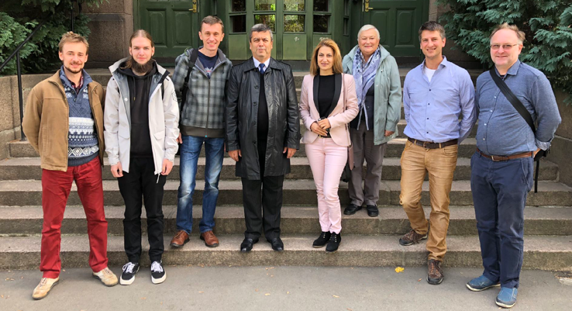
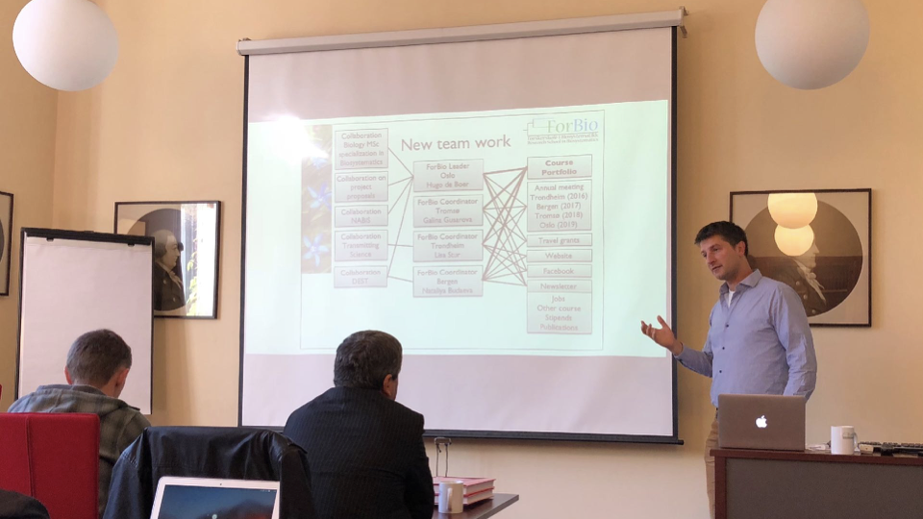
Activities
Kick-off meeting
(Oslo, Norway)
Train-the-mentors course
(Minsk, Belarus)
4 regional training courses
(Tajikistan, Belarus, Armenia, Ukraine)
Final symposium
(Oslo, Norway)
Kick-off meeting | February 2018 | Oslo, Norway
Notes:
DNA Barcoding workshop in Georgia – 2019-04
BioDATA II in planning…

Slide 13
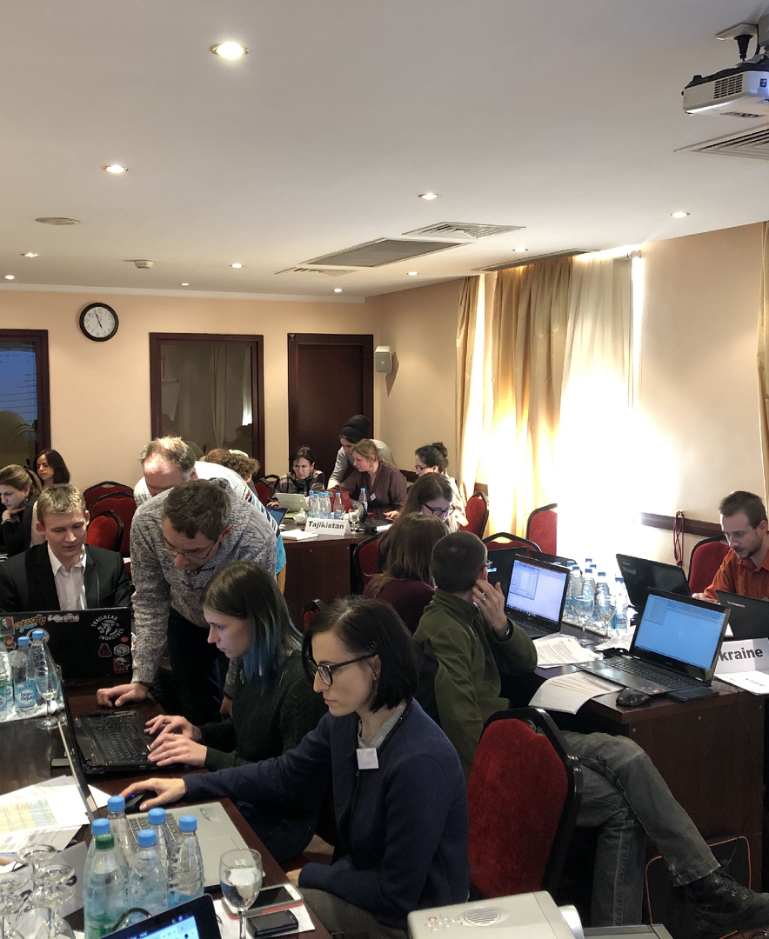
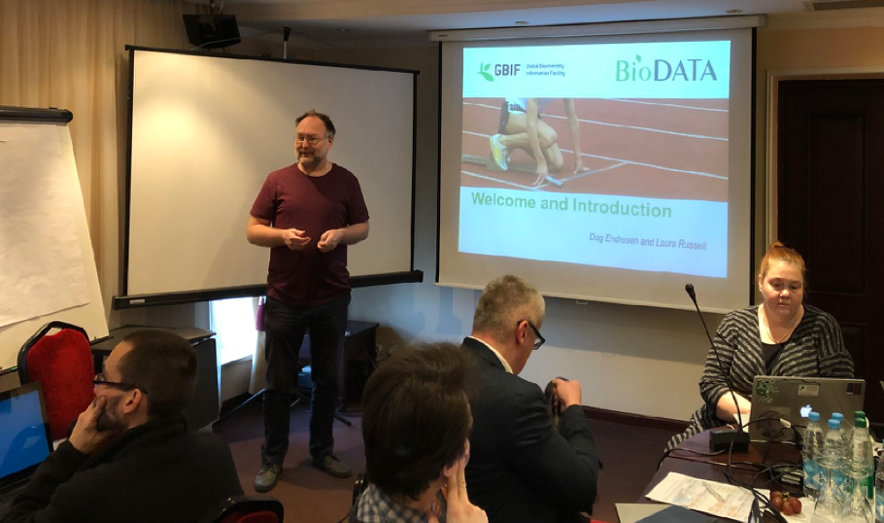
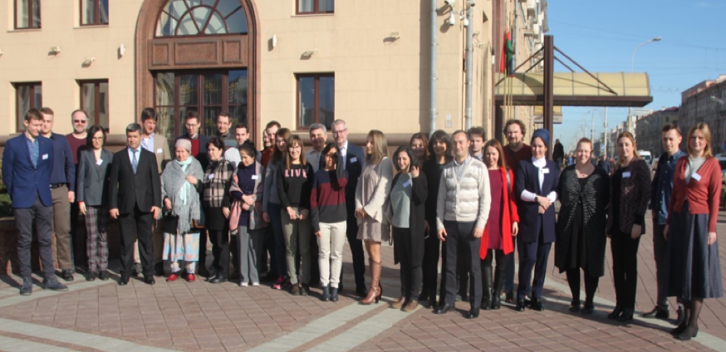
Activities
Train-the-mentors| February 2019 | Minsk, Belarus

Slide 14
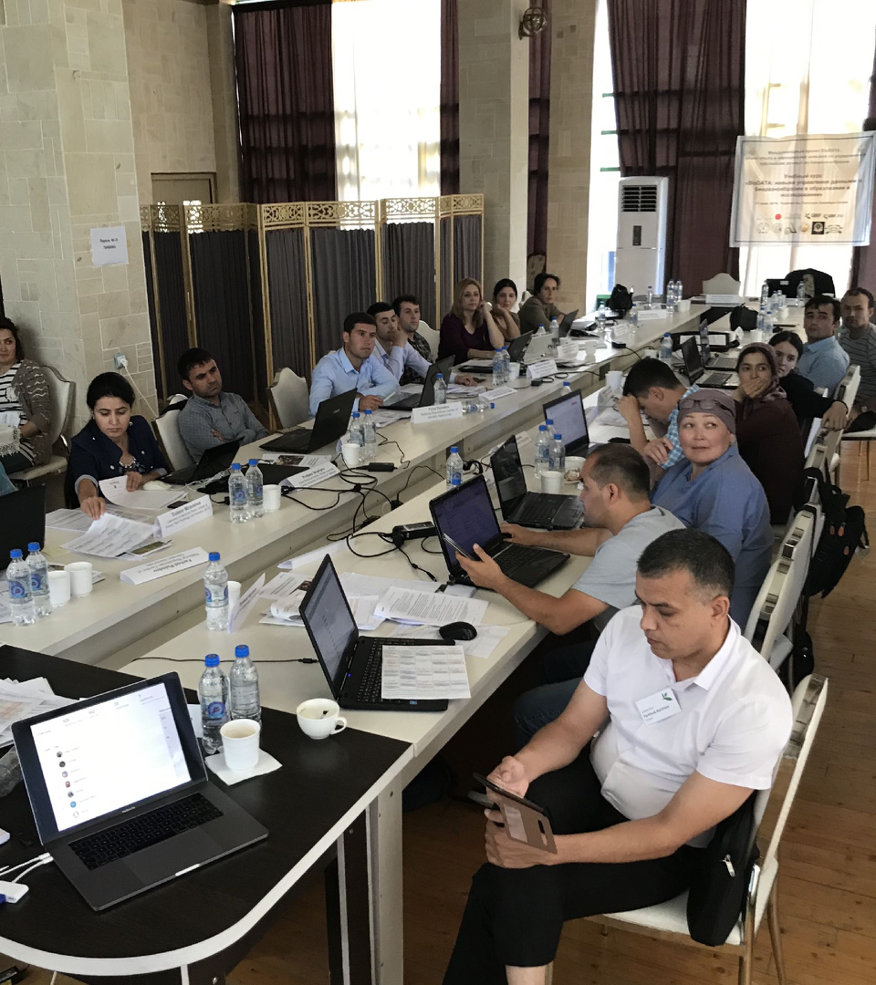
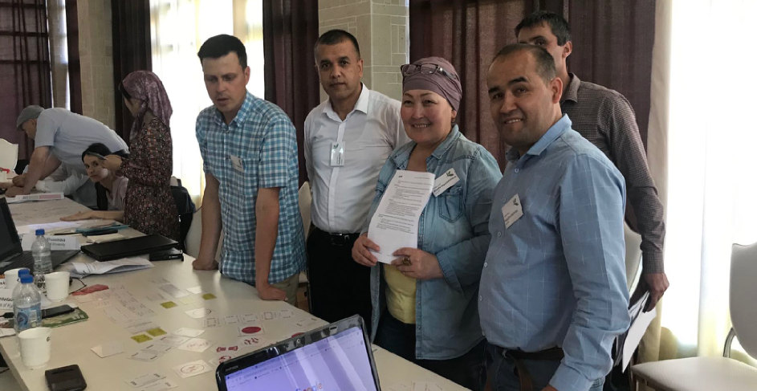
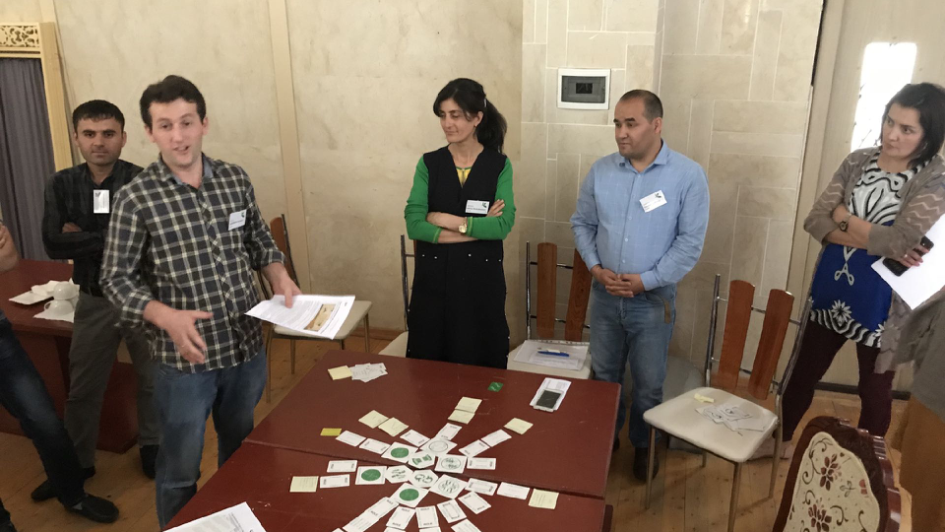
Activities
Including students from Uzbekistan and Kyrgyzstan
Regional training| June 2019 | Shambari, Tajikistan
Notes:
TODO: Including students from Uzbekistan and Kyrgyzstan

Slide 15

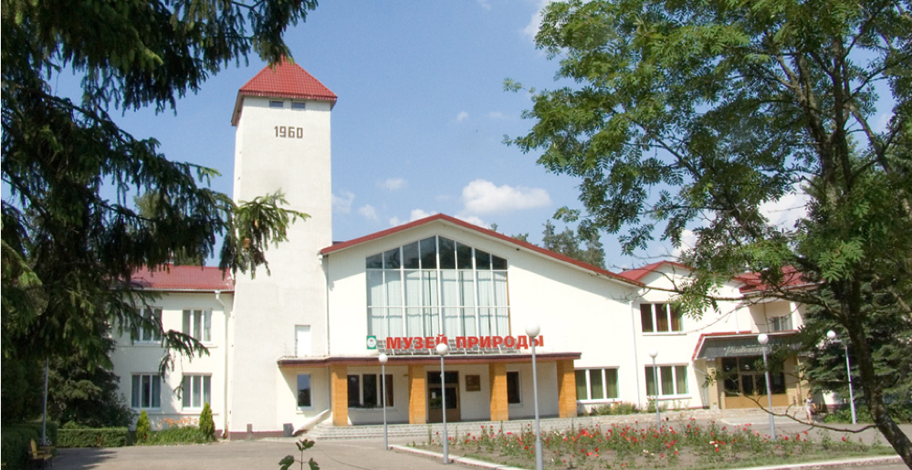
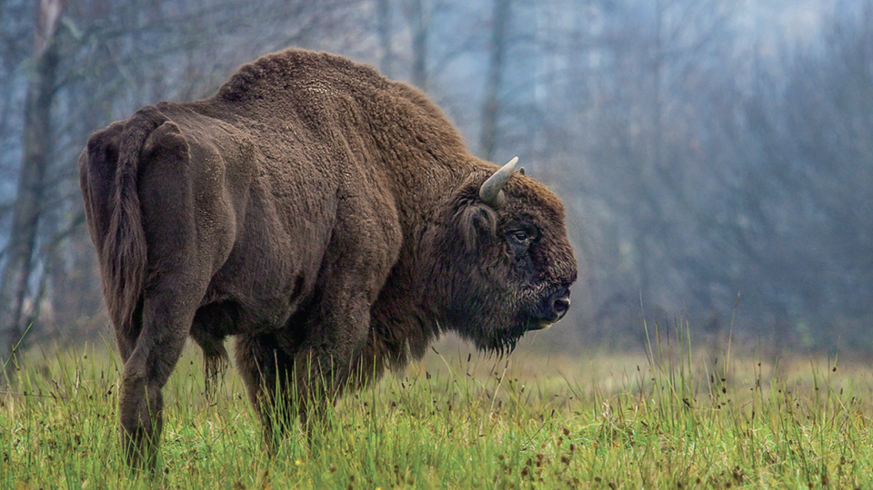
Activities
Including students from Latvia and Moldavia
Regional training| November 2019 | Białowieża, Belarus
Participants from Belarus:
National Academy of Science of Belarus
Baranovichi State University
Belarusian State University
Gomel State University
Grodno State University
Vitebsk State University
National Park “Braslavskie Ozera”
National Park “Pripyatsky”
Notes:
TODO: Add Latvia and Lithuania participants …

Slide 16
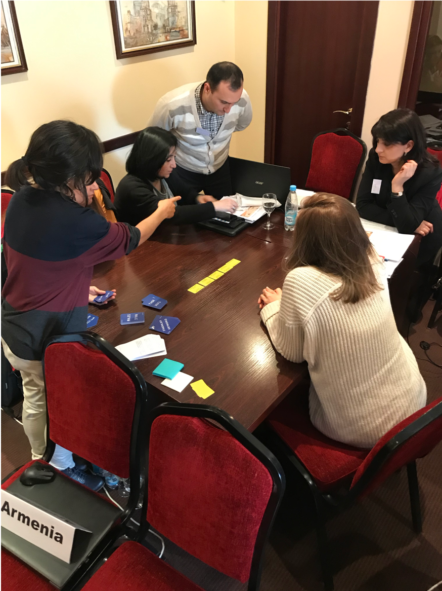
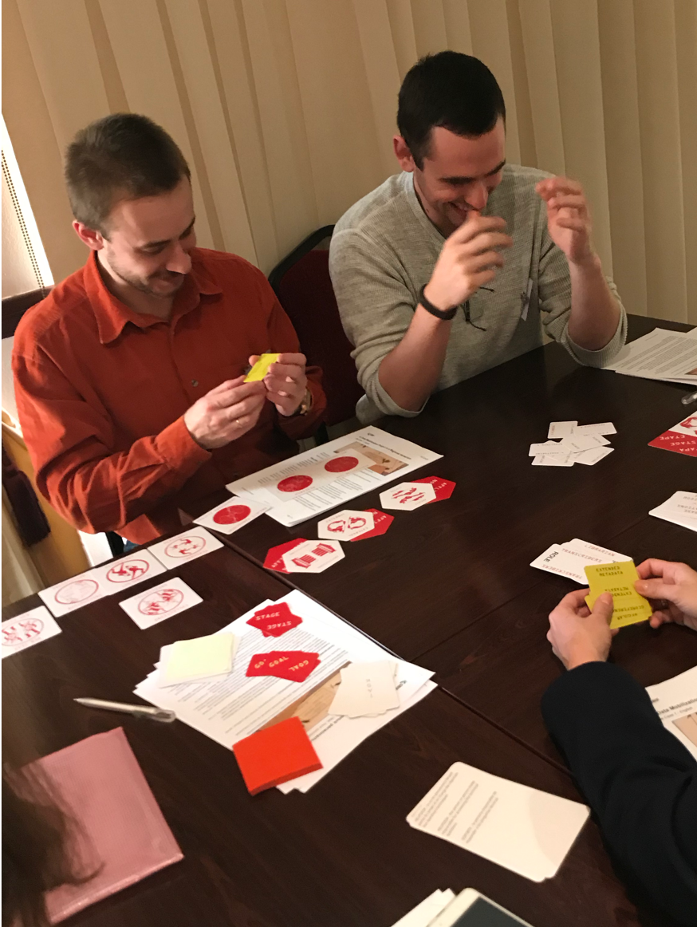
Activities
Regional training| April 2020 | Yerevan, Armenia
Regional training| October 2020 | Ukraine
Notes:
DNA Barcoding workshop in Georgia – 2019-04

Slide 17
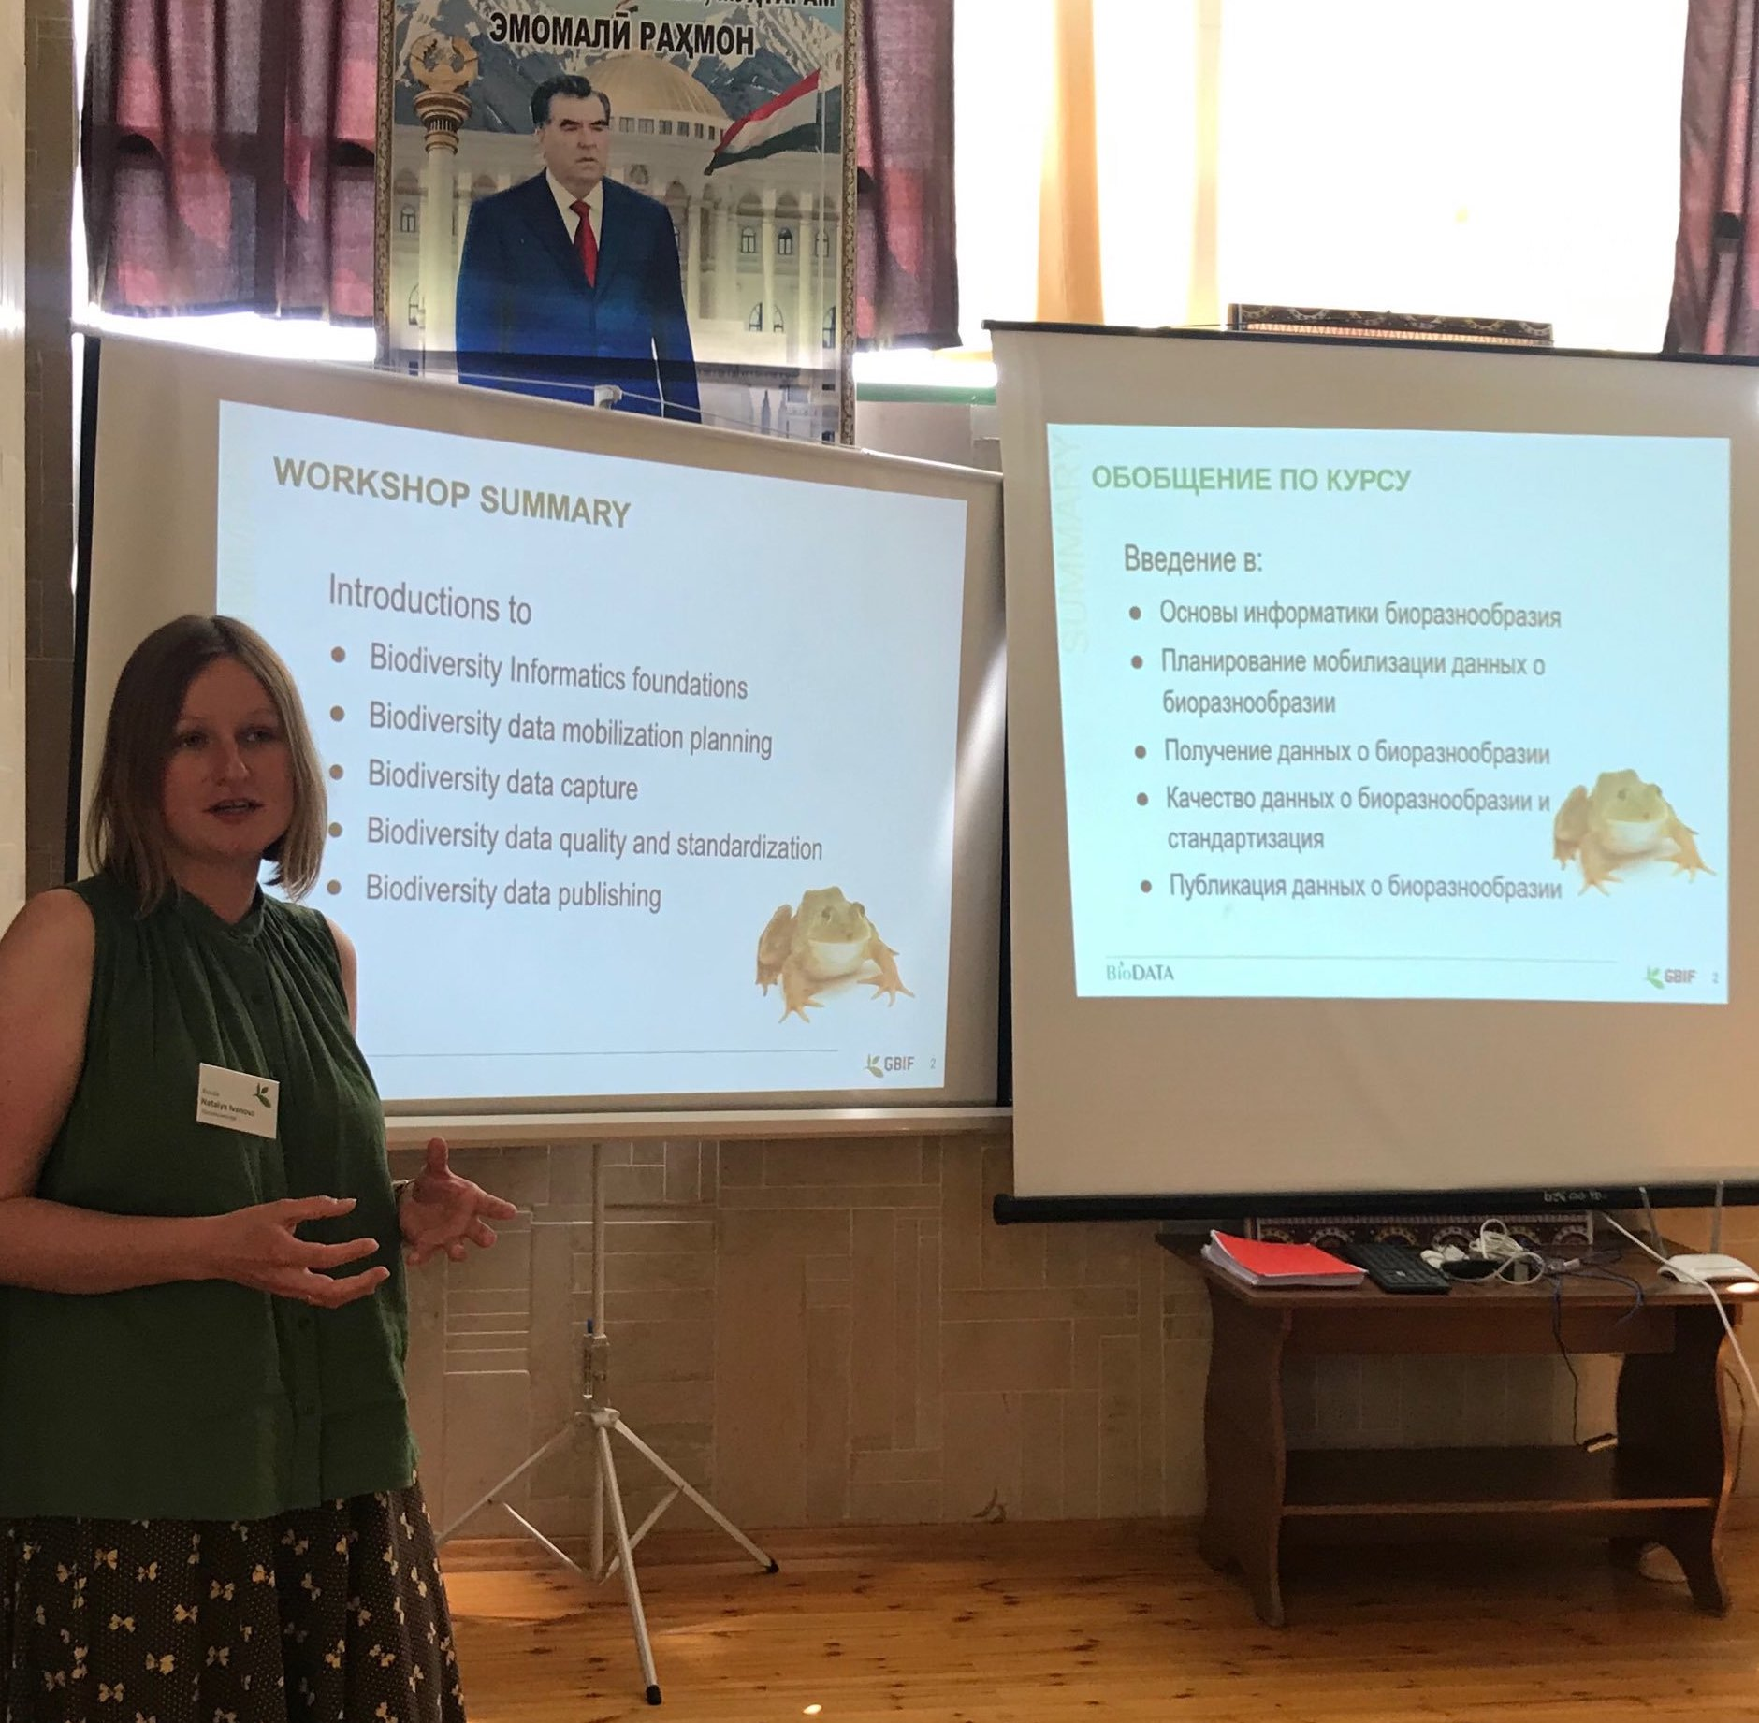
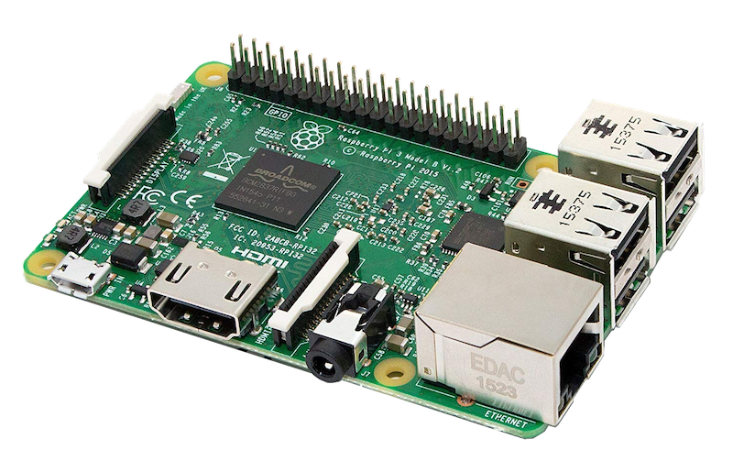
Challenges
Language barriers – all training materials were translated to Russian (by the GBIF.ru team)
Internet connectivity – the course IPT and all course training materials was provided from a small Raspberry Pi server installed in the class room

Slide 18


Success
Belarus joined GBIF as associate country July 2019
Armenia and Tajikistan are preparing to join GBIF
Ukraine are preparing data publication in GBIF

Slide 19
Biodiversity Data for
Internationalization in higher education
SS48 - Biodiversity informatics community capacity enhancement, Biodiversity Next, Leiden | 25 October 2019
Notes:
Symposium SS48 – Strengthening the biodiversity informatics community of practice through caåacity enhancement, Biodiversity Next, Leiden Friday 25 October 2019 (12 minutes)
BioDATA – Biodiversity Data for Internationalization in Higher Education | www.nhm.uio.no/english/research/projects/biodata
Global Biodiversity Information Facility | www.gbif.org
GBIF Norway, UiO Natural History Museum in Oslo, University in Oslo | www.gbif.no
ForBio Research School in Biosystematics | www.forbio.uio.no

