Slide 1

Open Regional Fund for South-East Europe Implementation of Biodiversity Agreements
Oslo | 22 May 2019

Slide 2
Agenda
What is an Open Regional Fund (ORF)?
ORF Implementation of Biodiversity Agreements (ORF BDU)
Biodiversity Information Management and Reporting (BIMR)
Implementation of BIMR 2 activities
Partnership with GBIF and DiSSCo
Regional cooperation with the Republic of Croatia
Communication in ORF BDU
2
Notes:
This presentation will start with a general overview of what an ORF is and what the GIZ‘s target in the West Balkans are.
Secondly, the ORF BDU will be explained. This includes its aim, its structure and the most important partners.
Each sub-project that is part of the ORF BDU will be introduced.
Eventually the contribution of each sub-project to the module outputs and the linkages between the different sub-project will be explained.
Since gender aspects play an important role in GIZ, this part will explain their relevance in the ORF BDU
Lastly, the communication and outreach of the ORF BDU is explained.

Slide 3

What is an Open Regional Fund for South-East Europe (ORF)?
Promote regional cooperation to jointly deal with regional issues
Economies: Albania, Bosnia and Herzegovina, Kosovo, Montenegro, North Macedonia, Serbia
Consist of sub-projects which contribute to an overall objective
At least three economies involved in each sub-project
Sub-project managers in different economies - main coordination in the GIZ-office in Sarajevo
6 ORFs in South-East Europe (SEE):
  (1) Energy Efficiency, (2) EU Integration, (3) Foreign Trade Promotion, (4) Implementation of Biodiversity Agreements, (5) Legal Reform and (6) Modernisation of Municipal Services
3
Notes:
Regional cooperation plays an increasingly important role for economic integration, for preserving peace and security and for biodiversity protection.
It provides a forum for identifying common challenges as well as common political values, for concluding political agreements and developing policies. Also, private sector and civil society groups coming together at a regional level in a variety of policy areas – even in regions that lack institutionalised, regional governmental structures, can play a crucial role for sustainable development.
ORFs are GIZ projects in the West Balkans that promote regional cooperation to jointly deal with certain regional issues. The ORFs deal with specific topics, but share the common goal of promoting regional cooperation.
West Balkans, according to the ORF‘s definition includes the follwoing economies: Albania, Bosnia and Herzegovina, Kosovo*, Montenegro, North Macedonia, Serbia. In one project Croatian NGOs are included as mentoring partners.
Each ORF is comprised of multiple sub-projects that focus on specific outputs – together they form ORF outputs and contribute to the ORF module objective
The ORFs are following a transnational approach. This means that at least three countries are involved in each sub-project
Additionally, the ORF staff is located in different countries (GIZ offices in Belgrade, Podgorica, Pristina, Sarajevo, Skopje and Tirana). The main coordination in the GIZ-office in Sarajevo
There are currently 6 ORFs in SEE: (1) Energy Efficiency, (2) EU Integration, (3) Foreign Trade Promotion, (4) Implementation of Biodiversity Agreements, (5) Legal Reform and (6) Modernisation of Municipal Services. All contribute to the programme objective of promoting SEEs’ economies’ process of EU accession.

Slide 4
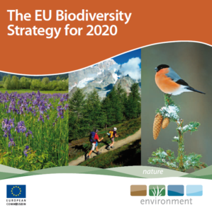



What is the ORF BDU?
What we are doing with our partners
Context
Assist relevant stakeholders in fulfilling international agreements and EU-regulations
Support established structures in improving their performance as interest groups
Improve regional exchange of information on biodiversity conservation among stakeholders
Provide knowledge and know-how about biodiversity conservation to stakeholders from the public sector, academia and civil society
Capacity building of various institutions involved in decision-making, research and education
South-East Europe is rich in biodiversity and harbours a large variety of ecosystems and endemic species
The economies have made progress in preserving their biodiversity, but strategic planning and implementation across borders is still insufficient
International agreements, such as: CBD, Agenda 2030, EU legislation
Commissioner: BMZ
Budget: 2.5 Mio. €
Term: 09/2018 – 12/2020
What we build upon
ORF Biodiversity (BD, 2015-2018)
Capacities for biodiversity information management were improved
Preconditions for a transboundary ecosystem management in the Sharr/Sar Planina/Korab-Koritnik region were created
Recommendations for applying ESAV in the region were developed
Capacities of regional NGOs were strengthened
The BDTF was established and started operating
4
22 May 2019
Notes:
The context:
The Western Balkan region is exceptionally rich in terms of biodiversity and harbours a large variety of ecosystems that range from Mediterranean coastal areas, over rivers, forests and steppes to high alpine mountain regions. A large number of flora and fauna occurring in the Western Balkans are endemic and numerous habitats are still in their natural state.
Biodiversity aspects are rarely taken into account when focal points of development are specified and development plans are drawn up – despite the fact that biological diversity provides foods, helps to maintain air and water quality, and is also of great socio-cultural and economic value
The SEE economies have commited themselves to international agreements and need to comply with certain EU-regulations if they want to join the EU. Furthermore, the ORF BDU is directly linked to the EU Biodiversity Strategy, the Agenda 2030 and the Convention on Biological Diversity. This means that its actions contribute to the Aichi Biodiversity Targets and to the Sustainable development goals (SDGs).
There are various connections and contributions to the Aichi biodiversity targets. These will be described for each sub-project separately. In general, the measures are most closely linked to the Strategic Goals A and E, but also help achieving other goals:
Goal A: Address the underlying causes of biodiversity loss by mainstreaming biodiversity across government and society
Goal E: Enhance implementation through participatory planning, knowledge management and capacity building
An overall and direct connection to the Agenda 2030 is given through the SDG 15, which the project helps to achieve:
Goal 15: Protect, restore and promote sustainable use of terrestrial ecosystems, sustainably manage forests, combat desertification, and halt and reverse land degradation and halt biodiversity loss
Other SDGs are also affected by some of the sub-projects.
What we build upon
The previous project (ORF BD 2015 – 2018, Volume 3 mio. €) aimed to support regional cooperation of biodiversity-relevant organisations in Southeast Europe for the implementation of the EU Biodiversity Strategy.
Overall: The ORF BD participated in the preparation of a joint declaration of ministers of environmental protection regarding the EU 2020 Biodiversity Strategy (April 2016) and renewed in November 2017. Biodiversity has become one of environmental topics taken into account by the Regional Cooperation Council (RCC) in updating the 2020 Growth Strategy of Southeast Europe for the period 2017-2019. A task force for biodiversity conservation established and started working (leading to the new SP BDTF).
BIMR: Policy recommendations for handling biodiversity-related data (for an EU-compliant biodiversity information system) were prepared by partner countries and implemented as a pilot.
BioNET: The engagement of the civil society was institutionalised through the establishment of a biodiversity-related NGO network with a statute and work plan and first awareness raising measures (BioNET).
ESAV: The new topic of ecosystem services and their economic and social assessment was introduced in the region with the support of the project.
TEM: The cooperation on biodiversity conservation in the Sharr/Sar Planina/Korab-Koritnik region has been improved and partly institutionalized
What we are doing with our partners:
All actions that the ORF BDU is undertaking assist relevant stakeholders with fulfilling international agreements and EU-regulations. Four focus areas of our work are:
Support established structures in improving their performance as interest groups
Improve regional exchange of information on biodiversity conservation among regional stakeholders
Provide knowledge and know-how about biodiversity conservation to stakeholders from the public sector, academia and civil society
Capacity building of various institutions involved in decision-making, research and education
The ORF BDU consist of five sub-projects which will be introduced in the coming slides

Slide 5





Module objective
Regional cooperation between the economies of the Western Balkans regarding the fulfilment of international obligations for the preservation of biodiversity, and EU-related obligations in particular, has been strengthened
Strengthen regional structures
Improve information and knowledge management
Promote ecosystem services assessments
Outputs
TEM2
ESAV2
BioNET2
BIMR2
BDTF
Transboundary Ecosystem Management
Ecosystem Services Assessment and Valuation
Regional Network of biodiversity-related Civil Society Organizations
Regional Network for Biodiversity Information Management and Reporting
Biodiversity Task Force
5
22 May 2019
Notes:
The ORF BDU consists of five sub-projects which will be discussed in more detail later. This slide shows that the sub-projects are linked among each other and jointly contribute to the module outputs and objective.
The module objective is: Regional cooperation between the economies of the Western Balkans regarding the fulfilment of international obligations for the preservation of biodiversity, and EU-related obligations in particular, has been strengthened.
This shall be achieved through the Outputs:
Strengthen regional structures
Improve information and knowledge management
Promote ecosystem services assessments

Slide 6



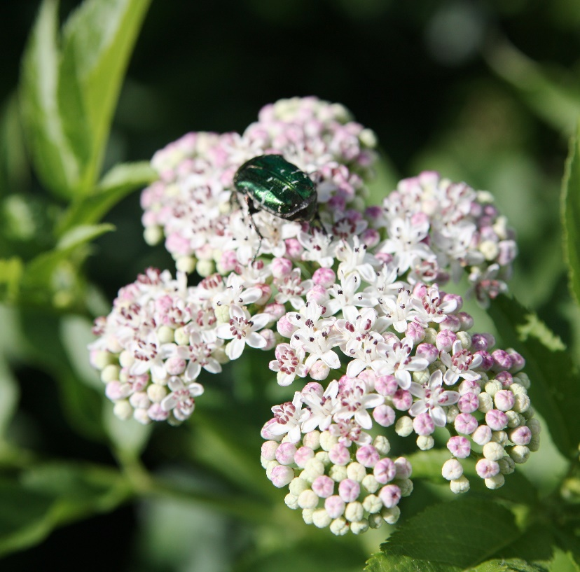
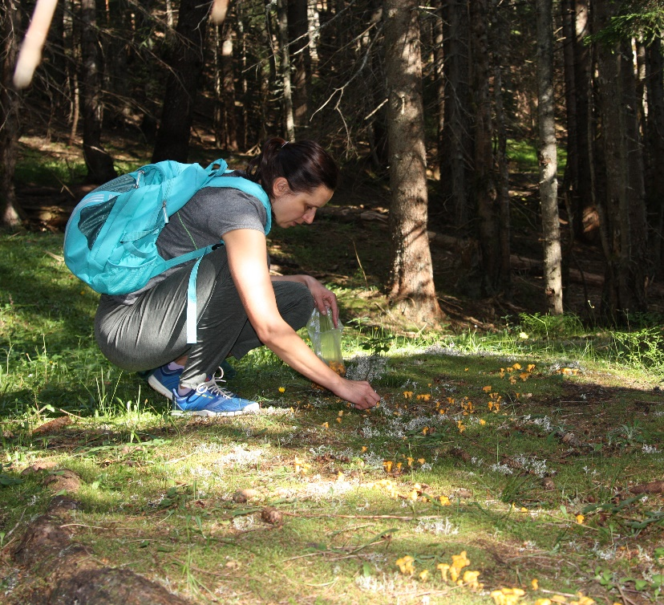








BIMR 2 Monitoring and reporting biodiversity data
BMZ-funded
02/2019 – 12/2020
Budget 250,000 €
All EU accession economies in SEE
Challenge:
A regional concerted approach for biodiversity data management and reporting is missing
Even though the political and legal framework conditions for biodiversity protection are in place, the strategic and operation implementation are still remaining to be inadequate
Authorities lack technical, organizational and financial capacities and skills for biodiversity data management and reporting
Building on:
Regional and National Assessments of BIMR Baseline developed
Regional BIMR Guidelines developed
Photo
Objective
The strengthened BIMR Regional Platform elevates transparency in biodiversity data management at the regional level
Approach:
Developing a BIMR Policy Paper on the establishment and maintenance of an information system
Improving biodiversity data management to ensure structured and standardized data and global availability
Partners
BIMR Regional Platform
Global Biodiversity Information Facility (GBIF)
Distributed System of Scientific Collections (DiSSCo)
Aichi
SDGs
6
22 May 2019
Notes:
This measure supports the development of a biodiversity data management system. It is funded by the BMZ, has a budget of 250,000€ and the actions and partners are focused specifically onto Bosnia and Herzegovina, Montenegro and North Macedonia.
The challenge:
A regional mechanism for Biodiversity Information Management and Reporting (BIMR) is missing
Therefore the protection of natural resources and compliance with EU-legislation and other international agreements is insufficiently monitored
Technical, organizational and financial capacities for biodiversity data management are inadequate for integration into national policies
What we are building on:
Common understanding of BIMR established
Regional BIMR guideline developed
BIMR policy paper to tackle existing gaps and obstacles
Objective:
The strengthened BIMR Regional Platform elevates transparency in biodiversity data management at the regional level
Our approach
Developing a BIMR Policy Paper on the establishment and maintenance of BIMR systems to strengthen the regional cooperation, develop shared understandings and approaches and support the national enagement
Improving biodiversity data management to ensure a standardized storage and global availability to ease exchange and use of data for international partners (eg. via GBIF) that are relevant with regards to EU and CBD
Partners:
BIMR Regional Platform (Ministries of Environment, Institutes for Nature Conservation and Environmental Protection Agencies in SEE)
Global Biodiversity Information Facility (GBIF)
Link to international agreements
As part of this measure, the project is strengthening the partners in implementing reporting that is in conformity with the EU Biodiversity Strategy and other EU requirements (for example the Natura 2000 network).
Link to Aichi target 12 (Reducing risk of extinction): Better monitoring can lead to a more effective protection of endangered species
Link to Aichi target 19 (Sharing information and knowledge): This target is directly linked to the sub-project’s outputs
Link to SDG 14: BIMR includes aquatic species and can lead to improving their protection
Link to SDG 15: BIMR includes terrestrial species and can lead to improving their protection
Link to SDG 17: Making biodiversity data available and sharing it can help other stakeholders to get involved and build partnerships

Slide 7

BIMR in the context of regional cooperation & legislation
MNE
KOS
SRB
ALB
MAK
BiH
Regional Working Group on the Environment (RWGE)
representatives
representatives
Biodiversity Task Force (BDTF)
BIMR Regional Platform
BIMR deliverables
7
22 May 2019
Notes:
This slide explains the process of how the BDTF embedded into the political structure in the West Balkans.
The BDTF is the focus of the sub-project
Policy papers (in some cases results from other sub-projects) are submitted to and endorsed by the BDTF
The policy papers (and other outputs of the BDTF) are processed to the RWGE which is a part of the RCC. All West Balkan economies are respresented in the RCC.
From here, the propositions/content is further processed to the national governments, where it feeds into national action plans or legislation.
The national governments send representatives (usually from the environmental ministries or equivalents) to the BDTF.

Slide 8
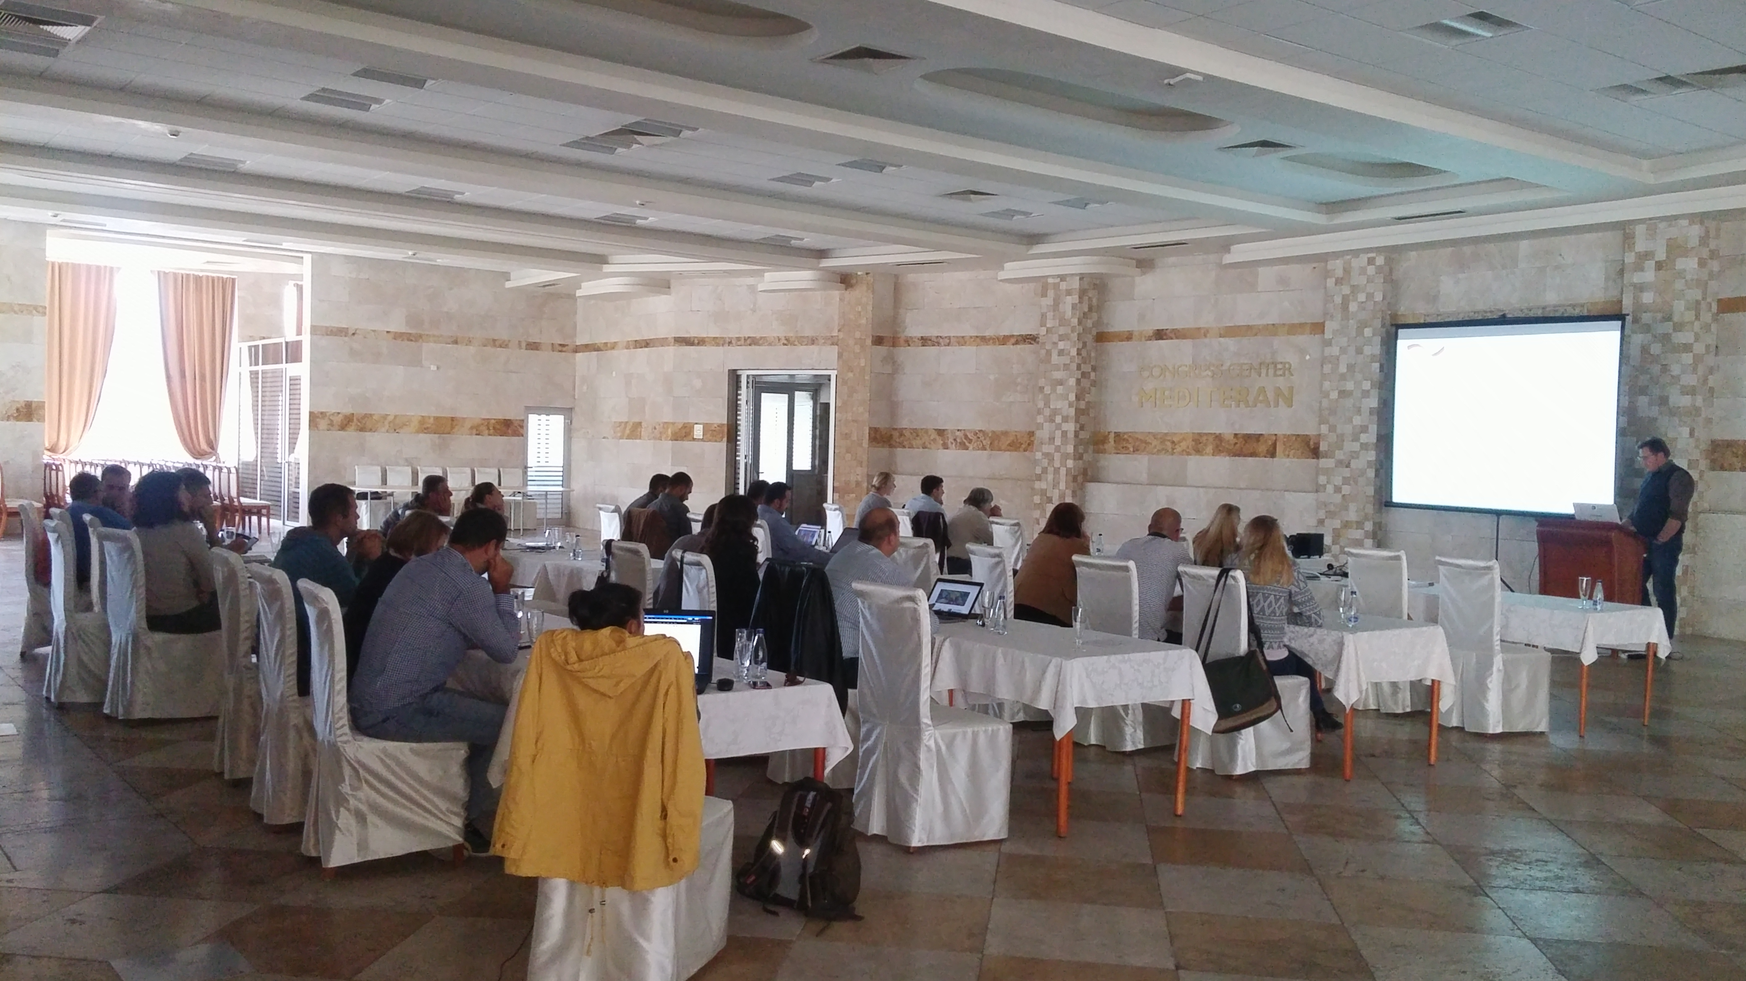
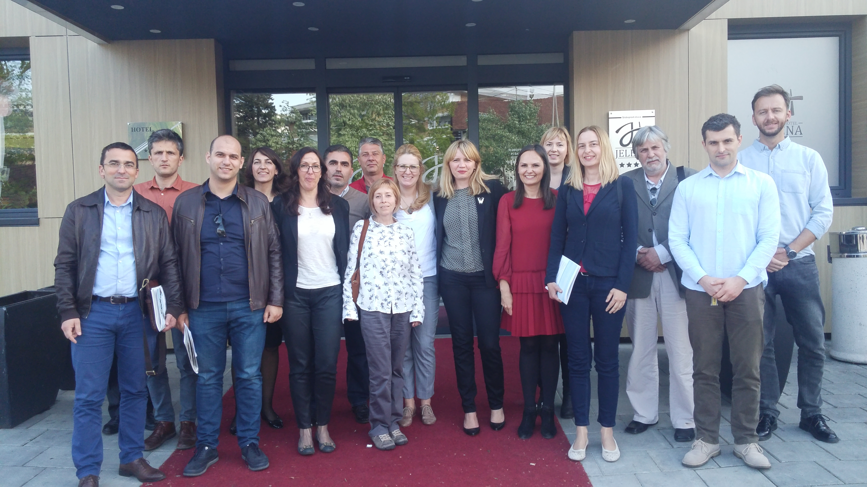
BIMR Regional Platform
Consultative regional technical group
  26 nominated representatives from the Ministries in charge of Environment, Environmental Protection Agencies and Institutes for Nature Conservation from SEE and Croatia,
  supports advisory work at the national/regional level, communicates and disseminates information on activities relevant for data management and reporting in respective institutions and other sectors and initiatives, verifies and presents deliverables, mobilizes institutional, scientific and technical networks at the national/regional and international level.
  Mode of Operation and Workplan,
  Three BIMR Regional Platform Meetings planned
Spring, 2019
Autumn, 2019
Spring, 2020
  Aims to enhance transparency in biodiversity data management at the regional level by strengthening the capacities of BIMR Regional Platform in order to meet CBD and EU requirements.

Slide 9
Implementation of two main activities
1) Devlopment of BIMR policy paper
Purpose: achieve higher political profile of biodiversity information management and reporting issue in the region, strategically plan activities to enable functional and operational biodiversity information management activities in the region and harmonization with the EU acqui requirements,
- Consists of methodology process, SWOT analysis, vision, focus areas and targets and Action Plan. Action Plan should be proposed and agreed among BIMR Regional Platform members and prepared in a way to be feasible, clear, resourceful and adjusted to the national circumstances and easier to implement
2) Improvement of BD data management
- Further update of List of Endemic Taxa of SEE
- Development of Information System for Nature Conservation (ISNCs) in Montenegro, Bosnia and Herzegovina and North Macedonia

Slide 10
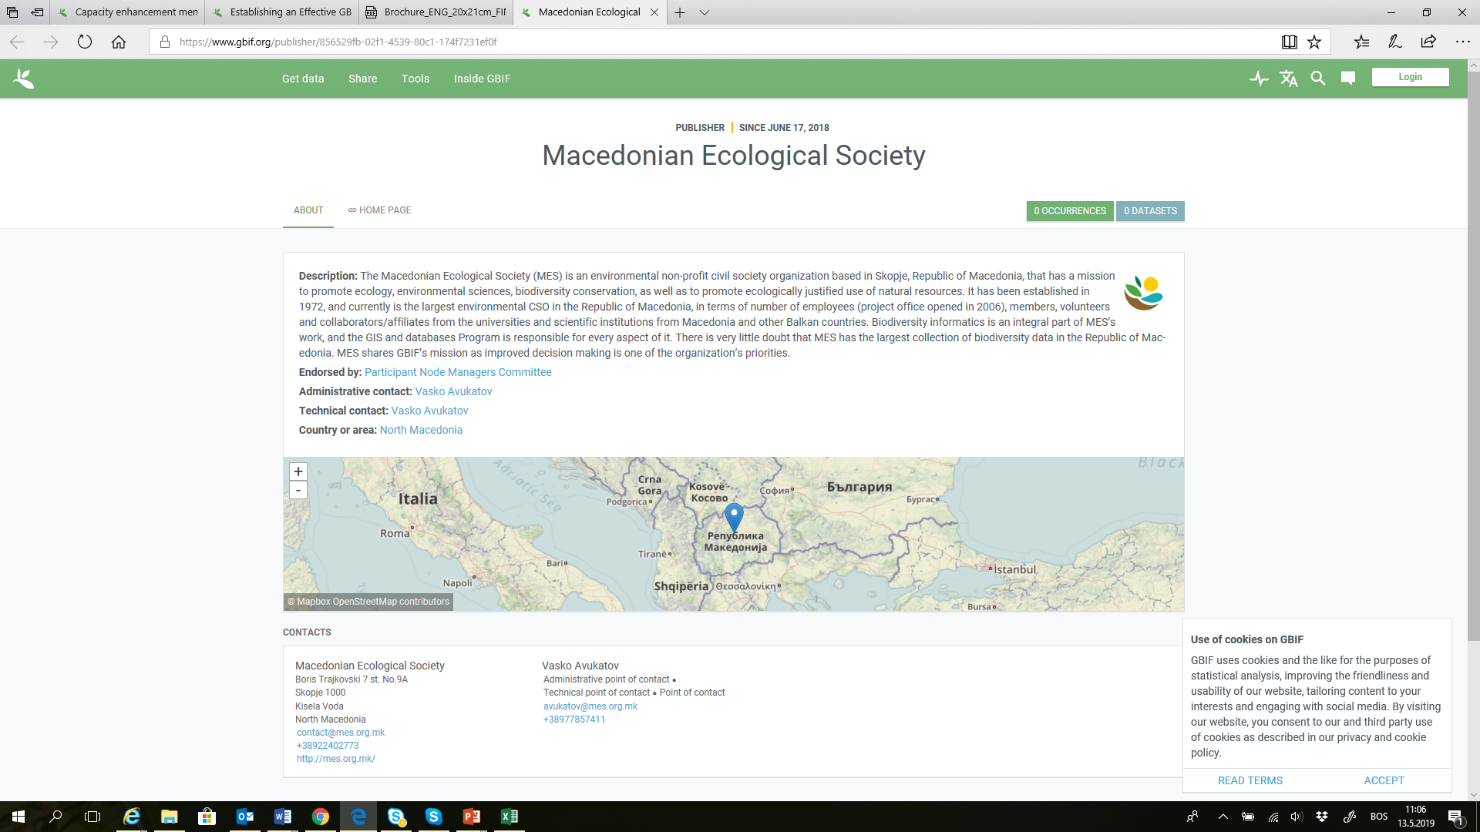
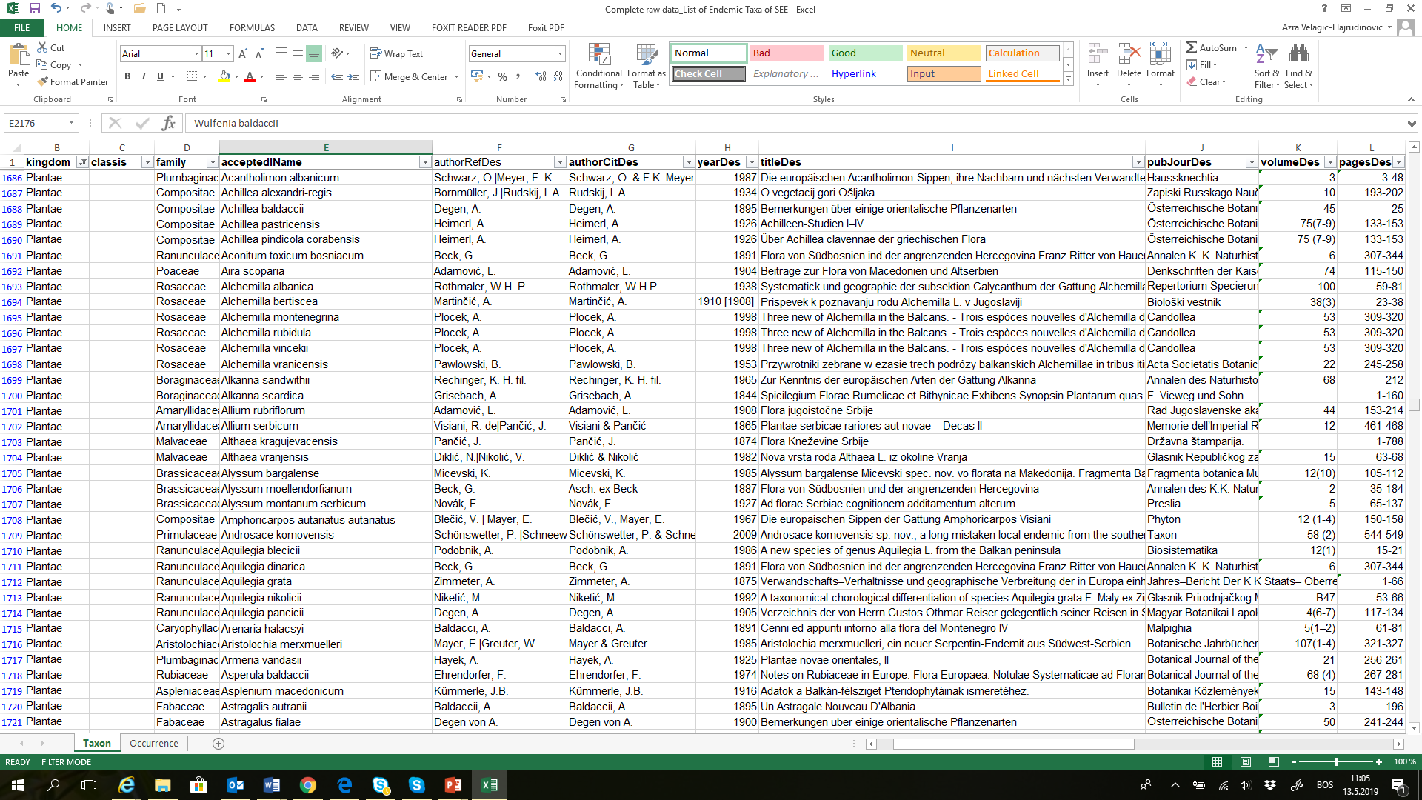
List of Endemic Taxa of SEE
Developed dataset
  Regional Expert Group – 13 taxonomists,
  Taxonomic groups - vascular plants, mammals, amphibians, reptiles and beetles,
  Used Darwin Core standard
  nearly 2.200 endemic taxa (1.598 species and 576 subspecies), almost 2.500 classic localities (2.430 were georeferenced).
GBIF publishing and promotion
  Macedonian Ecological Society, registered as GBIF publisher
  Document „Recommednations for future update“.
  Brochure,
  GBIF publishing (underway).
Further update
  New taxonomic groups – anthropods (subterrenean and aquatic), snails, slugs, fishes
  BD data paper,
  Update in ISNCs and GBIF network.

Slide 11
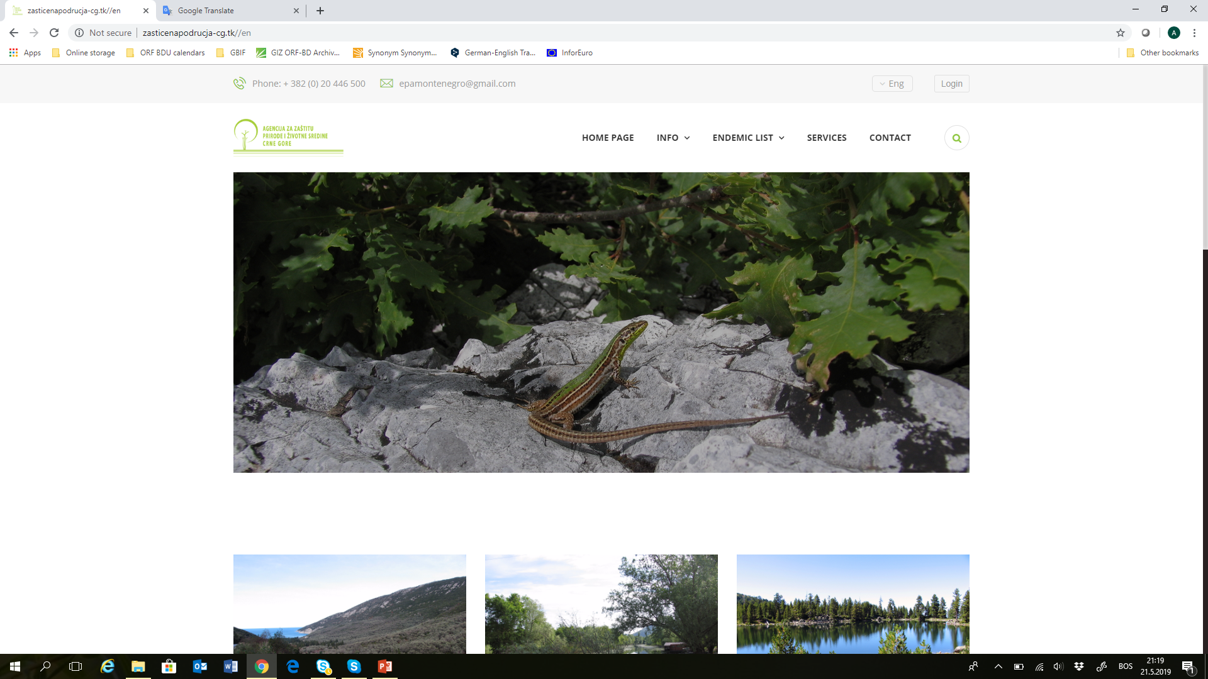
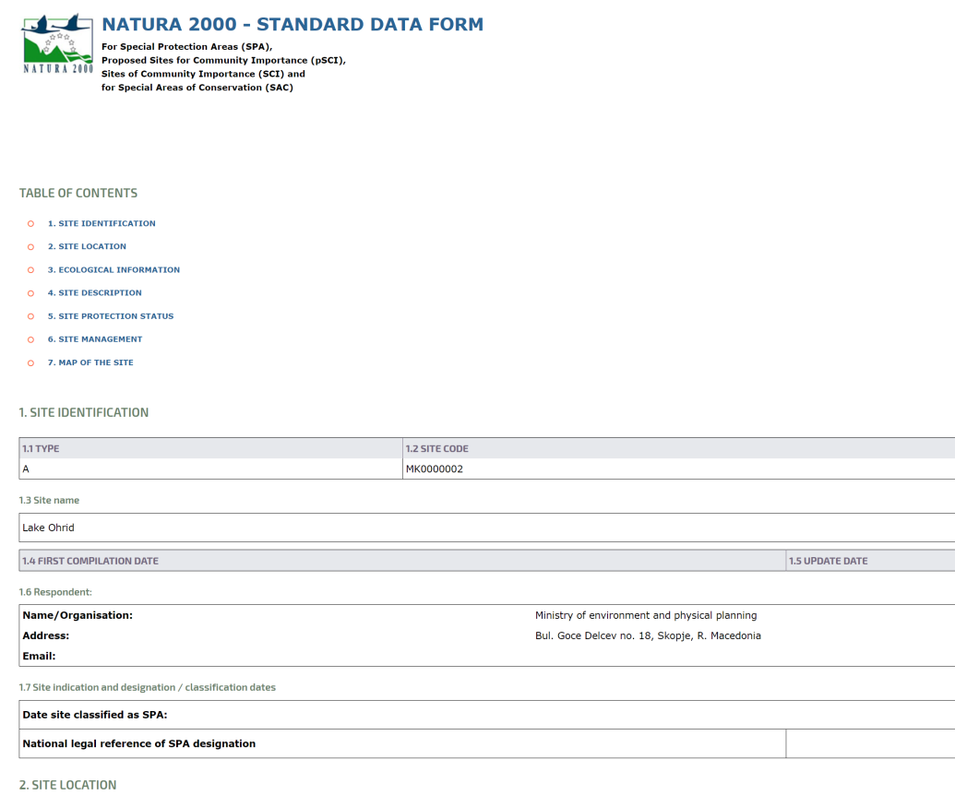
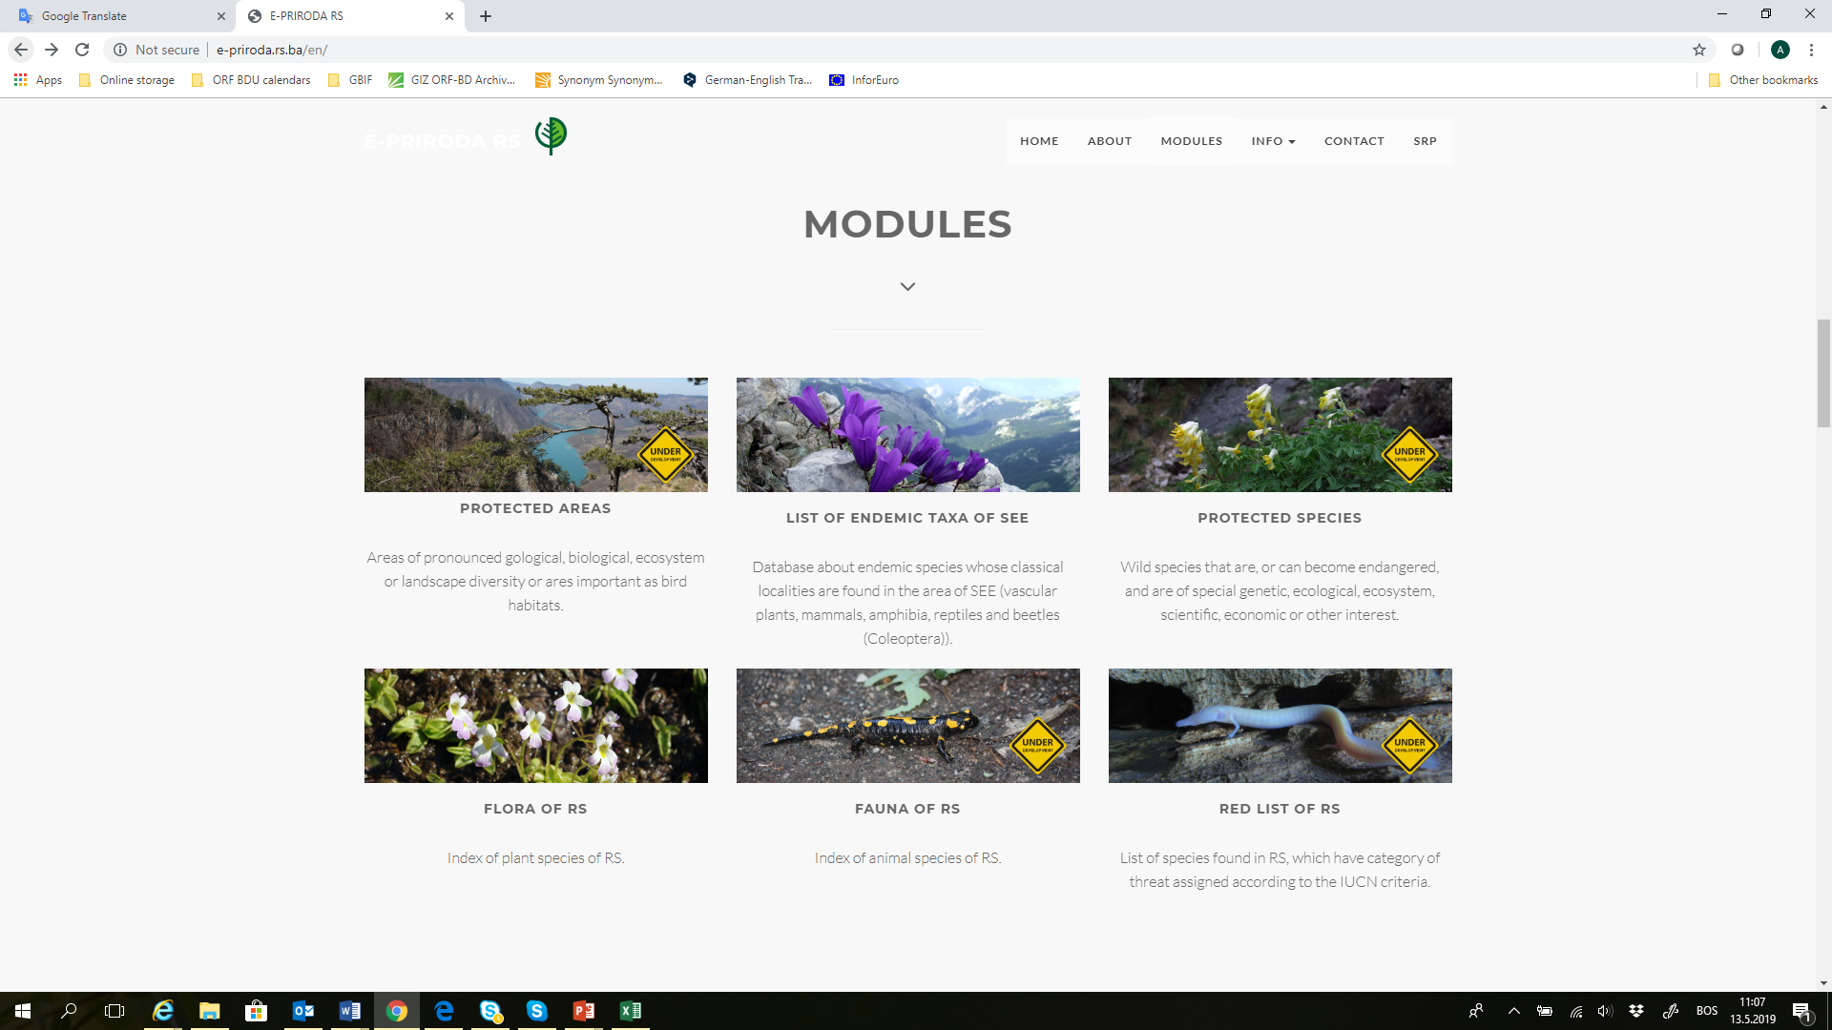
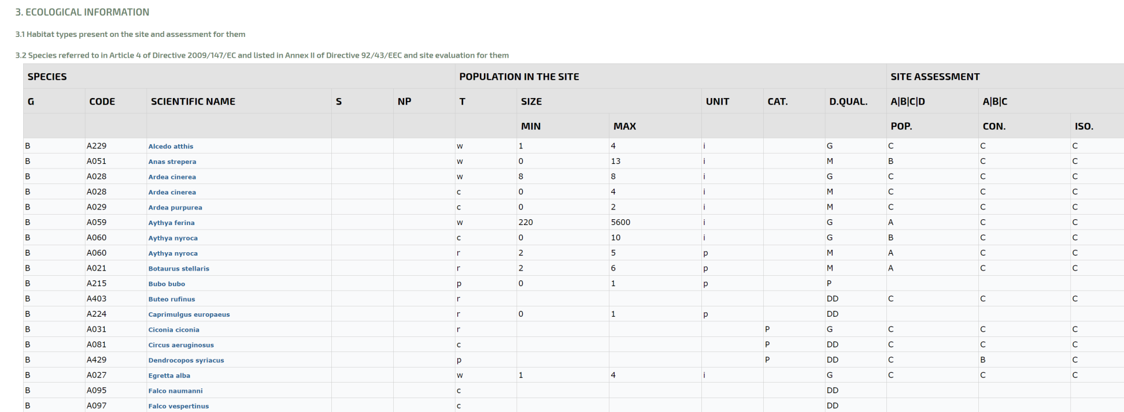
Development of Information System for Nature Conservation (ISNC)
Bosnia and Herzegovina
Republic Institute for Protection of Cultural-Historical and Natural Heritage in Republika Srpska
Environmental Fund of FBiH
http://e-priroda.rs.ba/en/
Next - Module on Protected Areas with geospatial functionality + taxonomic component
Montenegro
Environmental Protection Agency
http://zasticenapodrucja-cg.tk//en
Next - Module on Natura 2000 (?)
North Macedonia
Ministry of Environment and Physical Planning
SDF Natura 2000
Next – mobile application for data collection at the field (?)

Slide 12
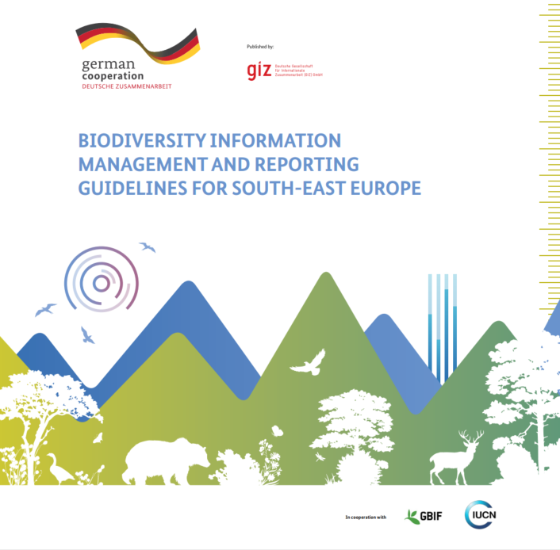
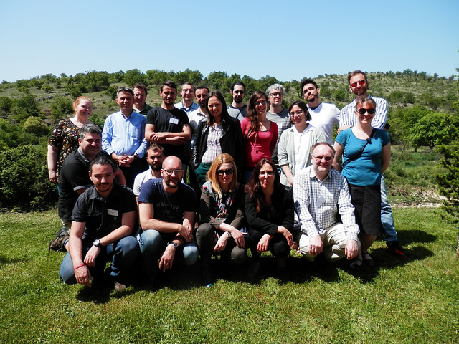
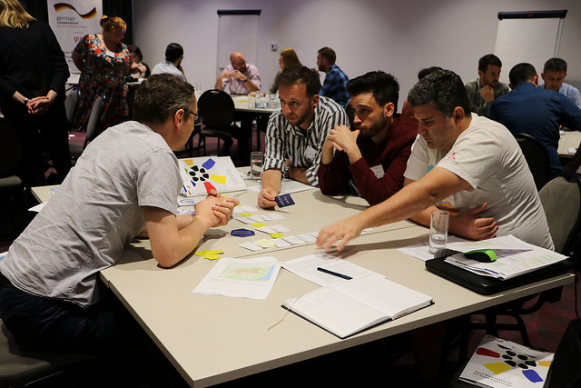
Partnership with GBIF
- Letter of Agreement (Feb 18, 2018), joint activities:
  GBIF’s contribution to and review of the document BIMR Regional Guidelines developed by GIZ/ORF BD,
  participation of GIZ/ORF BD supported by the GBIF hosting institution as an observer at the 10th GBIF European Node Meeting, 14-16 May 2018 in Tallinn, Estonia and
  organization of the first Biodiversity Data Mobilization Training for South-East Europe (SEE), 23-26 April, 2018 in Podgorica, Montenegro.

Slide 13

Partnership with GBIF (continued)
  Letter of Agreement (May, 2019), joint activities:
  Contribution to the BIMR policy paper and BIMR Regional Platform Meetings,
  engagement strategy to widen participation from SEE region and Croatia in the GBIF network,
  participation at the 11th GBIF European Node Meeting and dending on the progress of participation discussions, at the 12th GBIF European Node Meeting, in 2020;
  participation at the GBIF Global Nodes Training, Global Nodes Meeting, and potentially the GBIF Governing Board Meeting as observer,
  participation at the assigned and confirmed symposia within the international conference – Biodiversity_next,
  organization of the First Data Use for Decision Making Workshop for SEE planned for 4th quarter of 2019.

Slide 14

Partnership with DiSSCo
- Letter of Agreement (May 5, 2019), joint activities
  DiSSCo’s contribution to and review of the BIMR policy paper developed by GIZ/ORF-BDU,
  attendance of DiSSCo as an observer/speaker at one of the three planned BIMR Regional Platform Meetings,
  identify stakeholders (e.g. natural history museums, botanical gardens, Ministry of Science, universities) and develop a list of stakeholders for SEE region and Croatia,
  approach listed stakeholders by sending them the official letters (on behalf of GIZ/ORF-BDU and DiSSCo) and engaging them through the scheduled consultative meetings at the national level in SEE region and Croatia,
  organization of the First Regional Coordination Conference for SEE planned for spring 2020.

Slide 15
Regional Cooperation with the Republic of Croatia
Memorandum of Understanding (underway)
  Consultative meeting – July, 2019
Republic of Croatia towards GBIF membership
  In plan to join as Voting Participant in 2019
  Ministry of Environmental Protection and Energy
  Contact Jana Bedek (Senior Expert Advisor for Karst and Caves), jana.bedek@mzoe.hr
Notes:
Ministry of Environmental Protection and Energy is in process of reorganization at the moment. The formal process of joining the GBIF network will follow after the reorganization.

Slide 16
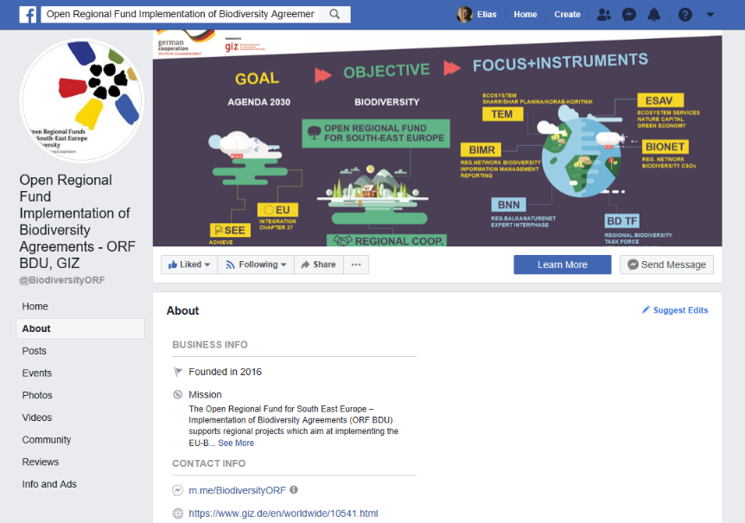
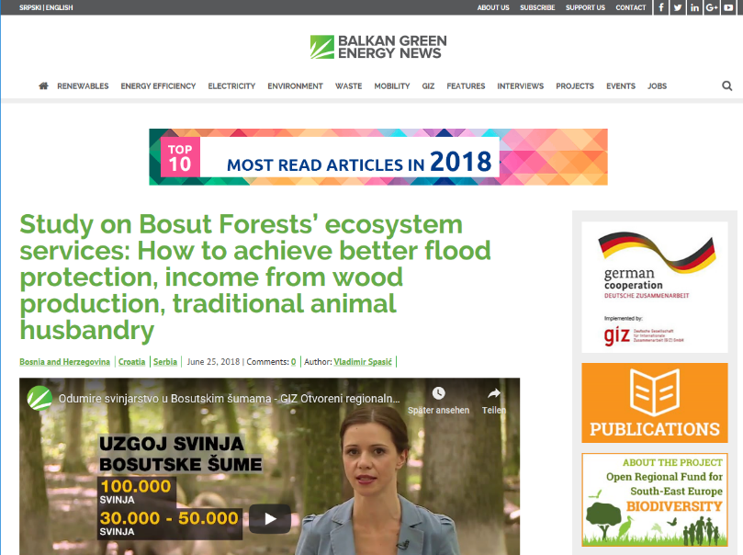
Communicating biodiversity
Facebook
Balkan Green Energy News
https://www.facebook.com/BiodiversityORF/
https://balkangreenenergynews.com/open-regional-fund-south-east-europe-biodiversity-orf-bd/
16
22 May 2019
Notes:
ORF BDU communication focuses on two channels:
Via Facebook a general audience is reached. Frequent updates show our regular work and allow insights into some of our events.
BGEN is directed to a professional audience. Here, in-depth articles and reports from and about our work are posted.

Slide 17

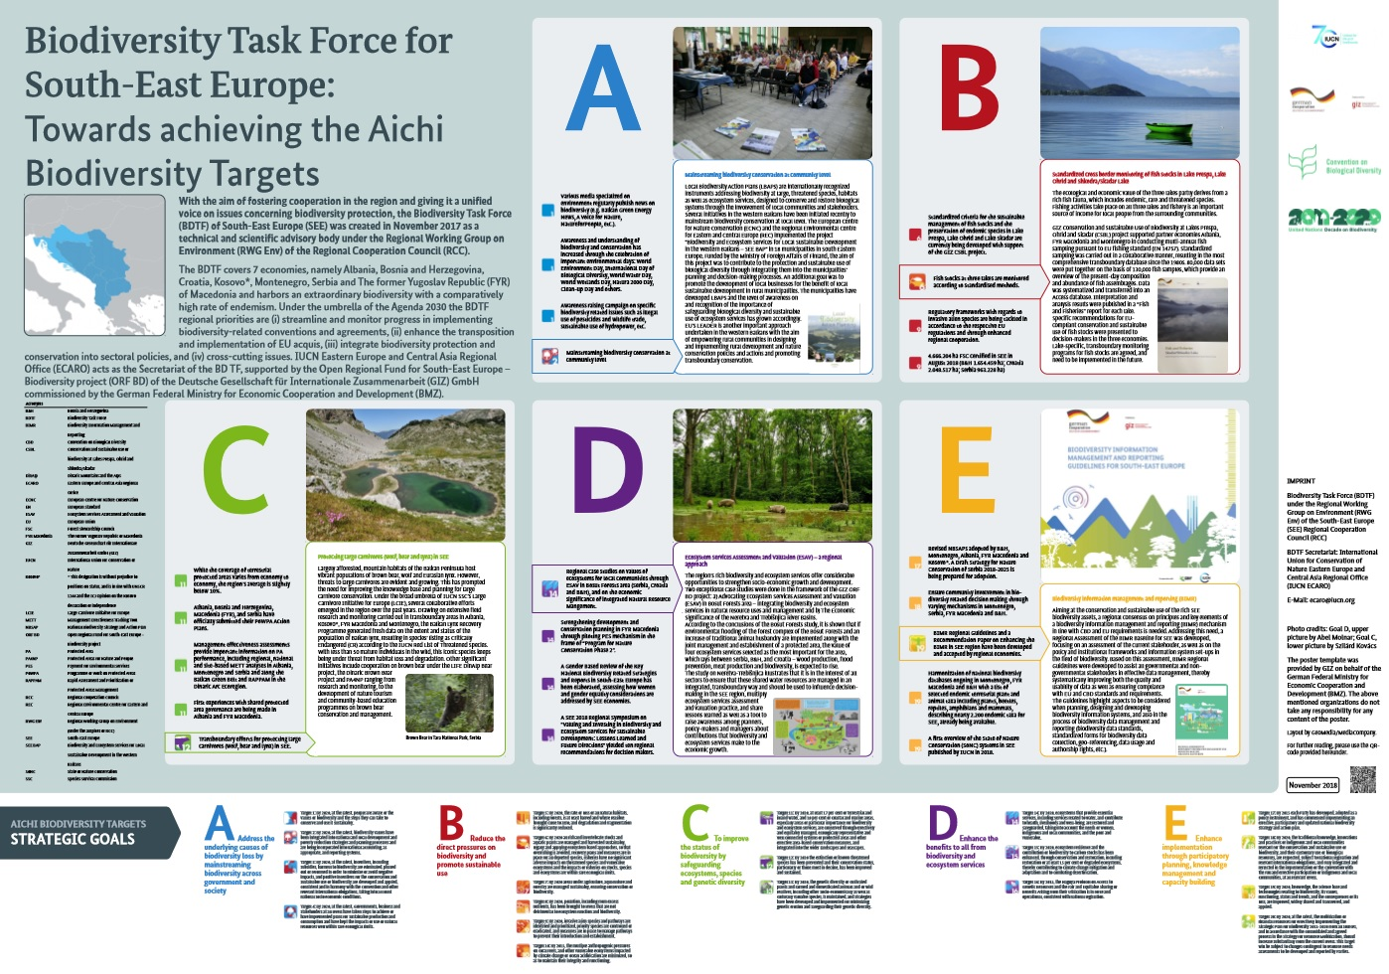
Communicating regional cooperation
Contribution at CBD COP 14
Side event at the 2018 UN Biodiversity Conference
Participation of representatives of European Commission and German Federal Ministry for Economic Cooperation and Development (BMZ)
Exchange of experiences with Southern African Development Community (SADC)
Importance of regional cooperation for achieving biodiversity targets and sustainable development was highlighted
Presentation of poster: “BDTF: Towards achieving the Aichi-Targets”
A consultation meeting of CBD on the Post-2020 Global Biodiversity Framework will be held in Belgrade in April 2019
17
22 May 2019
Notes:
A delegation of the BDTF participated in the CBD COP 14.
They organized a side event about regional approaches for achieving biodiversity targets
The side event was co-hosted with the SADC and had a high-level participation from the European Commission and the BMZ
Key outputs of the discussion:
regional planning, coordination and monitoring for sustainable development is important;
regional cooperation accelerates progress towards the achievement of biodiversity targets; and
a unified voice on biodiversity-related issues can help inspire sustainable development through regional approaches

Slide 18
Thank you!
Azra Velagic - Hajrudinovic
Project Manager
Open Regional Fund for South East Europe - Implementation of Biodiversity Agreements (ORF BDU)
Deutsche Gesellschaft für Internationale Zusammenarbeit (GIZ) GmbH
Zmaja od Bosne 7-7a Importanne Centar O3/VI
71 000 Sarajevo
Bosnia and Herzegovina
T + 387 33 957 549
M + 387 62 732 218
F + 387 33 957 501
E azra.velagic-hajrudinovic@giz.de
S azra.velagic-hajrudinovic
18
22 May 2019

