Slide 1
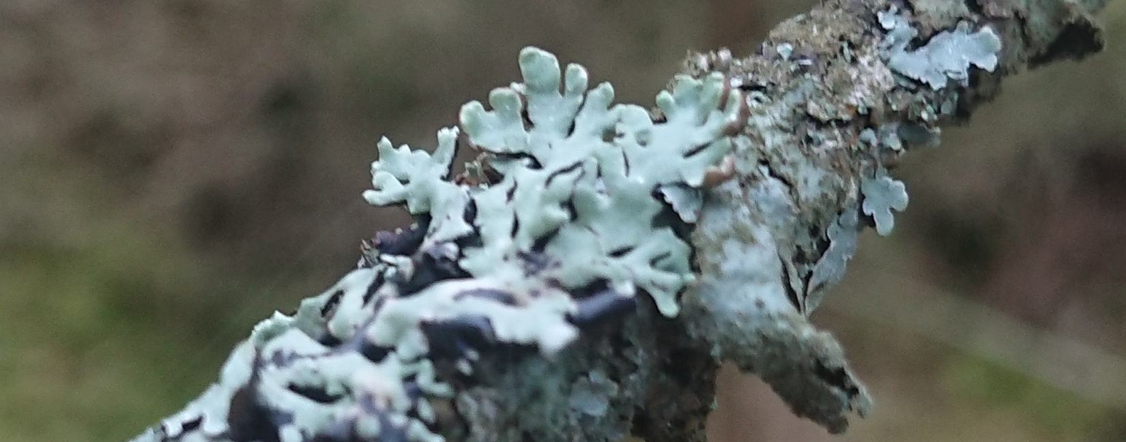
2019 EUROPEAN NODES MEETING
Hooded tube lichen (Hypogymnia physodes), Markabygda, Norway, 10 May 2019. Photo by. myrsnipa via iNaturalist research-grade observations, licensed under CC BY-NC 4.0.
Kyle Copas
Communications Manager, GBIF Secretariat
Oslo, 22 May 2019

Slide 2

BY THE NUMBERS
22 May 2018
Species occurrence records
Datasets
1,299,798,811
44,750
Country Participants
Organizational Participants
Publishers
59
38
1,405
Average records downloaded per month 2019 YTD
Avg monthly user sessions 2019 YTD
36.9 billion
166,106
Notes:
Useful to see GBIF in its different modalities:
A window on biodiversity
An informatics infrastructure focused on tools and standards in service to science and society
A global network on bioinformatics

Slide 3
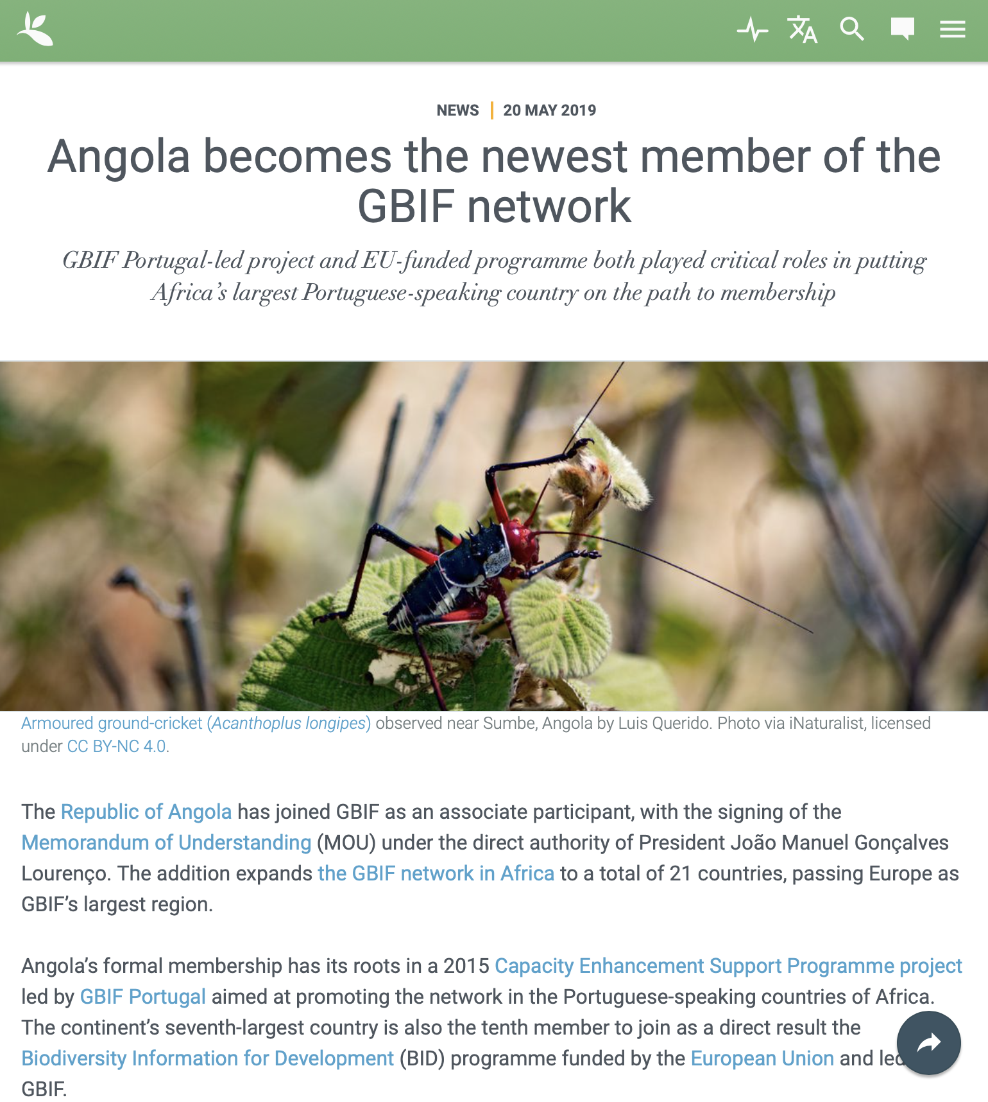
Latest news
The addition expands
the GBIF network in Africa to a total of 21 countries, passing Europe as
GBIF’s largest region.
https://www.gbif.org/news/65lsvpPbsAGGawC4gEGOoq

Slide 4
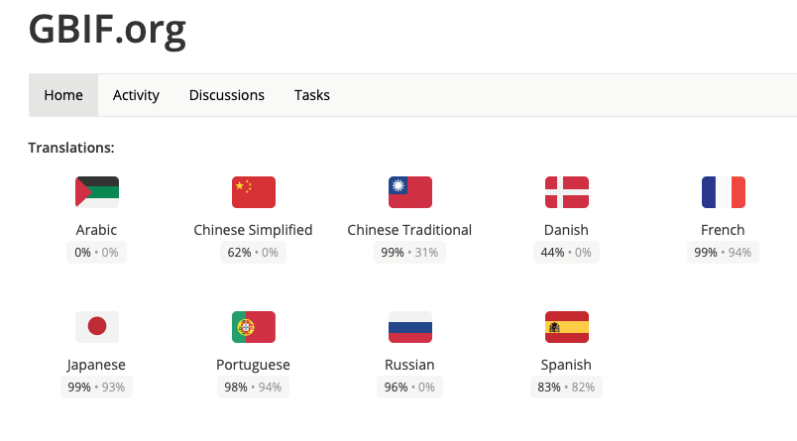
Internationalization
https://crowdin.com/project/gbif-portal

Slide 5
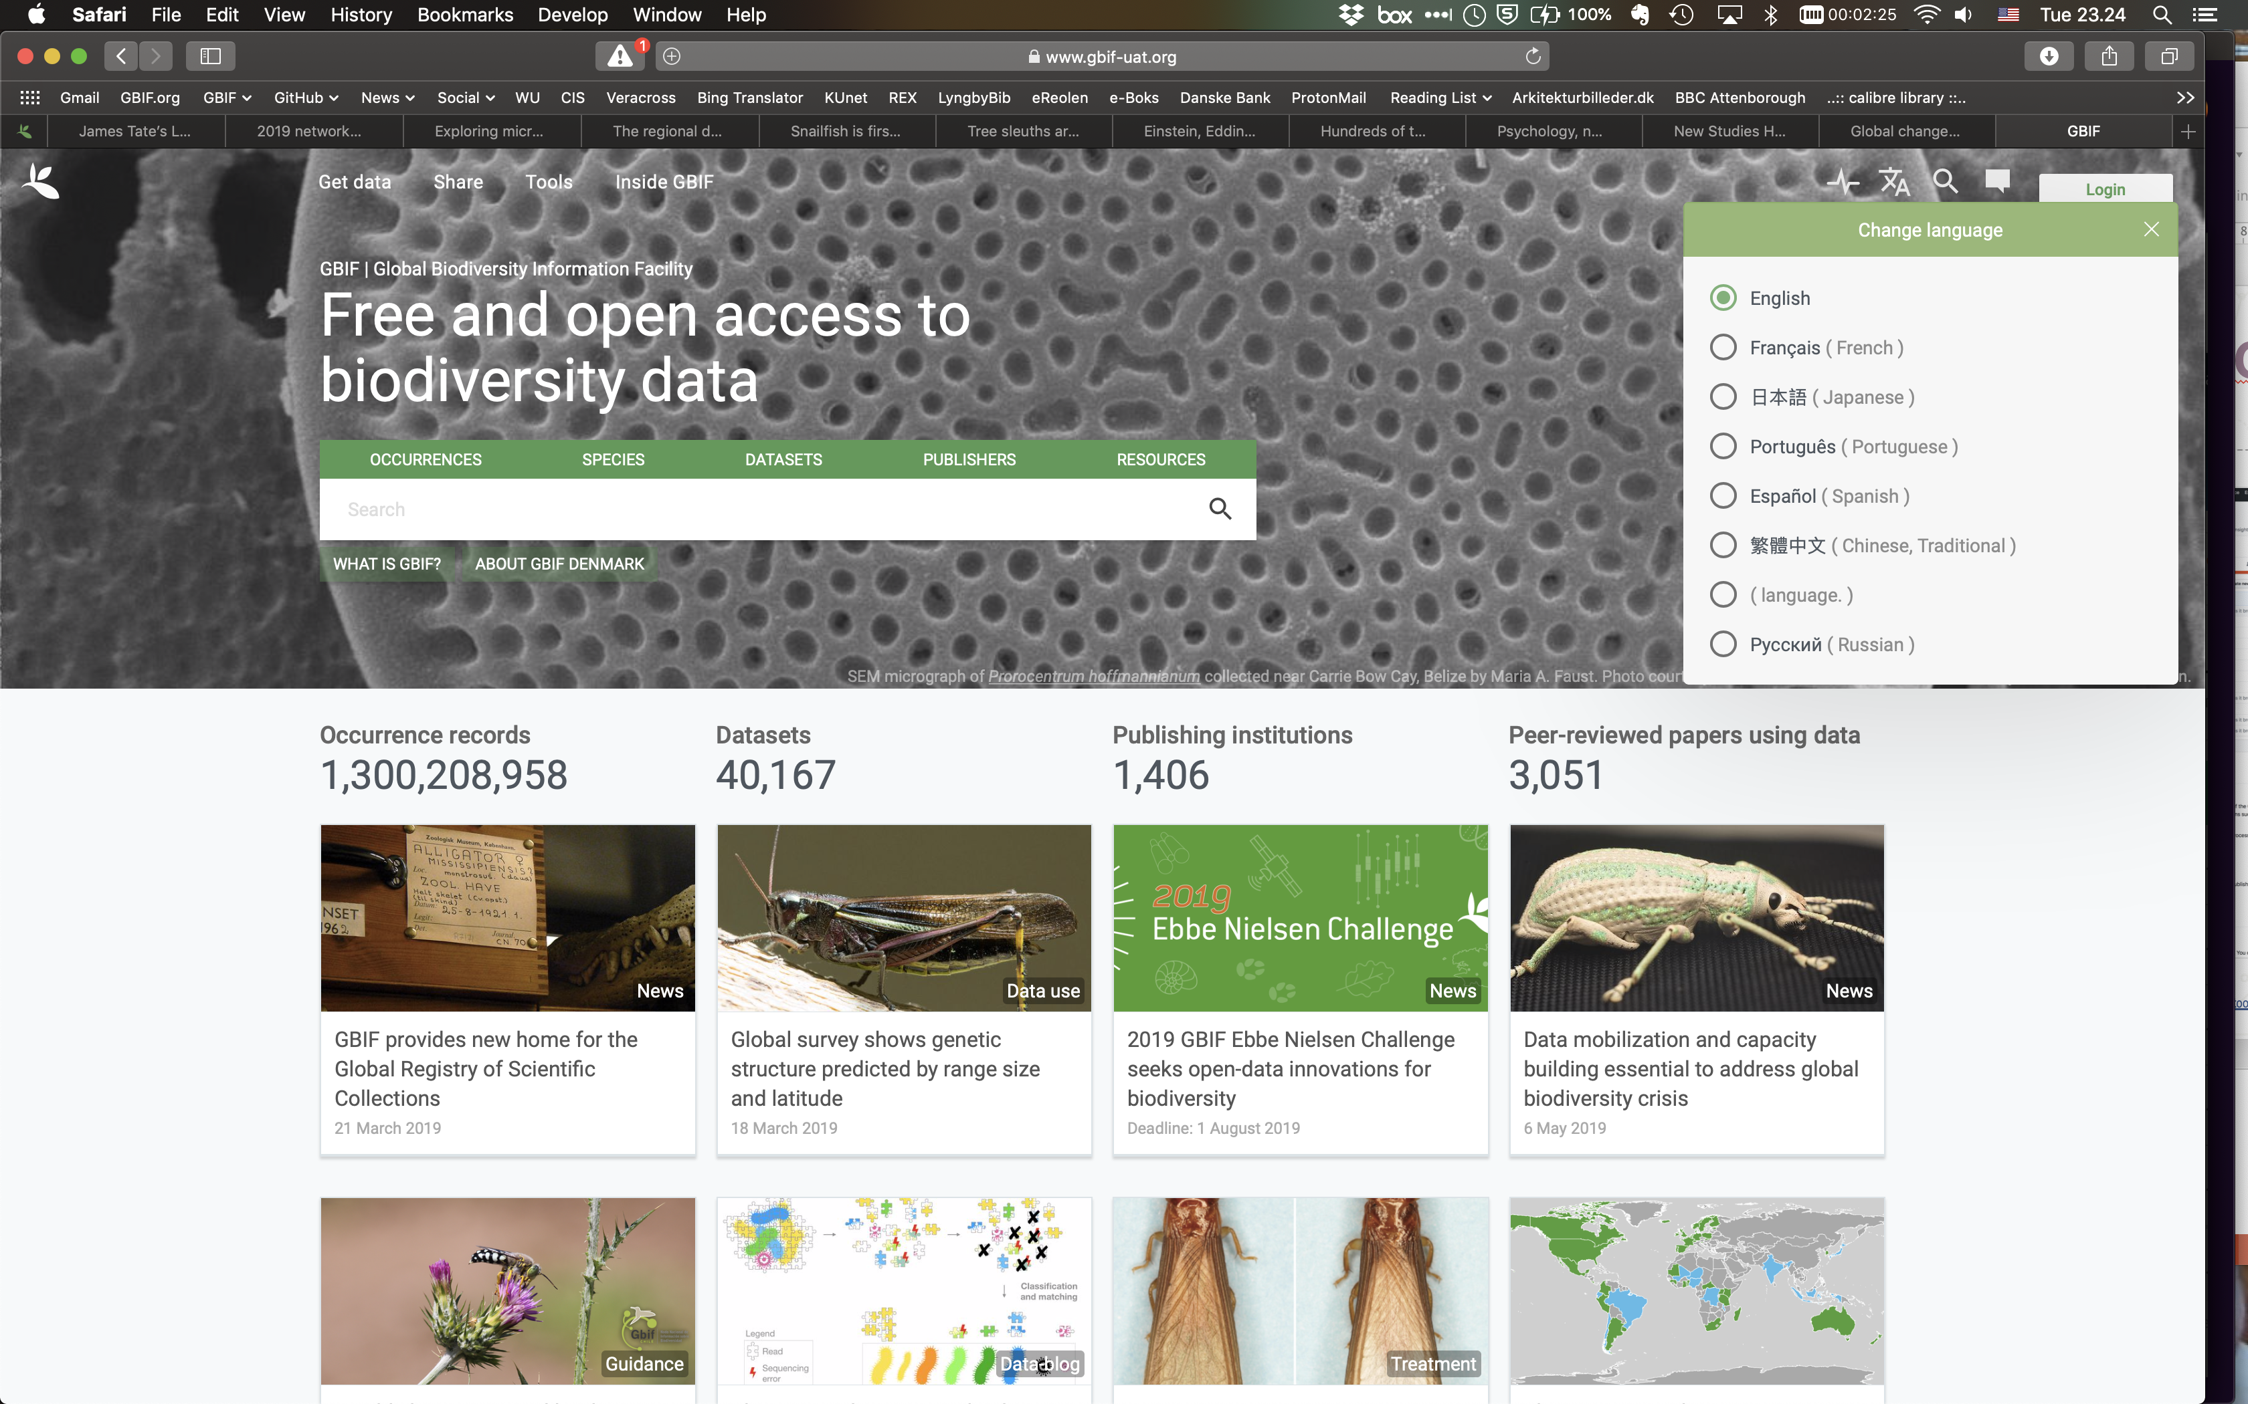
Internationalization
https://www.gbif-dev.org

Slide 6

Internationalization
Translation badge description, criteria and evidence being finalized
Badges will be awarded annually based on activity
Compiling list of past volunteers to award badges back to 2015 and the first BID translations
‘Priority 1’ website content largely in place, with page updates and additions ahead
https://docs.gbif-uat.org/effective-nodes-guidance/1.0/en/establishing-an-effective-gbif-participant-node.en.pdf
Notes:
Work programme item to ‘establish system for reviewing, prioritizing, updating and creating new documentation to support GBIF data publishers and users” (lead: Laura Russell)
Real-time system now publishing GitHub source material to HTML and PDF with full multilingual support
Documentation crosses into previous item on internationalization: the ‘nodes guidance document’ and its three translations were used as a prototype example
Update to English version earlier this year, but translation files are now set up and nearly ready for call to update translations in CrowdIn
First of set of five VertNet publications—a Spanish-language guide to OpenRefine—is nearly ready for network peer review

Slide 7
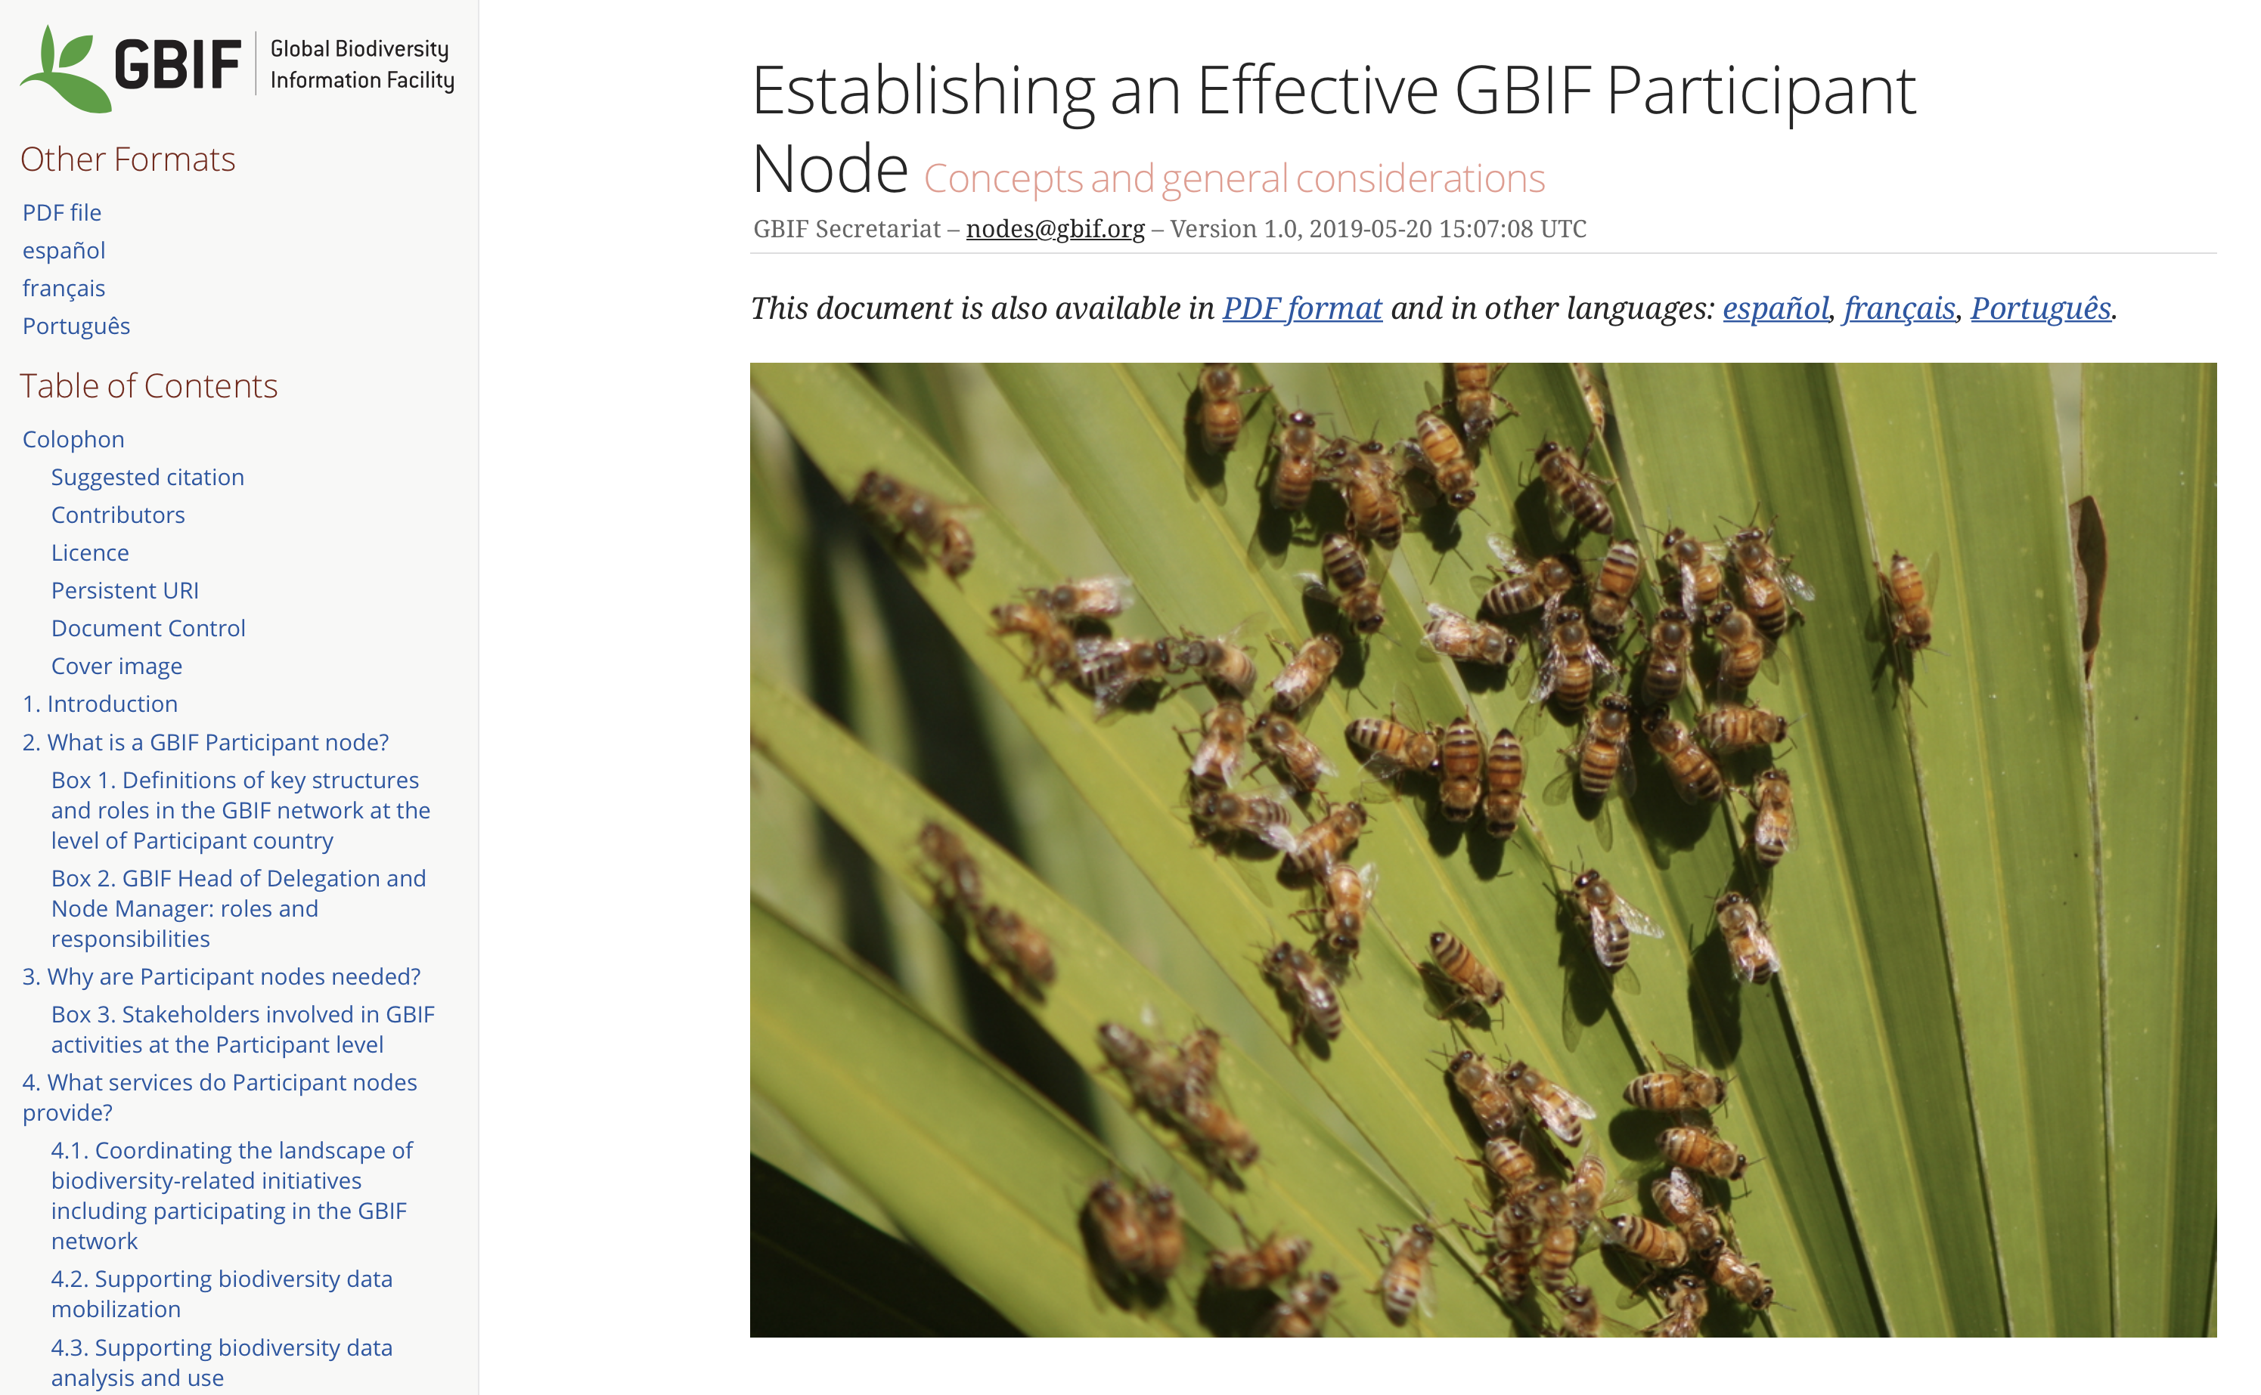
Digital documentation
https://docs.gbif-uat.org/effective-nodes-guidance/1.0/en/
Notes:
Work programme item to ‘establish system for reviewing, prioritizing, updating and creating new documentation to support GBIF data publishers and users” (lead: Laura Russell)
Real-time system now publishing GitHub source material to HTML and PDF with full multilingual support
Documentation crosses into previous item on internationalization: the ‘nodes guidance document’ and its three translations were used as a prototype example
Update to English version earlier this year, but translation files are now set up and nearly ready for call to update translations in CrowdIn
First of set of five VertNet publications—a Spanish-language guide to OpenRefine—is nearly ready for network peer review

Slide 8

Digital documentation
WP2019: ‘establish system for reviewing, prioritizing, updating and creating new documentation to support GBIF data publishers and users”
Nodes guidance doc served as prototype
Real-time system now publishing GitHub source material to HTML and PDF
Editorial panel now filled
https://docs.gbif-uat.org/effective-nodes-guidance/1.0/en/establishing-an-effective-gbif-participant-node.en.pdf
Notes:
Work programme item to ‘establish system for reviewing, prioritizing, updating and creating new documentation to support GBIF data publishers and users” (lead: Laura Russell)
Real-time system now publishing GitHub source material to HTML and PDF with full multilingual support
Documentation crosses into previous item on internationalization: the ‘nodes guidance document’ and its three translations were used as a prototype example
Update to English version earlier this year, but translation files are now set up and nearly ready for call to update translations in CrowdIn
First of set of five VertNet publications—a Spanish-language guide to OpenRefine—is nearly ready for network peer review

Slide 9
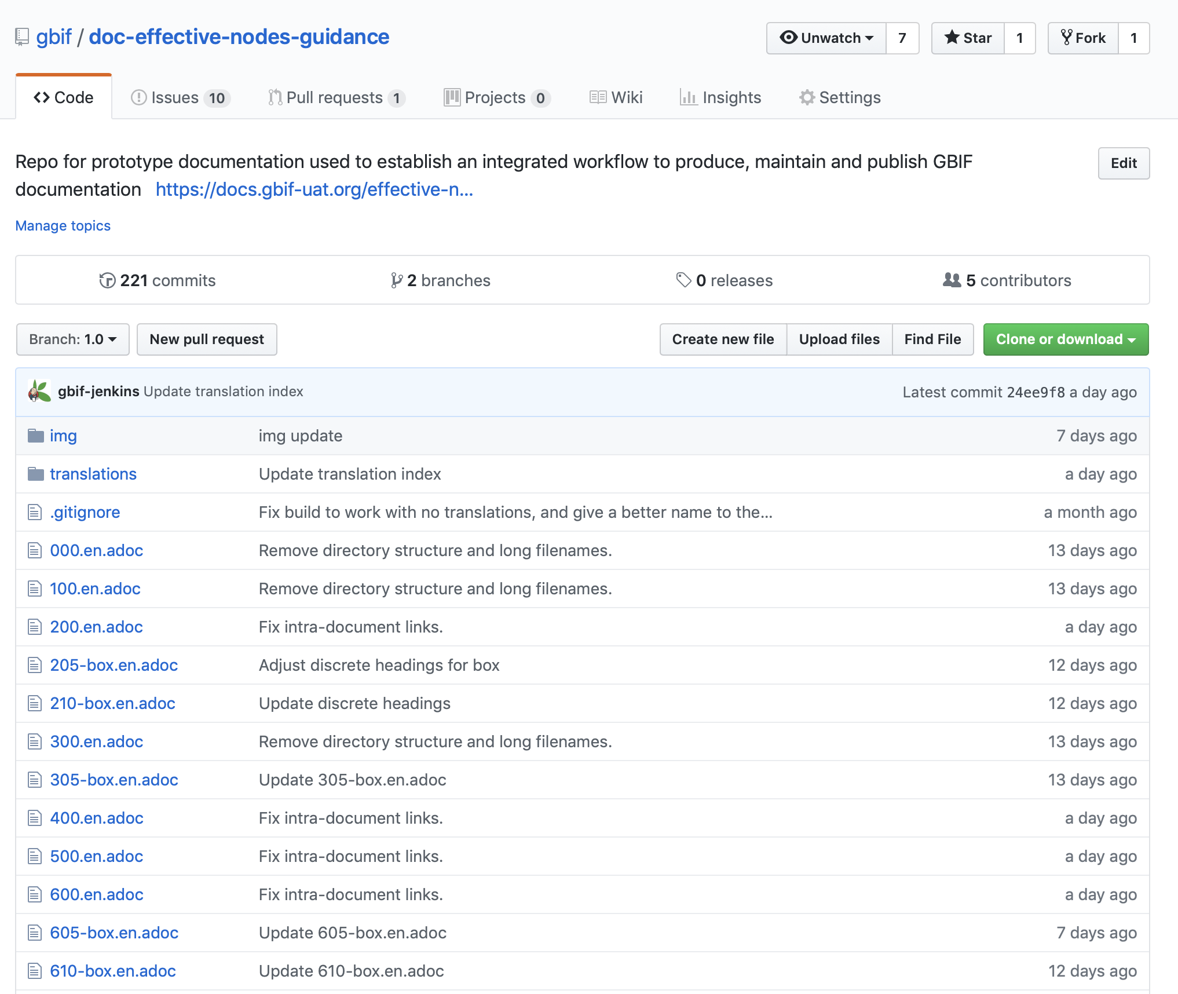
Digital documentation
https://github.com/gbif/doc-effective-nodes-guidance

Slide 10
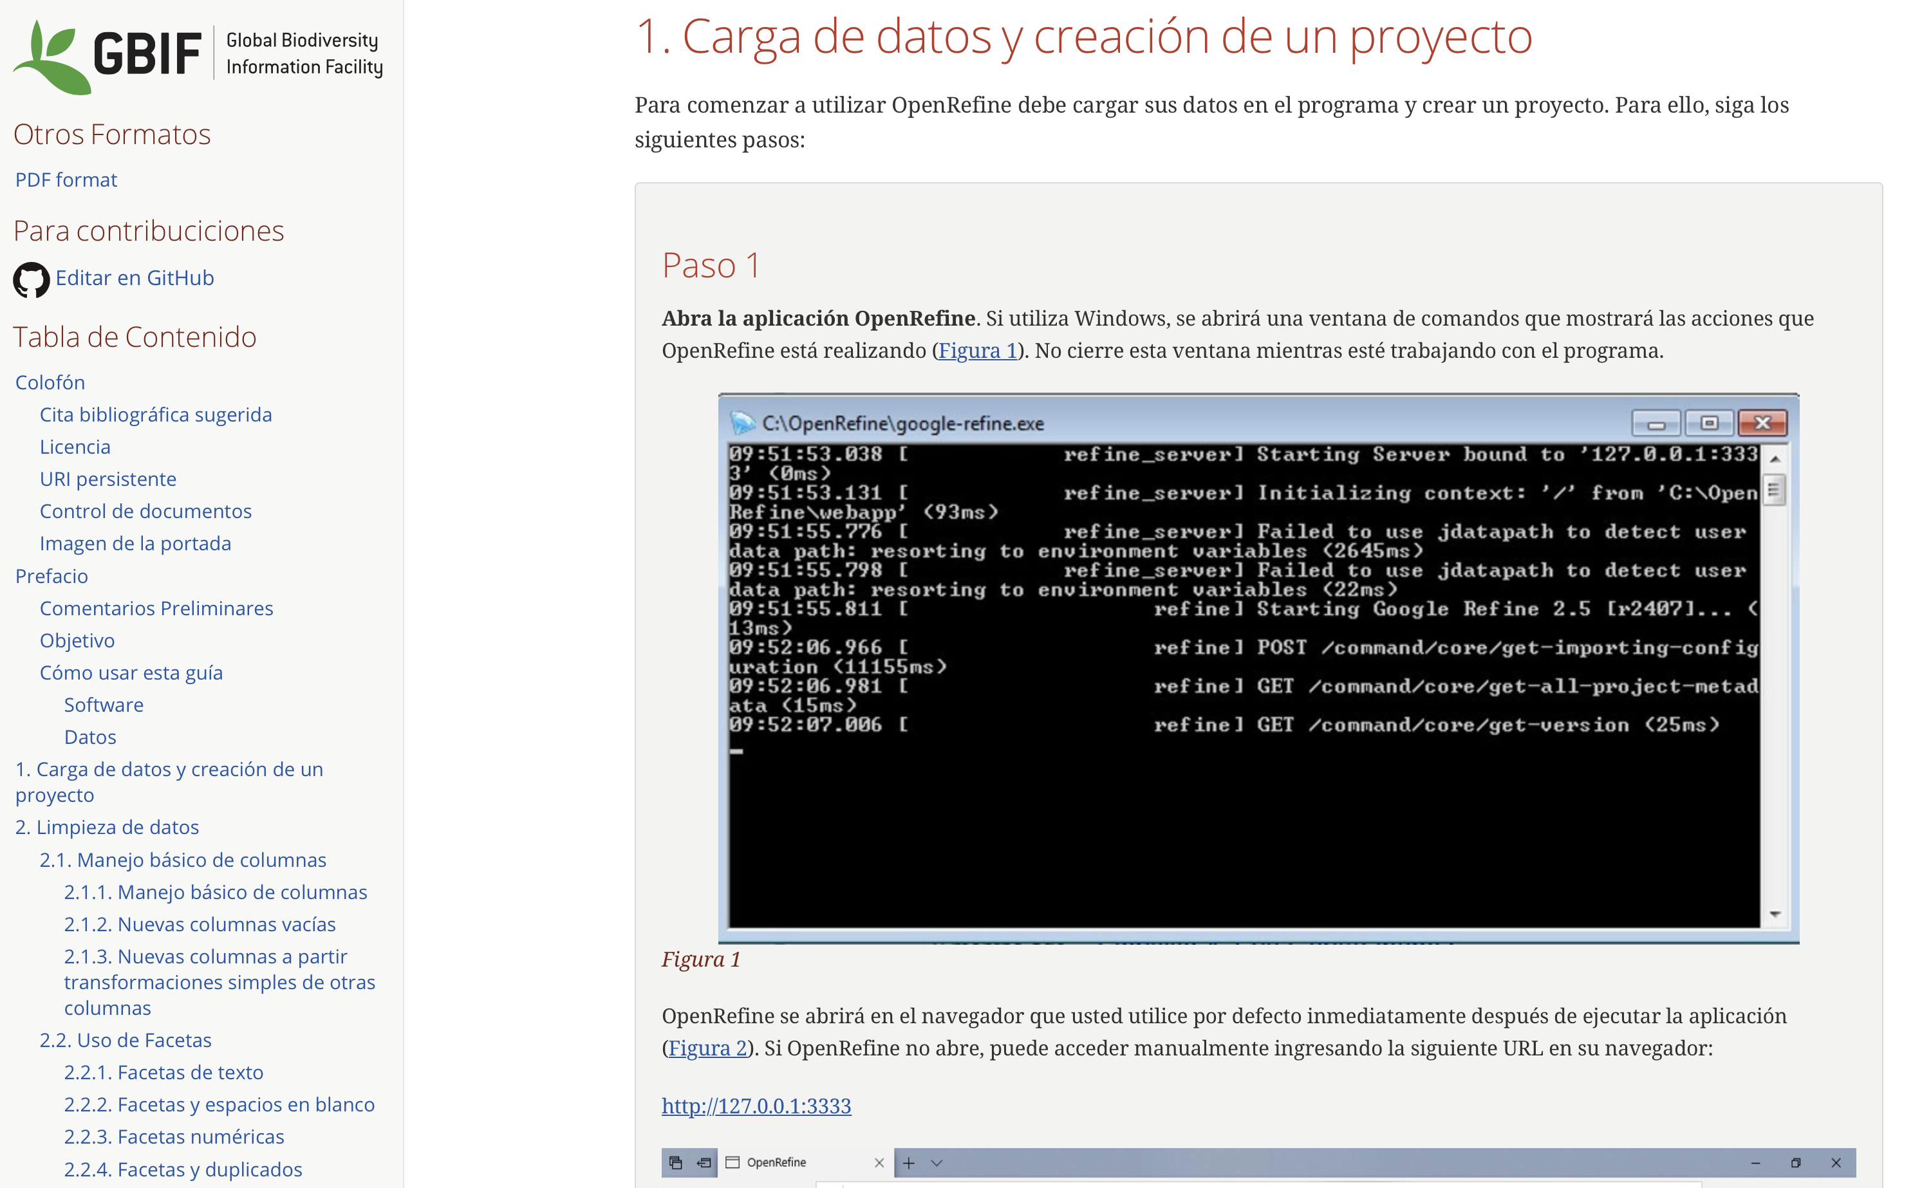
Digital documentation
https://docs.gbif-uat.org/openrefine-guide/1.0/es

Slide 11
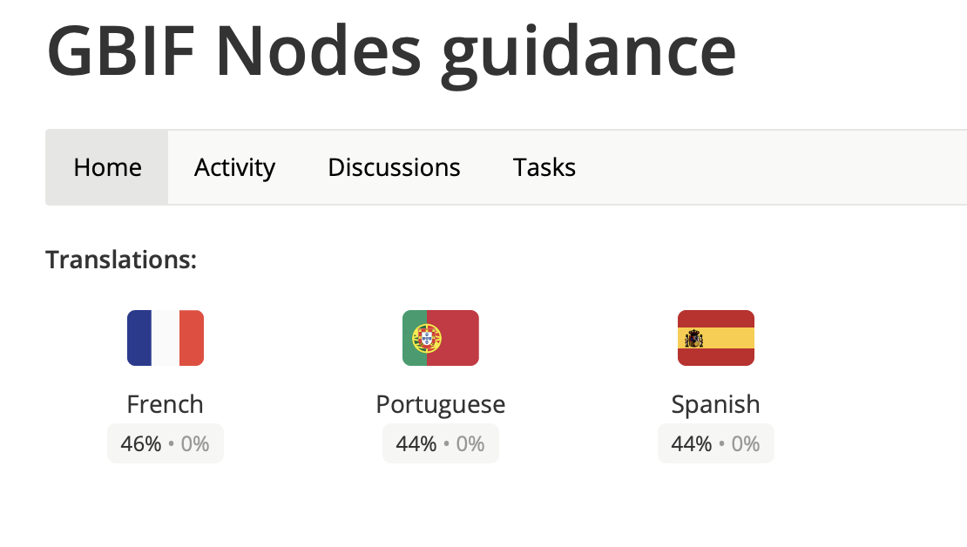
Internationalized Documentation
Guide to Nodes
https://crowdin.com/project/gbif-nodes-guidance

Slide 12
Documentation in translation

Slide 13
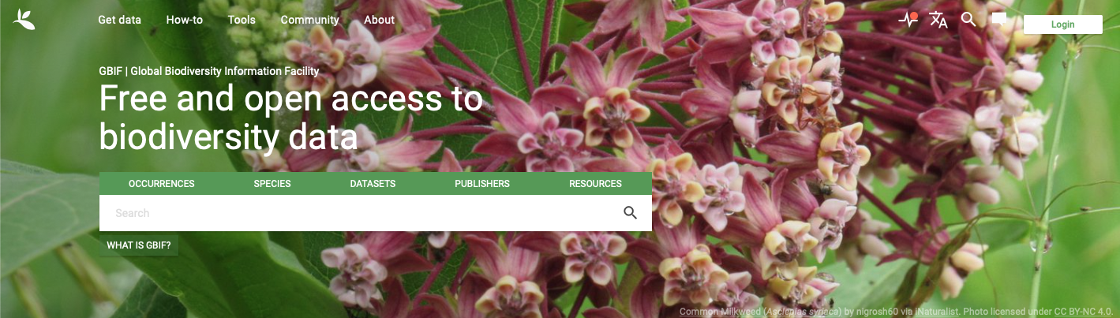
GBIF.org NAVIGATION UPDATES

Slide 14
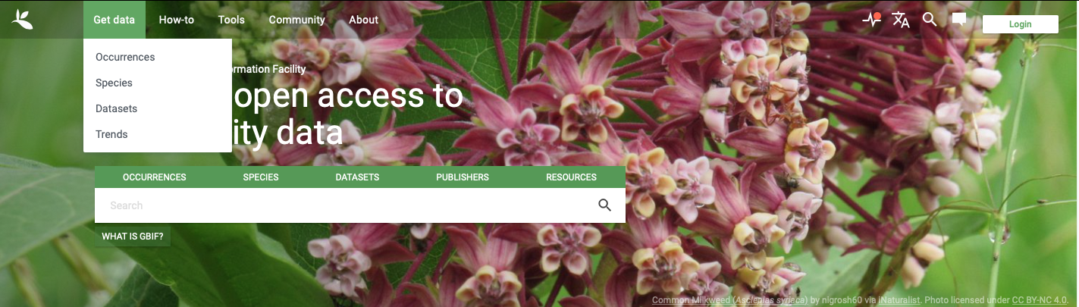
GBIF.org NAVIGATION UPDATES

Slide 15
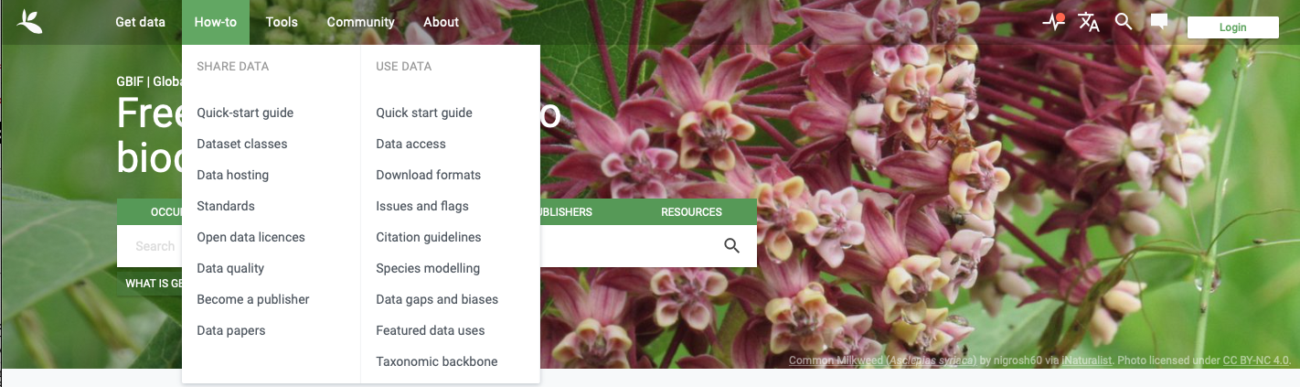
GBIF.org NAVIGATION UPDATES

Slide 16
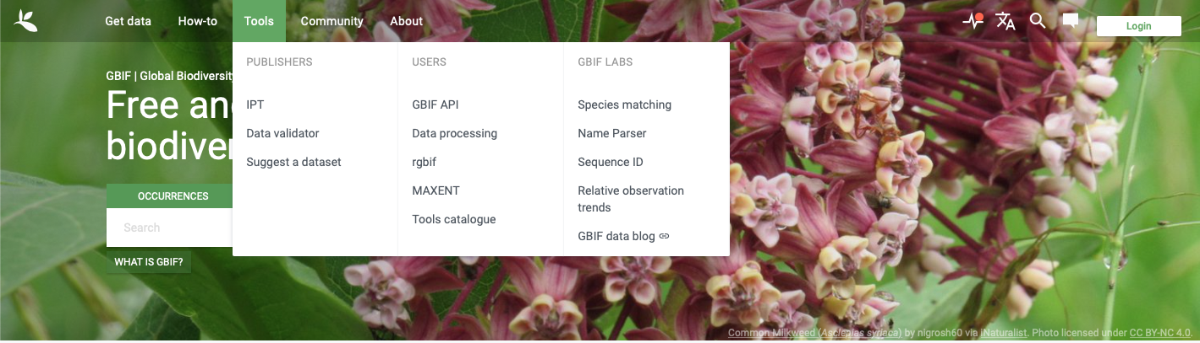
GBIF.org NAVIGATION UPDATES

Slide 17
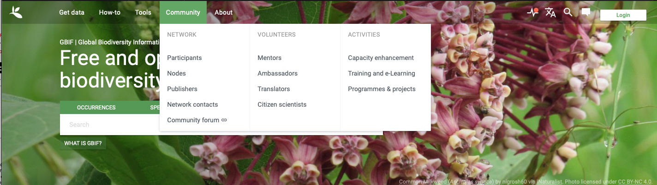
GBIF.org NAVIGATION UPDATES

Slide 18
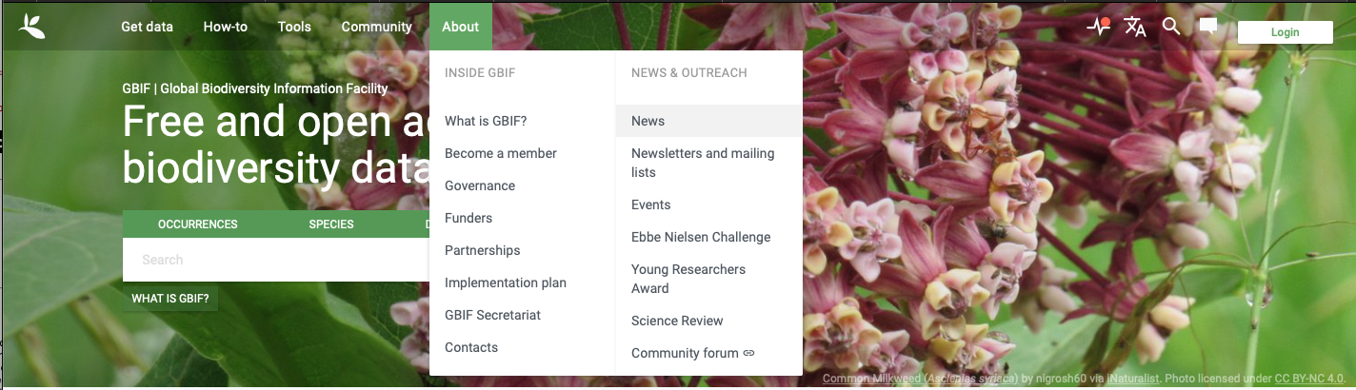
GBIF.org NAVIGATION UPDATES

Slide 19
Literature tracking & Citation

Slide 20
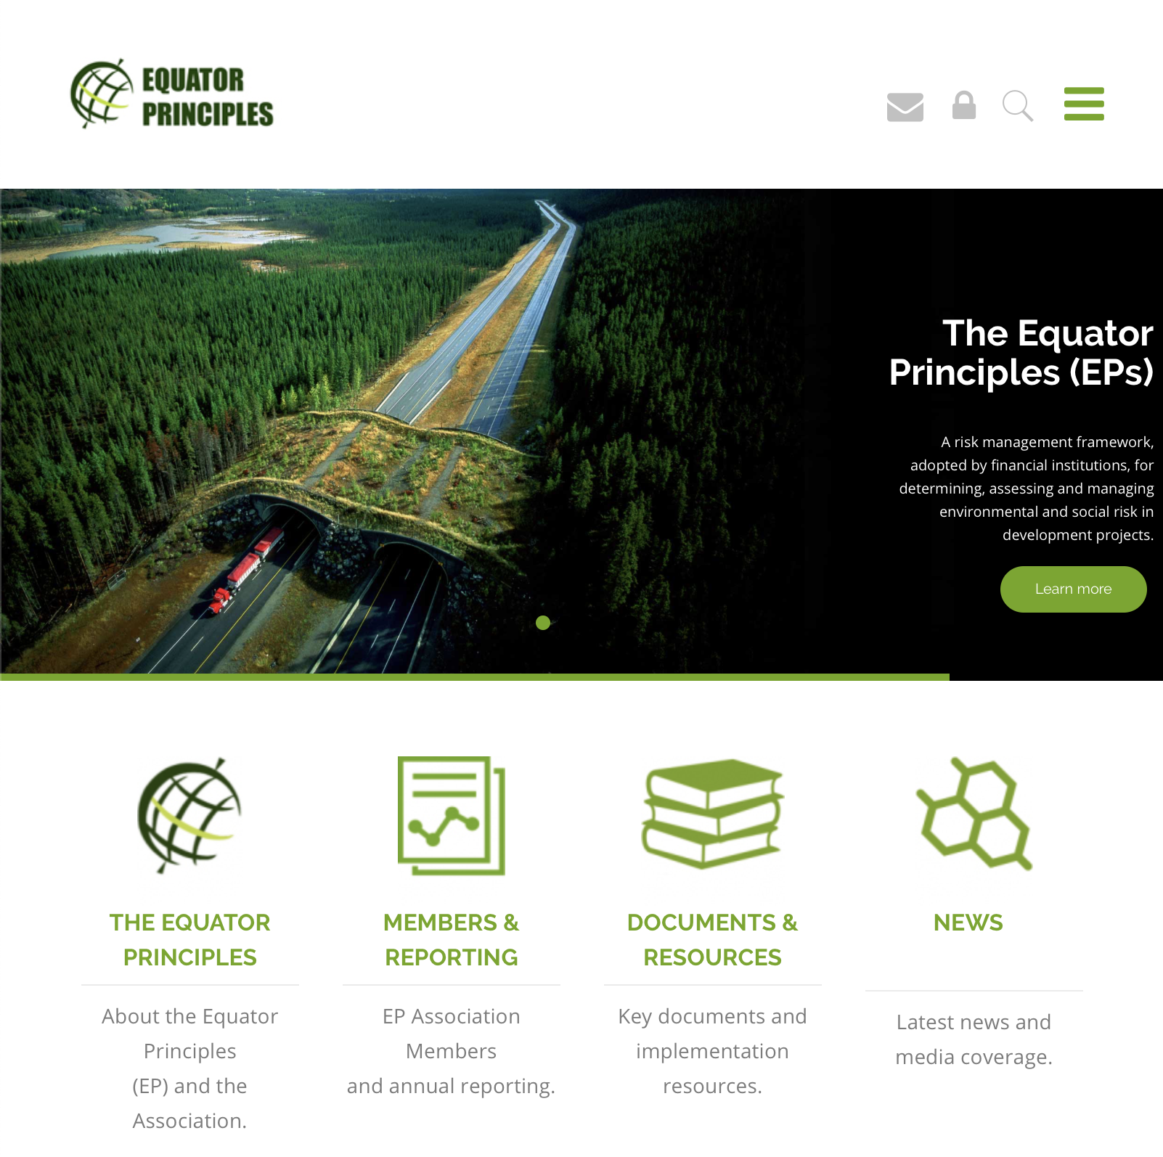
Private-Sector DatA
Secretariat collaborating with working group to put language into v4 of
The Equator Principles
90% of financial institutions support sharing clients’ EIA data with GBIF network
Network to collaborate in preparing summary guidance
Public review: fall 2019
https://equator-principles.com

Slide 21

GDPR more than just a four-letter word
Continued engagement after implementation of last year’s new EU (global) regulation
GBIF’s legal advice suggests proactive engagement of data publishers regarding its policies and suggested best practices
Need to engage nodes regarding the possibility of a twice-yearly publisher newsletter on operational issues

Slide 22

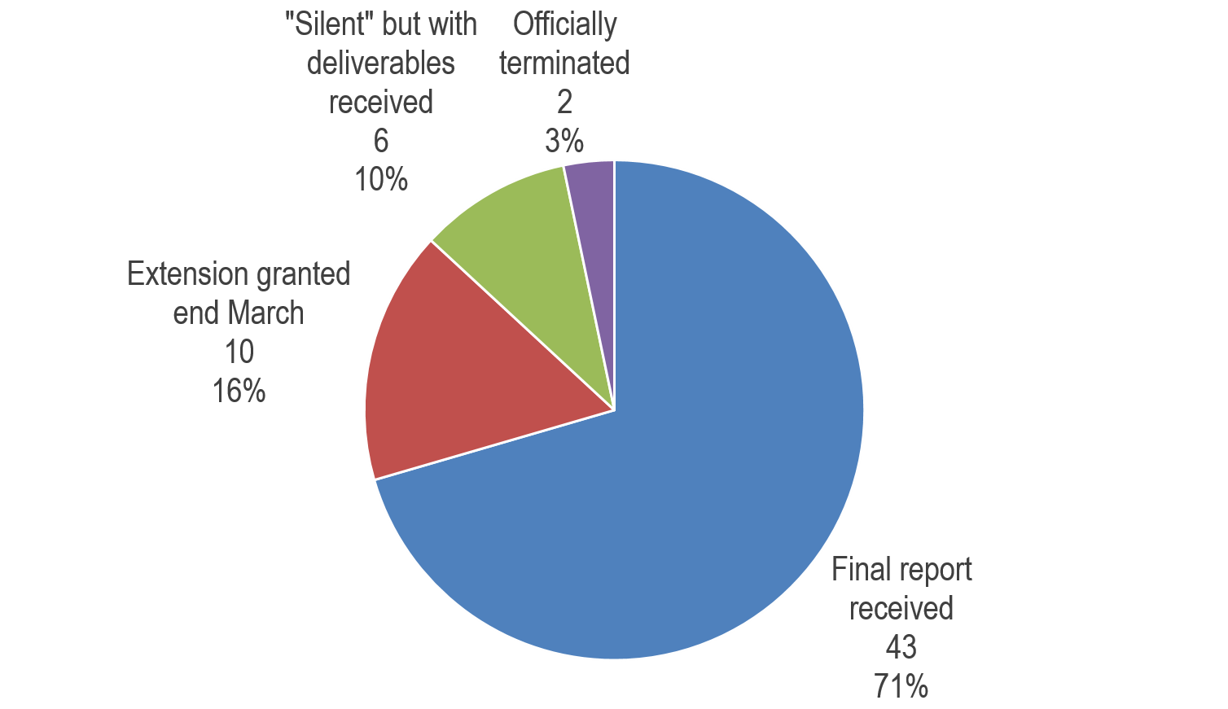
Finalizing projects
Final report deadline for 61 funded projects:
31 March
Notes:
Overview of where we are:
Acknowledge that this is a very big task for us and that we have had difficulties getting the project teams to manage the reporting.
We are dealing with capacity restraints on both sides.
We have kept good financial control – we haven’t been paying out costs that we have to get back.
Project teams have changed along the way, e.g. Guyana, KWS (3rd coordinator).
Aim to have closed the majority of the projects by the time of the next narrative report to DEVCO.
Number of projects of each type already finalized, granted deadlines, not yet finalized.

Slide 23
BID Impact study
Increased mobilization of biodiversity data
Sustainability through national & regional networks
Increased use of biodiversity data
Enhanced capacity
Notes:
Impact Study - an overview of the difference that the programme has made in the target regions, as well as in the GBIF community more widely. The impact study will follow up the baseline study carried out in 2016. Impact will be measured in four main areas: a) increased mobilization of biodiversity data from the target regions; b) increased use of biodiversity data in the target regions; c) enhanced capacity for mobilization and use of data in the target regions; and d) sustainability of biodiversity data mobilization and use in the target regions through establishment of national and regional biodiversity information networks.
Key indicators and sources
Drawing on the baseline study, the following indicators are recommended as the core of the impact study. The Consultant is welcome to suggest other indicators of impact.
Data mobilization eg. number of GBIF-registered data publishers from the BID target
regions over time, Increase in the total volume of biodiversity data published through GBIF by
institutions in the target countries of the three ACP regions, improvement in the taxonomic and geographic coverage of the biodiversity data available through GBIF.org in the target regions
We will evaluate the number of data records by country and by region, both as number of occurrence records and number of distinct taxa, comparing those metrics before and after the implementation of the BID programme. Regarding geographic coverage, maps will be produced showing density of
records at both times. Maps will also be produced distinguishing higher rank taxa (e.g., kingdoms, as appropriate). Depending on the available data, we will also assess the increase in the availability of threatened species data. To do so, we will cross-check the species records published through the BID programme with the IUCN database and assess the amount of threatened species reported in the regions of interest before and after the BID implementation.
Data use eg increase in the number of GBIF registered data users from the BID target regions, increase in the number of data downloads from GBIF.org both from the BID target regions and from other regions that concern records published by BID participants, increase in the number of peer-reviewed papers by authors from institutions located in the target regions citing use of GBIF as a data source, number of non-peer-reviewed papers and communications by authors from institutions funded by BID citing use of GBIF as a data source
Capacity enhancement eg increase in scores in both national and institutional capacity self-assessment, number of participants in BID capacity enhancement workshops, both on-site and online, receiving certification through the GBIF Digital Badges programme, number of GBIF Volunteer Mentors from the BID target countries, number of replications of BID capacity enhancement workshops within funded projects and their impact in terms of number of participants and institutions represented, number of trained personnel, both included and not included in the above-mentioned workshops
Sustainability eg number of new thematic, national and regional biodiversity information
platforms/networks in the target regions (both technical facilities and institutional/human networks), co-funding for new thematic, national and regional biodiversity information networks in the target regions, Number of new GBIF Participant countries and organizations from the BID target regions.
First draft – 31st March, final draft – 17 May, Final products 31st May ie slide deck for presentations

Slide 24
guiding examples
Best Practices Guide
What kind of data were mobilised?
What were the decisions that were influenced?
How was the data used to influence those decisions?
How can we learn from these examples for the future?
Notes:
This is the most challenging part of the funded projects. The aim is to draw on the most successful examples.
Guiding examples - This communication tool (small prinatable foramat) aims to highlight examples from within the BID programme where mobilised data have successfully supported policy needs. Its aims to showcase the approach taken by projects and the programme to support policy needs, how data from the BID programme have contributed to supporting policy needs and identify the key components of projects that were successful in this endeavour with a view to providing guidance to similar projects and improving on capacity-building activities in the future.
The document will introduce the BID programme, give an overview of the decision-making process in the region relating to biodiversity conservation and natural resource management and then provide examples (2 from Africa(small UGanda project and another) and one from each of the other regions(pacific regional and suriname national) on how data were successfully integrated. These examples will focus on
What kind of data were mobilised?
What were the decisions that were influenced?
How was the data used to influence those decisions – this will give an overview of not only which analyses were performed but also the process for how those analyses were taken up by policy makers.
Despite being a very limited sample, I hope to draw out some key components of a successful project that could help guide future projects.
I will not be measuring the relative impact of the BID project i.e. scale of investment vs level of influence in the region but will highlight in the introduction how absolute levels of data have increased in countries and put that in the context of the Aichi Targets.
First draft – 15th April, Final draft 31st May.

Slide 25
2019 regional meetings
Day 1 BID impacts in the region
Overall results in data mobilization and capacity enhancement
Day 2 Planning for the future
Integrating data supply and demand to ensure relevance
Day 3 Excursion & bioblitz
Day 4
Node management training
Best practices to be replicated
Networking between project teams and regional partners
Participating in GBIF going forward
Sustaining collaborative networks for data mobilization
Demo of data mobilization through citizen science
Coordinating existing efforts
Notes:
Summary of CE workshops,
No. badges assigned
No. mentors

Slide 26
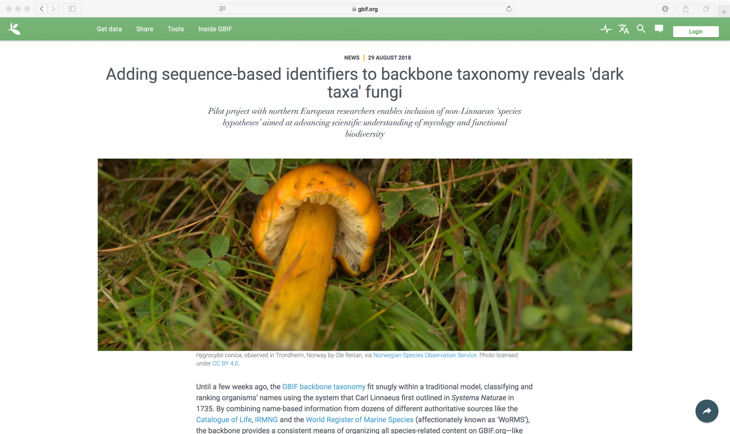

Notes:
Different marker genes are used as barcode in different taxonomic groups. Within Fungi, ITS has become the formal barcode.
In collaboration with the UNITE community, we have extended the GBIF backbone taxonomy to include stable OTU identifiers based on ITS, known as Species hypotheses.

Slide 27
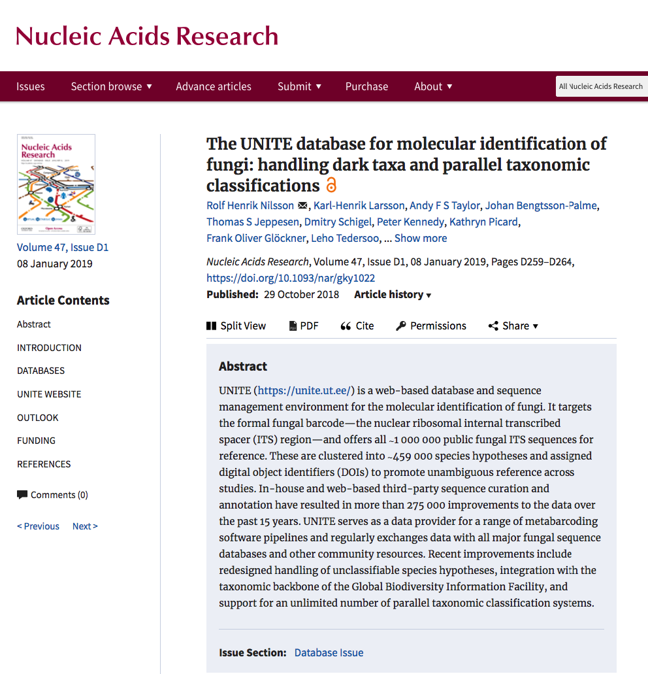
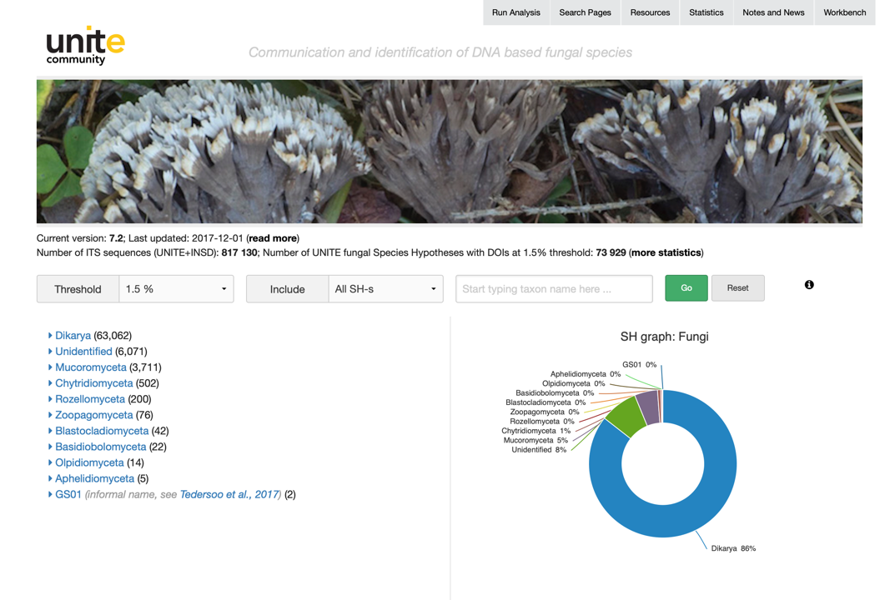
UNITE
Species hypotheses as identification & communication system
https://unite.ut.ee
Notes:
UNITE is a database and sequence management environment for the molecular identification of fungi. It targets the ITS region and offers all public fungal ITS sequences for reference. These are clustered into ∼459 000 species hypotheses at different thresholds and assigned digital object identifiers (DOIs) to promote unambiguous reference across studies.
You can read more about UNITE in this paper

Slide 28
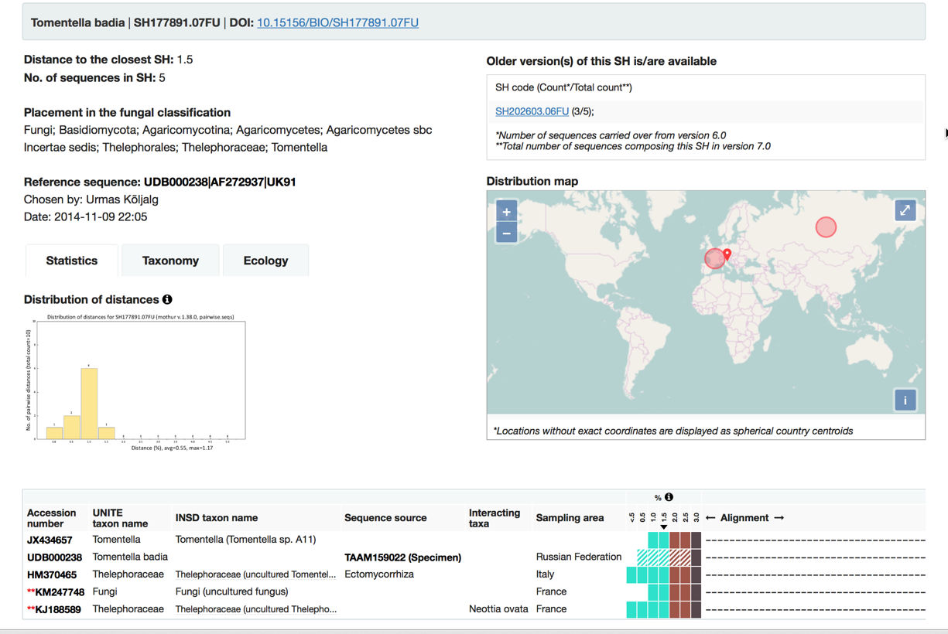
every unite SH has A DOI
(Digital Object Identifier)
Notes:
An example of a species hypothesis page in the Unite web portal, notice the DOI.
The species hypothesis consist of 5 sequences of mixed origin, one is from a specimen another from a Ectomycorrhiza sample from a root tip.
It is Important to mention that many species of Fungi cannot be formally described as botanical code requires a holotype to be deposited. But for Fungi not producing fuitbodies, this is not possible. These are the so-called dark taxa that only can be referenced by their Species Hypothesis

Slide 29
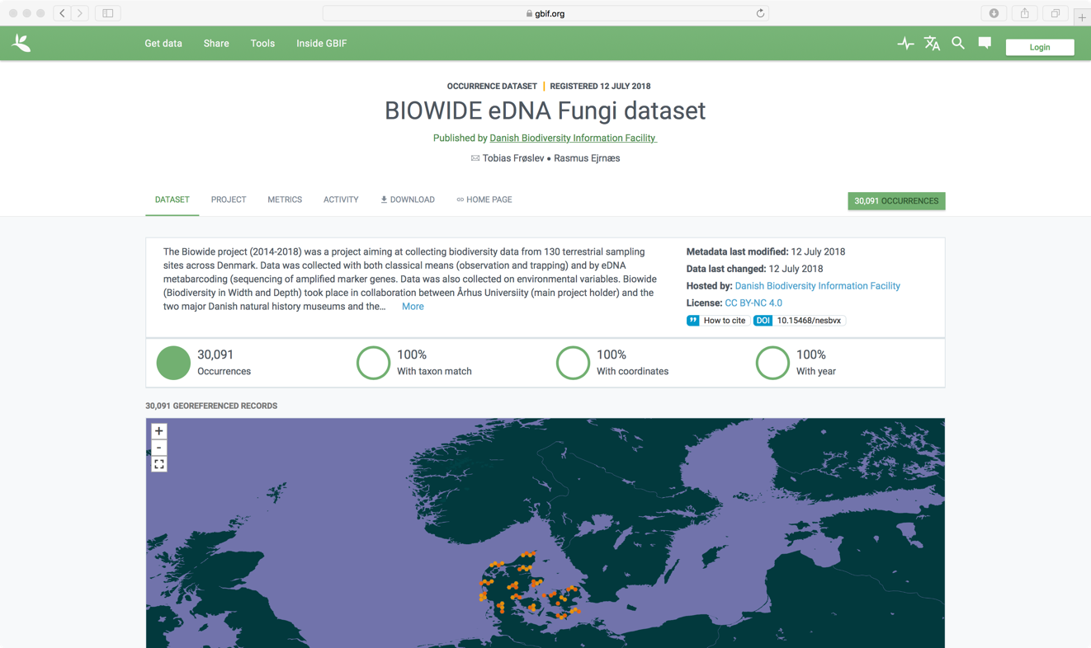
Biowide
Danish study with georeferenced fungal sequences
Notes:
To prove the concept we indexed a danish study of eDNA extracted from soil samples, using Species Hypotheses for taxonomic annotation.

Slide 30
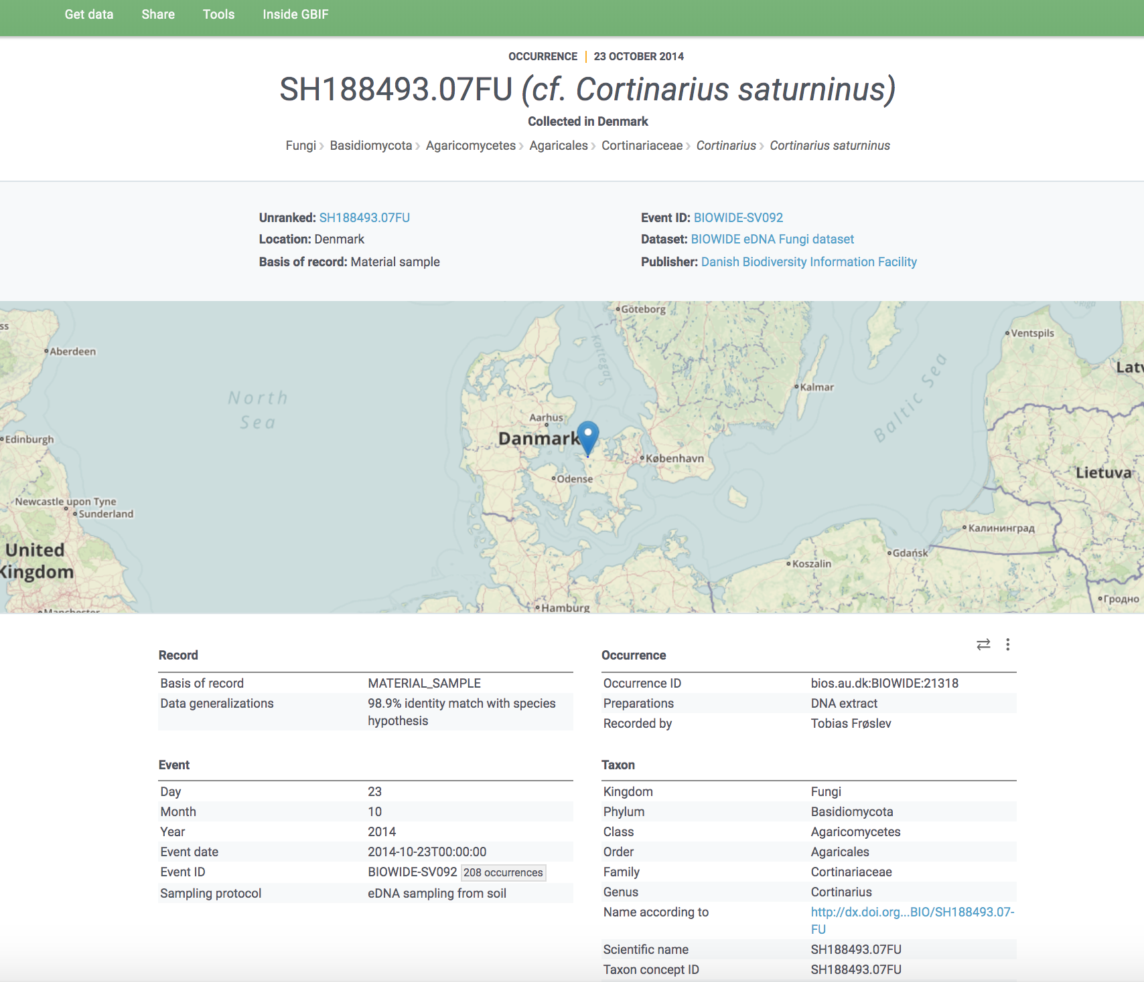
https://www.gbif.org/occurrence/1949680848
Notes:
A GBIF occurrence, but notice the taxonomic annotation

Slide 31
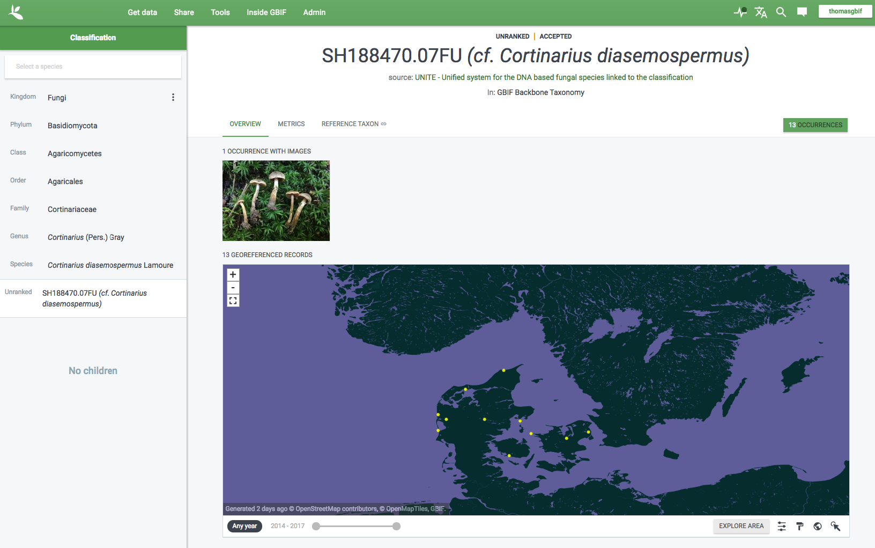
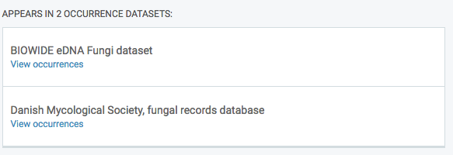
Synergy between eDNA data and specimen data
Notes:
Heres an example of the synergy produced by mixing datasets of specimens with eDNA data.
A species found in 13 sampling sites within the Biowide eDNA study, but also one collected and sequenced specimen from the Danish mycological society fungal records database.
The sequenced specimen reveals morphological traits of the taxon found in the eDNA, and the eDNA study contributes to the known distribution of the species.

Slide 32
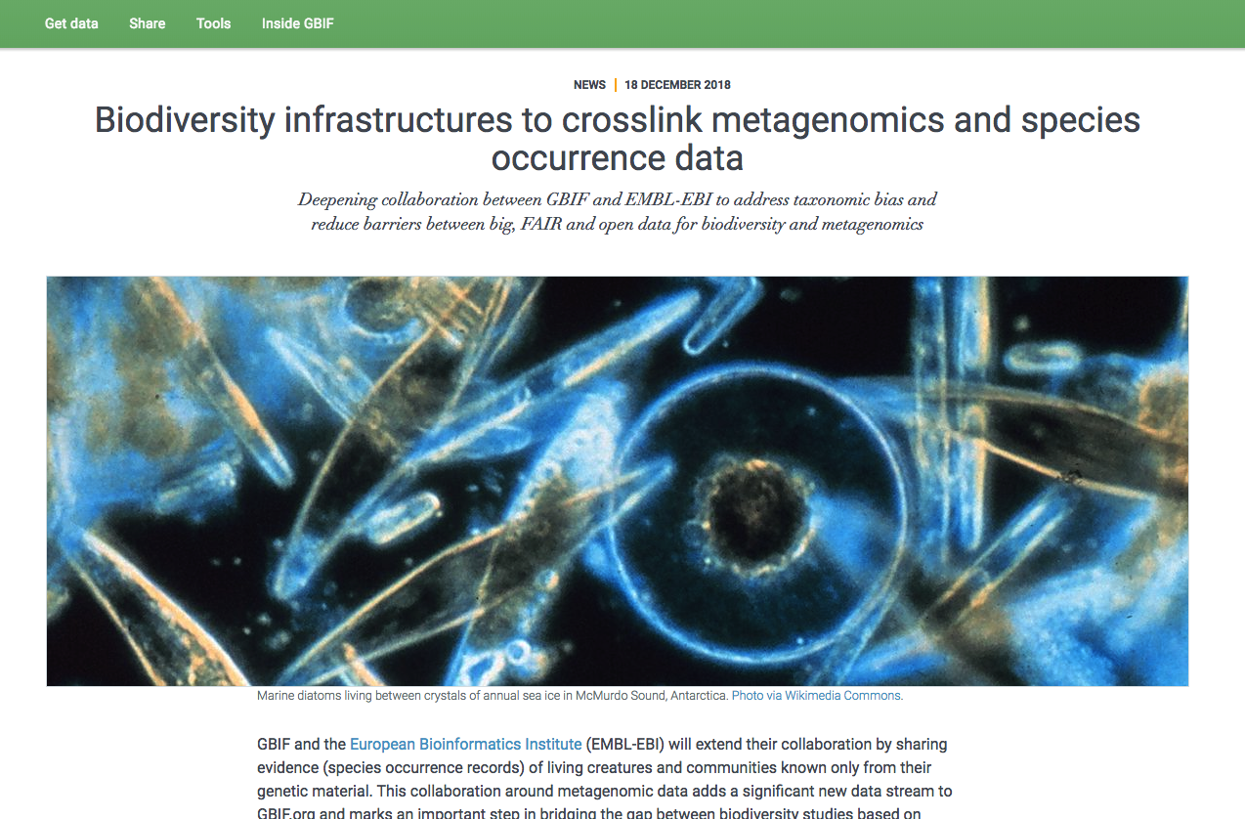

Notes:
The next data cross-linking I will cover is an extension of the collaboration between GBIF and the European Bioinformatics Institute who is sharing evidence of living creatures and communities known only from their genetic material. This collaboration around metagenomic data adds a significant new data stream to GBIF.org and marks an important step in bridging the gap between biodiversity studies based on molecular data and those that rely on morphological data.
Metagenomics research studies genetic material collected at a defined single time and place and uses DNA fragments as signatures to identify the organisms from molecular traces present in the sample. Since these samples are regularly and routinely collected using consistent methods, EBI can share them on GBIF.org as sampling-event datasets.

Slide 33
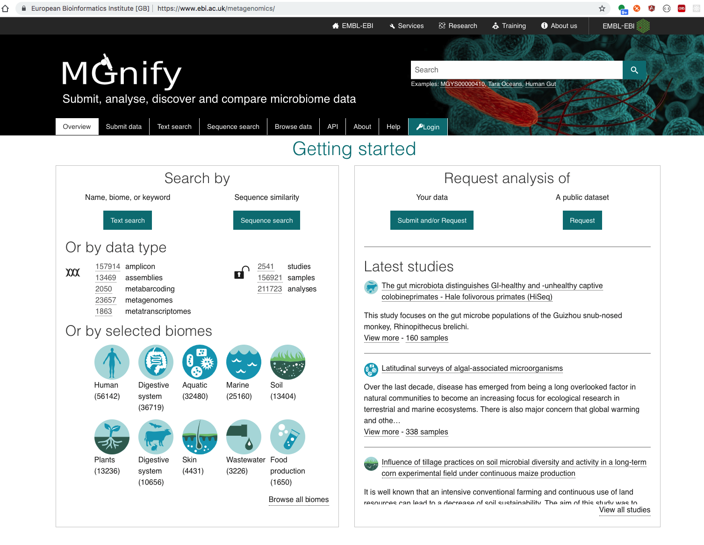
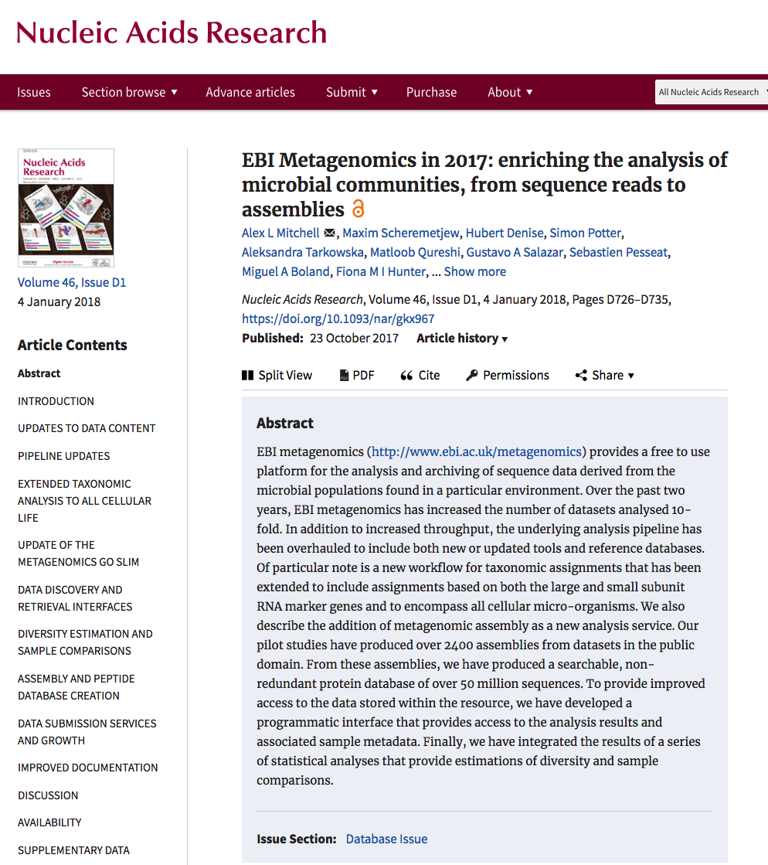
MGnify
A free-to-use analysis platform and database of analysed microbiome sequencing projects
Notes:
The former EBI Metagenomics, now Mgnify
MGnify is a free resource for the assembly, analysis, archiving and browsing of all types of microbiome derived sequence data, providing insights into the phylogenetic diversity and functional potential of environmental samples
You can read more about Mgnify in this paper.

Slide 34
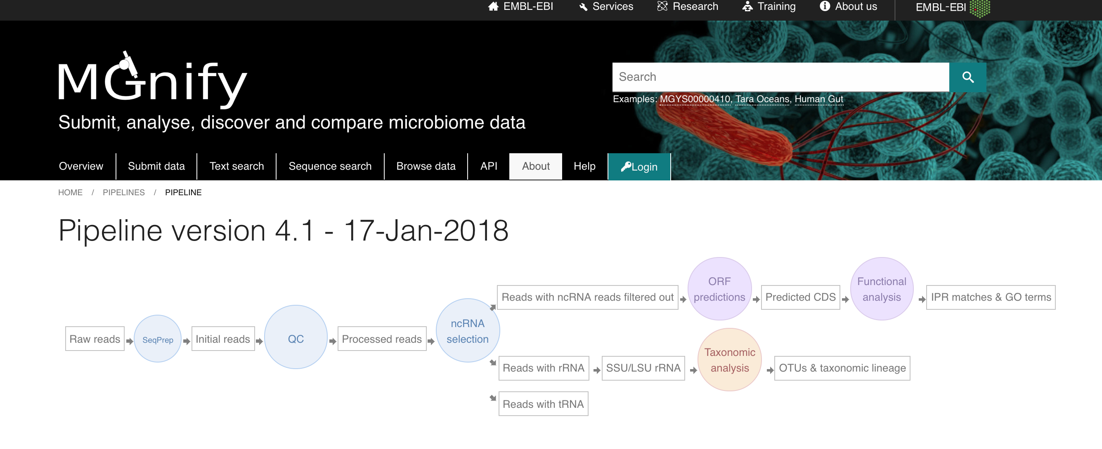
Mgnify pipeline
Notes:
Mgnify provides a unified pipeline used on more than 3000 different studies, making it possible to compare analyses results across studies.
The results of the taxonomic analyses are mapped into occurrence data and published to GBIF through a new API integration.

Slide 35
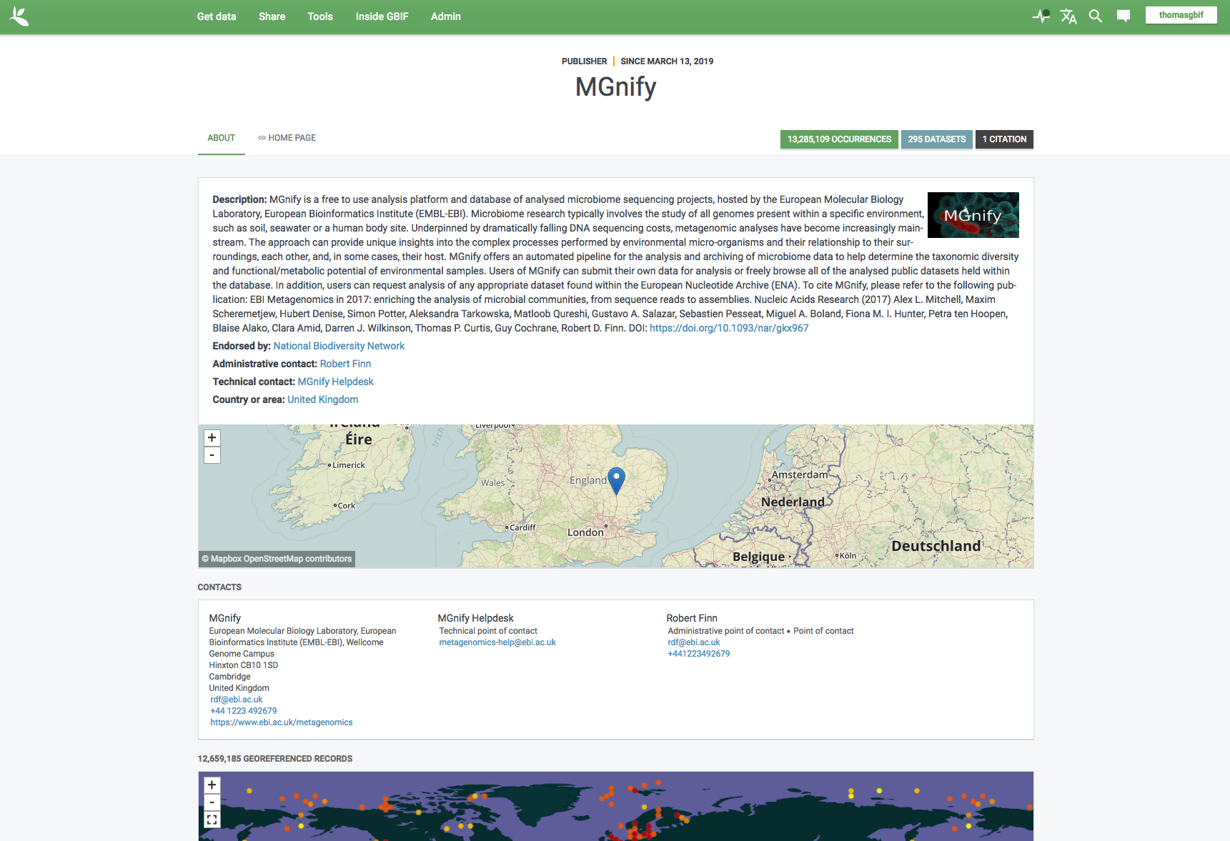
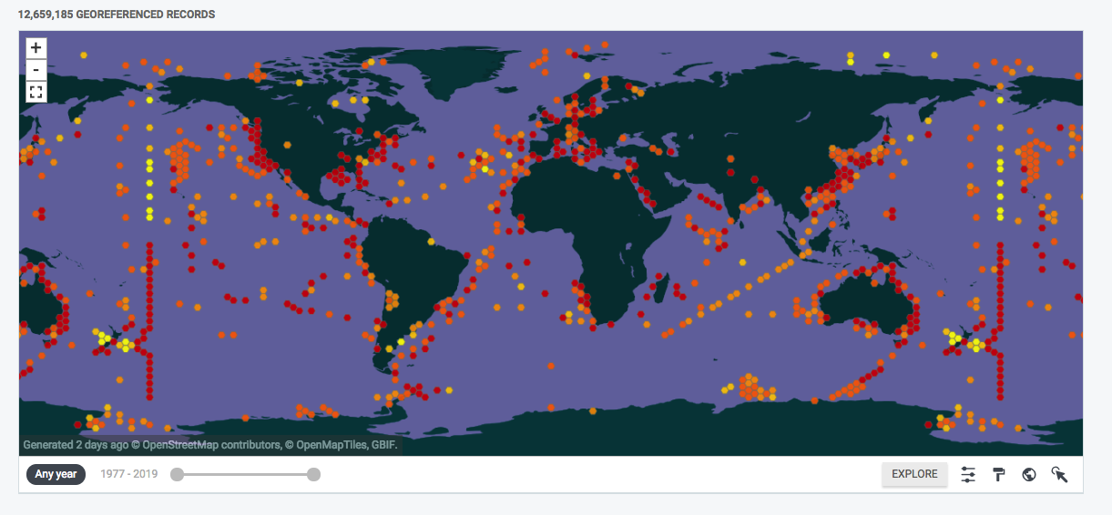
MGnify AS REPRESENTED IN GBIF.org
Notes:
Currently Mgnify publishes mainly data from marine water samples, but we expect more data from soil samples later this year

Slide 36
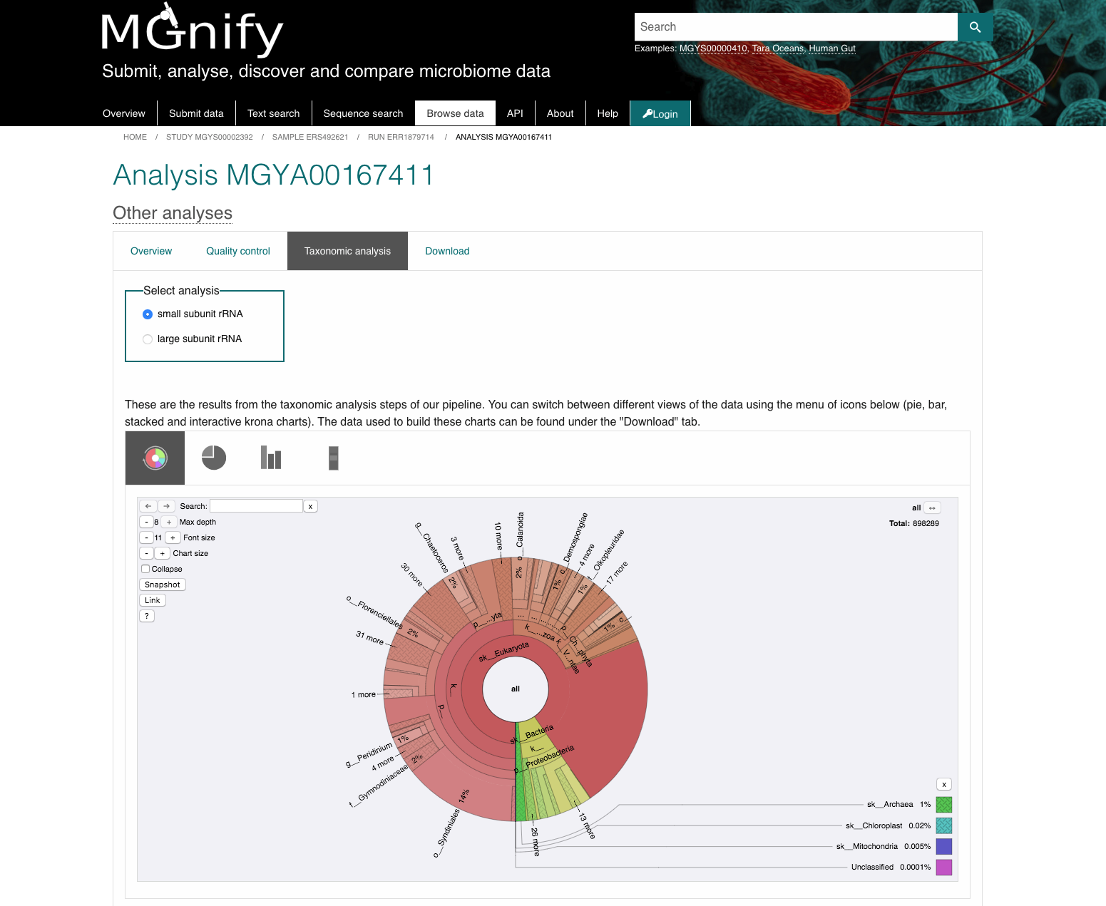
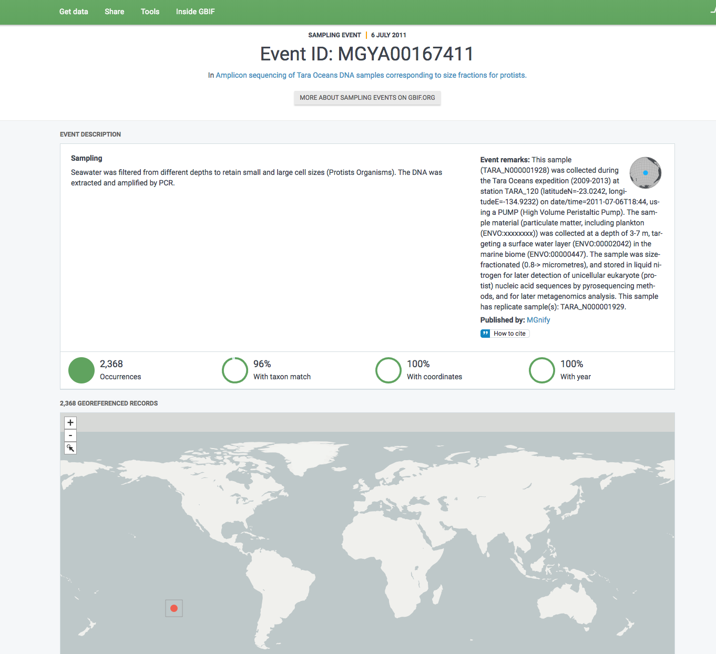
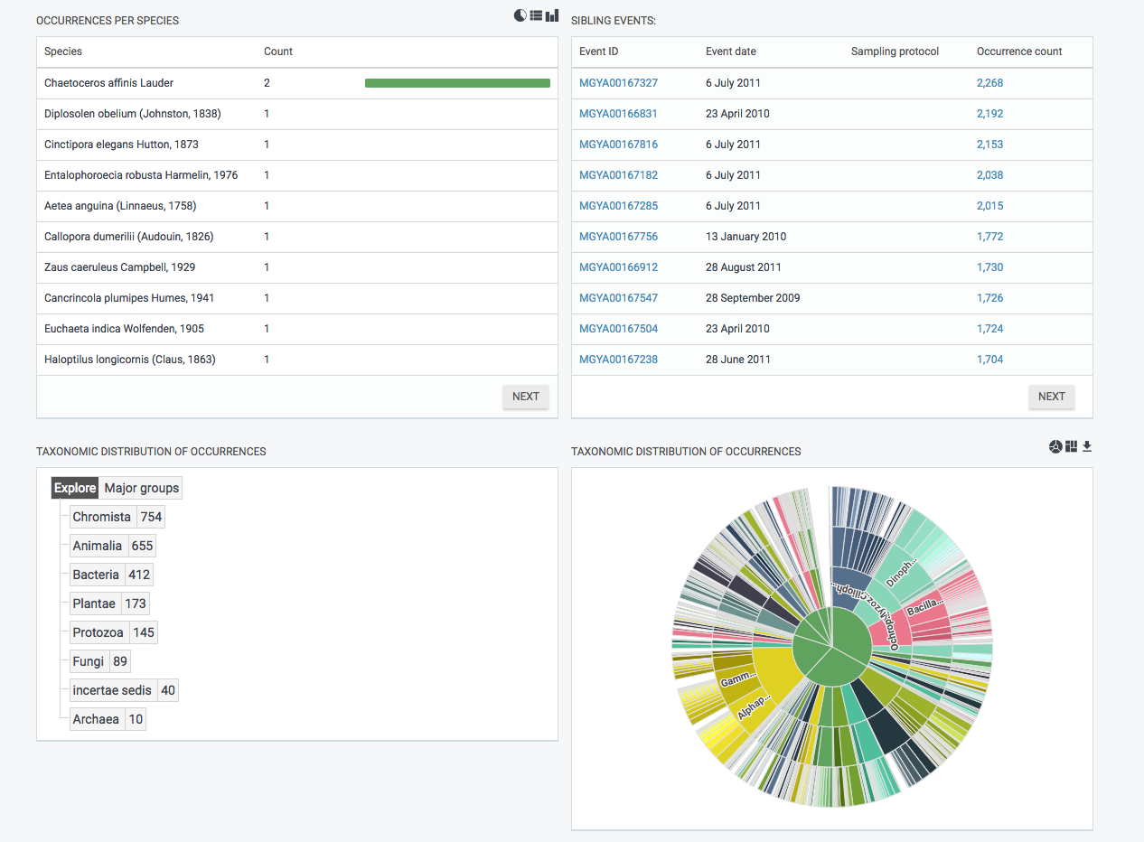
GBIF
MGnify
Notes:
Same analysis – two data facilities
The taxonomic composition looks different since mgnify shows relatvie abundance, wheras GBIF shows presence/absence

Slide 37
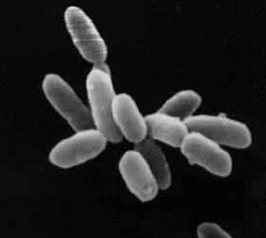
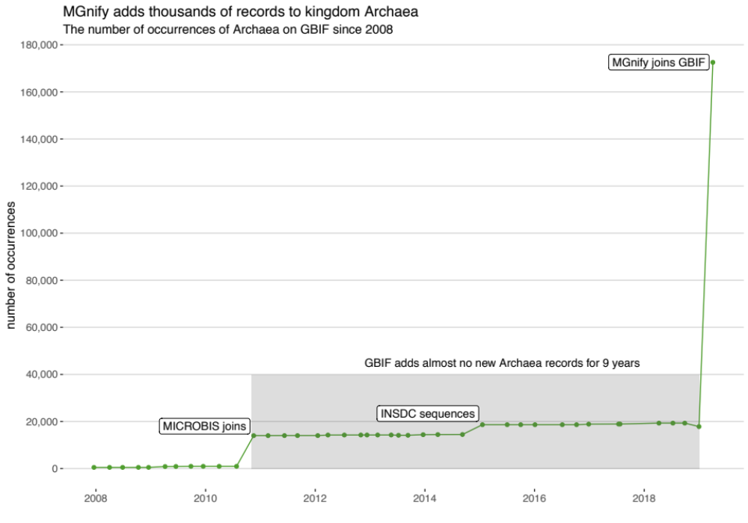
The kingdom archaea
Halobacteria
Notes:
One outcome of the data integration is a many doubling of occurrence records within the kingdom archaea

Slide 38
Top publishers
by number of occurrence records
10 April 2019
Notes:
GBIF still has many bird observations – eBird has impressing 562 million records.
The top publishers ( by occurrence count) are still a mix of bird observation databases and national biodiversity facilities.
But Mgnify sneaks in at a 13th place.

Slide 39


ThankS
GBIF incentive-prize competition on biodiversity data solutions
€34,000 in prizes
Open to individuals or teams
Deadline: 1 September 2019
bit.ly/ebbe2019
IPBES
Multiple calls for support now open (deadline)
Nominate experts to Task Forces (17/6)
In-kind support for technical support units (1/7)
Support Global Assessment with ‘uptake events’ (30/7)
www.ipbes.net
Notes:
Thank you for your attention.
Finally, two announcements:
The deadline for the famous Ebbe Nielsen challenge is approaching, this year with a double budget for the prizes, apply by 5 September
GBIF invites volunteers to represent the network and to promote quality data publishing and use at conferences and other venues. We will support you with presentation materials and other resources.

