Slide 1
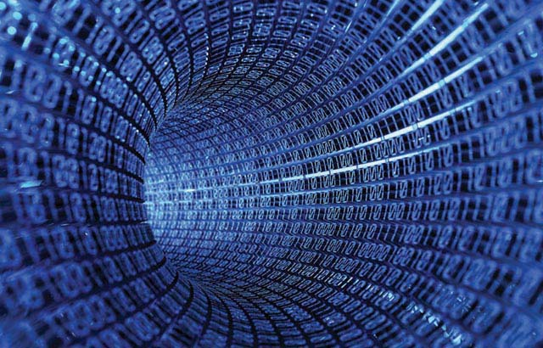
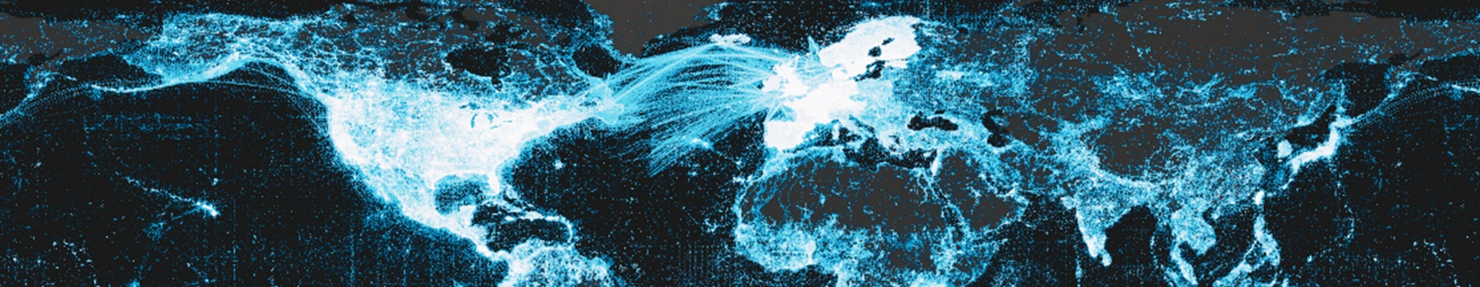












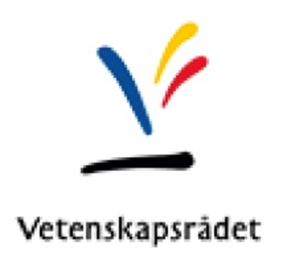
Biodiversity Atlas Sweden + Swedish LifeWatch =
Swedish Biodiversity Data Infrastructure (SBDI)
SBDI: New opportunities for data driven research
Anders Telenius, Fredrik Ronquist Swedish Museum of Natural History
Holger Dettki Swedish University of Agricultural Sciences

Slide 2
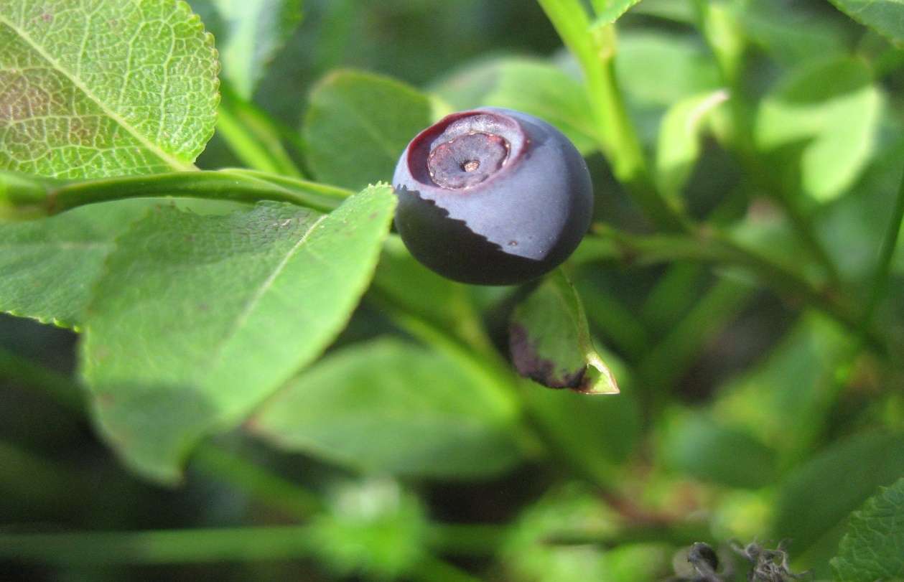
Biodiversity Atlas Sweden + Swedish LifeWatch =
Swedish Biodiversity Data Infrastructure (SBDI)
Biodiversity information systems offer services for easy data publication, access and interoperability, analysis and results visualization.
Biodiversity informatics brings rich opportunities for innovative, interdisciplinary research on biodiversity and ecosystems.

Slide 3
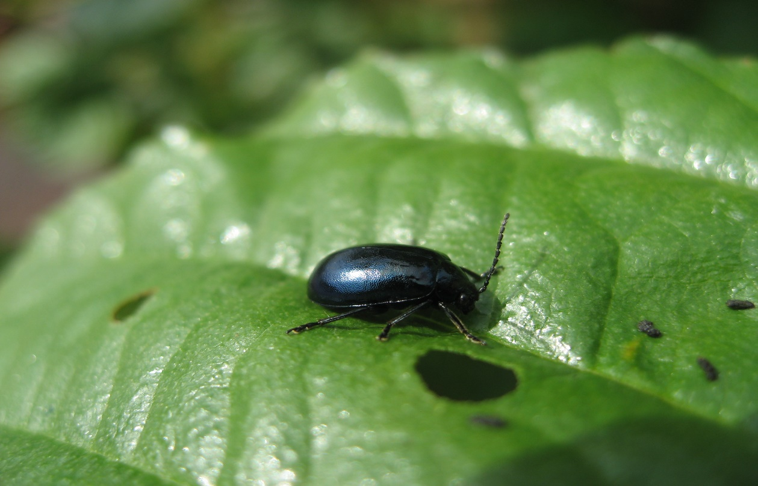
Biodiversity Atlas Sweden + Swedish LifeWatch =
Swedish Biodiversity Data Infrastructure (SBDI)
Swedish Biodiversity informatics, represented by the eleven partnering organizations in the present Biodiversity Atlas Sweden and Swedish LifeWatch consortia will merge into SBDI; a new national research infrastructure for biodiversity informatics 2021-2024.

Slide 4
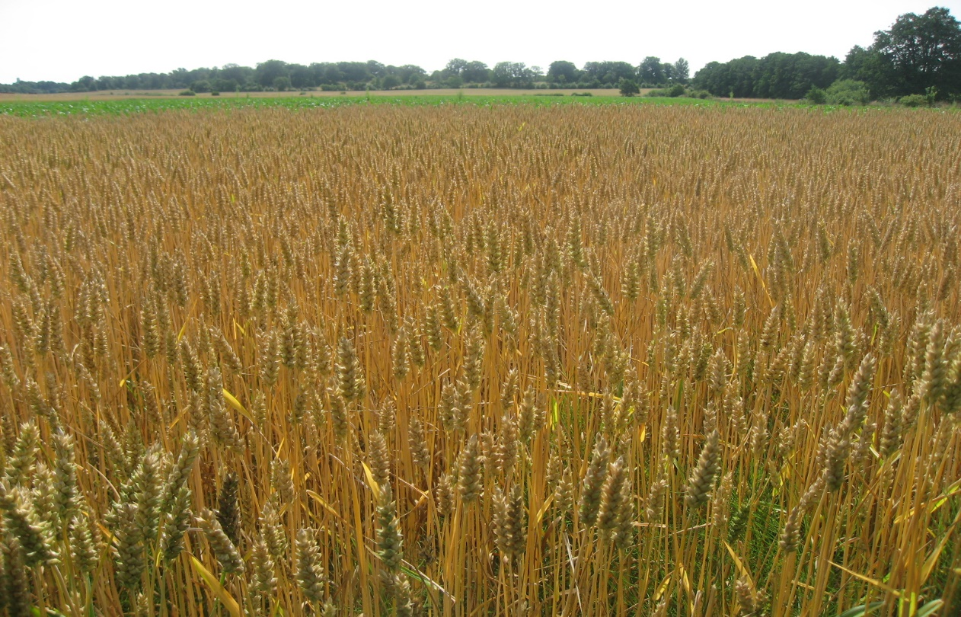
Biodiversity Atlas Sweden + Swedish LifeWatch =
Swedish Biodiversity Data Infrastructure (SBDI)
Primarily built upon the Atlas of Living Australia technology platform, SBDI adheres to the principle of ´Open data´/´Open Source´.
While systems development continues within the Living Atlases Community (LA) valuable Swedish components will be adapted and integrated into SBDI.

Slide 5
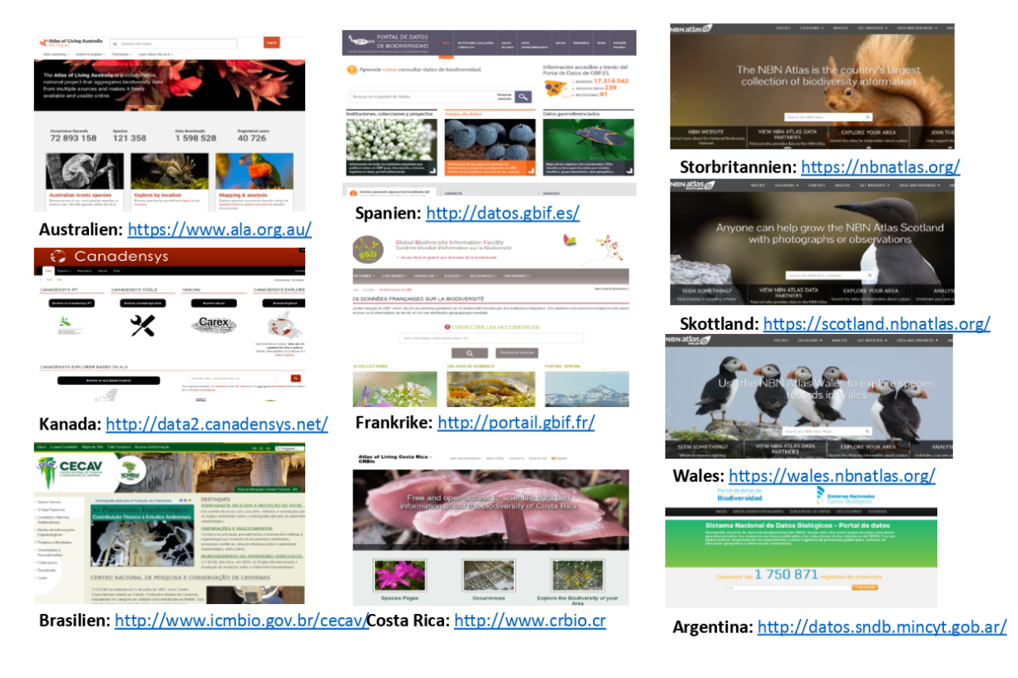
Biodiversity Atlas Sweden + Swedish LifeWatch =
Swedish Biodiversity Data Infrastructure (SBDI)
SBDI will handle not only occurrence data but by using enhanced/new standards protocols event-based (“research data”), stratified sampling and monitoring data, tracking and sensor data and molecular information will be accommodated.
LA is a rapidly growing community of developers and biodiversity information users - presently 15-20 Living Atlases are in operation or will be introduced in the near future. Initially funded nationally by the Australian government, LA is now supported by GBIF and member organizations across the globe.

Slide 6
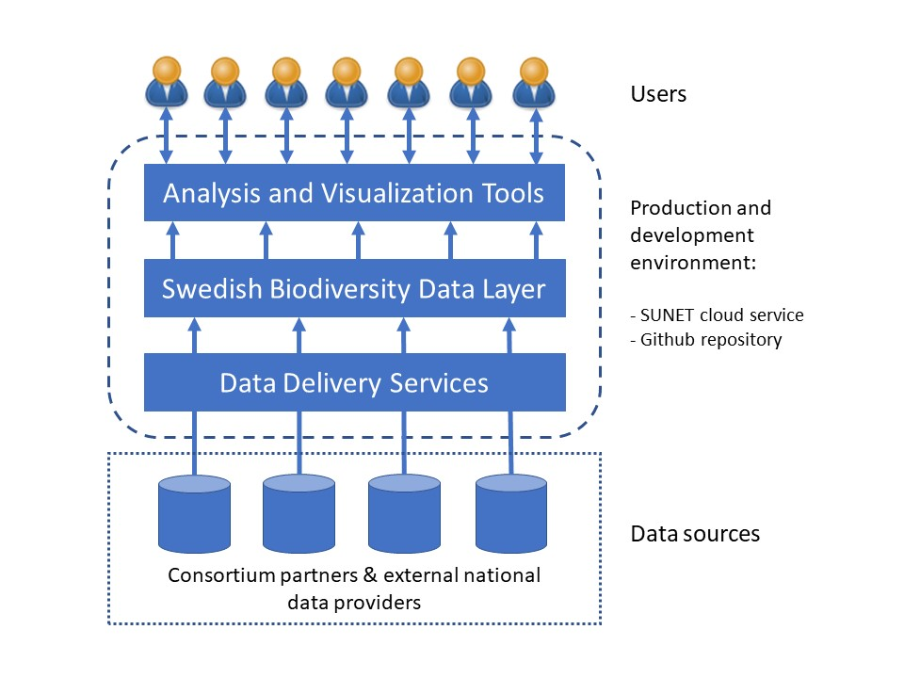
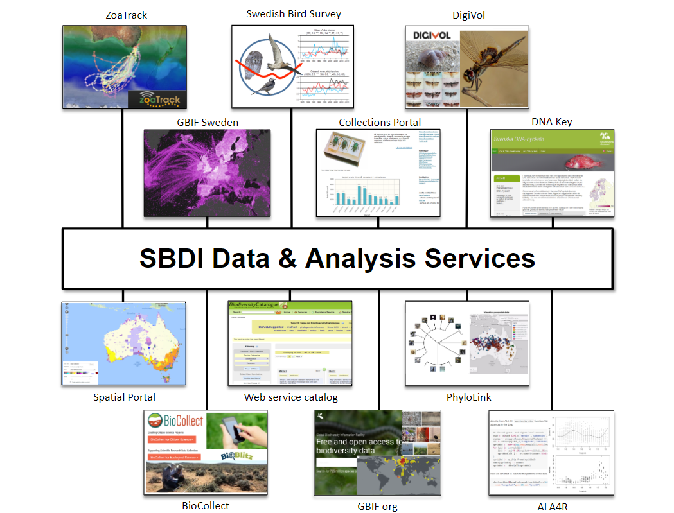
Biodiversity Atlas Sweden + Swedish LifeWatch =
Swedish Biodiversity Data Infrastructure (SBDI)
SBDI will handle not only occurrence data but by using enhanced/new standards protocols event-based (“research data”), stratified sampling and monitoring data, tracking and sensor data and molecular information will be accommodated.
SBDI will include Data Delivery Services, harvesting biodiversity data from national data providers into the common Swedish Biodiversity Data Layer, accessible for users through Analysis and Visualization Tools.

Slide 7
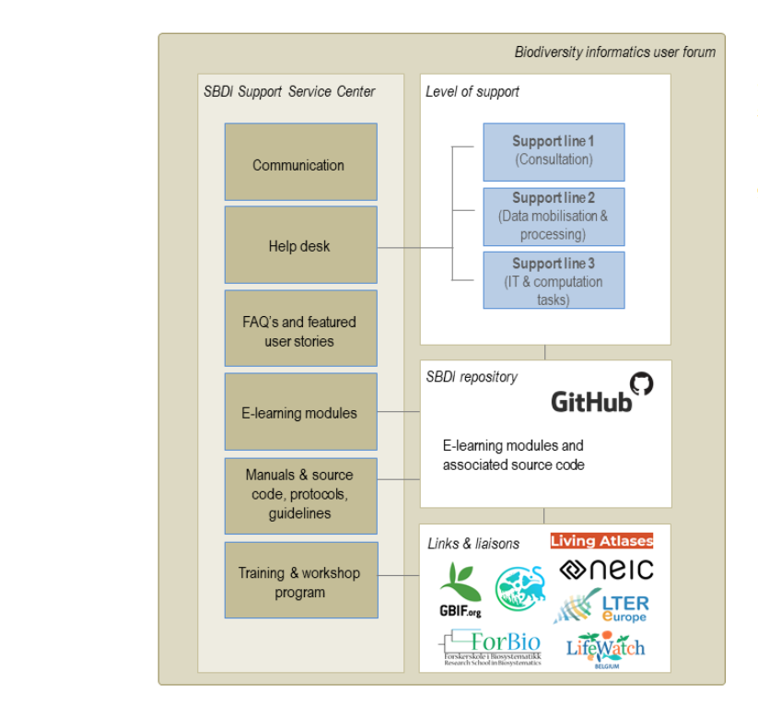
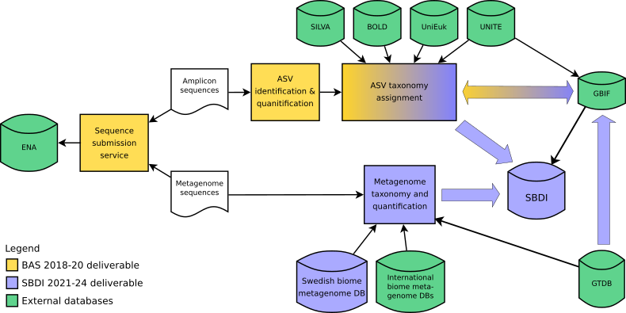
Biodiversity Atlas Sweden + Swedish LifeWatch =
Swedish Biodiversity Data Infrastructure (SBDI)
Comprising the Swedish GBIF node SBDI will represent Swedish Biodiversity Informatics nationally and internationally and comprise the Swedish GBIF node, GEO BON, CETAF, DiSSCo, GGBN, BOLD, Elixir etc.).
SBDI will include Data Delivery Services, harvesting biodiversity data from national data providers into the common Swedish Biodiversity Data Layer, accessible for users through Analysis and Visualization Tools.
Planned BAS/SBDI workflow for mobilization of molecular biodiversity data.
Serving users, SBDI will establish a Support Service Centre offering manuals, source code, protocols, guidelines, three-tier help desk, and training and workshop programs.

Slide 8
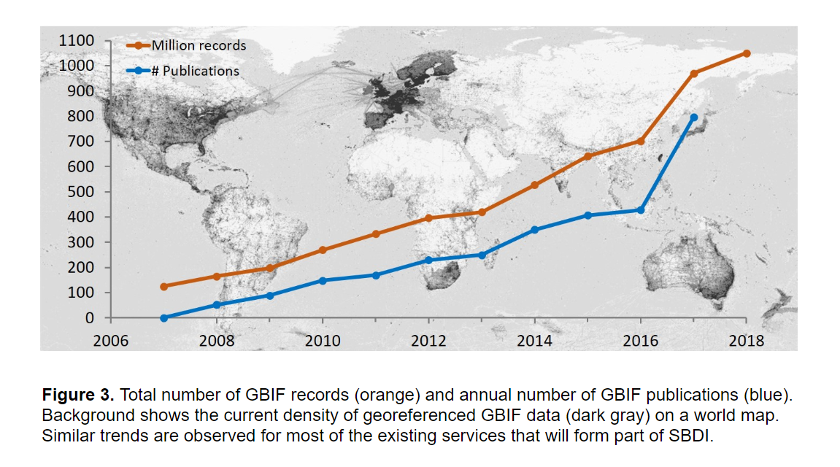
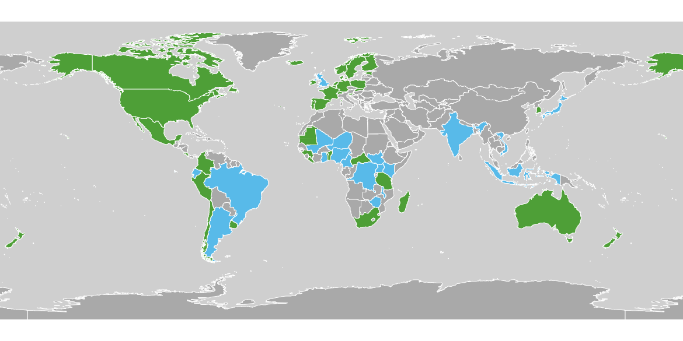
Biodiversity Atlas Sweden + Swedish LifeWatch =
Swedish Biodiversity Data Infrastructure (SBDI)
Comprising the Swedish GBIF node SBDI will represent Swedish Biodiversity Informatics nationally and internationally and collaborate with GEO BON, CETAF, DiSSCo, GGBN, BOLD, Elixir etc.
The already large use and impact of GBIF-mediated data is expected to grow considerably in the future.

Slide 9
Biodiversity Atlas Sweden + Swedish LifeWatch =
Swedish Biodiversity Data Infrastructure (SBDI)
NRM | Management, Technical lead, Collections data and Bird ringing data, Swedish GBIF node
SLU | Management, Communication, Biotelemetry data and federation services, WRAM client portal, Forest and landscape monitoring data, Marine and fish data
GU | Marine data, User support and training
KI | Microbiome sample sequencing
KTH | Metabarcoding and metagenomics, Microbiomes, Aquatic ecosystems
LnU | Marine ecosystems, Microbiomes, Zoonoses
LU | Biotelemetry, Systematic monitoring, Terrestrial ecosystems, Climate change effects on biodiversity
SMHI | Marine biological, physical and chemical data, SHARK, marine traits data, Nordic Microalgae, Plankton Toolbox
SU | Interactions between micro- and macrobiomes, Terrestrial ecosystems
UmU | SEAD archaeological and palaeoecological biodiversity data
UU | Metabarcoding, Freshwater and marine systems, Systematics and biodiversity
SBDI contents:
https://beta.bioatlas.se

