Slide 1

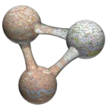


GBIF towards 2030
UiO Natural History Museum in Oslo, Department of Research and Collections, November 8th 2018 CC-BY Dag Endresen
Photo: ForBio/GBIF training at Baikal lake September 2018, CC-BY Dag Endresen
Notes:
UiO NHM Department of Research and Collections, Strategy seminar, Holmen fjordhotell, Asker, 8-9 November 2018.
Presented 8th November 2018, CC-by Dag Endresen, GBIF Norway, UiO Natural History Museum, University of Oslo
Photo: ForBio/GBIF training at Baikal lake September 2018, CC-BY Dag Endresen

Slide 2



GBIF.no towards a permanent research infrastructure
Funding periods (15 years, 2005-2019, 50 mNOK = 5.1 m€)
2005-2007 (3 years, RCN 4,5 mNOK, total 5,6 mNOK = 0,57 m€)
2008-2011 (4 years, RCN 6,3 mNOK, total 12 mNOK = 1,2 m€)
2012-2016 (5 years, RCN 13,0 mNOK, total 20 mNOK = 2,0 m€)
2017-2019 (3 years, RCN 9,2 mNOK, total 12 mNOK = 1,2 m€)
2020 --> permanent long-term infrastructure
Forskningsrådet (RCN)
UiO Naturhistorisk museum
Artsdatabanken (NBIC)

Slide 3



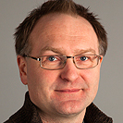

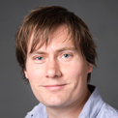

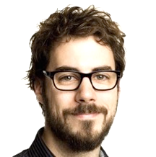
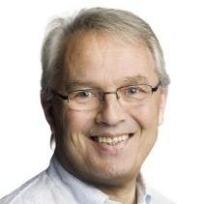

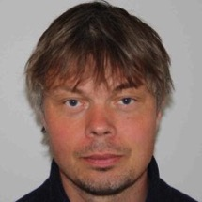
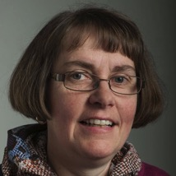
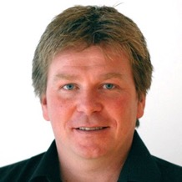
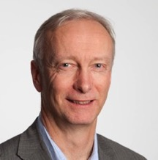
Status 2018
Node team at NHM, University of Oslo
  Dag Endresen, Node manager
  Christian Svindseth, Data manager
  Fridtjof Mehlum, Research director
  Vidar Bakken, part-time (30%)
Artsdatabanken, Trondheim
  Wouter Koch, node member
  Nils Valland, board member
NTNU University Museum
Anders Finstad, GBIF Science committee
  Solveig Bakken, board member
Research Council of Norway
  Christian Wexels Riser
  Per Backe-Hansen (until 2016)
Contact us at: helpdesk@gbif.no
Notes:
http://www.nhm.uio.no/forskning/prosjekter/gbif/
http://www.gbif.no
http://www.gbif.no/people/
http://www.gbif.no/about/

Slide 4

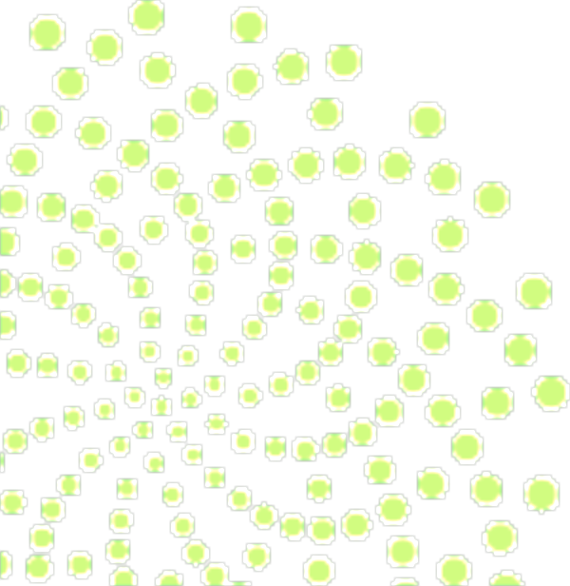
Towards a new governance model for GBIF-Norway

Slide 5

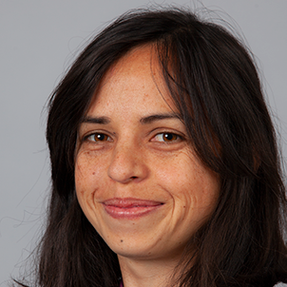


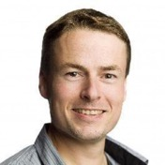
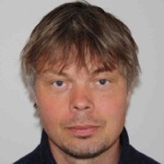
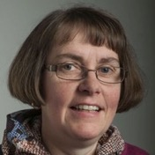


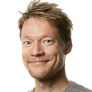

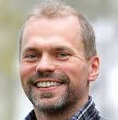
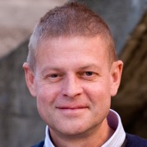
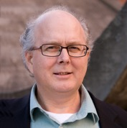
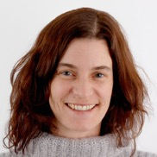
Node team at NHM, University of Oslo
  Dag Endresen, Node manager
  Vidar Bakken, part-time
  Vacancy, Data manager
Artsdatabanken, Trondheim
  Wouter Koch, node member
  Nils Valland, board member
  Stein A. Hoem, IT Manager
NTNU University Museum
Anders Finstad, GBIF Science committee
  Solveig Bakken, board member
  Data scientist (?)
Norwegian Institute for Nature Research
Erlend B. Nilsen, Science ambassador
  Roald Vang, IT Manager
  Frank Hanssen, node member
Research Council of Norway
  Research Infrastructure Team
Notes:
http://www.nhm.uio.no/forskning/prosjekter/gbif/
http://www.gbif.no
http://www.gbif.no/people/
http://www.gbif.no/about/
RCN Research Infrastructure: Asbjørn Mo, Odd Ivar Eriksen, Marte Qvenild, Solveig Flock

Slide 6





GBIF-Norway Node consortium
Towards formalized sharing of Node responsibilities

Slide 7
GBIF towards 2030

Slide 8



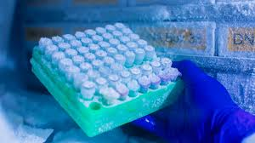



Nature Biobank (NIBIGEN)
Museum services as Repository for a broader range of MateralSample (than PreservedSpecimen)

Slide 9


Living Norway Ecological Data Network is established as a joint effort to promote management of ecological reserach data in agreement with FAIR principles.
This include data mobilization efforts, development and deployment of new tools and e-infrastructure, contributing to the international development of data standards, and development of education and training for students and established researchers.
Living Norway is currently working to secure funding. (6. Sept 2019)
Living Norway will contribute to and be part of the Living Atlas community.
Living Norway is embedded with the Norwegian node of the Global Biodiversity Information Facility (GBIF).
National Seminar 11 to 12 June 2019.

