Slide 1

Eija-Leena Laiho
24.5.2019
GBIF European Nodes meeting
Oslo

Slide 2

Biodiversity Informatics Unit
@Finnish Museum of Natural History
Species Information team (4)
ICT
team (8)
Digitization team (15)
Roadmap for research infrastructures, 2018 ->

Slide 3

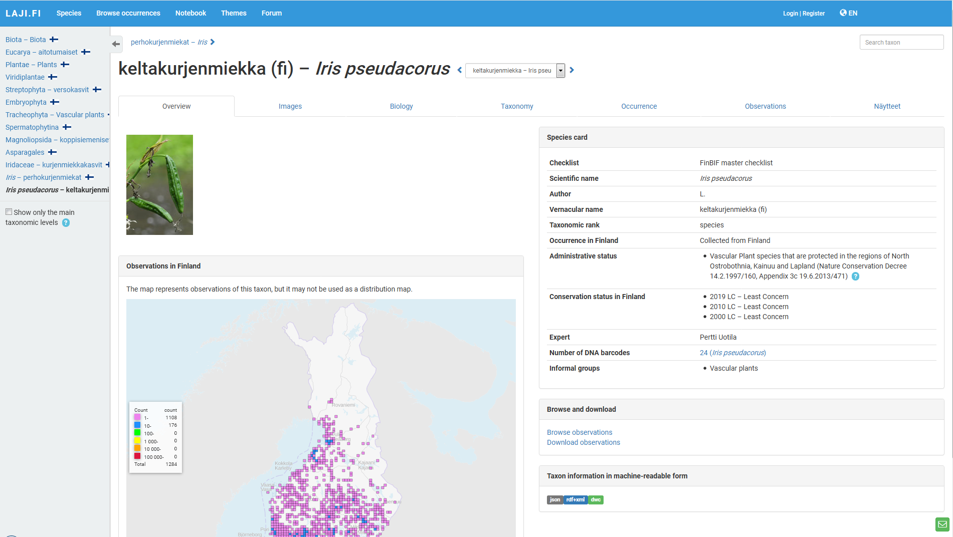
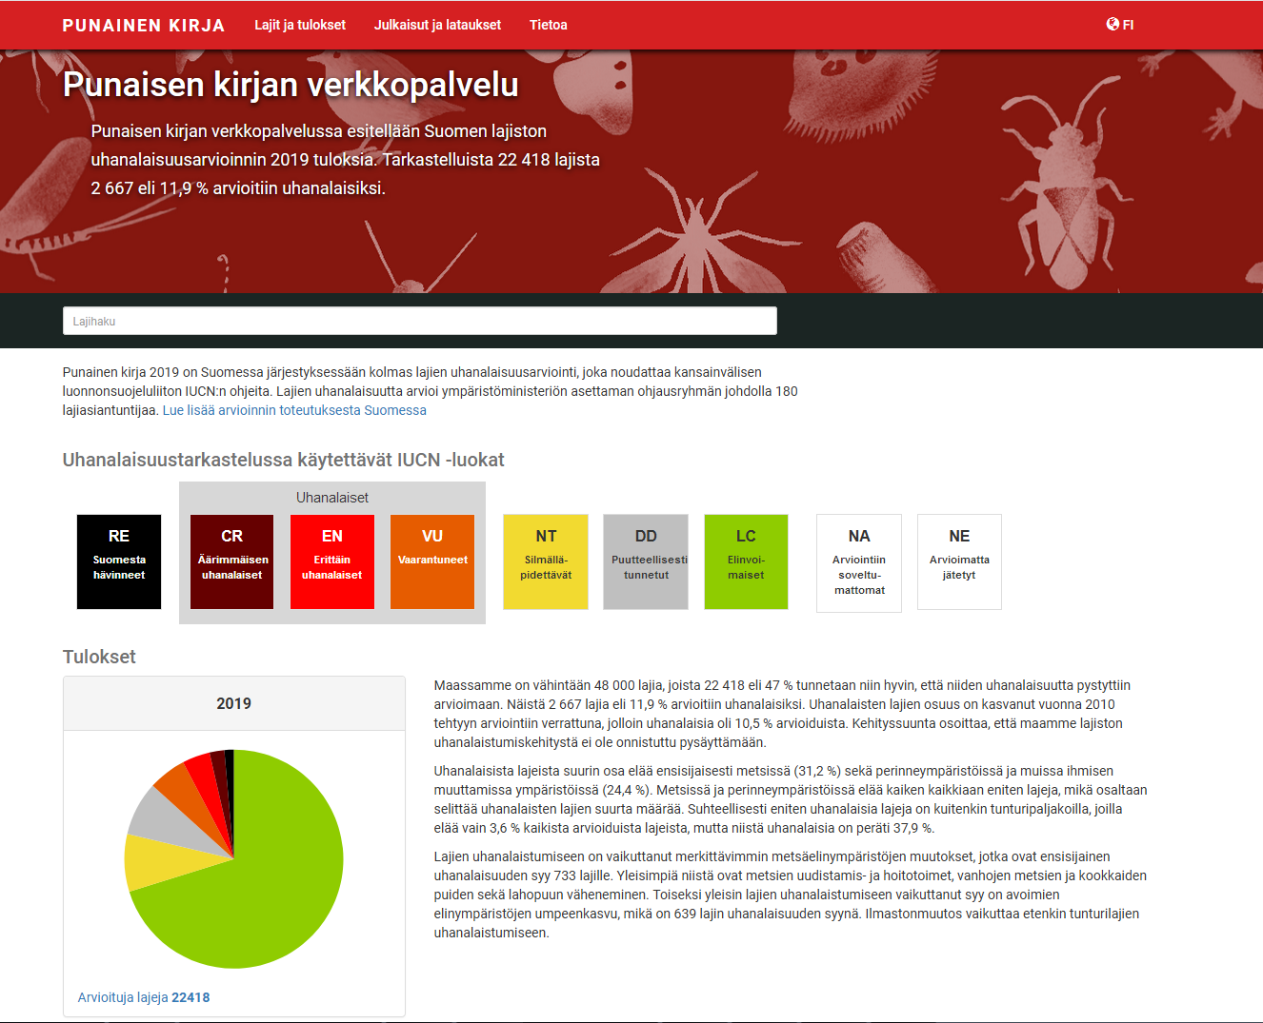
Recent progress:
First Checklist of Finnish species
Kotka
collection management system (label designer)
Collection competition for schools
taxonid.org
Bird monitoring systems
(Line transect count of land birds,
Winter Bird Census)
schema.laji.fi
api.laji.fi
Laji.fi species pages (complete redesign)
Notebook (mass upload,
closed old systems: Insect database
and Hatikka)
IUCN Red List 2019
Tools for public authorities (eradication of invasive alien species)

Slide 4
Work in progress:
Hands on
Annotations
Agreements with partners
New invasive alien species portal
Nagoya protocol + Kotka
Life+
projects
Docu-mentation
ICEDIG,
Synthesys+

