Slide 1
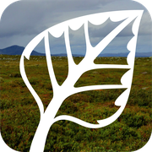
Natur I endring
Nuts and bolts
Michal Torma

Slide 2
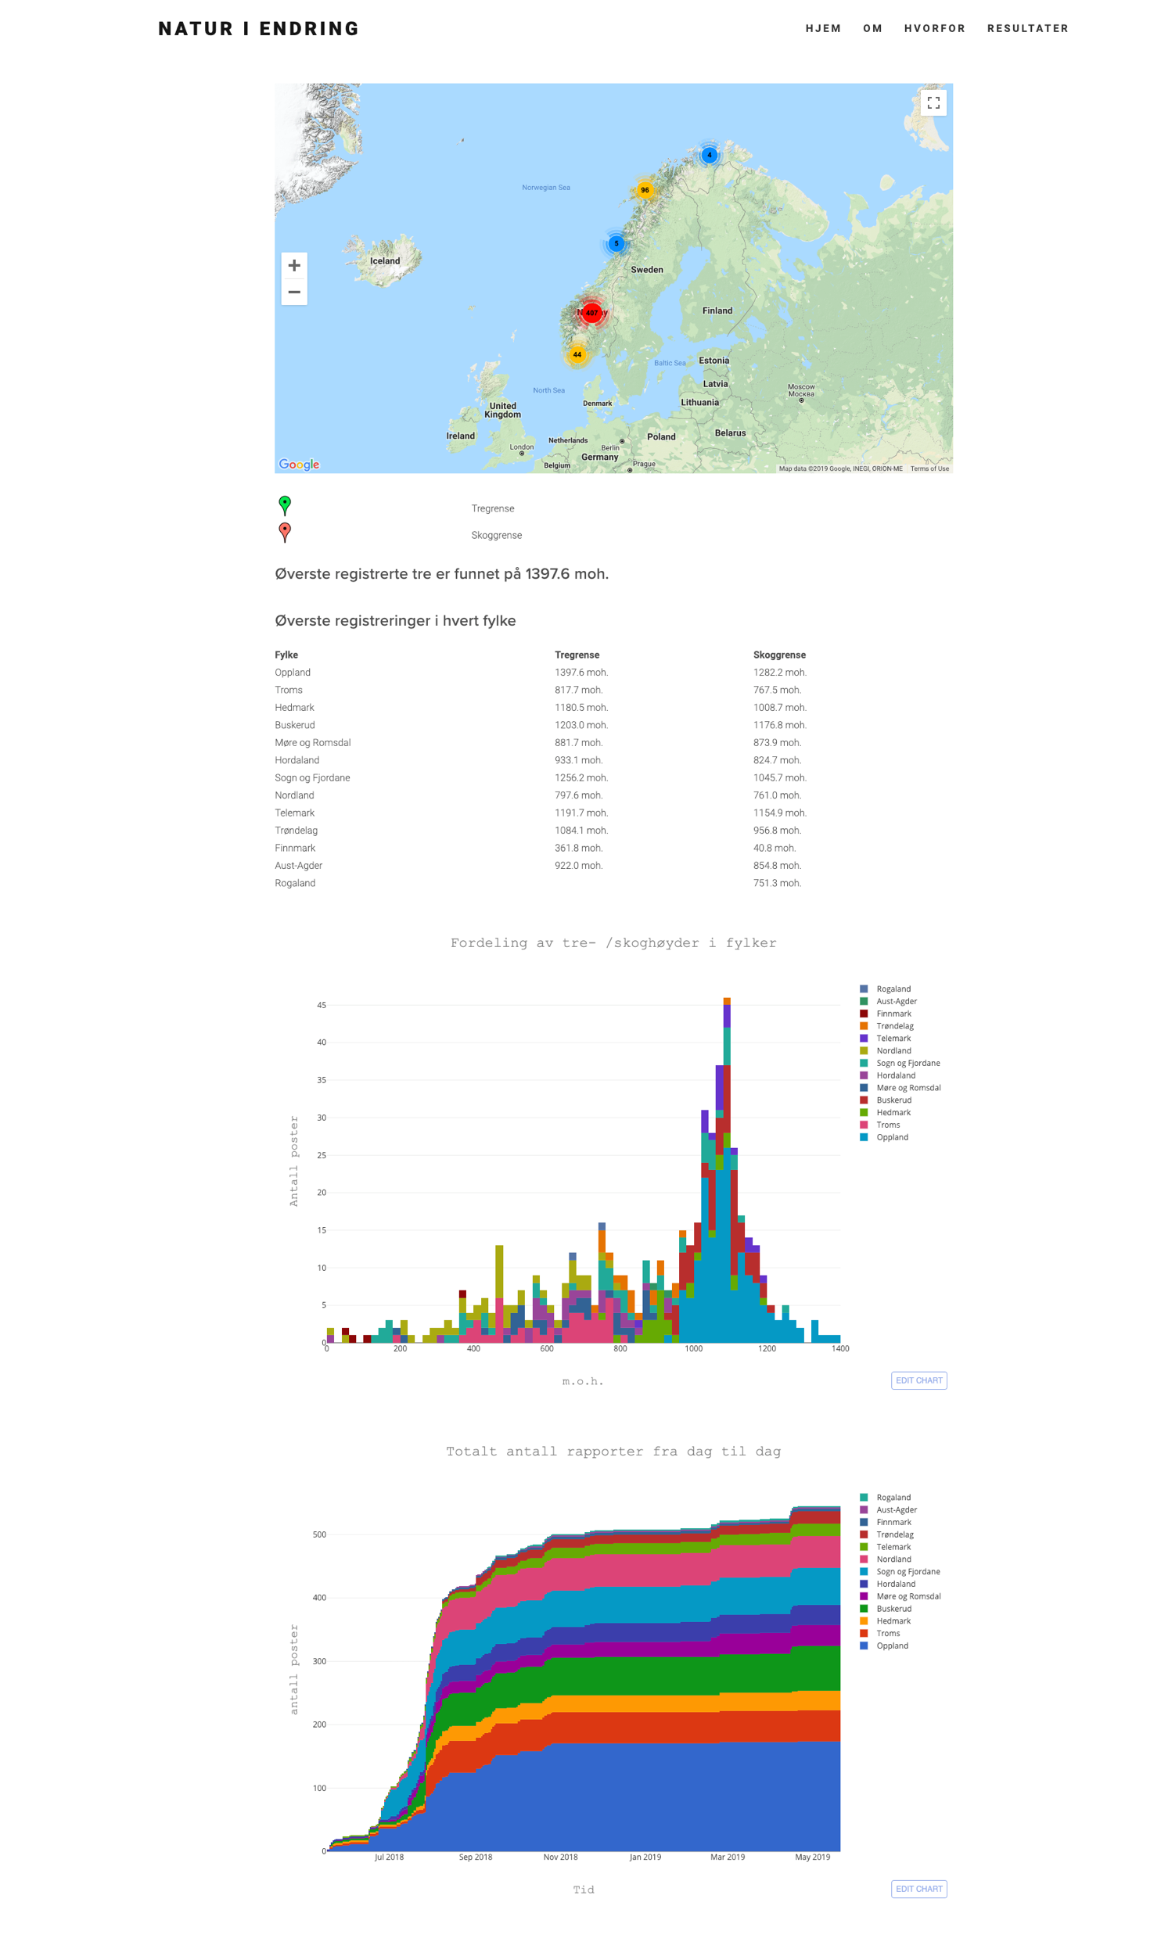
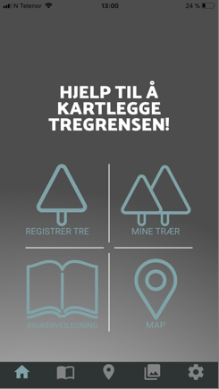
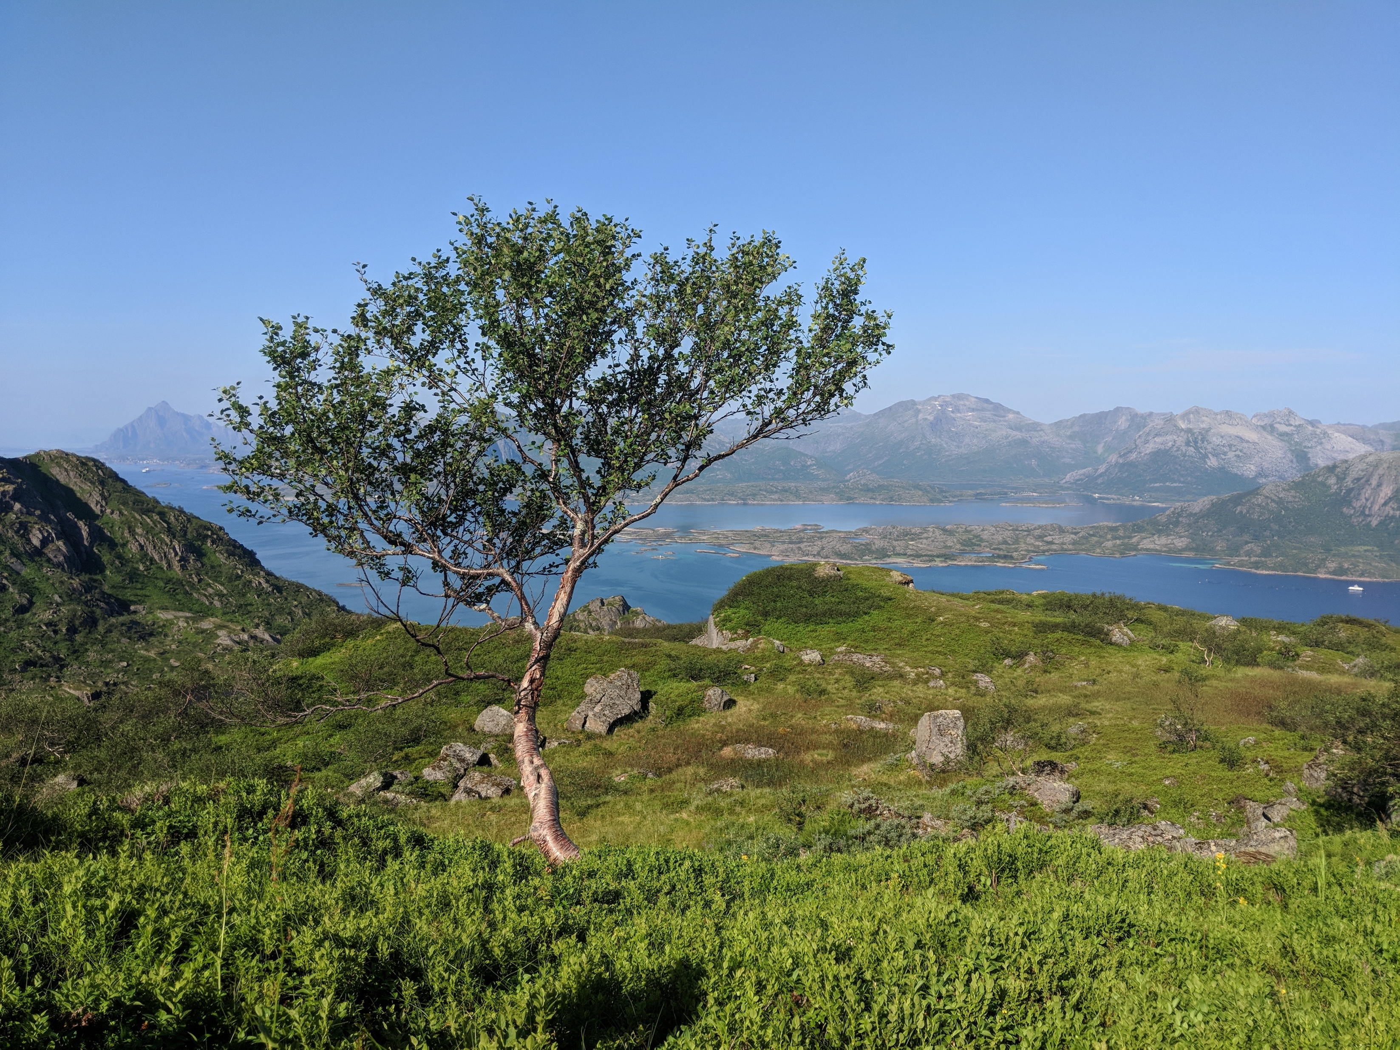
About the project
Natur I endring
Citizen science project with focus on treeline and forest line data collection
Native mobile app based input
Offline data collection capable
Near live and interactive results
Scalable infrastructure

Slide 3
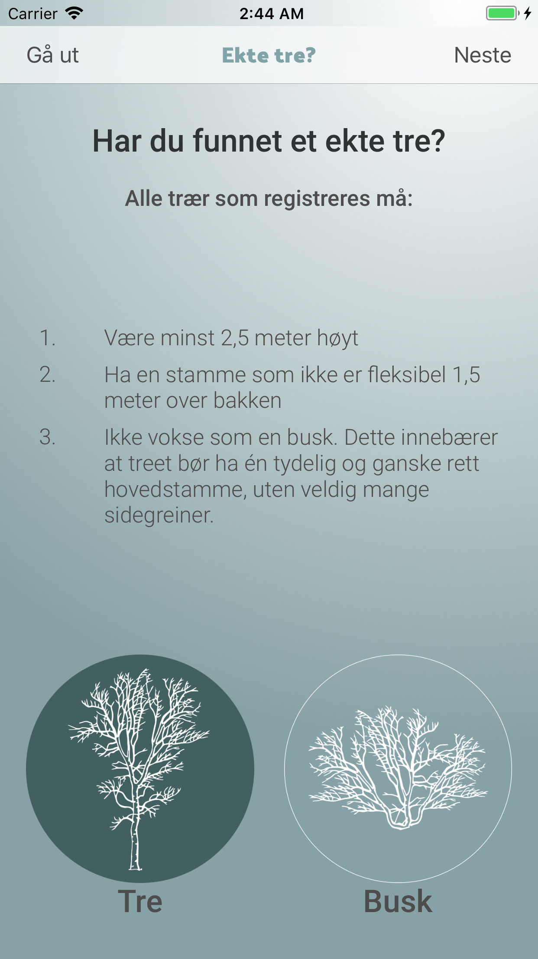
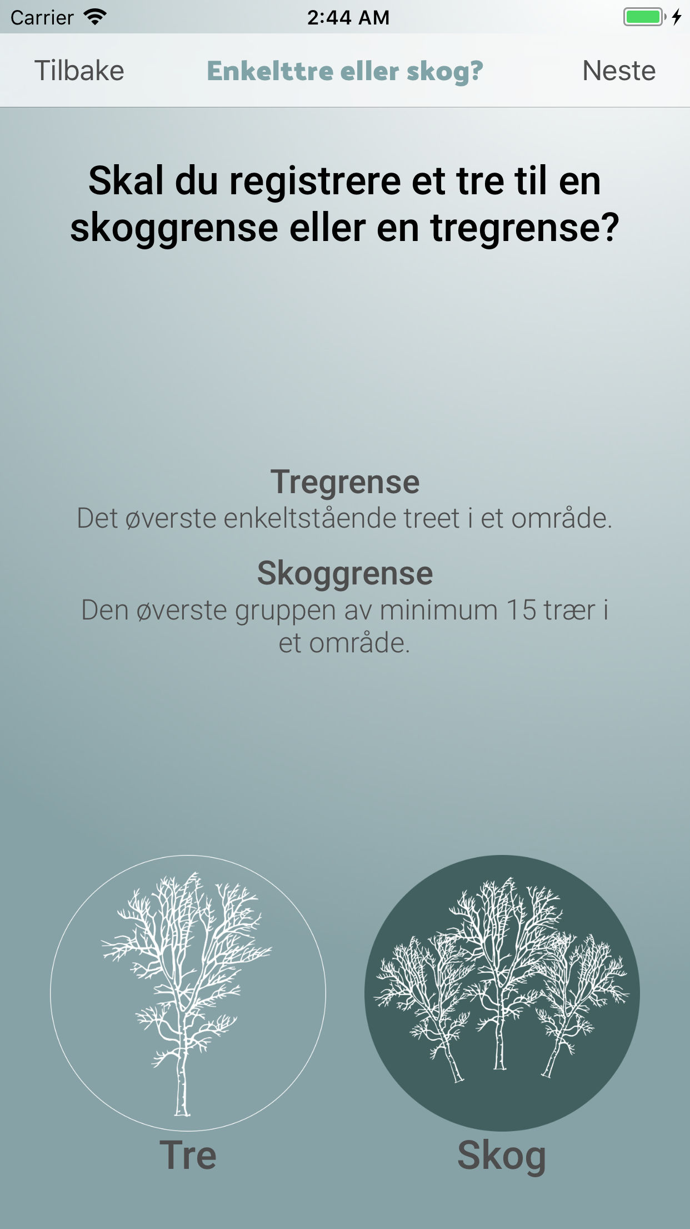
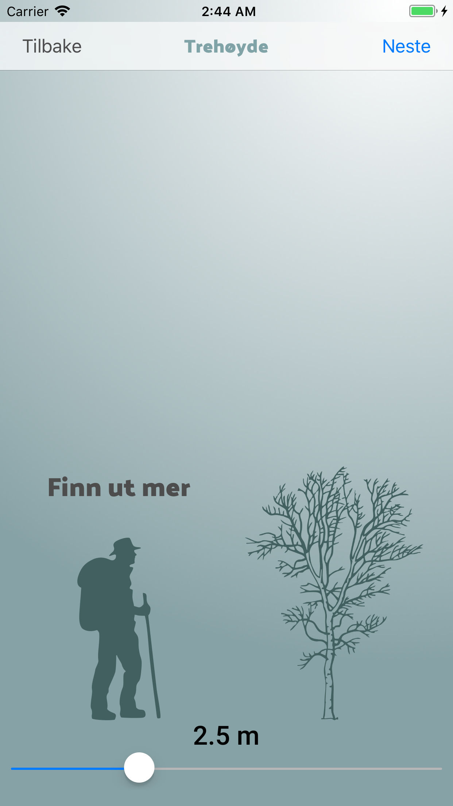
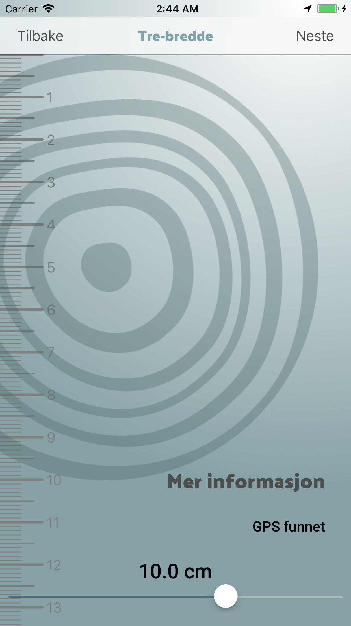
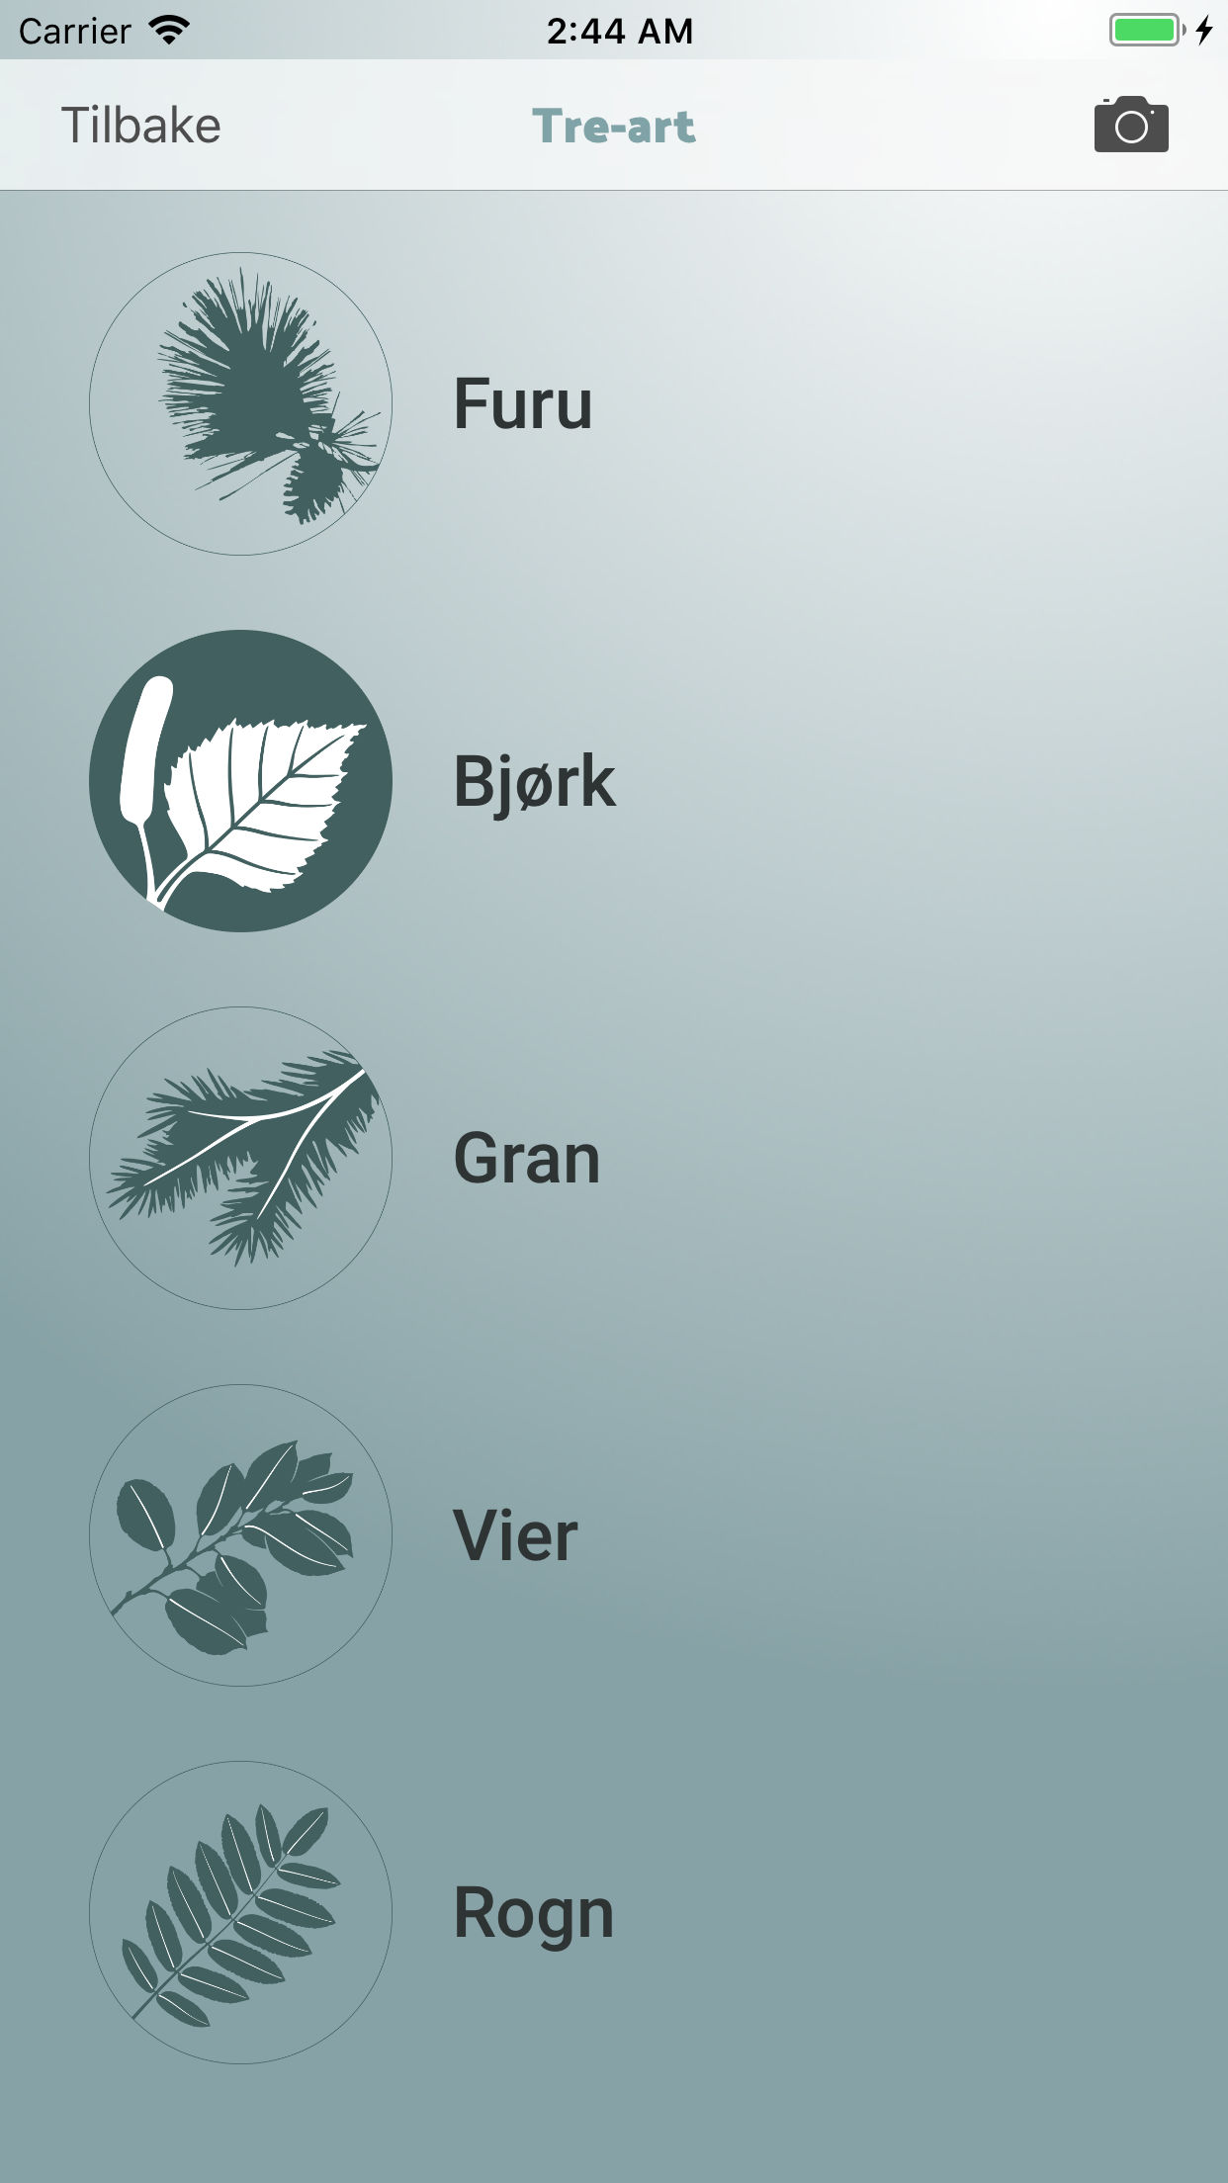
Registration process
Natur I endring

Slide 4
Mobile app
Natur I endring
Written in native code - Kotlin(Android) and Swift(iOS)
Utilizes GNSS localization capabilities while registration is in progress to assure flawless registration. User usually does not see when high precision fix was acquired.
Off-line capable with local SQLite database used as a buffer.
Communicate with the server only once connected to favorable internet connection. No user interaction needed

Slide 5

Backend
Natur I endring
Open-source based
Linux server (Ubuntu 16.04) running on DigitalOcean virtual server platform - advantage of backup, uptime and scalability at reasonable price.
We use MariaDB 10.1 to store all of the collected data. We store photos separately on the drive and link to them in the DB. (Transferring to PostGis in 2.0)

Slide 6
Backend - API
Natur i endring
API is written in Python 3.6 using Flask micro-services library. API server is running behind NGINX load balancer and uWSGI parallelisation layer tending to following tasks:
User registration and login API for indirect communication with WordPress
Reports upload API
Open API for verified records and statistics (for map in app and on Results page)

Slide 7
Api security
Natur I endring
All communication is protected by SSL encryption which is industry standard
hashed token + pepper verification
Generates random token, adds pepper , hashes it and save to database.
App requests something
Token request
Token
Adds pepper to the token hashes it and uses this as a part of an actual request
Actual request + hashed authentication token
Compares authentication header with DB and proceeds with fulfilling the request

Slide 8
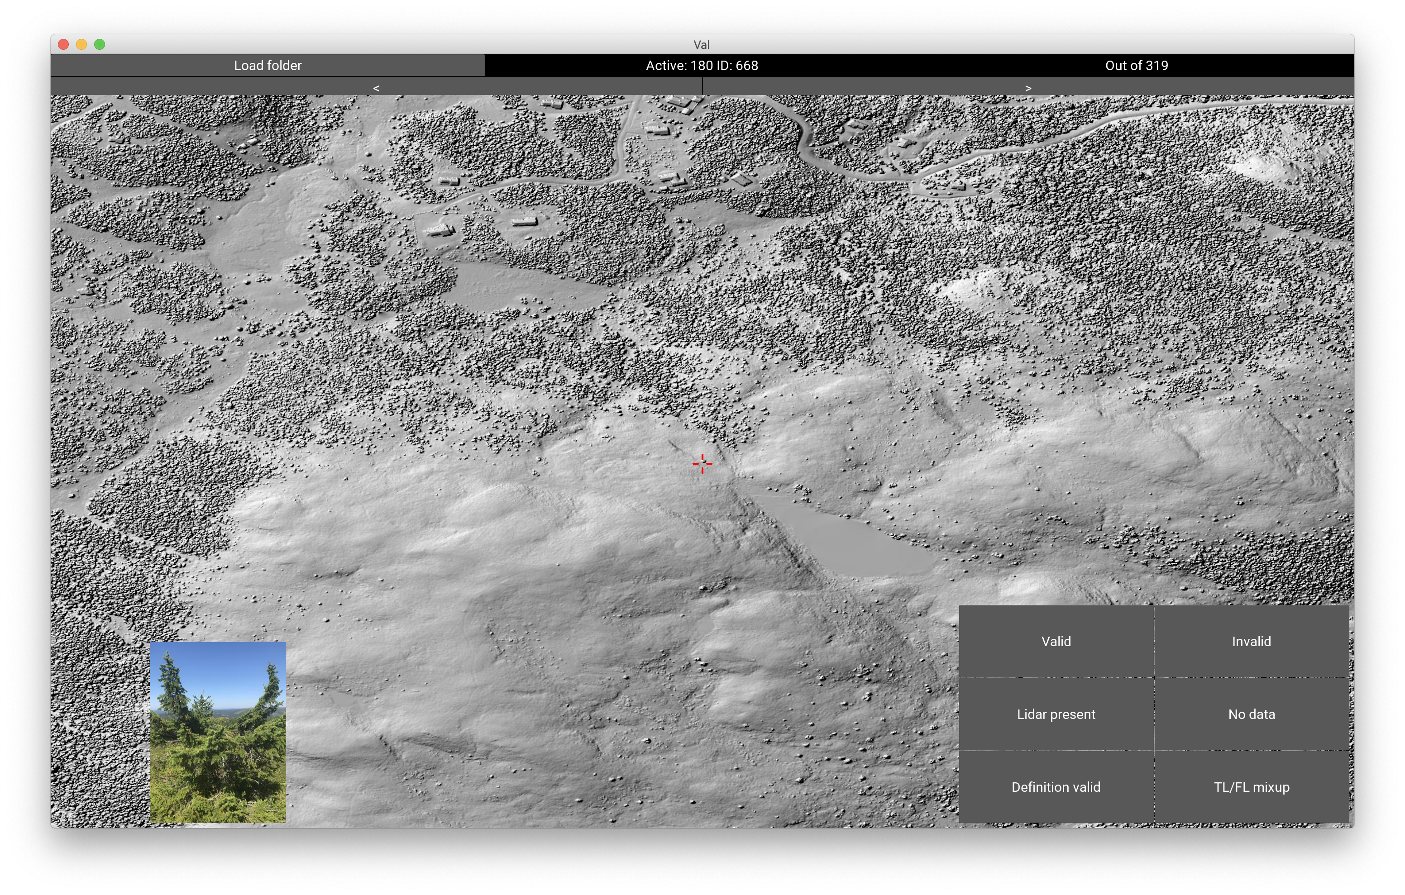
Backend - daily task
Natur I endring
Cron tasks run once a day at 1:00
Get DEM altitude from geonorge.no WMS service
Compare location with expected boundaries shapefile
Identify county of new registrations
Get LIDAR surrounding from hoydedata.no (if applicable).
Photo manipulation and EXIF metadata stripping
Generate plots for results page using plot.ly
Automatic maintenance

Slide 9

Natur I endring
Infrastructure
Squarespace
Business plan supports
Custom JS scripts
Map
Report
User registration
Stats
Nginx
load balancer
plot.ly charts
Local SQLite DB
uWSGI
parallelisation
Apache
Flask
microserver (Python)
WordPress
- users management
- administrative frontend
- report verification
Main DB
MariaDB 10.1.25
Server
DigitalOcean
Ubuntu 16.04.4 LTS

Slide 10
Results after one year
Natur I endring
545 valid registrations
3392 registered users (116 active)
Field test:
Species identification was 100% correct
Tree height and DBH identified within expected margin 97% times
58% treelines valid - mean Δ altitude to real line 15m
65% forest lines valid – mean Δ altitude to real line 9m

Slide 11
Results from survey
Natur I endring
Users don’t generally like notifications on their phone, but wouldn’t mind being reminded to register when it’s relevant
TV promotion is the most affective way to get inactive users
Users contribute because they want to contribute to the science and want to learn new things – material prices are not highly relevant
Notes:
Social media

Slide 12


Future - Natur I endring 2.0
Natur I endring
Rewriting app to Flutter/Dart (backed by Google) to merge 2 codebases to one
Implement administrative role to the app with notifications about new registrations
JSON based configuration for different/multiple data collection pipelines
Use geofencing capabilities to notify users about the app.
Gamify the app to motivate finding even higher trees.

Slide 13
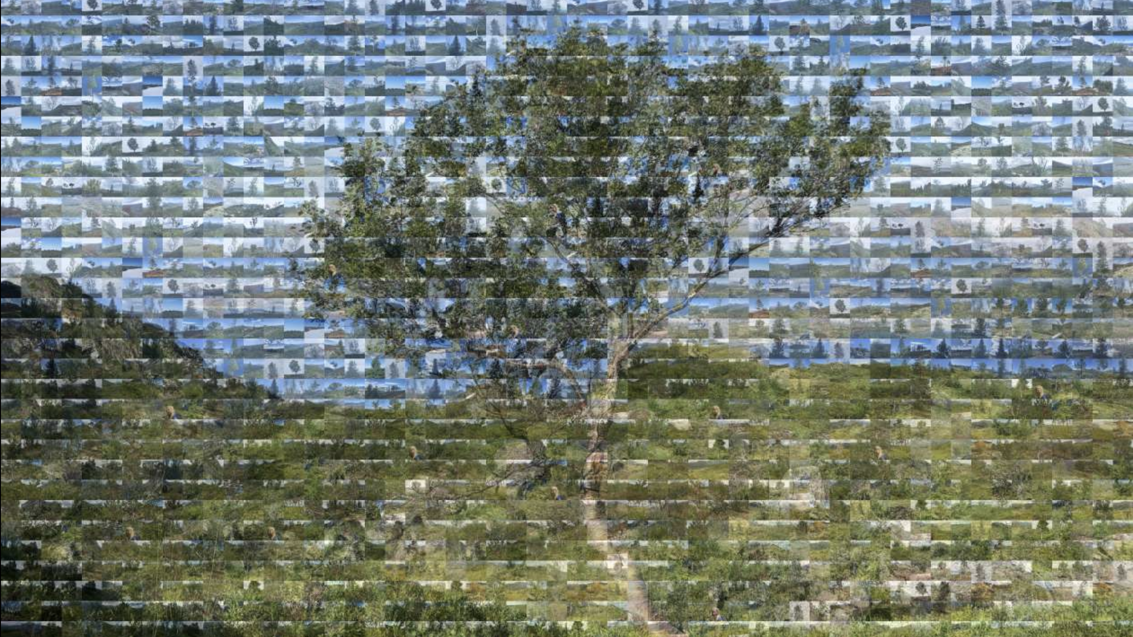
Thank you for your attention

