Slide 1


Capacity development activities from Norway
Rukaya Johaadien, Vidar Bakken & Dag Endresen | GBIF Norway
GBIF Community Webinar | 28th April 2021
Notes:
Slide 1 (5 sec) Hi everyone! Welcome to the update form GBIF Norway.

Slide 2
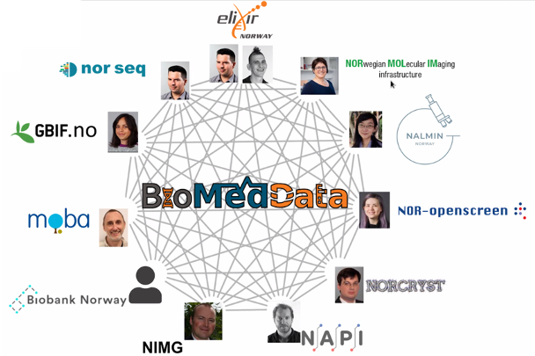
BioMedData and ELIXIR
National data infrastructure between molecular life science RIs and ELIXIR
Bi-monthly meetings also e.g. joint FAIR data course, common DMP tool
GBIF Norway to:
publish species occurrences
ensure GBIF molecular sequence data gets published to ELIXIR
Capacity development at GBIF Norway
Notes:
Slide 2 (43 sec) GBIF Norway is involved in an initiative called BioMedData. It’s a collaborative project between ELIXIR Norway and 10 other molecular life science research infrastructures. We have group bi-monthly meetings and other activities. For example there was a FAIR data management course this Wednesday and most recently there was a workshop to develop a data management plan (DMP) tool. Our long-term goal in this partnership is obviously to help publish species occurrences from the participating research infrastructures but also to ensure that GBIF molecular sequence data gets published to ELIXIR.

Slide 3


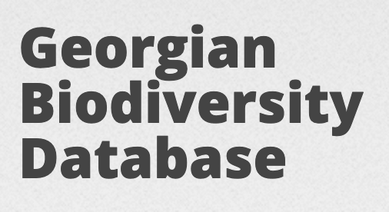



BioDATA course on metabarcoding
BioDATA teaching activities in 2020 were affected by COVID travel restrictions.
Adapting training curriculum for online sessions (GBIFS, Laura Russell).
Adding an extra (online) course on DNA barcodes in Georgia in June 2021:
Accessing & using biodiversity data from BOLD and GBIF
Introduction to data publishing in BOLD and GBIF
Concepts of meta barcoding (data focus)
FAIR data & open data management best practice
Local partners:
Georgian Biodiversity Database: biodiversity-georgia.net
Caucasus Barcode of Life (CaBOL) https://ggbc.eu
Capacity development at GBIF Norway
Notes:
Slide 3 (28 sec) BioDATA teaching activities in 2020 were severely affected by the COVID travel restrictions. So we have been adapting the curriculum for online training together with Laura at the Secretariat. We have also been working on adding an extra course on meta-barcodes together with colleagues in Georgia.
Development of a new BioDATA course on metabarcoding for online teaching in Georgia in June 2021.

Slide 4


Application for BioDATA continuation
Project title: BioDATA Advanced - Accelerating biodiversity research through barcodes, collection, and observation data
Project partners:
Norway: University of Oslo Natural History Museum
Russian Federation: South-Siberian Botanical Garden
South Africa: South African Biodiversity Institute (SANBI)
GBIF Norway | GBIF South Africa (SANBI) | GBIF Secretariat
8 courses on advanced biodiversity data skills (2022-2024)
6 student internships RU ZA NO
Capacity development at GBIF Norway
Notes:
Slide 4 (56 sec) In February this year we applied to the Norwegian Agency DIKU for funds for a new BioDATA project called BioDATA Advanced. The project partners are the Natural History Museum at the University of Oslo; staff including Hugo de Boer (HoD), me (Rukaya Johaadien), and Dag Endresen; The South-Siberian Botanical Garden in Russia; and in South Africa we have SANBI where Fatima Parker Ali is the GBIF Node Manager and point of contact; and of course Dmitry Schigel and Laura Russell in the Secretariat is also involved. We plan to have 8 biodiversity data skills courses and 6 student internships. Keep your fingers crossed fro us, we should hear weather our application has been successful very soon. Hopefully before the end of the month, I believe.
GBIF Norway HoD Hugo de Boer at PI; Node Manager Dag Endresen and Data Manager Rukaya Johaadien contributing as as teachers.
GBIF South Africa (SANBI) contact point Node Manager Fatima Parker
GBIF Secretariat staff Dmitry Schigel and Laura Russell
Call DIKU UTFORSK - funding decision expected in late April 2021 (very soon)

Slide 5

GBIF Norway and OpenPSD
OpenPSD project
  Spain, Portugal, Norway, Colombia, and France
  data publishing & usage from private companies
  provide mentoring, workshop, and documentation activities
DNV dataset of 2 million occurrences: Marine data from the oil industry: https://doi.org/10.15468/q8qykg
(4 citations already!)
Also published 6 other private sector datasets from 3 private sector companies, (these are companies dealing with impact assessment/EIAs, i.e. environmental consultants)
Lots of activity in this area
https://www.gbif.no/projects/openpsd/
Notes:
Slide 5 (33 sec) GBIF Spain, Portugal, Norway, Colombia and France developed together a GBIF CESP funded project, the OpenPSD, to provide guidelines and develop capacity enhancement in the private sector industry for using and publishing GBIF-mediated data. From Norway we approached the oil energy sector and private companies providing impact assessments for the environment policy purposes.
https://www.gbif.no/projects/openpsd/
https://www.gbif.org/project/2Zik1tfJoh3C92ZslvhDIr/openpsd-promoting-publication-and-use-of-private-sector-data-on-biodiversity

Slide 6

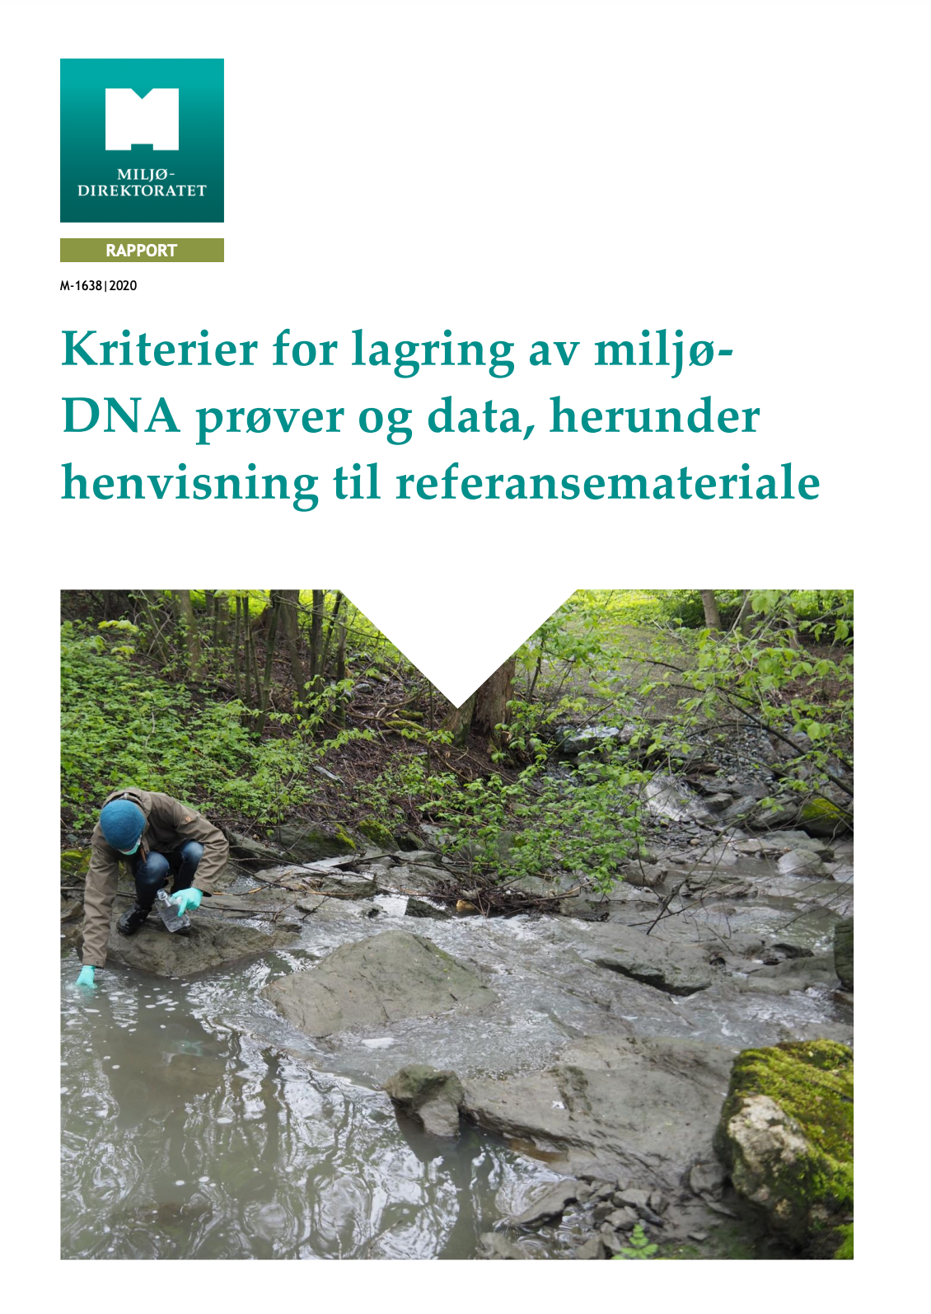
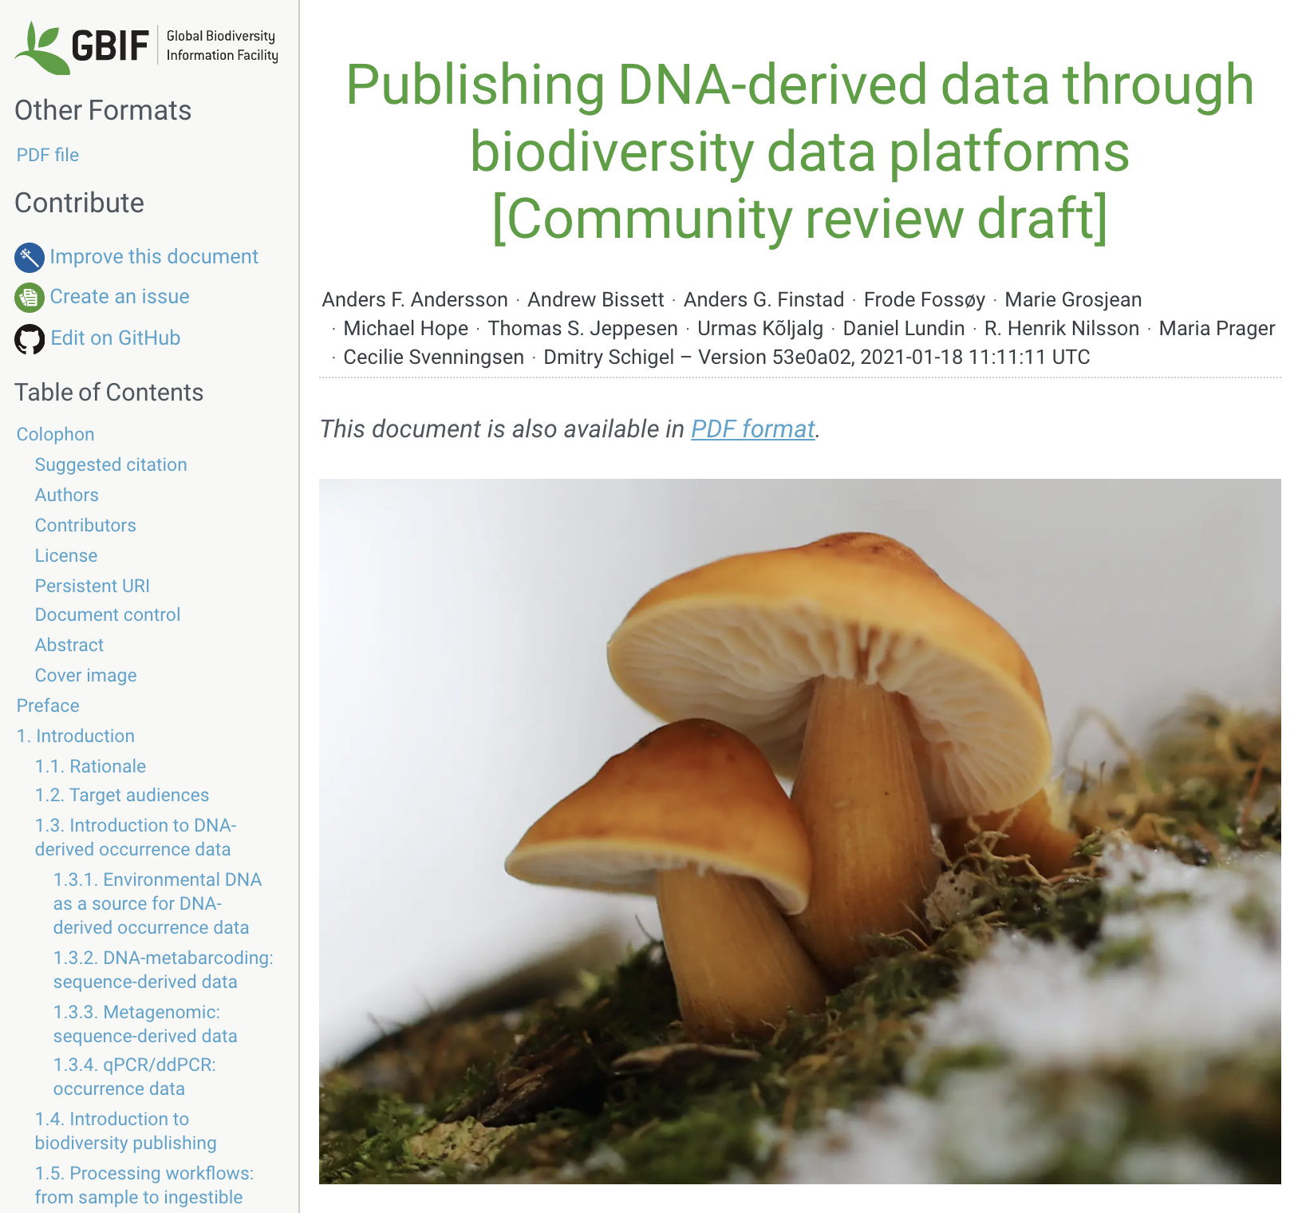
Environment sampling based datasets (maybe?) not based on occurrences
The Norwegian Environment Agency has developed guidelines for biodiversity data workflows (through GBIF).
  → GBIF guidelines for collecting and publishing environmental DNA monitoring data.
Under development - exploring compatibility of Darwin Core and GBIF for ecological “occurrences” of community and Nature Type data.
Compatibility with - Event | Occurrence | Organism | …??
Capacity development at GBIF Norway
Notes:
Slide 6 (36 sec) Together with the Norwegian Environment Agency and colleagues from the emerging Living Norway Ecological Data Network - and extension of the GBIF node, we have been working on developing guidelines for environmental DNA data to enter the data workflow of GBIF. And, in particular, we have struggled with the compatibility of Darwin Core for ecological occurrences of community data and Nature Type data.
NEED for richer data models and data types to cover Nature Type data (“community” type of “organism” / ”occurrence”) – concept = Nature Types in Norway
Challenges with mobilizing NiN - Nature in Norway data (in increasing demand from policy sector and private sector engaged to deliver these data -- through the GBIF/Artskart data pipelines)
Kriterier for lagring av miljø-DNA prøver og data, herunder henvisning til referansemateriale (2020). Anders Gravbrøt Finstad, Hugo de Boer, May Bente Brurberg, Geir Dahle, Kristin Skarsfjord Edgar, Alexander Eiler, Torbjørn Ekrem, Dag Endresen, Frode Fossøy, Haakon Hansen, Anders Hobæk, Stein Arild Hoem, Aino Hosia, Knut Anders Hovstad, Thomas Stjernegaard Jeppesen, Arild Johnsen, Eveliina Kallioiniemi, Aud Larsen, Jan T. Lifjeld, Iva Pitelkova, Maria Prager, Jessica Louise Ray, Ingrid Salvesen, Trude Vrålstad, Endre Willassen. Miljødirektoratet, Trondheim. https://www.miljodirektoratet.no/globalassets/publikasjoner/m1638/m1638.pdf
Andersson AF, Bissett A, Finstad AG, Fossøy F, Grosjean M, Hope M, Jeppesen TS, Kõljalg U, Lundin D, Nilsson RN, Prager M, Svenningsen C & Schigel D (2020) Publishing DNA-derived data through biodiversity data platforms. Copenhagen: GBIF Secretariat. https://doi.org/10.35035/doc-vf1a-nr22
Halvorsen, Rune; Skarpaas, Olav; Bryn, Anders; Bratli, Harald; Erikstad, Lars; Simensen, Trond & Lieungh, Eva (2020). Towards a systematics of ecodiversity: the Ecosyst framework. Global Ecology and Biogeography. ISSN 1466-822X. 29(11): 1887-1906. https://doi.org/10.1111/geb.13164

Slide 7


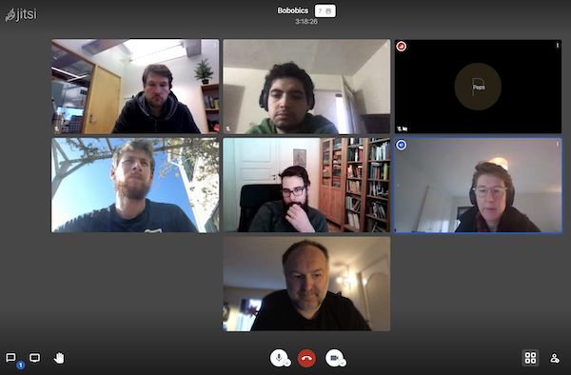


Biodiversity Informatics lectures (Trondheim)
Symposium on biodiversity informatics and GBIF metadata standards
for post-graduate PhD-fellows based in Trondheim (December 2020).
  Interdisciplinary PhD student group using citizen science methodology for problems in ecology
Post-graduate (MSc) lectures on biodiversity informatics (January 2021).
Capacity development at GBIF Norway
Notes:
Slide 7 (23 sec) As COVID pushed teaching online we provided a digital symposium on biodiversity informatics and GBIF metadata standards for a group of PhD students in Trondheim working with citizen science methodology to solve problems in ecology. And also provided student lectures on the master level.
https://www.gbif.no/events/2020/symposium-december.html
https://www.gbif.no/events/2021/lecture-ntnu-gbif.html

Slide 8


GBIF data access with R course - reused
Post-graduate R course developed for the Nordic Oikos Conference in February 2018 - is still reused
https://github.com/GBIF-Europe/nordic_oikos_2018_r/
(last updated in April 2021 for reuse in Tromsø)
Capacity development at GBIF Norway
Notes:
Slide 8 (14 sec) Our GBIF training course on GBIF data access and use with R, developed for the Nordic Oikos conference in 2018 is still being reused. Most recently by students in Tromsø.
https://github.com/GBIF-Europe/nordic_oikos_2018_r/blob/master/README.md

Slide 9
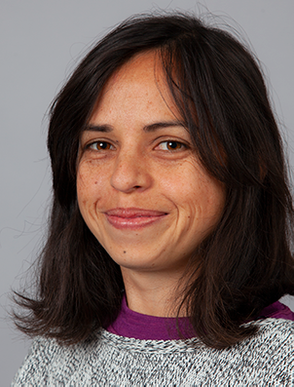




GBIF Norway node staff (April 2021)
Rukaya Johaadien
Data Manager
Vidar Bakken
Outreach Officer (20%)
Dag Endresen
Node Manager
Capacity development at GBIF Norway
Notes:
Slide 9 (3 sec)

Slide 10
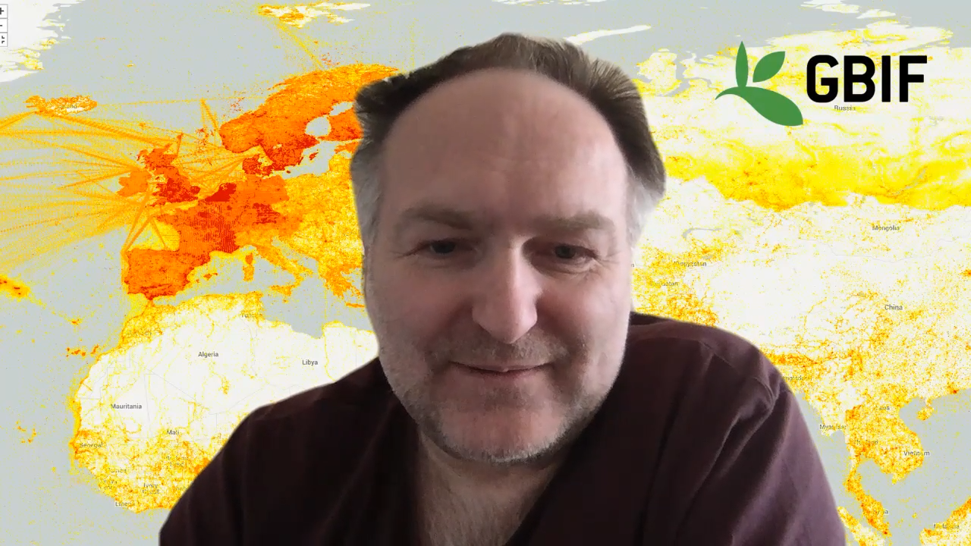
GBIF Norway node staff (April 2021)
Capacity development at GBIF Norway
Notes:
Slide 10 (20 sec) Hi, I am Rukaya Johaadien and I work as the data manager at GBIF Norway. And I am Vidar Bakken, I work part-time for GBIF Norway. I work mainly to get datasets into the GBIF system.

Slide 11
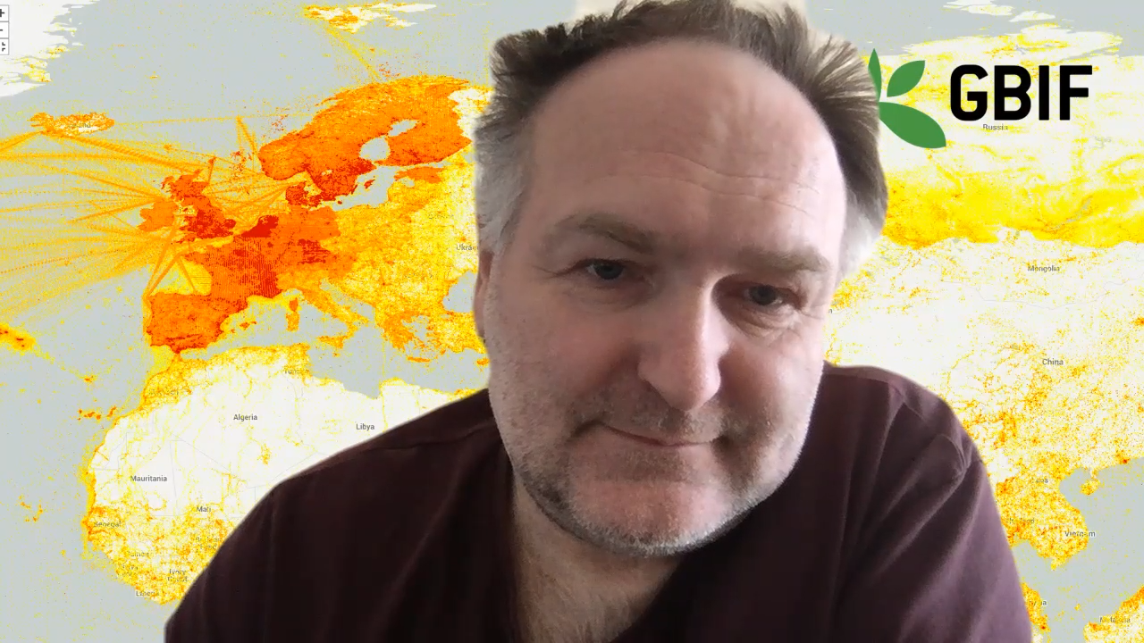
GBIF Norway node (2021 - 2025)
Next project phase
GBIF Norway 2021-2025 pending funding confirmation
National Node Partnership Consortium with node staff from:
University of Oslo (UiO NHM)
Norwegian Biodiversity Information Centre (NBIC)
Norwegian University of Science and Technology (NTNU UM)
Arctic University of Norway (UiT)
University of Bergen (UiB UM)
Norwegian Institute for Nature Research (NINA)
Rukaya Johaadien
Data Manager
Vidar Bakken
Outreach Officer (20%)
Dag Endresen
Node Manager
Capacity development at GBIF Norway
Notes:
Slide 11 (32 sec) And I am Dag Endresen the Node Manager for GBIF Norway. Before we close I will give a brief update an ongoing process in the node. We are currently in between funding periods. And pending decision from the Research Council (RCN) we start a new 5-year period soon. In the next period we will re-organize the node as a national consortium partnership including colleagues in the node staff from across more institutions. Thank you for listening to the update from GBIF Norway.

Slide 12
GBIF Norway node staff (April 2021)
Next project phase
GBIF Norway 2021-2025 pending funding confirmation
National Node Partnership Consortium with node staff from:
University of Oslo (UiO NHM)
Norwegian Biodiversity Information Centre (NBIC)
Norwegian University of Science and Technology (NTNU UM)
Arctic University of Norway (UiT)
University of Bergen (UiB UM)
Norwegian Institute for Nature Research (NINA)
Rukaya Johaadien
Data Manager
Vidar Bakken
Outreach Officer (20%)
Dag Endresen
Node Manager
Capacity development at GBIF Norway
Notes:
Slide 12 (10 sec)

