Slide 1
The Role of Biodiversity Informatics In the Global Biodiversity Information Facility
Dag Endresen | GBIF Node Manager for Norway
Global Biodiversity Information Facility (GBIF)
Illustration by Shahzaib Damn Cruze Wiki Commons CC BY-SA 4.0
Seminar | GC University of Lahore, Pakistan | 18th May 2021
Notes:
The role of Biodiversity informatics at the Global Biodiversity Information Facility (GBIF) – presented by Dag Endresen, GBIF Node Manager for Norway; University of Oslo;
Slides credit: Based on a slide-set by GBIF Scientific Officer Dmitry Schigel <dschigel@gbif.org>; Biodiversity Open Data Ambassadors, https://www.gbif.org/article/6dNF1d0tgcI4cmqeoS2sQ4/biodiversity-open-data-ambassadors
Slides available at https://www.slideshare.net/DagEndresen/20210127biodiversityinformaticsgbif52slides
Background image: Government College University, Lahore - Clock tower and main building, CC BY-SA 4.0 Shahzaib Damn Cruze. https://commons.wikimedia.org/wiki/File:Government_College_University,_Lahore_-_Clock_tower_and_main_building.jpg

Slide 2
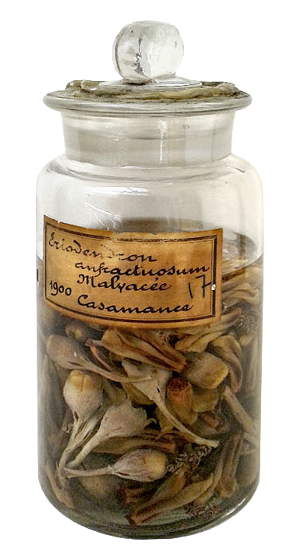
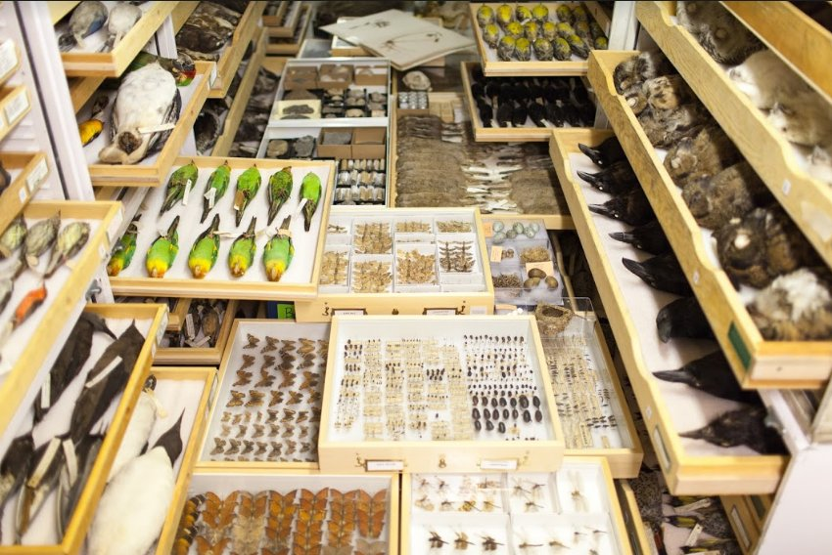
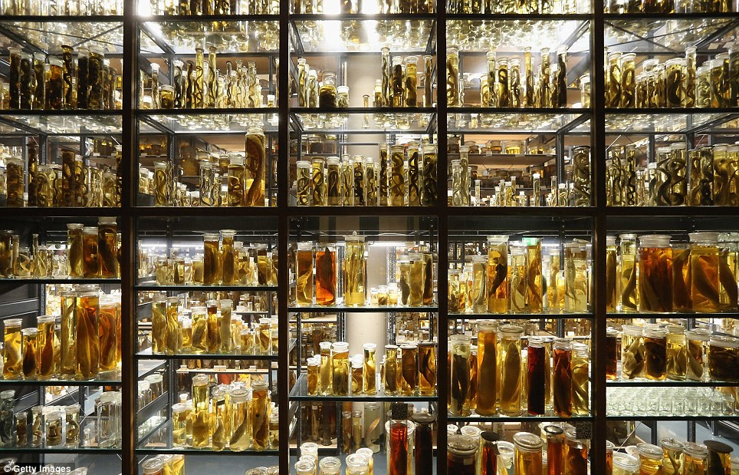
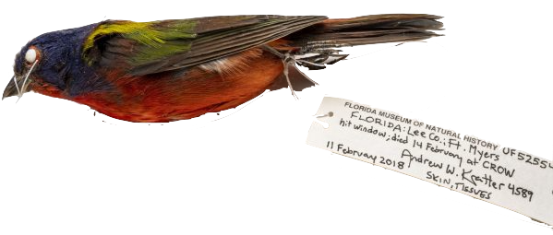



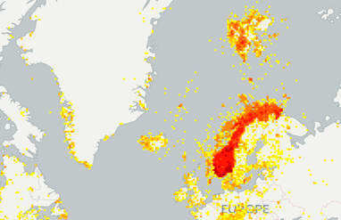



GBIF provides a biodiversity data infrastructure

Slide 3
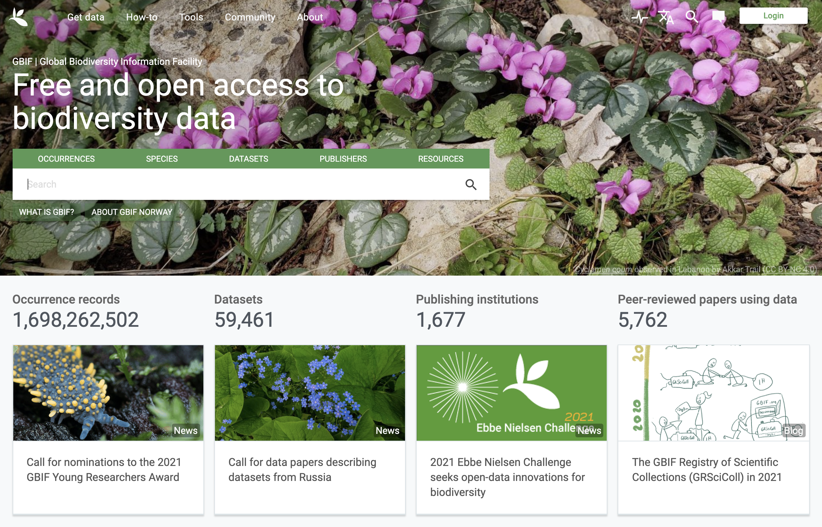
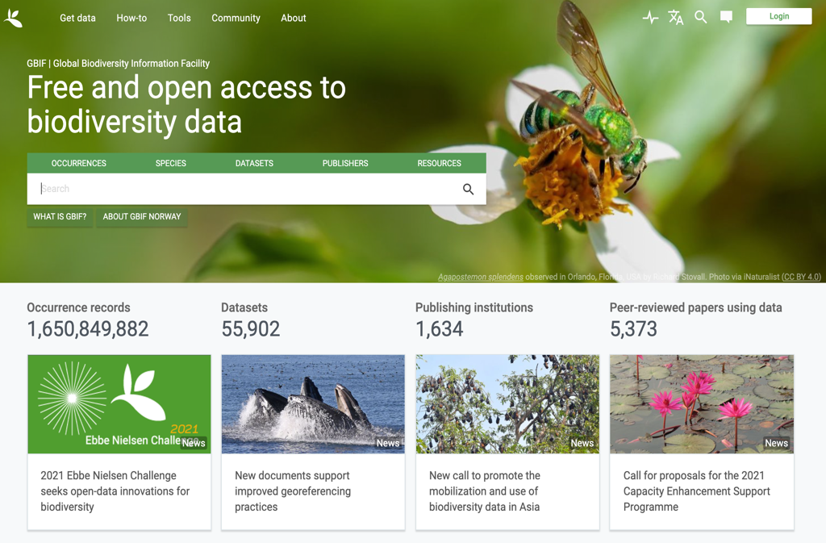
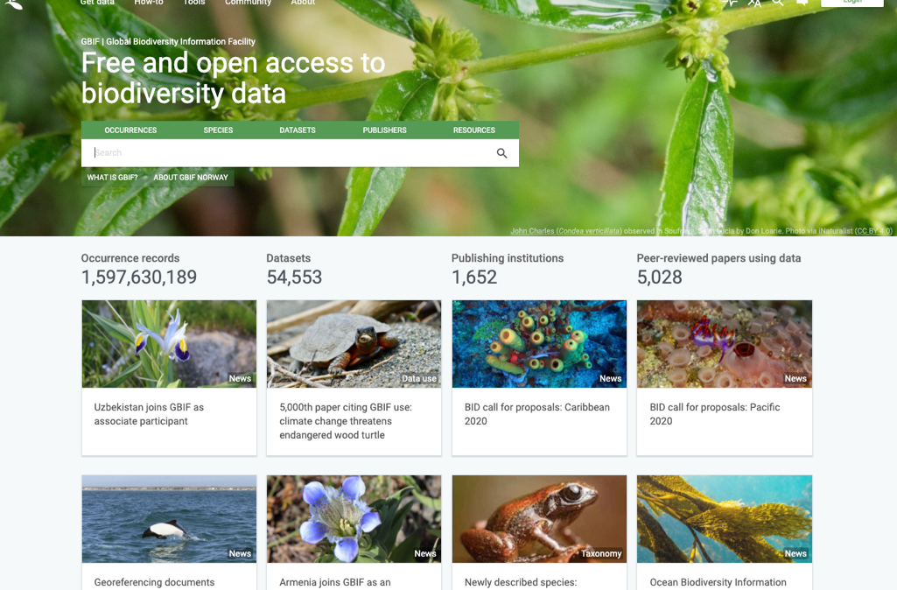
What is gbif?
Intergovernmental network and research infrastructure
Provides anyone, anywhere, free and open access to data about all types of life on Earth
Voluntary collaboration through Memorandum of Understanding (MoU)
Participant nodes, Secretariat in Copenhagen, Denmark
https://www.gbif.org
Notes:
https://www.gbif.org/

Slide 4
GBIF Participant countries
41 | Voting Participants
20 | Associate Countries
40 | Other Associate
1677 | Data publishers
Notes:
Participation - https://www.gbif.org/the-gbif-network

Slide 5
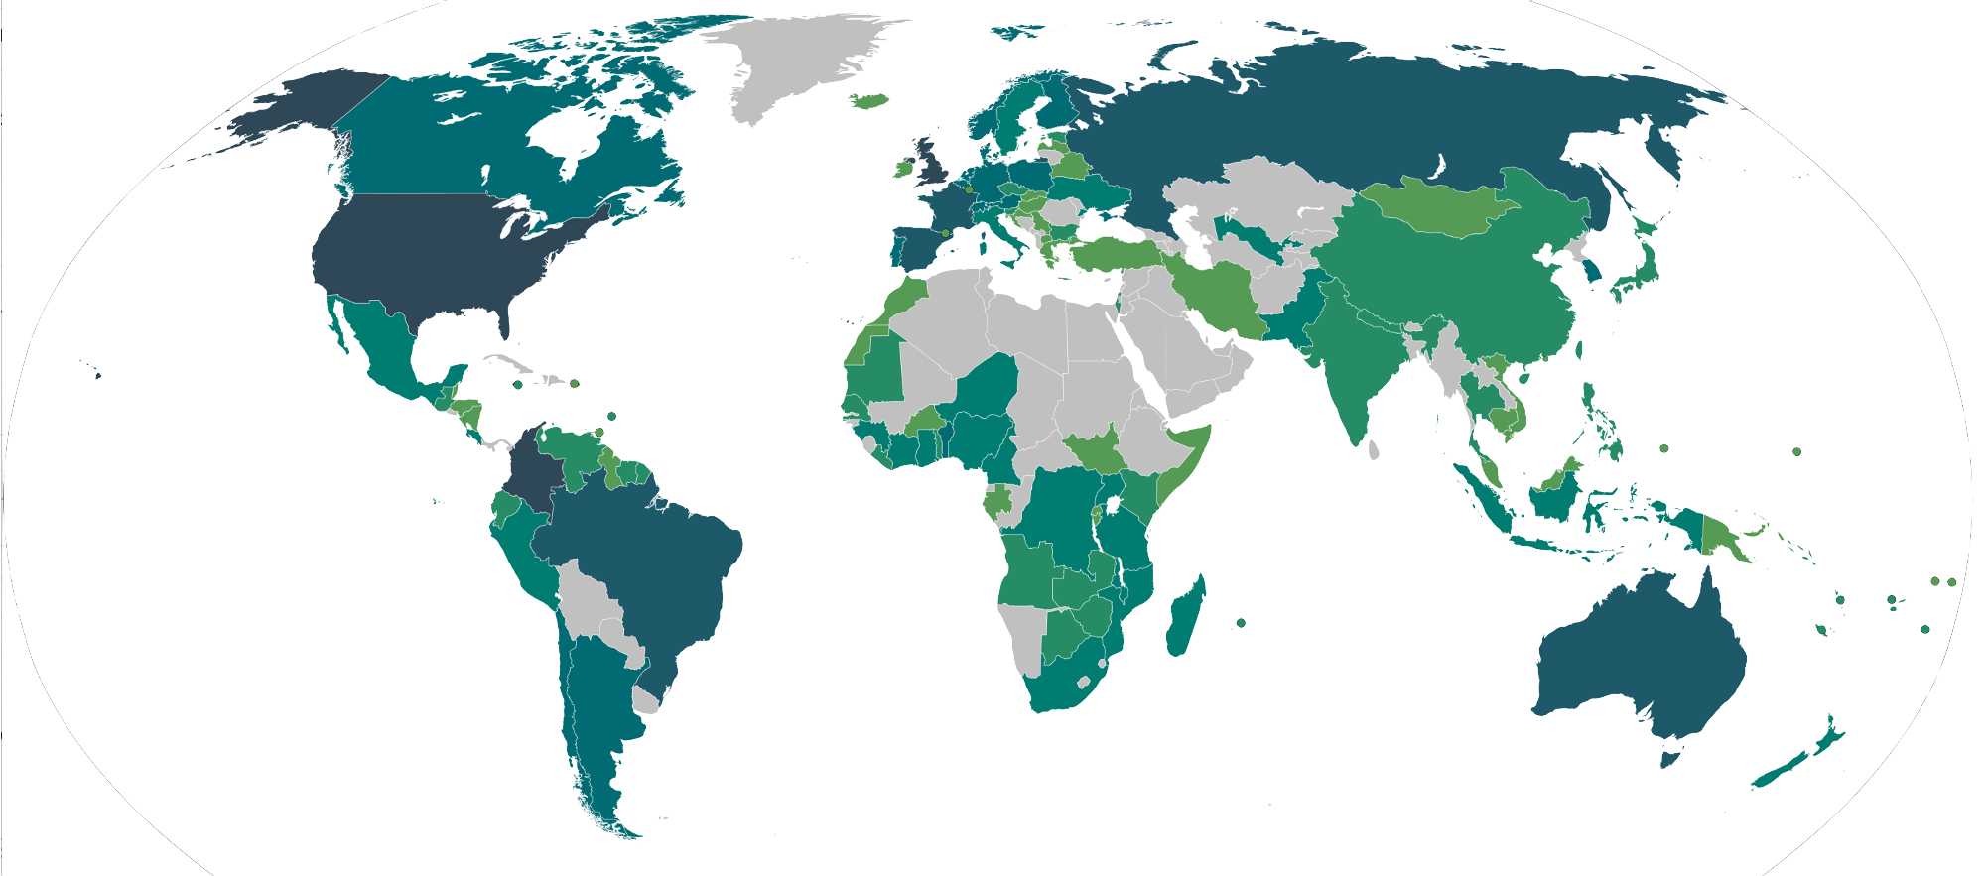
The gbif data publisher network

Slide 6
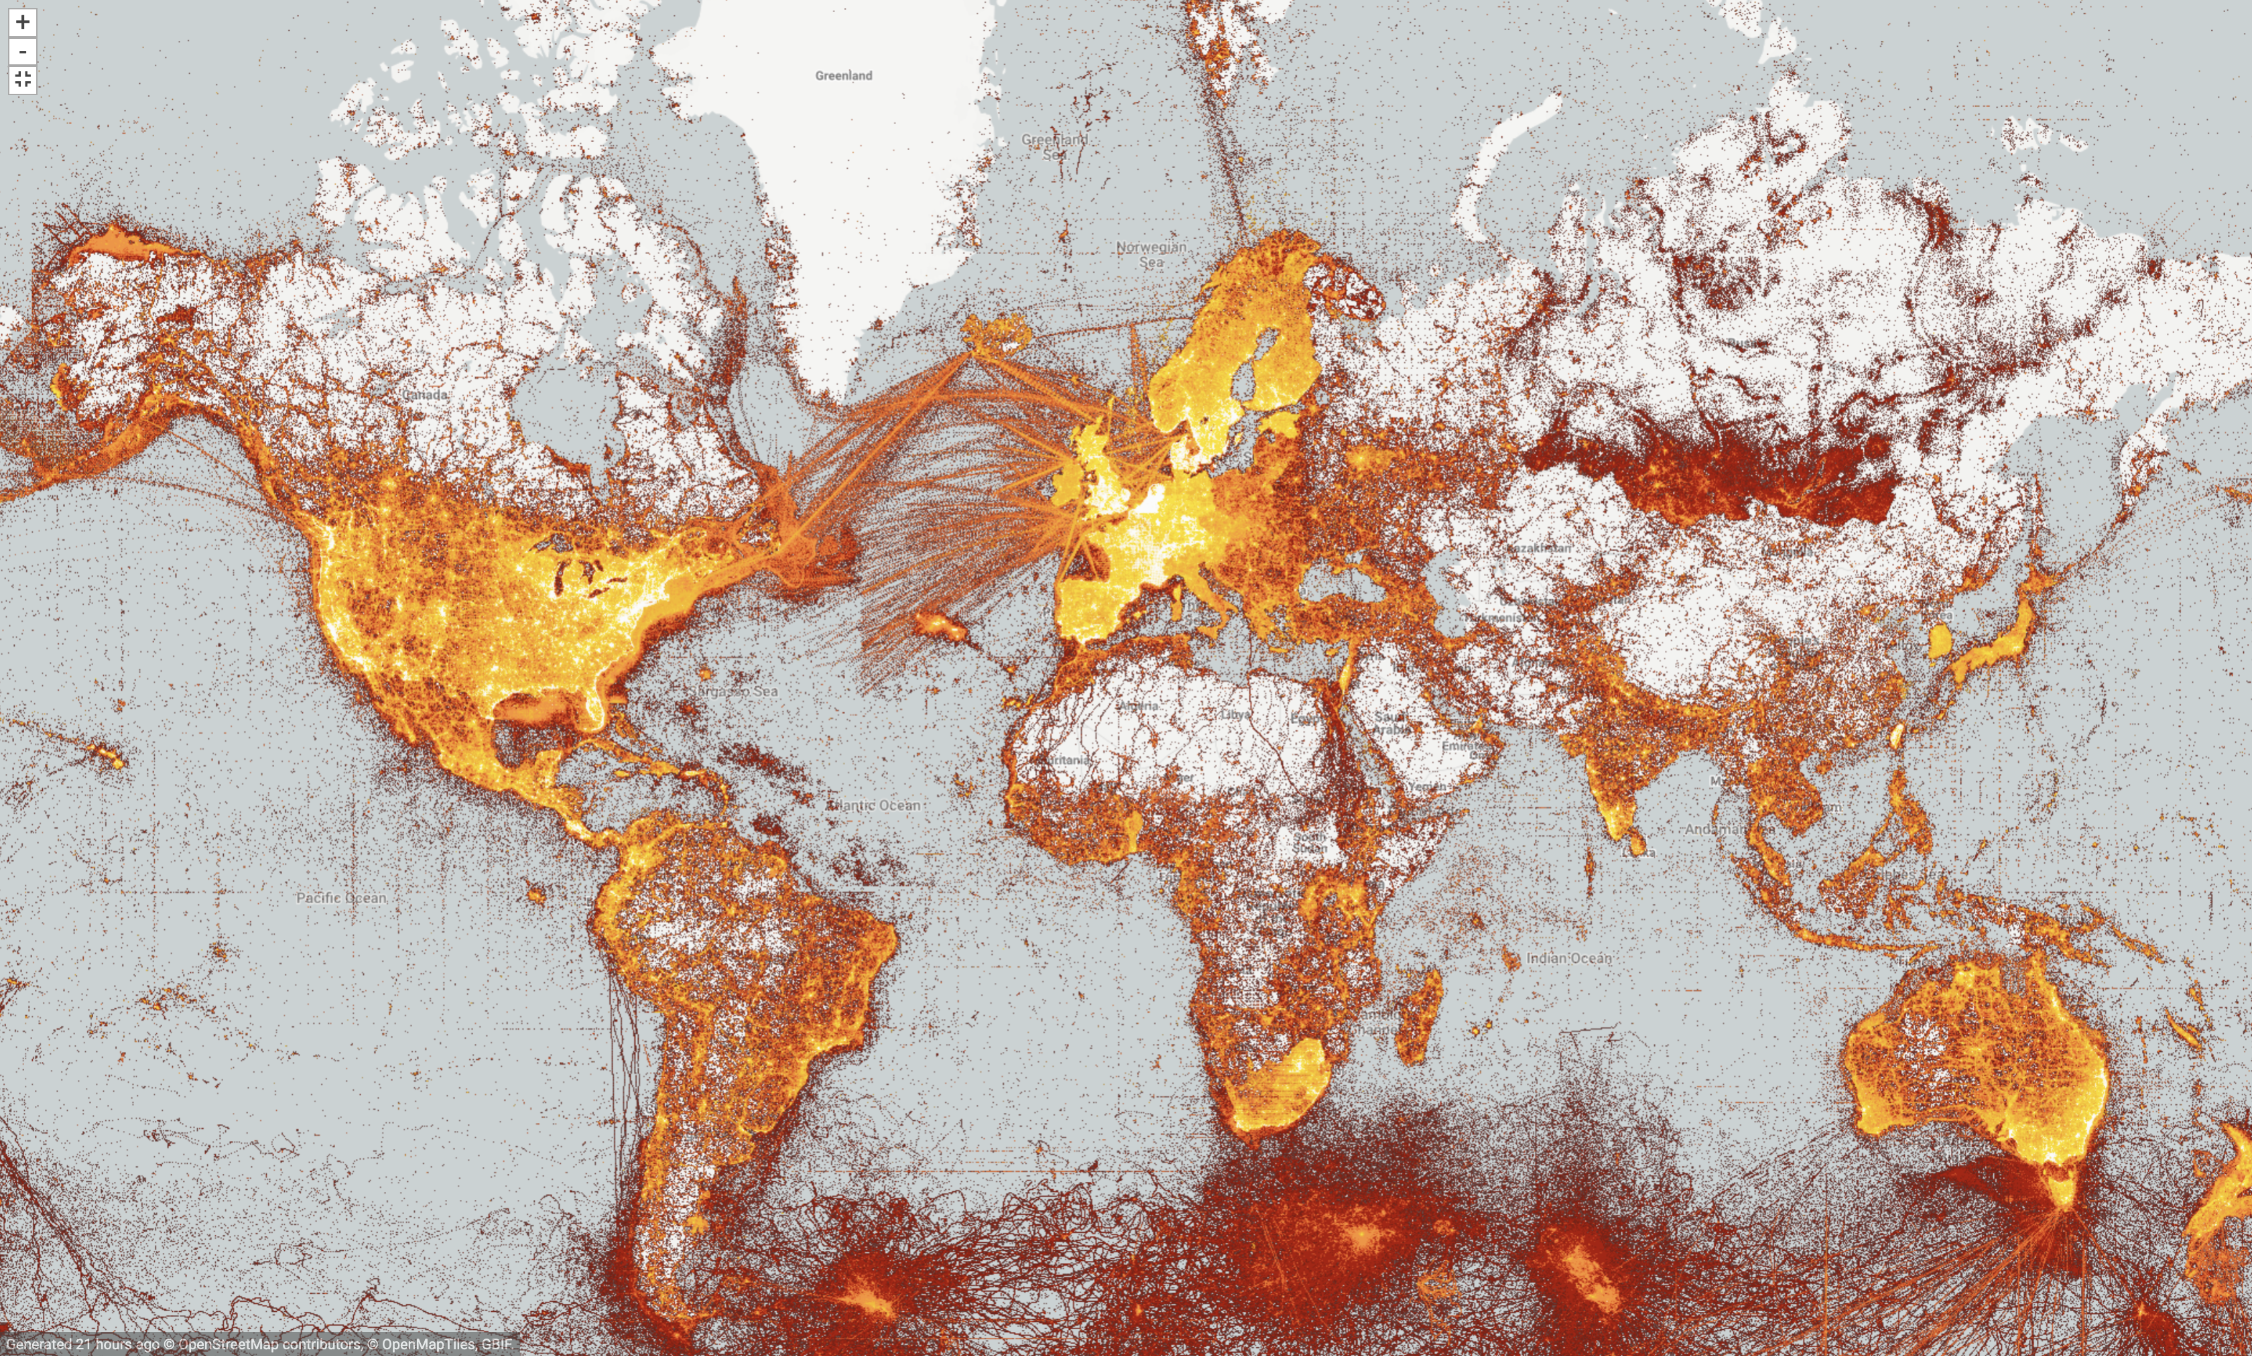
GBIF Data coverage
Map updated 14th March 2021

Slide 7
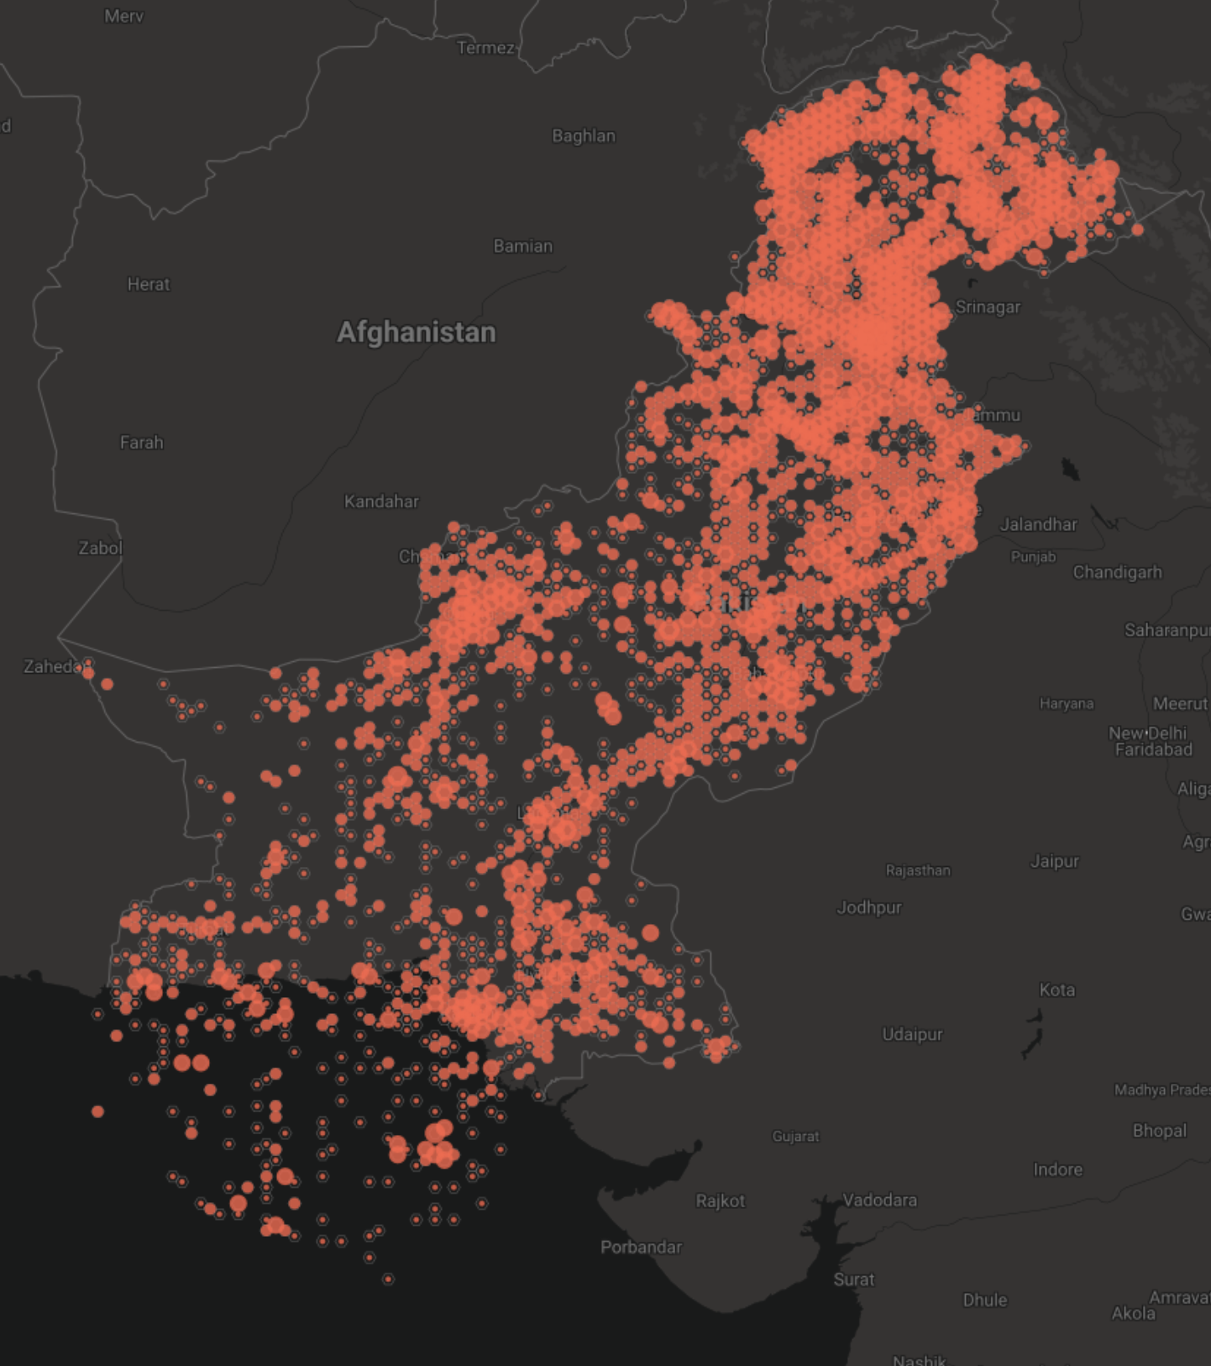








Milestones - Pakistan and GBIF
Pakistan was an associate member of GBIF from August 2001 to 2017.
March 2006 a GBIF mentor project between Pakistan and Australia – installed the DiGIR data publishing toolkit, hosted by the Pakistan Museum of Natural History in Islamabad (2 datasets), and the BioLink digitisation and collection management database.
Recent capacity development projects between Pakistan and USA (Mary Barkeworth) with datasets hosted from the OpenHerbarium (US GBIF node iDigBio) and Symbiota collection digitsation and management database (8 datasets). The BIFA program is funded by the Government of Japan.
Species data from Pakistan in GBIF
Notes:
Capacity development projects involving Symbiota and Mary Barkworth were funded through the BIFA programme, with funds from Ministry of Environment, Japan. You can see the associated datasets at https://www.gbif.org/project/5AVwgL7izSysQO2mquiYQ8/georeferencing-and-mobilization-of-plant-occurrence-data-from-pakistan#datasets and https://www.gbif.org/project/6LnVHo5YGGpEGSaIApzjyF/expanding-the-value-and-reach-of-plant-data-mobilization-in-pakistan#datasets .

Slide 8

digitization
of collections
Notes:
Digitization

Slide 9
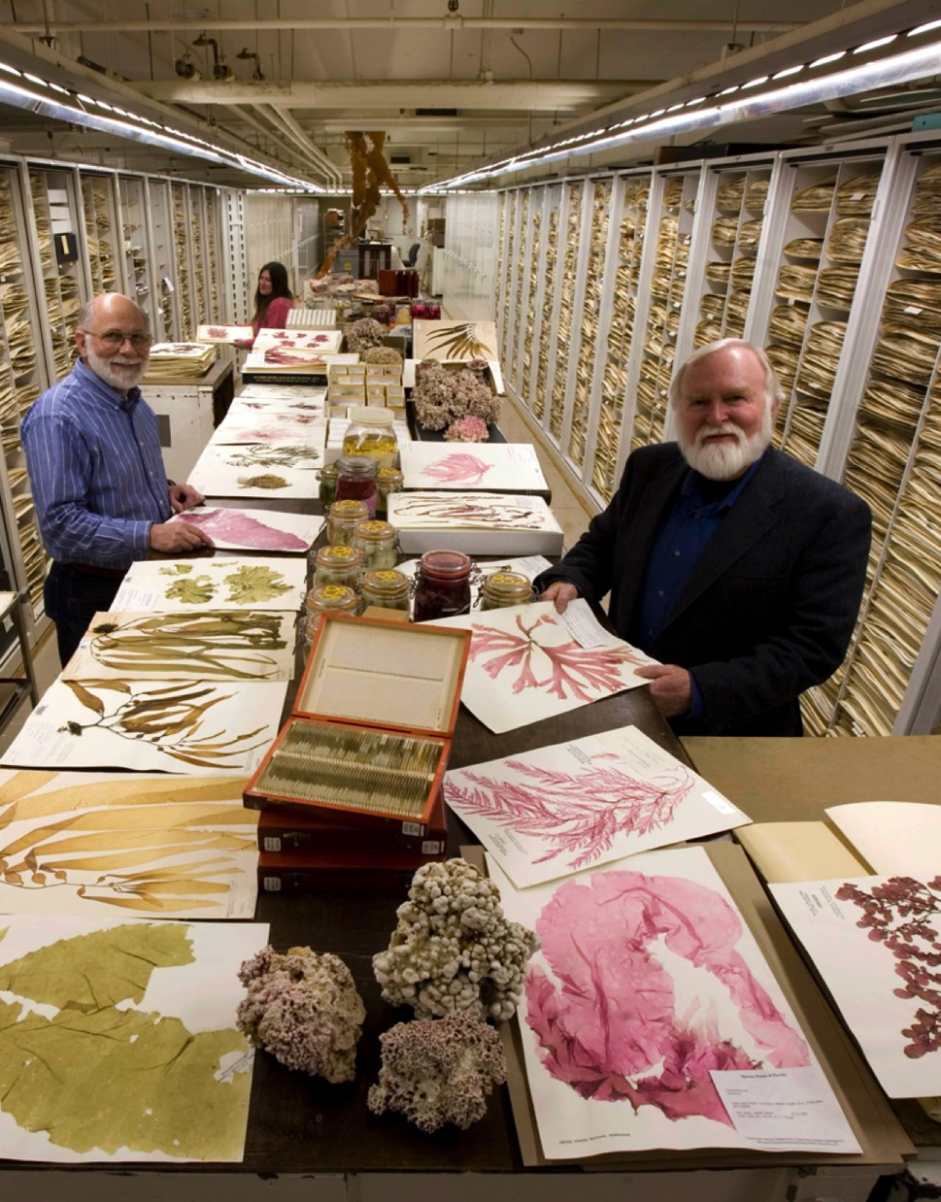
Very few museum specimens are digitized
Natural history museum collections worldwide conserve an estimated
1.2 - 3 billion specimens.
(Ariño 2010; Duckworth et al. 1993)
GBIF publishes 1,7 billion records – including 233 million specimens.
approx. 10% coverage??
Photo: Botany Collection, Algae, Smithsonian National Museum of Natural History Museum, by Chip Clark.
Notes:
* Ariño A. (2010). Approaches to estimating the universe of natural history collections data. Biodiversity Informatics, 7:81–92. [Estimate 1.2 to 2.1 billion museum specimens]
* Duckworth, W.D., Genoways, H.H. and Rose, C.L. (1993). Preserving Natural Science Collections: Chronicle of our Environment Heritage. Washington, DC: National Institute for the Conservation of Cultural Property 140 pp. [Estimate 2-3 billion museum specimens]
* Smith VS and Blagoderov V (2012). Bringing collections out of the dark. ZooKeys 209: 1-6. DOI: 10.3897/zookeys.209.3699
* Scoble MJ (2010). Natural History collections digitization: Rationale and value. Biodiversity Informatics, 7: 77-80.
* Berendsohn W., Chavan V., Macklin J.A. (2010). GBIF task group on the global strategy and action plan for the mobilization of NHM collections data. Biodiversity Informatics, 7:67-71.
Photo: Botany Collection, Algae, Smithsonian National Museum of Natural History Museum, by Chip Clark.

Slide 10
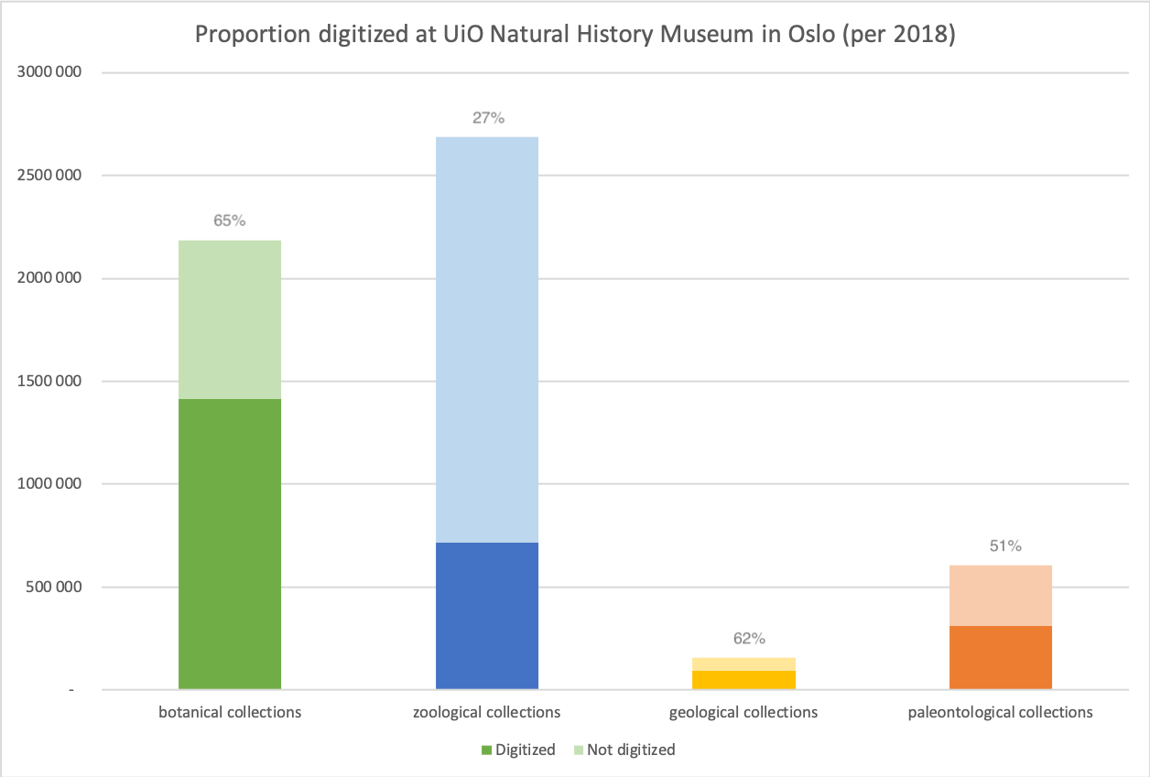

Digitized specimens at the university of Oslo (approx. 47%)
https://wiki.uio.no/nhm/skf/best-practices/index.php/Samlingstall
Notes:
Samlingstallene 2018 – en oppsummering
https://wiki.uio.no/nhm/skf/best-practices/index.php/Samlingstall

Slide 11
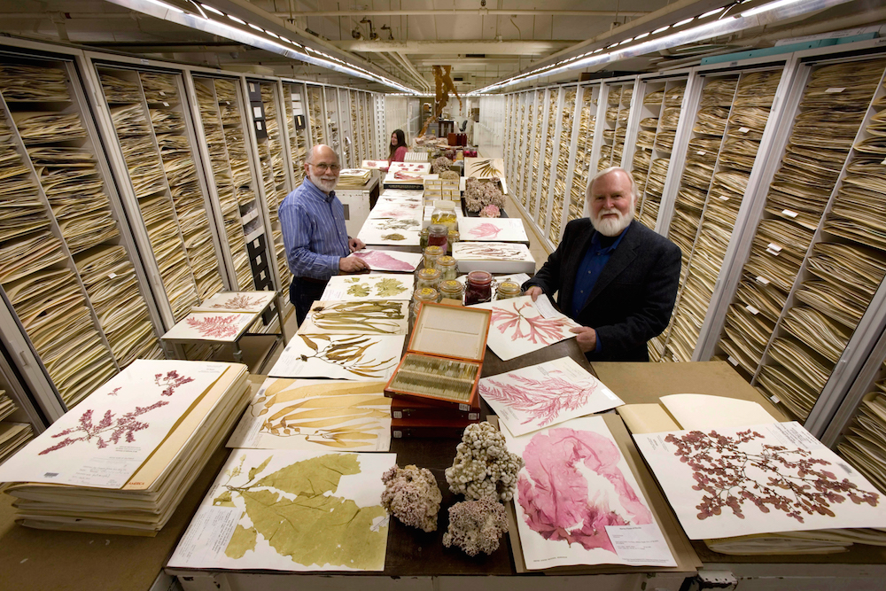
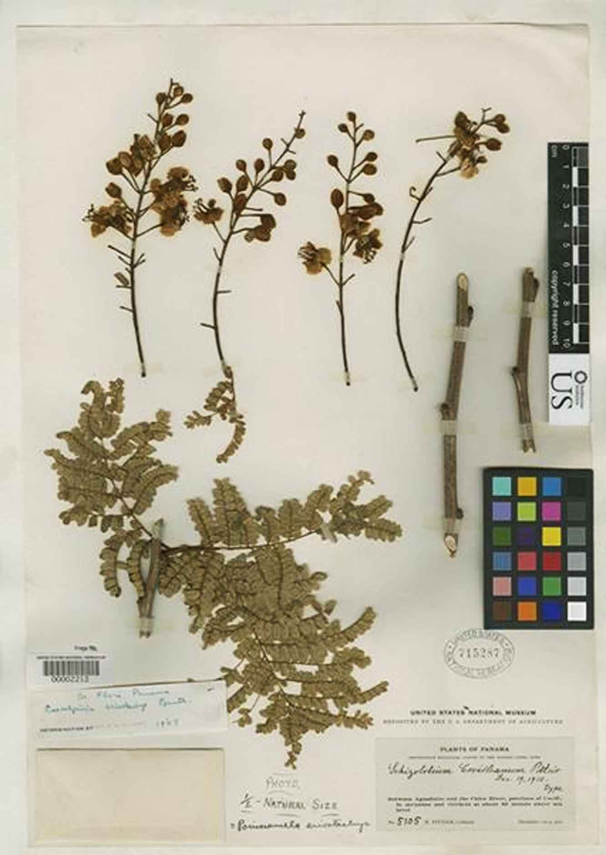

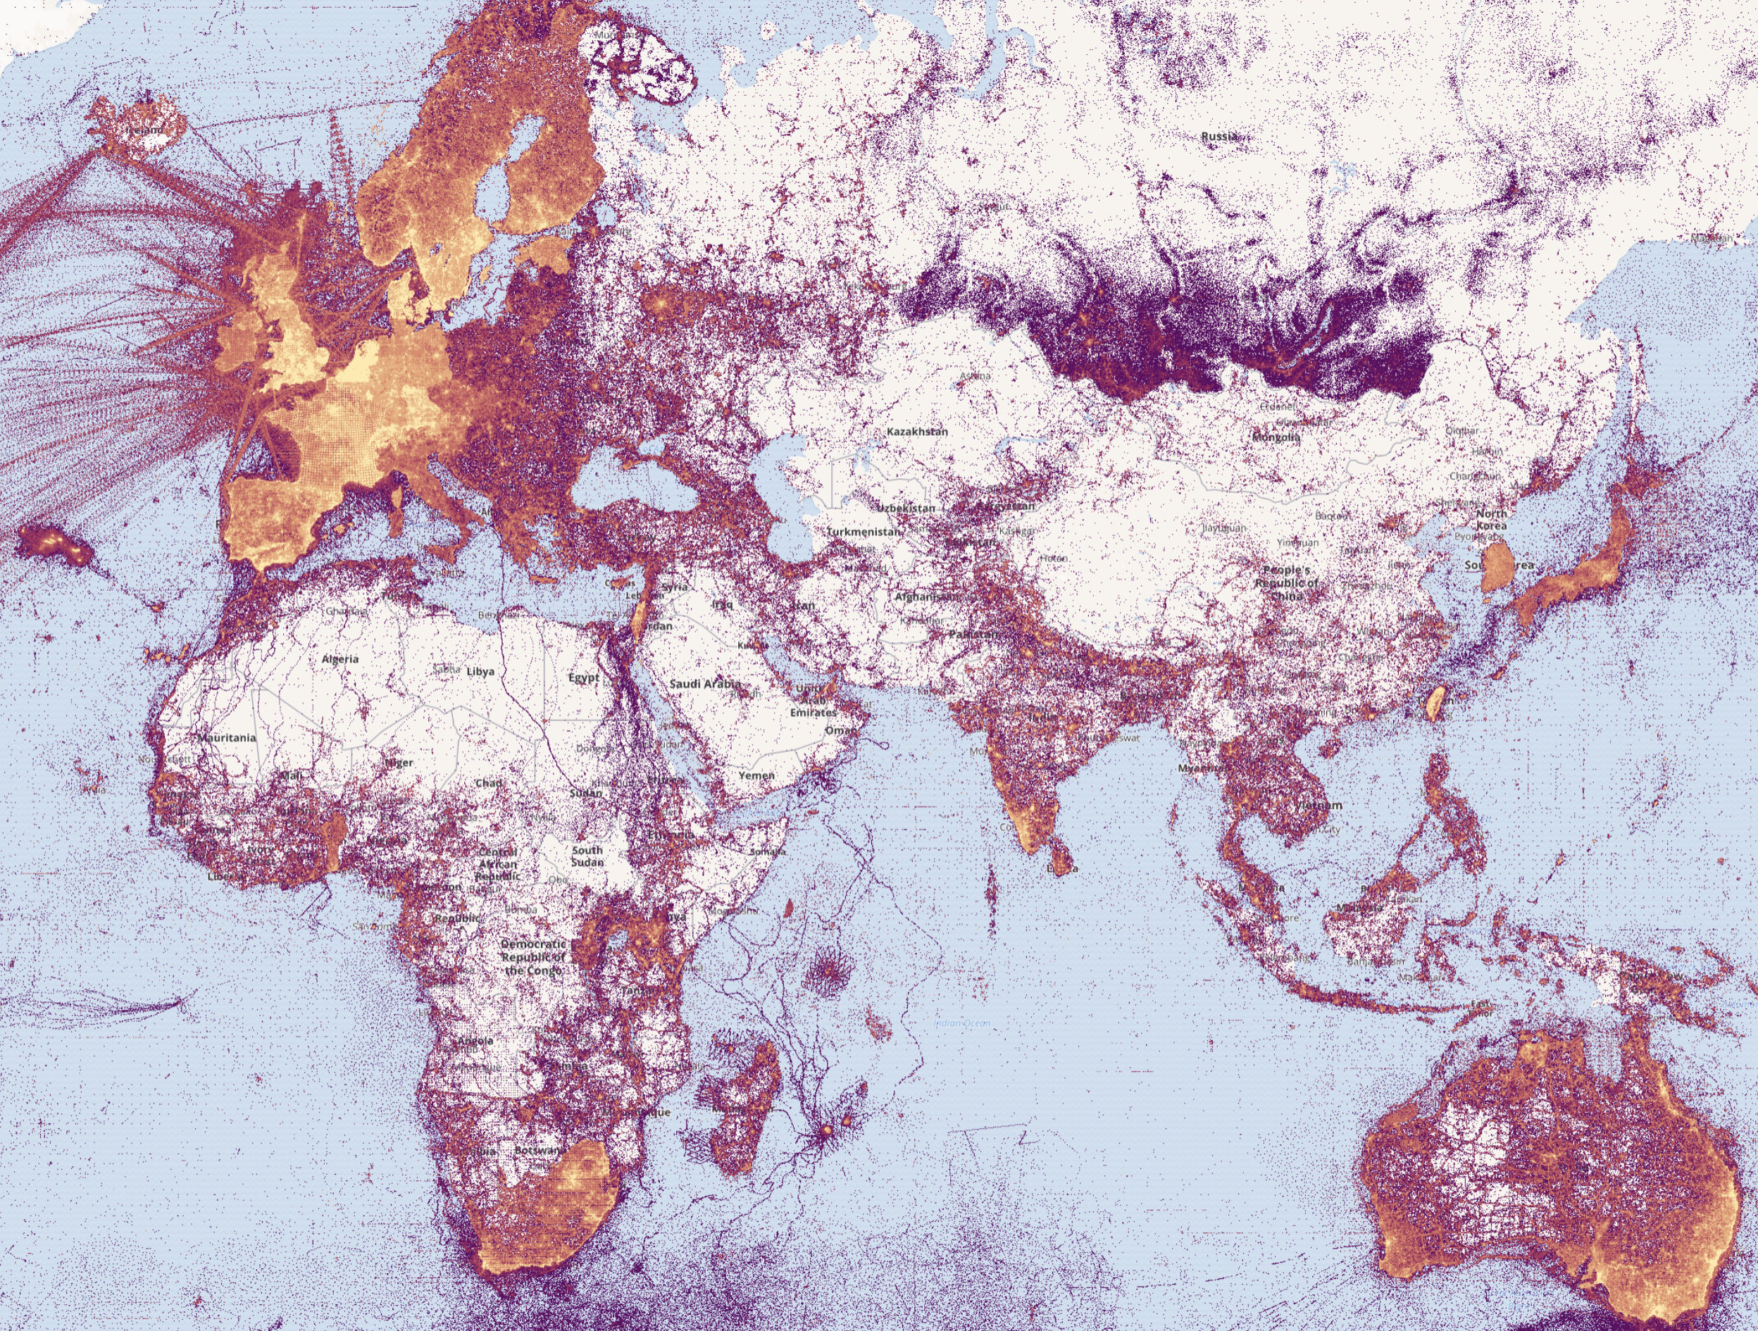
Digitisation of museum collections and herbaria

Slide 12
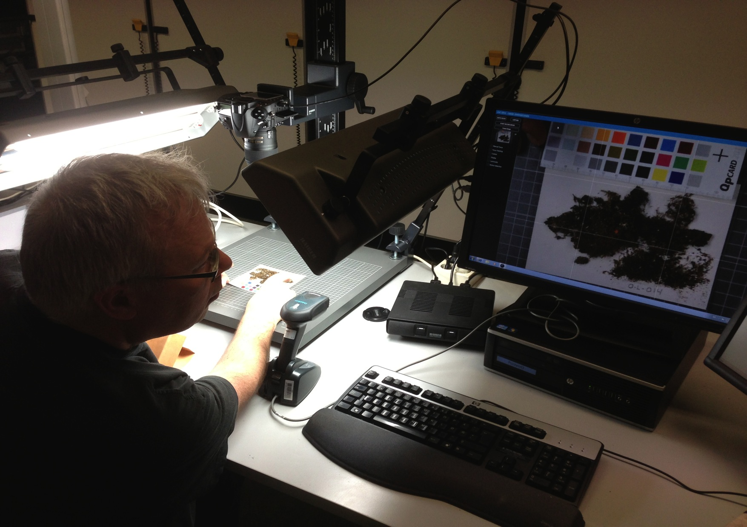

Catalog number: O-L-000014 Identifier: urn:uuid:41d9cbb4-4590-4265-8079-ca44d46d27c3
human-friendly
machine-friendly
Transcription of labels UiO Lichen herbarium (2012)
Notes:
Imaging of the Lichen Type specimens, attaching UUIDs as QR Codes to the herbarium sheets. http://purl.org/nhmuio/id/41d9cbb4-4590-4265-8079-ca44d46d27c3, catalog number O-L-000014. http://nhm2.uio.no/typephotos/lichens/typephotoS.php?f=O-L-000014_s.jpg
See also: http://nhm2.uio.no/lav/web/index.html
Photo CC-by Dag Endresen, University of Oslo, Natural History Museum

Slide 13
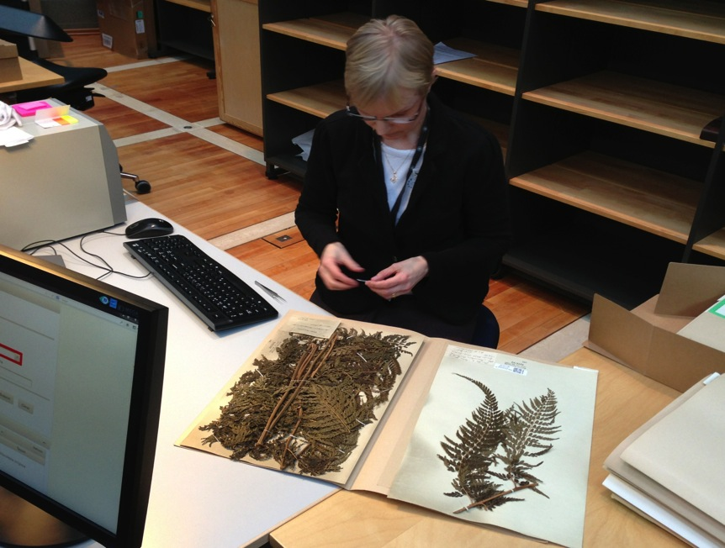
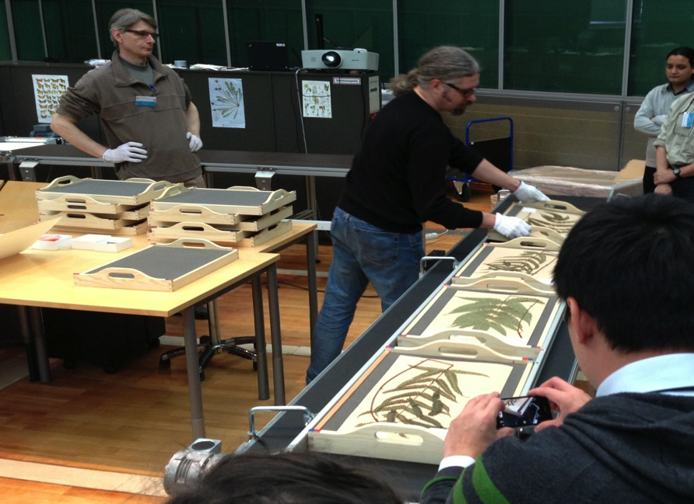

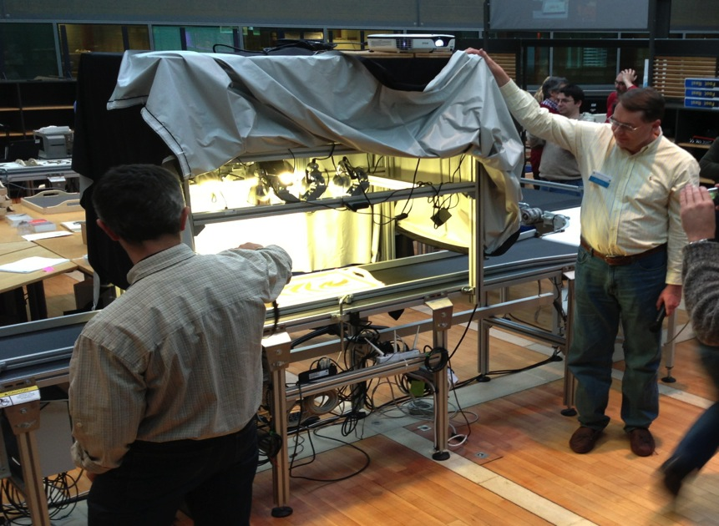
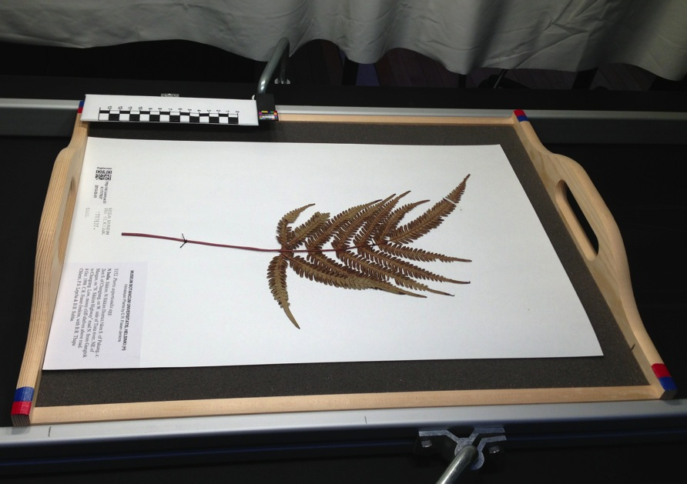
“Industrial” assembly line workflow routines
Notes:
Imaging of the UiO herbarium specimens out-sourced at Digitarium in Joensuu, Finland, photos: Dag Endresen, CC-by-3.0.

Slide 14
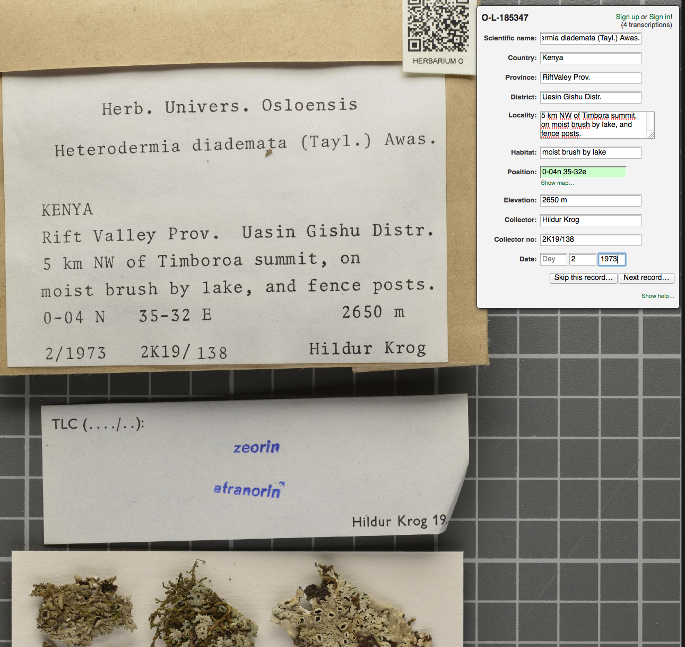
http://gbif.no/dugnad/
Notes:
PROTOTYPE transcription portal: http://gbif.no/transcribe

Slide 15
open data
Notes:
Digitization

Slide 16
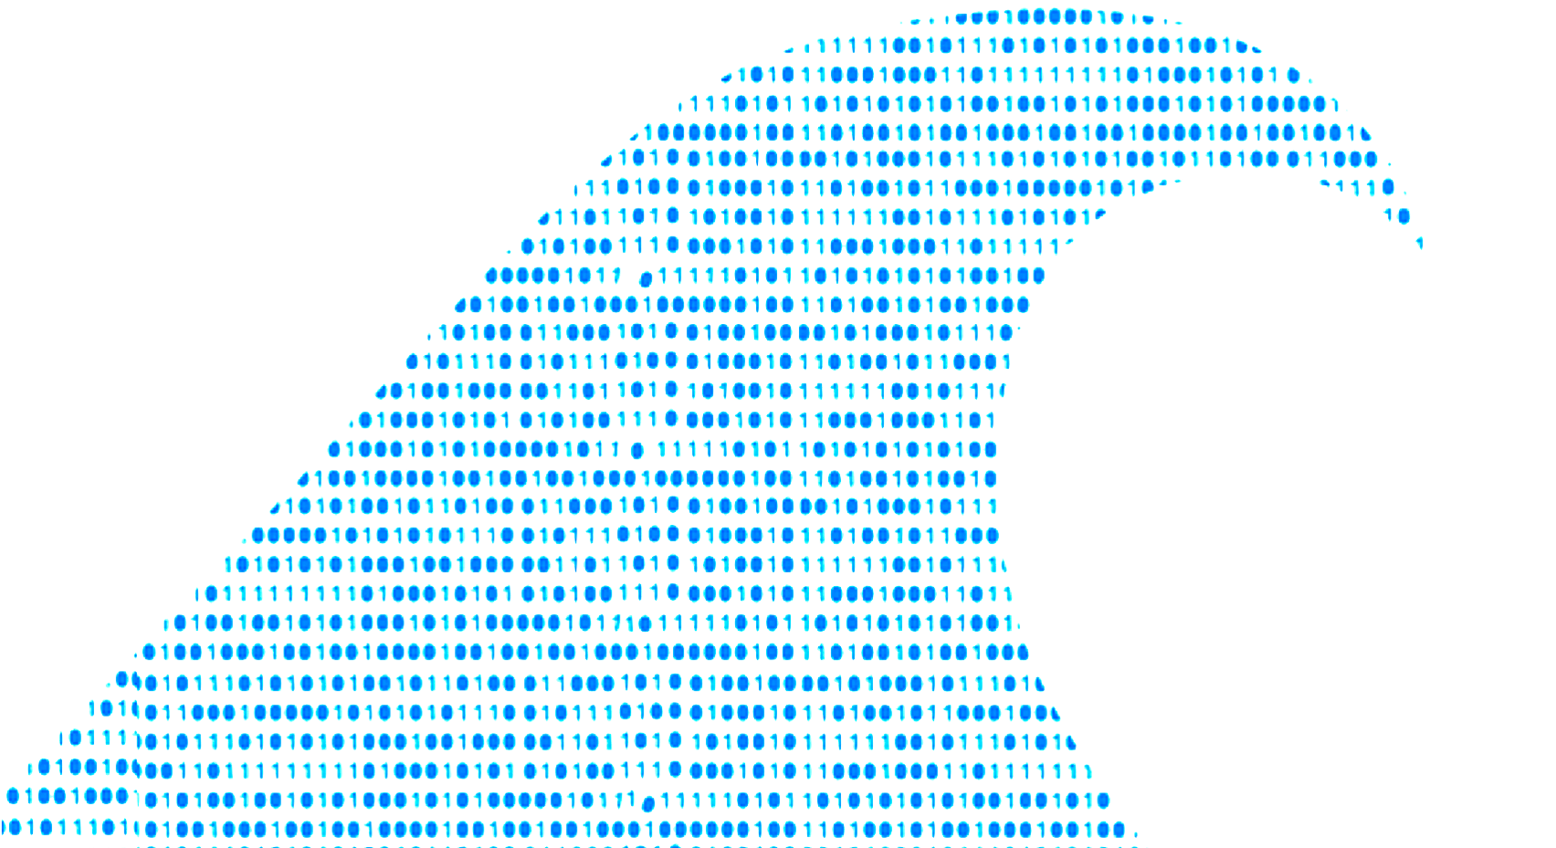

Why should Students learn open Science?

Slide 17


Why Should Museums care about open Science?

Slide 18
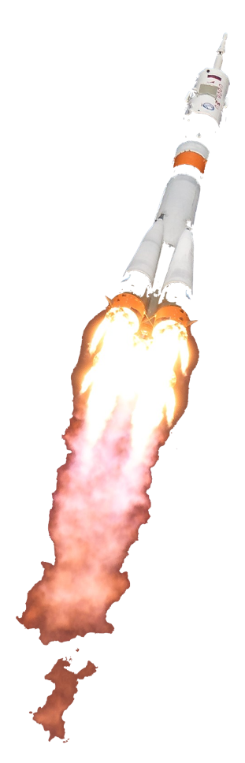
Why teach students open Science?
We are in the middle of an ongoing paradigm shift in scientific practice (and impact metrics).
The open science wave is moving fast!
Young scientists will need different skills, than was needed previously to succeed in academia.
Researchers will need to develop different approaches, than they needed in the past – to remain relevant.
Society is quickly gaining Big Data maturity and will expect new services from biodiversity information and research.

Slide 19
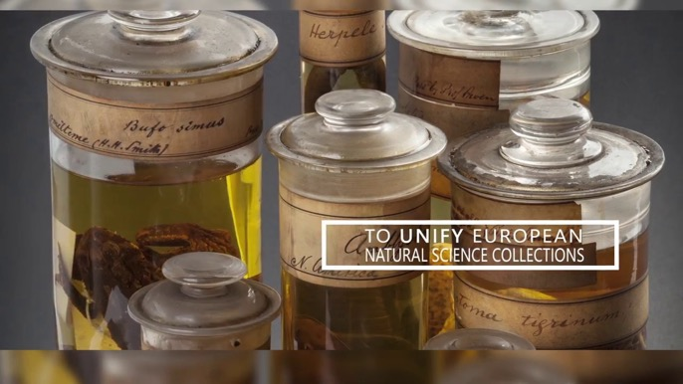


Data Citation as a new currency of Science
Peer-reviewed scholarly papers in high impact journals maintain considerable weight for impact metrics.
A movement is under way to build similar status for open data, open metadata, open material samples, and other open scientific research products…
Notes:
DORA https://sfdora.org/

Slide 20

Declaration on Research Assessment
DORA recognizes the need to improve how the outputs of scholarly research are evaluated.
DORA’s vision is to advance practical and robust approaches to research assessment globally and across all scholarly disciplines.
  The Declaration on Research Assessment (DORA) was developed in San Francisco in 2012.
  It has become a worldwide initiative covering all scholarly disciplines and key stakeholders.
  Covering funders, publishers, professional societies, institutions, and researchers.
  To date (2021-03-14), 17 085 individuals & 2 169 organizations in 145 countries have signed DORA.
  Including 12 universities and research institutions from Pakistan
Notes:
To date (2021-05-13), 17 394 individuals and 2 217 organizations in 145 countries have signed DORA.
To date (2021-01-26), 16 873 individuals and 2 139 organizations in 144 countries have signed DORA.
Pakistan -- https://sfdora.org/signers/?_organization_country=pakistan&_signer_type=organisation
Norway -- https://sfdora.org/signers/?_organization_country=norway&_signer_type=organisation
The Research Council of Norway (RCN) signed #sfDORA in May 2018. https://twitter.com/dorassessment/status/999349311417745409
WHEN will UiO sign? (Signed by NMBU, NTNU, UiT, UiA, UiS, DKNVS, OsloMet, Oslo Univ Hospital…)

Slide 21



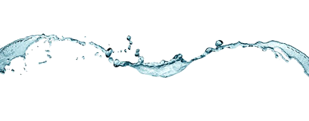





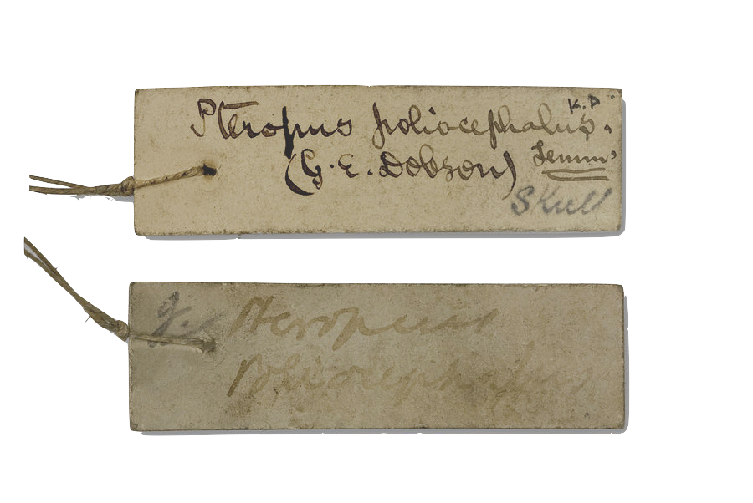
new possibilities for novel curiosity-driven research
Young
Researcher
Biodiversity Informatics
Open science
Traditional
museum science
Global Biodiversity Information Facility
Notes:
Fair use rationale: The image is of unknown source, retrieved from an Internet search. The image is used to illustrate the principle of expanding context that stable identifiers can be subject to. An identifier used in a particular context, such as the Internet, could be exposed to a larger context at a later future time. The image is used in an educational and not-for-profit, non-commercial purpose.

Slide 22








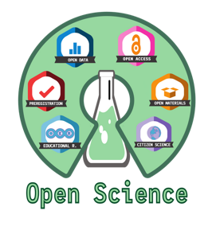


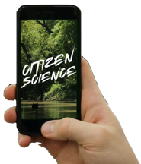



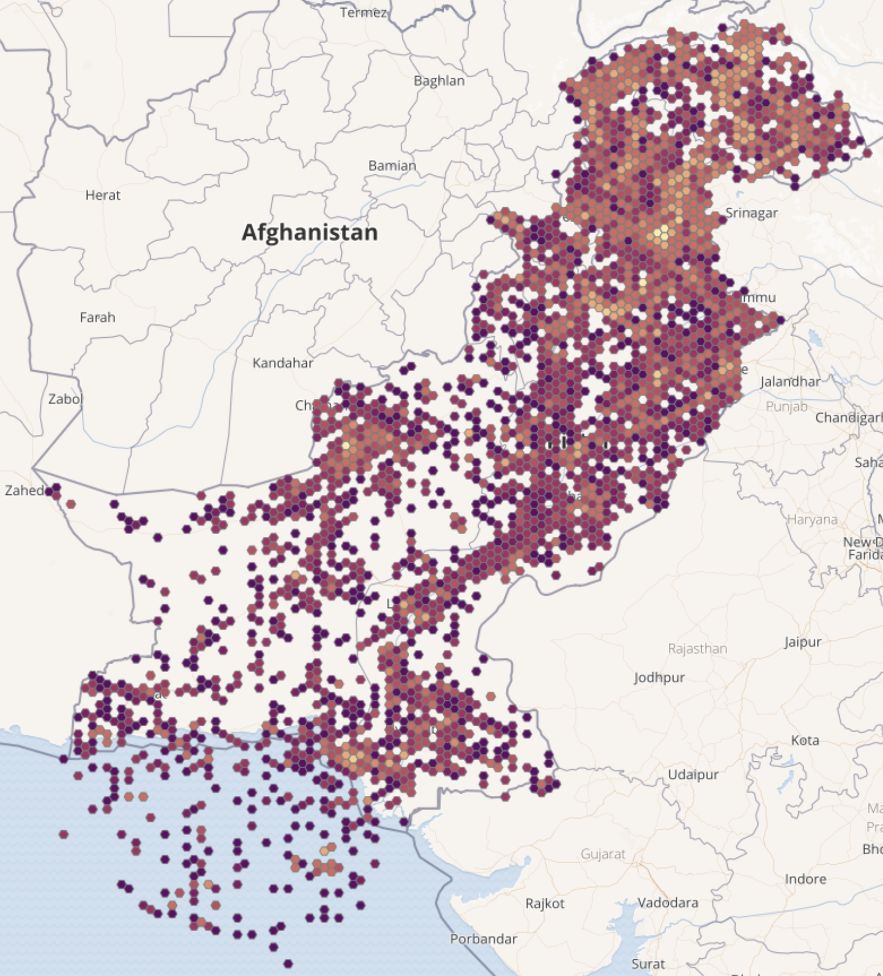
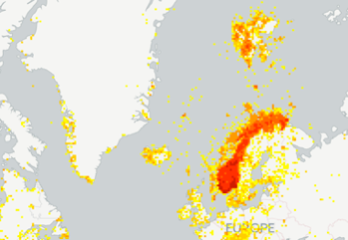
Career opportunities
Skills for open research and open data are in increasing demand!
Bring benefits for your career as a (young) researcher.
Add research datasets to your CV and online researcher profiles.

Slide 23

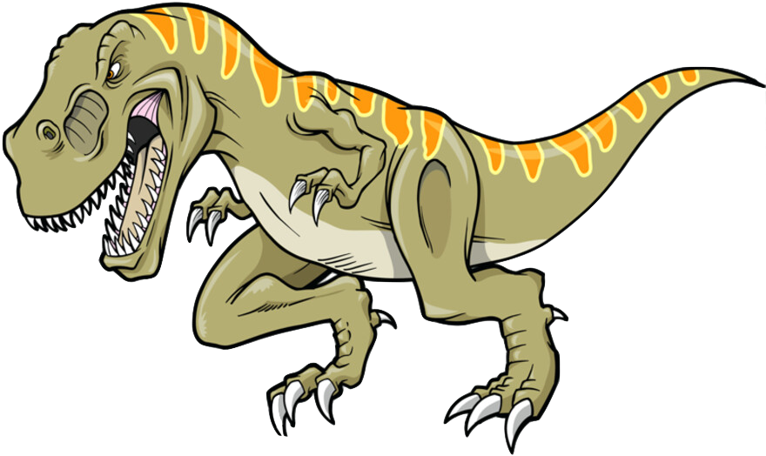
opportunities
Enables new research methodologies that were not possible before.
Scientific citation metrics for collections and specimen data.
Funding opportunities.
Notes:
GBIF opens up new benefits and opportunities for our museums and herbaria

Slide 24

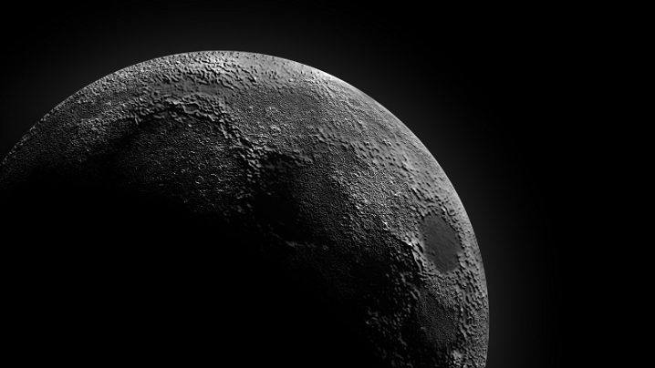
the dark side

Slide 25

Reproducibility crisis
"Scientific irreproducibility — the inability to repeat others' experiments and reach the same conclusion” (Nature 2016)
Baker (2016) 1,500 scientists lift the lid on reproducibility. Nature. doi:10.1038/533452a
Notes:
Illustration: David Klein (1918-2005) – fair use, for education
Is there a reproducibility crisis?
Baker (2016) 1,500 scientists lift the lid on reproducibility. Nature 533: 452-454 (26 May 2016) doi:10.1038/533452a
Baker (2016) Reproducibility: Seek out stronger science. Nature 537: 703-704 (29 September 2016) doi:10.1038/nj7622-703a
Nature editorial (2016) Reality check on reproducibility. Nature 533: 437 (26 May 2016) doi:10.1038/533437a
Baker (2016) Statisticians issue warning over misuse of P values. Nature 531: 151 (10 March 2016) doi:10.1038/nature.2016.19503
Nosek et al. (2015) Promoting an open research culture. Science 348(6242): 1422-1425. DOI:10.1126/science.aab2374
Leek and Peng (2015) Statistics: P values are just the tip of the iceberg. Nature 520: 612 (30 April 2015) doi:10.1038/520612°
Nuzzo (2015) How scientists fool themnselves – and how they can stop. Nature 526: 182–185 (08 October 2015) doi:10.1038/526182a
Hayden (2013) Weak statistical standards implicated in scientific irreproducibility. Nature doi:10.1038/nature.2013.14131
Young (2012) Replication studies: Bad copy. Nature 485, 298–300 (17 May 2012) doi:10.1038/485298a
Callaway (2011) Reports finds massive fraud at Dutch universities. Nature 479, 15 (1 November 2011) doi:10.1038/479015a

Slide 26
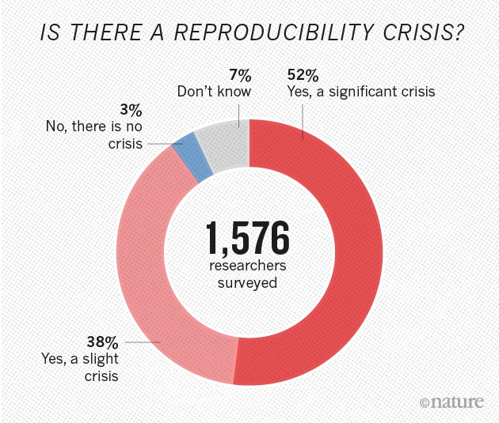
Scientific irreproducibility
is a growing concern.
Open Science solution: researchers to share their methods, data, computer code and results in central data repositories.
For physical real-world samples we also need herbarium specimen and bio-repositories (museums).
Baker (2016) 1,500 scientists lift the lid on reproducibility. Nature. doi:10.1038/533452a
Notes:
Is there a reproducibility crisis?
Baker (2016) 1,500 scientists lift the lid on reproducibility. Nature 533: 452-454 (26 May 2016) doi:10.1038/533452a
Baker (2016) Reproducibility: Seek out stronger science. Nature 537: 703-704 (29 September 2016) doi:10.1038/nj7622-703a
Nature editorial (2016) Reality check on reproducibility. Nature 533: 437 (26 May 2016) doi:10.1038/533437a
Baker (2016) Statisticians issue warning over misuse of P values. Nature 531: 151 (10 March 2016) doi:10.1038/nature.2016.19503
Nosek et al. (2015) Promoting an open research culture. Science 348(6242): 1422-1425. DOI:10.1126/science.aab2374
Leek and Peng (2015) Statistics: P values are just the tip of the iceberg. Nature 520: 612 (30 April 2015) doi:10.1038/520612°
Nuzzo (2015) How scientists fool themnselves – and how they can stop. Nature 526: 182–185 (08 October 2015) doi:10.1038/526182a
Hayden (2013) Weak statistical standards implicated in scientific irreproducibility. Nature doi:10.1038/nature.2013.14131
Young (2012) Replication studies: Bad copy. Nature 485, 298–300 (17 May 2012) doi:10.1038/485298a
Callaway (2011) Reports finds massive fraud at Dutch universities. Nature 479, 15 (1 November 2011) doi:10.1038/479015a

Slide 27
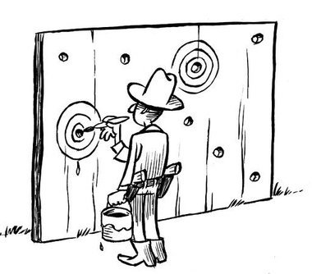
Will anybody trust closed science again?
Studies (1,2) indicates that p-hacking is a significant problem – sometimes even without the scientist even being aware of doing so.
Pre-registered (open) data provides a good insurance against suspicion of both data dredging (and plain data falsification).
“p-hacking” = occurs when researchers collect or select data or statistical analyses until nonsignificant results become significant (data fishing, …)
(1) Head et al. (2015) The Extent and Consequences of P-Hacking in Science . PLoS Biol. doi:10.1371/journal.pbio.1002106
(2) Ioannidis (2005). "Why Most Published Research Findings Are False". PLoS Medicine. doi:10.1371/journal.pmed.0020124.
Notes:
Ioannidis, John P.A. (August 30, 2005). "Why Most Published Research Findings Are False". PLoS Medicine. San Francisco: Public Library of Science. 2 (8): e124. doi:10.1371/journal.pmed.0020124.
Head, Megan L.; Holman, Luke; Lanfear, Rob; Kahn, Andrew T.; Jennions, Michael D. (13 March 2015). "The Extent and Consequences of P-Hacking in Science". PLOS Biology. 13 (3): e1002106. doi:10.1371/journal.pbio.1002106
For full reproducibility we also need access to the physical biological material – deposited in museum collections and biobank-repositories.

Slide 28
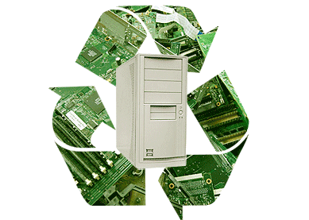
reuse of research data
Notes:
The following slides are Reuse of teaching curriculum – from the GBIF BioDATA training curriculum on data mobilisation

Slide 29
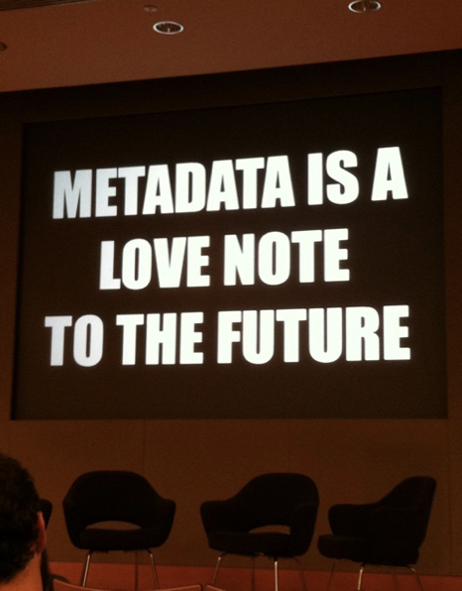
What is metadata?
Metadata, literally means “data about data”.
  Identify & discover its existence
  Learn how to access or acquire data
  Understand its fitness-for-use
Notes:
Slide source CC-BY EUDAT (2016) http://www.slideshare.net/EUDAT/introduction-to-metadata-57336324

Slide 30
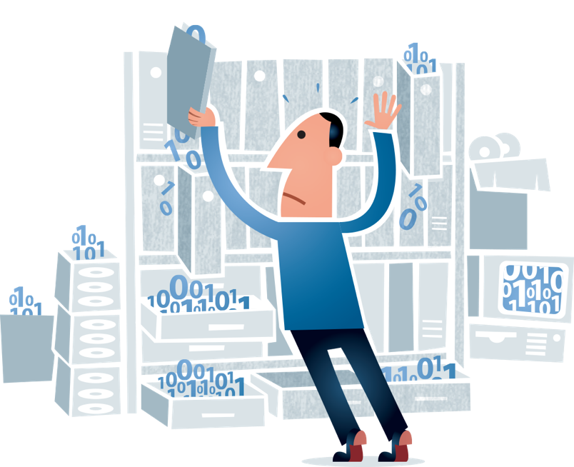
Data Management Plan (DMP)
A formal document that describes how research data will be handled during a research project, and after the project is completed.
Plan data management before the project begins.
Including costs of data management & archiving.
Reduce the loss of data.
DMP saves time in the long run
Promotes data fitness for reuse.
Reduce duplication of existing scientific studies.
Illustration CC BY Jørgen Stamp
Notes:
Illustration CC BY Jørgen Stamp, https://digitalbevaring.dk/
https://en.wikipedia.org/wiki/Data_management_plan
https://innsida.ntnu.no/wiki/-/wiki/English/Data+management+plan
https://www.uio.no/english/for-employees/support/research/research-data-management/data-management-plan/

Slide 31

What is a data paper?
A data paper is a peer reviewed document describing a dataset, published in a peer reviewed journal.
It takes effort to prepare, curate and describe data.
  Data papers provide recognition for this effort by means of a scholarly article.
  Recognition for improving the fitness for reuse for your own datasets.
  Recognition for making legacy research data available for reuse.
Notes:
https://www.gbif.org/data-papers

Slide 32

Data citation principles
Data to be legitimate citable products of research.
Data citations giving scholarly credit and attribution.
In scholarly literature, whenever claims are based on data, data should always be cited.
Persistent method for identification of data, that is machine actionable, globally unique, universal.
Data citation facilitate access to data or at least to metadata.
Unique identifiers that persist even beyond the lifespan of the data.
Data citation identify and access the specific data that support verification of the claim (provenance, time-slice, version).
Flexible, but attention to interoperability of practices across communities.
Data Citation Synthesis Group: Joint Declaration of Data Citation Principles. Martone M. (ed.) San Diego CA: FORCE11; 2014; https://doi.org/10.25490/a97f-egyk
Notes:
Data Citation Synthesis Group: Joint Declaration of Data Citation Principles. Martone M. (ed.) San Diego CA: FORCE11; 2014 https://doi.org/10.25490/a97f-egyk
https://www.force11.org/datacitationprinciples | https://www.force11.org/group/joint-declaration-data-citation-principles-final
Endorsement List
Preamble
Sound, reproducible scholarship rests upon a foundation of robust, accessible data. For this to be so in practice as well as theory, data must be accorded due importance in the practice of scholarship and in the enduring scholarly record. In other words, data should be considered legitimate, citable products of research. Data citation, like the citation of other evidence and sources, is good research practice and is part of the scholarly ecosystem supporting data reuse.
In support of this assertion, and to encourage good practice, we offer a set of guiding principles for data within scholarly literature, another dataset, or any other research object.
These principles are the synthesis of work by a number of groups. As we move into the next phase, we welcome your participation and endorsement of these principles.
--
Principles
The Data Citation Principles cover purpose, function and attributes of citations. These principles recognize the dual necessity of creating citation practices that are both human understandable and machine-actionable.
These citation principles are not comprehensive recommendations for data stewardship. And, as practices vary across communities and technologies will evolve over time, we do not include recommendations for specific implementations, but encourage communities to develop practices and tools that embody these principles.
The principles are grouped so as to facilitate understanding, rather than according to any perceived criteria of importance.
1. Importance
Data should be considered legitimate, citable products of research. Data citations should be accorded the same importance in the scholarly record as citations of other research objects, such as publications [1].
2. Credit and Attribution
Data citations should facilitate giving scholarly credit and normative and legal attribution to all contributors to the data, recognizing that a single style or mechanism of attribution may not be applicable to all data [2].
3. Evidence
In scholarly literature, whenever and wherever a claim relies upon data, the corresponding data should be cited [3].
4. Unique Identification
A data citation should include a persistent method for identification that is machine actionable, globally unique, and widely used by a community [4].
5. Access
Data citations should facilitate access to the data themselves and to such associated metadata, documentation, code, and other materials, as are necessary for both humans and machines to make informed use of the referenced data [5].
6. Persistence
Unique identifiers, and metadata describing the data, and its disposition, should persist -- even beyond the lifespan of the data they describe[6].
7. Specificity and Verifiability
Data citations should facilitate identification of, access to, and verification of the specific data that support a claim. Citations or citation metadata should include information about provenance and fixity sufficient to facilitate verfiying that the specific timeslice, version and/or granular portion of data retrieved subsequently is the same as was originally cited [7].
8. Interoperability and Flexibility
Data citation methods should be sufficiently flexible to accommodate the variant practices among communities, but should not differ so much that they compromise interoperability of data citation practices across communities [8].

Slide 33

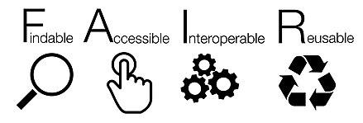
… researchers need to do more than simply post their data on the web for it to be re-usable.
FAIR data is about machine-readable data
Notes:
Wilkinson et al. 2016 doi:10.1038/sdata.2016.18

Slide 34
What is FAIR data?
FINDABLE → Data and supplementary materials have sufficiently rich metadata and a unique and persistent identifier.
ACCESSIBLE → Metadata and data are understandable to humans and machines. Data is deposited in a trusted repository.
INTEROPERABLE → Metadata use a formal, accessible, shared, and broadly applicable language for knowledge representation.
REUSABLE → Data and collections have a clear usage licenses and provide accurate information on provenance.
https://www.go-fair.org/
Notes:
https://www.go-fair.org/

Slide 35


Invest 5% of research funds in ensuring data are reusable
It is irresponsible to support research but not data stewardship. Huge sums of taxpayer funds go to waste because such data cannot be reused.
On average, 5% of overall research costs should go towards data stewardship.
If data are treated properly, researchers will have significantly more time to do research.
Barend Mons, Nature 578: 491, 27 February 2020
Barend Mons co-leads GO FAIR and co-author of the FAIR principles (2016)
Notes:
Berend Mons (2020) Invest 5% of research funds in ensuring data are reusable. Nature 578: 491 doi:10.1038/d41586-020-00505-7
https://doi.org/10.1038/d41586-020-00505-7
Wilkinson, Mark D.; Dumontier, Michel; Aalbersberg, IJsbrand Jan; Appleton, Gabrielle; Axton, Myles; Baak, Arie; Blomberg, Niklas; Boiten, Jan-Willem; da Silva Santos, Luiz Bonino; Bourne, Philip E.; Bouwman, Jildau; Brookes, Anthony J.; Clark, Tim; Crosas, Mercè; Dillo, Ingrid; Dumon, Olivier; Edmunds, Scott; Evelo, Chris T.; Finkers, Richard; Gonzalez-Beltran, Alejandra; Gray, Alasdair J.G.; Groth, Paul; Goble, Carole; Grethe, Jeffrey S.; Heringa, Jaap; ’t Hoen, Peter A.C; Hooft, Rob; Kuhn, Tobias; Kok, Ruben; Kok, Joost; Lusher, Scott J.; Martone, Maryann E.; Mons, Albert; Packer, Abel L.; Persson, Bengt; Rocca-Serra, Philippe; Roos, Marco; van Schaik, Rene; Sansone, Susanna-Assunta; Schultes, Erik; Sengstag, Thierry; Slater, Ted; Strawn, George; Swertz, Morris A.; Thompson, Mark; van der Lei, Johan; van Mulligen, Erik; Velterop, Jan; Waagmeester, Andra; Wittenburg, Peter; Wolstencroft, Katherine; Zhao, Jun; Mons, Barend (15 March 2016). "The FAIR Guiding Principles for scientific data management and stewardship". Scientific Data. p. 160018. doi:10.1038/sdata.2016.18

Slide 36

Notes:
https://www.gbif.org

Slide 37


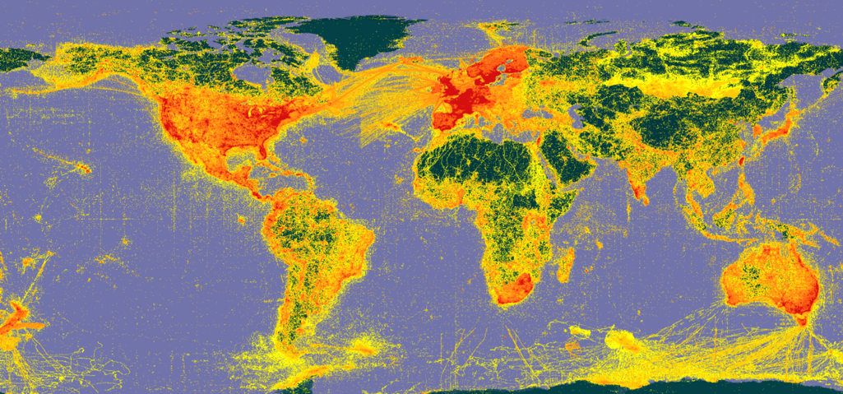





A window on evidence about where species HAVE lived, and when
Observations
Digitized specimens
Data publishing and indexing
Literature
Common standards (DwC)
Data discovery and use
Remote-sensing
Environmental DNA

Slide 38


BY THE NUMBERS | 18 May 2021
1 698 262 502
59 461
Datasets
Species occurrence records
1 677
5 762
Peer-review papers
using data
61
40
Country Participants
Organizational Participants
23.6 billion
Average records downloaded per month
(2020)
Publishers
Notes:
A window on biodiversity
An informatics infrastructure focused on tools and standards in service to science and society
A global network on bioinformatics
---
https://www.gbif.org/resource/search?contentType=literature&literatureType=journal&relevance=GBIF_USED&peerReview=true

Slide 39









BY THE NUMBERS | 15 May 2021 - Pakistan
78 976
10
Datasets (published from)
Species occurrence records (published from)
9
18
Peer-review papers
using data (co-author from Pakistan
Publishers
(from Pakistan)
https://www.gbif.org/country/PK/summary
Notes:
https://www.gbif.org/country/PK/summary
https://www.gbif.org/resource/search?contentType=literature&literatureType=journal&relevance=GBIF_USED&countriesOfResearcher=PK&peerReview=true

Slide 40
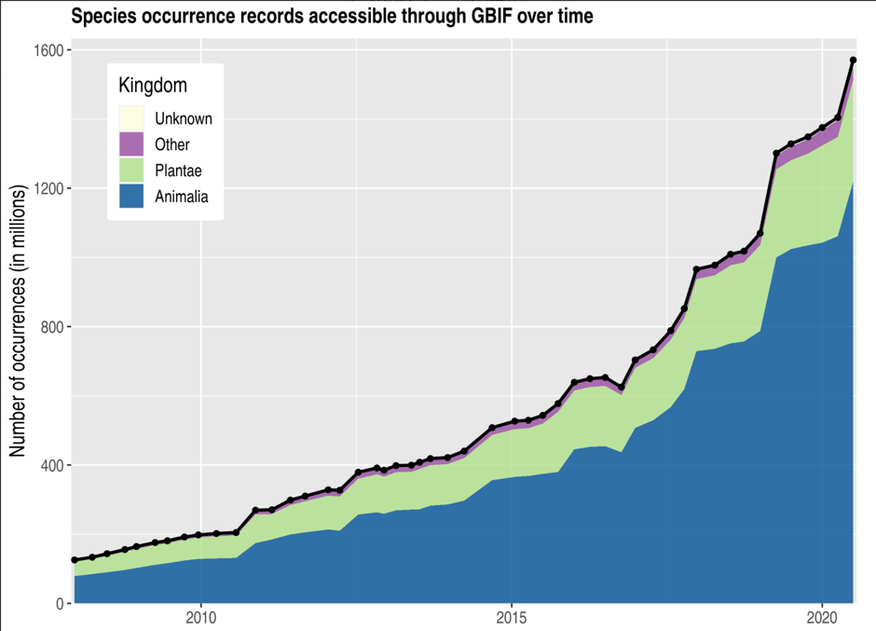
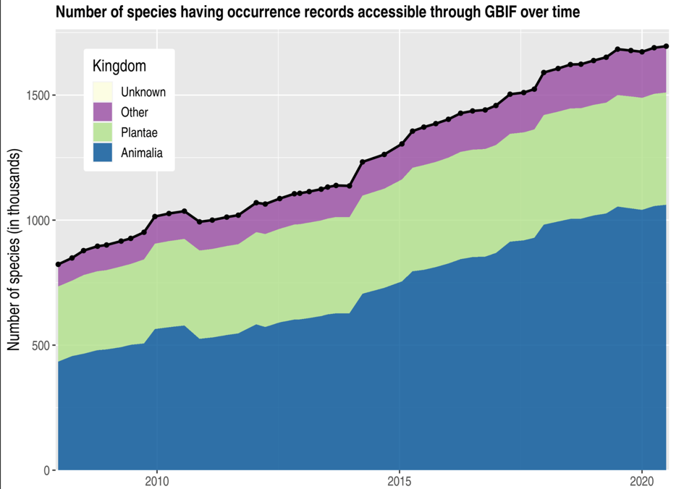



Data trends on GBIF.org
% specimens
Notes:
Data growth and evolution of evidence

Slide 41
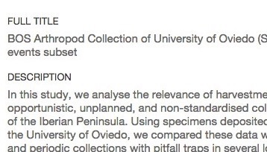
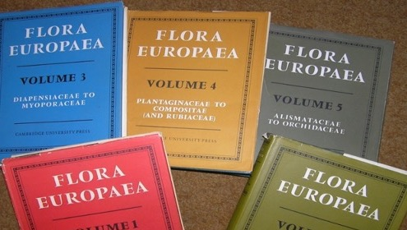

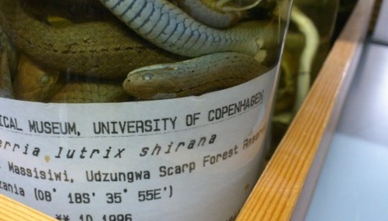
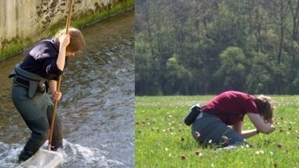
Data richness levels supported by Gbif
Dataset description,
taxonomic/geographic/temporal scope
List of taxa
regional or thematic (e.g. invasive, medicinal)
M
C
Dataset metadata
Species checklists
Species occurrences
dates, coordinates, basis of record
Species occurrences and sampling events
dates, coordinates, sampling effort / protocol, abundance
O
SE
Occurrence-only data
Sampling-event data
Notes:
Four richness levels -- https://www.gbif.org/dataset-classes

Slide 42
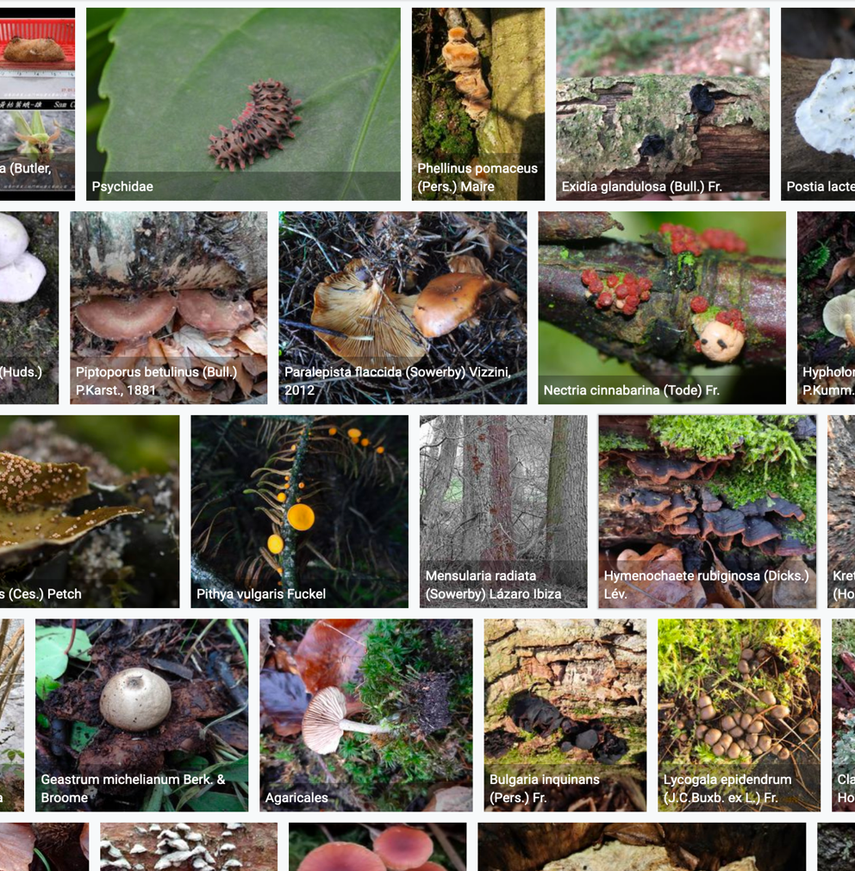
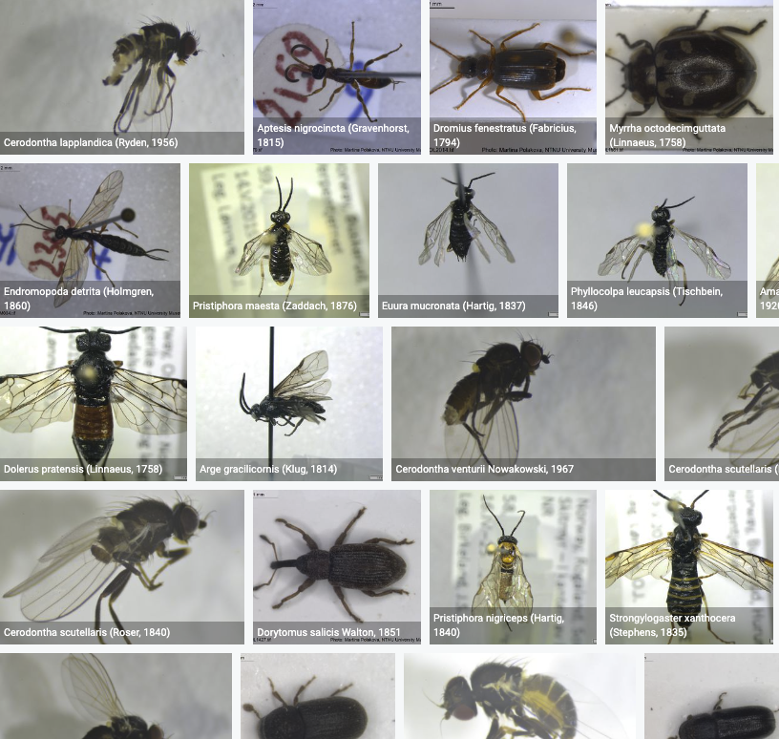



Species occurrence records with Multimedia evidence
Status 15th May 2021
80 million records with taxonomically identified images
200 million specimens
1 411 million human observations
34 million material samples
724 177 audio files
2 845 video files
https://www.gbif.org/occurrence/gallery
Notes:
Multimedia resources
Status 2021-01-27:
75 million records with taxonomically identified images (1.8 million from Norway)
41.1 million specimens (Norway: 884 763)
31.3 million human observations (Norway: 923 763)
1.4 million material samples (Norway: 38 386)
685 806 audio files (Norway: 3 566)
2 825 videos (Norway: 4)

Slide 43



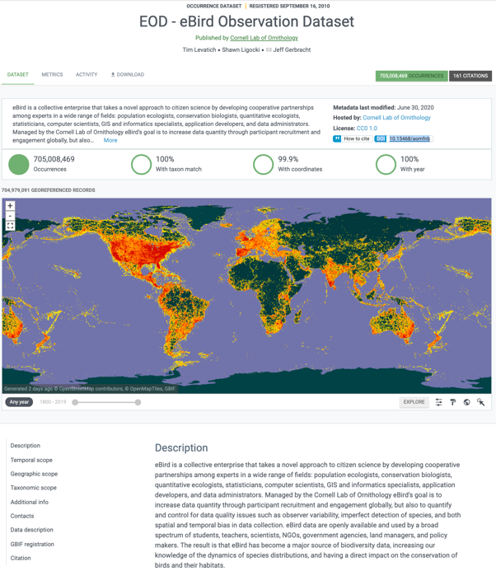
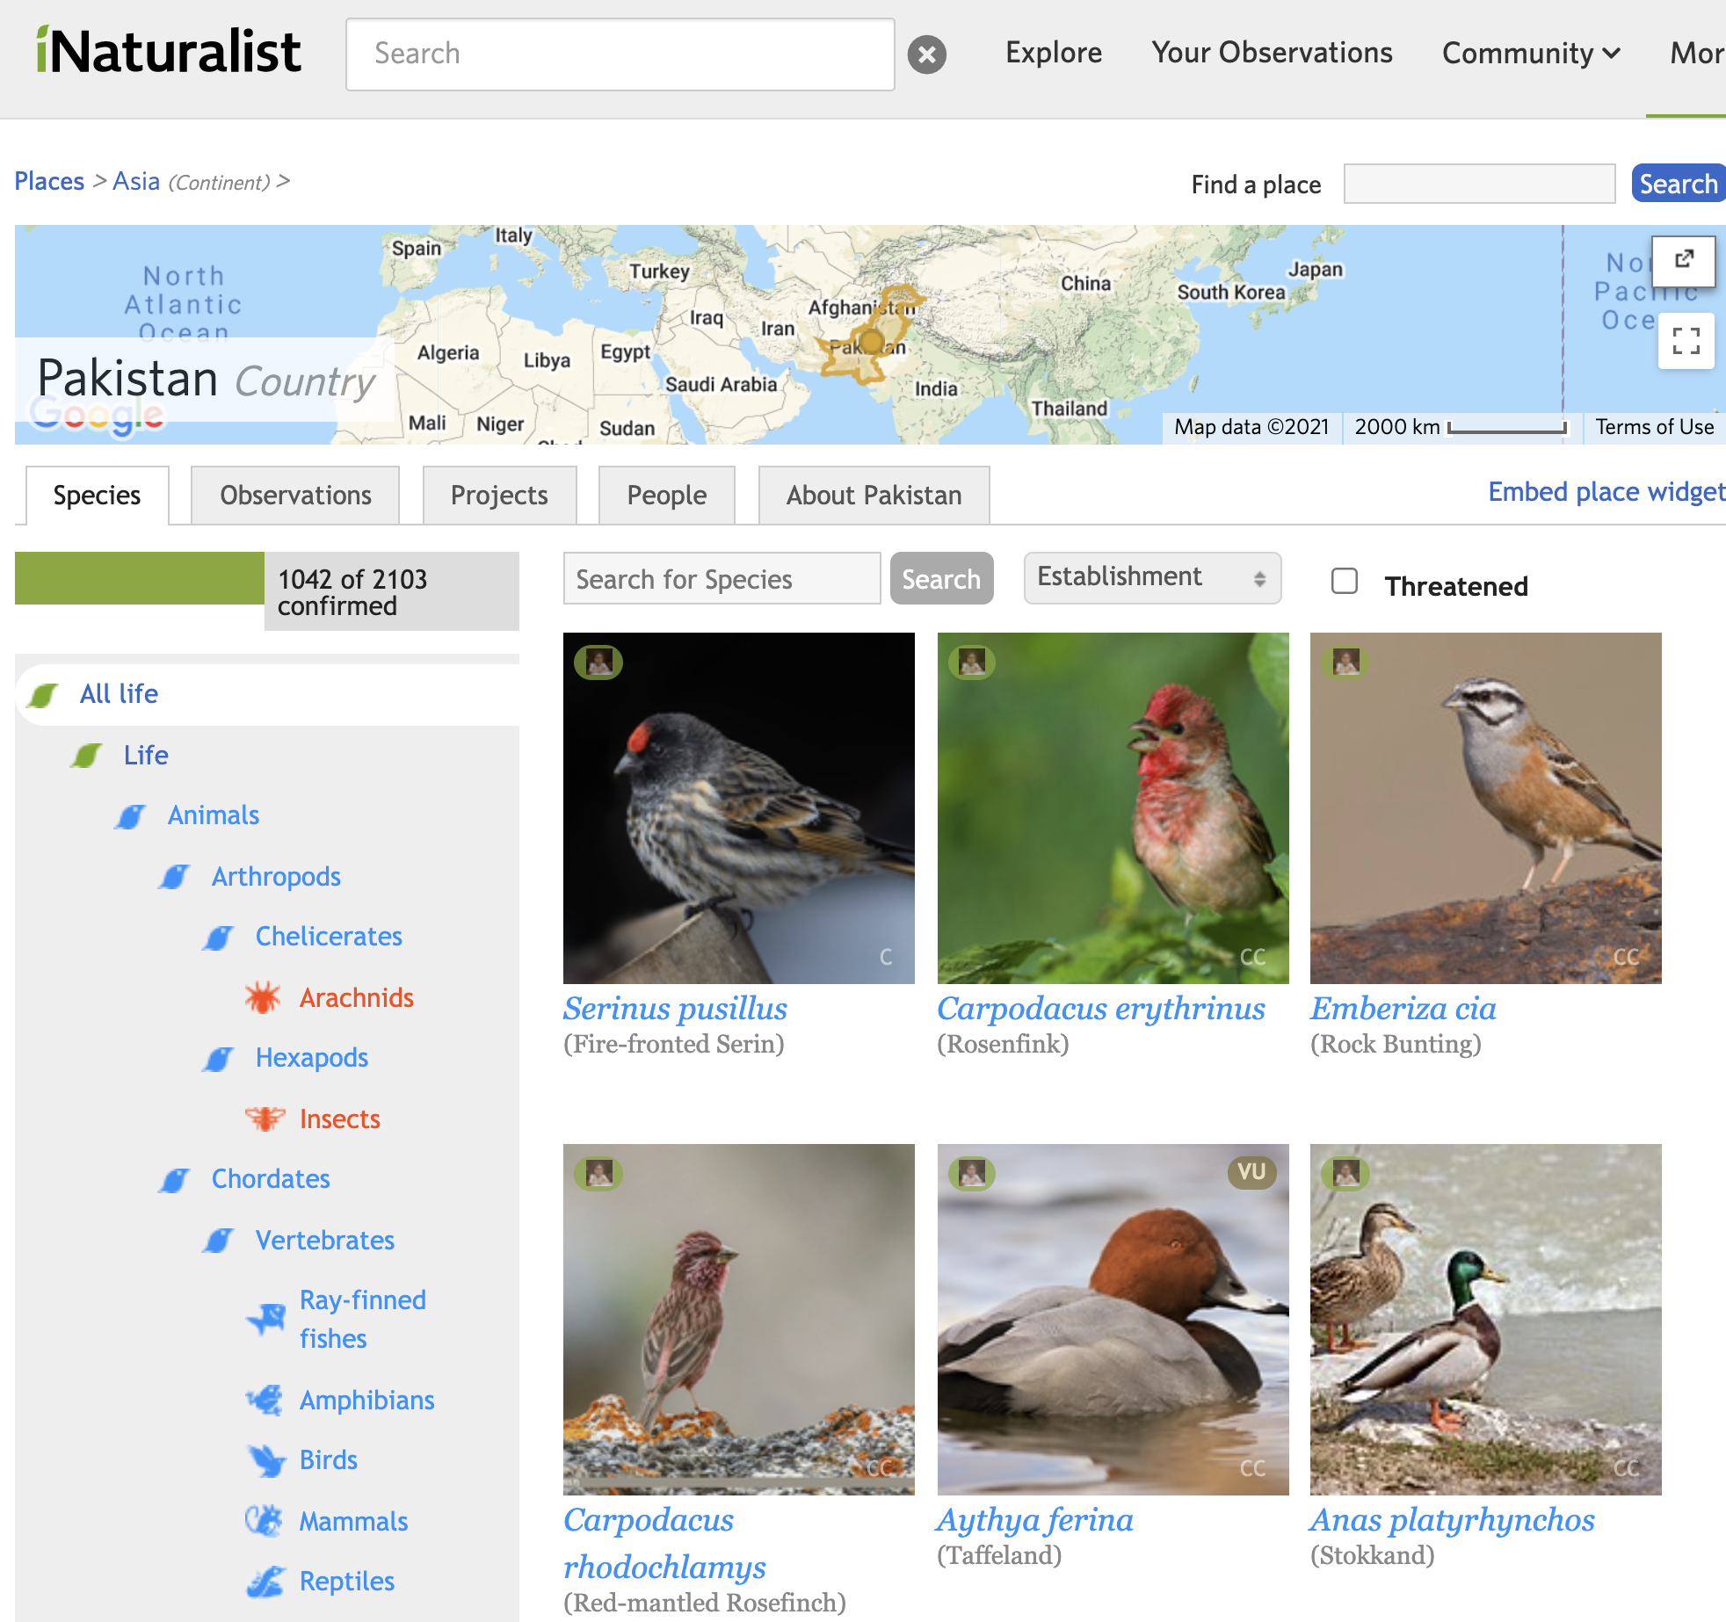


Sources of data in gbiF: citizen science observations
National crowdsourcing portals
Notes:
Citizen science
eBird: https://doi.org/10.15468/aomfnb
iNaturalist: https://doi.org/10.15468/ab3s5x
iNaturalist Pakistan: https://www.inaturalist.org/places/pakistan
NBIC Artsobservasjoner: https://doi.org/10.15468/zjbzel

Slide 44



Sources of data in gbiF: digitized specimens from Museum collections
Notes:
Museums and other collections
https://www.gbif.org/occurrence/1890156182
https://www.gbif.org/occurrence/583422783

Slide 45







Sources of data in gbiF: taxonomic literature, old and new
Data liberation
Notes:
Taxonomic literature and data liberation
Palaearctic Dataset: https://doi.org/10.5852/ejt.2018.417

Slide 46




Sources of data in gbiF: DNA sequence-derived occurrence data
Notes:
eDNA, a promise of speed and coverage
MGnify -- Atlantic salmon microbiota: https://doi.org/10.15468/ox86z5
MGnify data publisher: https://www.gbif.org/publisher/ab733144-7043-4e88-bd4f-fca7bf858880

Slide 47




Global biodiversity vs. digitally available data
1200 mill.
animals
300 m
plants
20 m
fungi
16 m
bacteria
0,04 m
virus
Troudet et al. Nature Scientific Reports 2017
Image: FL Fawcett in Wheller Ann. Entomol. Soc. Am. 1990
Notes:
Taxon equality

Slide 48

data publishing
Notes:
https://www.gbif.org

Slide 49

Publish your datasets with GBIF
Step 1: digitize collections & herbaria
Step 2: register for endorsement in GBIF
Step 3: convert to Darwin Core format
Step 4: publish from national GBIF node
Alternative: publish from regional GBIF cloud data repository - cloud.gbif.org/eca
Alternative: Many citizen science data platforms publish data in GBIF
Notes:
http://www.gbif.org/resource/80635
http://www.gbif.org/publishing-data/summary
http://www.gbif.org/publishing-data/request-endorsement#/intro

Slide 50





data use
Notes:
https://www.gbif.org

Slide 51


















GBIF: Multiple-purpose data publishing services
Environment directive reporting
Darwin Core
Bio-Collections
& ecology datasets
Research data portals
portal
Notes:
One-stop data publishing for data-flow into multiple information systems

Slide 52






POLICY LINKS
Notes:
CBD: https://www.cbd.int/countries/?country=pk
GBIF: https://www.gbif.org/country/PK/summary
CBD: https://www.cbd.int/countries/?country=no
GBIF: https://www.gbif.org/country/NO/summary

Slide 53




Policy Links: Aichi targetsupporting biodiversity indicators
- Trend in invasive alien species introductions (through Global Register of Introduced and Invasive Species)
Species Protection Index
Protected Area Representativeness Index
Comprehensiveness of conservation of socioeconomically/culturally valuable species
Agrobiodiversity Index
Crop Wild Relative Index
Growth in species occurrence records accessible through GBIF
Species Status Information Index
Notes:
Aichi and post-2020
https://www.cbd.int/cooperation/csp/gbif.shtml
https://www.cbd.int/csp/survey/GBIF.pdf

Slide 54




A data resource to support research and sustainable development
Conservation
Protected areas
Threatened species
Invasive species risk
Food Security
Crop wild relatives
In situ, ex situ conservation of genetic diversity
Fisheries planning
Climate change
Modelling impacts on species ranges
Adaptation strategies
Mitigation benefits, risks
Human health
Disease risk based on occurrence of vectors, hosts, reservoirs
Medicinal plants
Hazards e.g. snakebite
Notes:
So we've brought all of this data together, but for what purpose? Through tracking the citations of GBIF in research, and its onward relevance to policy and decisions, we can build up a picture of how all of those involved in sharing standardized data, from the volunteer wildlife observer to researchers and museum curators, are contributing to the knowledge that supports better decisions for our planet and our societies. Just some examples:
- Data shared through GBIF supports CONSERVATION, by helping to identify the most important sites for protected areas; by underpinning assessment of species extinction risk through the Red Listing process; and by tracking the actual and predicted spread of invasive alien species.
- Data shared through GBIF supports FOOD SECURITY, by mapping the distribution of the wild relatives of the most important food crops, and therefore the location of the genetic resources that need to be conserved for future plant breeding; and by providing information on both marine and freshwater fish species - along with other wild species important for nutrition.
- Data shared through GBIF supports action on CLIMATE CHANGE, through helping to model how species ranges will change under different climate change scenarios, informing strategies to adapt to climate change, and assessing the impacts of measures to mitigate climate change, for example increased production of biofuels and hydropower.
- And finally, data shared through GBIF supports HUMAN HEALTH, by tracking the distribution of species that act as vectors, hosts and reservoirs of human diseases; by helping to map medicinal plant species, and by assessing risks posted by significant public health hazards such as snakebite.

Slide 55


Credit for data reuse
To incentivize the sharing of useful data, the scientific enterprise needs a well-defined system that links individuals with reuse of data sets they generate
Pierce et al. Credit data generators for data reuse, Nature 6 June 2019
Notes:
Pierce HH, Dev A, Statham E, Bierer BE. (2019) Credit data generators for data reuse. Nature. 2019 Jun;570(7759):30-32. doi: 10.1038/d41586-019-01715-4. https://doi.org/10.1038/d41586-019-01715-4

Slide 56




Peer-reviewed publications using GBIF-mediated data September 2020
~ 2-3 papers a day
#CiteTheDOI
Notes:
Use in research litterature

Slide 57
How to cite Data mediated by GBIF ata citation
Download data from GBIF.org
and receive recommended citation with a download DOI
Cite the DOI in published research or other work
Example: GBIF.org (12 October 2020) GBIF Occurrence Download https//doi.org/10.15468/dl.xxxxxx
#CiteTheDOI
Notes:
How to cite data

Slide 58

Why cite data?ata citation
  Good academic practice for transparent and reproducible research
  Credit institutions who shared data and supported your research
  Help data publishing institutions to demonstrate value of digitization and data publication through research
  Correct citation encourages data sharing
  Data accessed through GBIF is free for all – but not free of obligations: see the user agreement
#CiteTheDOI
Notes:
Why cite data?

Slide 59


The research data lifecycle
GBIF.org
Notes:
Research Data Lifecycle
Image credit Sydney University: https://library.sydney.edu.au/research/data-management/images/Research_data_lifecycle_final_20150827.png
https://library.sydney.edu.au/research/data-management/research-data-management.html

Slide 60

Dag Endresen | GBIF Norway
helpdesk@gbif.no

Slide 62
#CiteTheDOI
Notes:
#CiteTheDOI

Slide 63








Dataset DOIs
Download DOI
Archive DOI
Bibliographic DOI
Source dataset #1
Source dataset #2
GBIF download
Final state of data
Filter
Process
Analyze & publish
Source dataset #3
Archive
Notes:
GBIF DOI explained 1 of 3

Slide 64
Dataset DOIs
Download DOI
Archive DOI
Bibliographic DOI
Source dataset #1
Source dataset #2
GBIF download
Final state of data
Filter
Process
Analyze & publish
Source dataset #3
Archive
Notes:
GBIF DOI explained 2 of 3

Slide 65

Dataset DOIs
Download DOI
Archive DOI
Bibliographic DOI
Source dataset #1
Possible with persistent object identifiers
(possible with persistent object identifiers)
Source dataset #2
GBIF download
Final state of data
Filter
Process
Analyze & publish
Source dataset #3
Archive
Notes:
GBIF DOI explained 2 of 3

Slide 66


new tools
Notes:
https://www.gbif.org

Slide 67

Bionomia
Link natural history specimens to the world's collectors.
Notes:
https://bionomia.net/help-others

Slide 68


Occurrence ID | urn:catalog:O:V:2007334
Catalogue number | 2007334
Material Sample ID | urn:uuid:0574816d-3d99-41b8-b3b8-c6035de0e929
Other catalogue numbers | urn:uuid:0574816d-3d99-41b8-b3b8-c6035de0e929
Event date | 1971-01-04
Recorded by | Johannes Lid
Recorded by ID | http://www.wikidata.org/entity/Q94522
Date identified | 1971-01-04T00:00:00
Identified by | Johannes Lid
Identified by ID | http://www.wikidata.org/entity/Q94522
Notes:
https://www.gbif.org/occurrence/search?recorded_by_id=https:~2F~2Fwww.wikidata.org~2Fwiki~2FQ94522&identified_by_id=https:~2F~2Fwww.wikidata.org~2Fwiki~2FQ94522&advanced=1&occurrence_status=present
https://www.gbif.org/occurrence/1095052193

Slide 69

molecular DNA data

Slide 70










Latin names are ruled by the Codes
ICN
Domain (Eukarya)
Kingdom (Animalia)
Phylum (Chordata)
Class (Mammalia)
Order (Primates)
Family (Hominidae)
Genus (Homo)
Species
(Homo sapiens)
PhyloCode
ICZN
Notes:
From Codes to OTUs
Algae, Fungi and Plants – International Code of Nomenclature for algae, fungi, and plants (ICN), which in July 2011 replaced the International Code of Botanical Nomenclature (ICBN) and the earlier International Rules of Botanical Nomenclature.
Animals – International Code of Zoological Nomenclature (ICZN)
Bacteria and Archaea – International Code of Nomenclature of Prokaryotes (ICNP), which in 2008 replaced the International Code of Nomenclature of Bacteria (ICNB)
Cultivated plants – International Code of Nomenclature for Cultivated Plants (ICNCP)
Plant associations – International Code of Phytosociological Nomenclature (ICPN)
Viruses – The International Code of Virus Classification and Nomenclature (ICVCN); see also virus classification
PhyloCode

Slide 71






OTU = Operational Taxonomic Unit
Species DNA Barcode
OTU = SH,
Species hypothesis numbers [DOI]
SH ABC0001
GBIF
backbone taxonomy
OTU = BIN,
Barcode identification number
BIN DEF0002
Notes:
GBIF is integrating OTUs to the taxonomic backbone. OTU = Operational Taxonomic Unit
https://www.gbif.org/news/2UfGq1L6iXbSu0ElamvVlH/gbif-introduces-new-version-of-the-backbone-taxonomy (News item 2019-09-25)
https://www.gbif.org/news/2LrgV5t3ZuGeU2WIymSEuk/adding-sequence-based-identifiers-to-backbone-taxonomy-reveals-dark-taxa-fungi (News item 2018-08-29)
https://data-blog.gbif.org/post/gbif-molecular-data/ (Blog post 2019-04-24)
https://data-blog.gbif.org/post/gbif-molecular-data-quality/ (Blog post 2019-04-26)
UNITE OTU SH checklist: https://doi.org/10.15468/mkpcy3 (2018)
iBOL BIN checklist: https://doi.org/10.15468/wvfqoi (2019)

Slide 72

NEW GBIF GUIDE: Publishing sequence-derived data through biodiversity discovery platforms
Authors from Australia, Norway, Sweden, Denmark, UNITE, and GBIF
Based on practical mapping and data publishing experiences
Cross-platform
About 40 pages long ”cookbook”
  Introduction – refresh your ”data culinary” knowledge
  Categorization – what ”data ingredients” you got to publish?
  Mapping – choose and follow the ”recipe”
  Visuals – clarity and guidelines
  Future prospects
  Resources: glossary, links, references
  Based on Darwin Core and MIxS data standards
Notes:
Andersson AF, Bissett A, Finstad AG, Fossøy F, Grosjean M, Hope M, Jeppesen TS, Kõljalg U, Lundin D, Nilsson RN, Prager M, Svenningsen C & Schigel D (2020) Publishing sequence-derived data through biodiversity data platforms [Community review draft]. Copenhagen: GBIF Secretariat. https://doi.org/10.35035/doc-vf1a-nr22.

