Slide 1

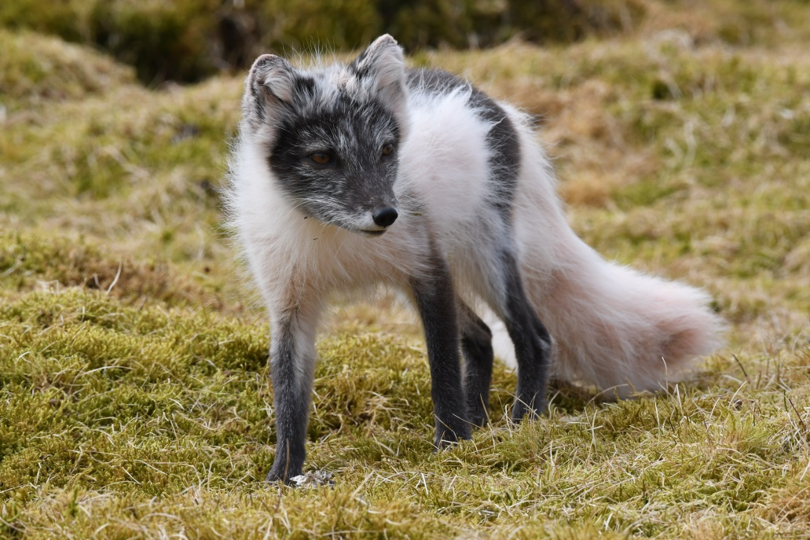
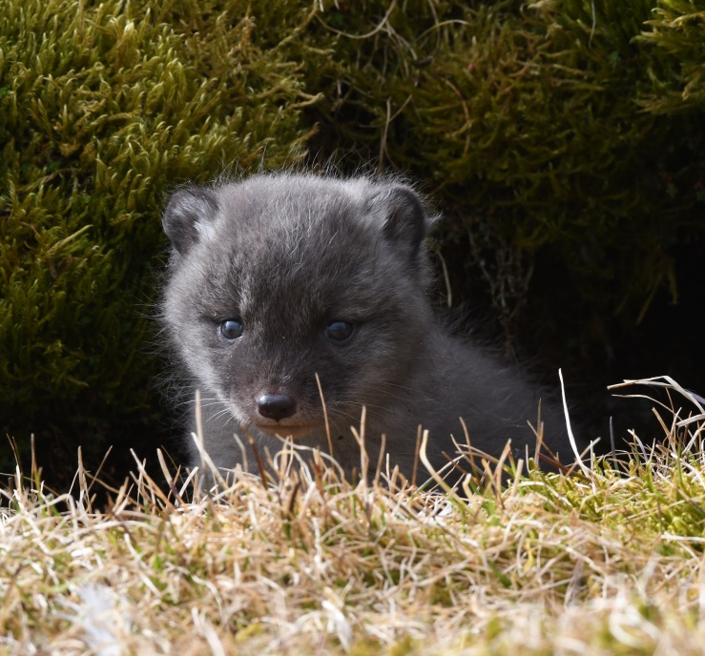
Publishing biodiversity data in norway
Vidar Bakken (GBIF-Norway)

Slide 2
The Species observation system (Artsobservasjoner) and GBIF
In Norway there are primarily two ways to publish biodiversity data
  Species observation system (Artsobservasjoner)
  GBIF

Slide 3
Species observation system (Artsobservasjoner)
Managed by the Norwegian Biodiversity Information Centre (Artsdatabanken)
Originally made mainly for amateurs, but is now extended to cover all possible observers.
The species data can be freely used with attribution (BB BY 4.0). Images may have different regulations.
Covers Norway, Svalbard and Jan Mayen
Almost 30 million records in the database

Slide 4
GBIF – Global Biodiversity Information Facility
GBIF—the Global Biodiversity Information Facility—is an international network and data infrastructure funded by the world's governments and aimed at providing anyone, anywhere, open access to data about all types of life on Earth.
Covers the whole globe
Private persons can not publish biodiversity data in GBIF
More than 2.2 billion records in the database

Slide 5
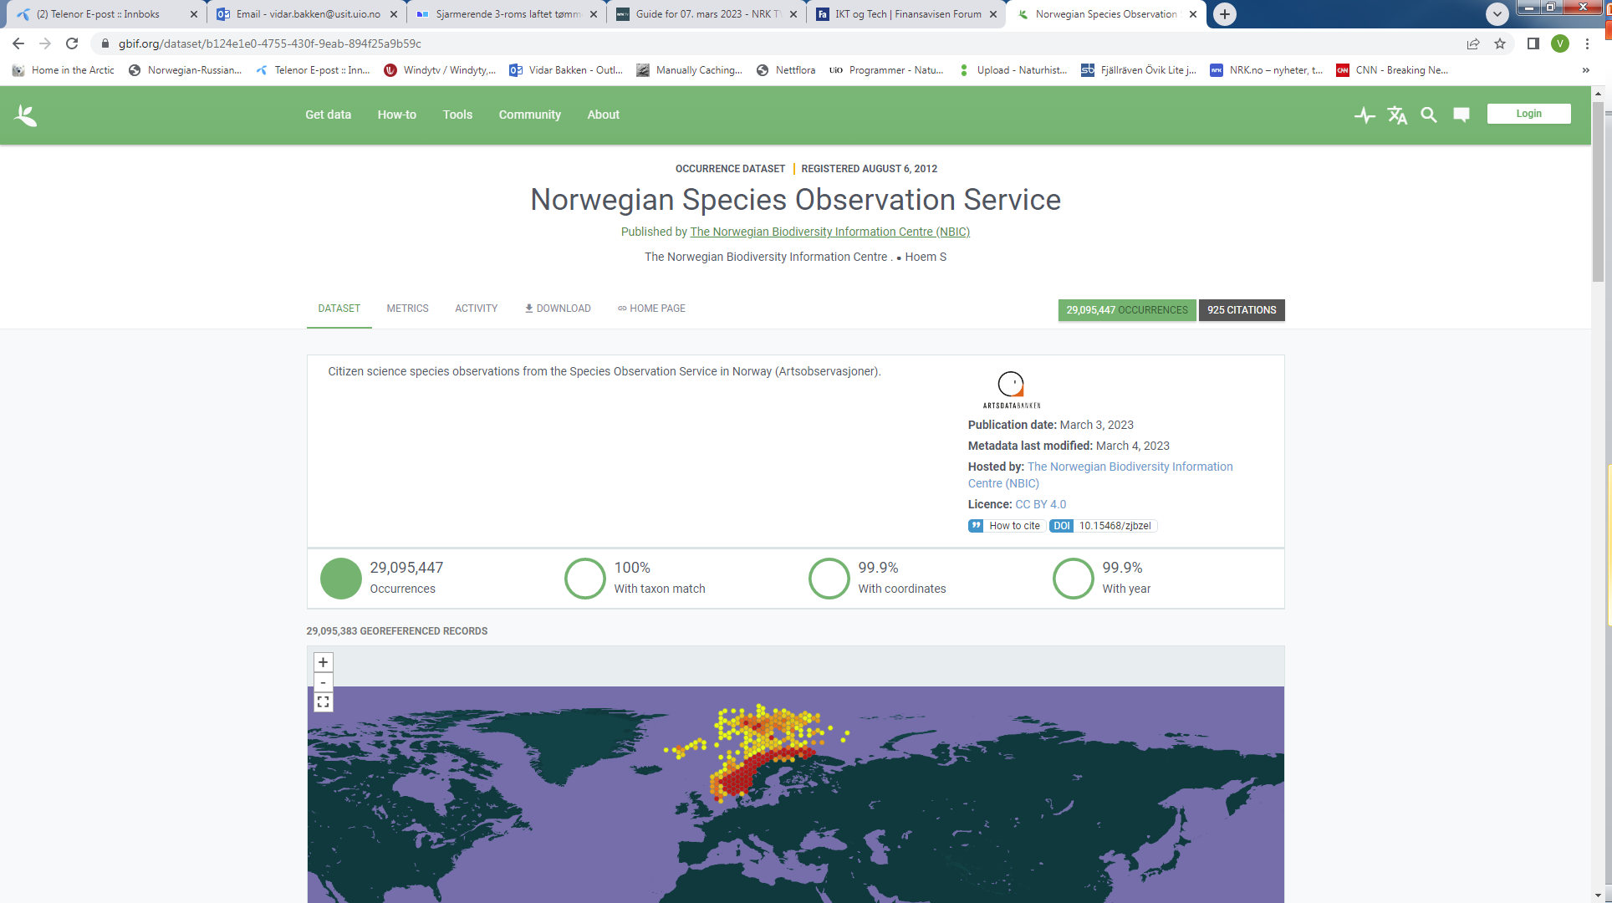

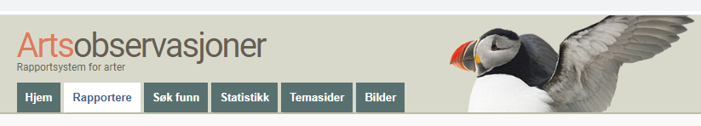
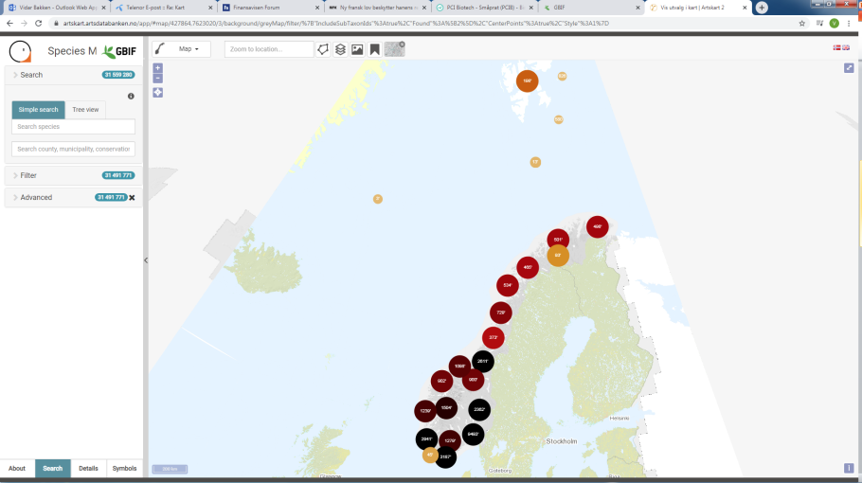
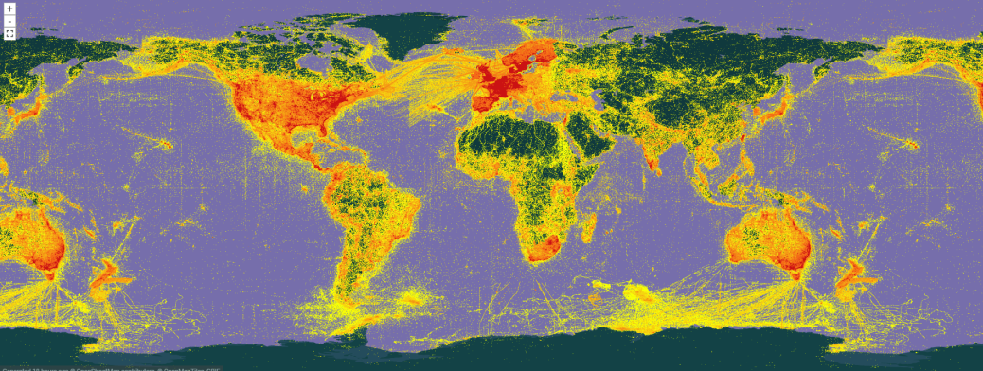
Data flow
iNaturalist
eBird
++
GBIF portal
Artskart

Slide 6
Dataflyt – Artsobservasjoner – GBIF – Artskart – m.fl.
Artskart
GBIF
Artsobservasjoner
iNaturalist
eBird

Slide 7
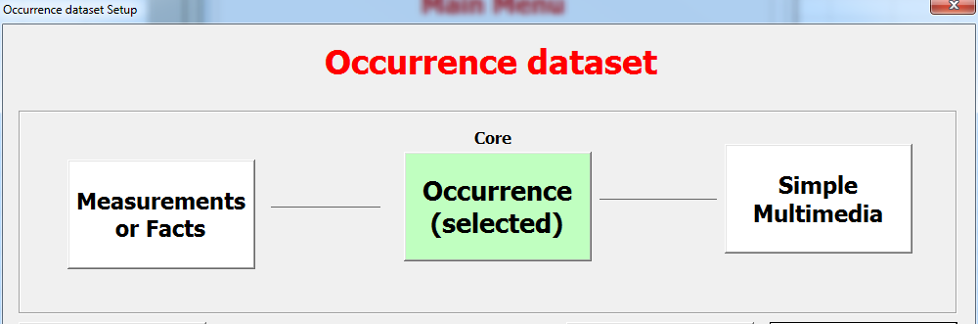
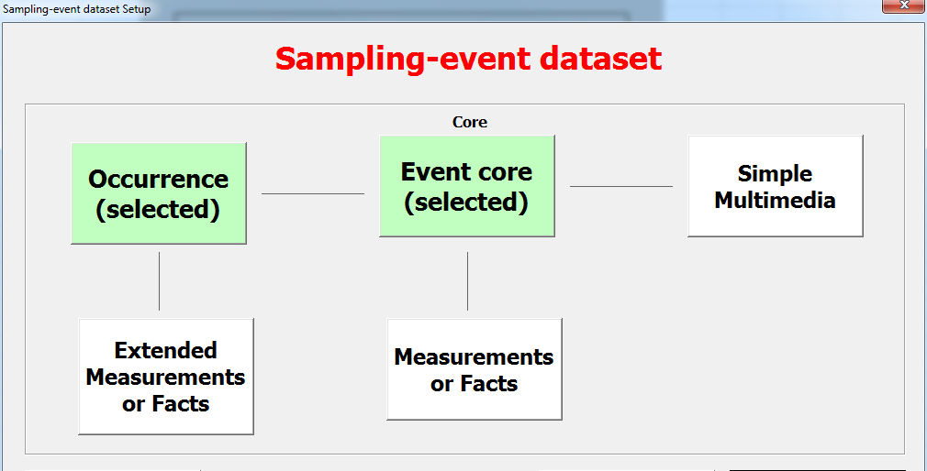
Four varying levels of richness (data types):
Resource metadata – structured information about the dataset, without any data
Checklist data – lists of species belonging to some category (e.g. taxonomic, geographic, trait-based, red list, crop wild relatives).
Occurrence data – lists of species occurring at a particular place and normally on a specified date.
Sampling event data — lists of collecting events and their observed species, together with data on sampling methods and often with quantitative information, i.e. with documented sampling effort.

Slide 8
Artsobservasjoner and GBIF
Theme | Artsobservasjoner | GBIF
Area | Norway, Svalbard and Jan Mayen | Global
Format | Fixed (flat table) | Flexible (Darwin core)
Citation | General | Specified (dataset)
Metadata | Project level | Extended
License | Fixed | Flexible (3 levels)
Ownership (Artskart) | Observer/Partner | Observer/Institution/company
CC0, for data made available for any use without any restrictions
CC BY, for data made available for any use with appropriate attribution
CC BY-NC, for data made available for any non-commercial use with appropriate attribution
Citation
Næstad F, Brittain J (2023). Benthic core samples from Øvre Heimdalsvatn, Norway, 2000. University of Oslo. Sampling event dataset https://doi.org/10.15468/8dcfht accessed via GBIF.org on 2023-03-11.

Slide 9
Creative Commons licenses used by GBIF
CC0, for data made available for any use without any restrictions
CC BY, for data made available for any use with appropriate attribution
CC BY-NC, for data made available for any non-commercial use with appropriate attribution

Slide 10
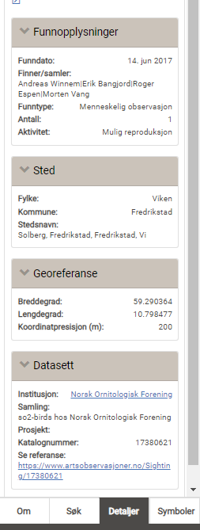
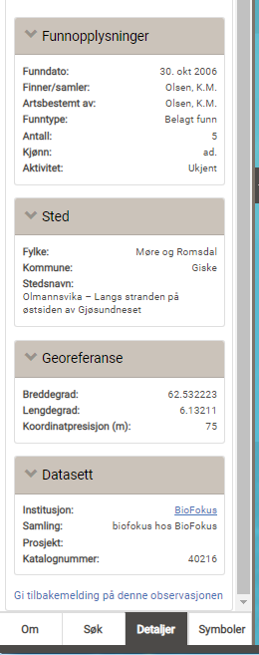
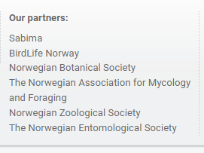
When published in Artsobservasjoner the institution in Artskart will be one of the partners (e.g. Norsk Ornitologisk Forening). Data from GBIF will have the publishing institution.

Slide 11
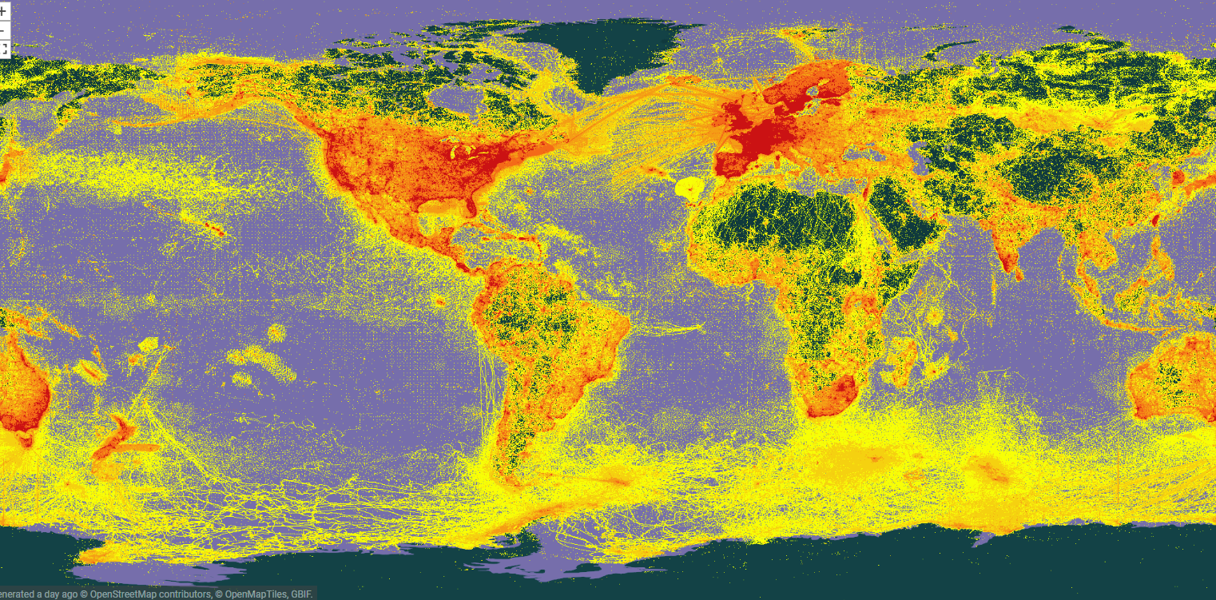
Global GBIF data
2 285 683 853 Occurrence records (March 11, 2023)

