Slide 1
Global Biodiversity Information Facility - Norway
November 2025
IRSAE metabarcoding school, Drøbak | 21th November 2025
Notes:
CC BY 4.0 Global Biodiversity Information Facility; GBIF.org & GBIF.no, Illustration: GBIF data portal, https://www.gbif.org

Slide 2
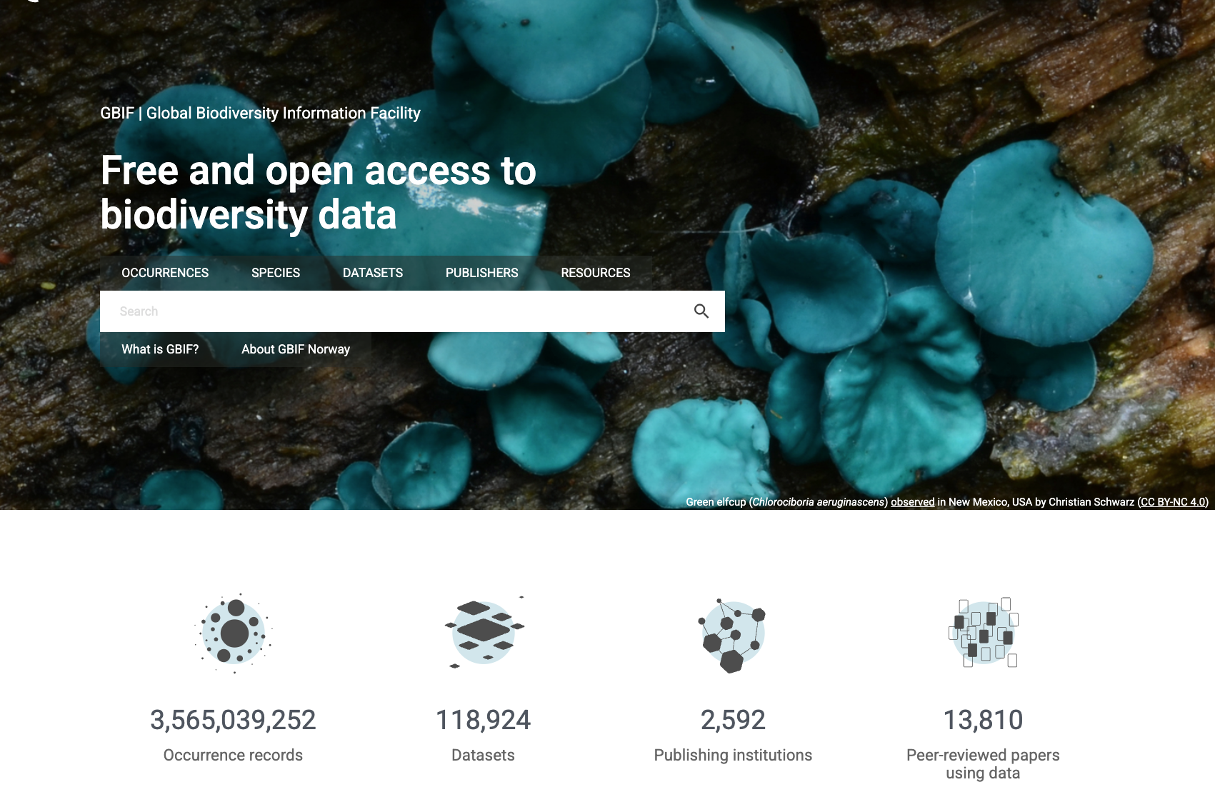
What is GBIF?
Intergovernmental network and research infrastructure
Provides anyone, anywhere, free and open access to data about all types of life on Earth
Voluntary collaboration through Memorandum of Understanding (MoU)
Participant nodes, Secretariat in Copenhagen, Denmark
https://www.gbif.org
Notes:
https://www.gbif.org/

Slide 3

Vision
Mission
A world in which the best possible biodiversity data underpins research, policy and decisions.
To mobilize the data, skills and technologies needed to make comprehensive biodiversity information freely available for science and decisions addressing biodiversity loss and sustainable development

Slide 4
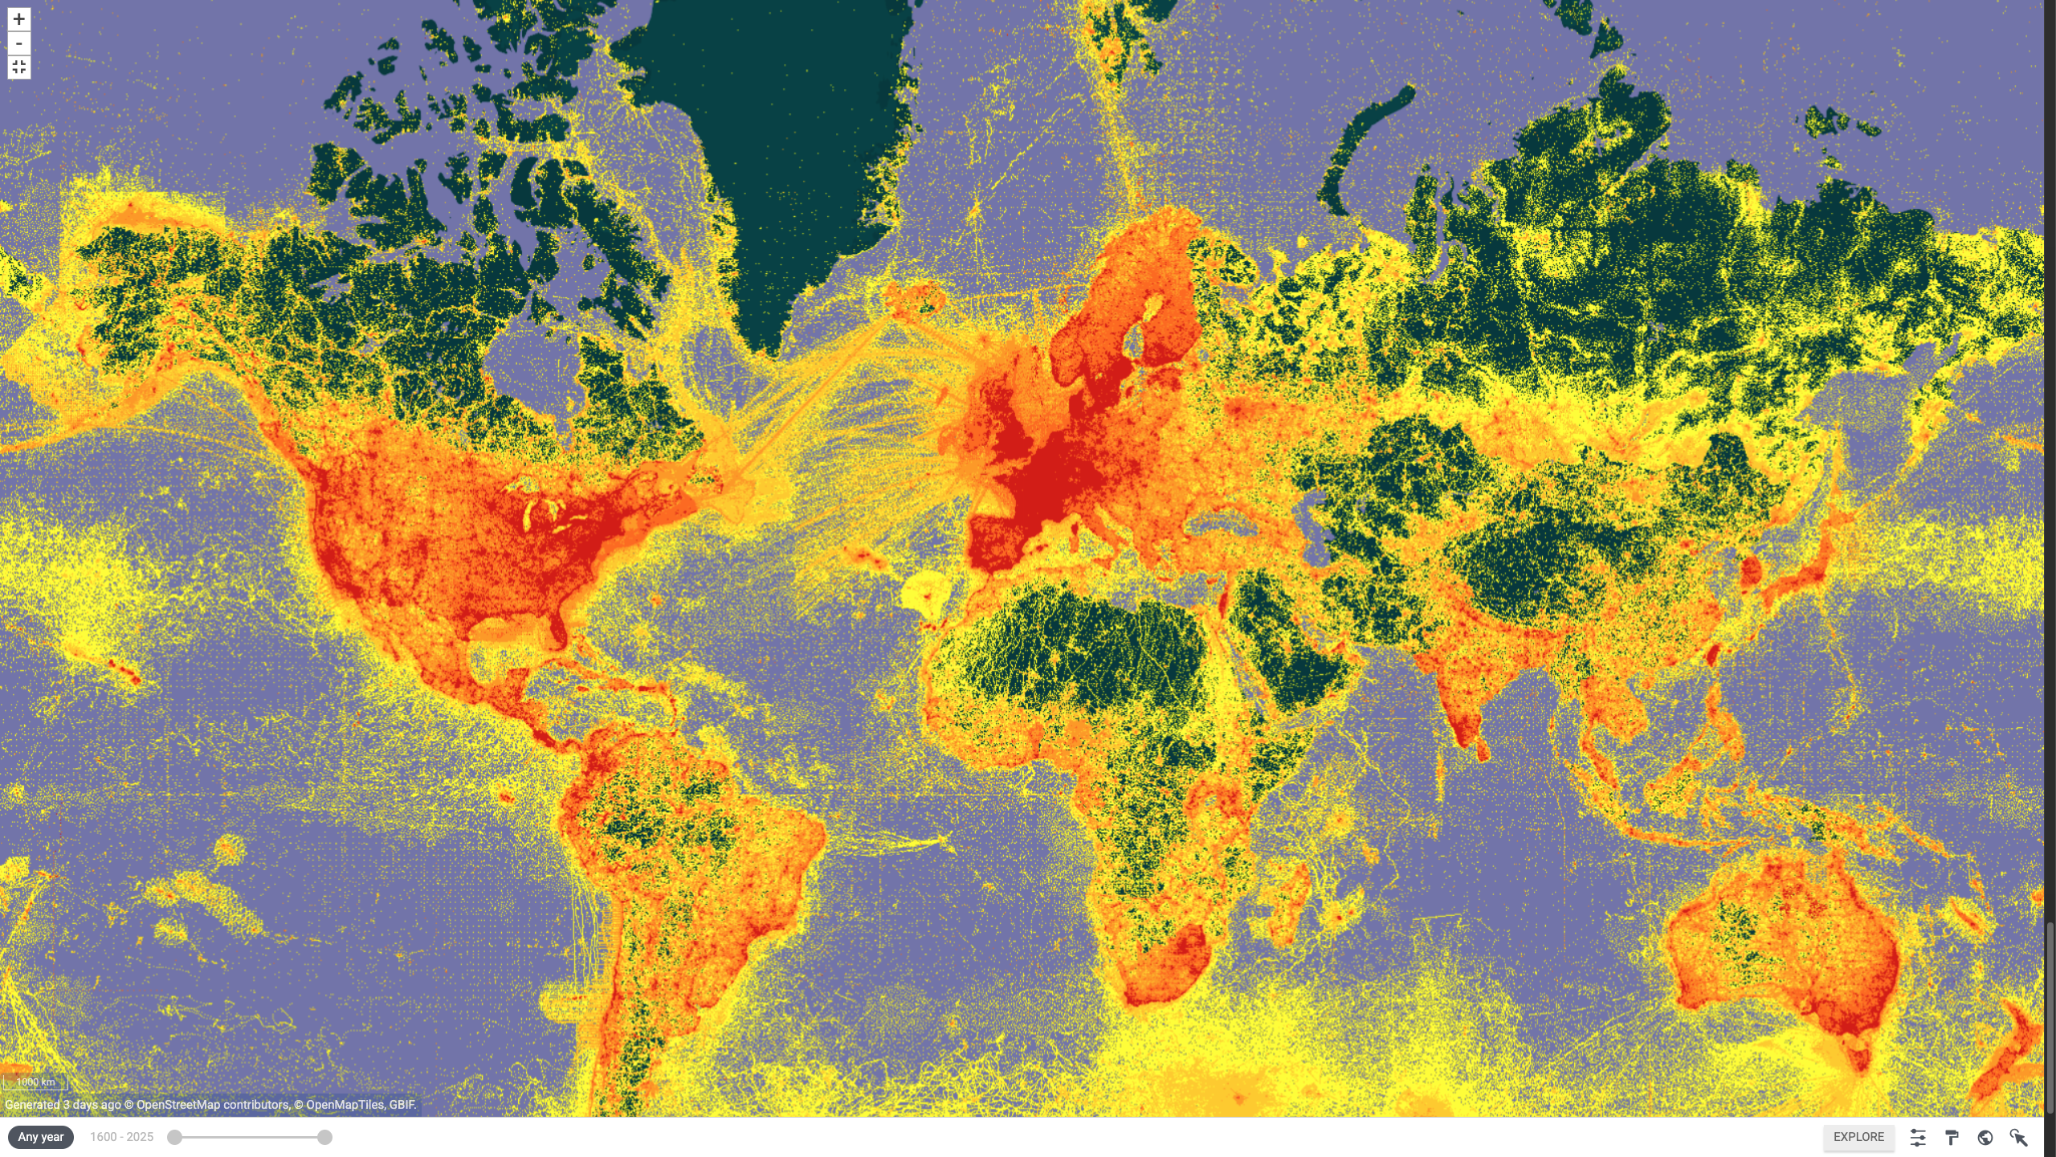
Data From the GBIF Network November 2025

Slide 5


Datasets
Hosted portals
118,924
58
Country Participants
69
Peer-review papers
using data
13,810
Organizational Participants
Average records
downloaded per month (2025)
42
273.0 billion
Species
occurrence records
Publishers
2,592
3,565,039,252
By the numbers | November 2025
www.gbif.org

Slide 6
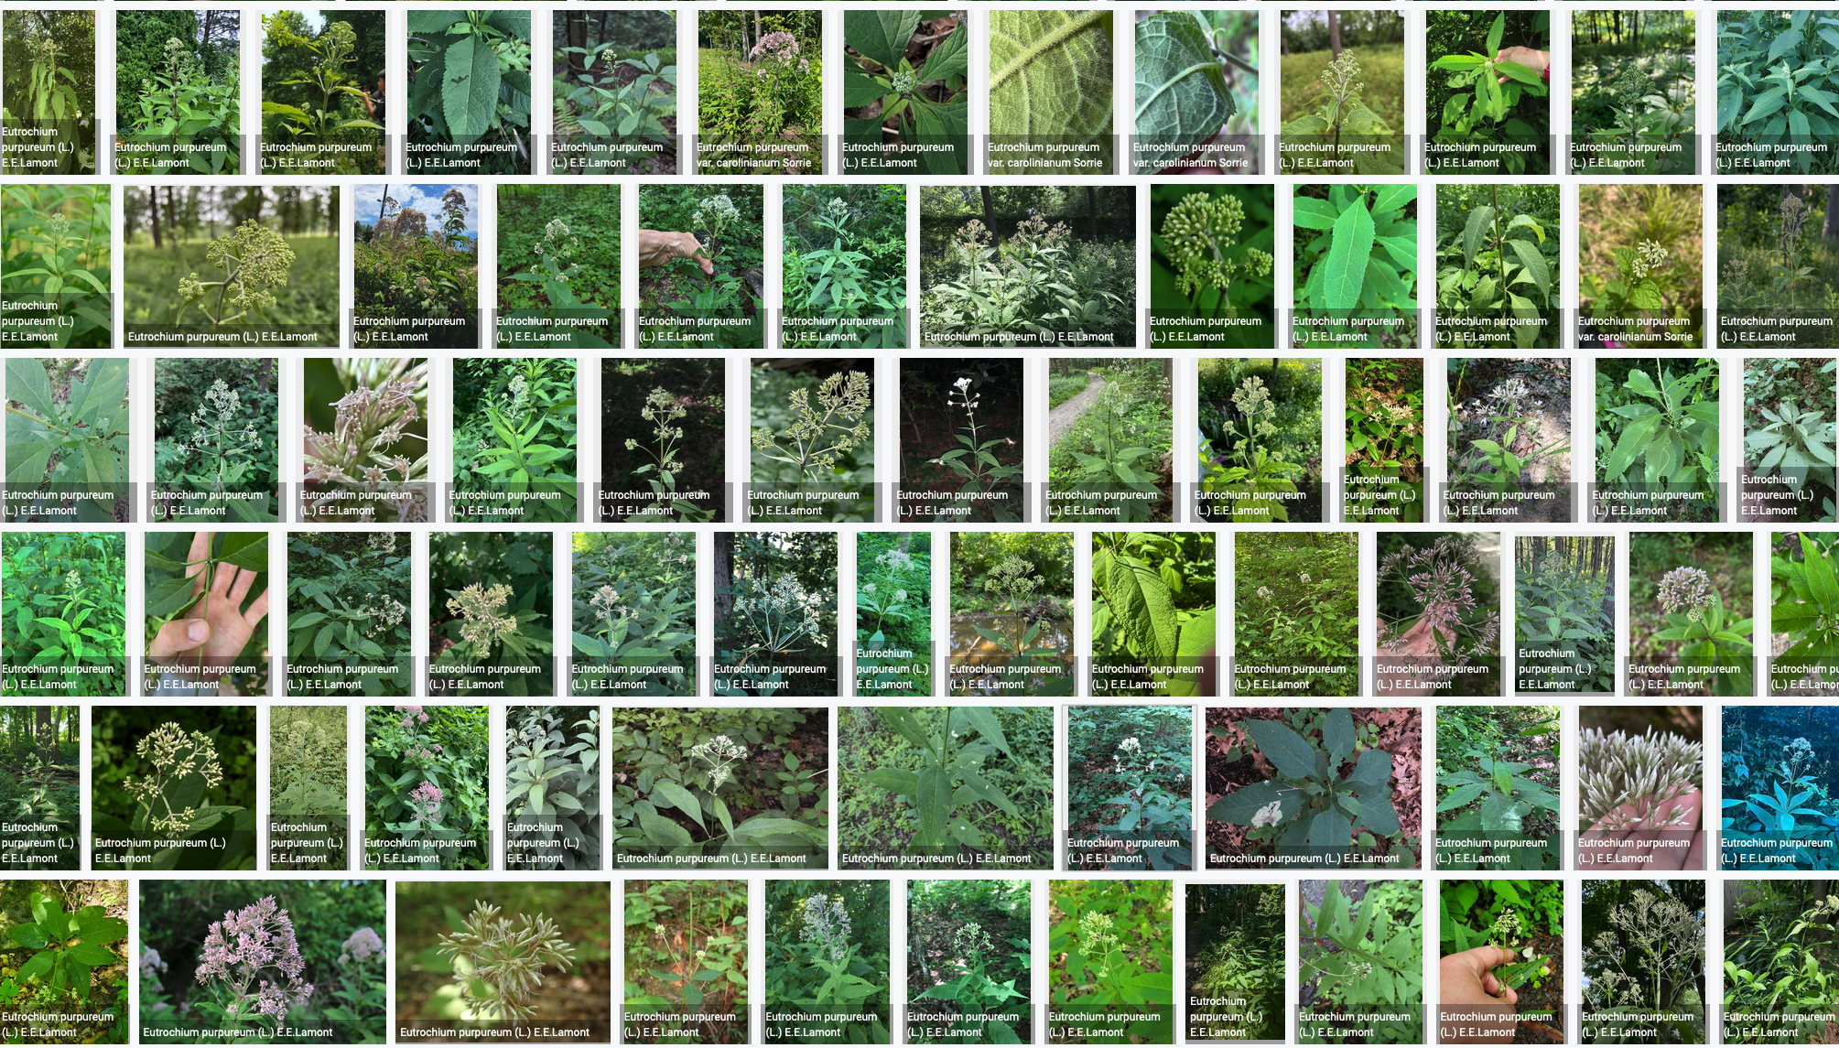



Species occurrence records with multimedia evidence
November 2025
260.3 million records with taxonomically identified images
177.3 million human observations
73.0 million specimens
7.1 million material samples
1.5 million fossil specimens
1,816,073 audio files
5,439 videos
https://www.gbif.org/occurrence/gallery?media_type=StillImage
Notes:
https://www.gbif.org/occurrence/gallery?advanced=1&occurrence_status=present
https://www.gbif.org/occurrence/gallery?media_type=StillImage&advanced=1&occurrence_status=present

Slide 7
GBIF Participant countries
November 2025
Voting Countries (46)
Associate Countries (23)

Slide 8
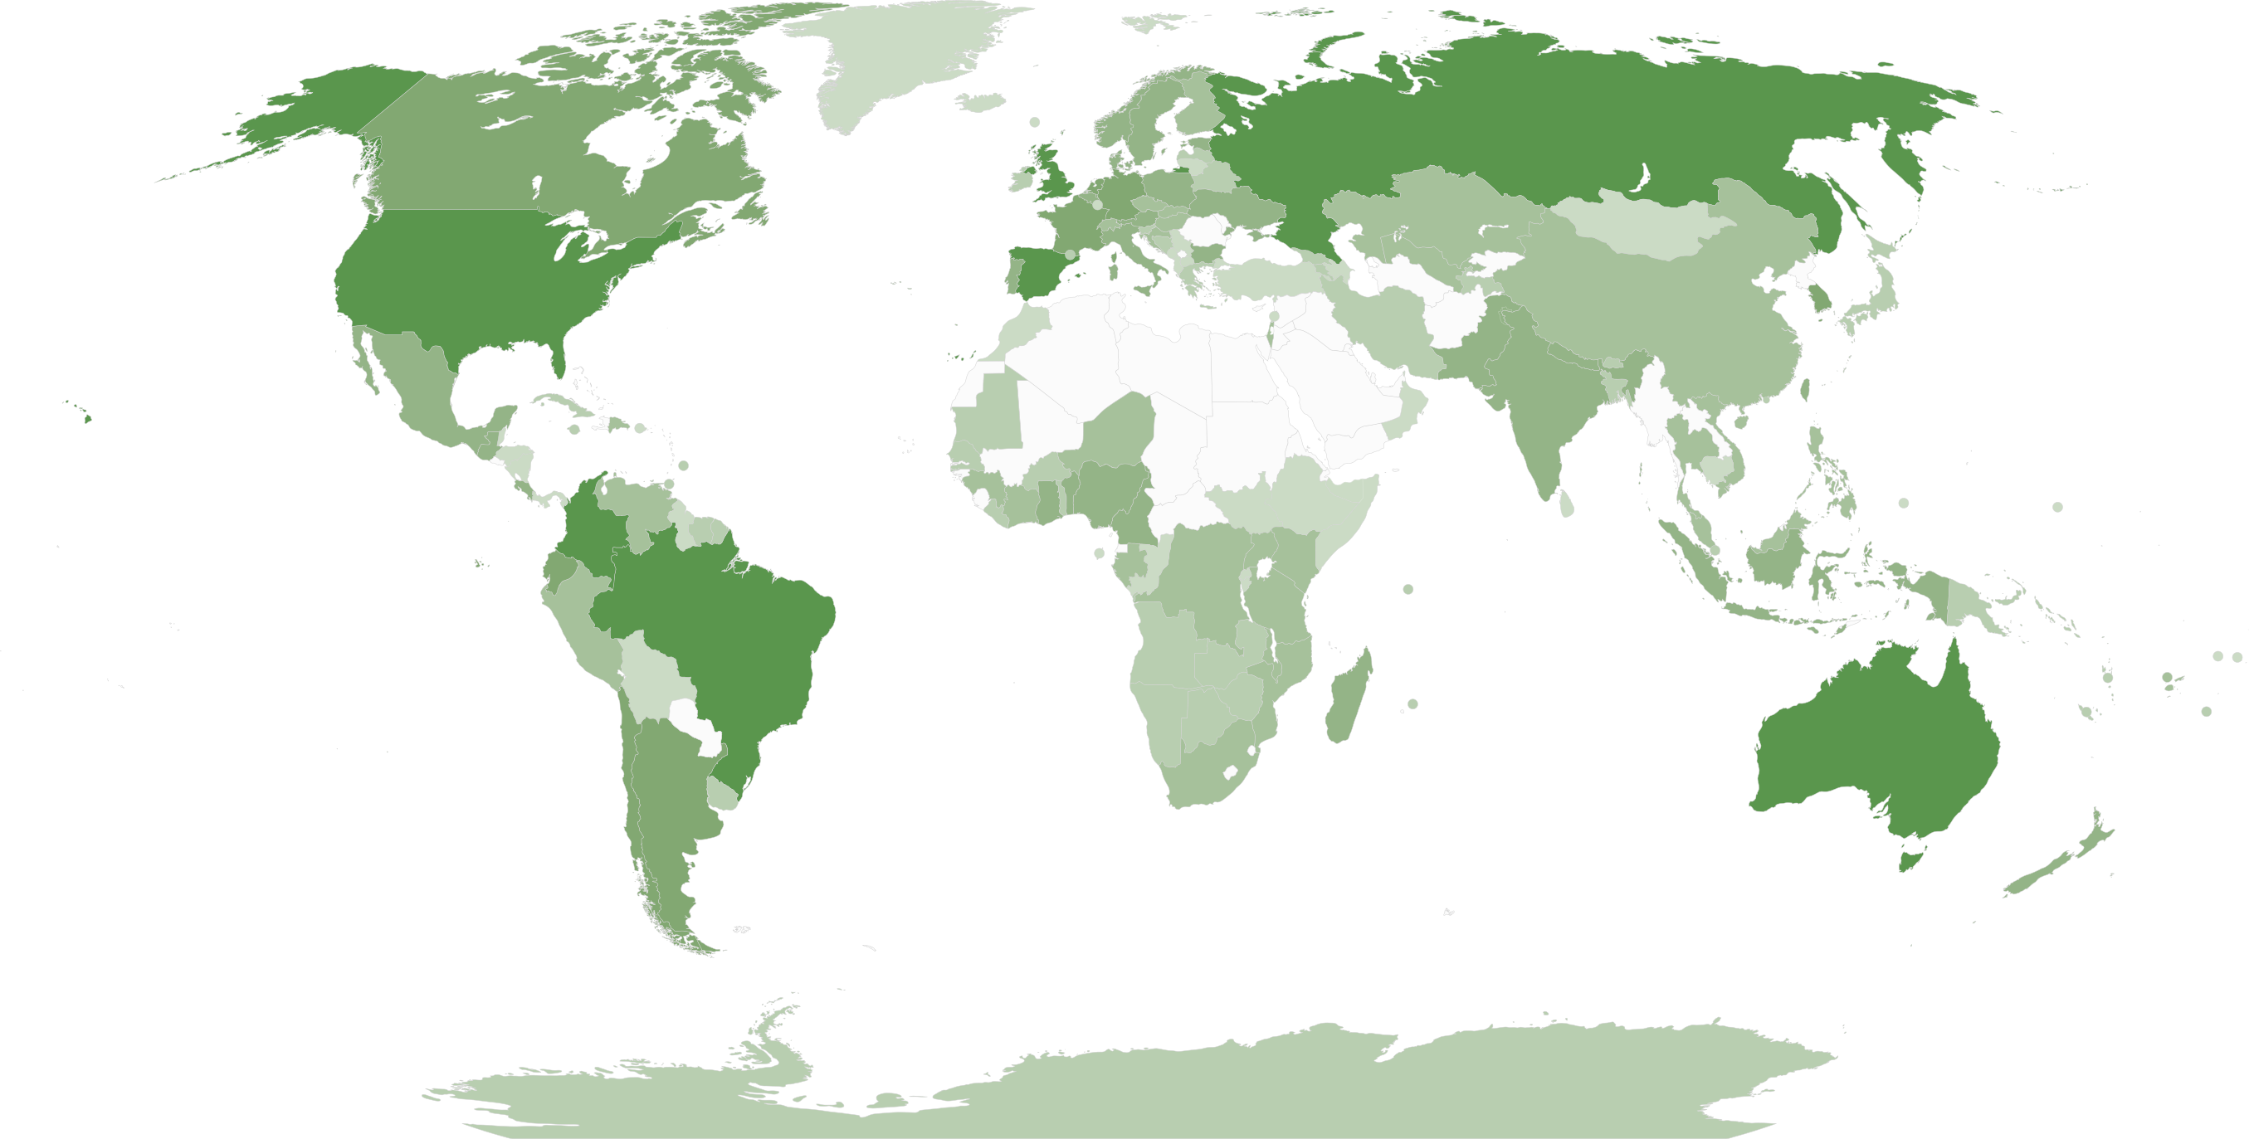
GBIF network of data publishing institutions
August 2025
149
countries/areas with institutions
sharing data through GBIF
Number of active publishers by country or area

Slide 9

Occurrences published by country: 2025
November 2025
Rank | Country/Territory | 2025 (Nov) | 2024 total | 2024 rank
1 | United States (US) | 62,508,873 | 33,821,261 | 1
2 | Netherlands (NL) | 15,492,849 | 22,828,689 | 2
3 | Belgium (BE) | 15,237,666 | 2,495,213 | 13
4 | Sweden (SE) | 14,567,458 | 9,411,544 | 4
5 | France (FR) | 8,807,747 | 209,879 | 9
5 | United Kingdom (GB) | 5,967,436 | 3,452,259 | 6
6 | Norway (NO) | 5,346,401 | 5,429,355 | 5
7 | Canada (CA) | 2,966,297 | 2,381,581 | 7
8 | Denmark (DK) | 1,660,716 | 4,919,717 | 8
9 | Germany (DE) | 209,240 | 163,806 | 21
OTHER COUNTRIES + AREAS | OTHER COUNTRIES + AREAS | 27,805,198 | 85,113,198
TOTAL |  | 160,569,881 | 107,666,470
Notes:
https://api.gbif.org/v1/occurrence/search?publishingCountry=US&modified=2025
https://api.gbif.org/v1/occurrence/search?publishingCountry=GB&modified=2025

Slide 10
GBIF.org traffic by country: 2025
July 2025
Rank | Country/Territory | Visitors | Visits | Effective visits* | % Effective visits | 2024 rank | Pages / visit
1 | United States | 438,240 | 513,431 | 215,641 | 9.28 % | 1 | 4.13
2 | China | 681,012 | 1,519,664 | 212,753 | 9.15 % | 7 | 3.41
3 | Colombia | 200,079 | 253,724 | 121,788 | 5.24 % | 2 | 4.88
4 | Indonesia | 156,379 | 192,106 | 111,421 | 4.79 % | 3 | 6.02
5 | Spain | 169,904 | 213,102 | 110,813 | 4.77 % | 4 | 6.08
6 | France | 232,762 | 275,916 | 110,366 | 4.75 % | 5 | 4.31
7 | Brazil | 196,835 | 232,094 | 109,084 | 4.69 % | 8 | 4.79
8 | Germany | 176,298 | 216,238 | 99,551 | 4.28 % | 9 | 5.40
9 | Mexico | 156,317 | 185,509 | 70,760 | 3.67 % | 6 | 4.70
10 | India | 153,906 | 172.585 | 69,505 | 3.04 % | 10 | 4.28
 | TOTAL | 4,505,094 | 6,117,962 | 2,324,826 | 100.00% |  | 4.66

Slide 11
Data download requests by country: 2025
July 2025
Rank | Country |  | 2025 | 2024 total | 2024 rank
1 | China | 41,998 |  | 63,485 | 1
2 | United States | 35,340 |  | 41,921 | 2
3 | Mexico | 19,086 |  | 29,712 | 3
4 | Brazil | 12,412 |  | 21,641 | 4
5 | Colombia | 11,592 |  | 21,274 | 5
6 | United Kingdom | 10,458 |  | 13,502 | 7
7 | Spain | 9,408 |  | 14,704 | 6
8 | Germany | 6,794 |  | 8,558 | 10
9 | Canada | 6,013 |  | 8,946 | 8
10 | Italy | 5,300 |  | 5,344 | 13
OTHER COUNTRIES + AREAS | ALL OTHERS | 80,090 |  | 115,002
TOTAL |  | 238,491 |  | 347,717
165
countries, islands & territories where users have ≥5 requested downloads in 2025
Notes:
DOWNLOAD ADJUSTMENTS FOR USERS ≥500 DOWNLOADS FOR JAN-JUNE 2025: BR (1): 620; CN (5): 7989; CZ (1): 873; DE (1): 1232 ; DK (1): 526; ES (1): 2229; FR (1): 834; GB (5): 7705; HR (1): 1176; IT (1): 873; JP (1) 1315; KR (1): 2043; MX (1): 1414; NL (1): 693; US (7): 9491; ZA (1): 24987

Slide 12

Peer-reviewed publications using GBIF-mediated data
November 2025
Notes:
The next 3 slides are showcasing PPT standard or Live charts.
To create a chart simply click on the Insert tap on the ribbon > Click on Chart > chose a chart of your choice (in this example I chose, Bar) > add in your data in the automatically opened Excel sheet and see your chart changing and adopting to the new information you have entered in the data sheet.

Slide 13
Data use in peer-reviewed journals: 2025
April 2025
Peer-reviewed uses by country
Peer-reviewed uses by region
End of Year |  |  | 2025 total | 2024 total | 2024 rank
1 | China |  | 187 | 529 | 1
2 | United States |  | 134 | 486 | 2
3 | United Kingdom |  | 52 | 186 | 5
4 | Brazil |  | 48 | 238 | 3
5 | Germany |  | 43 | 186 | 6
6 | Spain |  | 37 | 171 | 7
6 | Mexico |  | 37 | 186 | 4
8 | Australia |  | 31 | 104 | 10
9 | Italy |  | 28 | 107 | 8
10 | India |  | 27 | 78 | 12

Slide 14

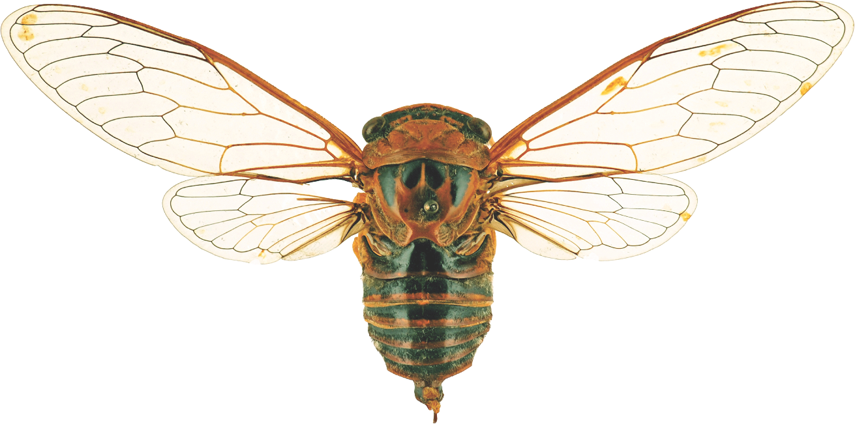
Suggestions reviewed
Institutions
8,787
2,766
vv
Countries
Collections
125
10,158
Country editors
Digitized specimens
68
248,566,791
GRSciColl by the numbers | August 2025
scientific-collections.gbif.org
Notes:
Our community of editors is doing a huge work to update GRSciColl. In 2024 alone, more than 1600 entries were added to GRSciColl. At the core of the GRSciColl work are our Nodes and the GBIF Regional support teams which have been working on reaching out to institutions in GRSciColl as an entry point to sharing GBIF data.

Slide 15




Hosted portals update
13
GBIF national Participants and regions
8
Institutional
54
Hosted portals in production
6
27
Networks/thematic networks
Scientific journal

Slide 16
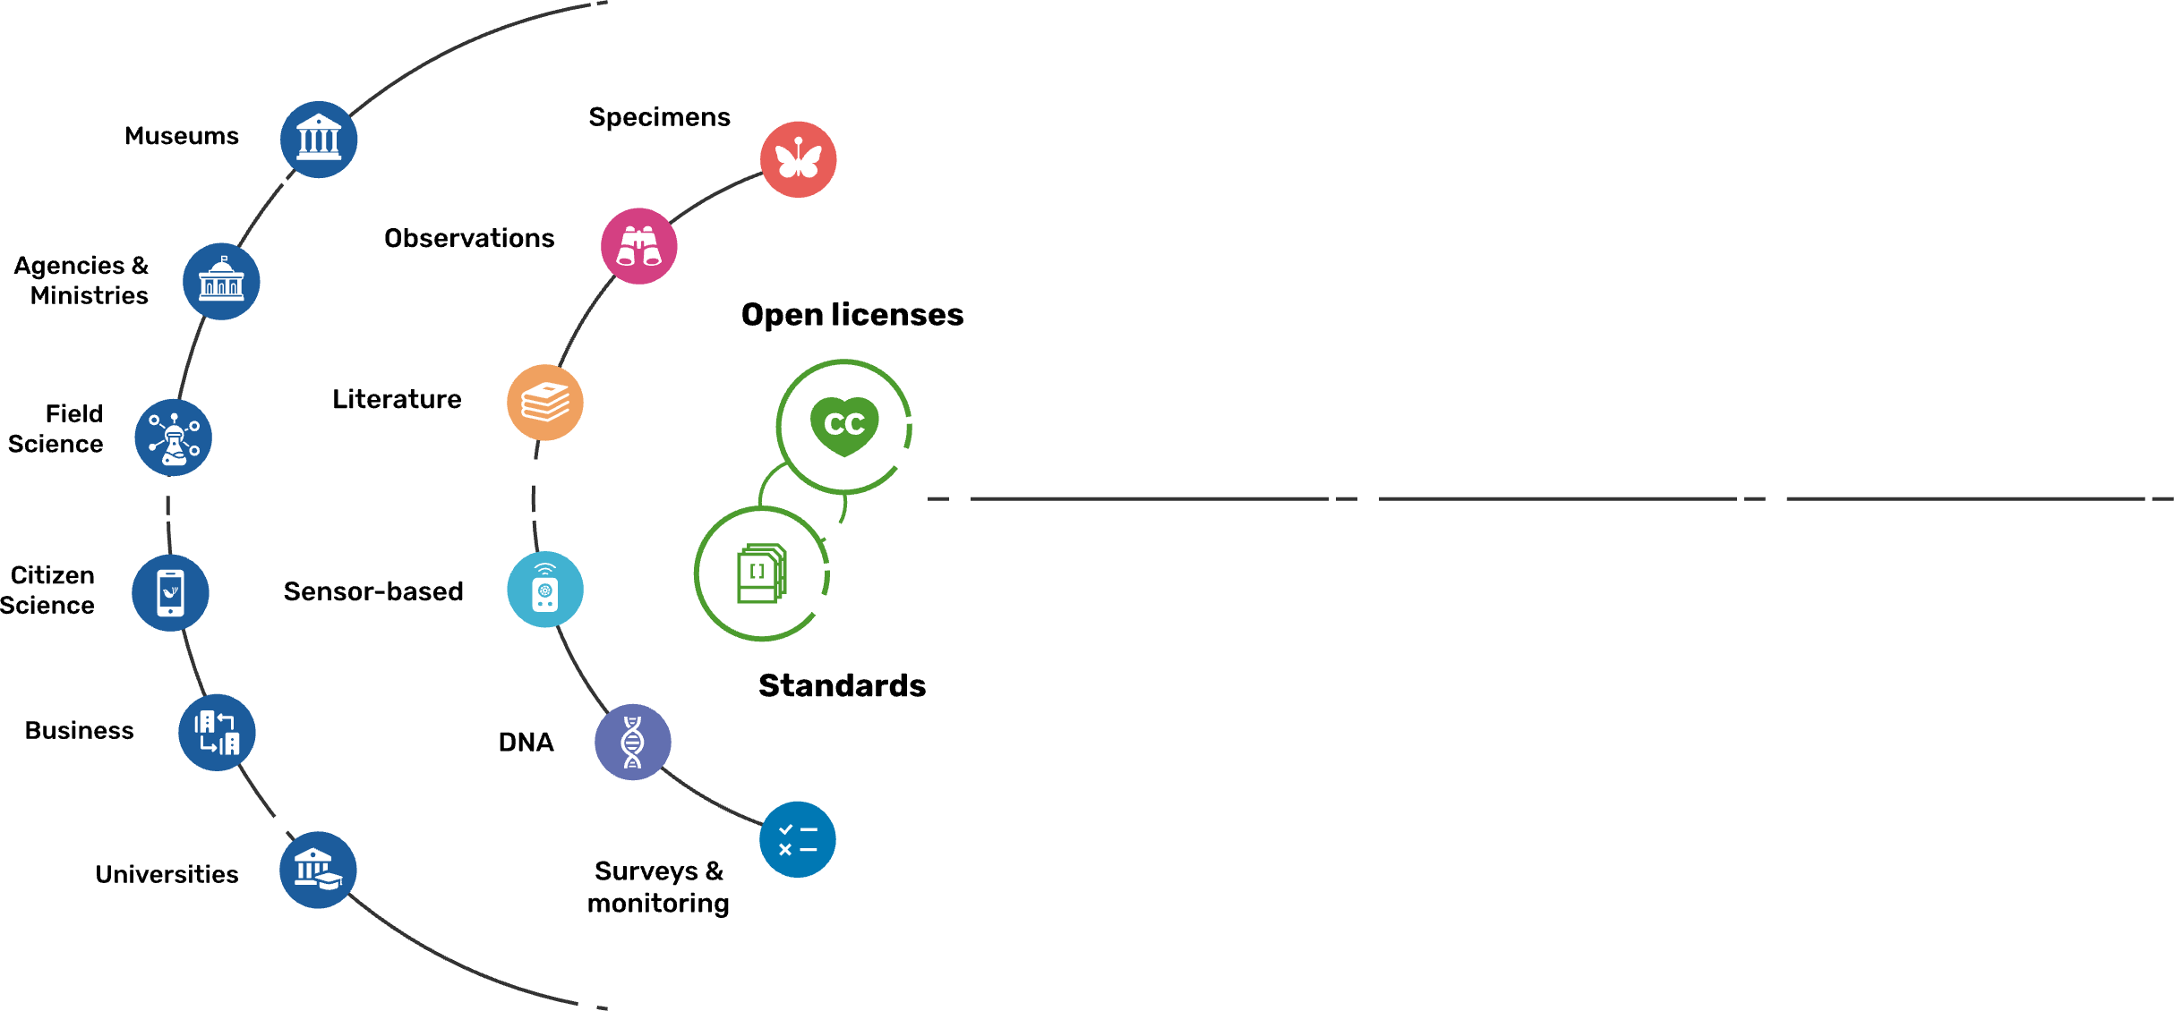
Sources of biodiversity evidence
Create
Combine sources
of evidence

Slide 17
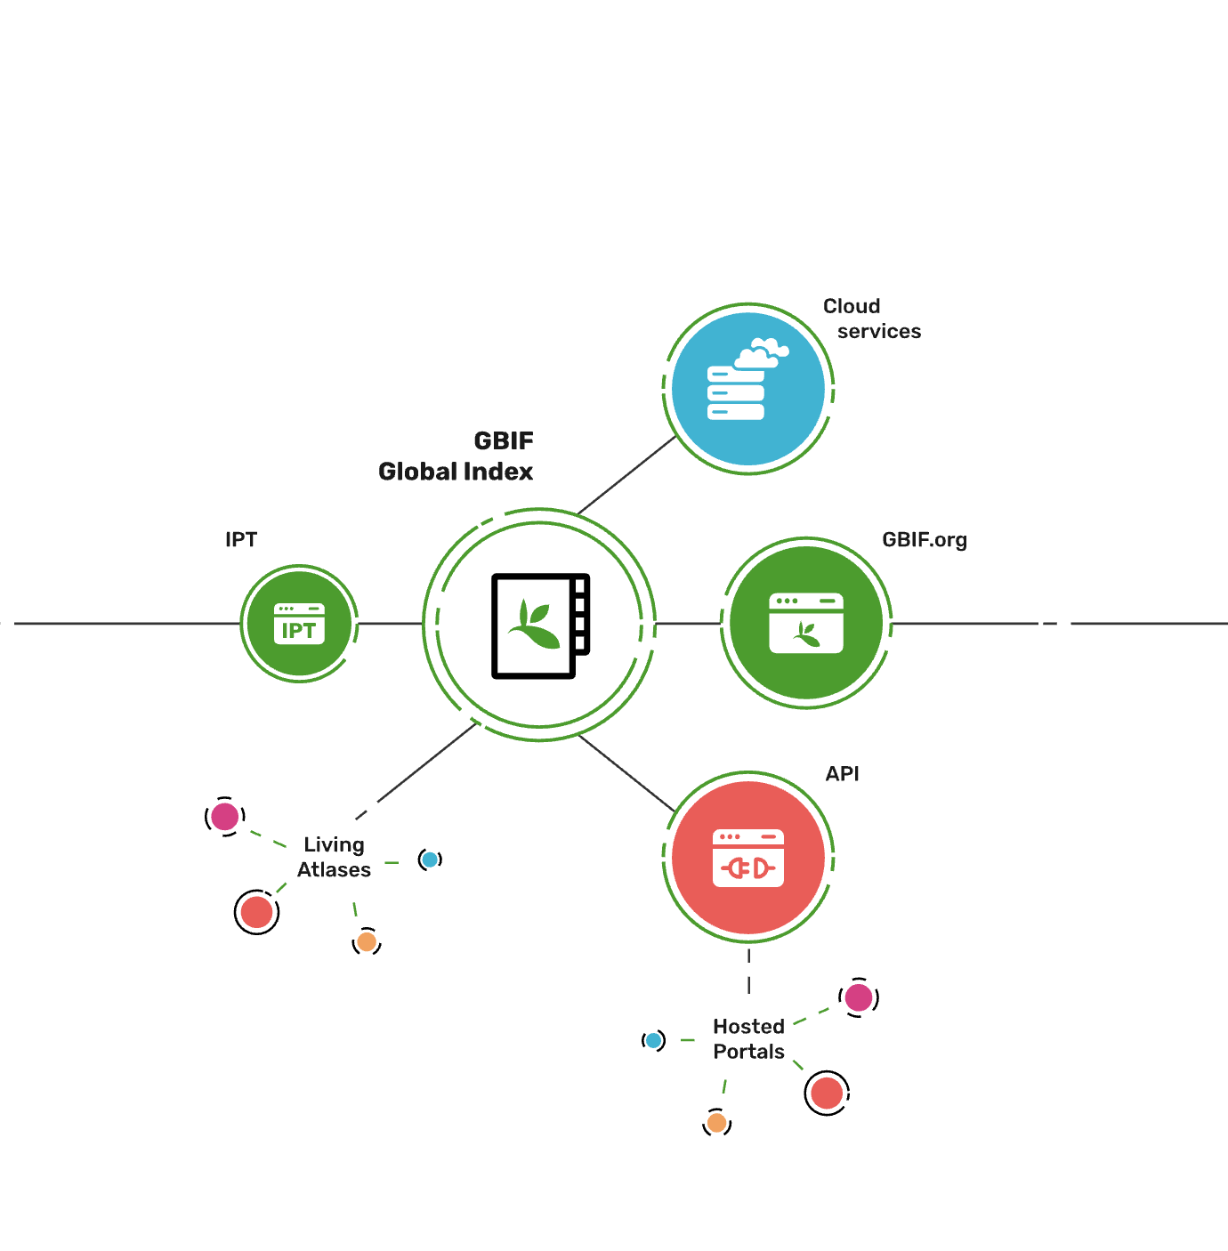
Access to biodiversity evidence
Share
FAIR and open access

Slide 18
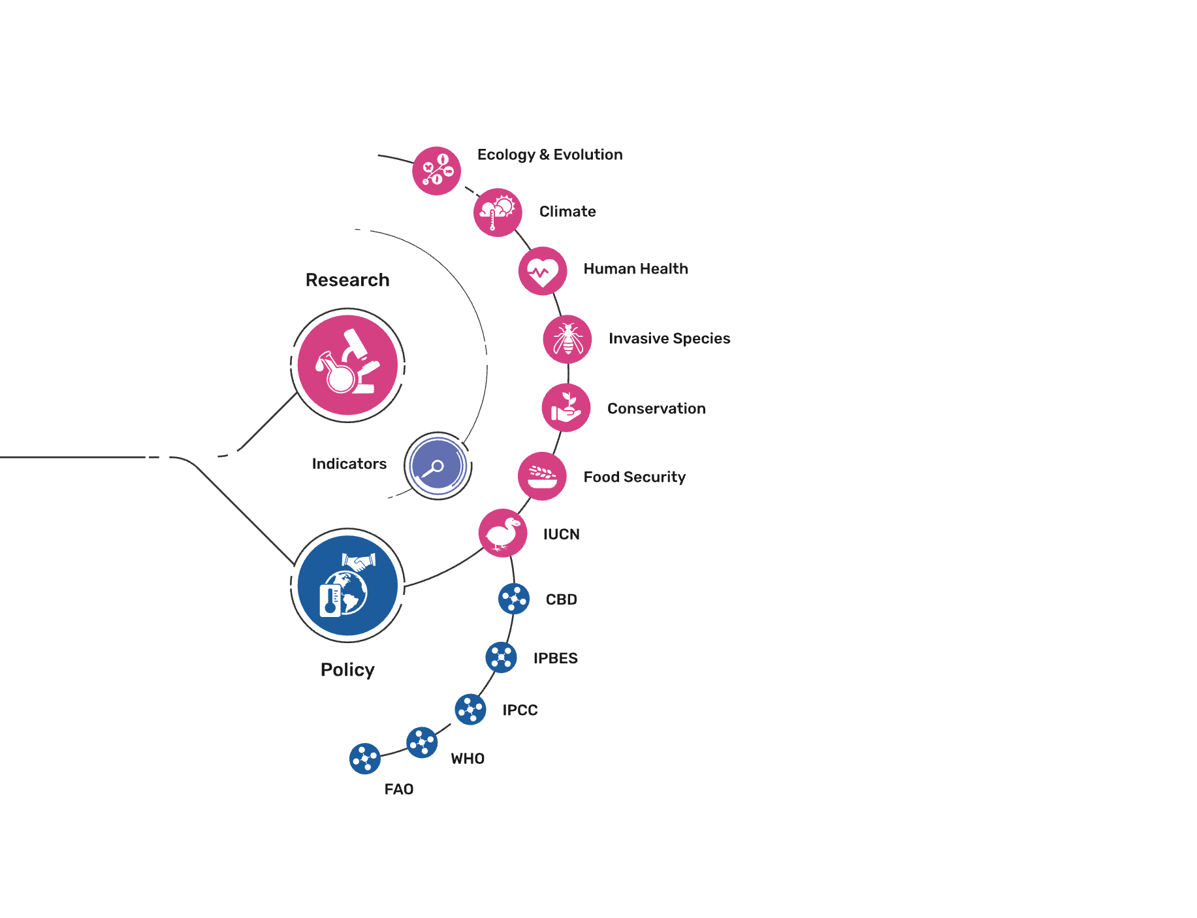
Uses of biodiversity evidence
Transform
Apply and use data

Slide 19
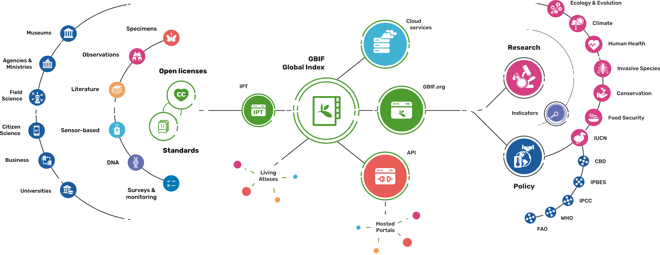
Providing biodiversity evidence for research and policy

Slide 20








data use
Notes:
https://www.gbif.org

Slide 21
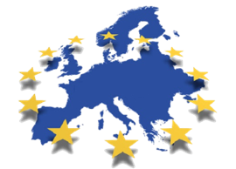
















GBIF: Multiple-purpose data publishing services
Environment directive reporting
Darwin Core
Bio-Collections
& other datasets
Research data portals
portal
Notes:
One-stop data publishing for data-flow into multiple information systems

Slide 22
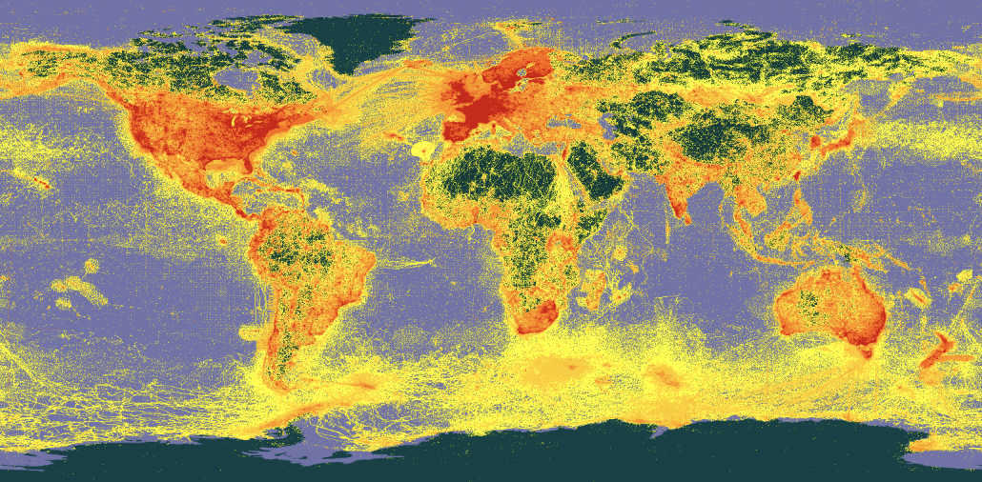


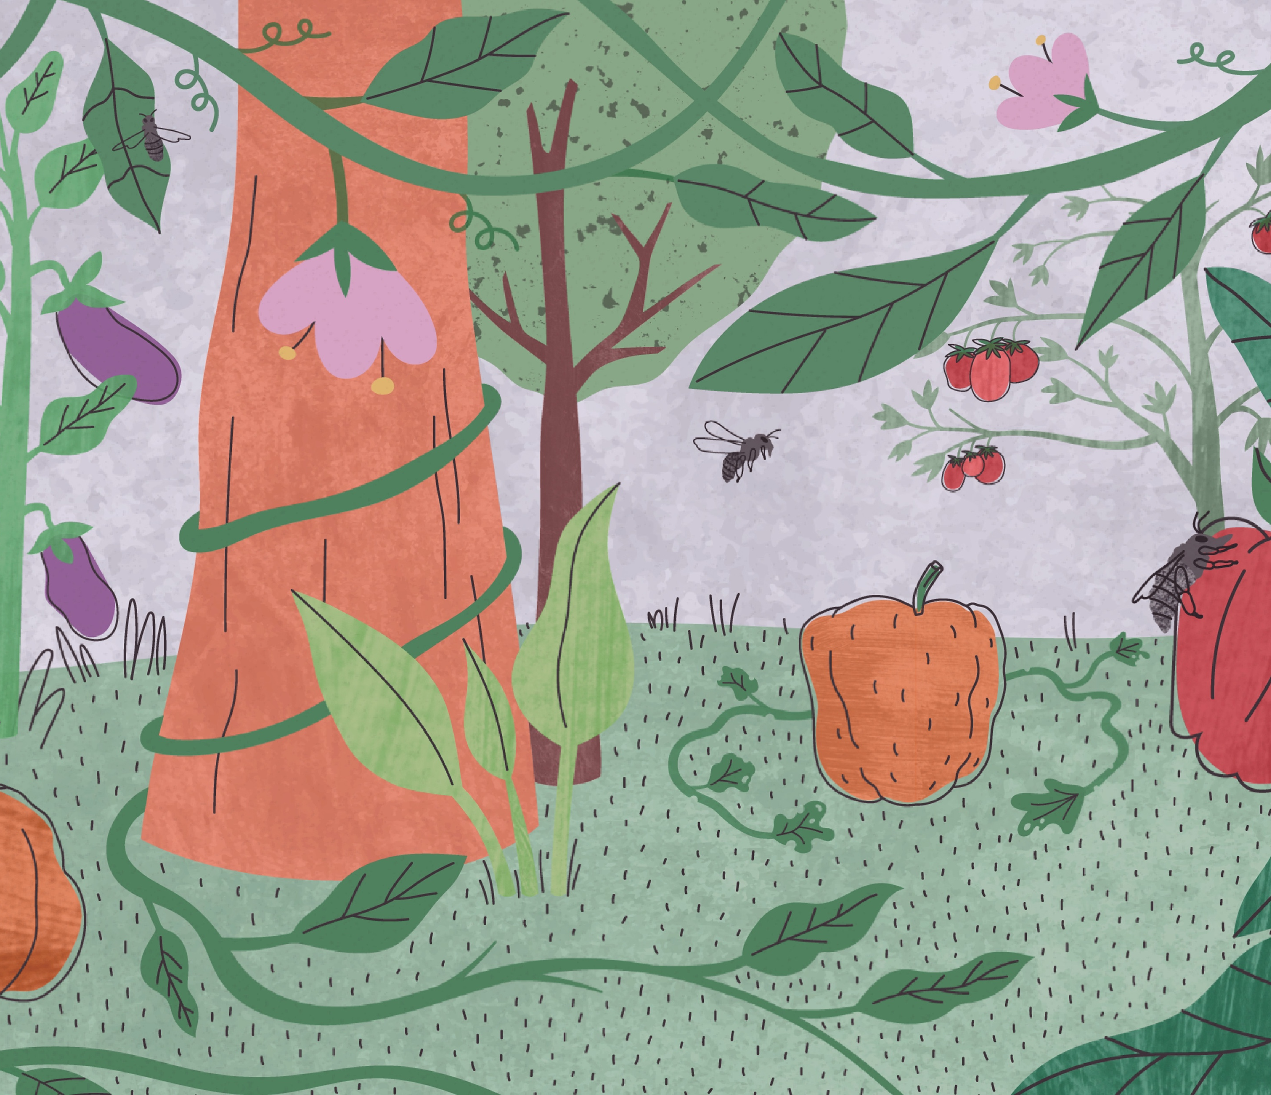
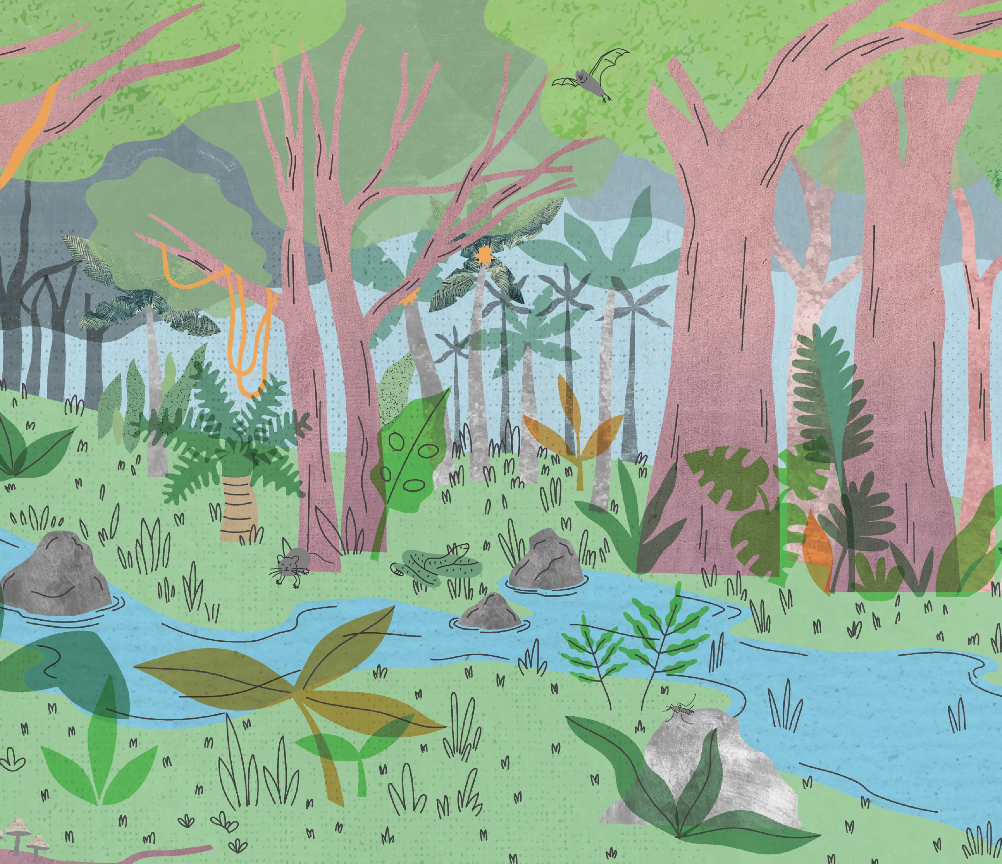

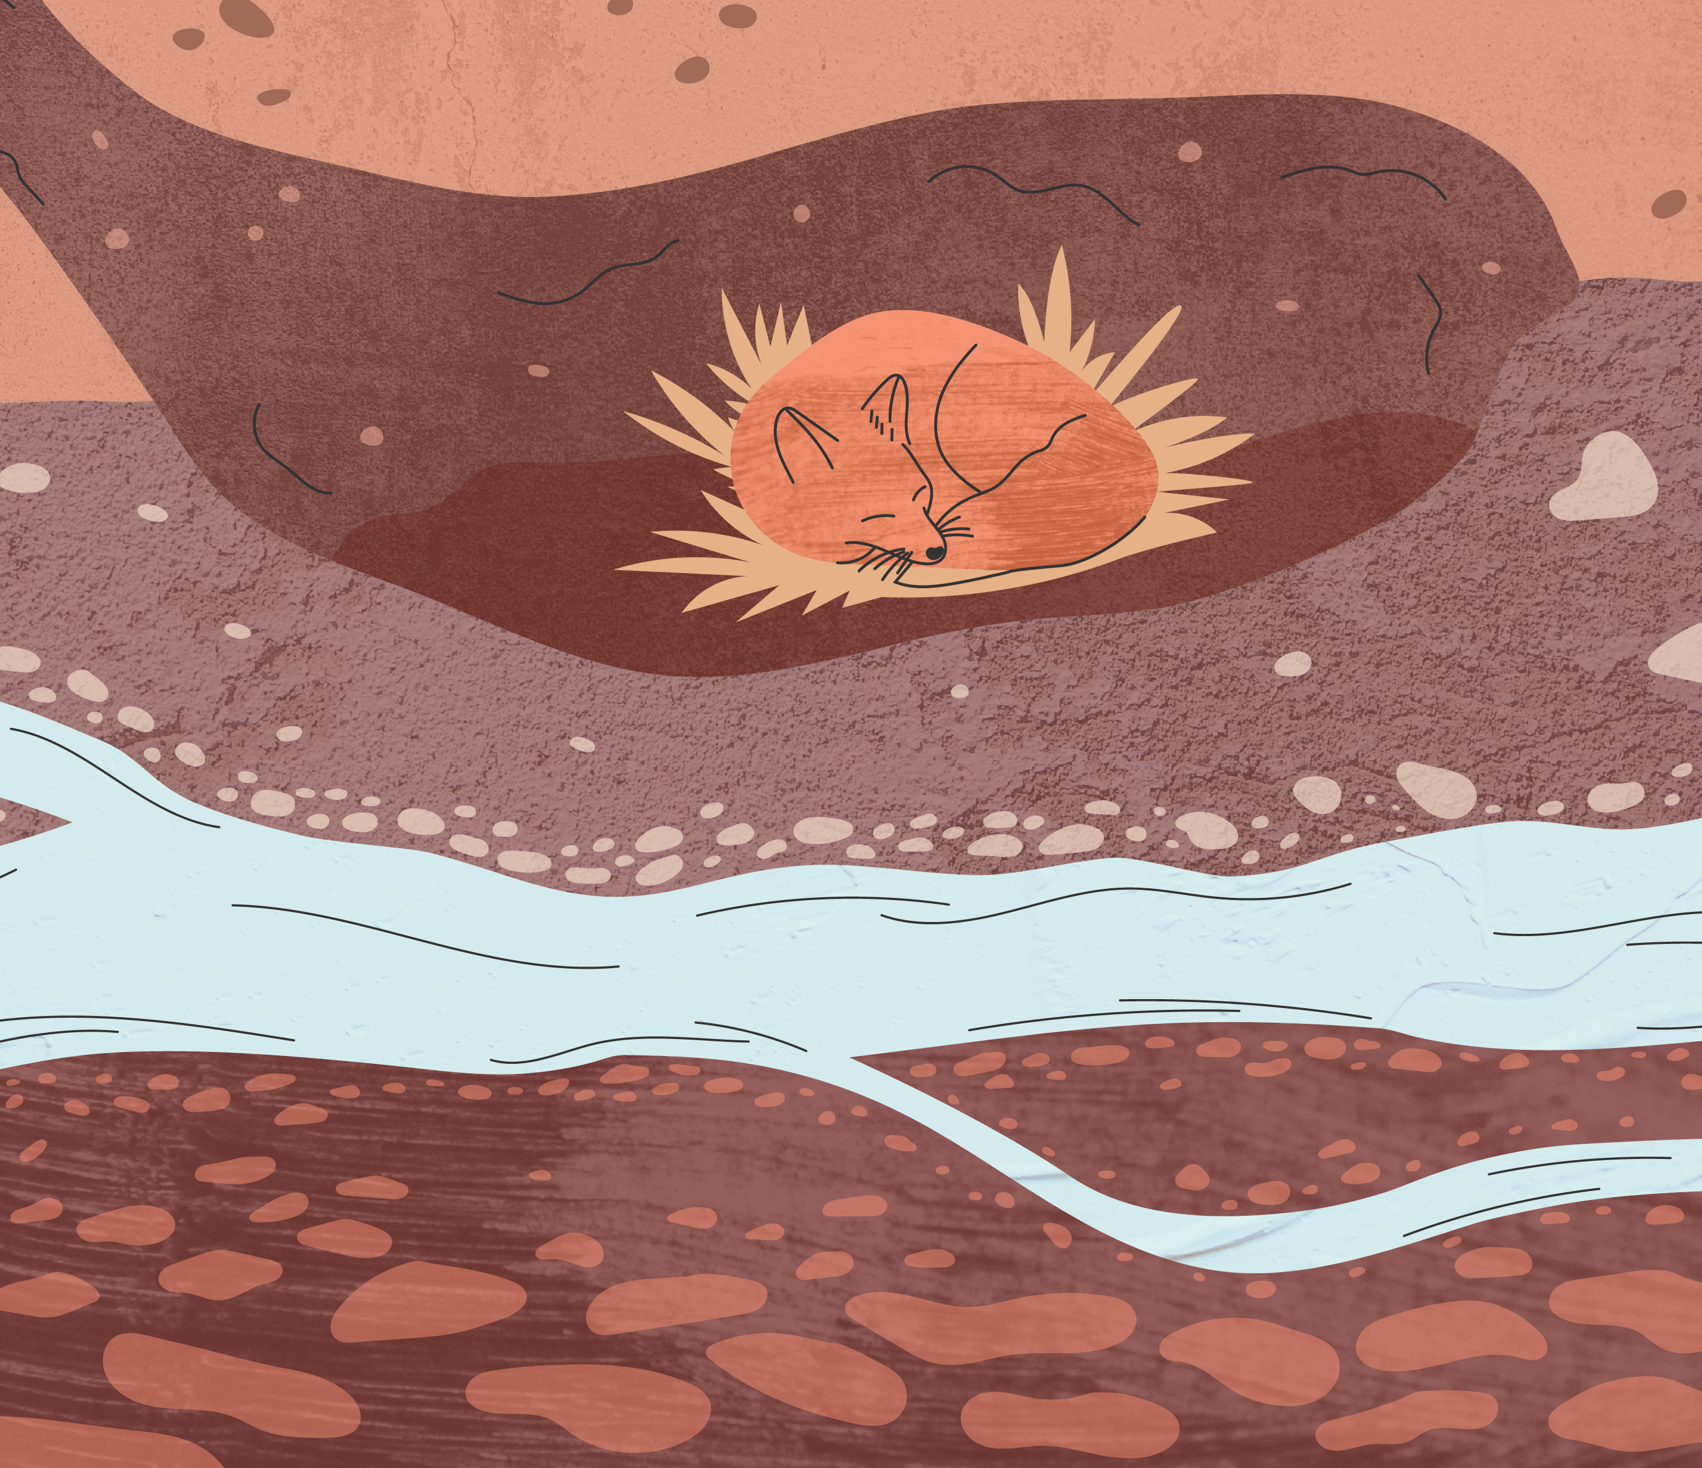

GBIF’s contribution to the Sustainable Development Goals
GBIF-mediated data supports many components of SDGs 14 and 15 on marine, freshwater and terrestrial biodiversity
GBIF supports research and policy relating to agriculture, fisheries and many aspects of food production See https://www.gbif.org/food
GBIF supports policy goals relating to human health, in particular with data relating to disease vectors See https://www.gbif.org/health
GBIF supports global efforts both to mitigate and to adapt to climate change, e.g. modelling species range shifts See https://www.gbif.org/climate
Food
Health
Health
Health
Health
Climate

Slide 23
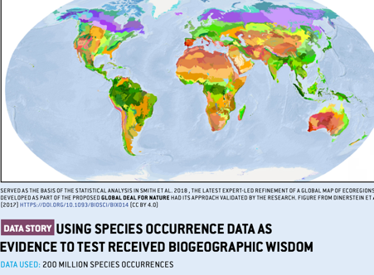
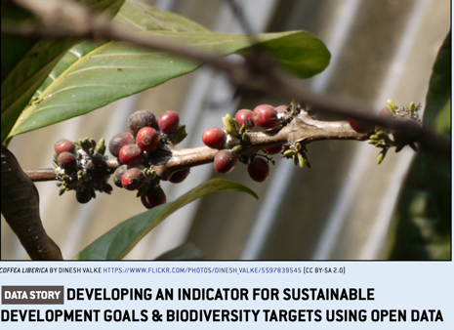
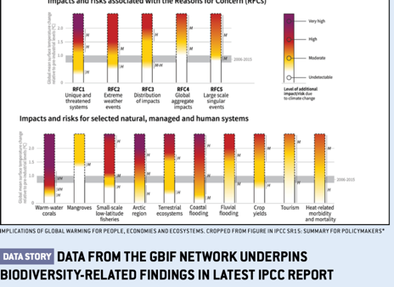
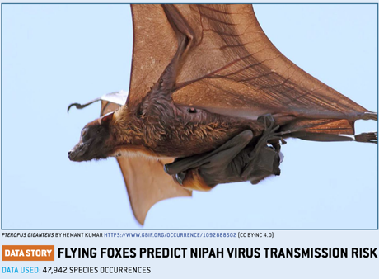
A data resource to support research and sustainable development
Conservation
Protected areas
Threatened species
Invasive species risk
Food Security
Crop wild relatives
In situ, ex situ conservation of genetic diversity
Fisheries planning
Climate change
Modelling impacts on species ranges
Adaptation strategies
Mitigation benefits, risks
Human health
Disease risk based on occurrence of vectors, hosts, reservoirs
Medicinal plants
Hazards e.g. snakebite
Notes:
So we've brought all of this data together, but for what purpose? Through tracking the citations of GBIF in research, and its onward relevance to policy and decisions, we can build up a picture of how all of those involved in sharing standardized data, from the volunteer wildlife observer to researchers and museum curators, are contributing to the knowledge that supports better decisions for our planet and our societies. Just some examples:
- Data shared through GBIF supports CONSERVATION, by helping to identify the most important sites for protected areas; by underpinning assessment of species extinction risk through the Red Listing process; and by tracking the actual and predicted spread of invasive alien species.
- Data shared through GBIF supports FOOD SECURITY, by mapping the distribution of the wild relatives of the most important food crops, and therefore the location of the genetic resources that need to be conserved for future plant breeding; and by providing information on both marine and freshwater fish species - along with other wild species important for nutrition.
- Data shared through GBIF supports action on CLIMATE CHANGE, through helping to model how species ranges will change under different climate change scenarios, informing strategies to adapt to climate change, and assessing the impacts of measures to mitigate climate change, for example increased production of biofuels and hydropower.
- And finally, data shared through GBIF supports HUMAN HEALTH, by tracking the distribution of species that act as vectors, hosts and reservoirs of human diseases; by helping to map medicinal plant species, and by assessing risks posted by significant public health hazards such as snakebite.

Slide 24
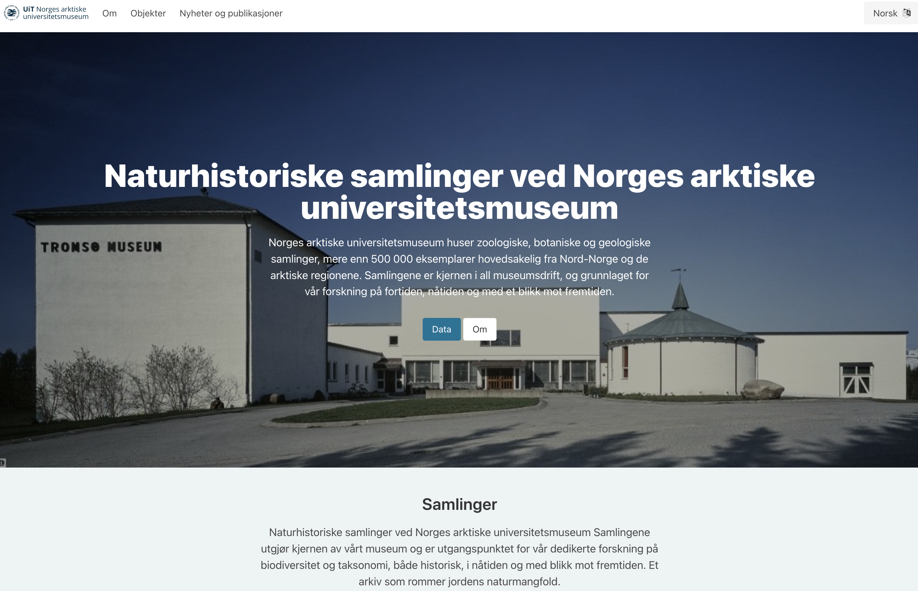
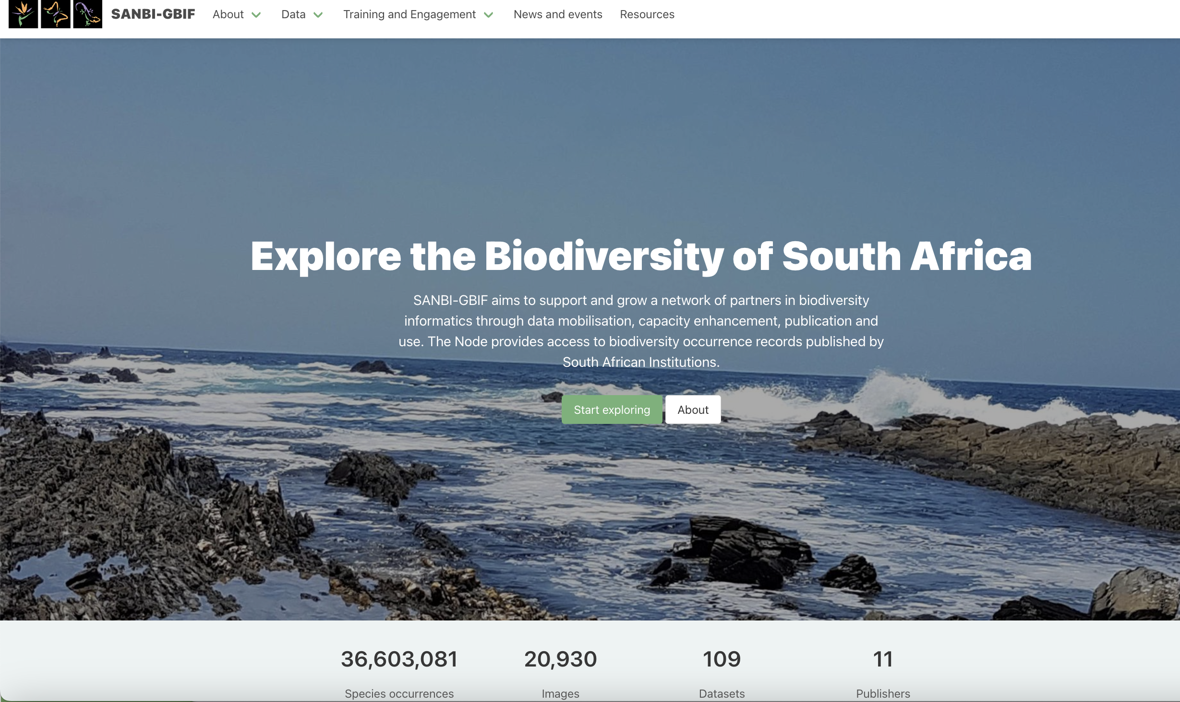
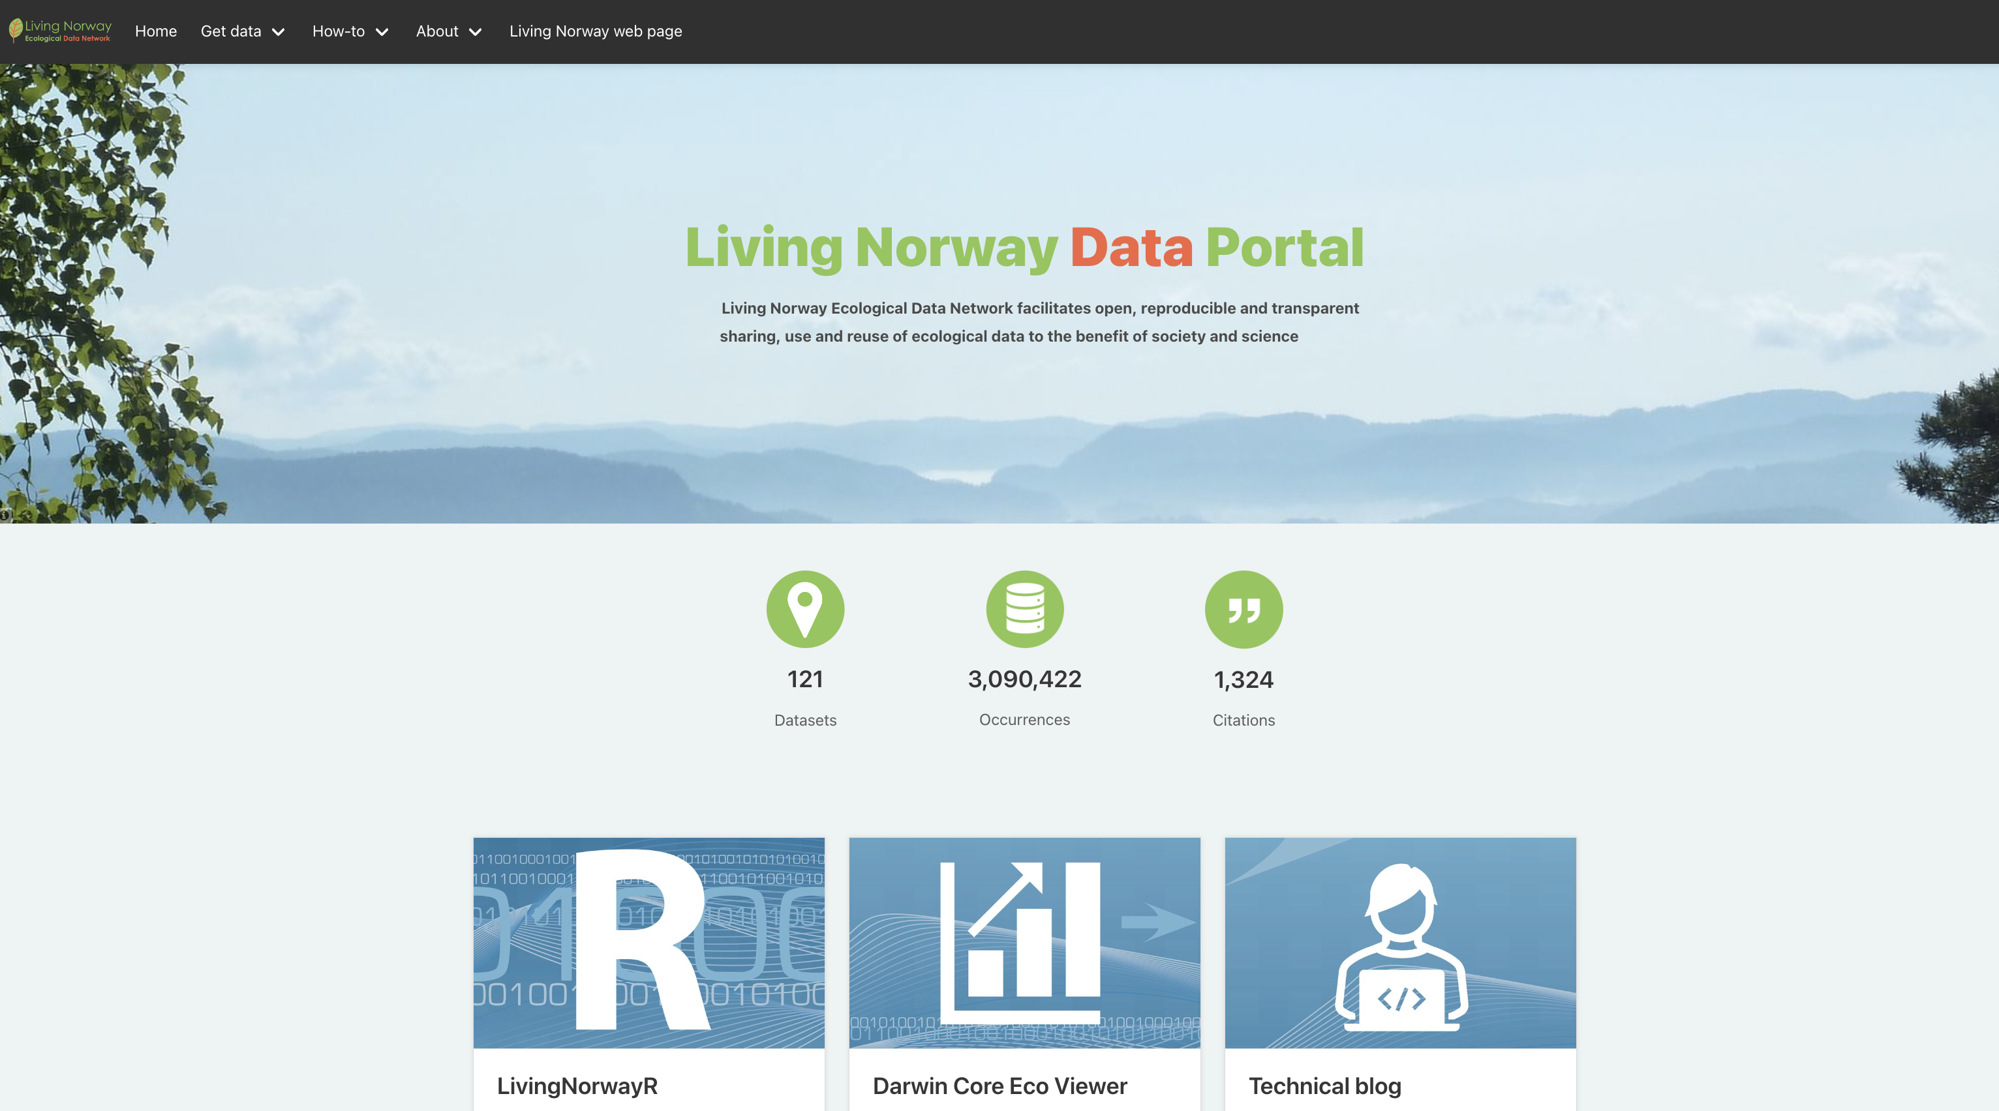
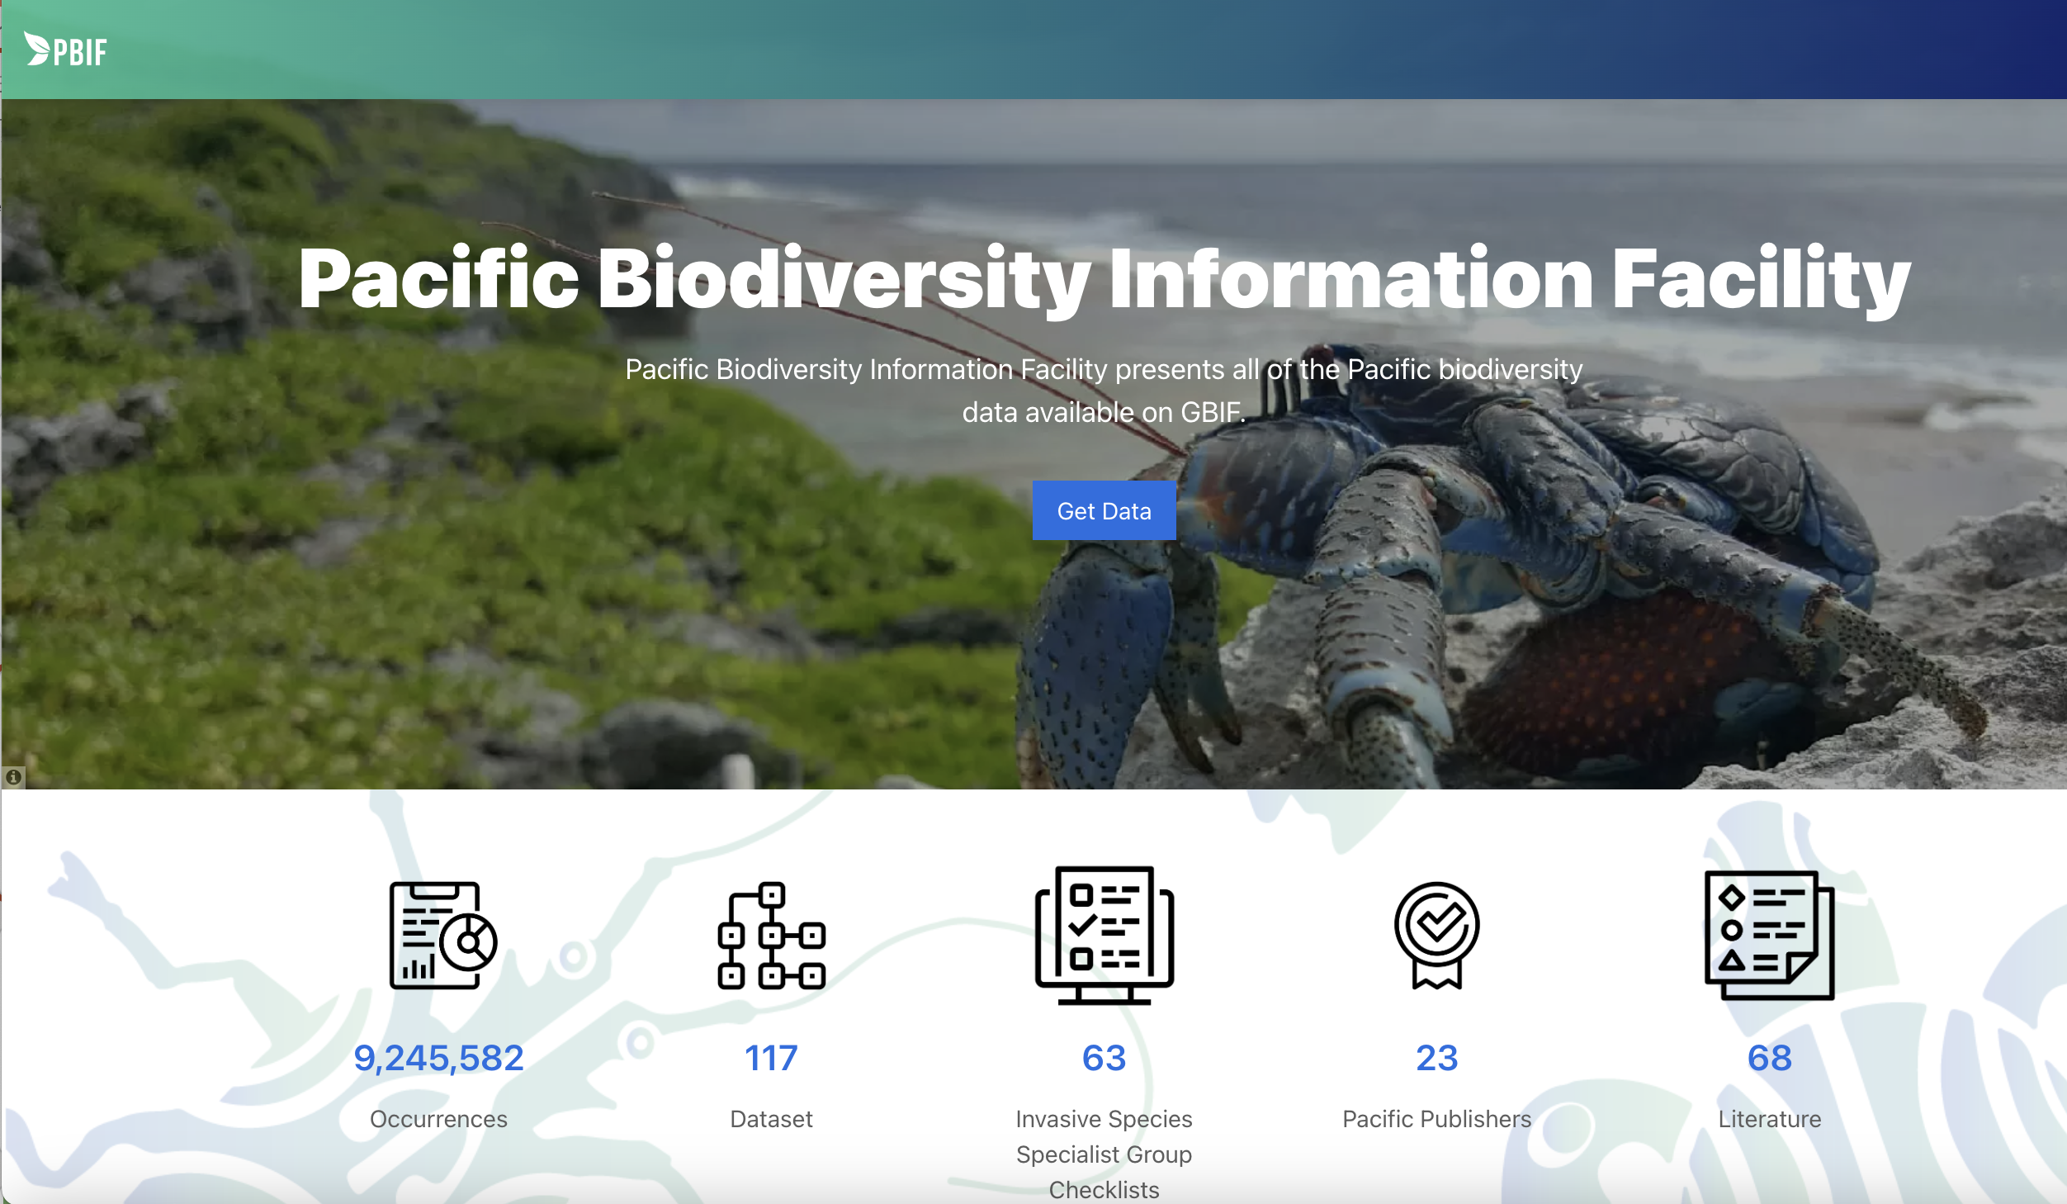
Hosted portals as a showcase for national and regional nodes
Notes:
https://www.gbif.org/hosted-portals
https://specimens.tromsomuseum.no/
https://data.livingnorway.no/

Slide 25
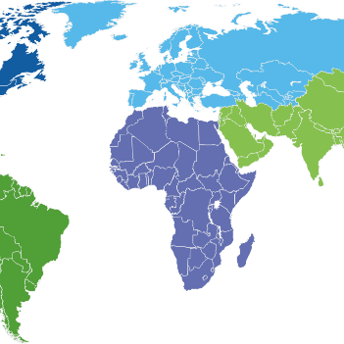

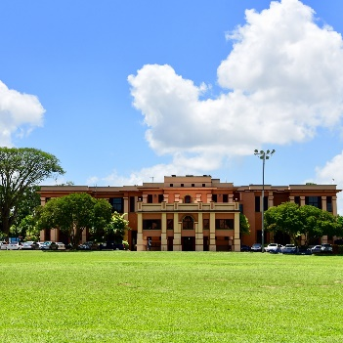
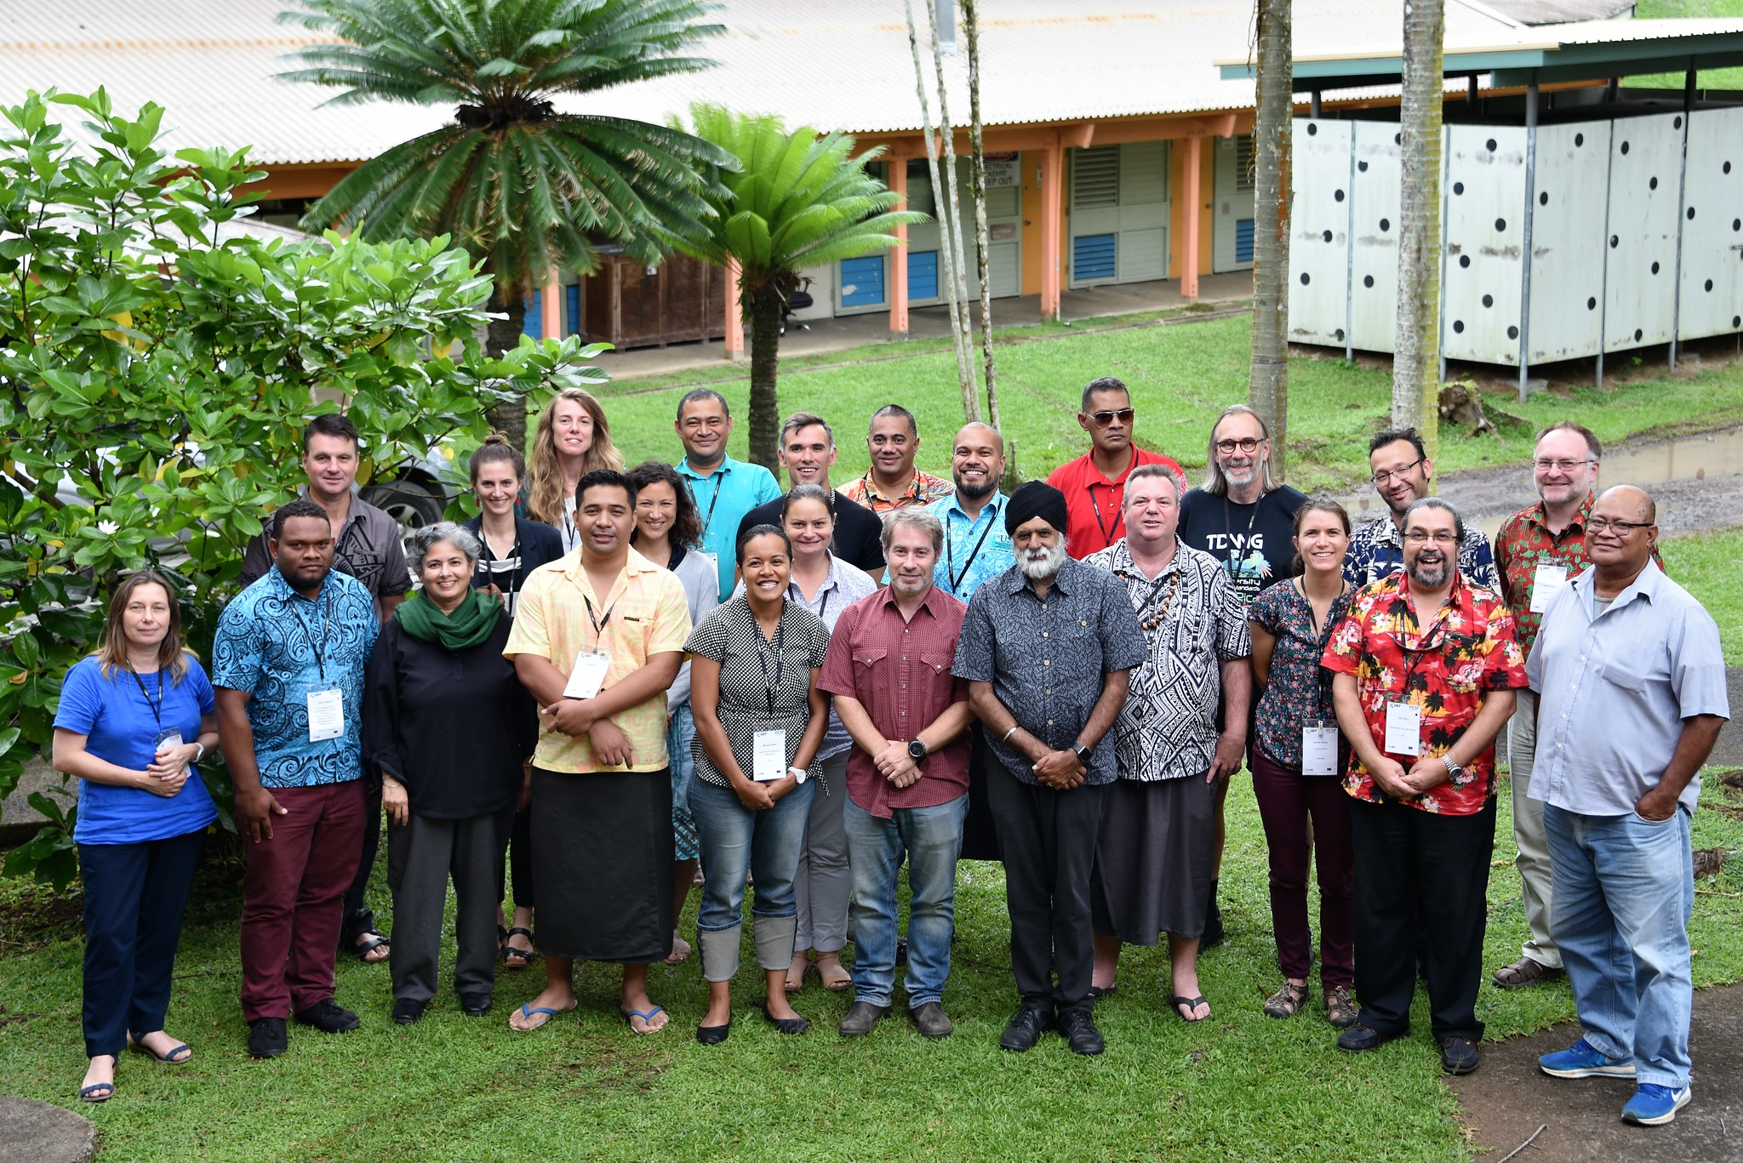
Capacity development levels
Regional
National
Institutional
Individual
Coordinate and raise the visibility of the GBIF community of practice and network
Develop national biodiversity information facilities
Build partnerships that drive the institutionalization of biodiversity data mobilization and use of GBIF-mediated data
Strengthen and grow GBIF’s community of practice
Notes:
And we target these objectives by working to develop capacity on nested levels that you see here: from individual level to institutional level, to national level and to regional level – each with a defined capacity goal.
This framework helps our work in the community & capacity area because by working across these levels we can embed capacity in the layers of our network, enabling capacity at each level to strengthen the network as a whole, which ultimately supports the sustainability of this work.

Slide 26
GBIF course curricula
Notes:
https://www.gbif.org

Slide 27
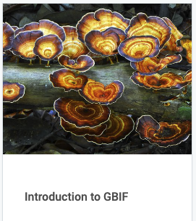
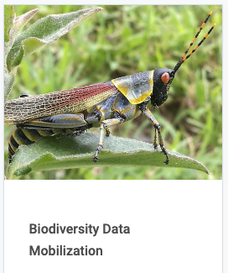
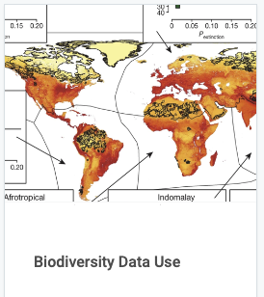
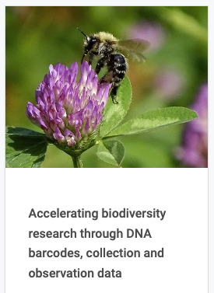
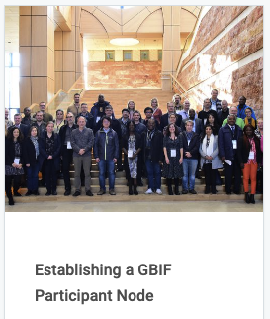
GBIF curriculum
The GBIF Secretariat, in collaboration with our community of trainers and mentors, develops curricula on biodiversity data mobilization and use. These courses are available online for self-paced use or can be adapted for onsite or virtual workshops.
… and more
Notes:
https://docs.gbif.org/documentation-guidelines/en/#current-documents
https://docs.gbif.org/course-introduction-to-gbif/en/
https://docs.gbif.org/course-data-mobilization/en/
https://docs.gbif.org/course-data-use/en/
https://docs.gbif.org/course-dna-barcoding/en/
https://elearning.gbif.es/course/64/about
https://docs.gbif-uat.org/course-checklistbank-tutorial/en/

Slide 28



GBIF curriculum – Volunteer Mentors
Volunteer Mentor
Becoming a volunteer mentor is an opportunity to collaborate with the growing community of scientists, institutions, and networks involved in the mobilization and use of biodiversity data, and to make new connections all around the world. GBIF maintains an open call for volunteers to join this group of mentors and trainers.
Badge – BASIC & ADVANCED
Project Mentor
Certified Trainer

Slide 29
data publishing
Notes:
https://www.gbif.org

Slide 30

Role and functions of a GBIF node coordinating a biodiversity information facility
Supports research communities
Supports policy and decisions
Engages and enables data publishing community
Provides technical services for biodiversity data management

Slide 31

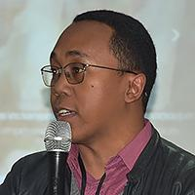
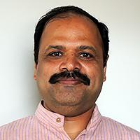


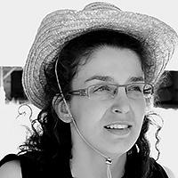


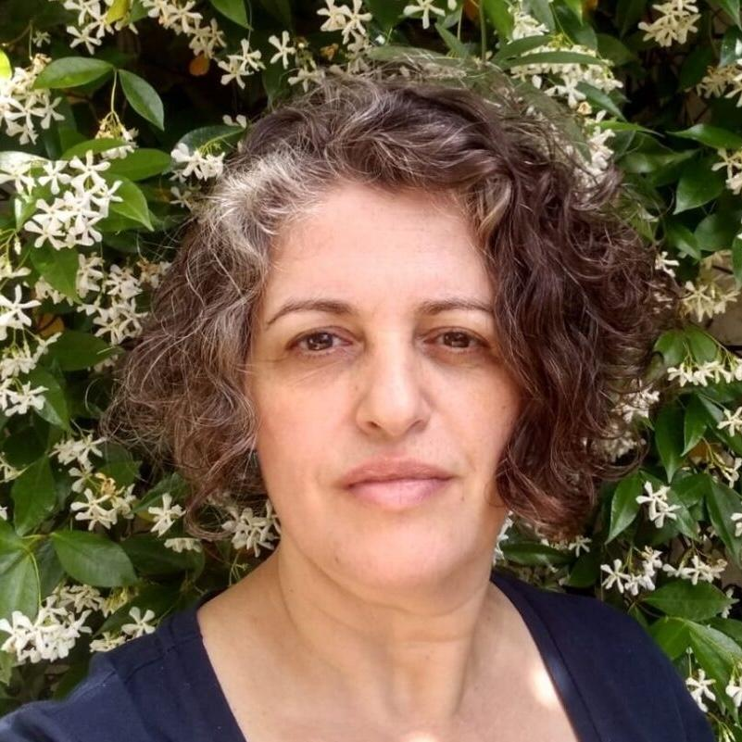
Regional support teams
Africa | Laban Musinguzy (Uganda) Tsiky Rabetrano (Madagascar)
Asia | Vijay Barve (India) Melissa Liu (Taiwan) Lily Shrestha (Nepal)
Europe and Central Asia | Salza Palpurina (Bulgaria) Oleg Borodin (Belarus)
Latin America, the Caribbean and the Pacific | Leonardo Buitrago (Colombia) Anabela Plos (Argentina)
Regional support contractors to complement nodes support from national participants.

Slide 32
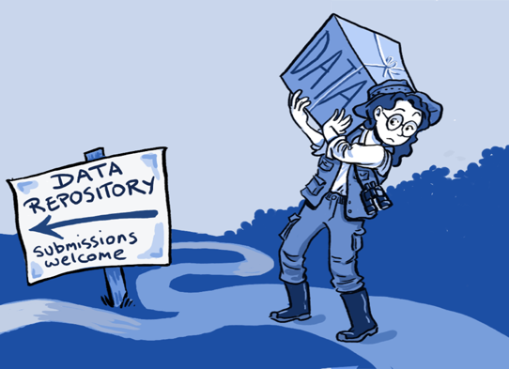
Publish your datasets with GBIF
Step 1: digitize collections & herbaria
Step 2: register for endorsement in GBIF
Step 3: convert to Darwin Core format
Step 4: publish from national GBIF node
Alternative: publish from the regional GBIF cloud data repository – https://cloud.gbif.org/
Alternative: Many citizen science data platforms publish data in GBIF
Notes:
http://www.gbif.org/resource/80635
http://www.gbif.org/publishing-data/summary
http://www.gbif.org/publishing-data/request-endorsement#/intro

Slide 33


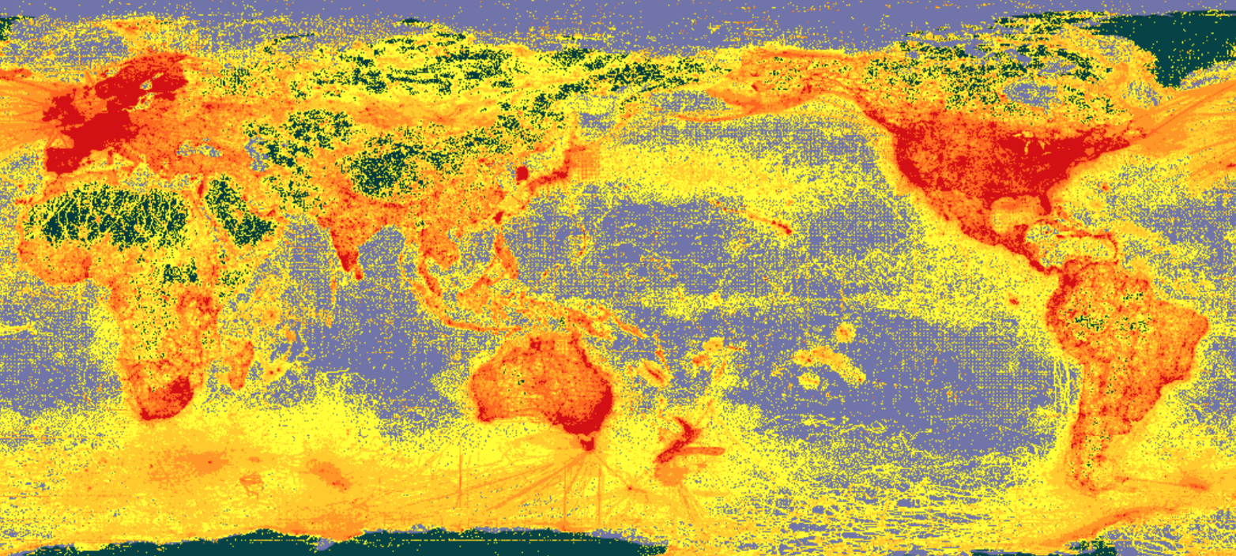







A window on evidence about where species have lived, and when
Observations/surveys
Digitized specimens
Data publishing and indexing
Literature
Common standards (DwC)
Satellite tracking
Environmental DNA
Data discovery and use

Slide 34
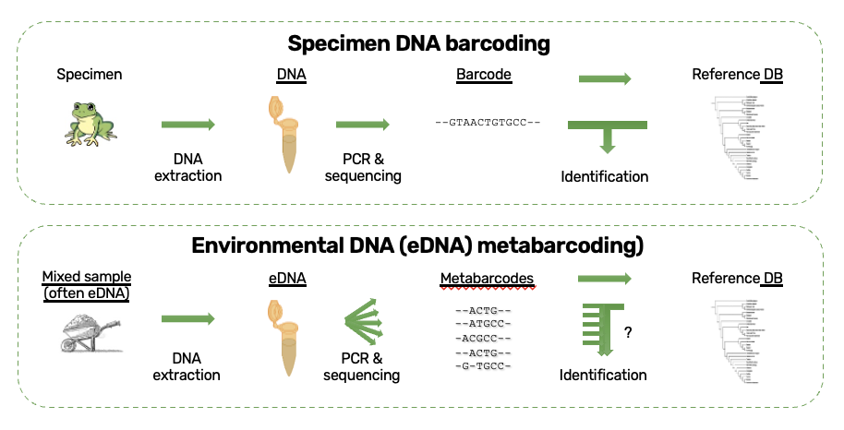
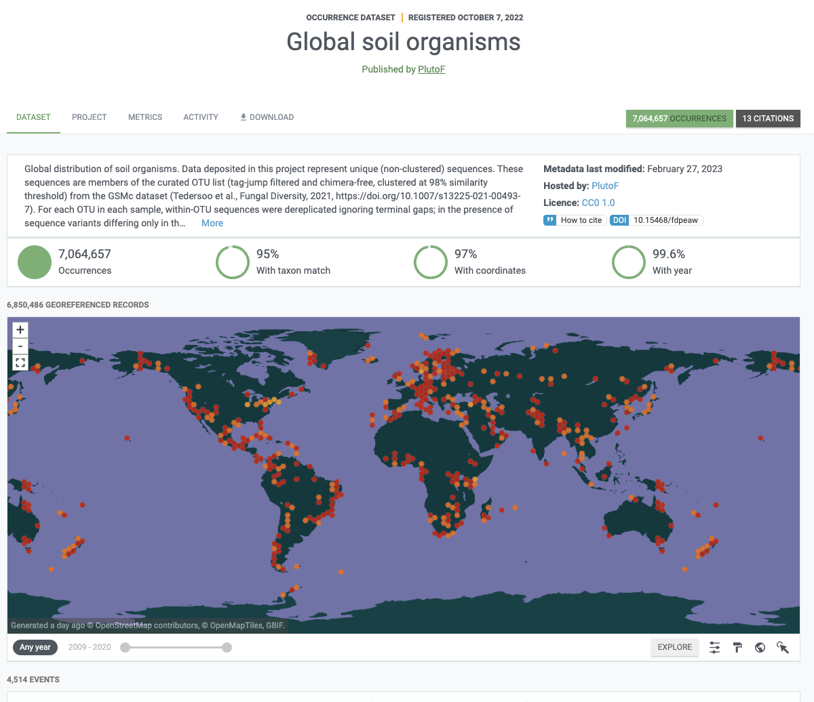
Exploring biodiversity through DNA evidence

Slide 35

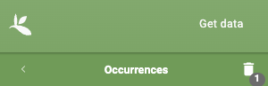
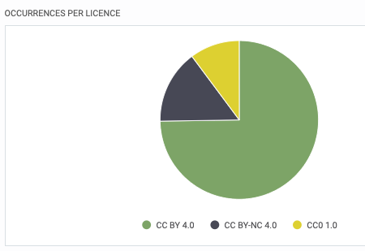
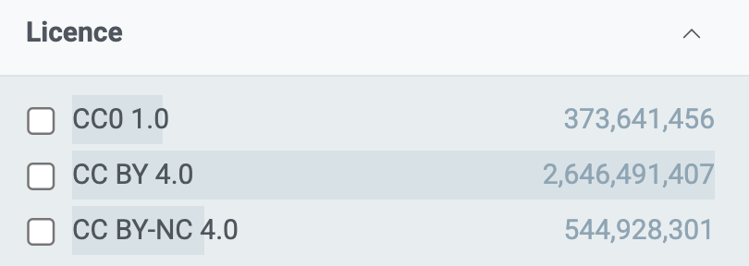
GBIF Data licenses

Slide 36
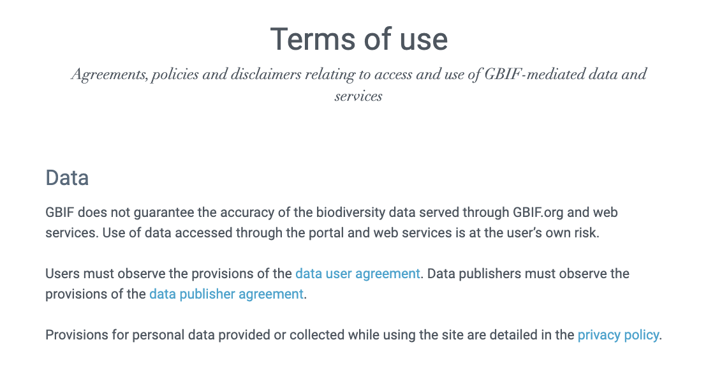
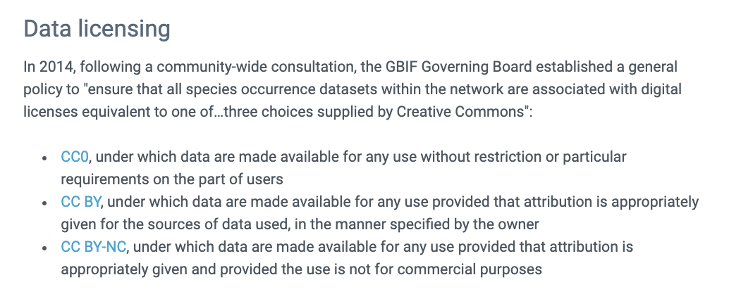
GBIF terms and agreements

Slide 37
Metabarcoding Toolkit
Notes:
https://www.gbif.org

Slide 38
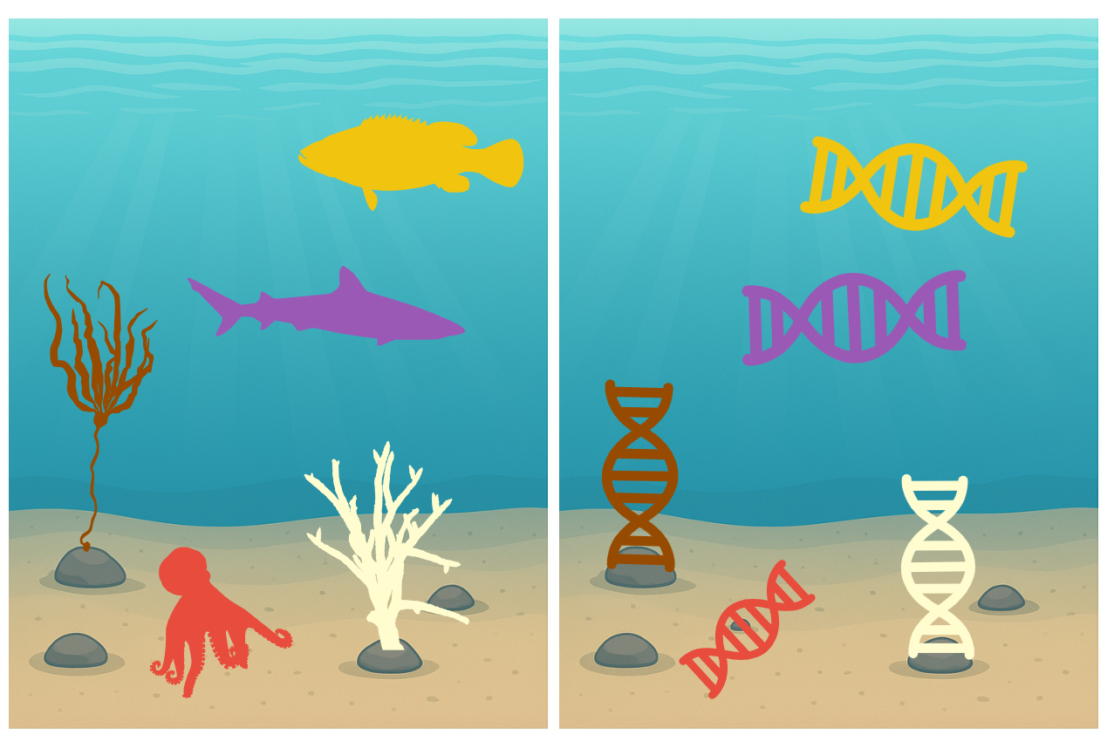
eDNA can reduce the resources needed to observe biodiversity
Based on slides from Zachary Gold and Susie Theroux

Slide 39

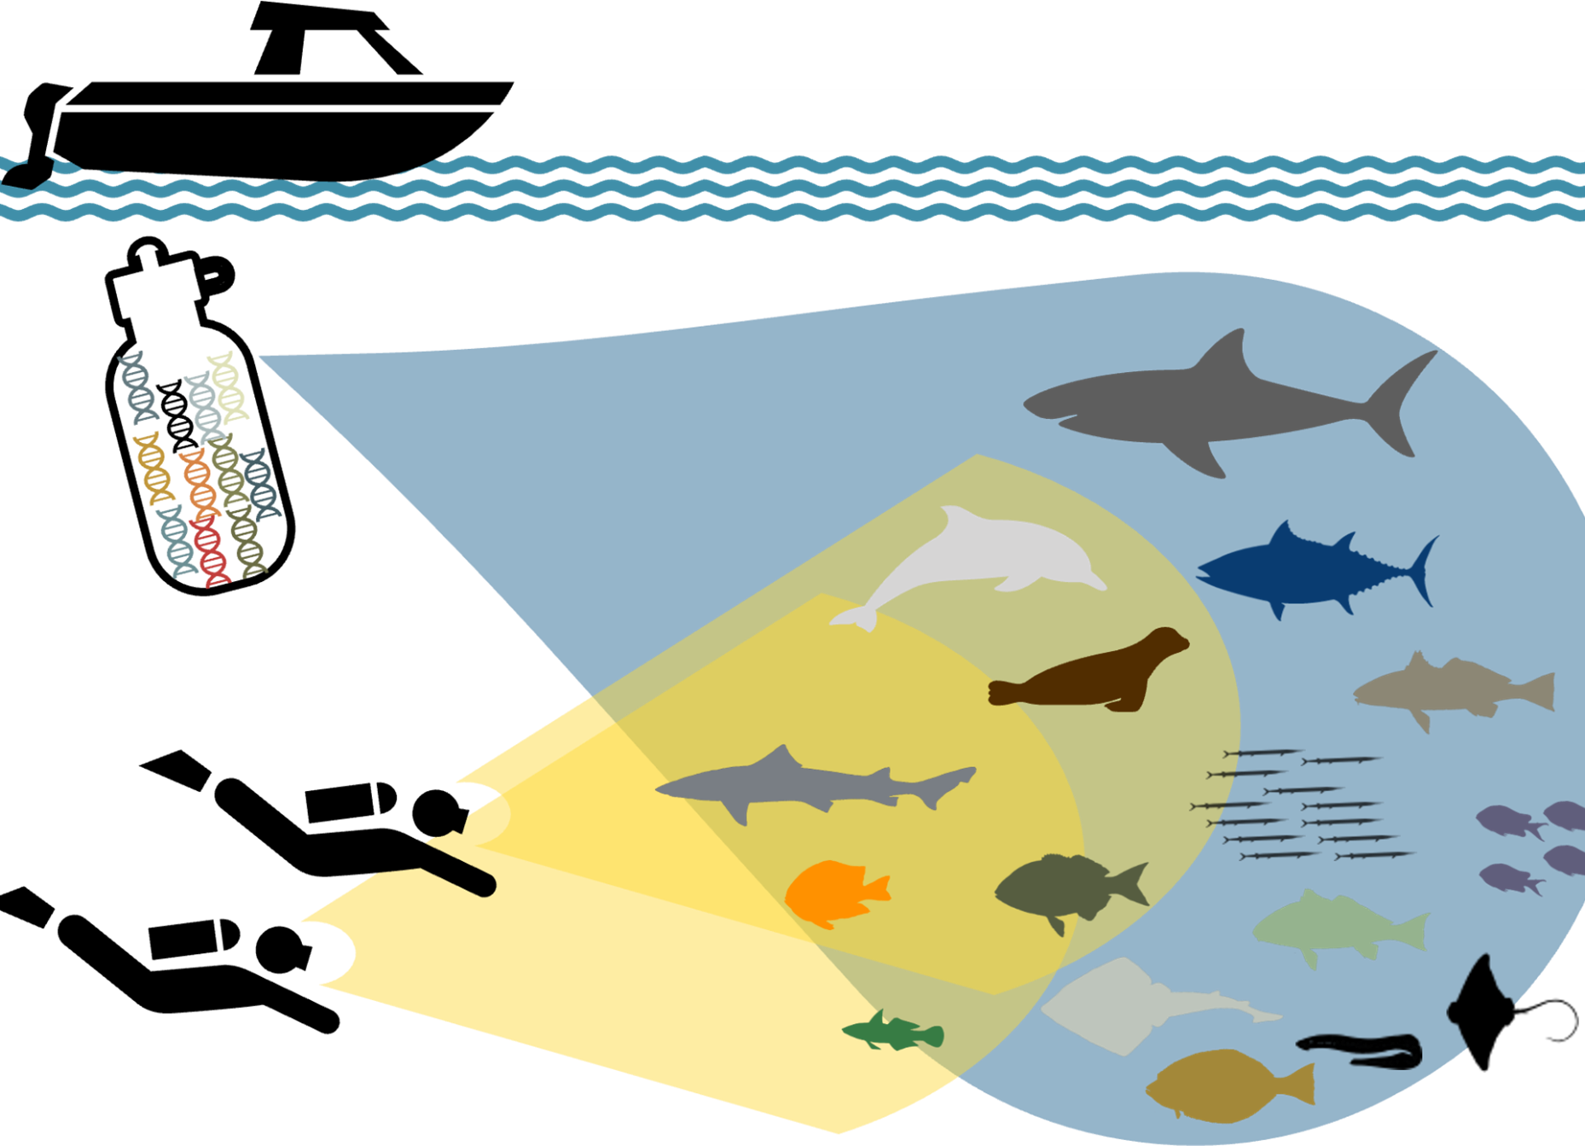
eDNA helps, but it’s not a silver bullet
Share
FAIR and open access
Based on slides from Zachary Gold and Susie Theroux

Slide 40
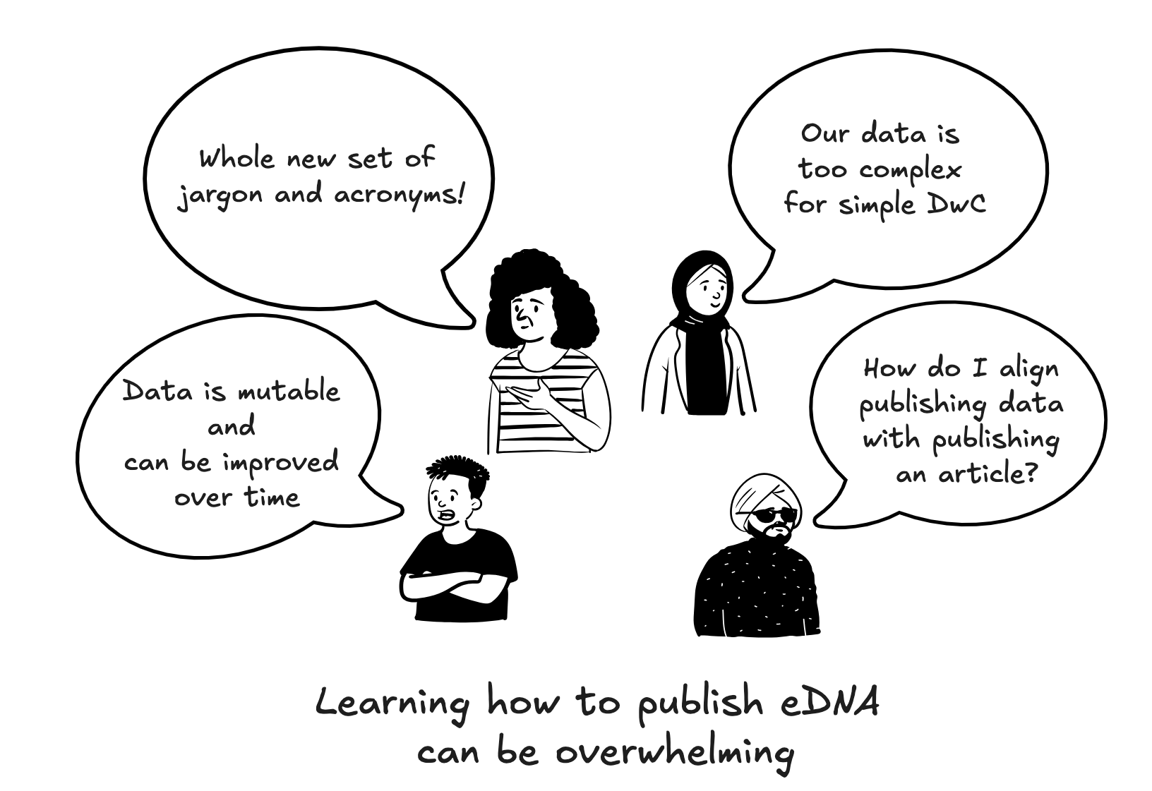
What concerns do users have about publishing eDNA?
Notes:
Whole new set of jargon and acronyms for many data providers
Data is mutable and can be improved over time
The flexibility of the terms and the QC can be overwhelming (but are answered in the guide FAQ)
Our data is too complex for simple DwC
How do I align publishing data and DOI minting with publishing an article?

Slide 41
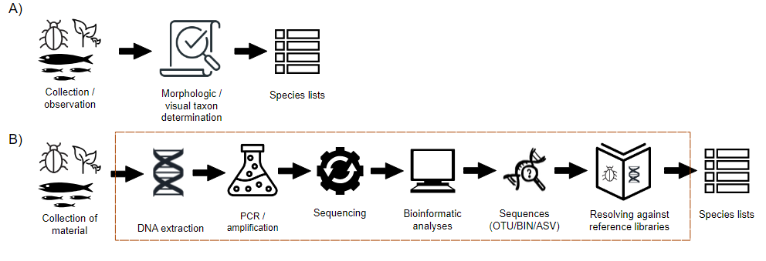
The DNA-Derived Data Extension
Modified from Figure 2:
Abarenkov K, Andersson AF, Bissett A, Finstad AG, Fossøy F, Grosjean M, Hope M, Jeppesen TS, Kõljalg U, Lundin D, Nilsson RN, Prager M, Provoost P, Schigel D, Suominen S, Svenningsen C & Frøslev TG (2023) Publishing DNA-derived data through biodiversity data platforms, v1.3. Copenhagen: GBIF Secretariat. https://doi.org/10.35035/doc-vf1a-nr22.

Slide 42
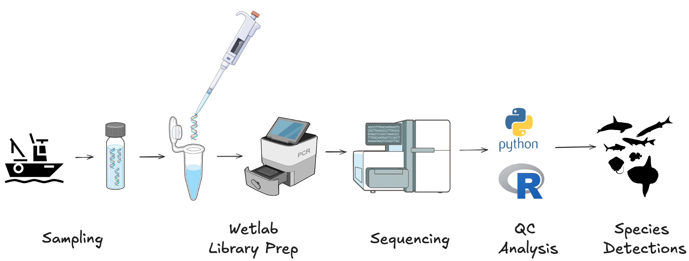
Based on slides from Zachary Gold and Susie Theroux

Slide 43
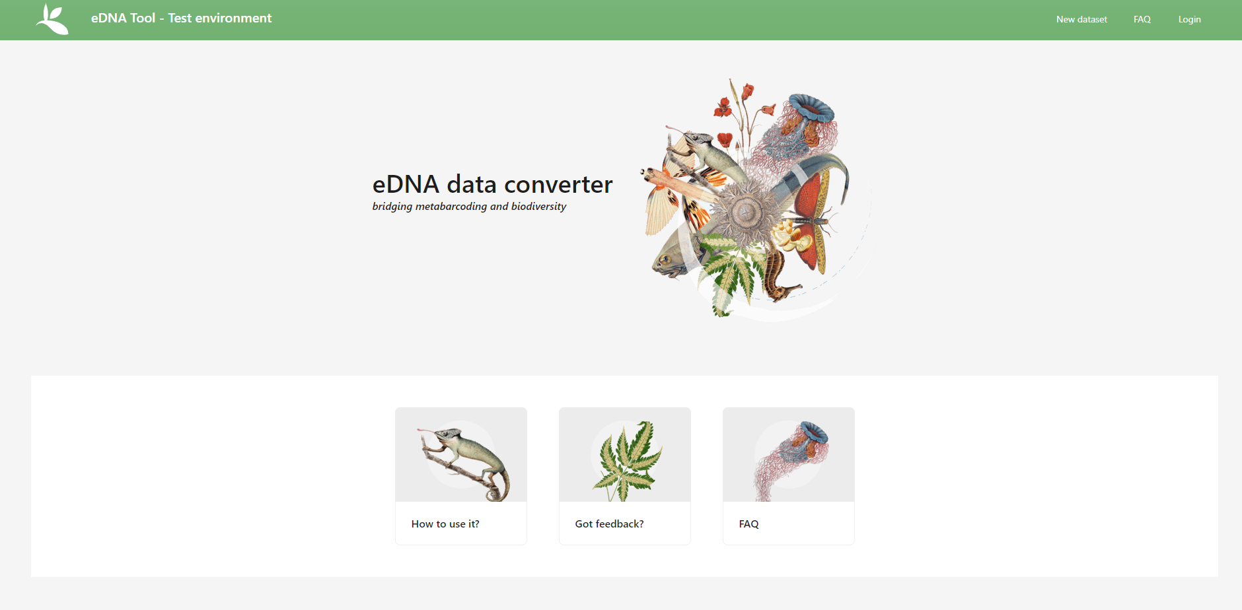
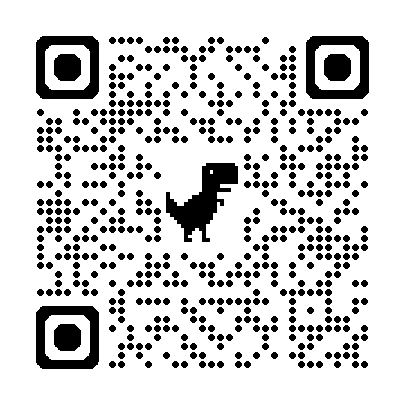
GBIF Metabarcoding Toolkit (MDT)

Slide 44


Core Components
Excel Templates
Metabarcoding Requirements
MDT feedback mechanisms
MDT Sandbox environment
https://docs.gbif-test.org/mdt-user-guide/en/

Slide 45

MDT Core Components
Figure 8 from the MDT User Guide

Slide 46
MDT Excel Templates
6.1. OTU table template 1 – Excel workbook
A workbook with three/four sheets: OTU_table, Taxonomy, Samples and (optionally) Study. Template 1.
6.2. OTU table template 2 – Excel workbook with fasta file
Same as #1, except instead of having the sequences in the Taxonomy sheet, a fasta file (seqs.fasta) is provided. Template 2.
6.3. OTU table template 3 – TSV format
Three/four tsv (or csv) files OTU_table.tsv, Taxonomy.tsv, Samples.tsv, and (optionally) Study.tsv containing study-wide global values. Template 3.
6.4. OTU table template 4 – TSV format with fasta file
Same as #3, except instead of having the sequences in the Taxonomy.tsv, a fasta file (seqs.fasta) is provided. Template 4.

Slide 47
MDT Requirements
Fields to be Provided by User
Required
DNA_sequence
scientificName
eventDate
eventID (Sample ID used by default)
Highly Recommended
materialSampleID, recordedBy
decimalLatitude, decimalLongitude
target_gene, target_subfragment
pcr_primer_forward, pcr_primer_reverse
pcr_primer_name_forward, pcr_primer_name_reverse
pcr_primer_reference, seq_meth
otu_class_appr, otu_seq_comp_appr, otu_db
kingdom
Recommended
env_broad_scale, env_local_scale, env_medium,
associatedSequences, lib_layout, sop,
samplingProtocol, identificationRemarks, identificationReferences,
phylum, class, order, family, genus
Fields Automatically Handled by MDT
The following fields are automatically populated and require no user input:
basisOfRecord, occurrenceID
organismQuantity, organismQuantityType
sampleSizeValue, sampleSizeUnit
taxonID, eventID

Slide 48
MDT Feedback mechanisms
Report a bug:
https://github.com/gbif/metabarcoding-data-toolkit-ui/issues/new
Request a feature:
https://github.com/gbif/metabarcoding-data-toolkit-ui/issues/new
GBIF Discourse:
https://discourse.gbif.org/t/for-matters-relating-to-the-metabarcoding-data-toolkit-or-the-datatype-in-general/5484

Slide 49




Example published datasets that use the DNA-derived data extension
Museum Specimen + DNA extension
Exploring marine biodiversity
with 16S + 18S
COI eDNA of intertidal zone
qPCR + metabarcoding of invasive species
Example Occurrence: https://www.gbif.org/occurrence/4445072107
Dataset Link: https://www.gbif.org/dataset/040c5662-da76-4782-a48e-cdea1892d14c
Example Occurrence: https://www.gbif.org/occurrence/444507210
Dataset Link: https://www.gbif.org/dataset/9012def0-bd87-48a0-ac9e-e0e78dd37689
Example Occurrence: https://www.gbif.org/occurrence/4537370216
Dataset Link: https://www.gbif.org/dataset/9358fbd7-cfd0-4eab-99fa-0934396a0529
Example Occurrence: https://www.gbif.org/occurrence/4406079323
Dataset Link: https://www.gbif.org/dataset/b88e40a8-c39e-4f8f-962a-7f6d93a977a4

Slide 50




Strengths of eDNA
Sampling
High Sensitivity
Standardization of biases
Burden
Ease of sampling, collect samples remotely
Minimal environmental impact
Filters, DNA extracts, and sequences can be preserved long term, allowing reanalysis
Improved detection of rare and cryptic species
Detect broad diversity of species simultaneously, from microbes to mammals
Ability to standardize taxonomic analyses
Minimize biases and increase comparability of data across sampling programs
Low cost per sample
Fast data turnaround times
Based on slides from Zachary Gold and Susie Theroux

Slide 51

eDNA at GBIF: how it is accessed and used

Slide 52


Suggested Reading
Abarenkov K, Andersson AF, Bissett A, Finstad AG, Fossøy F, Grosjean M, Hope M, Jeppesen TS, Kõljalg U, Lundin D, Nilsson RN, Prager M, Provoost P, Schigel D, Suominen S, Svenningsen C & Frøslev TG (2023) Publishing DNA-derived data through biodiversity data platforms, v1.3. Copenhagen: GBIF Secretariat. https://doi.org/10.35035/doc-vf1a-nr22.

Slide 53

EXERCISES

Slide 54
MDT Sandbox environment - hands on (15 min)
Work through the MDT Quick Start Guide, exploring the tool and user documentation with the example dataset provided in the Quick Start Guide
https://docs.gbif-test.org/mdt-user-guide/en/#simple_quick_start
https://mdt.gbif-test.org/
https://mdt.gbif.no/

Slide 55
https://mdt.gbif-test.org/
https://mdt.gbif.no/

Slide 56
ChatIPT (AI LLM bot)
https://chatipt.svc.gbif.no/

Slide 57

GBIF Norway
Dag Endresen | Node Manager
helpdesk@gbif.no

