Slide 1




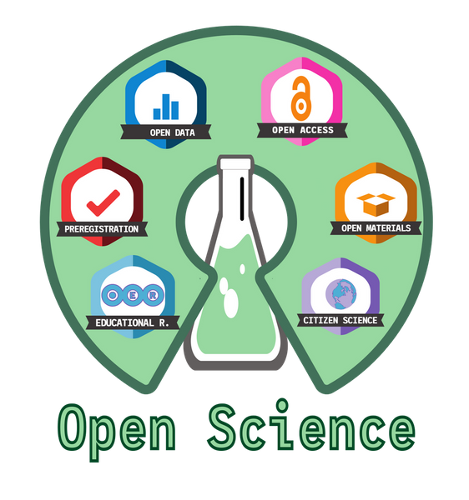

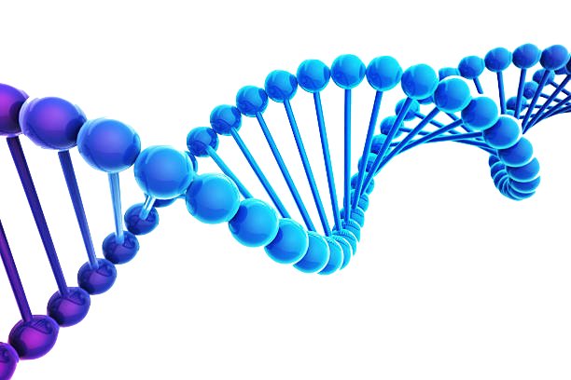
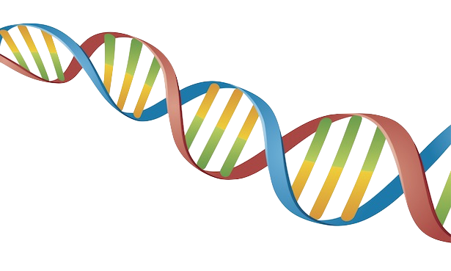




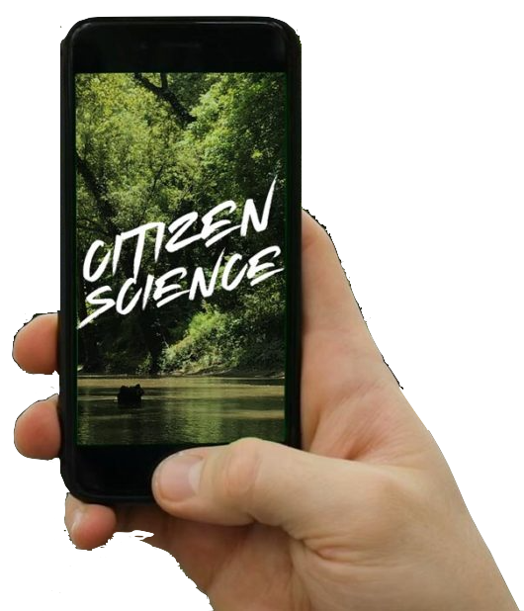

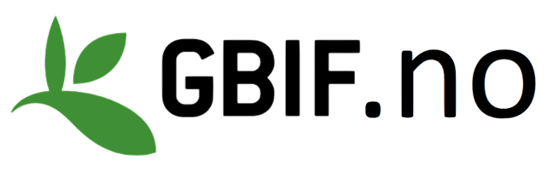

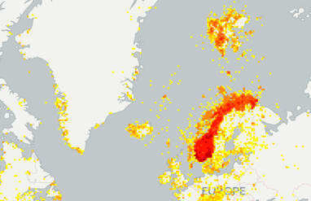

What is Open Science and why is it important for students?
Notes:
CC-BY Dag Endresen, GBIF.no, UiO Natural History Museum in Oslo, University in Oslo.
Illustration: Occurrences located in Norway from the GBIF data portal, http://www.gbif.org/country/NO/summary

Slide 2
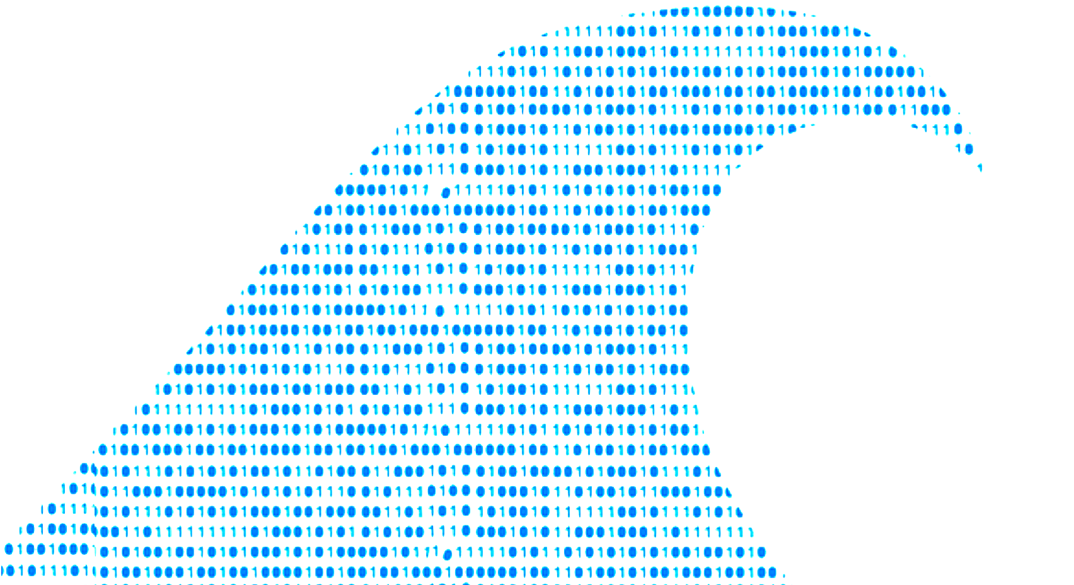


WHY TEACH STUDENTS OPEN SCIENCE ?
We are in the middle of an ongoing paradigm shift in scientific practice (and impact metrics).
Young scientists will (already today) need different skills, than was needed previously – to succeed in academia.

Slide 3

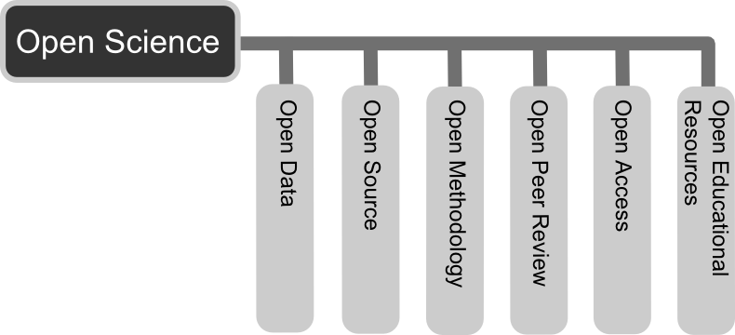

Slide 4
WHAT IS OPEN SCIENCE?
Open science is the movement to make scientific research (including publications, data, physical samples, and software) and its dissemination accessible to all levels of an inquiring society, amateur or professional (Woelfle et al. 2011).
Open science is transparent and accessible knowledge that is shared and developed through collaborative networks (Vicente-Saez et al. 2018).
Open Science can be seen as a continuation of, rather than a revolution in, practices begun in the 17th century with the advent of the academic journal (David 2004).
Woelfle, M.; Olliaro, P.; Todd, M. H. (2011). "Open science is a research accelerator". Nature Chemistry. 3 (10): 745–748. doi:10.1038/nchem.1149
Vicente-Saez, Ruben; Martinez-Fuentes, Clara (2018). "Open Science now: A systematic literature review for an integrated definition". Journal of Business Research. 88: 428–436. doi:10.1016/j.jbusres.2017.12.043
David, P. A. (2004). "Understanding the emergence of 'open science' institutions: Functionalist economics in historical context". Industrial and Corporate Change. 13 (4): 571–589. doi:10.1093/icc/dth023
https://en.wikipedia.org/wiki/Open_science
Notes:
Woelfle, M.; Olliaro, P.; Todd, M. H. (2011). "Open science is a research accelerator". Nature Chemistry. 3 (10): 745–748. doi:10.1038/nchem.1149
Vicente-Saez, Ruben; Martinez-Fuentes, Clara (2018). "Open Science now: A systematic literature review for an integrated definition". Journal of Business Research. 88: 428–436.
doi:10.1016/j.jbusres.2017.12.043
David, P. A. (2004). "Understanding the emergence of 'open science' institutions: Functionalist economics in historical context". Industrial and Corporate Change. 13 (4): 571–589. doi:10.1093/icc/dth023
https://en.wikipedia.org/wiki/Open_science

Slide 5

Open Access (OA): Research results distributed online and free of costs or other barriers – often meaning free access to research articles.
Open Science: Researchers to share their methods, computer code and research data in central data repositories.
Open Data: is freely available to everyone to use and re-publish as they wish, without restrictions from copyright, patents or other mechanisms of control.
FAIR data principles: findable, accessible, interoperable and reusable.
Notes:
For full reproducibility we also need access to the physical biological material – deposited in museum collections and biobank-repositories.

Slide 6

WHY OPEN RESEARCH DATA?
Notes:
Researcher illustration by Ikhwanudin from https://pngtree.com/freepng/researcher-woman_8526034.html?sol=downref&id=bef

Slide 7
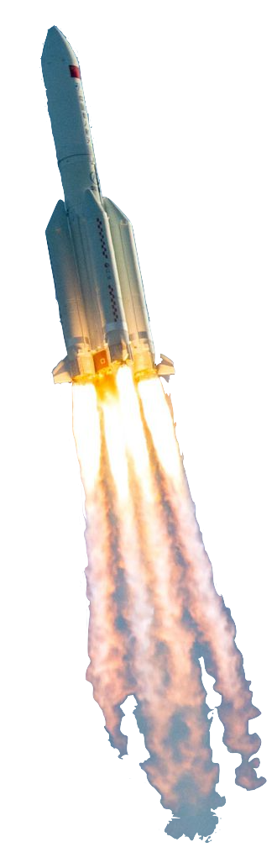
WHY OPEN RESEARCH DATA?
We are in the middle of an ongoing paradigm shift in scientific practice (and impact metrics).
Researchers will need to develop different approaches, than they needed in the past – to remain relevant.
Society is gaining Big Data maturity and will expect new services from marine sciences.
The open science wave is moving fast!

Slide 8



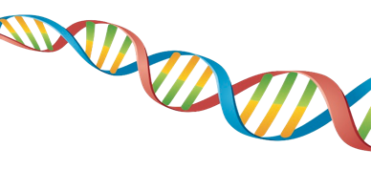







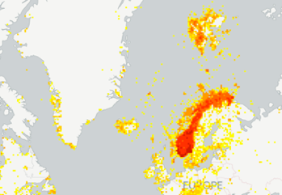
OPPORTUNITIES
Enables new research methodologies that were not possible before.
Skills for open research and open data are in increasing demand!
Funding opportunities.
GBIF brings new benefits and opportunities for our museums.

Slide 9









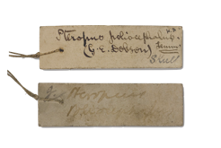
Open science is expanding your possibilities…
Open science
Traditional science

Slide 10
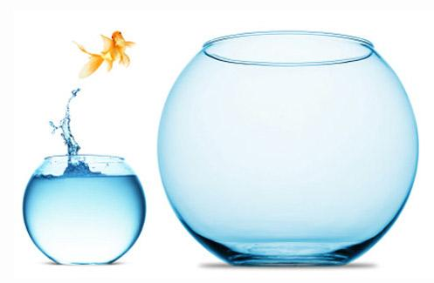

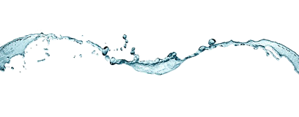
Open science is expanding your possibilities…
Open science
Traditional science
Notes:
Fair use rationale: The image is of unknown source, retrieved from an Internet search. The image is used to illustrate the principle of expanding context that stable identifiers can be subject to. An identifier used in a particular context, such as the Internet, could be exposed to a larger context at a later future time. The image is used in an educational and not-for-profit, non-commercial purpose.

Slide 11


INCENTIVES FOR DATA REUSE
To incentivize the sharing of useful data, the scientific enterprise needs a well-defined system that links individuals with reuse of data sets they generate
Pierce et al. Credit data generators for data reuse, Nature 6 June 2019
Notes:
Pierce HH, Dev A, Statham E, Bierer BE. (2019) Credit data generators for data reuse. Nature. 2019 Jun;570(7759):30-32. doi: 10.1038/d41586-019-01715-4. https://doi.org/10.1038/d41586-019-01715-4

Slide 12
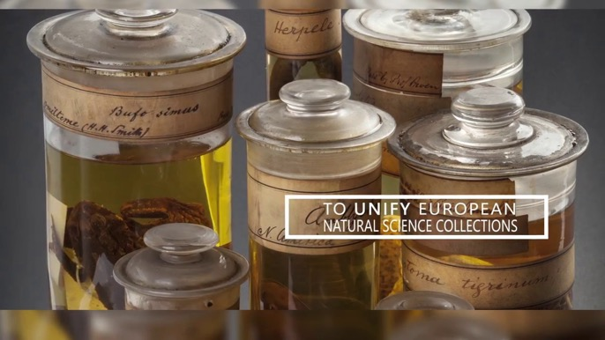
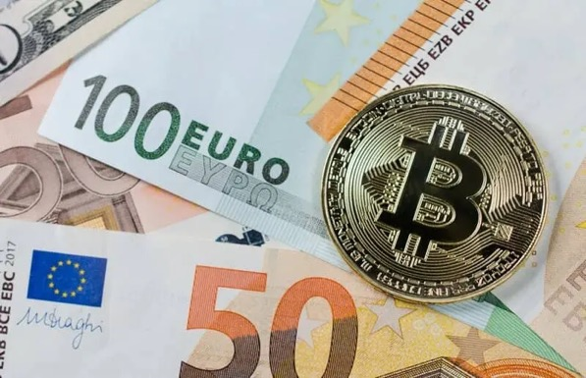
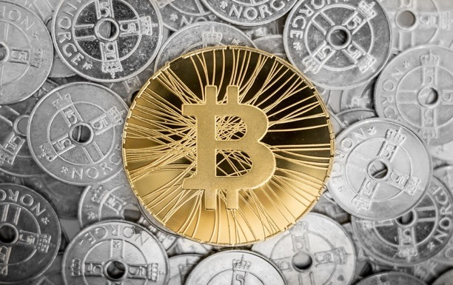

DATA CITATION - A NEW CURRENCY OF SCIENCE
Peer-reviewed scholarly papers in high impact journals still maintain considerable weight for scientific careers.
A movement is under way to build similar status for open data, open metadata, open material samples, and other open access scientific research products…
Notes:
DORA https://sfdora.org/

Slide 13

SCIENCE CURRENCIES (CITATION)
Peer-reviewed scholarly papers in high impact journals (still) maintain considerable weight for scientific careers.
A movement is under way to build similar status for open data, open metadata, and other open science products…

Slide 14


DECLARATION ON RESEARCH ASSESSMENT
DORA recognizes the need to improve the ways in which the outputs of scholarly research are evaluated.
Worldwide movement covering all scholarly disciplines and all key stakeholders including funders, publishers, professional societies, institutions (universities), and researchers.
Developed in 2012 in San Francisco
To date (2025-11-20), 23 057 individuals and 3 516 organizations in 168 countries have signed DORA.
The Research Council of Norway (RCN) signed DORA in May 2018 [link]
Notes:
To date (2025-11-20), 23 057 individuals and 3 516 organizations in 168 countries have signed DORA.
To date (2023-04-25), 20 248 individuals and 2 810 organizations in 160 countries have signed DORA.
To date (2022-11-07), 18 190 individuals and 2 365 organizations in 148 countries have signed DORA.
To date (2021-11-09), 18 190 individuals and 2 365 organizations in 148 countries have signed DORA.
To date (2021-01-26), 16 873 individuals and 2 139 organizations in 144 countries have signed DORA.
DORA’s vision is to advance practical and robust approaches to research assessment globally and across all scholarly disciplines.
May 2018 The Research Council of Norway signed #sfDORA! https://twitter.com/dorassessment/status/999349311417745409
https://sfdora.org/signers/?_organization_country=norway&_signer_type=organisation
Signed by: Univ of Agder (UiA), Univ of Stavanger (UiS), Oslo University Hospital, OsloMet, Norw Univ of Life Sciences (NMBU), Research Council of Norway (RCN), Inland Norway Univ of Applied Scienences (INN), The Royal Norwegian Society of Sciences and Letters (DKNVS), Norwegian University of Science and Technology (NTNU), University College of Southeast Norway, University of Tromsø - The Arctic University of Norway (UiT)

Slide 15
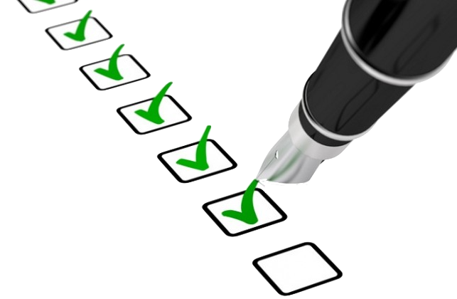
SCIENTIFIC JOURNALS REQUIREMENTS

Slide 16
Open research data policies
Eg. Springer Nature:
All original articles must include a data availability statement.
Strongly encourage that all datasets supporting the analysis and conclusions of the paper are made publicly available at the time of publication.
Peer reviewers are entitled to request access to underlying data (and code) when needed to perform their evaluation of a manuscript.
Recognize it is not always possible to share research data publicly, for instance when privacy of research participants could be compromised. (Statement of conditions for access required).
https://www.springernature.com/gp/authors/research-data-policy
Notes:
https://www.springernature.com/gp/authors/research-data-policy

Slide 17
RESEARCH FUNDING REQUIREMENTS

Slide 18

OPEN RESEARCH DATA
2014: The Research Council of Norway expects all research data from projects funded by the Research Council to be made freely available as open data.
In some situations, there can be valid and justified reasons for exceptions.
Forskningsrådet (2014). ISBN: 978-82-12-03361-0
https://www.forskningsradet.no/en/research-policy-strategy/open-science/research-data/
Notes:
Forskningsrådet (2014) Tilgjengeliggjøring av forskningsdata: Policy for Norges forskningsråd. ISBN: 978-82-12-03361-0
https://www.forskningsradet.no/en/research-policy-strategy/open-science/research-data/
https://www.forskningsradet.no/contentassets/e4cd6d2c23cf49d4989bb10c5eea087a/the-research-council-of-norways-policy-for-open-access-to-research-data.pdf
Forskningsrådet (2016) Tilgjengeliggjøring av forskningsdata og data for forskning: Kunnskapsgrunnlag til KDs arbeid med en nasjonal strategi for tilgjengeliggjøring av data. ISBN: 978-82-12-03566-9
DAMVAD (2014) Sharing and archiving of publicly funded research data: Report to the Research Council of Norway. 11/04/14.
--
"Forskningsrådet forventer at alle forskningsdata i prosjekter finansiert av Forskningsrådet, er åpent tilgjengelig. I noen tilfeller kan det likevel være gode grunner til at ikke alle er åpne"
http://www.forskningsradet.no/no/Apen_tilgang/1254001019169
http://www.forskningsradet.no/no/Artikkel/Apen_tilgang_til_forskningsdata/1254001013535
--
Kunnskapsdepartementet (2016) Nasjonale retningslinjer for åpen tilgang til forskningsdata: Rapport til Kunnskapsdepartementet 14.06.2016.
https://www.regjeringen.no/contentassets/72e9794a183647e5b53ec39ba8cf516a/rapport-nasjonale-retningslinjer-for-apen-tilgang-til-forskningsresultater.pdf
--
UiO open data
http://www.uio.no/om/aktuelt/rektors-blogg/2017/hvordan-behandler-vi-forskningsdata.html

Slide 19
UNIVERSITY REQUIREMENTS

Slide 20

NOR-CAM (2021)
Guiding principles for the assessment and evaluation of research(ers) in light of the transition to Open Science. Proposes a more holistic framework for recognition and rewards in academic research assessment.
Academic institutions when recruiting academic and scientific staff; in processes related to promotion from one scientific career stage to the next; career guidance of employees by department and research leaders
Funders when assessing project managers and participants in connection with research applications.
National authorities when evaluating of Norwegian research and education.
Notes:
https://www.uhr.no/en/news-from-uhr/nor-cam-a-toolbox-for-recognition-and-rewards-in-academic-careers.5780.aspx

Slide 21

GOVERNMENT POLICIES

Slide 22
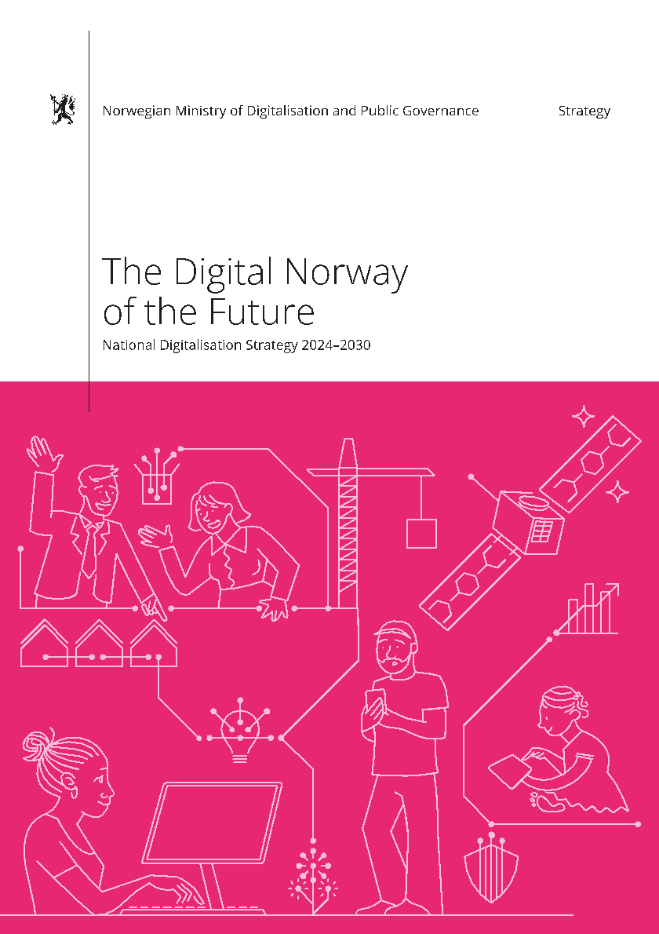
New national strategy of digitization:
Norway shall become the most digitized country in the world
Press release | Date: 2024-09-26 | Ministry of Digitization and Public Governance | Office of the Prime Minister
Notes:
https://www.regjeringen.no/no/aktuelt/norge-skal-bli-verdens-mest-digitaliserte-lan/id3055039/
Ny nasjonal digitaliseringsstrategi: Norge skal bli verdens mest digitaliserte land
Pressemelding | Dato: 26.09.2024 | Digitaliserings- og forvaltningsdepartementet | Statsministerens kontor
https://www.regjeringen.no/no/dokumenter/fremtidens-digitale-norge/id3054645/
https://www.regjeringen.no/en/dokumenter/the-digital-norway-of-the-future/id3054645/

Slide 23
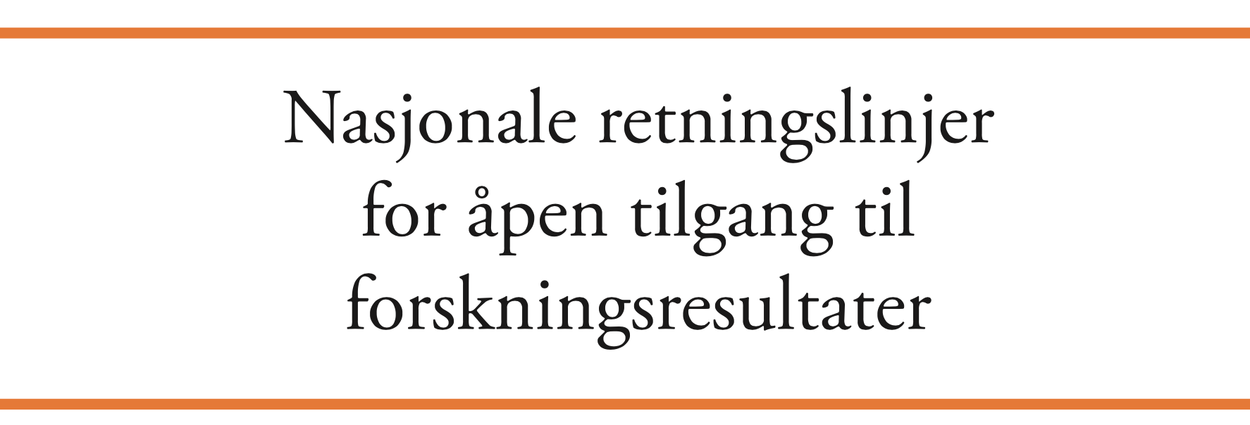

Norway is to be a careful pioneer in open access to research results.
Norway to follow the ambition of EU on full open access to publicly funded research.
Results of research supported by public and public-private funds freely available to and reusable by anyone.
Kunnskapsdepartementet (2016)
EU (2016) Competitiveness Council, 26-27/05/2016
EU (2007) INSPIRE Directive
Notes:
--
Kunnskapsdepartementet (2016) Nasjonale retningslinjer for åpen tilgang til forskningsresultater: Rapport til Kunnskapsdepartementet 14.06.2016.
https://www.regjeringen.no/contentassets/72e9794a183647e5b53ec39ba8cf516a/rapport-nasjonale-retningslinjer-for-apen-tilgang-til-forskningsresultater.pdf
--
EU - Competitiveness Council, 26-27/05/2016
http://www.consilium.europa.eu/en/meetings/compet/2016/05/26-27/
"Open Science is a topic which is very dear to our hearts. During the Netherlands presidency, we have aimed at bringing Europe to the forefront of global change and at leading the transition to a new way of doing research and science based on openness, big data and cloud computing." Sander Dekker, State Secretary of Education, Culture and Science of the Netherlands
--
Enserink M (2016) In dramatic stetement, European leaders call for 'immediate' open access to all scientific papers by 2020. Science May. 27, 2016, DOI: 10.1126/science.aag0577
--
https://www.theguardian.com/science/2016/may/28/eu-ministers-2020-target-free-access-scientific-papers
--
EU INSPIRE Directive :: Infrastructure for spatial information in Europe
http://inspire.ec.europa.eu/
The INSPIRE Directive: a brief description: https://www.youtube.com/watch?v=xew6qI-6wNk
2007-04-26, Directive 2007/2/EC of the European Parliament and of the Council of 14 March 2007 establishing an Infrastructure for Spatial Information in the European Community (INSPIRE)
--
ec.europa.eu/research/openscience
openAIRE.eu
http://ec.europa.eu/research/press/2016/pdf/opendata-infographic_072016.pdf#view=fit&pagemode=none

Slide 24

REPRODUCIBILITY CRISIS

Slide 25

REPRODUCIBILITY CRISIS
"Scientific irreproducibility — the inability to repeat others' experiments and reach the same conclusion” (Nature 2016)
Baker (2016) 1,500 scientists lift the lid on reproducibility. Nature. doi:10.1038/533452a
Notes:
Illustration: David Klein (1918-2005) – fair use, for education
Is there a reproducibility crisis?
Baker (2016) 1,500 scientists lift the lid on reproducibility. Nature 533: 452-454 (26 May 2016) doi:10.1038/533452a
Baker (2016) Reproducibility: Seek out stronger science. Nature 537: 703-704 (29 September 2016) doi:10.1038/nj7622-703a
Nature editorial (2016) Reality check on reproducibility. Nature 533: 437 (26 May 2016) doi:10.1038/533437a
Baker (2016) Statisticians issue warning over misuse of P values. Nature 531: 151 (10 March 2016) doi:10.1038/nature.2016.19503
Nosek et al. (2015) Promoting an open research culture. Science 348(6242): 1422-1425. DOI:10.1126/science.aab2374
Leek and Peng (2015) Statistics: P values are just the tip of the iceberg. Nature 520: 612 (30 April 2015) doi:10.1038/520612°
Nuzzo (2015) How scientists fool themselves – and how they can stop. Nature 526: 182–185 (08 October 2015) doi:10.1038/526182a
Hayden (2013) Weak statistical standards implicated in scientific irreproducibility. Nature doi:10.1038/nature.2013.14131
Young (2012) Replication studies: Bad copy. Nature 485, 298–300 (17 May 2012) doi:10.1038/485298a
Callaway (2011) Reports finds massive fraud at Dutch universities. Nature 479, 15 (1 November 2011) doi:10.1038/479015a

Slide 26
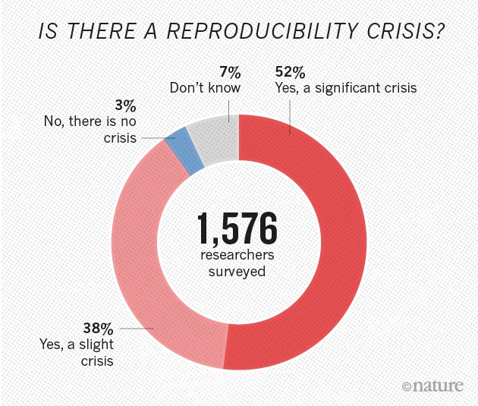
"Scientific irreproducibility — the inability to repeat others' experiments and reach the same conclusion — is a growing concern”.
Baker (2016) Nature doi:10.1038/533452a
Open Science solution: researchers to share their methods, data, computer code and results in central data repositories.
Note that we also need herbarium specimen and bio-repositories (eg. museums).
Notes:
Is there a reproducibility crisis?
Baker (2016) 1,500 scientists lift the lid on reproducibility. Nature 533: 452-454 (26 May 2016) doi:10.1038/533452a
Baker (2016) Reproducibility: Seek out stronger science. Nature 537: 703-704 (29 September 2016) doi:10.1038/nj7622-703a
Nature editorial (2016) Reality check on reproducibility. Nature 533: 437 (26 May 2016) doi:10.1038/533437a
Baker (2016) Statisticians issue warning over misuse of P values. Nature 531: 151 (10 March 2016) doi:10.1038/nature.2016.19503
Nosek et al. (2015) Promoting an open research culture. Science 348(6242): 1422-1425. DOI:10.1126/science.aab2374
Leek and Peng (2015) Statistics: P values are just the tip of the iceberg. Nature 520: 612 (30 April 2015) doi:10.1038/520612°
Nuzzo (2015) How scientists fool themnselves – and how they can stop. Nature 526: 182–185 (08 October 2015) doi:10.1038/526182a
Hayden (2013) Weak statistical standards implicated in scientific irreproducibility. Nature doi:10.1038/nature.2013.14131
Young (2012) Replication studies: Bad copy. Nature 485, 298–300 (17 May 2012) doi:10.1038/485298a
Callaway (2011) Reports finds massive fraud at Dutch universities. Nature 479, 15 (1 November 2011) doi:10.1038/479015a

Slide 27
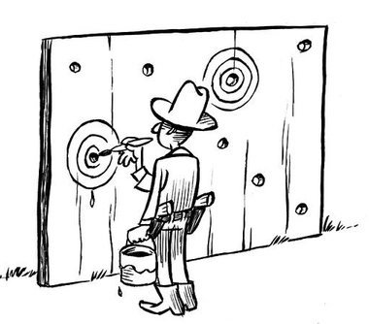
WILL ANYBODY TRUST CLOSED SCIENCE AGAIN?
Studies indicates that p-hacking is a significant problem - sometimes even without the scientist even being aware of it.
Pre-registered (open) data provides a good insurance against suspicion of both data dredging (and plain data falsification).
“p-hacking” (data dredging, data fishing, …) occurs when researchers collect or select data or statistical analyses until non-significant results become significant.
Ioannidis (2005). "Why Most Published Research Findings Are False". PLoS Medicine. doi:10.1371/journal.pmed.0020124.
Head et al. (2015) The Extent and Consequences of P-Hacking in Science. PLoS Biol. doi:10.1371/journal.pbio.1002106
Notes:
Ioannidis, John P.A. (August 30, 2005). "Why Most Published Research Findings Are False". PLoS Medicine. San Francisco: Public Library of Science. 2 (8): e124. doi:10.1371/journal.pmed.0020124.
Head, Megan L.; Holman, Luke; Lanfear, Rob; Kahn, Andrew T.; Jennions, Michael D. (13 March 2015). "The Extent and Consequences of P-Hacking in Science". PLOS Biology. 13 (3): e1002106. doi:10.1371/journal.pbio.1002106
For full reproducibility we also need access to the physical biological material – deposited in museum collections and biobank-repositories.

Slide 28
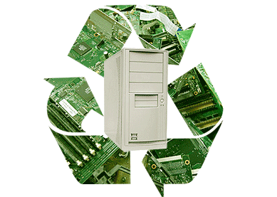
Reuse of research data and other research products
Notes:
The following slides are Reuse of teaching curriculum – from the GBIF BioDATA training curriculum on data mobilisation

Slide 29

Data Citation Principles
Data to be legitimate citable products of research.
Data citations giving scholarly credit and attribution.
In scholarly literature, whenever claims are based on data, data should always be cited.
Persistent method for identification of data, that is machine actionable, globally unique, universal.
Data citation facilitate access to data or at least to metadata.
Unique identifiers that persist even beyond the lifespan of the data.
Data citation identify and access the specific data that support verification of the claim (provenance, time-slice, version).
Flexible, but attention to interoperability of practices across communities.
Data Citation Synthesis Group: Joint Declaration of Data Citation Principles. Martone M. (ed.) San Diego CA: FORCE11; 2014
Notes:
Joint Declaration of Data Citation Principles - FINAL
When citing please use: Data Citation Synthesis Group: Joint Declaration of Data Citation Principles. Martone M. (ed.) San Diego CA: FORCE11; 2014 [/datacitation].
Endorsement List
Preamble
Sound, reproducible scholarship rests upon a foundation of robust, accessible data. For this to be so in practice as well as theory, data must be accorded due importance in the practice of scholarship and in the enduring scholarly record. In other words, data should be considered legitimate, citable products of research. Data citation, like the citation of other evidence and sources, is good research practice and is part of the scholarly ecosystem supporting data reuse.
In support of this assertion, and to encourage good practice, we offer a set of guiding principles for data within scholarly literature, another dataset, or any other research object.
These principles are the synthesis of work by a number of groups. As we move into the next phase, we welcome your participation and endorsement of these principles.
--
Principles
The Data Citation Principles cover purpose, function and attributes of citations. These principles recognize the dual necessity of creating citation practices that are both human understandable and machine-actionable.
These citation principles are not comprehensive recommendations for data stewardship. And, as practices vary across communities and technologies will evolve over time, we do not include recommendations for specific implementations, but encourage communities to develop practices and tools that embody these principles.
The principles are grouped so as to facilitate understanding, rather than according to any perceived criteria of importance.
1. Importance
Data should be considered legitimate, citable products of research. Data citations should be accorded the same importance in the scholarly record as citations of other research objects, such as publications[1].
2. Credit and Attribution
Data citations should facilitate giving scholarly credit and normative and legal attribution to all contributors to the data, recognizing that a single style or mechanism of attribution may not be applicable to all data[2].
3. Evidence
In scholarly literature, whenever and wherever a claim relies upon data, the corresponding data should be cited[3].
4. Unique Identification
A data citation should include a persistent method for identification that is machine actionable, globally unique, and widely used by a community[4].
5. Access
Data citations should facilitate access to the data themselves and to such associated metadata, documentation, code, and other materials, as are necessary for both humans and machines to make informed use of the referenced data[5].
6. Persistence
Unique identifiers, and metadata describing the data, and its disposition, should persist -- even beyond the lifespan of the data they describe[6].
7. Specificity and Verifiability
Data citations should facilitate identification of, access to, and verification of the specific data that support a claim. Citations or citation metadata should include information about provenance and fixity sufficient to facilitate verfiying that the specific timeslice, version and/or granular portion of data retrieved subsequently is the same as was originally cited[7].
8. Interoperability and Flexibility
Data citation methods should be sufficiently flexible to accommodate the variant practices among communities, but should not differ so much that they compromise interoperability of data citation practices across communities[8].
When citing this document please use: Data Citation Synthesis Group: Joint Declaration of Data Citation Principles. Martone M. (ed.) San Diego CA: FORCE11; 2014 [https://www.force11.org/group/joint-declaration-data-citation-principles-final].

Slide 30
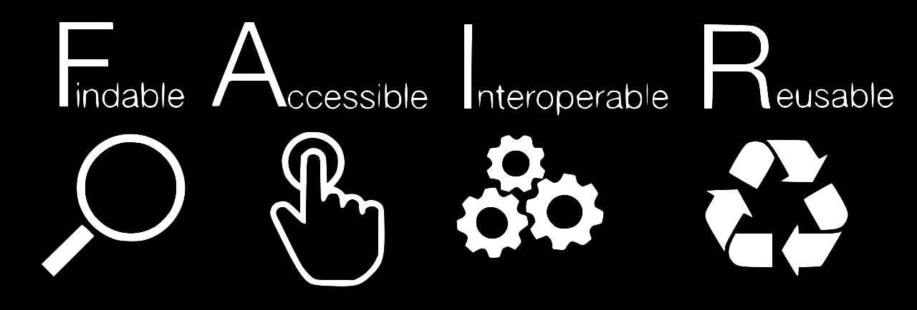
FAIR data is about machine-readable data
researchers need to do more than simply post their data on the web for it to be re-usable.
Notes:
Wilkinson et al. 2016 doi:10.1038/sdata.2016.18
Global Biodiversity Information Facility (GBIF) provides certified FAIR data sharing for all biodiversity datasets
Distributed System of Scientific Collections (DiSSCo) will implement FAIR data principles for natural history collections

Slide 31

What is FAIR Data?
FINDABLE
  Data and supplementary materials have sufficiently rich metadata and a unique and persistent identifier.
ACCESSIBLE
  Metadata and data are understandable to humans and machines. Data is deposited in a trusted repository.
INTEROPERABLE
  Metadata use a formal, accessible, shared, and broadly applicable language for knowledge representation.
REUSABLE
  Data and collections have a clear usage licenses and provide accurate information on provenance.
https://www.go-fair.org/
Notes:
https://www.go-fair.org/
https://libereurope.eu/wp-content/uploads/2017/12/LIBER-FAIR-Data.pdf

Slide 32
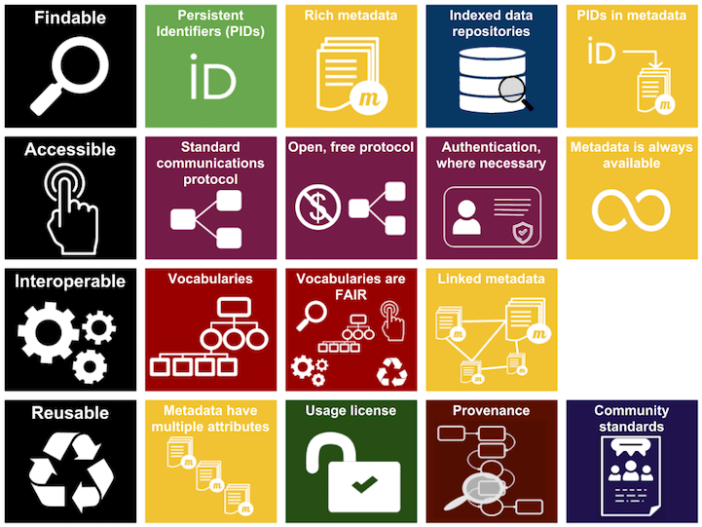
FAIR DATA PRINCIPLES

Slide 33
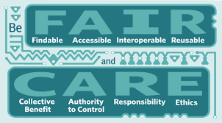
CARE DATA PRINCIPLES

Slide 34
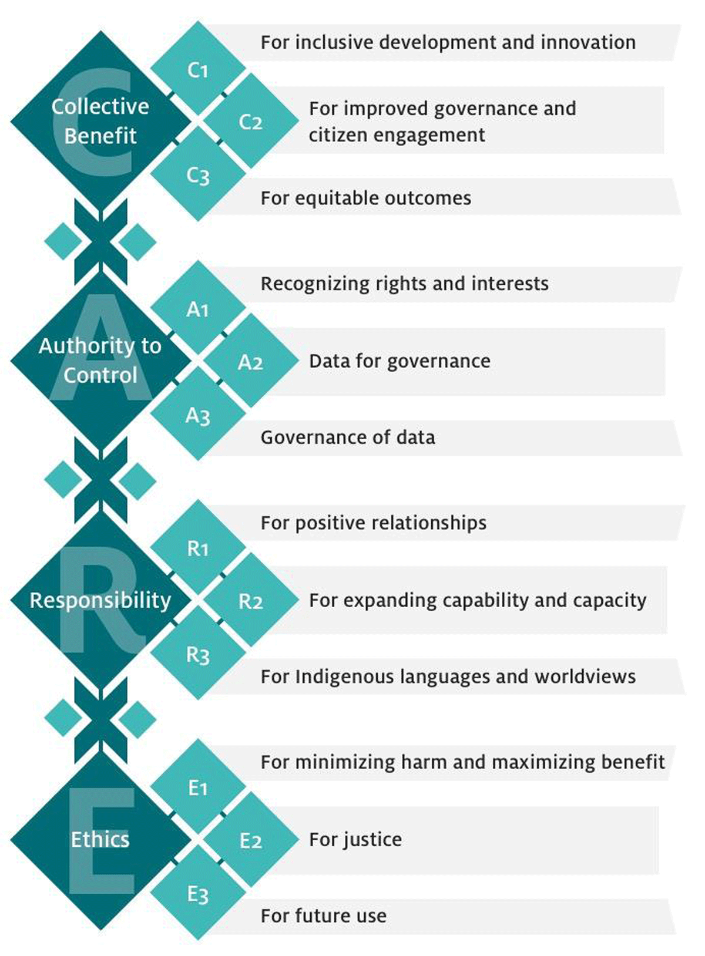
CARE DATA PRINCIPLES
CARE is an acronym which stands for:
  Collective Benefit,
  Authority to Control,
  Responsibility,
  Ethics
CARE was created by the International Indigenous Data Sovereignty Interest Group, a group that is a part of the Research Data Alliance.
Resolve Indigenous Peoples’ rights to and interests in their data across the data lifecycle.
Building on FAIR data principles while ensuring indigenous interests.

Slide 35

META-
DATA

Slide 36
Why publish open data?
Data produced using public funds should be regarded as a common good, and should be made available for inspection, interpretation and re-use by third parties.
Needless duplication of data-collecting efforts and costs will be reduced.
Open data increases transparency and overall quality of research.
Published data can be re-analysed, verified, and improved by others.
Data publication increase recognition and opportunities for collaboration.
Published data can be cited and re-used, alone or in combination with other data.
Data owners and collection managers can trace data use and citation.
Data creators, their institutions and funding agencies can be credited.
Data can be integrated with other datasets across space and time.
Open data increases potential for interdisciplinary research and re-use in new contexts not envisioned by the data creator.
Penev et al. (2017) https://doi.org/10.3897/rio.3.e12431

Slide 37
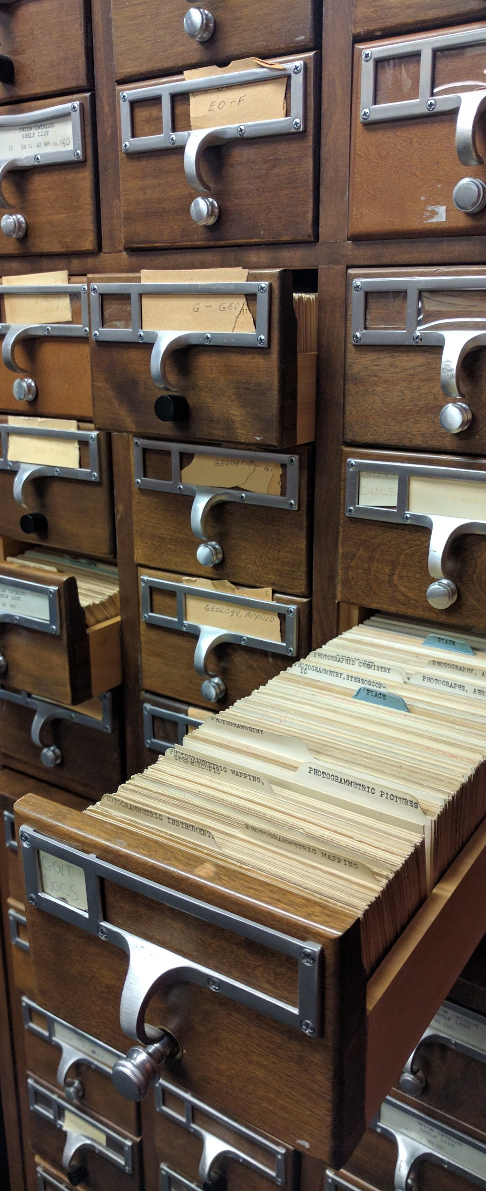
Why metadata?
In general, metadata should allow a prospective end user of data to:
1. identify/discover its existence,
2. learn how to access or acquire the data,
3. understand its fitness-for-use,
4. learn how to transfer (obtain a copy of) the data, and
5. learn how the data should be used.
Photo CC BY-SA Jennifer Fagan-Fry (NOAA)

Slide 38
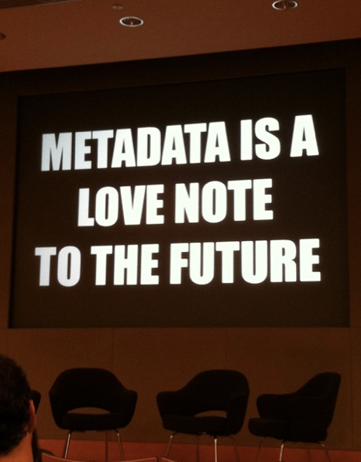
What is Metadata?
Metadata, literally “data about data”
An essential component of a data management system, describing such aspects as the “what, where, when, who and how” pertaining to a resource.
Photo: CC-BY by Cea+ http://www.flickr.com/photos/centralasian/8071729256
Slide source CC BY EUDAT (2016) |
Notes:
Slide source CC-BY EUDAT (2016) http://www.slideshare.net/EUDAT/introduction-to-metadata-57336324

Slide 39
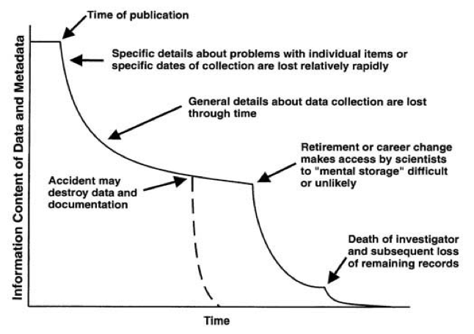
Data entropy
Illustration from: The Loss of Information about Data (Metadata) Over Time, Michener et al, 1997
Notes:
This diagram from Bill Michener (Michener et al. 1997) from DataOne in the United States shows how much information is lost over time. Metadata is a way to formalise this knowledge so your data retain meaning.

Slide 40

DATA MANAGEMENT PLAN
Illustration CC BY Jørgen Stamp

Slide 41
Data Management Plan (DMP)
A formal document that outlines how data are to be handled during a research project, and after the project is completed.
The goal is to plan data management before the project begins.
Including a plan for the costs of data management and archiving.
This saves time in the long run and promotes data fitness for reuse.
Reduce duplication of existing scientific studies.
Reduce the loss of data.
Illustration CC BY Jørgen Stamp
Notes:
Illustration CC BY Jørgen Stamp, https://digitalbevaring.dk/
https://en.wikipedia.org/wiki/Data_management_plan

Slide 42
Why write Data Management Plans?
A data management plan is a tool for making your research reproducible and thus trustworthy.
Good data curation saves you research time, because you, your collaborators, and others, will find, understand, and get access to your (own) research data.
Efficient data sharing provides broader distribution and impact for your research results.
Open research data, available for reuse, strengthens open and curiosity-driven research, and scientific breakthrough not originally foreseen by the original data producer.
Illustration CC BY Jørgen Stamp
Notes:
https://en.wikipedia.org/wiki/Data_management_plan
Illustration CC BY Jørgen Stamp, https://digitalbevaring.dk/ Creative Commons Attribution 2.5 Denmark License.
Data Management Plan, Georgia Tech Library, http://d7.library.gatech.edu/research-data/data-management-plan-components
10 Simple Rules for the Care and Feeding of Scientific Data, http://arxiv.org/abs/1401.2134, doi:10.1371/journal.pcbi.1003542

Slide 43

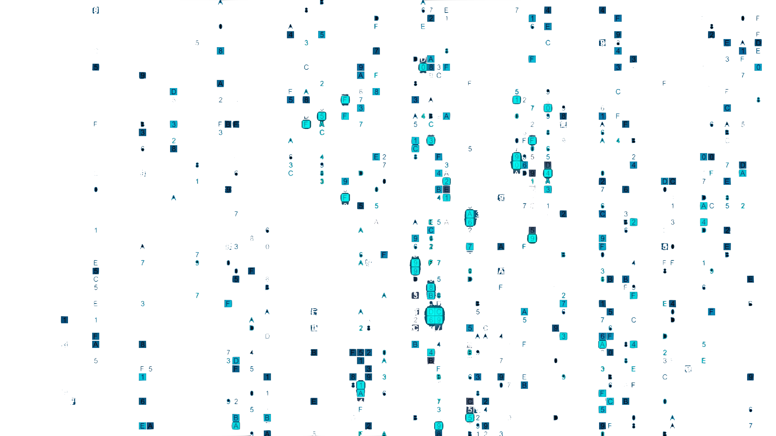
DATA PAPER

Slide 44
What is a «data paper»?
A data paper is a peer reviewed document describing a dataset, published in a peer reviewed journal. It takes effort to prepare, curate and describe data. Data papers provide recognition for this effort by means of a scholarly article.
Getting scholarly recognition for your datasets.
Promote and improve the fitness for reuse of your research data.
https://www.gbif.org/data-papers
Notes:
https://www.gbif.org/data-papers

Slide 45
Data papers explained
A data paper is a metadata document, describing a particular dataset or a group of datasets, published in the form of a peer-reviewed article in a scholarly journal.
Unlike a conventional research article, the primary purpose of a data paper is to describe data and the circumstances of their collection, rather than to report hypotheses and conclusions.
GBIF has been working with partners in academic publishing to promote the data paper as a means of bringing credit and recognition to all those involved in data publication.
https://www.gbif.org/data-papers
Notes:
https://www.gbif.org/data-papers

Slide 46
Why publish data papers?
Authoring clear, informative metadata is an essential step if biodiversity data are going to be discovered and used to inform research and decisions. This involves extra work, and data publishers need incentives to do it. In the absence of such incentives, too many datasets are published with poorly-documented metadata or, worse still, no metadata at all.
Data papers help to overcome barriers to authoring of metadata by providing clear acknowledgement of all those involved in the collection, management, curation and publishing of biodiversity data.
https://www.gbif.org/data-papers
Notes:
https://www.gbif.org/data-papers

Slide 47
By publishing a data paper
Receive credit through indexing and citation of the published paper, in the same way as with any conventional scholarly publication, offering benefits to authors in terms of recognition and career building.
Increase the visibility, usability and credibility of the data resources you publish.
Track more effectively the usage and citations of the data you publish.
https://www.gbif.org/data-papers
Notes:
https://www.gbif.org/data-papers

Slide 48

Machine-readable data …
Notes:
Data analysis

Slide 49
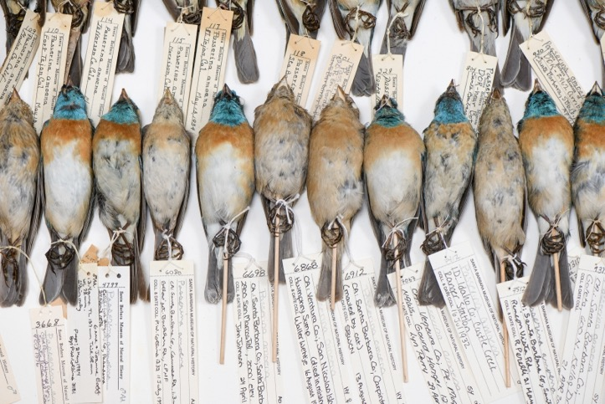
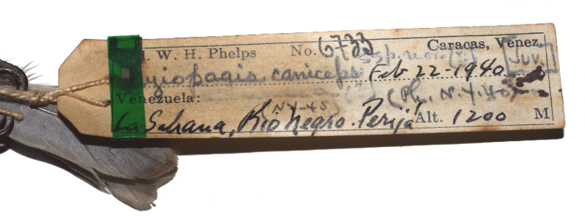
MACHINE-READABILITY REQUIRES PERSISTENT IDENTIFIERS
The purpose of identifiers is
… to name things
… making it possible to refer to them
To uniquely identify something, it needs a persistent identifier, a PID.
A Persistent Identifier is globally unique, persistent, and resolvable“.
A PID is resolvable when it allows both human and machine users to access an object or its representation, and its Kernel Information.
Kernel Information is a structured record that contains information (metadata) about the referred object, such as a pointer to the location where the data for the object can be found.

Slide 50
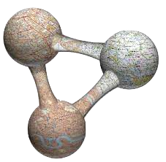



ROR for institutions
ORCID for people
DOI for datasets
GRSciColl UUID for collections
will enable the linking of museum collection specimens to scientific litterature and scientific actors (authors, curators, etc)
Digital Object Identifier (DOI)
Open Researcher and Contributor ID (ORCID)
Research Organisation Registry (ROR)
Universally Unique Identifier (UUID)
Notes:
Digital Object Identifier (DOI) - https://doi.org/
Open Researcher and Contributor ID (ORCID) - https://orcid.org/
Research Organisation Registry (ROR) - https://ror.org/ (start in early 2019)
https://dissco.tech/2020/04/11/identifiers-for-our-institutes-grid-and-ror/
https://en.wikipedia.org/wiki/Research_Organization_Registry
http://www.wikidata.org/entity/Q63565260

Slide 51


GBIF Norway
Dag Endresen | Node Manager
helpdesk@gbif.no

Slide 52
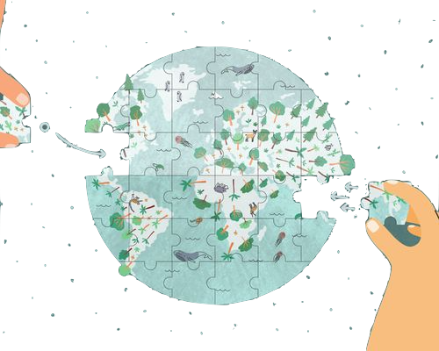
EXERCISES

Slide 53
EXERCISES FOR THE OPEN SCIENCE SESSION
Identify 5 data journals and describe why you would choose one journal over the other for documenting a GBIF dataset with a data paper.
  How is a data paper different from a normal research paper?
  Do you know of other relatively new types of research papers related to open science?
Identify 5 tools for writing a data management plan and describe the pros and cons of using each of them (for projects generating biodiversity data).
  What are some of the main topics to cover in a data management plan?
What data license would you choose for your biodiversity datasets – why?
  Which data licenses are supported by GBIF? For data? – for auxiliary data types such as photos?
The FAIR data principles states “as open as possible, as closed as necessary”. When should FAIR data be open and when should it be closed access? (In your opinion).

