Slide 1
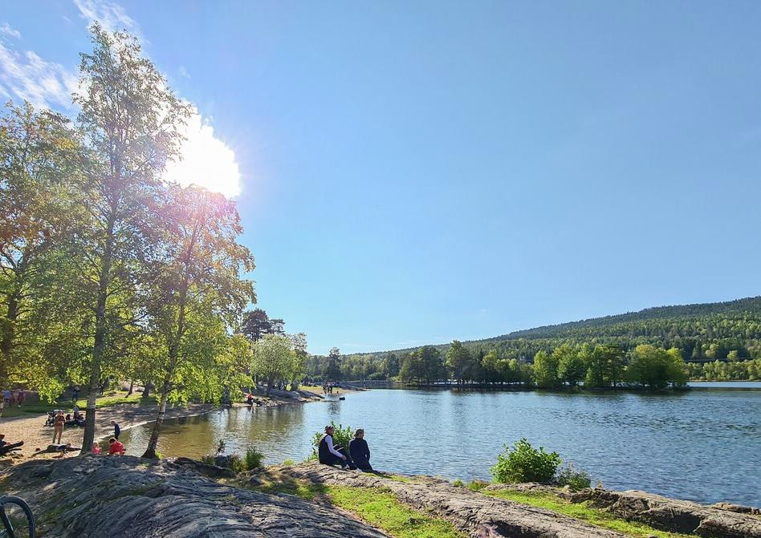




Expression of interest to host GBIF GB33 2026 in Oslo, Norway

Slide 2
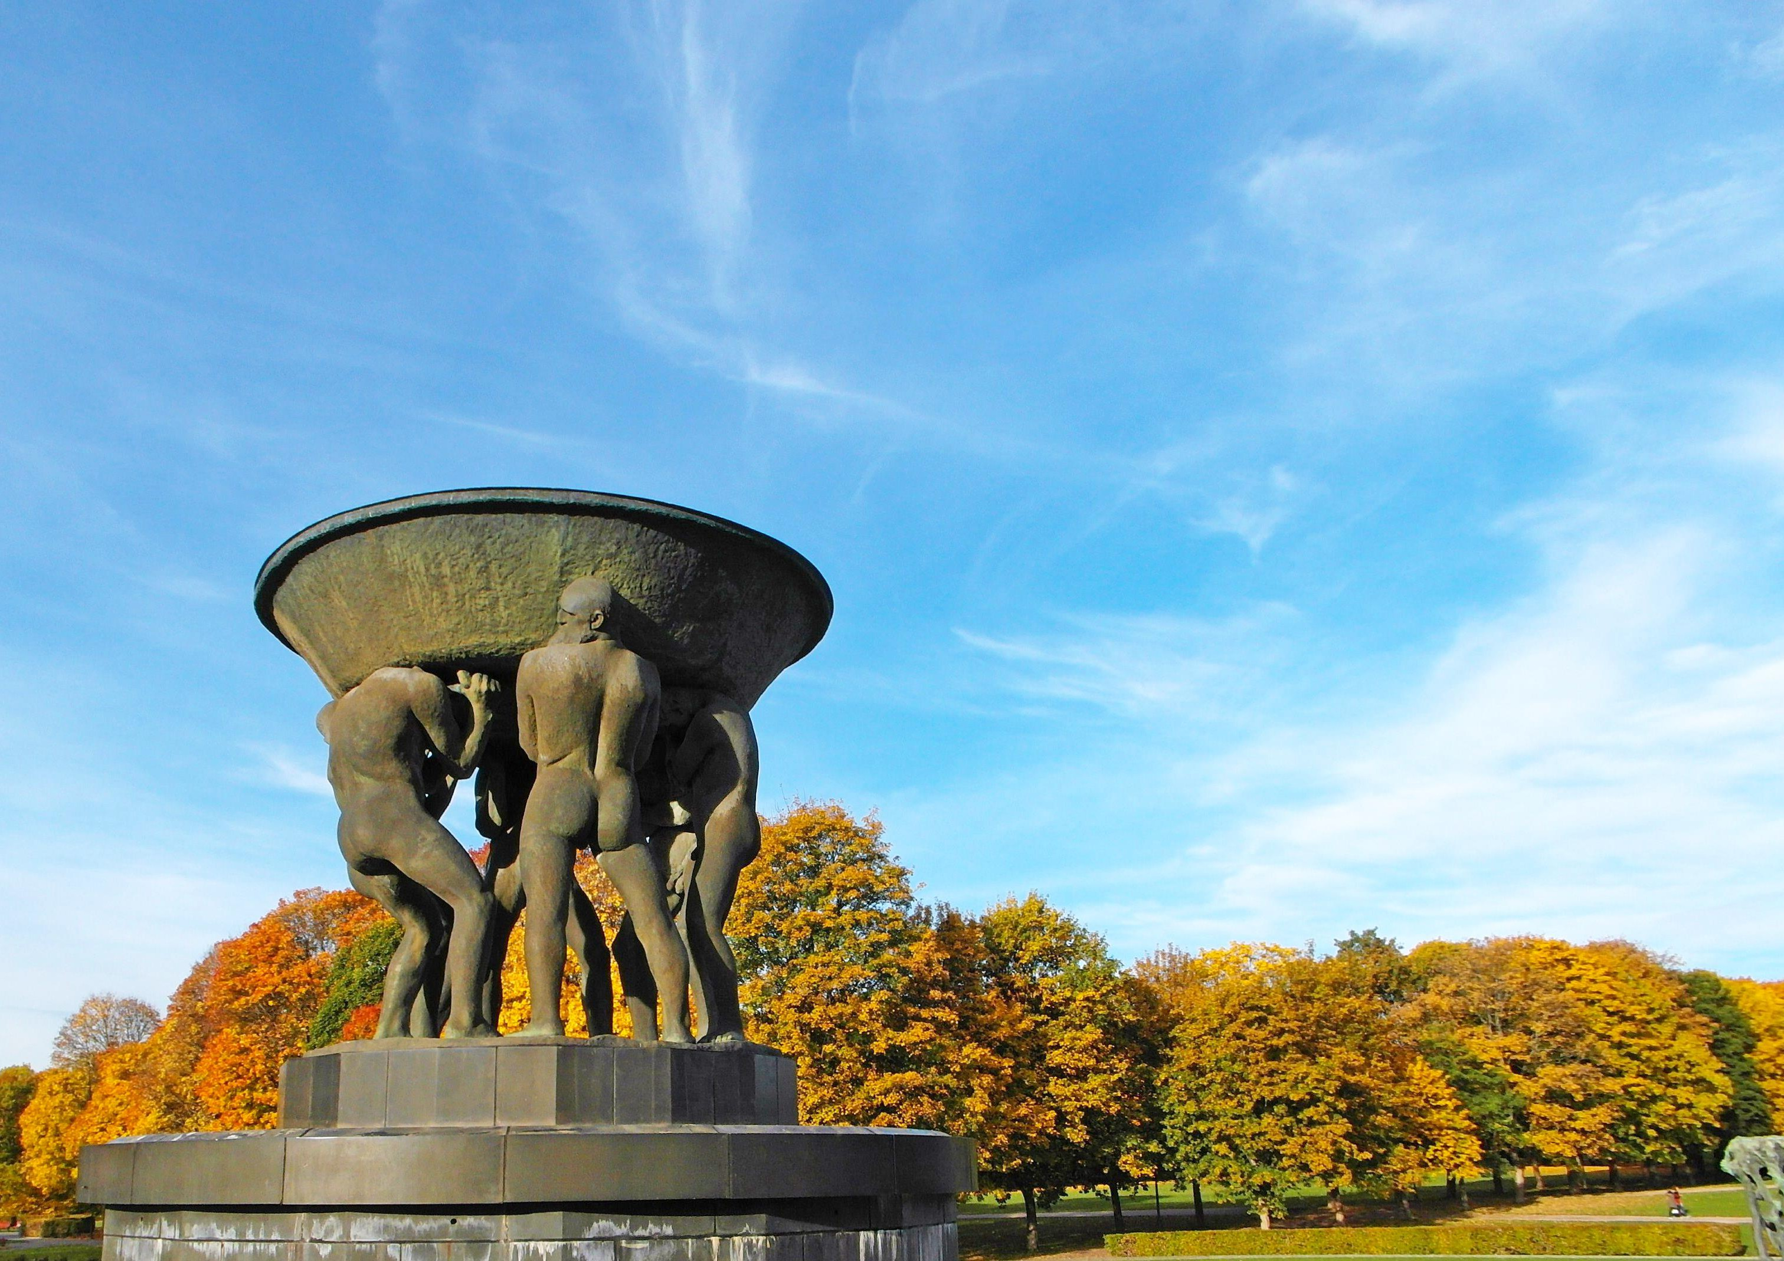
2026 is GBIF's 25th anniversary and a great opportunity to celebrate!

Slide 3

GB33 Suggested dates
PHOTO: KONSTANTANT
28th to 30th September 2026*
*Week 40 is school autumn holidays in Oslo
and hotel prices are lower

Slide 4

Venue Options

Slide 5
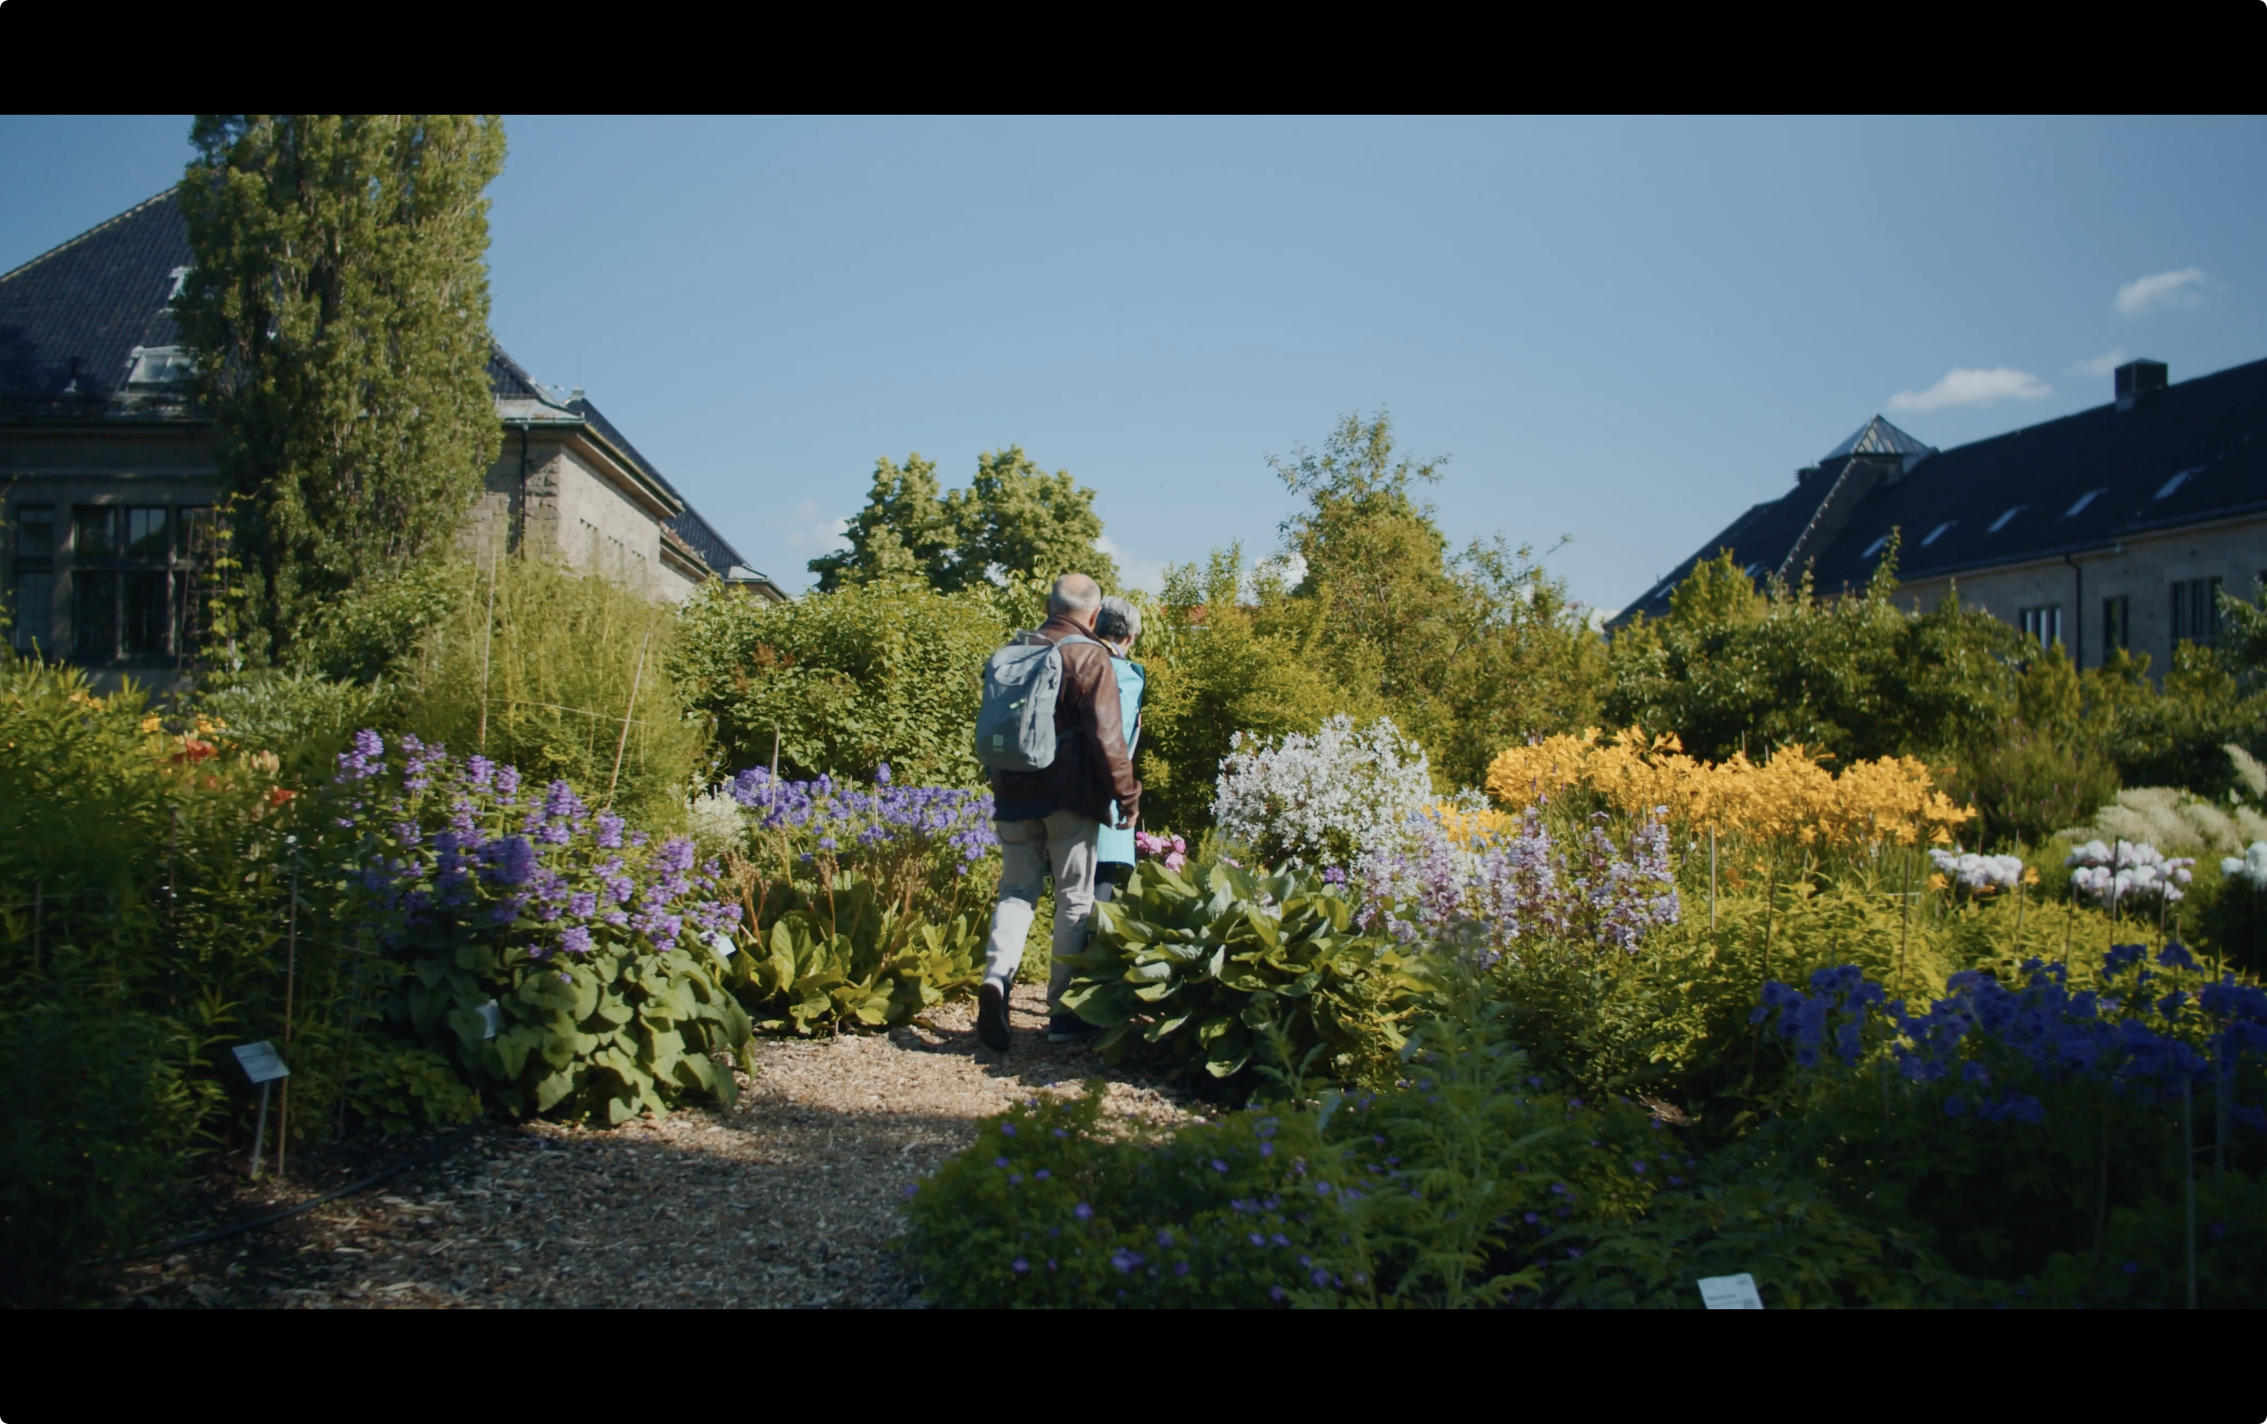
Oslo Botanical Garden
https://www.uio.no/om/finn-fram/omrader/toyen
Welcome reception at the Botanical Garden and Natural History Museum, Sunday 2026-09-27

Slide 6
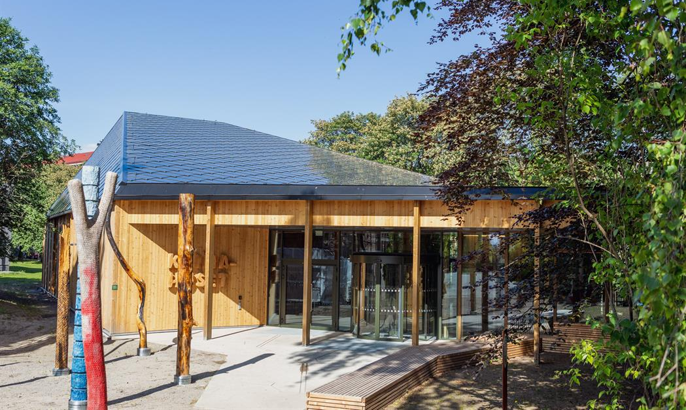
Oslo Climate House
https://www.nhm.uio.no/english/exhibitions/climate-house/
Welcome reception at the Botanical Garden and Natural History Museum, Sunday 2026-09-27

Slide 7
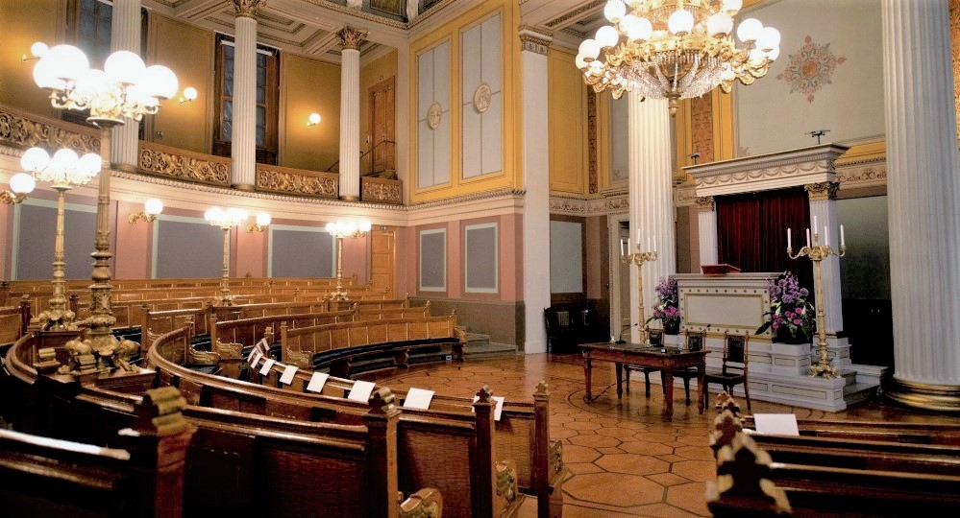
UiO Gamle Festsal
https://www.uio.no/om/finn-fram/omrader/sentrum/se02/
Venue option 1: University campus city centre
Auditorium capacity 240 people (+ 80 gallery)
Notes:
https://www.uio.no/om/regelverk/eiendom/leie-lokaler/gamle-festsal/index.html
https://no.wikipedia.org/wiki/Gamle_Festsal
https://www.uio.no/om/finn-fram/omrader/sentrum/se02/

Slide 8
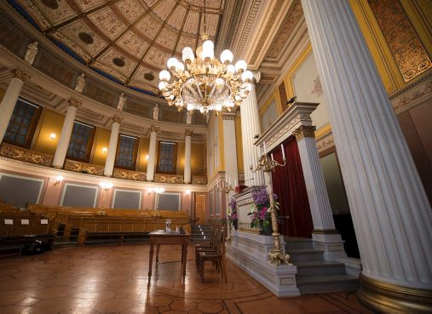
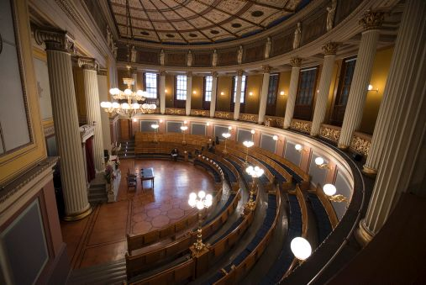
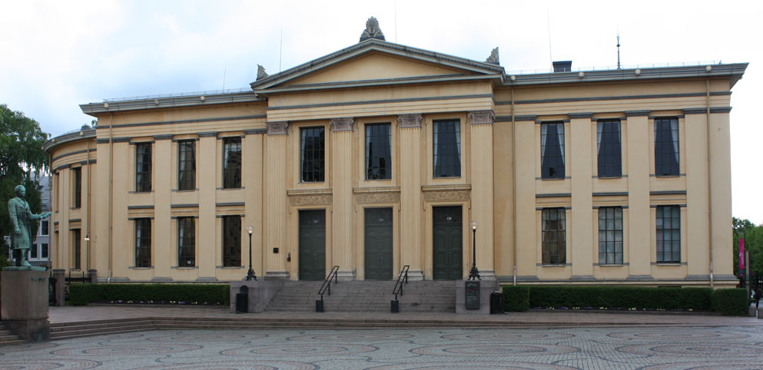
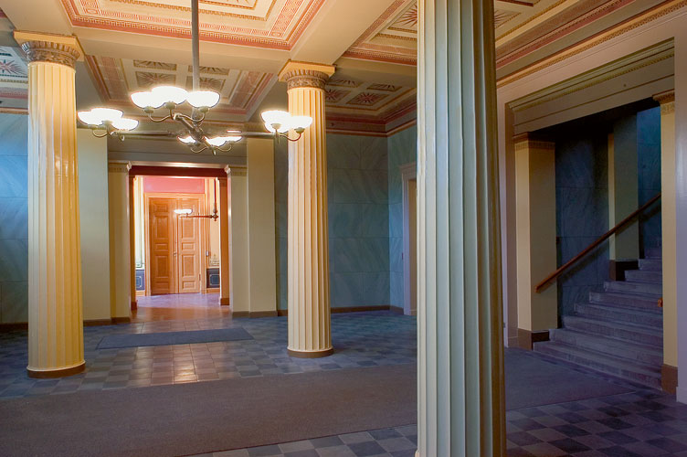
UiO Gamle Festsal
https://www.uio.no/om/finn-fram/omrader/sentrum/se02/
Notes:
https://www.uio.no/om/regelverk/eiendom/leie-lokaler/gamle-festsal/index.html
https://no.wikipedia.org/wiki/Gamle_Festsal
https://www.uio.no/om/finn-fram/omrader/sentrum/se02/

Slide 9
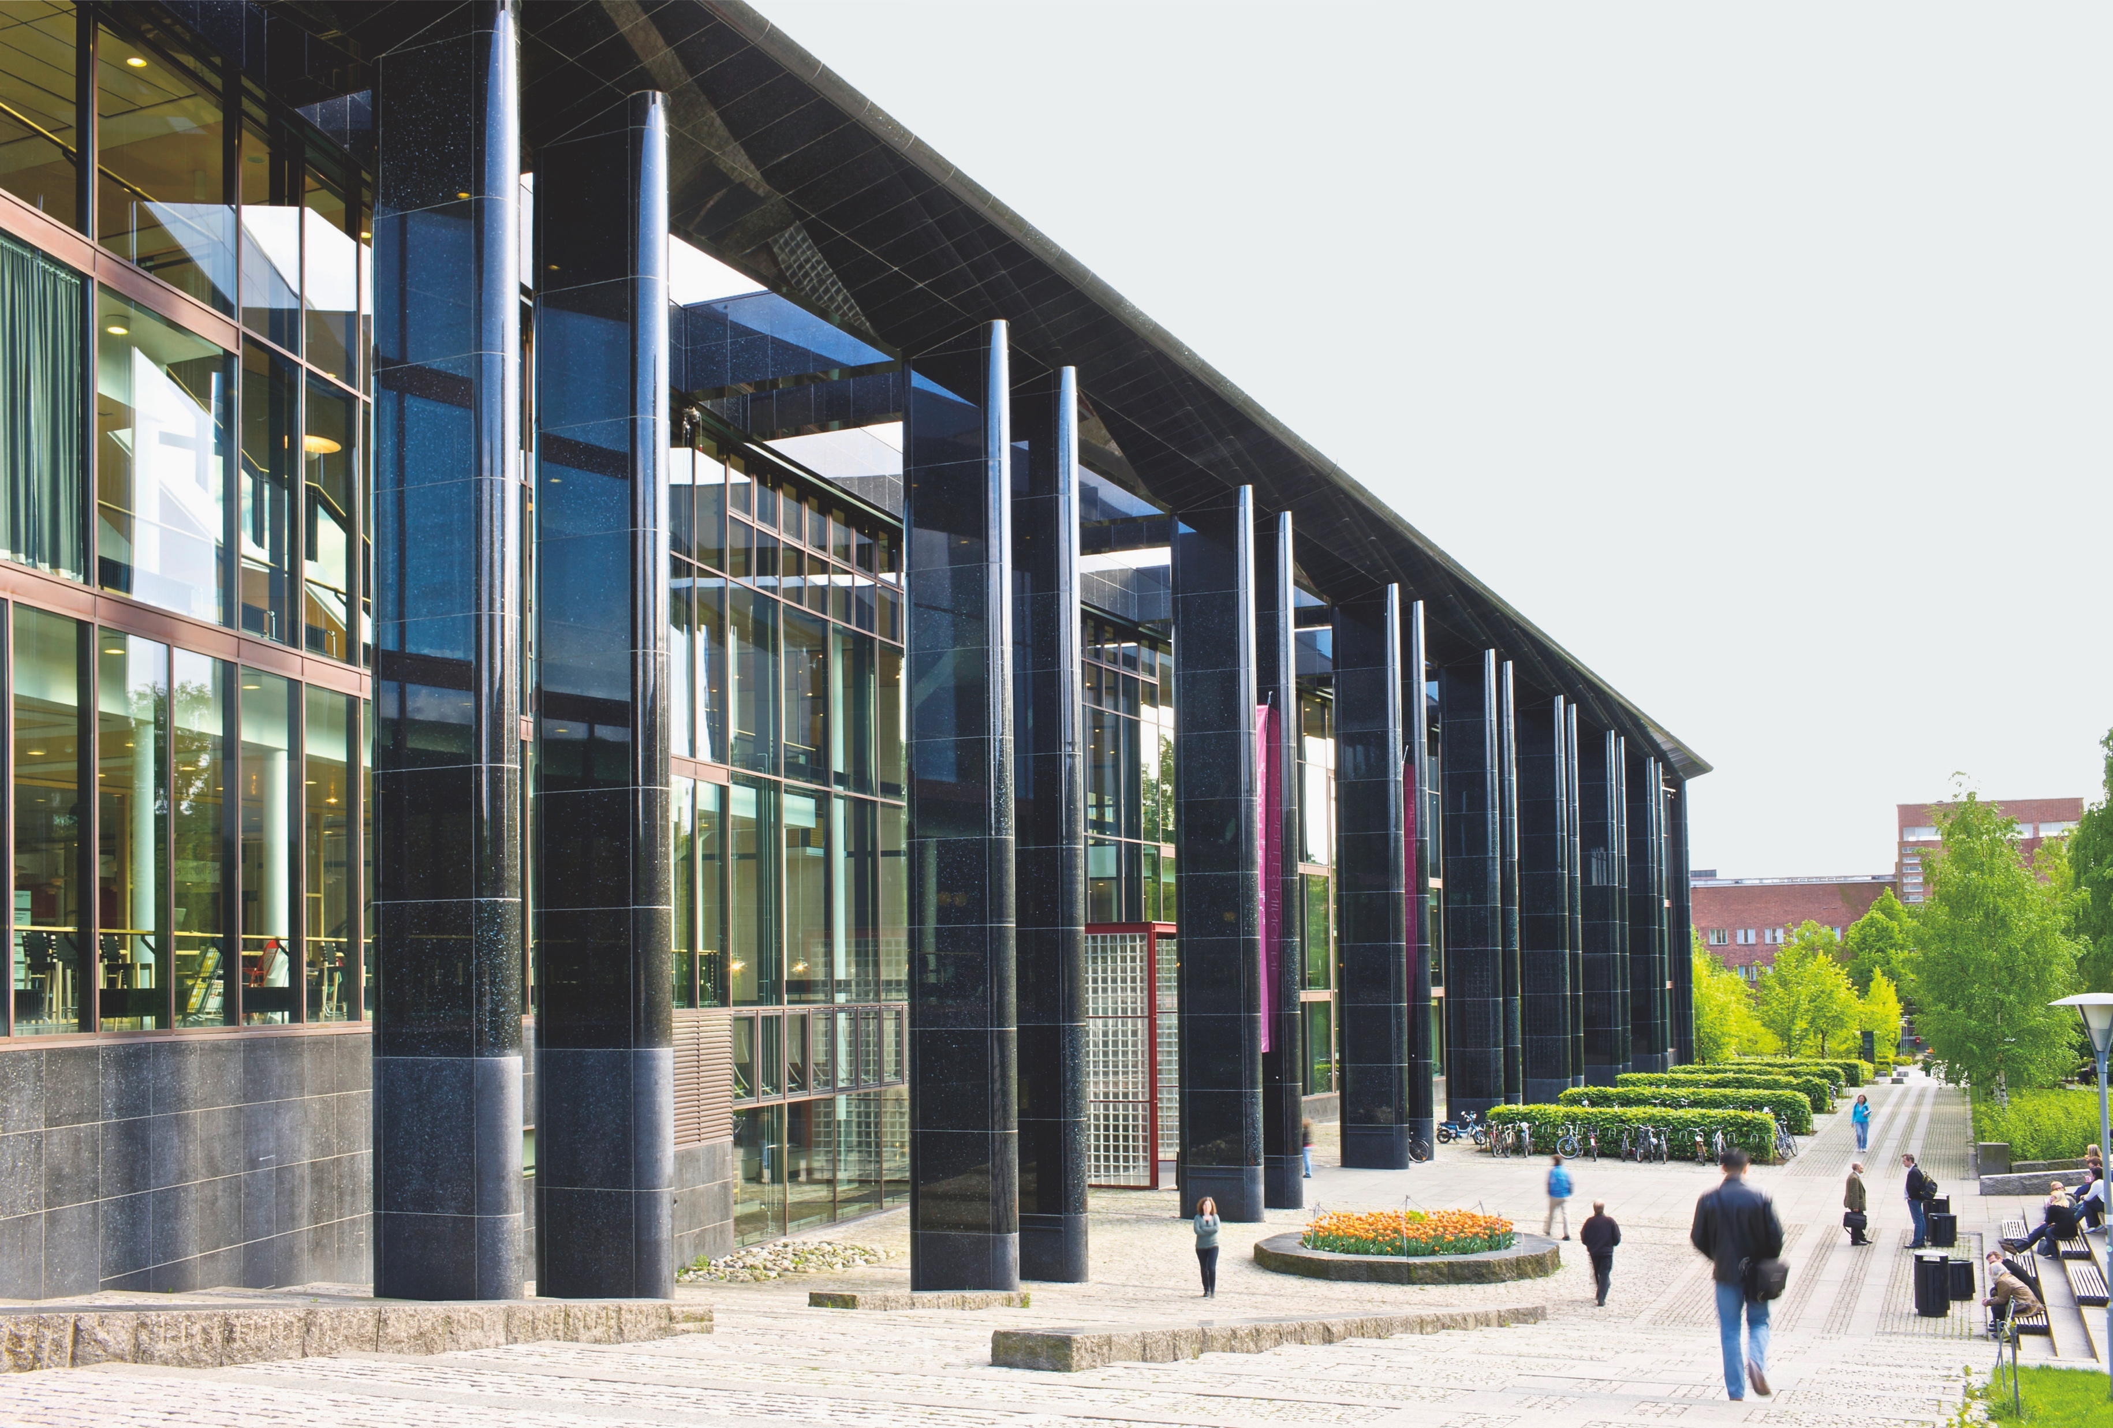
UiO University Library
https://www.ub.uio.no/english/
Venue option 2: University campus Blindern
Notes:
https://www.ub.uio.no/english/
https://www.uio.no/om/finn-fram/omrader/blindern/bl27/

Slide 10
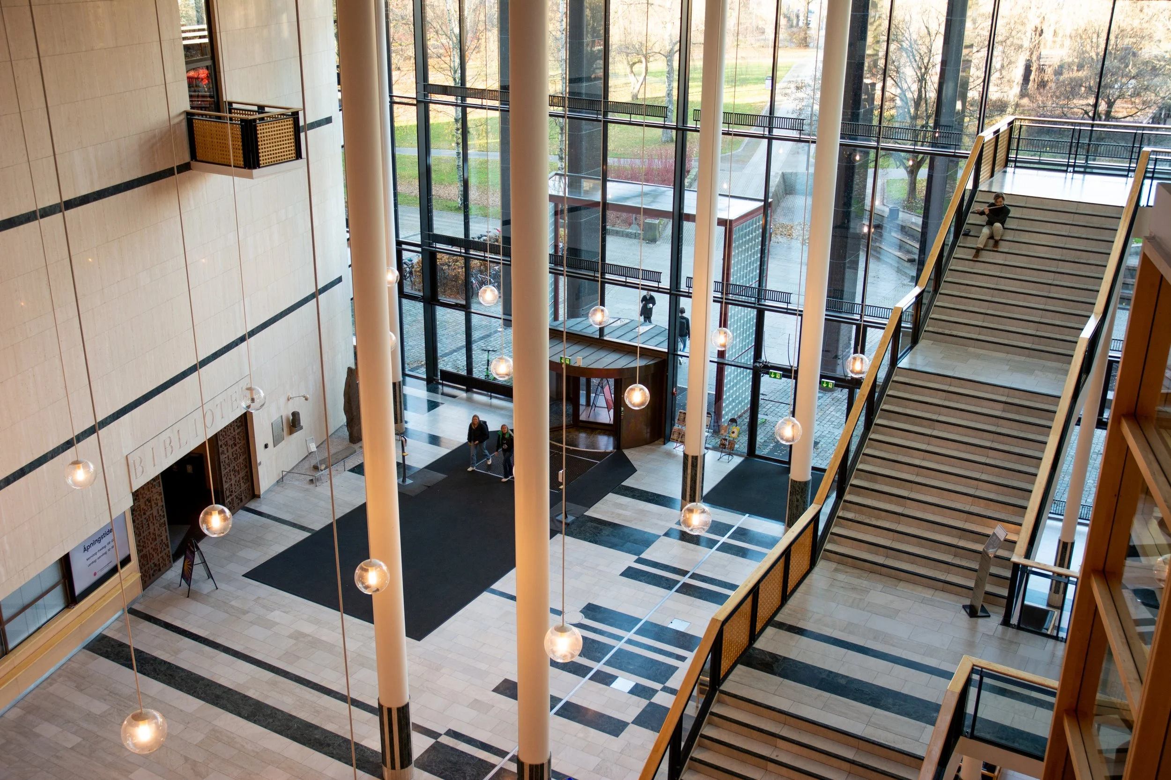
UiO University Library
https://www.ub.uio.no/english/
Venue option 2: University campus Blindern
Notes:
https://www.ub.uio.no/english/
https://www.uio.no/om/finn-fram/omrader/blindern/bl27/

Slide 11
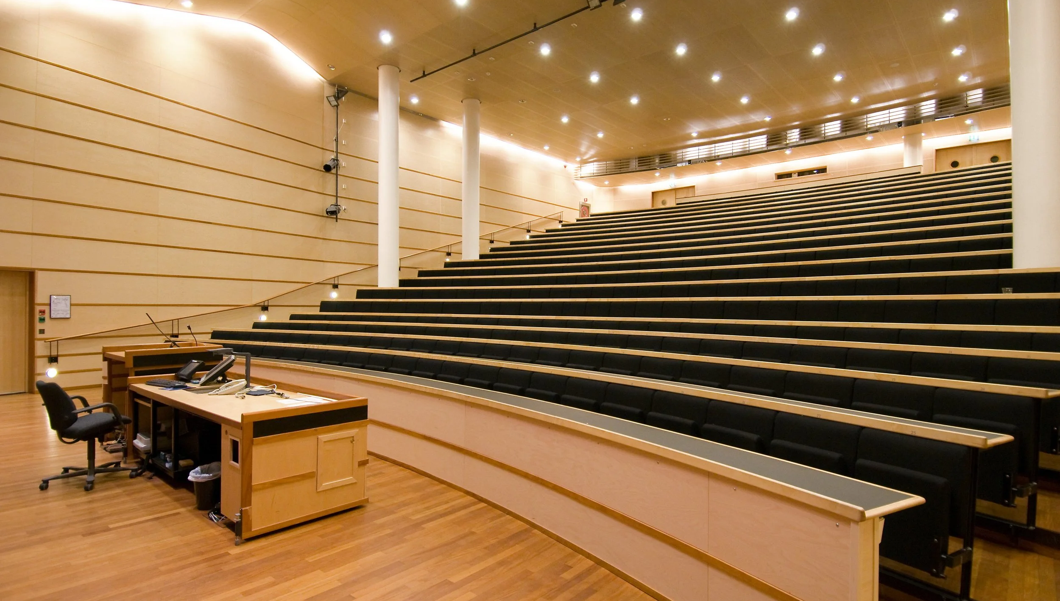
UiO University Library
https://www.ub.uio.no/english/
Venue option 2: University campus Blindern
Auditorium capacity 456 people
Notes:
https://www.ub.uio.no/english/
https://www.uio.no/om/finn-fram/omrader/blindern/bl27/

Slide 12
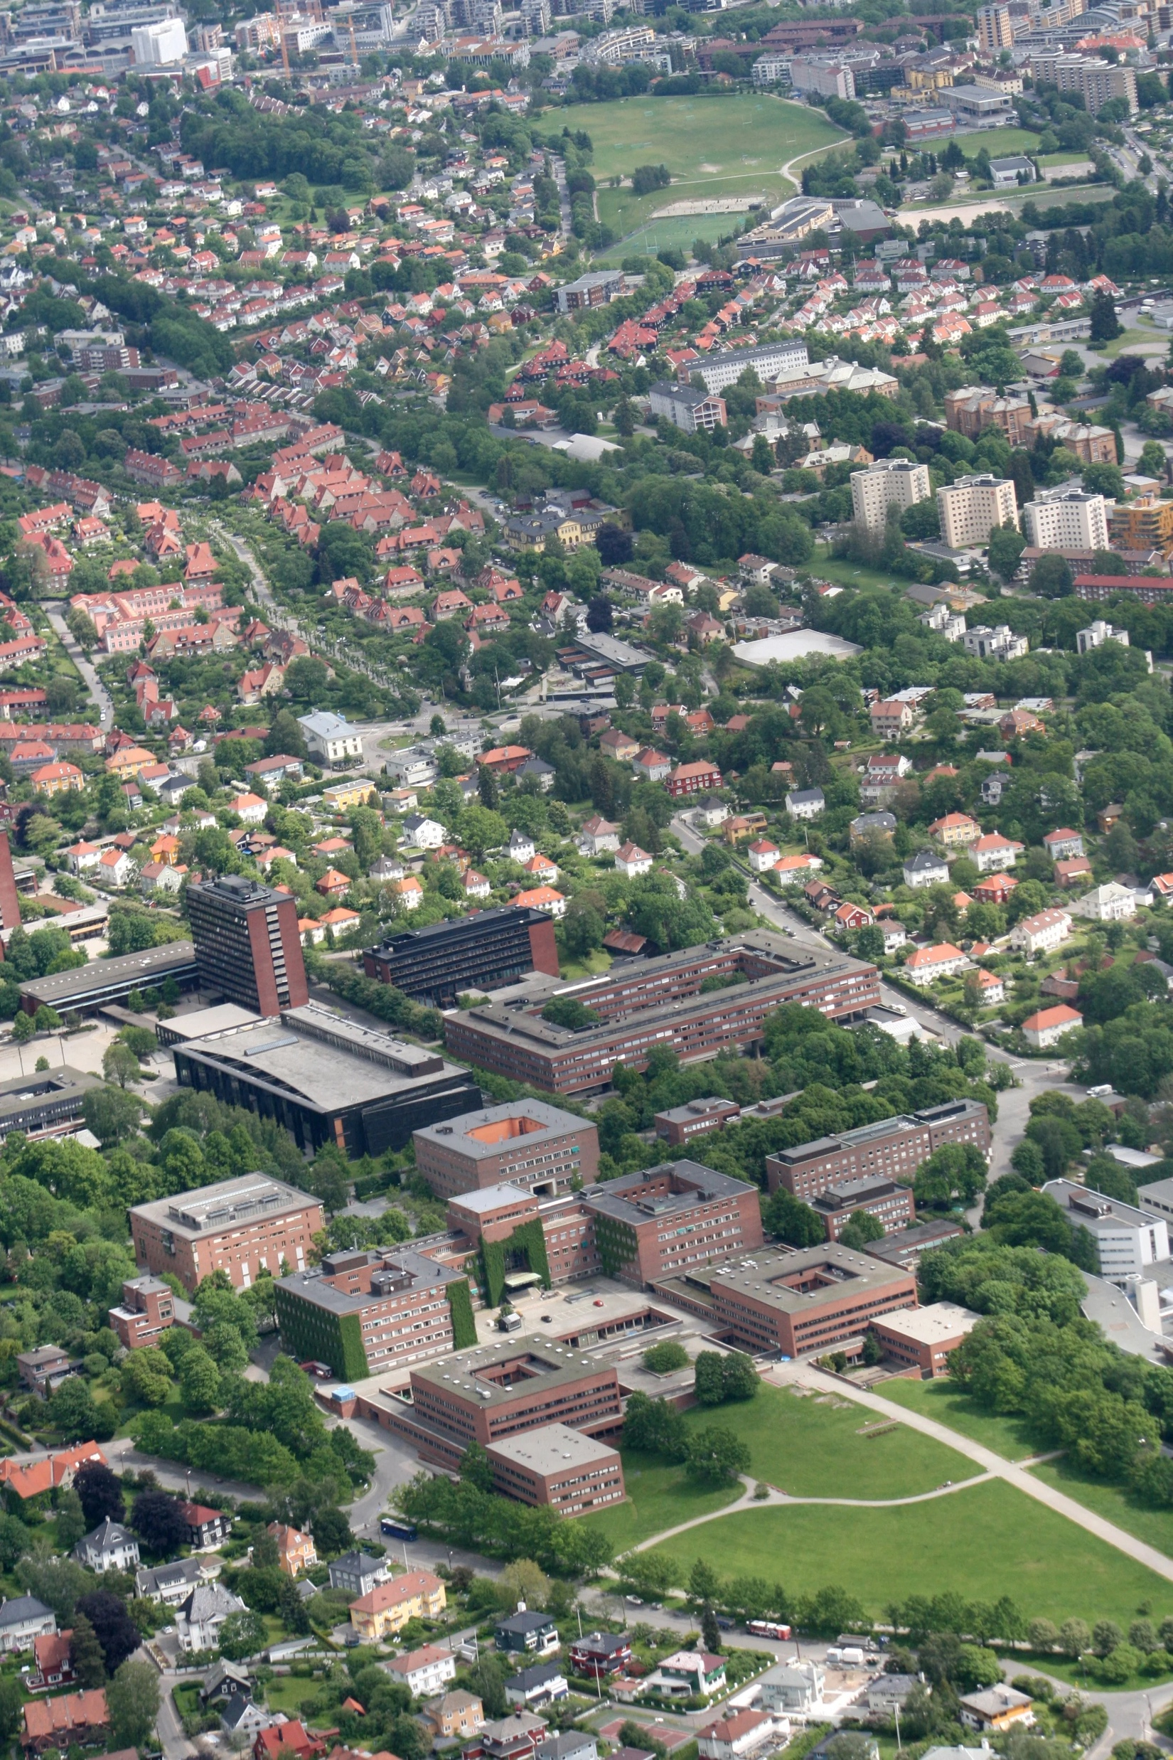
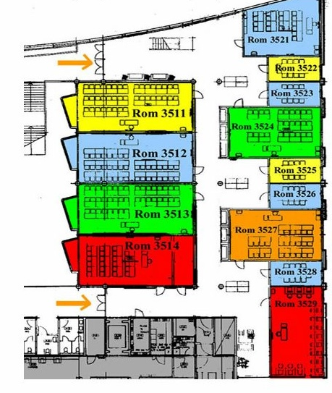
Many meeting rooms available 10 to 50 people
UiO University Library
https://www.ub.uio.no/english/
Notes:
https://www.ub.uio.no/english/
https://www.uio.no/om/finn-fram/omrader/blindern/bl27/

Slide 13

Photo: Ratio arkitekter/KVANT-1
UiO Life Science Building
Norway's largest university and hospital building 97,500 square meters, move-in starts in 2026
Notes:
https://www.uio.no/english/research/strategic-research-areas/life-science/about/building/

Slide 14

PHOTO: SOLOVIOVALIUDMYLA
17 000 hotel rooms in Oslo.
6 000 rooms within a 10 min walk of Oslo Central Station.
Rates include breakfast.
No additional hotel tax.
Wi-Fi is always free.
Accommodation
13

Slide 15

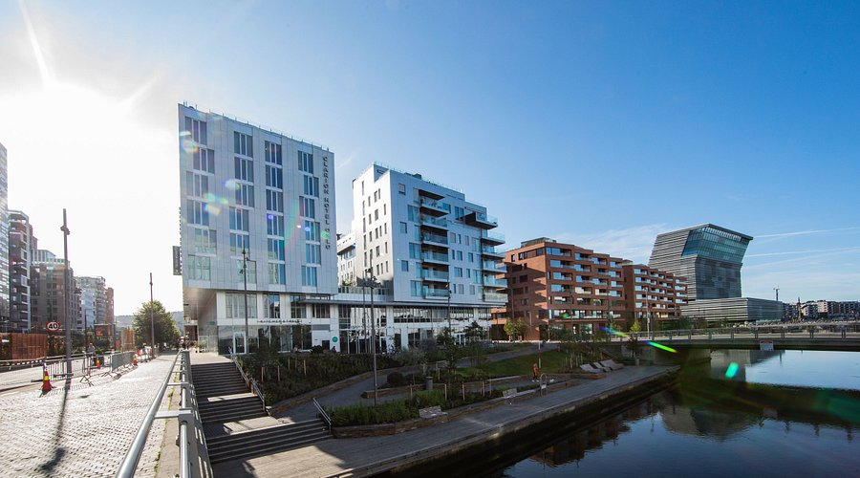
CLARION HOTEL OSLO
255 rooms
50 km to Oslo airport
500 m to Oslo Central Station
20% discount (block reservation)
block reservation prepared

Slide 16
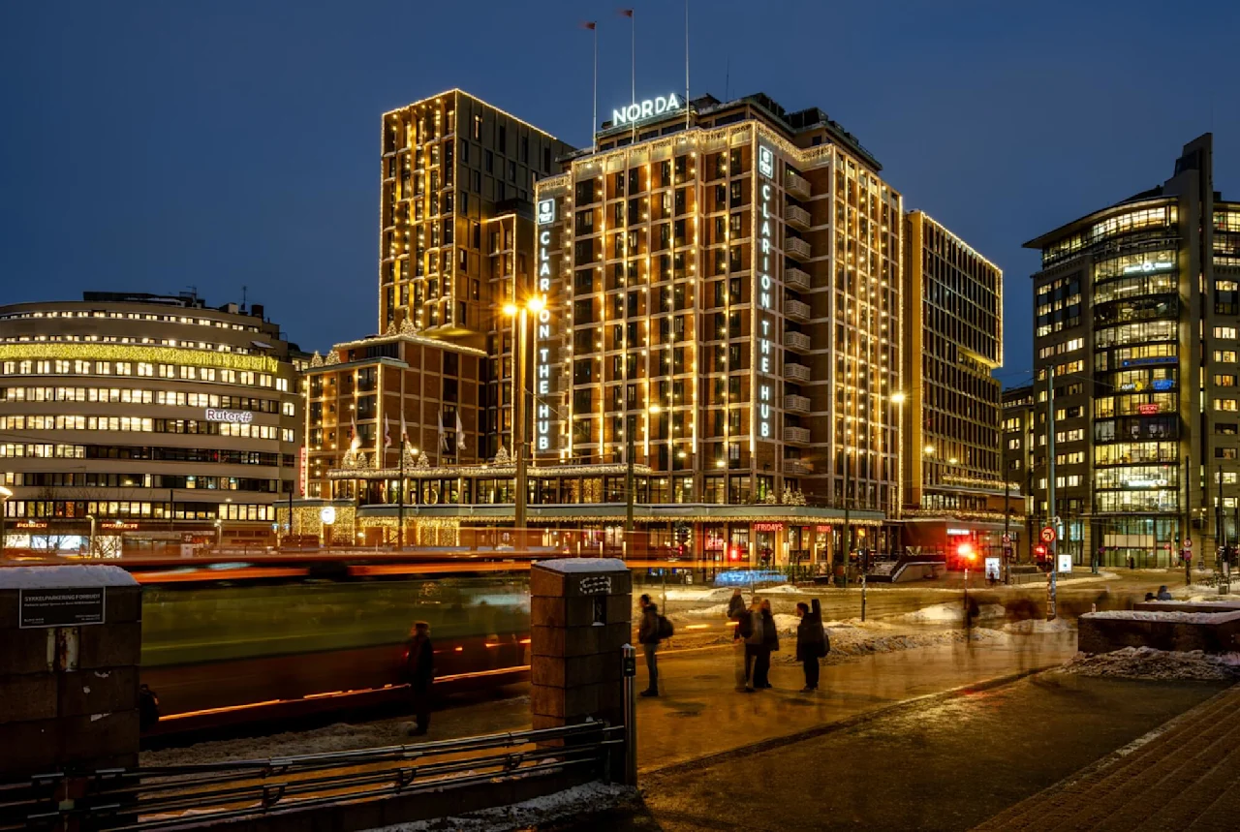
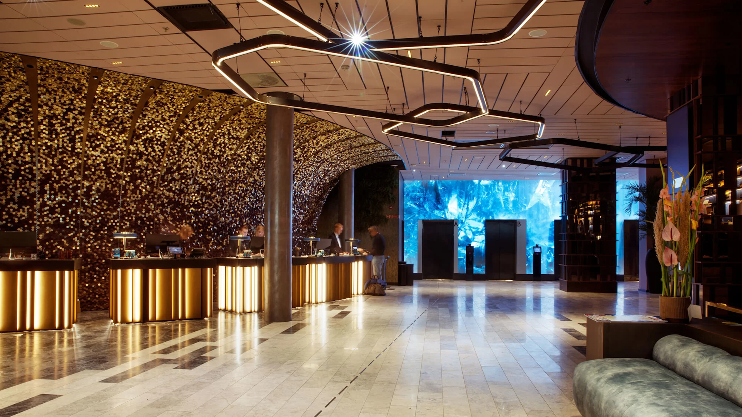
CLARION HOTEL THE HUB
810 rooms
50 km to Oslo airport
150 m to Oslo Central Station
20% discount (block reservation)
block reservation prepared

Slide 17
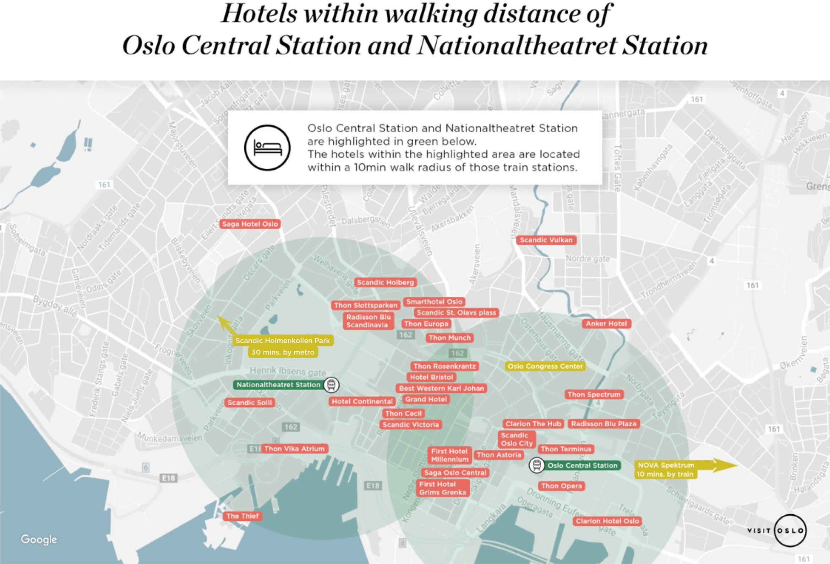
14

Slide 18

Transportation

Slide 19
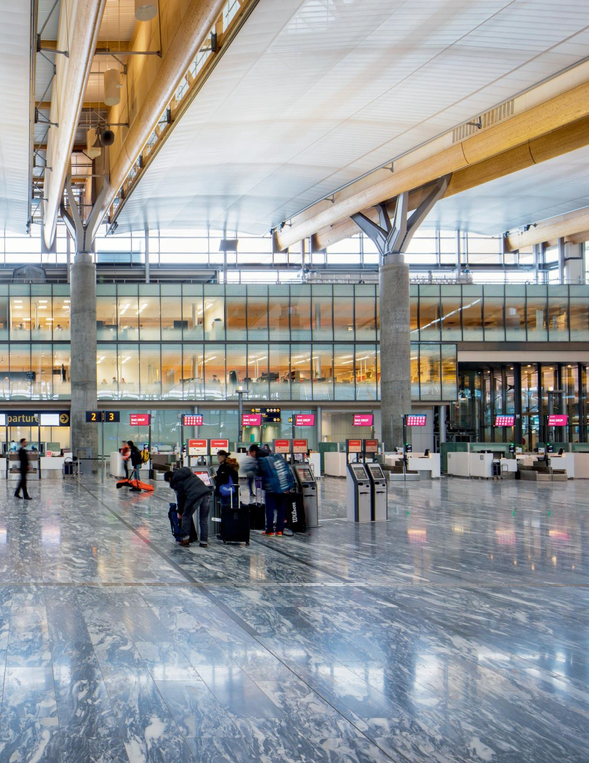
Oslo Airport
Direct routes to 112 international destinations.
Airport train 19 min to Oslo Central Station
One of Europe’s most modern airports, new terminal opened in 2017.
Eco-friendly terminals; snow collected in winter cools the airport in summer.
Contactless and self-service check-in, bag-drop and boarding.
Europe’s most punctual major airport according to Eurocontrol statistics.

Slide 20


REYKJAVIK
OUTSIDE EUROPE
HELSINKI
ST.PETERSBURG
OSLO
1h
2h
3h
4h
New York | 8.5 hours
Dubai | 6.5 hours
Qatar | 6.5 hours
Los Angeles | 10.5 hours
Toronto | 10 hours
Beijing | 12 hours
Tokyo | 15 hours
Bangkok | 14 hours
Hong Kong | 14.5 hours
Johannesburg | 15 hours
Vancouver | 14 hours
Sydney | 23.5 hours
STOCKHOLM
TALLIN
EDINBURGH
RIGA
MOSCOW
COPENHAGEN
VILNIUS
DUBLIN
MINSK
LONDON
AMSTERDAM
BERLIN
WARSAW
BRUSSELS
KIEV
PRAGUE
PARIS
VIENNA
MUNICH
BUDAPEST
MILAN
BELGRADE
LISBON
MADRID
BARCELONA
ROME
ISTANBUL
ATHENS
Flight times and routes
28

Slide 21
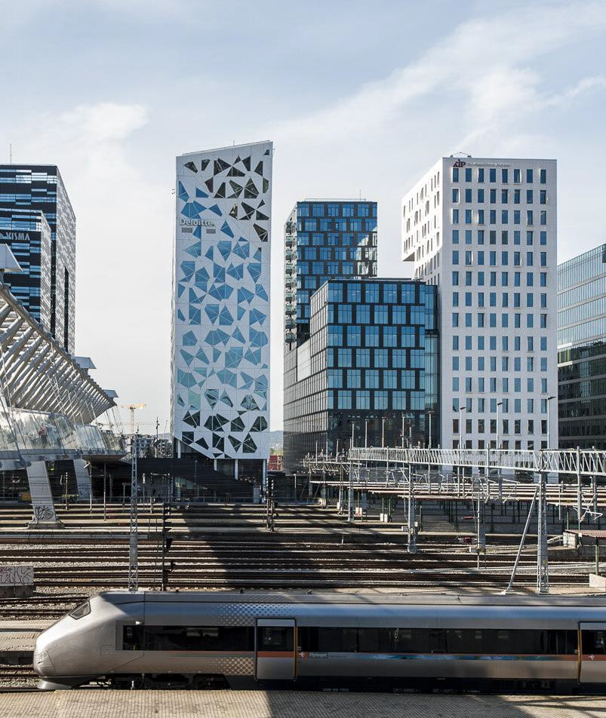



Public Transportation
From OSL airport to the city center within 19min
Event organizers can integrate transport passes in the conference badges as a QR code
Congress passes are valid from Oslo Airport and within Oslo.
60% REDUCTION ON CONGRESS PASS
Norway's only high-speed train also provides fast and comfortable transport between Oslo Airport
(OSL) at Gardermoen and several stops in the
Oslo region.
NB! Not included in the congress pass
Airport Express Train
29

Slide 22
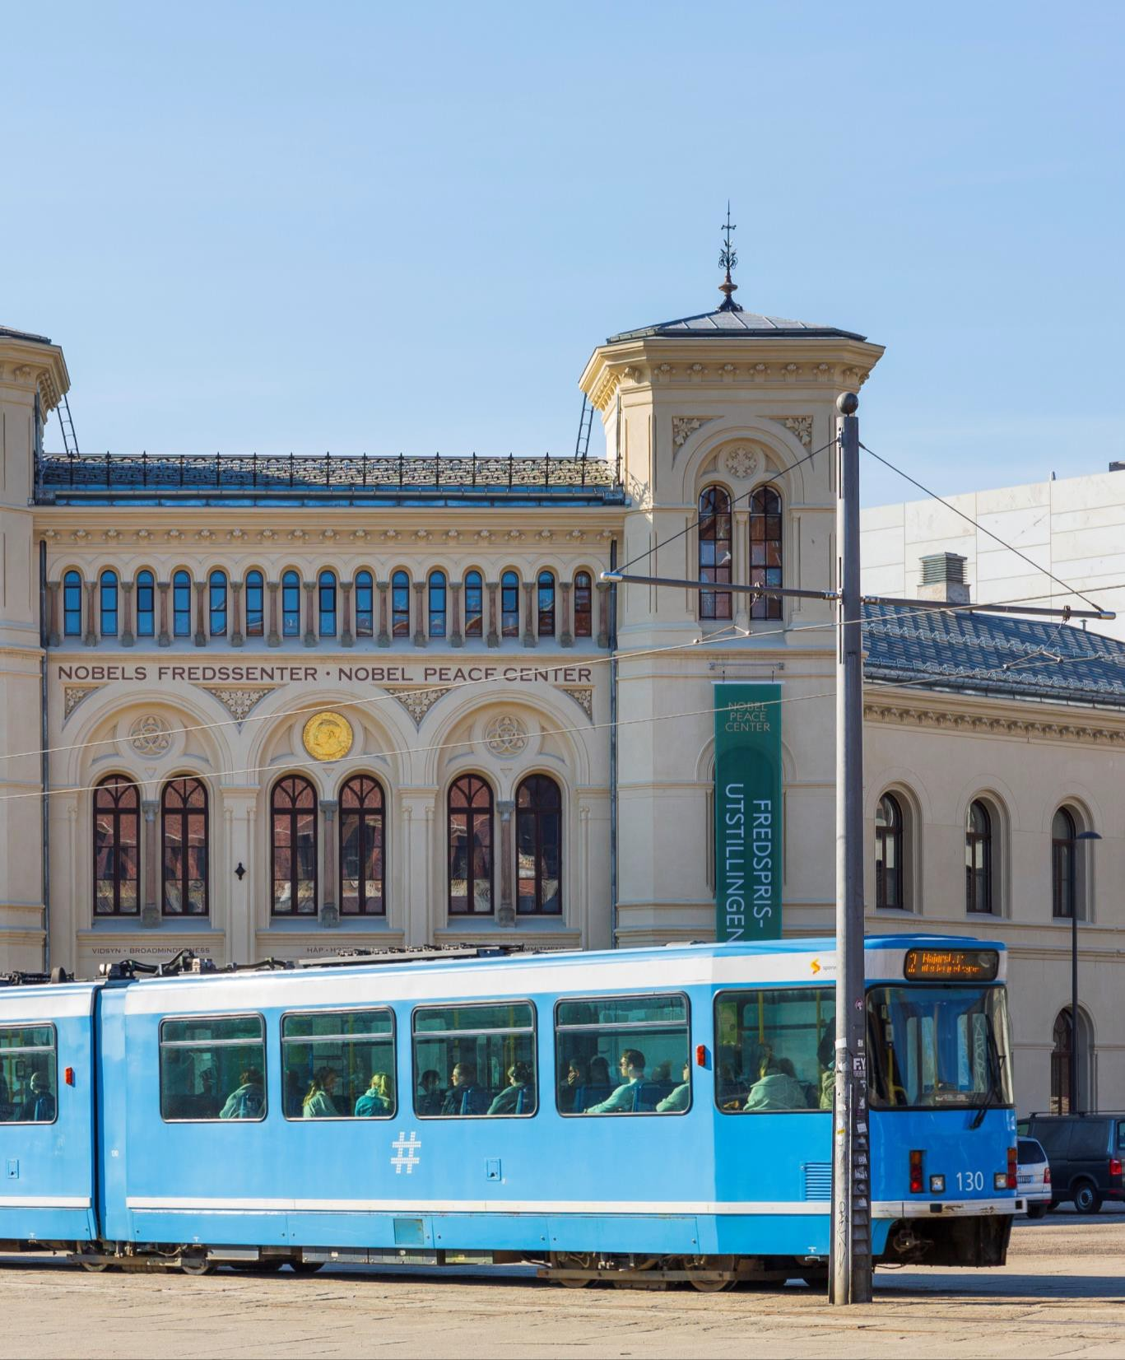
Getting around
Everything in the city centre is within walking distance. In need of local transportation, Oslo’s excellent public transportation system makes it easy to travel around the city.
Distances between attractions are often quite short, so you can explore a lot of the city by walking or biking.
Accessibility:
Useful links concerning physical accessibility in Oslo. https://www.visitoslo.com/en/oslo/practical- information/accessibility/
30

Slide 23
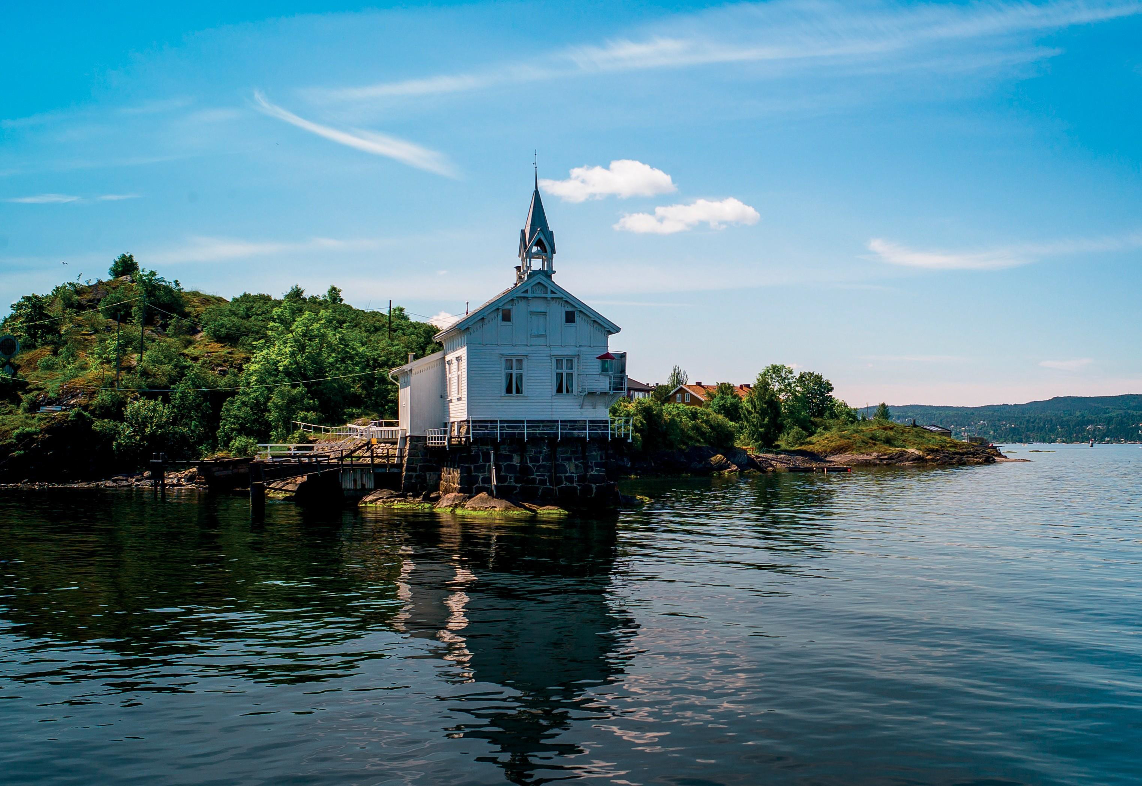
Key Attributes
PHOTO: CHRISROOSFOTOGRAFIE

Slide 24

Oslo
as a conference host
PHOTO: PIPOP_B
Oslo is easily accessible from all over the world
19 minutes from airport to city centre with high-speed trains
Oslo offers 17.000 hotel rooms in 2024
Breakfast buffet included in the room rate
Free use of Wi-Fi at venues, hotels, restaurants and trains
Oslo has an urban, compact city centre with everything within walking distance
Effective public transportation network
Green credentials; 2nd on GDS Index in 2023, and European Green Capital 2019
A friendly population who likes to speak English
Delivers high-level quality in every service aspect
Reliable providers and suppliers
32

Slide 25
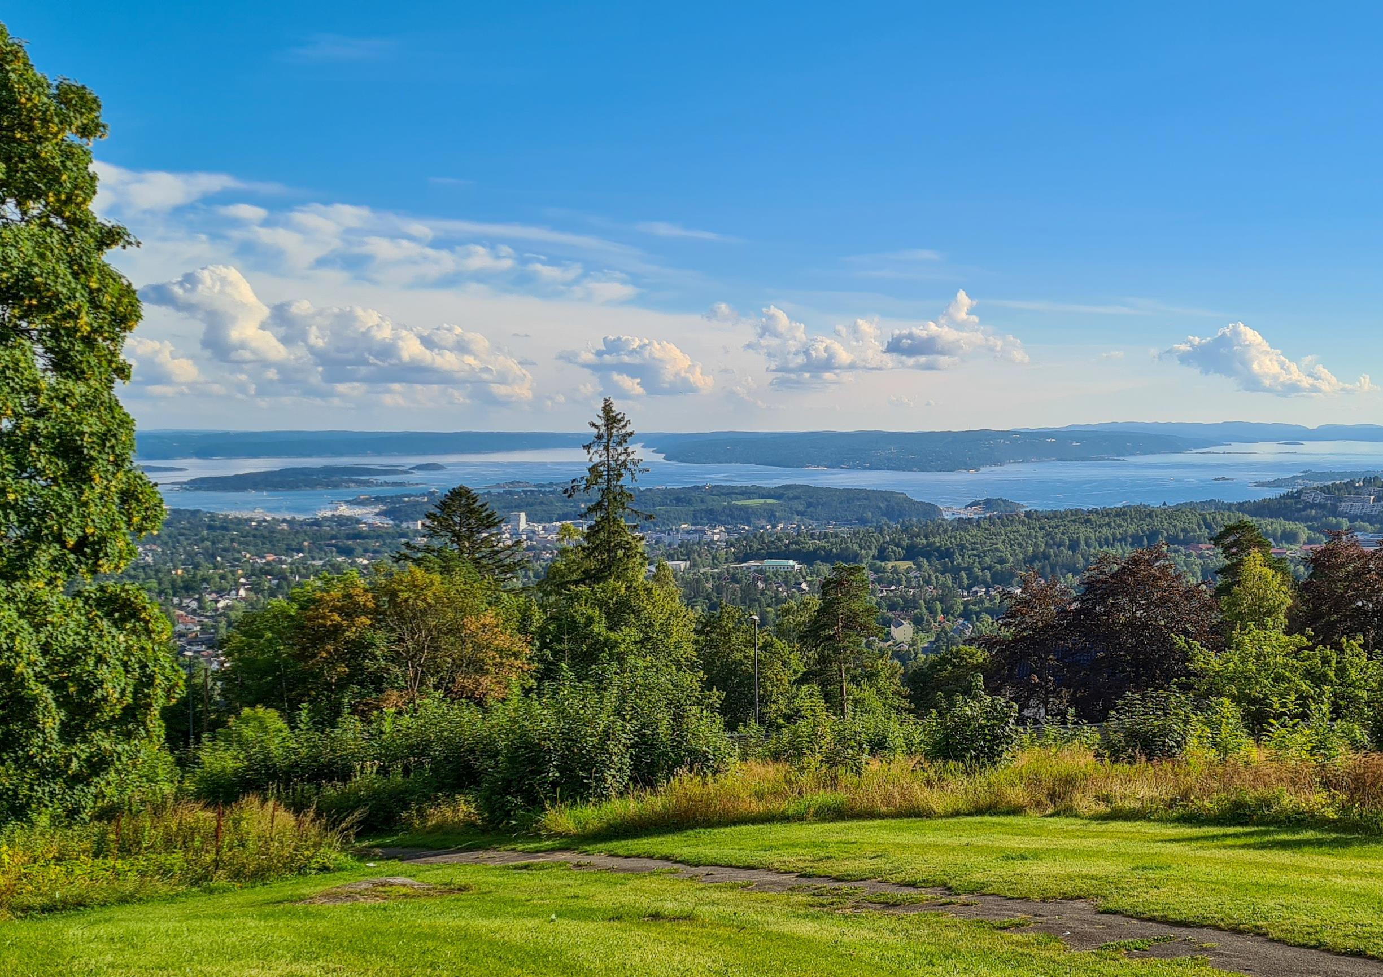
Oslo Green Facts
Around 95 % of the hotels hold a sustainability certification
97 % of the energy consumption in Oslo comes from renewable resources
By 2030 carbon emissions will be reduced by 95% compared to 2009 levels
In 2023 Oslo listed as the 2nd most sustainable conference destination according to the GDS Index
In 2022 Oslo ranked as number one on the Sustainable City Index
Oslo has over 200 km of cycle paths, and 243 city bike rental stations
Since 2020 public transportation only use renewable energy, mostly electric
Walking, cycling and public transport are the preferred modes of travel
OSLO Airport is Carbon Accredited Airport and among the world's greenest
The tap water in Oslo is of high quality and safe to drink
Oslo was the European Green Capital in 2019
33

Slide 26



CITY PARKS
VIGELAND SCULPTURE PARK
The Vigeland Sculpture park is one of Oslo’s most famous sights, and most visited attraction in Norway. A walk through this park of more than 200 sculptures in bronze, granite and cast iron, is a journey through life, as seen by Gustav Vigeland.
On a nice day the park is full of people; here you can go for a run, walk the dog, have a picnic or barbecue, play badminton or just enjoy the sun. The Park has Norway's biggest collection of roses; a total of 14,000 plants of 150 different species.
Free entrance.
EKEBERGPARKEN
The Ekeberg Sculpture Park opened in 2013 and has quickly gained status among Europe’s many sculpture parks. This is a modern park with approx. 42 sculptures and installations today, but more are planned in the coming years. Guided tours through these parks are offered in several languages.
Shortly after the official opening, the Wall Street Journal named Ekebergparken one of the world's
five best sculpture parks.
Free entrance.
BOTANICAL GARDEN
Large garden at Tøyen with ample botanical variety and diversity. Most of the area is designed as an Arboretum, with approximately 1800 different plants. The garden holds a large and varied collection of trees and shrubs planted in a systematic fashion after plant family.
The greenhouses The Palm House from 1868 and The Victoria House from 1876 present exotic plants from other parts of the world.
Free entrance.

Slide 27
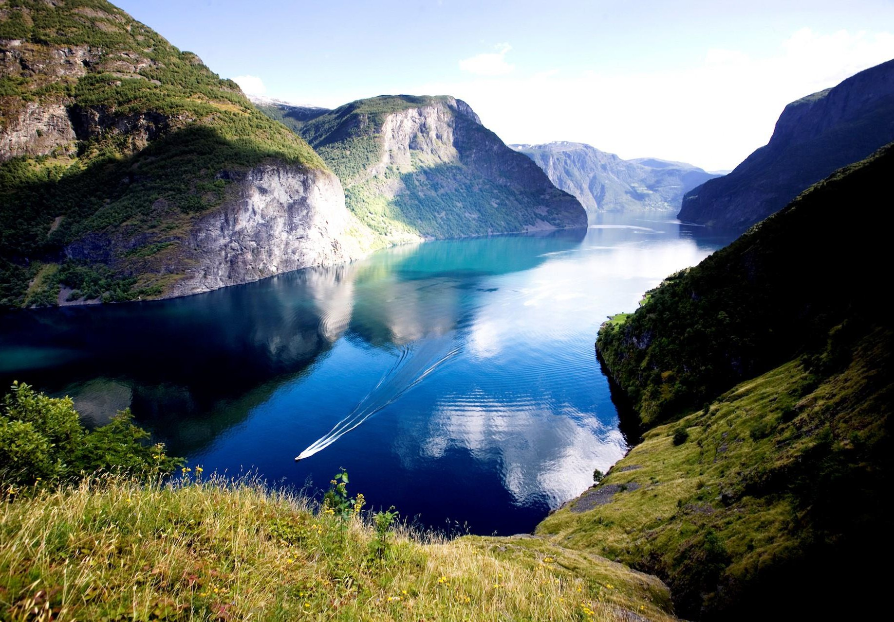




PRE/POST TOURS
NORWAY IN A NUTSHELL
PHOTO: TOMASZMAJEWSKI
Notes:
This legendary tour takes you through Norway’s most breathtaking UNESCO-protected fjord and mountain scenery, as well as a trip on Europe’s top scenic rail journey.
The Norway in a nutshell® tour takes you through some of Norway's most beautiful fjord scenery. You will experience the scenic Bergen Railway, the breathtaking Flåm Railway, the Aurlandsfjord, the narrow and dramatic UNESCO-protected Nærøyfjord and a bus trip through the beautiful scenery of Western Norway.
The trip is available as a day tour or as a tour with overnight stays en route. You can start the tour in Oslo and end up in Bergen.
Website and photos: www.fjordtours.com

Slide 28
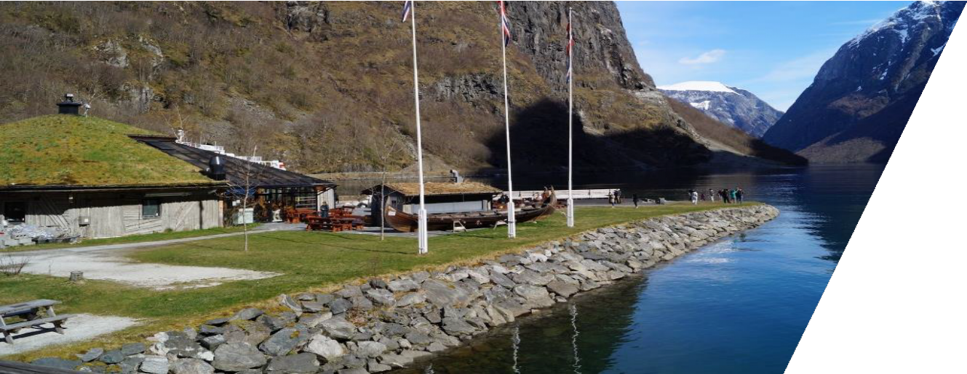
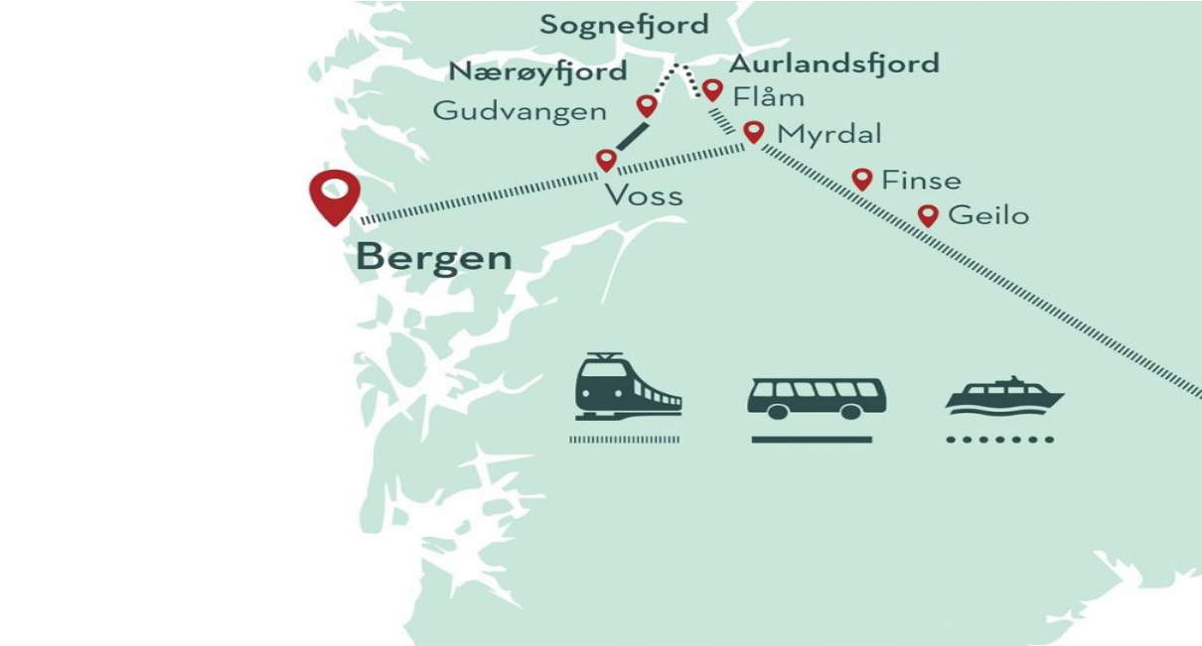

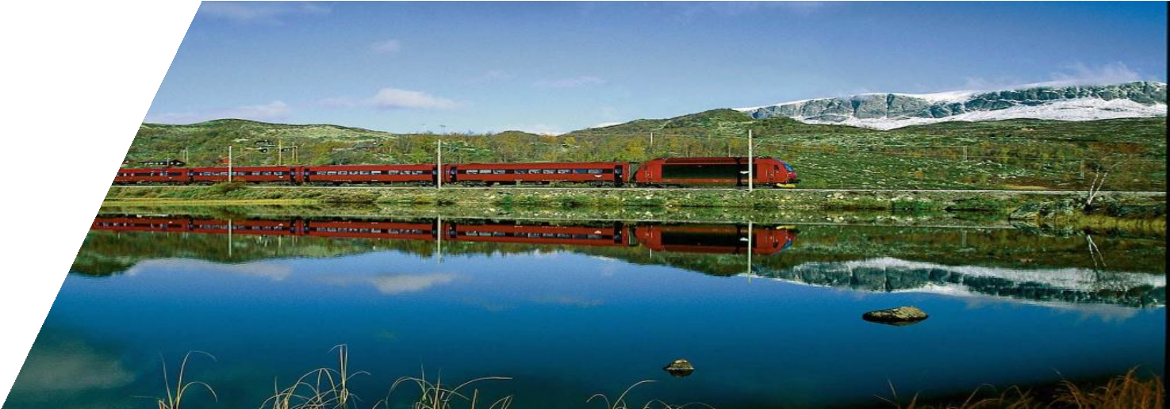

Slide 29

TDWG 2026 in Oslo
21st to 25th September
(the week before GB33)

Slide 30
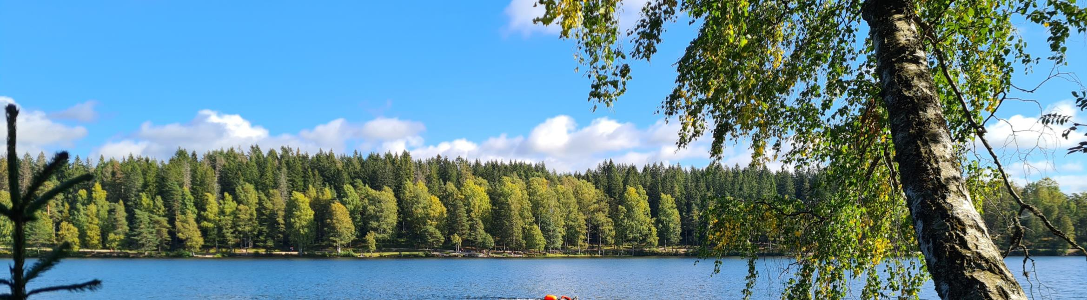
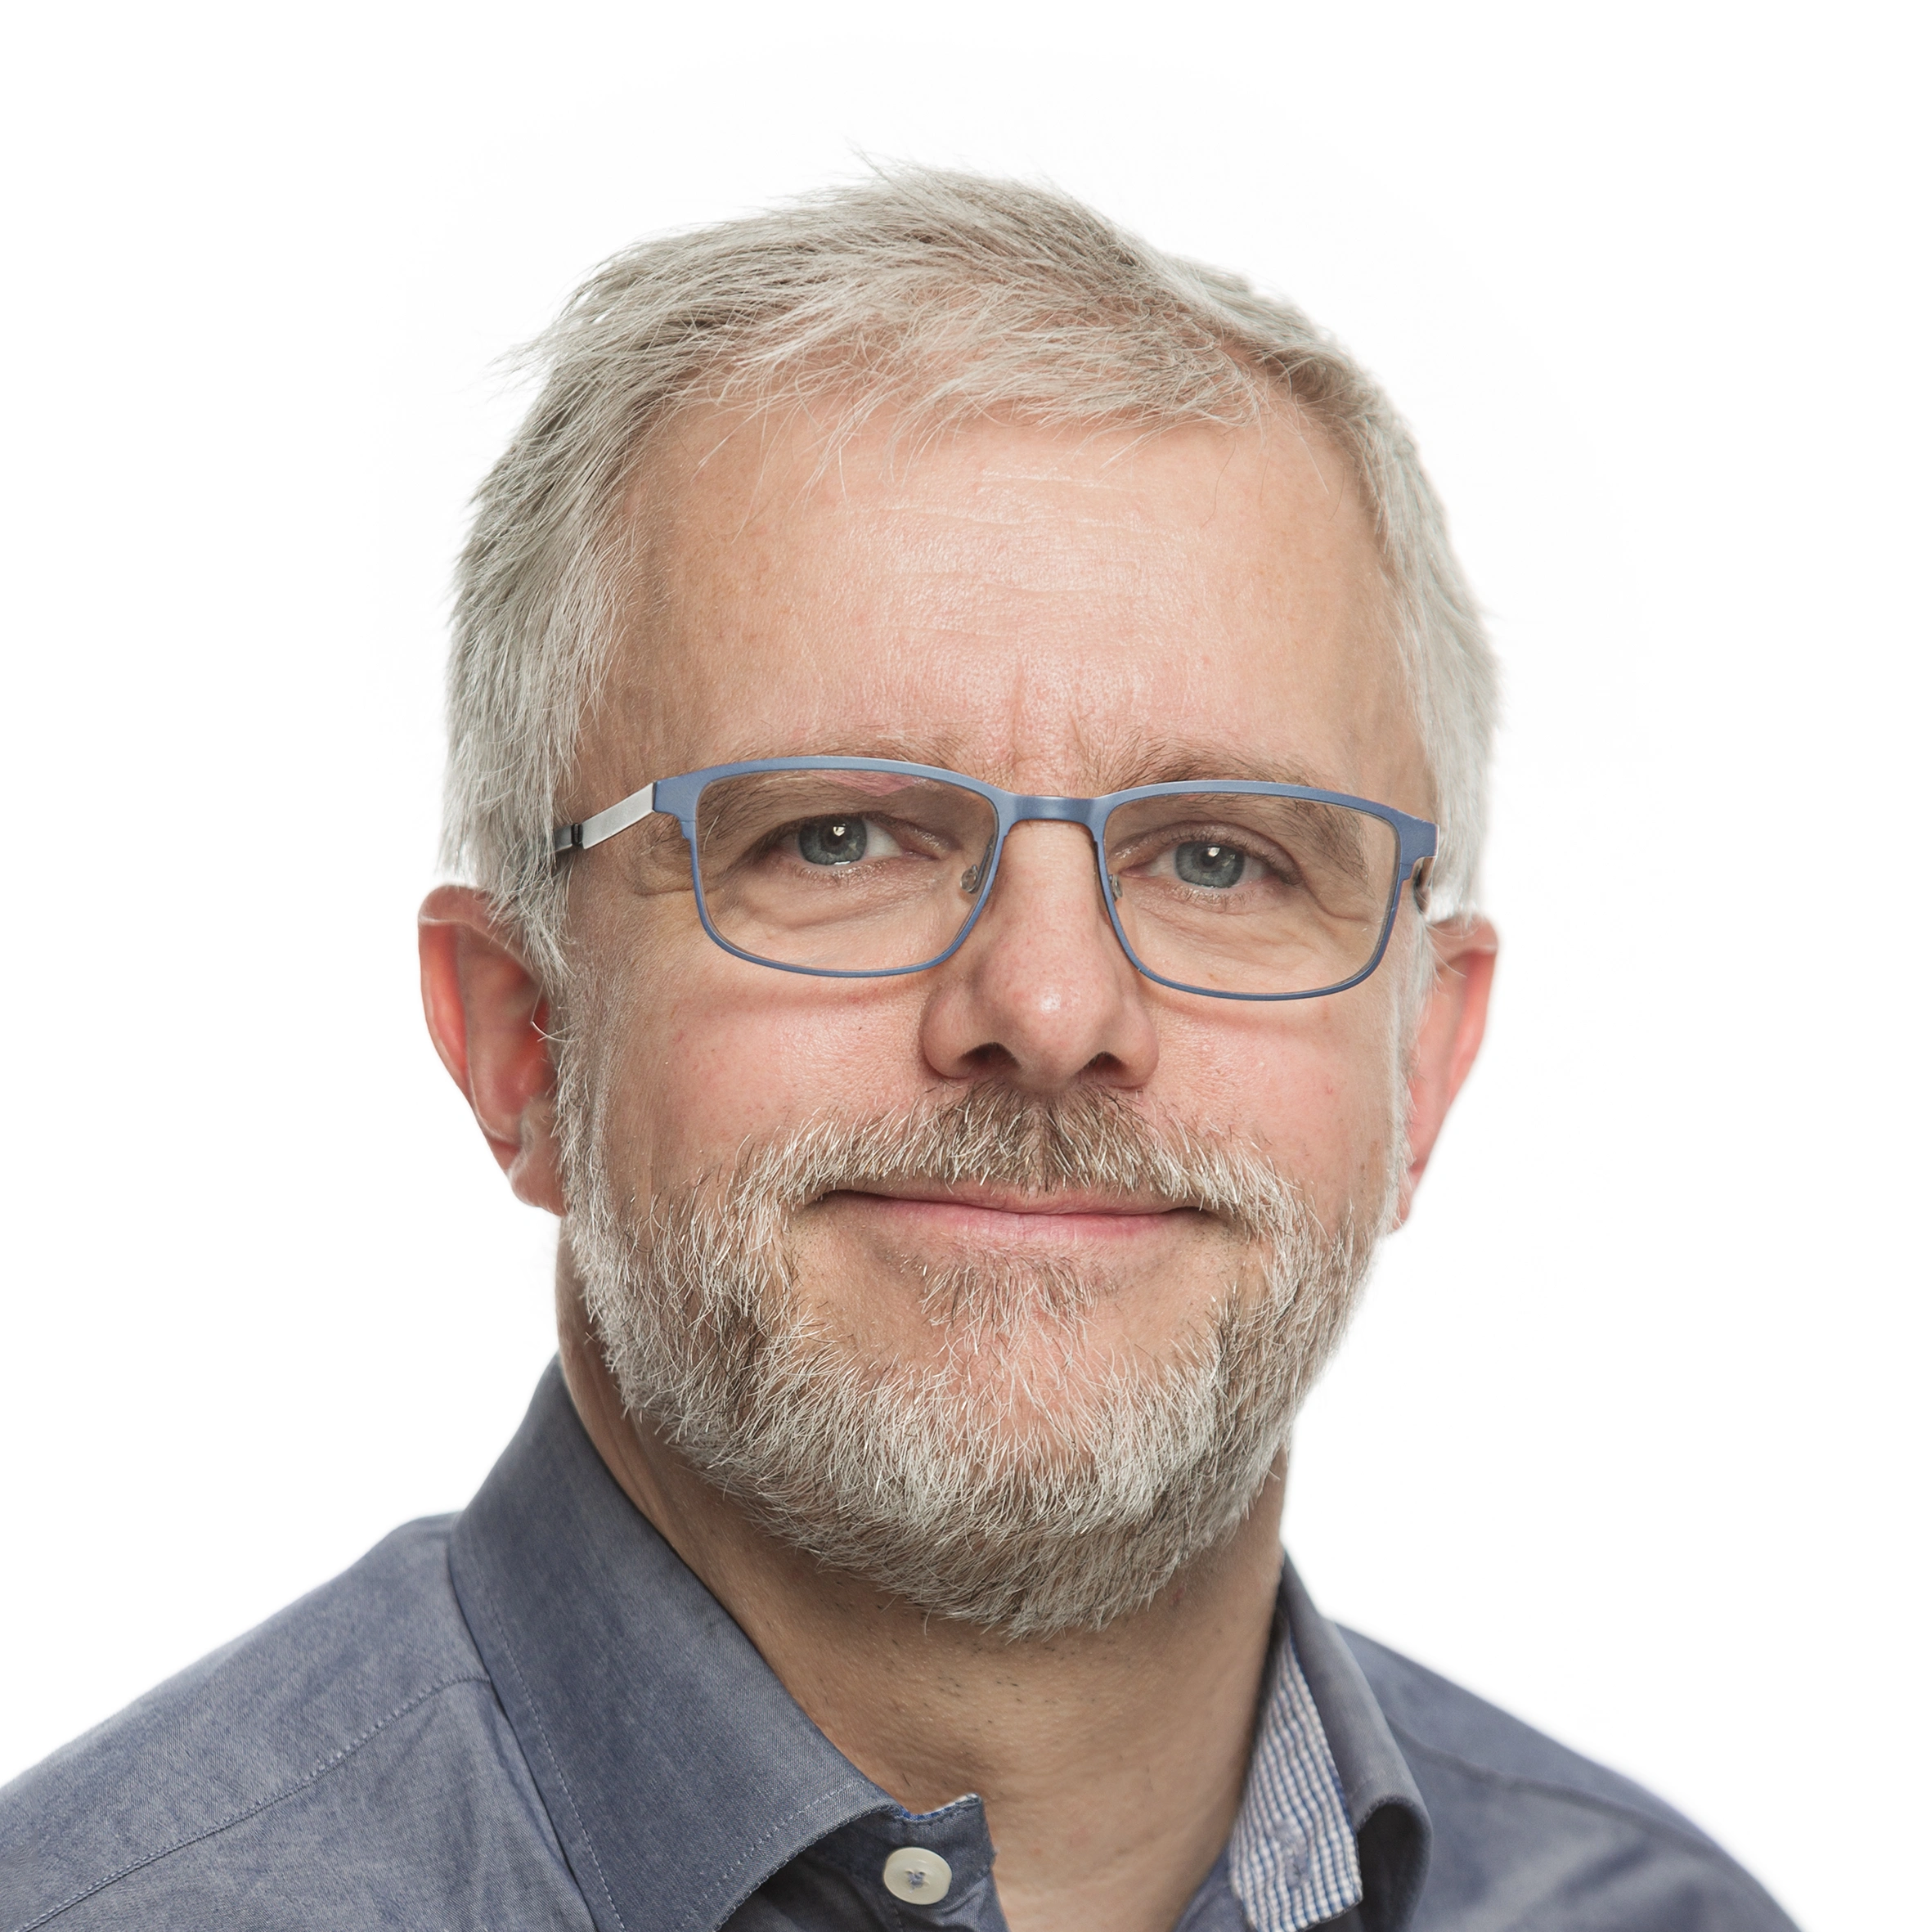
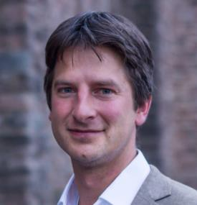
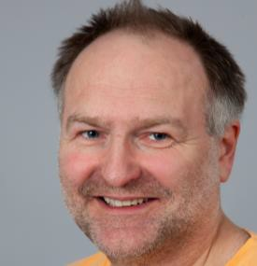



Local Organising Committee
Head of Delegation
Hugo de Boer
Research Director
Professor
Alternative Head of Delegation
Arild Lindgaard
Norwegian Biodiversity Information Centre (NBIC)
Node Manager
Dag Endresen
Chief Engineer, PhD
GBIF Representative for Europe & Central Asia

Slide 31



Welcome to Oslo 28 to 30 September 2026

