Slide 1
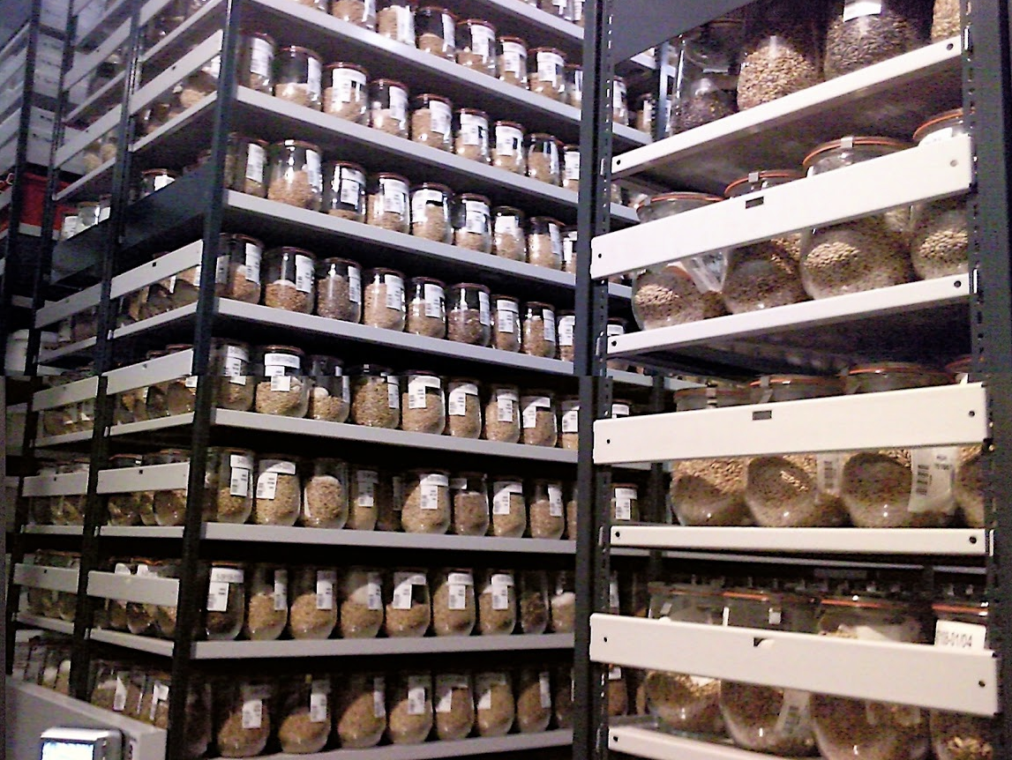



Searching for traits of resistance to crop diseases and pests in wheat and barley landraces
Dag Endresen
GBIF Norway, University of Oslo
Notes:
8th International Triticeae Symposium 2017 (8ITS) Key note 13th June 2017, Wernigerode, Germany
Illustration photo: IPK Gatersleben genebank cold storage, photo by Dag Endresen, May 2010, Gatersleben, Germany, CC-by.
Predictive characterization of wheat and barley landraces
Searching for traits of resistance to crop diseases and pests in wheat and barley landraces
Focused Identification of Germplasm Strategy (FIGS) analysis for the wild relatives of the cultivated plants.
Presented by Dag Endresen, GBIF Norway, University of Oslo for the 8th International Triticeae Symposium, Wernigerode, Germany, 13th June 2017

Slide 2

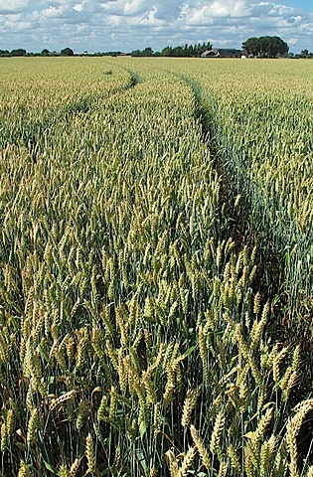
TOPICS:
Predictive characterization
  Predictive link between climate data and trait data
  Some examples of studies:
    Morphology of Nordic barley
    Net blotch on barley
    Stem rust on wheat
Agricultural biodiversity informatics and GBIF
Open data publication
Wheat at Alnarp in Sweden June 2010, CC-BY Dag Endresen
Notes:
Photo: Wheat, Triticum aestivum L., at Nöbbelöv in Lund Sweden, June 2010 CC-by Dag Endresen. URL: http://www.flickr.com/photos/dag_endresen/4826175873/, https://picasaweb.google.com/dag.endresen/GermplasmCrops#5497796034327520578

Slide 3
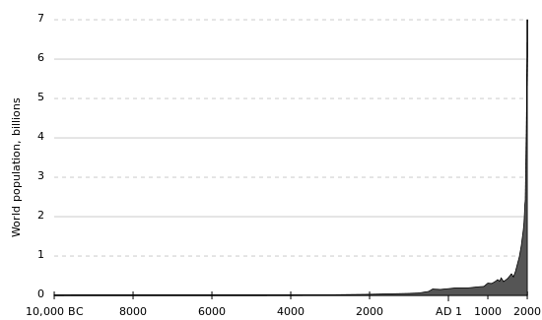
World human population (est.) 10,000 BC – 2000 AD.
  To feed the human population in 2050 we will require agricultural production to increase by 70% globally, and 100% in developing countries.
  (FAO, 2011; FAO, IFAD & WFP, 2014).
Industrial
age
(Industrial
agriculture)
Middle
ages
Origin of agriculture
Bronze age
Iron age
Illustration: Wiki Commons Public Domain.
FAO (2011). Looking ahead in world food and agriculture: Perspectives to 2050. . ISBN 978-92-5-106903-5 (p.272).
Notes:
Wiki Commons, Public Domain, http://en.wikipedia.org/wiki/File:Population_curve.svg
FAO (2011). Looking ahead in world food and agriculture: Perspectives to 2050. Edited by Piero Conforti. FAO, Economic and Social Development Department, Rome. ISBN 978-92-5-106903-5.
Page 235: “For these projections to materialize, annual world agricultural production would need to increase by 70 percent over the period from 2005/2007 to 2050”.
Page 272: “Nevertheless, agricultural production would still need to increase by 70 percent (and nearly 100 percent in developing countries) by 2050 to cope with a 40 percent increase in world population and to raise average food consumption to 3130 kcal per person per day by 2050. This translates into additional production of 1 billion tonnes of cereals and 200 million tonnes of meat a year by 2050 (compared with production in 2005/2007)”.
FAO, IFAD and WFP. 2014. The State of Food Insecurity in the World 2014. Strengthening the enabling environment for food security and nutrition. Rome, FAO. ISBN: 978-92-5-108543-1. http://www.fao.org/publications/sofi/2014/en/, http://www.fao.org/3/a-i4030e.pdf
FAO, IFAD and WFP. 2011. The State of Food Insecurity in the World 2011. How does international price volatility affect domestic economies and food security? Rome, FAO. ISBN: 978-92-5-106927-1. http://www.fao.org/docrep/014/i2330e/i2330e00.htm
Page 42: “FAO estimates indicate that global agricultural production will need to grow by 70 percent between 2005–07 and 2050, and by almost 100 percent in developing countries, to feed a population of more than 9 billion people in 2050”.
Alexandratos, N. and J. Bruinsma (2012). World agriculture towards 2030/2050: the 2012 revision. ESA Working paper No. 12-03. Rome, FAO.

Slide 4
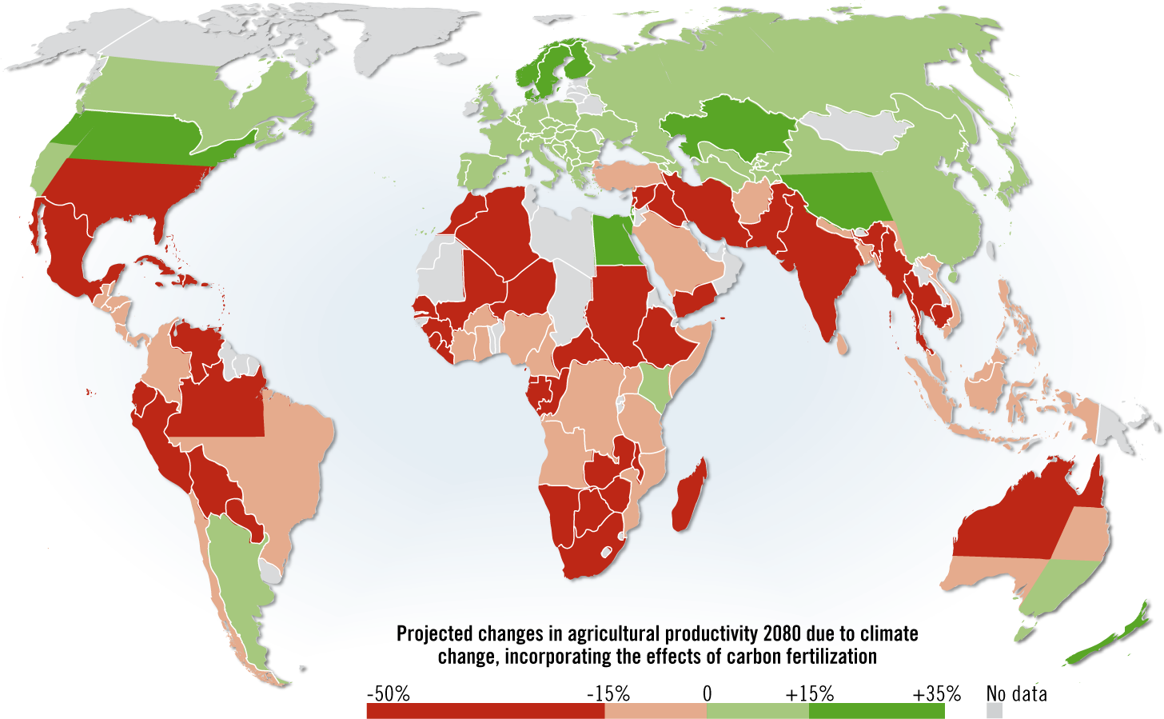
Projected impact of climate change on agricultural yields
Agricultural production will decrease by 2% each decade (IPCC AR5 WGII, 2014).
+ carbon fertilization
- evapotranspiration
Map by Hugo Ahlenius,
GRID-Arendal (2008).
Source: Cline W. (2007, 2008). Global Warming and Agriculture.
Notes:
Map: Hugo Ahlenius (2008). Projected agriculture in 2080 due to climate change. UNEP/GRID-Arendal. http://www.grida.no/graphicslib/detail/projected-agriculture-in-2080-due-to-climate-change_15f0
“Using this graphic and referring to it is encouraged, and please use it in presentations, web pages, newspapers, blogs and reports. For any form of publication, please include the link to this page and give the cartographer/designer credit (in this case Hugo Ahlenius, UNEP/GRID-Arendal)”.
Source: Cline, W. R. 2007. Global Warming and Agriculture: Impact Estimates by Country. Washington D.C., USA: Peterson Institute.
Africa: Kenya and Egypt are green – TODO: find out why. Kenya might get wetter, 18 out of 21 GCM models predict more rain Kenya.
--
William R. Cline (2007). Global Warming and Agriculture: Impacts estimated by country. Washington: Center for Global Development and
Peterson Institute for International Economics. ISBN 978-0-88132-403-7. http://bookstore.piie.com/book-store/4037.html, http://www.google.se/books?id=CwIQ-9YdjzQC
William R. Cline (2008). Global Warming and Agriculture. Finance and Development March 2008. https://www.imf.org/external/pubs/ft/fandd/2008/03/pdf/cline.pdf
MAP: Projected impact of climate change on agricultural yields (Cline, 2007): http://en.wikipedia.org/wiki/Climate_change_and_gender#mediaviewer/File:Projected_impact_of_climate_change_on_agricultural_yields_by_the_2080s,_compared_to_2003_levels_%28Cline,_2007%29.png
http://en.wikipedia.org/wiki/Climate_change_and_agriculture, http://en.wikipedia.org/wiki/Food_security
David B. Lobell, Marshall B. Burke, Claudia Tebaldi, Michael D. Mastrandrea, Walter P. Falcon, and Rosamond L. Naylor (2008). Prioritizing Climate Change Adaptation Needs for Food Security in 2030. Science 1 February 2008: 319 (5863), 607-610. [DOI:10.1126/science.1152339]
Anthony D Barnosky, James H Brown, Gretchen C Daily, Rodolfo Dirzo, Anne H Ehrlich, Paul R Ehrlich, Jussi T Eronen, Mikael Fortelius, Elizabeth A Hadly, Estella B Leopold, Harold A Mooney, John Peterson Myers, Rosamond L Naylor, Stephen Palumbi, Nils Chr Stenseth, and Marvalee H Wake (2014). Introducing the Scientific Consensus on Maintaining Humanity’s Life Support Systems in the 21st Century: Information for Policy Makers The Anthropocene Review April 2014 1: 78-109, doi:10.1177/2053019613516290
Intergovernmental Panel on Climate Change (IPCC) (2014). The Fifth Assessment Report (AR5). WG II: Impacts, Adaptation and Vulnerability – 31 March 2014.
http://www.ipcc.ch/report/ar5/index.shtml
IPCC AR5 (2014). Chapter 7. Food Security and Food production systems, http://ipcc-wg2.gov/AR5/images/uploads/WGIIAR5-Chap7_FGDall.pdf
“With low to medium confidence, they concluded that for about a 1 to 3 °C global mean temperature increase (by 2100, relative to the 1990–2000 average level) there would be productivity decreases for some cereals in low latitudes, and productivity increases in high latitudes”.
Cline (2008), https://www.imf.org/external/pubs/ft/fandd/2008/03/pdf/cline.pdf
“How climate affects agriculture: Climate change can affect agriculture in a variety of ways. Beyond a certain range of temperatures, warming tends to reduce yields because crops speed through their development, producing less grain in the process. And higher temperatures also interfere with the ability of plants to get and use moisture. Evaporation from the soil accelerates when temperatures rise and plants increase transpiration—that is, lose more moisture from their leaves. The combined effect is called “evapotranspiration.” Because global warming is likely to increase rainfall, the net impact of higher temperatures on water availability is a race between higher evapotranspiration and higher precipitation. Typically, that race is won by higher evapotranspiration. But a key culprit in climate change—carbon emissions—can also help agriculture by enhancing photosynthesis in many important, so-called C3, crops (such as wheat, rice, and soybeans). The science, however, is far from certain on the benefits of carbon fertilization. But we do know that this phenomenon does not much help C4 crops (such as sugar-cane and maize), which account for about one-fourth of all crops by value”. page 24.

Slide 5
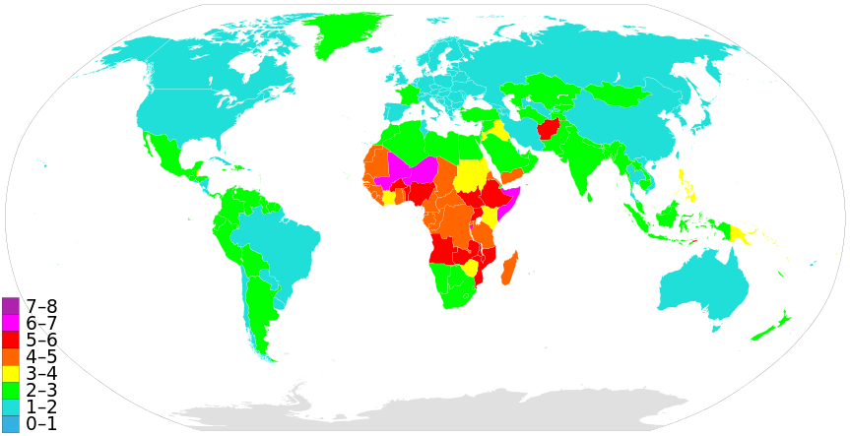

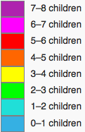
Population growth (total fertility rate)
Low population growth
Increased food production
(Cline 2007)
High population growth
Decreased food production
(Cline 2007)
CC-BY-SA Supaman89, Wiki Commons. Data from CIA World Fact Book (2014).
Notes:
CIA World Fact Book, Total fertility rate (TFR) compares figures for the average number of children that would be born per woman if all women lived to the end of their childbearing years and bore children according to a given fertility rate at each age. TFR is a more direct measure of the level of fertility than the crude birth rate, since it refers to births per woman.,
https://www.cia.gov/library/publications/the-world-factbook/rankorder/2127rank.html
https://www.cia.gov/library/publications/the-world-factbook/rankorder/rawdata_2127.txt
Map: http://en.wikipedia.org/wiki/World_population#mediaviewer/File:Countriesbyfertilityrate.svg, CC-BY-SA Supaman89, WikiCommons
Cline (2008), https://www.imf.org/external/pubs/ft/fandd/2008/03/pdf/cline.pdf

Slide 6
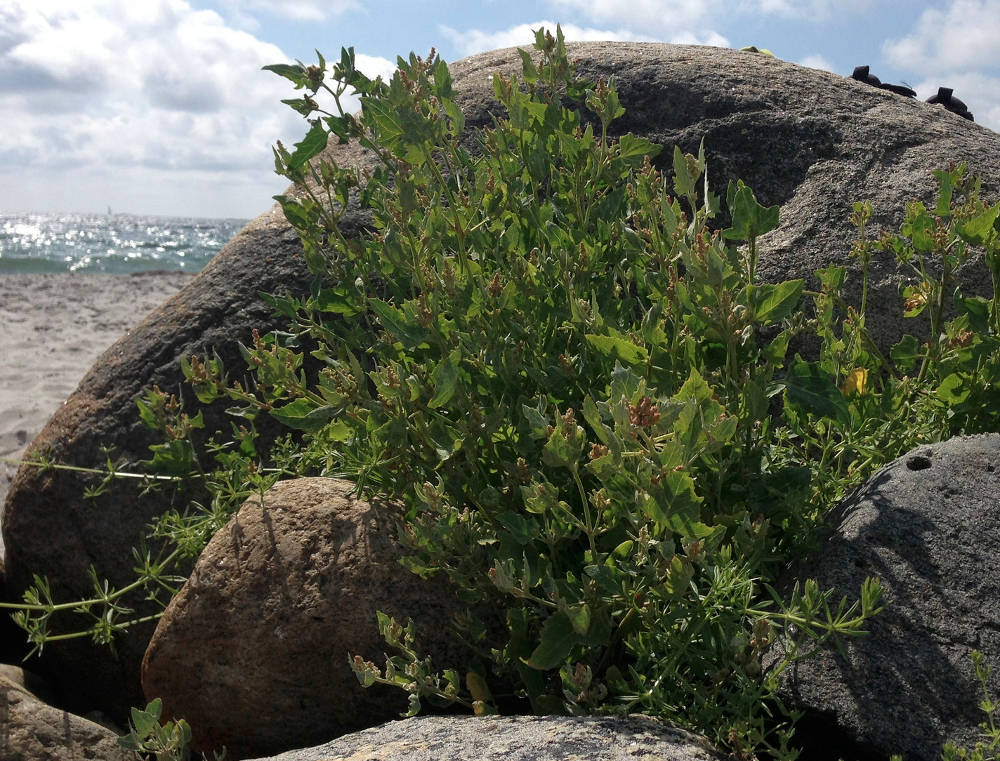
WE NEED CROPS:
with higher yields
with higher nutritional value
adapted to degraded lands
adapted to changing environments
Untapped genetic diversity can be found in:
Traditional cultivars, landraces
and Crop Wild Relatives!
Sea cale (Crambe maritima L.) at Spornes, Tromøy, Norway, July 2013, CC-by Dag Endresen.
Notes:
Illustration, Sea cale (Crambe maritima L.) at Spornes, Tromøy, Norway, July 2013. CC-by Dag Endresen, https://www.flickr.com/photos/dag_endresen/15300422265/
Nigel Maxted and Shelagh Kell (2009). Establishment of a Global Network for the In Situ Conservation of Crop Wild Relatives: Status and Needs. FAO, Rome.
http://www.fao.org/docrep/013/i1500e/i1500e18a.pdf
http://www.the-scientist.com/?articles.view/articleNo/40026/title/Wild-Relatives/

Slide 7
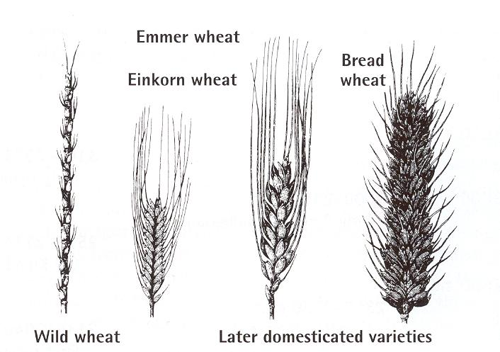
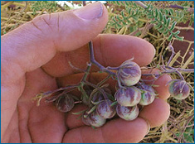
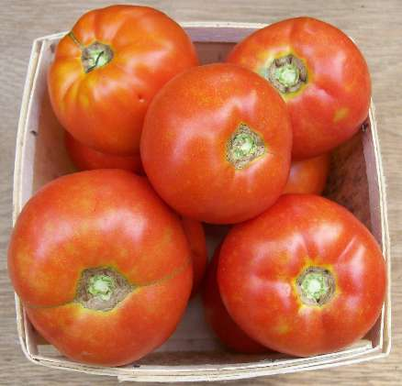
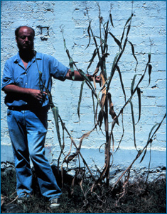
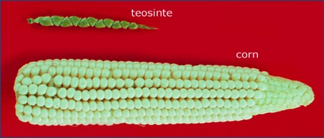
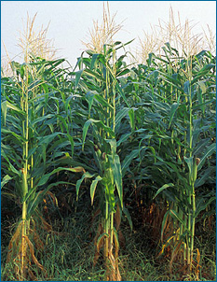
Domestication and cultivated plants:
Utilizing genetic potential from the wild
wild tomato
cultivated tomato
wild teosinte
cultivation
cultivated
corn, maize
Notes:
Genetic resources from the wild relatives of the cultivated plants contributes the raw material required for domesticated forms and the further development of these food crops. Genebanks preserve and provides plant genetic resources for utilization by plant breeders and other bona fide use.

Slide 8
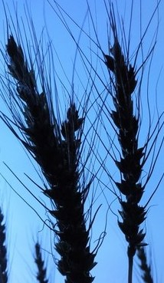
Traditional cultivars, landraces
“Landraces have a certain genetic integrity. They are recognizable morphologically; farmers have names for them and different landraces are understood to differ in adaptation to soil type, time of seeding, date of maturity, height, nutritive value, use and other properties. Most important, they are genetically diverse” (Harlan 1975).
"A landrace is a dynamic population(s) of a cultivated plant that has a historical origin, distinct identity and lacks formal crop improvement, as well as often being genetically diverse, locally adapted and associated with traditional farming systems" (Villa et al. 2005).
Notes:
Illustration: Hare barley (Hordeum murinum ssp. leporinum) Sesimbra, Portugal April 2016 CC-BY Dag Endresen, http://www.inaturalist.org/observations/3027829 http://www.gbif.org/occurrence/1306574202
Illustration: Cultivated barley (Hordeum vulgare) June 2007, Gatersleben Germany CC-BY Dag Endresen, http://www.inaturalist.org/observations/63715
Definition of Crop Wild Relative species (CWR)
"those wild plant taxa more or less closely related to species of direct socio-economic importance including food, fodder and forage crops, medicinal plants, condiments, ornamental and forestry species, as well as those related to crops used for industrial purposes such as oils and fibres" (Maxted et al. 2006). Crop wild relatives are used as a source of genes for plant improvement.
Definition of Landrace
“Landraces have a certain genetic integrity. They are recognizable morphologically; farmers have names for them and different landraces are understood to differ in adaptation to soil type, time of seeding, date of maturity, height, nutritive value, use and other properties. Most important, they are genetically diverse” (Harlan 1975).
Harlan, J.R. (1975) Our vanishing genetic resources. Science 188: 618–621. DOI: 10.1126/science.188.4188.617
"A landrace is a dynamic population(s) of a cultivated plant that has a historical origin, distinct identity and lacks formal crop improvement, as well as often being genetically diverse, locally adapted and associated with traditional farming systems" (Villa et al. 2005).
Villa TCC, Maxted N, Scholten M, and Ford-Lloyd B (2005). Defining and identifying crop landraces. Plant Genetic Resources: Characterization and Utilization 3(3): 373-
384. doi:10.1079/PGR200591

Slide 9
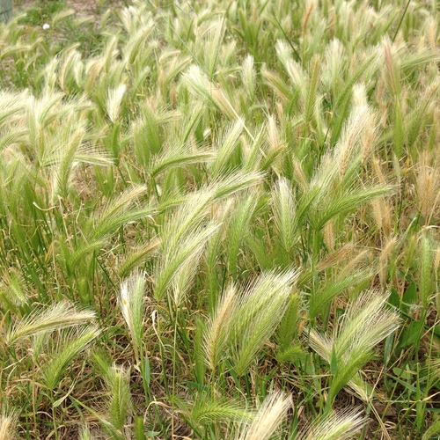
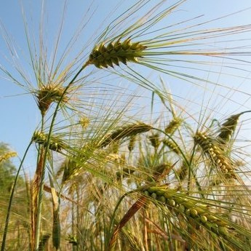
What are crop wild relatives?
Hare barley (Hordeum murinum ssp. leporinum) Sesimbra, Portugal April 2016 CC-BY Dag Endresen
Crop wild relatives (CWR) are wild plant species closely related to crops.
They have an indirect use as gene donors for crop improvement due to their relatively close genetic relationship to crops.
They are an important socio-economic resource that offer novel genetic diversity required to maintain future food security.
Broad definition (Maxted et al. 2006)
CWR = all taxa within the same genus as a crop
Cultivated barley (Hordeum vulgare L.) June 2007, Gatersleben Germany CC-BY Dag Endresen
Notes:
Illustration: Hare barley (Hordeum murinum ssp. leporinum) Sesimbra, Portugal April 2016 CC-BY Dag Endresen, http://www.inaturalist.org/observations/3027829 http://www.gbif.org/occurrence/1306574202
Illustration: Cultivated barley (Hordeum vulgare) June 2007, Gatersleben Germany CC-BY Dag Endresen, http://www.inaturalist.org/observations/63715
--
Definition of Crop Wild Relative species (CWR)
"those wild plant taxa more or less closely related to species of direct socio-economic importance including food, fodder and forage crops, medicinal plants, condiments, ornamental and forestry species, as well as those related to crops used for industrial purposes such as oils and fibres" (Maxted et al. 2006). Crop wild relatives are used as a source of genes for plant improvement.
Maxted N, Ford-Lloyd BV, Jury SL, Kell SP, and Scholten MA (2006). Towards a definition of a crop wild relative. Biodiversity and Conservation 15: 2673–2685. doi:10.1007/s10531-005- 5409-6

Slide 10
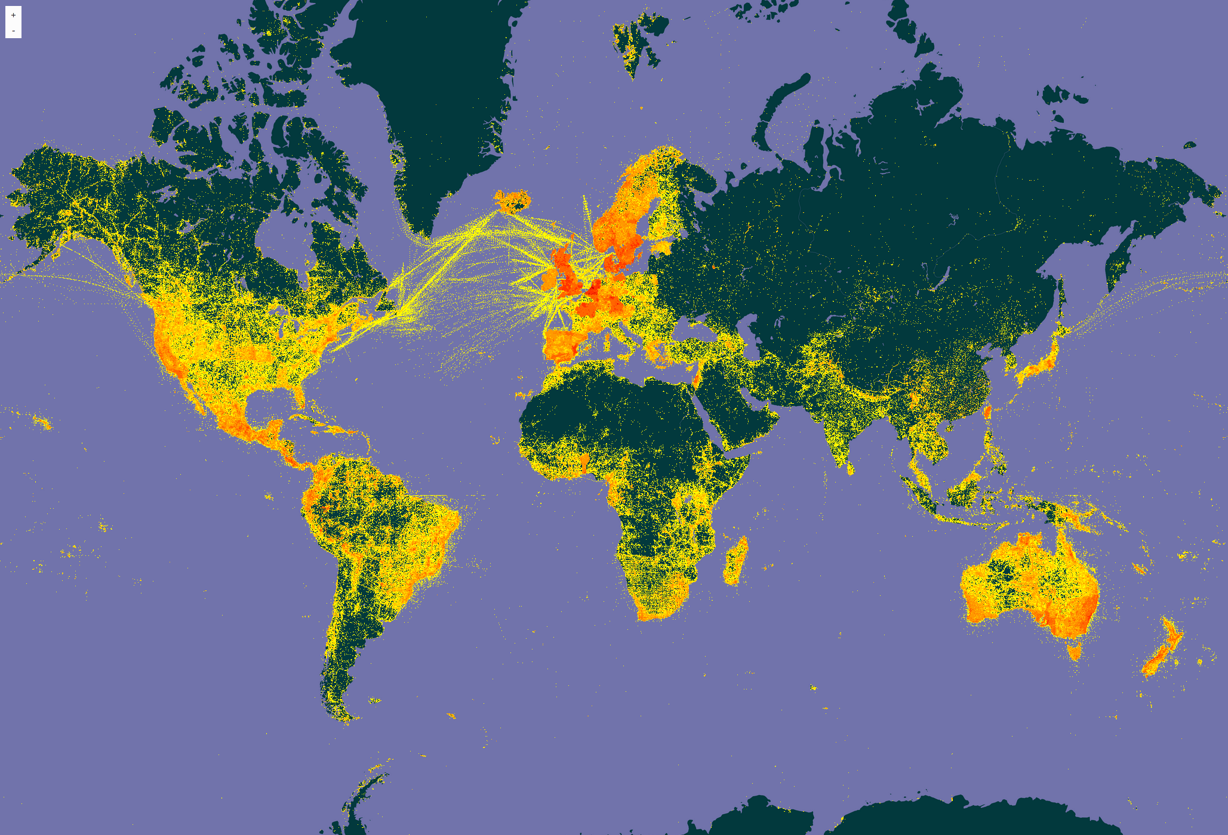

Crop Wild Relatives account for around 21% of the world’s flora (Maxted and Kell 2009)
Density of georeferenced plant species occurrence records published through GBIF (see http://www.gbif.org/species/6)
Last updated: 2017-06-08
Notes:
Illustration, GBIF Portal, filter for Plants, http://www.gbif.org/species/6, updated 2017-06-08
Nigel Maxted and Shelagh Kell (2009). Establishment of a Global Network for the In Situ Conservation of Crop Wild Relatives: Status and Needs. FAO, Rome.
http://www.fao.org/docrep/013/i1500e/i1500e18a.pdf
CWR account for around 21% of the world’s flora (Maxted and Kell 2009)
Their natural populations are becoming more threatened - 2 out of 10! (Kell et al. 2012)
Ramírez-Villegas J, Khoury C, Jarvis A, Debouck DG, Guarino L (2010) A Gap Analysis Methodology for Collecting Crop Genepools: A Case Study with Phaseolus Beans. PLoS ONE 5(10): e13497. doi:10.1371/journal.pone.0013497

Slide 11
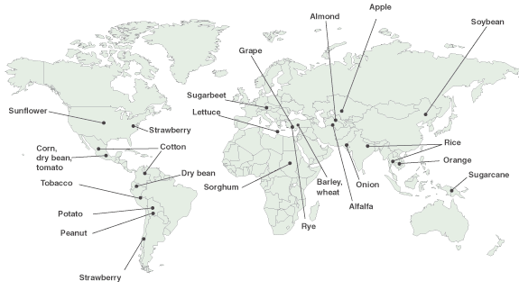
Centers of origin for selected crops
can provide places to search for traditional cultivars & CWRs
Map public domain by the United States Department of Agriculture (USDA).
http://commons.wikimedia.org/wiki/File:Feature2originmap600.png
Notes:
Centers of origin of selected crops. Note: The pointer locations indicate general regions where crops are believed to have first been domesticated. In some cases, the center of origin is uncertain. Other geographic regions also harbor important genetic diversity for these crops. Source: This map was developed by the General Accounting Office using data provided by the National Plant Germplasm System´s Exchange Office.
Map Public Domain: http://commons.wikimedia.org/wiki/File:Feature2originmap600.png
http://www.digitalhistory.uh.edu/active_learning/explorations/columbus/columbian_answers_plants.cfm

Slide 12
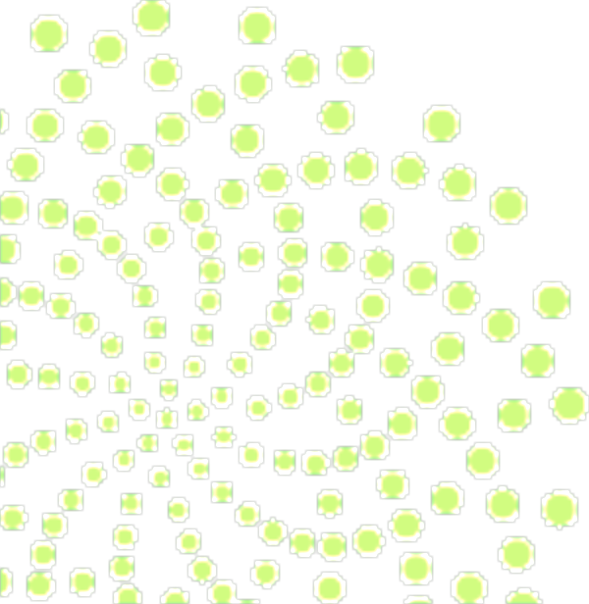
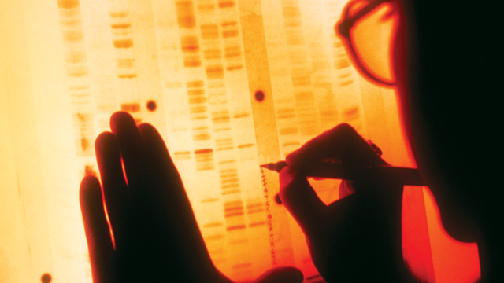
Predictive characterization
Focused Identification of Germplasm Strategy

Slide 13
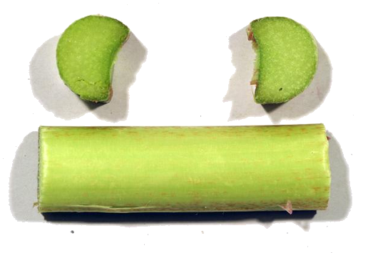
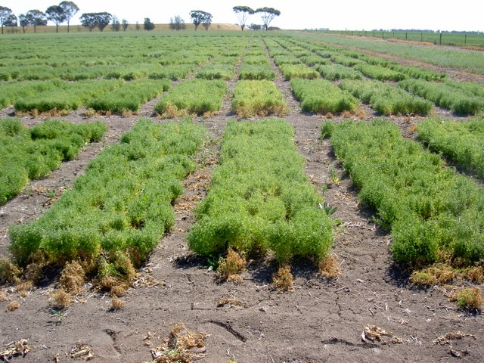
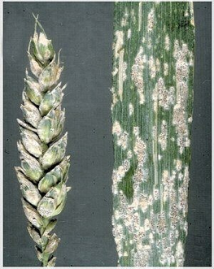
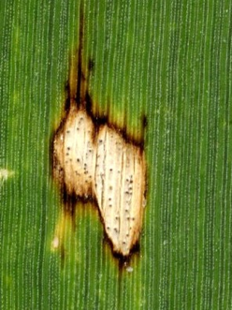
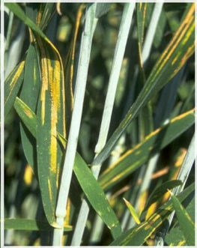
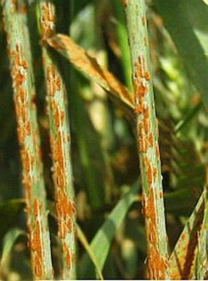
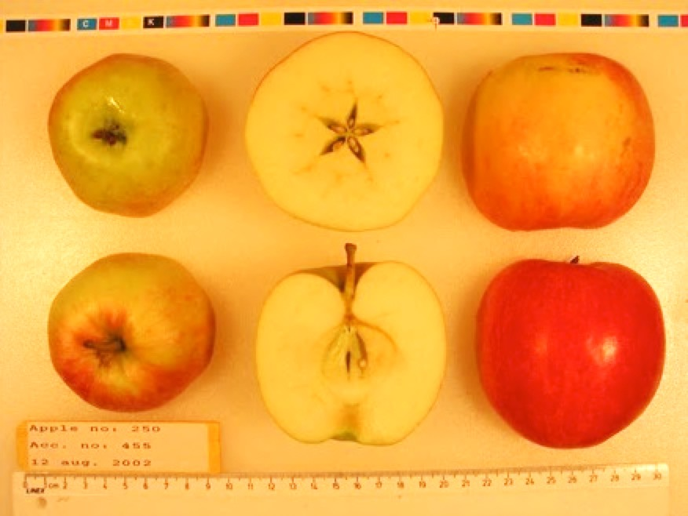
Crop breeding targets specific agricultural traits
Field trials in Horsham Australia for cold tolerance in chickpea (Cicer arietinum L.). CC-by D. Endresen
Rhubarb, Rheum x hybridum Murray, DKRHE43, by Gitte K. Bjørn
Powdery Mildew,
Blumeria graminis
Leaf spots
Ascochyta sp.
Yellow rust
Puccinia strilformis
Black stem rust
Puccinia graminis
Apple, Malus domestica Borkh.
Cultivar “Nanna” by Stein H Hjeltnes
Notes:
Fungus plant diseases, http://www.hgca.com/hgca/wde/diseases/
Apple, Malus domestica “Nanna” from Njøs in Norway by Stein Harald Hjeltnes, http://sesto.nordgen.org/sesto/index.php?scp=ngb&thm=pictures&mod=det&id=004019&img_size=768x512
Rhubarb, Rheum x hybridum Murray, DKRHE43, by Gitte K. Bjørn, http://sesto.nordgen.org/sesto/index.php?scp=ngb&thm=sesto&lev=acc&accide=28981&lst=img
Chickpea at Horsham in Australia, CC-by D Endresen, https://plus.google.com/photos/+DagEndresen/albums/5323049422958990705/5365279366656917090?banner=pwa&pid=5365279366656917090&oid=115547050550954466285

Slide 14
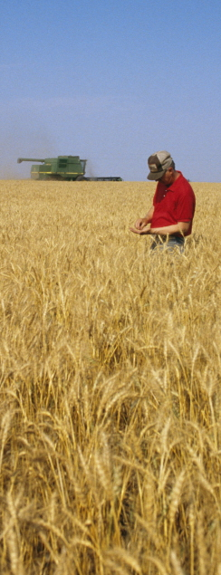
A needle in a hay stack
Scientists and plant breeders want a few hundred germplasm accessions to evaluate for a particular trait.
How does the scientist select a small subset likely to have the useful trait?
Photo from the USDA Photo archive, CC0.
Notes:
Photo from the USDA Photo archive. Slide text by Ken Street, ICARDA FIGS team (2009).

Slide 15
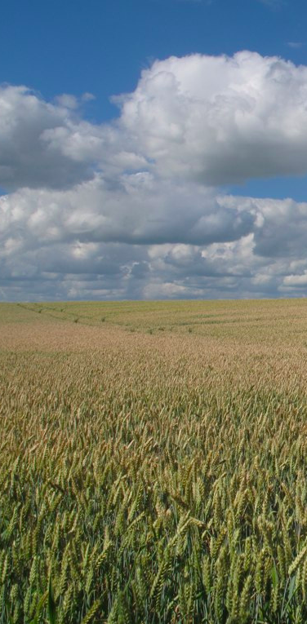
Aim:
  Identification of plant germplasm with a higher likelihood of having desired genetic diversity for a target trait property.
  Suggested solution:
  Using environment data layers for predictive characterization of crop traits a priori BEFORE field trials.
Bread wheat at Nöbbelöv in Lund, 2010
CC-BY Dag Endresen
Notes:
Photo: Bread wheat (Triticum aestivum L.) at Nöbbelöv in Lund July 2010 by Dag Endresen. URL: http://www.flickr.com/photos/dag_endresen/4826565058/

Slide 16



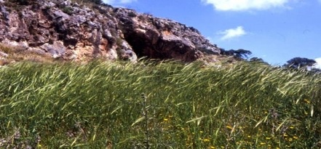
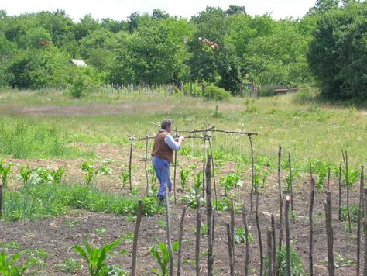
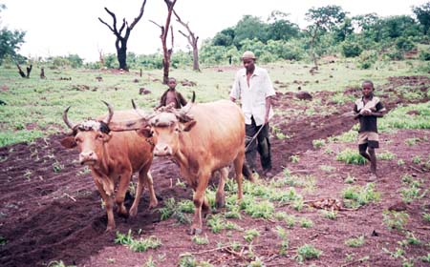

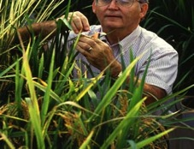

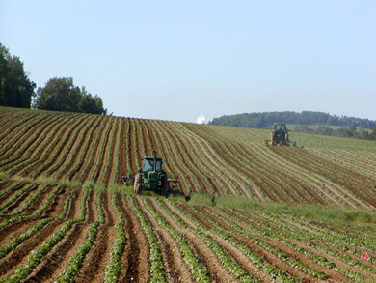
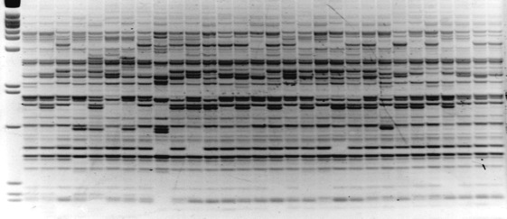
Climate effect during the domestication process
Wild relatives are shaped
by the environment.
Primitive cultivated crops are shaped by local climate and humans.
Traditional cultivated crops (landraces) are shaped by climate and humans.
Modern cultivated crops are mostly shaped by humans (plant breeders).
Perhaps future crops are shaped in the molecular laboratory…?
Notes:
Modern agriculture uses advanced plant varieties based on the most productive genetics. The original land races and wild forms produce lower yields, but their greater genetic variation contains a higher diversity in e.g. resistance to disease. High-yielding modern crops are therefore vulnerable when a new disease arises.

Slide 17
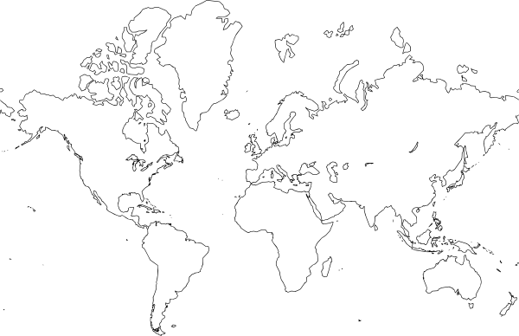








Predictive link between eco-geography and traits
During traditional cultivation the farmer will select for and introduce germplasm for improved suitability of the landrace to the local conditions.
Notes:
Illustration traditional cattle farming: http://commons.wikimedia.org/wiki/File:Traditional_farming_Guinea.jpg (USAID, Public Domain)

Slide 18
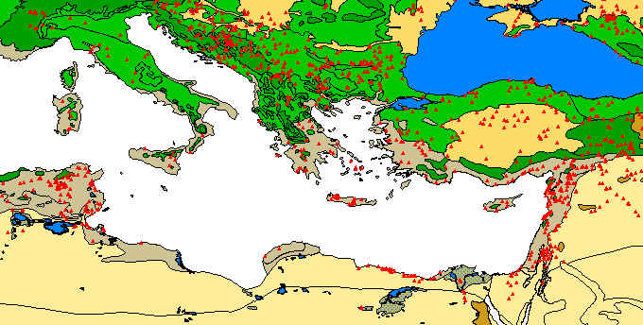
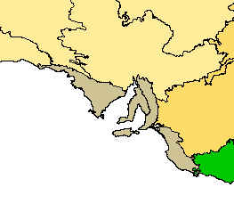
Focused Identification of Germplasm Strategy
Mediterranean Sea
South Australia
Origin of Concept:
Boron toxicity in marine sediments for wheat and barley genetic resources - example of late 1980s.
Michael Mackay (1986, 1990, 1995)
Notes:
This slide was originally made by Michael Mackay around 1995.
We can then use these layers of information as sieves, through which we can filter our accessions to identify those most likely to contain the genetic variation we are seeking.
We can “tune in” the environments from which we want to sample germplasm.
For example, we can specify annual precipitation, temperature during heading, humidity at another growth stage - and so on.
Then we tip our collection of accessions in the top of the FIGS machine and wait for those that filter out the bottom. These ones we evaluate thoroughly.
References:
* Mackay, M.C. (1986). Utilizing wheat genetic resources in Australia. p. 56-61. In: McLean, R. (ed). Proceedings of the 5th assembly wheat breeders' society in Australia, Merredin 18-22 Aug 1986. Western Australian Department of Agriculture, Perth, Australia. 580 p. ISBN: 9780730913269.
* Mackay, M.C. (1990). Strategic planning for effective evaluation of plant germplasm. p. 21–25. In: J.P. Srivastava and A.B. Damania (eds). Wheat genetic resources: Meeting diverse needs. John Wiley & Sons, Chichester, UK. ISBN 0-471-92880-1
* Mackay, M.C. (1995). One core collection or many? p. 199-210. In: T. Hodgkin, A.H.D. Brown, Th.J.L. van Hintum and A.A.V. Morales (eds). Core collections of plant genetic resources. Proceedings from the IBPGR/CGN/CENARGEN workshop on 'Core Collections: Improving the Management and Use of Plant Germplasm Collections', held in Brasilia August 1992. John Wiley & Sons, Chichester, UK. 269 p. ISBN: 978-0-471-95545-0.
* Mackay, M.C. (2011). Surfing the genepool, the effective and efficient use of plant genetic resources. PhD thesis. Department of Plant Breeding and Biotechnology, Faculty of landscape planning, horticulture and agricultural science, Swedish University of Agricultural Sciences (SLU), Alnarp. ISBN: 978-91-576-7634-4. Available at http://pub.epsilon.slu.se/8439/, verified 9 Dec 2011.

Slide 19
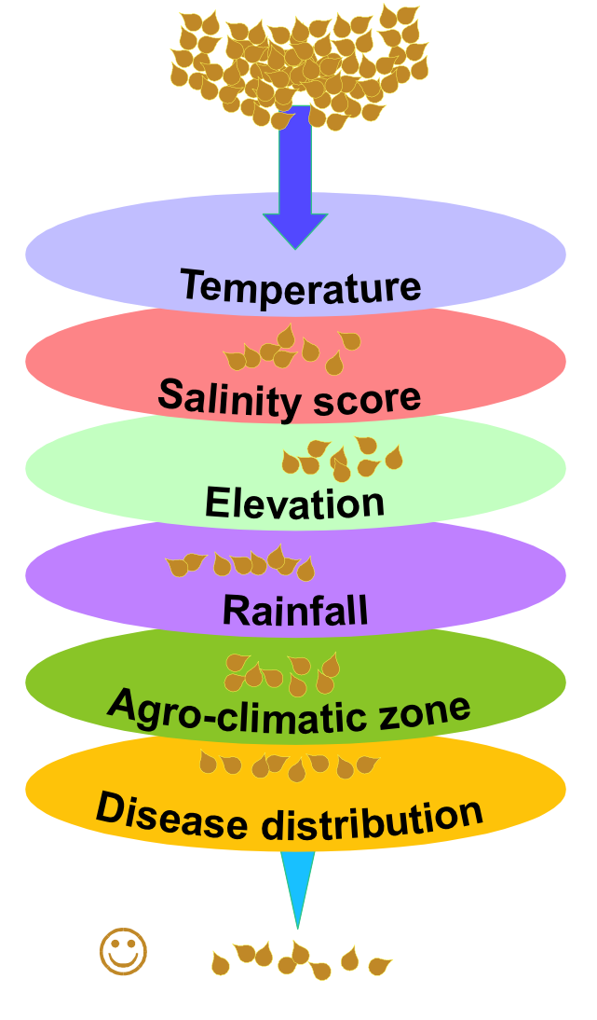
Focused Identification of Germplasm strategy
Identify new and useful genetic diversity for crop improvement.
  Heuristic experience and expert knowledge for finding upper and lower limits for environmental variables (1).
  Predictive eco-geographic data modelling analysis (2).
http://www.figstraitmine.org/
http://figs.icarda.org/ConsultationWiki/
Notes:
“We can then use these layers of information as sieves, through which we can filter our accessions to identify those most likely to contain the genetic variation we are seeking. We can “tune in” the environments from which we want to sample germplasm. For example, we can specify annual precipitation, temperature during heading, humidity at another growth stage - and so on. Then we tip our collection of accessions in the top of the FIGS machine and wait for those that filter out the bottom. These ones we evaluate thoroughly” (Michael Mackay, 1995).
References: * Mackay, M.C. (1986). Utilizing wheat genetic resources in Australia. p. 56-61. In: McLean, R. (ed.). Proceedings of the 5th assembly wheat breeders' society in Australia, Merredin 18-22 Aug 1986. Western Australian Department of Agriculture, Perth, Australia. 580 p. ISBN: 9780730913269. * Mackay, M.C. (1990). Strategic planning for effective evaluation of plant germplasm. p. 21–25. In: J.P. Srivastava and A.B. Damania (eds). Wheat genetic resources: Meeting diverse needs. John Wiley & Sons, Chichester, UK. ISBN 0-471-92880-1. * Mackay, M.C. (1995). One core collection or many? p. 199-210. In: T. Hodgkin, A.H.D. Brown, Th.J.L. van Hintum and A.A.V. Morales (eds). Core collections of plant genetic resources. Proceedings from the IBPGR/CGN/CENARGEN workshop on 'Core Collections: Improving the Management and Use of Plant Germplasm Collections', held in Brasilia August 1992. John Wiley & Sons, Chichester, UK. 269 p. ISBN: 978-0-471-95545-0. * Mackay, M.C. (2011). Surfing the genepool, the effective and efficient use of plant genetic resources. PhD thesis. Department of Plant Breeding and Biotechnology, Faculty of landscape planning, horticulture and agricultural science, Swedish University of Agricultural Sciences (SLU), Alnarp. ISBN: 978-91-576-7634-4. Available at http://pub.epsilon.slu.se/8439/, verified 9 Dec 2011.
Wikipedia: Heuristic ( /hjʉˈrɪstɨk/; or heuristics; Greek: "Εὑρίσκω", "find" or "discover") refers to experience-based techniques for problem solving, learning, and discovery. Where an exhaustive search is impractical, heuristic methods are used to speed up the process of finding a satisfactory solution. Examples of this method include using a "rule of thumb", an educated guess, an intuitive judgment, or common sense. In more precise terms, heuristics are strategies using readily accessible, though loosely applicable, information to control problem solving in human beings and machines.

Slide 20
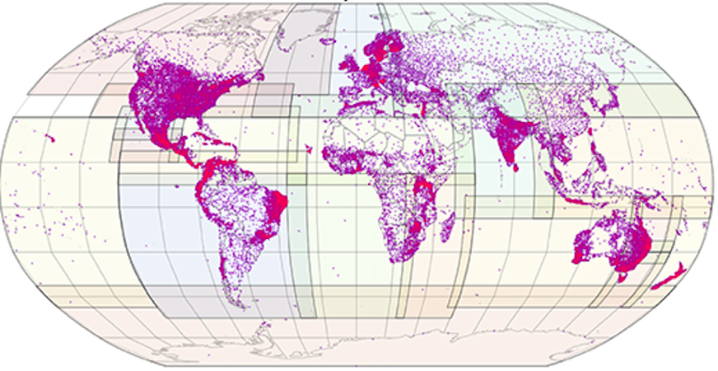
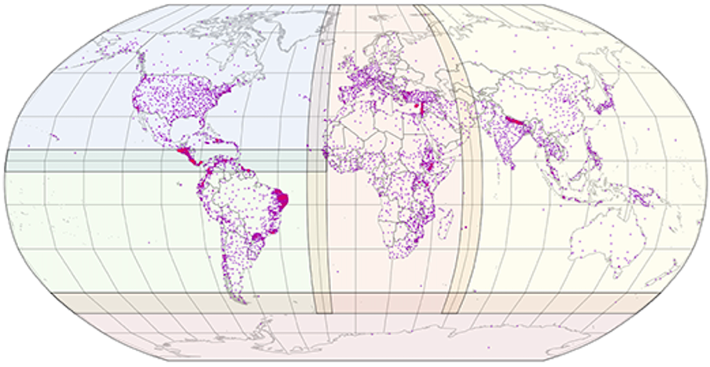
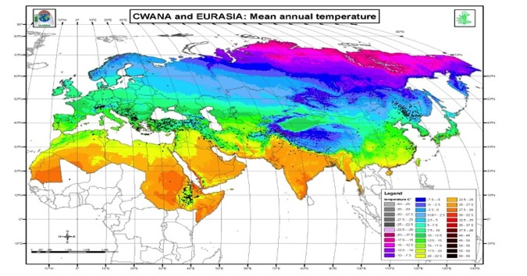
Climate data – WorldClim (v2 2016)
The climate data available from the WorldClim dataset (1 km² resolution)
http://www.worldclim.org/
(Hijmans et al. 2005 [v1];
Fick and Hijmans 2017 [v2])
Data from weather stations worldwide combined to a continuous surface layer.
Climate data for each landrace extracted from this surface layer.
Precipitation: 60 419 weather stations
Solar radiation: 9 118 weather stations
Notes:
Hijmans, R.J., S.E. Cameron, J.L. Parra, P.G. Jones and A. Jarvis (2005). Very high resolution interpolated climate surfaces for global land areas. International Journal of Climatology 25: 1965-1978. DOI: 10.1002/joc.1276
Total 20 590 weather stations with data for precipitation, and 7 280 with data for temperatures.
--
Fick, S.E. and R.J. Hijmans (2017). Worldclim 2: New 1-km spatial resolution climate surfaces for global land areas. International Journal of Climatology. DOI: 10.1002/joc.5086
New updated version issued 1st June 2016: http://worldclim.org/version2
Very high spatial resolution (approximately 1 km2), monthly temperature (minimum, maximum and average), precipitation, solar radiation, vapour pressure and wind speed, aggregated across a target temporal range of 1970–2000, using data from between 9000 and 60 000 weather stations.

Slide 21
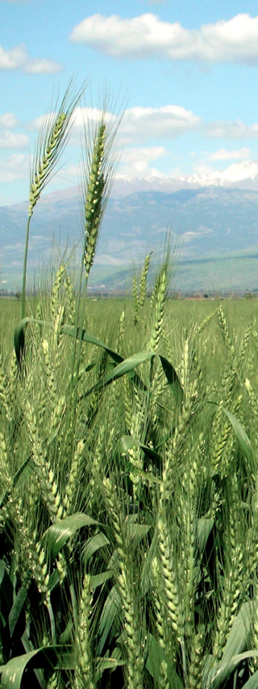
Limitations of FIGS
Landraces and wild relatives
  The link between climate data and the trait data (local adaptation) is required for trait mining with FIGS. Modern cultivars are not expected to show this predictive link.
Georeferenced accessions
  Trait mining with FIGS is based on multivariate models using climate data from the source location of the germplasm. To extract climate data the accessions need to be accurately georeferenced.
Wheat in the Hulah valley (Israel), 2007 by Aviad Bublil
Notes:
Photo: Wheat in the Hulah valley (Israel), 2007 by Aviad Bublil. License: Public Domain. http://commons.wikimedia.org/wiki/File:Wheat-haHula-ISRAEL2.JPG

Slide 22
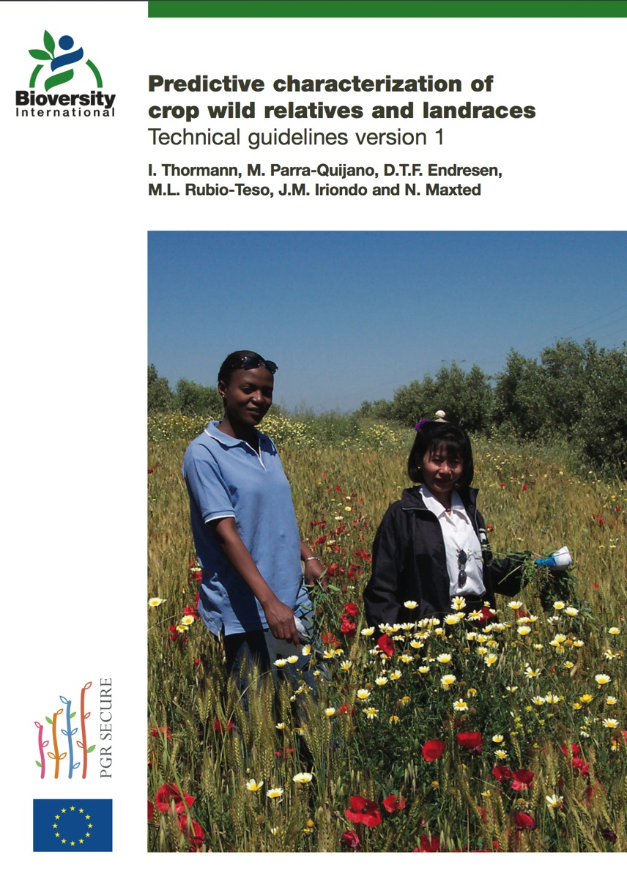
Guidelines for conducting predictive characterization.
Documented R-scripts and step-wise instructions.
Thormann I, Parra-Quijano M, Endresen DTF, Rubio-Teso ML, Iriondo JM & Maxted N (2014). Predictive characterization of crop wild relatives and landraces: Technical guidelines version 1.Bioversity International, Rome, Italy. 44 pp. ISBN: ISBN 978-92-9255-004-2.
Notes:
Guidelines for conducting predictive characterization. Documented R-scripts and easy to follow instructions.
--
Thormann I, Parra-Quijano M, Endresen DTF, Rubio-Teso ML, Iriondo JM & Maxted N (2014). Predictive characterization of crop wild relatives and landraces: Technical guidelines version 1.Bioversity International, Rome, Italy. 44 pp. ISBN: ISBN 978-92-9255-004-2.

Slide 23

Steps to follow:
Data collection and preparation
Geo-referencing of collecting locations
Pre-processing of dataset
Choose modeling method
Calibration of model
Validation of model
Application of predictive model
(Validation of prediction results)
Thormann I, Parra-Quijano M, Endresen DTF, Rubio-Teso ML, Iriondo JM, and Maxted N (2014). Predictive characterization of crop wild relatives and landraces: Technical guidelines. Bioversity International, Rome, Italy.
Notes:
Thormann I, Parra-Quijano M, Endresen DTF, Rubio-Teso ML, Iriondo JM, and Maxted N (2014). Predictive characterization of crop wild relatives and landraces: Technical guidelines. Bioversity International, Rome, Italy.

Slide 24
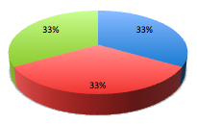

Data for the Trait Mining model
Training set
  For the initial calibration / training.
Calibration set
  For calibration and tuning.
  Often cross-validation on the training set is used to reduce the consumption of raw data.
Test set
  For the model validation / testing.
  Data not used in the model calibration.
  The best would of course be an independent test set!
Notes:
We often divide the data for a simulation model project in three equal parts: one set for initial model calibration or training, one set for further calibration or fine tuning; and one test set for validation on the model.

Slide 25
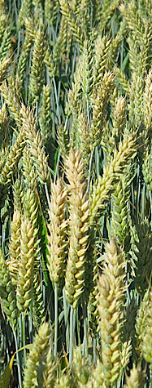
Choosing modeling method
“There is no silver bullet” (Qiao, Soberon and Peterson, 2015)
Choosing the appropriate data modeling method depend on the types of data quality issues you discover in your respective data set.
  Some modeling methods are more sensitive to some types of data quality issues and less sensitive to other issues.
  Different modeling methods or algorithms handle different types of data quality issues differently.
It is a bad strategy to simply choose the same method that performed well in your previous studies.
"Ensembles" can combine the qualities of multiple algorithms.
Notes:
Photo: Wheat field at Nöbbelöv, Lund Sweden July 2010, by Dag Endresen.
Qiao, H., Soberón, J. and Peterson, A. T. (2015), No silver bullets in correlative ecological niche modelling: insights from testing among many potential algorithms for niche estimation. Methods Ecol Evol, 6: 1126–1136. doi:10.1111/2041-210X.12397

Slide 26
Some data modeling methods
Parallel Factor Analysis (PARAFAC) (Multi-way)
Multi-linear Partial Least Squares (N-PLS) (Multi-way)
Soft Independent Modeling of Class Analogy (SIMCA)
k-Nearest Neighbor (kNN)
Partial Least Squares Discriminant Analysis (PLS-DA)
Linear Discriminant Analysis (LDA)
Principal component logistic regression (PCLR)
Generalized Partial Least Squares (GPLS)
Random Forests (RF)
Neural Networks (NN)
Support Vector Machines (SVM)
Boosted Regression Trees (BRT)
Multivariate Regression Trees (MRT)
Bayesian Regression Trees
Modeling methods used by Endresen (2010), Endresen et al. (2011, 2012), and Bari et al. (2012, 2016).
Notes:
Photo: Wheat field at Nöbbelöv in Lund, Sweden, July 2010, by Dag Endresen.

Slide 27
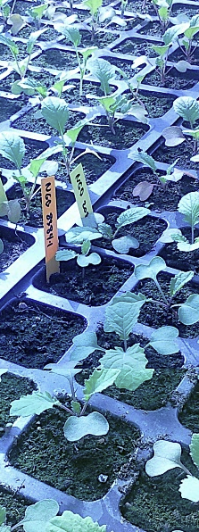
Validation of model results
Pearson product-moment correlation (R)
Coefficient of determination (R²)
Cohen’s Kappa (K)
Proportion observed agreement (PO)
Proportion positive agreement (PA)
Positive predictive value (PPV)
Positive diagnostic likelihood ratio (LR+)
Sensitivity and specificity
Area under the curve (AUC)
  Receiver operating characteristics (ROC)
Root mean square error (RMSE)
  RMSE of calibration (RMSEC)
  RMSE of cross-validation (RMSECV)
  RMSE of prediction (RMSEP)
Predicted residual sum of squares (PRESS)
Notes:
Photo CC-by Dag Endresen

Slide 28
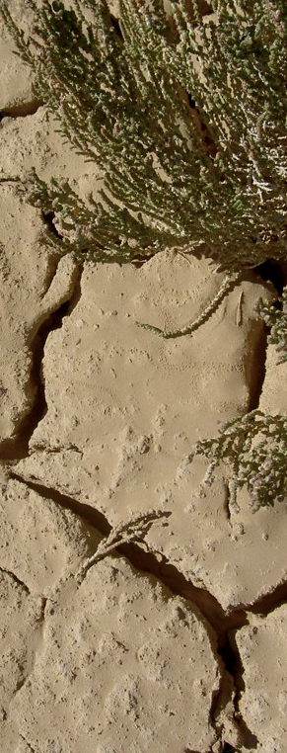
Prediction performance
Model performance indicators that work better for unbalanced class / skew prevalence – which is common for evaluation data.
Positive predictive value (PPV)
    PPV = True positives / (True positives + False positives)
    Classification performance for the identification of resistant samples (for the positives only)
Positive diagnostic likelihood ratio (LR+)
    LR+ = sensitivity / (1 – specificity)
    Less sensitive to prevalence than PPV
Notes:
Photo: South of Tunisia, by Dag Endresen, http://www.flickr.com/photos/dag_endresen/4221301525/

Slide 29
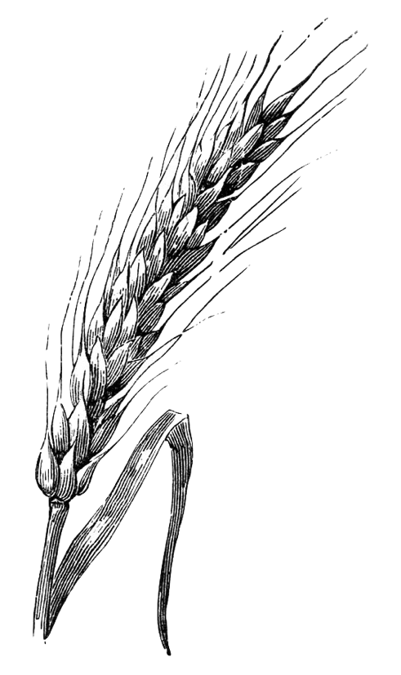
Examples of FIGS studies

Slide 30
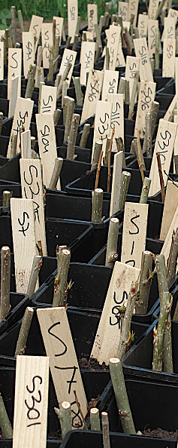
Example of studies:
Heuristic approach:
  Sunn pest on wheat (Bouhssini et al. 2009)
  Powdery mildew, Pm3 (Bhullar et al. 2009)
  Russian wheat aphid (Bouhssini et al. 2011)
Multi-way approach:
  Morphological traits Nordic Barley landraces (Endresen 2010)
Multivariate approach:
  Net blotch on barley landraces (Endresen et al. 2011)
  Stem rust on wheat landraces (Endresen et al. 2011)
  Stem rust on wheat landraces (Bari et al. 2012)
  Ug99 stem rust on wheat (Endresen et al. 2012)
  Faba bean drought tolerance (Khazaei et al. 2013a, 2013b)
  Stripe (yellow) rust on wheat (Bari et al. 2014)
  Faba bean drought adaptation (Bari et al. 2016)
Crop wild relatives:
  Technical guidelines (Thormann et al. 2014)
  Avena CWR (Thormann et al. 2015)
Salix Accessions at Alnarp, 2011 by Dag Endresen, CC-By
Notes:
Photo: Salix Accessions at Alnarp, 2011 by Dag Endresen, https://picasaweb.google.com/lh/photo/ub14FvkbCURoZp3WMkdd-tMTjNZETYmyPJy0liipFm0?feat=directlink
References:
* Bouhssini, M., Street, K., Joubi, A., Ibrahim, Z., Rihawi, F. (2009). Sources of wheat resistance to Sunn pest, Eurygaster integriceps Puton, in Syria. Genetic Resources and Crop Evolution. DOI: 10.1007/s10722-009-9427-1
* Bhullar, N.K., K. Street, M. Mackay, N. Yahiaoui, and B. Keller (2009). Unlocking wheat genetic resources for the molecular identification of previously undescribed functional alleles at the Pm3 resistance locus. PNAS 106(23):9519-9524. DOI: 10.1073/pnas.0904152106
* Bouhssini M El, Street K, Amri A, Mackay M, Ogbonnaya FC, Omran A, Abdalla O, Baum M, Dabbous A, and Rihawi F (2011). Sources of resistance in bread wheat to Russian wheat aphid (Diuraphis noxia) in Syria identified using the focused identification of germplasm strategy (FIGS). Plant breeding 130: 96-97. DOI: 10.1111/j.1439-0523.2010.01814.x
* Endresen, D.T.F. (2010). Predictive association between trait data and ecogeographic data for Nordic barley landraces. Crop Science 50: 2418-2430. DOI: 10.2135/cropsci2010.03.0174
* Endresen, D.T.F., K. Street, M. Mackay, A. Bari, E. De Pauw (2011). Predictive association between biotic stress traits and ecogeographic data for wheat and barley landraces. Crop Science 51: 2036-2055. DOI: 10.2135/cropsci2010.12.0717
* Bari, A., K. Street, , M. Mackay, D.T.F. Endresen, E. De Pauw, and A. Amri (2012). Focused Identification of Germplasm Strategy (FIGS) detects wheat stem rust resistance linked to environment variables. Genetic Resources and Crop Evolution 59:1465-1481. doi:10.1007/s10722-011-9775-5
* Endresen, D.T.F., K. Street, M. Mackay, A. Bari, E. De Pauw, K. Nazari, and A. Yahyaoui (2012). Sources of Resistance to Stem Rust (Ug99) in Bread Wheat and Durum Wheat Identified Using Focused Identification of Germplasm Strategy (FIGS). Crop Science 52:764-773. doi: 10.2135/cropsci2011.08.0427; Published online 8 Dec 2011.
* Khazaei H, Street K, Santanen A, Bari A, Stoddard FL (2013a). Do faba bean (Vicia faba L.) accessions from environments with contrasting seasonal moisture availabilities differ in stomatal characteristics and related traits? Genetic Resources and Crop Evolution 60: 2343-2357. DOI: 10.1007/s10722-013-0002-4
* Khazaei H, Street K, Bari A, Mackay M, Stoddard FL (2013b). The FIGS (Focused Identification of Germplasm Strategy) Approach Identifies Traits Related to Drought Adaptation in Vicia faba Genetic Resources. PLoS ONE 8(5): e63107. doi:10.1371/journal.pone.0063107
* Bari A, Amri A, Street K, Mackay M, De Pauw E, Sanders R, Nazari K, Humeid B, Konopka J, & Alo F (2014). Predicting resistance to stripe (yellow) rust (Puccinia striiformis) in wheat genetic resources using focused identification of germplasm strategy. The Journal of Agricultural Sciences 152(6): 906-916. doi:10.1017/S0021859613000543 ISSN: 0021-8596.
* Bari, A., Khazaei, H., Stoddard, F.L., Street K., Sillanpää MJ, Chaubey YP, Dayanandan S, Endresen DTF, De Pauw E, Damania AB (2016) Climatic Change 134: 667. doi:10.1007/s10584-015-1541-9
* Thormann I, Parra-Quijano M, Endresen DTF, Rubio-Teso ML, Iriondo JM, and Maxted N (2014). Predictive characterization of crop wild relatives and landraces: Technical guidelines. Bioversity International, Rome, Italy.
* Thormann I, Parra Quijano M, Iriondo JM, Rubio Teso ML, Endresen DT, Maxted N, Dias S, and Dulloo ME (2015) Two predictive characterization approaches to search for target traits in crop wild relatives and landraces. Crop Wild Relative 10: 16-18.

Slide 31



Sunn pest on wheat
(Heuristic FIGS approach 2009)
No previous sources of Sunn pest resistance had been found in hexaploid wheat.
  2 000 accessions were screened at ICARDA without results during 2000 to 2006.
  No resistant accessions found.
A FIGS set of 534 accessions was developed and screened in 2007 and 2008.
  Starting with 16 000 wheat landraces from VIR, ICARDA and AWCC.
  Excluding origin CHN, PAK, IND - were Sunn pest was only recently reported (6 328 accessions).
  One accession per collecting site (2 830 accessions).
  Excluding dry environments below 280 mm/year.
  Excluding sites of low winter temperature below 10 degrees Celsius (1 502 accessions).
  Reduced to 534 accessions, using PCA clustering.
10 new resistant accessions were found!
  Bouhssini, M., K. Street, A. Joubi, Z. Ibrahim, and F. Rihawi (2009). Sources of wheat resistance to Sunn pest, Eurygaster integriceps Puton, in Syria. Genetic Resources and Crop Evolution 56:1065-1069. doi:10.1007/s10722-009-9427-1
Based on a slide by Ken Street, ICARDA
Notes:
* Bouhssini, M., Street, K., Joubi, A., Ibrahim, Z., Rihawi, F. (2009). Sources of wheat resistance to Sunn pest, Eurygaster integriceps Puton, in Syria. Genetic Resources and Crop Evolution. URL http://dx.doi.org/10.1007/s10722-009-9427-1, http://www.springerlink.com/content/587250g7qr073636/ (Recent FIGS study at ICARDA, Syria.)

Slide 32


Powdery mildew on wheat
(Heuristic FIGS approach 2009)
A powdery mildew resistance set was derived based on the environmental conditions for PM hotspots.
  Starting with 16,089 wheat landraces (6159 sites).
  FIGS subset of 1320 wheat accessions (420 sites).
  211 accessions were scored as resistant in the field trials.
  Only 7 resistance alleles (Pm3a to Pm3g) were previously known at the Pm3 locus.
  7 new resistance alleles (Pm3h to Pm3n) were found in this study.
  Bhullar, N.K., K. Street, M. Mackay, N. Yahiaoui, and B. Keller (2009). Unlocking wheat genetic resources for the molecular identification of previously undescribed functional alleles at the Pm3 resistance locus. PNAS 106(23):9519-9524. doi:10.1073/pnas.0904152106
Powdery mildew on wheat. Bhullar et al (2009) PNAS 106: 9519-9524, Fig 2.
Notes:
Photo: Bhullar et al (2009). PNAS 106:9519-9524, Figure 2.
Bhullar, N.K., K. Street, M. Mackay, N. Yahiaoui, and B. Keller (2009). Unlocking wheat genetic resources for the molecular identification of previously undescribed functional alleles at the Pm3 resistance locus. PNAS 106(23):9519-9524. DOI: 10.1073/pnas.0904152106. http://www.pnas.org/content/106/23/9519.full
Wikipedia: Heuristic ( /hjʉˈrɪstɨk/; or heuristics; Greek: "Εὑρίσκω", "find" or "discover") refers to experience-based techniques for problem solving, learning, and discovery. Where an exhaustive search is impractical, heuristic methods are used to speed up the process of finding a satisfactory solution. Examples of this method include using a "rule of thumb", an educated guess, an intuitive judgment, or common sense. In more precise terms, heuristics are strategies using readily accessible, though loosely applicable, information to control problem solving in human beings and machines.

Slide 33






Morphological traits in Nordic Barley landraces
Endresen, D.T.F. (2010). Predictive association between trait data and ecogeographic data for Nordic barley landraces. Crop Science 50: 2418-2430. DOI: 10.2135/cropsci2010.03.0174
Field observations by Agnese Kolodinska Brantestam (2002 to 2003)
Multi-way N-PLS data analysis
Bjørke (NOR)
Landskrona (SWE)
Priekuli (LVA)
Notes:
The barley trait dataset was developed by Kolodinska Brantestam (2005) and published as part of her doctoral thesis. The field trials were performed in two replications during 2 yr (2002 and 2003), at three locations (Bjørke in southern Norway, Landskrona in southern Sweden, and Priekuļi in Latvia). Six agronomic traits were scored: days to heading (from 1 June), days to maturity (from 1 July), plant height (cm), harvest index (percent), volumetric weight (kg/hl) and thousand-grain weight (gram).
--
Kolodinska Brantestam, Agnese (2005). A century of breeding - is genetic erosion a reality? [PhD Doctoral thesis]. Sveriges lantbruksuniv. [Swedish Agricultural University] (SLU), Alnarp. Acta Universitatis agriculturae Sueciae, 1652-6880 ; 2005:30. ISBN 91-576-7029-3. Available at http://pub.epsilon.slu.se/797/
--
Endresen, D.T.F. (2010). Predictive association between trait data and eco-geographic data for Nordic barley landraces. Crop Science 50: 2418-2430. DOI: 10.2135/cropsci2010.03.0174
--
Nordic barley landraces included in this study: NGB27 NGB456 NGB468 NGB469 NGB775 NGB776 NGB792 NGB2072 NGB2565 NGB4641 NGB4701 NGB6300 NGB9529 NGB13458
--
Accession no. Locality and country of origin Elevation Latitude Longitude
NGB27 Sarkalahti, Luumäki, Finland 95 61.033 27.333
NGB456 Dønna, Nordland, Norway 71 66.117 12.500
NGB468 Trysil, Norway 400 61.283 12.283
NGB469 Bjørneby, Norway 400 61.283 12.283
NGB775 Överkalix, Allsån, Sweden† 45 66.400 22.933
NGB776 Överkalix, Sweden 100 66.400 22.767
NGB792 Luusua, Kemijärvi, Finland 145 66.483 27.350
NGB2072 Finset, Norway 1220 60.600 7.500
NGB2565 Öland, Sweden 11 56.733 16.667
NGB4641 Støvring, Jylland, Denmark 55 56.883 9.833
NGB4701 Faroe Islands 81 62.017 −6.767
NGB6300 Faroe Islands 81 62.017 −6.767
NGB9529 Lyderupgaard, Denmark 9 56.567 9.350
NGB13458 Koskenkylä, Rovaniemi, Finland 91 66.517 25.867
--
NGB27, http://sesto.nordgen.org/sesto/index.php?scp=ngb&thm=sesto&accnumtxt=27
NGB456, http://sesto.nordgen.org/sesto/index.php?scp=ngb&thm=sesto&accnumtxt=456
NGB468, http://sesto.nordgen.org/sesto/index.php?scp=ngb&thm=sesto&accnumtxt=468
NGB469, http://sesto.nordgen.org/sesto/index.php?scp=ngb&thm=sesto&accnumtxt=469
NGB775, http://sesto.nordgen.org/sesto/index.php?scp=ngb&thm=sesto&accnumtxt=775
NGB776, http://sesto.nordgen.org/sesto/index.php?scp=ngb&thm=sesto&accnumtxt=776
NGB792, http://sesto.nordgen.org/sesto/index.php?scp=ngb&thm=sesto&accnumtxt=792
NGB2072, http://sesto.nordgen.org/sesto/index.php?scp=ngb&thm=sesto&accnumtxt=2072
NGB2565, http://sesto.nordgen.org/sesto/index.php?scp=ngb&thm=sesto&accnumtxt=2565
NGB4641, http://sesto.nordgen.org/sesto/index.php?scp=ngb&thm=sesto&accnumtxt=4641
NGB4701, http://sesto.nordgen.org/sesto/index.php?scp=ngb&thm=sesto&accnumtxt=4701
NGB6300, http://sesto.nordgen.org/sesto/index.php?scp=ngb&thm=sesto&accnumtxt=6300
NGB9529, http://sesto.nordgen.org/sesto/index.php?scp=ngb&thm=sesto&accnumtxt=9529
NGB13458, http://sesto.nordgen.org/sesto/index.php?scp=ngb&thm=sesto&accnumtxt=13458
--

Slide 34
Multi-way data structure (N-PLS)
36 variables
Min. temperature
Max. temperature
Precipitation
Jan, Feb, Mar, …
(mode 2)
Jan, Feb, Mar, …
(mode 2)
Jan, Feb, Mar, …
(mode 2)
mode 1
14 samples
1st level for mode 3
2nd level for mode 3
3rd level for mode 3
Precipitation
Max temp
(mode 3)
3 climate variables
Min temp
14 samples (mode 1)
14 samples (mode 1)
12 months (mode 2)
12 months (mode 2)

Slide 35
Multi-way N-PLS results: Nordic barley landraces
Experiment Site Year |  | Heading days | Ripening days | Length of plant | Harvest index | Volumetric weight | Thousand grain weight³
LVA | 2002¹ | n.s. | n.s. | n.s. | n.s. | *** | n.s.
LVA | 2003 | *** | n.s. | ** | ** | *** | n.s.
NOR | 2002 | - | * | ** | *** | ** | n.s.
NOR | 2003 | ** | *** | *** | * | * | n.s.
SWE | 2002 | ** | *** | n.s. | ** | * | n.s.
SWE | 2003² | n.s. | ** | n.s. | n.s. | ** | n.s.
*** | Significant at the 0.001 level (p-value)
** | Significant at the 0.01 level
* | Significant at the 0.05 level
n.s. | Not significant (at the above levels)
¹ LVA 2002 | Germination on spikes (very wet June)
² SWE 2003 | Incomplete grain filling (very dry June)
³ The thousand grain weight was not predicted well.
Endresen, D.T.F. (2010). Predictive association between trait data and ecogeographic data for Nordic barley landraces. Crop Science 50: 2418-2430. doi:10.2135/cropsci2010.03.0174
Notes:
Endresen, D.T.F. (2010). Predictive association between trait data and eco-geographic data for Nordic barley landraces. Crop Science 50: 2418-2430. DOI: 10.2135/cropsci2010.03.0174

Slide 36


Net blotch on barley landraces
Green dots indicate collecting sites for resistant wheat landraces and red dots collecting sites for susceptible landraces.
Field experiments made in Minnesota, North Dakota and Georgia in the USA.
USDA GRIN, trait data online:
http://www.ars-grin.gov/cgi-bin/npgs/html/desc.pl?1041
Notes:
GRIN database (USDA-ARS, National Plant Germplasm System, Germplasm Resources Information Network, online http://www.ars-grin.gov/npgs)
USDA GRIN, trait data online: http://www.ars-grin.gov/cgi-bin/npgs/html/desc.pl?1041
Dr Harold Bockelman extracted the trait data (C&E)

Slide 37

Multivariate SIMCA results:
Net blotch on barley
Dataset (unit) | PPV | LR+ | Estimated gain
Net blotch (accession) | 0.54 (0.48-0.60) | 1.75 (1.42-2.17) | 1.35 (1.19-1.50)
Random | 0.40 (0.35-0.45) | 0.99 (0.84-1.17) | 0.99 (0.87-1.12)
(prevalence 40 % resistant samples)
PPV = Positive Predictive Value; LR+ = Positive Diagnostic Likelihood Ratio
Endresen, D.T.F., K. Street, M. Mackay, A. Bari, & E. De Pauw (2011). Predictive association between biotic stress traits and ecogeographic data for wheat and barley landraces. Crop Science 51: 2036-2055. doi:10.2135/cropsci2010.12.0717
Notes:
Endresen, D.T.F., K. Street, M. Mackay, A. Bari, E. De Pauw (2011). Predictive association between biotic stress traits and ecogeographic data for wheat and barley landraces. Crop Science 51: 2036-2055. DOI: 10.2135/cropsci2010.12.0717

Slide 38

SIMCA analysis (PCA model for each class)
Example from the stem rust set:
Principal component 3
2 PCs
3 PCs
Principal component 1
 | Resistant samples
 | Intermediate
 | Susceptible
1 PC
*
Principal component 2
Illustration modified from Wise et al., 2006:201 (PLS Toolbox software manual)
Notes:
Left side illustration is modified from Wise et al., 2006:201 (PLS Toolbox software manual). The right side illustration is made by the PLS Toolbox software in MATLAB.

Slide 39



Stem rust on wheat landraces
Green dots indicate collecting sites for resistant wheat landraces and red dots collecting sites for susceptible landraces.
USDA trait data: www.ars-grin.gov/cgi-bin/npgs/html/desc.pl?65049
Field experiments were made in Minnesota by Don McVey
Notes:
GRIN database (USDA-ARS, National Plant Germplasm System, Germplasm Resources Information Network, online http://www.ars-grin.gov/npgs)
USDA GRIN, trait data online: http://www.ars-grin.gov/cgi-bin/npgs/html/desc.pl?65049
Endresen, D.T.F., K. Street, M. Mackay, A. Bari, E. De Pauw (2011). Predictive association between biotic stress traits and ecogeographic data for wheat and barley landraces. Crop Science 51: 2036-2055. DOI: 10.2135/cropsci2010.12.0717
Bari, A., K. Street, , M. Mackay, D.T.F. Endresen, E. De Pauw, and A. Amri (2012). Focused Identification of Germplasm Strategy (FIGS) detects wheat stem rust resistance linked to environment variables. Genetic Resources and Crop Evolution 59(7):1465-1481. DOI:10.1007/s10722-011-9775-5

Slide 40

Multivariate SIMCA results:
Stem rust on wheat
SIMCA classification | PPV | LR+ | Estimated gain
Stem rust (site) | 0.50 (0.40-0.60) | 4.00 (2.85-5.66) | 2.51 (2.02-2.98)
Random | 0.19 (0.13-0.26) | 0.94 (0.63-1.39) | 0.95 (0.66-1.33)
(prevalence 20 % resistant samples)
PPV = Positive Predictive Value; LR+ = Positive Diagnostic Likelihood Ratio
Endresen, D.T.F., K. Street, M. Mackay, A. Bari, & E. De Pauw (2011). Predictive association between biotic stress traits and ecogeographic data for wheat and barley landraces. Crop Science 51: 2036-2055. doi:10.2135/cropsci2010.12.0717
Photo: USDA ARS Image k1192-1
Notes:
Photo: USDA ARS Image k1192-1, http://www.ars.usda.gov/is/graphics/photos/mar09/k11192-1.htm
Endresen, D.T.F., K. Street, M. Mackay, A. Bari, E. De Pauw (2011). Predictive association between biotic stress traits and ecogeographic data for wheat and barley landraces. Crop Science 51: 2036-2055. DOI: 10.2135/cropsci2010.12.0717
Bari, A., K. Street, , M. Mackay, D.T.F. Endresen, E. De Pauw, and A. Amri (2012). Focused Identification of Germplasm Strategy (FIGS) detects wheat stem rust resistance linked to environment variables. Genetic Resources and Crop Evolution 59(7):1465-1481. DOI:10.1007/s10722-011-9775-5

Slide 41


Multivariate results:
Stem rust on wheat
Abdallah Bari
Scientist ICARDA
Classifier method | AUC | Cohen’s Kappa
Principal Component Regression (PCR) | 0.69 (0.68-0.70) | 0.40 (0.37-0.42)
Partial Least Squares (PLS) | 0.69 (0.68-0.70) | 0.41 (0.39-0.43)
Random Forest (RF) | 0.70 (0.69-0.71) | 0.42 (0.40-0.44)
Support Vector Machines (SVM) | 0.71 (0.70-0.72) | 0.44 (0.42-0.45)
Artificial Neural Networks (ANN) | 0.71 (0.70-0.72) | 0.44 (0.42-0.46)
AUC = Area Under the ROC Curve (ROC, Receiver Operating Curve)
Bari, A., K. Street, , M. Mackay, D.T.F. Endresen, E. De Pauw, & A. Amri (2012). Focused Identification of Germplasm Strategy (FIGS) detects wheat stem rust resistance linked to environment variables. Genetic Resources and Crop Evolution 59(7):1465-1481. doi:10.1007/s10722-011-9775-5
Photo Ug99 stem rust on wheat, by Petr Kosina/CIMMYT
Notes:
Photo Ug99 stem rust on wheat, by Petr Kosina/CIMMYT, CC-by-nc-sa, http://www.flickr.com/photos/cimmyt/5447282461/

Slide 42


Stem rust (Ug99) on wheat
Ug99 set with 4563 wheat landraces screened for Ug99 in Yemen in 2007, with prevalence of 10.2 % resistant accessions. True trait scores were reported for 20% of the accessions (825 samples) as training set. We then used SIMCA to select 500 accessions more likely to be resistant from the remaining 3728 accessions (with the true trait scores in the larger set of 3728 accessions hidden to the person making the analysis). This set of 500 accessions held 25.8 % resistant samples and thus 2.3 times higher than expected by chance.
Endresen, D.T.F., K. Street, M. Mackay, A. Bari, E. De Pauw, K. Nazari, & A. Yahyaoui (2012). Sources of Resistance to Stem Rust (Ug99) in Bread Wheat and Durum Wheat Identified Using Focused Identification of Germplasm Strategy (FIGS). Crop Science 52(2):764-773. doi:10.2135/cropsci2011.08.0427
Notes:
Endresen, D.T.F., K. Street, M. Mackay, A. Bari, E. De Pauw, K. Nazari, and A. Yahyaoui (2012). Sources of Resistance to Stem Rust (Ug99) in Bread Wheat and Durum Wheat Identified Using Focused Identification of Germplasm Strategy (FIGS). Crop Science [online first]. doi: 10.2135/cropsci2011.08.0427; Published online 8 Dec 2011.

Slide 43

Multivariate results:
Stem rust (Ug99) on wheat
Classifier method | PPV | LR+ | Estimated gain
Pre-study, training set 550 accessions – validation test set 275 accessions
kNN (pre-study) | 0.29 (0.13-0.53) | 5.61 (2.21-14.28) | 4.14 (1.86-7.57)
SIMCA | 0.28 (0.14-0.48) | 5.26 (2.51-11.01) | 4.00 (2.00-6.86)
Ensemble classifier | 0.33 (0.12-0.65) | 8.09 (2.23-29.42) | 6.47 (2.05-11.06)
Random | 0.06 (0.01-0.27) | 0.95 (0.13-6.73) | 0.97 (0.16-4.35)
Blind study, training set 825 – blind validation test set 3738 accessions
Ensemble classifier | 0.26 (0.22-0.30) | 2.78 (2.34-3.31) | 2.32 (2.00-2.68)
Random | 0.11 (0.09-0.15) | 1.02 (0.77-1.36) | 0.95 (0.77-1.32)
PPV = Positive Predictive Value; LR+ = Positive Diagnostic Likelihood Ratio
Endresen, D.T.F., K. Street, M. Mackay, A. Bari, E. De Pauw, K. Nazari, & A. Yahyaoui (2012). Sources of Resistance to Stem Rust (Ug99) in Bread Wheat and Durum Wheat Identified Using Focused Identification of Germplasm Strategy (FIGS). Crop Science 52(2):764-773. doi:10.2135/cropsci2011.08.0427
Ug99 rust resistance trials on wheat at Njoro, Kenya. By Petr Kosina/CIMMYT, CC-by-sa-nc.
Notes:
Illustration: Young winter wheat plants in a growth chamber at Njoro Agricultural Research Station in Kenya, part of international trials for screening for resistance to Ug99, the new and virulent strain of stem rust that emerged in Uganda in 1999. Photo by Petr Kosina/CIMMYT, cc-by-nc-sa, http://www.flickr.com/photos/cimmyt/4809044405/

Slide 44




8th International Triticeae Symposium, Wernigerode 2017
Global Biodiversity Information Facility
Dag Endresen
GBIF Norway
UiO Natural History Museum in Oslo
University of Oslo
Wernigerode, Germany, June 13th 2017
Slides: CC-BY-4.0 GBIF.no
Notes:
8th International Triticeae Symposium, Wernigerode June 2017

Slide 45

Status
10th June 2017
GBIF enables free and open access to biodiversity data online.
We are an international government-initiated and -funded initiative focused on making biodiversity data available to all and anyone, for scientific research, conservation and sustainable development.
Notes:
GBIF: http://www.gbif.org/
what is the Global Biodiversity Information Facility? GBIF enables free and open access to biodiversity data online. We are an international government-initiated and funded initiative focused on making biodiversity data available to all and anyone, for scientific research, conservation and sustainable development.
Hva er Global Biodiversity Information Facility (GBIF)? GBIF arbeider for fri og åpen tilgang til biodiversitetsdata online. Vi er et internasjonalt og statlig initiert og finansiert nettverk med fokus på å bidra til at biodiversitetsdata er tilgjengelig for alle og enhver, for vitenskapelig forskning, bevaring og bærekraftig utvikling.

Slide 46


Updated 29th March 2017
Asia (lack of data)
Africa (lack of data)
1900
2017
Notes:
Updated 29th March 2017

Slide 47

Data published through GBIF.org
data availability
www.gbif.org/analytics/global

Slide 48


Discover and download data
in GBIF

Slide 49

Triticeae occurrence data in GBIF
Total 1 565 639 occurrences of Triticeae
Notes:
Triticeae occurrence data published in GBIF
--
https://demo.gbif.org/occurrence/map?taxon_key=2703501&taxon_key=4127121&taxon_key=2703050&taxon_key=2705808&taxon_key=2705193&taxon_key=4113716&taxon_key=4115295&taxon_key=6432586&taxon_key=4142061&taxon_key=2704853&taxon_key=7415787&taxon_key=8255807&taxon_key=2705881&taxon_key=2705934&taxon_key=7324780&taxon_key=5290243&taxon_key=2703302&taxon_key=4932540&taxon_key=4932451&taxon_key=2704657&taxon_key=3232809&taxon_key=8180972&taxon_key=4117265&taxon_key=5428469&taxon_key=2706050&taxon_key=7325479&taxon_key=4130607&taxon_key=2706325&taxon_key=6431292&taxon_key=2705041&taxon_key=6432785&taxon_key=6432756&taxon_key=6432319&taxon_key=2705965&taxon_key=2703542&taxon_key=2705665&taxon_key=2704132&taxon_key=8365666&taxon_key=2706388&taxon_key=7325825
--
http://www.gbif.org/occurrence/search?TAXON_KEY=2703501&TAXON_KEY=4127121&TAXON_KEY=2703050&TAXON_KEY=2705808&TAXON_KEY=2705193&TAXON_KEY=4113716&TAXON_KEY=4115295&TAXON_KEY=6432586&TAXON_KEY=4142061&TAXON_KEY=2704853&TAXON_KEY=7415787&TAXON_KEY=8255807&TAXON_KEY=2705881&TAXON_KEY=2705934&TAXON_KEY=7324780&TAXON_KEY=5290243&TAXON_KEY=2703302&TAXON_KEY=4932540&TAXON_KEY=4932451&TAXON_KEY=2704657&TAXON_KEY=3232809&TAXON_KEY=8180972&TAXON_KEY=4117265&TAXON_KEY=5428469&TAXON_KEY=2706050&TAXON_KEY=7325479&TAXON_KEY=4130607&TAXON_KEY=2706325&TAXON_KEY=6431292&TAXON_KEY=2705041&TAXON_KEY=6432785&TAXON_KEY=6432756&TAXON_KEY=6432319&TAXON_KEY=2705965&TAXON_KEY=2703542&TAXON_KEY=2705665&TAXON_KEY=2704132&TAXON_KEY=8365666&TAXON_KEY=2706388&TAXON_KEY=7325825#
--
--
Basis of record:
observation, 29 488
literature, 608
preserved specimen, 481 275
fossil specimen, 35
living specimen, 79 530
human observation, 559 058
machine observation, 150
material sample, 46
unknown, 408 964
--
Country:
Netherlands: 179605
France: 126707
United States: 99317
Germany: 88617
United Kingdom: 64632
Sweden: 64355
Spain: 60301
Afghanistan: 42334
Denmark: 40290
Belgium: 38939
--
Publisher
Bioversity International 511,179
Alterra, Wageningen UR 161,621
Centro Internacional de Agricultura Tropical (CIAT) 130,226
SPN - Service du Patrimoine naturel, Muséum national d'Histoire naturelle, Paris 88,187
ArtDatabanken 40,918
US National Plant Germplasm System 40,040
Bundesamt für Naturschutz / Netzwerk Phytodiversität Deutschland 35,487
Research Institute for Nature and Forest (INBO) 26,843
Plant Breeding and Acclimatization Institute (IHAR) - National Research Institute 24,299
Botanical Society of Britain & Ireland 20,841
--
Institution code:
wur-alterra 161,621
mex002 94,100
bioversity-ecpgr 80,689
ita303 66,441
syr002 60,383
rus001 55,749
deu146 53,727
pol003 45,076
bfn 31,800
usa029 31,179
--
Dataset:
EURISCO, The European Genetic Resources Search Catalogue 283,167
Dutch Vegetation Database (LVD) 161,621
The System-wide Information Network for Genetic Resources (SINGER) 155,046
A global database for the distributions of crop wild relatives 130,226
INPN - Données flore des CBN agrégées par la FCBN 76,432
SINGER Coordinator 66,441
Artportalen (Swedish Species Observation System) 40,918
United States National Plant Germplasm System Collection 40,040
Flora von Deutschland (Phanerogamen) 31,800
Florabank1 - A grid-based database on vascular plant distribution in the northern part of Belgium (Flanders and the Brussels Capital region) 26,831
--
License:
CC0 1.0: 147915
CC BY 4.0: 1176429
CC BY-NC 4.0: 234810
unspecified: 0
unsupported: 0
--
Year:
1994: 17617
2005: 17222
1999: 16267
1984: 15449
2009: 14768
2004: 14537
2003: 13770
2010: 13491
1987: 13067
1995: 13062
--
Month:
July: 128063
June: 109216
August: 95497
September: 56116
May: 53805
January: 51449
October: 29994
April: 15829
December: 13853
November: 8387
--

Slide 50

Triticeae occurrence data in GBIF
Total 1 565 639 occurrences of Triticeae
Basis of record:
observation | 29 488
literature | 608
preserved specimen | 481 275
fossil specimen | 35
living specimen | 79 530
human observation | 559 058
machine observation | 150
material sample | 46
unknown | 408 964
other … | 6 485
Country:
Netherlands | 179 605
France | 126 707
United States | 99 317
Germany | 88 617
United Kingdom | 64 632
Sweden | 64 355
Spain | 60 301
Afghanistan | 42 334
Denmark | 40 290
Belgium | 38 939
other … | 760 542
Notes:
Basis of record observation 29 488 literature 608 preserved specimen 481 275 fossil specimen 35 living specimen 79 530 human observation 559 058 machine observation 150 material sample 46 unknown 408 964 other, not reported 6 485 -- Country Netherlands 179 605 France 126 707 United States 99 317 Germany 88 617 United Kingdom 64 632 Sweden 64 355 Spain 60 301 Afghanistan 42 334 Denmark 40 290 Belgium 38 939 other, not reported 760 542 -- Publisher Bioversity International 511 179 Alterra, Wageningen UR 161 621 Centro Internacional de Agricultura Tropical (CIAT) 130 226 SPN - Service du Patrimoine naturel, Muséum national d'Histoire naturelle, Paris 88 187 ArtDatabanken 40 918 US National Plant Germplasm System 40 040 Bundesamt für Naturschutz / Netzwerk Phytodiversität Deutschland 35 487 Research Institute for Nature and Forest (INBO) 26 843 Plant Breeding and Acclimatization Institute (IHAR) - National Research Institute 24 299 Botanical Society of Britain & Ireland 20 841 other 485 998 -- Institution code wur-alterra 161 621 mex002 94 100 bioversity-ecpgr 80 689 ita303 66 441 syr002 60 383 rus001 55 749 deu146 53 727 pol003 45 076 bfn 31 800 usa029 31 179 other 884 874 -- Dataset EURISCO, The European Genetic Resources Search Catalogue 283 167 Dutch Vegetation Database (LVD) 161 621 The System-wide Information Network for Genetic Resources (SINGER) 155 046 A global database for the distributions of crop wild relatives 130 226 INPN - Données flore des CBN agrégées par la FCBN 76 432 SINGER Coordinator 66 441 Artportalen (Swedish Species Observation System) 40 918 United States National Plant Germplasm System Collection 40 040 Flora von Deutschland (Phanerogamen) 31 800 Florabank1 - A grid-based database on vascular plant distribution in the northern part of Belgium 26 831 other 553 117 -- License CC0 1.0 147 915 CC BY 4.0 1 176 429 CC BY-NC 4.0 234 810 unspecified 0 unsupported 0 other, not reported 6 485 -- Year 1994 17 617 2005 17 222 1999 16 267 1984 15 449 2009 14 768 2004 14 537 2003 13 770 2010 13 491 1987 13 067 1995 13 062 other, not reported 1 416 389 -- Month July 128 063 June 109 216 August 95 497 September 56 116 May 53 805 January 51 449 October 29 994 April 15 829 December 13 853 November 8 387 other, not reported 1 003 430 --

Slide 51
Triticeae occurrence data in GBIF
Total 1 565 639 occurrences of Triticeae
Publisher:
Bioversity International (CGIAR, ECPGR) | 511 179
Alterra, Wageningen UR, Netherlands | 161 621
Centro Internacional de Agricultura Tropical (CIAT) | 130 226
Service du Patrimoine naturel, Muséum national d'Histoire naturelle, Paris | 88 187
ArtDatabanken, Sweden | 40 918
US National Plant Germplasm System, USA | 40 040
Bundesamt für Naturschutz / Netzwerk Phytodiversität Deutschland | 35 487
Research Institute for Nature and Forest (INBO), Belgium | 26 843
Plant Breeding and Acclimatization Institute (IHAR), Poland | 24 299
Botanical Society of Britain & Ireland | 20 841
other … | 485 998
Notes:
Basis of record observation 29 488 literature 608 preserved specimen 481 275 fossil specimen 35 living specimen 79 530 human observation 559 058 machine observation 150 material sample 46 unknown 408 964 other, not reported 6 485 -- Country Netherlands 179 605 France 126 707 United States 99 317 Germany 88 617 United Kingdom 64 632 Sweden 64 355 Spain 60 301 Afghanistan 42 334 Denmark 40 290 Belgium 38 939 other, not reported 760 542 -- Publisher Bioversity International 511 179 Alterra, Wageningen UR 161 621 Centro Internacional de Agricultura Tropical (CIAT) 130 226 SPN - Service du Patrimoine naturel, Muséum national d'Histoire naturelle, Paris 88 187 ArtDatabanken 40 918 US National Plant Germplasm System 40 040 Bundesamt für Naturschutz / Netzwerk Phytodiversität Deutschland 35 487 Research Institute for Nature and Forest (INBO) 26 843 Plant Breeding and Acclimatization Institute (IHAR) - National Research Institute 24 299 Botanical Society of Britain & Ireland 20 841 other 485 998 -- Institution code wur-alterra 161 621 mex002 94 100 bioversity-ecpgr 80 689 ita303 66 441 syr002 60 383 rus001 55 749 deu146 53 727 pol003 45 076 bfn 31 800 usa029 31 179 other 884 874 -- Dataset EURISCO, The European Genetic Resources Search Catalogue 283 167 Dutch Vegetation Database (LVD) 161 621 The System-wide Information Network for Genetic Resources (SINGER) 155 046 A global database for the distributions of crop wild relatives 130 226 INPN - Données flore des CBN agrégées par la FCBN 76 432 SINGER Coordinator 66 441 Artportalen (Swedish Species Observation System) 40 918 United States National Plant Germplasm System Collection 40 040 Flora von Deutschland (Phanerogamen) 31 800 Florabank1 - A grid-based database on vascular plant distribution in the northern part of Belgium 26 831 other 553 117 -- License CC0 1.0 147 915 CC BY 4.0 1 176 429 CC BY-NC 4.0 234 810 unspecified 0 unsupported 0 other, not reported 6 485 -- Year 1994 17 617 2005 17 222 1999 16 267 1984 15 449 2009 14 768 2004 14 537 2003 13 770 2010 13 491 1987 13 067 1995 13 062 other, not reported 1 416 389 -- Month July 128 063 June 109 216 August 95 497 September 56 116 May 53 805 January 51 449 October 29 994 April 15 829 December 13 853 November 8 387 other, not reported 1 003 430 --

Slide 52
Triticeae occurrence data in GBIF
Total 1 565 639 occurrences of Triticeae
Dataset:
EURISCO, The European Genetic Resources Search Catalogue | 283 167
Dutch Vegetation Database (LVD) | 161 621
The System-wide Information Network for Genetic Resources (SINGER) | 155 046
A global database for the distributions of crop wild relatives | 130 226
INPN - Données flore des CBN agrégées par la FCBN | 76 432
SINGER Coordinator | 66 441
Artportalen (Swedish Species Observation System) | 40 918
United States National Plant Germplasm System Collection | 40 040
Flora von Deutschland (Phanerogamen) | 31 800
Florabank1 - A grid-based database on vascular plant distribution in the northern part of Belgium | 26 831
other … | 553 117
Notes:
Basis of record observation 29 488 literature 608 preserved specimen 481 275 fossil specimen 35 living specimen 79 530 human observation 559 058 machine observation 150 material sample 46 unknown 408 964 other, not reported 6 485 -- Country Netherlands 179 605 France 126 707 United States 99 317 Germany 88 617 United Kingdom 64 632 Sweden 64 355 Spain 60 301 Afghanistan 42 334 Denmark 40 290 Belgium 38 939 other, not reported 760 542 -- Publisher Bioversity International 511 179 Alterra, Wageningen UR 161 621 Centro Internacional de Agricultura Tropical (CIAT) 130 226 SPN - Service du Patrimoine naturel, Muséum national d'Histoire naturelle, Paris 88 187 ArtDatabanken 40 918 US National Plant Germplasm System 40 040 Bundesamt für Naturschutz / Netzwerk Phytodiversität Deutschland 35 487 Research Institute for Nature and Forest (INBO) 26 843 Plant Breeding and Acclimatization Institute (IHAR) - National Research Institute 24 299 Botanical Society of Britain & Ireland 20 841 other 485 998 -- Institution code wur-alterra 161 621 mex002 94 100 bioversity-ecpgr 80 689 ita303 66 441 syr002 60 383 rus001 55 749 deu146 53 727 pol003 45 076 bfn 31 800 usa029 31 179 other 884 874 -- Dataset EURISCO, The European Genetic Resources Search Catalogue 283 167 Dutch Vegetation Database (LVD) 161 621 The System-wide Information Network for Genetic Resources (SINGER) 155 046 A global database for the distributions of crop wild relatives 130 226 INPN - Données flore des CBN agrégées par la FCBN 76 432 SINGER Coordinator 66 441 Artportalen (Swedish Species Observation System) 40 918 United States National Plant Germplasm System Collection 40 040 Flora von Deutschland (Phanerogamen) 31 800 Florabank1 - A grid-based database on vascular plant distribution in the northern part of Belgium 26 831 other 553 117 -- License CC0 1.0 147 915 CC BY 4.0 1 176 429 CC BY-NC 4.0 234 810 unspecified 0 unsupported 0 other, not reported 6 485 -- Year 1994 17 617 2005 17 222 1999 16 267 1984 15 449 2009 14 768 2004 14 537 2003 13 770 2010 13 491 1987 13 067 1995 13 062 other, not reported 1 416 389 -- Month July 128 063 June 109 216 August 95 497 September 56 116 May 53 805 January 51 449 October 29 994 April 15 829 December 13 853 November 8 387 other, not reported 1 003 430 --

Slide 53


Notes:
Download identifier: doi:10.15468/dl.3z2bmo
GBIF.org (9 June 2017) GBIF Occurrence Download doi:10.15468/dl.3z2bmo
https://doi.org/10.15468/dl.3z2bmo
https://demo.gbif.org/occurrence/download/0099404-160910150852091
--
Total 1 565 639 occurrences of Triticeae
--
Search query that was run (first)
http://demo.gbif.org/occurrence/search?TAXON_KEY=2703501&TAXON_KEY=4127121&TAXON_KEY=2703050&TAXON_KEY=2705808&TAXON_KEY=2705193&TAXON_KEY=4113716&TAXON_KEY=4115295&TAXON_KEY=6432586&TAXON_KEY=4142061&TAXON_KEY=2704853&TAXON_KEY=7415787&TAXON_KEY=8255807&TAXON_KEY=2705881&TAXON_KEY=2705934&TAXON_KEY=7324780&TAXON_KEY=5290243&TAXON_KEY=2703302&TAXON_KEY=4932540&TAXON_KEY=4932451&TAXON_KEY=2704657&TAXON_KEY=3232809&TAXON_KEY=8180972&TAXON_KEY=4117265&TAXON_KEY=5428469&TAXON_KEY=2706050&TAXON_KEY=7325479&TAXON_KEY=4130607&TAXON_KEY=2706325&TAXON_KEY=6431292&TAXON_KEY=2705041&TAXON_KEY=6432785&TAXON_KEY=6432756&TAXON_KEY=6432319&TAXON_KEY=2705965&TAXON_KEY=2703542&TAXON_KEY=2705665&TAXON_KEY=2704132&TAXON_KEY=8365666&TAXON_KEY=2706388&TAXON_KEY=7325825
--
Download query that was run:
https://demo.gbif.org/occurrence/download?taxon_key=2703501&taxon_key=4127121&taxon_key=2703050&taxon_key=2705808&taxon_key=2705193&taxon_key=4113716&taxon_key=4115295&taxon_key=6432586&taxon_key=4142061&taxon_key=2704853&taxon_key=7415787&taxon_key=8255807&taxon_key=2705881&taxon_key=2705934&taxon_key=7324780&taxon_key=5290243&taxon_key=2703302&taxon_key=4932540&taxon_key=4932451&taxon_key=2704657&taxon_key=3232809&taxon_key=8180972&taxon_key=4117265&taxon_key=5428469&taxon_key=2706050&taxon_key=7325479&taxon_key=4130607&taxon_key=2706325&taxon_key=6431292&taxon_key=2705041&taxon_key=6432785&taxon_key=6432756&taxon_key=6432319&taxon_key=2705965&taxon_key=2703542&taxon_key=2705665&taxon_key=2704132&taxon_key=8365666&taxon_key=2706388&taxon_key=7325825

Slide 54

Triticeae published data in GBIF
Citing the data download DOI will resolve to the dataset DOIs assigned for each dataset contributing data records to the download set.
This way, all data publishers contributing data records will be credited!
Notes:
Download identifier: doi:10.15468/dl.3z2bmo
GBIF.org (9 June 2017) GBIF Occurrence Download doi:10.15468/dl.3z2bmo
https://doi.org/10.15468/dl.3z2bmo
https://demo.gbif.org/occurrence/download/0099404-160910150852091

Slide 55

Scientific use of GBIF-mediated data

Slide 56


data access and use
Peer-reviewed publications using GBIF-mediated data
Illustration CC-BY Doublecompile
Notes:
Illustration: CC-BY Doublecompile, https://commons.wikimedia.org/wiki/File:DrawingIntellectGirl.svg

Slide 57

Peer-reviewed uses, by country and region, 2016
2016
Total # of papers by country
1 | United States | 148
2 | United Kingdom | 61
3 | Germany | 51
4 | Brazil | 50
5 | Australia | 48
6 | China | 41
6 | Mexico | 41
8 | France | 39
9 | Spain | 31
10 | Canada | 25
10 | South Africa | 25
data access and use
Total # of papers by region
1 | Europe | 351
2 | North America | 173
3 | Latin America | 134
4 | Asia | 94
5 | Africa | 58
6 | Oceania | 54

Slide 58


Featured research - Agriculture
 | Ostrowski M, Prosperi J, and David J (2016) Potential Implications of Climate Change on Aegilops Species Distribution: Sympatry of These Crop Wild Relatives with the Major European Crop Triticum aestivum and Conservation Issues. PLoS One 11(4) e0153974. doi:10.1371/journal.pone.0153974
 | Galluzzi, G, Dufour, D, Thomas, E, van Zonneveld, M, Escobar Salamanca, AF, Giraldo Toro, A, … Gonzalez Mejia, A (2015). An Integrated Hypothesis on the Domestication of Bactris gasipaes. PLoS One, 10(12), e0144644. doi:10.1371/journal.pone.0144644. Author countries: Colombia, Costa Rica. Crop: Peach palm (Bactris gasipaes) -- GBIF News Story
 | Solberg, SØ and Chou, YY (2017) Conservation of Indigenous Vegetables from a Hotspot in Tropical Asia: What Did We Learn from Vavilov? Frontiers in Plant Science. doi:10.3389/fpls.2016.01982 Author country: Taiwan. 108 787 species occurrence records used. Crop: Vegetables.
 | Osawa T, Kohyama K and Mitsuhashi H (2016) Trade-off relationship between modern agriculture and biodiversity: Heavy consolidation work has a long-term negative impact on plant species diversity. Land Use Policy. Elsevier BV, 78–84. Available at doi:10.1016/j.landusepol.2016.02.001. Author countries: Japan. 1000 species occurrence data records used.
 | Phillips, J., Magos Brehm, J., van Oort, B., Asdal, Å., Rasmussen, M., & Maxted, N. (2017) Climate change and national crop wild relative conservation planning. Ambio 1-14. First Online 18 February 2017 doi:10.1007/s13280-017-0905-y Author countries: UK, Norway
 | Phillips J, Asdal Å, Brehm JM, Rasmussen M, and Maxted N (2016) In situ and ex situ diversity analysis of priority crop wild relatives in Norway. Diversity and distributions 22(11): 1112-1126. doi:10.1111/ddi.12470. Author countries: United Kingdom, Portugal, Norway.
data access and use
Aegilops cylindrica roadside in Montana by Matt Lavin licensed under CC BY 2.0.
Peach palm (Bactris gasipaes) by CIFOR licensed under CC BY-NC 2.0
http://www.gbif.org/newsroom/uses/agriculture
Notes:
GBIF has established itself as an essential infrastructure underpinning science and policy related to biodiversity. Demonstrated by the growing volume of peer-reviewed research using data discovered and accessed through GBIF.
GBIF Portal, data use: http://www.gbif.org/using-data/summary
Featured data use – agriculture: http://www.gbif.org/newsroom/uses/agriculture
GBIF Science Review 2016: http://www.gbif.org/resource/82873
GBIF Brochure 2016, http://www.gbif.org/resource/80813

Slide 59


The Global Crop Wild Relative Occurrence Database include data from hundreds of data sources – including GBIF
The CWR Database is again published in GBIF
(excluding the data records originating from GBIF)
doi:10.15468/jyrthk
Vincent et al.N (2013). A prioritized crop wild relative inventory to help underpin global food security. doi:10.1016/j.biocon.2013.08.011
Notes:
The Global Crop Wild Relative Occurrence Database
http://www.cwrdiversity.org/checklist/cwr-occurrences.php
https://doi.org/10.15468/jyrthk
http://www.gbif.org/dataset/07044577-bd82-4089-9f3a-f4a9d2170b2e/activity
--
Vincent H, Wiersema J, Kell S, Fielder H, Dobbie S, Castañeda-Álvarez NP, Guarino L, Eastwood R, Leon B, and Maxted N (2013). A prioritized crop wild relative inventory to help underpin global food security. Biological Conservation 167: 265–275. doi:10.1016/j.biocon.2013.08.011

Slide 60



The Nordic Crop Wild Relative (CWR) Checklist is published in GBIF
doi:10.15468/itkype
Nordic CWR conservation priorities are developed using GBIF-mediated data.

Slide 61

Examples of use for GBIF-mediated data
CWR conservation in Norway
Development of a conservation plan for Crop Wild Relatives in Norway with extracted CWR species occurrence data points from GBIF.
Phillips, J., Magos Brehm, J., van Oort, B. Asdal, Å., Rasmussen, M., Maxted, N. (2017) Climate change and national crop wild relative conservation planning. Ambio. DOI:10.1007/s13280-017-0905-y
Phillips, J., Asdal, Å., Brehm, J.M., Rasmussen M., Maxted, N. (2016) In situ and ex situ diversity analysis of priority crop wild relatives in Norway. Diversity and Distributions, 22, 1112–1126. DOI: 10.1111/ddi.12470
2030
2050
2070
2080
Figure. The average predicted taxon richness of 187 priority CWR in Norway under RCP 2.6 for the years a 2030, b 2050, c 2070, d 2080. Raster grid cell size 0.0416, approximately equal to 4 × 8 km² (Philips et al. 2017)
http://www.gbif.org/newsroom/uses/2016-phillips-et-al
Notes:
http://www.gbif.org/newsroom/uses/2016-phillips-et-al
Philips et al 2016, 2017; doi:10.1007/s13280-017-0905-y
Figure. The average predicted taxon richness of 187 priority CWR in Norway under RCP 2.6 for the years a 2030, b 2050, c 2070, d 2080. Raster grid cell size 0.0416, approximately equal to 4 × 8 km² (Philips et al. 2017)
--
Figure. The predicted distribution of 187 priority CWR in Norway under the current climatic conditions. Red areas indicate taxon-rich areas with up to 124 taxa found there, and green areas indicate low taxon richness. Raster grid cell size 0.0416, approximately equal to 4 × 8 km2 (Philips et al. 2017)

Slide 62


Biodiversity Collecting Mission Database
158 252 occurrences
doi:10.15468/ulk1iz
(Dataset published in GBIF last week)
Notes:
https://demo.gbif.org/dataset/33795d9d-3f94-4b0e-a2f6-d3a03cfce7aa
https://doi.org/10.15468/ulk1iz

Slide 63

GBIF and Bioversity (2016) Final report of the task group on GBIF data fitness for use in agrobiodiversity. Global Biodiversity Information Facility, Copenhagen. http://www.gbif.org/resource/82283
Notes:
GBIF and Bioversity (2016) Final report of the task group on GBIF data fitness for use in agrobiodiversity. Global Biodiversity Information Facility, Copenhagen. http://www.gbif.org/resource/82283
https://cgspace.cgiar.org/handle/10568/77851 & https://www.duo.uio.no/handle/10852/50041
News story:
http://www.gbif.org/newsroom/news/agrobiodiversity_report

Slide 64





Darwin Core
data exchange standard
Notes:
Darwin Core terms: http://rs.tdwg.org/dwc/terms/ -- https://terms.tdwg.org/wiki/Darwin_Core
Darwin Core germplasm extension: https://terms.tdwg.org/wiki/Germplasm -- http://purl.org/germplasm/germplasmTerm#TERM
Evaluation data is published in an extension (not yet fully searchable)
Example: http://doi.org/10.15468/gkeszo -- http://www.gbif.org/occurrence/1040328345/verbatim

Slide 65


Darwin Core – a vocabulary of terms
Wieczorek J, Bloom D, Guralnick R, Blum S, Döring M, De Giovanni R, Robertson T, and Vieglais D (2012) Darwin Core: An Evolving Community-Developed Biodiversity Data Standard. PLoS ONE 7(1): e29715. (doi:10.1371/journal.pone.0029715)
Notes:
Wieczorek, John; D. Bloom, R. Guralnick, S. Blum, M. Döring, R. De Giovanni, T. Robertson, and D. Vieglais (2012) Darwin Core: An Evolving Community-Developed Biodiversity Data Standard. PLoS ONE 7(1): e29715. doi:10.1371/journal.pone.0029715

Slide 66

Endresen, D.T.F. and H. Knüpffer (2012). The Darwin Core extension for genebanks opens up new opportunities for sharing genebank data sets. Biodiversity Informatics 8:11-29. DOI: https://doi.org/10.17161/bi.v8i1.4095
Notes:
* Endresen, D., S. Gaiji, and T. Robertson (2009). DarwinCore Germplasm Extension and deployment in the GBIF infrastructure. Proceedings of TDWG 2009, Montpellier, France. Bioversity Information Standards (TDWG). Available at http://www.tdwg.org/proceedings/article/view/464
* Endresen, D.T.F. and H. Knüpffer (2012). The Darwin Core extension for genebanks opens up new opportunities for sharing genebank data sets. Biodiversity Informatics 8:11-29. Available online at https://journals.ku.edu/index.php/jbi/article/view/4095 DOI: https://doi.org/10.17161/bi.v8i1.4095

Slide 67

Why did we make a Darwin Core extension for germplasm data?
Upgrade germplasm data publishing pathways
The objective (1) was to enable sharing of germplasm information using the standard web-service based biodiversity data publishing toolkits maintained by the Global Biodiversity Information Facility (GBIF) and the Biodiversity Information Standards (TDWG).
Upgrade data types to include trait data
The objective (2) was to expand on the germplasm data types published to germplasm data portal from basic passport data to include in particular crop trait evaluation information.
Endresen, D.T.F. and H. Knüpffer (2012). The Darwin Core extension for genebanks opens up new opportunities for sharing genebank data sets. Biodiversity Informatics 8:11-29. DOI:10.17161/bi.v8i1.4095
CC-BY, Dag Endresen
Notes:
Illustration photo by Dag Endresen (CC-by), Black pepper, white and green pepper (Piper nigrum L.); pink pepper (Schinus terebinthifolius Raddi).
--
* Endresen, D., S. Gaiji, and T. Robertson (2009). DarwinCore Germplasm Extension and deployment in the GBIF infrastructure. Proceedings of TDWG 2009, Montpellier, France. Bioversity Information Standards (TDWG). Available at http://www.tdwg.org/proceedings/article/view/464
* Endresen, D.T.F. and H. Knüpffer (2012). The Darwin Core extension for genebanks opens up new opportunities for sharing genebank data sets. Biodiversity Informatics 8:11-29. Available online at https://journals.ku.edu/index.php/jbi/article/view/4095 DOI: https://doi.org/10.17161/bi.v8i1.4095

Slide 68









→ Multiple-purpose data export services
European Crop Databases
Darwin Core
archive
Genebank
dataset
European EURISCO Catalog
Global Crop Registries
Crop
portals
GBIF
68

Slide 69



Notes:
De Pooter D, Appeltans W, Bailly N, Bristol S, Deneudt K, Eliezer M, Fujioka E, Giorgetti A, Goldstein P, Lewis M, Lipizer M, Mackay K, Marin M, Moncoiffé G, Nikolopoulou S, Provoost P, Rauch S, Roubicek A, Torres C, van de Putte A, Vandepitte L, Vanhoorne B, Vinci M, Wambiji N, Watts D, Klein Salas E, Hernandez F (2017) Toward a new data standard for combined marine biological and environmental datasets - expanding OBIS beyond species occurrences. Biodiversity Data Journal 5: e10989. https://doi.org/10.3897/BDJ.5.e10989
--
https://github.com/iobis/extension
https://www.slideshare.net/OBIS-IOC/expanding-obis-beyond-species-occurrence-data-including-sampling-event-facts-and-measurements-related-to-the-environment
License: CC Attribution License Published on Jun 8, 2016; By UNESCO-IOC/IODE Ocean Biogeographic Information System

Slide 70


Notes:
De Pooter D, Appeltans W, Bailly N, Bristol S, Deneudt K, Eliezer M, Fujioka E, Giorgetti A, Goldstein P, Lewis M, Lipizer M, Mackay K, Marin M, Moncoiffé G, Nikolopoulou S, Provoost P, Rauch S, Roubicek A, Torres C, van de Putte A, Vandepitte L, Vanhoorne B, Vinci M, Wambiji N, Watts D, Klein Salas E, Hernandez F (2017) Toward a new data standard for combined marine biological and environmental datasets - expanding OBIS beyond species occurrences. Biodiversity Data Journal 5: e10989. https://doi.org/10.3897/BDJ.5.e10989
--
https://github.com/iobis/extension
https://www.slideshare.net/OBIS-IOC/expanding-obis-beyond-species-occurrence-data-including-sampling-event-facts-and-measurements-related-to-the-environment
License: CC Attribution License Published on Jun 8, 2016; By UNESCO-IOC/IODE Ocean Biogeographic Information System

Slide 71

Extended MeasurementOrFact(s) Extension allows linking to external URI of a controlled vocabulary
ID: the identifier used by DwC-A standard to link the eMoF to the Core file.
occurrenceID (new): identifier to link the eMoF with the occurrence extension.
measurementType: The nature of the measurement, fact, characteristic, or assertion.
measurementTypeID (new): An identifier for the measurementType (global unique identifier, URI)
measurementValue: The value of the measurement, fact, characteristic, or assertion.
measurementValueID (new): An identifier for facts stored in the column
measurementValue (global unique identifier, URI)
measurementAccuracy: The description of the potential error associated with the measurementValue.
measurementUnit: The value of the measurement, fact, characteristic, or assertion.
measurementUnitID (new): An identifier for the measurementUnit (global unique identifier, URI)
measurementDeterminedDate: The date on which the MeasurementOrFact was made.
measurementDeterminedBy: A list (concatenated and separated) of names of people, groups, or organizations who determined the value of the MeasurementOrFact.
measurementMethod: A description of or reference to (publication, URI) the method or protocol used to determine the measurement, fact, characteristic, or assertion.
measurementRemarks: Comments or notes accompanying the MeasurementOrFact.
Notes:
OBIS-ENV-DATA Extended MeasurementOrFact extension allows for parameter standardization (linking to external URL of a controlled vocabulary
--
De Pooter D, Appeltans W, Bailly N, Bristol S, Deneudt K, Eliezer M, Fujioka E, Giorgetti A, Goldstein P, Lewis M, Lipizer M, Mackay K, Marin M, Moncoiffé G, Nikolopoulou S, Provoost P, Rauch S, Roubicek A, Torres C, van de Putte A, Vandepitte L, Vanhoorne B, Vinci M, Wambiji N, Watts D, Klein Salas E, Hernandez F (2017) Toward a new data standard for combined marine biological and environmental datasets - expanding OBIS beyond species occurrences. Biodiversity Data Journal 5: e10989. https://doi.org/10.3897/BDJ.5.e10989
--
https://github.com/iobis/extension
https://www.slideshare.net/OBIS-IOC/expanding-obis-beyond-species-occurrence-data-including-sampling-event-facts-and-measurements-related-to-the-environment
License: CC Attribution License Published on Jun 8, 2016; By UNESCO-IOC/IODE Ocean Biogeographic Information System

Slide 72

BIG DATA
A new paradigm:
reuse of research data

Slide 73

Semantic technologies for integrating different types of agricultural crop information (genebank collections and accessions, phenotypic trait data, and molecular data) are well advanced.
More efforts will be needed to advance organizational and institutional uptake for these types of (big data) information infrastructures to realize their potential.
Notes:
Semantic technologies for integrating different types of PGRFA information (genebank collections and accessions, phenotypic trait data, and molecular data) are well advanced. More efforts will be needed to advance organizational and institutional uptake for these types of data structures to realize their potential.

Slide 74

"The new availability of huge amounts of data, along with the statistical tools to crunch these numbers, offers a whole new way of understanding the world. Correlation supersedes causation, and science can advance even without coherent models, unified theories, or really any mechanistic explanation at all." (Chris Anderson, Wired Magazine, 2008)
Notes:
"The new availability of huge amounts of data, along with the statistical tools to crunch these numbers, offers a whole new way of understanding the world. Correlation supersedes causation, and science can advance even without coherent models, unified theories, or really any mechanistic explanation at all." Chris Anderson (2008) the End of Theory: The data deluge makes the scientific method obsolete. WIRED Magazine 16.07
Pigliucci M (2009) The end of theory in science? EMBO Reports 10(6). doi:10.1038/embor.2009.111

Slide 75

"We are increasingly relying on machines that derive conclusions from models that they themselves have created, models that are often beyond human comprehension, models that “think” about the world differently than we do" (David Weinberger 2017).
Notes:
"We are increasingly relying on machines that derive conclusions from models that they themselves have created, models that are often beyond human comprehension, models that “think” about the world differently than we do."
David Weinberger (2017) Alien Knowledge: When machines justify knowledge. Backchannel blog, https://backchannel.com/our-machines-now-have-knowledge-well-never-understand-857a479dcc0e
--
"The new availability of huge amounts of data, along with the statistical tools to crunch these numbers, offers a whole new way of understanding the world. Correlation supersedes causation, and science can advance even without coherent models, unified theories, or really any mechanistic explanation at all." Chris Anderson (2008) the End of Theory: The data deluge makes the scientific method obsolete. WIRED Magazine 16.07

Slide 76

Proportion of people farming is declining
Notes:
Source: USDA
--
http://www.agclassroom.org/gan/timeline/farmers_land.htm
1790 Total population: 3,929,214; farmers 90% of labor force
--
http://rogerpielkejr.blogspot.de/2012/02/politics-and-economics-of-manufacturing.html
http://2.bp.blogspot.com/_otfwl2zc6Qc/TEG50rHIcTI/AAAAAAAAN_k/P2vYUl5VwpU/s1600/farmjobs.jpg
"Today [2012] agriculture represents about 1% of the US economy and about 1 million jobs. Despite these declines -- far larger than those experienced by manufacturing -- no one is talking about revitalizing American farming".
--
http://mjperry.blogspot.de/2010/07/increased-worker-productivity-has.html
"the loss of millions of farm jobs due to the ongoing and significant increases in worker productivity that reduced farming jobs as a share of total jobs from 90% in the 1700s to the current level of only about 2.6%"
--
See also: Vox, 40 maps that explain food in America, by Ezra Klein and Susannah Locke on June 9, 2014
https://www.vox.com/a/explain-food-america
https://cdn2.vox-cdn.com/assets/4565243/Ag_workforce.png
We have fewer people working in agriculture now
So this is a chart, not a map (that'll happen occasionally in this list). But what it shows is kind of amazing. In 1840, almost 70 percent of the American labor force worked in agriculture. America's economy was, flatly, about agriculture. But that was changing — and fast. By 2000, barely two percent of the American labor force worked in agriculture. The US economy had transformed totally.

Slide 77









































































































“Things can happen in a band, or any type of collaboration, that would not otherwise happen” (Jim Coleman, Jazz-musician).
77

Slide 78
Searching for traits of resistance to crop diseases and pests in wheat and barley landraces
Dag Endresen
GBIF Norway, University of Oslo
Notes:
8th International Triticeae Symposium 2017 (8ITS) Key note 13th June 2017, Wernigerode, Germany
Illustration photo: IPK Gatersleben genebank cold storage, photo by Dag Endresen, May 2010, Gatersleben, Germany, CC-by.
Predictive characterization of wheat and barley landraces
Searching for traits of resistance to crop diseases and pests in wheat and barley landraces
Focused Identification of Germplasm Strategy (FIGS) analysis for the wild relatives of the cultivated plants.
Presented by Dag Endresen, GBIF Norway, University of Oslo for the 8th International Triticeae Symposium, Wernigerode, Germany, 13th June 2017

