Slide 1

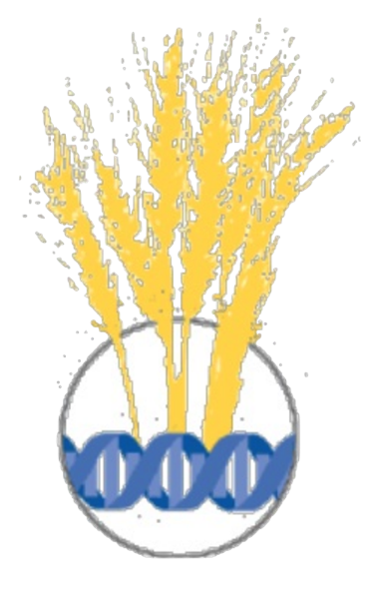




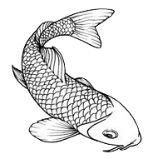
Event core for measurement or fact data
Belspo, Brussel, January 2018
Notes:
Event core for measurement or fact, OBIS/GBIF Meeting, Belspo, Brussel, January 2018

Slide 2
Event core and measurements
Event core (since 2015) opens up new functionality for data published in GBIF!
Limitations of the star-schema is a frequently mentioned obstacle…
  E.g. when connecting measurement or facts (MoF) only core entities can be described.
"OBIS eMoF" provides flexible solutions that could be further generalized and suggested as the new updated "GBIF:MoF" standard…?

Slide 3
DwC archive – application schema
DwC Event (since 2015)
  http://rs.gbif.org/core/dwc_event_2016_06_21.xml
DwC Occurrence
  http://rs.gbif.org/core/dwc_occurrence_2015-07-02.xml
DwC Measurement or fact
  http://rs.gbif.org/extension/dwc/measurements_or_facts.xml
OBIS Extended measurement or fact
  http://rs.gbif.org/extension/obis/extended_measurement_or_fact.xml
Notes:
Darwin Core Event -- http://rs.gbif.org/core/dwc_event_2016_06_21.xml
DwC Occurrence -- http://rs.gbif.org/core/dwc_occurrence_2015-07-02.xml
DwC Measurement or fact -- http://rs.gbif.org/extension/dwc/measurements_or_facts.xml
OBIS Extended measurement or fact -- http://rs.gbif.org/extension/obis/extended_measurement_or_fact.xml

Slide 4

Use case : Measurements for both events and occurrences in the same dataset
OBIS expeditions are sampling more data than only organism occurrences (e.g. environment).
--> development of a new extended measurement and fact extension (for DwC-archives)

Slide 5





Integrated Publishing Toolkit
Star Schema (DwC-archive)
International Oceanographic
Data and Information Exchange
Occurrence core
MoF = Measurement or Fact
1
∞
MoF Extension
Here: MoF describes only the Occurrences
Event core
Sample event is the DwC core
1
1
∞
Occurrence Extension
∞
MoF Extension
Here: MoF describes only the Event
Slide by:
OBIS-ENV-DATA

Slide 6
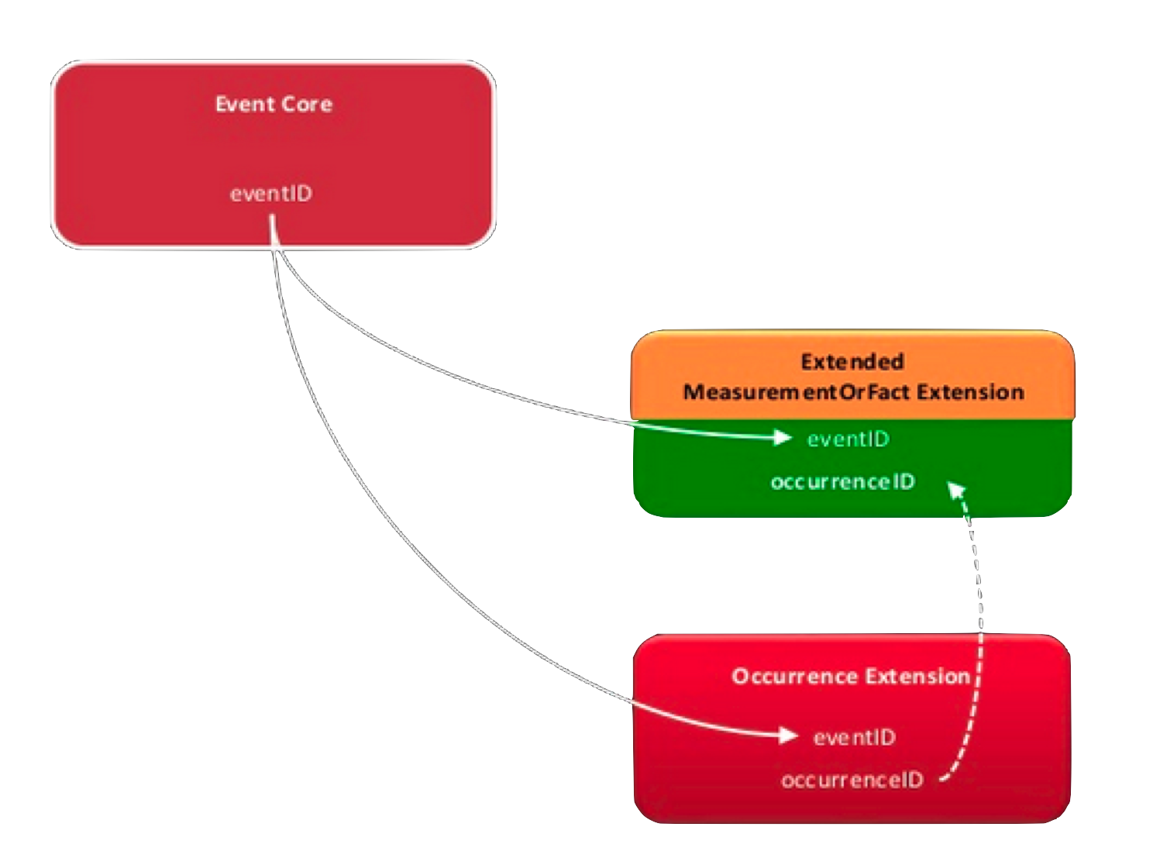

Notes:
De Pooter D, Appeltans W, Bailly N, Bristol S, Deneudt K, Eliezer M, Fujioka E, Giorgetti A, Goldstein P, Lewis M, Lipizer M, Mackay K, Marin M, Moncoiffé G, Nikolopoulou S, Provoost P, Rauch S, Roubicek A, Torres C, van de Putte A, Vandepitte L, Vanhoorne B, Vinci M, Wambiji N, Watts D, Klein Salas E, Hernandez F (2017) Toward a new data standard for combined marine biological and environmental datasets - expanding OBIS beyond species occurrences. Biodiversity Data Journal 5: e10989. https://doi.org/10.3897/BDJ.5.e10989
--
https://github.com/iobis/extension
https://www.slideshare.net/OBIS-IOC/expanding-obis-beyond-species-occurrence-data-including-sampling-event-facts-and-measurements-related-to-the-environment
License: CC Attribution License Published on Jun 8, 2016; By UNESCO-IOC/IODE Ocean Biogeographic Information System

Slide 7

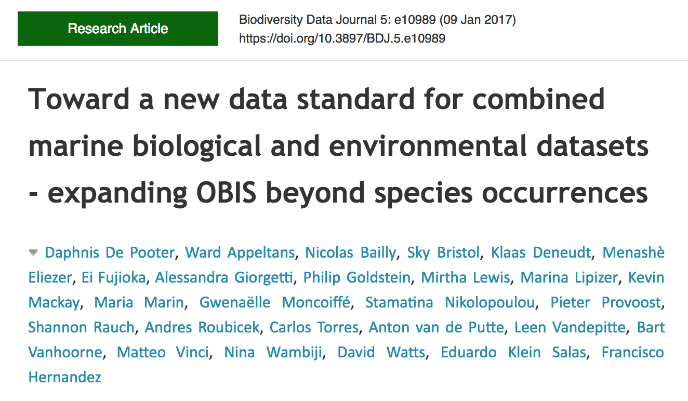

Notes:
De Pooter D, Appeltans W, Bailly N, Bristol S, Deneudt K, Eliezer M, Fujioka E, Giorgetti A, Goldstein P, Lewis M, Lipizer M, Mackay K, Marin M, Moncoiffé G, Nikolopoulou S, Provoost P, Rauch S, Roubicek A, Torres C, van de Putte A, Vandepitte L, Vanhoorne B, Vinci M, Wambiji N, Watts D, Klein Salas E, Hernandez F (2017) Toward a new data standard for combined marine biological and environmental datasets - expanding OBIS beyond species occurrences. Biodiversity Data Journal 5: e10989. https://doi.org/10.3897/BDJ.5.e10989
--
https://github.com/iobis/extension
https://www.slideshare.net/OBIS-IOC/expanding-obis-beyond-species-occurrence-data-including-sampling-event-facts-and-measurements-related-to-the-environment
License: CC Attribution License Published on Jun 8, 2016; By UNESCO-IOC/IODE Ocean Biogeographic Information System

Slide 8
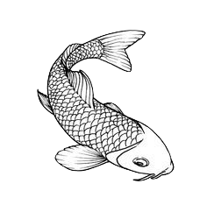
Slide by:
OBIS-ENV-DATA
The extended MeasurementOrFact extension
allows for parameter standardization (linking to
external URI of a controlled vocabulary)
    ID: Link to the core record (here: a link to the event)
    occurrenceID (new): identifier to link the eMoF with the occurrence extension
    measurementType: The nature of the measurement or fact (MoF)
    measurementTypeID (new): identifier for the measurementType (global unique identifier, URI)
    measurementValue: the value of the MoF
    measurementValueID (new): identifier for facts reported as measurementValue (URI)
    measurementAccuracy: description of the potential error or accuracy of the MoF
    measurementUnit: measurement unit (SI unit; meter, gram, etc)
    measurementUnitID (new): identifier for the measurementUnit (URI)
    measurementDeterminedDate: date on which the MOF was made
    measurementDeterminedBy: list of people, groups, or organizations who recorded the MoF
    measurementMethod: description or reference to (publication, URI) for the method or protocol used
    measurementRemarks: Comments or notes to the MoF

Slide 9
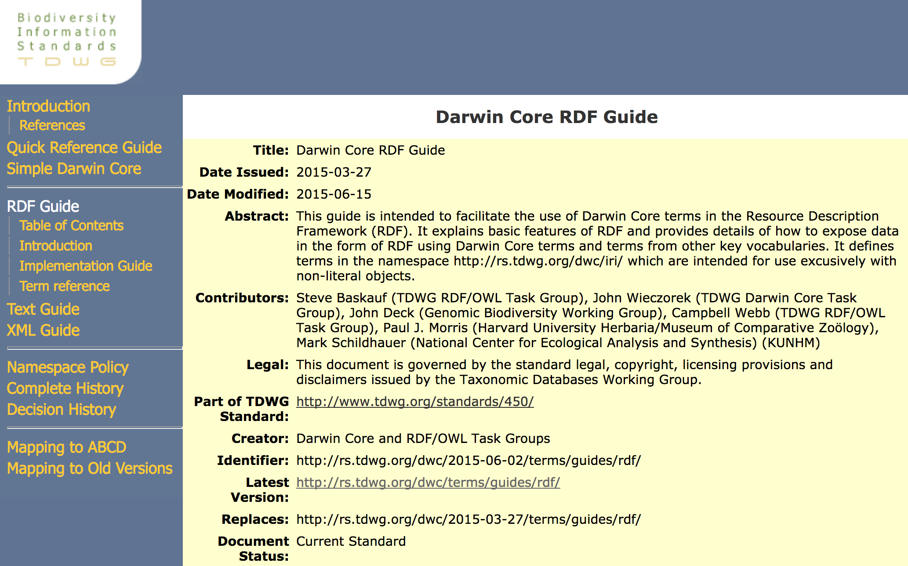
Notes:
Baskauf S, J. Wieczorek, J. Deck, C. Webb, P.J. Morris and M. Schildhauer (2015) Darwin Core RDF Guide, Biodiversity Information Standards, http://rs.tdwg.org/dwc/terms/guides/rdf/

Slide 10
dwciri: namespace
The dwciri: namespace is intended for use exclusively with non-literal objects.
http://rs.tdwg.org/dwc/iri/
Baskauf S, Wieczorek J, Deck J, Webb C, Morris PJ and Schildhauer M (2015) Darwin Core RDF Guide, Biodiversity Information Standards http://rs.tdwg.org/dwc/terms/guides/rdf/
Baskauf SJ, Wieczorek J, Deck J, Webb CO (2016) Lessons learned from adapting the Darwin Core vocabulary standard for use in RDF. Semantic Web 7(6): 617-627, DOI: 10.3233/SW-150199
Notes:
Baskauf S, Wieczorek J, Deck J, Webb C, Morris PJ and Schildhauer M (2015) Darwin Core RDF Guide, Biodiversity Information Standards http://rs.tdwg.org/dwc/terms/guides/rdf/
Baskauf SJ, Wieczorek J, Deck J, Webb CO (2016) Lessons learned from adapting the Darwin Core vocabulary standard for use in RDF. Semantic Web 7(6): 617-627, DOI: 10.3233/SW-150199

Slide 11
dwciri: and dwc: terms
If a term in the dwciri: namespace has an analogue in the dwc: namespace having the same local name, the dwciri: term will have the same meaning as its dwc: counterpart, but is intended to have an IRI-reference object.

Slide 12
Darwin Core RDF guide and the dwciri: namespace term already have alternatives for some of the new terms minted by the OBIS eMoF.
emof = http://rs.iobis.org/obis/terms/
dwciri = http://rs.tdwg.org/dwc/iri/
emof:measurementTypeID = dwciri:measurementType
emof:measurementUnitID = dwciri:measurementUnit
emof:measurementValueID (no analogue in dwciri - useful addition)
see also:
dwciri:measurementDeterminedBy
dwciri:measurementMethod
dwciri:samplingProtocol
DwC RDF Guide: http://rs.tdwg.org/dwc/terms/guides/rdf/index.htm#2.9_MeasurementOrFact_instances
Notes:
Darwin Core RDF Guide: http://rs.tdwg.org/dwc/terms/guides/rdf/index.htm#2.9_MeasurementOrFact_instances

Slide 13
Linking MoF instances to resources
"Darwin Core does not provide the object properties that would be required to describe precisely how the dwc:MeasurementOrFact instance was related to the dwc:Occurrence instance, the dwc:Organism whose occurrence was recorded, or the dwc:PreservedSpecimen that was collected".
Examples of the DwC RDF Guide use dcterms:relation to link MoF instances to the respective resources.
Baskauf et al. 2015, Darwin Core RDF Guide, chapter 2.9
Notes:
Baskauf S, J. Wieczorek, J. Deck, C. Webb, P.J. Morris and M. Schildhauer (2015) Darwin Core RDF Guide, Biodiversity Information Standards http://rs.tdwg.org/dwc/terms/guides/rdf/ Chapter 2.9

Slide 14
DwC RDF Guide MoF example 31
Example 31 - Turtle
<http://mczbase.mcz.harvard.edu/guid/MCZ:Mamm:67231>
a dwc:Occurrence;
dcterms:relation [a dwc:MeasurementOrFact ;
dwc:measurementType "tail length" ;
dwciri:measurementType <http://purl.obolibrary.org/obo/VT_0002758> ;
dwc:measurementValue "25"^^xsd:int ; dwc:measurementUnit "mm" ;
dwciri:measurementUnit <http://mimi.case.edu/ontologies/2009/1/UnitsOntology#millimeter> ;
dwc:measurementAccuracy "0.5"^^xsd:decimal ;
dwc:measurementDeterminedDate "2009-08-22"^^xsd:date ;
dwc:measurementDeterminedBy "Ryan B Stephens" ;
dwciri:measurementDeterminedBy <http://scholar.google.com/citations?user=RAsUdjoAAAAJ> ;
dwc:measurementMethod "unspecified" ;
dwciri:measurementMethod <http://purl.obolibrary.org/obo/MMO_0000160> ;
dwc:measurementRemarks "Accuracy from significant digits."@en].

Slide 15
Unintended consequences of ID terms
In its normative definition, each Darwin Core ID term is declared to be rdfs:subPropertyOf dcterms:identifier.
In RDF, the purpose of a subproperty declaration is to allow a client with reasoning capability to infer a triple containing a broader (and presumably more well-known) property.
(Applicable to RDF-serialization, less so to text-or XML-serialization).

Slide 16
DwC RDF Guide ID term example 23
Example 23 : Turtle (incorrect usage)
<http://guid.mvz.org/identifications/23459>
a dwc:Identification; dwc:identifiedBy "Richard Sage";
dwc:dateIdentified "2000"^^xsd:gYear;
dwc:taxonID "http://lsid.tdwg.org/urn:lsid:catalogueoflife.org:taxon:d79c11aa-29c1-102b-9a4a-00304854f820:col20120721".
possible incorrect inference:
dcterms:identifier "http://lsid.tdwg.org/urn:lsid:catalogueoflife.org:taxon:d79c11aa-29c1-102b-9a4a-00304854f820:col20120721".

Slide 18

Use case : linking between multiple archives
Joint collecting expeditions collecting material that end up in different museums, herbaria, and genebanks.
(1) Collecting events published in one DwC-archive
(2) Collection specimens in other DwC-archive(s)
(3) … and experiments in a third set of DwC-archives

Slide 19
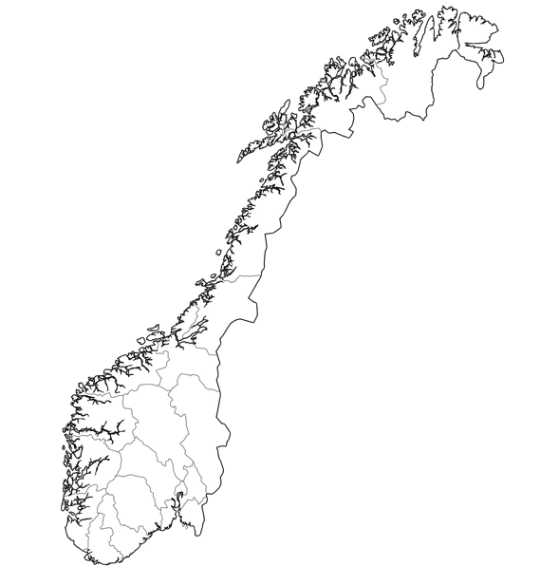

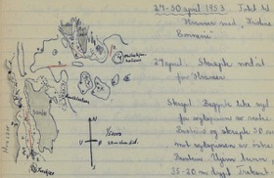

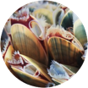
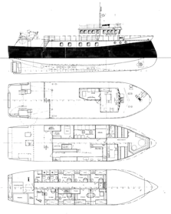





Example of a joint, collaborative collection mission:
same sampling event – but specimens sent to to different museum collections
Dannevig collections (280 collecting events)
http://doi.org/10.15468/hwvr0m
Material from the same expedition –> 4 herbaria, and 4 datasets (DwC-A).
UiT : Arthropod collection
http://doi.org/10.15468/vjkvxg
NTNU : Algae herbarium
https://doi.org/10.15468/elzhsu
UiB : Cephalaspidean Gastropods
http://doi.org/10.15468/sbomfu
UiO : Dannevig- and Drobak-
collections Polychaeta
https://doi.org/10.15468/y6cctp
Notes:
Joint collection missions, same event, specimens sent to to different museum collections

Slide 20

Proposing a new use case:
Measurement events as dwc:Event
Experiments with living specimens
at a location and date that is
different from the collecting event.

