Slide 1
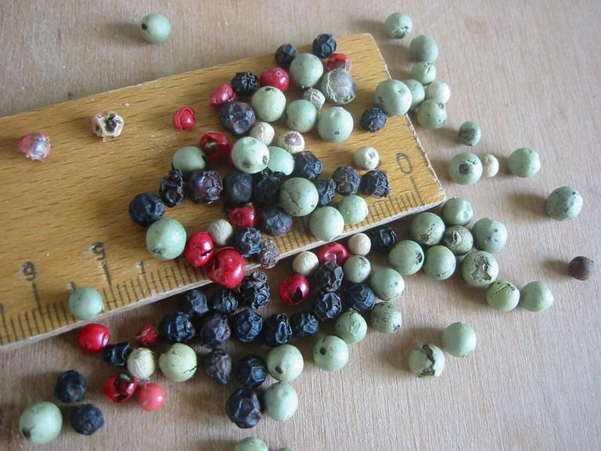
Event core for measurement or fact data
Belspo, Brussel, January 2018
Image CC-BY Dag Endresen
Notes:
Event core for measurement or fact, OBIS/GBIF Meeting, Belspo, Brussel, January 2018
Illustration image CC-BY Dag Endresen, http://sesto.nordgen.org/sesto/index.php?scp=ngb&thm=pictures&mod=det&id=003844

Slide 2
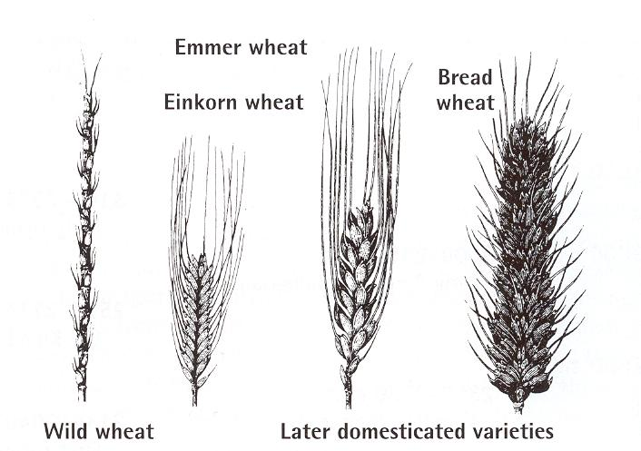
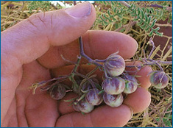
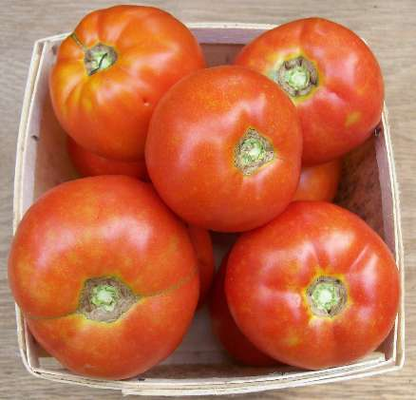
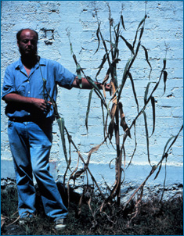
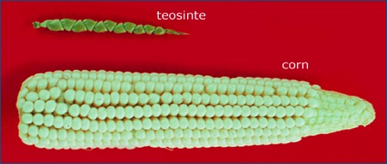
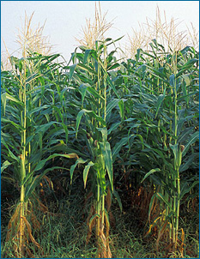
Domestication and cultivated plants:
Utilizing genetic potential from the wild
wild tomato
cultivated tomato
wild teosinte
cultivation
cultivated
corn, maize
Notes:
Genetic resources from the wild relatives of the cultivated plants contributes the raw material required for domesticated forms and the further development of these food crops. Genebanks preserve and provides plant genetic resources for utilization by plant breeders and other bona fide use.

Slide 3
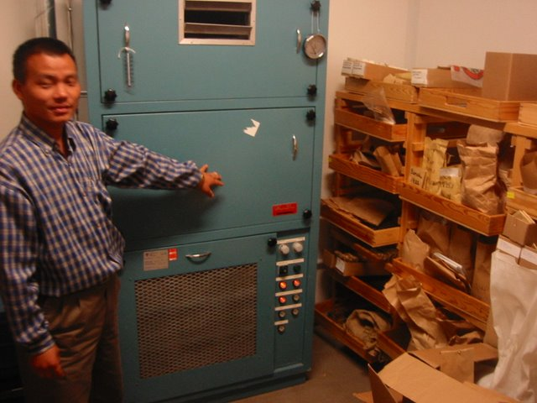
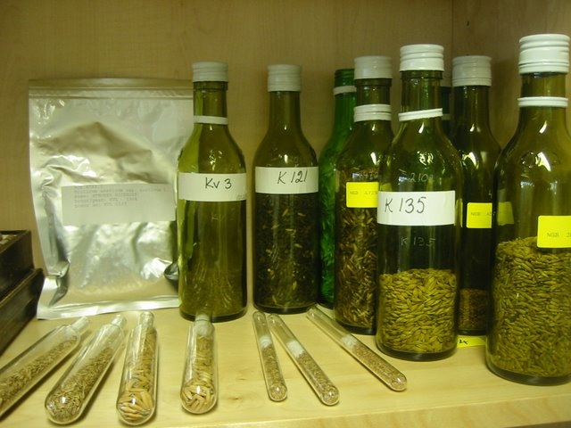
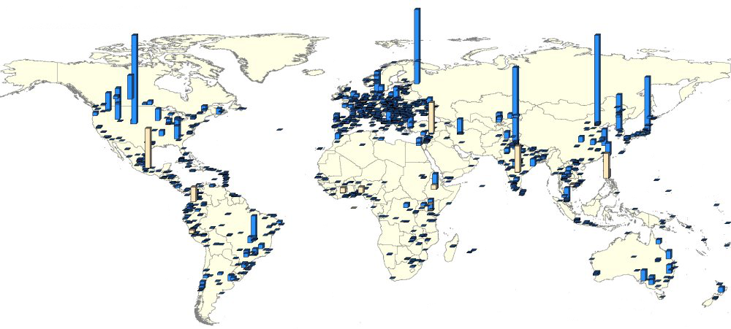
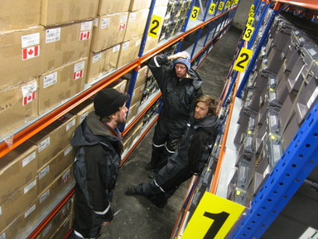
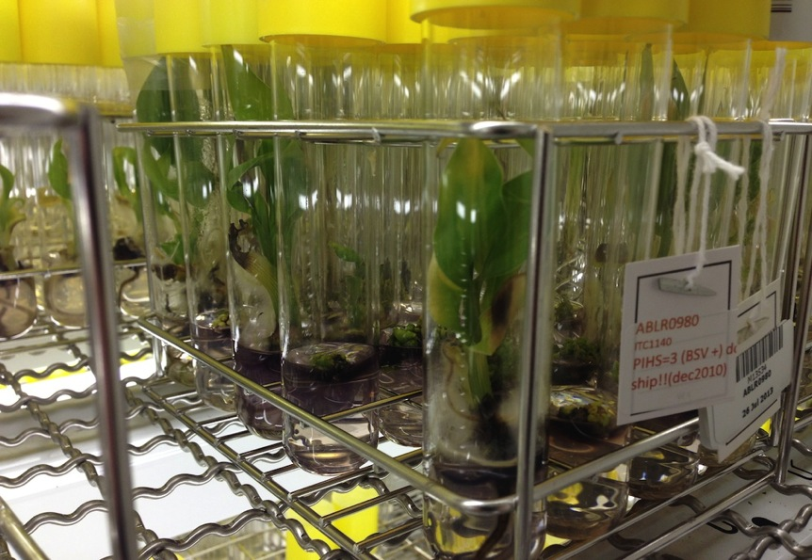
Ex situ genebank collections for plant genetic resources
Seed drying room
Alnarp
Seed containers
Alnarp
Svalbard Global
Seed Vault
Musa in vitro
Leuven
Notes:
More than 7.4 million genebank accessions; and more than 1400 genebanks - including approximately 140 large genebanks each holding more than 10.000 accessions: Second Report on the State of the World’s Plant Genetic Resources for Food and Agriculture (2010) Food and Agriculture Organization of the United Nations (FAO).
Map of genebanks: http://apps3.fao.org/wiews/wiews.jsp, http://apps3.fao.org/wiews/img/gbanksall.jpg, http://apps3.fao.org/wiews/img/gbanks130.jpg

Slide 4
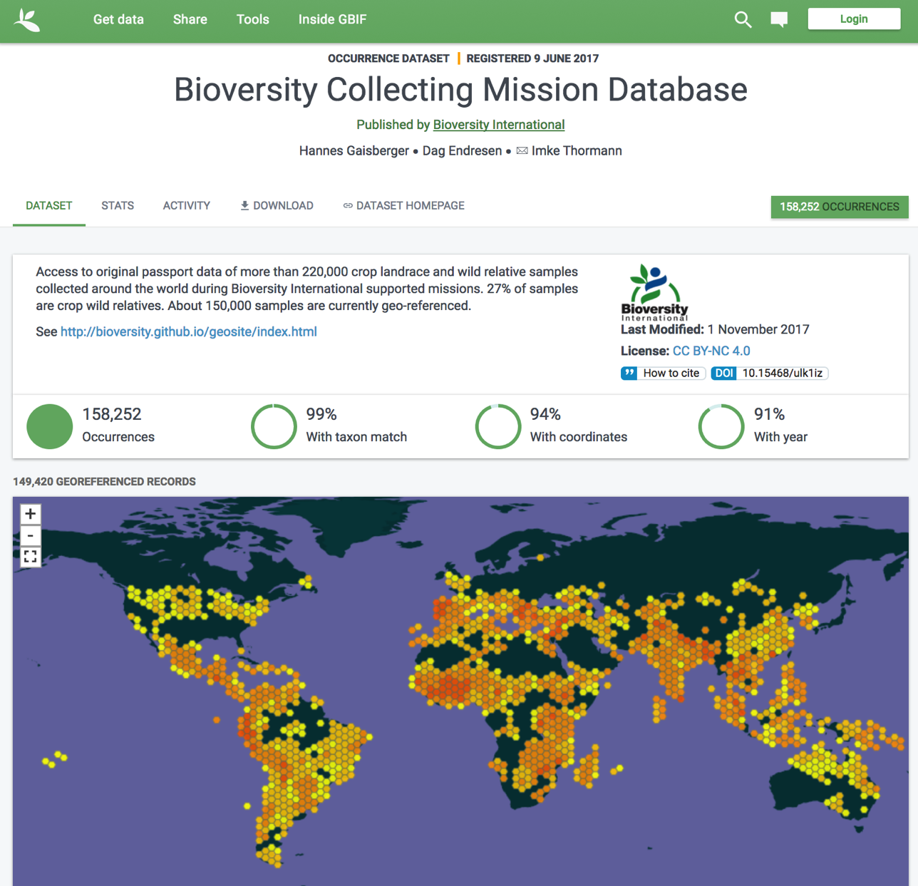


Biodiversity Collecting Mission Database
158 252 occurrences
doi:10.15468/ulk1iz
(Dataset published in GBIF June 2017)
Notes:
Gaisberger H, Endresen D (2017). Bioversity Collecting Mission Database. Version 1.8. Bioversity International. Occurrence Dataset https://doi.org/10.15468/ulk1iz accessed via GBIF.org on 2017-11-15.

Slide 5
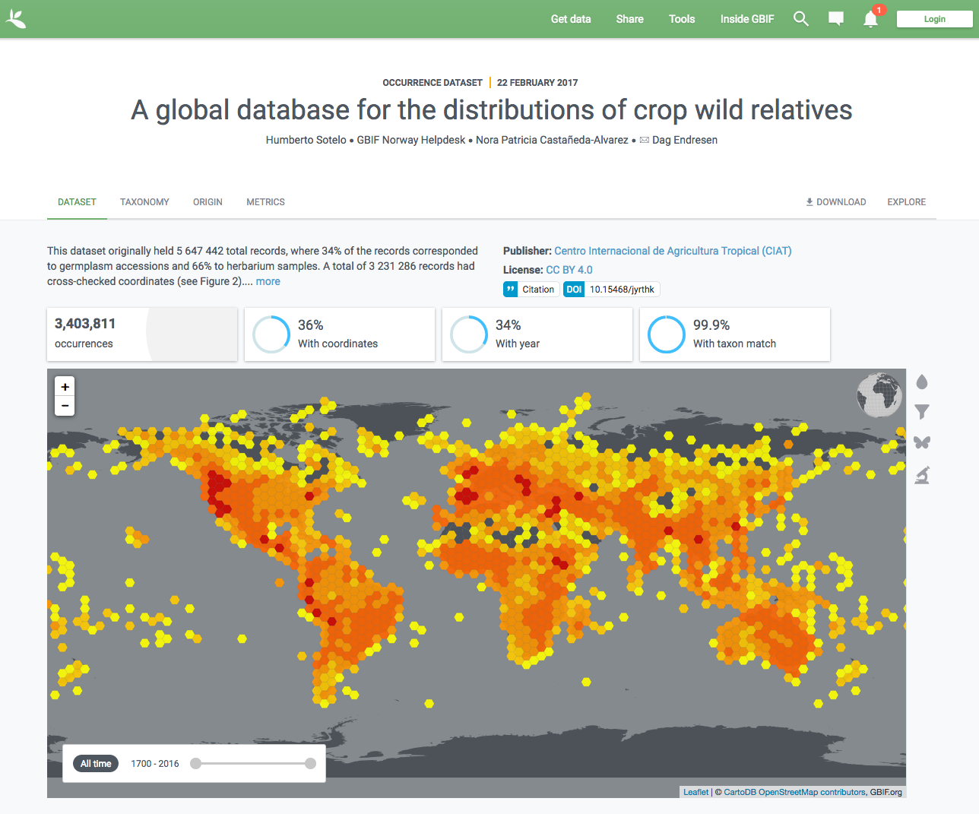

The Global Crop Wild Relative Occurrence Database include data from hundreds of data sources – including GBIF
The CWR Database was published in GBIF (2016)
(excluding the data records originating from GBIF)
doi:10.15468/jyrthk
Vincent et al.N (2013). A prioritized crop wild relative inventory to help underpin global food security. doi:10.1016/j.biocon.2013.08.011
Notes:
The Global Crop Wild Relative Occurrence Database
http://www.cwrdiversity.org/checklist/cwr-occurrences.php
https://doi.org/10.15468/jyrthk
http://www.gbif.org/dataset/07044577-bd82-4089-9f3a-f4a9d2170b2e/activity
--
Vincent H, Wiersema J, Kell S, Fielder H, Dobbie S, Castañeda-Álvarez NP, Guarino L, Eastwood R, Leon B, and Maxted N (2013). A prioritized crop wild relative inventory to help underpin global food security. Biological Conservation 167: 265–275. doi:10.1016/j.biocon.2013.08.011

Slide 6
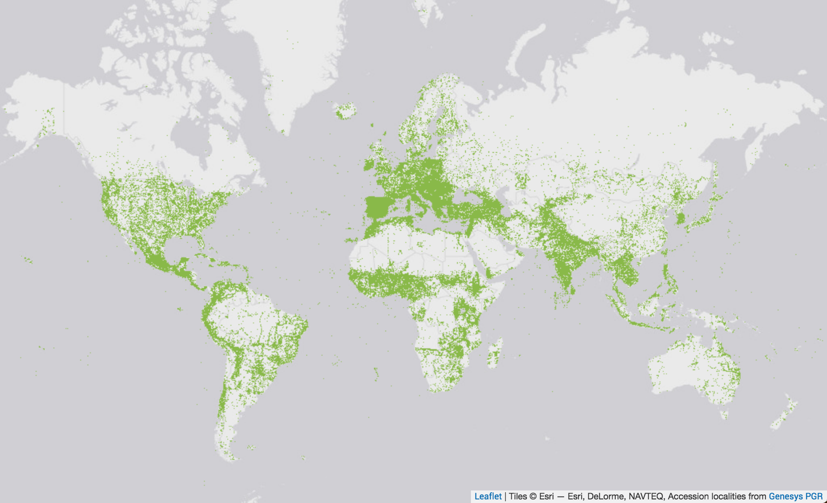
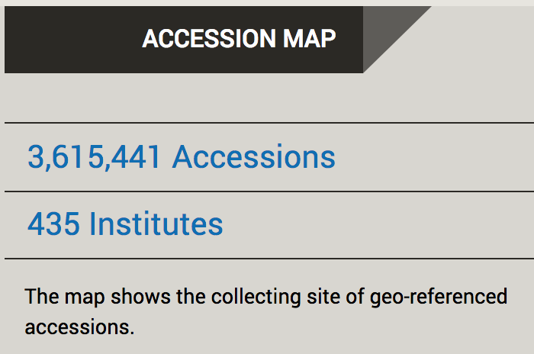


Notes:
GeneSys, status January 2018: 3,615,441 accessions : 435 institutes, http://www.genesys-pgr.org/
GeneSys, status November 2017: 2,616,328 accessions : 447 institutes : 252 countries, http://www.genesys-pgr.org/
GeneSys, status November 2015: 2,616,328 accessions : 447 institutes : 252 countries, http://www.genesys-pgr.org/
GeneSys, status October 2014: 2,802,770 accessions : 446 institutes : 252 countries, http://www.genesys-pgr.org/

Slide 7
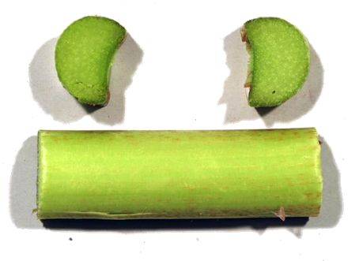
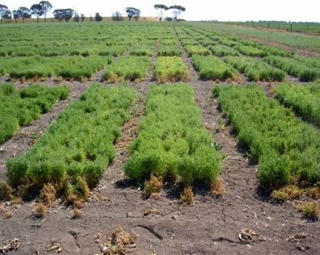
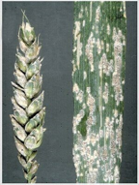
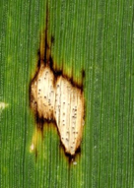
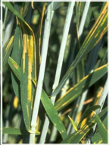
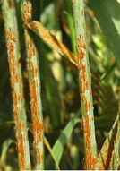
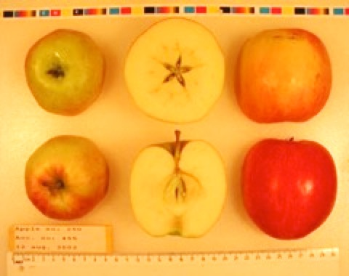
Crop genetic diversity for agricultural traits
Field trials in Horsham Australia for cold tolerance in chickpea (Cicer arietinum L.). CC-by D. Endresen
Rhubarb, Rheum x hybridum Murray, DKRHE43, by Gitte K. Bjørn
Powdery Mildew,
Blumeria graminis
Leaf spots
Ascochyta sp.
Yellow rust
Puccinia strilformis
Black stem rust
Puccinia graminis
Apple, Malus domestica Borkh.
Cultivar “Nanna” by Stein H Hjeltnes
Notes:
Fungus plant diseases, http://www.hgca.com/hgca/wde/diseases/
Apple, Malus domestica “Nanna” from Njøs in Norway by Stein Harald Hjeltnes, http://sesto.nordgen.org/sesto/index.php?scp=ngb&thm=pictures&mod=det&id=004019&img_size=768x512
Rhubarb, Rheum x hybridum Murray, DKRHE43, by Gitte K. Bjørn, http://sesto.nordgen.org/sesto/index.php?scp=ngb&thm=sesto&lev=acc&accide=28981&lst=img
Chickpea at Horsham in Australia, CC-by D Endresen, https://plus.google.com/photos/+DagEndresen/albums/5323049422958990705/5365279366656917090?banner=pwa&pid=5365279366656917090&oid=115547050550954466285

Slide 8

Use case : Measurements for both events and occurrences in the same dataset
OBIS expeditions are sampling more data than only organism occurrences.
--> development of a new extended measurement and fact extension (for DwC-archives)

Slide 9
Sampling more data than just species occurrence
Water sample from a Niskin bottle
Core sample from a Van Veen grab
plankton net with CTD
Video plankton recorder
OTN tags

Slide 10

Event
1
EVENT HIERARCHY makes it possible to record differences in sampling time, location, and depth while still grouping these samples together to the same station visit.
Event 1.1
MoF
A1
MoF
A2
Event 1.1.1
MoF
B3
MoF
B1
Occ
3
Occ
1
Occ
2
MoF
B2
OBIS-ENV-DATA
Slides by:
OBIS-ENV-DATA

Slide 11
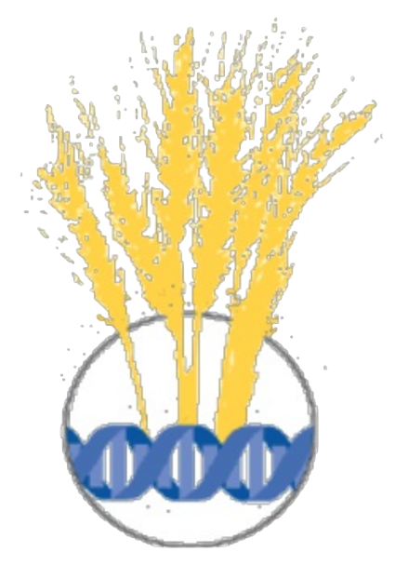
Proposing a new use case:
Measurement events as dwc:Event
Experiments with living specimens
at a location and date that is
different from the collecting event.

Slide 12
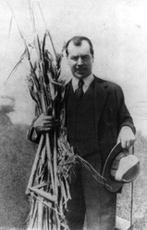
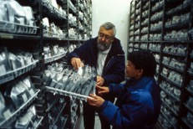
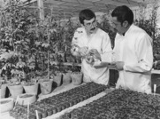
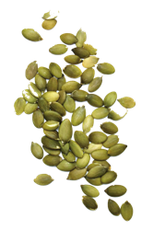
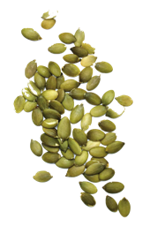
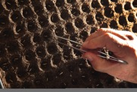
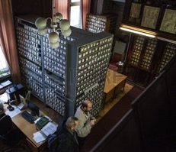
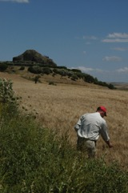
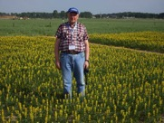
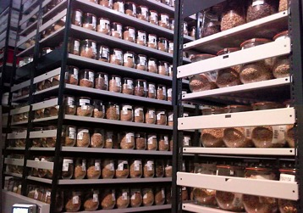
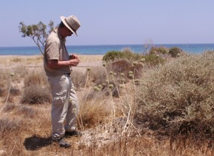
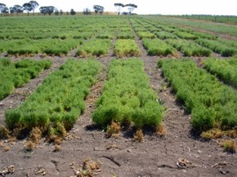
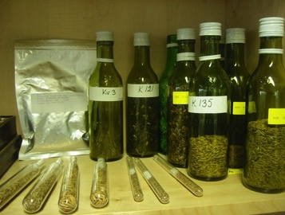
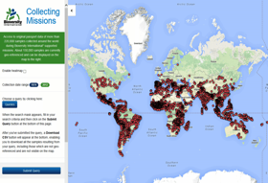
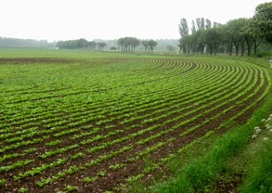
Collecting expeditions
Genebank, collections
Field/lab experiments
Seeds from collecting trip expeditions are deposited in genebank collections.
Living seeds from genebank collections are used for field or laboratory experiments.
Notes:
Seeds from expeditions deposited in genebank collections

Slide 13
Germplasm material flow
Material samples from many different collecting missions are deposited in different genebanks.
Material from public genebanks are included in other genebank collections (and breeders collections).
Material from different genebanks (and thus many different collecting events) are included in each field trial experiment.
Collecting Event ≠ Measurement Event (MoF)

Slide 14
European meeting on C&E ("MoF")
Aim to publish trait data (characterization and evaluation, C&E) from online crop portals.
European genebank meeting in Bonn May 2009 (ECPGR ICT Group).
Developed guidelines & data exchange models.
Some harmonization with Darwin Core and DwC Measurement or Fact (MoF).
→ DwC germplasm extension, released 2012.
→ GBIF data fitness for use in agrobiodiversity, 2016.
→ EURISCO C&E data models, implemented 2017.

Slide 15
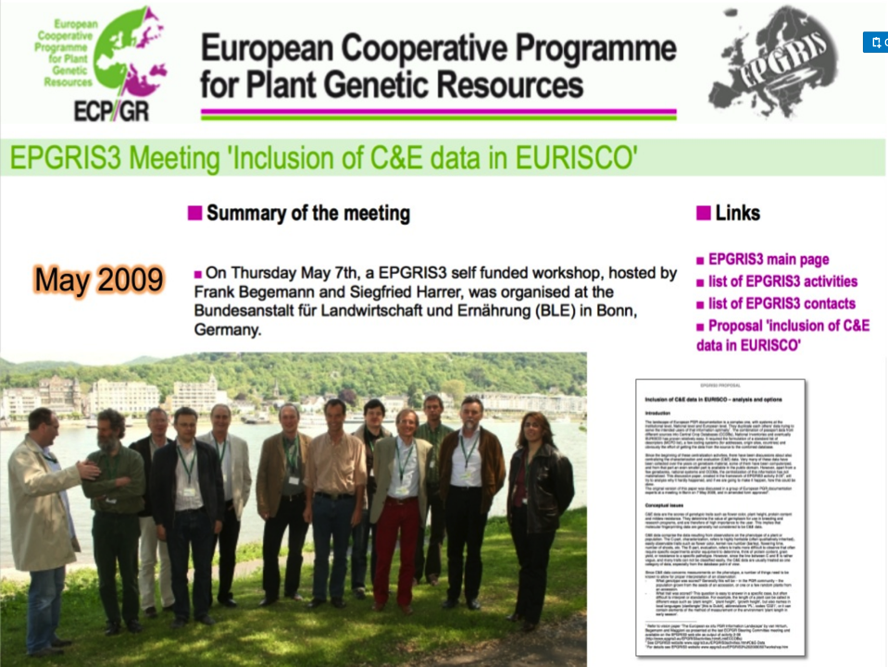
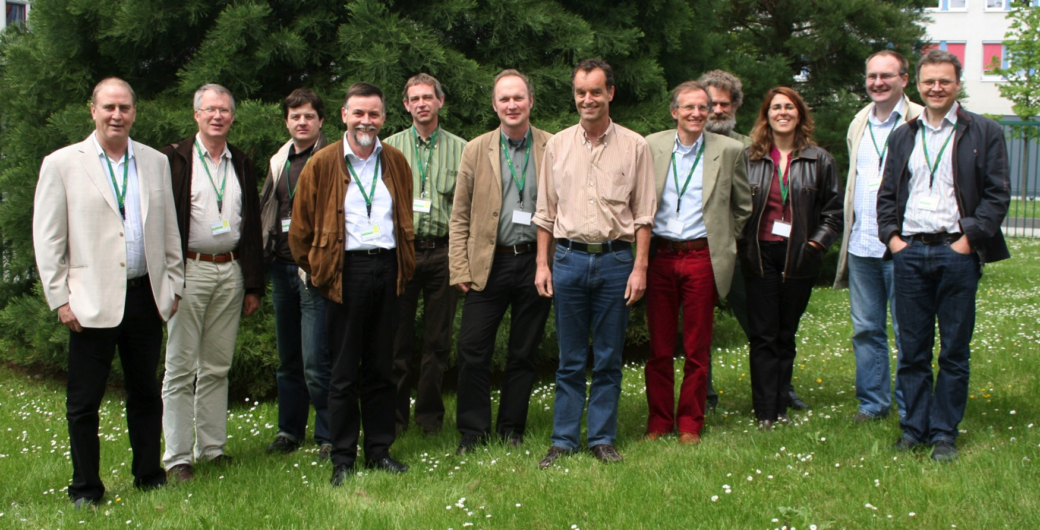
May 2009

Slide 16
ECPGR C&E trait data model (1/2)
ECPGR trait data
Genotype : Identity of the germplasm material
Trait : Type of measurement, protocol
  Method : How the trait was scored
Experiment : Location and date of the experiment (dwc:Event)
Score: Measurement value (dwc:MoF)

Slide 17
ECPGR C&E trait data model (2/2)
DATASET
  uploadercode (FK)
  dataset_remark
  (dataset_id)
GENOTYPE
  genotype_number (PK)
  genotype_nicode
  genotype_instcode
  genotype_accenumb
  genotype_genus
TRAIT
  trait_number (PK)
  trait_name
  trait_remark
  trait_method
EXPERIMENT
  experiment_number (PK)
  experiment_description
  experiment_year
  experiment_longitude
  experiment_latitude
  experiment_report
SCORE
  genotype_number (FK)
  experiment_number (FK)
  trait_number (FK)
  score
  -

Slide 18
Darwin Core Germplasm extension (1)
dct = http://purl.org/dc/terms/
dctype = http://purl.org/dc/dcmitype/
dsw = http://purl.org/dsw/
dwc = http://rs.tdwg.org/dwc/terms/
geo = http://www.w3.org/2003/01/geo/wgs84_pos#
g = http://purl.org/germplasm/germplasmTerm#
gtype = http://purl.org/germplasm/germplasmType#
mcpd = Alercia et al. (2015, 2012, 2001, 1997)
epgris3 = van Hintum (2009)
Notes:
Alercia, A., S. Diulgheroff, and T. Metz (2001). FAO/IPGRI Multi-crop passport descriptors, December 2001. International Plant Genetic Resources Institute (IPGRI) / Food and Agriculture Organization of the United Nations (FAO), Rome, Italy. 4 pp. Available at http://www.bioversityinternational.org/e-library/publications/detail/faoipgri-multi-crop-passport-descriptors-mcpd/
Alercia A., S. Diulgheroff, and M. Mackay (2012). FAO/Bioversity Multi-crop passport descriptors v.2 [MCPD v.2]. Food and Agriculture Organization of the United Nations (FAO), and Bioversity International, Rome, Italy. 11 pp. Available at http://www.bioversityinternational.org/e-library/publications/detail/faobioversity-multi-crop-passport-descriptors-v2-mcpd-v2/
Alercia A., S. Diulgheroff, and M. Mackay (2015). FAO/Bioversity Multi-crop passport descriptors v.2.1 [MCPD v.2.1]. Food and Agriculture Organization of the United Nations (FAO), and Bioversity International, Rome, Italy. 11 pp. Available at http://www.bioversityinternational.org/e-library/publications/detail/faobioversity-multi-crop-passport-descriptors-v21-mcpd-v21/
van Hintum T (2009). Inclusion of C&E data in EURISCO: analysis and option. EPGRIS3 white paper proposal. Available online at <http://cgn.websites.wur.nl/pgr/epgris3/docs/activities/2-05/Inclusion%20of%20C&E%20data.pdf>, see also: <http://cgn.websites.wur.nl/pgr/epgris3/EPGRIS3%2020090507workshop.htm>.
Endresen DTF, and Knüpffer H (2012). The Darwin Core extension for genebanks opens up new opportunities for sharing genebank data sets. Biodiversity Informatics 8:11-29. doi:10.17161/bi.v8i1.4095

Slide 19
Darwin Core Germplasm extension (2)
Germplasm type (class terms)
  dctype:Dataset
  dwc:Taxon
  gtype:GermplasmAccession (dsw:LivingSpecimen)
  gtype:CollectingEvent (dwc:Event)
  gtype:BreedingEvent [dwc:Event]?
  gtype:AcquisitionEvent [dwc:Event]?
  gtype:SafetyDuplication [dwc:Event]?
  gtype:TreatyOrRegulation
  gtype:MeasurementTrait
  gtype:MeasurementTrial (dwc:Event)
  gtype:MeasurementScore (dwc:MeasurementOrFact)

Slide 20
Darwin Core Germplasm extension (3)
gtype:GermplasmAccession (see also: dsw:Specimen and dsw:LivingSpecimen)
  dwc:occurrenceID
  dwc:catalogNumber (mcpd:ACCENUMB)
  g:germplasmID (epgris3:GENOTYPE_NUMBER)
  g:germplasmIdentifier (mcpd:ACCENAME)
  g:biologicalStatus (mcpd:SAMPSTAT)
  g:storageCondition (mcpd:STORAGE)
  dwc:otherCatalogNumbers (mcpd:OTHERNUMB)
  dwc:occurrenceDetails
  dwc:occurrenceRemarks

Slide 21
Darwin Core Germplasm extension (4)
gtype:MeasurementTrait (measurement methodology, descriptor)
  g:measurementTraitID
  g:measurementTraitIdentifier (epgris3:TRAIT_NUMBER)
  g:measurementTraitName (epgris3:TRAIT_NAME)
  g:measurementTraitCategory
  g:measurementTraitScale
  g:measurementTraitSource
  g:measurementTraitRemarks (epgris3:TRAIT_REMARK)
  dwc:measurementType
  dwc:measurementMethod

Slide 22
Darwin Core Germplasm extension (5)
gtype:MeasurementTrial (experiment trial season, see dwc:Event)
  g:measurementTrialID
  g:measurementTrialIdentifier (epgris3:experiment_number)
  g:measurementTrialYear (epgris3:experiment_year)
  geo:location
  geo:lat (epgris3:experiment_latitude)
  geo:long (epgris3:experiment_longitude)
  geo:alt
  g:measurementTrialReport (epgris3:experiment_report)
  g:measurementTrialRemarks (epgris3:experiment_description)

Slide 23
Darwin Core Germplasm extension (6)
gtype:MeasurementScore (see dwc:MeasurementOrFact)
  dwc:measurementID
  dwc:measurementType
  dwc:measurementValue
  dwc:measurementAccuracy
  dwc:measurementUnit
  dwc:measurementDeterminedDate
  dwc:measurementDeterminedBy
  dwc:measurementMethod
  dwc:measurementRemarks
  g:measurementByInstituteID
  g:measurementGrowthStage
  dwc:occurrenceID
  dwc:catalogNumber
  g:germplasmID
  g:germplasmIdentifier
  g:measurementExperimentID
  g:measurementExperimentIdentifier
  g:measurementMethodID
  g:measurementMethodIdentifier

Slide 24

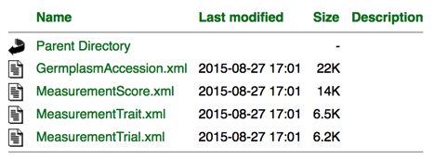
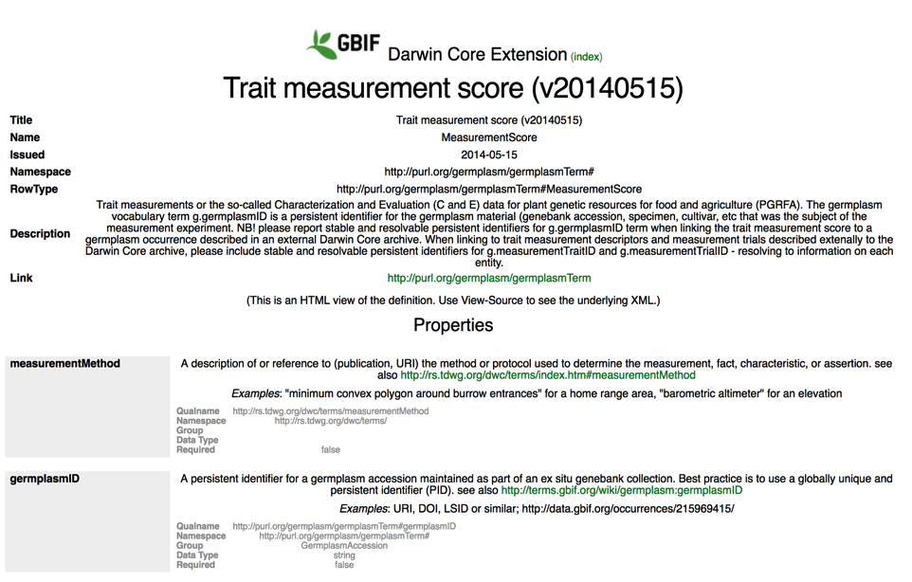

dwc:MeasurementOrFact
g:MeasurementScore (2013)
iode:eMeasurementOrFact (2016)
Notes:
http://rs.gbif.org/extension/germplasm/

Slide 25
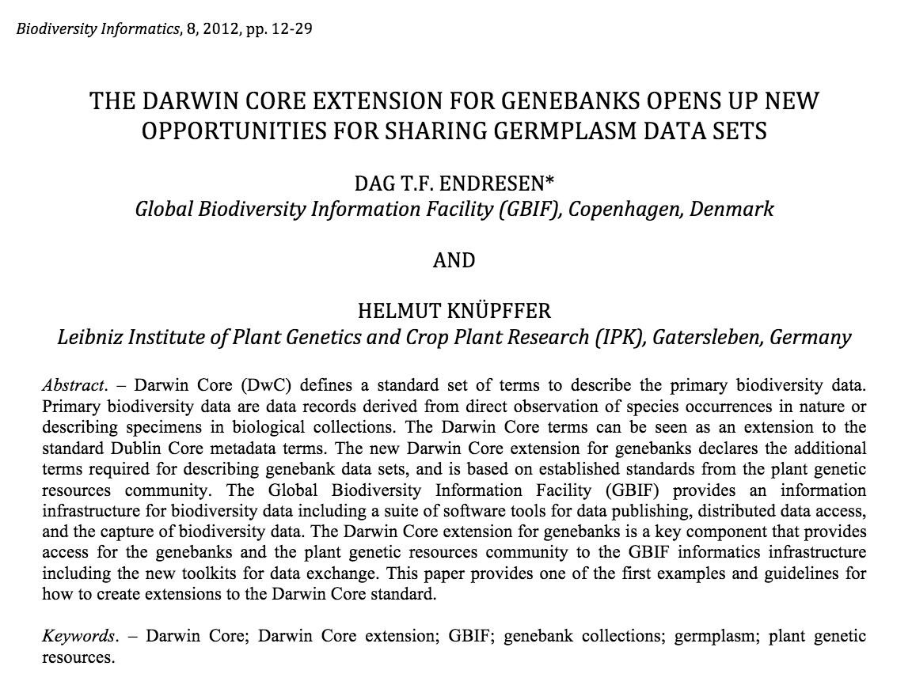
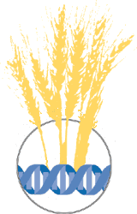
Endresen, D.T.F. and H. Knüpffer (2012). The Darwin Core extension for genebanks opens up new opportunities for sharing genebank data sets. Biodiversity Informatics 8:11-29. DOI: https://doi.org/10.17161/bi.v8i1.4095
Notes:
* Endresen, D., S. Gaiji, and T. Robertson (2009). DarwinCore Germplasm Extension and deployment in the GBIF infrastructure. Proceedings of TDWG 2009, Montpellier, France. Bioversity Information Standards (TDWG). Available at http://www.tdwg.org/proceedings/article/view/464
* Endresen, D.T.F. and H. Knüpffer (2012). The Darwin Core extension for genebanks opens up new opportunities for sharing genebank data sets. Biodiversity Informatics 8:11-29. Available online at https://journals.ku.edu/index.php/jbi/article/view/4095 DOI: https://doi.org/10.17161/bi.v8i1.4095

Slide 26
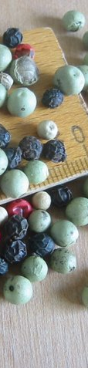
Why did we make a Darwin Core extension for germplasm data?
Upgrade germplasm data pathways to use web services
The objective (1) was to enable sharing of germplasm information using the standard web-service based biodiversity data publishing toolkits maintained by the Global Biodiversity Information Facility (GBIF) and the Biodiversity Information Standards (TDWG).
Upgrade data types to include trait data
The objective (2) was to expand on the germplasm data types published to germplasm data portal from basic passport data to include in particular crop trait information.
CC-BY, Dag Endresen
Notes:
Illustration photo by Dag Endresen (CC-by), Black pepper, white and green pepper (Piper nigrum L.); pink pepper (Schinus terebinthifolius Raddi).
--
* Endresen, D., S. Gaiji, and T. Robertson (2009). DarwinCore Germplasm Extension and deployment in the GBIF infrastructure. Proceedings of TDWG 2009, Montpellier, France. Bioversity Information Standards (TDWG). Available at http://www.tdwg.org/proceedings/article/view/464
* Endresen, D.T.F. and H. Knüpffer (2012). The Darwin Core extension for genebanks opens up new opportunities for sharing genebank data sets. Biodiversity Informatics 8:11-29. Available online at https://journals.ku.edu/index.php/jbi/article/view/4095 DOI: https://doi.org/10.17161/bi.v8i1.4095

Slide 27
DwC Event Core + eMoF
DwC Event Core + eMoF, as proposed by iOBIS, opens up promising possibilities for publishing also crop trait /C&E) data!!
  Using the GBIF infrastructure for data exchange.
  With collaboration on data exchange schema between thematic domains (terrestrial crops, marine, etc).

Slide 28
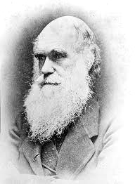


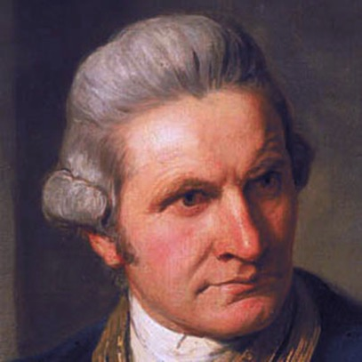
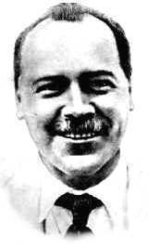
Notes:
Biodiversity : Darwin Core is named after Charles Darwin (1809-1882)
Marine biodiversity: Explorers such as Captain James Cook (1728-1779), Charles Darwin (1809-1882) and Wyville Thomson(1830-1882) made revolutionary contributions to the history of marine biology.
Agricultural biodiversity: Nikolai Ivanovich Vavilov (Russian: Никола́й Ива́нович Вави́лов) (November 25, 1887 – January 26, 1943) was a prominent Russian and Soviet botanist and geneticist best known for having identified the centres of origin of cultivated plants.

