Slide 1
Global Biodiversity Information Facility
Executive Secretary Joe Miller – GBIF Secretariat
Dag Endresen - GBIF Norway, University of Oslo
Illustration: GBIF data portal
FAO Plant Treaty GLIS SAC meeting, Rome | 8-9 May 2023
Notes:
Illustration: GBIF data portal, https://www.gbif.org

Slide 2
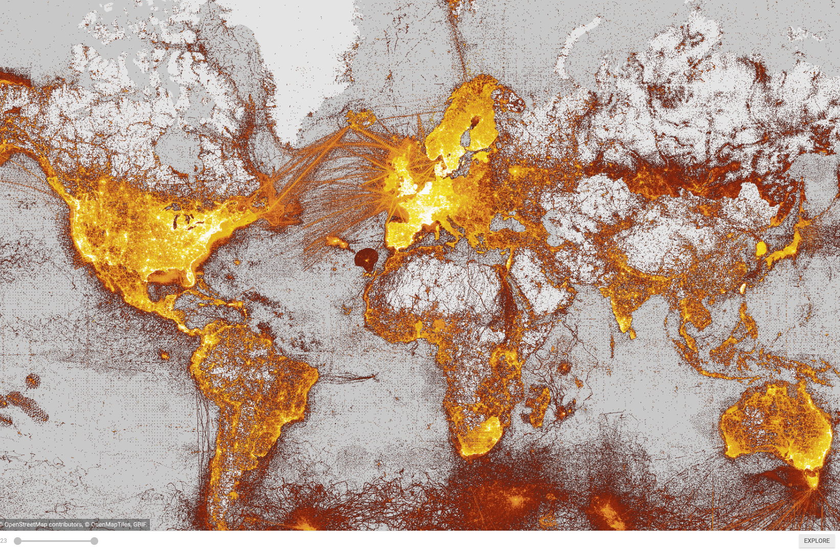
What is gbif?
Intergovernmental network and research infrastructure
Provides anyone, anywhere, free and open access to data about all types of life on Earth
Distributed research data infrastructure based on national participant NODES
Secretariat in Copenhagen, Denmark
https://www.gbif.org
Notes:
https://www.gbif.org/

Slide 3
GBIF Participant countries 5th May 2023
Voting Countries (42)
Associate Countries (22)
Notes:
This map is fully editable. This map is a grouped element of all the countries in the world. All the countries are named correctly and can be accessed and selected via the Selection Pane. There are ways you can edit and make changes to the map. But please remember to always make a copy of the map on your slide and never make changes to the toolkit version. Please take a look at the next few slides to find out different ways of editing this map.

Slide 4
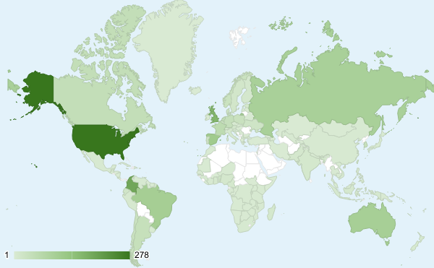
GBIF Network of Data publishing institutions 8th May 2023
134
countries/areas
with institutions sharing data through GBIF
Top 10 countries: number of data publishers
1 | United States | 357
2 | Colombia | 200
3 | United Kingdom | 181
4 | Spain | 128
5 | Russian Federation | 128
6 | Brazil | 113
7 | Australia | 108
8 | France | 63
9 | Canada | 57
10 | Netherlands | 45
-- | Italy (observer) | 20

Slide 5
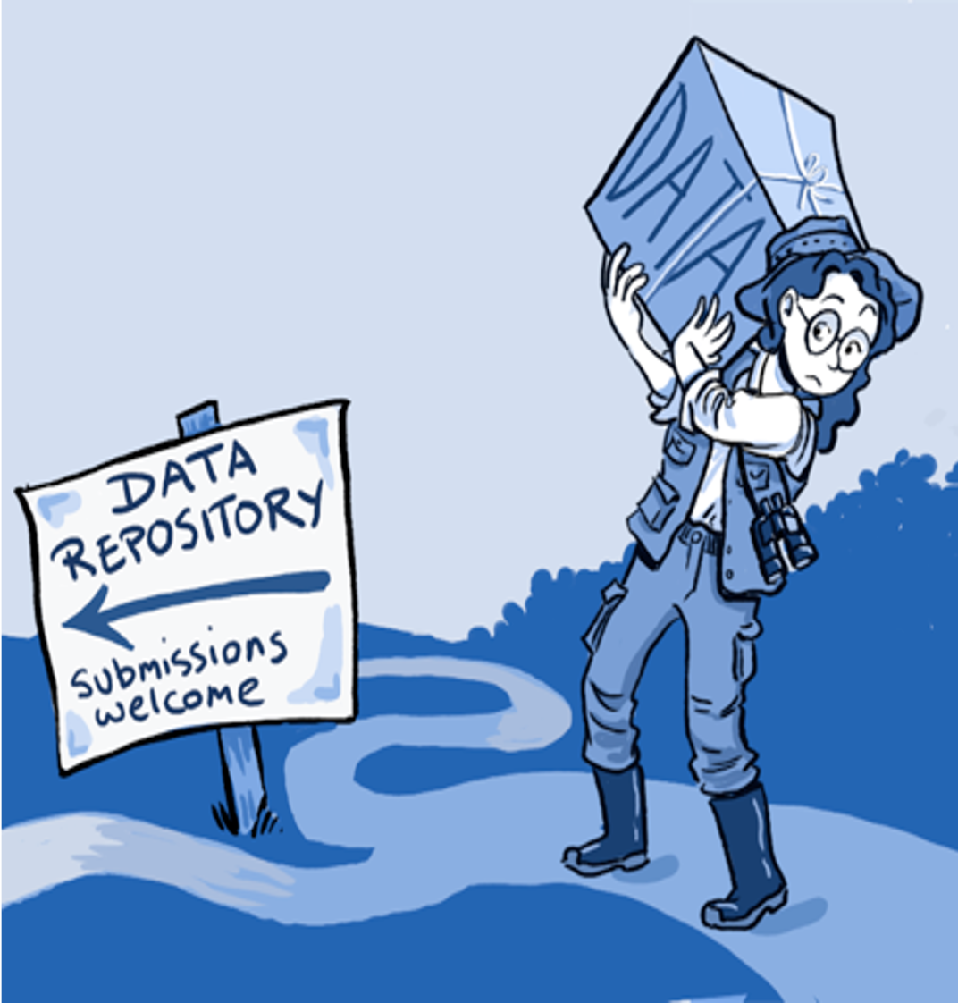
Publish PGRFA datasets with GBIF
National GBIF nodes offer support with professional data preparation and publication (data stewardship).
The GBIF community including the national GBIF nodes offer training and capacity building for open and FAIR data management.
GBIF Nodes can support national PGRFA focal points with data services.
The Plant Treaty can collaborate with GBIF to mobilize country membership and data publication efforts.
Notes:
http://www.gbif.org/resource/80635
http://www.gbif.org/publishing-data/summary
http://www.gbif.org/publishing-data/request-endorsement#/intro

Slide 6
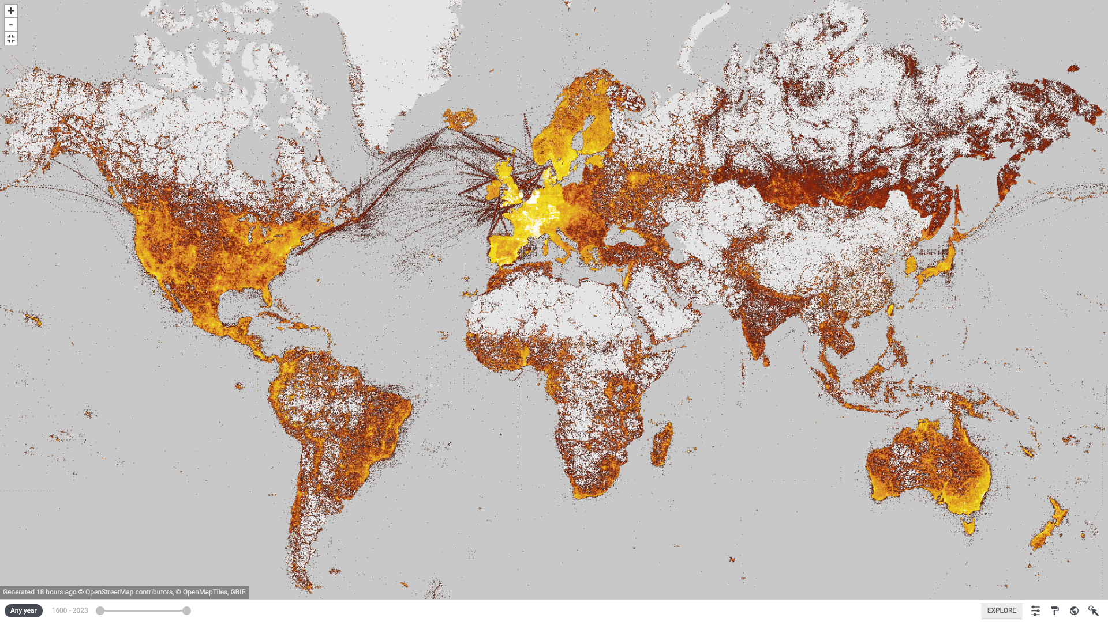

Crop Wild Relatives account for around 21% of the world’s flora (Maxted and Kell 2009)
Density of georeferenced plant species occurrence records published through GBIF (see http://www.gbif.org/species/6)
Notes:
Illustration, GBIF Portal, filter for Plants, http://www.gbif.org/species/6, map updated 2023-05-03
Nigel Maxted and Shelagh Kell (2009). Establishment of a Global Network for the In Situ Conservation of Crop Wild Relatives: Status and Needs. FAO, Rome.
http://www.fao.org/docrep/013/i1500e/i1500e18a.pdf
CWR account for around 21% of the world’s flora (Maxted and Kell 2009)
Their natural populations are becoming more threatened - 2 out of 10! (Kell et al. 2012)
Ramírez-Villegas J, Khoury C, Jarvis A, Debouck DG, Guarino L (2010) A Gap Analysis Methodology for Collecting Crop Genepools: A Case Study with Phaseolus Beans. PLoS ONE 5(10): e13497. doi:10.1371/journal.pone.0013497

Slide 7
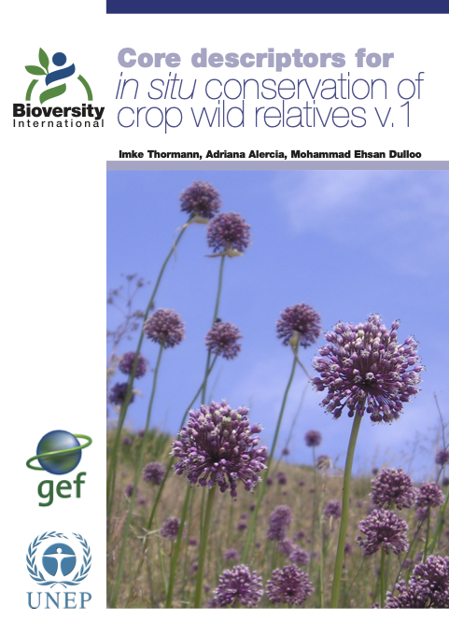
In situ CWR data streams are already flowing through GBIF
Many crop wild relatives conserved in situ are already an integrated part of the GBIF portal. (CWRs are an estimated 21% of the flora).
The Plant Treaty, PGRFA-, and GBIF experts (including national nodes) can work together on the implementation of the descriptors for CWR conservation in situ.
Including harmonization with Darwin Core and the development of extensions for data publishing services.
Complementary strategic missions!!!
Notes:
Thormann I, Alercia A, Dulloo ME. 2013. Core descriptors for in situ conservation of crop wild relatives v.1. Bioversity International, Rome, Italy. ISBN-978-92-9043-935-6. Cover photo: Wild Allium in Italy. A. Lane.

Slide 8
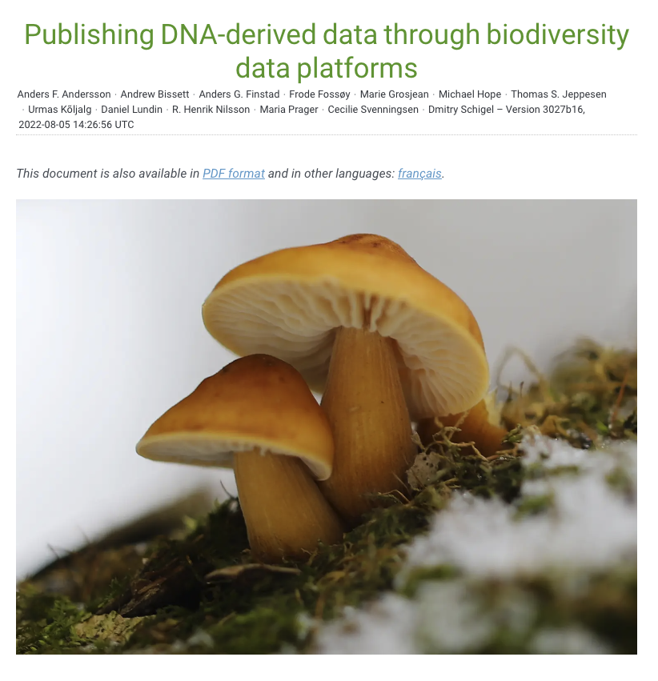
Digital Sequence information / Genetic sequence data
GBIF has developed data mobilisation guidelines for DNA-derived data available for reuse by GLIS.
Based on Darwin Core and MIxS data standards.
DNA-detected biodiversity information mobilization has high strategic priority in GBIF!
Complementary strategic priorities!
Notes:
Andersson AF, Bissett A, Finstad AG, Fossøy F, Grosjean M, Hope M, Jeppesen TS, Kõljalg U, Lundin D, Nilsson RN, Prager M, Svenningsen C & Schigel D (2020) Publishing sequence-derived data through biodiversity data platforms. Copenhagen: GBIF Secretariat. https://doi.org/10.35035/doc-vf1a-nr22.

Slide 9

Biodiversity Digital Twin (biodt.eu)
GBIF and GBIF Norway participate in the Horizon Europe development of digital twins for biodiversity (2022-2025).
Including a digital twin for the crop wild relative genepool of grasspea (Lathyrus).
Including a digital twin for DNA-detected biodiversity in poorly known habitats.
The Plant Treaty and PGRFA researchers are very relevant target end-users and partners!
Notes:
https://biodt.eu/use-cases

Slide 10

Collection specimens and genebank accessions
The Multi-Crop Passport Descriptors (MCPD) for genebank accessions conserved ex situ are already compliant with GBIF.
MCPD mapped to the ABCD data standard for implementation with the BioCASe data publishing toolkit (Berhendsohn and Knüpffer 2006).
MCPD mapped to the Darwin Core data standard and the Darwin Core germplasm extension for implementation in the GBIF Integrated data Publishing Toolkit (IPT) (Endresen and Knüpffer 2012).
Notes:
Andersson AF, Bissett A, Finstad AG, Fossøy F, Grosjean M, Hope M, Jeppesen TS, Kõljalg U, Lundin D, Nilsson RN, Prager M, Svenningsen C & Schigel D (2020) Publishing sequence-derived data through biodiversity data platforms. Copenhagen: GBIF Secretariat. https://doi.org/10.35035/doc-vf1a-nr22.

Slide 11

Global Registry of Scientific Collections
GRSciColl was established by CBOL at Smithsonian in 2013
Hosting of GRSciColl was transferred from CBOL to GBIF in 2019
May 2023: 8 133 institutions7 045 scientific collections registered
Notes:
The Global Registry of Scientific Collections (GRSciColl) was a community-curated clearing house of colletions information developed by the Consortium of the Barcode of Life (CBOL) – launched in 2013.
Hosting the GRSciColl was transferred to GBIF in 2018 and the upgraded portal came back online in 2019.
https://www.gbif.org/grscicoll
https://scicoll.org/grscicoll.html
https://data-blog.gbif.org/post/grscicoll-2021/
https://github.com/gbif/registry/blob/master/roadmap-grscicoll.md
8 133 collection-holding institutions
7 045 scientific collections
17 000 collection staff members
https://www.gbif.org/grscicoll

Slide 12
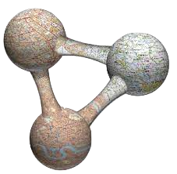



ROR for institutions
ORCID for people
DOI for datasets
GRSciColl UUID for collections
(& e.g. DOIs for specimens)
will enable the linking of collection specimens (including genebank accessions) to scientific litterature and scientific actors (authors, curators, etc)→ Integration of collections with the Web of Science metrics
Digital Object Identifier (DOI)
Open Researcher and Contributor ID (ORCID)
Research Organisation Registry (ROR)
Universally Unique Identifier (UUID)
Notes:
Digital Object Identifier (DOI) - https://doi.org/
Open Researcher and Contributor ID (ORCID) - https://orcid.org/
Research Organisation Registry (ROR) - https://ror.org/ (start in early 2019)
https://dissco.tech/2020/04/11/identifiers-for-our-institutes-grid-and-ror/
https://en.wikipedia.org/wiki/Research_Organization_Registry
http://www.wikidata.org/entity/Q63565260

Slide 13
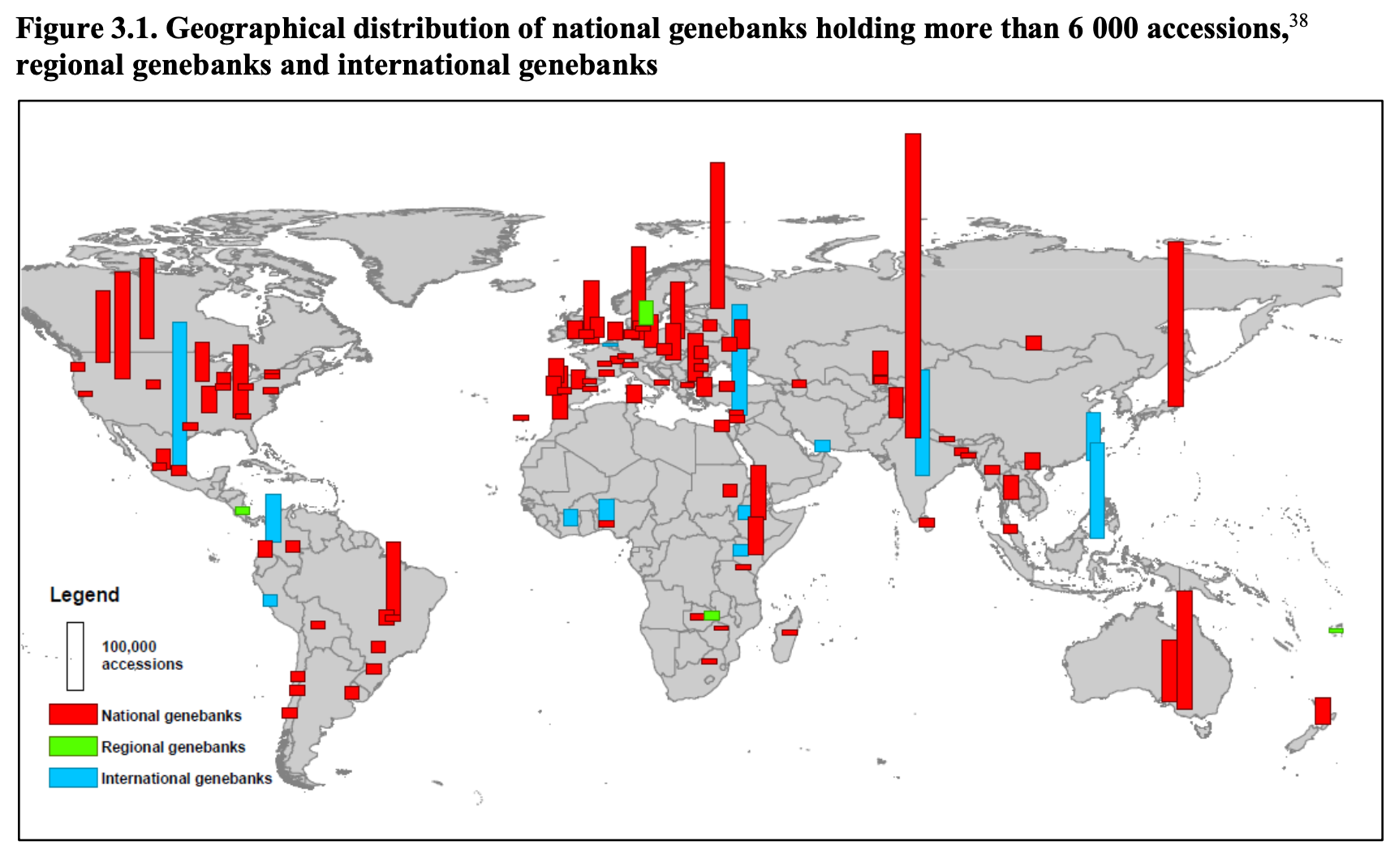
The FAO WIEWS Organization table could be linked with GrSciColl
More than 17,000 organizations engaged in the conservation and sustainable use of PGRFA are registered by FAO and assigned a WIEWS INSTCODE.
Recommendation
WIEWS INSTCODE → ROR ID
PGRFA collections → GRSciColl (link systems)
Notes:
https://www.fao.org/wiews/data/organizations/en/?no_cache=1

Slide 14
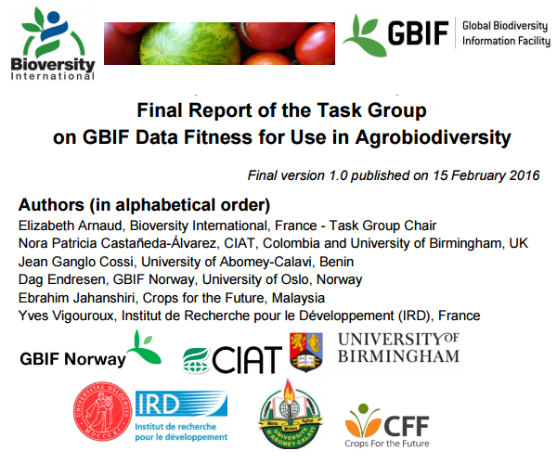
Agrobiodiversity fitness for use task group
GBIF and Bioversity (2016) task group on GBIF data fitness for use in agrobiodiversity.
New GBIF agrobiodiversity task group is in planning – to review the implementation of the recommendations (to be decided).
The Plant Treaty could join the formation of a new agrobiodiversity task group.
Notes:
GBIF and Bioversity (2016) Final report of the task group on GBIF data fitness for use in agrobiodiversity. Global Biodiversity Information Facility, Copenhagen. http://www.gbif.org/resource/82283
https://cgspace.cgiar.org/handle/10568/77851 & https://www.duo.uio.no/handle/10852/50041
News story: http://www.gbif.org/newsroom/news/agrobiodiversity_report

Slide 15
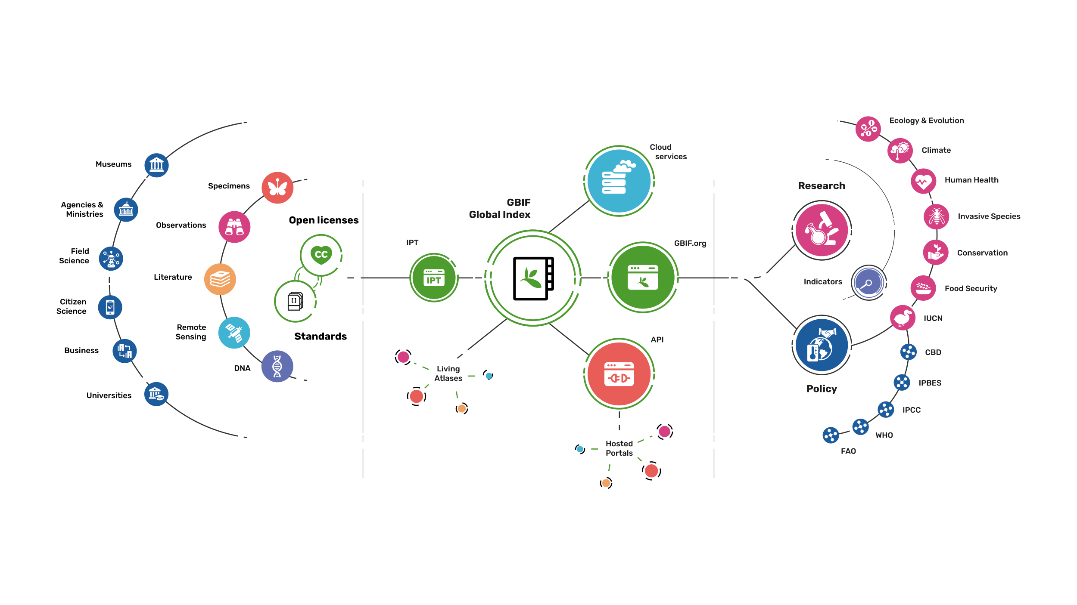
Providing biodiversity Evidence for research and policy

Slide 16


Joe Miller
Executive Secretary
GBIF Secretariat
Dag Endresen
Node Manager
GBIF Norway
Notes:
GLIS relevant Services from national GBIF Nodes
National GBIF nodes can work with national PGRFA focal points to develop and deliver modern, dynamic and automatic data mobilisation services.
GBIF has developed data mobilisation guidelines for DNA-derived data available for reuse by GLIS.
The Multi-Crop Passport Descriptors (MCPD) for genebank accessions conserved ex situ are already mapped to Darwin Core and the DwC germplasm extension.
Many crop wild relatives conserved in situ are already an integrated part of the GBIF portal. (CWRs are an estimated 21% of the flora).
GBIF experts (and national nodes) can contribute to the development of the descriptors for CWR conservation in situ, including harmonization with Darwin Core and the development of extensions for data publishing services.
Genebank collections (in WIEWS, etc.) could be linked to the GBIF-hosted Global Registry of Scientific Collections (GRSciColl) – for deeper integration of collections with the overall web-of-science metrics.

