Slide 1
Evakuering av Herbariet i Kherson, Ukraina
Dag Endresen - GBIF Norge - Universitetet i Oslo
Illustrasjon: GBIF data portal
Arkivforbundet, Sandefjord | 2023-06-01
Notes:
Illustration: Evacuation of the Kherson State University Herbarium (KHER) to Ivano-Franovich

Slide 2
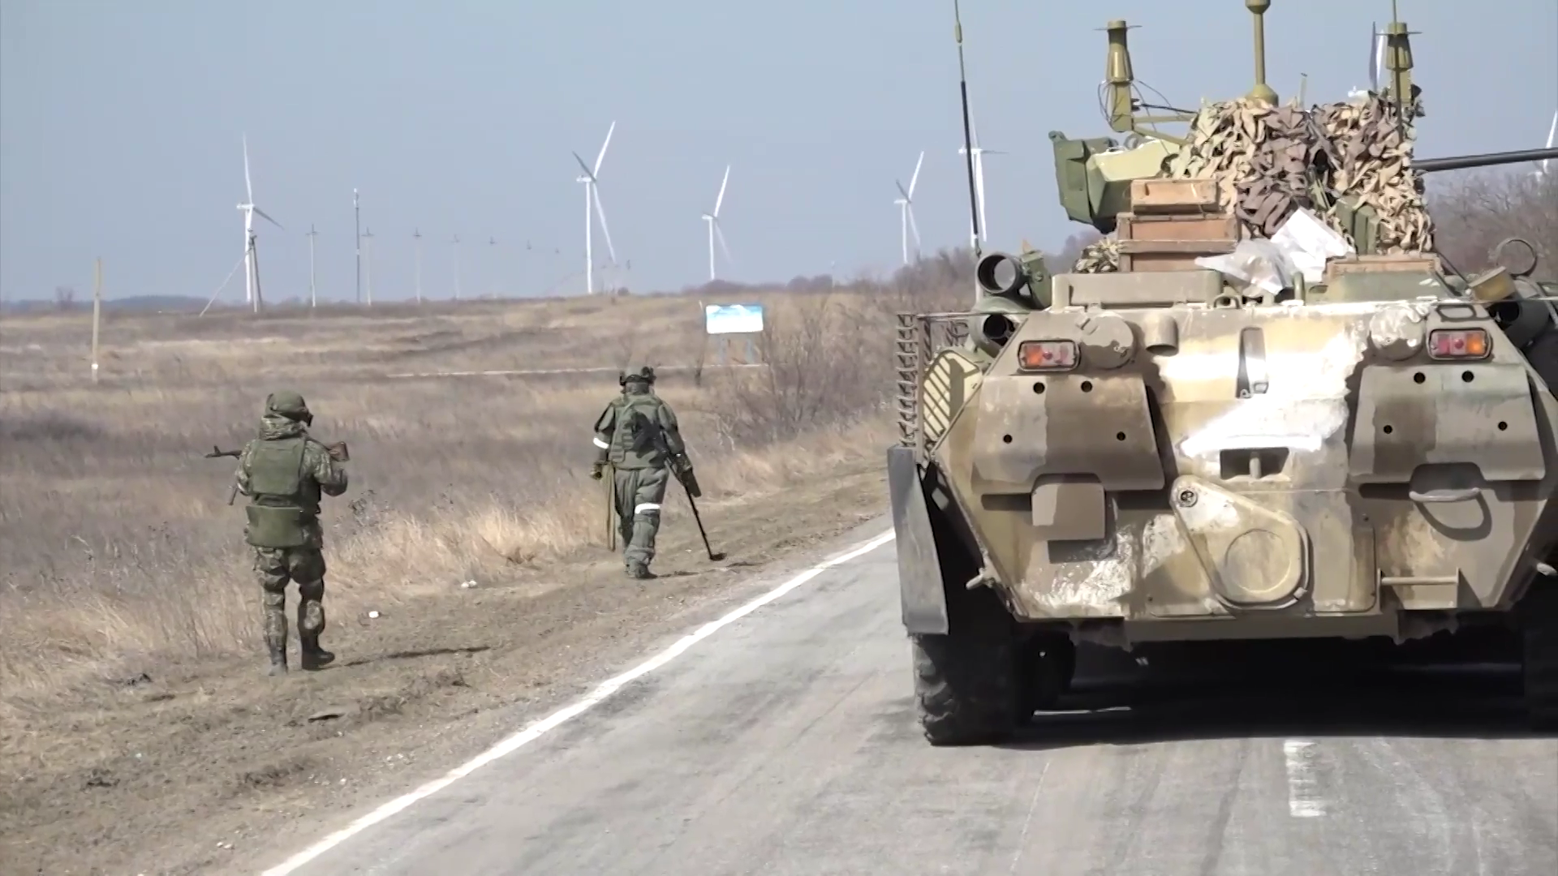
Russian occupation of Kherson (March to November 2022)
March 2022, Russian occupation of Kherson
November 2022, liberation of Kherson
Still today ongoing shelling of Kherson from Russian army…
Ukrainian cultural heritage remain under significant threath from Russian agression!
Notes:
Russian engineer troops of the Southern Military District conduct de-mining operations in the Kherson region, March 2022
https://commons.wikimedia.org/wiki/File:%D0%A0%D0%B0%D0%B7%D0%BC%D0%B8%D0%BD%D0%B8%D1%80%D0%BE%D0%B2%D0%B0%D0%BD%D0%B8%D0%B5_%D1%81%D0%B5%D0%BB%D1%8C%D1%85%D0%BE%D0%B7%D1%83%D0%B3%D0%BE%D0%B4%D0%B8%D0%B9_%D0%B2_%D0%A5%D0%B5%D1%80%D1%81%D0%BE%D0%BD%D1%81%D0%BA%D0%BE%D0%B9_%D0%BE%D0%B1%D0%BB%D0%B0%D1%81%D1%82%D0%B8_001.png

Slide 3
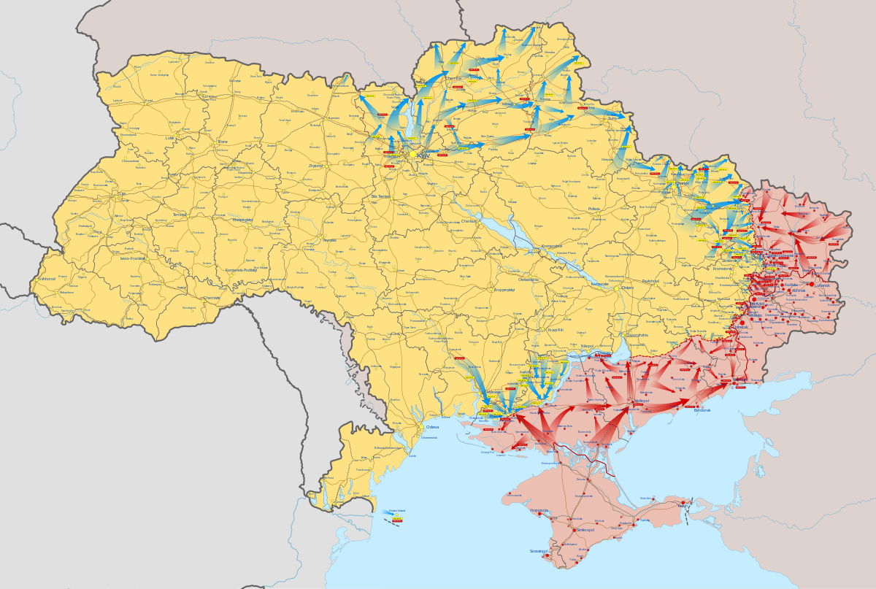


Kherson

Slide 4
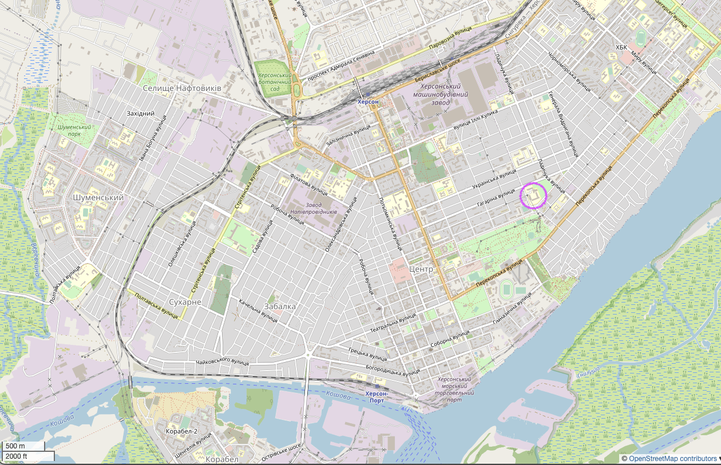

Kherson
Kherson State University
Kherson Nature Museum
Notes:
OpenStreetMap openstreetmap.org/copyright Open Database License (ODbL)

Slide 5
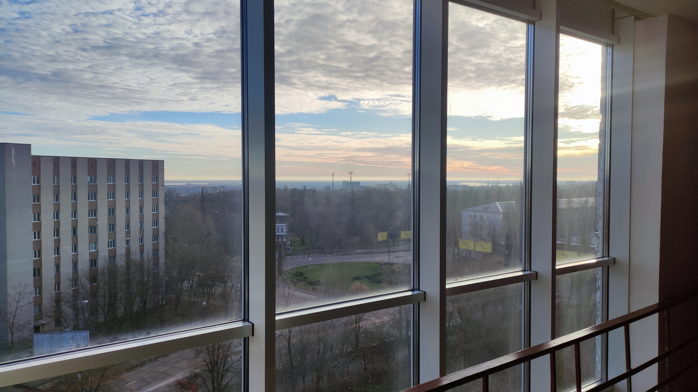
Kherson State University – Kherson Herbarium (KHER)
“Herbarium is situated on 7 floor. The windows overlook the left bank of the Dnipro, from which they are firing. In connection with heavy shelling, it is necessary to lower it from the seventh floor to the first. At least with a collection of lichens and mosses that are in paper boxes, this can be done” from email by professor Olexander Khodosovtsev on 2022-12-17
Dniper river
Notes:
Photo: Kherson State University, professor Alexander Khodosovtsev and professor Ivan Moysiyenko
2022-12-22, “23_view from windows of university to occupied left bank of Dniper”

Slide 6
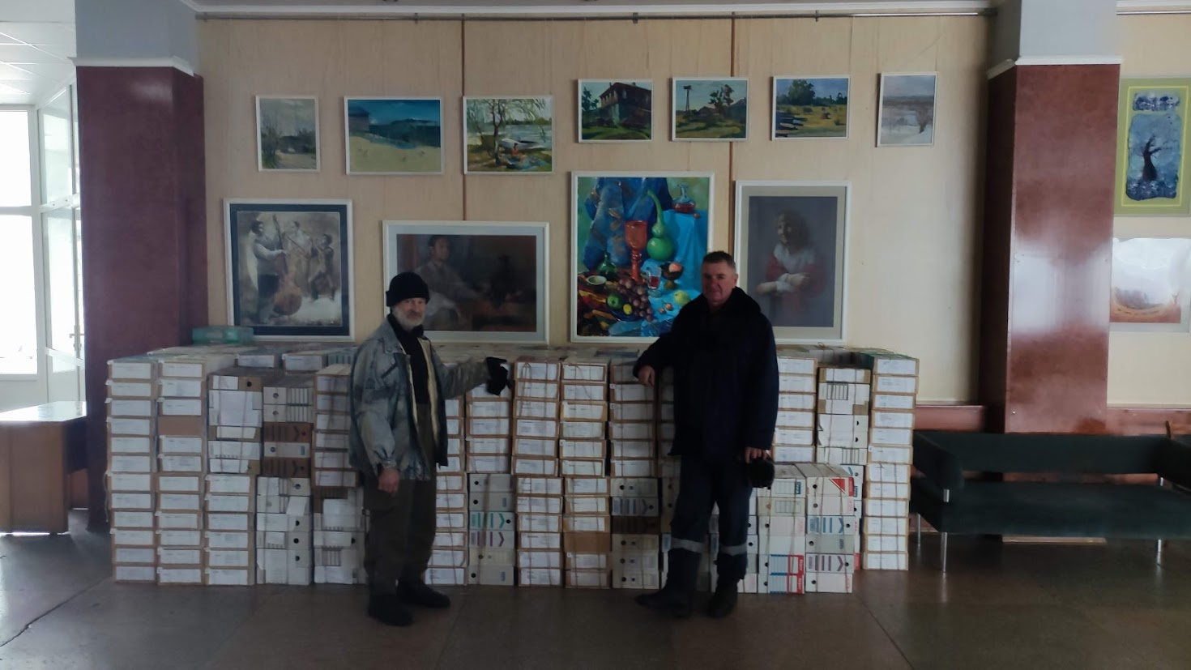
Julaften 24. desember 2022
“Here are two guys out of five, who helped to lower boxes from the seventh floor to the first floor without an elevator. We started doing it on time. In addition to Russian missiles, there is also humidity, which can also damage specimens. University premises without heating and electricity. Some books in my room have already become wavy.”
From email 2022-12-24 by Professor Olexander Khodosovtsev.
Notes:
Photo: Kherson State University, professor Olexander Khodosovtsev and professor Ivan Moysiyenko
KHER Kherson State University herbarium

Slide 7
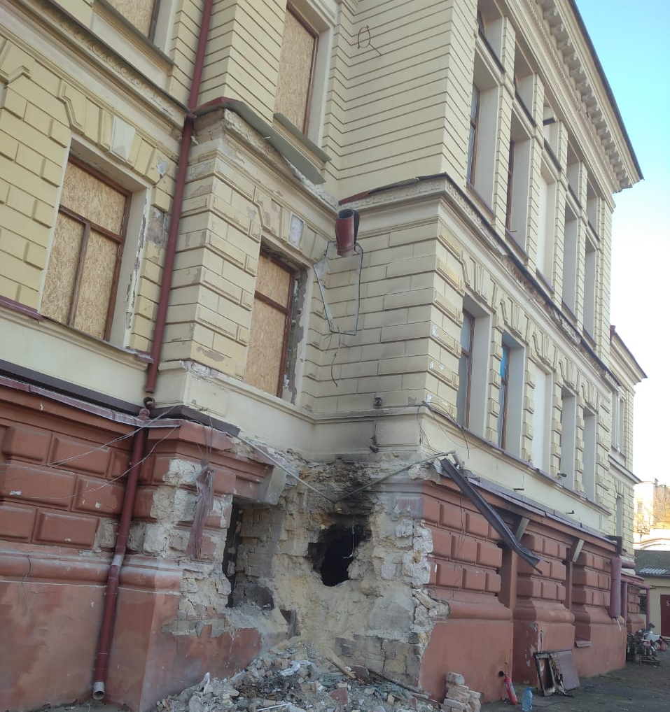
Kherson Nature Museum
Samme uken som Herbariet i Kherson ble pakket ned – ble også Kherson Regional Museum of Local Lore (KHEM) truffet av et russisk missil!!
Kherson Nature Museum har tilsvarende naturhistoriske samlinger (som har blitt delvis evakuert senere i vår).
KHEM herbarium har ca. 22 000 herbariebelegg karplanter, inkludert innsamlinger fra professor Joseph Paczoski.
Notes:
Photo: Kherson State University, professor Alexander Khodosovtsev and professor Ivan Moysiyenko

Slide 8
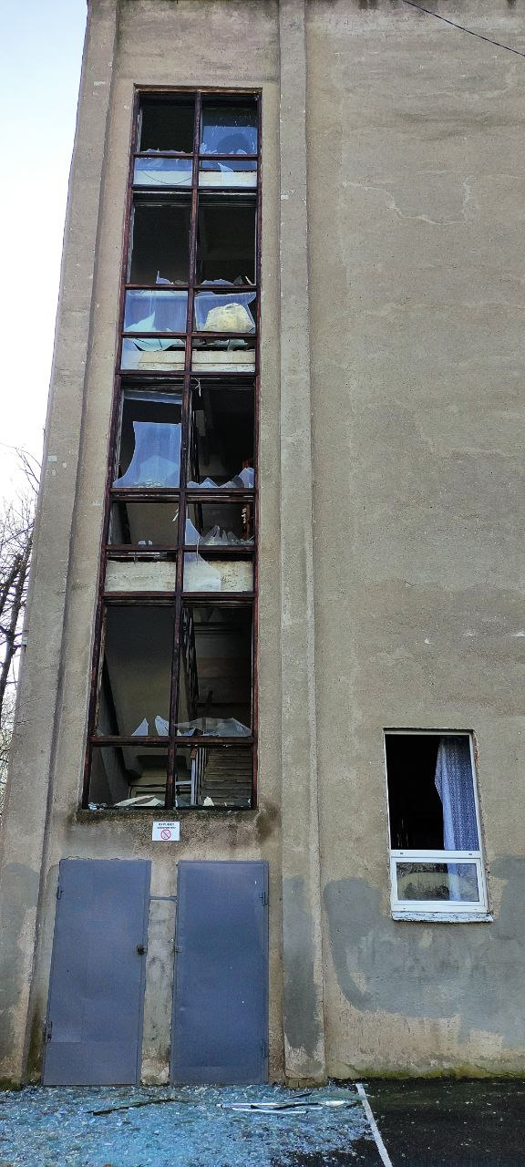
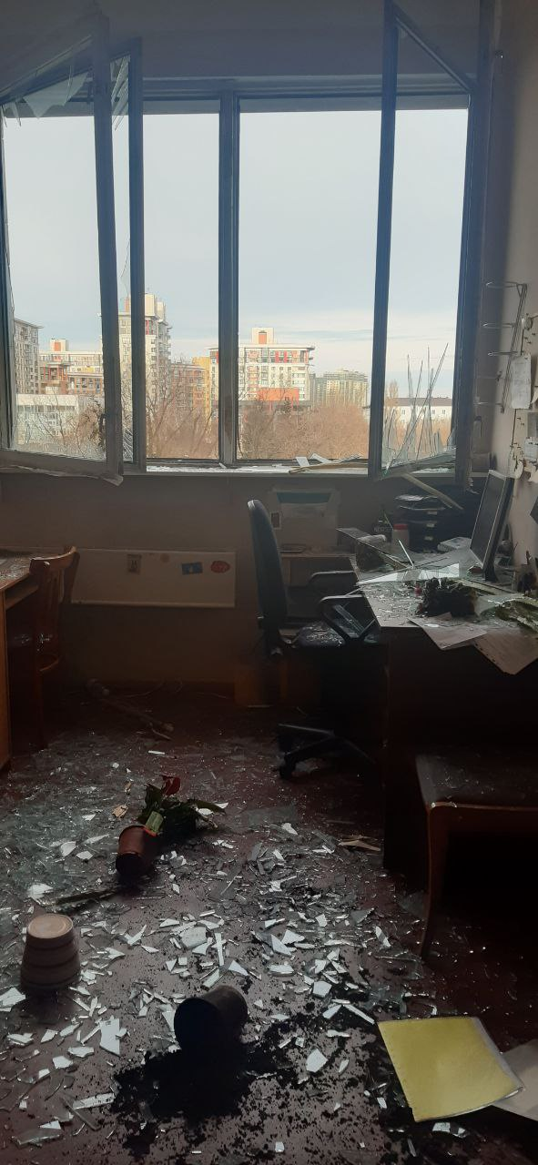
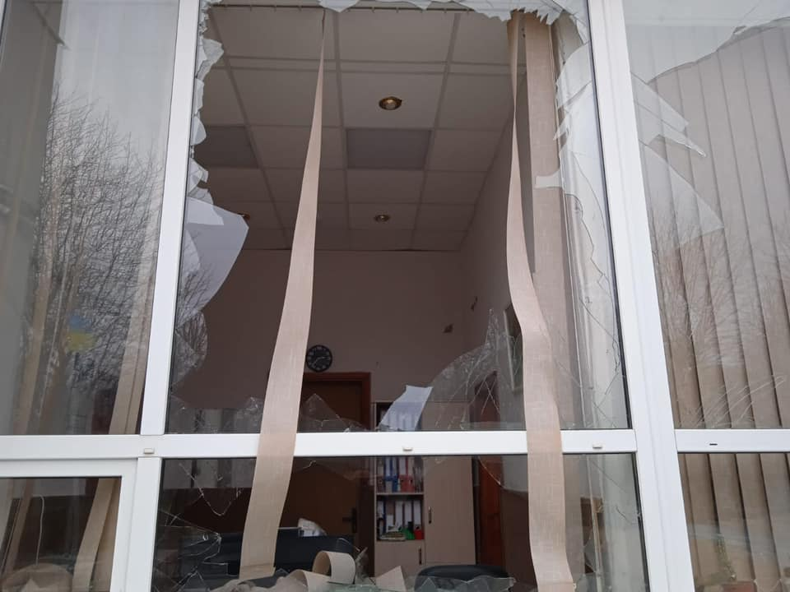
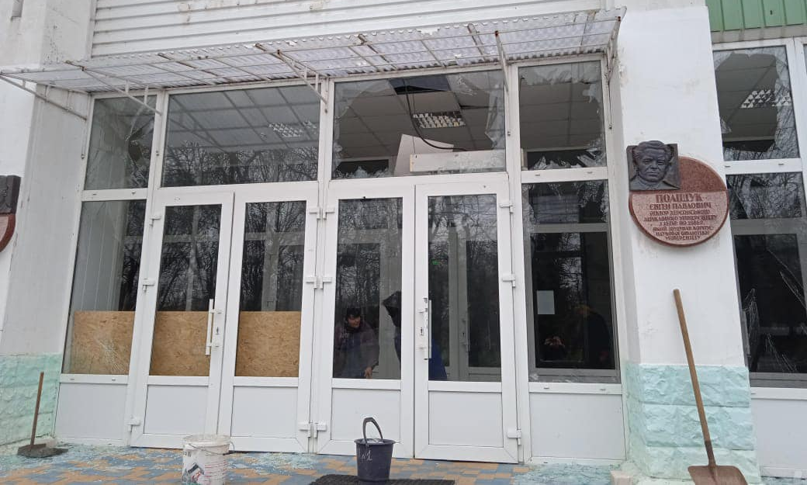
Kherson State University - December 2022 & January 2023
“Unfortunately, on New Year's Eve, the university was shelled again. The library, some administrative buildings, and the swimming pool were damaged. Today while working in the herbarium we heard explosions all day long. But we have to hope for the best.” From email 2023-01-02 by professor Ivan Moysiyenko
Notes:
Photo: Kherson State University, professor Alexander Khodosovtsev and professor Ivan Moysiyenko
2023-01-02--KHER Kherson State University herbarium

Slide 9
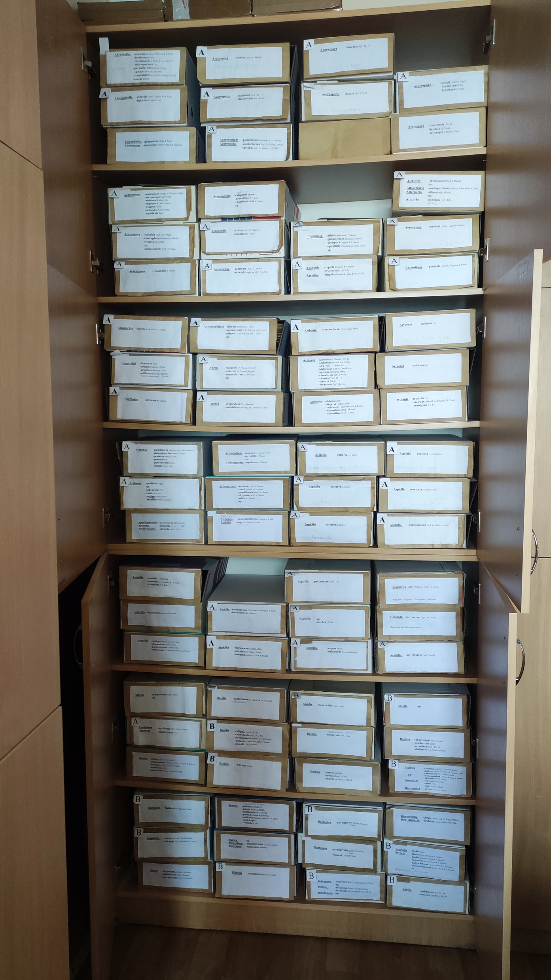
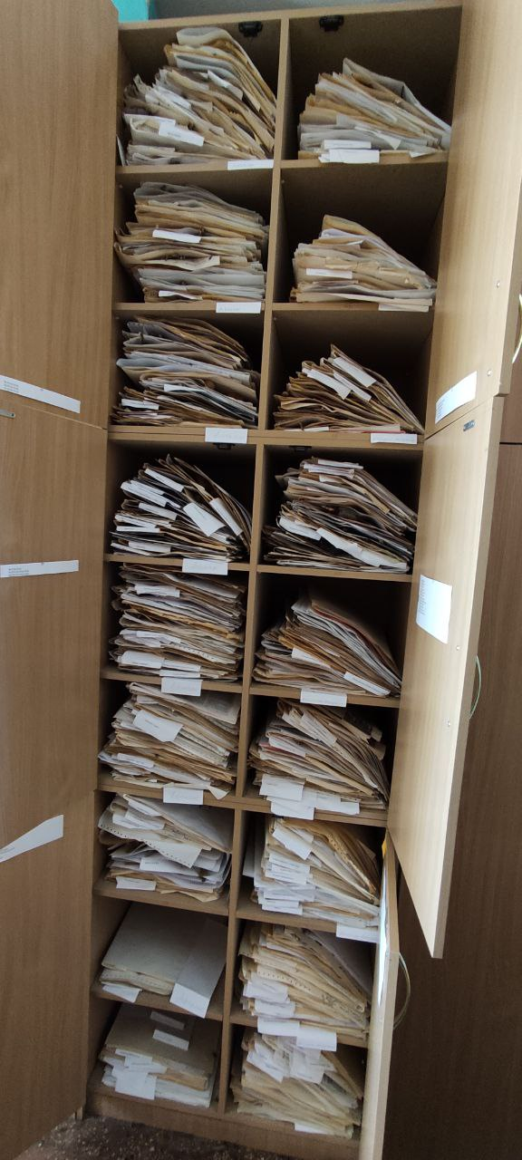
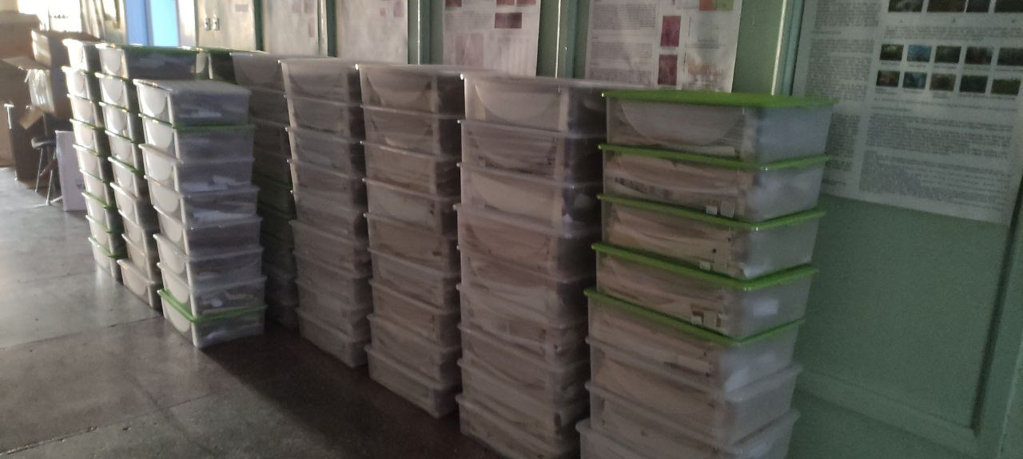
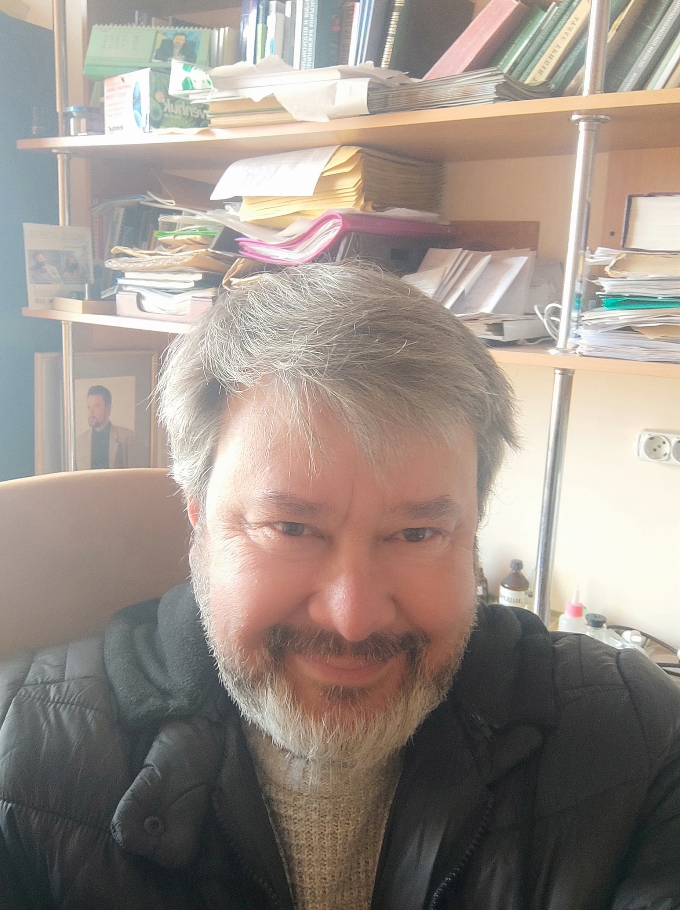
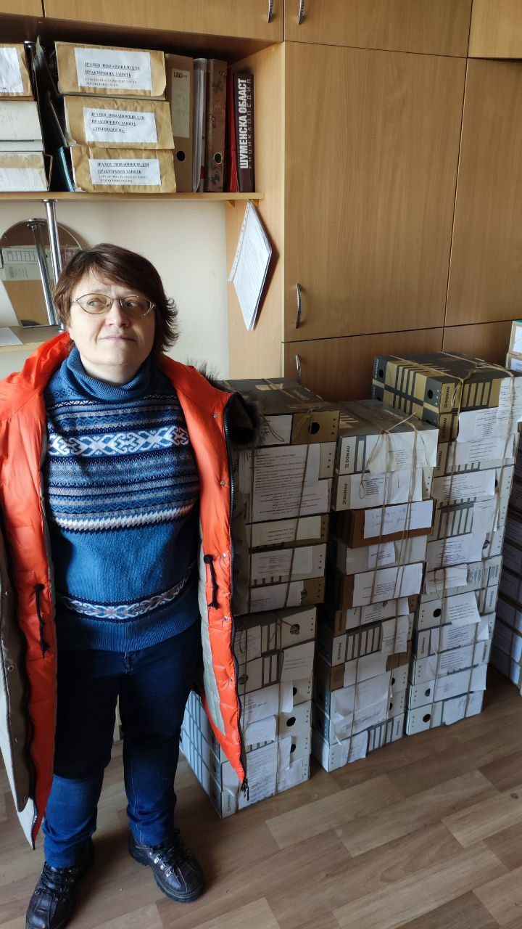
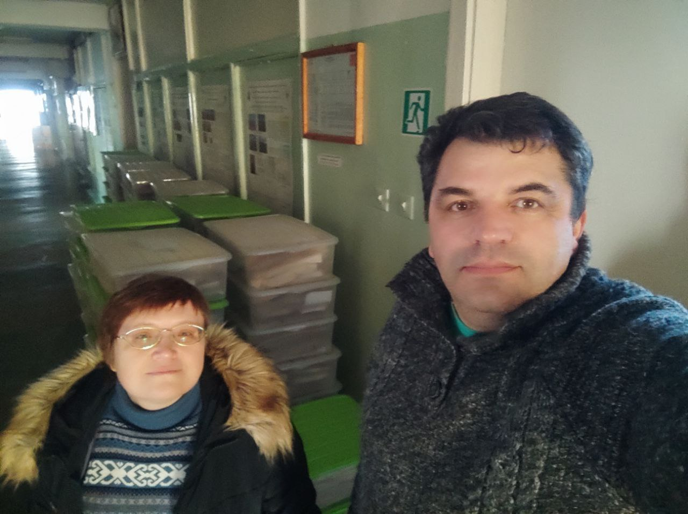
Pakking av herbariet – januar 2023
“Unfortunately, due to the lack of electricity and curfew, the work must be completed by 15.30. Therefore, the work is progressing slowly. But we hope to complete it on January 4. On January 5, we plan to load the truck. And we hope that on January 6 it will go to its destination” email 2023-01-02 from professor Ivan Moysiyenko
Professor Alexander Khodosovtsev
Bryophytes curator Nataliia_Zahorodniuk
Professor Ivan Moysienko
Notes:
Photo: Kherson State University, professor Alexander Khodosovtsev and professor Ivan Moysiyenko
KHER Kherson State University herbarium
Nataliia_Zahorodniuk_bryophytes_photo_2022-12-21_14-35-39

Slide 10
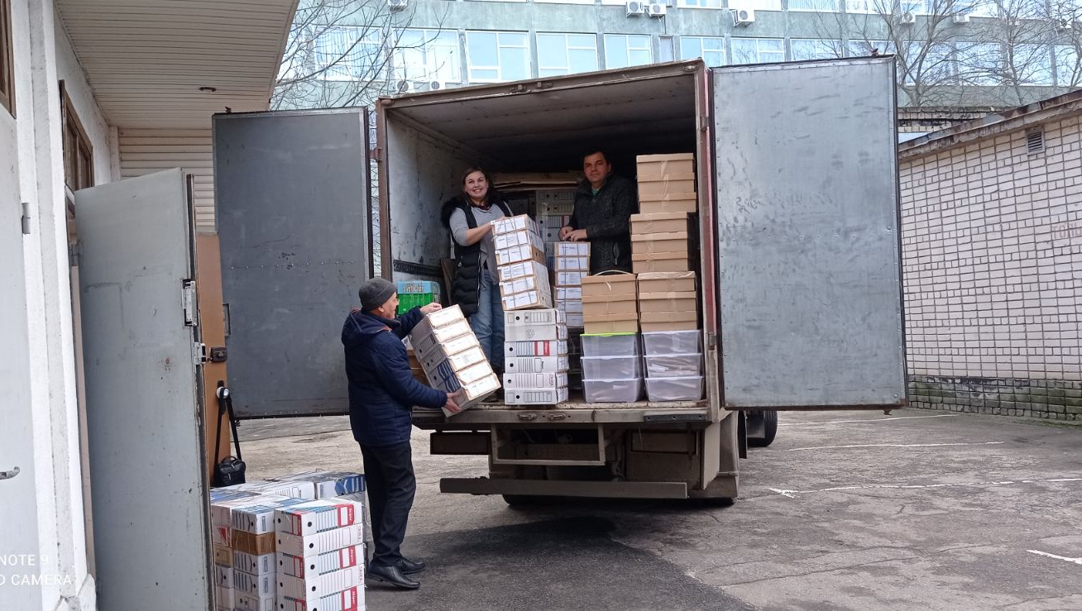
Avreise fra Kherson
“The truck with the herbarium is moving to Ivano-Frankivsk today. It left at 6 am from Kherson … explosions were heard all the time. A residential building was shelled today near the university, where a young man was killed. A fire station and other buildings were also destroyed. Therefore, I was once again convinced that we did the right thing by evacuating the herbarium.”
Professor Ivan Moysienko (email 2023-01-05)
Notes:
“My colleagues from the Department of Botany - Natalia Zagorodniuk and Maryna Zakharova, who were in Kherson at the time, helped me. The herbarium was loaded into the truck yesterday. The truck with the herbarium is moving to Ivano-Frankivsk today. It left at 6 am from Kherson. The truck should arrive in Ivano-Frankivsk tomorrow morning. We are in touch with the driver. He is moving according to the schedule.”
“… explosions were heard all the time. A residential building was shelled today near the university, where a young man was killed. A fire station and other buildings were also destroyed. Therefore, I was once again convinced that we did the right thing by evacuating the herbarium.”
Professor Ivan Moysienko (email 2023-01-05)
Photo: Kherson State University, professor Alexander Khodosovtsev and professor Ivan Moysiyenko

Slide 11
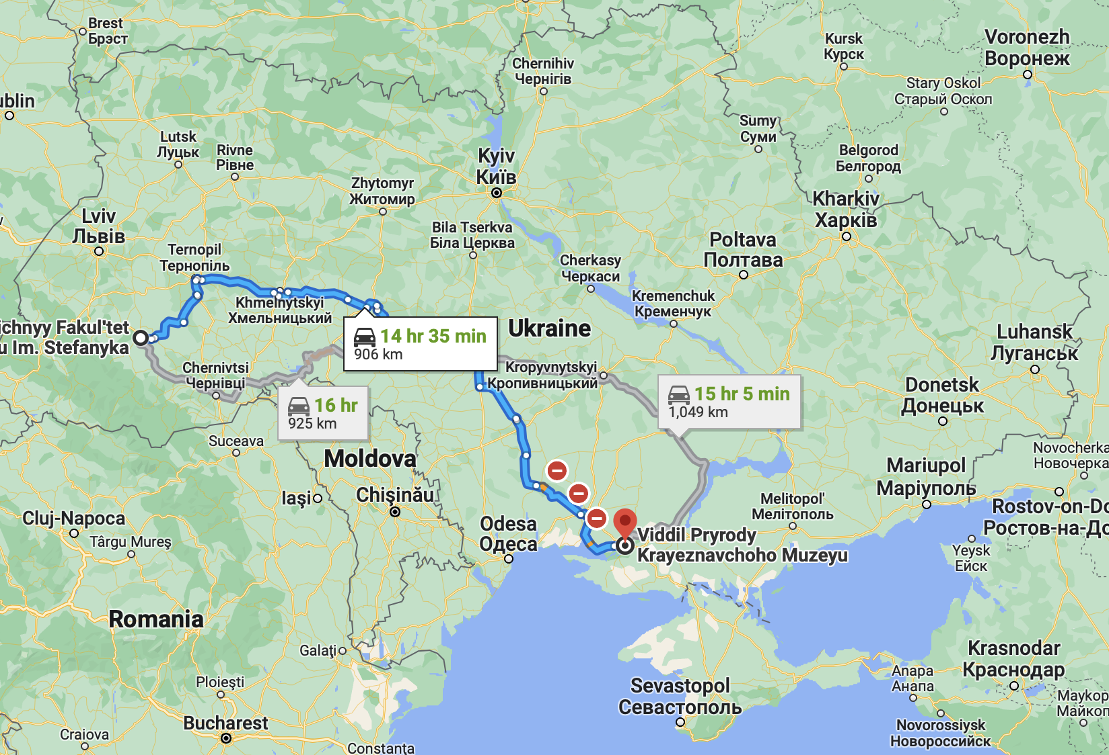
Kherson → Ivano-Frankivsk

Slide 12
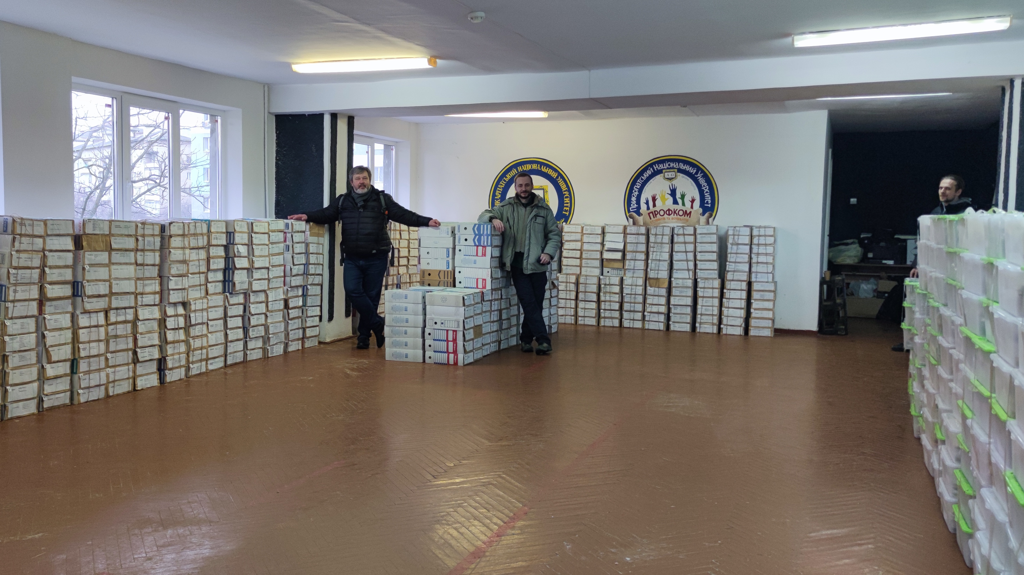
IH Vasyl Stefanyk Prycarpathian National University, Ivano-Frankivsk
Professor Alexander Khodosovtsev & Associate Professor Oleh Prylutskyi
Notes:
2023-01-07--IH Vasyl Stefanyk Prycarpathian National University
Professor Alexander Khodosovtsev and Associate Professor Oleh Prylutskyi
Vasyl Stefanyk Precarpathian National University, Shevchenka St, 57, Ivano-Frankivsk, Ivano-Frankivsk Oblast, Ukraine, 76000

Slide 13
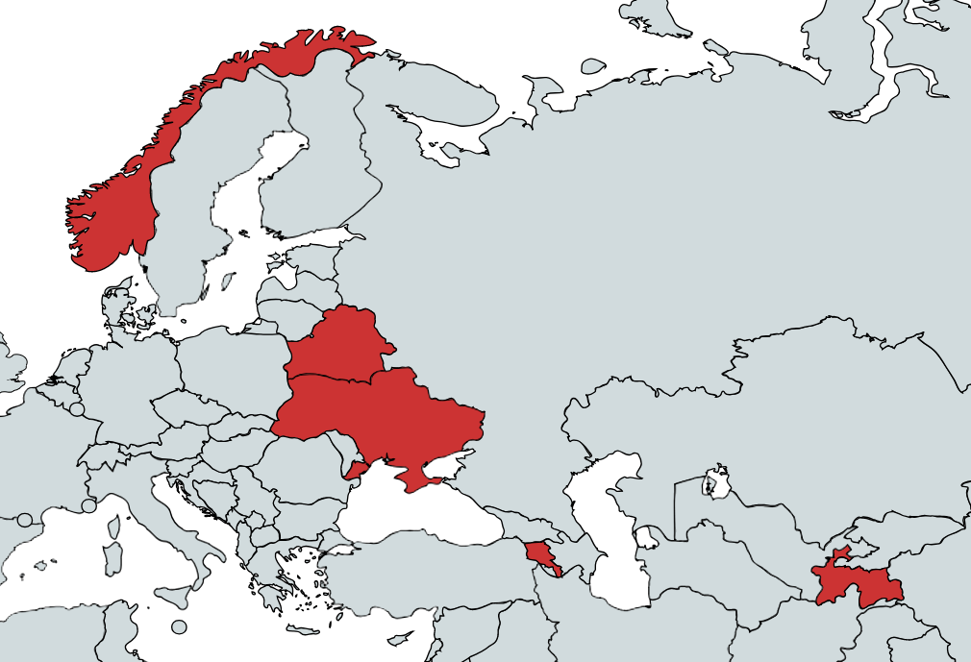





BioDATA 2018 - 2021
Norway
2018 - 2022
Belarus
Armenia
Tajikistan
Ukraine
Notes:
The BioDATA project from 2018 to 2022. The project includes project partners from Belarus, Ukraine, Armenia, Tajikistan, and Norway.
https://www.nhm.uio.no/english/research/projects/biodata/

Slide 14





Prosjekt partnere
University of Oslo (ForBio & GBIF Norway)
Armenian National Agrarian University
National Academy of Sciences of Belarus
Academy of Science & Zan va Zamin, Tajikistan
V.N. Karazin Kharkiv National University, Ukraine
GBIF Secretariat, Copenhagen
Notes:
https://www.nhm.uio.no/english/research/projects/biodata/

Slide 15
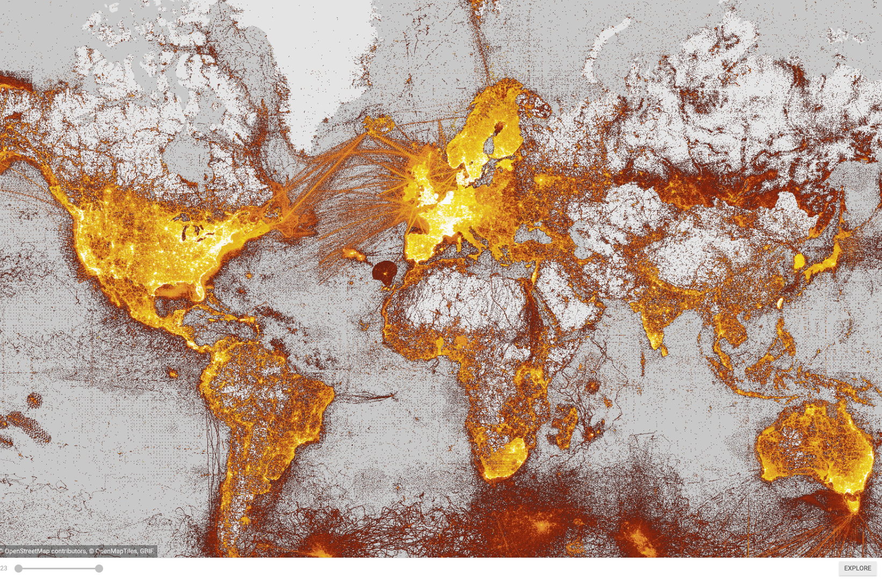
Hva er GBIF?
Intergovernmental network and research infrastructure
Provides anyone, anywhere, free and open access to data about all types of life on Earth
Distributed research data infrastructure based on national participant NODES
Secretariat in Copenhagen, Denmark
https://www.gbif.org
Notes:
https://www.gbif.org/

Slide 16
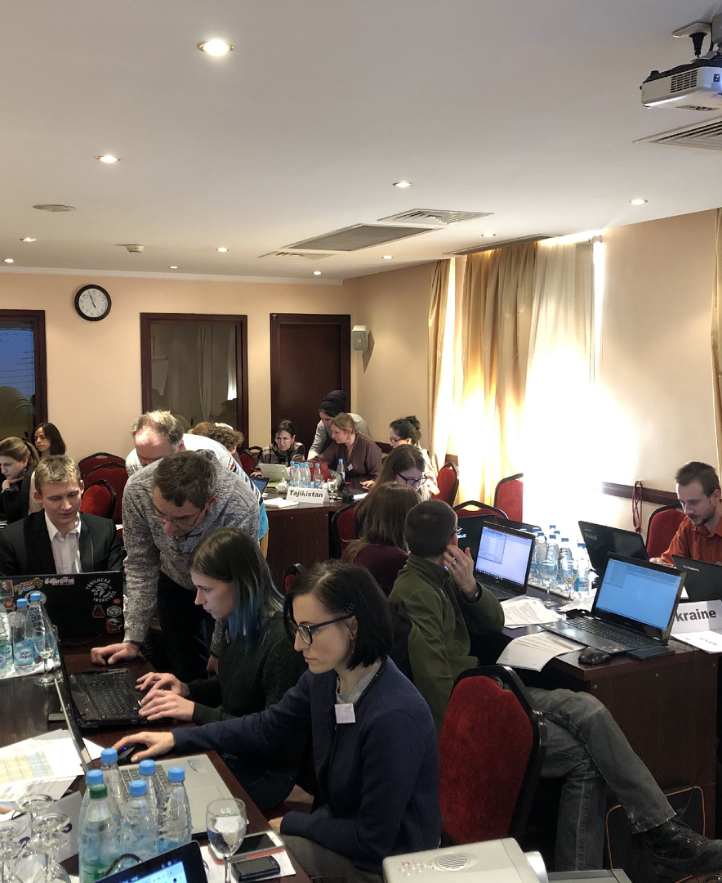
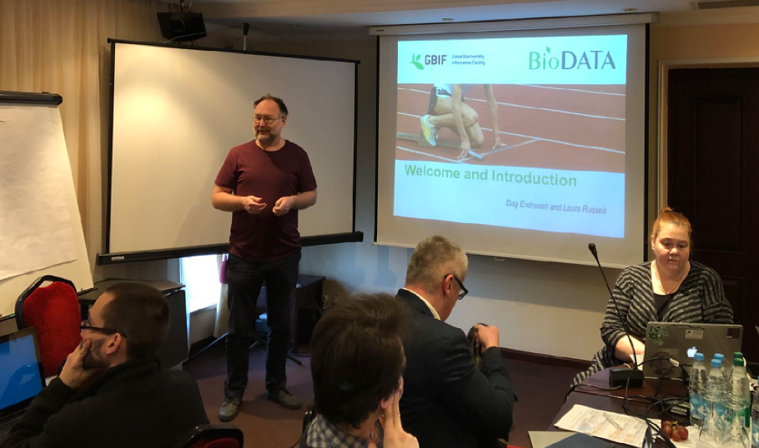
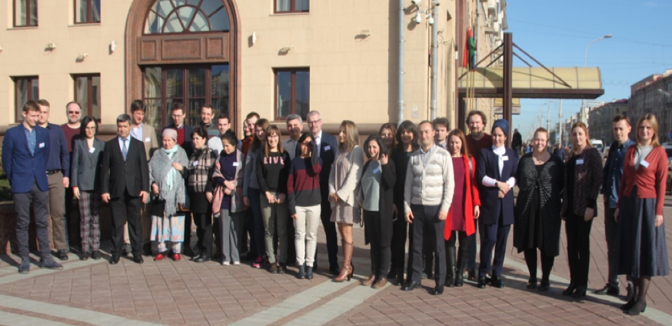
Activities
Train-the-mentors course
Staff from the project partners
Including from Ukraine
Train-the-mentors| February 2019 | Minsk, Belarus
Notes:
https://www.nhm.uio.no/english/research/projects/biodata/activities/201902-minsk.html

Slide 17
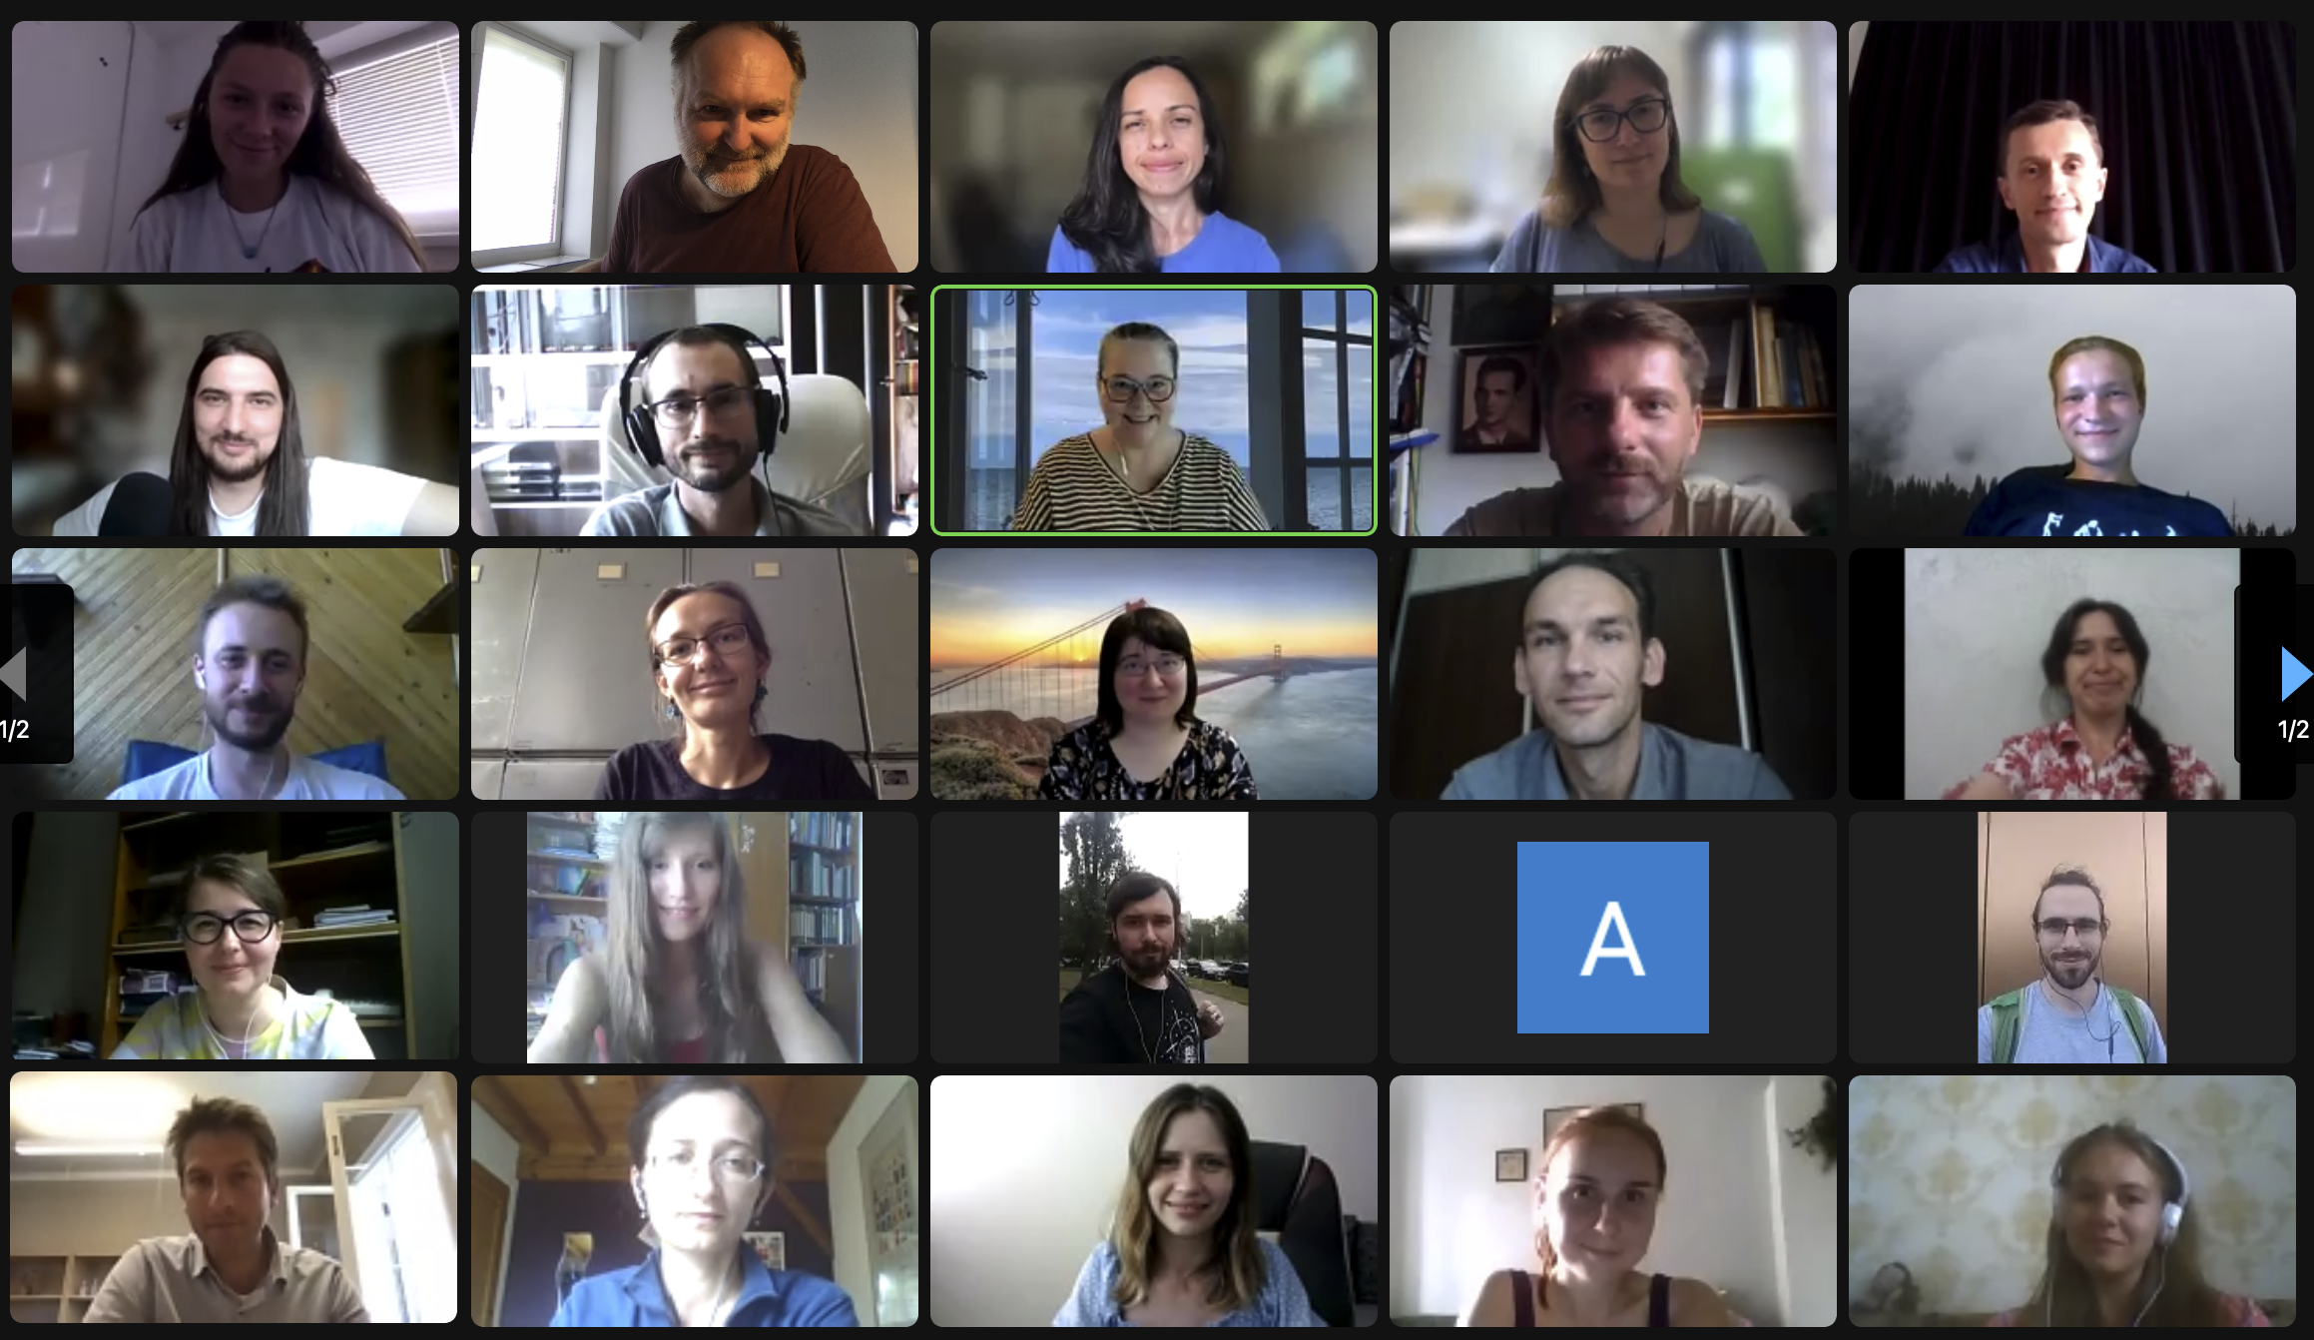
Online Course August 2022 Ukraine
Notes:
https://www.nhm.uio.no/english/research/projects/biodata/activities/2022-ukraine.html

Slide 18
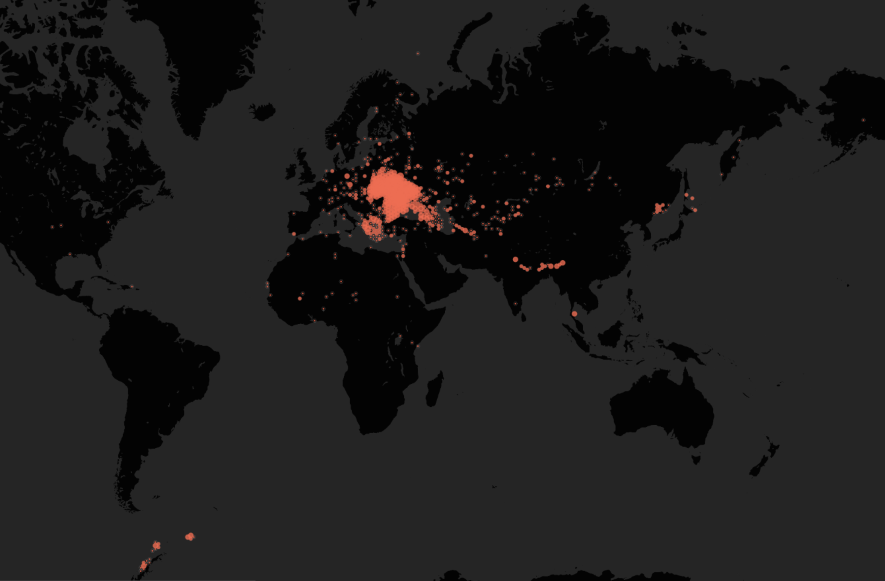
Data publisert fra institusjoner I Ukraina
Notes:
https://www.gbif.org/country/UA/summary

Slide 19

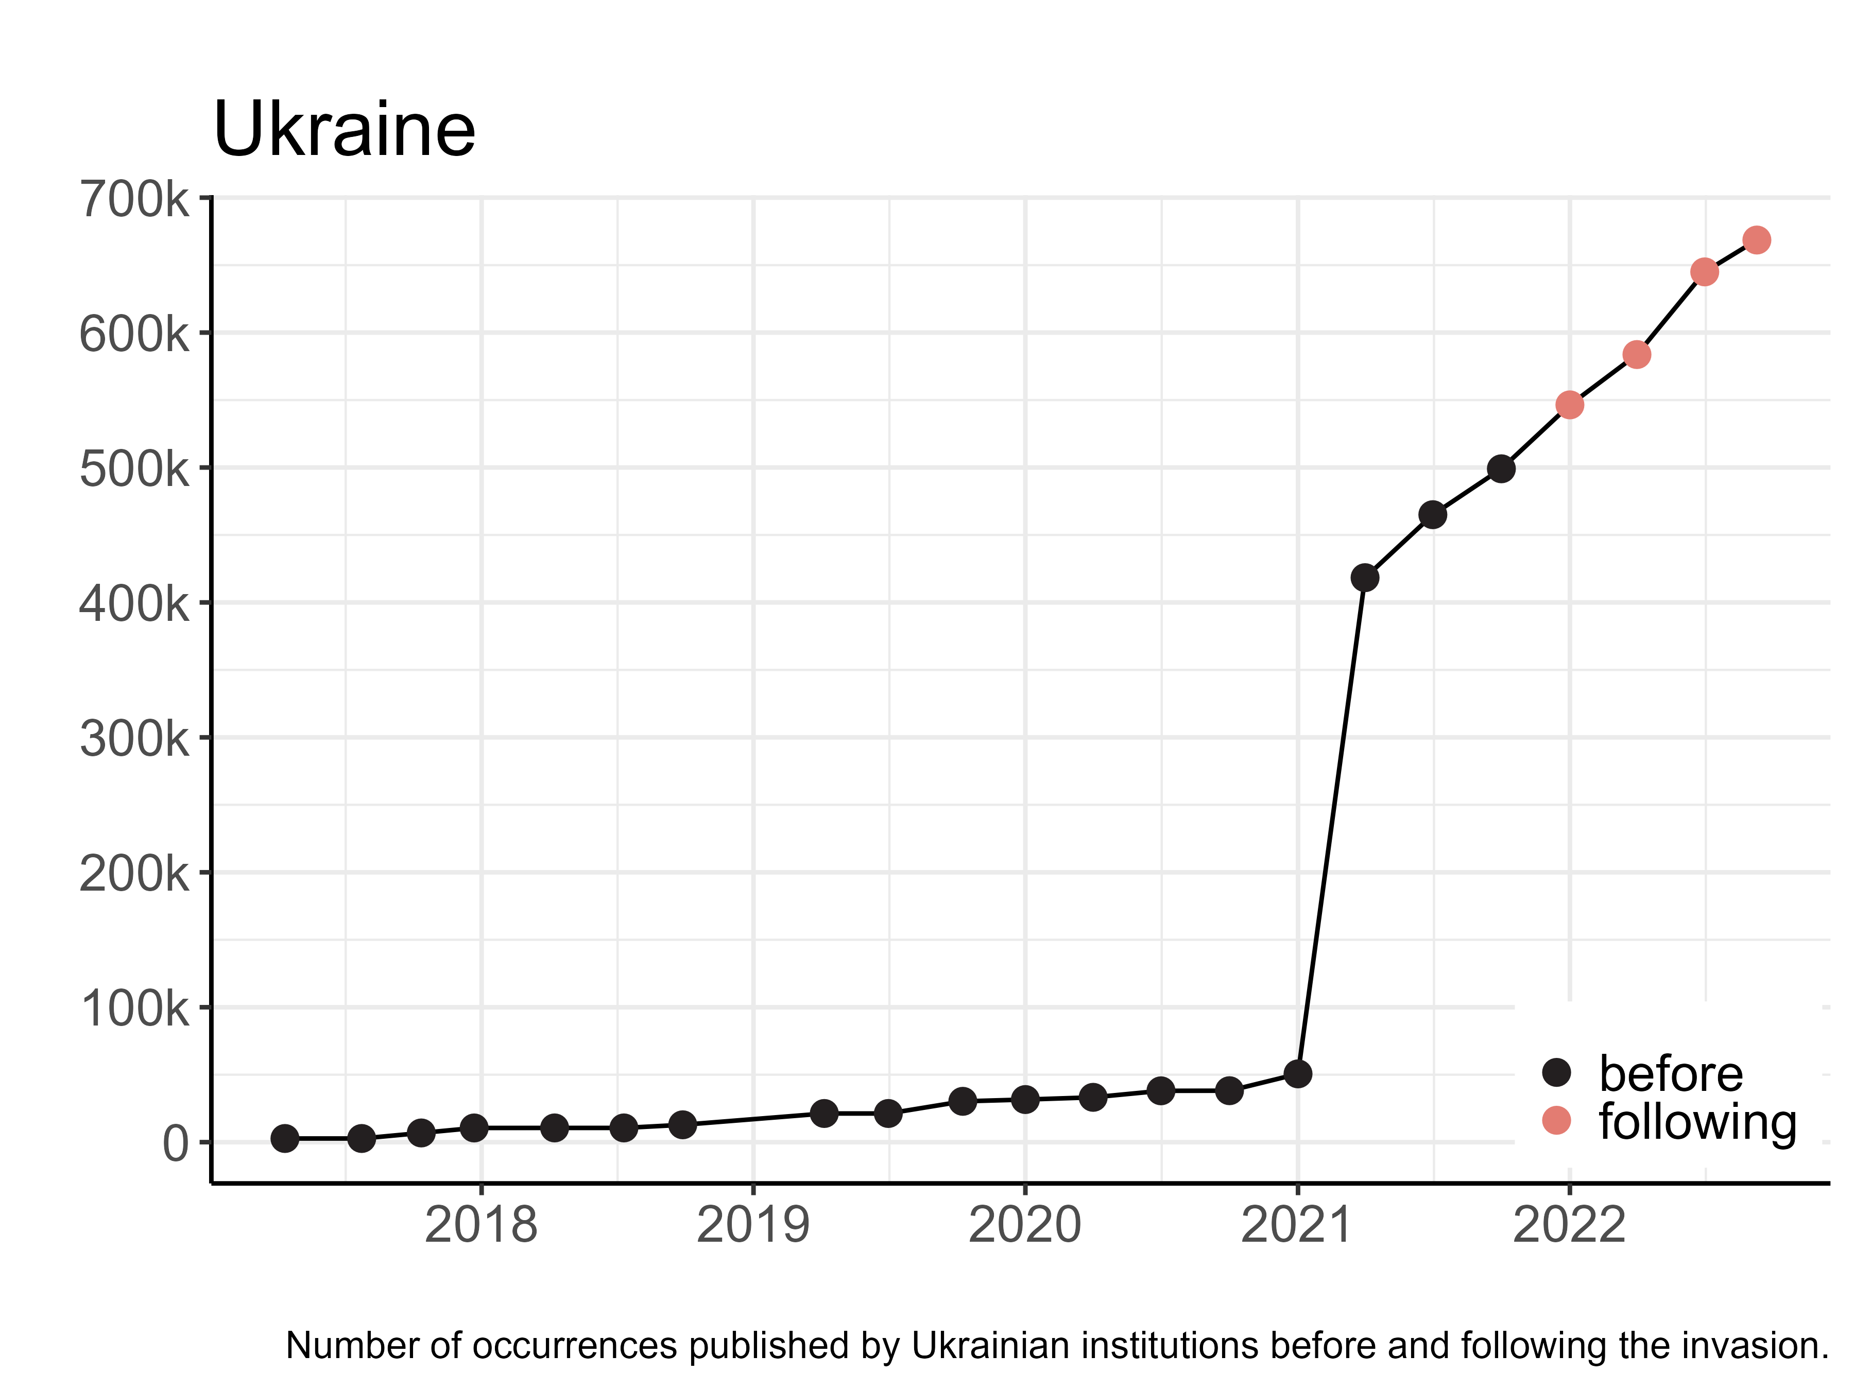
Data publisert åpent fra Ukraina I .
Notes:
https://www.gbif.org/country/UA/summary

Slide 20
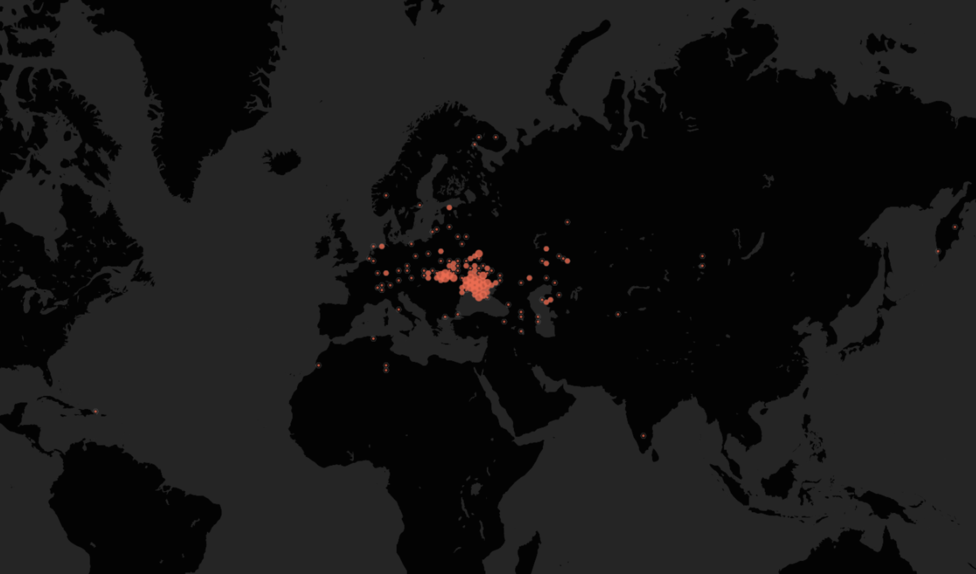

Data fra Herbariet I Kherson er publisert åpent I GBIF
7 659 herbariebelegg digitalisert (så langt)
Notes:
https://doi.org/10.15468/7c7xxz

Slide 21
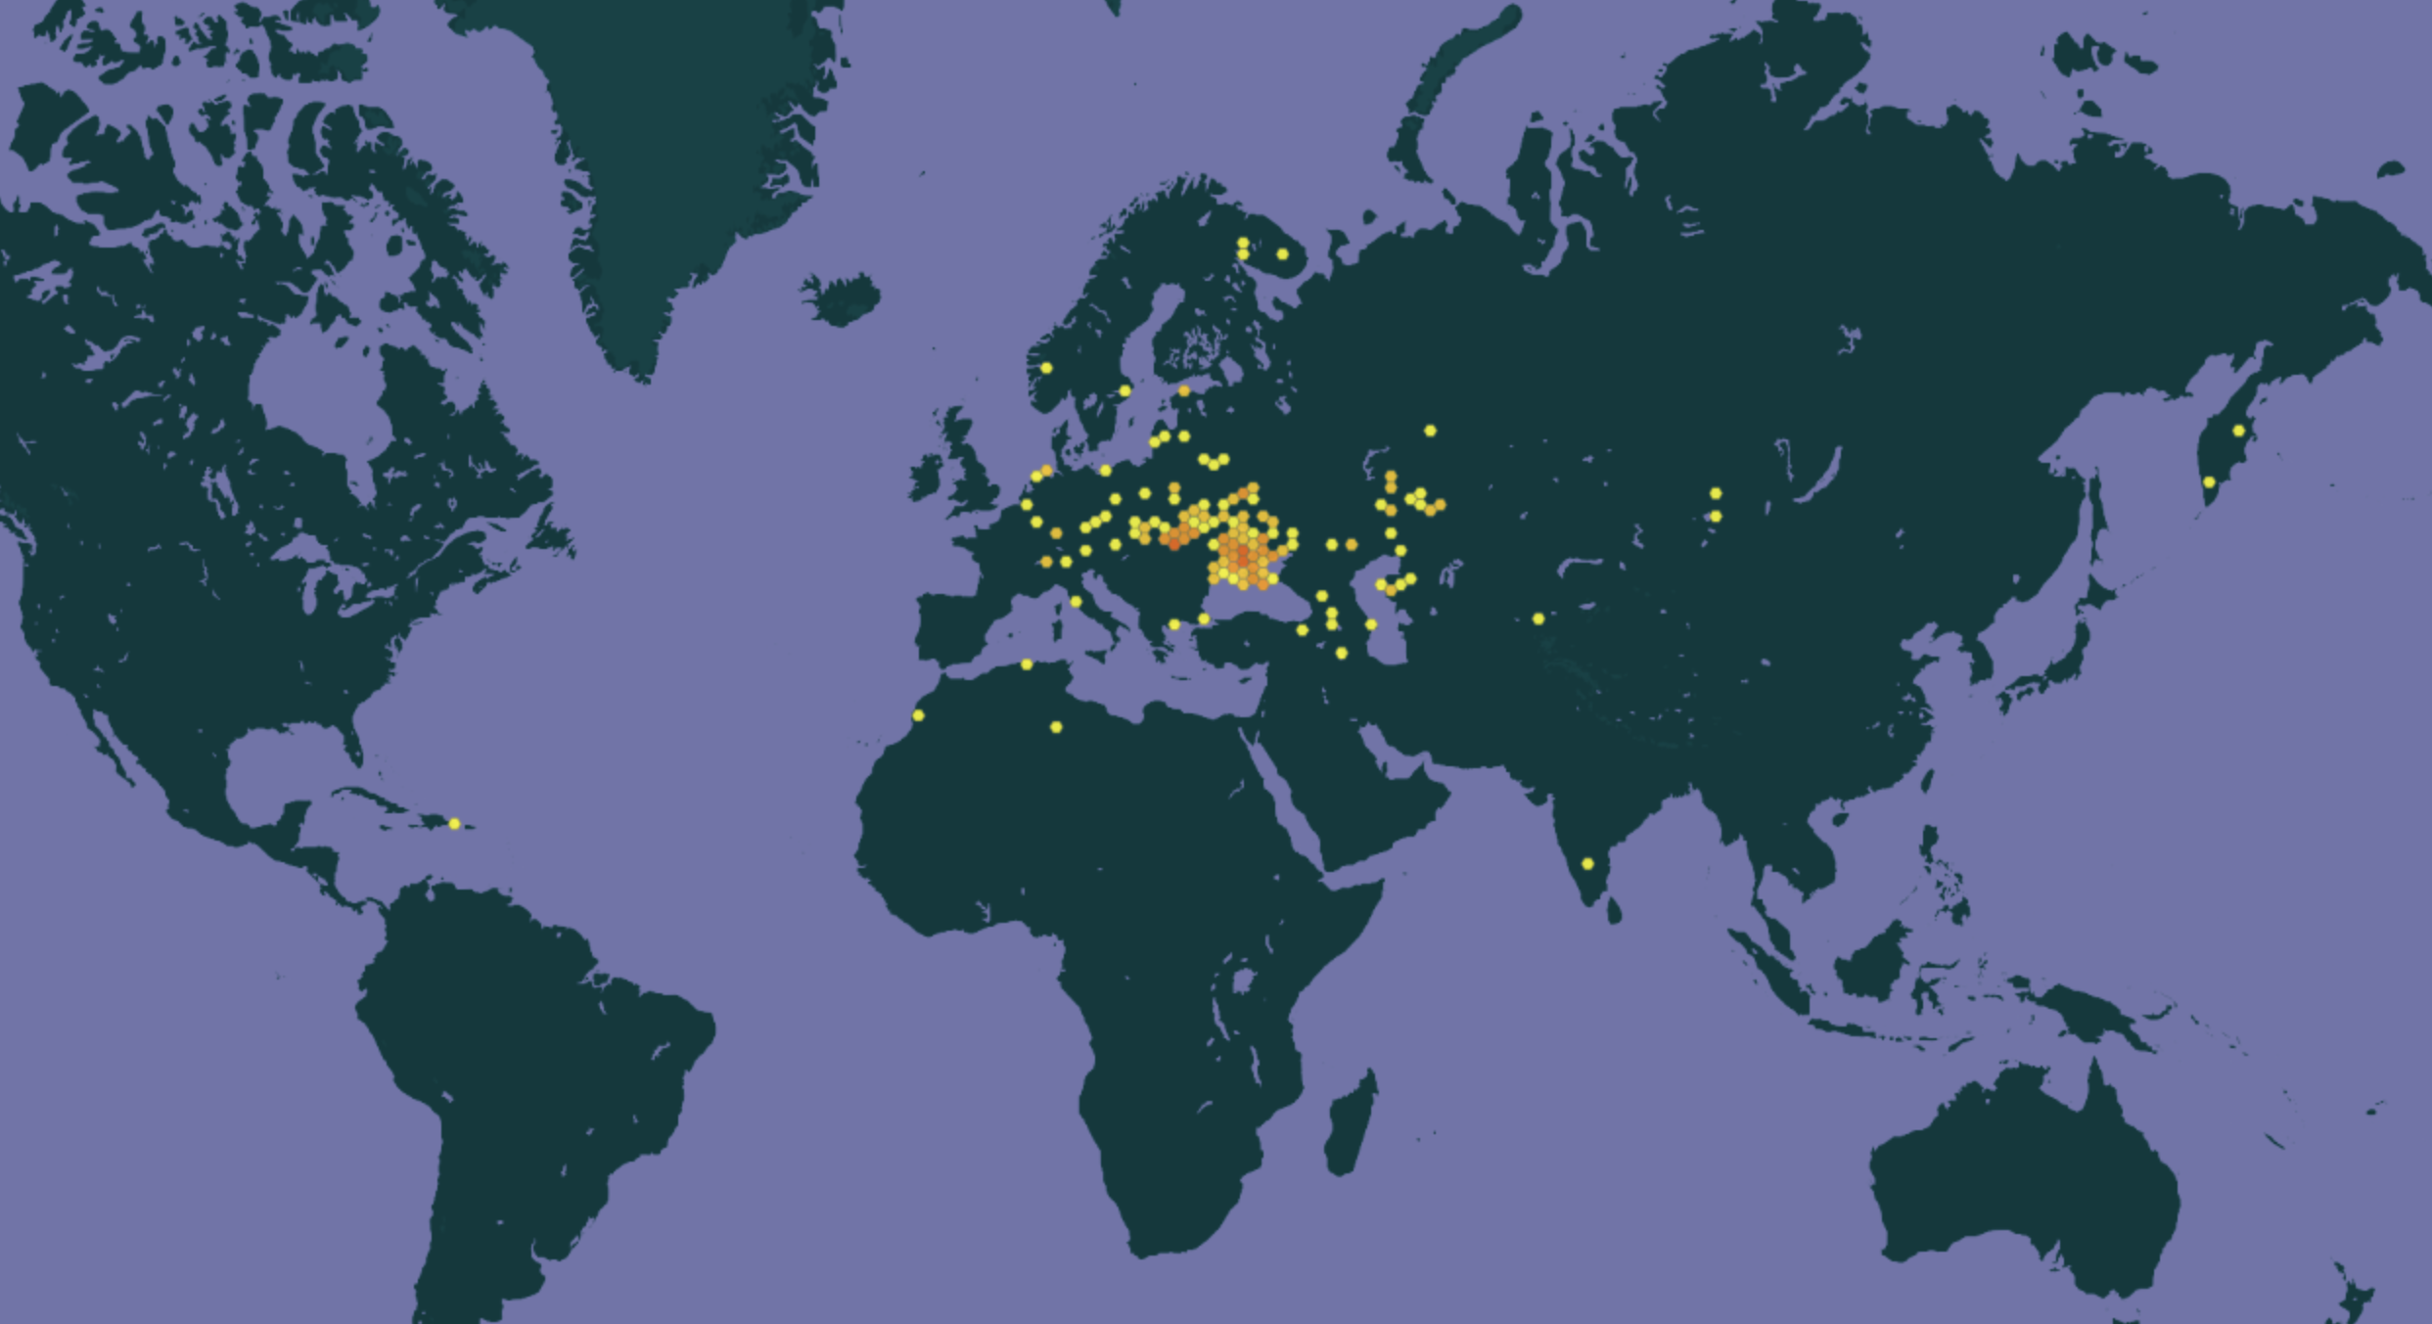
Data fra KHerson Herbariet er publisert åpent I GBIF
7 659 herbariebelegg digitalisert (så langt)

Slide 22
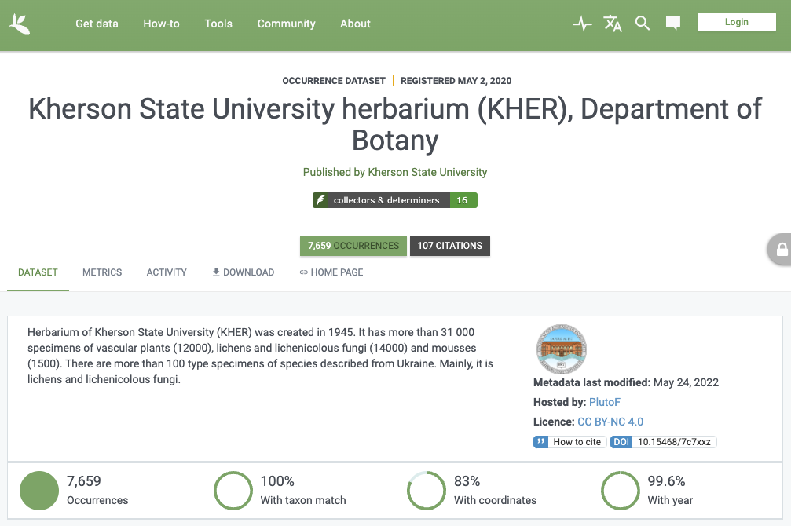
Kerson Herbarium datasett
doi:10.15468/7c7xxz
> 31 000 objekter
7 659 digitalisert
> 100 typer
Notes:
https://doi.org/10.15468/7c7xxz

Slide 23

Kherson herbarium datasett I GBIF
Dataposter fra herbariet i Kherson er allerede sitert gjenbrukt av andre forskere hele 107 publikasjoner,
inkludert i 87 forskningsartikler med fagfelleevaluering
og 6 forskningsartikler med en medforfatter fra Norge.
Notes:
https://www.gbif.org/resource/search?contentType=literature&gbifDatasetKey=f8faa08d-a029-4e62-97ed-cb7e97c30ba9

Slide 24


Dag Endresen
GBIF Node Manager Norway
Universitetet I Oslo

Slide 25


