Slide 1
Ontologies in biodiversity data management
Dag Endresen - GBIF Norway, University of Oslo
Illustration: GBIF data portal
UiO data managers network | 8 June 2023
Notes:
2023-06-08, UiO Digital Scholarship Centre (DSC), UiO University Library
Illustration: GBIF data portal, https://www.gbif.org
“Kunne du tenke deg å presentere noe om hvordan du bruker ontologier i datahåndtering på data managers Network Meeting 8. juni?
Kom gjerne med forslag til vinkling selv, evt andre som aktivt bruker ontologier i data management arbeidet.“ (Live Håndlykken Kvale, epost 2023-02-20)

Slide 2
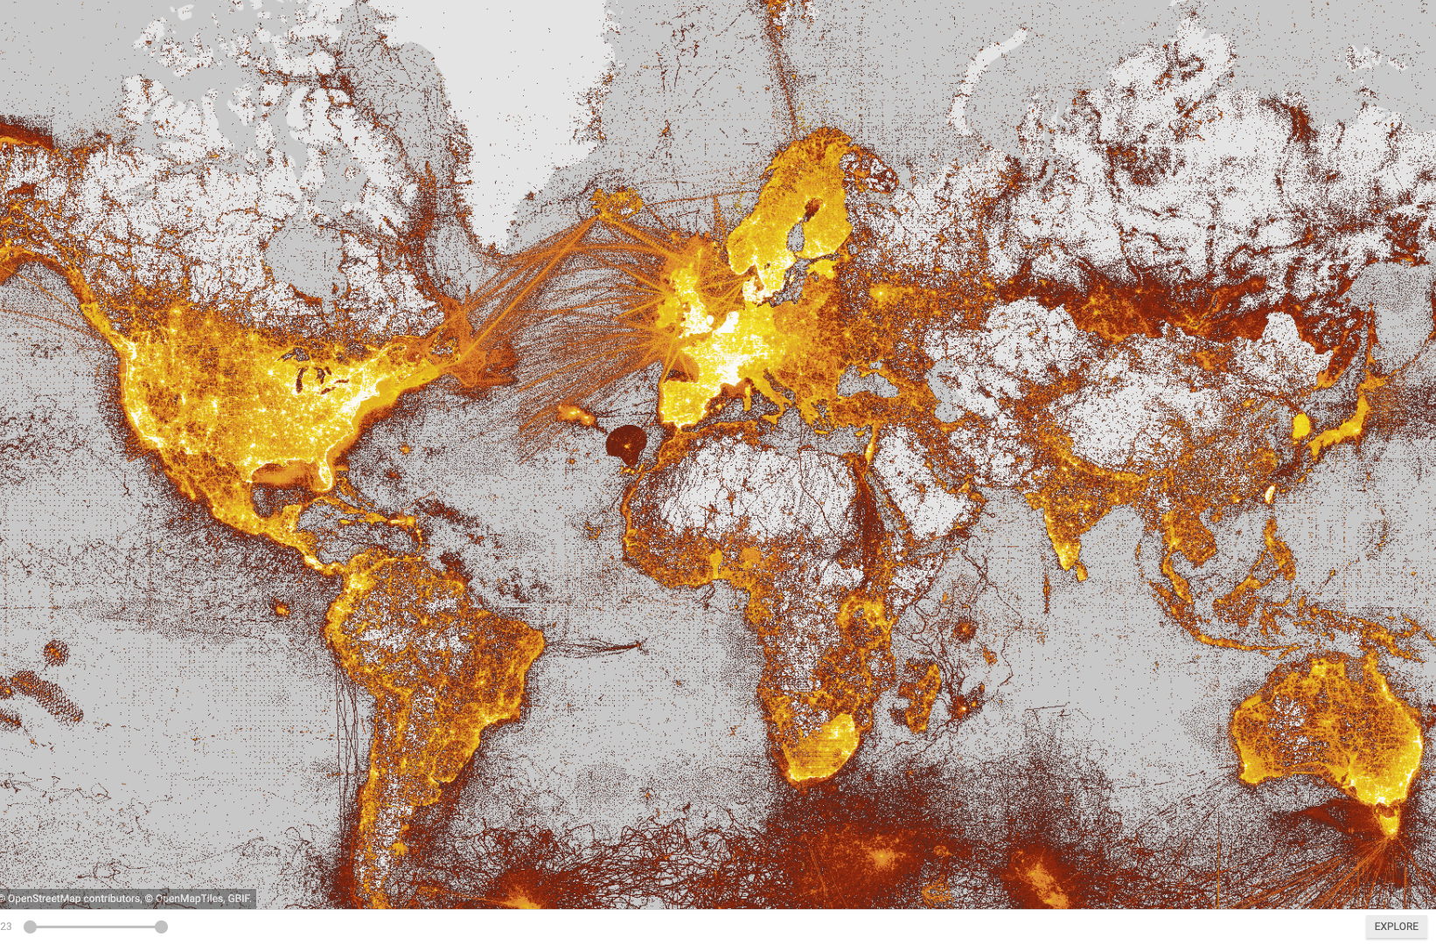
What is gbif?
Intergovernmental network and research infrastructure
Provides anyone, anywhere, free and open access to data about all types of life on Earth
Distributed research data infrastructure based on national participant NODES
Secretariat in Copenhagen, Denmark
https://www.gbif.org
Notes:
https://www.gbif.org/

Slide 3
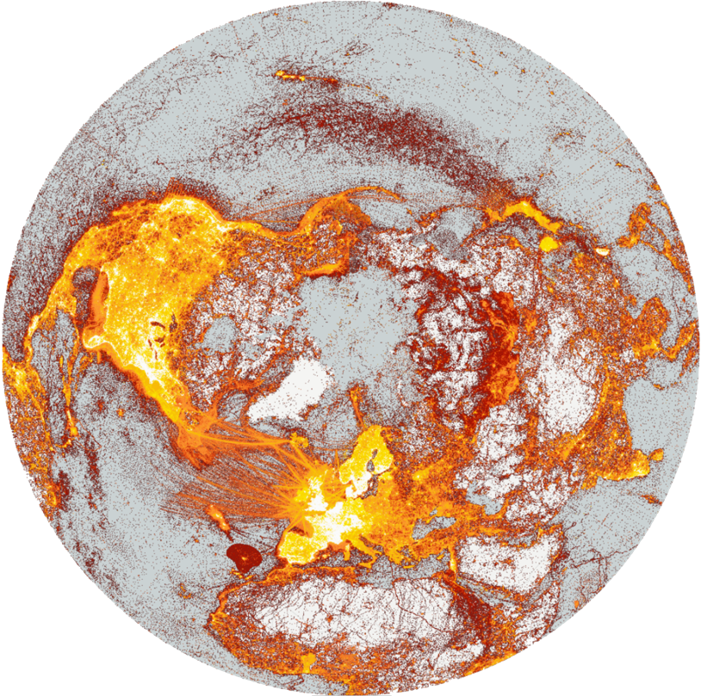







A window on evidence about where species HAVE lived, and when
Observations
Digitized specimens
Data publishing and indexing
Literature
Common standards (DwC)
Remote-sensing
Environmental DNA
Data discovery and use

Slide 4






Darwin Core Archive
Extensions
Identifications
Multimedia resources
MeasurementOrFact
ResourceRelationship
DNA-derived (MIxS, GGBN)
… and more
EML metadata
Darwin Core Archive
Core
Occurrence
Event
Taxon
Notes:
https://dwc.tdwg.org/terms/
https://dwc.tdwg.org/text/
https://rs.gbif.org/core/
https://rs.gbif.org/extension/
https://rs.gbif.org/extension/dwc/measurements_or_facts_2022-02-02.xml
https://rs.gbif.org/extension/dwc/identification.xml
https://rs.gbif.org/extension/dwc/resource_relationship_2022-02-02.xml
https://rs.gbif.org/extension/gbif/1.0/multimedia.xml
https://rs.gbif.org/extension/gbif/1.0/dna_derived_data_2022-02-23.xml

Slide 5


Slide 6

Darwin Core
Darwin Core is a data standard maintained by TDWG. It includes a glossary of terms (properties, elements, fields, columns, attributes, or concepts) intended to facilitate the sharing of information about biological diversity by providing identifiers, labels, and definitions. Darwin Core is primarily based on taxa, their occurrence in nature as documented by observations, specimens, samples, and related information.
Quick reference guide at https://dwc.tdwg.org/terms/
Darwin Core Archive (text guide) at https://dwc.tdwg.org/text/
Detailed list of DwC terms at https://dwc.tdwg.org/list/
DwC is maintained in a GitHub repository : https://github.com/tdwg/dwc
Darwin Core Q&A at: https://github.com/tdwg/dwc-qa
Notes:
https://dwc.tdwg.org/

Slide 7
Darwin Core Classes
Record-level
Occurrence *
Organism
MaterialSample
Event *
Location
GeologicalContext
Identification
Taxon *
MeasurementOrFact
ResourceRelationship
Asterix (*) are supported as “Cores” in GBIF
https://rs.gbif.org/core/
Most of the other classes available as “Extensions” in GBIF, meaning additional properties to the ”Core” records”
https://rs.gbif.org/extension/
Notes:
https://dwc.tdwg.org/terms/

Slide 8


TDWG VOMAG (Vocabulary Management standards)
TDWG Standards Documentation Standard (SDS) (2017)
TDWG Vocabulary Maintenance Standard (VMS) (2017)
TDWG standards ratification process, review manager guidelines (2009, updated 2021)
Notes:
TDWG Vocabulary Maintenance Specification (VMS): https://github.com/tdwg/vocab/blob/master/vms/maintenance-specification.md
TDWG Standards Documentation Standard (SDS): https://github.com/tdwg/vocab/blob/master/sds/documentation-specification.md
TDWG standards ratification process, https://www.tdwg.org/about/process/
TDWG Review Manager Guidelines, https://www.tdwg.org/about/review-managers/

Slide 9
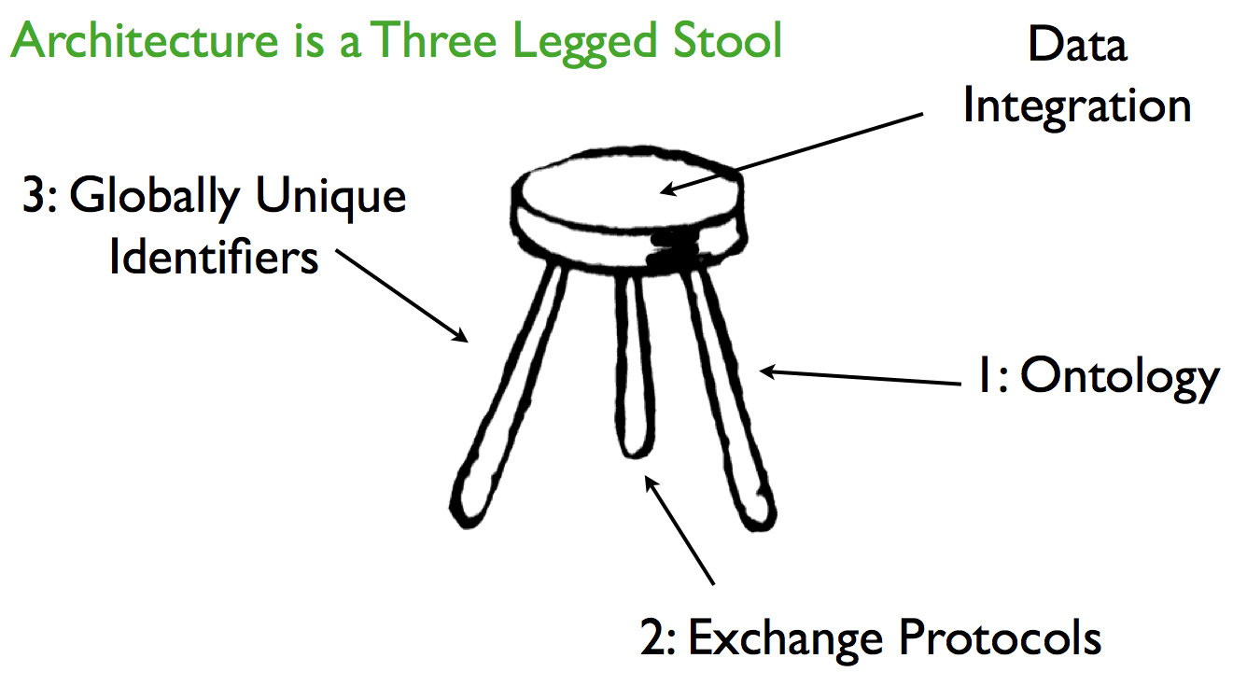
TDWG Technical Architecture | Vocabulary management
Vocabularies & ontologies are identified as one of the three core components in the TDWG technical architecture.
Notes:
TDWG TAG: http://wiki.tdwg.org/TAG
Hyam, R (2006). A technical architecture for TDWG standards. Proceedings of TDWG 2006, St Louis, Missouri, USA. http://www.tdwg.org/proceedings/article/viewArticle/88
Image from: http://www.tdwg.org/fileadmin/2007meeting/slides/Hyam_OntologiesInTdwgArchitecture_abs229.pdf

Slide 10
Vocabularies/ontologies
Provide a shared understanding of what we mean when describing biodiversity entities.
What kind of thing or property.
A list of things we as a community can agree upon the meaning of.
“Concept repository” with terms identified by URIs.
TDWG Technical Roadmap 2008. (TDWG TAG, convened by Roger Hyam).
Notes:
TDWG Technical Architecture Group (2008). TDWG Technical Roadmap 2008: http://wiki.tdwg.org/twiki/pub/TAG/RoadMap2008/TDWG_TAG_Roadmap_2008.pdf
Ontology Roadmap for eBiosphere (2009) http://wiki.tdwg.org/twiki/bin/view/TAG/OntologyRoadmap

Slide 11
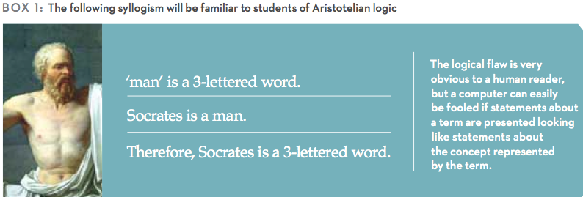
Term label versus Concept
Need to separate terms and term labels from the fundamental concepts behind the terminology.
Dextre Clarke, S.G. and L. Zeng (2012). From ISO 2788 to ISO 25964: the evolution of thesaurus Standards towards Interoperability and data modeling. ISQ Information Standards Quarterly 24(1): 20-26.
Will, L. (2012). The ISO 25964 Data Model for the Structure of an Information Retrieval Thesaurus. Bulletin of the American Society for Information Science and Technology 38(4): 48-51.
Notes:
Need to separate terms and term labels from the fundamental concepts behind the terminology.
“The SKOS (simple knowledge organization system) format is designed to present KOS data in a format that is suitable for machine inferencing and particularly for use in the Semantic Web (….) concepts – units of thought – and distinguishes these from the terms that are used to label these concepts. Will, L. (2012)
Will, L. (2012). The ISO 25964 Data Model for the Structure of an Information Retrieval Thesaurus. Bulletin of the American Society for Information Science and Technology 38(4): 48-51.

Slide 12
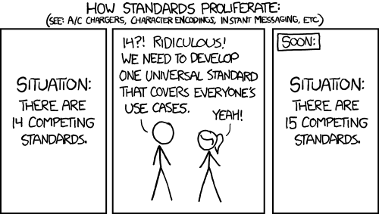
Data standards
XKCD CC BY-NC 2.5
http://xkcd.com/927/
Important principle: Re-use of terms from standardized terminologies wherever possible.
Notes:
The cartoon is from XKCD: http://xkcd.com/927/. This work is licensed under a Creative Commons Attribution-NonCommercial 2.5 License.

Slide 13

Biodiversity Semantics.
Notes:
https://www.gbif.org

Slide 14
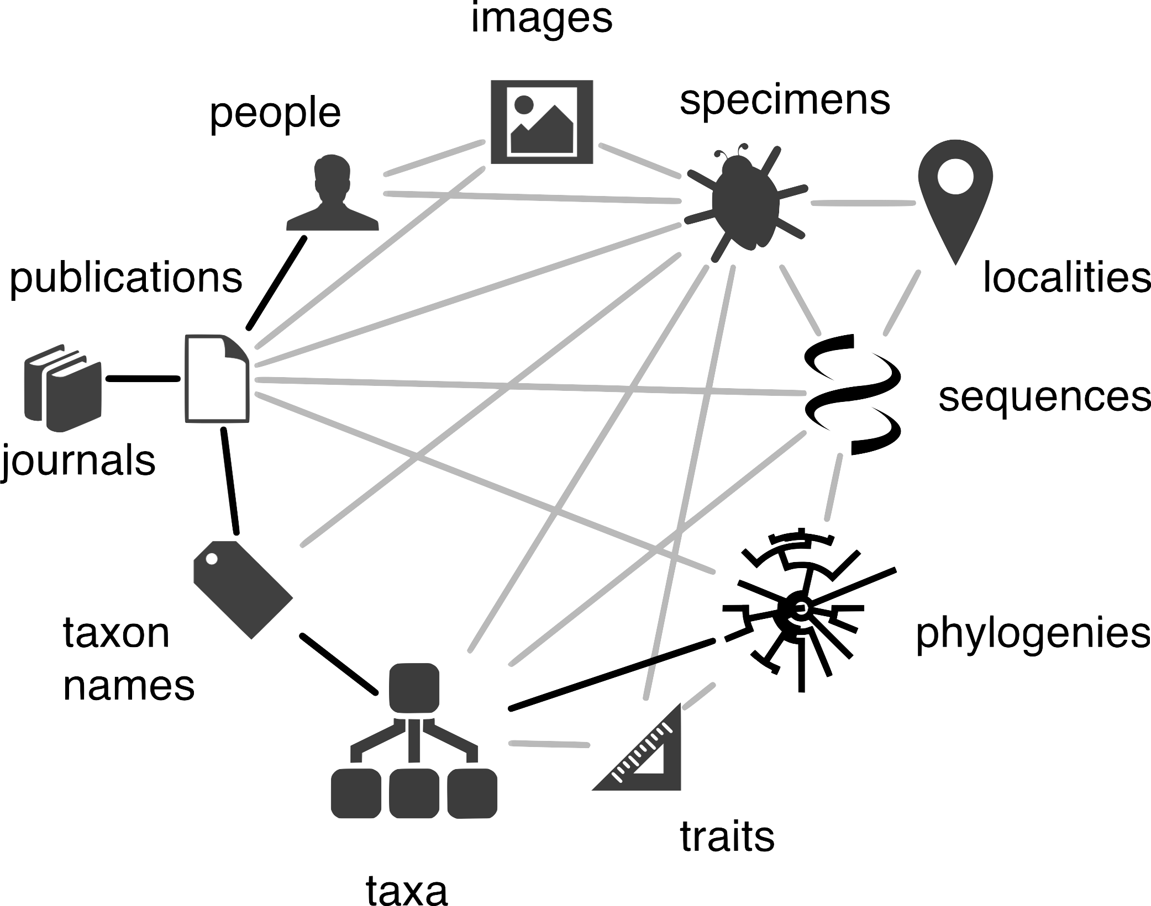

Biodiversity Knowledge representations
Biodiversity Knowledge Graph (Page, 2016)
Notes:
Creator:Rod Page, CC BY 4.0 via Wikimedia Commons https://commons.wikimedia.org/wiki/File:Biodiversity_knowledge_graph_by_Rod_Page.png
Page R (2016) Towards a biodiversity knowledge graph. Research Ideas and Outcomes 2: e8767. https://doi.org/10.3897/rio.2.e8767

Slide 15
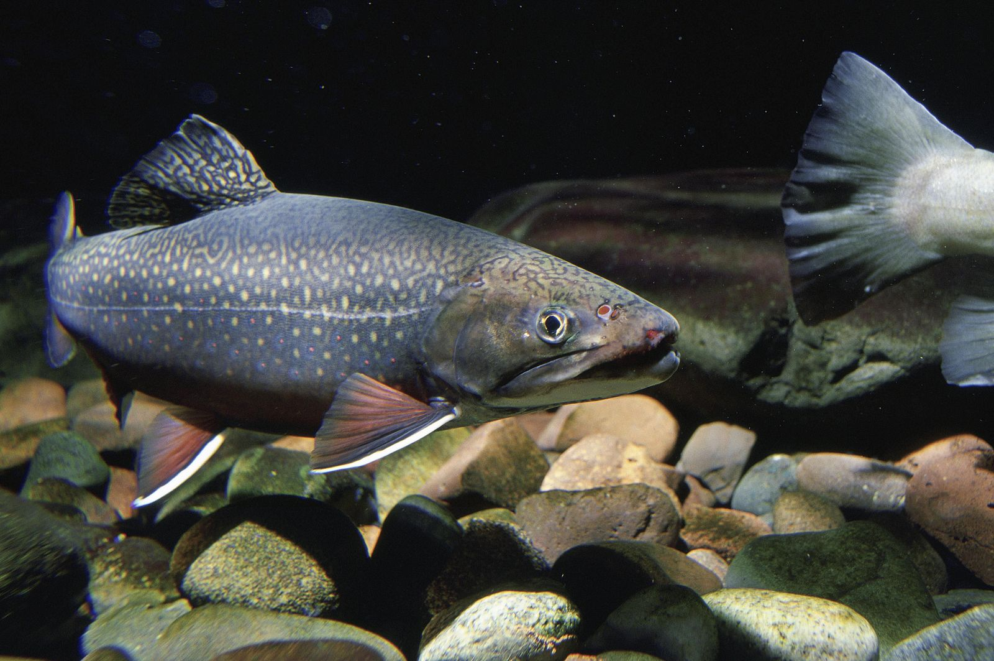
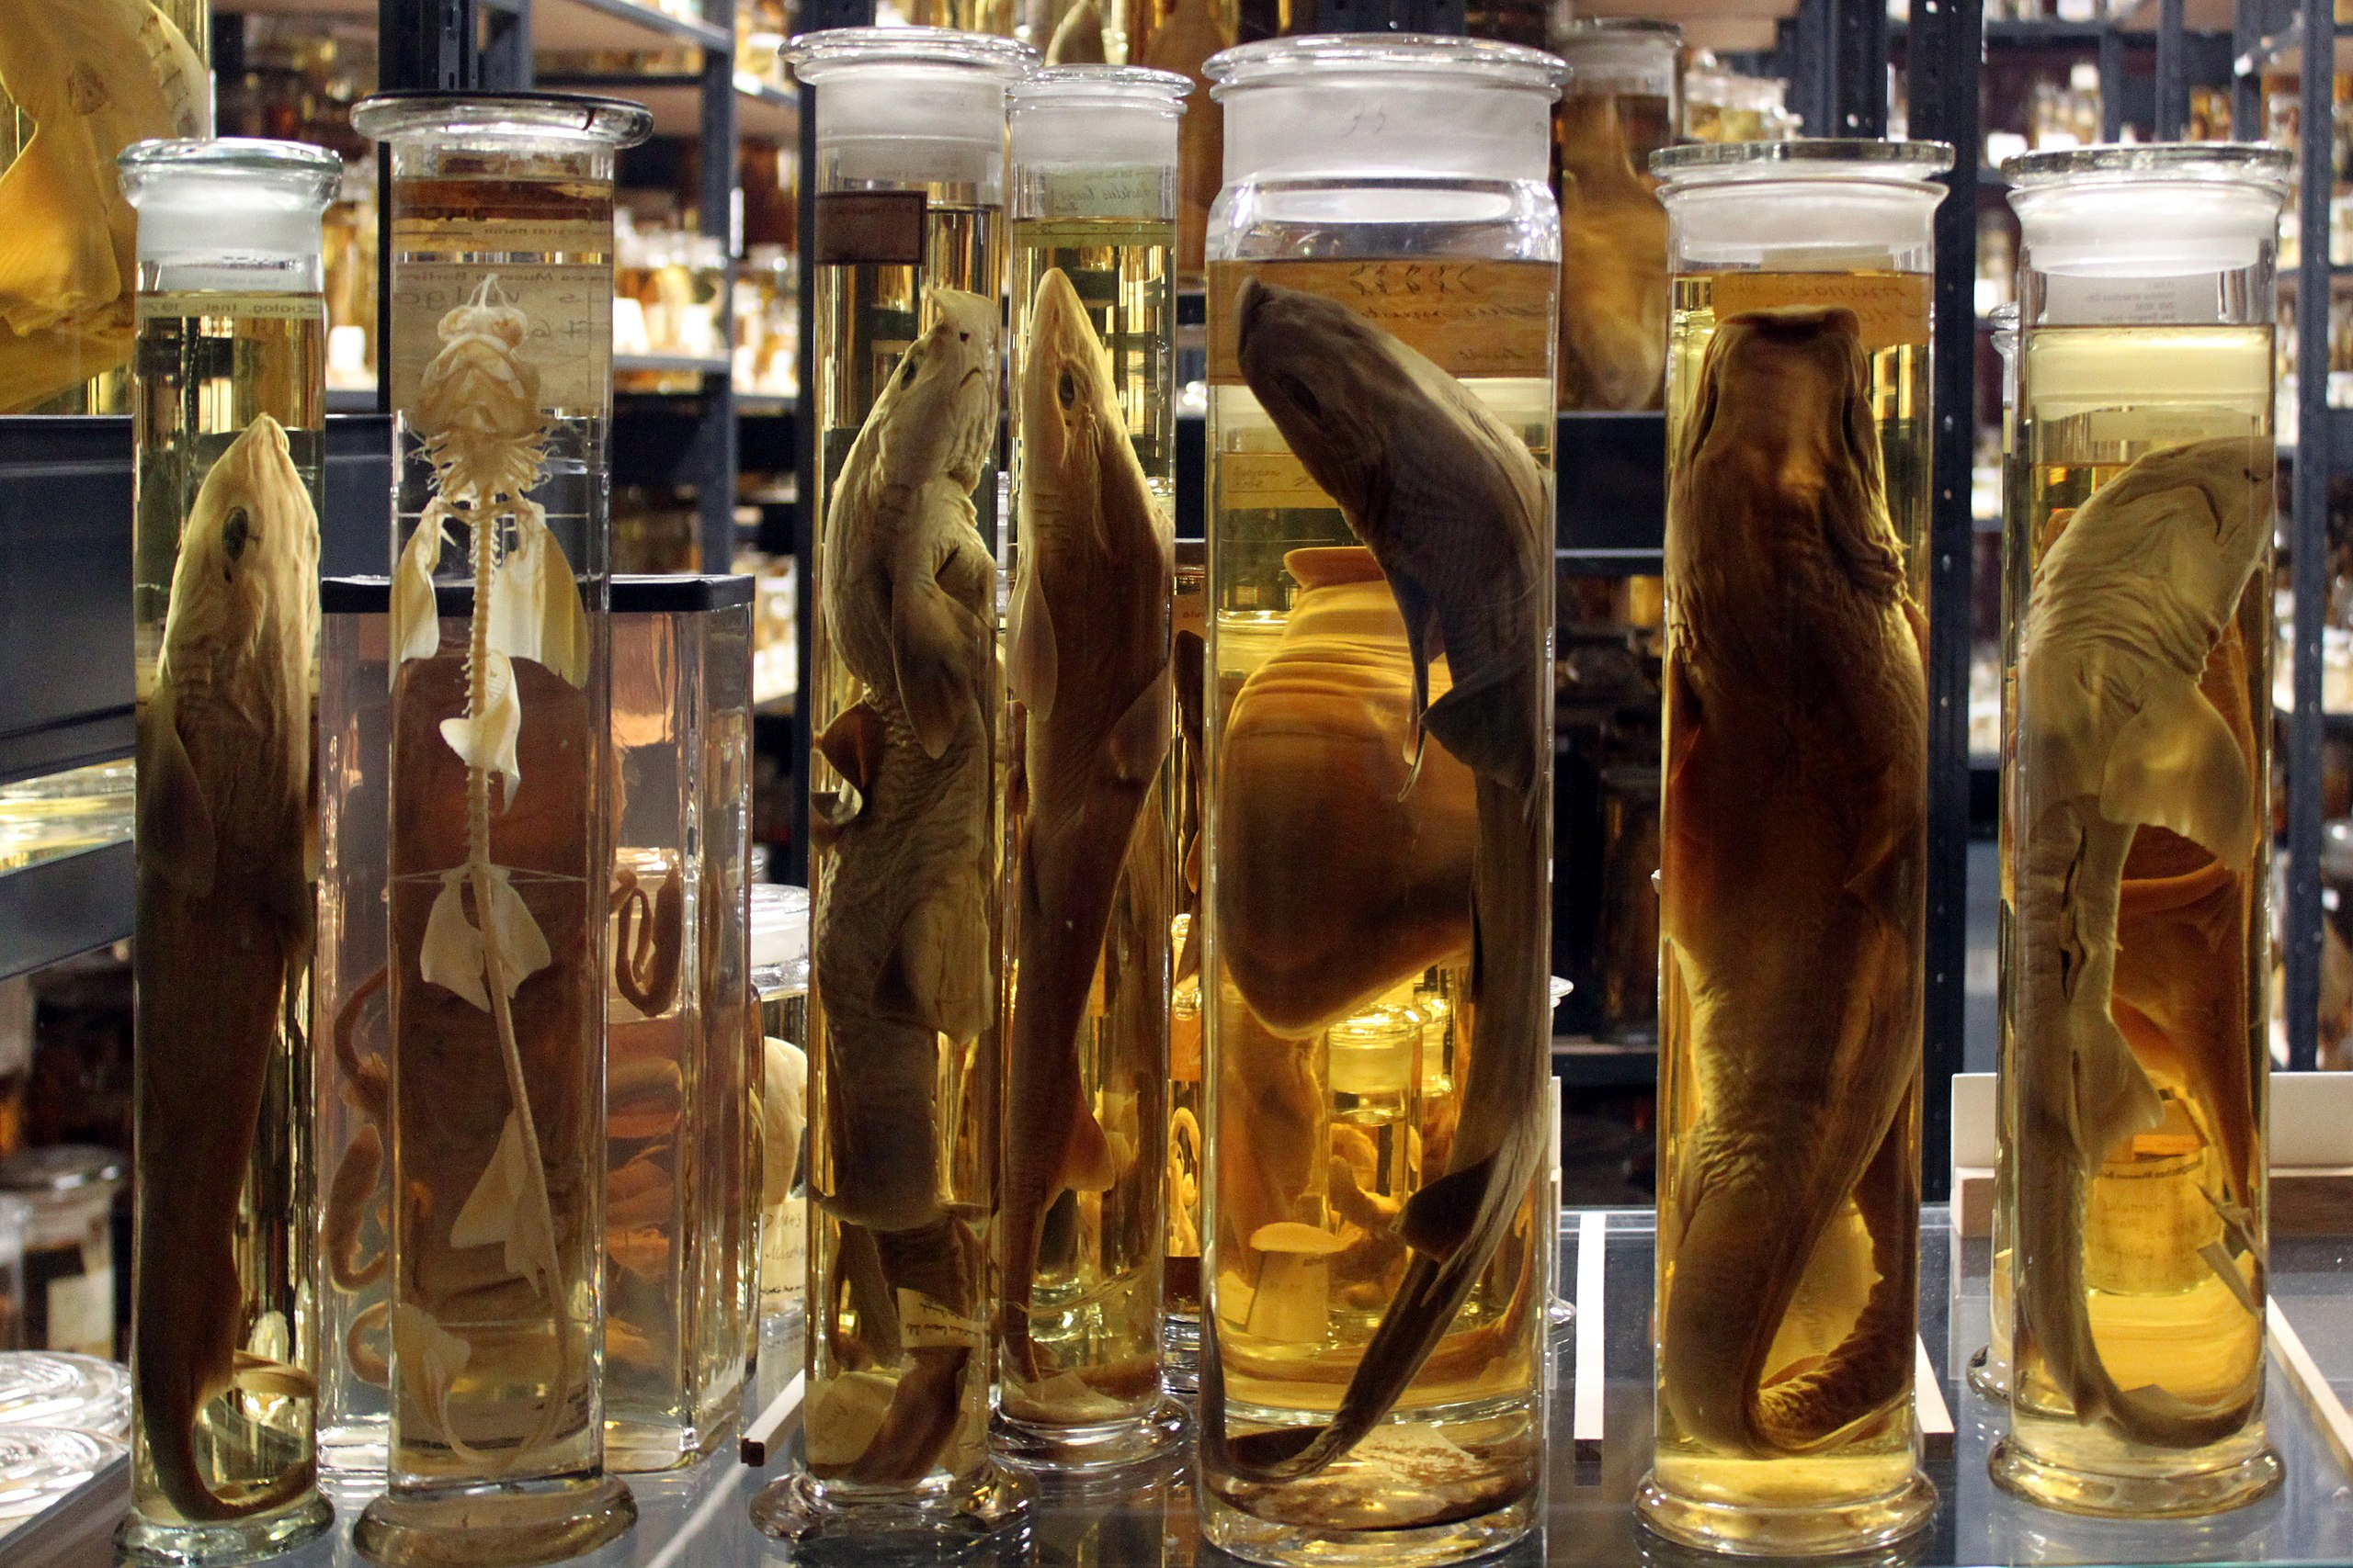
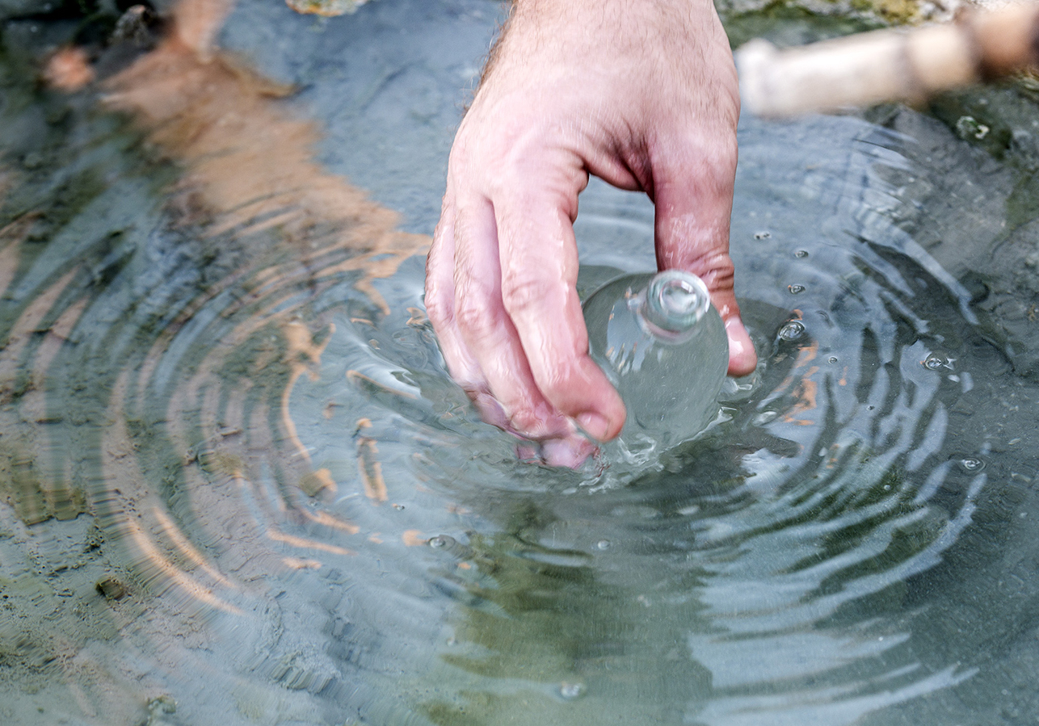
Species occurrence | collection specimen | Environment sample
Species occurrence
Collection specimen
Environment sample
Photo: Eric Engbretson, Public Domain
André Künzelmann, CC BY-SA 3.0
Anagoria, CC BY 3.0
Darwin Core Occurrence, Organism
BFO process
Darwin Core PreservedSpecimen
BFO material entity
OBI specimen
Darwin Core MaterialSample
BFO material entity
Notes:
Illustration photos via Wikimedia Commons:
Eric Engbretson, U.S. Fish and Wildlife Service, Public domain, via Wikimedia Commons, https://commons.wikimedia.org/wiki/File:Brook_trout_swims_in_native_stream_underwater_fish_image.jpg
André Künzelmann, CC BY-SA 3.0, https://commons.wikimedia.org/wiki/File:2013_Naturkundemuseum_Berlin_Alkohol-Forschungssammlung_04_anagoria.JPG
Anagoria, CC BY 3.0, https://commons.wikimedia.org/wiki/File:Water_resources,_taking_a_water_sample.jpg

Slide 16
Linking semantic models using top-level ontology (2012)
USA NSF funded RCN4GSC and BioSciCol project (Deck et al. 2012)
DwC & MIxS – Sample versus Specimen versus Occurrence.
RCN4GSC -- Track DNA extracts and environment samples.
BioSciCol – Track collection specimens (and processes acting on them).
→ Definitions linked to BFO (basic formal ontology).
Using a top-level ontology (here BFO) to unite previously disconnected ontologies
BFO continuants (continous existence) vs BFO occurents (processes unfolding through time)
Inspired by EnvO (Environment ontology) designed under the BFO & OBO Foundry principles
Aligned with GGBN (Global Genome Biodiversity Network)
→ Development of BCO (Bio-Collections Ontology) (Walls et al. 2014)
→ Adding new class MaterialSample (and materialSampleID term) to Darwin Core (2014)
Notes:
Deck et al (2013) Clarifying concepots and terms in biodiversity informatics. https:/doi.org/10.4056/sigs.3907833
Walls RL, Deck J, Guralnick R, Baskauf S, Beaman R, et al. (2014) Semantics in Support of Biodiversity Knowledge Discovery: An Introduction to the Biological Collections Ontology and Related Ontologies. PLoS ONE 9(3): e89606. doi:10.1371/journal.pone.0089606

Slide 17
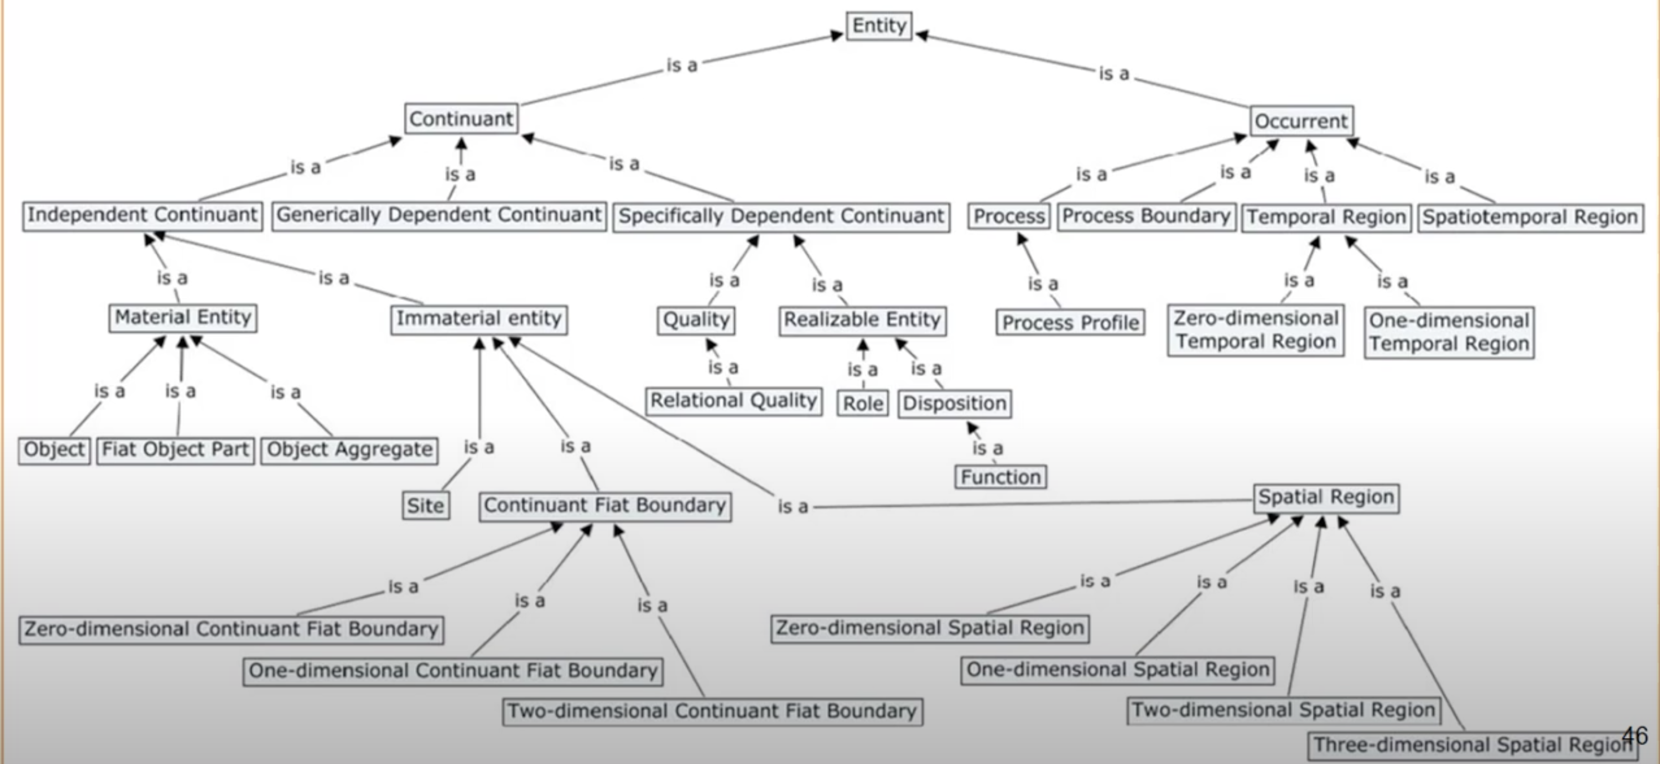
BFO – Basic Formal Ontology
Notes:
BFO home, https://basic-formal-ontology.org/
BFO at OntoBee, https://ontobee.org/ontology/BFO

Slide 18
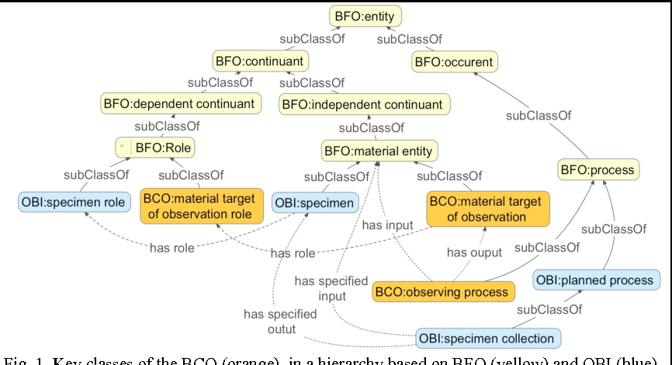
BCO – Biological Collections Ontology (Walls et al. 2014)
Notes:
BCO – Biological Collections Ontology, https://github.com/BiodiversityOntologies/bco, https://ontobee.org/ontology/BCO
OBI = Ontology for Biomedical Investigations, https://ontobee.org/ontology/OBI, http://obi-ontology.org/
IAO = Information Artefact Ontology, https://ontobee.org/ontology/IAO
Walls RL, Deck J, Guralnick R, Baskauf S, Beaman R, et al. (2014) Semantics in Support of Biodiversity Knowledge Discovery: An Introduction to the Biological Collections Ontology and Related Ontologies. PLoS ONE 9(3): e89606. https://doi.org/10.1371/journal.pone.0089606
Walls, R.L., & Guralnick, R.P. (2014). A Specimen-based View of the World Using the Biological Collections Ontology to Model Biodiversity Collections.
Ramona L. Walls, Pier Luigi Buttigieg, John Deck, Rob Guralnick, John Wieczorek (2018) Integrating and Managing Biodiversity Data with the Biocollections Ontology, https://doi.org/10.3233/978-1-61499-854-9-81 http://ebooks.iospress.nl/volumearticle/49542

Slide 19
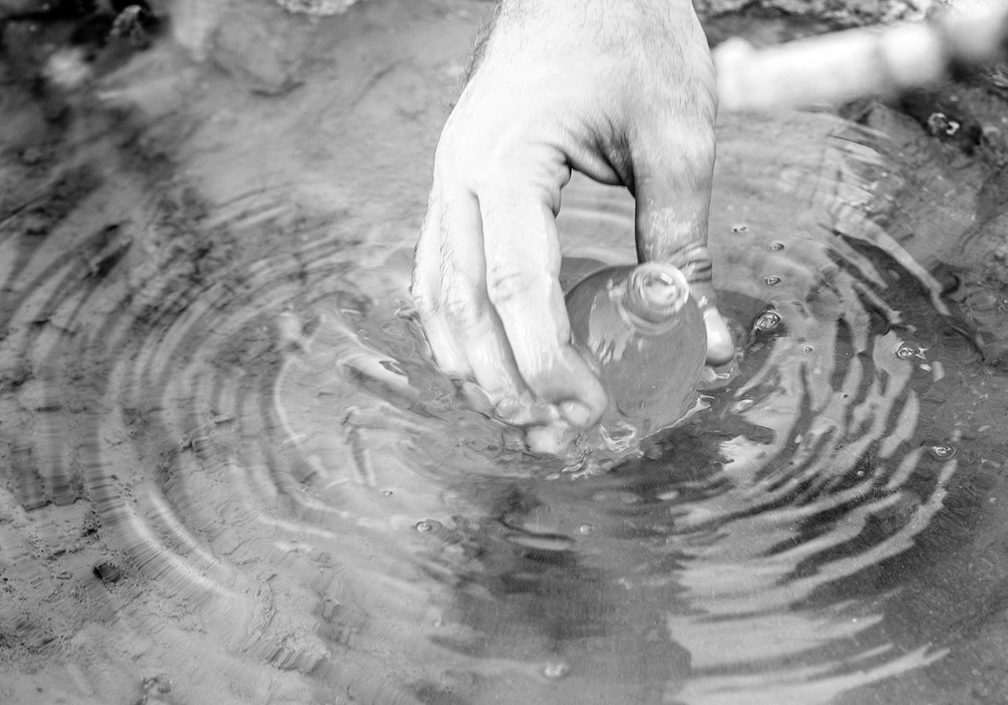
Species occurrence | collection specimen | Environment sample
Species occurrence
Collection specimen
Photo: Eric Engbretson, Public Domain
André Künzelmann, CC BY-SA 3.0
Anagoria, CC BY 3.0
Darwin Core Occurrence, Organism
BFO process
Darwin Core PreservedSpecimen
BFO material entity
OBI specimen
Notes:
Illustration photos via Wikimedia Commons:
Eric Engbretson, U.S. Fish and Wildlife Service, Public domain, via Wikimedia Commons, https://commons.wikimedia.org/wiki/File:Brook_trout_swims_in_native_stream_underwater_fish_image.jpg
André Künzelmann, CC BY-SA 3.0, https://commons.wikimedia.org/wiki/File:2013_Naturkundemuseum_Berlin_Alkohol-Forschungssammlung_04_anagoria.JPG
Anagoria, CC BY 3.0, https://commons.wikimedia.org/wiki/File:Water_resources,_taking_a_water_sample.jpg

Slide 20
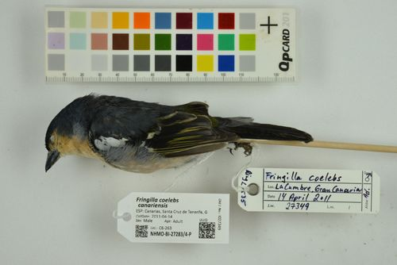
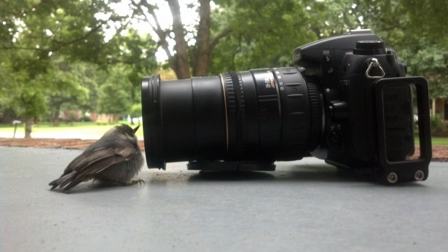
Specimen versus species occurrence
Specimen is product of a sampling process that generates a BFO material entity (OBI specimen).
A species occurrence is product of a BFO process that generates a IAO information content entity.
Need instance indentifiers to track DNA extracts and collection specimens.
These semantic specifications makes it possible (are required) to declare and/or infer relations between the material samples and species occurrences mediated through GBIF.
versus
Notes:
Photos
"Fringilla coelebs bakeri" - Fringilla coelebs subsp. bakeri Illera, Rando, Rodriguez-Exposito, Hernández, M, Claramunt, Martín & A, 2018 collected in Spain
(licensed under http://creativecommons.org/licenses/by/4.0/), https://www.gbif.org/occurrence/1208877607, http://www.unimus.no/felles/bilder/web_hent_bilde.php?id=14208217&type=jpeg
alex grichenko has released this “Bird Camera Watching” image under Public Domain license, https://www.publicdomainpictures.net/en/view-image.php?image=54100&picture=bird-camera-watching

Slide 21
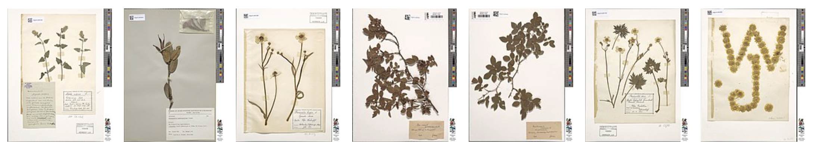
TDWG Material (sample) task group (2021-[2023])
The purpose of this task group is to investigate and make recommendations on current shortcomings in the capacity to share, re-use, compare, and relate physical objects to one another and to other concepts, and further integrate with other sources of biodiversity data.
Our main goal is to enable physical object data sharing as part of the TDWG corpus of standards.
The outcome will be to provide clear semantics for physical object classes and properties with possible recommendations for changes to the class associated with some properties.
Notes:
https://www.tdwg.org/community/osr/material-sample/
https://github.com/tdwg/material-sample
Illustration: https://commons.wikimedia.org/w/index.php?search=specimens

Slide 22
Species occurrence | collection specimen | Environment sample
Environment sample
Photo: Eric Engbretson, Public Domain
André Künzelmann, CC BY-SA 3.0
Anagoria, CC BY 3.0
Darwin Core MaterialSample
BFO material entity
Notes:
Illustration photos via Wikimedia Commons:
Eric Engbretson, U.S. Fish and Wildlife Service, Public domain, via Wikimedia Commons, https://commons.wikimedia.org/wiki/File:Brook_trout_swims_in_native_stream_underwater_fish_image.jpg
André Künzelmann, CC BY-SA 3.0, https://commons.wikimedia.org/wiki/File:2013_Naturkundemuseum_Berlin_Alkohol-Forschungssammlung_04_anagoria.JPG
Anagoria, CC BY 3.0, https://commons.wikimedia.org/wiki/File:Water_resources,_taking_a_water_sample.jpg

Slide 23
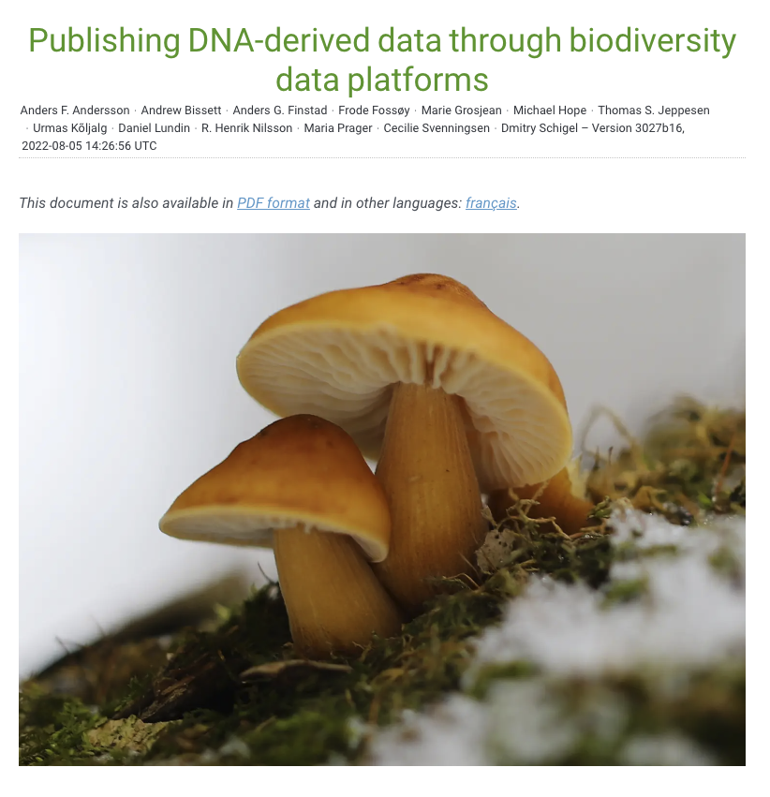
Digital Sequence information / Genetic sequence data
GBIF has developed data mobilisation guidelines for DNA-derived data available for reuse by GLIS.
Based on Darwin Core and MIxS data standards.
DNA-detected biodiversity information mobilization has high strategic priority in GBIF!
Notes:
Andersson AF, Bissett A, Finstad AG, Fossøy F, Grosjean M, Hope M, Jeppesen TS, Kõljalg U, Lundin D, Nilsson RN, Prager M, Svenningsen C & Schigel D (2020) Publishing sequence-derived data through biodiversity data platforms. Copenhagen: GBIF Secretariat. https://doi.org/10.35035/doc-vf1a-nr22.

Slide 24
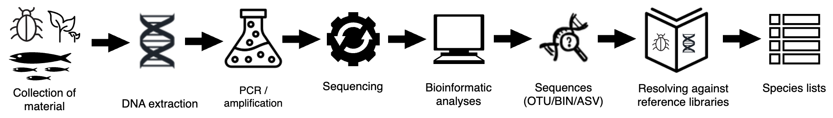
Metabarcoding environment DNA sampling process

Slide 25
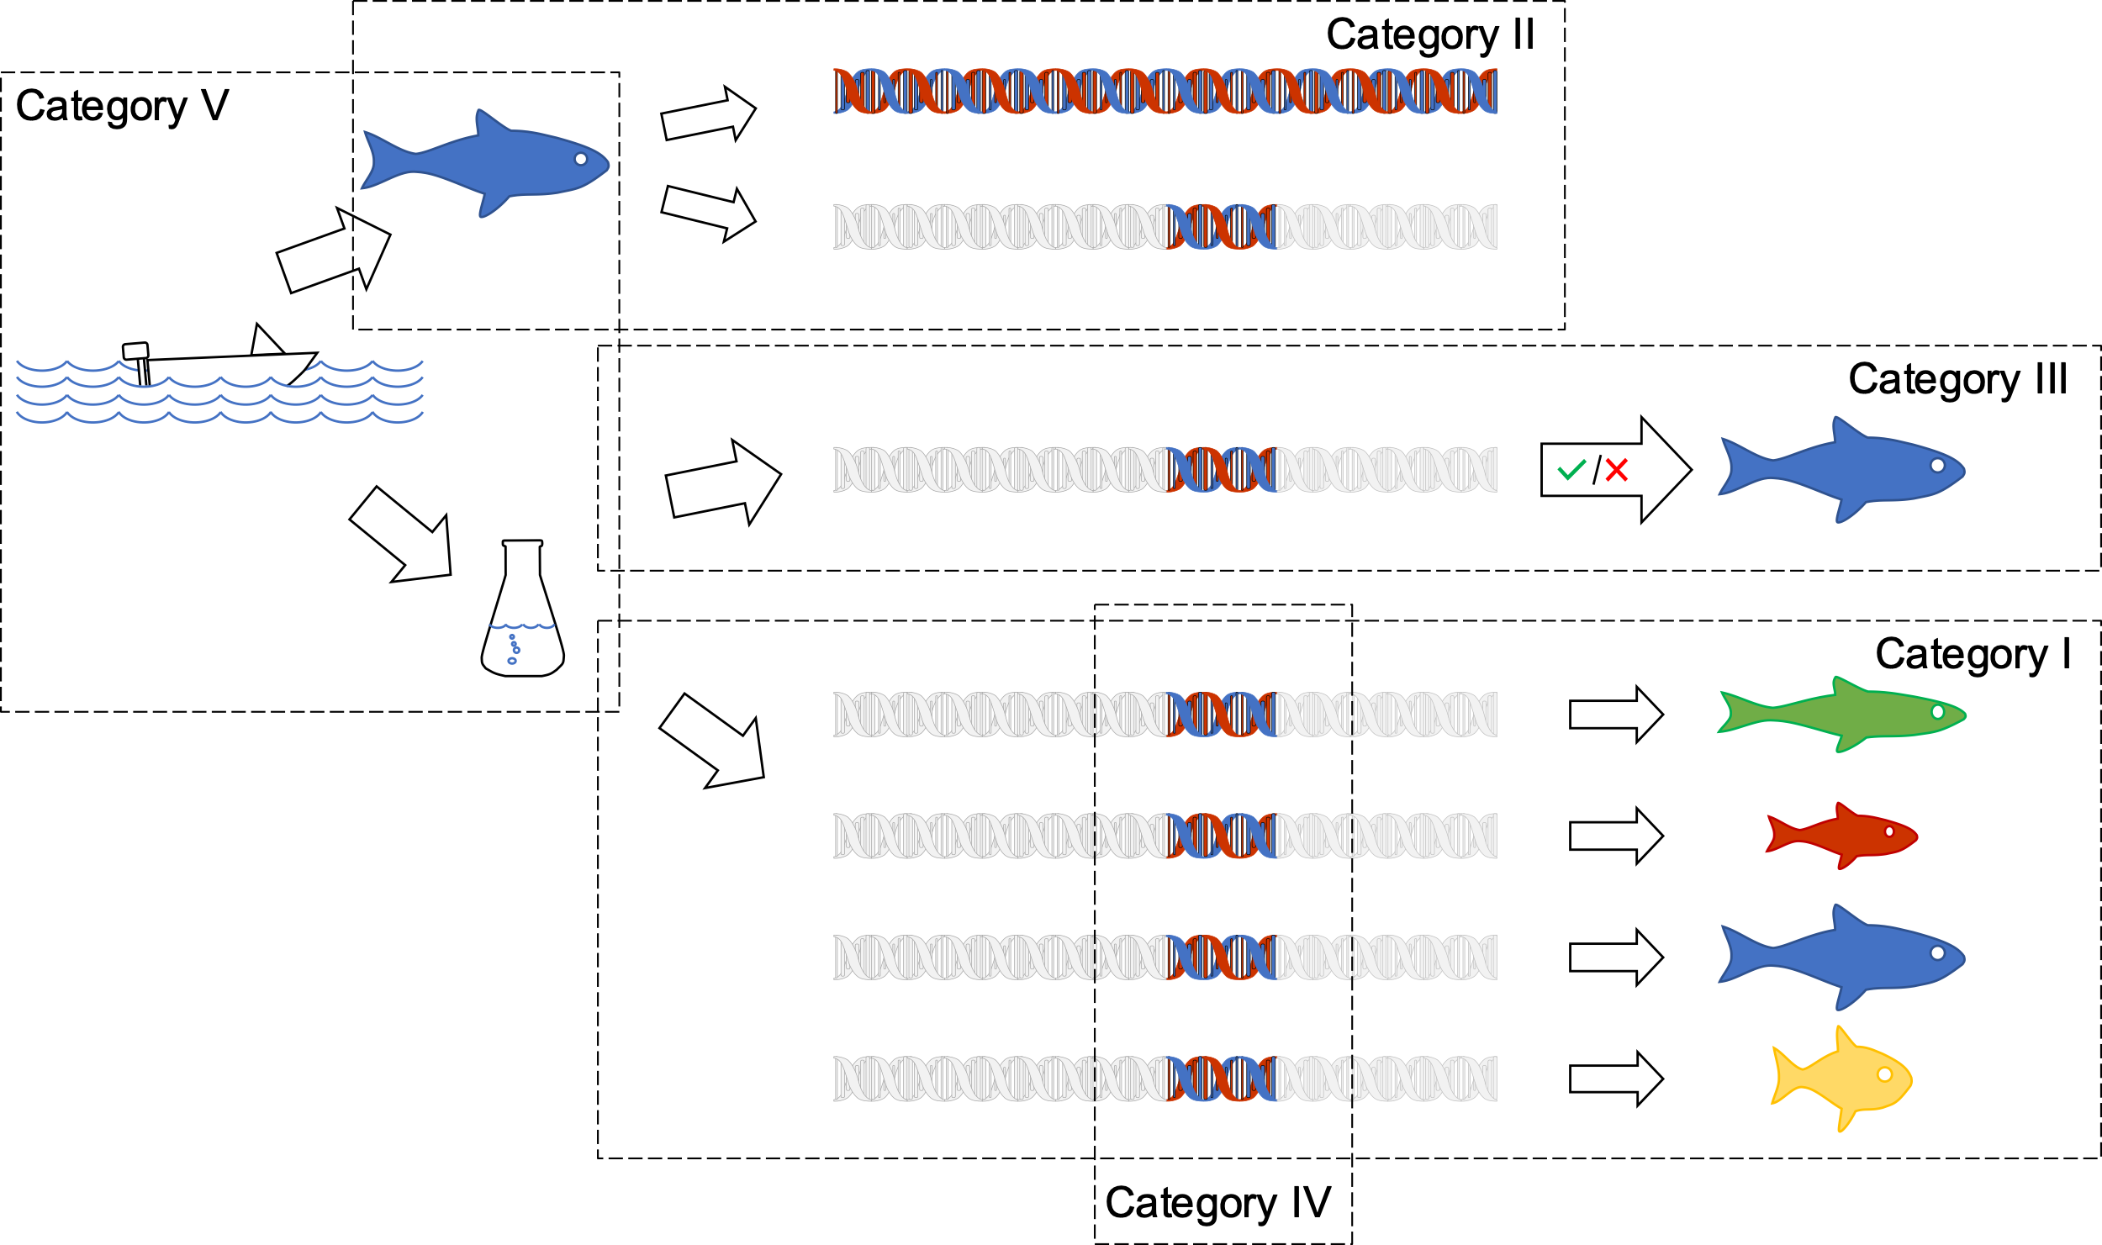
Metabarcoding – DNA detected species identification

Slide 26
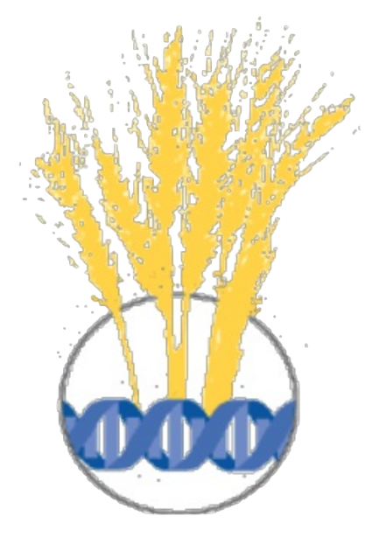
Agrobiodversity data standards

Slide 27
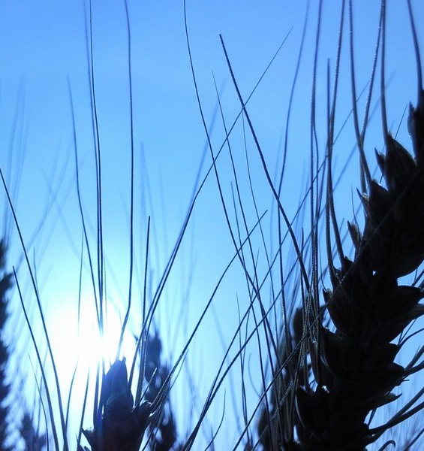

Crop Ontology
Crop Ontology – is harmonizing semantics for agricultural field data (trait measurement experiments)
Illustration Dag Endresen
Notes:
https://cropontology.org/
Illustration Nordic wheat landrace (Triticum aestivum L.) at Alnarp August 2010 CC BY Dag Endresen https://www.flickr.com/photos/dag_endresen/4998314457/in/dateposted/

Slide 28
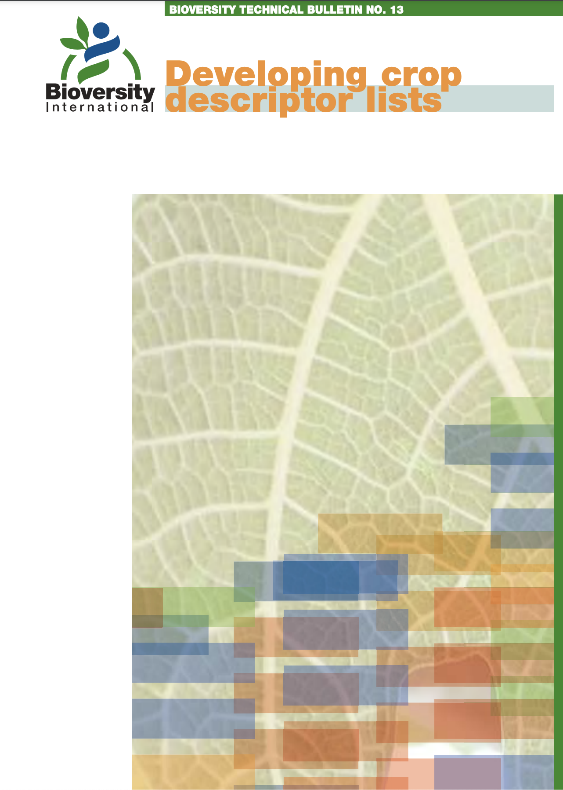
Crop descriptor lists (more than 100 crop standards, since 1970)
Published Descriptor Lists
Allium (E, S) 2000
Almond (revised)* (E) 1985
Apple* (E) 1982
Apricot* (E) 1984
Avocado (E, S) 1995
Bambara groundnut (E, F) 2000
Banana (E, S, F) 1996
Barley (E) 1994
Beta (E) 1991
Black pepper (E, S) 1995
Brassica and Raphanus (E) 1990
Brassica campestris L. (E) 1987
Buckwheat (E) 1994
Capsicum* (E, S) 1995
Cardamom (E) 1994
Carrot (E, S, F) 1999
Cashew* (E) 1986
Chenopodium pallidicaule (S) 2005
Cherry* (E) 1985
Chickpea (E) 1993
Citrus (E,F,S) 1999
Coconut (E) 1992
Coffee (E, S, F) 1996
Cotton (Revised)* (E) 1985
Cowpea* (E) 1983
Cultivated potato* (E) 1977
Echinochloa Millet* (E) 1983
Eggplant (E, F) 1990
Faba bean* (E) 1985
Fig (E) 2003
Finger millet* (E) 1985
Forage grass* (E) 1985
Forage legumes* (E) 1984
Grapevine (E, S, F) 1997
Groundnut (E, S, F) 1992
Jackfruit (E) 2000
Kodo millet* (E) 1983
Lathyrus spp. (E) 2000
Lentil* (E) 1985
Lima bean* (E) 1982
Litchi 2002
Lupin* (E, S) 1981
Maize (E, S, F, P) 1991
Mango (Revised) (E) 2006
Mangosteen (E) 2003
Medicago (Annual)* (E, F) 1991
Melon (E) 2003
Mung bean* (E) 1980
Oat* (E) 1985
Oca* (S) 2001
Oil palm (E) 1989
Palmier dattier (F) 2005
Panicum miliaceum
and P. sumatrense (E) 1985
Papaya (E) 1988
Peach* (E) 1985
Pear* (E) 1983
Pearl millet (E, F) 1993
Pepino (E) 2004
Phaseolus acutifolius (E) 1985
Phaseolus coccineus* (E) 1983
Phaseolus lunatus (P) 2001
Phaseolus vulgaris* (E, P) 1982
Pigeonpea (E) 1993
Pineapple (E) 1991
Pistacia (excluding
P. vera) (E) 1998
Pistachio (E, F, A, R) 1997
Plum* (E) 1985
Potato varieties* (E) 1985
Quinua* (S) 1981
Rambutan (E) 2003
Rice* (E) 2006
Rocket (E,I) 1999
Rye and Triticale* (E) 1985
Safflower* (E) 1983
Sesame* (E) 2004
Setaria italica
and S. pumila (E) 1985
Shea tree (E) 2006
Sorghum (E, F) 1993
Soyabean* (E, C) 1984
Strawberry (E) 1986
Sunflower* (E) 1985
Sweet potato (E, S, F) 1991
Taro (E, F, S) 1999
Tea (E, S, F) 1997
Tomato (E, S, F) 1996
Tropical fruit* (E) 1980
Ulluco (S) 2003
Vigna aconitifolia
and V. trilobata (E) 1985
Vigna mungo and
V. radiata (Rev.)* (E) 1985
Walnut (E) 1994
Wheat (Revised)* (E) 1985
Wheat and Aegilops* (E) 1978
White Clover (E) 1992
Winged Bean* (E) 1979
Xanthosoma* (E) 1989
Yam (E, S, F) 1997
Notes:
Bioversity International. 2007. Guidelines for the development of crop descriptor lists. Bioversity Technical Bulletin Series. Bioversity International, Rome, Italy. xii+72p. ISBN: 978-92-9043-792-1
https://cropgenebank.sgrp.cgiar.org/index.php/learning-space-mainmenu-454/manuals-and-handbooks-mainmenu-533/descriptors-mainmenu-547

Slide 29
Crop descriptors -- examples
Plant height (wheat)
  measured from ground level to the top of spikes, excluding awns. Average of 5 randomly selected plants
Plant Height (potato)
  The plant height of the main stem
Plant height (oat)
  Measure from ground level to the uppermost leaf ligule.
Plant height (Brassica)
  maximum plant height from ground to tip of terminal raceme
The same descriptor name (Plant height).
But different definitions.
→ need clear definitions
→ linked through clear semantics
Notes:
https://cropontology.org/search?q=plant+height
https://cropontology.org/term/CO_321:0000020
https://cropontology.org/term/CO_330:0000756
https://cropontology.org/term/CO_350:0000233
https://cropontology.org/term/CO_348:2100125
Fruit color
Light green
Green
Dark green
Leaf shape
Cordate
Obling
Ovate
Leaf shape of mature leaf
Cordate
Wedge shaped
Pentagonal
Circular

Slide 30
Crop descriptors -- examples
Plant height (wheat) → CO_321:0000020
  measured from ground level to the top of spikes, excluding awns. Average of 5 randomly selected plants
Plant Height (potato) → CO_330:0000756
  The plant height of the main stem
Plant height (oat) → CO_350:0000233
  Measure from ground level to the uppermost leaf ligule.
Plant height (Brassica) → CO_348:2100125
  maximum plant height from ground to tip of terminal raceme
clear definitions
linked through clear semantics
  https://cropontology.org/term/CO_321:0000020
  https://cropontology.org/term/CO_330:0000756
  https://cropontology.org/term/CO_350:0000233
  https://cropontology.org/term/CO_348:2100125
Notes:
https://cropontology.org/search?q=plant+height
https://cropontology.org/term/CO_321:0000020
https://cropontology.org/term/CO_330:0000756
https://cropontology.org/term/CO_350:0000233
https://cropontology.org/term/CO_348:2100125
Fruit color
Light green
Green
Dark green
Leaf shape
Cordate
Obling
Ovate
Leaf shape of mature leaf
Cordate
Wedge shaped
Pentagonal
Circular

Slide 31
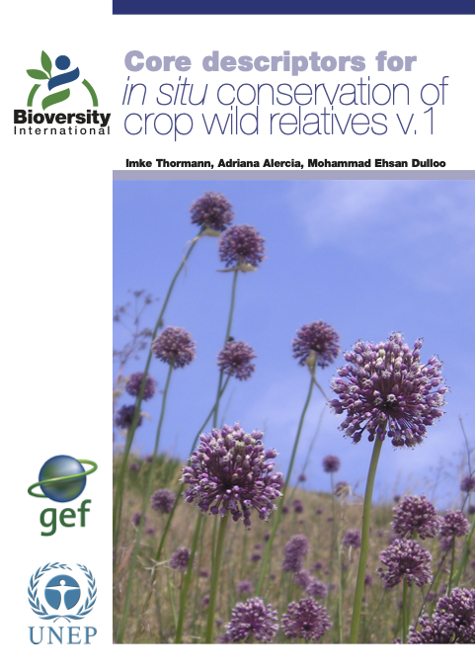
In situ CWR data streams are already flowing through GBIF
The Plant Treaty, PGRFA-, and GBIF experts (including national nodes) can work together on the implementation of the descriptors for CWR conservation in situ.
Including harmonization with Darwin Core and the development of extensions for data publishing services.
Many crop wild relatives conserved in situ are already an integrated part of the GBIF portal. (CWRs are an estimated 21% of the flora).
Notes:
Thormann I, Alercia A, Dulloo ME. 2013. Core descriptors for in situ conservation of crop wild relatives v.1. Bioversity International, Rome, Italy. ISBN-978-92-9043-935-6. Cover photo: Wild Allium in Italy. A. Lane.

Slide 32

Descriptors for Crop Wild Realtives conserved in situ
Alercia, A., López, F., Marsella, M., and Cerutti, A.L. 2021. Descriptors for Crop Wild Relatives conserved in situ (CWRI v.1). International Treaty on Plant Genetic Resources for Food and Agriculture. Rome. FAO.
https://doi.org/10.4060/cb3256en
→ Under development: CWR ontology
Notes:
Alercia, A., López, F., Marsella, M., and Cerutti, A.L. 2021. Descriptors for Crop Wild Relatives conserved in situ (CWRI v.1). International Treaty on Plant Genetic Resources for Food and Agriculture. Rome. FAO. https://doi.org/10.4060/cb3256en

Slide 33

Biodiversity Digital Twin (biodt.eu)
GBIF and GBIF Norway participate in the Horizon Europe development of digital twins for biodiversity (2022-2025).
Including a digital twin for the crop wild relative genepool of grasspea (Lathyrus).
Including a digital twin for DNA-detected biodiversity in poorly known habitats.
Including development of interoperability between community data standards – through ontologies.
Notes:
https://biodt.eu/use-cases

Slide 34


Dag Endresen
GBIF Node Manager for Norway
UiO Natural History Museum
Notes:
GLIS relevant Services from national GBIF Nodes
National GBIF nodes can work with national PGRFA focal points to develop and deliver modern, dynamic and automatic data mobilisation services.
GBIF has developed data mobilisation guidelines for DNA-derived data available for reuse by GLIS.
The Multi-Crop Passport Descriptors (MCPD) for genebank accessions conserved ex situ are already mapped to Darwin Core and the DwC germplasm extension.
Many crop wild relatives conserved in situ are already an integrated part of the GBIF portal. (CWRs are an estimated 21% of the flora).
GBIF experts (and national nodes) can contribute to the development of the descriptors for CWR conservation in situ, including harmonization with Darwin Core and the development of extensions for data publishing services.
Genebank collections (in WIEWS, etc.) could be linked to the GBIF-hosted Global Registry of Scientific Collections (GRSciColl) – for deeper integration of collections with the overall web-of-science metrics.

Slide 35
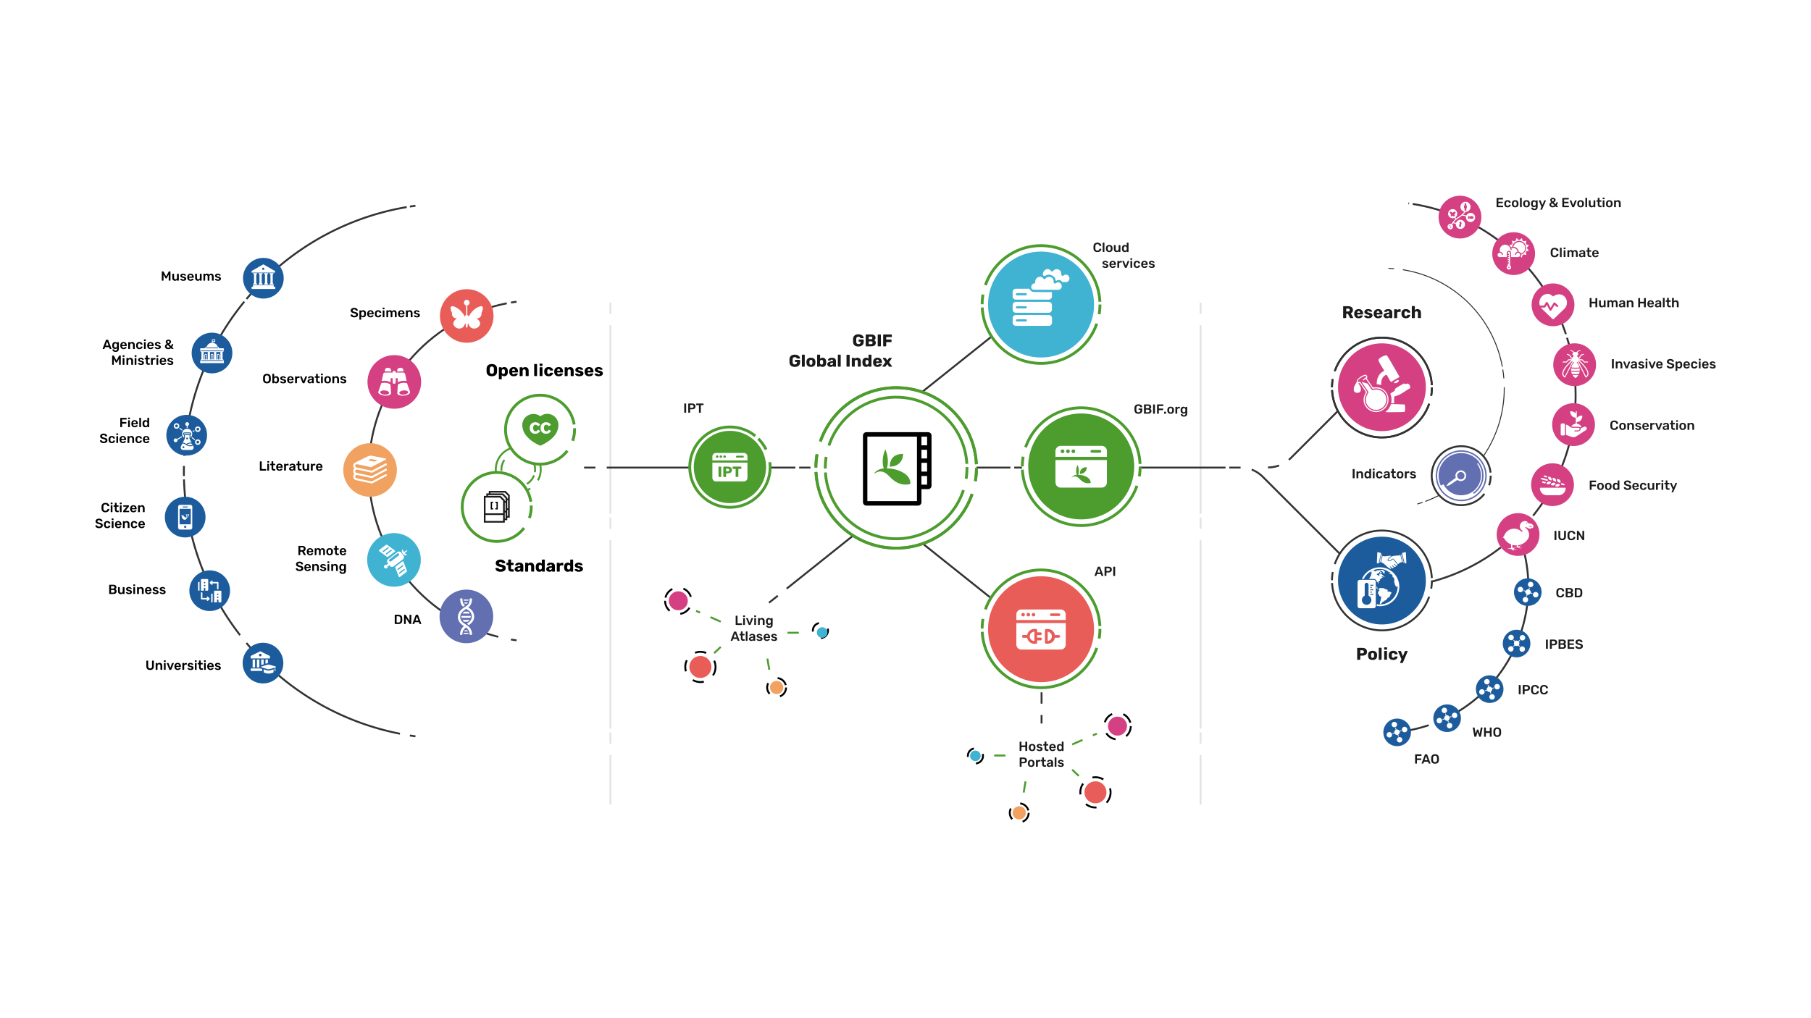
Providing biodiversity Evidence for research and policy

